Slide 1

1. ILM : QCD @ 0.7 GeV
2. dual-G: QCD @ low-x
JLAB 24’

Slide 2
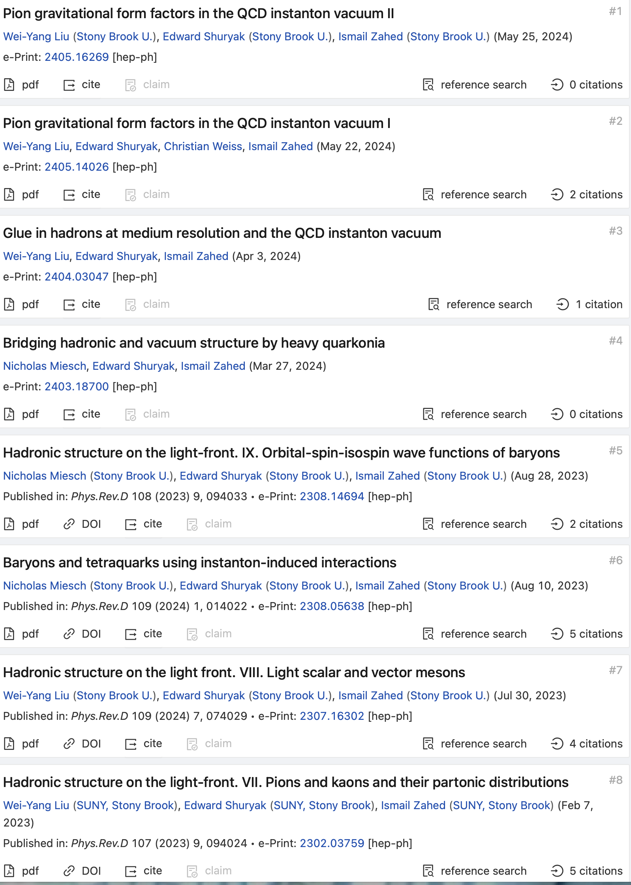
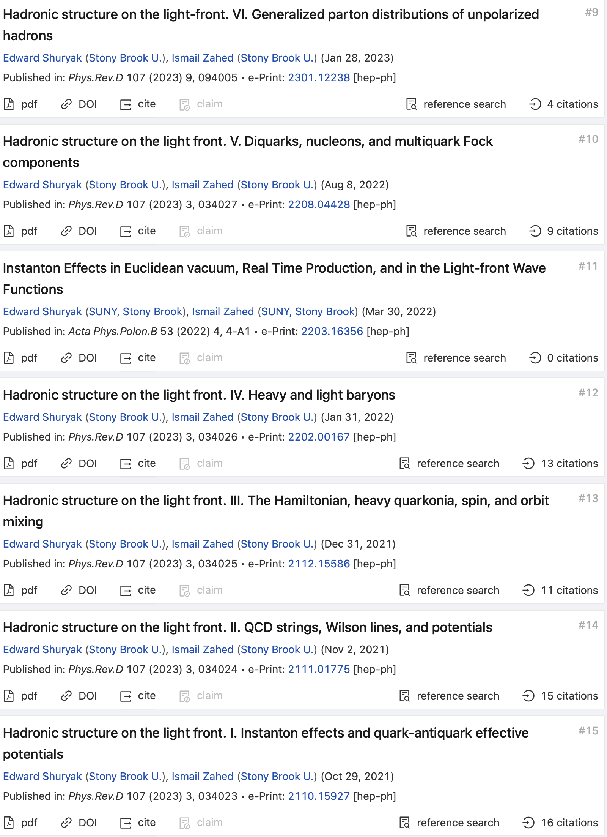
Program: ILM @ EIC

Slide 3
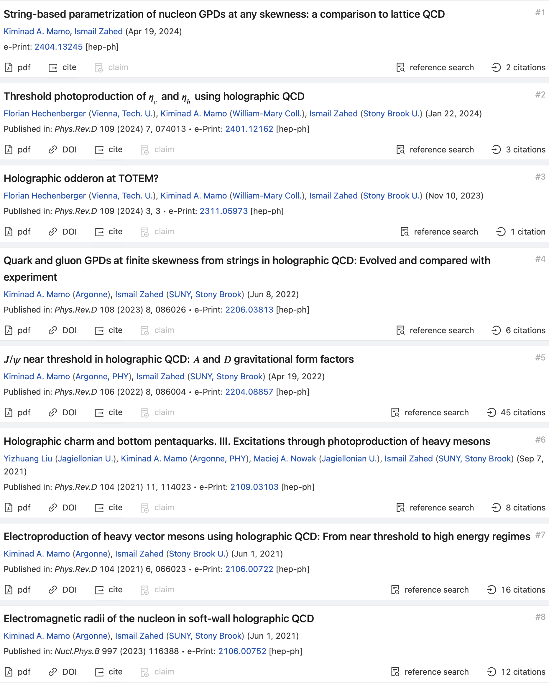
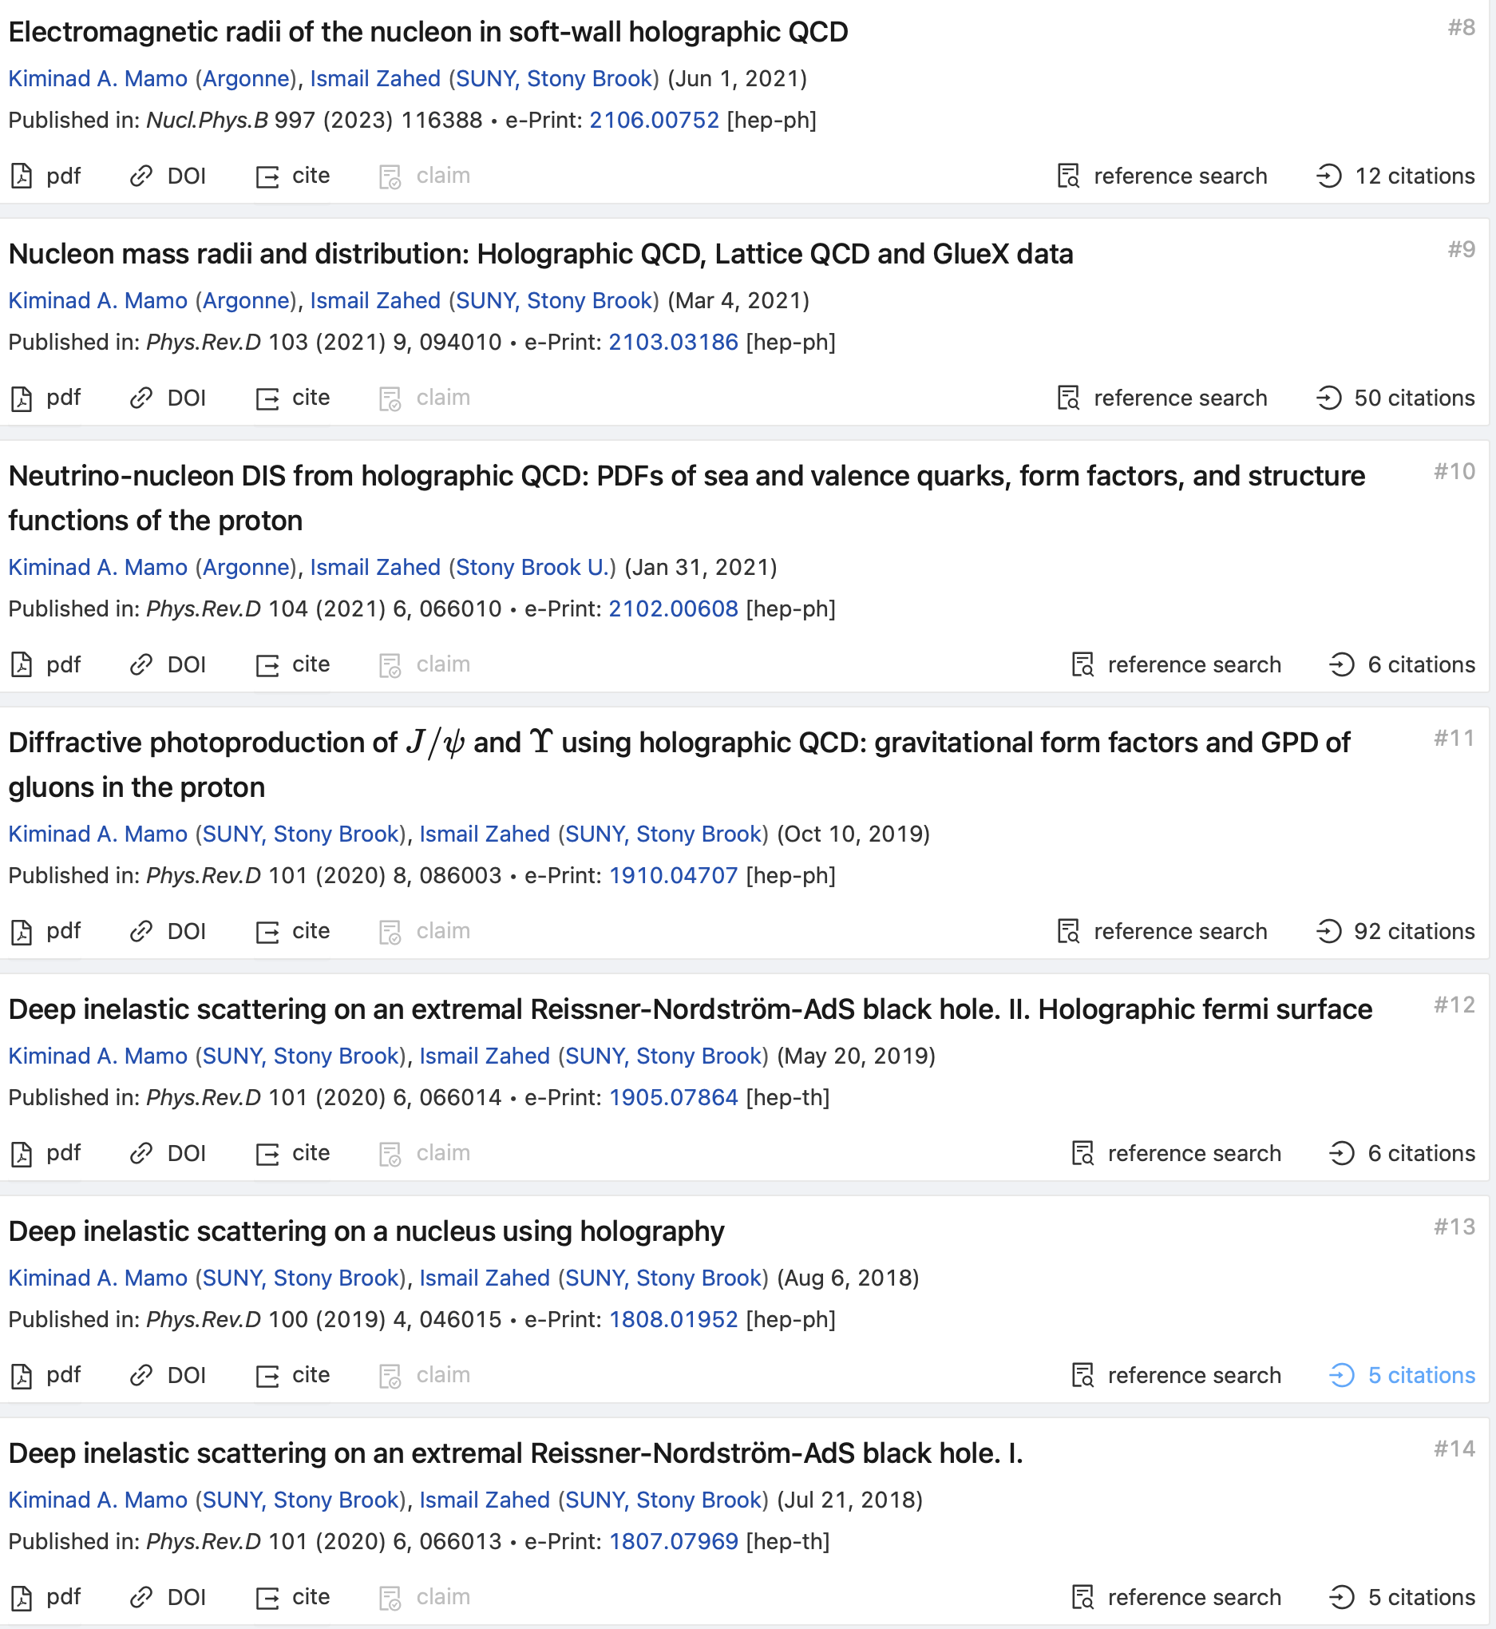
Program: Strings @ EIC

Slide 4
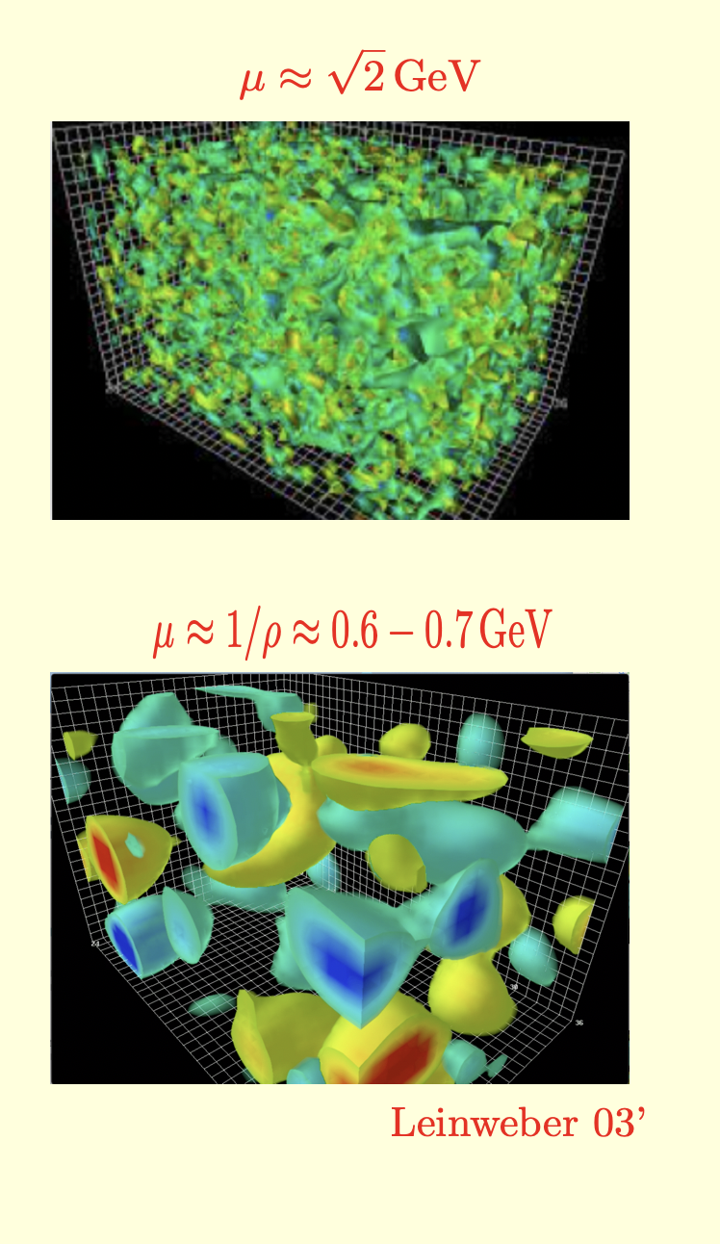
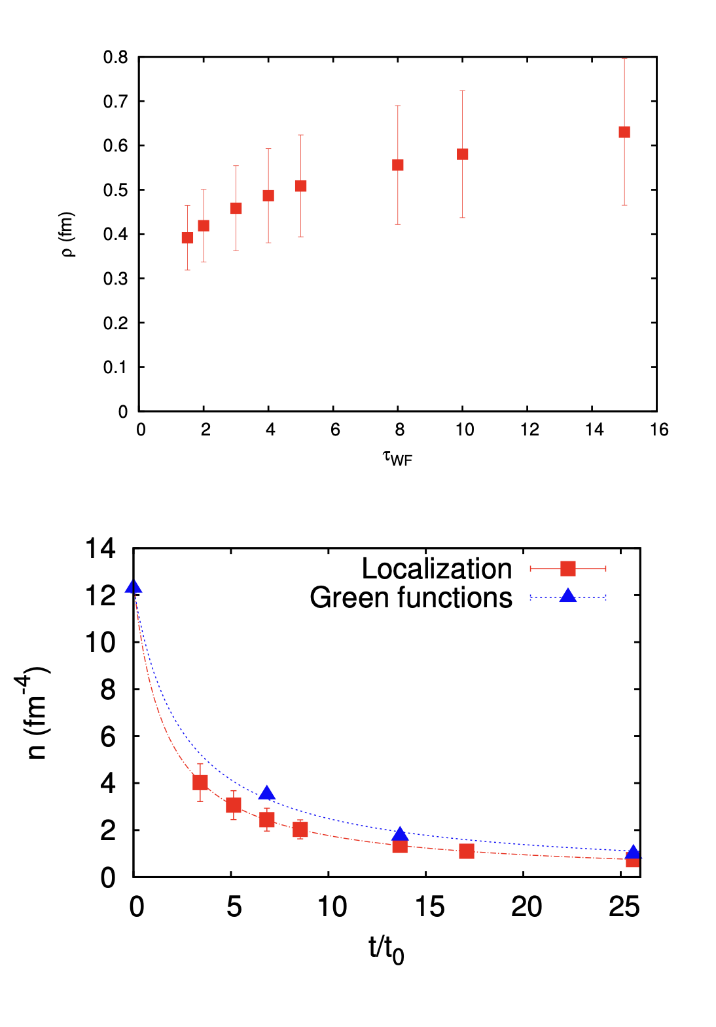
1. ILM: Mass/Spin
Topologically active vacuum
QCD Topological landscape

Slide 5
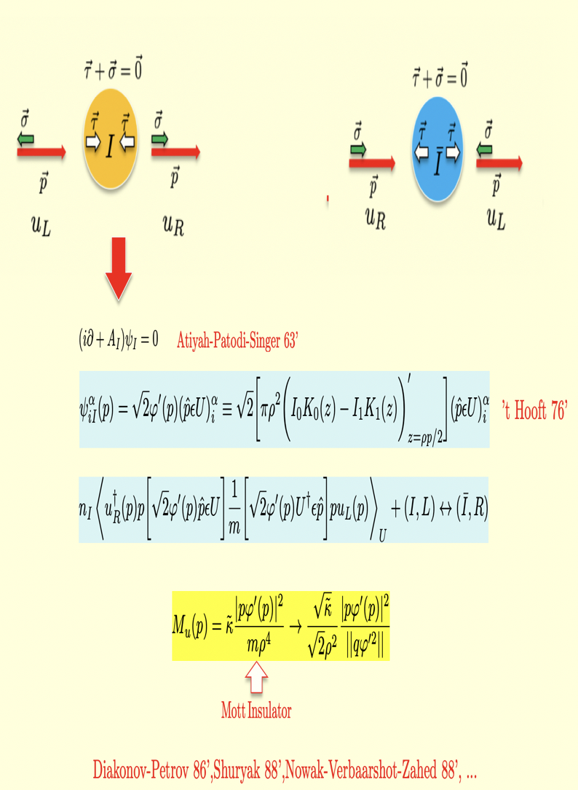
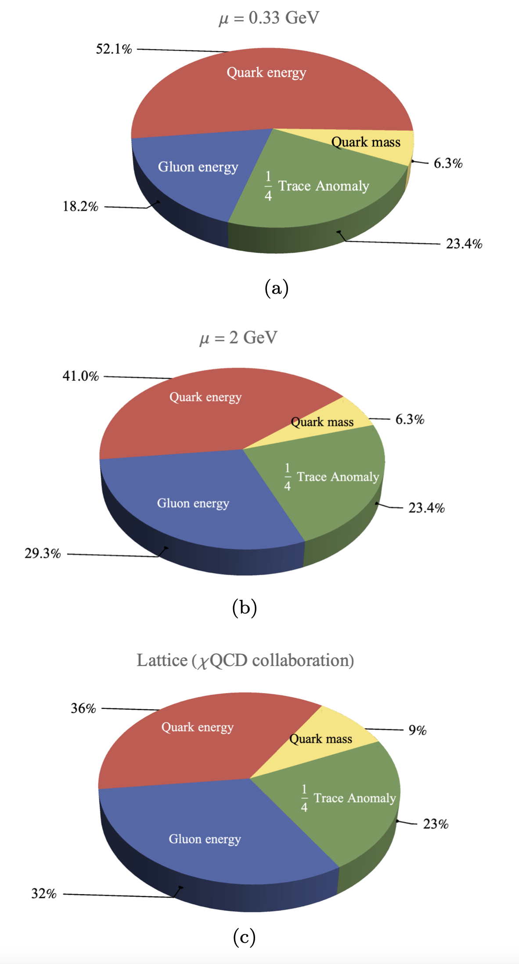
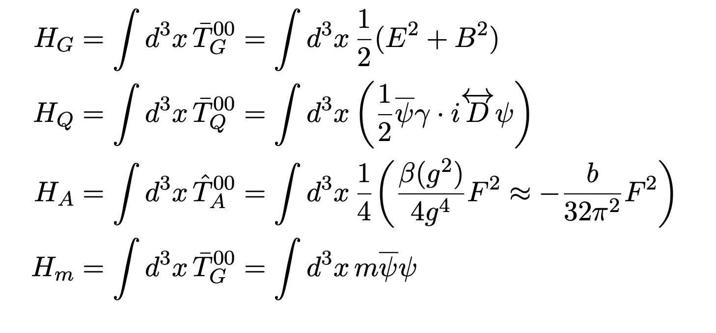
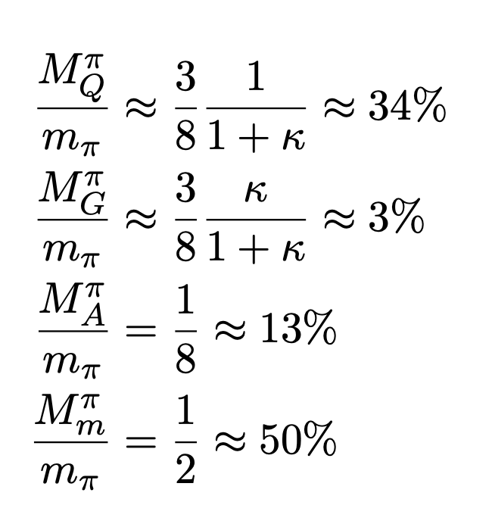
1. ILM: Mass/Spin
Mass generation
Ji pion mass budget
Ji nucleon mass budget

Slide 6
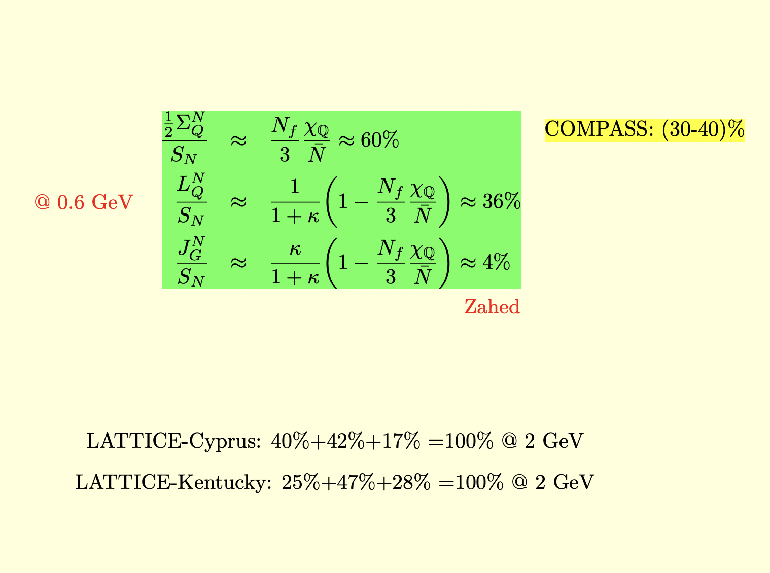
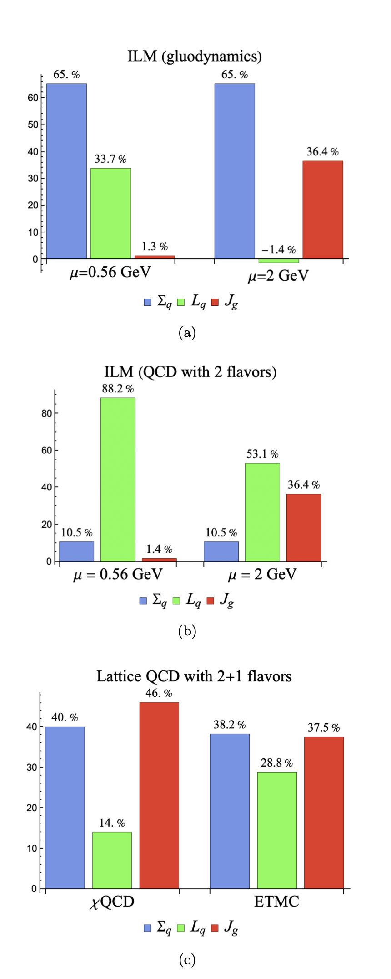
1. ILM: Mass/Spin
Ji spin decomposition
Ji Spin decomposition

Slide 7
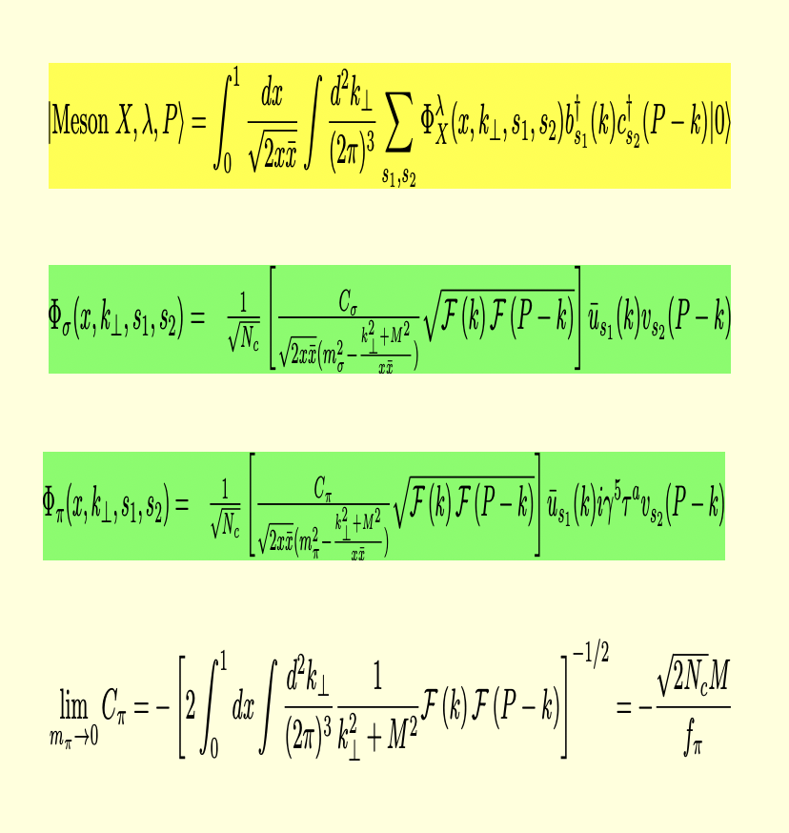
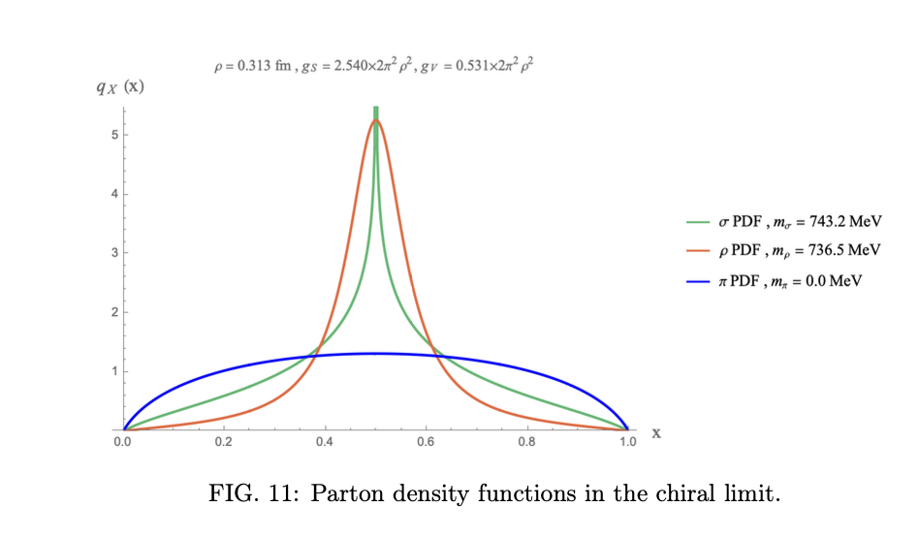

2. ILM: LFWFs
LF WFs in ILM
LF PDFs in ILM

Slide 8
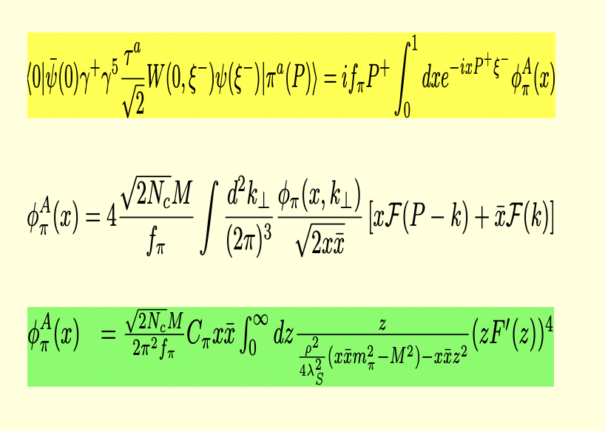
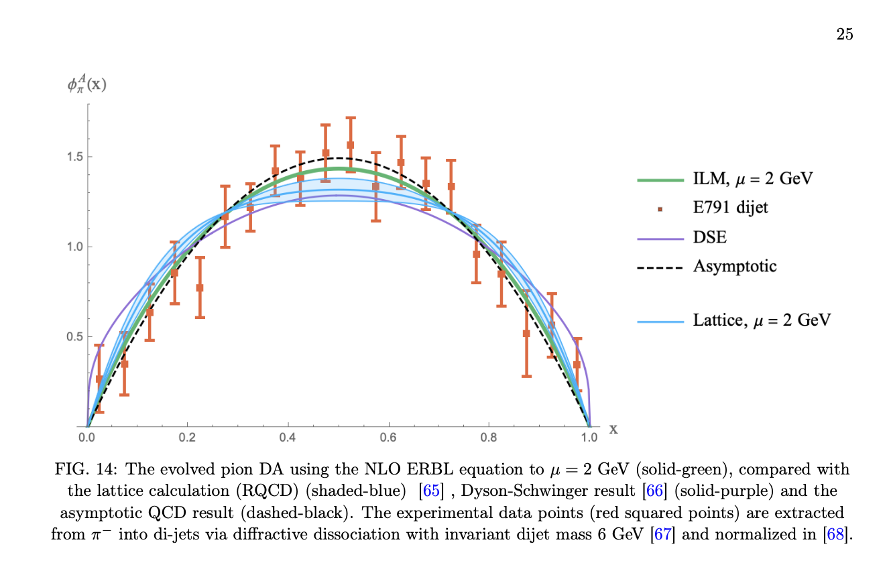
2. ILM: LFWFs
Twist-2 Pion DA in ILM
Twist-2 Pion DA

Slide 9
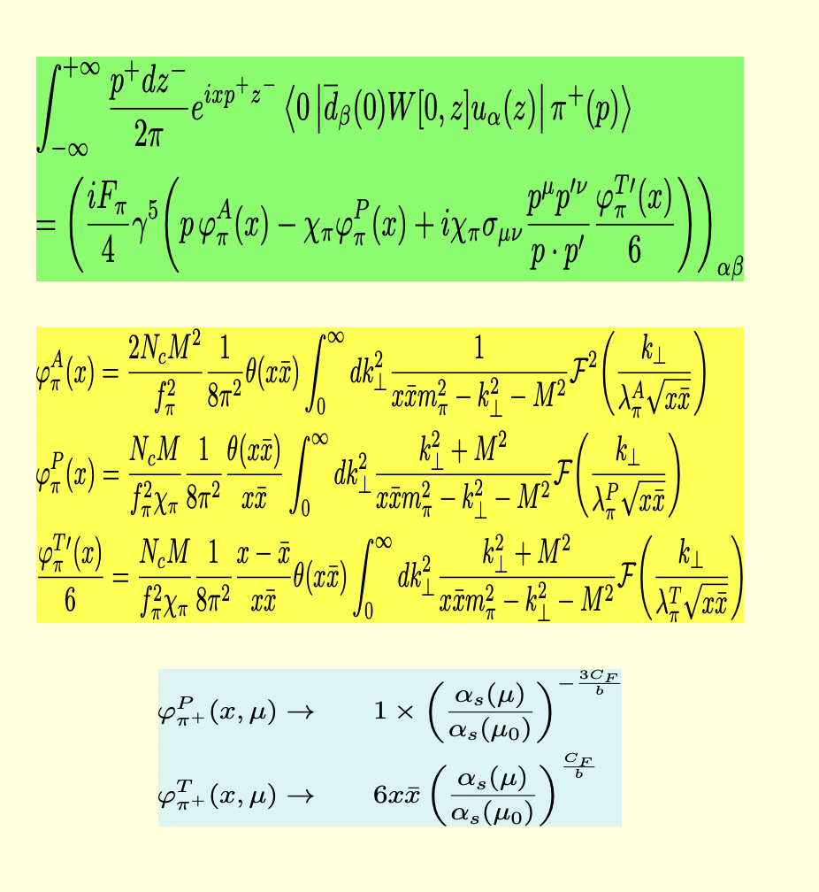
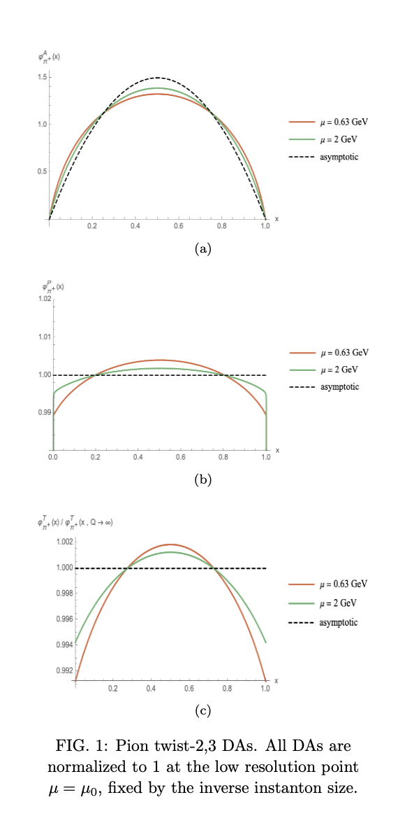
2. ILM: LFWFs
Twist-2,3 pion DA in ILM
Evolved Twist-2,3 pion DA

Slide 10
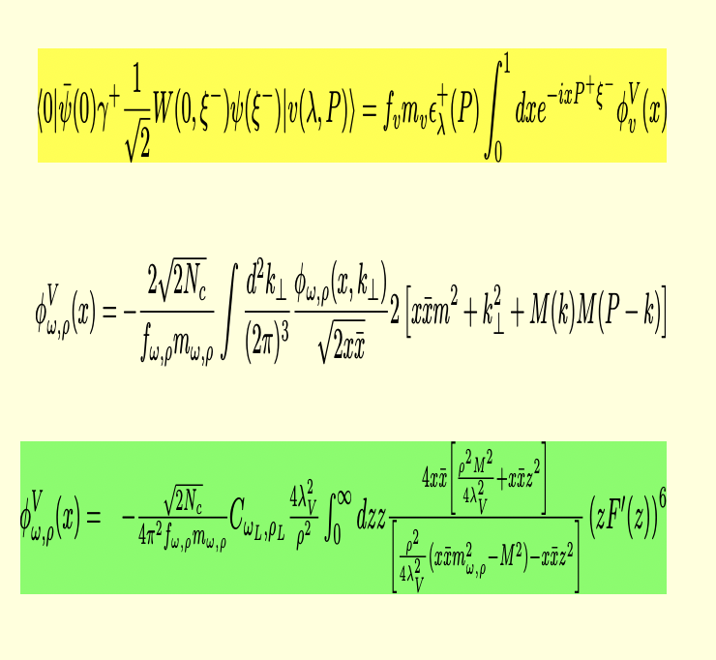
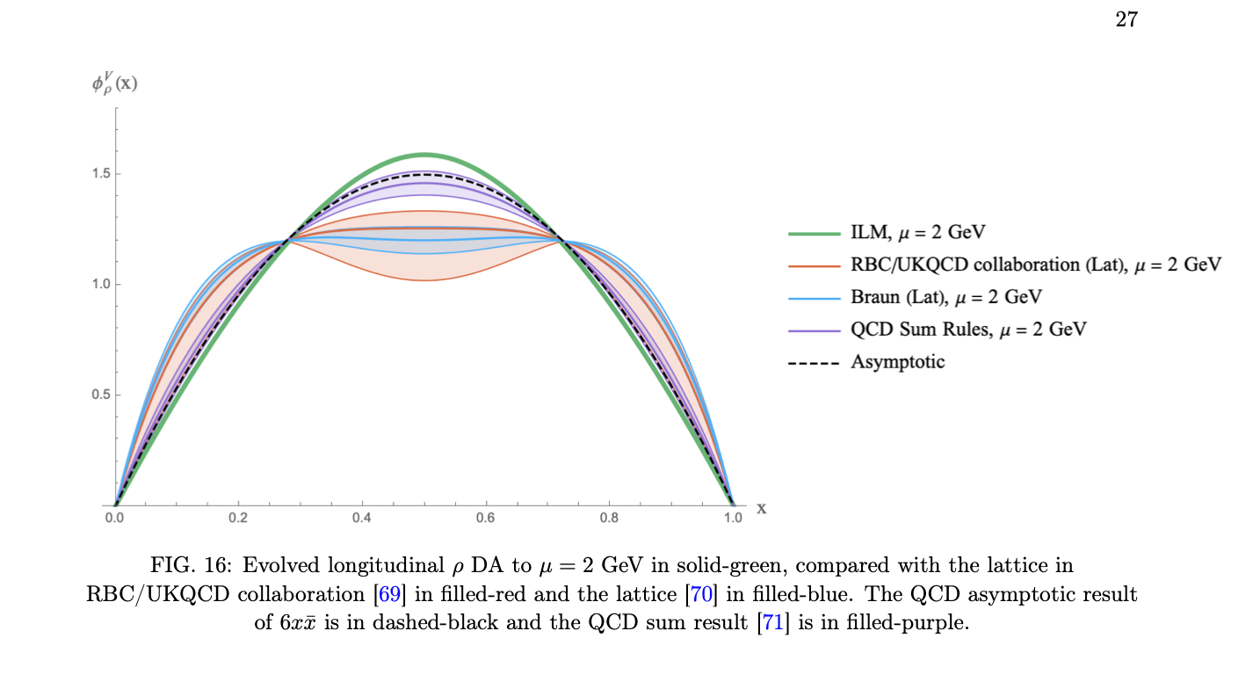
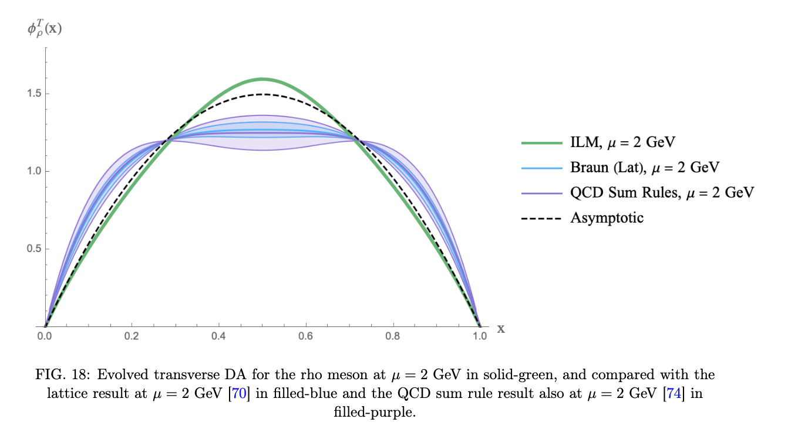

2. ILM: LFWFs
V-longitudinal in ILM
Rho-LT in ILM

Slide 11
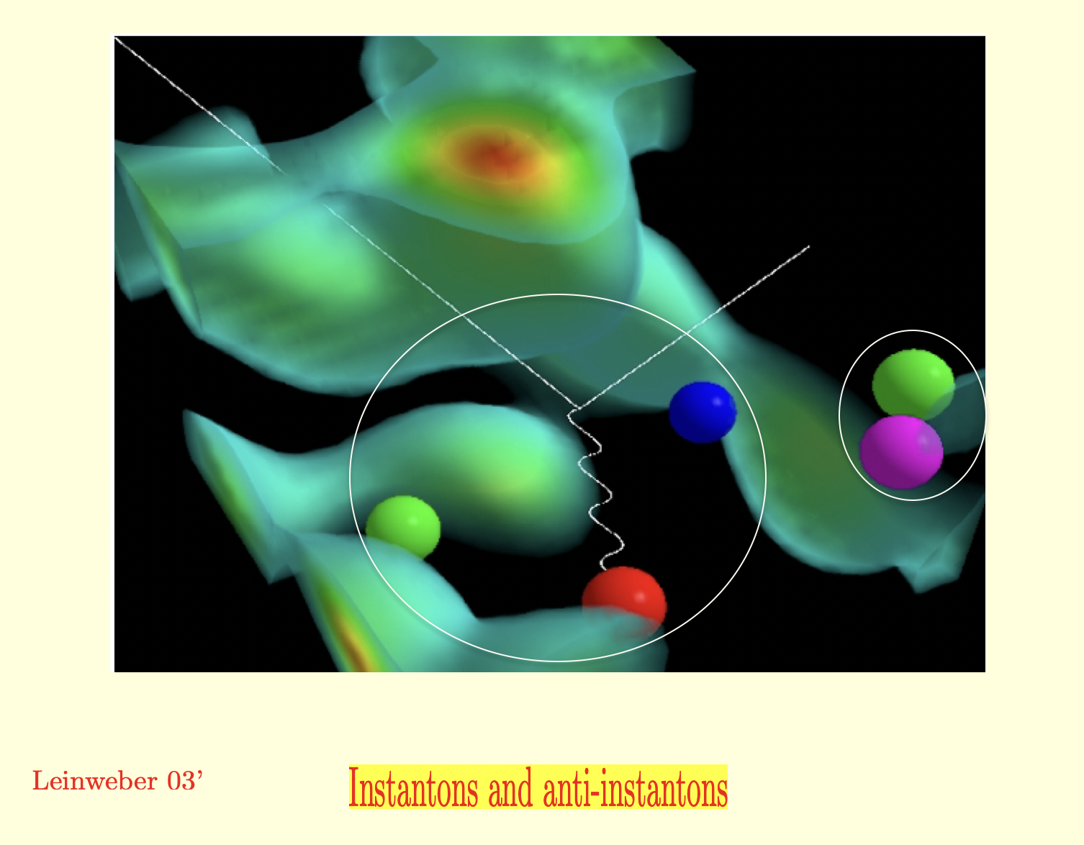
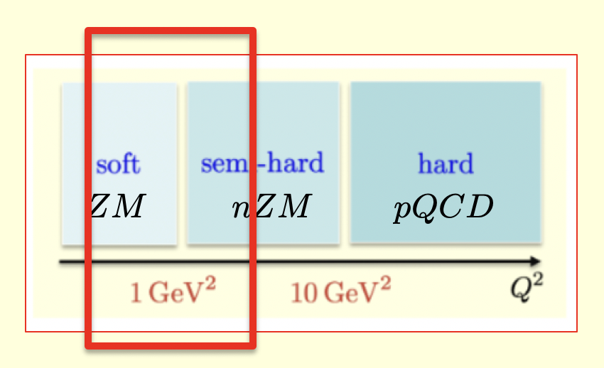
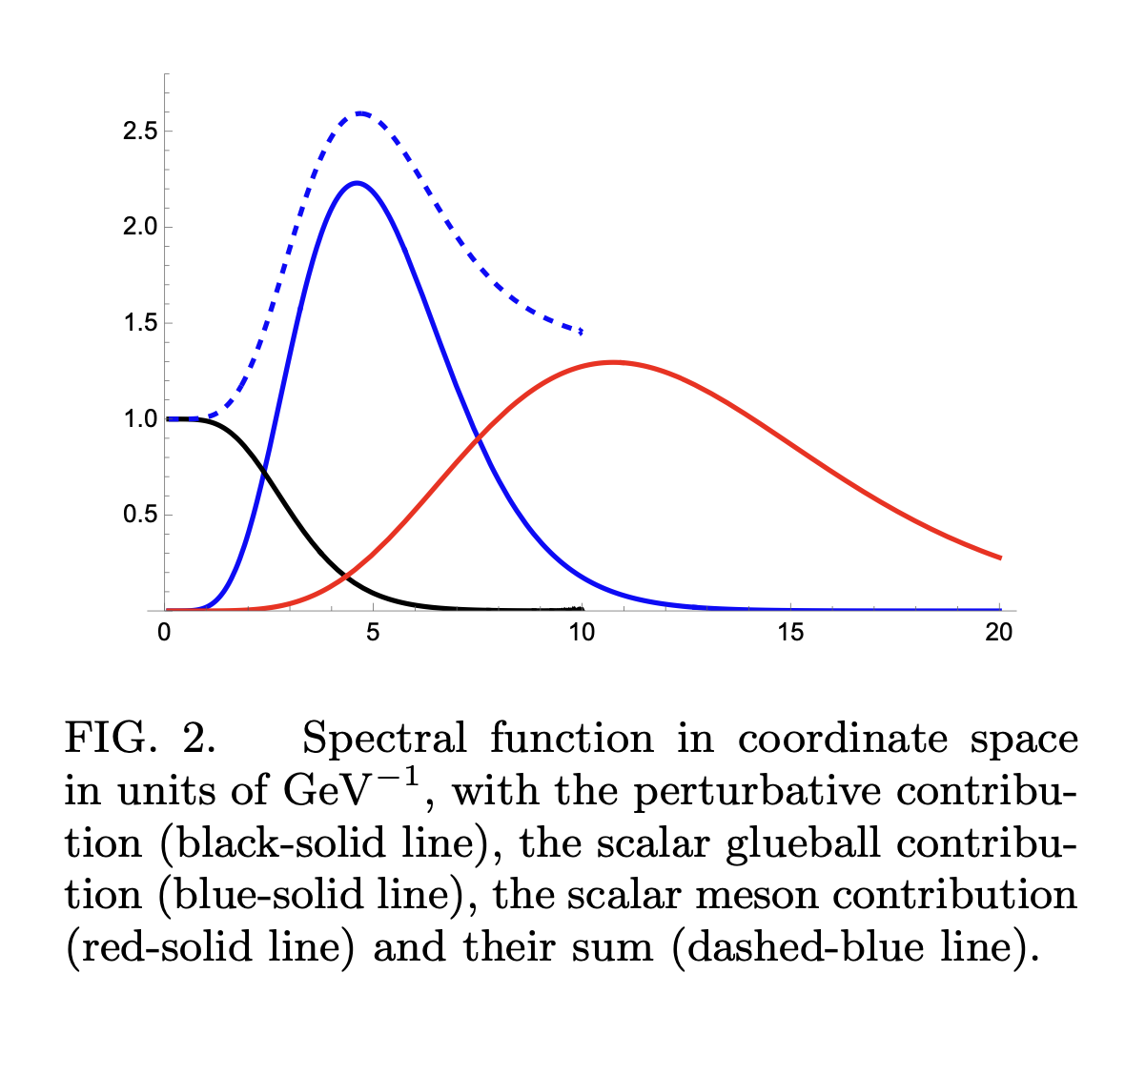
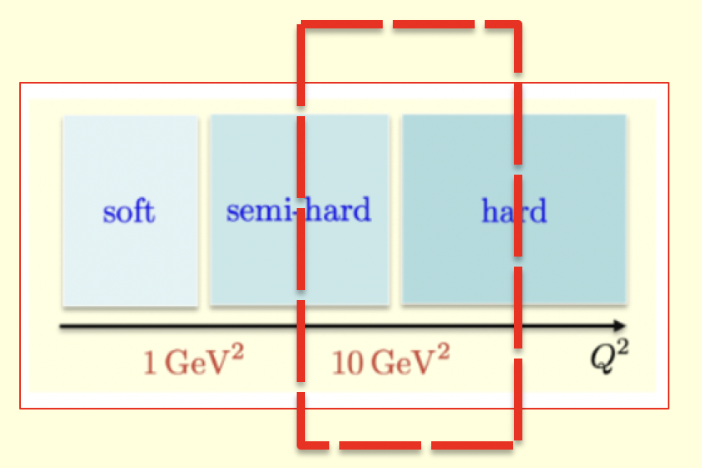
3. ILM: FFs
FFs in ILM
Regions for FFs in ILM

Slide 12
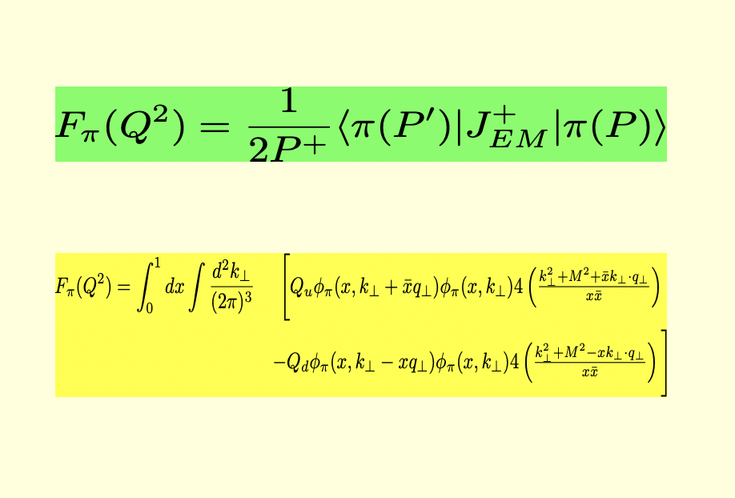
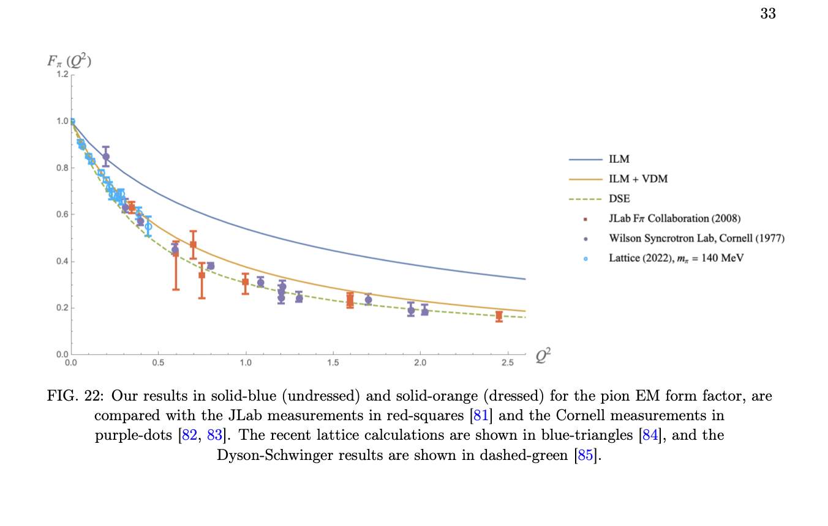
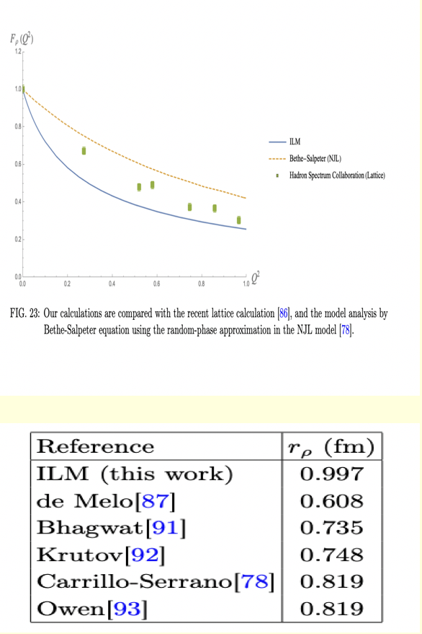
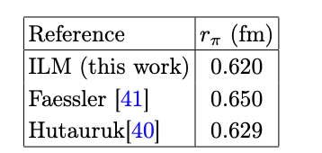
3. ILM: FFs
EM FF: soft region
Pion FF
Rho FF

Slide 13
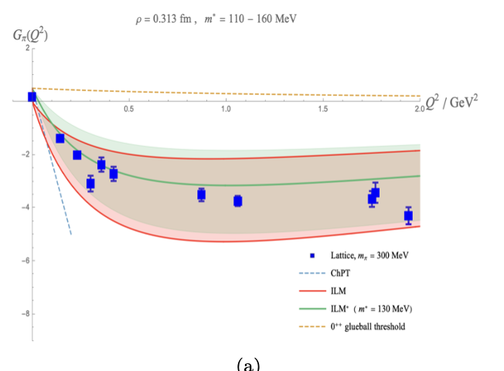
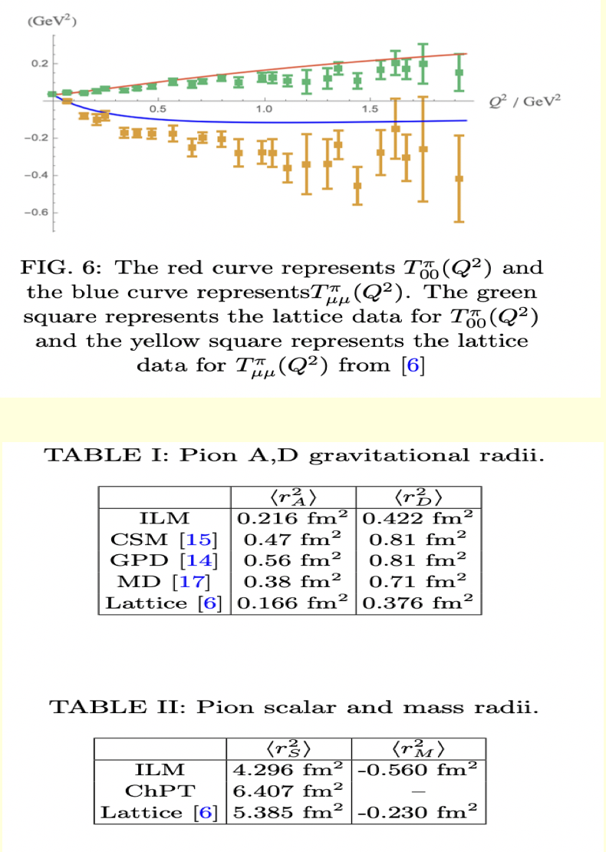
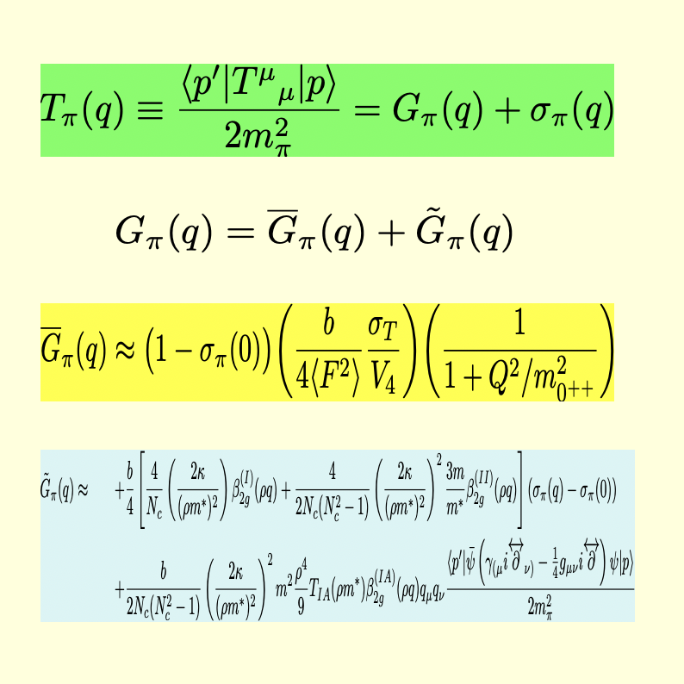
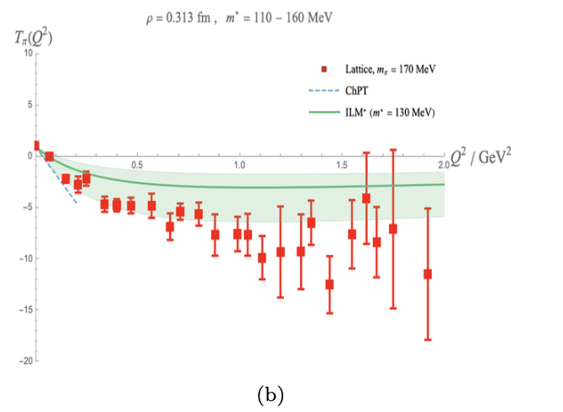
3. ILM: FFs
Pion EMT: Soft
Pion EMT FF
Pion EMT Radii

Slide 14
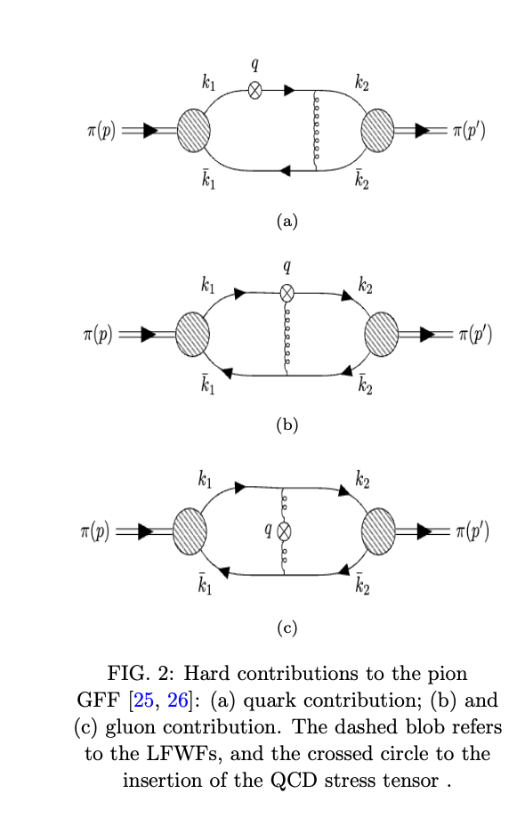
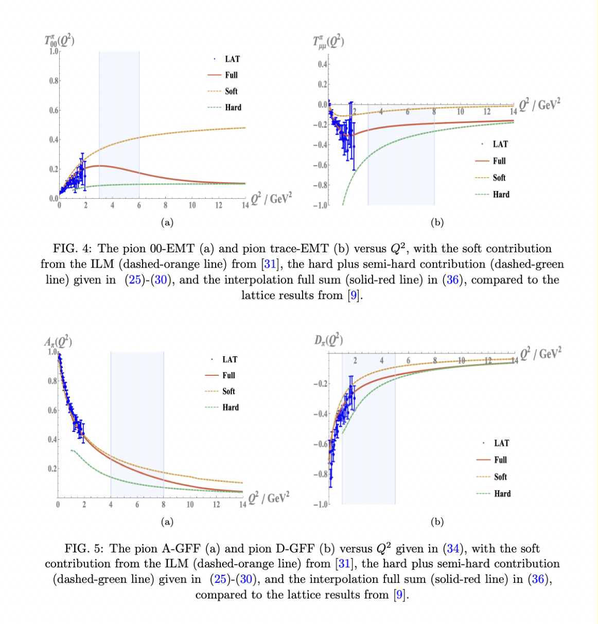
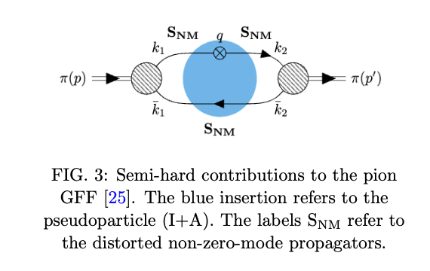
3. ILM: FFs
Pion EMT: semi-hard+hard
Pion EMT soft+hard

Slide 15
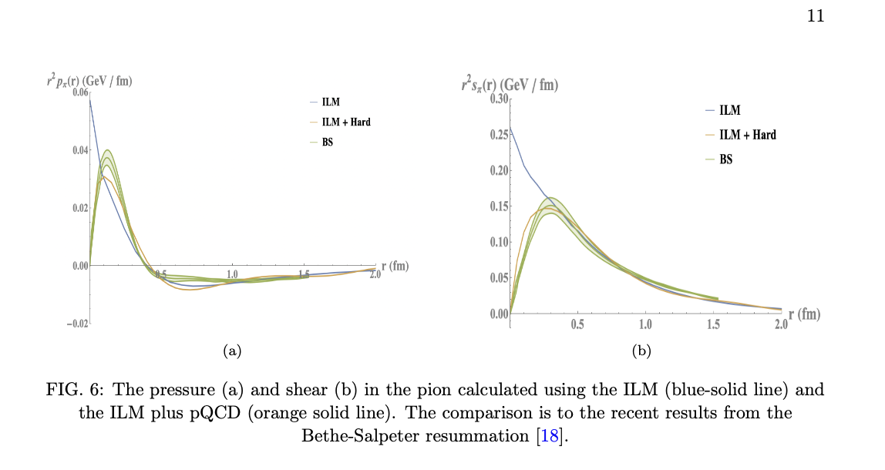
3. ILM: FFs
Pion pressure and shear

Slide 16

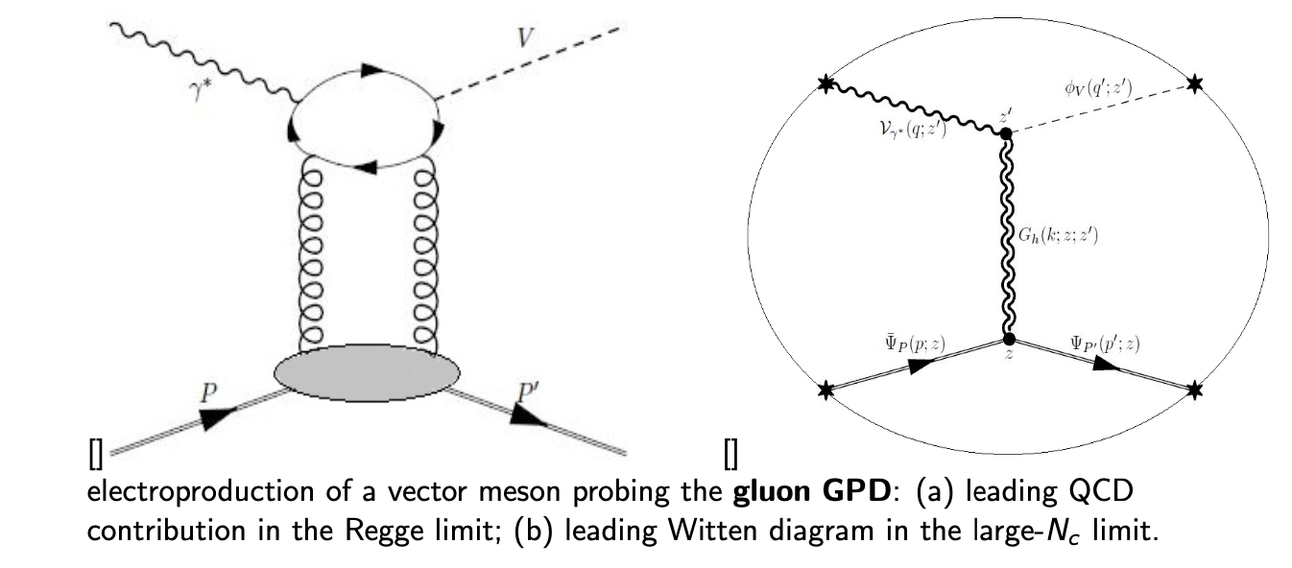

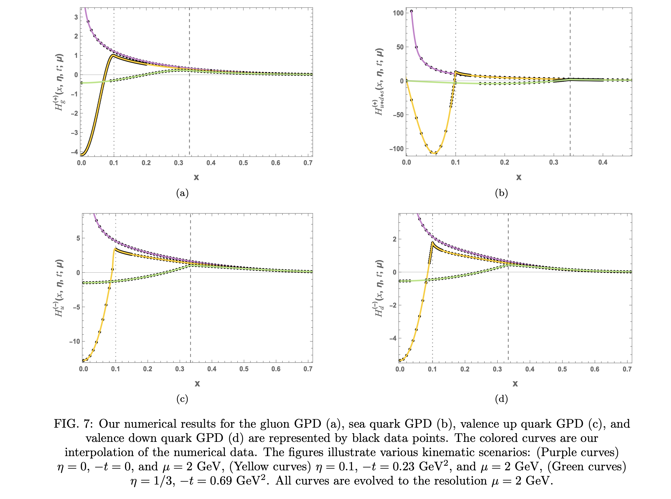


4. Stringy Gravity: GPDs
GPD in dual gravity
vs Lattice QCD and predictions

