Slide 1




Combined Analysis Status Report
From all GEn-II Students
Hunter Presley (& Arun)
Faraz Chahili, Kate Evans, Vimukthi Gamage, Jack Jackson, Sean Jeffas, Jacob Koenemann, Braian Mederos, Gary Penman
SBS Collaboration Meeting 09/2024
Notes:
Currently under production or commissioning?

Slide 2
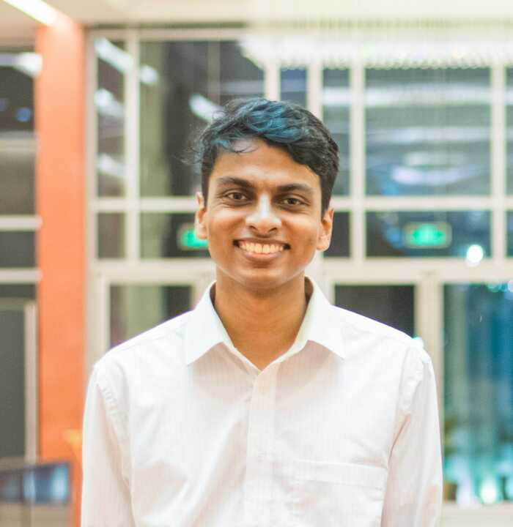
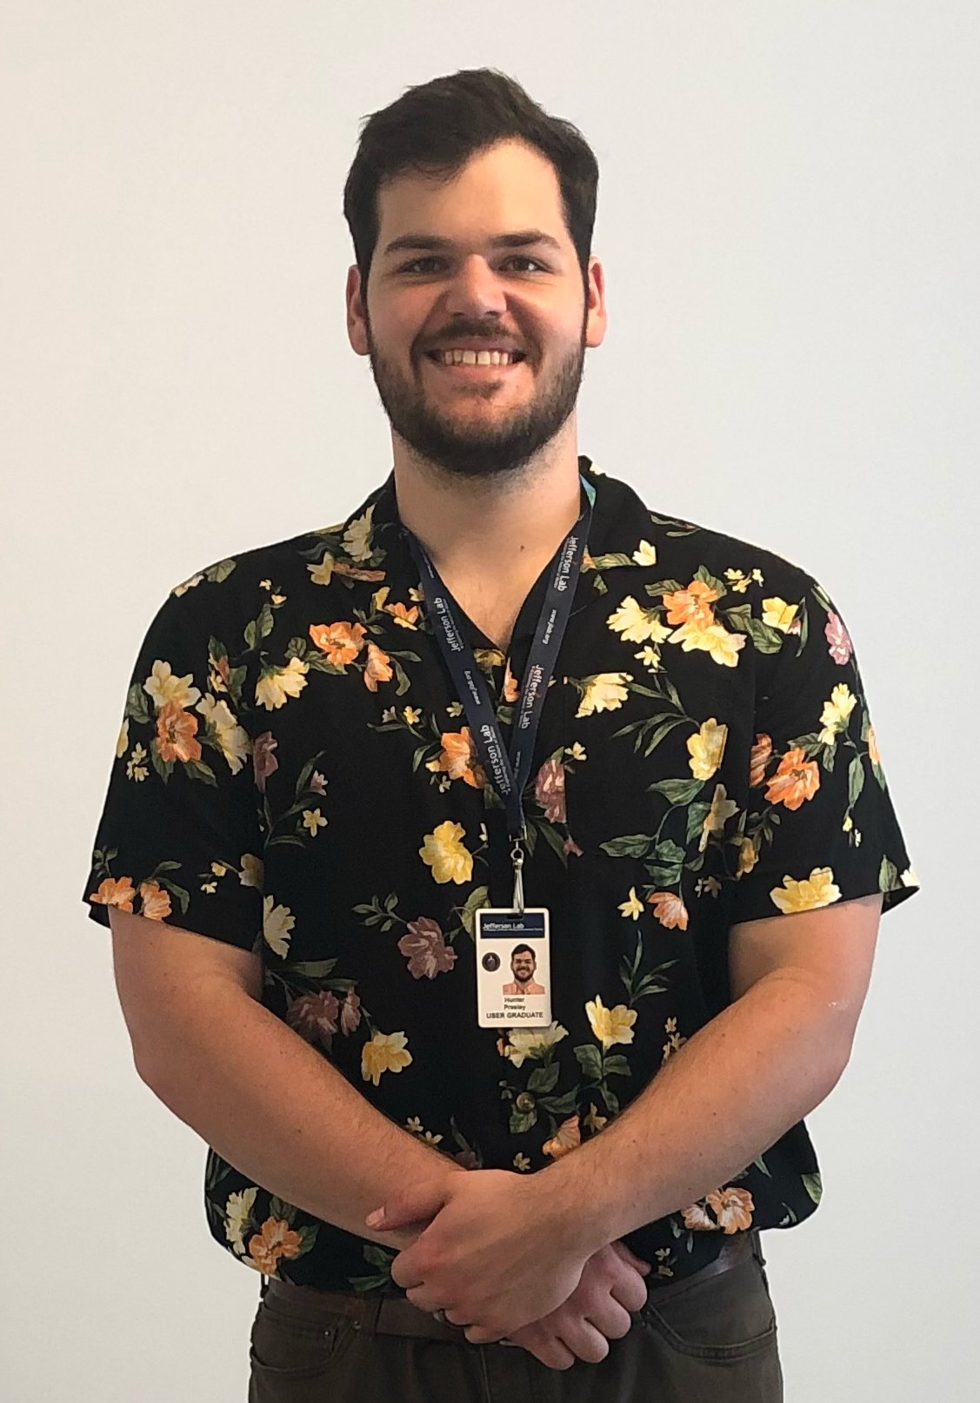
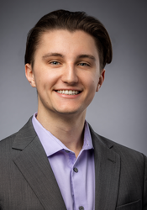

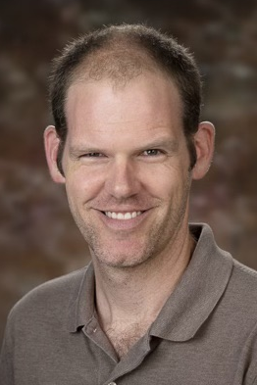


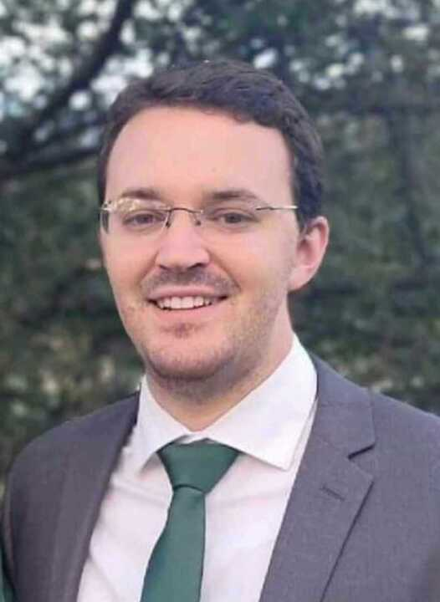
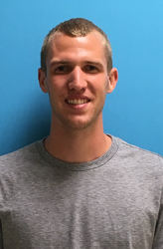




GEn-II Students
Vimukthi Gamage
Me
Jacob Koenemann
Kate Evans
Jack Jackson
Gary Penman
Faraz Chahili
GEMS
Target and HCAL
Target UVA
Braian Mederos
Sean Jeffas
Target and BBCAL
Target and GRINCH
Target and Hodo
Moller
Graduated July 2024
Target UVA
GEMS
Presley
SBS Collab Meeting, Sep 2024
Notes:
Bullet 2: at highq2 more than just spatial distr.

Slide 3

Outline
GEn-II experimental measurement
Flow chart and stages of analysis
Progress and status
Challenges moving forward
Presley
SBS Collab Meeting, Sep 2024
Notes:
Bullet 2: at highq2 more than just spatial distr.

Slide 7
SBS Form Factor Program
GMn : measure GMn/GMp up to Q² = 13.5 GeV² LD₂ target - Complete
GEn-II : measure GEn/GMn up to Q² = 10 GeV² ³He target - Complete
GEn-RP : measure GEn/GMn up to Q² = 4.5 GeV² LD₂ target - Complete
GEp : measure GEp/GMp up to Q² =12 GeV² LH₂ target - March 2025?
Goal of SBS Form Factor Program - Determine Sachs Electric and Magnetic Form Factors at unprecedentedly high Q² values with higher statistical uncertainty
Presley
SBS Collab Meeting, Sep 2024
Notes:
Bullet 2: at highq2 more than just spatial distr.

Slide 8
SBS Form Factor Program
GMp - published
2022 data taken
Q² [GeV]²
SBS
2025
2022-23 data taken
Presley
SBS Collab Meeting, Sep 2024
8

Slide 9
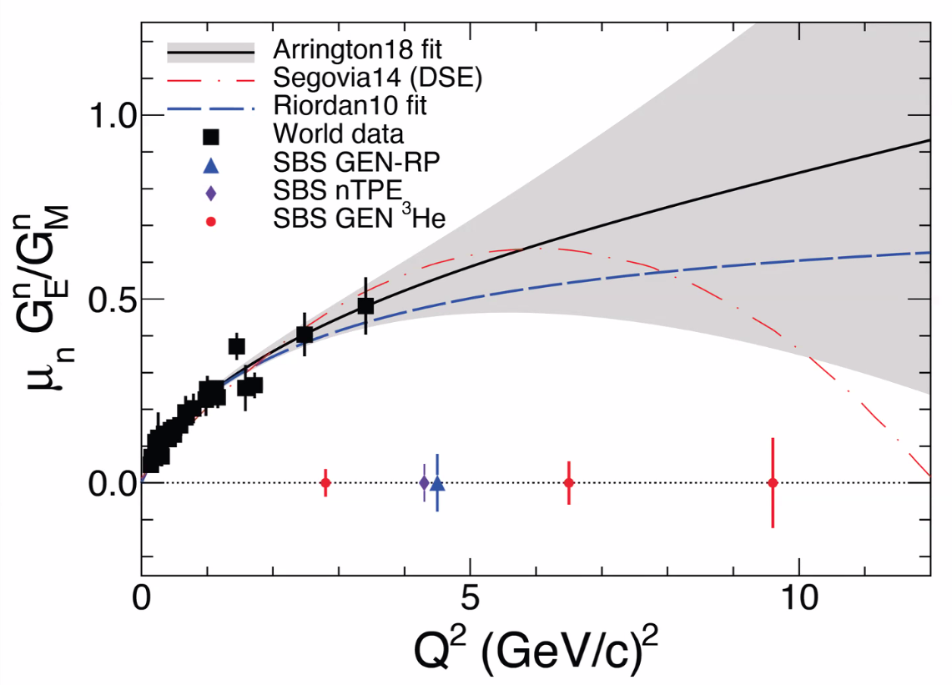
GEn-II and Elastic Nucleon Form Factors
Fundamental properties of a nucleon
Encodes information on the spatial distribution of charge and magnetization
Purpose: extract GEn at very high Q²
Asymmetry measurement with polarized electron beam and polarized ³He target - effective polarized neutron target
Presley
SBS Collab Meeting, Sep 2024
Notes:
Bullet 2: at highq2 more than just spatial distr.

Slide 10
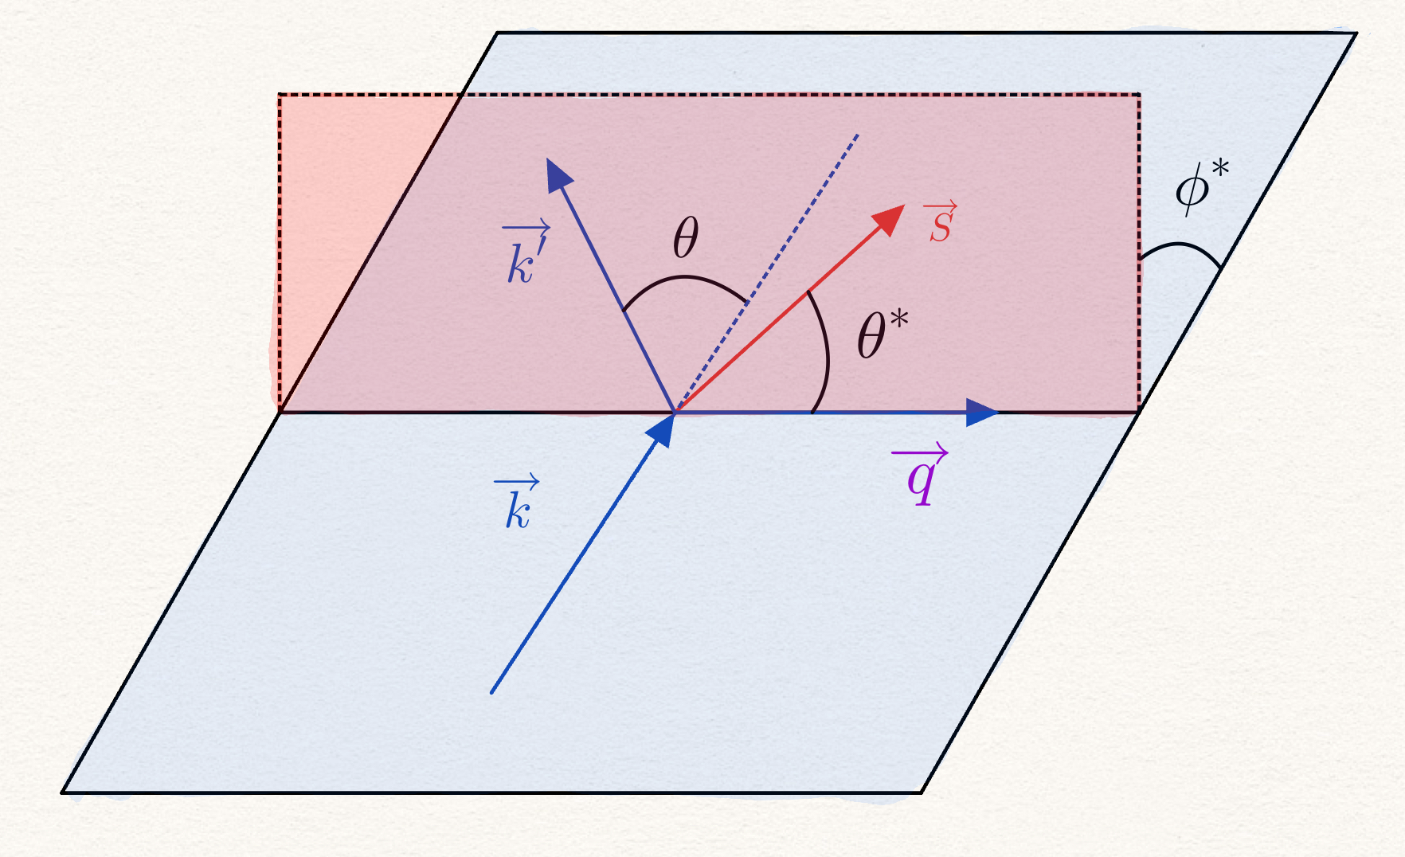
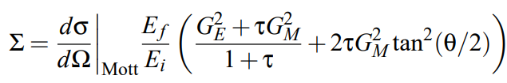
Experimental Measurement
Unpolarized Cross Section
Polarized Cross Section
Presley
SBS Collab Meeting, Sep 2024
Notes:
Bullet 2: at highq2 more than just spatial distr.

Slide 11
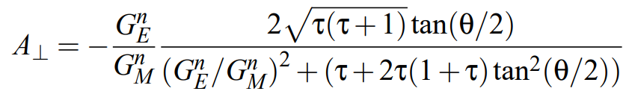
Experimental Measurement
Choose polarization transverse to Q²
Asymmetry proportional to the ratio of G^{n}_{E}/G^{n}_{M}
Presley
SBS Collab Meeting, Sep 2024
Notes:
Bullet 2: at highq2 more than just spatial distr.

Slide 12





Experimental Measurement - Raw
Employ all QE cuts
Count events with + and - helicity for each run
Run by run required due to varying polarizations
Presley
SBS Collab Meeting, Sep 2024

Slide 13
Corrections to Raw Asymmetry
For the following list must determine 2 things:
f - fraction of quasielastic sample the component occupies
A - asymmetry of said component
Accidentals, Inelastics, Pions, FSI, Protons
The nitrogen fraction must also be calculated using target measurements
Presley
SBS Collab Meeting, Sep 2024
Notes:
Bullet 2: at highq2 more than just spatial distr.

Slide 14
Analysis Flowchart
Raw Data
Data Quality Checks - 2
Data Selection - 3
Detector
Calibrations - 1
Pass 2 / 3 calibration - 4
Raw Asymmetry - 5
Physics
Asymmetry - 6
Polarimetry - 6a
Error Analysis
Statistical - 7a
Systematic - 7b
Physics Corrections - 6b
Red - To do
Green - In Progress
Other Corrections - 6c
GEn
Presley
SBS Collab Meeting, Sep 2024
Notes:
Bullet 2: at highq2 more than just spatial distr.

Slide 15
Stages of Analysis
Detector Calibration procedure
Data Selection
Asymmetry Corrections
Target and Beam Polarimetry Application
Sensitivity Study and Results
Presley
SBS Collab Meeting, Sep 2024
Notes:
Compare to seamus and freddies thesis

Slide 16
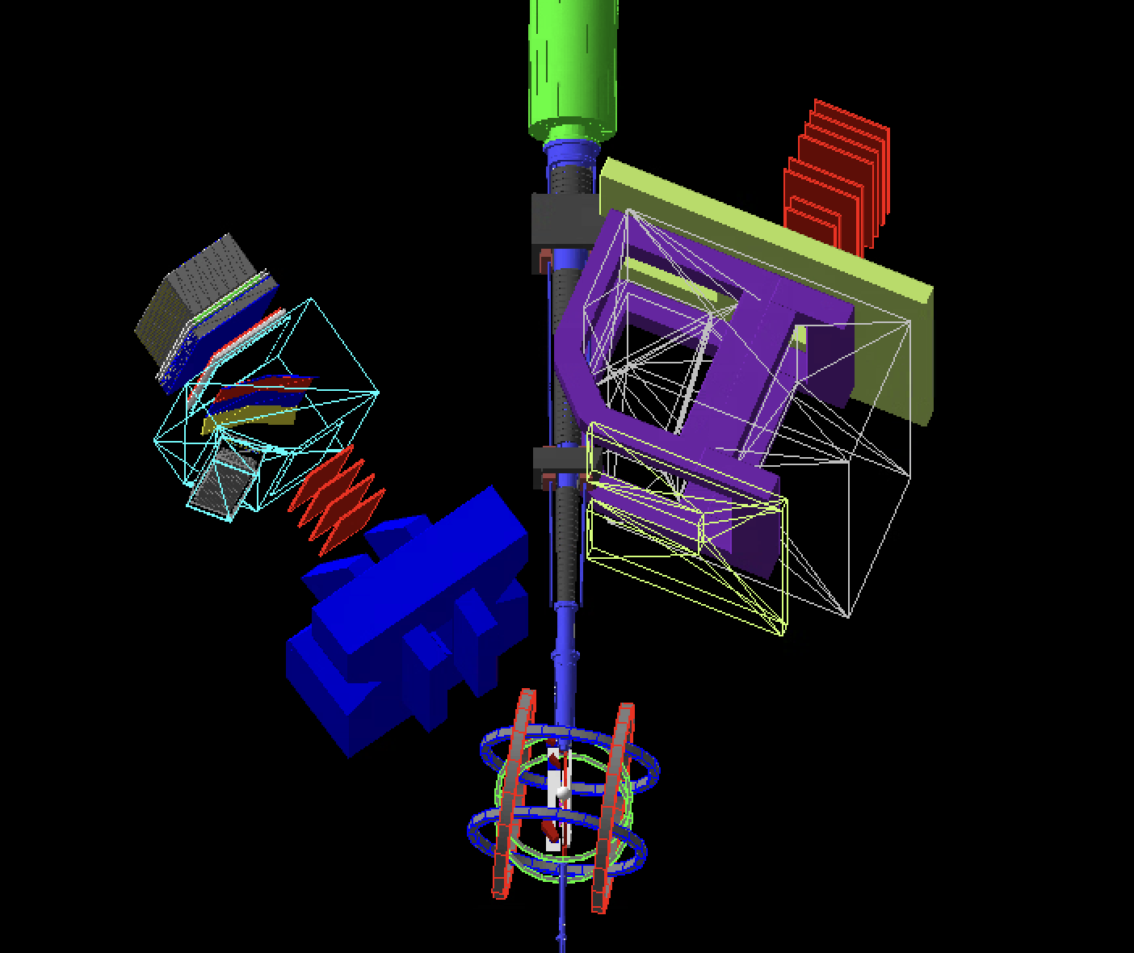
Detector Calibration
List of Subsystems
BBCal - Kate Evans
GEMs - Vimukthi Gamage and Sean Jeffas
GRINCH - Jack Jackson
HCal - Hunter Presley
Hodoscope - Gary Penman
BB Optics - Sean Jeffas
SBS Optics - Vimukthi Gamage
*Guidance from Andrew Puckett, Todd Averett, Gordon Cates, Bogdan Wojtsekhowski and other experienced GMn students, postdocs and senior collaborators!
Presley
SBS Collab Meeting, Sep 2024
Notes:
Pic of sbs detectors

Slide 17
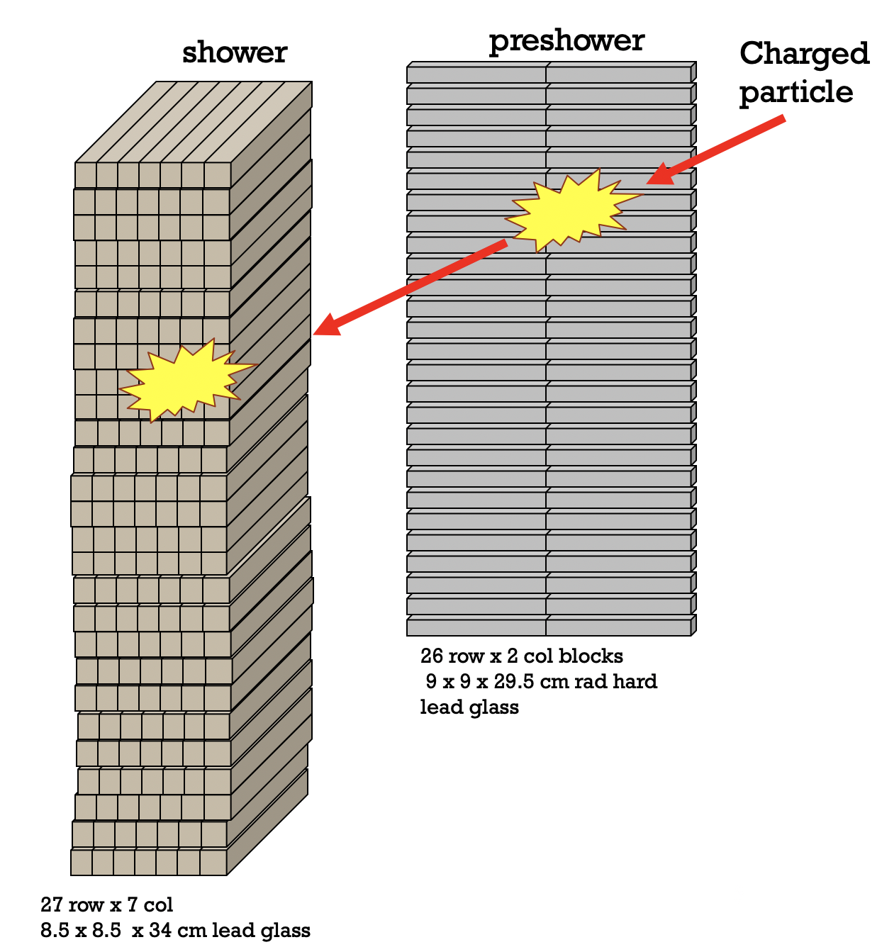
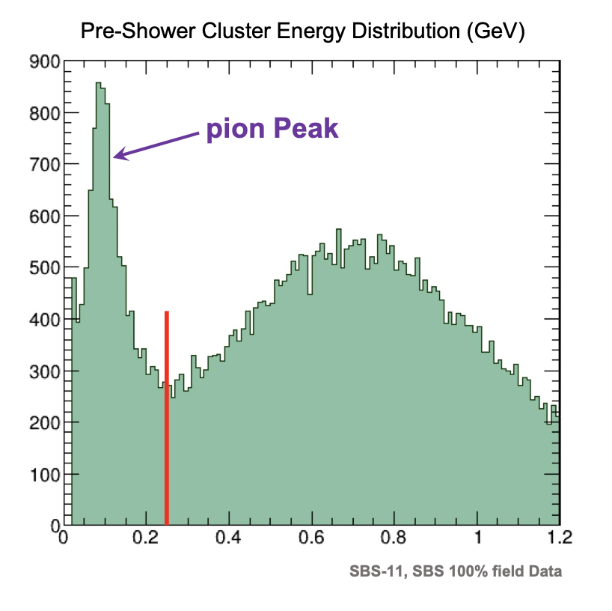
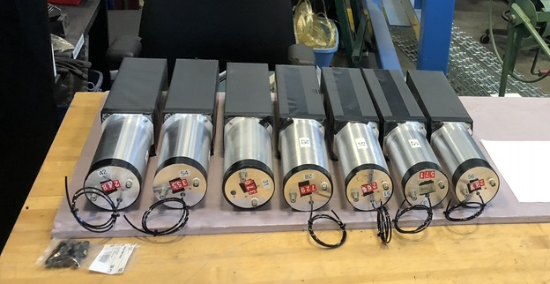
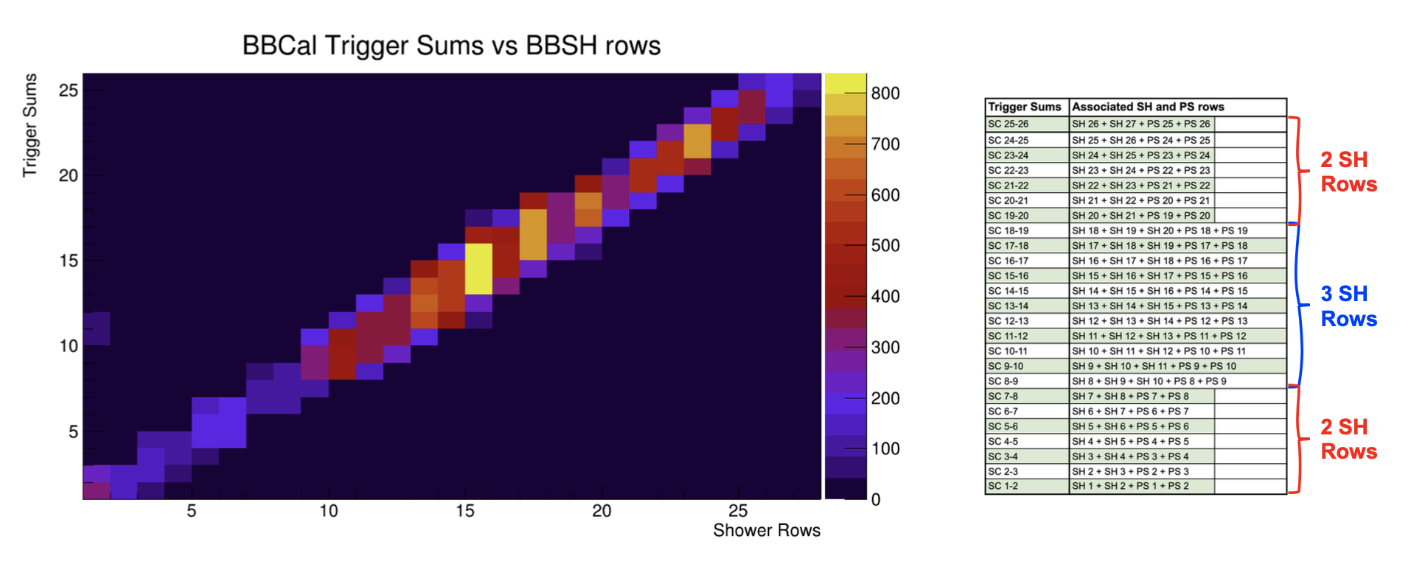
BBCAL
(Shower + Preshower)
Purpose
  Measures the scattered 𝑒! energy and crudely determines the track position.
  Provides handle for pion background rejection (PS energy deposit is used for this purpose)
  Provides trigger for the BigBite spectrometer
  Gives constraint for the track search region
General principles
  Collect Cherenkov light from relativistically charged particles including primaries and secondary e+/e- shower in electromagnetic cascades
  Long axis of preshower perpendicular to e⁻ or pion
  Long axis of shower parallel to e⁻ or pion

Slide 18
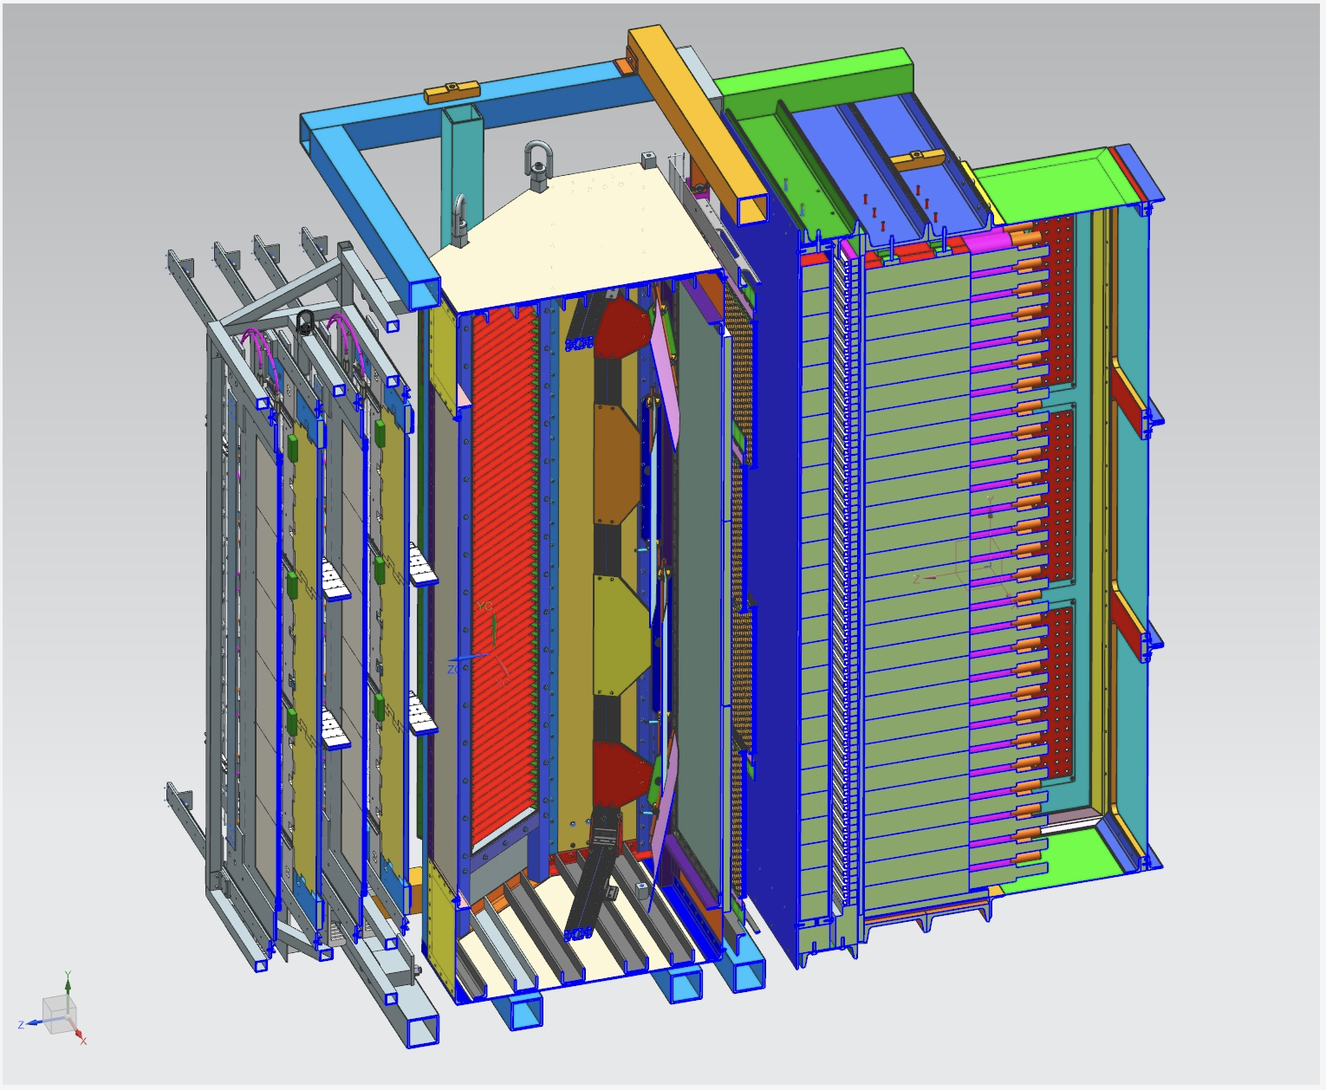
Detector Calibration
BBCAL
Calibration Concept
ꭓ² minimization of cluster energy compared to reconstructed electron energy
  Generate new ADC gain coefficients
Align ADC time of each block with respect to the hodoscope* cluster mean time
  Generate new ADC time offsets
Current Status
Energy calibrations are done and look good for all kinematics
Timing alignment was NOT done for the pass-1 mass replay and is being worked on for pass 2
Presley
SBS Collab Meeting, Sep 2024
Notes:
Bullet 2: at highq2 more than just spatial distr.

Slide 19
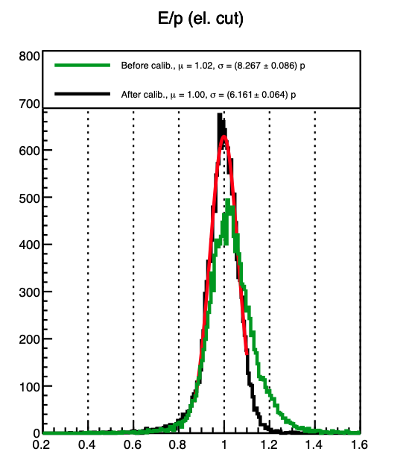
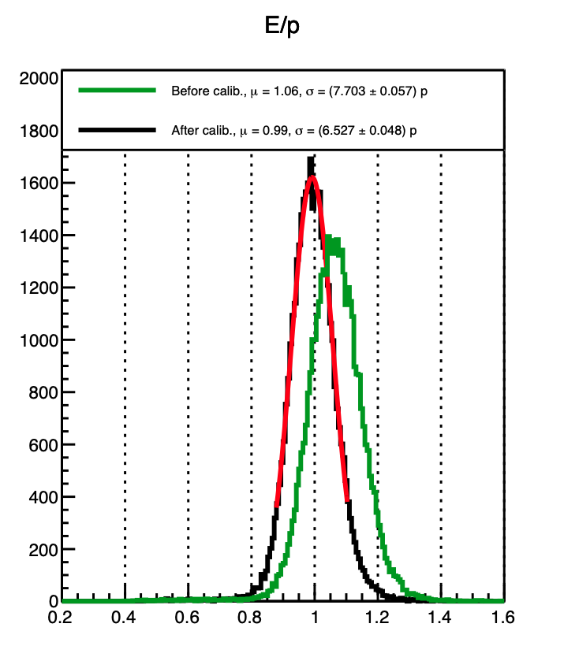
Detector Calibration
BBCal
Results
GEN2 using H2 data
GEN4-a using He3 data
Presley
SBS Collab Meeting, Sep 2024
Notes:
Bullet 2: at highq2 more than just spatial distr.

Slide 20
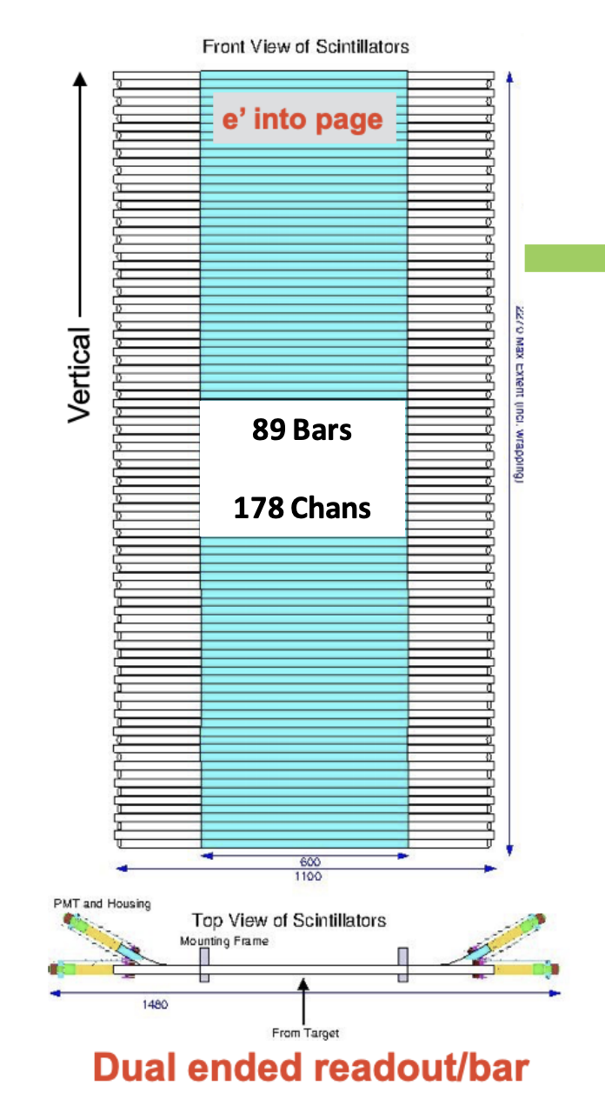
Timing Hodoscopes
Consists of 89 plastic scintillator paddles with a PMT on each side (178 channels)
Each PMT read out by dedicated 1190 TDC channel for precision timing
Designed to measure precision timing and position
Timing resolution: ~600 ps
  Can resolve e’ time-of-flight differences
Position resolution: ~5 cm
  Segmentation provides dispersive (vertical) resolution
  𝛥t = t_{left} - t_{right} and e’ track matching provides transverse (horizontal) resolution
Slide credit: Sebastian Seeds

Slide 21
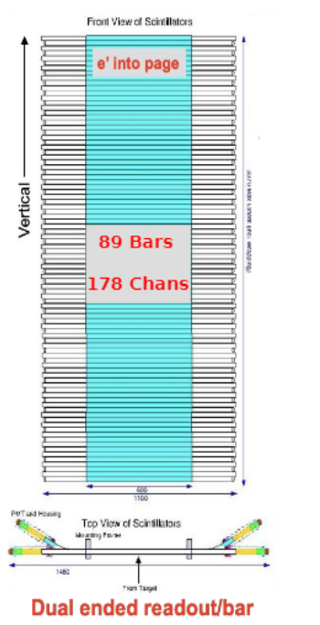
Detector Calibration
Timing Hodoscope
Calibration Concept
The hodoscope requires a timewalk and absolute timing offset calibration for each PMT (x178), as well as calibration of the scintillation speed of each plastic bar (x89).
Current Status
In Pass1 of the GEn data, these were performed separately. More recently a formalism was initialised (A. Puckett) to perform a more consistent global fit, and this is under further development. This includes correcting the timing of all systems (HCal, Hodo, RF) simultaneously in order to extract nucleon TOF.
Presley
SBS Collab Meeting, Sep 2024
Notes:
Bullet 2: at highq2 more than just spatial distr.

Slide 22
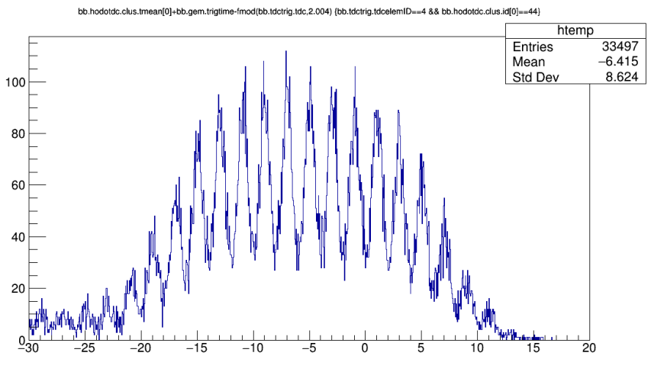
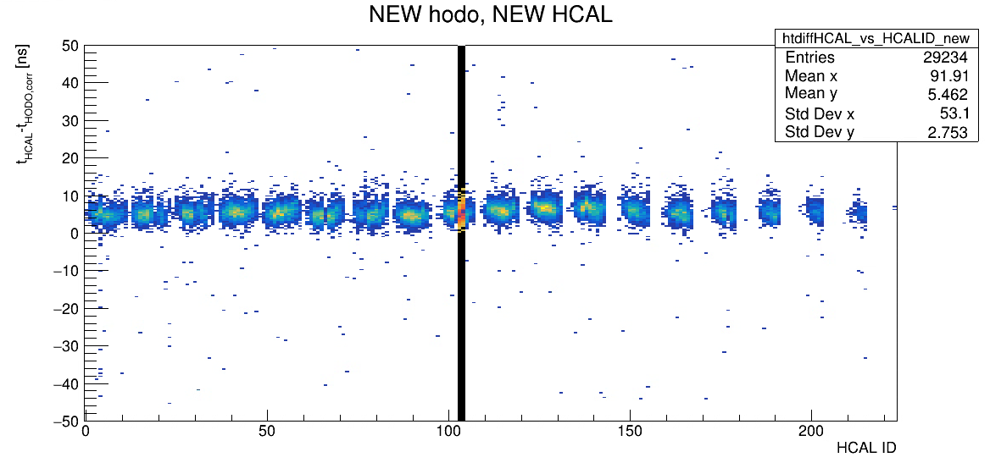
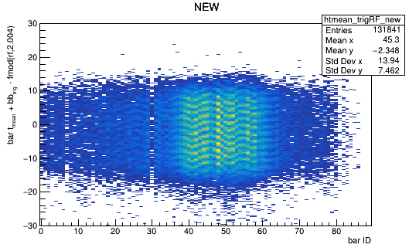
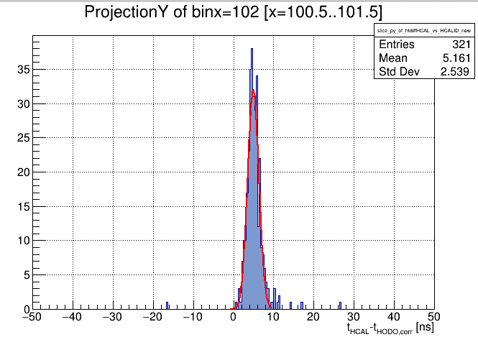
GEN Pass 2 (Working Towards)
Hodoscope
Initial run of “TOFcal” calibration script including some HCal parameters and the existing hodoscope global fit, begins to yield improvement in the TDC coincidence time
1.4ns
Still figuring out how to treat the trigger and RF times, for example. The “rf structure” is misaligned across the 89 bars

Slide 23
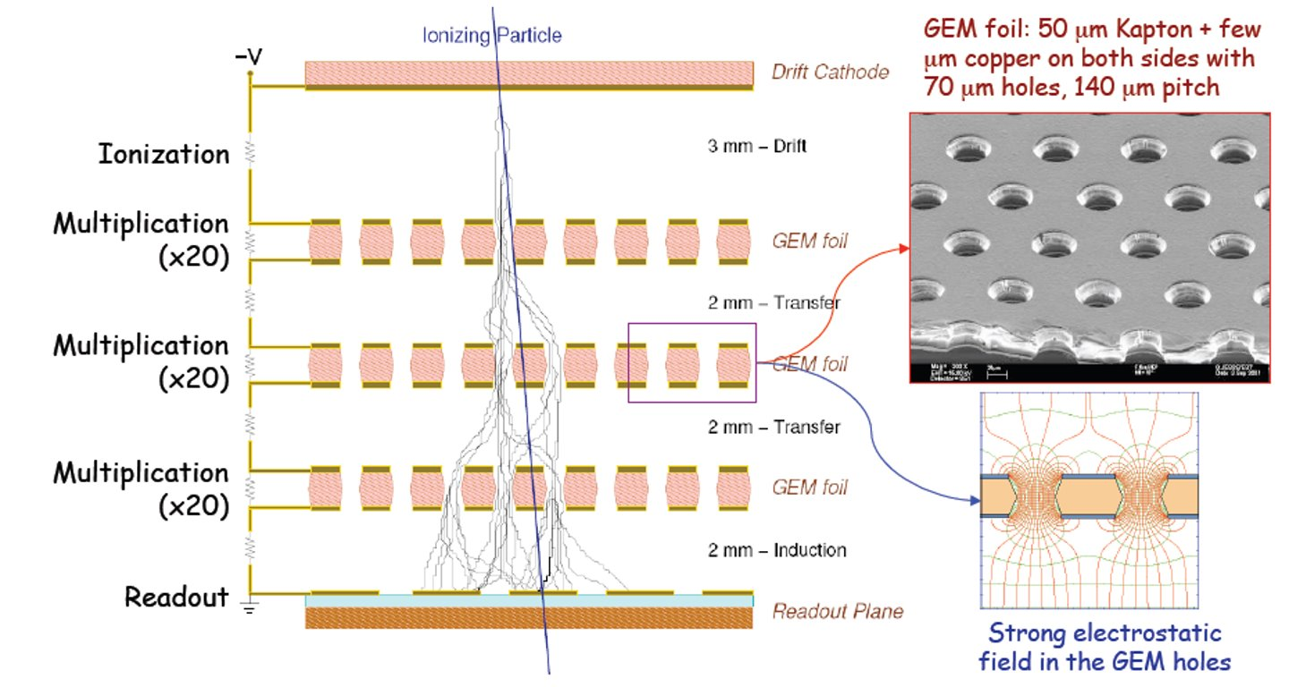
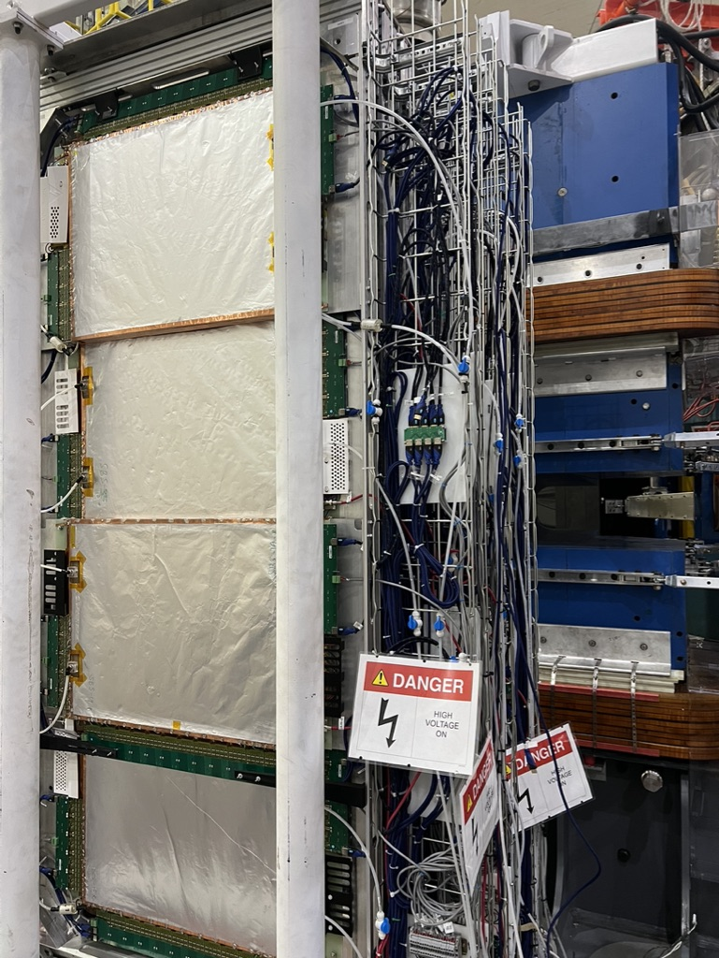
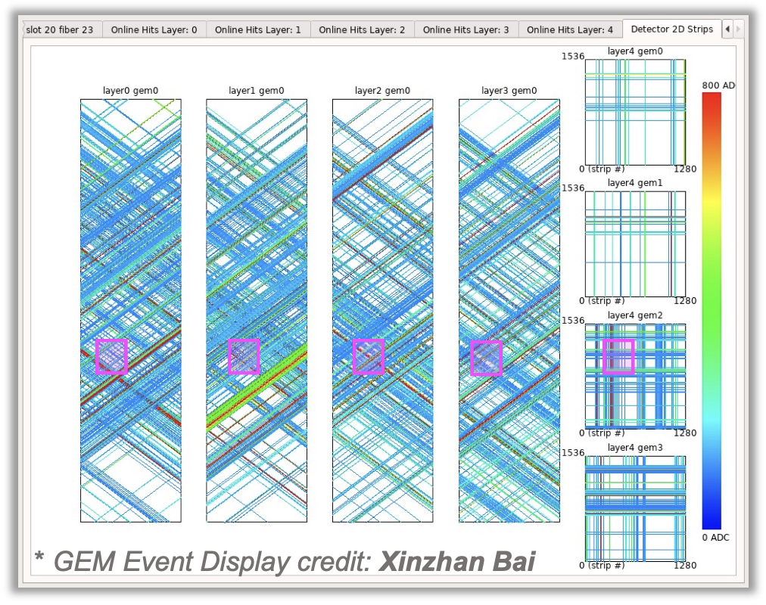
GEMs
(GAS ELECTRON MULTIPLIER)
e’ causes ionization of gas within cells with potential, accelerating them to segmented readout planes for tracking
Very high segmentation enables excellent position resolution (~7000 channels per layer!)
  5 layers in electron arm
Measures position and timing
  Position resolution: ~70 µm
  Timing resolution: ~10 ns
Position resolution enables precision tracking in the electron arm.
Primary detector subsystem responsible for tracking!
GEMs Single Event Display
Constraint Region
Typical event: many strips are firing at once!
Constraint reduces search region to 2-3% of active GEM area
Due to high luminosity, without constraints, combinatorics can regularly reach to > 1M competing tracks per event!

Slide 24
GEMs
Calibration Concept
Alignment - difference between the absolute hit position and the track position for each module is minimized to arrive at the accurate alignment
Gain Match - adc asymmetry due to u, v cluster APVs are minimized
ADC threshold - ADC thresholds are chosen such that the lowest 0.3% of ADC values are removed
Timing Calibration - U/V and Δt timing distributions are fitted with gaussians, 4.5σ and 5σ cut are used respectively
Current Status
Electron arm (BigBite) GEMs are calibrated for all kinematic points by Sean Jeffas
Hadron arm (SuperBigBite) GEMs are a working progress with the aim of Hcal energy calibration
Presley
SBS Collab Meeting, Sep 2024
Notes:
Bullet 2: at highq2 more than just spatial distr.

Slide 25
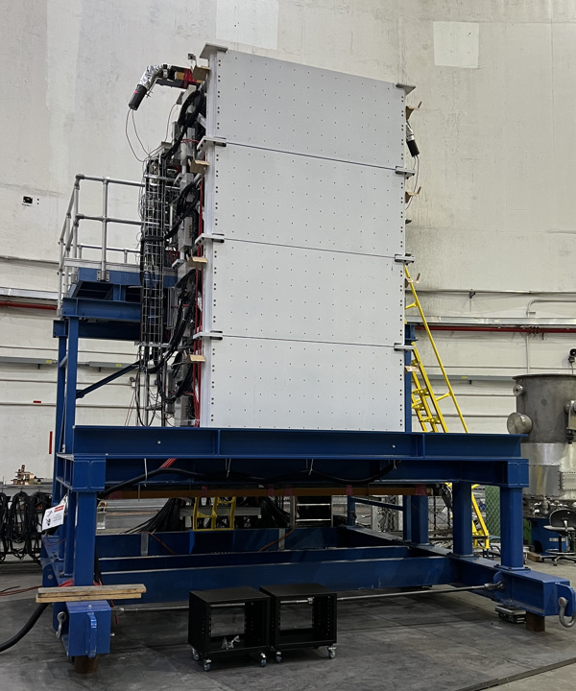
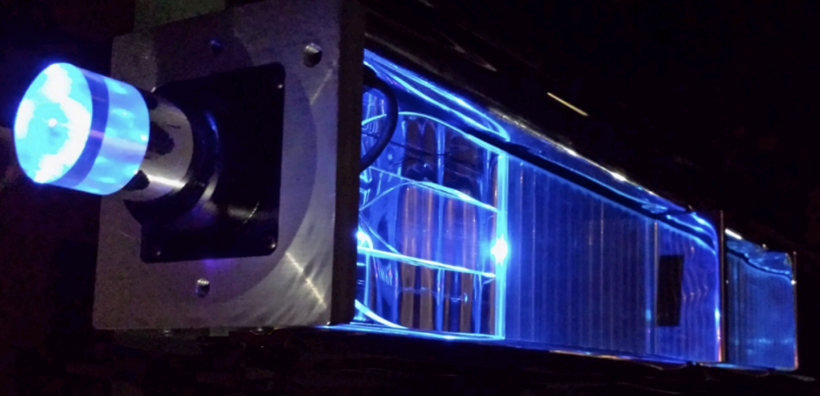
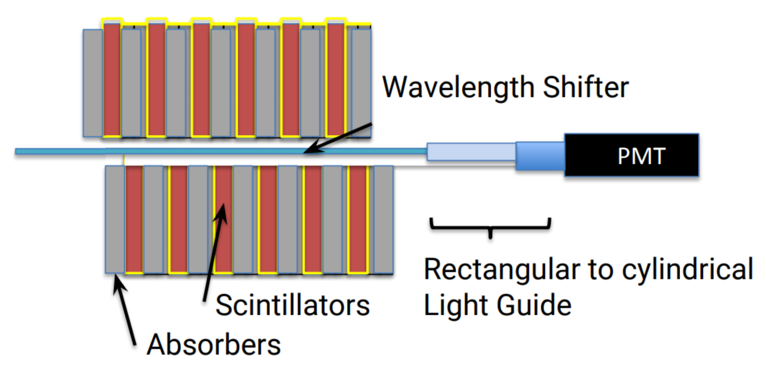
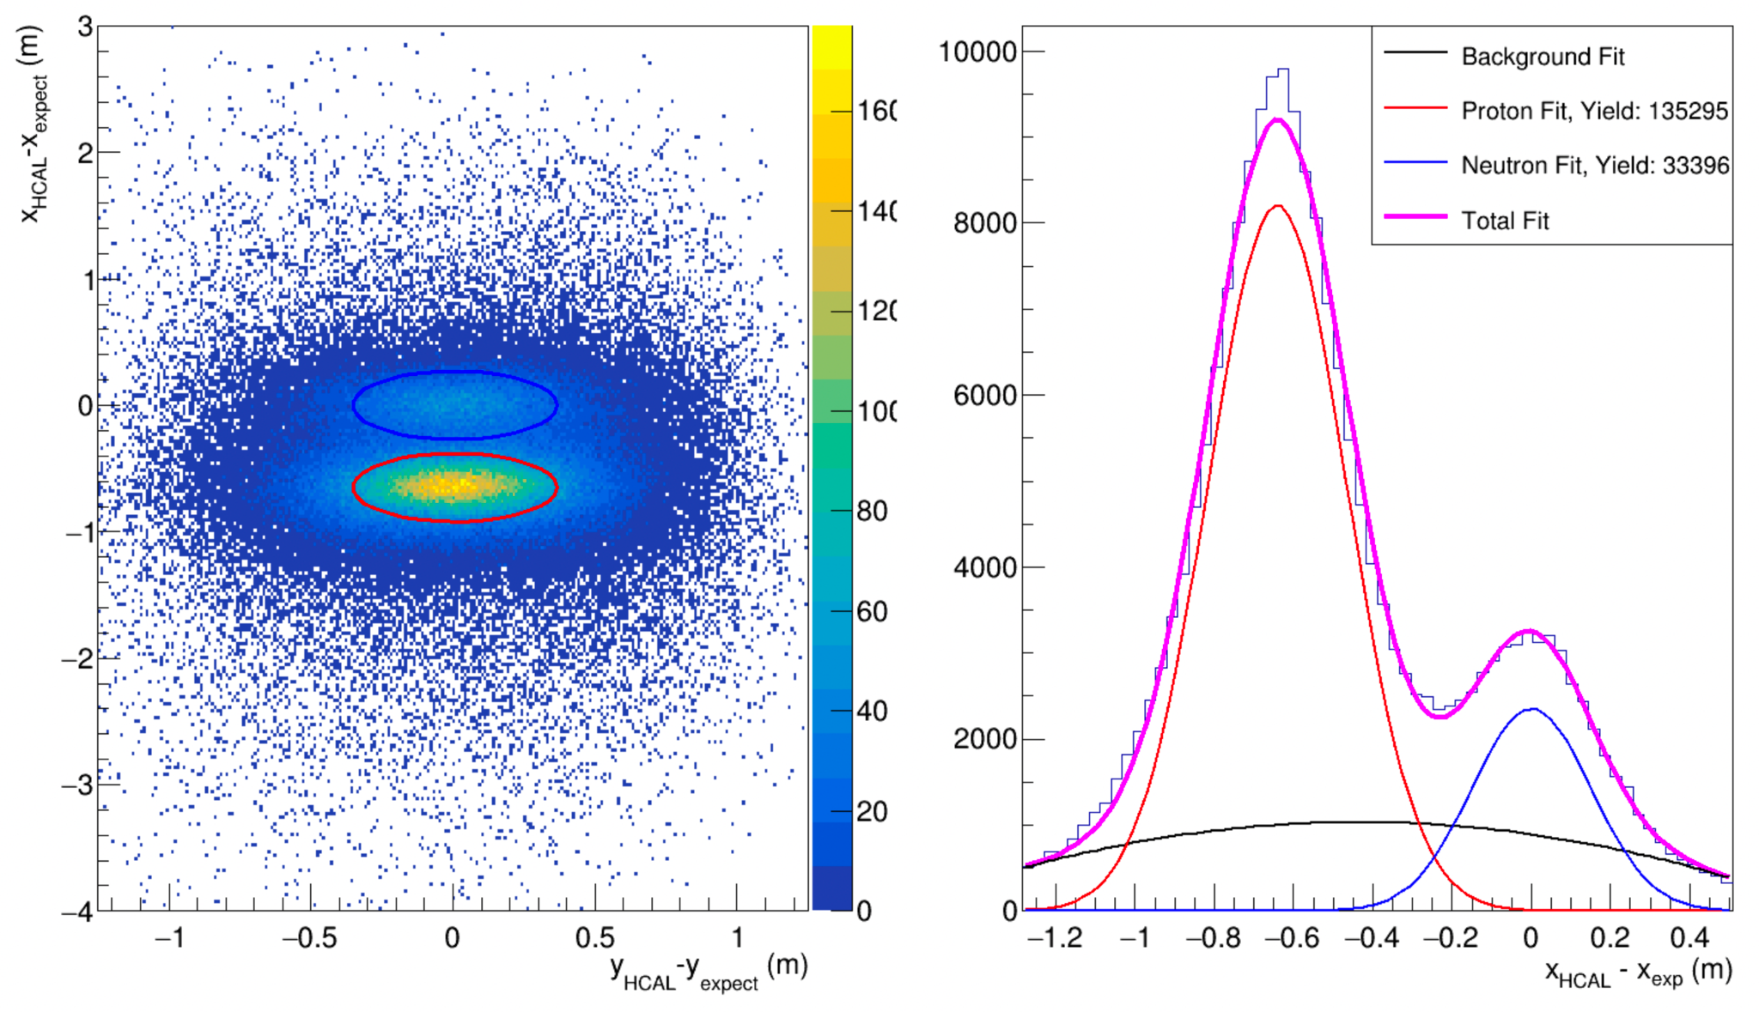
HCAL
HCal is a sampling, segmented hadron calorimeter
  12 col x 24 row (288 channels)
  fADC250 flash analog to digital and f1TDC time to digital converters (all channels)
HCal measures hadron energy, position, and precision timing
Energy: Hadrons interact with iron absorbers to create showers of many particles, shower energy is converted to light via scintillator, and light is converted to analog signal via PMT. PMT signals are read out by analog-to-digital converters (ADC) and time-to-digital converters (TDC).
  A portion of the initial hadron energy is sampled: the sampling fraction
  Simulated/observed energy sampling fraction: ~10%
  Simulated/observed energy resolution: ~40%
Position: Shower deposits energy in localized set of modules (a cluster). Hadron position in HCal reconstructed via energy-weighted cluster centroid
  Simulated/observed position resolution: ~7cm
Timing: Difference in time between signal in HCal and hodoscope corrected trigger
  Observed single-channel timing resolution: ~1.3 ns
Primary detector responsible for measuring scattered hadrons and associated yields
Single module
1/288 Single Modules in HCal

Slide 26
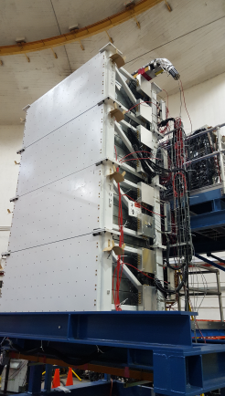
HCAL
Calibration Concept
Identify timing and energy of detected recoiled nucleon
Align fADC and TDC times
Set fADC gain coefficients
Current Status
First pass of calibrations completed
Timing and energy calibration procedure needs to be optimized before pass 2
  New timing calibration procedure
  SBS GEMs being implemented for energy calibration
Presley
SBS Collab Meeting, Sep 2024
Notes:
Bullet 2: at highq2 more than just spatial distr.

Slide 27
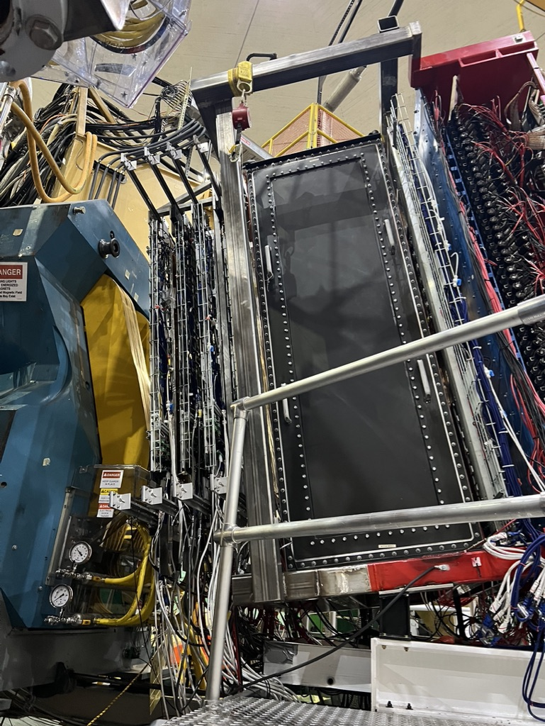
GRINCH (Gas RINg imaging CHerenkov)
The Gas Ring ImagiNg CHerenkov, GRINCH
  Heavy gas (C₄F₈) filled light-tight “coffin” box promotes cherenkov reactions with charged electrons and pions
  510 PMTs in a honeycomb array designed to resolve electron rings
Measures timing with unique properties
  Each PMT is read out by a single time to
  digital converter (TDC) channel
  Timing resolution ~4.5 ns
Designed to mitigate pion contamination for better quasi-elastic e’ selection
  Much heavier pions with similar momentum as e’ move more slowly and produce smaller rings
  Pion threshold ~2.7 GeV/c
Provides efficient pion rejection over all kinematics.

Slide 28
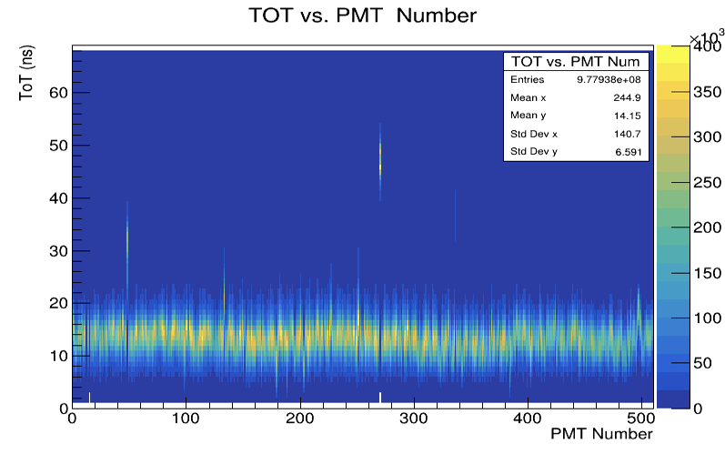
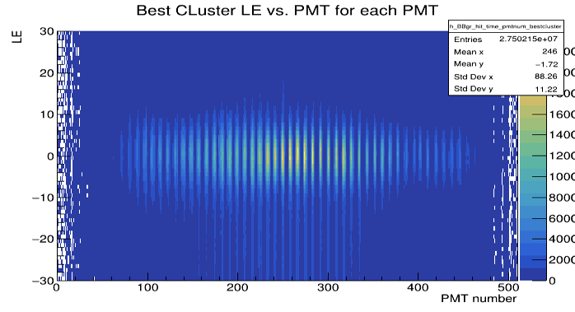
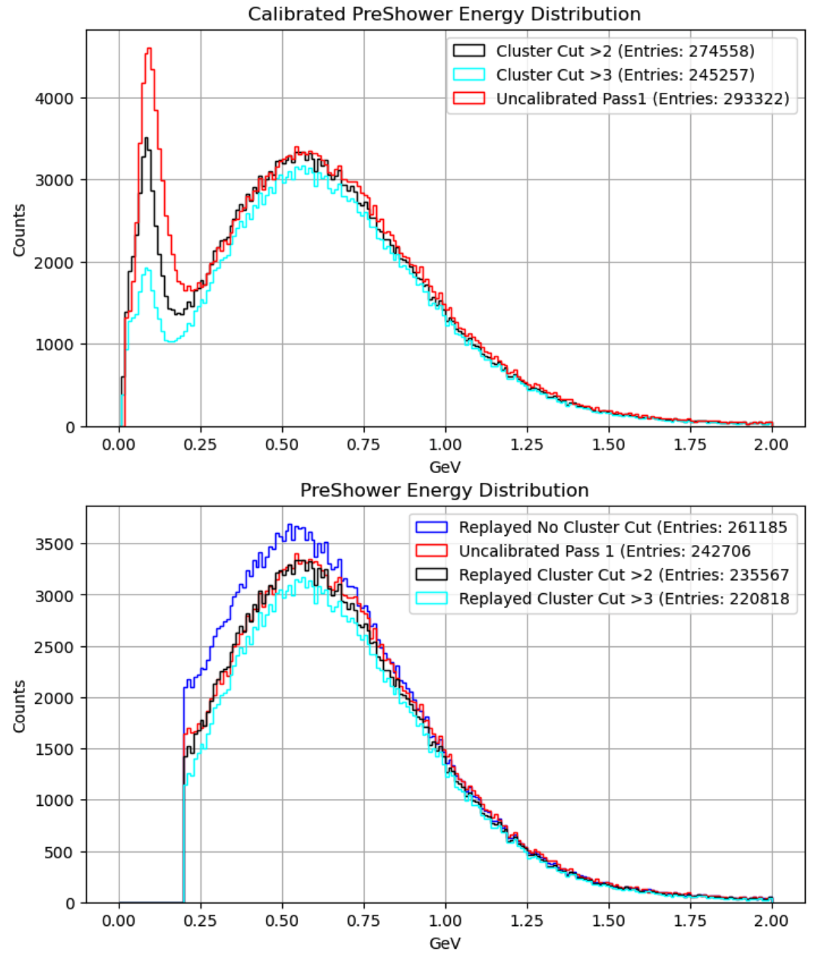
Detector Calibration
GRINCH
Calibration Concept
Check time over threshold (ToT) for the 510 photomultiplier tubes (PMTs)
  ToT vs. PMT should be centered ~12.5ns
Align and set timing offsets for the leading edge (LE) for each PMT
Current Status
LE calibrations ready for pass2 (all kinematics)
First looks at GRINCH efficiency
Cut studies
  ToT, # of (GRINCH) Clusters, PS Energy, W², etc.
Presley
SBS Collab Meeting, Sep 2024
Notes:
Bullet 2: at highq2 more than just spatial distr.

Slide 29
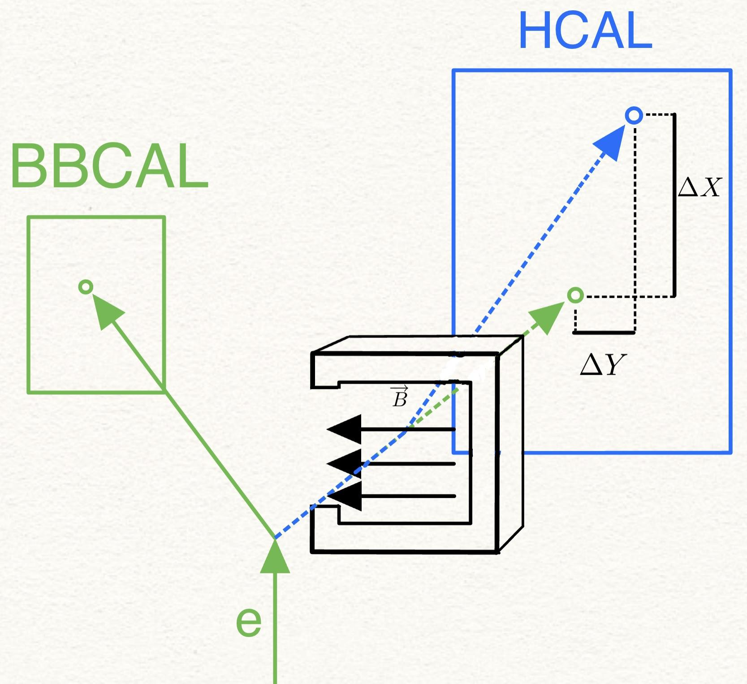
Identifying Protons and Neutrons
Data Selection
Calculate expected recoiled nucleon location with BBCal
This calculation doesn’t consider SBS magnet
  Expected location should have larger discrepancy with actual location for protons in the dispersive direction
dX - Difference between expected and actual in dispersive direction
dY - Difference between expected and actual in non-dispersive direction
Presley
SBS Collab Meeting, Sep 2024
Notes:
Bullet 2: at highq2 more than just spatial distr.

Slide 30
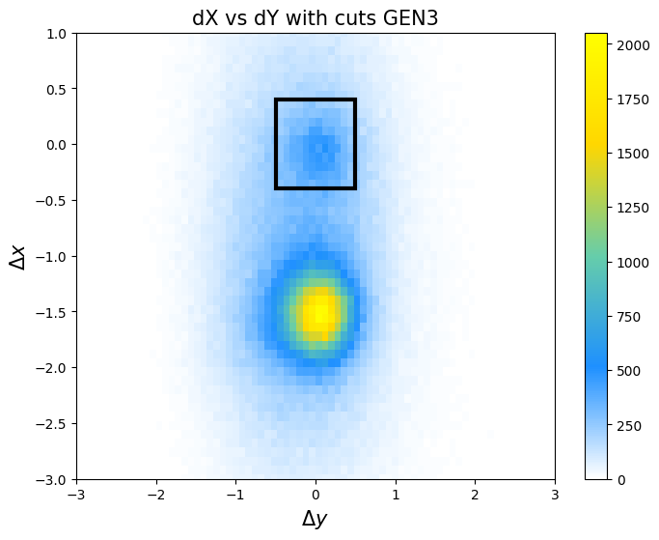
Quasi Elastic Cuts
Data Selection
dX
dY
W2
Coincidence
Presley
SBS Collab Meeting, Sep 2024
Notes:
Bullet 2: at highq2 more than just spatial distr.

Slide 31
dX and dY
Data Selection
Presley
SBS Collab Meeting, Sep 2024
Notes:
Bullet 2: at highq2 more than just spatial distr.

Slide 32
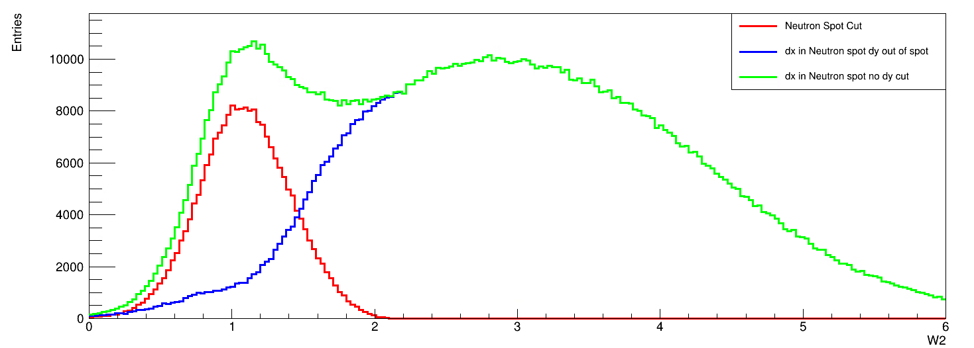
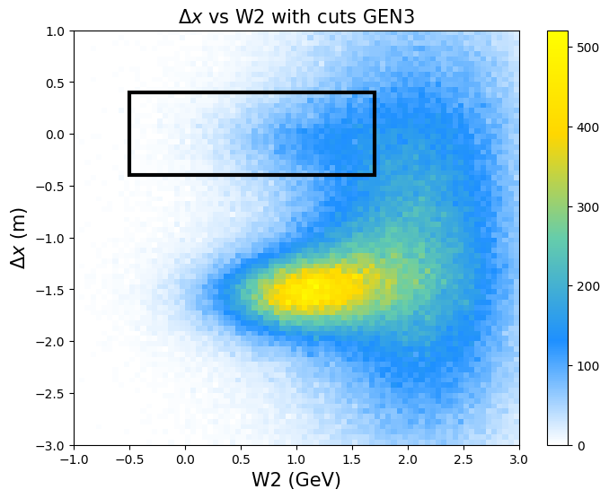
W2
Data Selection
Presley
SBS Collab Meeting, Sep 2024
Notes:
Bullet 2: at highq2 more than just spatial distr.

Slide 33
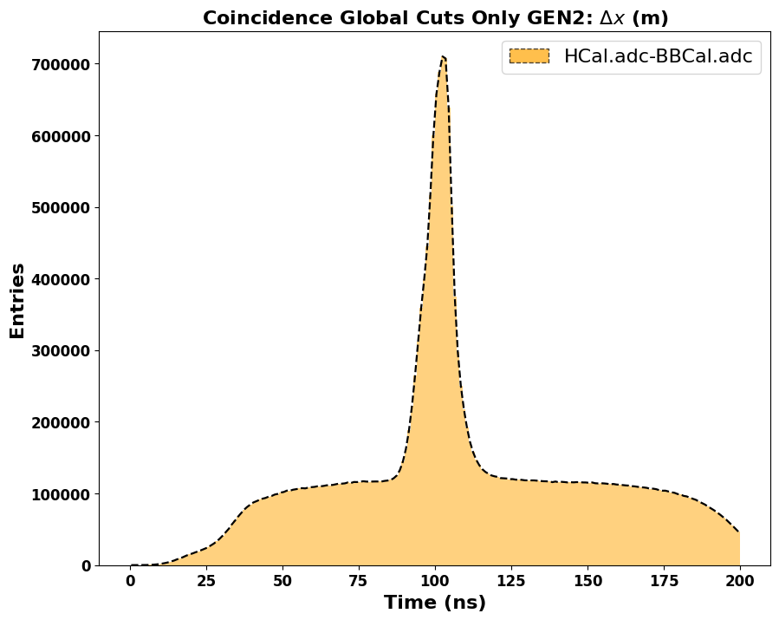
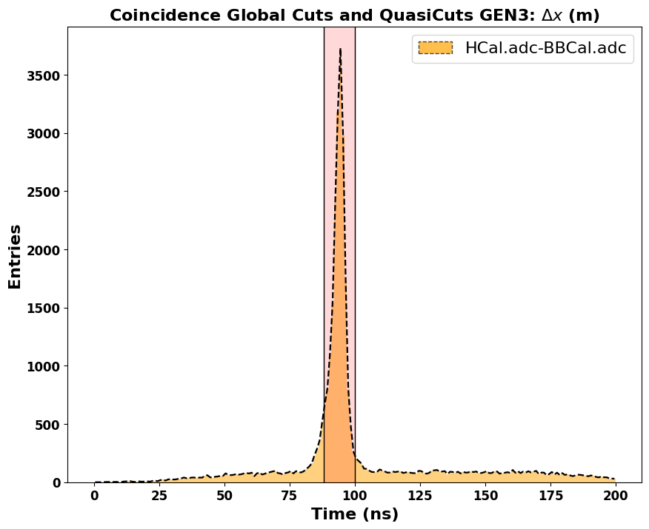
Coincidence cut
Data Selection
HCal.adc.t - BBCal.adc.t
Rough cuts on dxdy -> clear coincidence
Presley
SBS Collab Meeting, Sep 2024
Notes:
Bullet 2: at highq2 more than just spatial distr.

Slide 34
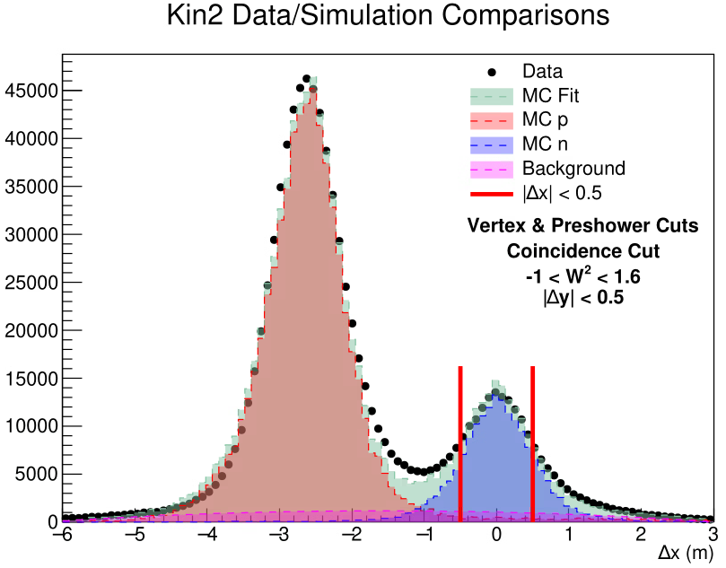
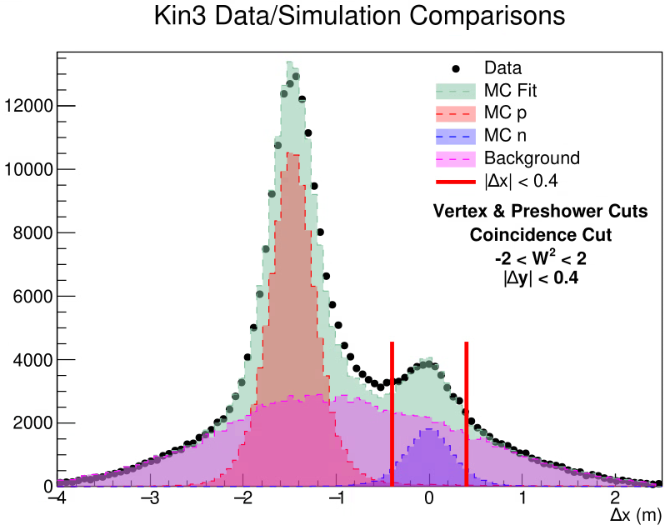
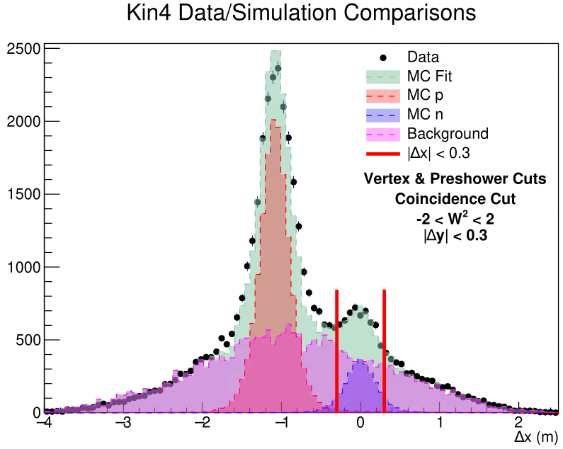
Event selection
Plot credit: Sean Jeffas
Irreducible Background at large $Q^{2}$
Efforts underway to understand and integrate the inelastic generator into the mainstream analysis framework
Presley
SBS Collab Meeting, Sep 2024
34

Slide 35
Summary
GEn-II successfully completed data taking with a high luminosity polarized 3He target!
Highly motivated group that meets weekly for analysis meetings
Major analysis efforts are underway in terms of timing, calibrations, energy reconstruction, simulations and beam and target polarimetries
1 graduated, 8 to go!
Presley
SBS Collab Meeting, Sep 2024
Notes:
Bullet 2: at highq2 more than just spatial distr.

Slide 36
GEn-II Students
Vimukthi Gamage
Me
Jacob Koenemann
Kate Evans
Jack Jackson
Gary Penman
Faraz Chahili
GEMS
Target and HCAL
Target UVA
Braiain Mederos
Sean Jeffas
Target and BBCAL
Target and GRINCH
Target and Hodo
Moller
Graduated July 2024
Target UVA
GEMS
Presley
SBS Collab Meeting, Sep 2024
Notes:
Bullet 2: at highq2 more than just spatial distr.

Slide 37
Extras
Presley
SBS Collab Meeting, Sep 2024
Notes:
Bullet 2: at highq2 more than just spatial distr.

Slide 38
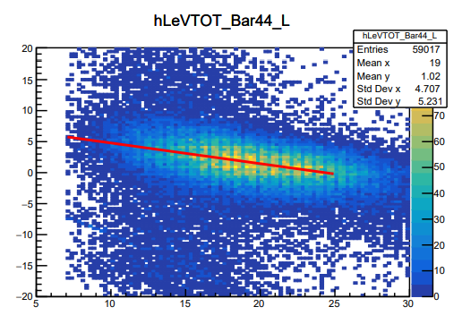
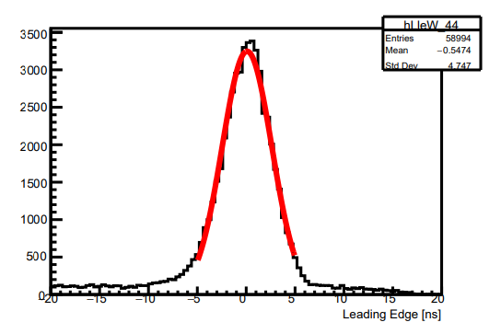
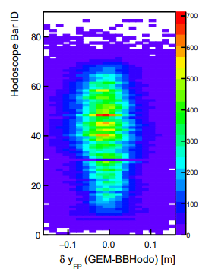
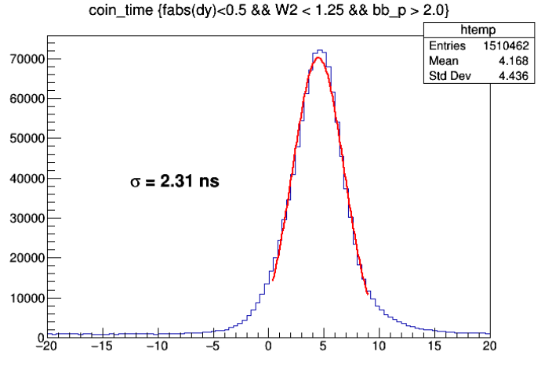
GEN Pass 1
Hodoscope
Timewalk observed in TDC Leading Edge vs TOT (Bar 44)
Post TW correction alignment check (Bar 44)
HCal TDC - Hodo TDC Coincidence Time resolution after Pass1
Position alignment relative to GEMs in dispersive plane after v_{scint} calibration

Slide 39
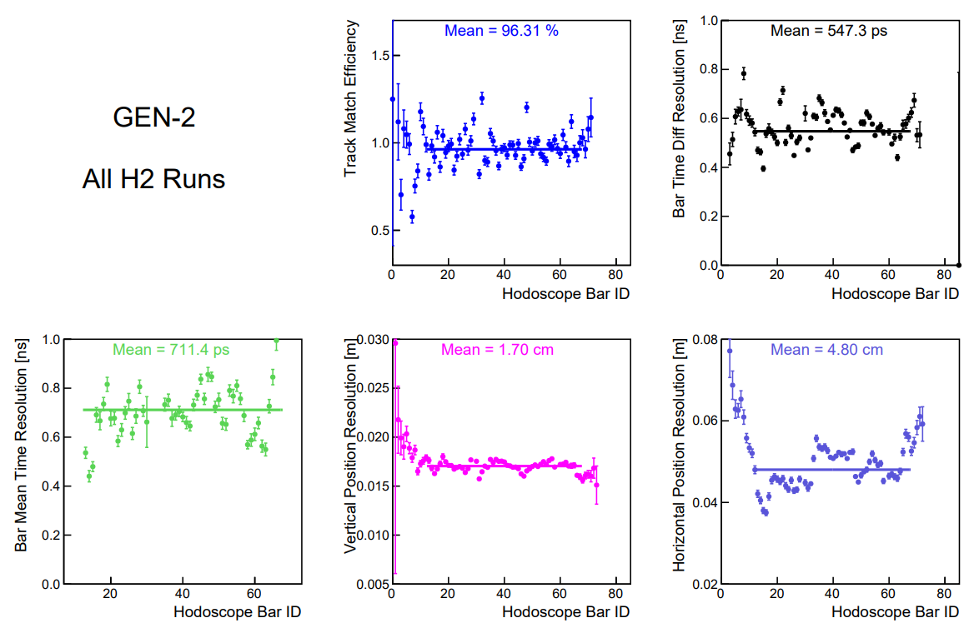
Hodoscope

Slide 40
GEN Pass 2 (Working Towards)
Hodoscope
Initial run of “TOFcal” calibration script including some HCal parameters and the existing hodoscope global fit, begins to yield improvement in the TDC coincidence time
1.4ns
Still figuring out how to treat the trigger and RF times, for example. The “rf structure” is misaligned across the 89 bars

