Slide 1

Deep Threshold Phi-Production
SBS Collaboration Meeting
13 September 2024
Charles Hyde
Old Dominion University

Slide 2
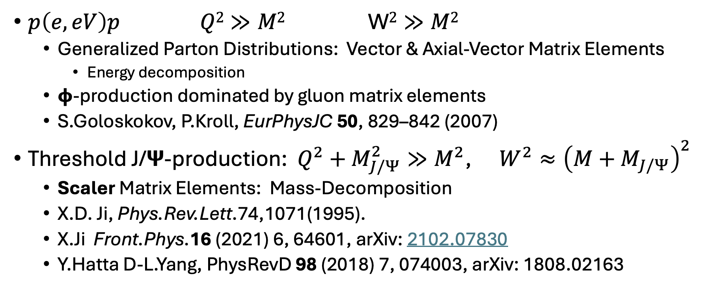
Deep Virtual Vector-Meson Electroproduction
$p\left(e,eV\right)p$ $Q2≫M2$ W$2≫M2$
  Generalized Parton Distributions: Vector & Axial-Vector Matrix Elements
    Energy decomposition
  𝞍-production dominated by gluon matrix elements
  S.Goloskokov, P.Kroll, EurPhysJC 50, 829–842 (2007)
Threshold J/𝝭-production: $Q^{2}+M_{J/Ψ}^{2}≫M^{2}$, $W^{2}≈{\left(M+M_{J/Ψ}\right)}^{2}$
  Scaler Matrix Elements: Mass-Decomposition
  X.D. Ji, Phys.Rev.Lett.74,1071(1995).
  X.Ji Front.Phys.16 (2021) 6, 64601, arXiv: 2102.07830
  Y.Hatta D-L.Yang, PhysRevD 98 (2018) 7, 074003, arXiv: 1808.02163

Slide 3
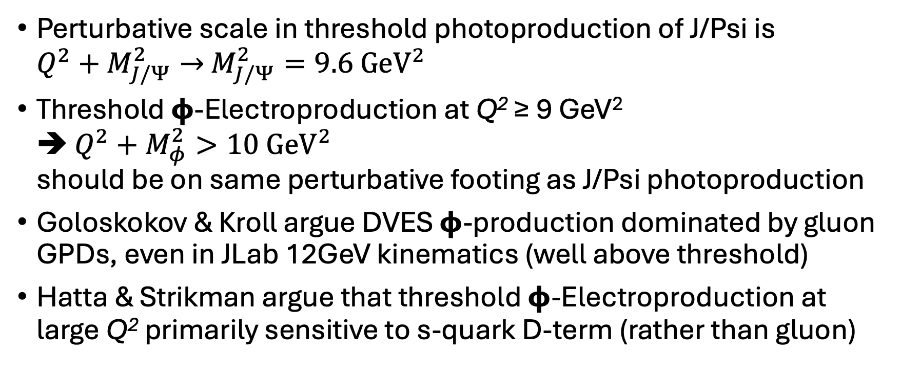
Motivation for High-Q² Measurement of Threshold Electroproduction of 𝞍-meson
Perturbative scale in threshold photoproduction of J/Psi is
$Q^{2}+M_{J/Ψ}^{2}→$ $M_{J/Ψ}^{2}=9.6 {\text{GeV}}^{2}$
Threshold 𝞍-Electroproduction at Q² ≥ 9 GeV²
➔ $Q^{2}+M_{φ}^{2}>10{ \text{GeV}}^{2}$
should be on same perturbative footing as J/Psi photoproduction
Goloskokov & Kroll argue DVES 𝞍-production dominated by gluon GPDs, even in JLab 12GeV kinematics (well above threshold)
Hatta & Strikman argue that threshold 𝞍-Electroproduction at large Q² primarily sensitive to s-quark D-term (rather than gluon)

Slide 4

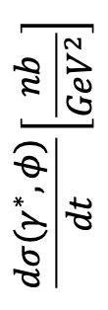
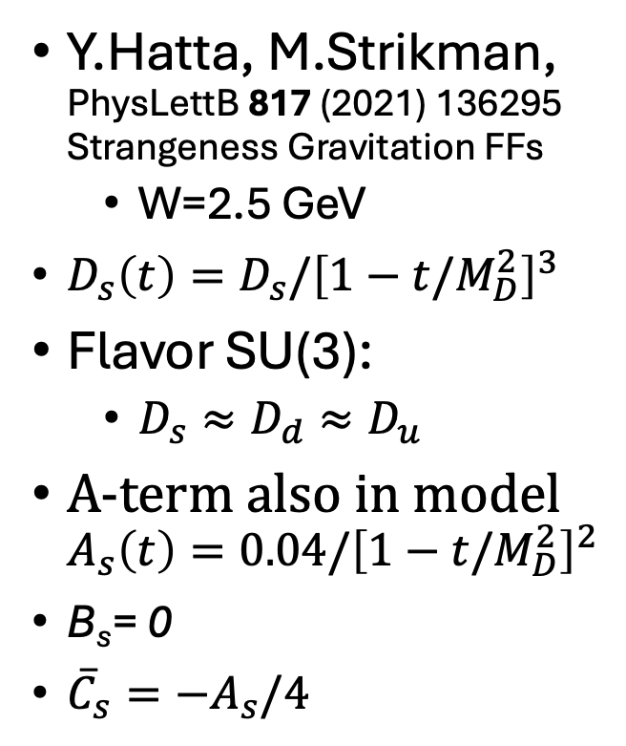
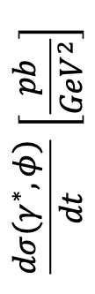



Threshold Deep 𝞍
D_{s} = 0.4
0.0
–0.4
–0.7
–1.3
$$Q^{2}=3.8 {\text{GeV}}^{2}$$
Y.Hatta, M.Strikman, PhysLettB 817 (2021) 136295
Strangeness Gravitation FFs
  W=2.5 GeV
$D_{s}\left(t\right)=D_{s}/{\left[1−t/M_{D}^{2}\right]}^{3}$
Flavor SU(3):
  $D_{s}≈D_{d}≈D_{u}$
A-term also in model
$A_{s}\left(t\right)=0.04/{\left[1−t/M_{D}^{2}\right]}^{2}$
B_{s}= 0
${\overline{C}}_{s}=−A_{s}/4$
W=2.5 GeV
$$\frac{dσ(γ^{∗},φ)}{dt}\left[\frac{nb}{{GeV}^{2}}\right]$$
$$−t {\text{GeV}}^{2}$$
$$Q^{2}=20. {\text{GeV}}^{2}$$
$$\frac{dσ(γ^{∗},φ)}{dt} \left[\frac{pb}{{GeV}^{2}}\right]$$
W=2.5 GeV
$$−t {\text{GeV}}^{2}$$

Slide 5
The 11 GeV Window of Opportunity
Near threshold, proton and phi ~colinear
Large Q²: 𝜙 is boosted forward, K⁺K– are in small decay cone.
Detect scattered electron in BigBite, all hadrons in SBS.
SBS Hcal for triggering
SBS PID with Aerogel RICH?

Slide 6
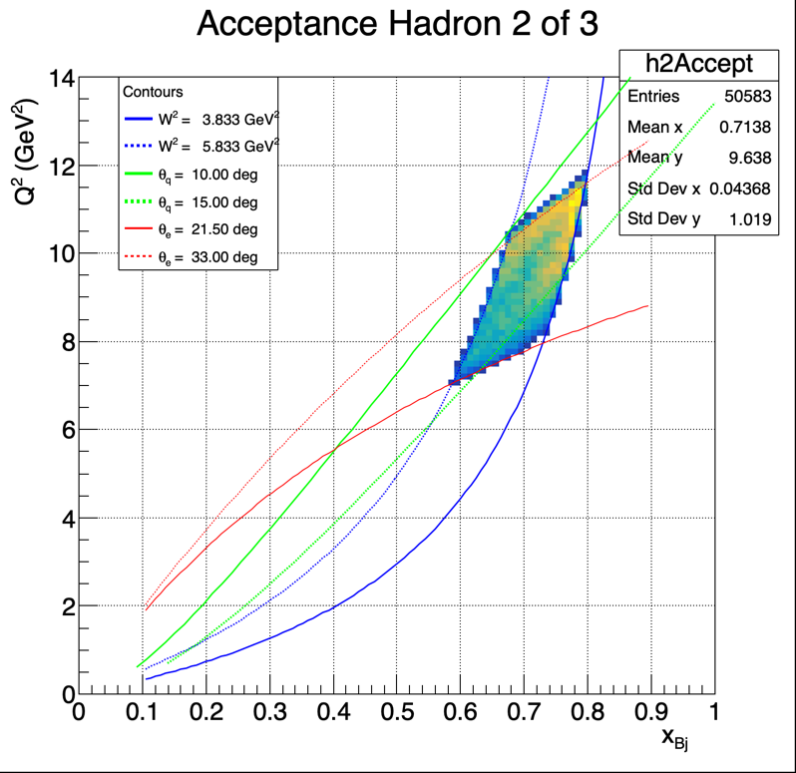

SBS Configuration
Center SBS at 12.5°
  Solid Angle 30 msr
  3:1 V:H Aspect ratio
NPS Calo at –27.5°
  BigBite “Sweep”
  Calo at 3m
  $ΔΩ≈50 \text{msr}$

Slide 7
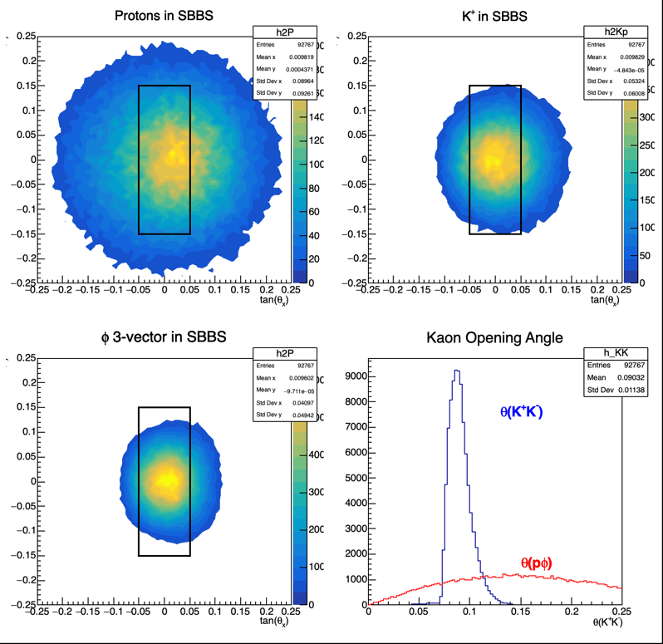
Phase Space Simulation
Generated Hadrons
Electrons detected

Slide 8
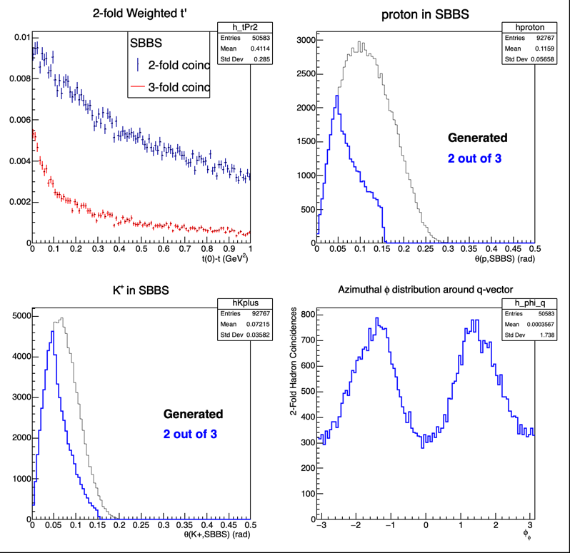
Accepted Events
Not great
Maybe sufficient to do a measurement?

Slide 9
Things to do:
Get cross section model in appropriate W², Q² range
Determine realistic acceptance and resolution models of SBS and electron arm
Detailed simulations
Suggestions and collaborators welcome!

