Slide 1
Status Updates on SBS Hadron-Calorimeter (HCAL)
Jiwan Poudel
Jefferson Lab

Slide 2
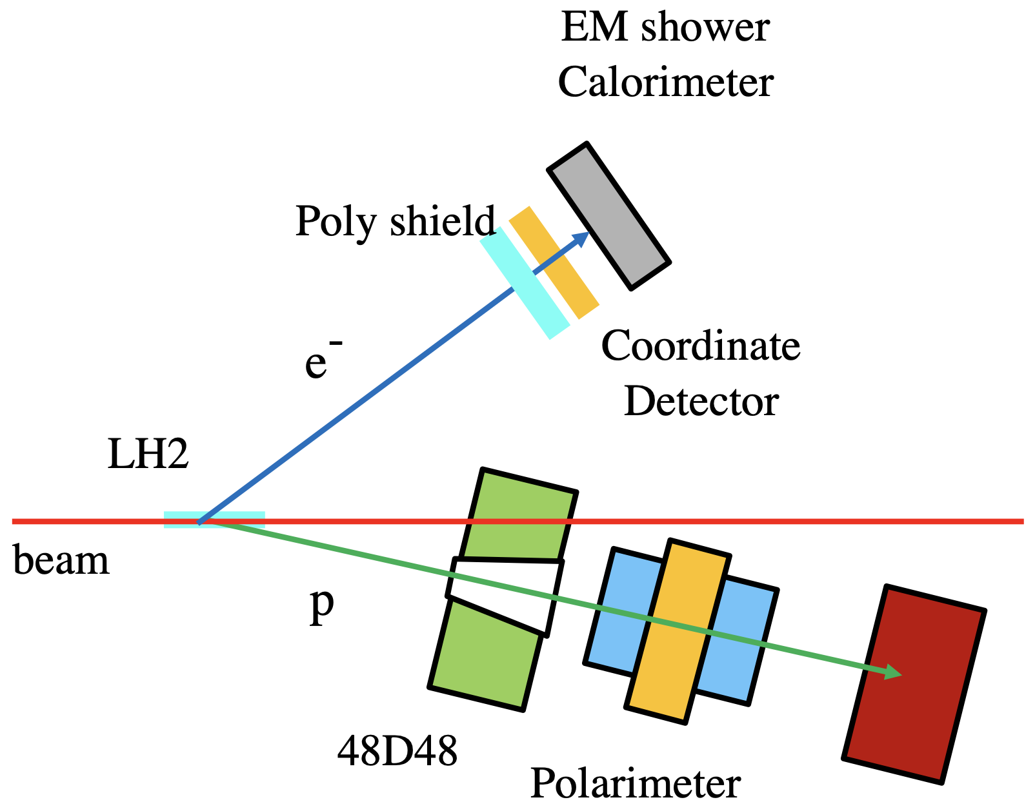
Background
Super Big-Bite Programs: Study of nucleons form factors (G_{E} and G_{M})
  E12-09-019 -> GMn (data collection completed in 2020)
  E12-09-016 -> GEn (data collection completed in 2023)
  E12-17-004 -> GEn-RP (data collection completed in 2024)
  E12-07-109 -> GEp (2025)
Hadron (protons/neutrons) Calorimeter is a primary detector for SBS Program in the hadron arm!!

Slide 3
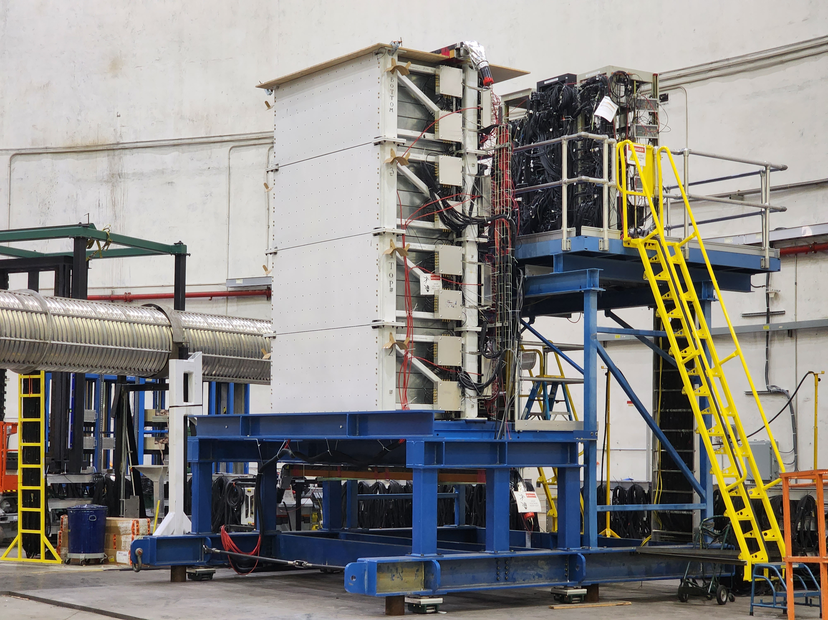
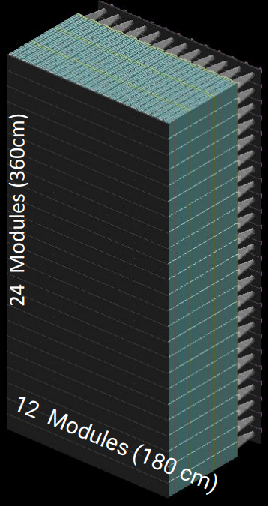
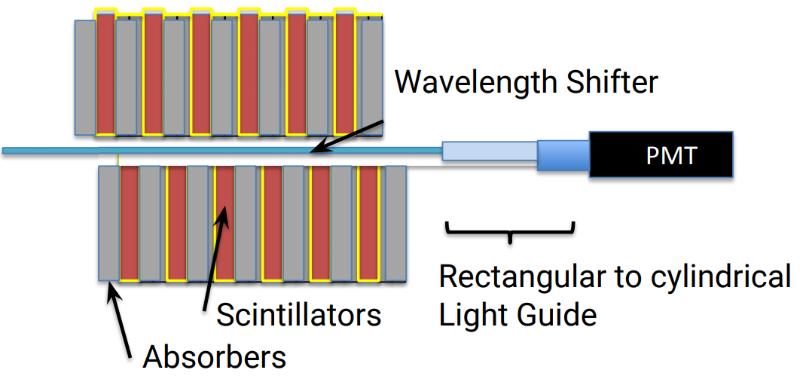
HCAL Detector
Hadron (protons/neutrons) Calorimeter Detector
Segmented Calorimeter to detect high energy nucleons: 288 modules (12x24 blocks of 15x15x100cm dimension)
Each module: 40 layers of Iron absorbers alternate with scintillators, and a wavelength shifter in the middle

Slide 4
HCAL Data Acquistion
Signals amplification (10x) at the Front end (HCAL upper platform) and readout at the back end (DAQ bunker)
Signal waveform (ADCs) and timing (TDCs) information in data stream
Summing modules for HCAL Analog trigger (threshold on 8x8 sum)
HCAL Digital trigger with VTP (3x3 cluster): ~2.5 us lookback window
HCAL Digital Trigger
VTP
HCAL Detector
fADC patch panel
Splitter
Discriminator
10x Amplifier
fADC250
Summing modules (4x4)
TDC patch panel
Discriminator
f1TDC
Discriminator
HCAL Analog Trigger
fADC patch panel
TDC patch panel
Front End
Back End

Slide 5
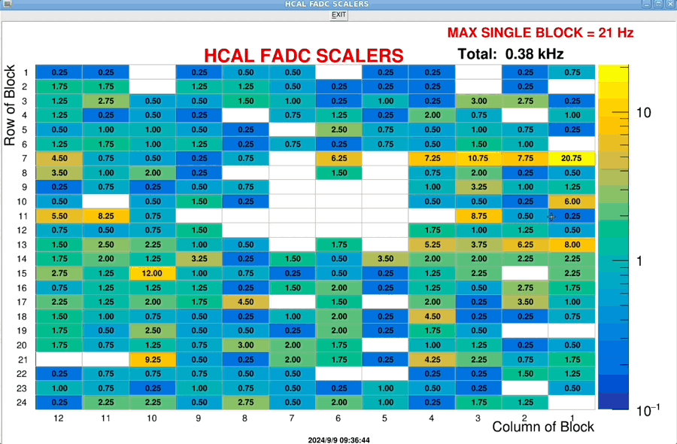
HCAL Scalers
Scalers from fADC
fADC channels mapped to detector row/column
Easy to figure out problematic channels
Center 12 blocks (row 5 and 7) have issue: no counts at all
12 blocks => 1 HV module in bad state
Further investigation ongoing for few noisy channel

Slide 6
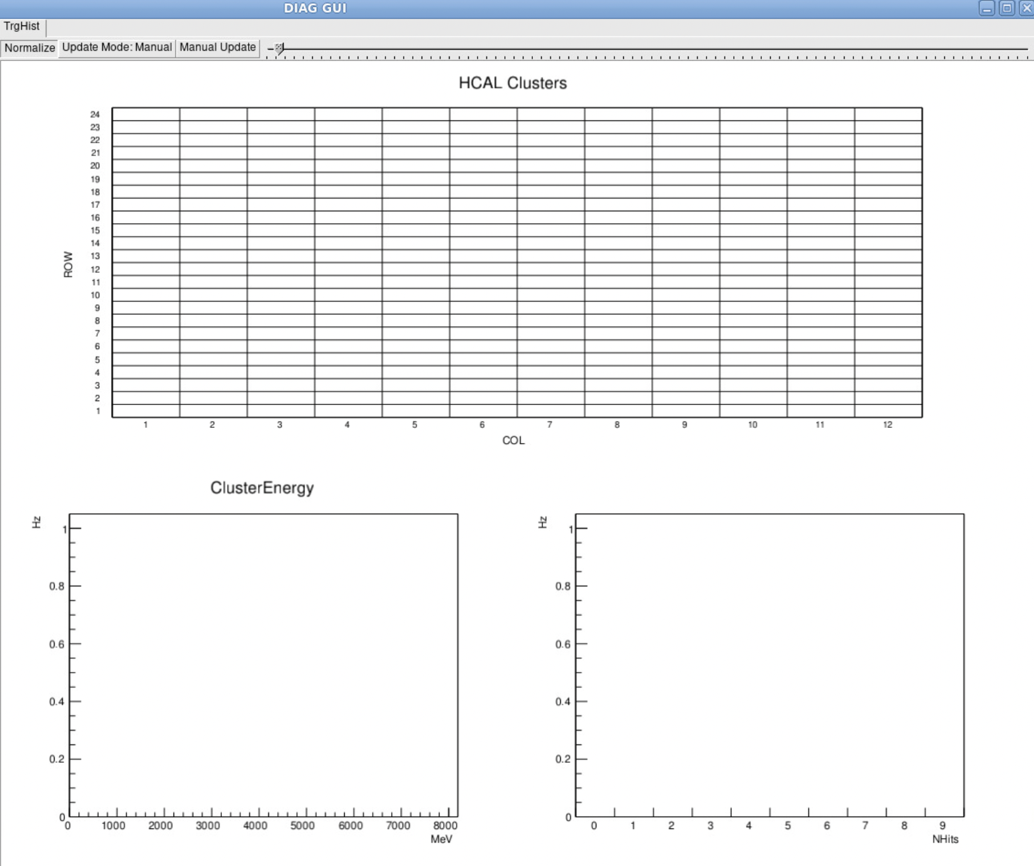
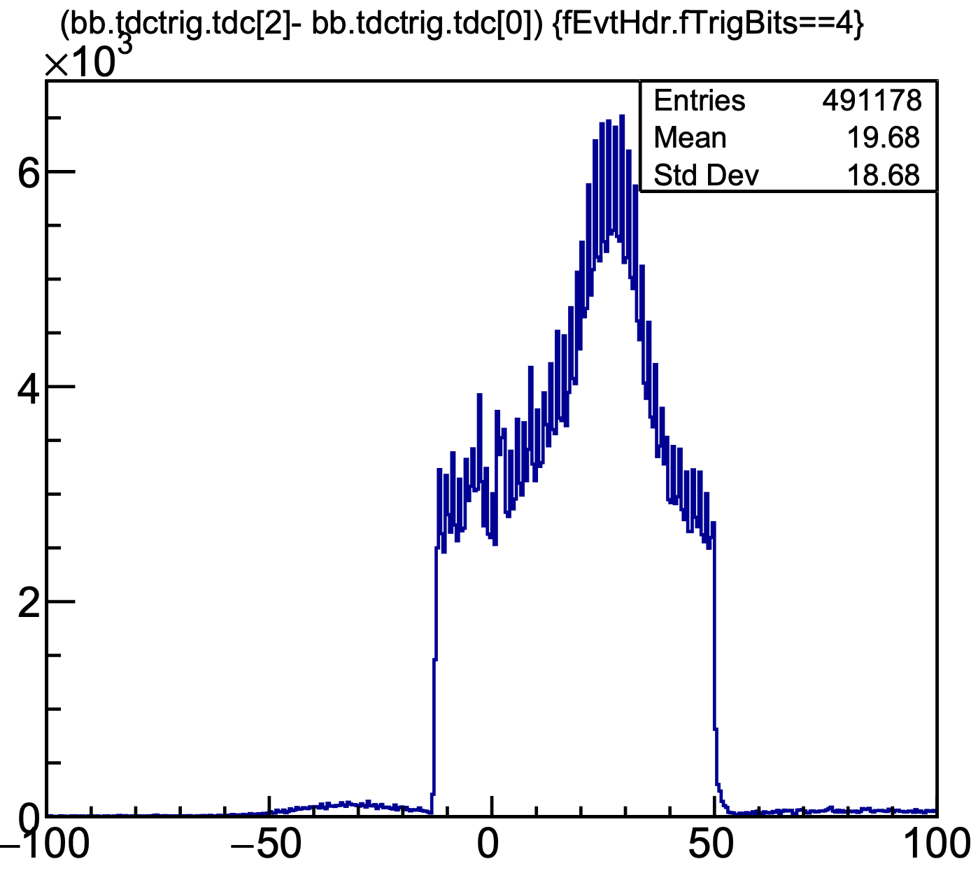
HCAL Clusters and Trigger
hcalvtp and hcal fadc configuration ready to test VTP clustering and digital trigger
3x3 clusters threshold to get triggers from the HCAL
Diaggui from Ben Raydo for monitoring the cluster position and energy in the VTP while getting digital trigger out
coincidence trigger
(analog)

Slide 7
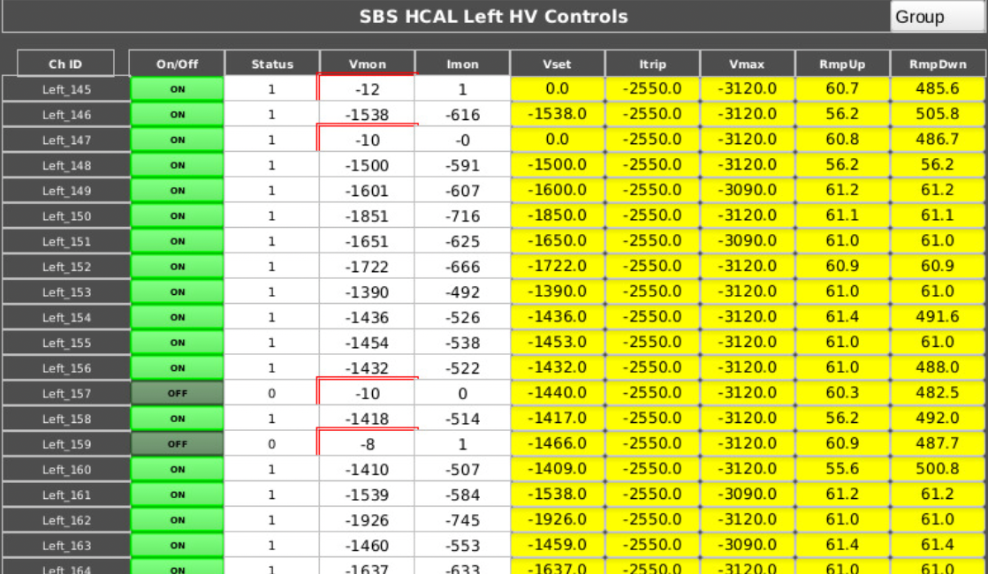
HCAL HV (updates)
Bad state of Lecroy HV modules: Vset voltage also dropped to 0 V
No alarms for shift crew (as standard alarm available only for difference of Vset and VMon voltages
Added HI and HIHI on Vmon itself (>-500 V) to show error in HV GUI
Added second set of delayed (4 min) alarms on HCAL Vmon for shift-crews during Gen-RP
Few spare HV modules coming from Bigbite Calorimeter

Slide 8
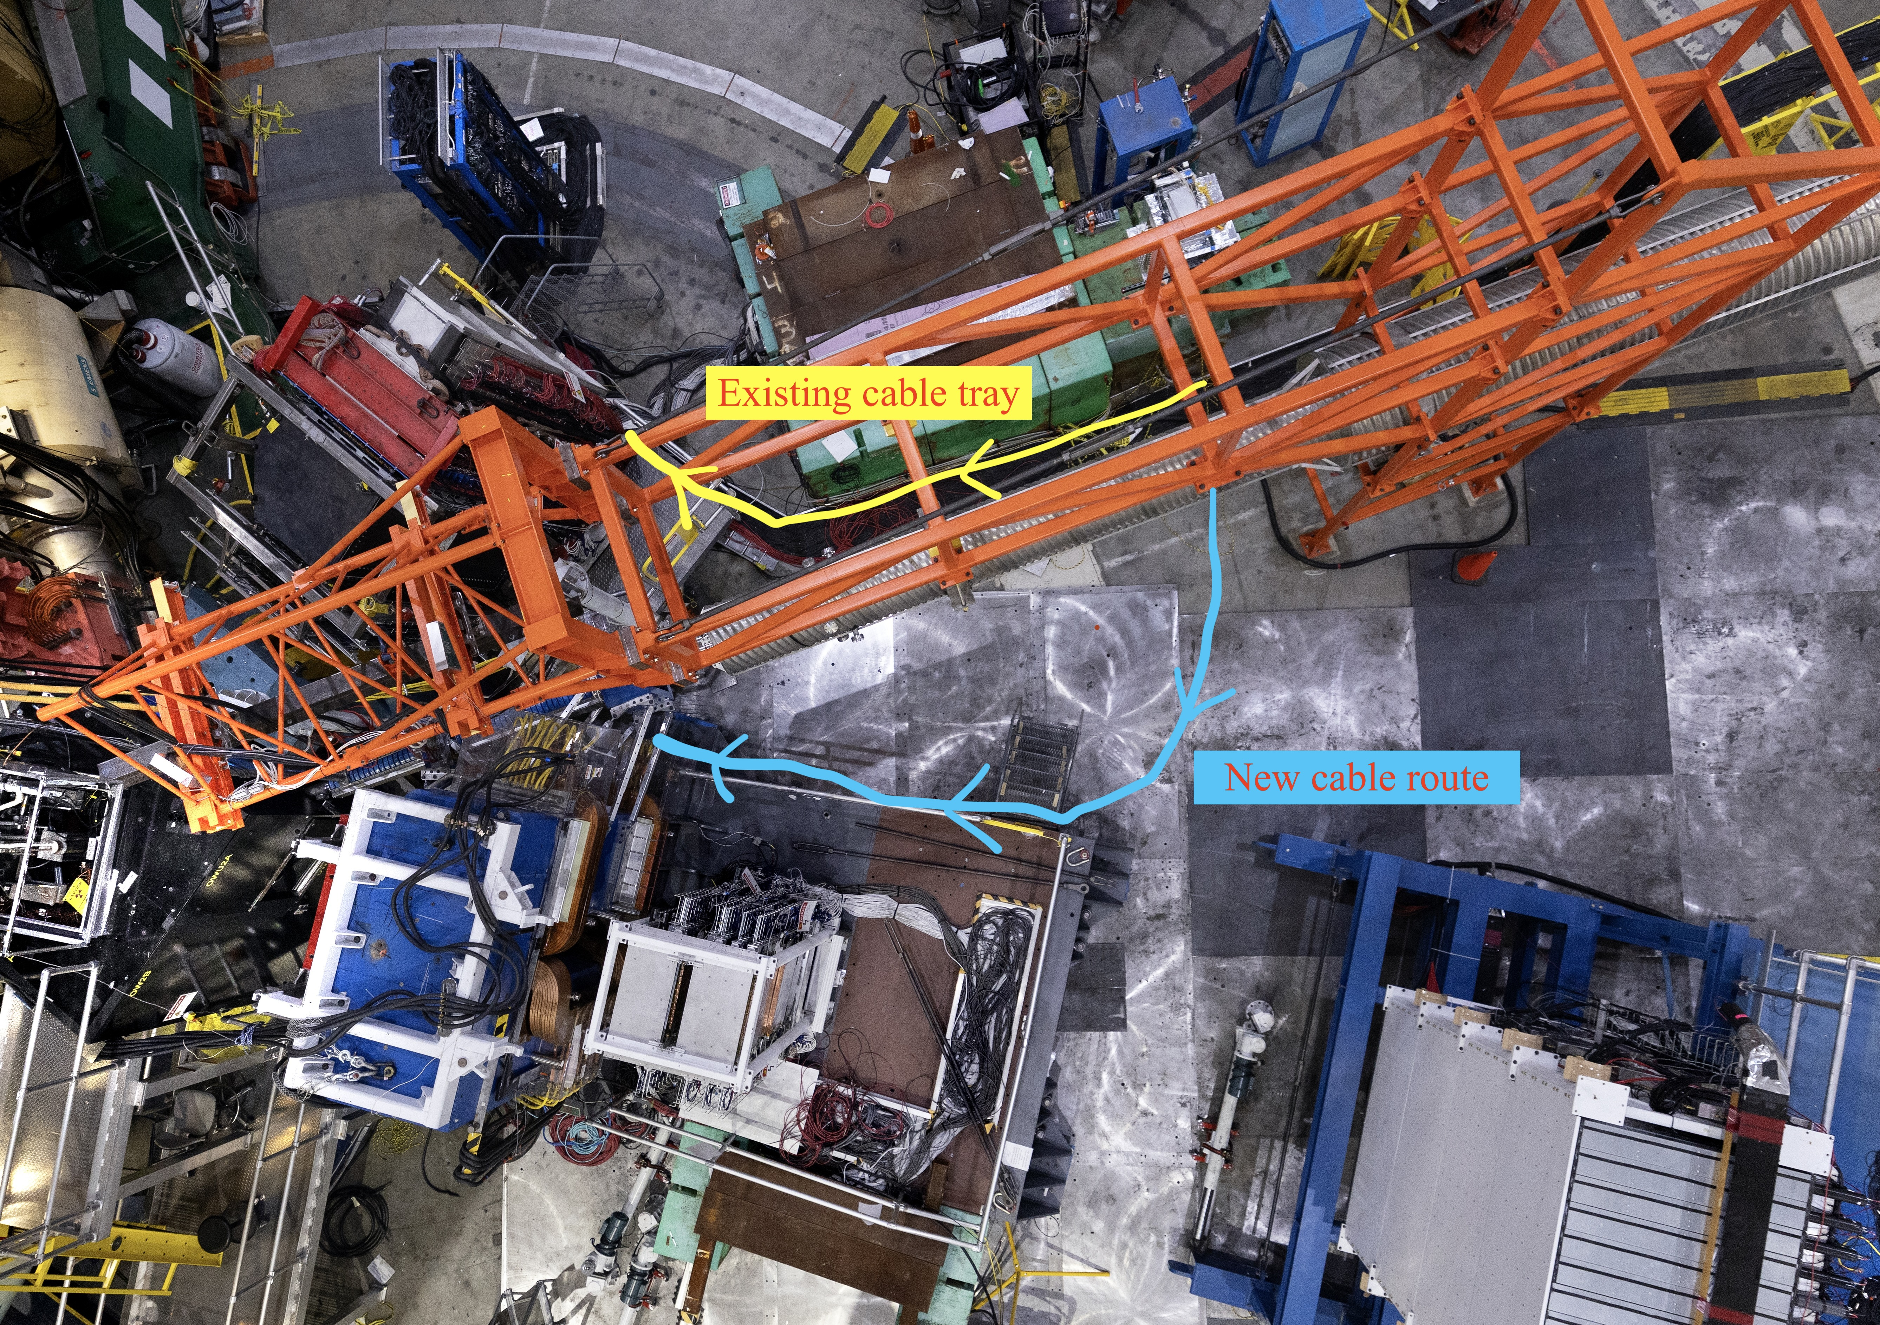
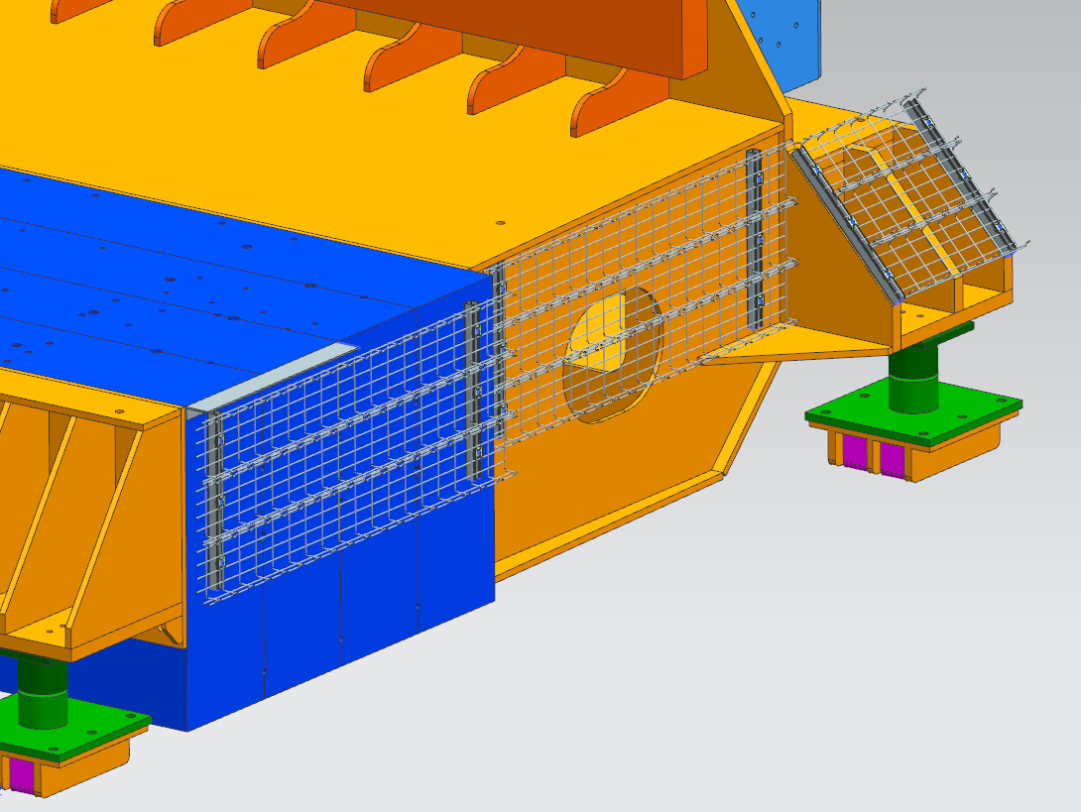
Rerouting the HCAL Cabling
HCAL cabling requires rerouting to make space for positioning ECAL
Reroute plan already in place, but need the Bigbite magnet to be moved out
Cable trays

Slide 9
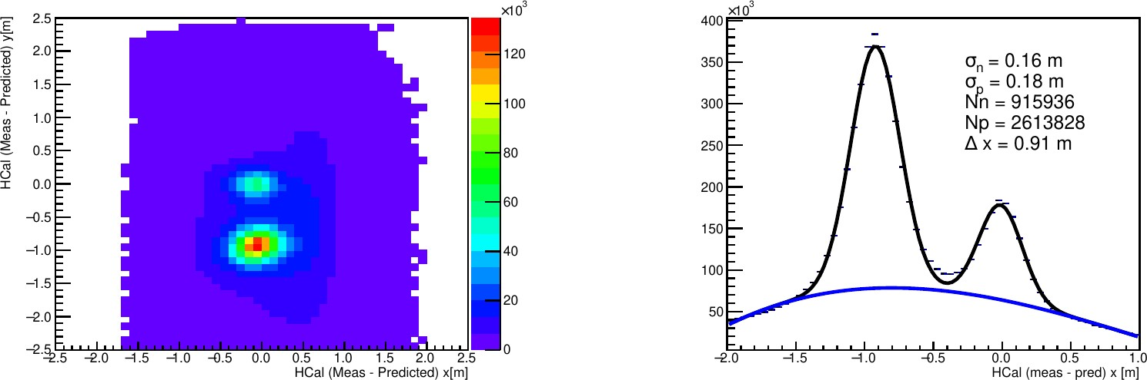
HCAL Performance during GEn-RP
Separation of Proton and neutron using the HCAL during GEn-RP: Credit to David Hamilton
Proton
Neutron
Neutron
Proton

Slide 10
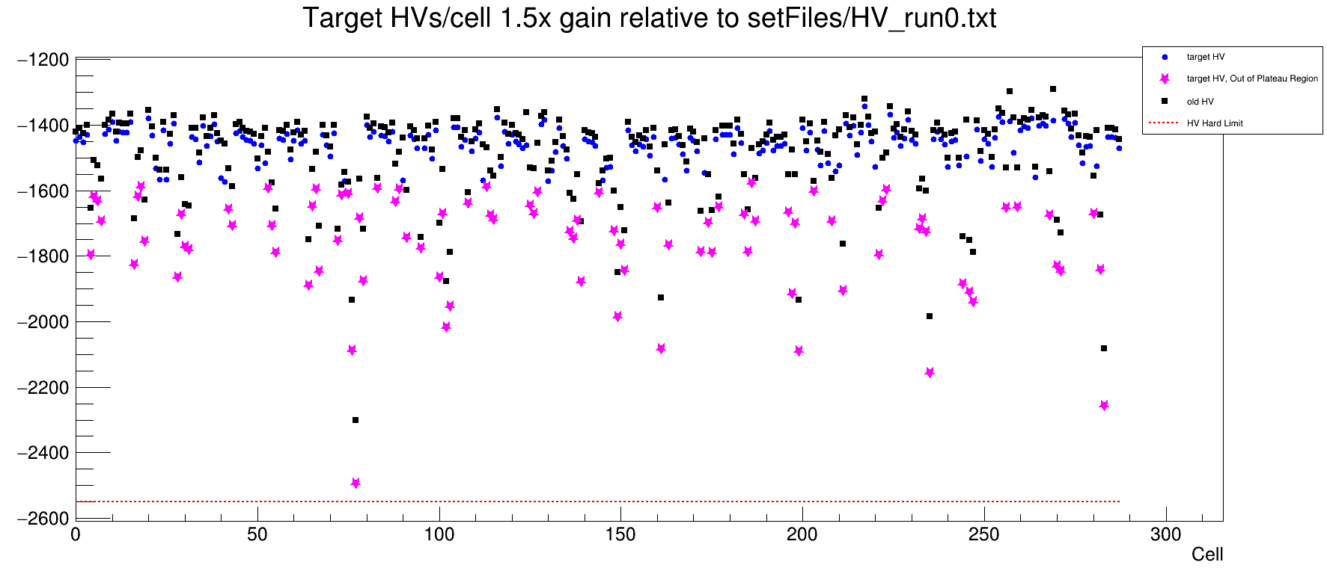
HCAL HV during GEn-RP
PMTs:
XP2262: Max. 2400 V
XP2282: Max. 2200 V
Used alpha parameters (from Sebastian and Scott) to obtain these new HV setting

Slide 11
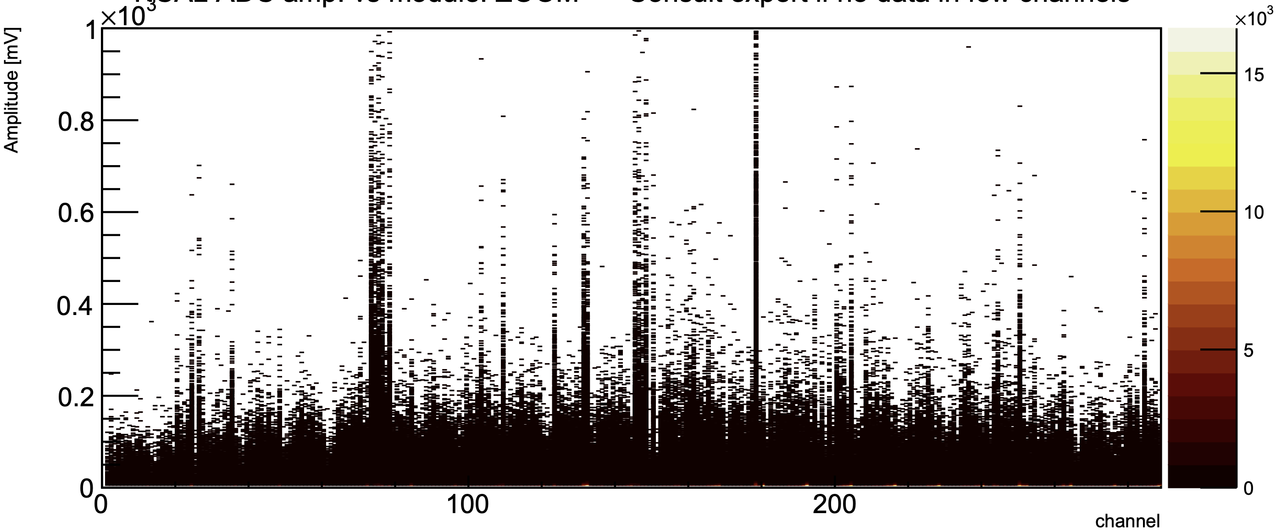
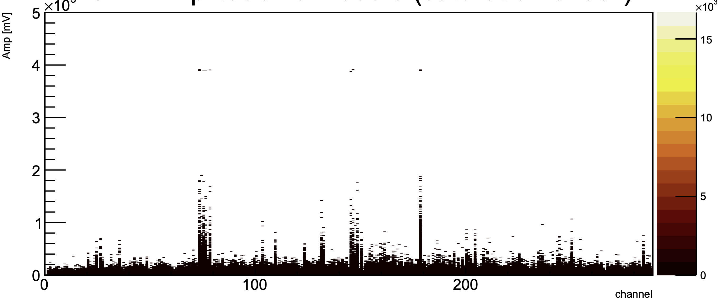
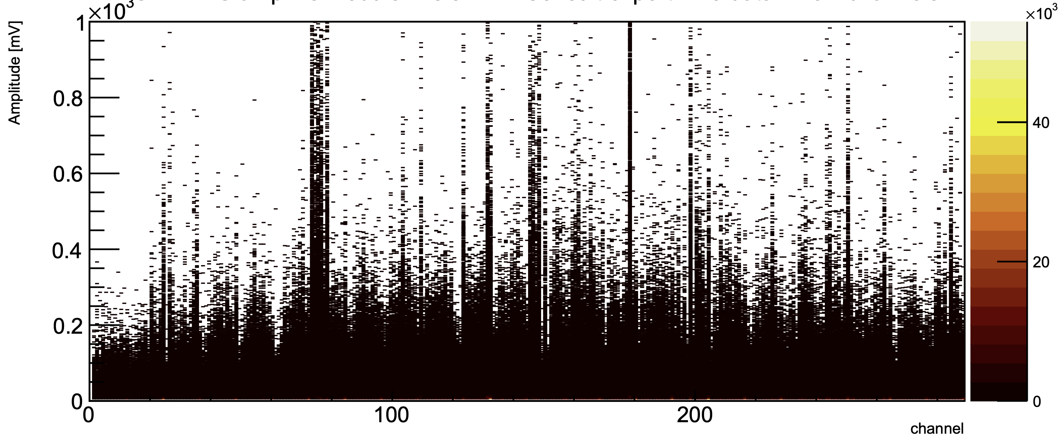
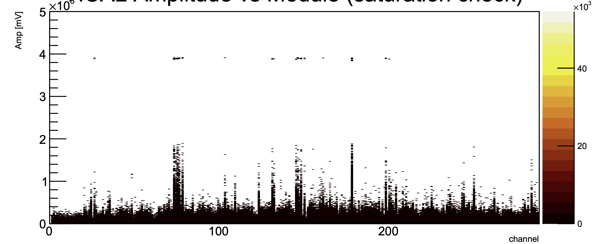
HCAL during GEn-RP
ADC amplitude Distribution over all modules
ADC amplitude showing saturation
Initial HV
Initial HV
Increased HV
(1.5x gain)
Increased HV
(1.5x gain)

Slide 12
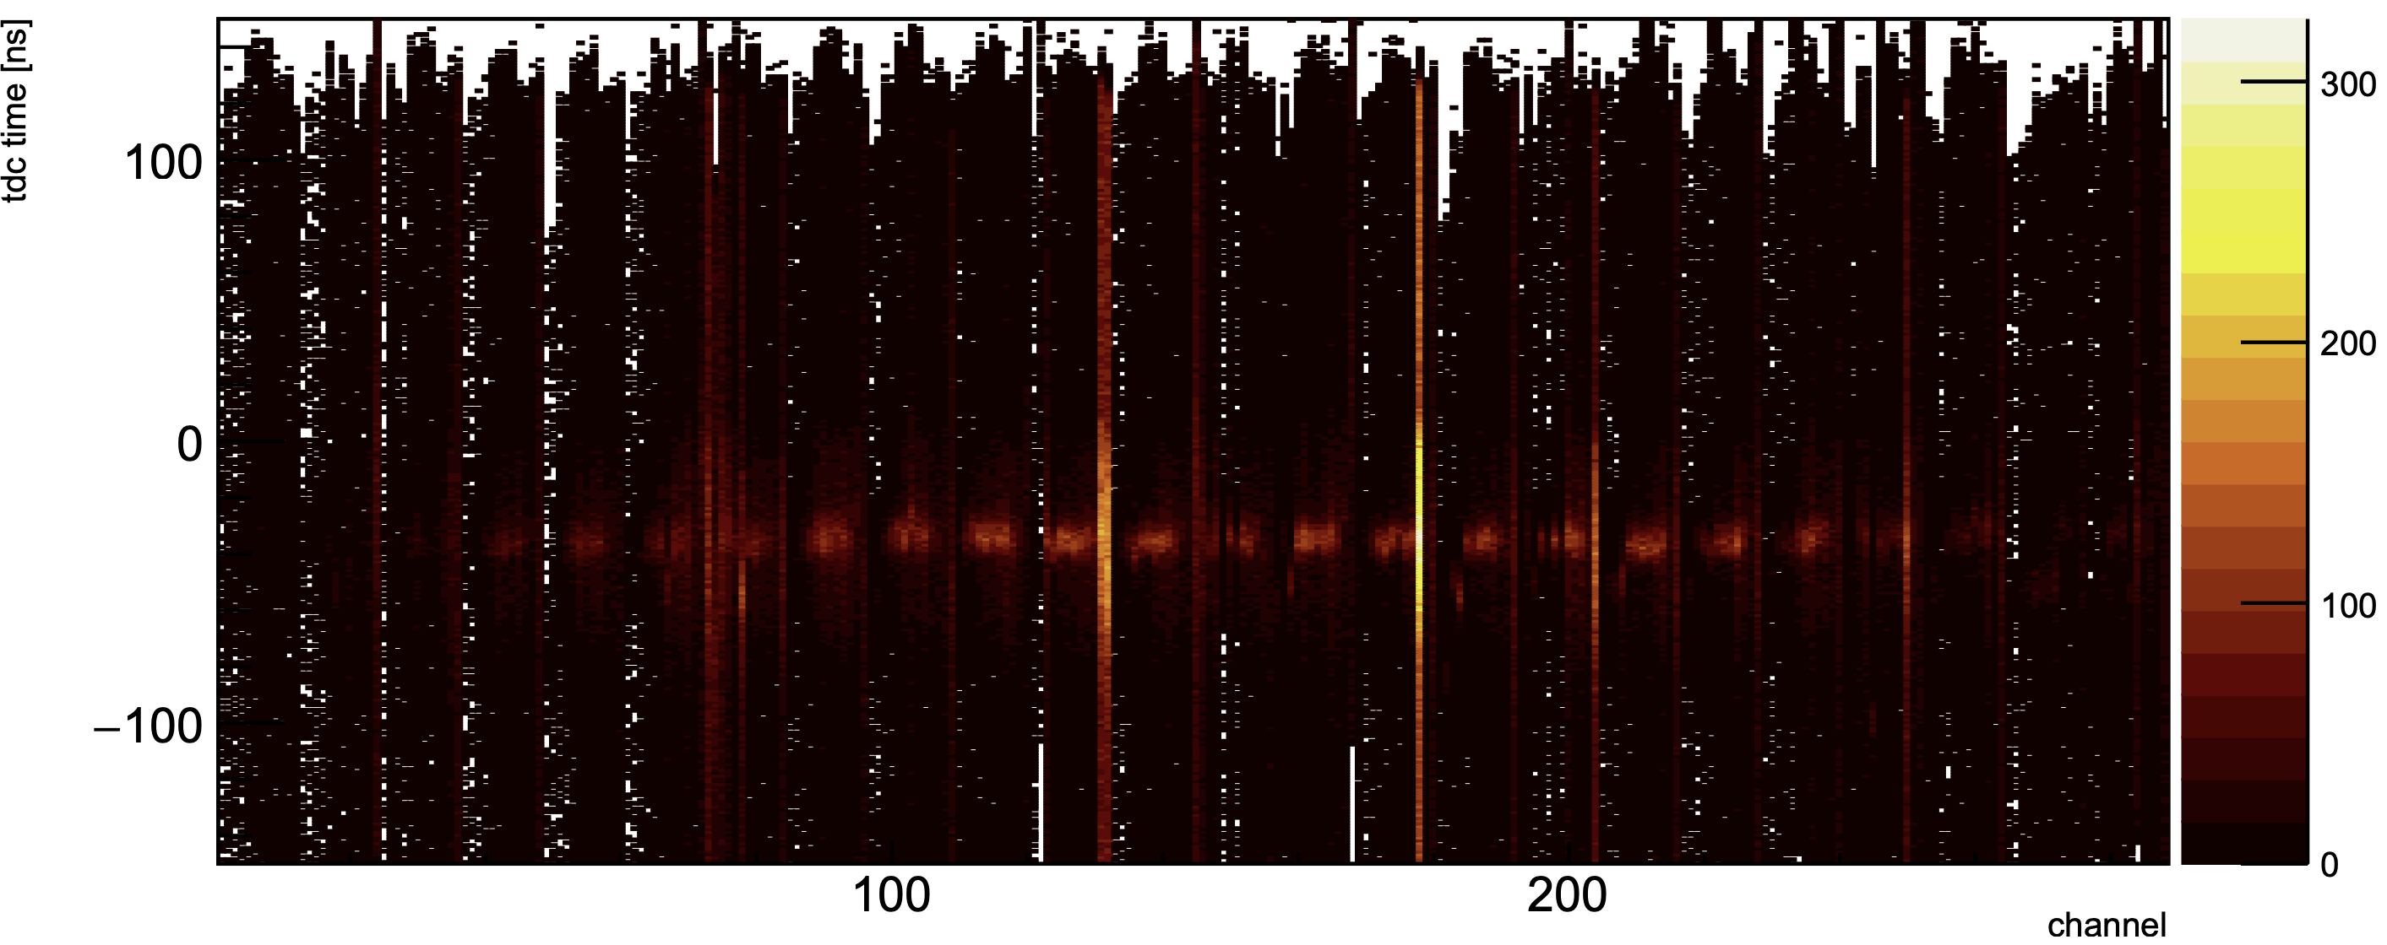
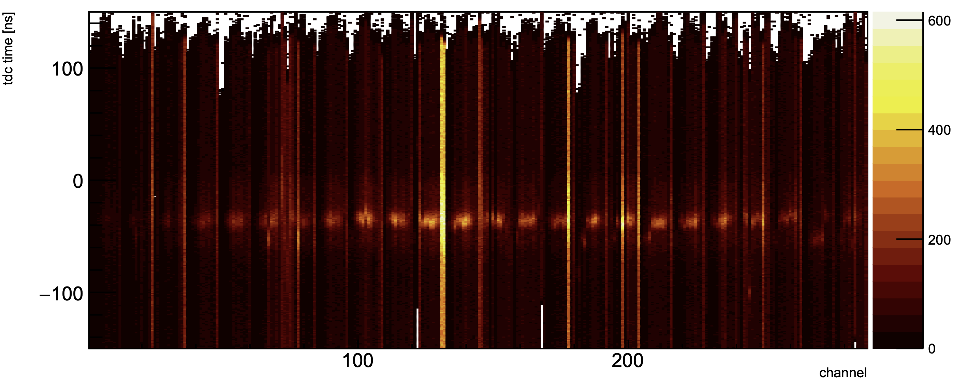
HCAL during GEn-RP
TDC Distribution over all modules
Initial HV
Increased HV
(1.5x gain)

Slide 13
Summary
All HCAL modules are working fine except few noisy channels
Few HV modules seems flaky, which will be replaced with spares from Bigbite side
Test on HCAL digital trigger is ongoing
HCAL fADC scaler gui and clustering gui are ready for diagnosis purpose
Rerouting of HCAL cabling will be done within few weeks
Ongoing work for new gain coefficients and calibration script (in relation with HV setting)

