Slide 1
ECal Status Update
Don Jones
SBS Collaboration Meeting
Sept. 12, 2024

Slide 2
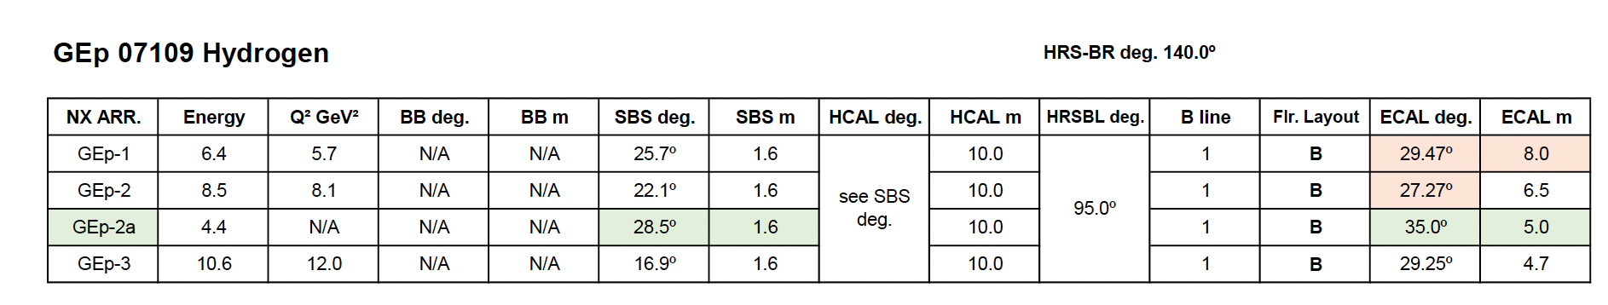
ECal has 4 positions (3 moves)

Slide 3
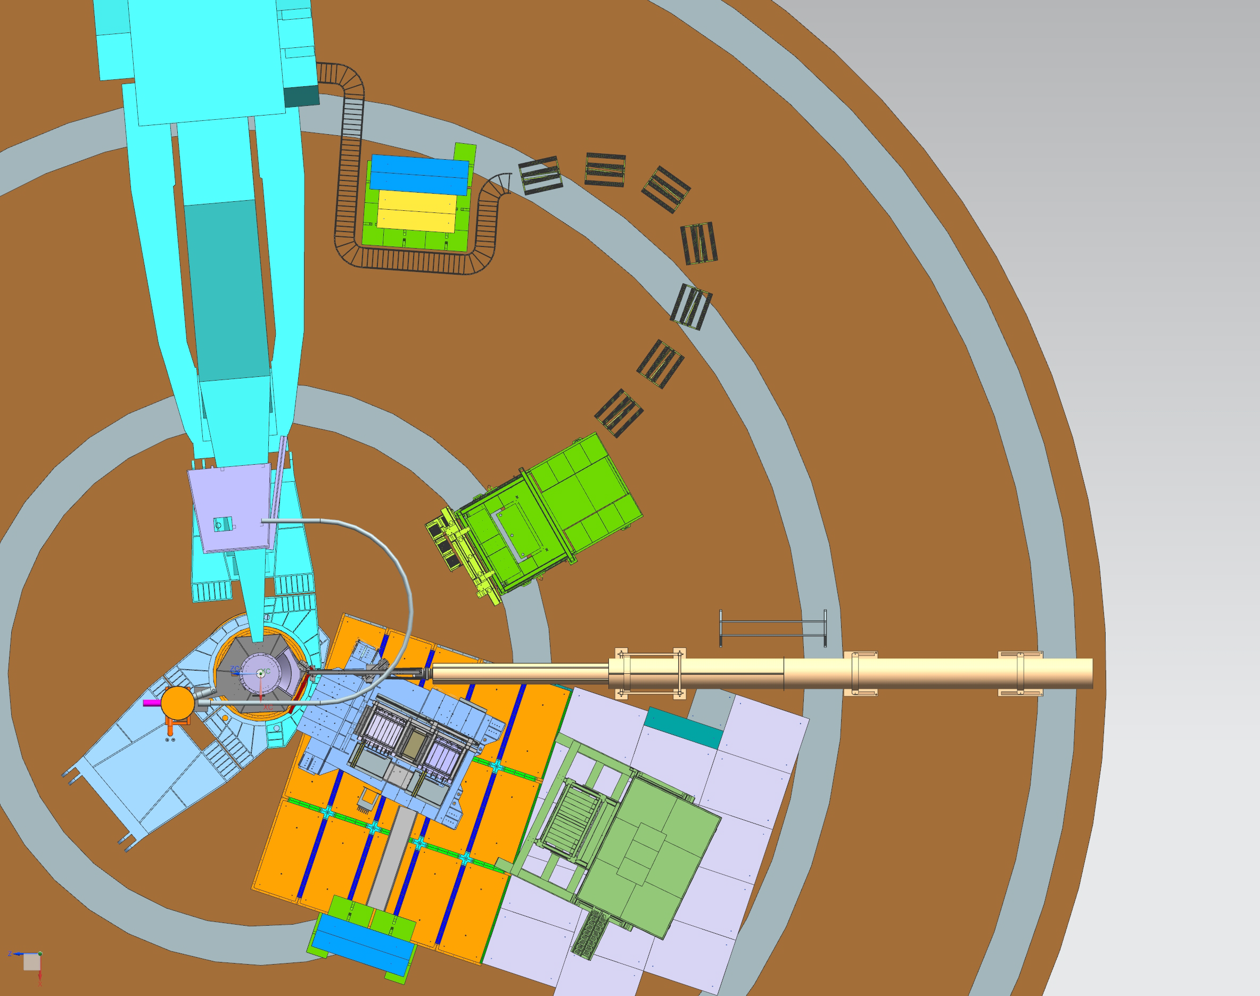

GEP-1
m

Slide 4
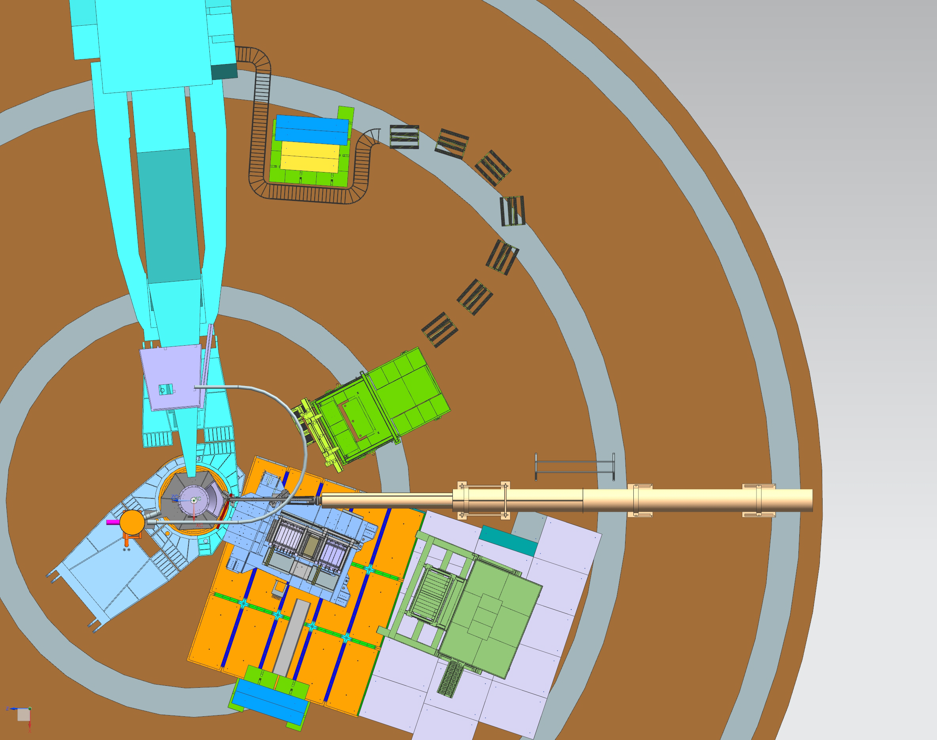

GEP-2
m

Slide 5
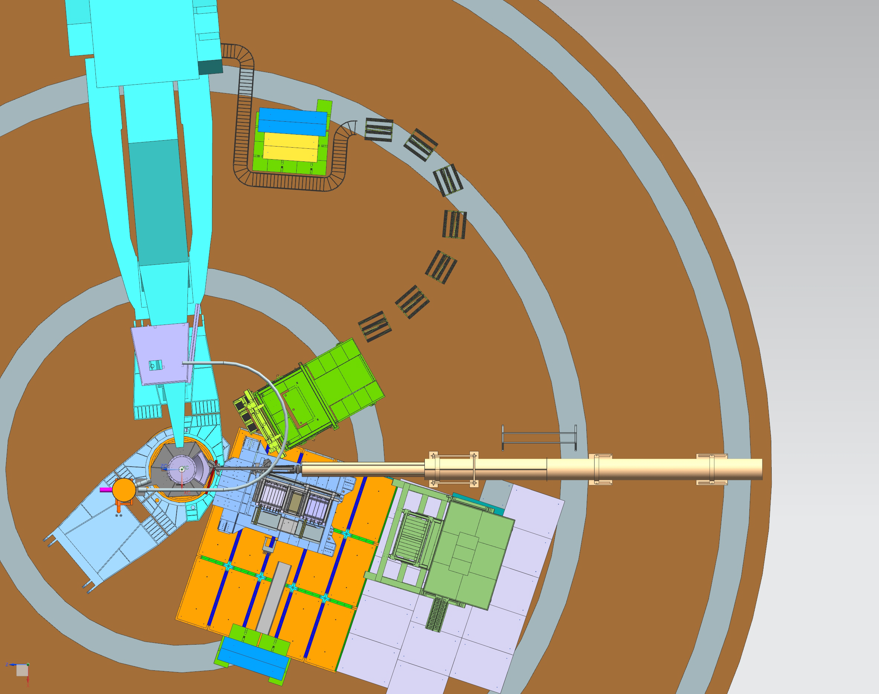

GEP-3
m

Slide 6
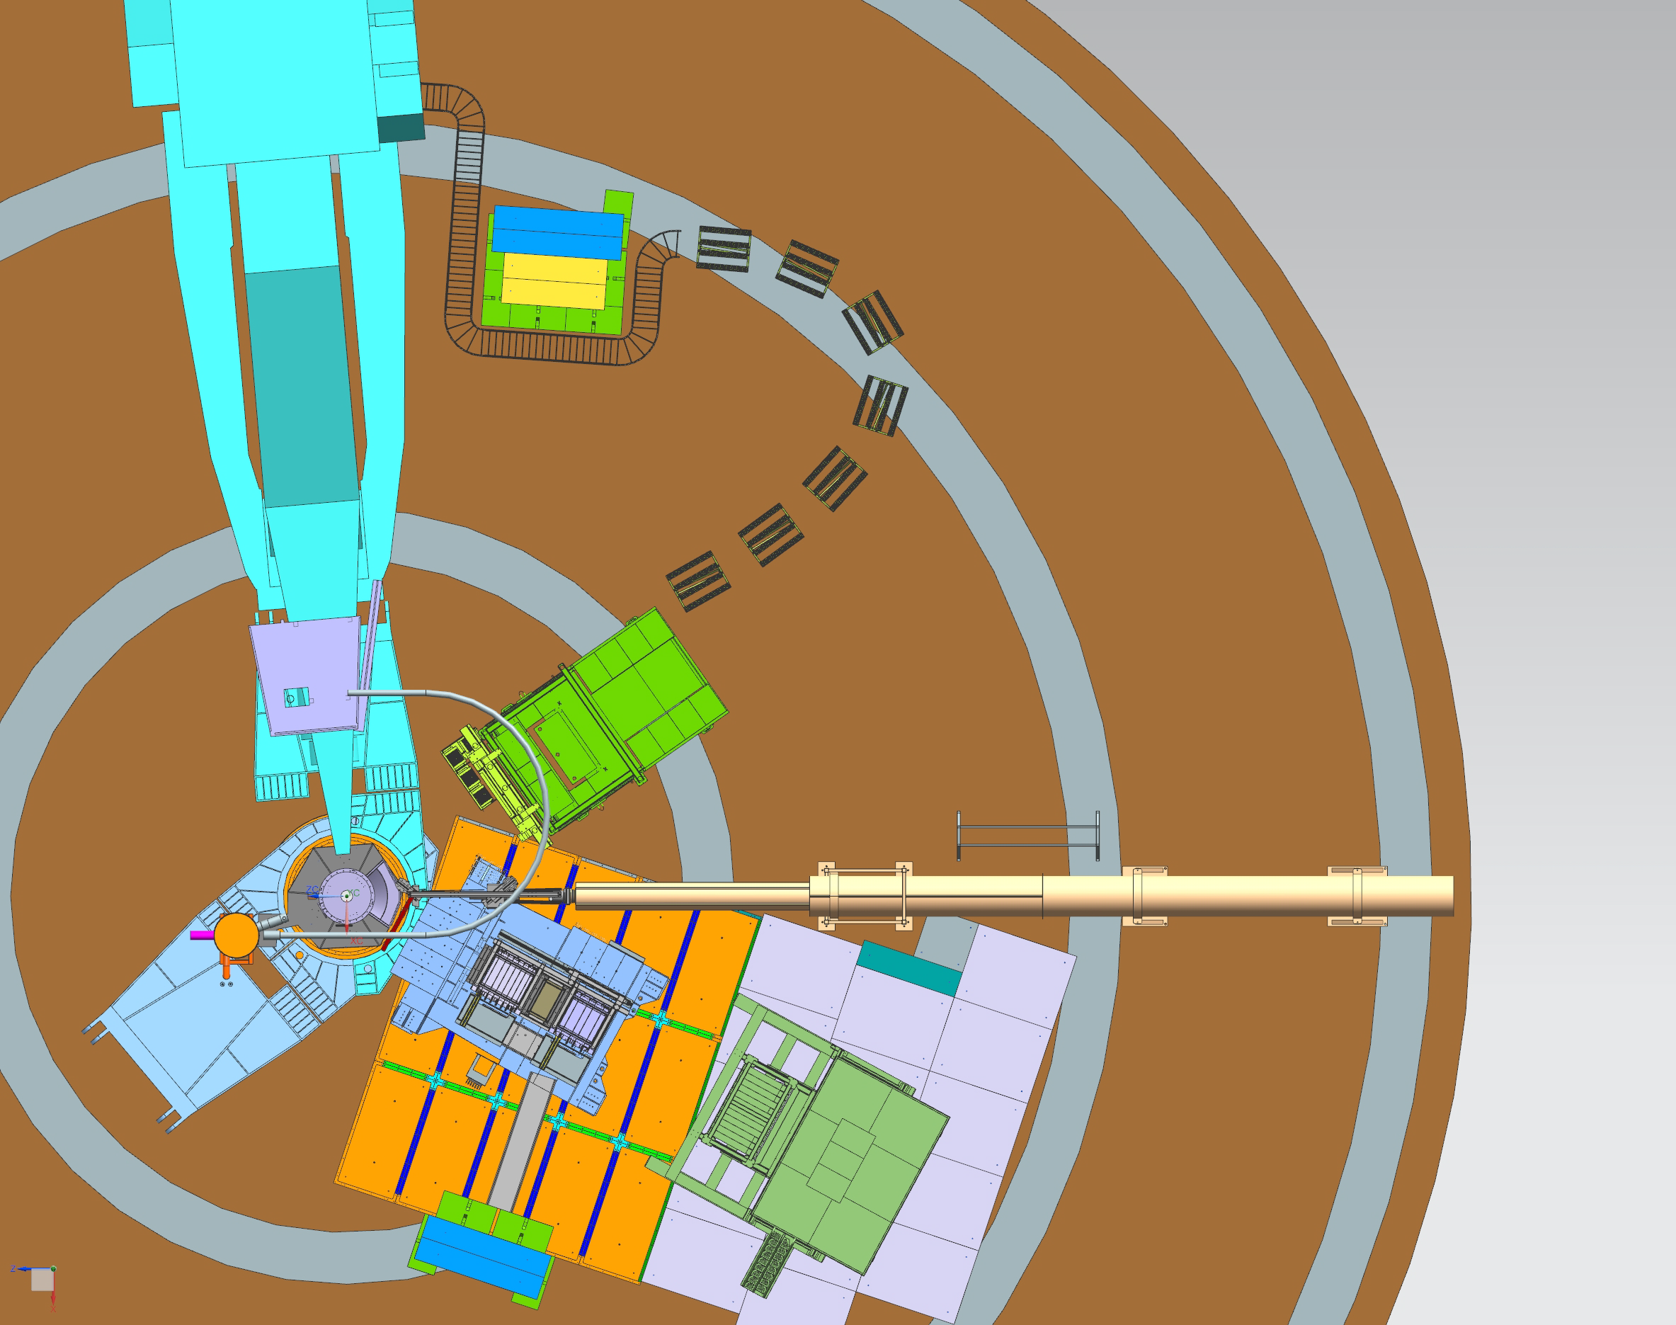

GEP-2a
m

Slide 7
Unexpected setbacks
Mu metal shields were not the right size or thickness. Spent several weeks making new shields.
Soldering of bases was not completed. Aram, from Armenia finished several hundred over a few weeks.
Signal cables connecting inside detector enclosure to front end had some loose LEMO connectors. Had to check all and repair a few.
640 Custom made 3m LEMO to BNC cables had noisy connection to ground so had to return them. Using cables borrowed from future SoLID experiment.

Slide 8
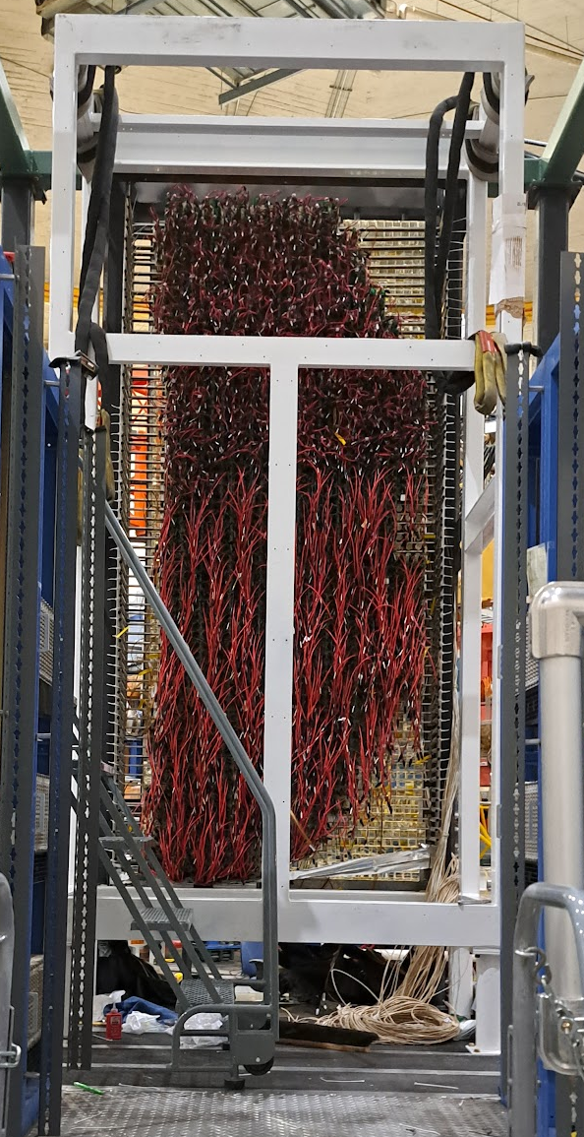
PMT+base preparation and installation
PMT+base testing complete
Installation of PMTs+bases completed two weeks ago!
Finishing up wiring the patch panels that mount on the rear of the detector. Installation of these will happen soon.
After this the signal cables must be routed out of the enclosure to the front end electronics racks
Simona with help from Jimmy taking the lead on this

Slide 9
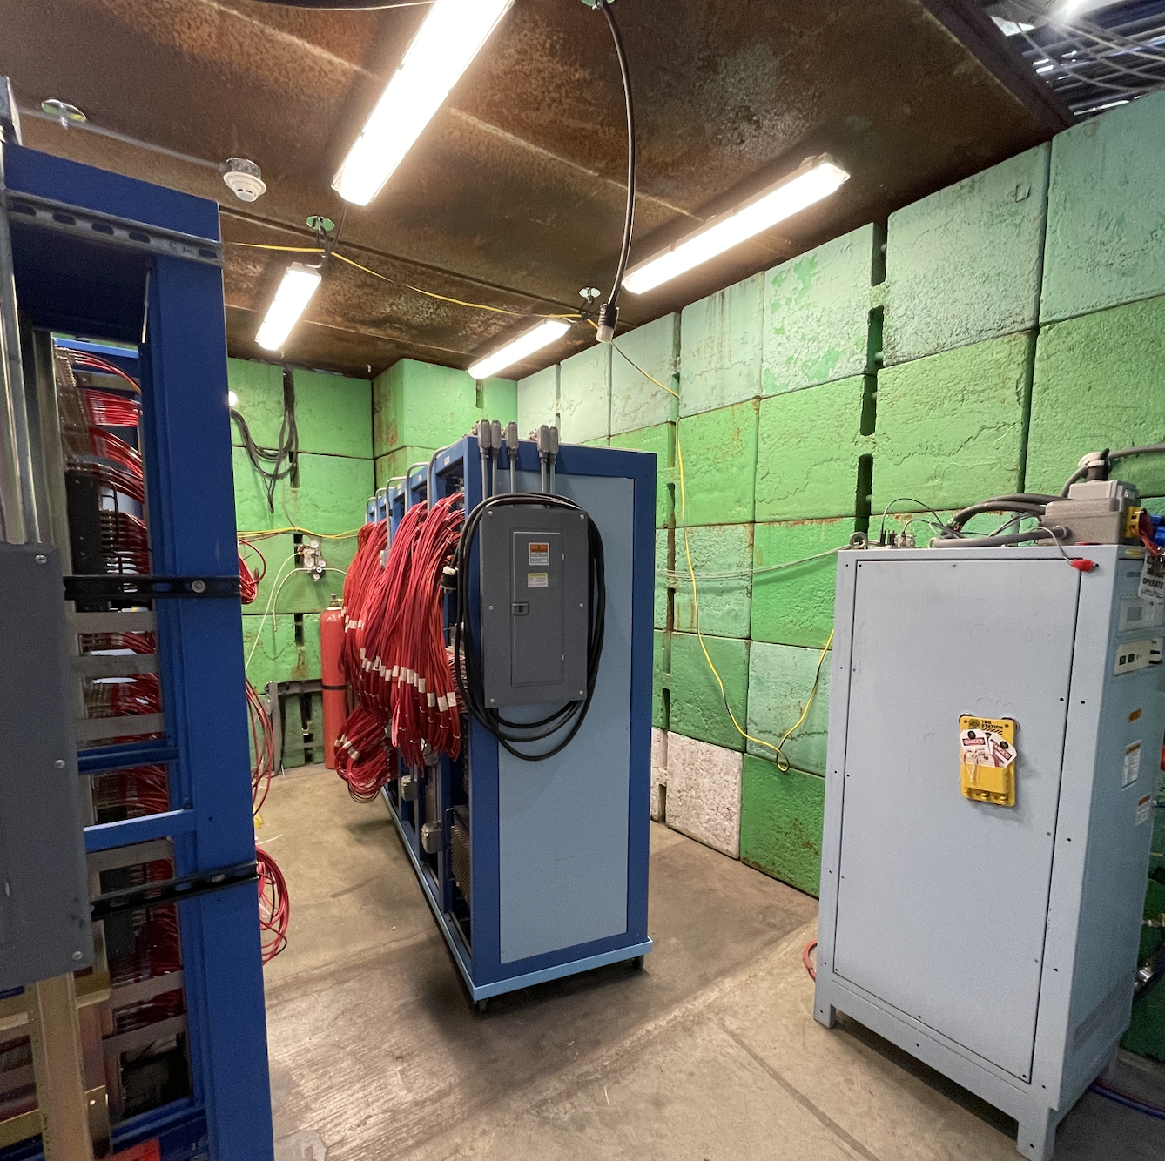
HV supplies
LeCroy HV supplies all connected
Debugging of remote control still ongoing but mostly complete.
  Updated software/OS on RaspPis
  Located issues with unresponsive HV cards
Jimmy took the lead with software help from Bob M.

Slide 10
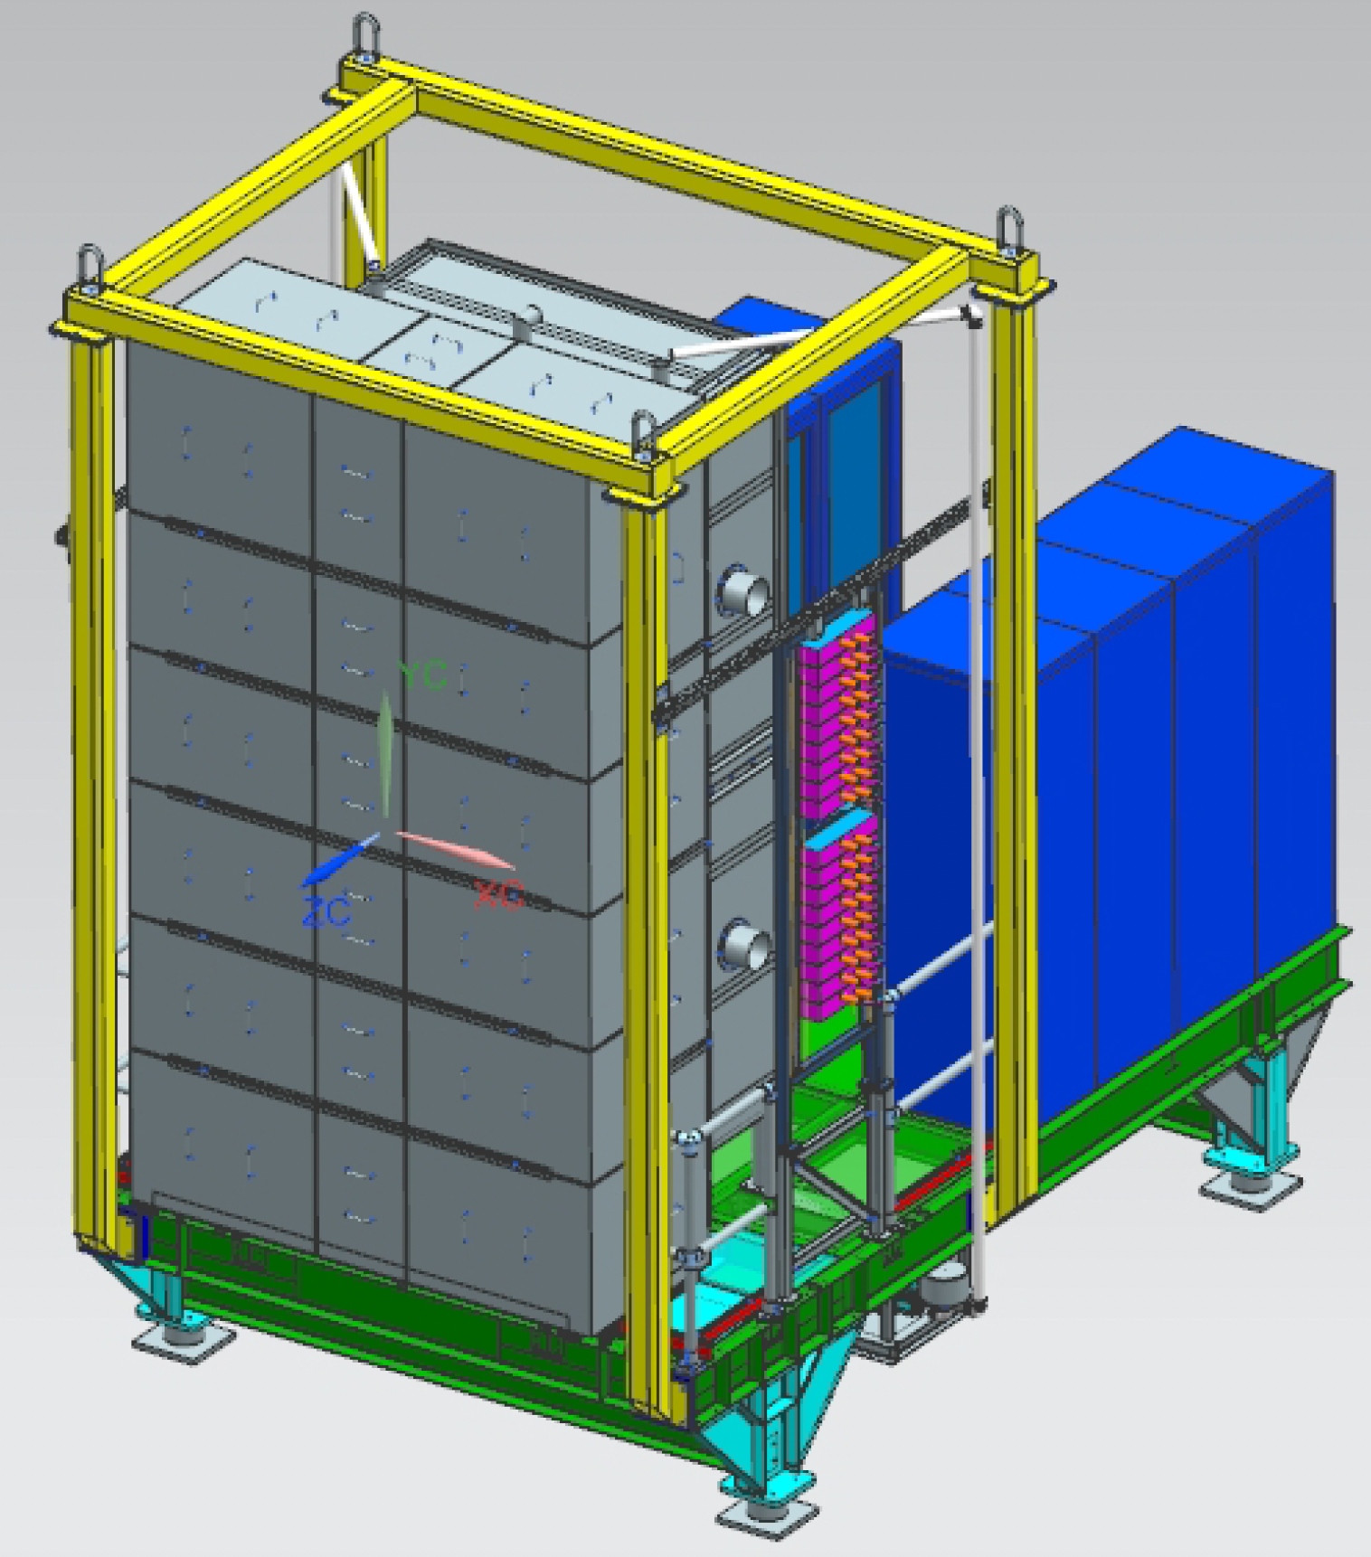
HV To Dos
Attach HV cables to patch panels on rear of detector and run to HV module racks outside enclosure
Run 72 24 ch HV cables from platform to DAQ rack in DAQ bunker
Test remote control of all channels

Slide 11
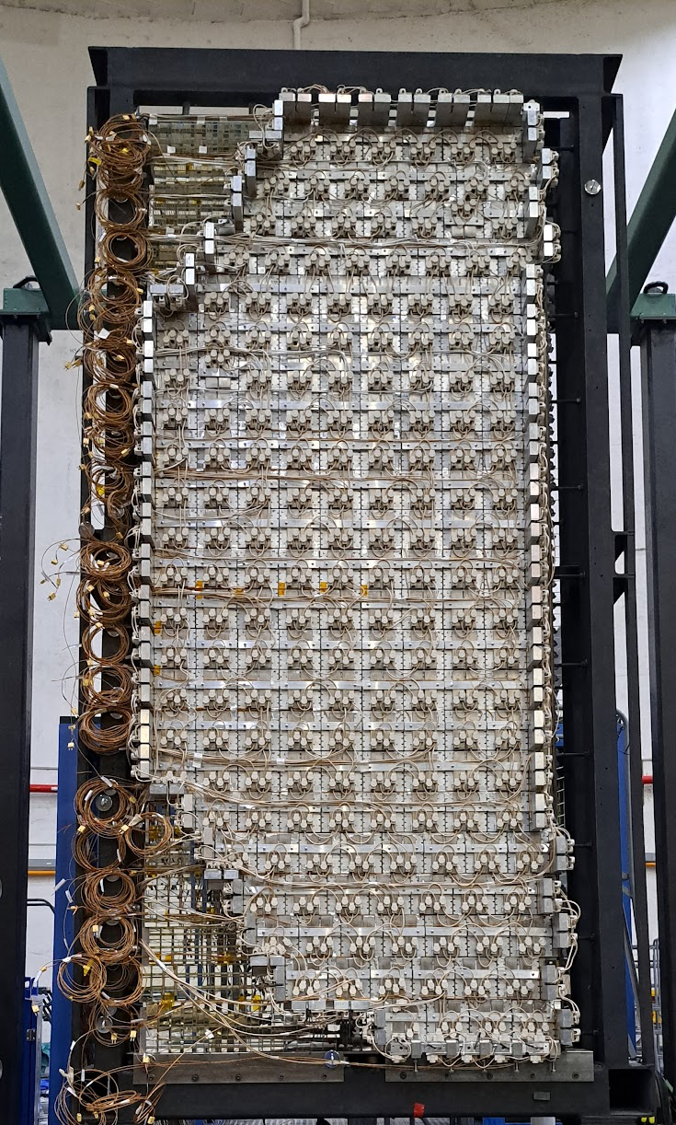
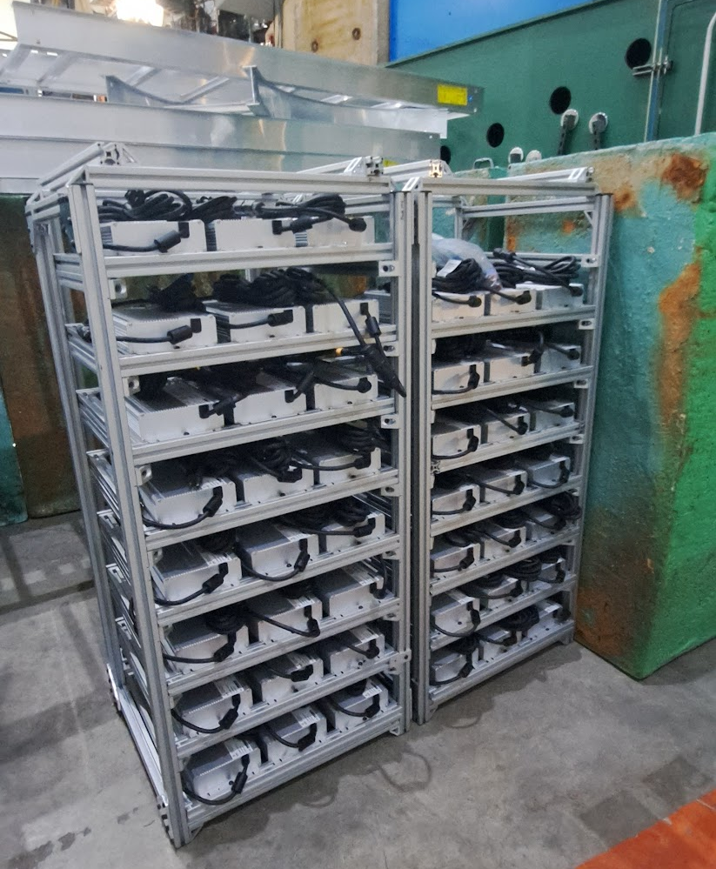
ECal heater system
Heater system designed to run on <50 VDC.
48 heater zones and >200 thermocouples have been installed
Power connections to the zones are being completed and zone-by-zone testing is underway (heating each zone to 50-60 degC)
D. Jones taking lead
DSG (Marc McMullen) taking lead on heater controls and monitoring
Developing a large scale control following the successful prototype model with each zone having its own set temperature and current to heaters adjusted by PID control loop.
Power supply racks

Slide 12

Heater monitoring and safety
Report from fire engineering company says ECal safe with existing controls, without further fire suppression. Recommends using plenum rated wiring inside enclosure where possible
Temperature monitoring of front plates, front and rear of crystals and rear of light guides al read out and sent to EPICs by controls software.
Emergency shutdown buttons will be installed in hall and Counting House.
Power cut to all circuits if any of several thermocouples monitoring different regions of the detector enclosure go over set values.

Slide 13
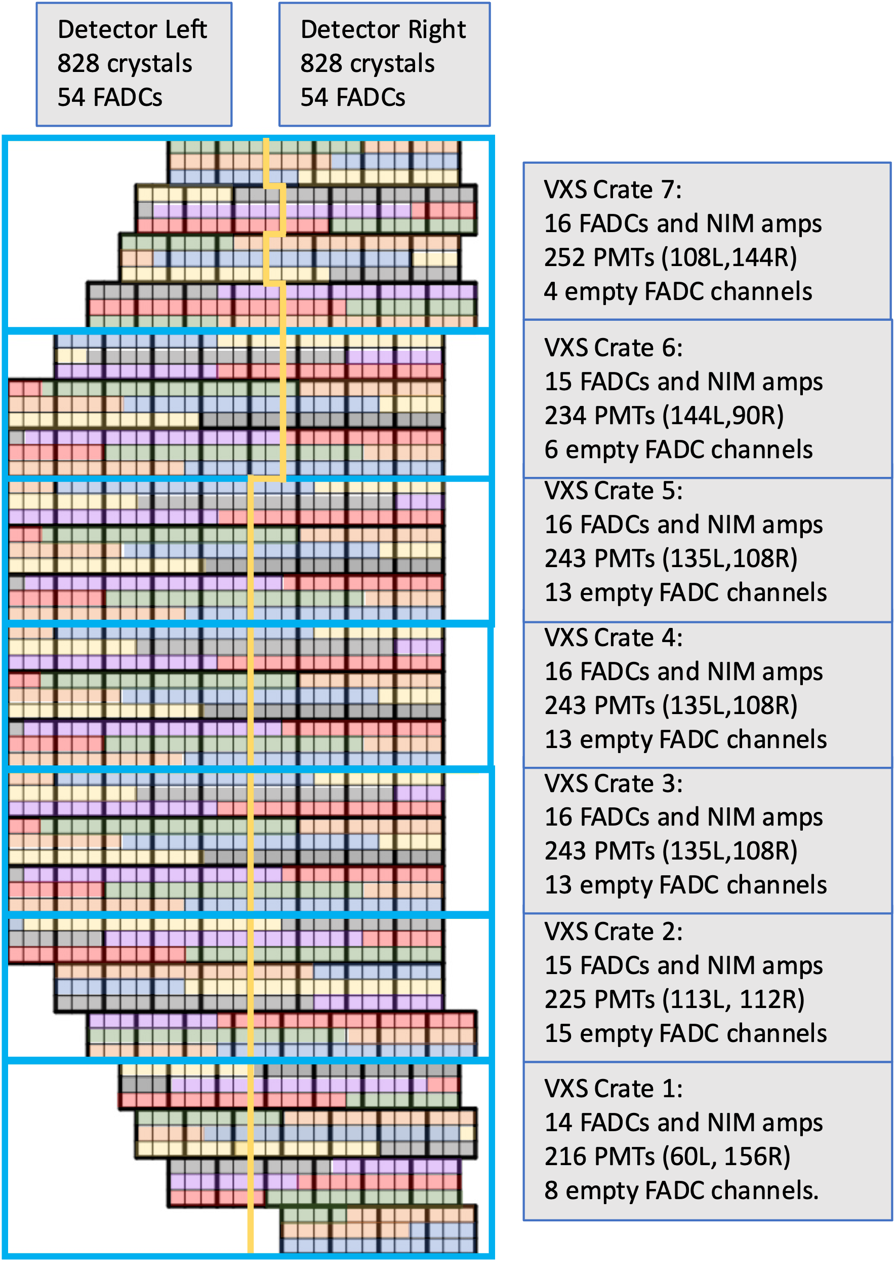
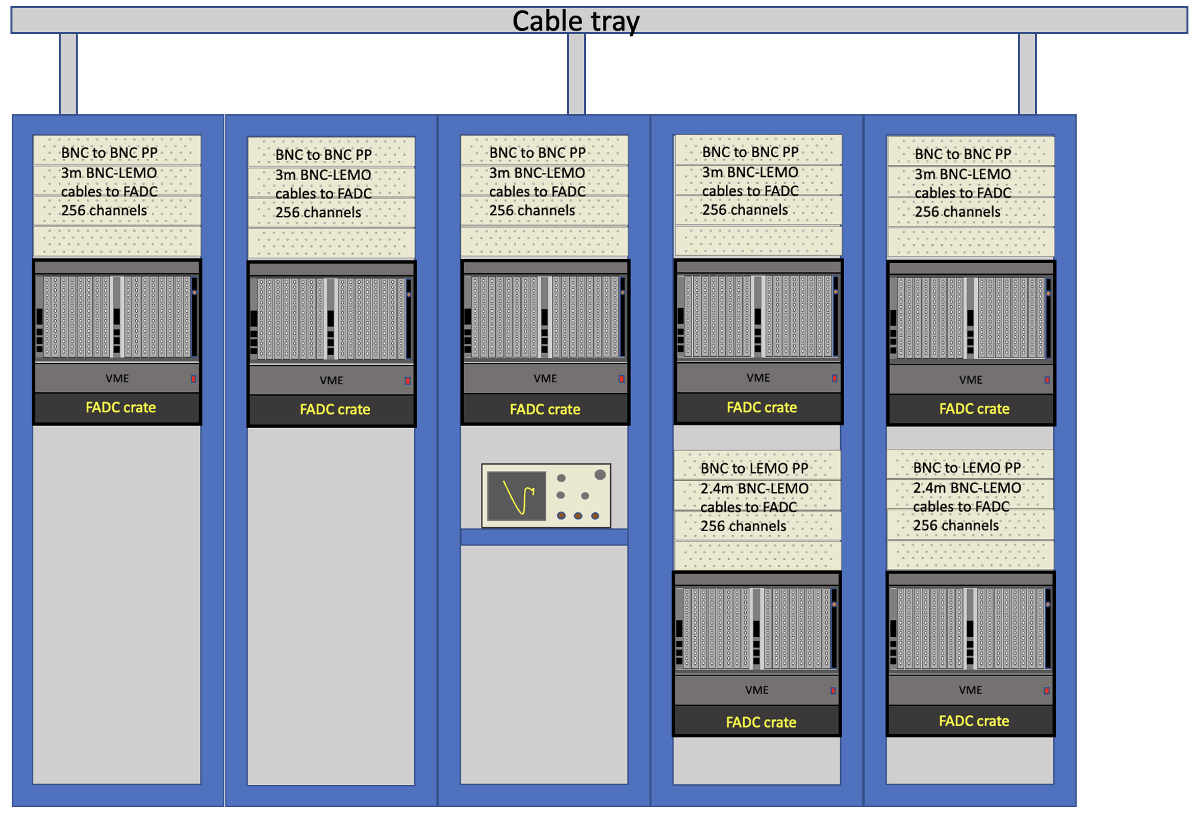
FADC-based DAQ
1656 channels to 108 FADCs in 7 crates contained in 4 racks

Slide 14
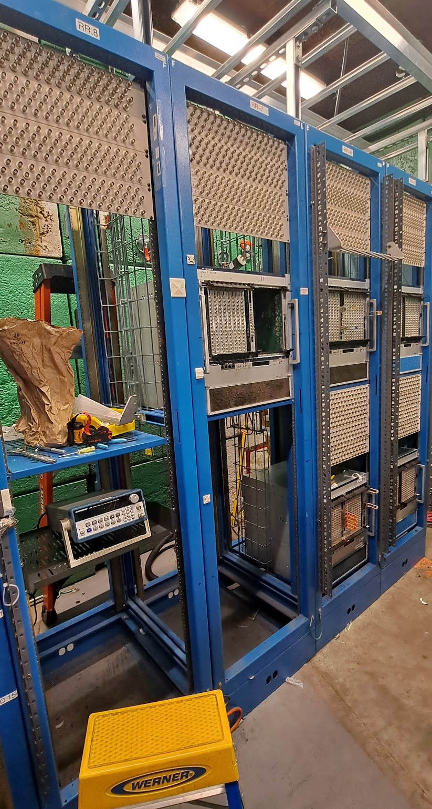
FADC-based DAQ
Electronics from GEN removed
5 of 7 VME crates installed
Patch panels installed and labeled
Cables on hand and mostly labeled
Jimmy taking the lead with Simona enlisting help from Hall C designers for rack and cable design

Slide 15
Cables and connections
Signal cables from PMTs to front end modules
Signal cables front end to DAQ patch panels
Signal cables from DAQ patch panels to FADCs
HV cables from PMTs to HV modules on ECal platform
HV cables (24 ch) from platform modules to DAQ bunker HV modules
SHV cables from HV modules to HV supplies (already installed)
Albert S. leading the cable production, testing and labeling effort

Slide 16

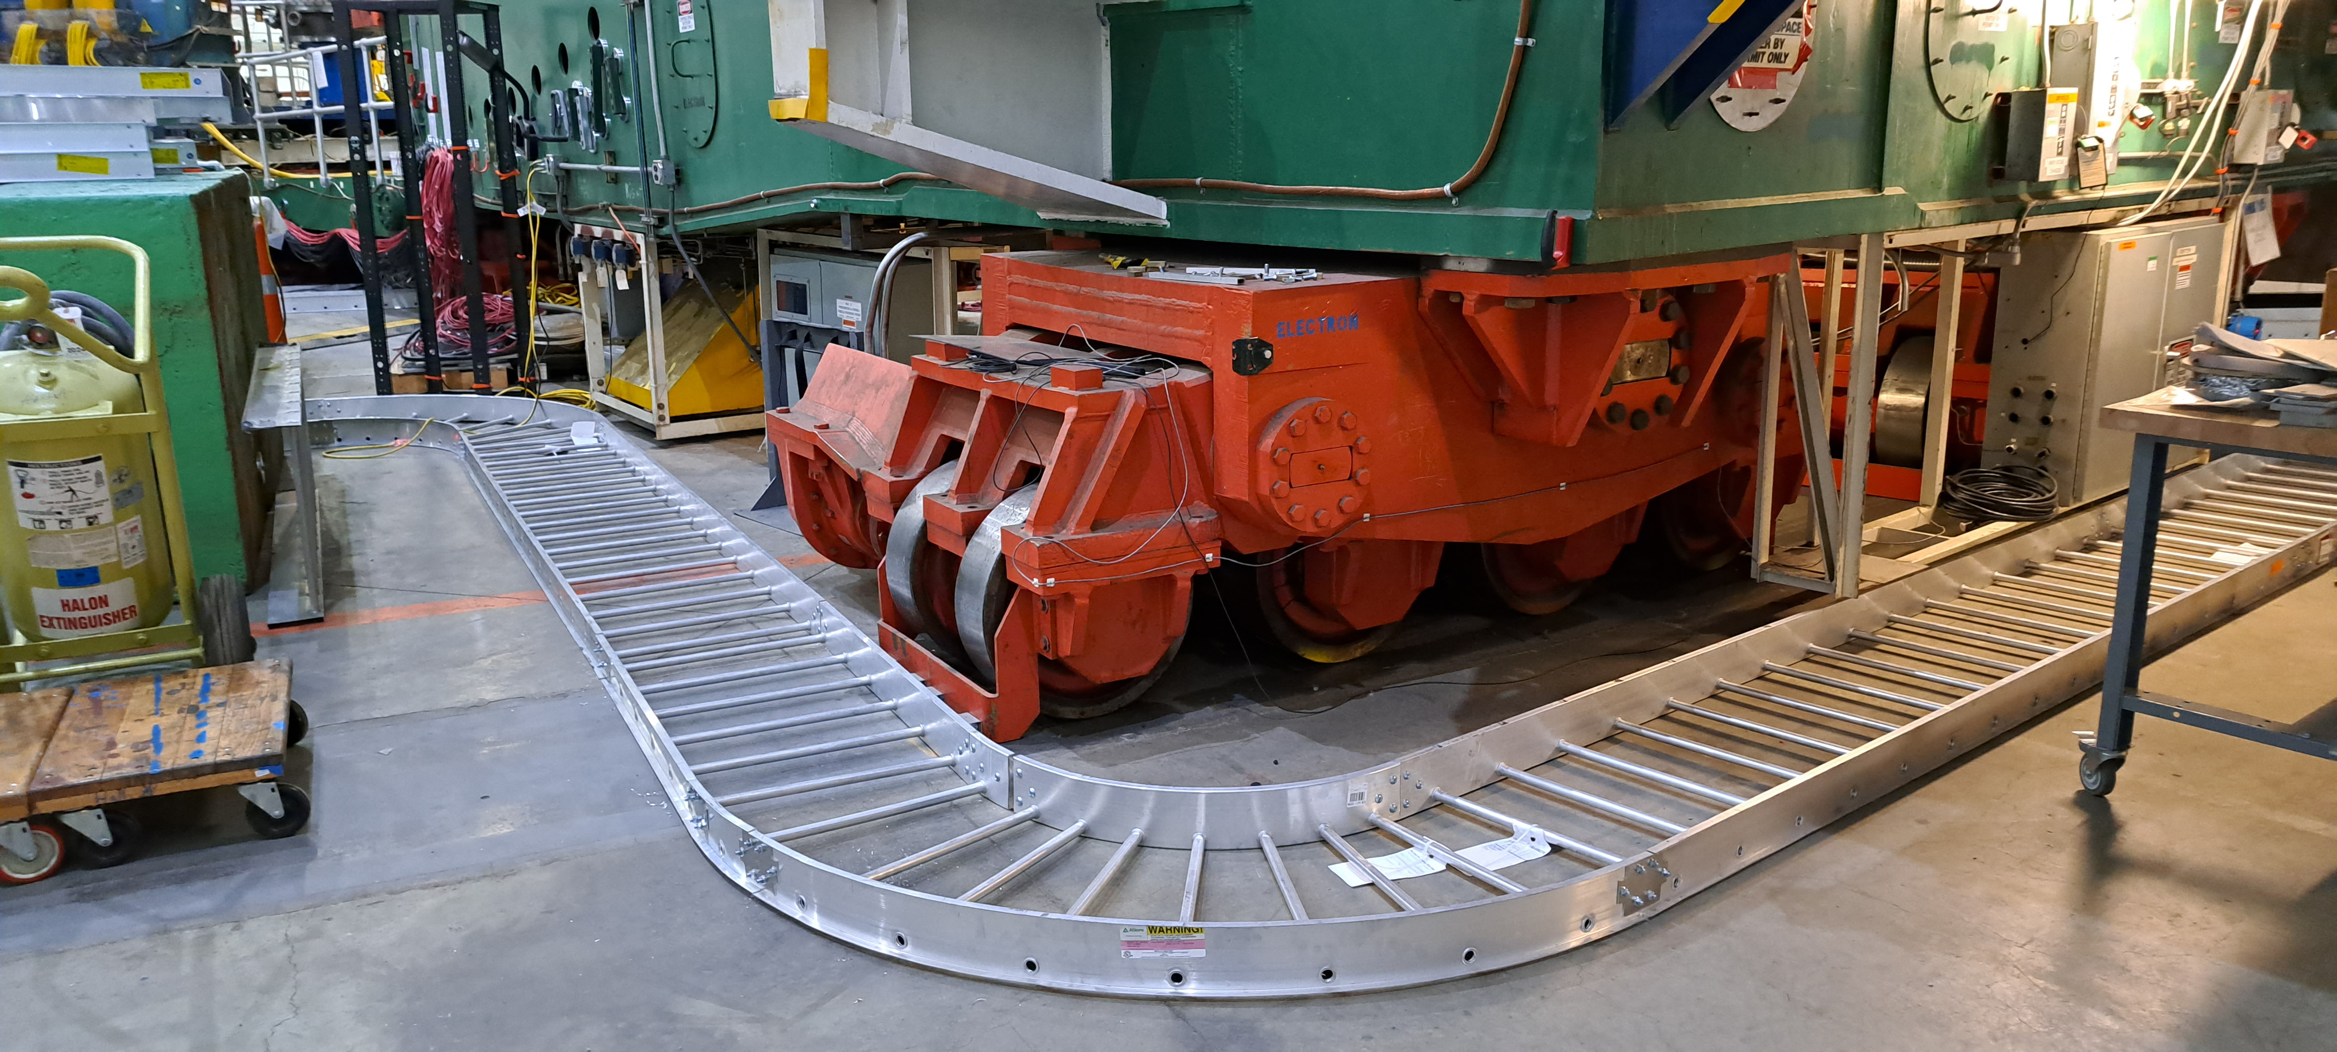
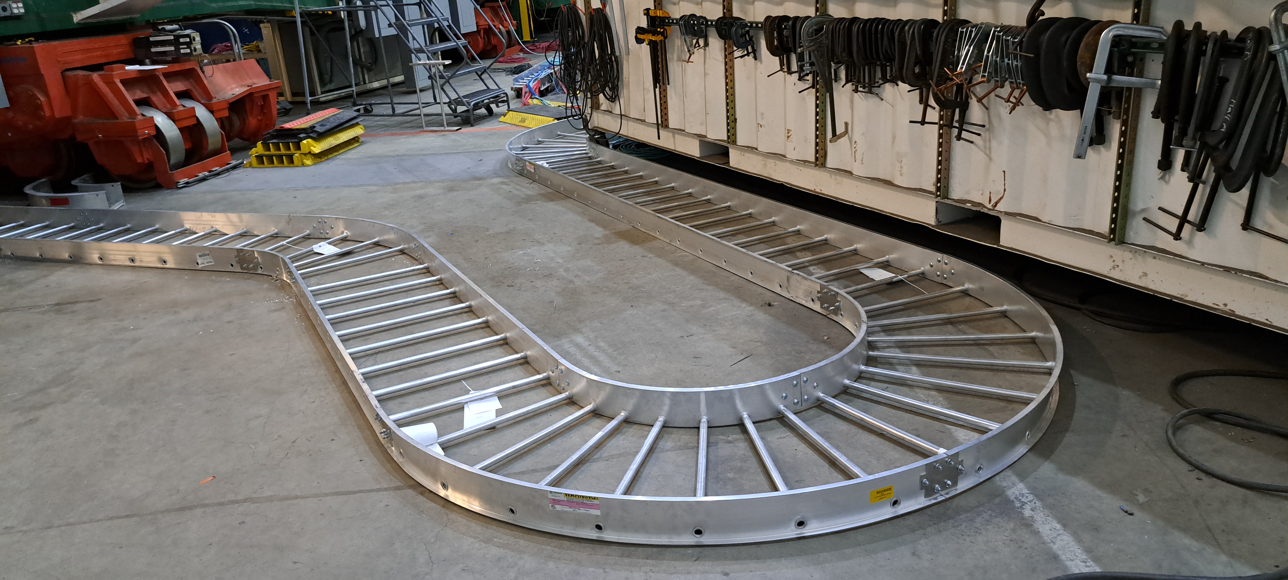
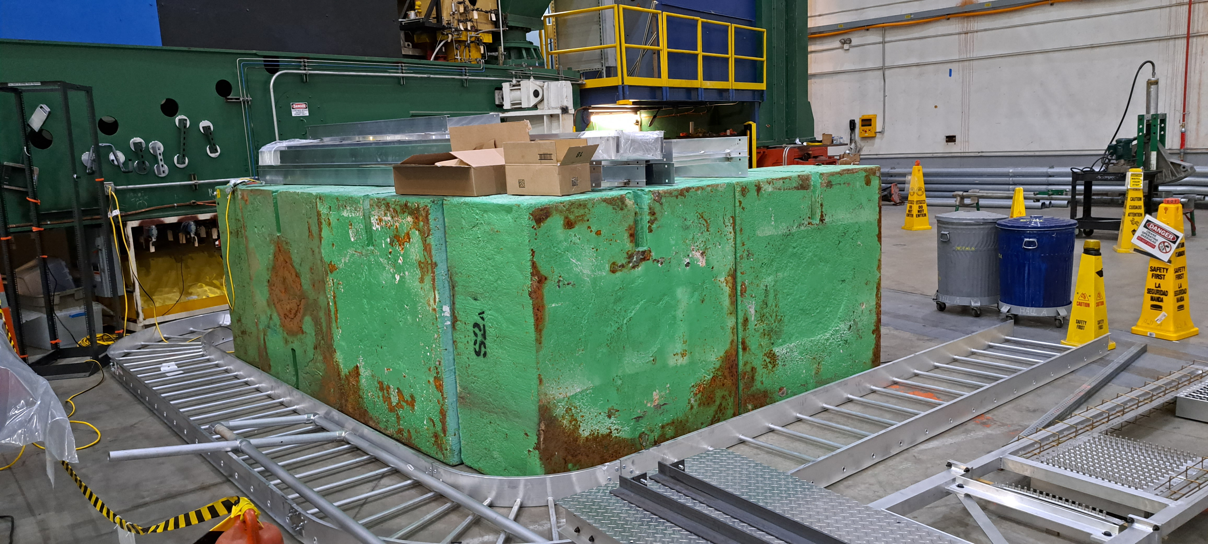
Cable trays

Slide 17
New plan for CDET
Due to overhead cryogenics line, CDET cannot be moved to closest position by crane.
New plan is to directly attach it to the ECal platform so that it moves with it
Requires new engineering, design and modification which is causing further schedule slip

Slide 18
Schedule
With the safety pause, our schedule is delayed
We were planning for an initial 50% cosmic test in September
What has to happen first?
  ECal moved into GEP-1 position, insulated walls installed, heater system installation complete, small bunker built, cable tray system installed, cooling system installed, at least 50% PMTs+patch panels installed with cables to front end signal cables to DAQ run, DAQ installed and cosmic trigger set up.
Realistically that is not likely to happen now until November at the earliest
We would like the full detector installed and ready for testing by sometime in December

Slide 19
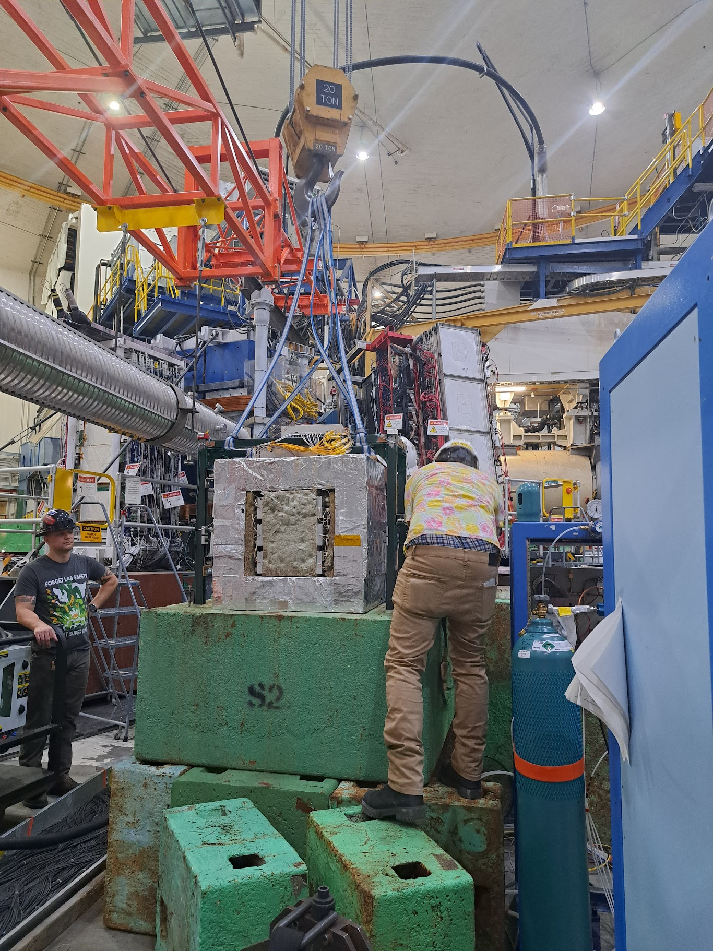
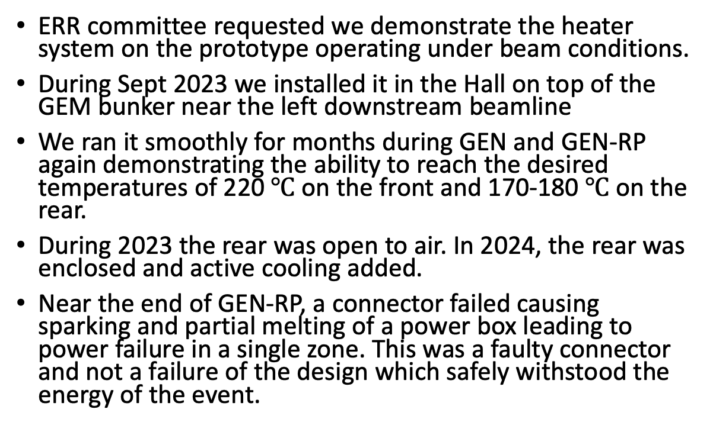
Prototype heated detector in Hall
ERR committee requested we demonstrate the heater system on the prototype operating under beam conditions.
During Sept 2023 we installed it in the Hall on top of the GEM bunker near the left downstream beamline
We ran it smoothly for months during GEN and GEN-RP again demonstrating the ability to reach the desired temperatures of 220 $℃$ on the front and 170-180 $℃$ on the rear.
During 2023 the rear was open to air. In 2024, the rear was enclosed and active cooling added.
Near the end of GEN-RP, a connector failed causing sparking and partial melting of a power box leading to power failure in a single zone. This was a faulty connector and not a failure of the design which safely withstood the energy of the event.

Slide 20
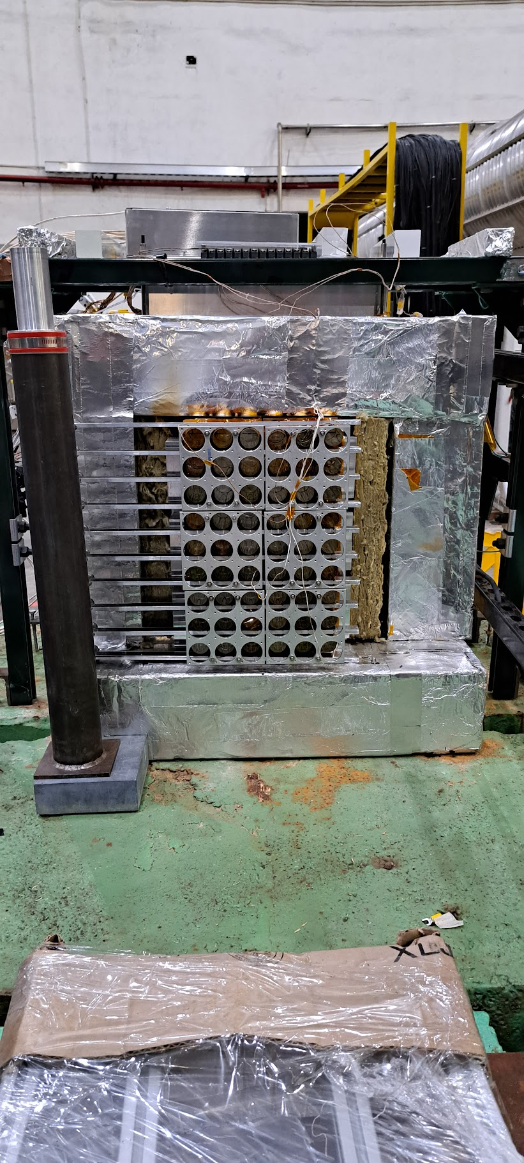
Adding active cooling
Installed manifold and conduits with air jets for each light guide similar to system for full scale
Installed a rear aluminum enclosure and an air pump on the system

Slide 21
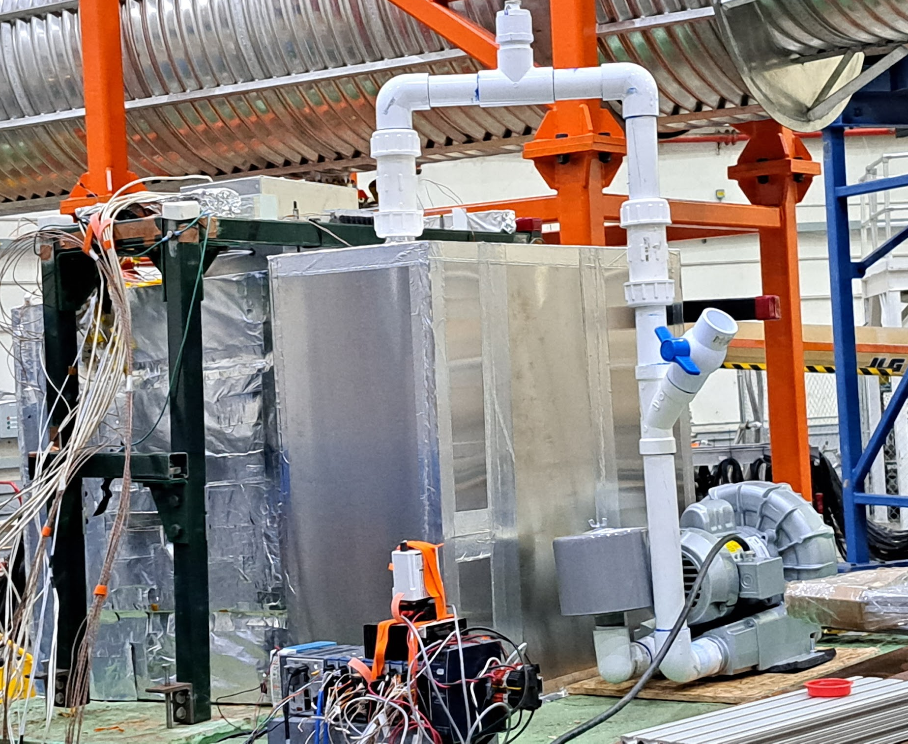
Cooled prototype
Pressure gauge
2.25” outlet hole
Valve
Detector Enclosure
Aluminum Enclosure
Pump

Slide 22
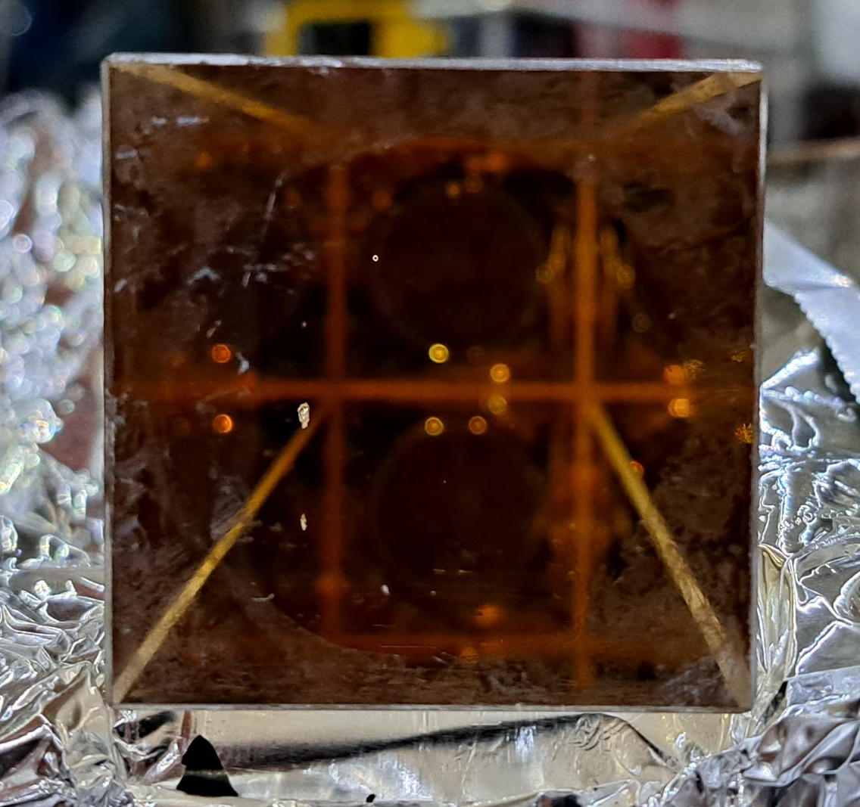
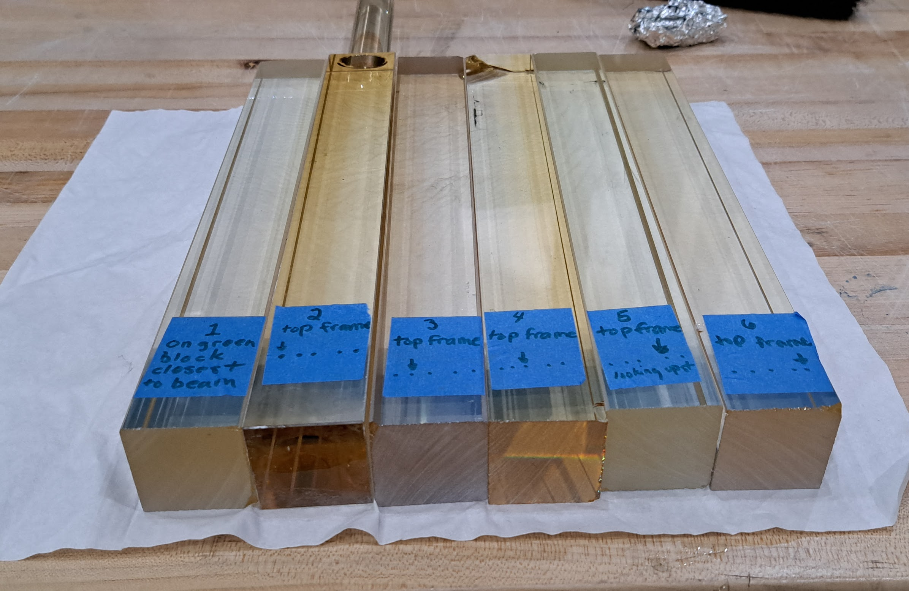
Post mortem cont..
6 5 4 3 2
We also placed 6 unheated spectator crystals around the detector
Ones closest to beamline showed darkening
1
1. 2. 3. 4. 5. 6

Slide 23
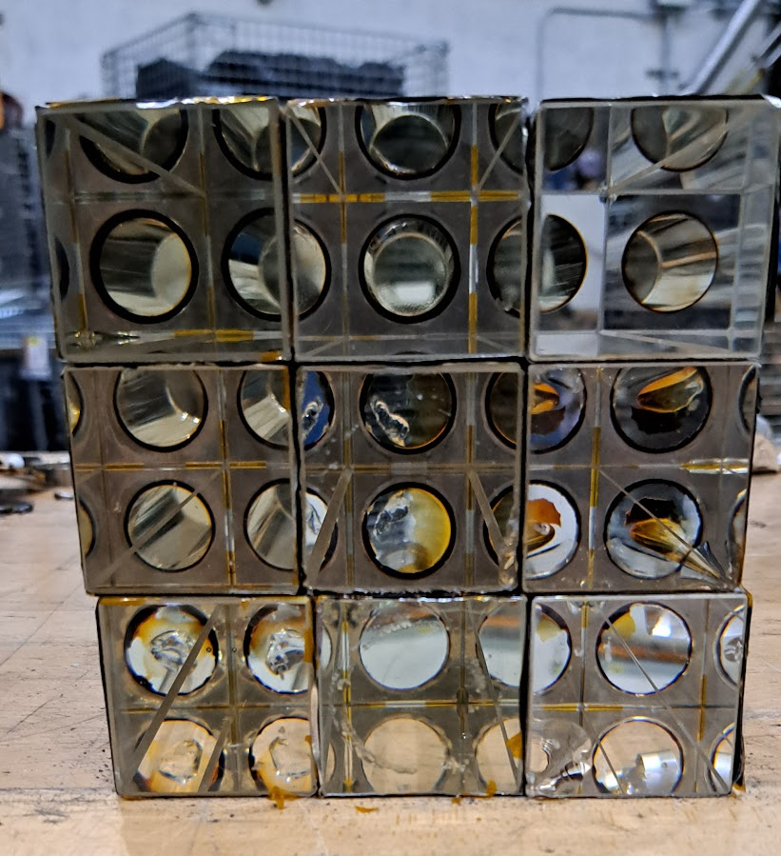
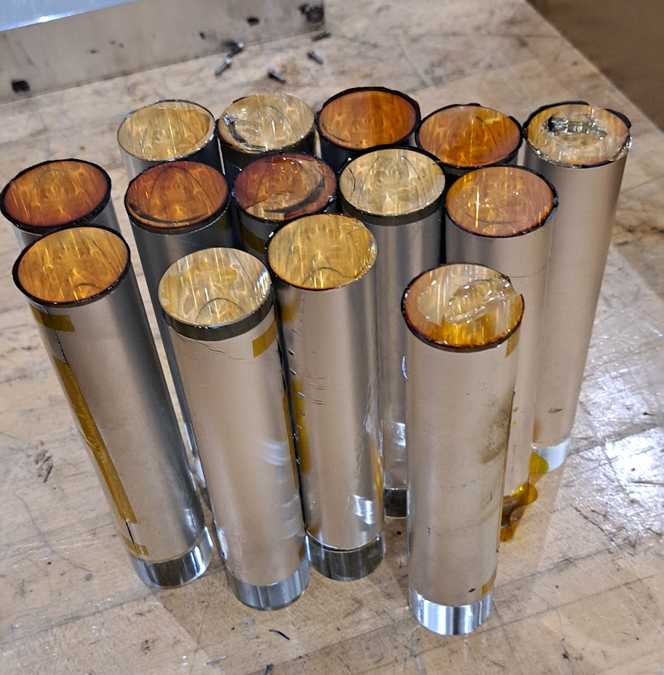
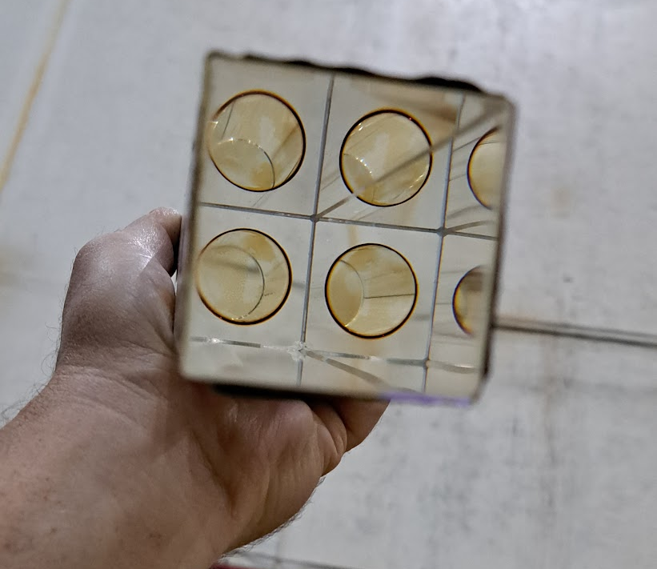
Post mortem cont..
supermodule crystals closest to the beam line
Heated crystals still clear. Shown on the right is the supermodule crystals closest to the beam line which would have seen the most radiation
However, a number of glue joints between the crystal and light guide had darkened significantly throughout the detector
Those that retained strong and full adhesion were usually almost clear, but those that had become loose were quite dark
Note: this darkening is not the result of radiation but of heat and oxidation. This is obvious when you see clear glue across the face of well-coupled light guides and a dark ring of glue at the edge. Also, darkening was independent of distance from the beam and dependent completely on quality of adhesion
light guides that came loose showing glue discoloration
Single crystal with good light guide adhesion shows glue rim discoloration

Slide 24
Conclusions from darkened adhesive
Glue is darkened by exposure to heat and air. We know this because
  The glue on the well-fastened light guides is still relatively clear across the face of the light guide but dark at the edges.
  Light guides whose adhesion failed have a variation of darkness of glue showing that ones who failed early are darkest having the longest exposure time
  The 1656 Light guides on ECal that have not been been exposed to heat do not show signs of darkening.
We have to limit the exposure of light guides to heat. We will empirically find the lowest temperatures at which sufficient annealing is achieved.
If a light guide is obviously loose or the glue is deteriorating, it is preferrable to scrape the glue off and simply push it back against the crystal without adhesive rather than have darkened glue.
We will avoid keeping the detector hot for extended periods without beam

Slide 25
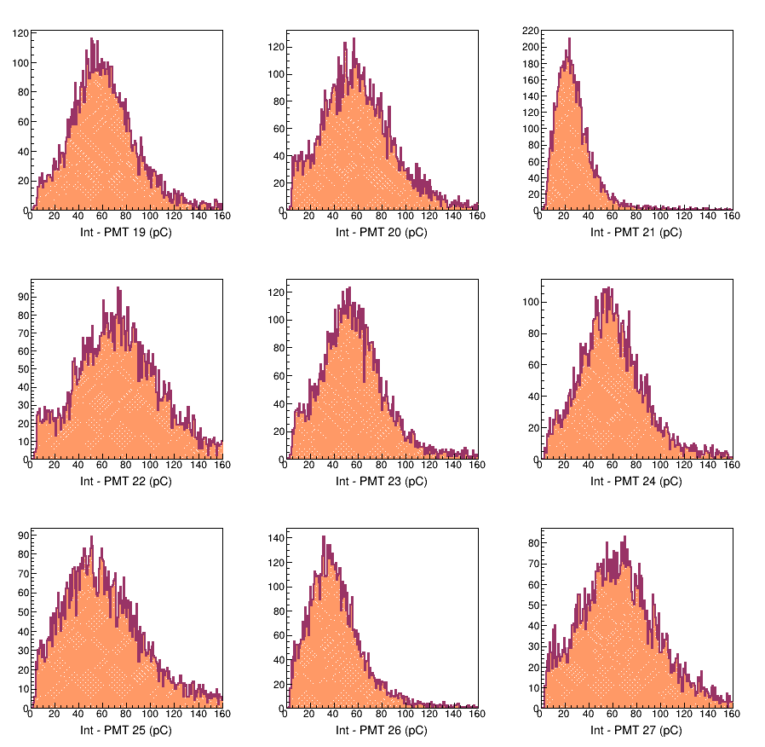
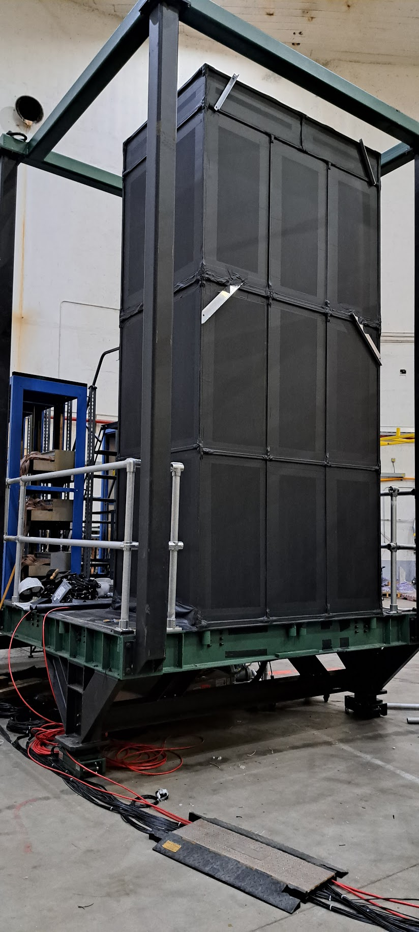
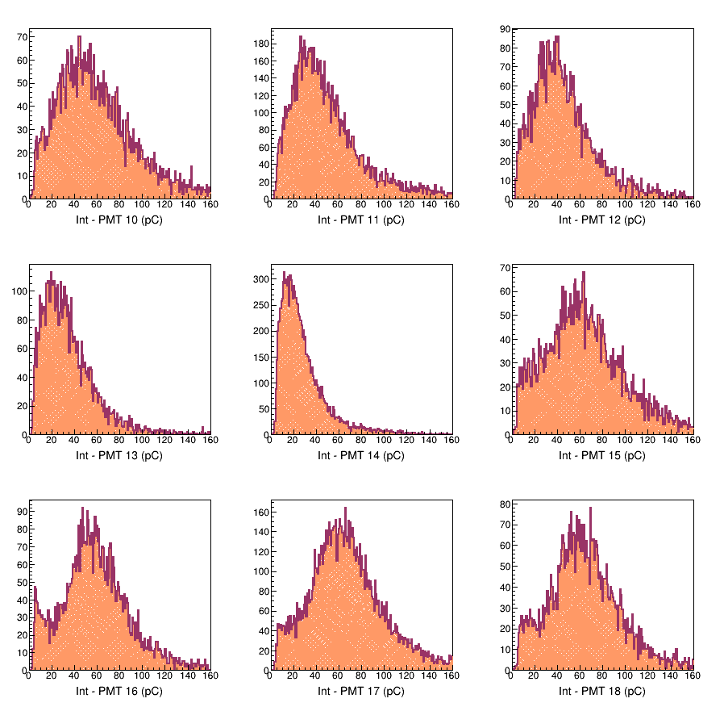
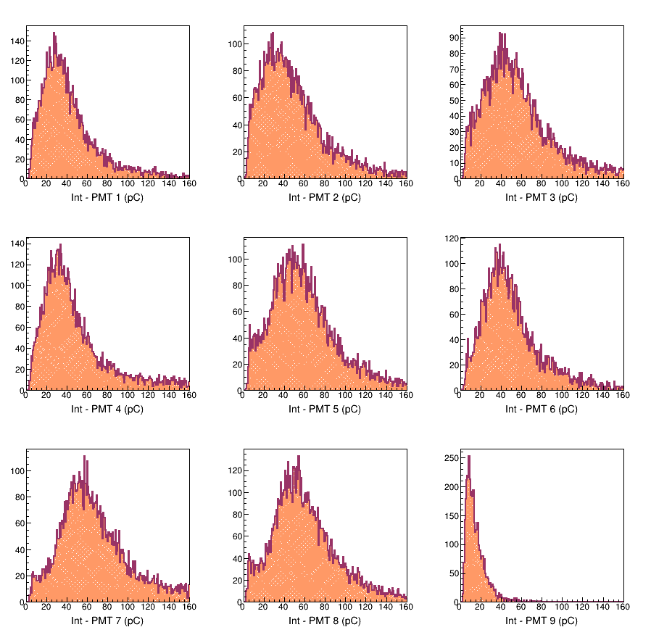
27-ch cosmic test
Trigger developed by Hanjie at Simona’s request
Saw significantly lower response from several channels
Found noisy BNC-LEMO signal cables with bad ground connection
Began developing procedure and software for gain matching and debugging
Software development meetings will start next week
Gain-matching software based on BigBite is being deployed for ECal.

Slide 26
Personnel
Throughout the summer we had help from:
  Undergraduates Keagan Bell and Ryan McLaughlin (VT)
  Graduate students Mahmoud Gomina (VT), Jhih-Ying(UMass) VT, Kip Hunt (UConn) and Jacob McMurtry (UVA)
  Post docs: Deb Biswas (VT)
  Researchers and techs: Karen, Samvel and Aram (Armenia), Maurizio (INFN)
Now our personnel are rather depleted
  Don, Jimmy, Simona and Albert (remotely) leading efforts
  Ryan and Samvel are here for a few weeks
  Kip and Jhih-Ying are active
  Hem Bhatt is available for a few days
  Vincenzo and Nunzio (INFN) are here for two weeks
If you can help, please let us know.

Slide 27
Questions?

