Slide 1
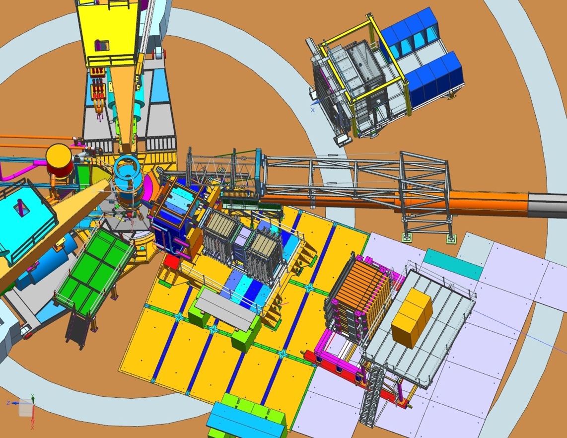
GEp Engineering/Design Status
Robin Wines
September 2024
OLD IMAGE

Slide 2

GEp
ECAL
CDET
BL1
SBS
HCAL
SBS GEMs
Additional GEM electronics region

Slide 3
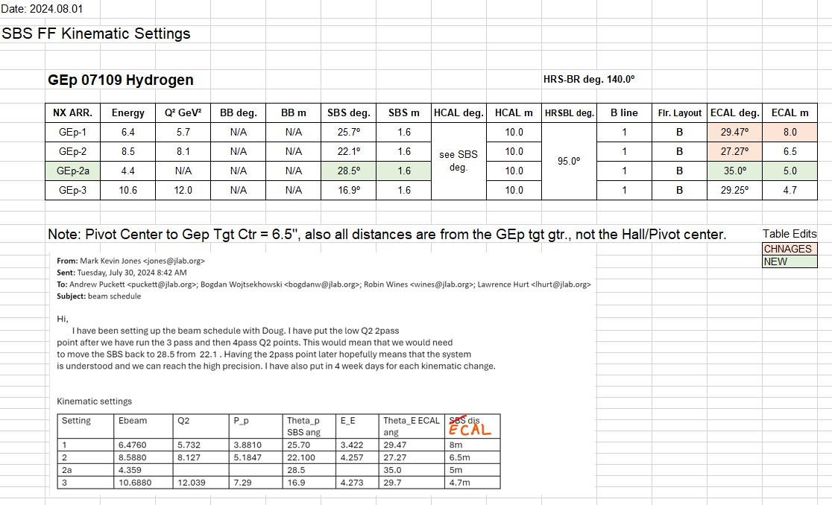
Kinematics

Slide 4
GEp-1

Slide 5
GEp-2

Slide 6
GEp-2a

Slide 7
GEp-3

Slide 8
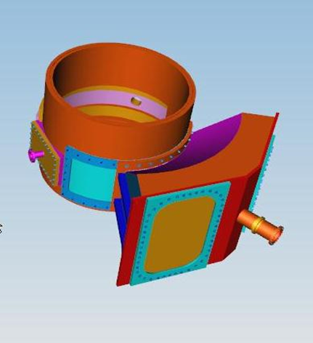
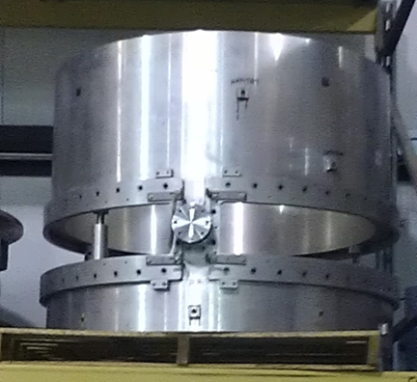
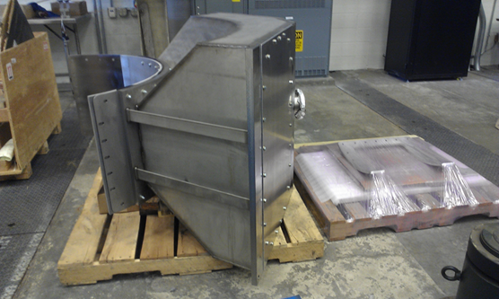
Target
Pivot platform needs to be modified to allow clearance for configurations
Windows need to be tested, plan to complete test by end of September.
Snout to be supported with jack stands.
Coordinating rotation of chamber, target install and snout fit test now.
Vacuum Snout
Target Chamber

Slide 9
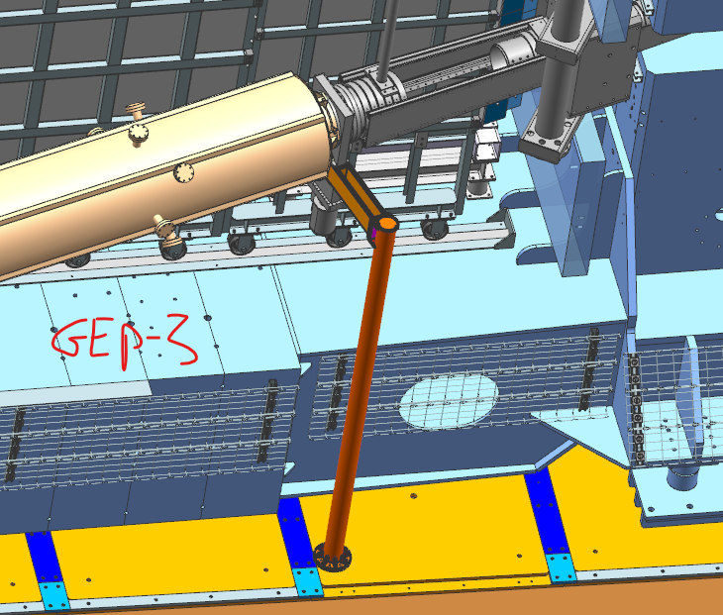
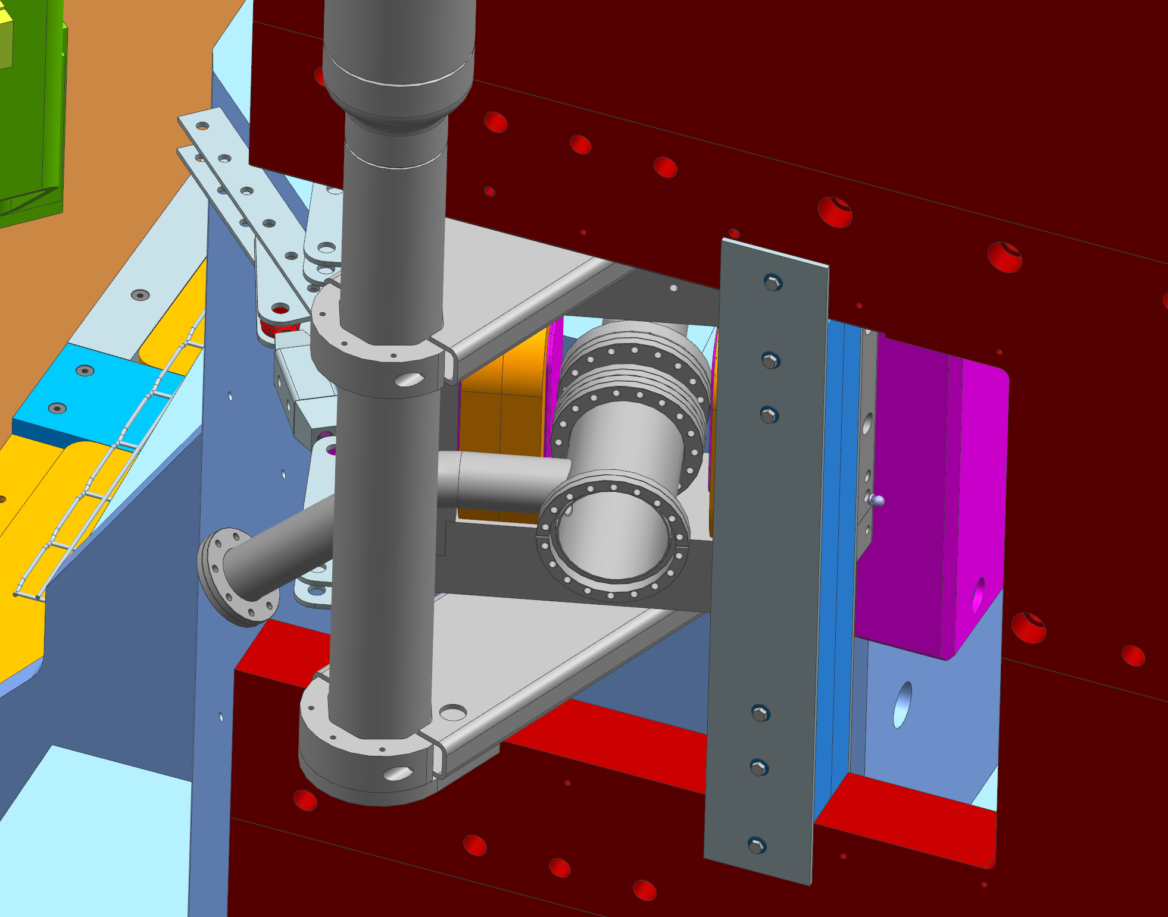
Downstream beamline
Gate valve needs support post fabricated.
All parts in-house for differential pumping section- needs assembly- Target group/Hall A technicians. Bellows needs 4 tabs attached to each conflat.

Slide 10
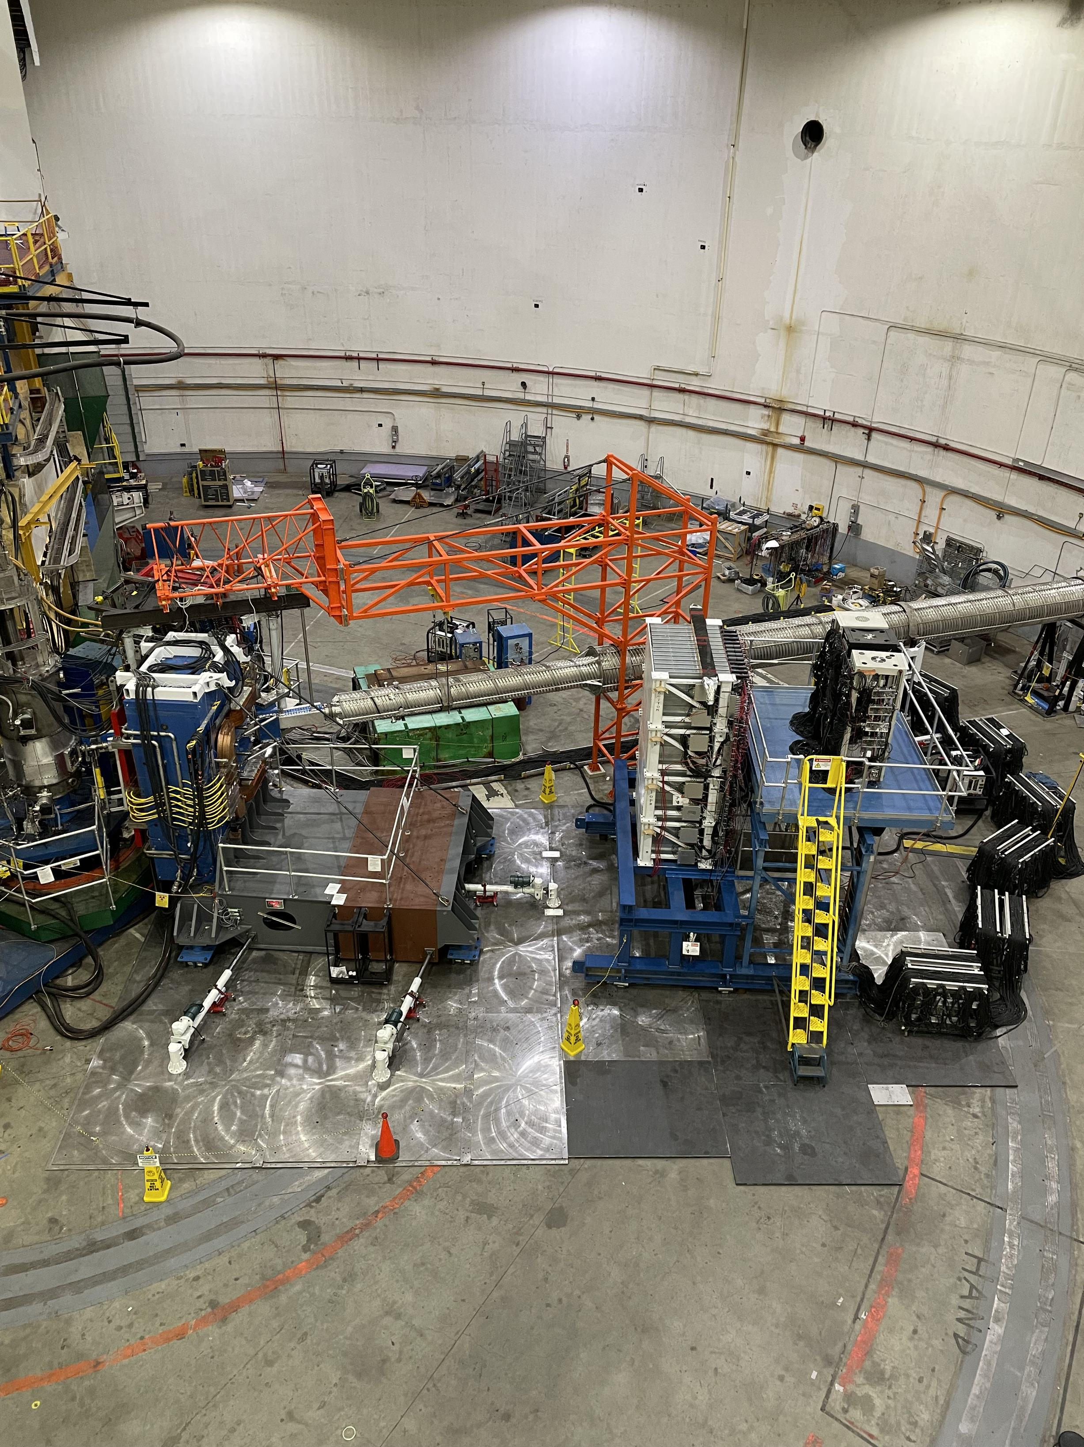
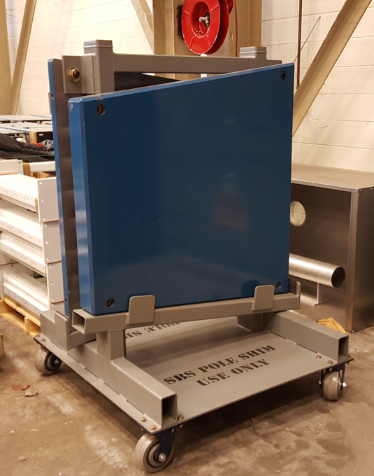
SBS Magnet, Pole Shims and Field Clamps
Existing SBS magnet will be needed with all coils powered, both field clamps on and pole shims inserted.
Are SBS Magnet and Corrector settings tabulated?

Slide 11
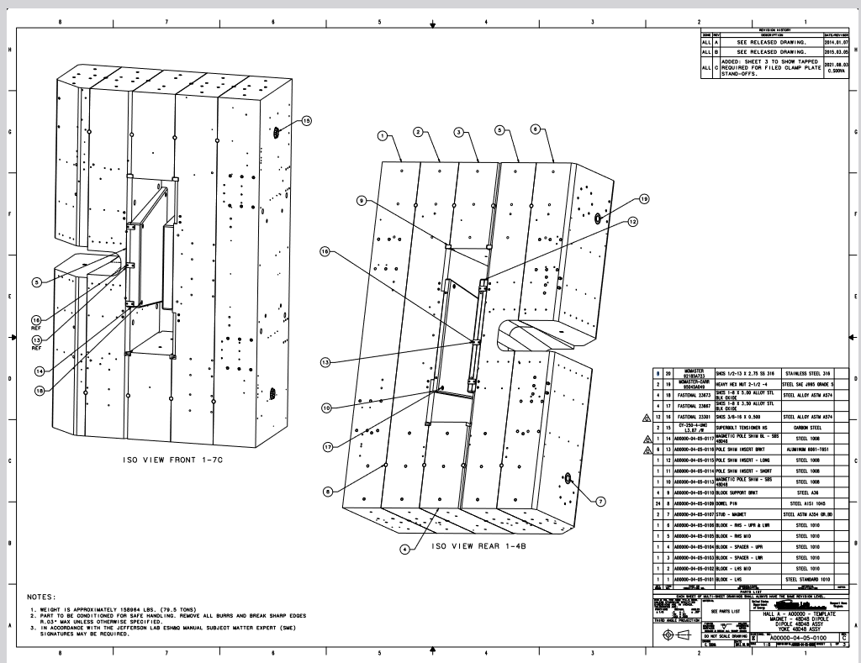
Pole Shim Inserts
Pole shims are installed.

Slide 12
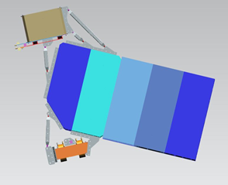
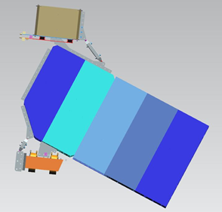
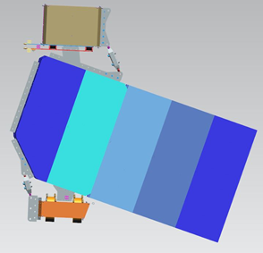
Correctors
Existing correctors to be used with existing Beamline-1(BL1) configuration.
Corrector braces in-house for GEp 1,2 and 3. GEp-2a analyzed and designed, existing piece is being modified.
Gep-2
Gep-3
Gep-1

Slide 13
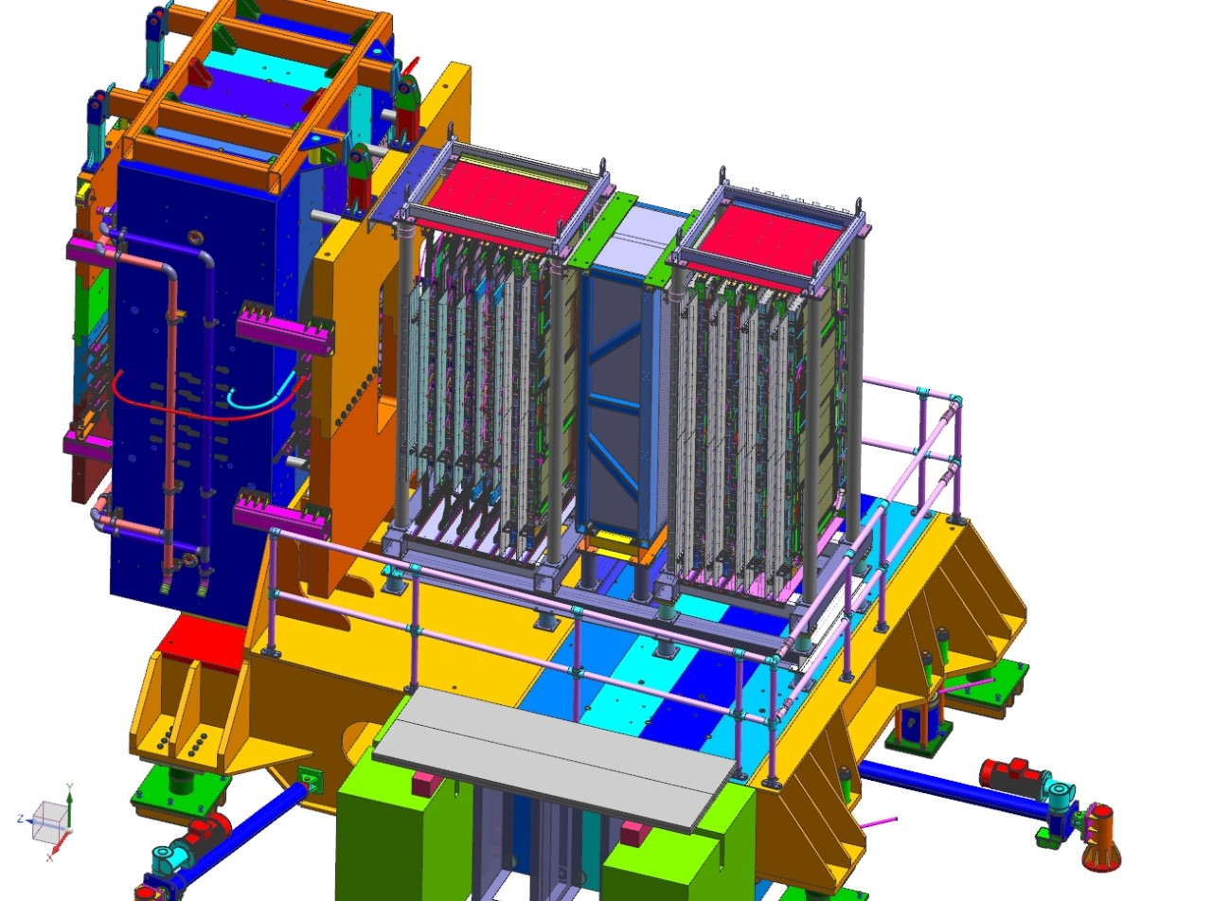
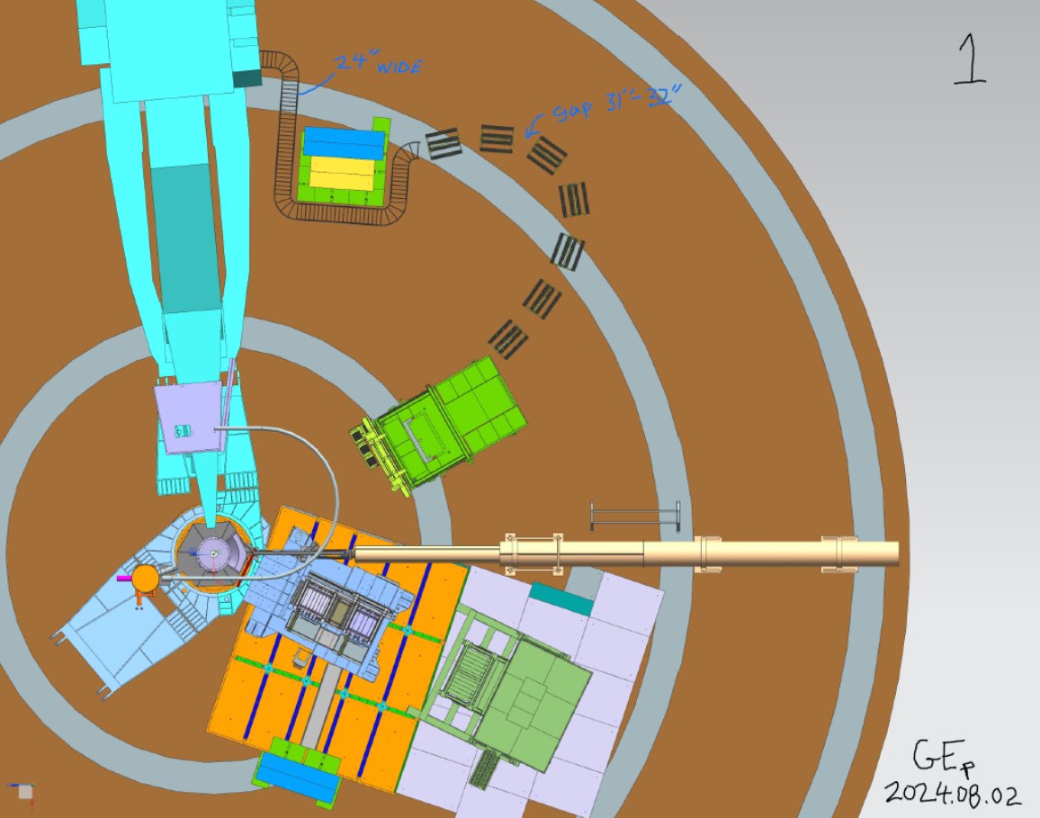
SBS Detector/GEMs
Forces require bracing of structure to field clamp and base of counterweight structure.
OLD IMAGES
Cables to run at CW surface height to hut. Need support for cables across floor and cover on CW area

Slide 14
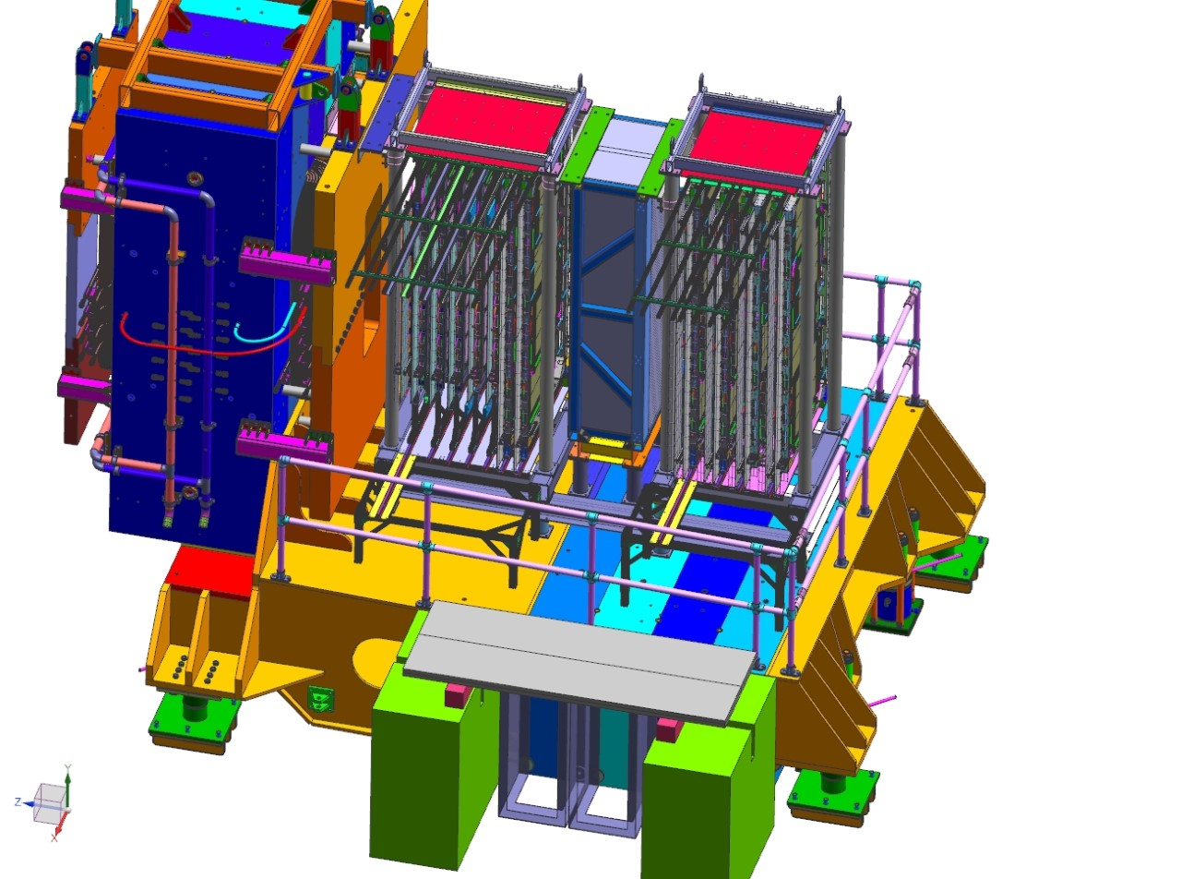
SBS Detector Access
OLD IMAGE
Detector access remains an issue.
Trying to configure a fall protection method.

Slide 15
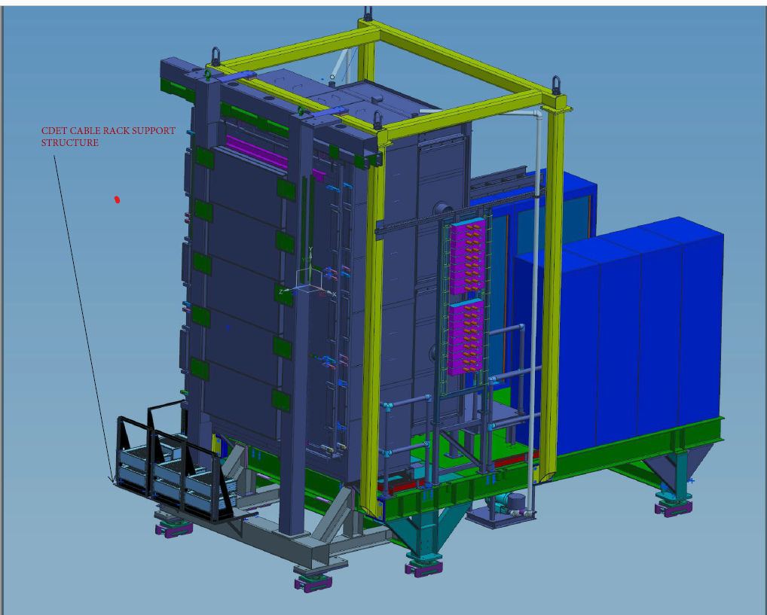
CDET
CDET panel support frame with lifting panel needed for lifting/rotating support. Need to order lifting panel.
Original frame to be cut to fit through truck ramp.

Slide 16
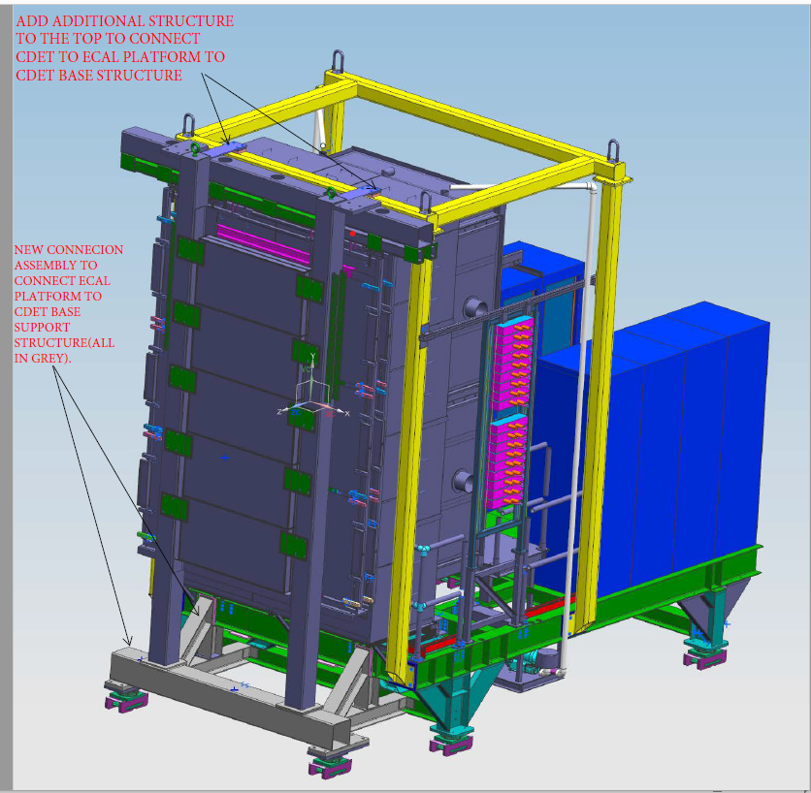
ECAL and CDET
Constraints in Hall require ECAL and CDET to move together. New supports being designed to connect two detectors and allow motion on Hilman rollers.
Analysis complete, creating drawings to fabricate.
Also need anchor points determined for moving into different configurations.
Goal to have structures modified by end of September for CDET assembly to start.
Assembly of CDET frame to ECAL frame to be determined by detectors.
Need stops for fixing positions.

Slide 17
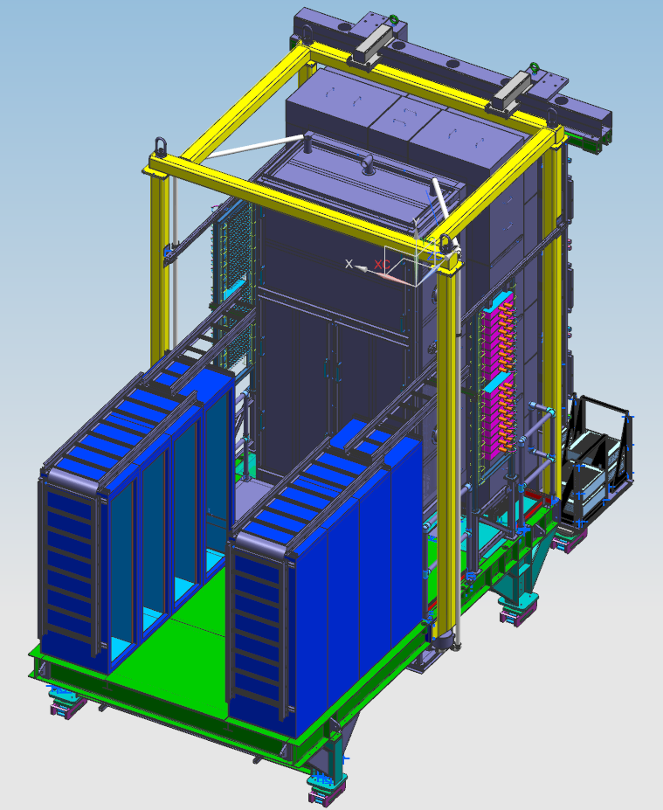
ECAL
Adding new cable tray routing
For signal cables.

Slide 18

HCAL
Existing HCAL to continue use in Hall for GEp.
Cables continue with use of cart configuration. Cables across floor to be moved to support on side of counterweight structure then under HRS-L.

Slide 19
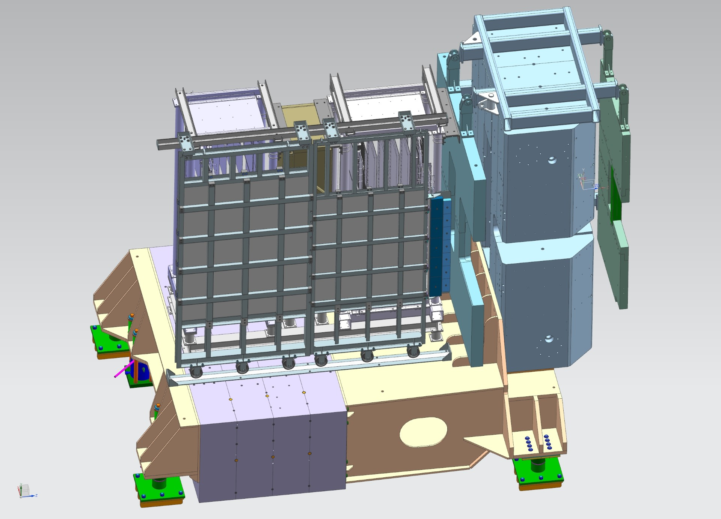
Lead Shielding
Lead insert required in upstream field clamp. Fabricated and in-house.
Lead wall required to be redesigned to be removable in sections and supported on CW in all configurations. Concept developed and analyzed. Detailing designs.

Slide 20
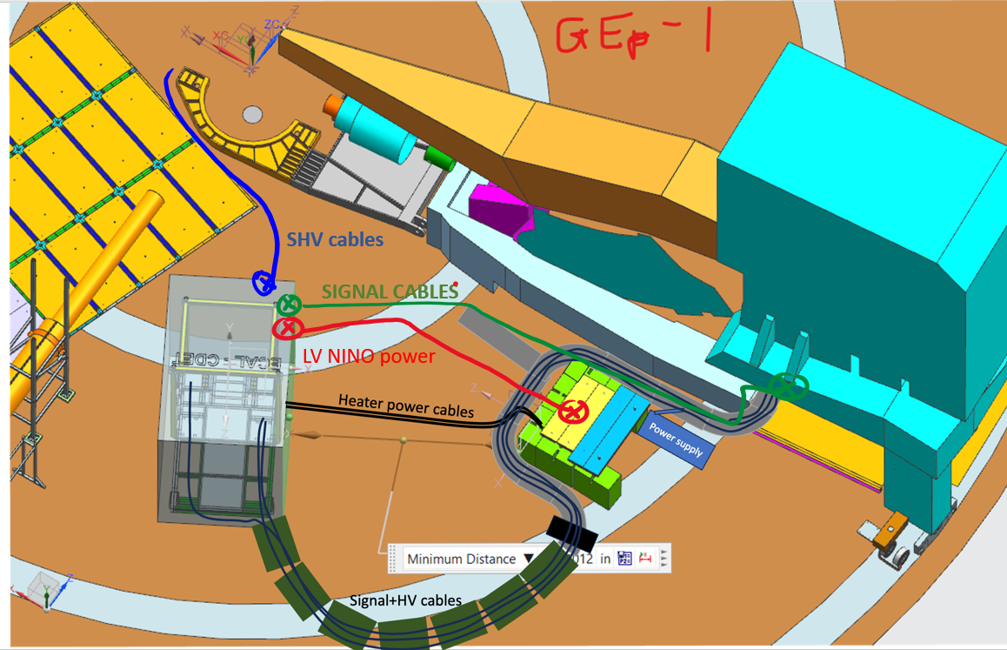
Cable Layout- ECAL and CDET

Slide 21
Summary
Design and drawing efforts will be completed by October.
Remaining purchases and fabrications are being split between FY24 and FY25 funds.
Thank you !
Questions ?

