Slide 1
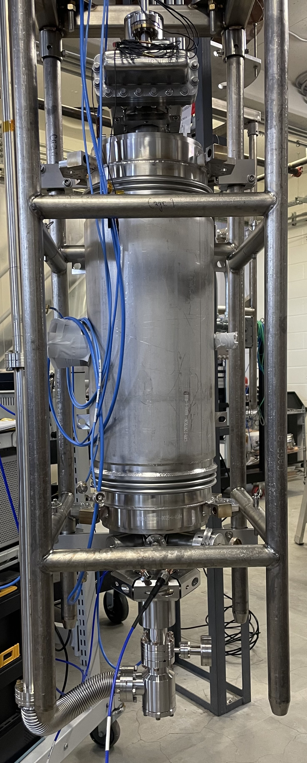
FY25 LDRD Proposal Review
Multiple Mode Excitation System for Processing Multicell SRF Cavities
Peter Owen

Slide 2
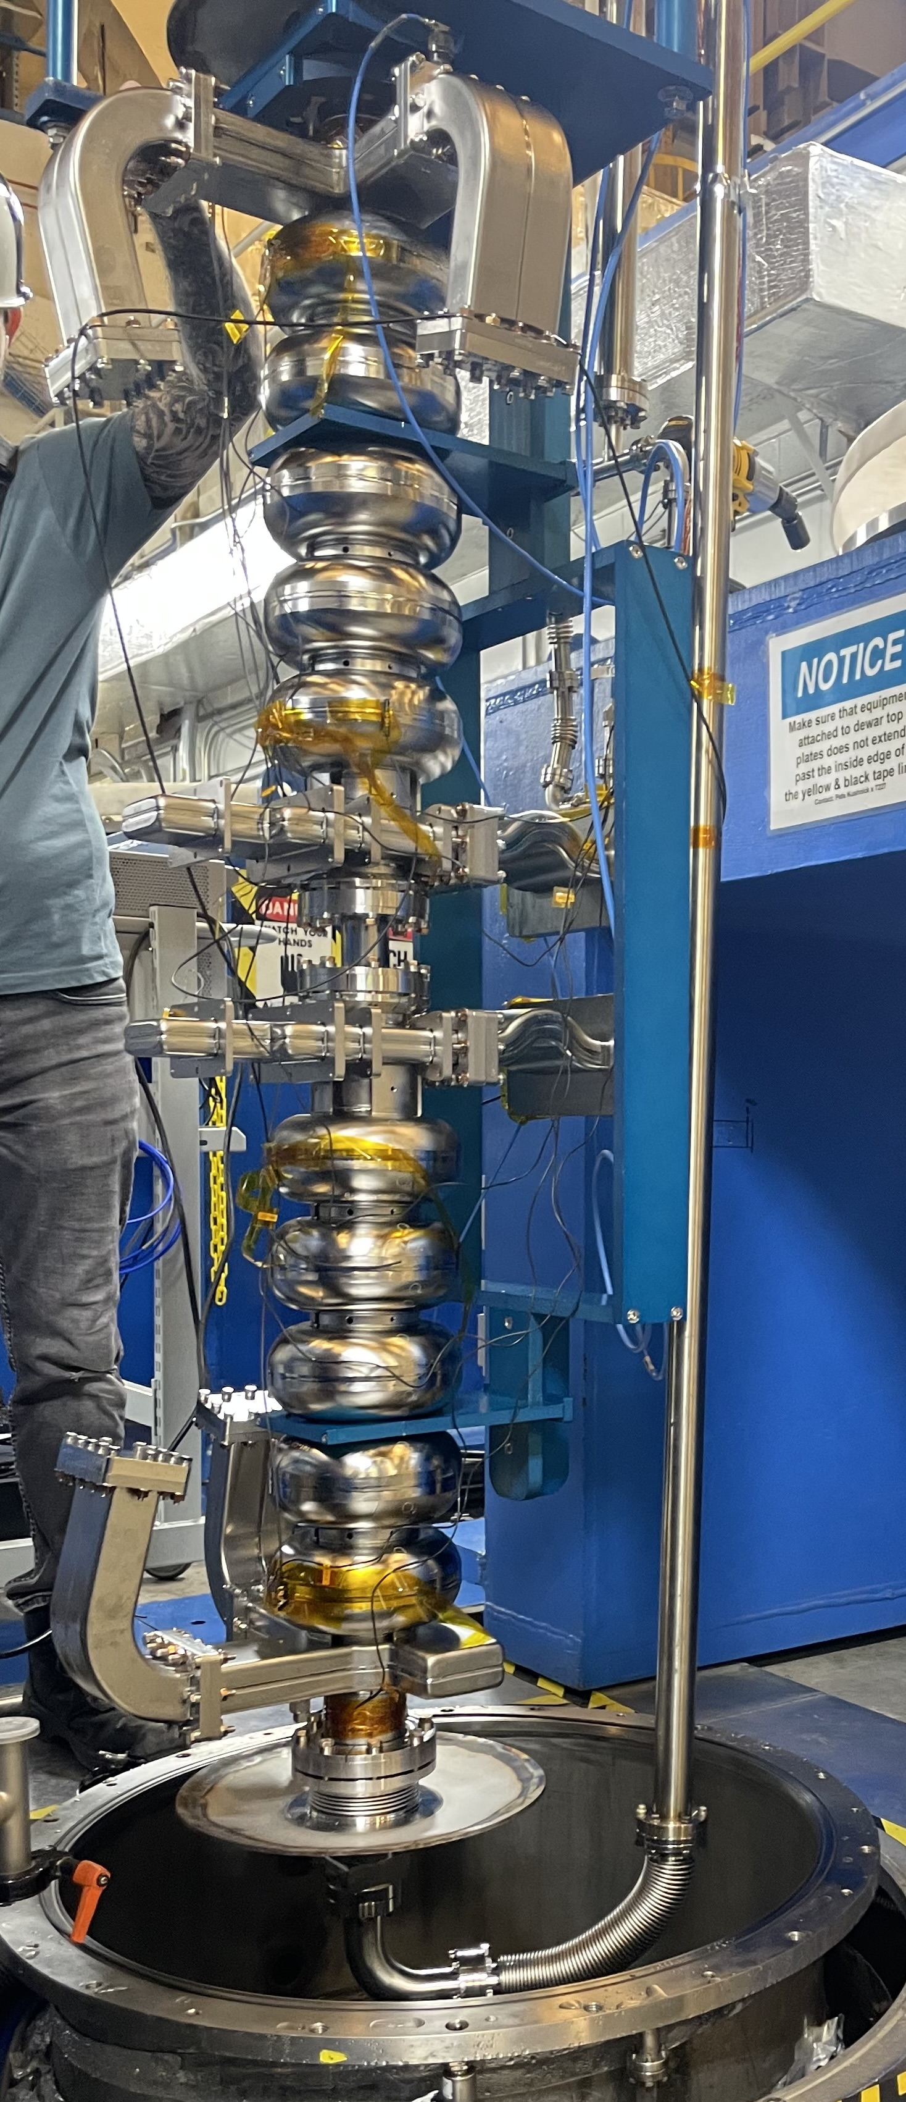
Goal
This LDRD project will develop a new RF system that supports the latest methods of SRF cavity testing including multiple mode excitation in multiple testing environments and will serve as a test bed for future measurement methods.
A pair of C75 cavities are loaded into a dewar in the Vertical Test Area (VTA)

Slide 3
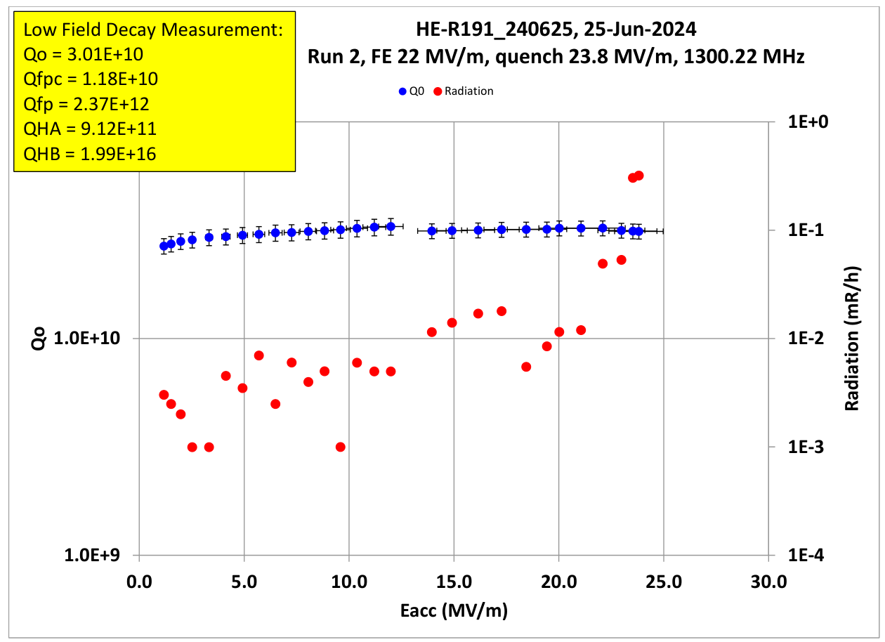
SRF Cavity Testing – Vertical Test Area
300+ SRF cavities are tested in VTA every year
Key cavity parameters tested:
Maximum cavity gradient (E_{acc})
Heat loss from the cavity (Q₀)
Detect Field Emission (FEonset)
RF control of cavity handled by Low-Level RF (LLRF) systems designed for CEBAF
Measurement of cavity properties requires precise quantization of RF signals emitted from the cavity
Multiple instruments used for measurements: power meters, frequency counter, crystal detector
Calculate the key parameters from these measurements [Powers]

Slide 4
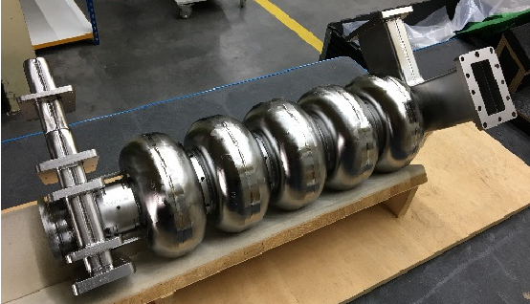
New Testing Tools - Multiple Mode Excitation
Multicell cavities have a set of RF resonant modes called the pi modes, each with a unique frequency and field distribution
Excite two (or more) modes simultaneously to focus RF energy in certain cells
Potential benefit for processing multicell cavities
Need 50 MHz bandwidth to reach all pi modes
Focused power can find quench limit in cells
Inform corrective actions taken after cavity test (inspection, chemistry, cleaning)
Works even if cavity has helium vessel
Left: Bare C75 cavity
Right: C100 cavity on test stand with helium vessel

Slide 5
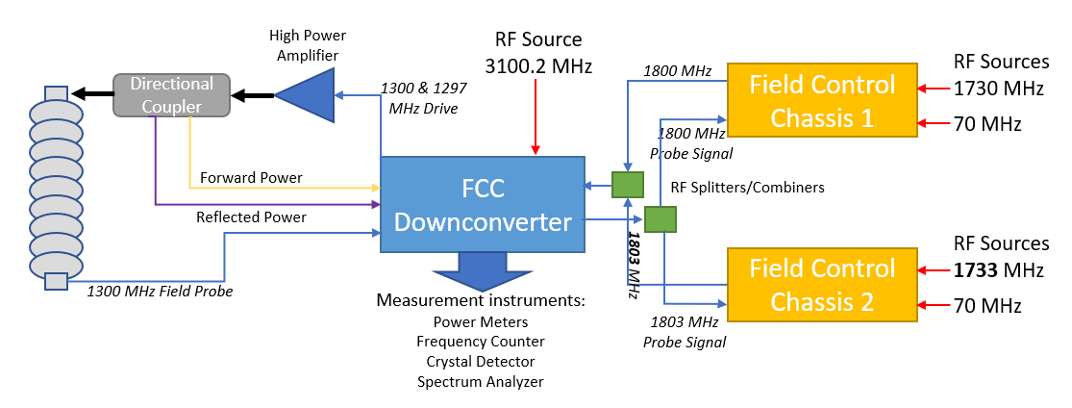
New Testing Method - Mode Suppression
Mode Mixing interfered with testing on every LCLSII-HE cavity (9 cells)
Excite one mode in a cavity (9/9 pi mode)
Due to multipacting, another mode is excited (7/9 pi mode)
Superposition of modes prevent measurement of cavity parameters
Developed a method to suppress second mode using a second LLRF control system [Owen]
Centered on undesired mode, drive mode 180º out of phase
Currently limited on how far apart the two modes can be, ~3 MHz

Slide 6
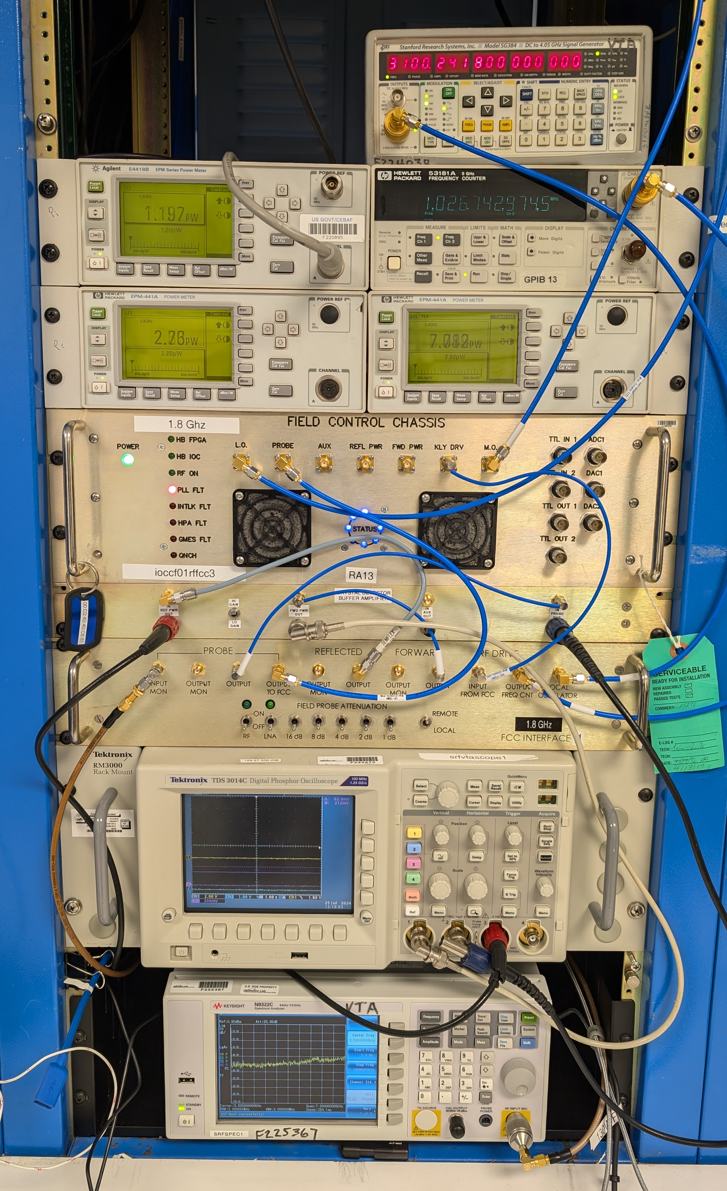
Current RF Systems
CEBAF LLRF Field Control Chassis
Digital Self-Excited Loop (SEL) to lock frequency, control amplitude and phase
Designed to run CEBAF cryomodules
1497 MHz, narrow bandwidth
EPICS interface
Fault detection
Interlocks
Some LLRF systems borrowed for cavity control in VTA
Required ‘dumming down’, only certain features used, interlocks bypassed
Need an EPICS server to operate
Interface chassis needed for cavities of different frequencies
LLRF control and measurement system in the VTA

Slide 7
New RF System
Software Defined Radios
Designed for RF communications
Down convert and sample a wide range of RF frequencies (1 MHz – 8 GHz)
Multiple input and output channels
Powerful onboard FPGA controllers to generate and process signals
Will program device with algorithms to control and measure cavity properties
Measure frequency, amplitude and phase of signals simultaneously
Self Excited Loop and other control modes such as GDR (Generator-Driven Resonator) and SELAP (SEL with Amplitude and Phase) for accelerator environments
Flexible, commercially available system
Available for off-site RF cavity tests [Ciovati] and small accelerators
NI USRP X410

Slide 8
Project Goals
Final choice and procurement of a suitable device: Consult with RF engineers, manufacturers
Develop new RF controls: Implement SEL optimized for multi-mode excitation from the start
Measurement of Signals: frequency, amplitude, phase, synchronous data
LabVIEW User Interface: Needed for testing in VTA, Cryomodule Testing Facility (CMTF)
Test on cavity in VTA: First test of new system, compare against existing systems for accuracy
Test on cryomodule in CMTF: Demonstrate cryomodule operation, system stability
Explore new RF control measurement techniques

Slide 9
Project Budget
Requested Budget for Effort by Investigator
Name of Investigator | Role (PI, Co-I, etc.) | FY25 Budget ($K) | FY25 Effort (% FTE) | FY26 Budget ($K) | FY26 Effort (% FTE) | Total Budget ($K) | Total Effort (%FTE)
Peter Owen | PI | 73.2 | 40% | 74.5 | 40% | 147.7 | 80%
James Latshaw | RF Firmware | 73.2 | 40% | 55.9 | 30% | 129.1 | 70%
Ramakrishna Bachimanchi | RF Firmware | 23.5 | 10% |  |  | 23.5 | 10%
Tomasz Plawski | RF Firmware | 13.8 | 5% |  |  | 13.8 | 5%
Anthony Mave-Colon | Technician | 1 | 1% |  |  | 1 | 1%
Subtotal for effort |  | 184.7 | 96% | 130.4 | 70% | 315.1 | 166%
Equipment | Non-capital | 31.8 |  |  |  | 31.8
Materials/ Supplies | Custom RF chassis | 21.2 |  | 31.9 |  | 53.1
Total for effort |  | 237.7 |  | 162.2 |  | 399.9

Slide 10
Future Test Methods
New methods of cavity control and measurement always being suggested and published
Fermilab – Using vector properties of RF signals to measure a cavity like a network analyzer [Frolov]
Uppsala – Use high acquisition speed and repeated decay measurements to estimate Q0 and QL in a cryomodule using least-squares fit [Ziemann]
Not tested or proven at Jefferson Lab
Would require extensive development on existing CEBAF LLRF systems
Development on new SDR - LLRF system would be quicker – designed to be flexible from the start
If proven successful, could provide big benefits to operations in accuracy and efficiency
Quantum SRF cavity measurements
New and growing application of SRF technology
High frequency cavities, strict timing requirements
Flexible SDR can be adapted for new measurements
Commercially-available system would be basis for small accelerator operations
End user only needs to develop software on the commercial platform
Present accelerator RF systems use custom hardware platforms

Slide 11
Questions?
Summary
New RF control and measurement system
Latest methods of SRF cavity testing
Multiple mode excitation
Multiple testing environments
Test bed for future measurement methods
References:
Practical Aspects of SRF Cavity Testing and Operations. Powers, Tom. Dresden, Germany: SRF2019, 2019. THTU3.
Prevention of Dual-Mode Excitation in 9-Cell Cavities for LCLSII-HE. Owen, Peter. Grand Rapids : SRF2023, 2023. WEPWB110.
Development of a prototype superconducting radio-frequency cavity. Ciovati, Gianluigi, et al. s.l. : Physical Review Accelerators and Beams, 2023, Vol. 26. 044701.
Vector Calibration for Vertical Tests of Superconducting RF Cavities. Frolov, Daniil. Batavia, IL : Fermilab, 2023. TM-2721-TD.
A new method to measure the unloaded quality factor of superconducting cavities. Ziemann, Volker. s.l. : Physical Review Accelerators and Beams, 2024, Vol. 27. arXiv:2312.17548.

Slide 12
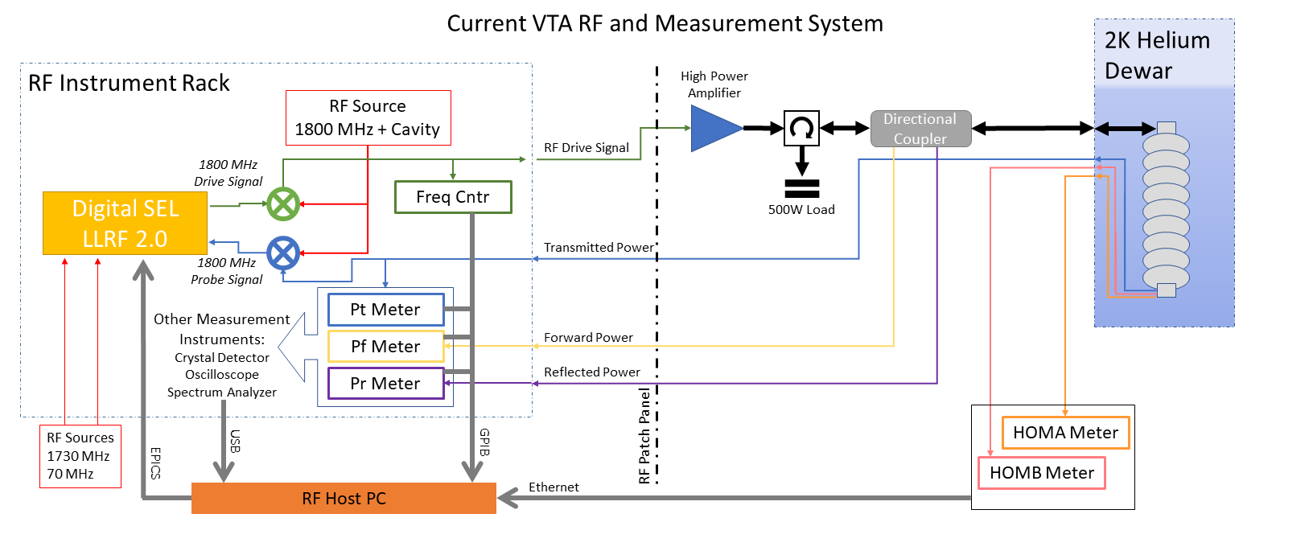
Backup figures

