Slide 1
Enhancement of Energy and Operational Flexibility for 22 GeV CEBAF
Donish Khan On Behalf Of Salim Ogur
Alex Bogacz
Bamunuvita Gamage

Slide 2
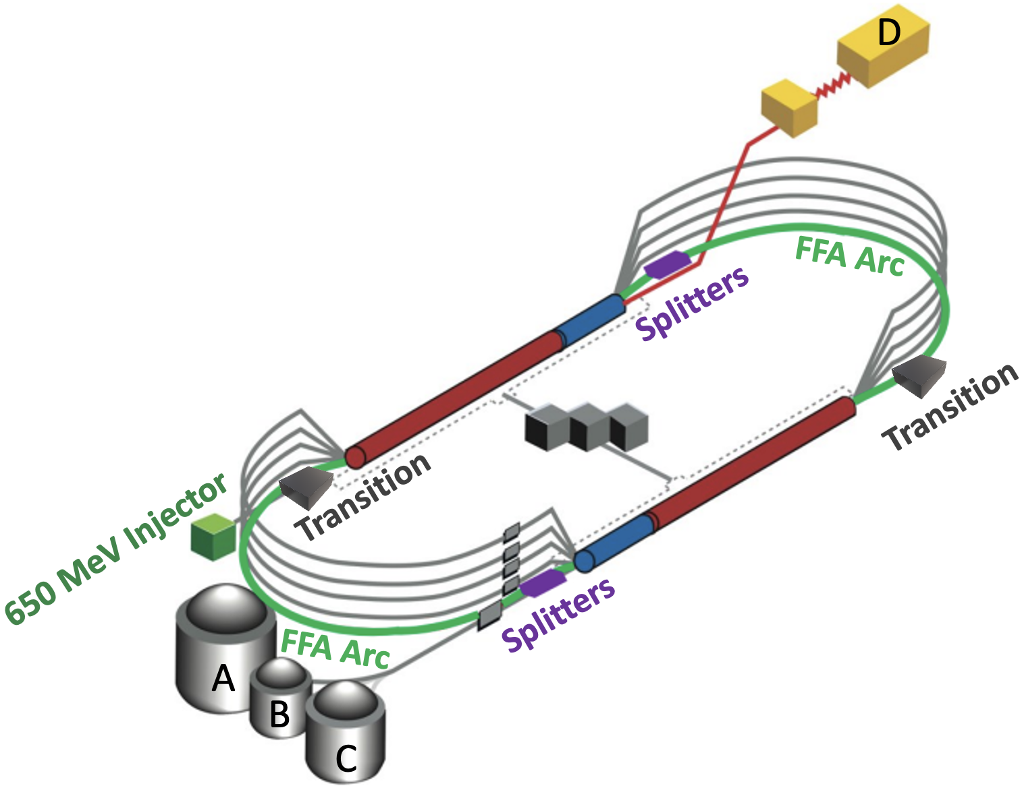
Proposal Background
Our proposal focuses on the 22 GeV CEBAF upgrade and addresses JLAB’s Accelerator S&T initiative!
We will look to enhance the energy and operational flexibility of the current 22 GeV CEBAF beam transport
Current energy acceptance is 1%
Goal energy acceptance is 10%
Modification of the Fixed-Field Alternating (FFA) gradient arc’s lattice:
Using a Flexible Momentum Compaction (FMC) structure
Incorporating higher-order magnetic field components into the FFA permanent magnets.
Main Focus
FFA Arc
Splitters
Transition

Slide 3
Project Scope
Our project’s scope can be organized into 3 categories:
Enhance 22 GeV CEBAF’s energy and operational flexibility
Theoretical and Simulation Studies
Compatibility and Integration Studies
Modification of FFA Permanent Magnets

Slide 4
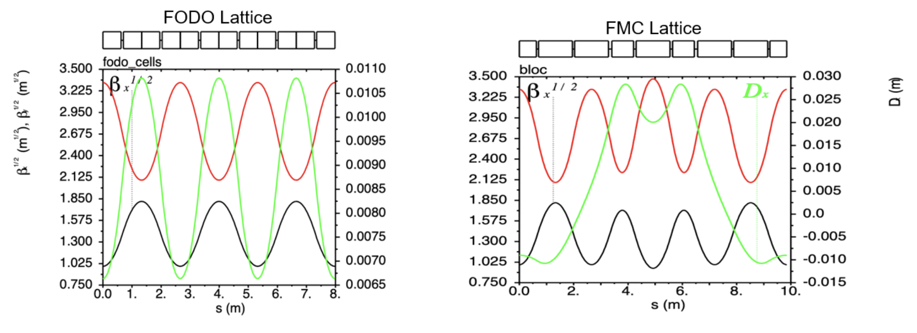
Project Scope 1: Theoretical and Simulation Studies
Theoretical and Simulation Studies:
Modify the FFA arc lattice using an FMC structure.
Translate the redesigned lattice optics into simulation codes (Bmad, ELEGANT, OptiMX).
Conduct consequent studies on dynamic aperture, betatron tunes, error tolerance, orbit correction, collective effects, and energy acceptance.
Notice the FMC dispersion, $D_{x}$ it’s bipolar and isochronous! Expected to relax the conditions of the adjacent Splitter/Transition sections

Slide 5
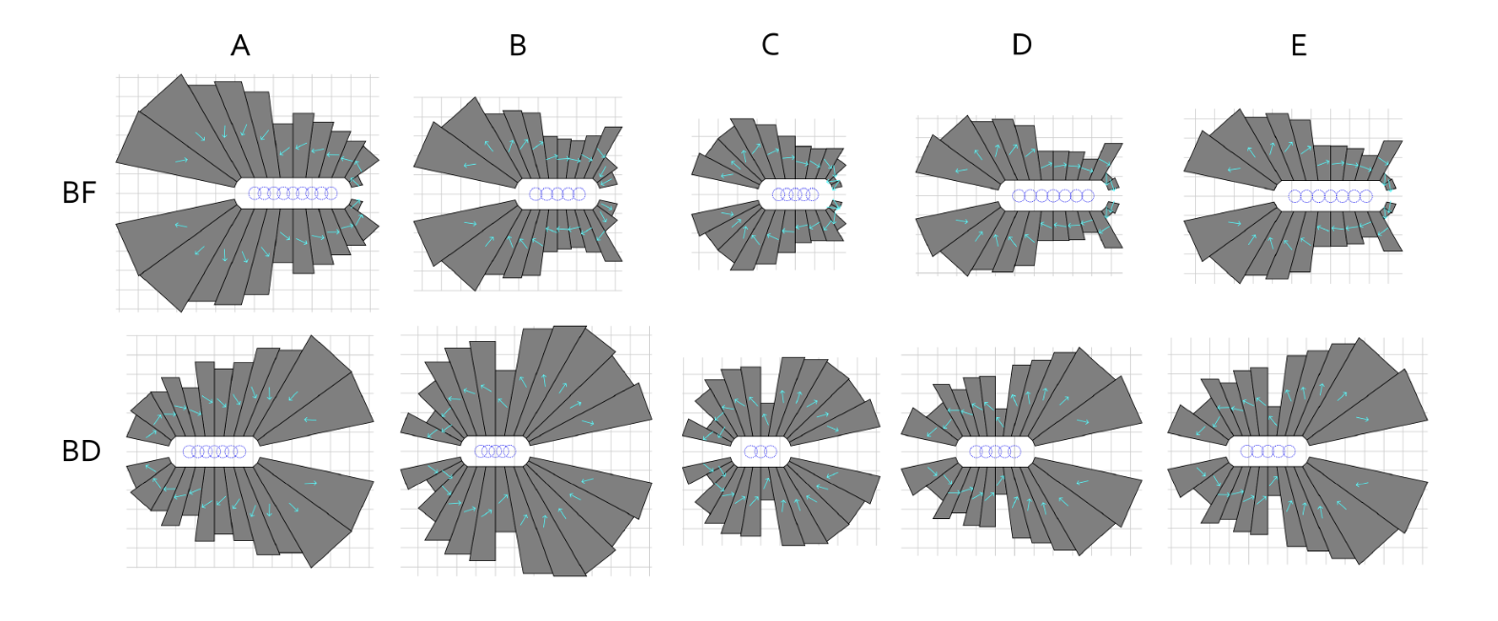
Project Scope 2: Modify FFA Permanent Magnets
Modification of FFA Permanent Magnets:
Model FFA permanent magnets using higher-order magnetic field components (i.e. sextupole).
Optimize the geometric design of the magnets using in-house tools and collaboration with Brookhaven National Laboratory (BNL).
First-Order Layouts
Higher-Order Layouts
Initial magnet designs have shown to increase FFA’s energy aperture!
To scale
To scale

Slide 6
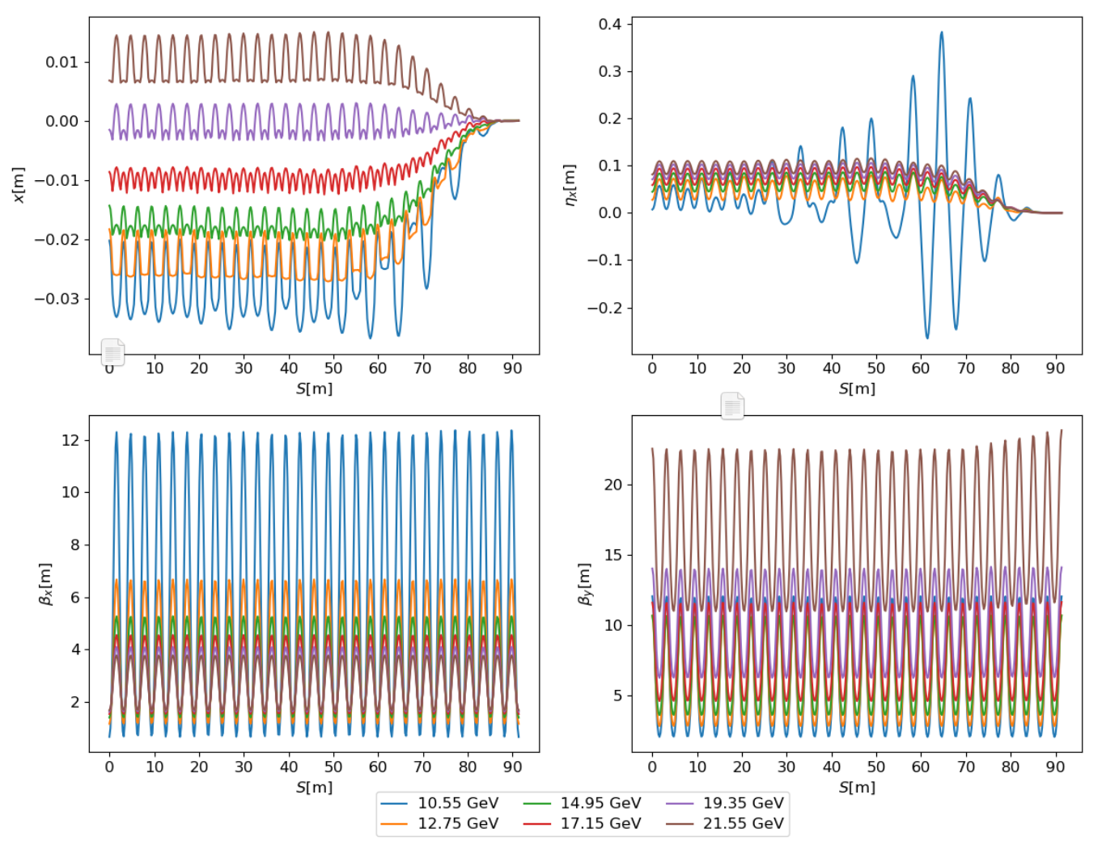
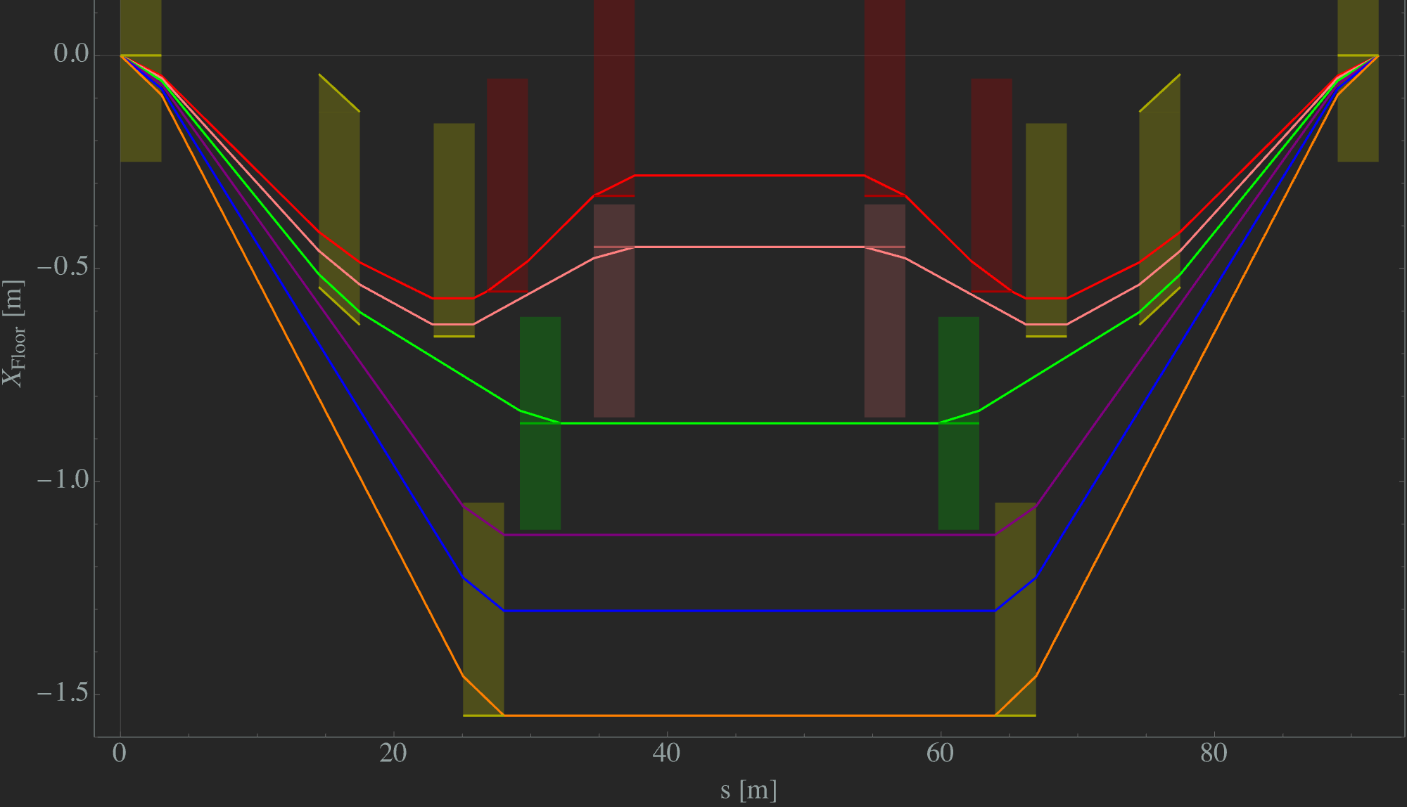
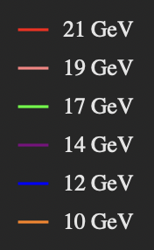
Project Scope 3: Compatibility and Integration Studies
Compatibility and Integration Studies:
Ensure compatibility of the modified FFA lattice with the rest of the CEBAF beam transport systems.
Tune the Splitter and Transition beamlines to match the new FFA optics; expected to alleviate matching workload.
Perform pseudo start-to-end (S2E) simulations to evaluate the impact of the new FFA arcs on the entire accelerator system
SPLITTERS
TRANSITION

Slide 7
Milestones & Deliverables
FY25
Q1
Q2
Q3
Q4
Theoretical study of FFA optics; FMC lattice
FMC lattice impact on Splitter/Transition
Explore higher-order magnetic components in permanent magnet
Complete Splitter & Transition retune
Complete radiative effects and update 22 GeV lattice repository
Complete Orbit correction & error tolerance simulations
Characterize beam quality & optimize
Characterize FFA arc
Q1
Q2
Q3
Q4
FY26

Slide 8
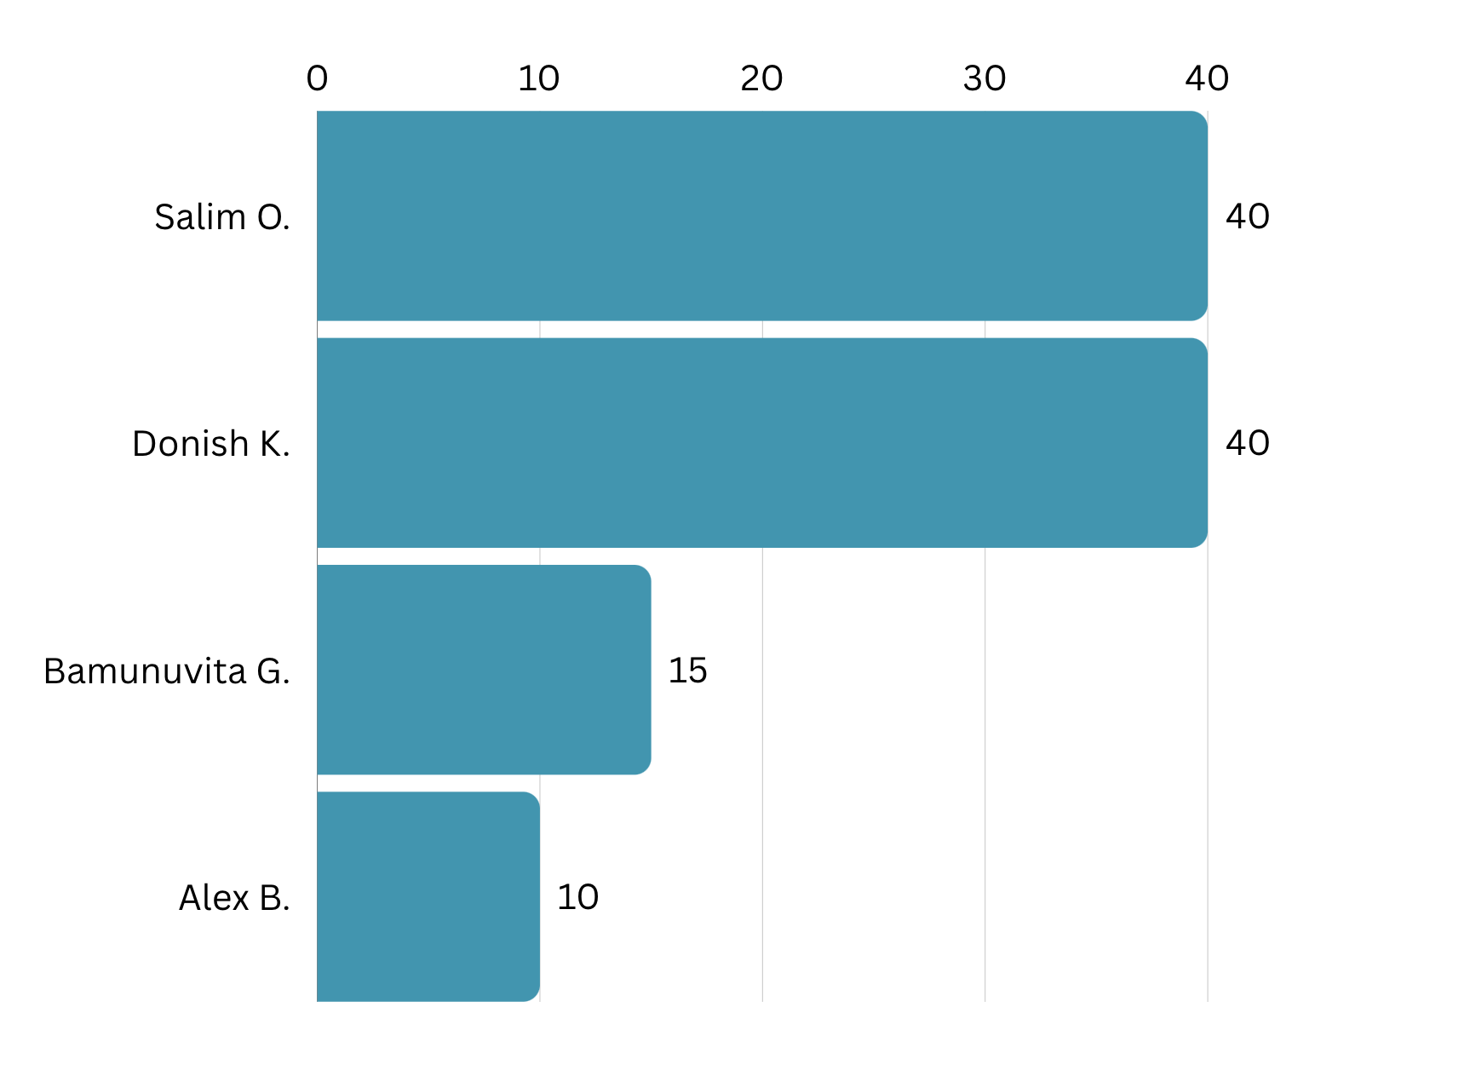
Meet The Team
FTE % Effort For FY25-FY26
Salim Ogur (Principal Investigator):
Manage the project, perform theoretical calculations, design work, and assist with simulations.
Donish Khan (Co-Investigator):
Deputy for oversight, perform design work, and provide simulation support. Splitters SME.
Randi Gamage (Co-Investigator):
Perform design work, simulations, and calculations. Transition SME.
Alex Bogacz (Co-Investigator):
Provide general guidance and senior expertise in accelerator beam optics and lattice design.
Software: Bmad, ELEGANT, OptiMX, HalbachArea

