Slide 1
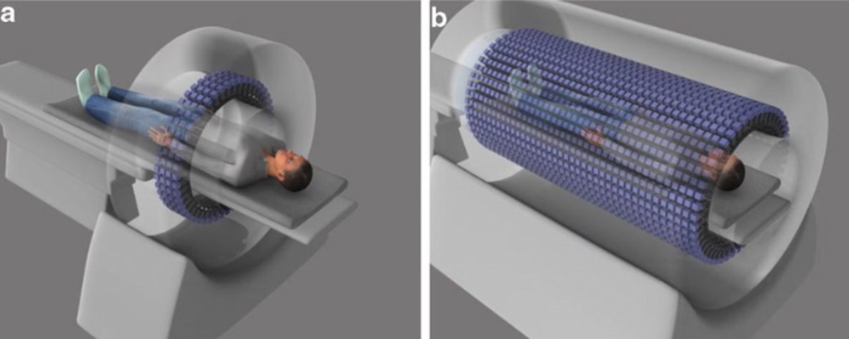
Implementation and Capability Testing of Scalable Streaming Readout Data Acquisition and Analysis Architecture for Medical Imaging
Towards Modular Human Total-body Positron-Emission Tomography (PET)
LYSO Pixel
F-18
LYSO Pixel
State of the art Total-Body PET
Cartoon of fluorodeoxyglucose (FDG) e⁺ annihilation, two 511 keV γ's coincident in detectors for tomography
Cameron Clarke, BRIC Staff Scientist
Radiation Detector & Imaging (RD&I) Group
LDRD - July 26, 2024
Standard Phototube
Standard Phototube
Standard Phototube
Standard Phototube
Position sensitive phototube
Position sensitive phototube
Position sensitive phototube
Position sensitive phototube
SiPM array
SiPM array
SiPM array
SiPM array

Slide 2
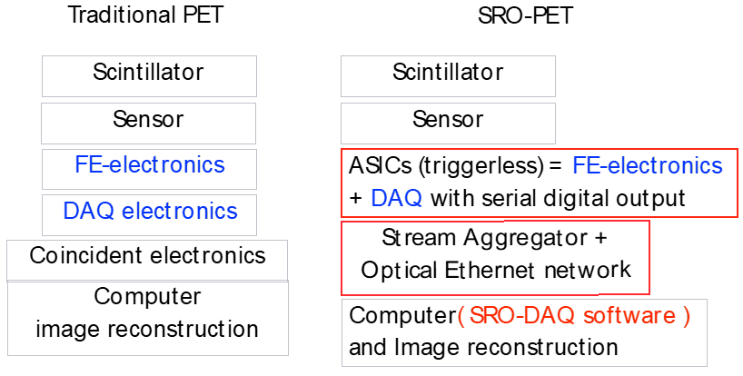
Project Description: SRO PET System Development
What is the problem?
PET measures functional behavior in the body → F-18 uptake
Challenge of PET is to minimize dose, maintain diagnostics
Total-body pet involves O(10⁴) detectors, O(10⁶) pixels
Traditional PET data handling:
  Based on fixed L2 triggers
  Coincidence analysis inflexibly limits output data
What we propose to do to address this:
Streaming Read-Out (SRO) Data Acquisition (DAQ)
Parallelized and distributed coincidence analysis
Deployed with a prototype modular PET detector system
Performing system scaling capability testing
Schematic showing difference of traditional, triggered PET coincidence DAQ vs. SRO paradigm
→ SRO shifts to Application Specific Integrated Circuit (ASIC) and FPGA-based DAQ and software distributed analysis
2

Slide 3
Project Description: SRO PET System Development
The project's novelty, innovation, and value is:
Leverages JLab ’s advanced Nuclear Physics DAQ techniques
Implements modern high-performance computing for parallelized real-time analysis
Fosters collaboration between JLab support groups
Develops modular PET systems moving away from hardware DAQ and coincidence processing
Furthers Biomedical Research and Innovation Center's (BRIC) mission promoting biomedical applications
Produces a demonstration architecture and system – a platform for future funding and science
3

Slide 4
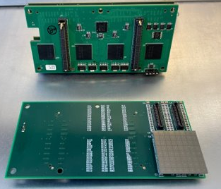
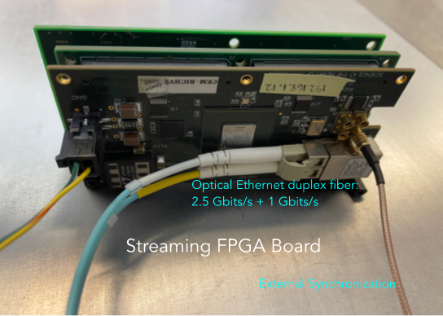
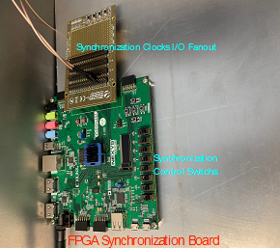
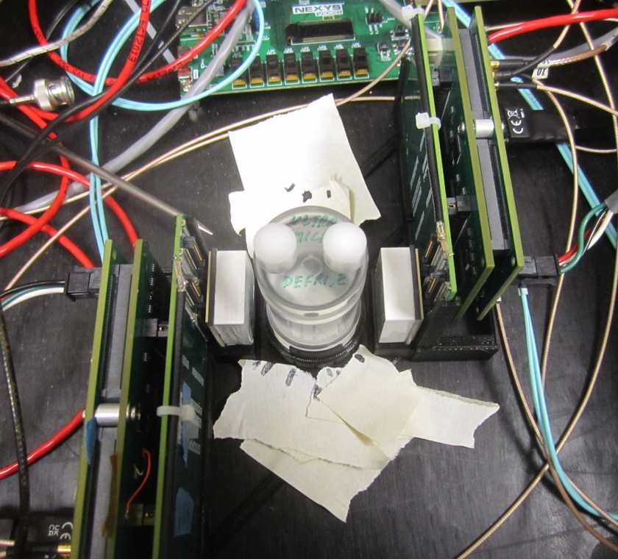
Project Description: SRO PET System Development
How: Collaboration amongst 3 key JLab support groups
Radiation Detector and Imaging (RD&I) group
  Build on RD&I group's prototype PET detectors and data streaming system
Experimental Physics Software and Computing Infrastructure (EPSCI) group
  Utilize EPSCI's SRO "Environment for Real-time Streaming, Acquisition, and Processing" (ERSAP) architecture
Fast Electronics and Data Acquisition (FEDAQ) group
  Applying FEDAQ expertise with ASICs and FPGAs
128 (32 x 4) channels
PetiROC ASIC board
Prototype PETIROC
Sensor board
Prototype SRO PET detector – Silicon Photo-Multiplier (SiPM) and PETIROC ASIC readout
FPGA based PETIROC data stream production
FPGA synchronization board to manage array of detectors' coincidence timing
2 Prototype PET detectors set up in coincidence around a rotating FDG phantom at University of Maryland Baltimore (UMAB) School of Medicine
4

Slide 5
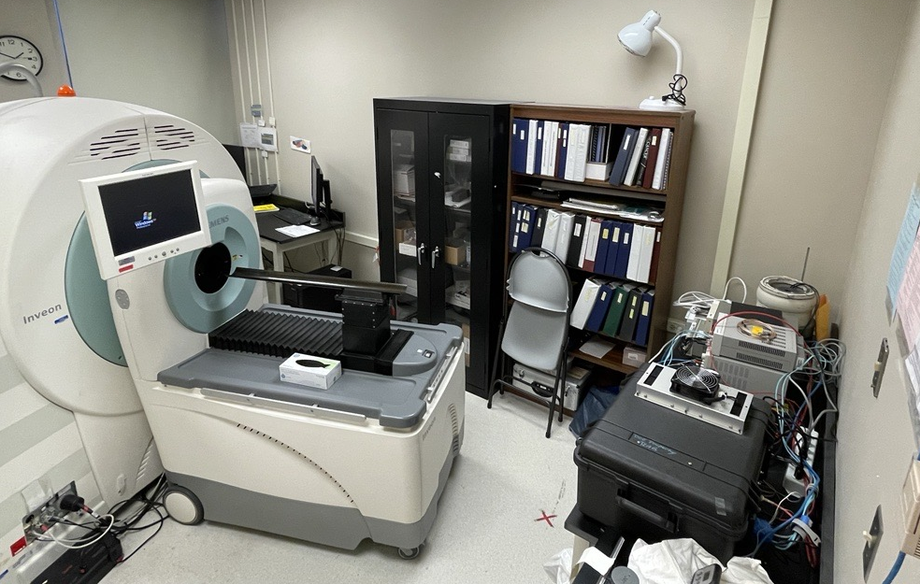
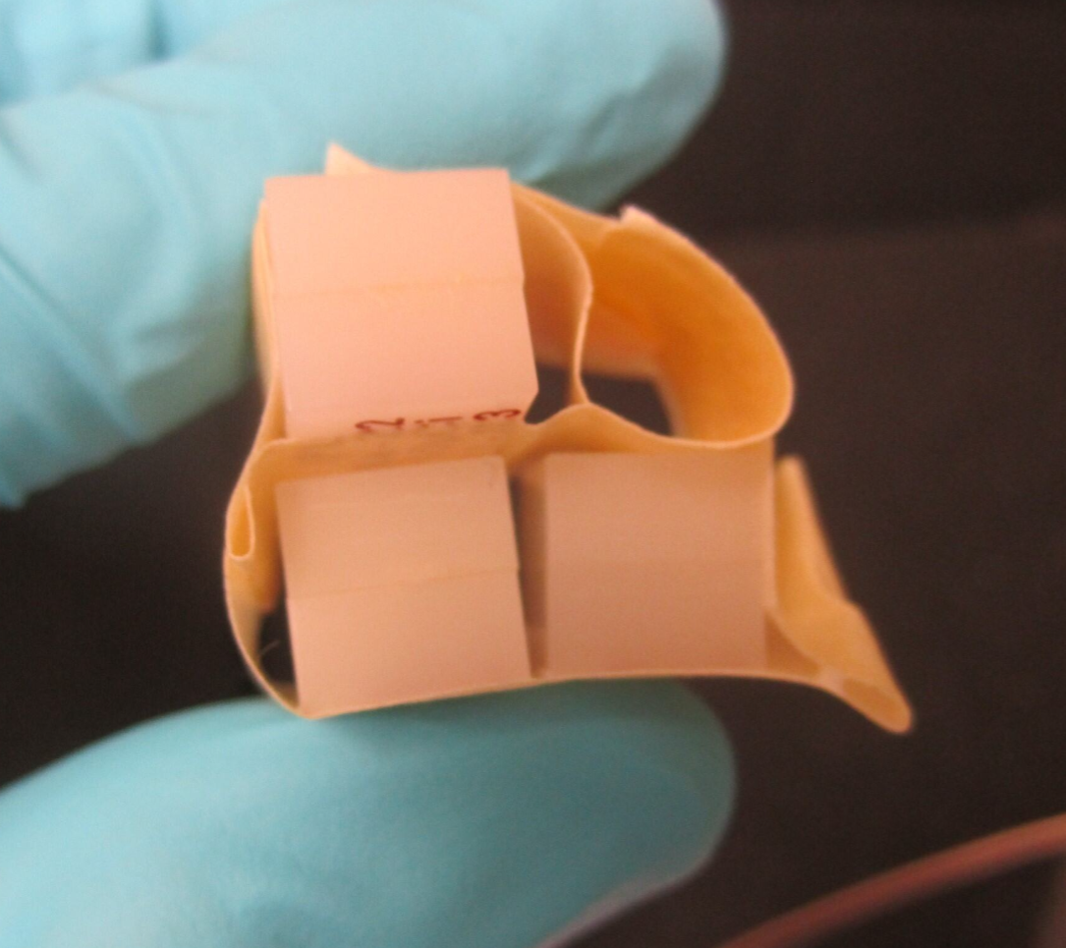
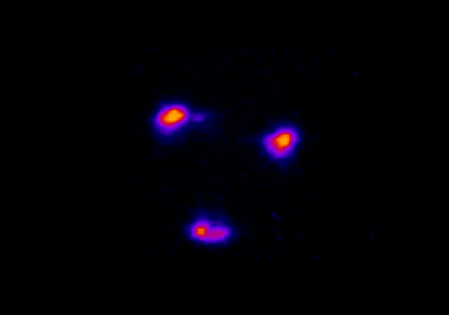
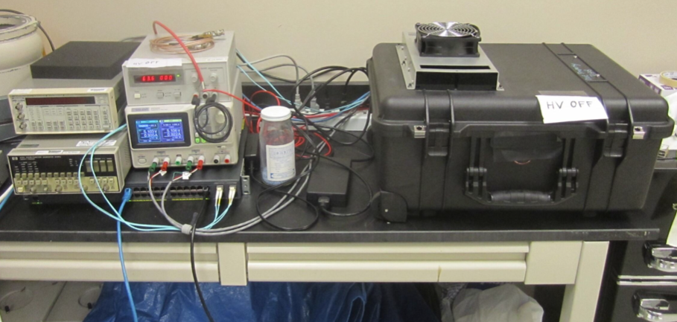
Project Description: SRO PET System Development
When:
3-part scope over 2 years:
  1) Year 1: Design ERSAP PET SRO implementation based on RD&I Kmax system
  2) Year 1: Design modular array detectors based on RD&I PETIROC ASIC prototypes
  3a) Year 2: Assemble and deploy modular PET array, verify imaging performance at UMAB
  3b) Year 2: Study detector geometry scaling with distributed high-performance computing (HPC)
Where:
JLab RD&I group lab in the ARC Building
UMAB School of Medicine
3D image reconstruction (from Seung Joon Lee)
RD&I group's SRO PET test-set up at UMAB School of Medicine core imaging facility in June 2024
Siemens Inveon PET/CT small animal reference system (left) and JLab SRO PET prototype (right)
Example: 4-point source configuration
5

Slide 6
Team
Role | Person | Capacity | Scope | FTE FY 25 | FTE FY 26
PI: | Cameron Clarke | BRIC scientist | 1, 2, 3 | 40% | 40%
Co-I: | Wenze Xi | Medical imaging scientist | 1, 3 | 10% | 10%
Principle developer: | John McKisson | Software engineer | 1, 2, 3 | 25% | 25%
Engineering support: | Seung Joon Lee | Biomedical engineer | 2, 3 | 2.5% | 2.5%
Electronics developer: | Benjamin Raydo | Electronics engineer | 1, 2 | 15% | 0%
Software developer: | Vardan Gyurjyan | DAQ scientist | 1 | 15% | 0%
Advisor – Computing: | David Lawrence | EPSCI group leader | Advisor | - | -
Advisor – Imaging: | Drew Weisenberger | RD&I group leader | Advisor | - | -
Advisor – Imaging: | Eric Christy | Nuclear scientist | Advisor | - | -
6

Slide 7
Deliverables
Deliverables – milestones and timeline:
Three primary aims
  Implement ERSAP to existing SRO PET detectors, DAQ, and analysis system in FY 25
  Design and build improved version of modular PETIROC ASIC PET detectors in FY 25
  Deploy detector array, perform imaging and parallelized scaling tests with distributed computing in FY 26
Year 1 |  |  | Year 2
1) | Implement ERSAP in FY 25: Implement FPGA based PETIROC signal digitization Factorize analysis components into ERSAP microservices Reproduce old system performance with ERSAP-based system Develop vertical multi-threaded, horizontal multi-node scaling | FY 2025: Month 3 Month 6 Month 9 Month 12 | 3) | Deploy detector array, imaging and parallelized scaling tests in FY 26: Procure and test new detector front-ends Integrate modular 8-detector array with new SRO system Verify detector and imaging performance for new system Deploy the system and perform phantom imaging tests at UMAB Finalize reports on local and farm streaming scalability tests | FY 2026: Month 3 Month 3 Month 6 Month 6 Month 12
2) | Design and build modular PETIROC ASIC PET detectors in FY 25: Optimize FPGA multi-detector readout firmware Optimize detector power supply and readout cabling Design and order new PETIROC modular detector PCBs Get electronics parts, build, and test 8 new detector front-ends | FY 2025: Month 3 Month 3 Month 6 Month 12
7

Slide 8
Budget
Budget: $476.7 for the total project
FY 25 – Total = $251.7k
  Personnel: $218.5k
  Travel: $3k for conferences
  Equipment:
    $10.5k - 10/100Gbps multi-channel fiber network switch
  Materials: $18k
    $3k - Printed Circuit Board NRE
    $1k - Detector Printed Circuit Boards purchases
    $3k - Detector Assembly Board NRE
    $1k - Detector Assembly Board purchases
    $8k - PETIROC ASICs
    $2k - Detector components
FY 26 – Total = $225.0k
  Personnel: $142.6k
  Travel: $19.5k for conferences, $4.5k for imaging tests at UMAB travel
  Materials: $50k
    $24k - SiPMs
    $24k - LYSO
    $2k - Power Supplies
  Contracts:
    $5k – UMAB imaging and radiopharmaceutical source
8

Slide 9
Conclusion
SRO PET project is ready – will provide a valuable platform and capability projection:
Builds off existing RD&I and FEDAQ collaboration
  Based on FEDAQ work from Hall B Alert TOF detector
  Extends recent work at UMAB with RD&I Kmax DAQ and PETIROC ASIC detector SRO PET system
Develops collaborations between RD&I, EPSCI, and FEDAQ groups
Directly supports BRIC mission
  Applies JLab technologies to biomedical applications
  Expands development avenues of JLab technologies
  Results in a well-characterized, modular, easily reconfigurable imaging platform
Resulting platform is attractive for future funding:
  Grants from DOE Biological and Environmental Research (BER)
  Grants from NIH National Institute of Biomedical Imaging and Bioengineering (NIBIB), NCI, etc.
  Industry partners, facilitated through RD&I group and BRIC:
    Hospitals seeking imaging, dosimetry, or quality assurance applications
    Industry partners with detector, front-end electronics, or other related development
    Collaborations for pre-clinical imaging system development
9

Slide 10



Project Description: SRO PET System Development
Why – strategic value and impact to the lab's mission:
To follow up on BRIC NIH/DOE joint workshops in 2021 and 2023
To explore modern DAQ and analysis outside of hall physics
To apply JLab's technology to biomedicine in service of BRIC mission
To enable medical imaging system research at JLab with the BRIC:
  PET detector basic research
  DAQ and analysis configuration platform
  Hadron-beam radiotherapy QA capabilities – real-time PET diagnostics
  Total-Body PET systems
To attract outside industry or
funding agency partnerships
BRIC serves as a clearinghouse for biomedical applications, partnerships, and technology transfer at JLab
Report from the first NIH/DOE Joint Workshop (2021)
BRIC Ribbon Cutting, March 24, 2023
10

Slide 11
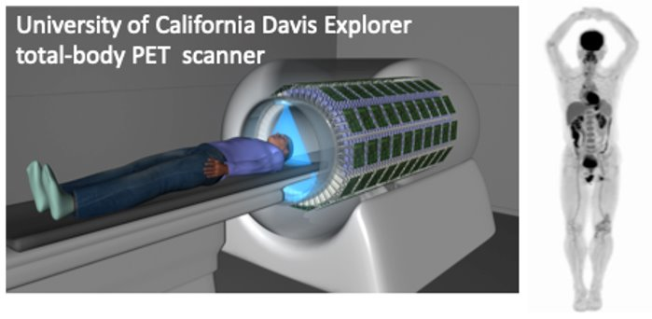
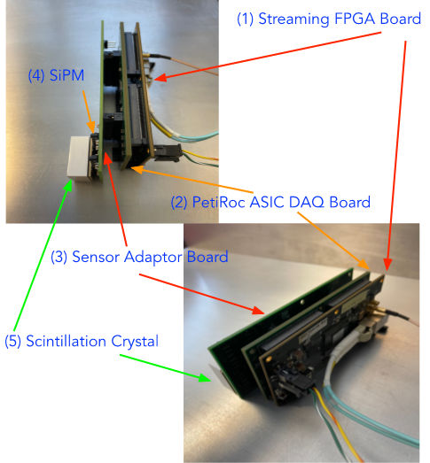
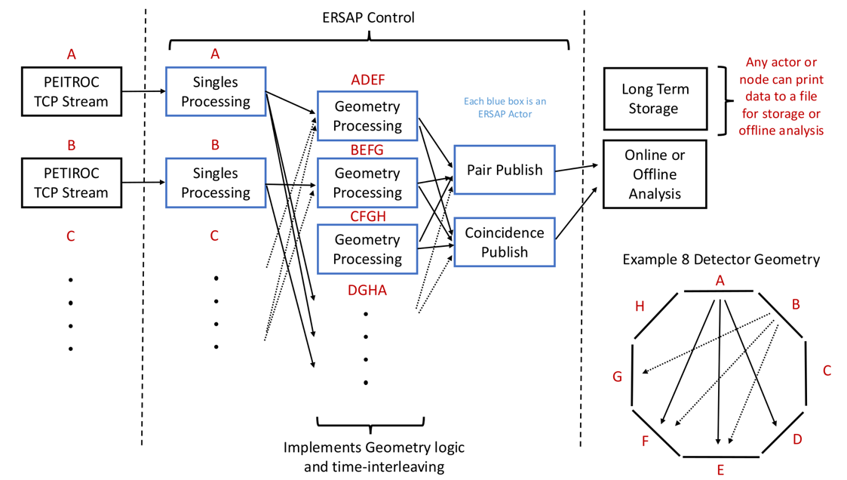
Project Description: SRO PET System Development
What:
SRO DAQ and parallelized PET analysis implementation
Deployed with a new prototype PET detector system
LYSO Pixel
F-18
Schematic showing difference of traditional, triggered PET coincidence DAQ vs. Streaming Read-Out (SRO) DAQ paradigm
LYSO Pixel
Cartoon of positron annihilation and two 511 keV gammas coincident in crystal scintillator measurements for tomography
Rendering of UC Davis EXPLORER system (left) and a representative total-body PET scan (right)
FEDAQ: Fast Electronics and Data Acquisition group
Benjamin Raydo represent the FEDAQ group on this proposal
LYSO: Lutetium-yttrium oxyorthosilicate
Used as the sensitive detector for gamma conversion to optical photons
SiPM: Silicon Photo-Multiplier
Multi-pixel analog optical photon signal conversion and amplification device, feeds to ASIC
PETIROC: An application specific integrated circuit (ASIC) used for SiPM signal processing
PETIROC is tuned to work well for PET where sub-nanosecond timing resolution is needed
8-detector geometry configuration to test horizontal and vertical SRO PET parallelization
LYSO, SiPM, PETIROC ASIC, and FPGA based PET detector prototype developed for RD&I group's SRO PET prototype system
11

Slide 12
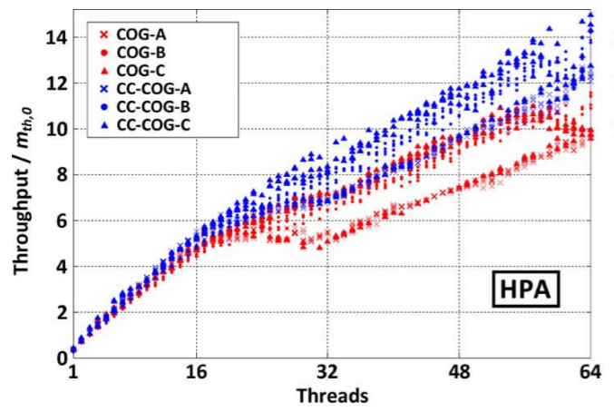
Project Description: SRO PET System Development
What:
SRO DAQ and parallelized PET analysis implementation
Deployed with a new prototype PET detector system
Performing system scaling capability testing
LYSO Pixel
F-18
LYSO Pixel
Schematic showing difference of traditional, triggered PET coincidence DAQ vs. Streaming Read-Out (SRO) DAQ paradigm
Cartoon of positron annihilation and two 511 keV gammas coincident in crystal scintillator measurements for tomography
Rendering of UC Davis EXPLORER system (left) and a representative total-body PET scan (right)
Goldschmidt, et al. "Towards software-based real-time singles and coincidence processing of digital PET detector raw data." IEEE Transactions on Nuclear Science 60, no. 3 (2013): 1550-1559.
Multi-threaded PET analysis scaling performance for Philips' digital SiPM "EXPLORER" development
8-detector geometry configuration to test horizontal and vertical SRO PET parallelization
12

Slide 13
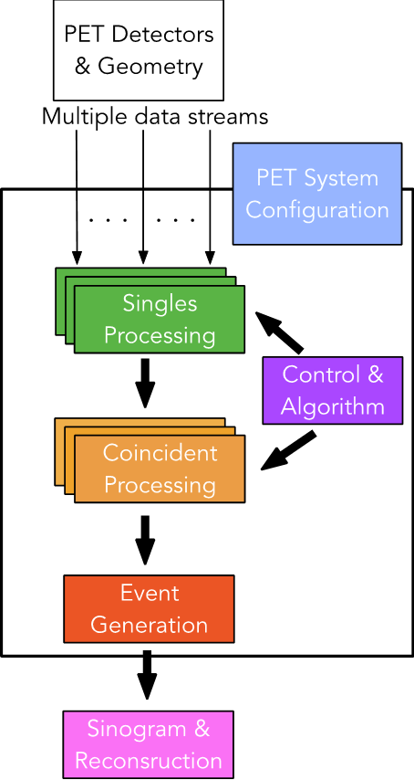
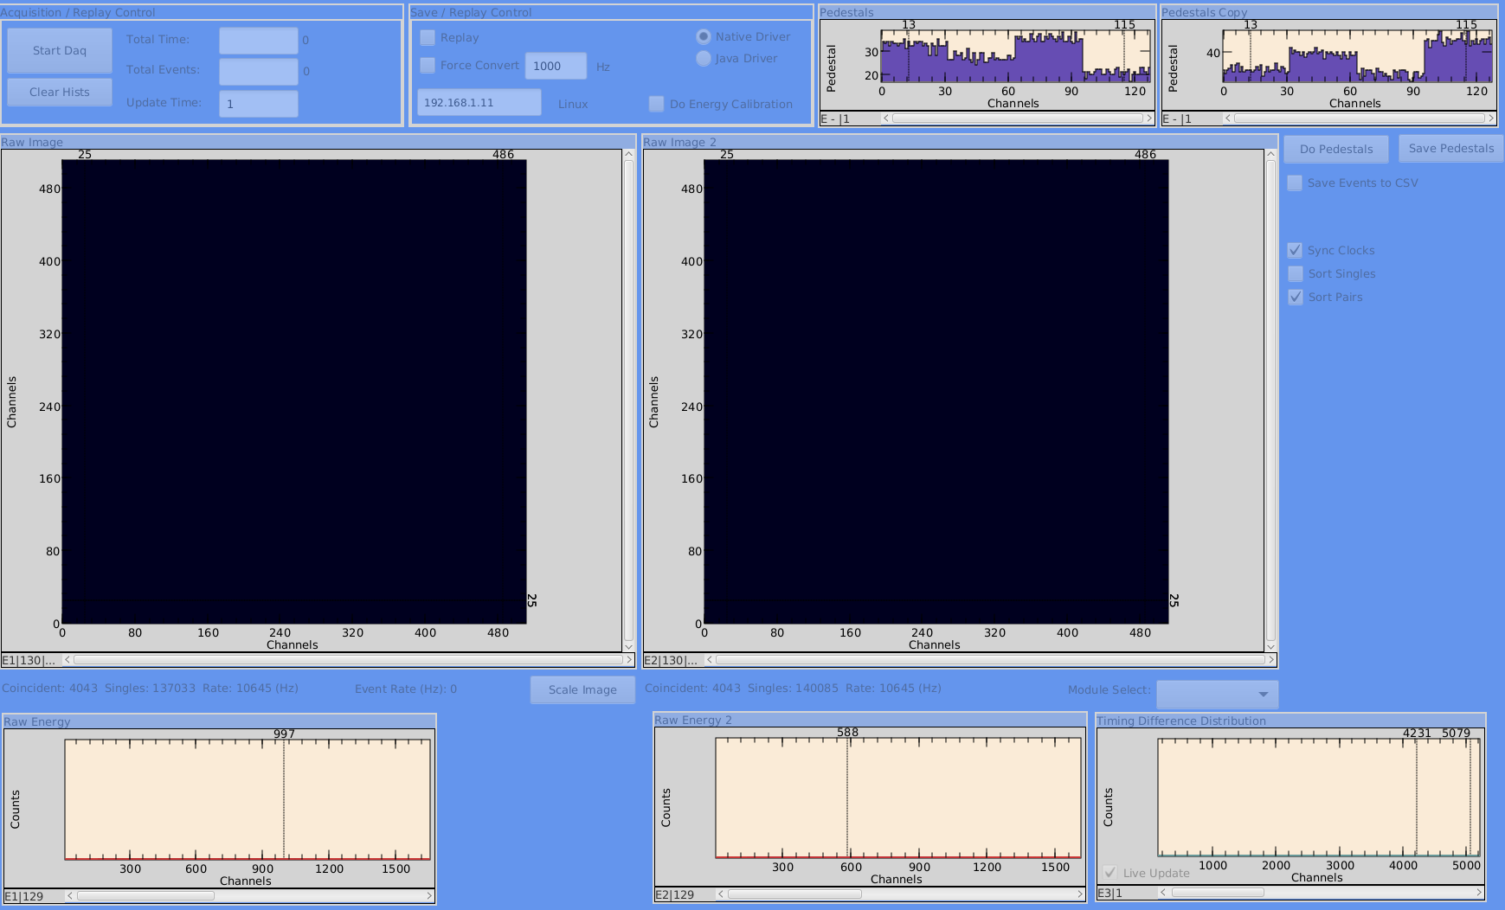
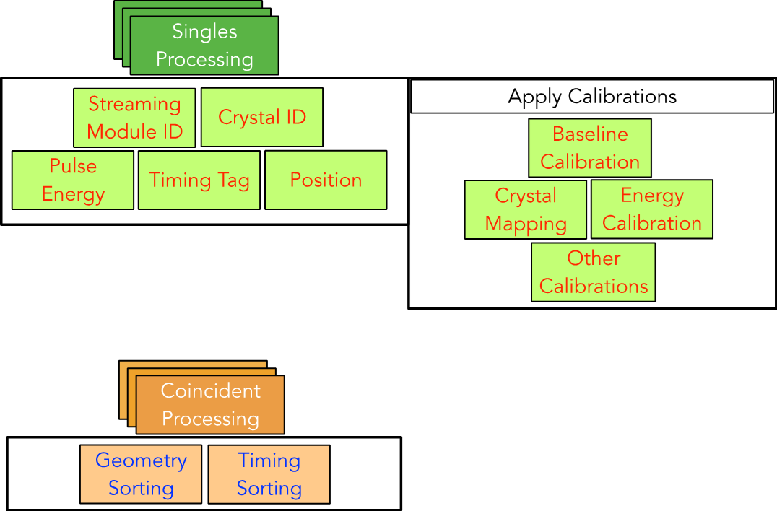
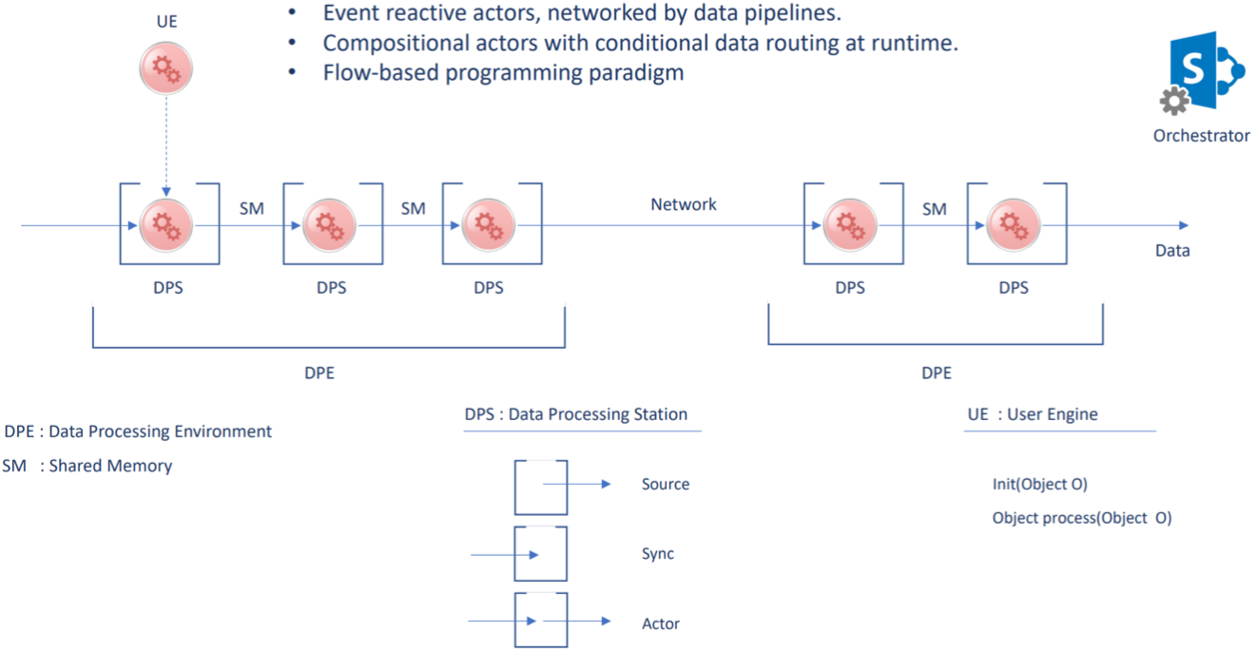
Project Description: SRO PET System Development
How:
Building on RD&I group's prototype PET detectors and data streaming system
Utilizing EPSCI group's SRO ERSAP architecture
Applying FEDAQ expertise with ASICs and FPGAs
SRO-DAQ software trigger:
Calibration equivalent to
L1-level trigger
Kmax DAQ interface reading out PET detectors and performing real-time coincidence analysis
2 Prototype PET detectors set up in coincidence around a rotating FDG phantom at University of Maryland Baltimore (UMAB) School of Medicine
SRO-DAQ software trigger:
Coincident processing equivalent to
L2-level trigger
ERSAP example data-stream and analysis flow control
128 (32 x 4) channels
PetiROC ASIC board
Source
Prototype PETIROC
Sensor board
Sink
Actor
Experimental Physics Software and Computing Infrastructure (EPSCI) group's Environment for Real-time Streaming, Acquisition, and Processing (ERSAP)
13

Slide 14
Project Description: SRO PET System Development
ERSAP example data-stream and analysis flow control
Source
Sink
Actor
Experimental Physics Software and Computing Infrastructure (EPSCI) group's Environment for Real-time Streaming, Acquisition, and Processing (ERSAP)
14

Slide 15
Project Description: SRO PET System Development
SRO-DAQ software trigger:
Calibration equivalent to
L1-level trigger
SRO-DAQ software trigger:
Coincident processing equivalent to
L2-level trigger
Streaming Readout diagram for PET – implemented by RD&I group in Kmax
15

Slide 16
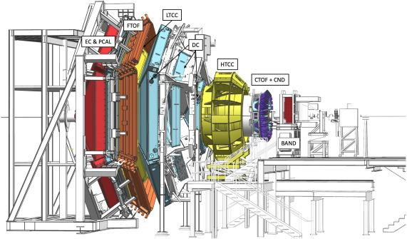

Streaming Readout Applications in JLAB
Streaming readout (SRO) comprises both:
  SRO-enabled hardware, and
  SRO-DAQ software
Latest JLab nuclear physics experiment with SRO:
  NEMO project, KM3NeT-ITA (Towers) project
  TriDAS software framework
TriDAS for SRO-DAQ software
Flexible on detector geometry, data format, and standalone L2 trigger algorithm
Multithreaded for many data streams
Reconstructs the events
Filters the data for the relevant events
*TriDAS model from Dr. Laura Capelli, et, al, INFN-CNAF, ”TriDAS”, Workshop X on Streaming Readout, May 19, 2022
16

Slide 17
Proposed ERSAP SRO Parallelized Architecture
Schematic diagram of the SRO DAQ (left of dashed lines), ERSAP stream handling and analysis architecture (between dashed lines), and octagonal detector configuration (bottom right).
17

