Slide 1
Broader Use Cases for Data Processing Units in HPDF-H Testbeds
Responding to JLab FY25 LDRD call for proposal
Xinxin ("Cissie") Mei

Slide 2
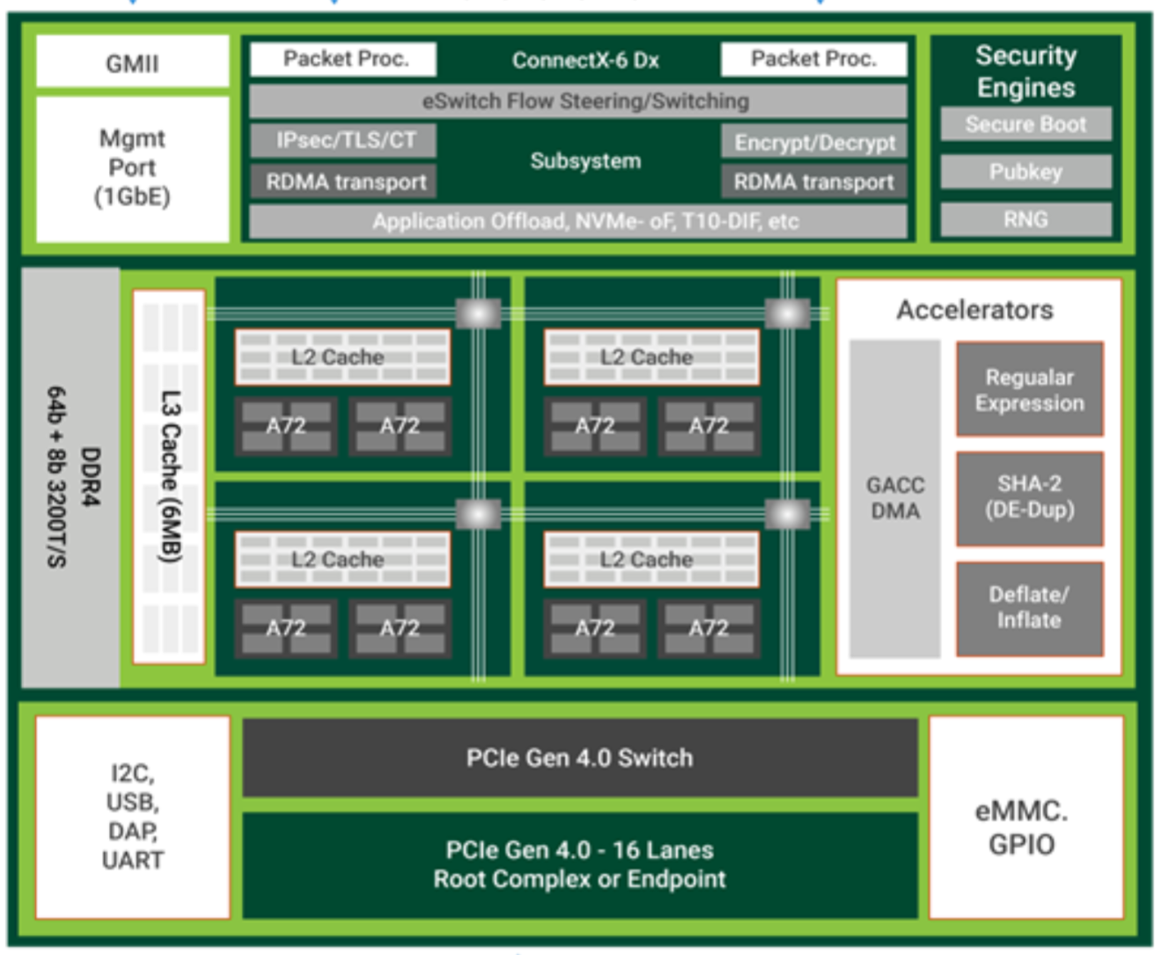
Background – Data Processing Units (DPUs)
Smart NICs + on-chip Arm CPUs & accelerators => DPUs
Traditional 100GbE NIC
 | CPU | DPU | GPU
Networking | ⭐️ ⭐️ | ⭐️ ⭐️ ⭐️ | ⭐️
Computing | ⭐️ ⭐️ | ⭐️ | ⭐️ ⭐️ ⭐️
Designed to offload data-intensive workloads from CPUs
More heterogenous data center
Tailored for data-intensive workloads, such as AI applications
Improve the overall data center efficiency
Smart resource utilization
Green computing
The block diagram of NVIDIA BlueField-2 DPU
Notes:
To begin with the story, let us first look at what is Data Processing Unit, aka, DPU? In the high performance computing data center, the network operates at a speed higher than 100 Gbps. The network interface cards, or NICs, capable of providing 100+ Gbps are often called smart NICs.
Nowadays, people begin to put CPUs and other hardware accelerators to the smart NIC, making it a small data processing unit.
We can look at the right side picture of this slide. It's the block diagram of an NVIDIA BlueField-2 DPU. On the top, inside this purple box, it's a traditional 100 GbE NIC. In the center, there are 8 Arm CPU cores and serval accelerator engines.
With these DPUs, the overall data center efficiency can be improved. The CPU resources are more devoted to the sequential complex computing tasks. And, we can get a higher throughput with a lower cost, as well as, conserve less energy.

Slide 3
Project Description
Leveraging Data Processing Units (DPUs) within the HPDF-H early testbed to enhance future HPDF monitoring and Kubernetes provisioning services.
Fine-grain telemetry​
Key technology:
eBPF (extended Berkeley Packet Filter), RD. 2014
DOCA (NVIDIA DPU software framework), RD. 2021
DPDK (Data Plane Development Kit), RD. 2010
...
Kubernetes deployment & offloading​​
Key technology:
Kubernetes, RD. 2015
Cilium (eBPF-based Networking, Observability, Security), RD.2017
...
Notes:
Now let's look back into our project. The overarching goal is to leverage the DPU within the HPDF early testbed to enhance future HPDF monitoring and Kubernetes provisioning services.
We have 2 sub-objectives. One is the fine-grain telemetry, the other is K8s deployment and offloading.
We are going to investigate emerging computer science technologies such as eBPF, DOCA, DPDK, Kubernetes, Cilium, etc

Slide 4
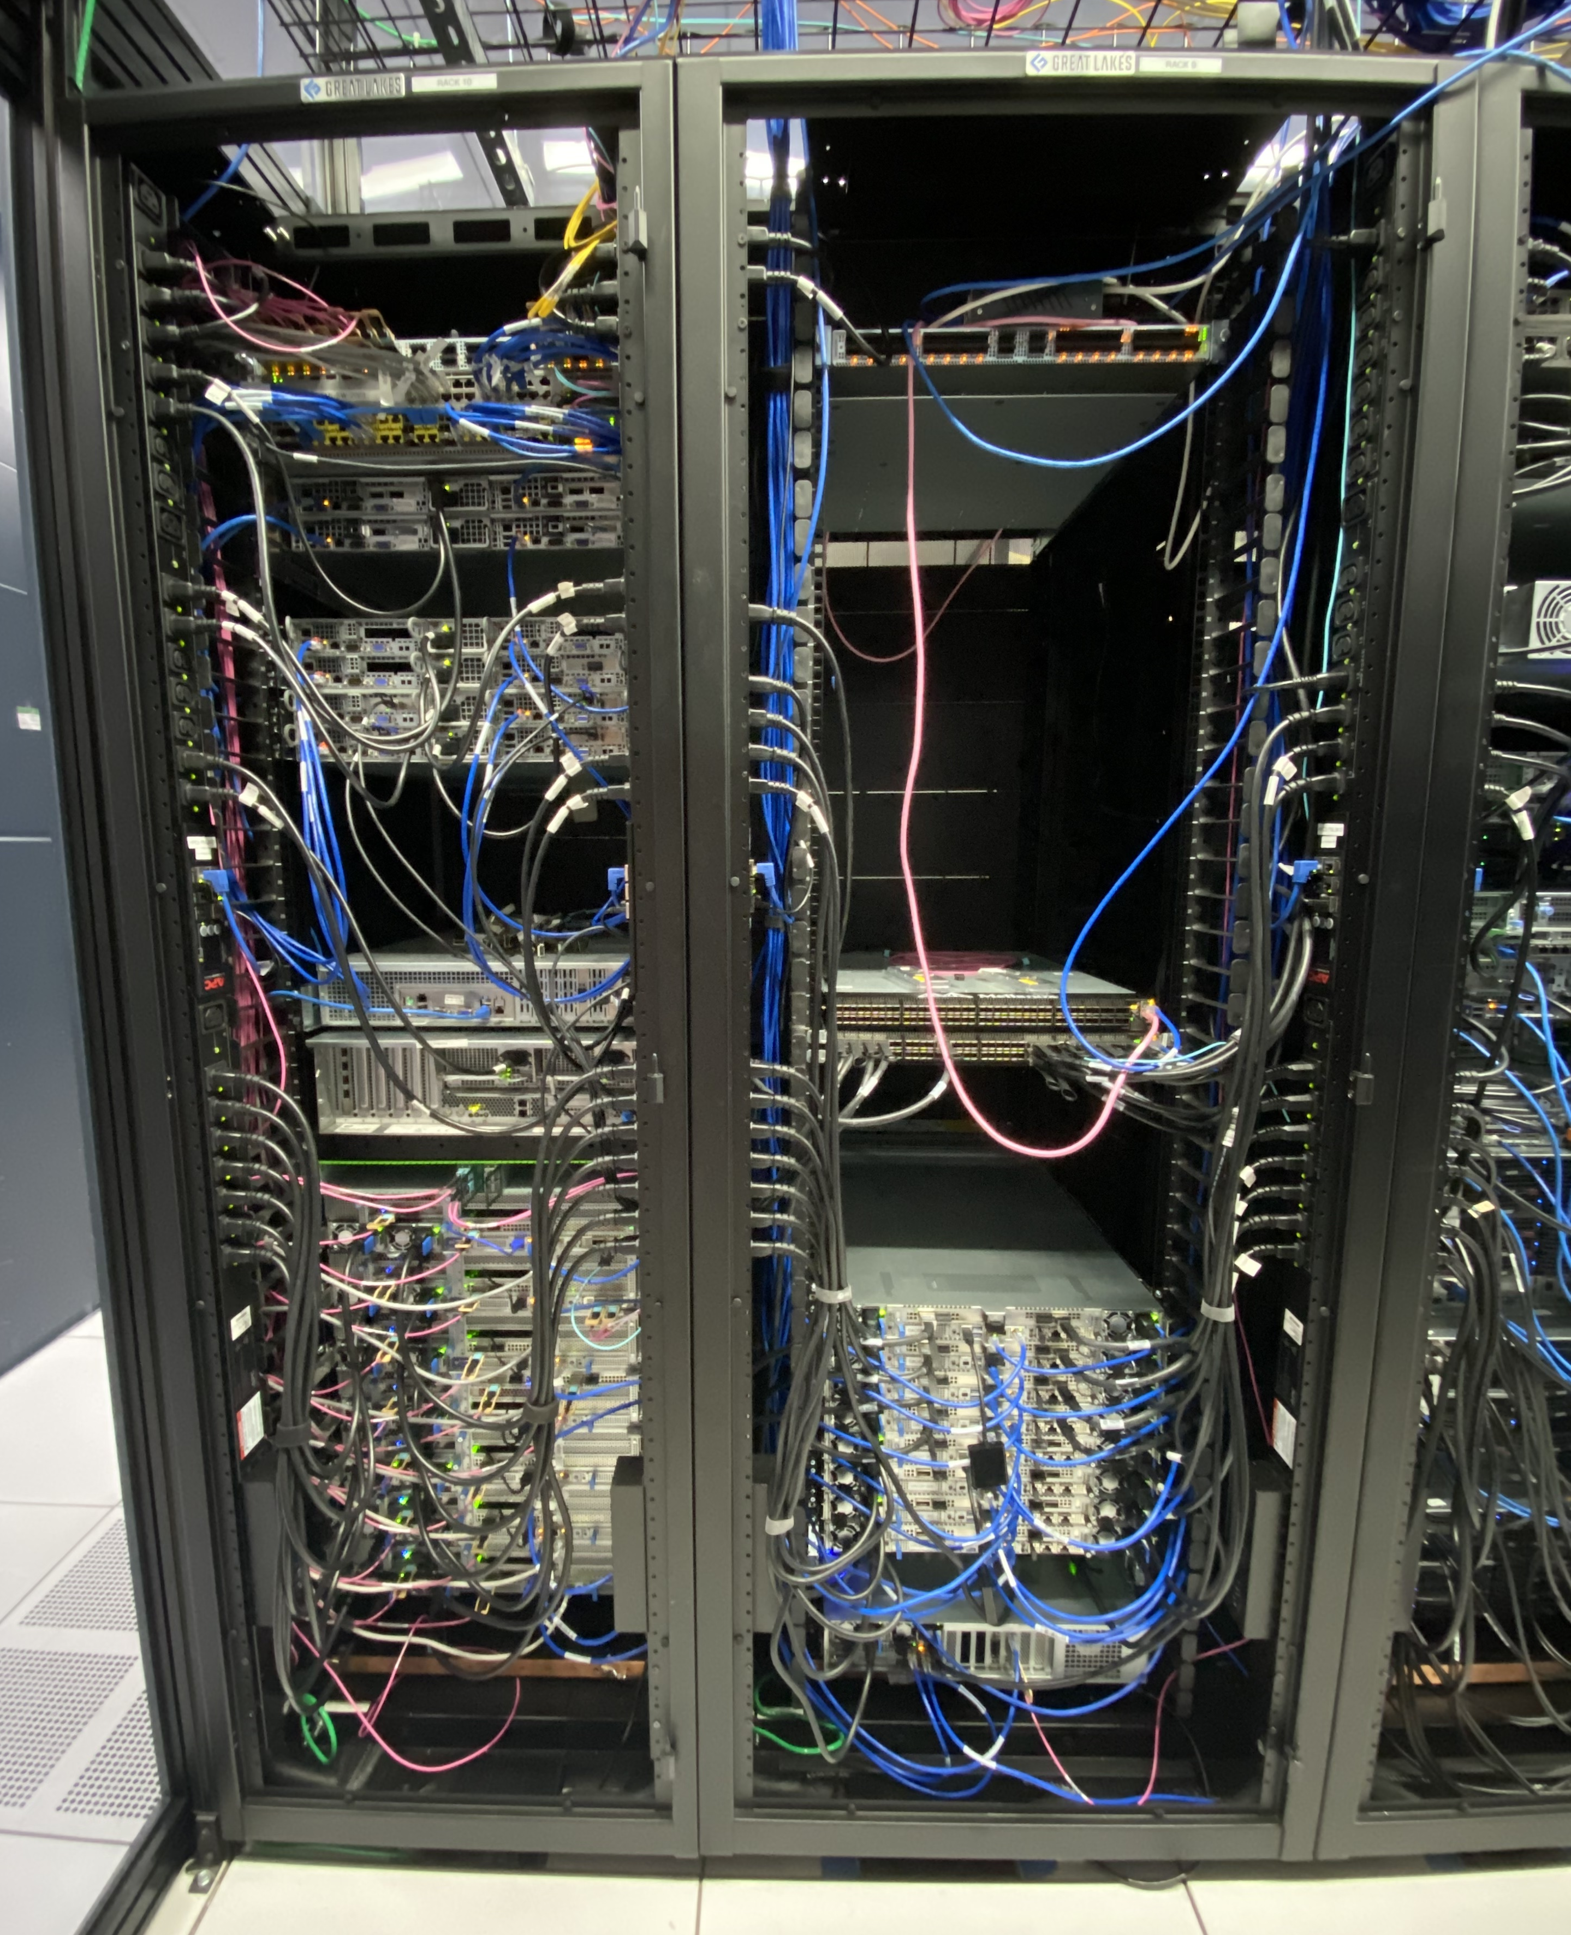
Scope
Current IRIAD testbed and its high-speed interconnection
Next-generation milli-second level telemetry demonstrator to match the future 400Gbps HPDF data transfer nodes.
Orchestration, auto management of HPDF data streaming services and DPU offloading.
Notes:
The right side is a picture of the current IRIAD or HPDF-H early testbed.
The left side rack is basically ejfat nodes, which serve as the data transfer nodes, or DTNs between JLab and ESnet. They are connected via the 100 GbE.
At the bottom of the right side rack, we have a heterogenous node "nvidarm", which is equipped with ARM CPUs, GPUs, and our spotlight guy, a BlueField-2 DPU.
Our scope is to explore this DPU node to deliver results on:
Next-generation ...
Orchestration, auto ...

Slide 5
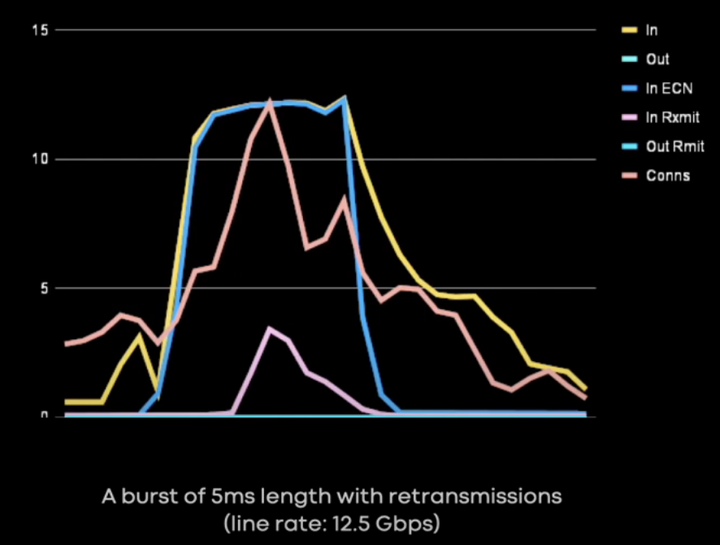
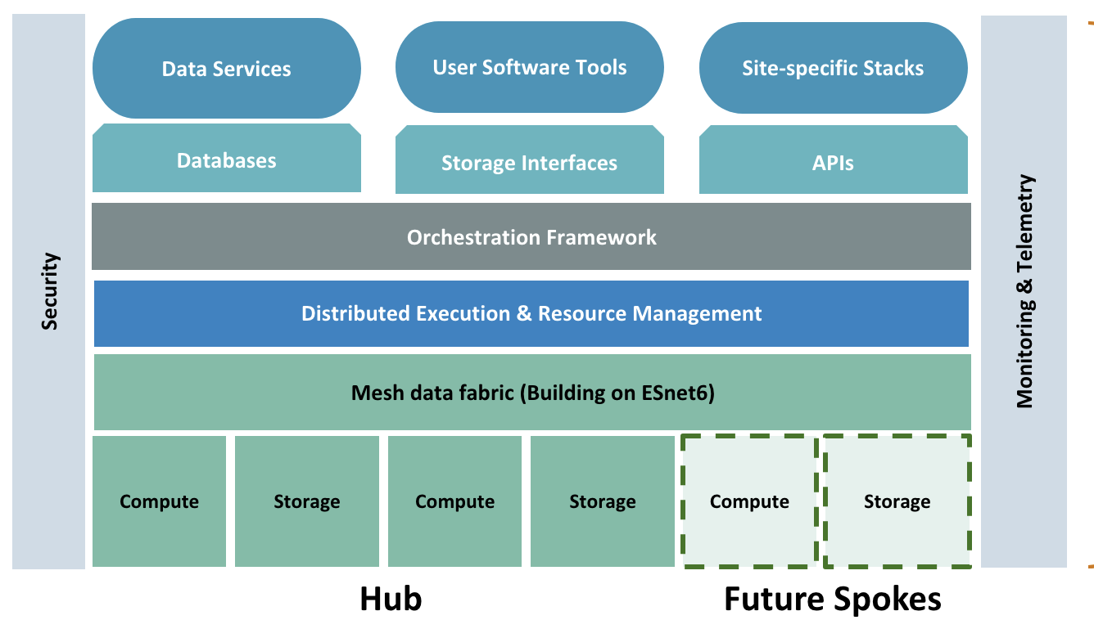
Impact
Data center management: microburst detection
Advanced HPDF software development
Network congestions occur at milli-second level!
Planned HPDF software stack
Notes:
Now let's look at the impact of this project.
First I am going to talk about why a fine-grain telemetry is necessary. The typical monitoring stack we use today strongly relies in Prometheus, which is both an Internet scraper and a time-series database. The scraper runs at a sampling interval varying from a few seconds to a few minutes. The larger the data center is, the coarser the time interval is. Which means that, when an incidents happened, we see it a few seconds later. But, as we can find from the left side picture, which depicts the real world case, the network congestions in the modern data centers are at millisecond level. Those are called microbursts and very common in modern data centers. With the existing Prometheus-based telemetry system, we are unable to detect such microbursts. This is why the IT domain is looking into next-generation network monitoring tools. The HPDF-H facility is expected to operate at 400 Gbps, a speed higher than most of the cloud platforms. We need a fine-grain telemetry system which is capable to detect the millisecond microbursts thus enable further actions.
The other impact is on the HPDF software development. The right side is the proposed software stack taken from the June HPDF tech handouts. Orchestration and telemetry are two main components in the stack. We are not satisfied with the basic implementation of these components. We look into a more efficient utilization of data center resources and push the R&D of cutting-edge computational technologies.

Slide 6
Strategy value to the Laboratory’s mission
Nuclear Physics Research: R&D leading to or supporting new scientific research directions and new generation of experiments which leverage existing TJNAF research areas or facilities, including investigations of scientific reach of electron scattering at higher energies or beam intensities. Proposals that would enable nuclear physics capability to be exploited in other areas, such as high-energy physics, will also be considered.
Data and Computational S&T: Areas of interest include projects at the intersection between data science other laboratory core capabilities, such as detector simulation, science and/or technology demonstrators for HPDF and automated operations for data centers, EIC and CEBAF. In addition, proposals in mission expansion activities such as the application of Data Science to facilities outside of TJNAF and emerging priorities in applied computer science, cyber security, health, climate, and Data Science R&D will be encouraged.
Advanced Detector Technologies: Areas of interest include development of advanced detector and related technologies that facilitate novel approaches in capability, size, performance or cost for the broad TJNAF science program - including science at 22 GeV energies, detectors that can accept high luminosity beams, and detector applications in medicine and industry.
Accelerator S&T: Areas of interest include R&D toward a cost-effective energy upgrade to 22 GeV, and toward a positron beam at 12 GeV. Proposed work will be based on TJNAF’s core strengths in accelerator science and technology.
Notes:
We copied the 4 thrusts of the Lab's strategy values here. Our project responds to the second one, particularly on "science and/or technology demonstrators for HPDF and automated operations for data centers".

Slide 7
Innovation
Cutting edge CS technology, first-of-kind study in JLab – technically challenging!
eBPF released in 2014; DPDK released in 2010; BlueField DPU & DOCA released in 2020
Kubernetes & Cilium: the orchestration tool of AWS, Azure and Google cloud
Target at advanced HPDF software development but apply to general data centers
Closely related to JLab CST projects
Realtime data streaming: SRO-RTDP (FY24-25 LDRD), EJFAT/E2SAR (DOE IRI)
AI-optimized data center management: ADAPTS (FY23-24 LDRD)
Notes:
Our project is highly innovative.
To the best of my knowledge, this project is first in the Lab to study the CS technologies including but not limited to DPU, eBPF, DOCA, etc...
Most of these technologies, as you can find from the slide, were released within 10 years.
They are not found in current JLab data center management software stack and this project is really looking into the future.
At the same time, though this project is targeting at the HPDF software development, it can apply to general data center as well.
It's also closely related to other CST projects, such as streaming data readout and AI-driven data center management.

Slide 8
Team
PI: Xinxin ("Cissie") Mei, CST, CSS II
Co-PI: Jie Chen, CST, SCSS
Contributor: Jeng-Yuan Tsai, CST, Postdoc
Advisor: Amitoj Singh, Carl Timmer, CST
2016, PhD in CS
GPU computing and energy conservation of data centers
2019, IT startup
GPU CUDA algorithm R&D; FPGA cluster remote management and telemetry
2021, NVIDIA
Telemetry and automation of a top5 HPC data center, Selene
2022, JLab, LDRD
PHASM, LDRD FY22-23: GPU, AI; SRO-RTDP, LDRD FY24-25
2023, JLab, HPDF
IRI: EJFAT & E2SAR, DAOS, DPU
Existing work
Jie and Cissie: DPU R&D
DOCA environment setup on "nvidarm"
GPUNetIO: receiving UDP packets on GPU
DPU Direct memory access (DMA),
GPU <-> DPU <-> Host CPU
Jeng-Yuan: Virtual Kubelets
Encapsulated EJFAT & ERSAP data streaming workflows deployed on various platforms, including NERSC Perlmutter HPC
Carl: eBPF-based XDP
EJFAT. Zero-copy UDP packets forwarding from NIC to user space
Notes:
Now let's talk something about myself. I got my PhD in 2016. Before I joined JLab, I have been working in the IT industry for a few years. All my past responsibilities tied closely to heterogeneous hardware and cluster or data center management, including a top 5 HPC, Selene. I joined JLab 2 years ago via an AI-related LDRD project PHASM. Then last year I switched to the HPDF team. Currently I am involved in another LDRD project led by David Lawrence and the DOE IRI R&D.
Our team has the right people to push the project. On the right side, I listed what we have done related to this project. Our Co-PI Jie and I carried the most preliminary DPU R&D in JLab. The contributor, Jeng-Yuan has spent the whole last year on the JLab IRI research and has got extensive experience in deploying data streaming via virtual Kubernetes. Our advisor, Carl, has explored the eBPF-based zero-copy UDP packets forwarding.

Slide 9
Deliverables
Bottomline
Portable eBPF hooks able to capture milli-second level runtime metrics of a single x86 node.
Mid-level
Operational eBPF-enhanced E2SAR data plane on both the DPU and host CPU of “nvidarm”.
Deployment of Kubernetes on the HPDF-H testbed to manage data streaming services.
Advanced
A functional Kubernetes demo cluster provisioning some HPDF-H data streaming services.
A fully functional distributed fine-grain telemetry system that reports data streaming metrics.
A demonstrative Kubernetes deployment that incorporates DPU network offloading and/or eBPF optimizations.
Notes:
This slide is about the deliverables of our project.
As I have stated before, our project is technically challenging that I expect that we are going to face many unknow problems.
To ensure the delivery of our project goals, we evaluate our outcomes across three levels: bottom-line, mid-level and advanced. I am 100% sure that the bottom line is going to be met.

Slide 10
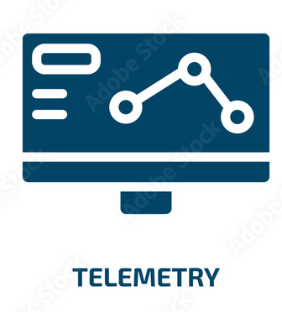
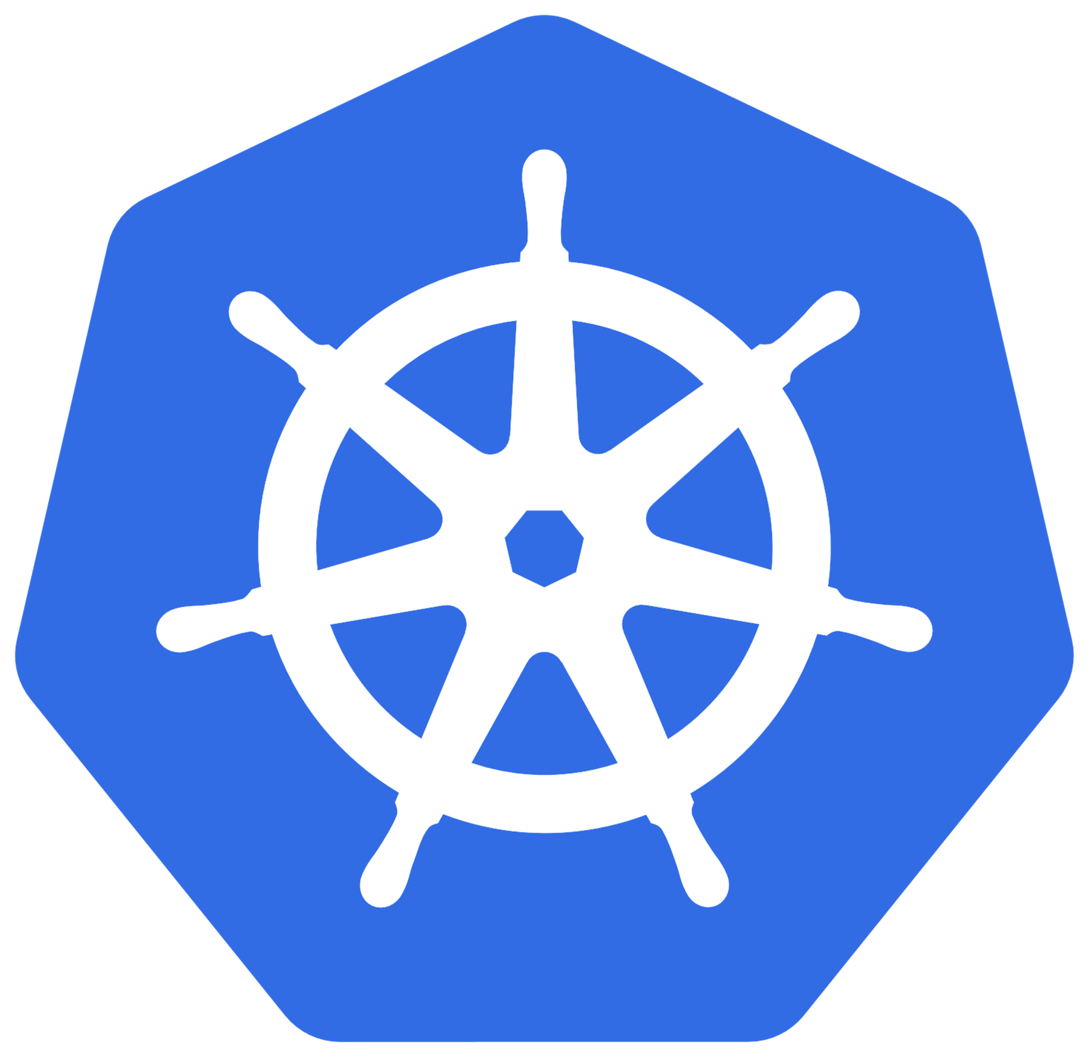
Milestones and Timeline
Objective 1-1: Understand the eBPF runtime mechanism for both ARM and x86 platforms.
Objective 1-2: Integrate eBPF hooks with existing HPDF data streaming applications.
Objective 1-3: Transfer and store the distributed telemetry data quasi real-time.
Objective 1-4: Upgrade BlueField-2 DPU to the latest DPU hardware.
Objective 1-5: Apply the telemetry system to automated data center management.
Objective 2-1: Encapsulate existing HPDF-H containerized applications into Kubernetes services. Objective 2-2: Deploy the Kubernetes control plane on “nvidarm” and offload its network functions.
Objective 2-3: Offload Kubernetes allgather components to DPUs.
Objective 2-4: Explore eBPF enhanced Kubernetes tools.
Objectives |  | Telemetry |  |  |  |  | Kubernetes
 |  | Obj 1-1 | Obj 1-2 | Obj 1-3 | Obj 1-4 | Obj 1-5 | Obj 2-1 | Obj 2-2 | Obj 2-3 | Obj 2-4
FY25 | Q1 (Oct-Dec 2024)
 | Q2 (Jan-Mar 2025)
 | Q3 (April-June 2025)
 | Q4 (July-Sep 2025)
FY26 | Q1 (Oct-Dec 2025)
 | Q2 (Jan-Mar 2026)
 | Q3 (April-June 2026)
 | Q4 (July-Sep 2026)
Notes:
We also worked out a detailed step-by-step milestones of our 2 objectives and their projected timeline.

Slide 11
Funding & Summary
Budget
Labor
New DPU hardware: NVIDIA BlueField-3 or successors
Future funding
SCIOPS: general data center management
HPDF software development
DOE ASCR early career?!
Summary
Scope: fine-grain telemetry and Kubernetes deployment & offloading leveraging DPUs
Highly innovative & technical challenging
Closely related to HPDF and other CST projects
Budget ($K) | Total | FY25 | FY26
 | 455.5 | 209.6 | 245.8
Notes:
The majority of the founding will be spent on the labor, while at the same time, we propose to purchase the latest BF DPU hardware. This is because when the HPDF-H is built up, the bandwidth will be upgraded. Our current DPU is not capable to process the future 400 Gbps network traffic.
For the future funding, I think HPDF software development and SCIOPS will be highly related. I myself could try to apply for DOE ASCR early career award since I got my PhD less than 10 years. But you know, that's easily to fail.
To summarize, we propose a project to leverage the DPUs to explore fine-grain telemetry and Kubernetes deployment as well as offloading.
Our project is highly innovative and technical challenging. It's closely related to HPDF and other CST projects

Slide 12
Q&A

Slide 13
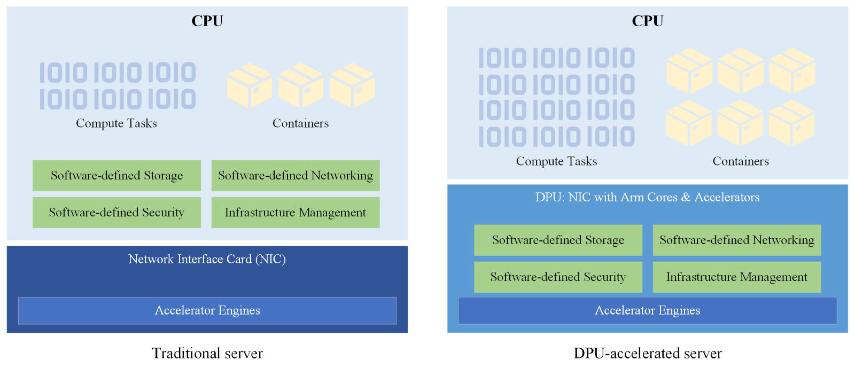
Backup – DPUs in data center
The green blocks represent data-intensive workloads, and the light blue blocks represent CPUs. In modern data centers, with the upgrades from traditional NICs (left side) to DPUs (right side), data-intensive tasks can be offloaded from CPUs to DPUs, thus enabling CPUs to handle more compute tasks.

Slide 14
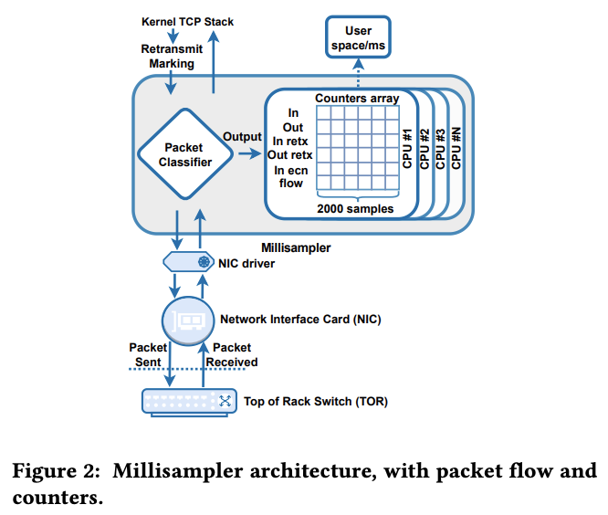
Backup - MilliSampler
Millisampler – Meta's eBPF-based tc filter that runs in the kernel to collect fine-timescale data.
eBPF sampling interval: 100 us, 1ms, 10 ms
Metrics are collected per CPU core
Batch processing: each run contains 2000 eBPF samples; 1 run per hour; last for 4 days
​Ehab Ghabashneh, Yimeng Zhao, Cristian Lumezanu, Neil Spring, Srikanth Sundaresan, and Sanjay Rao. 2022. A microscopic view of bursts, buffer contention, and loss in data centers. In Proceedings of the 22nd ACM Internet Measurement Conference (IMC '22). Association for Computing Machinery, New York, NY, USA, 567–580. https://doi.org/10.1145/3517745.3561430​
https://engineering.fb.com/2023/04/17/networking-traffic/millisampler-network-traffic-analysis
https://www.facebook.com/watch/?v=1135811427018906
https://github.com/facebookresearch/Millisampler-data

Slide 15
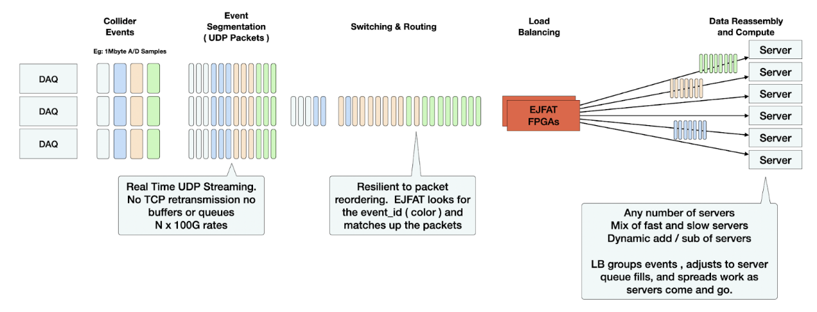
Backup - EJFAT
ESnet-JLab FPGA Accelerated Transport Load Balancer

Slide 16
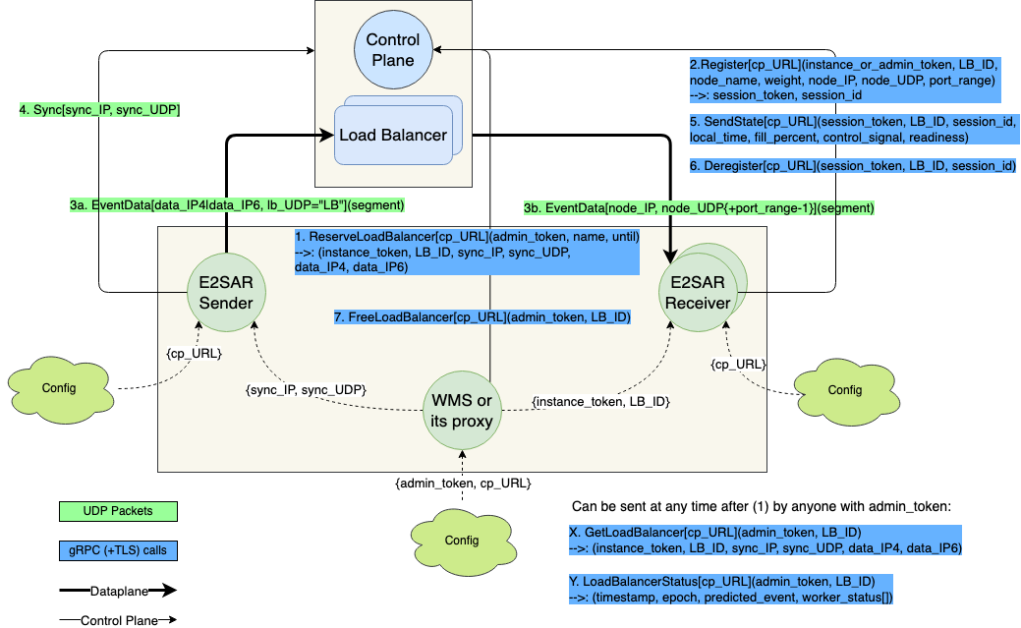
Backup - E2SAR
E2SAR (EJFAT Event Segmentation And Reassembly) is a library for streaming event data from science instruments through FPGA-based EJFAT hardware-assisted load-balancers (LBs).

Slide 17
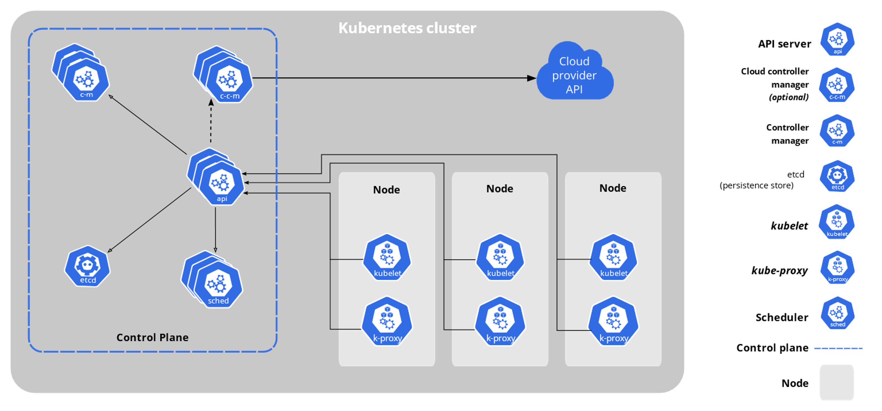
Backup - Kubernetes
The components of a Kubernetes cluster

Slide 18
Requirements
Project description
Scope
Team
Impact and strategic value to the Laboratory’s mission
Level of innovation
Deliverables with corresponding timeline and milestones
Budget and budget justification
Potential future funding

