Slide 1
FFA@CEBAF Permanent Magnet Resiliency in Real Radiation Environment
2024 LDRD Renewal Proposal (LDRD-2) for FY25
Ryan Bodenstein, KIRSTEN DEITRICK, EDITH NISSEN, RANDIKA GAMAGE

Slide 2
Outline:
Overview/Progress of this Project
Magnets
Measurements
Modeling
Dosimetry
Status & Budget
Questions Answered
The Plan for FY25
Changes
Quarterly Goals
Work Breakdown
Budget
Future Funding
Concluding Statements

Slide 3
The LDRD is:
LDRD is studying the degradation of permanent magnet materials in a radiation environment similar to anticipated operational conditions
2 permanent magnet (PM) materials (NdFeB and SmCo)
Wide range of radiation doses
Appropriate dosimetry to measure doses and types of radiation
Ryan Bodenstein is PI (35% of time)
Kirsten Deitrick is Co-I (10% of time)
Edith Nissen is Co-I (20% of time)
Randika Gamage is Co-I (30% of time)
Support from Joe Meyers (Magnet Measurement), David Hamlette (RadCon), and Neil Wilson (Installation), Joe Gubeli (3D Printing)
Directly addresses JLAAC recommendation from March 2023:
R30 states, “Validate the loss tolerances of the permanent magnet with irradiation experiments.”

Slide 4
LDRD – The Plan Overview
The main point of the LDRD is to study the degradation of permanent magnet materials in a radiation environment which resembles their intended operational environment as closely as possible.
We will use the data to extrapolate to the energies expected for the FFA@CEBAF energy upgrade.
Two candidate materials, NdFeB and SmCo, of appropriate grades and treatments, are being studied.
NdFeB (N42EH & N52SH) and SmCo (SmCo33H & SmCo35) will be placed in a wide range of radiation environments at the lab (in the tunnel, Halls, etc…).
Single samples and reverse-flux assemblies will both be studied.
Dosimetry will be placed alongside all samples to measure doses and the type of radiation at each location.
Using a high-precision teslameter and Helmholtz coil on mobile measurement setups, we will measure the samples as often as the CEBAF accelerator schedule allows.
Using the data gathered from above, as well as detailed simulations of the dosages and external studies, we will extrapolate our data to the relevant energy ranges and model the magnet degradation.

Slide 5
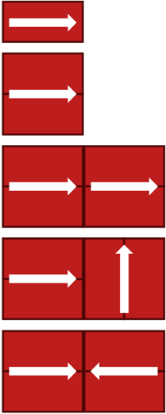
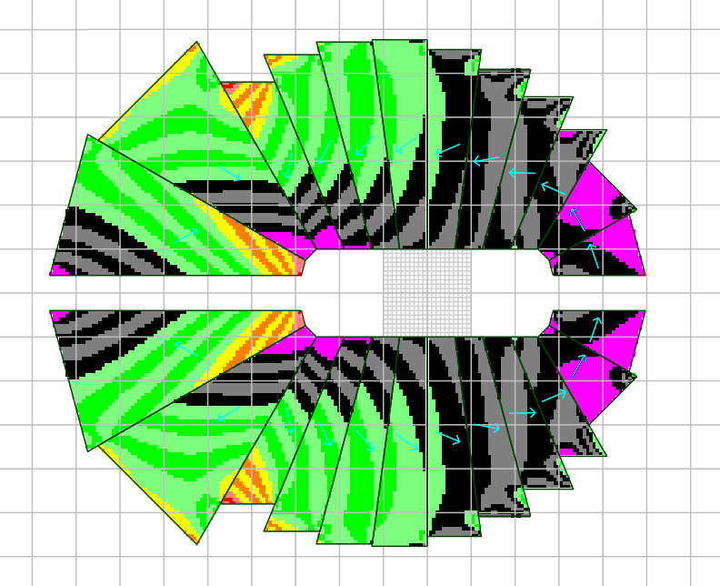
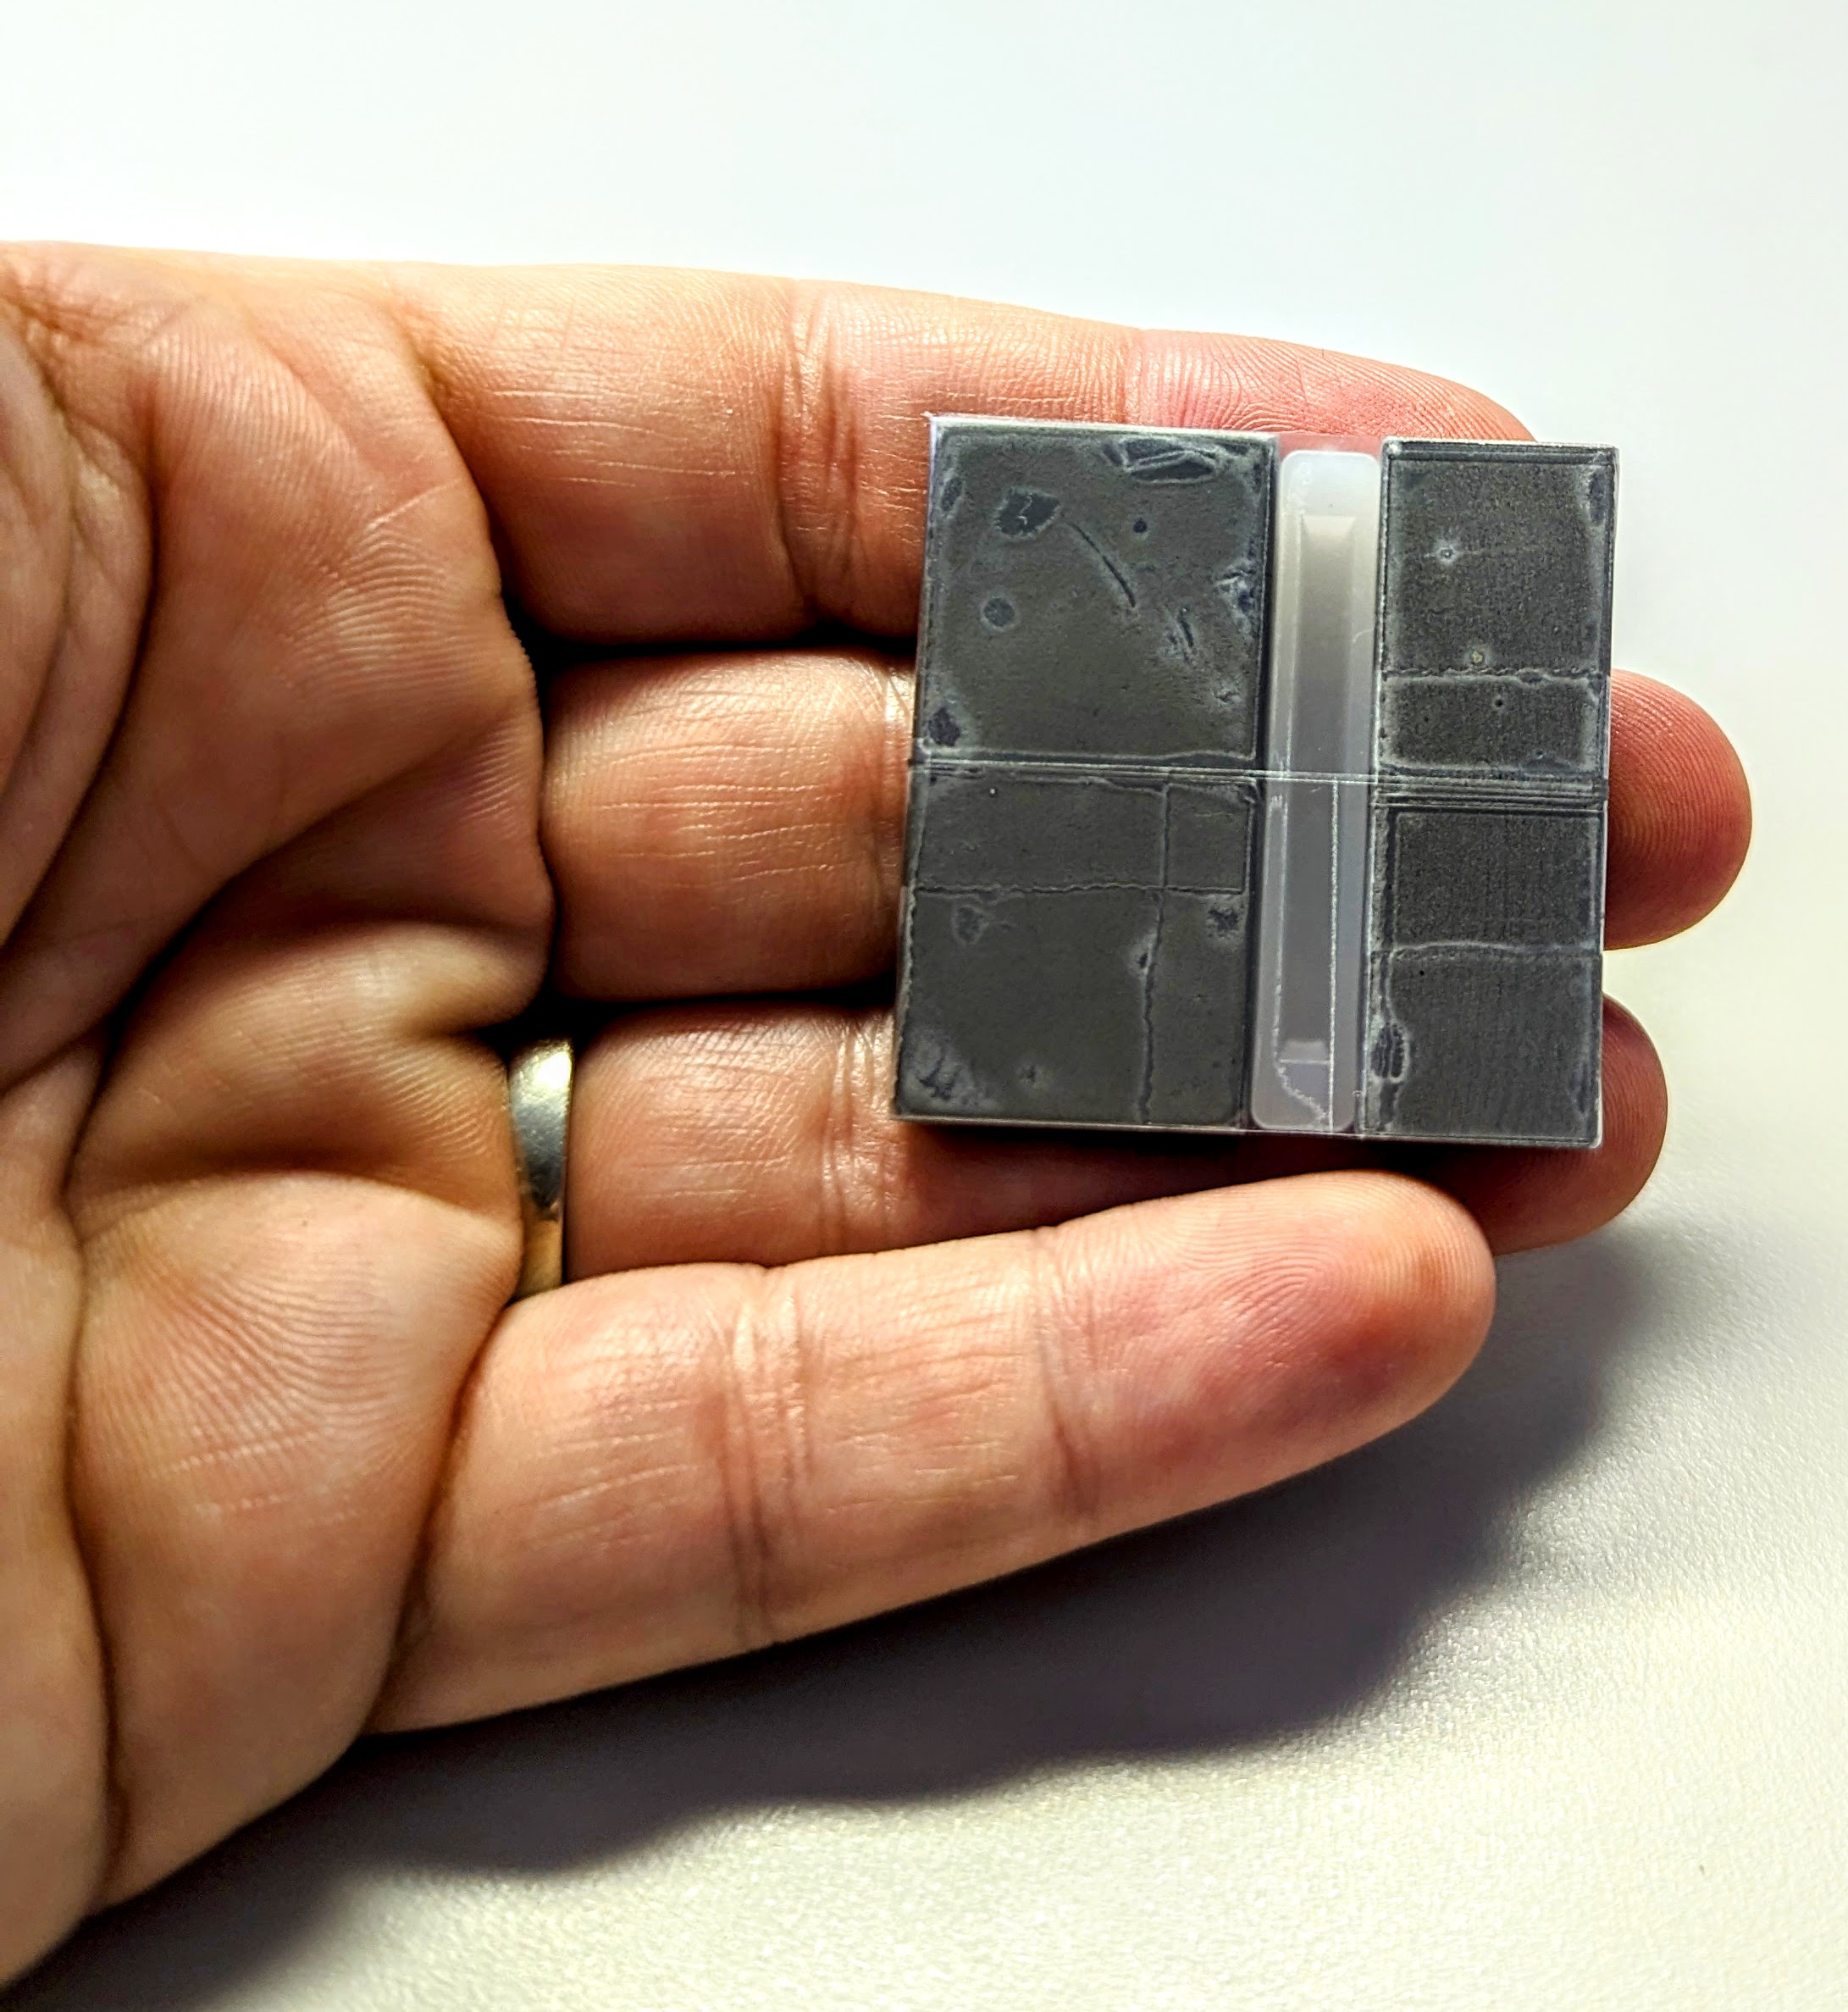
The Magnets
2 grades of NdFeB + 2 grades of SmCo
Strength, heat resistance, etc…
2 sizes:
Single samples – 1.5 x 0.75 (m) x 0.25”
Pair assembly samples – 1.5 x 0.5 (m) x 0.25”
S. J. Brooks, “Permanent Magnets for the CEBAF 24GeV Upgrade”, in Proc. IPAC'22, Bangkok, Thailand, Jun. 2022, pp. 2792-2795. https://doi.org/10.18429/JACoW-IPAC2022-THPOTK011
Two samples with spacer. Left is NdFeB single sample, right is SmCo pair assembly sample. Field aligned horizontally in photo. Both are covered in tape for safety.

Slide 6
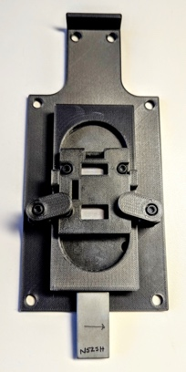
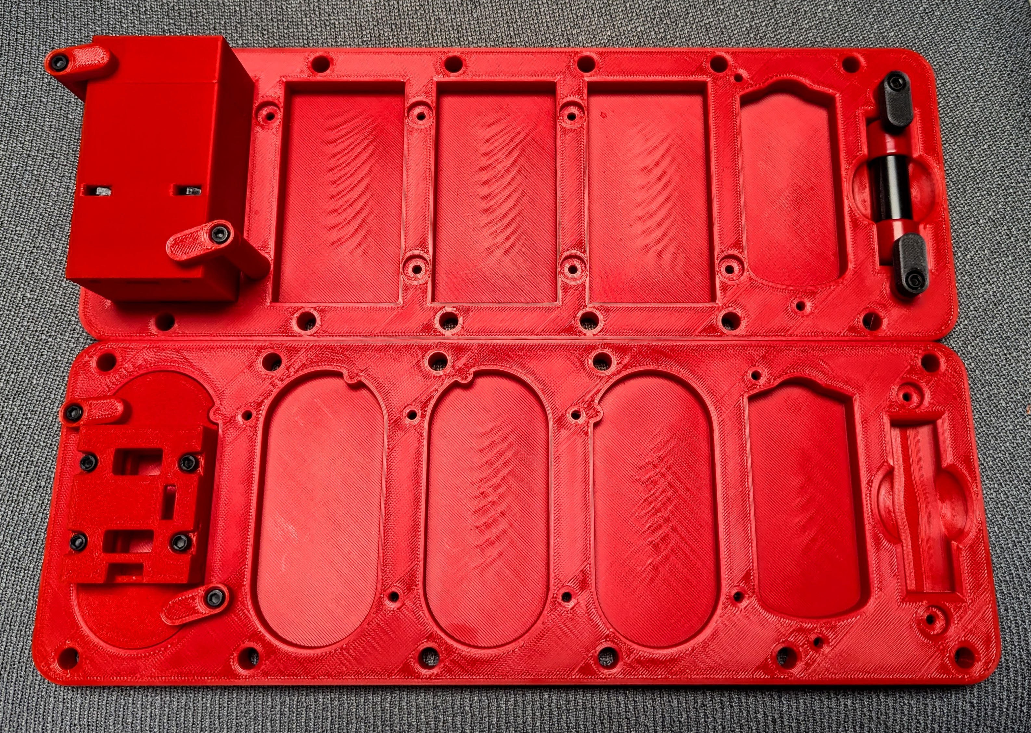
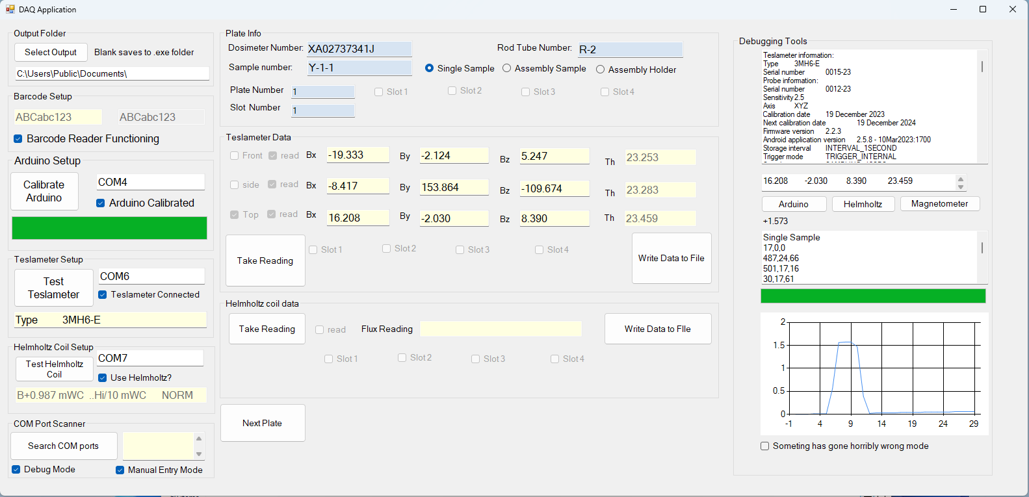
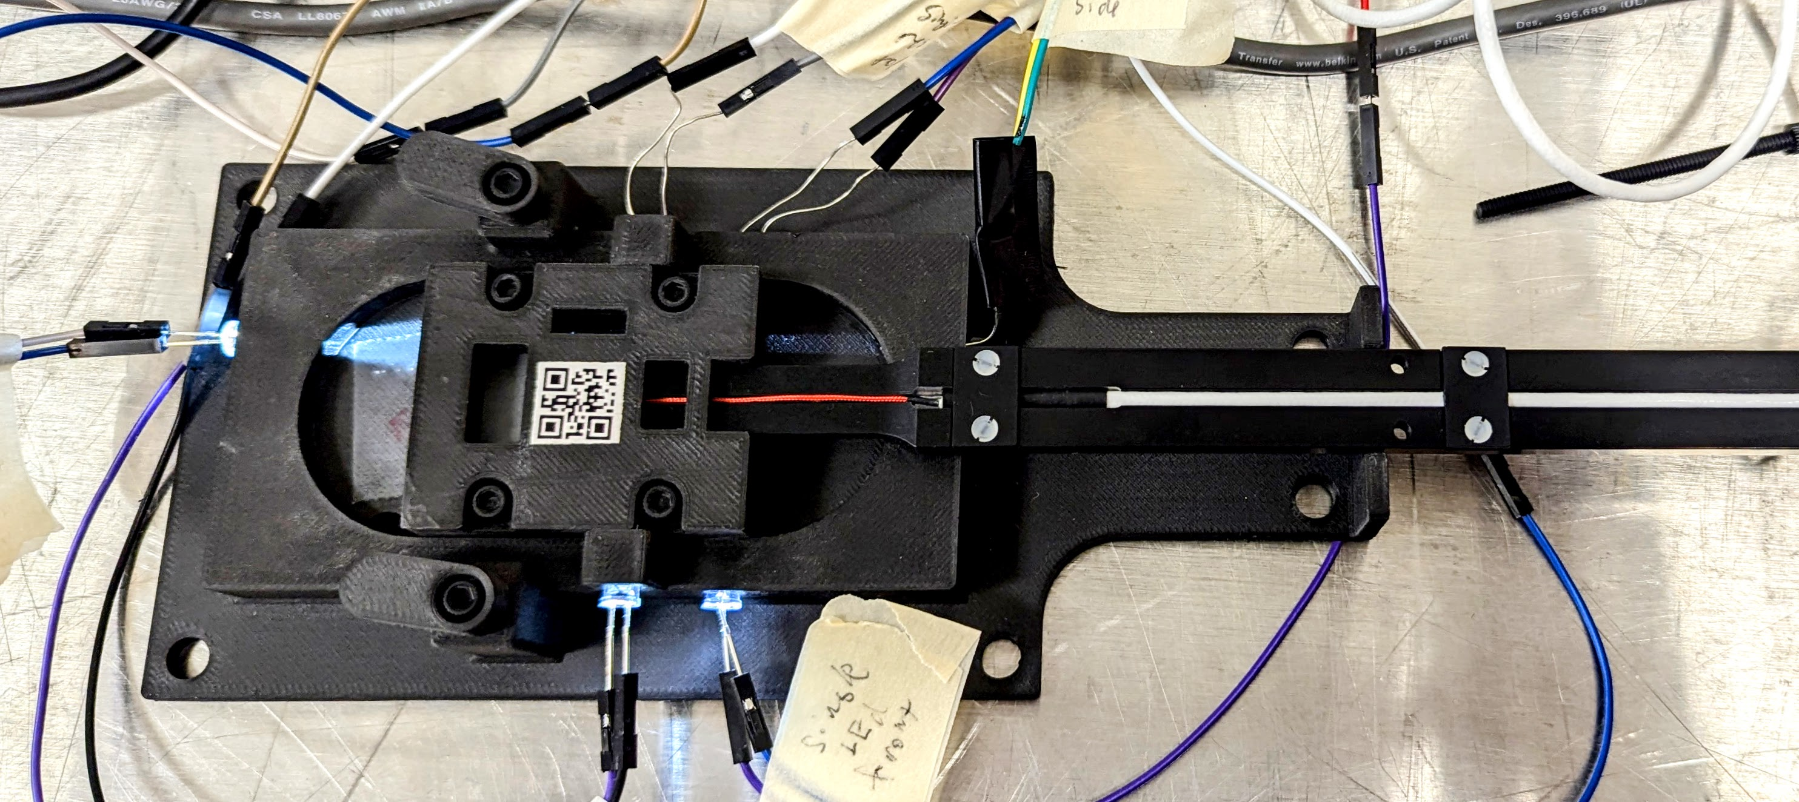
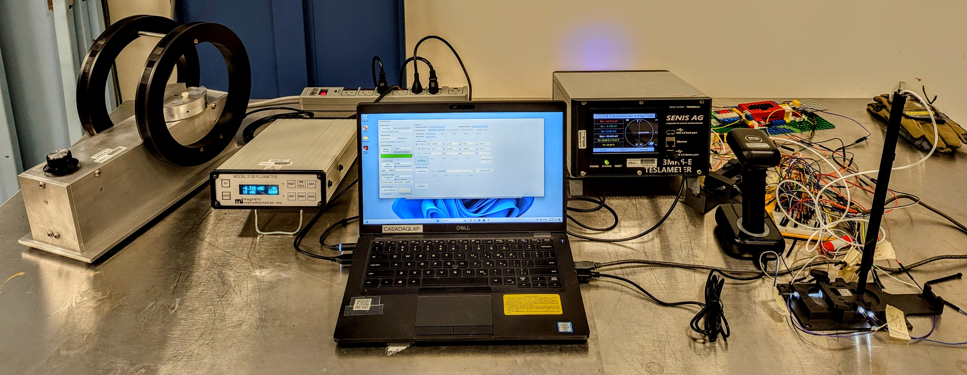
The Measurements
3D print mounting systems for the samples, as well as custom DAQ.
A large range of doses will allow us to better determine the rate at which we can expect demagnetization over time, and at higher energies.
Using a mobile testing setup with a high-precision teslameter (Senis 3MH6) and a Helmholtz coil (Magnetic Instrumentation Model HCP w/Rotator & Fluxmeter), measure the samples in the tunnel during accelerator down time.

Slide 7
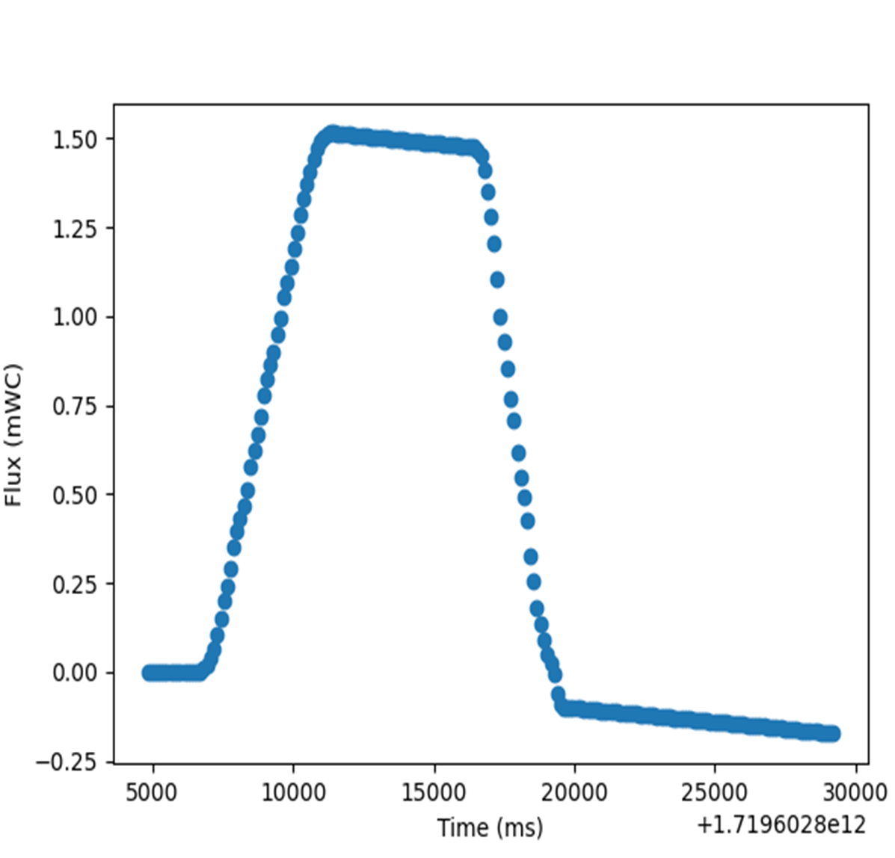
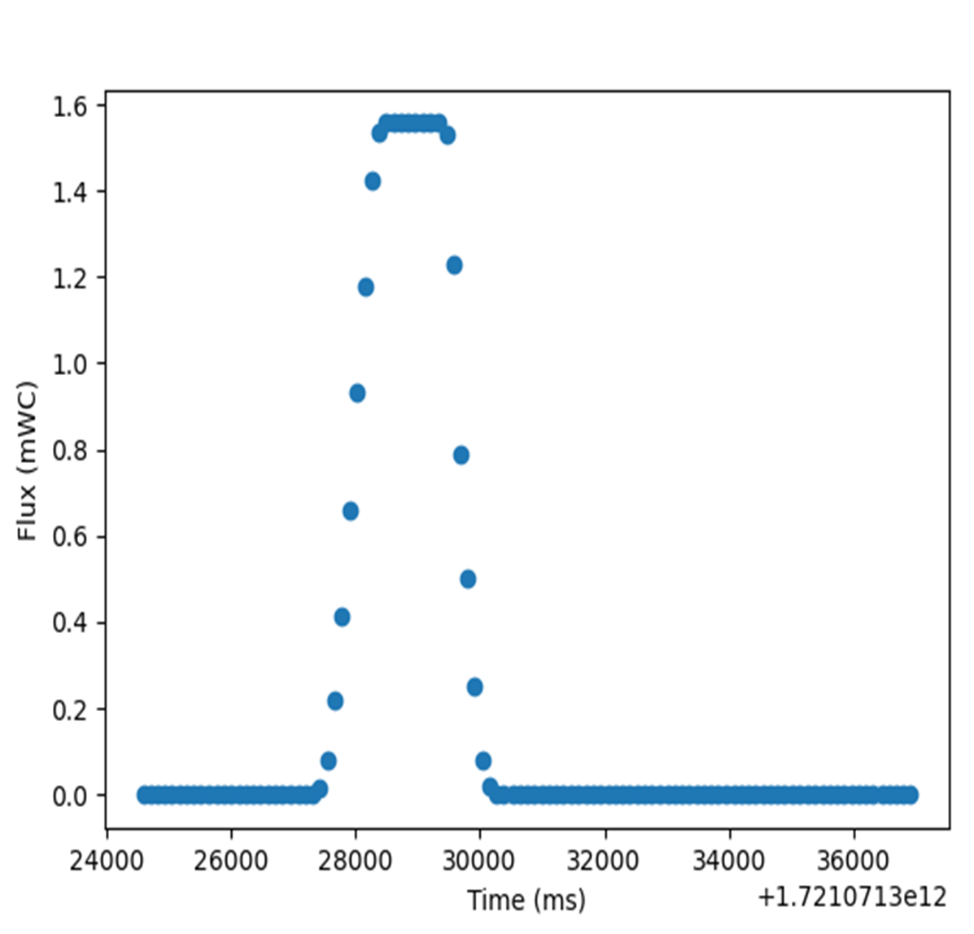
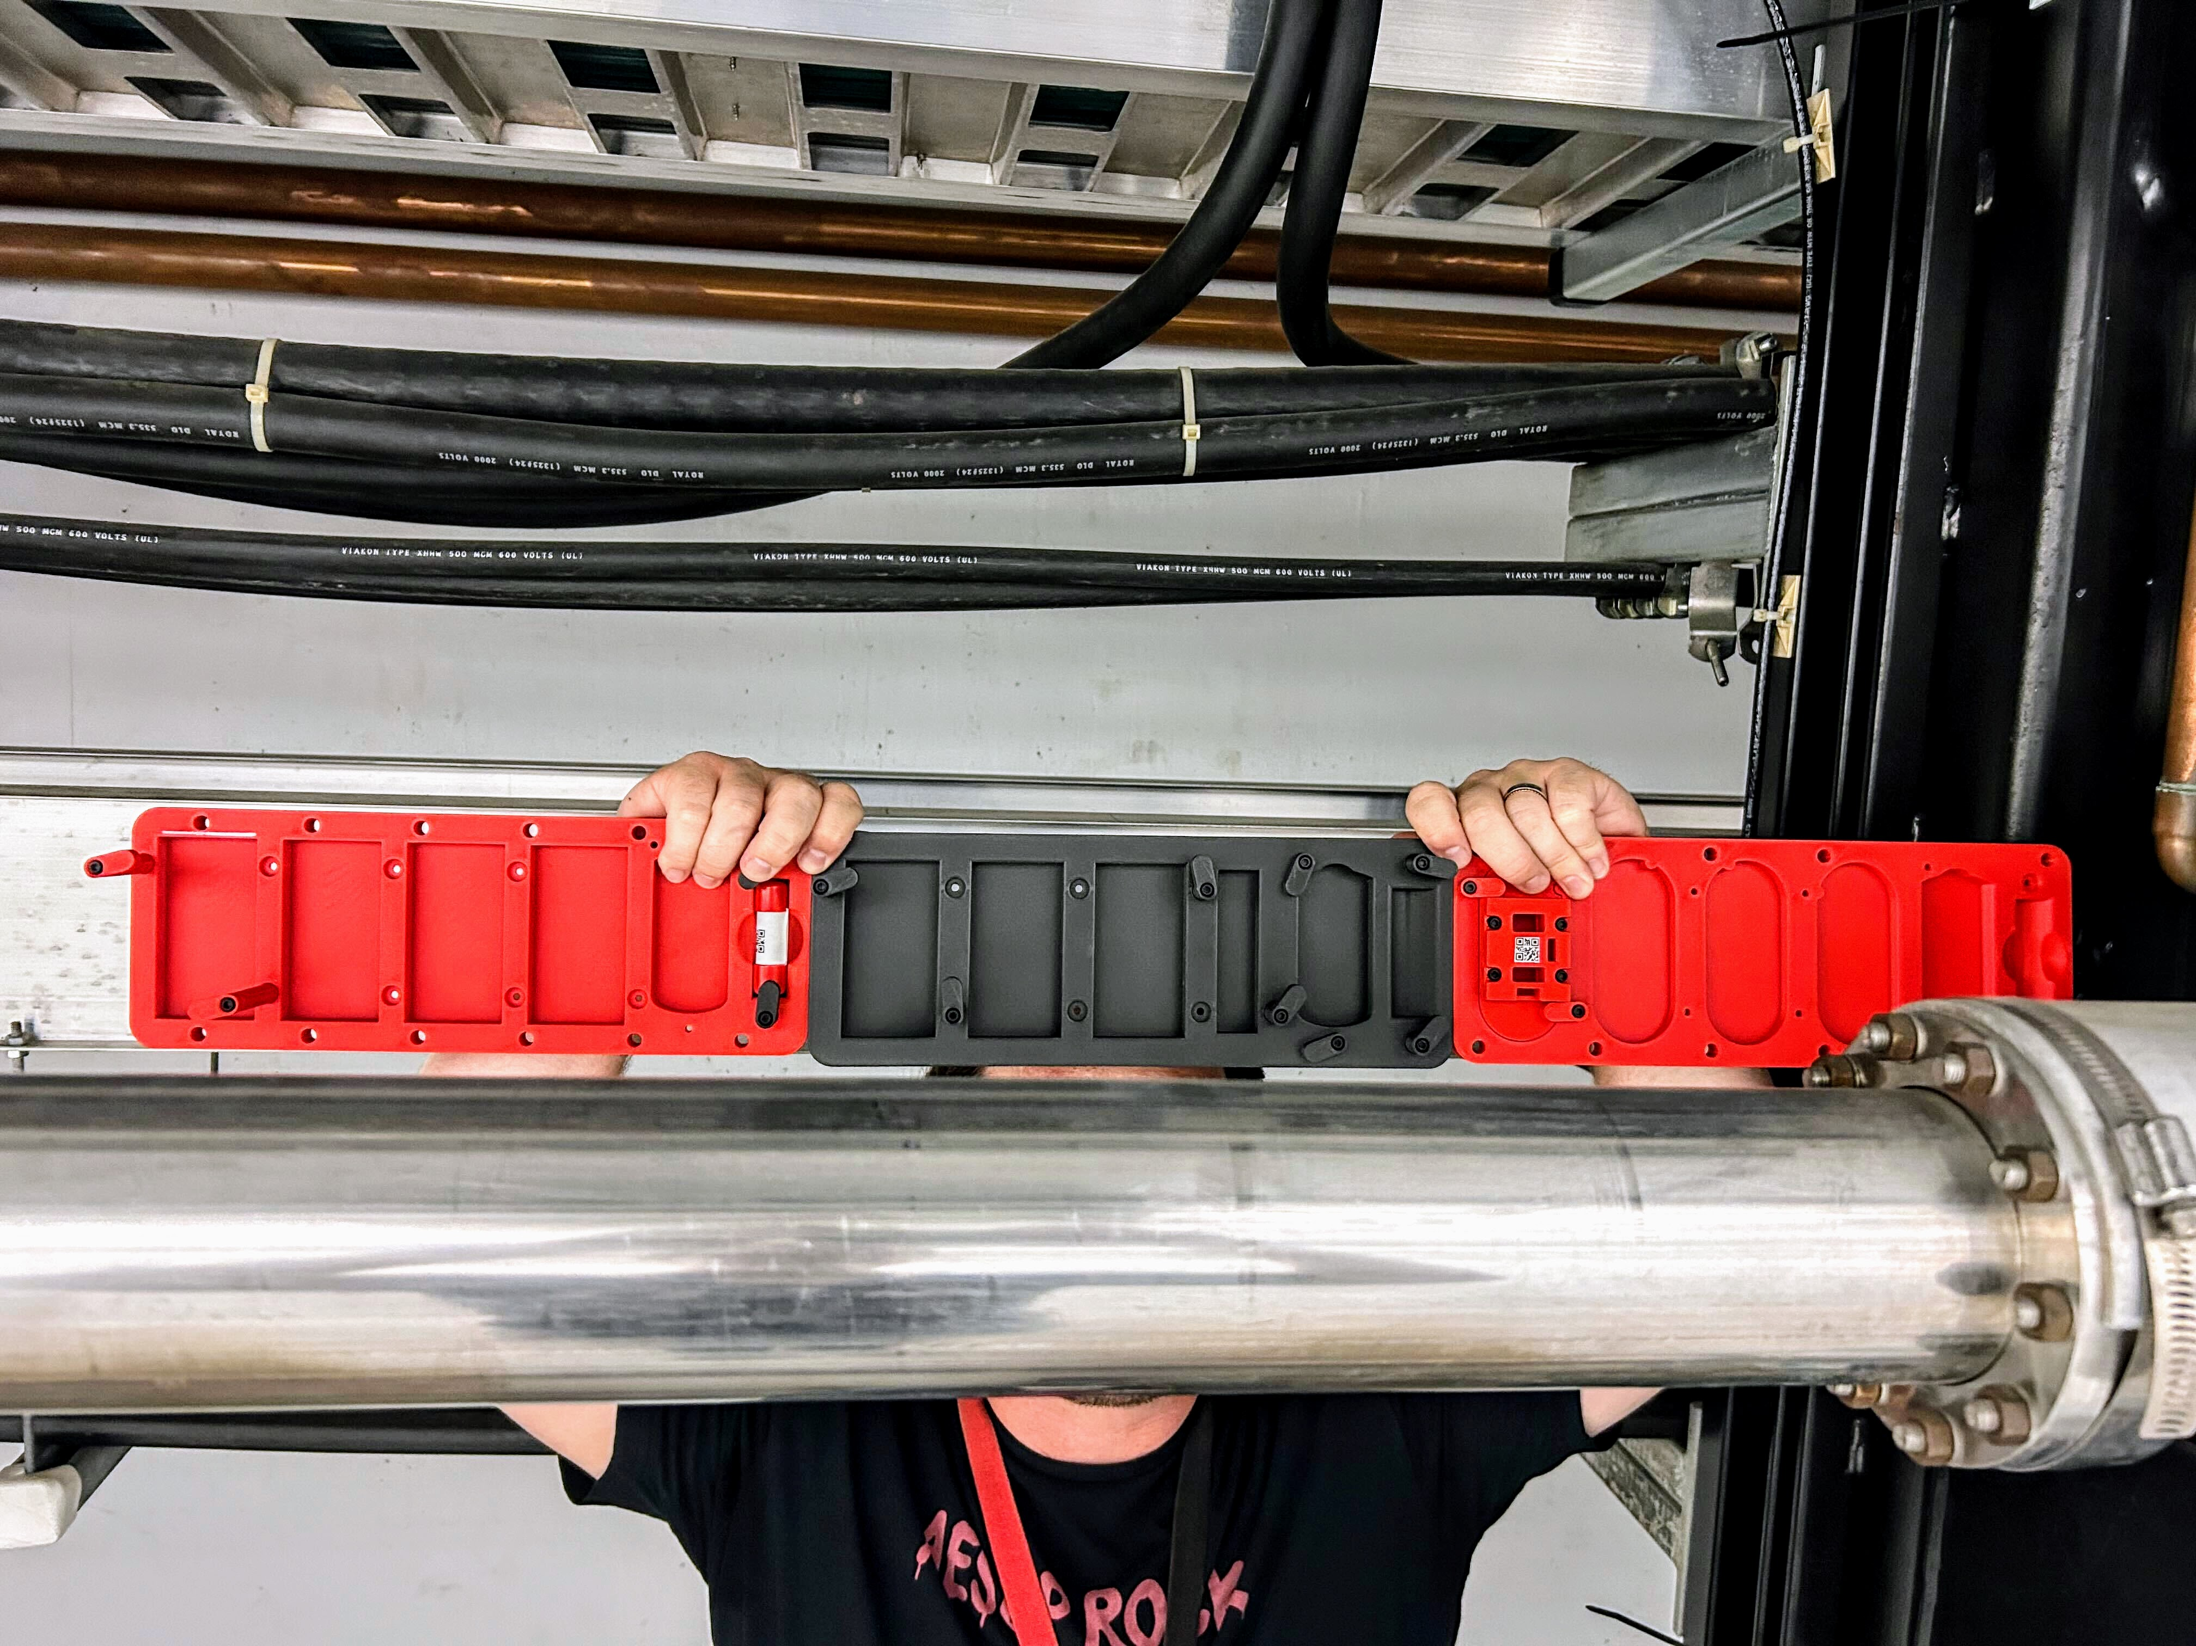
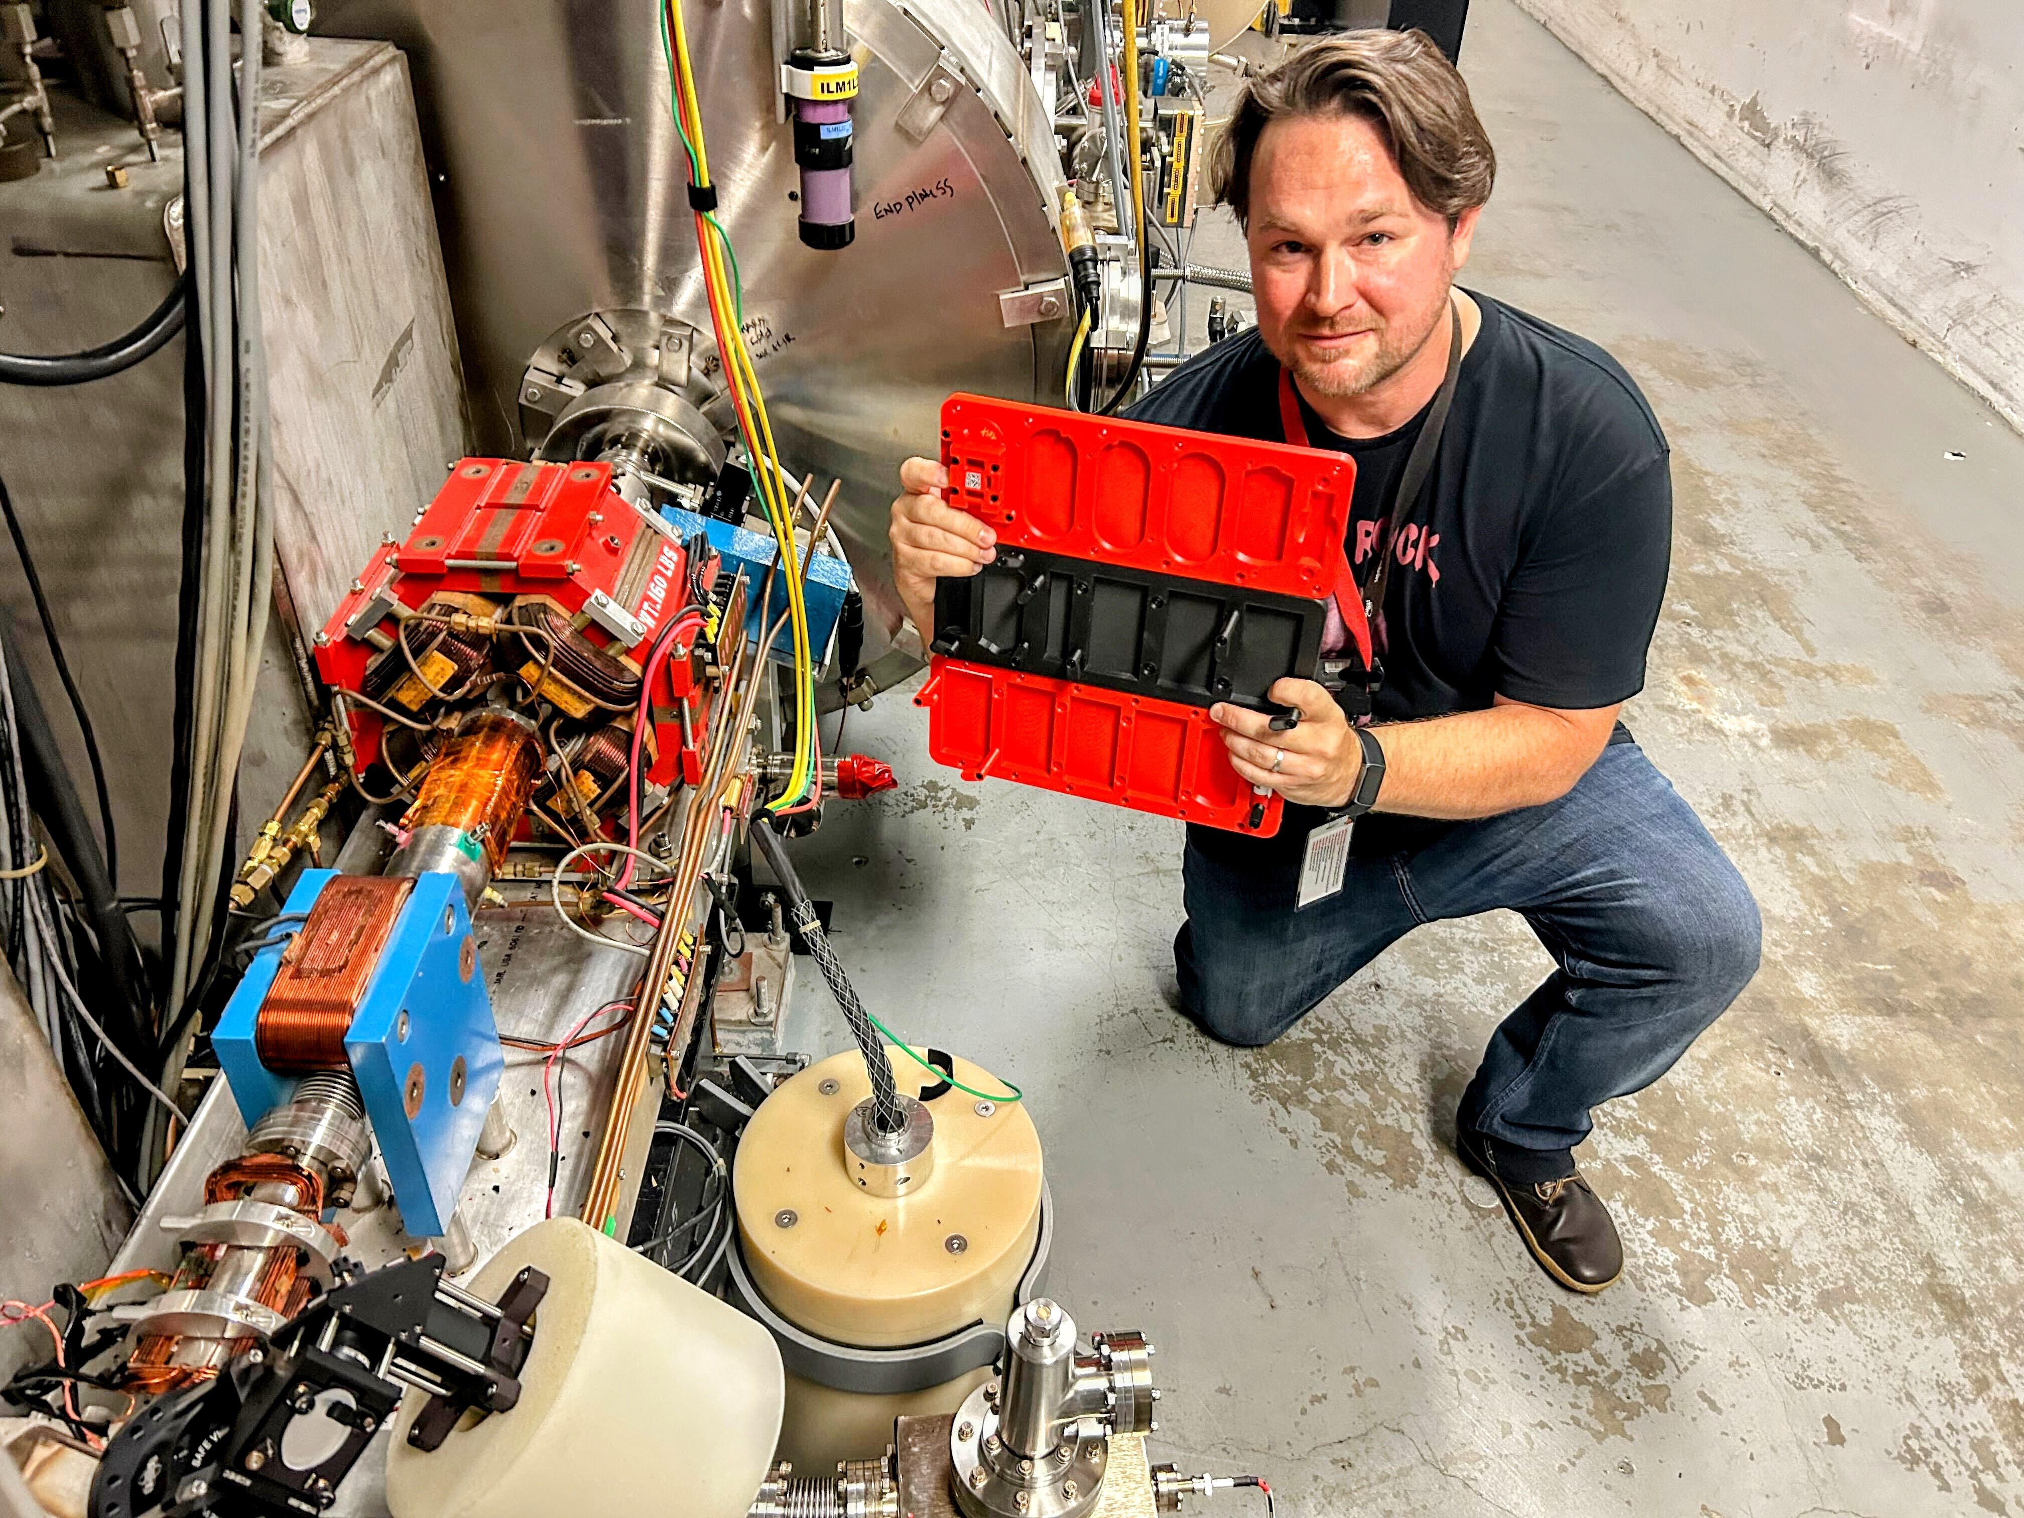
The Measurements
Summer student (Colin Decker) helped to develop Helmholtz Coil procedures and provided error analysis.
Installation will occur once all 3D prints arrive and are assembled/measured.
Measurements will occur during tunnel access – currently planned every two weeks during maintenance.

Slide 8
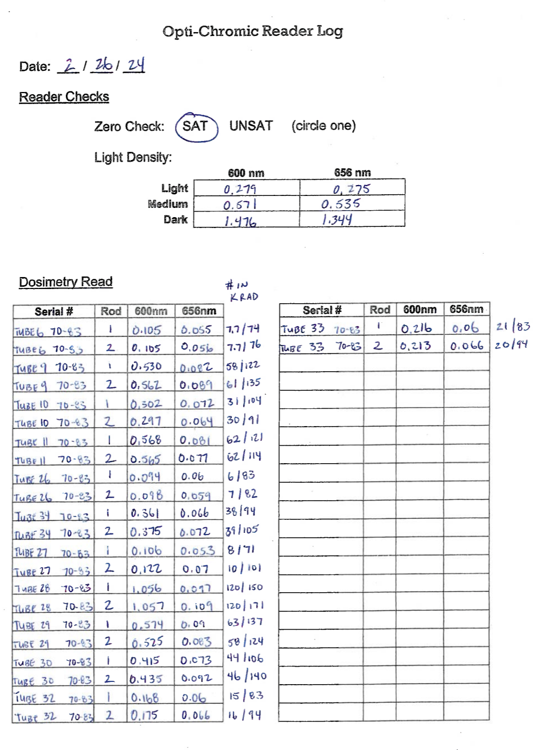
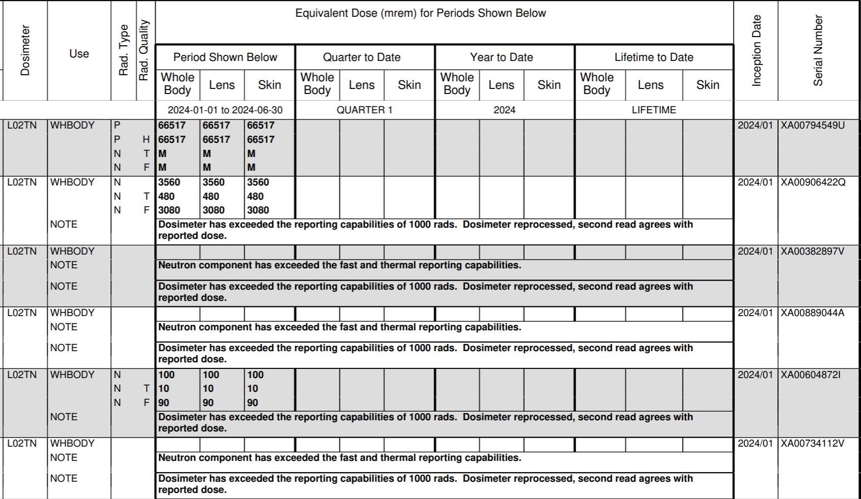
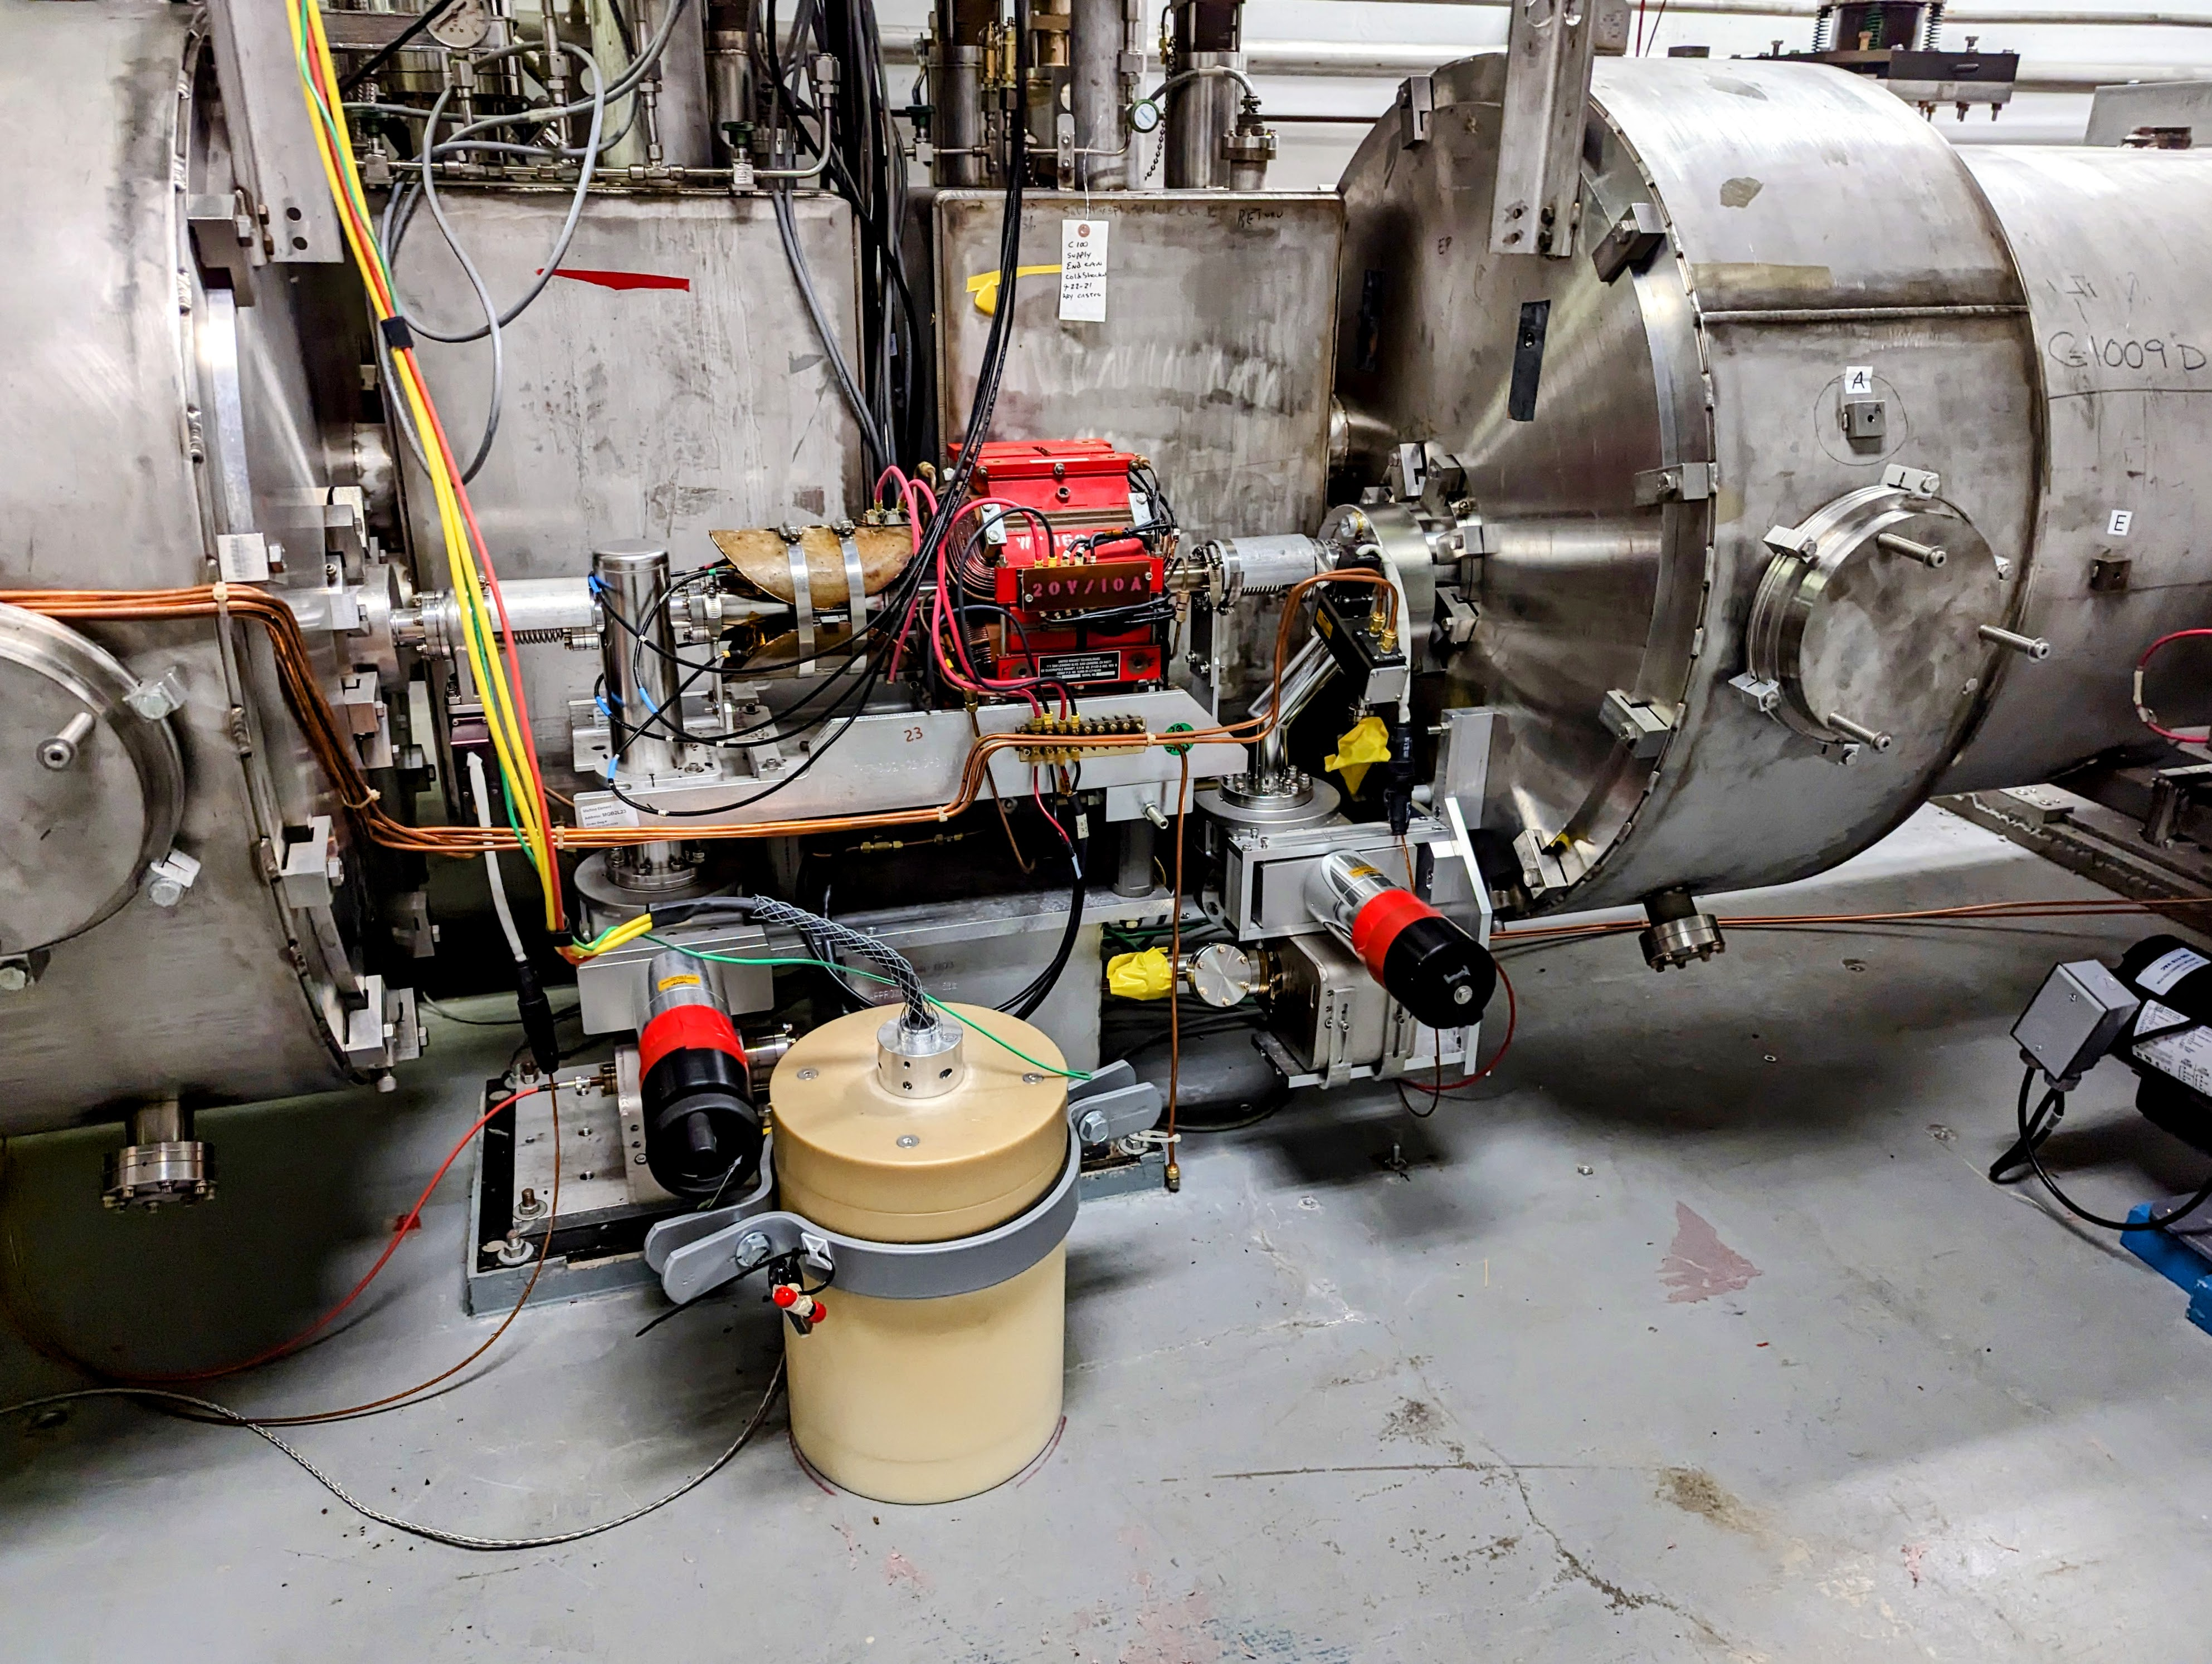
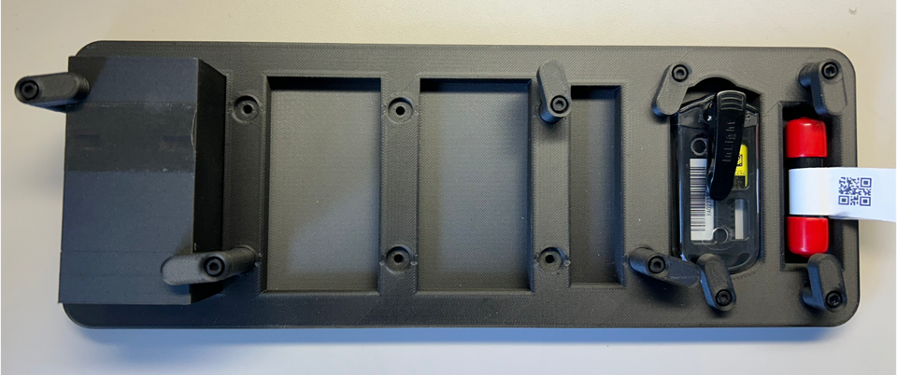
The Dosimetry
RadCon supplied area dosimeters (neutrons and gamma), as well as low and high-dose optichromic rods will be used to measure radiation dose at samples.
NDX data will supplement dose reading in locations where present.
Radiation data is error prone, even with dedicated online radiation monitoring. (More on this later.)

Slide 9
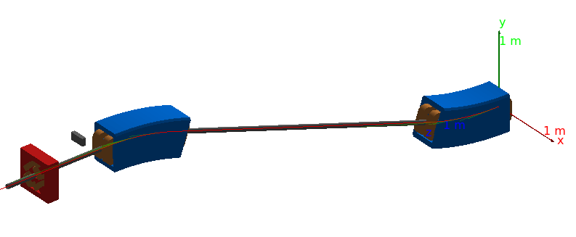
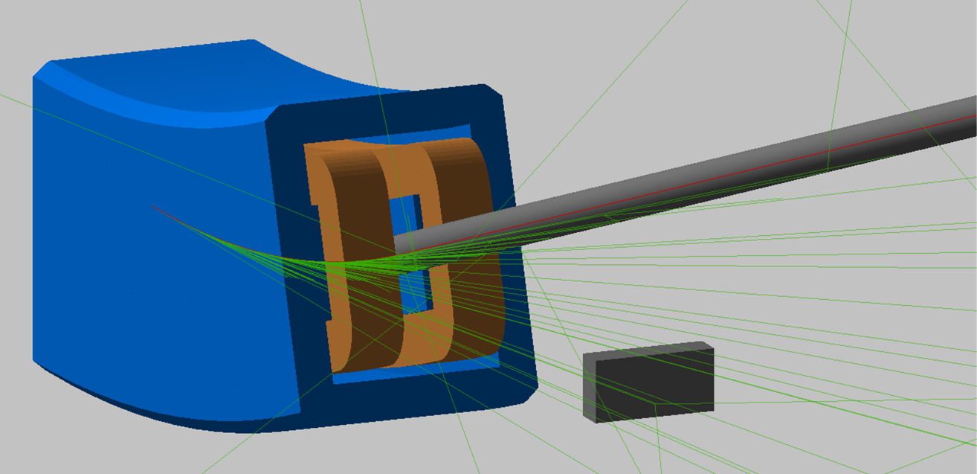
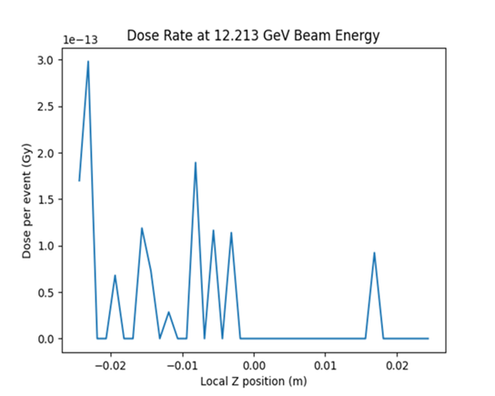
The Simulations
BDSIM simulations will be used to better understand the doses that occur at the FFA@CEBAF energies.
Our starting models will be based upon the simulated doses and previous external studies which most closely resemble our operating environment.
As we gather data, we will refine the models to best explain the observed behaviors.
This will be used to extrapolate for the higher energies that we cannot yet reach.

Slide 10
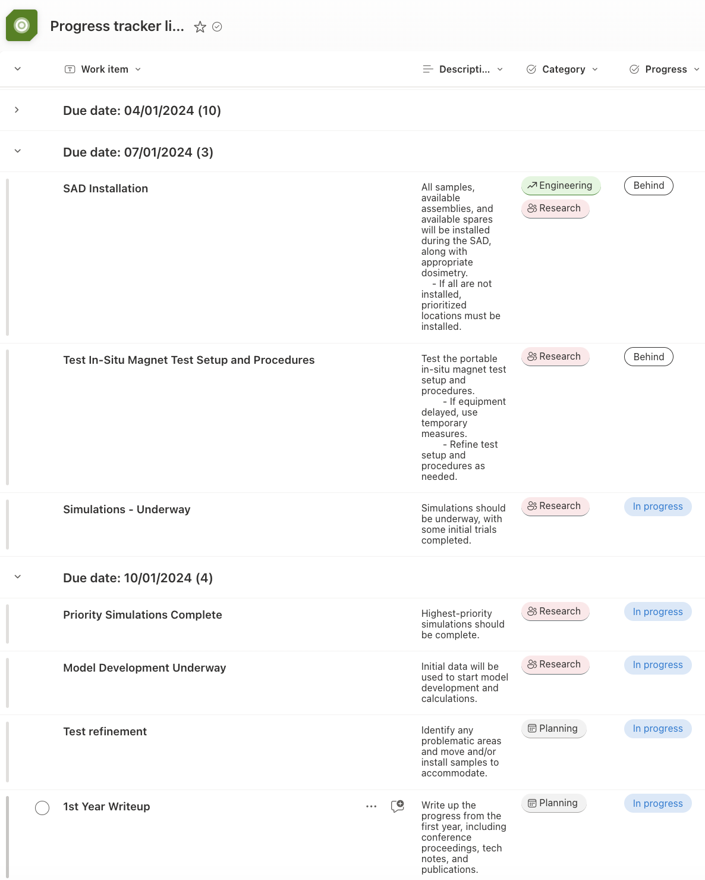
The Status
All Q1 and Q2 milestones met, except “bonus” studies.
Shipping delays, broken components, and work pauses (and associated fallout/re-prioritizations) have impacted our timeline.
Extended SAD is a mixed blessing: it gives us time to install during the SAD, but delays data taking until after January 2025.
Presented at IPAC24 (3 proceedings), invited talk at ERL 2024 in September (1 proceedings).
Interest in collaboration with Cockcroft Institute, RHUL, BNL, and possibly CERN.

Slide 11
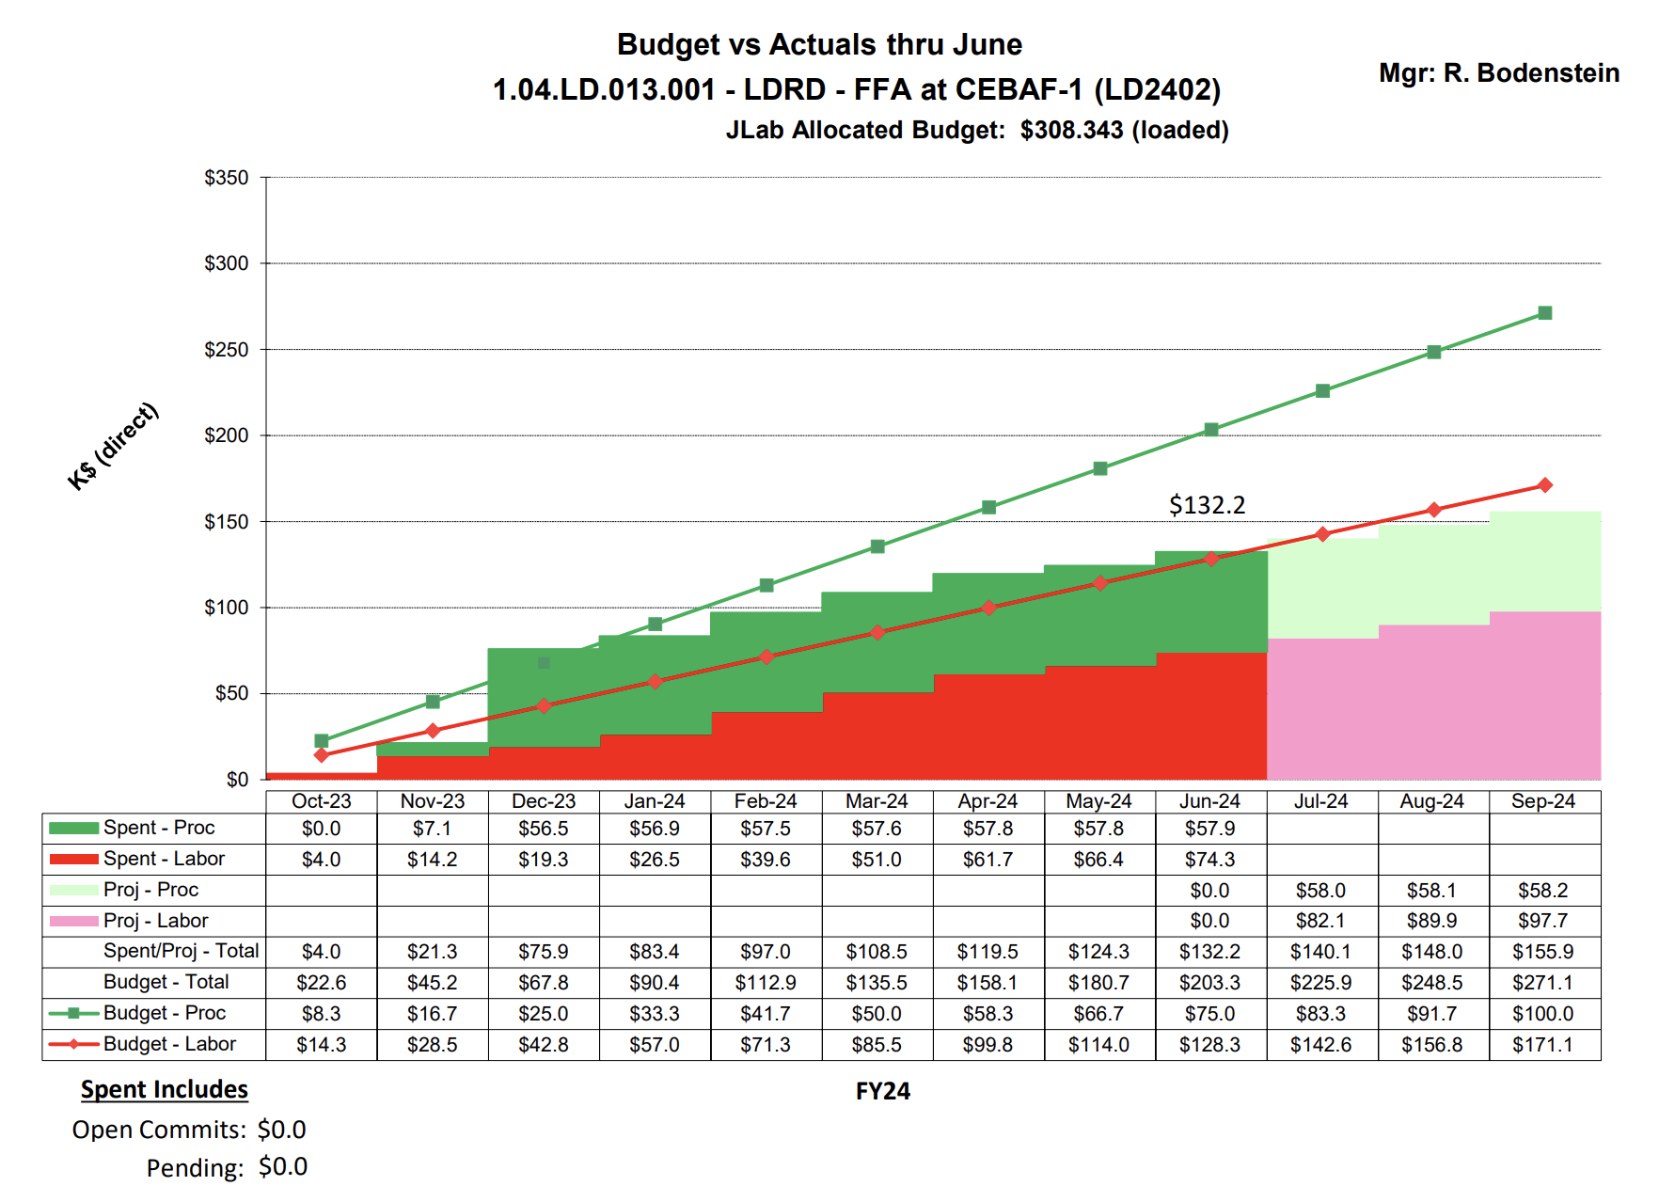
The Budget
Will bulk order 3D prints upon review of test prints (2nd round)
~$7K (estimate, TBD)
2 X Lab Carts
$1-1.5K
Installation may not happen until FY25 (extended SAD)
Teslameter calibration due December

Slide 12
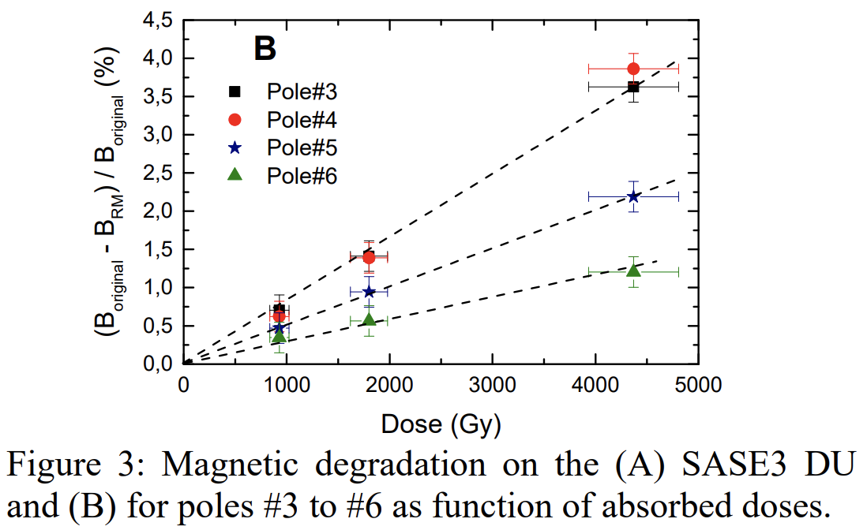
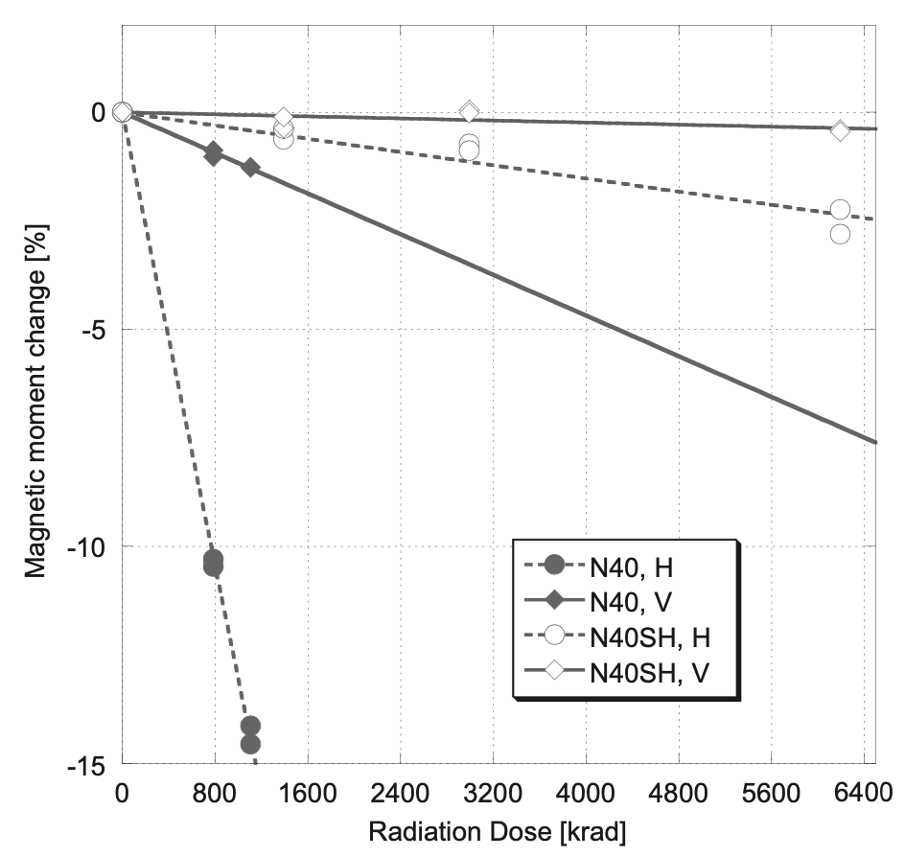
Questions Answered - 1
Q: There were apparently many issues with understanding the collected radiation dose data in FY24. It is not clear if these issues were fully resolved with the plans for FY25. What impact does the problematic FY24 data have on the LDRD outcome?
Problem 1: Saturation – We found a gap in coverage, and are filling that gap with additional low-dose optichromic rods.
Problem 2: NDX produces odd, large negative values at times – An operator has shown us how to pull raw data in a new way so that we can cut and integrate ourselves.
Note: Few studies measure actual dose – most calculate. Those that measure also have very large error bars.
A.B. Temnykh, “Measurement of NdFeB permanent magnets demagnetization induced by high energy electron radiation”, https://doi.org/10.1016/j.nima.2008.01.002.
F. Wolff-Fabris, et al., “Status of the Radiation Damage on the European XFEL Undulator Systems”, doi:10.18429/JACoW-IPAC2018-WEYGBD2

Slide 13
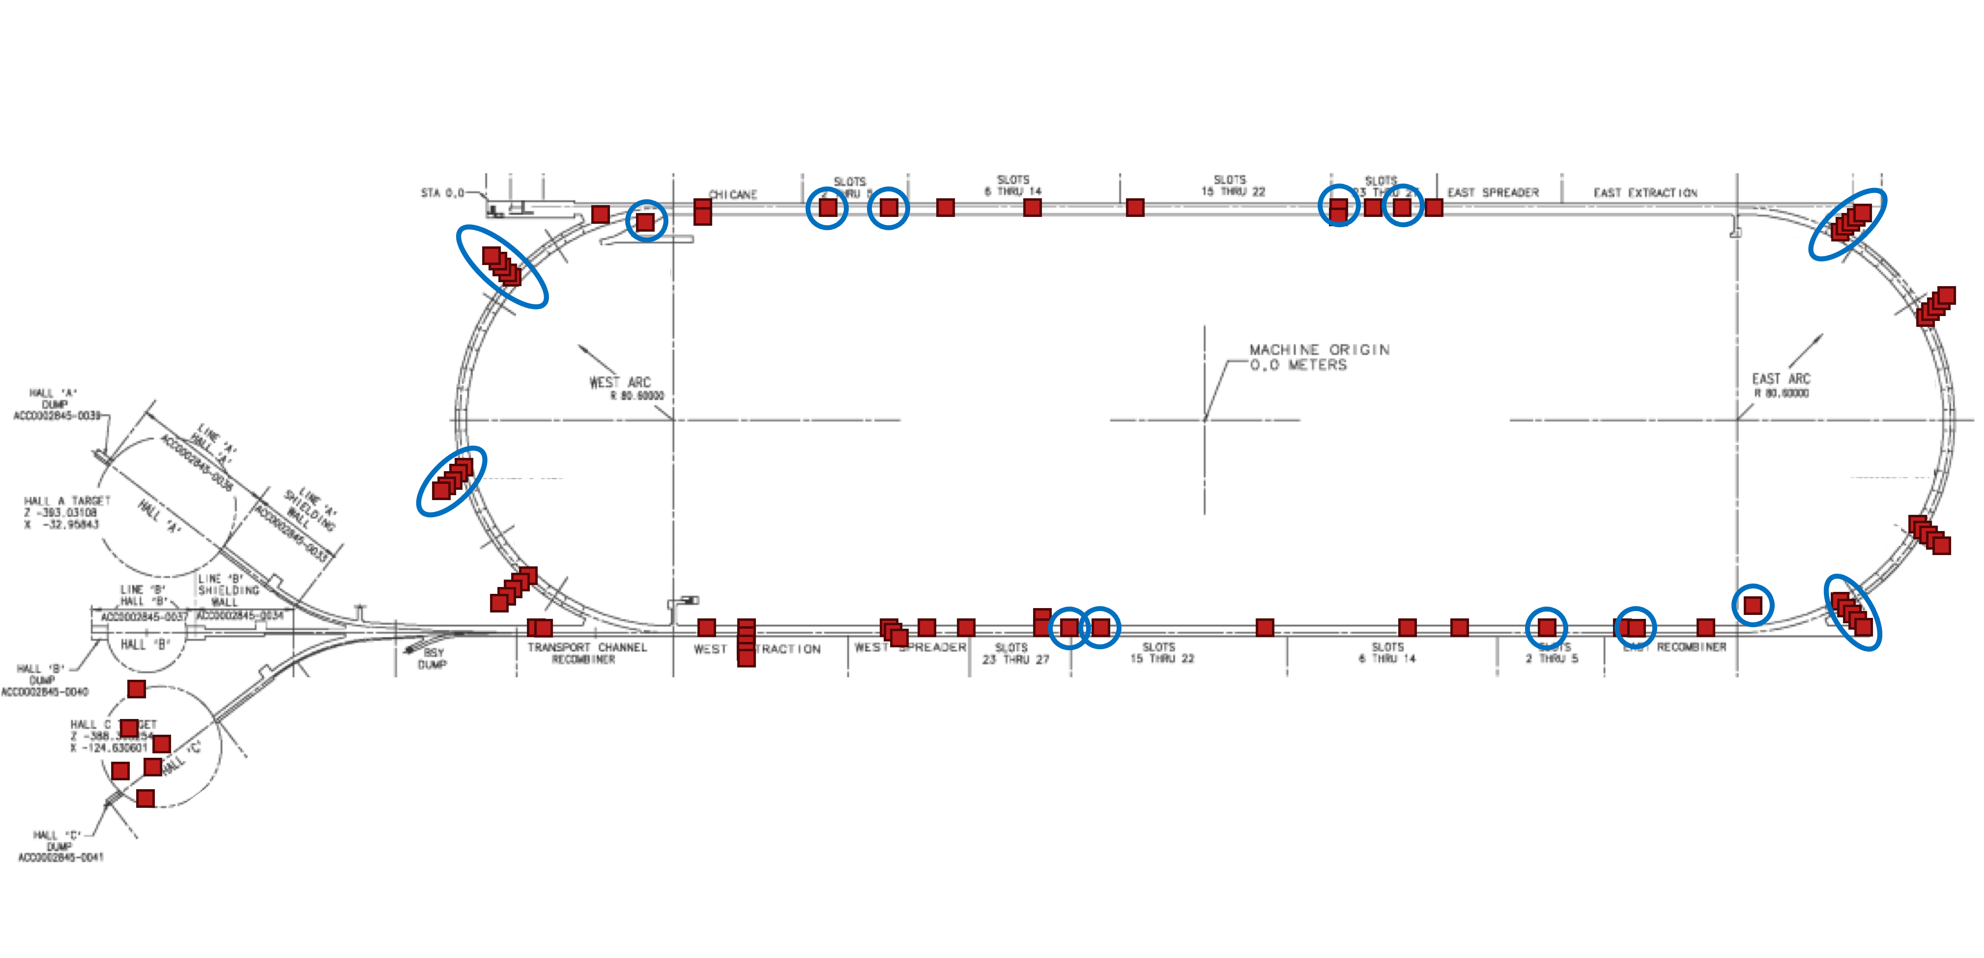
Questions Answered - 2
Q: No results were shown in the proposal for data collection results from the FY24 monitoring. It would be appropriate to see a map of the accelerator showing where the monitoring is being conducted and some overview of the results.
Doses ranged:
0 - 120 krad for photons,
0 – Saturated for neutrons.
Low dose rods will help.
Installed/analyzed Dosimetry
Location to install samples

Slide 14
Questions Answered - 3
Q: What is your method for relating radiation hardness based on short-term dose accumulation numbers to those relevant for long-term exposure of the magnets?
Studies show that the demagnetization is due to total integrated dose, with the exception of beam-strike events.
Some parts of the mechanism is due to thermal changes, but these are also related to integrated dose.
Our study will be using a wide range of doses, and reading the magnet data many times, giving demagnetization data along with integrated doses.
We will then use our range of integrated doses and demagnetization data to extrapolate for higher integrated doses.
Beam strike events *can* show some level of ”recovery” after the event – this would be investigated if our “bonus” study for FY25 is approved by JLab and CERN.

Slide 15
Questions Answered - 4
Q: Your metrics for studying radiation hardware are limited only to measurements of the magnetic field of the samples. Do you plan any testing of the samples after long radiation exposure to measure their mechanical properties?
This is outside of the scope of our study, as well as our expertise. However, such a study could be possible. If interested parties would like, and the magnets are later removed from the tunnel and cleared by RadCon, they could be compared to non-irradiated samples to study the differences.
We are avoiding removing the magnets from the tunnel due to concerns of activation.
SmCo does contain cobalt, which can be activated. This would need to be considered for any such study.

Slide 16
LDRD – The Plan – Goals for FY25
FY25 Quarter 1:
Finish simulation layouts (geometric layout, GEANT4 physics lists, etc…) and placements for sample sites around CEBAF
If delayed, focus on highest-priority sites
Finish installation of components during extended SAD
If further delays, install priority locations first
Test and refine in-situ measurement protocols in the tunnel before CEBAF beam returns to users
If unable, have plan to test during maintenance and other beam downtimes
FY25 Quarter 2:
Gather data as regularly as feasible, given safety and access restrictions
Currently plan every maintenance day (every two weeks) and parasitically as available
Using partial data, external results, and partial simulation results gathered thus far, refine the extrapolation model(s) to reflect the most up-to-date expectations for magnet degradation at higher beam energies
Prepare to present the status at IPAC and/or other conferences
FY25 Quarter 3:
All priority simulations should be complete
If not all, the highest priority simulations, which contribute most to the extrapolation models, must be complete
Present results at IPAC and/or other conferences
Start writing journal paper(s)
FY25 Quarter 4:
Wrap up all data taking for project
If allowed, samples can remain in place for future study
Request dosimetry funding for continued study
Finalize models and extrapolations, including errors and uncertainties
Write up project (tech notes, proceedings, etc…) and submit to at least one journal

Slide 17
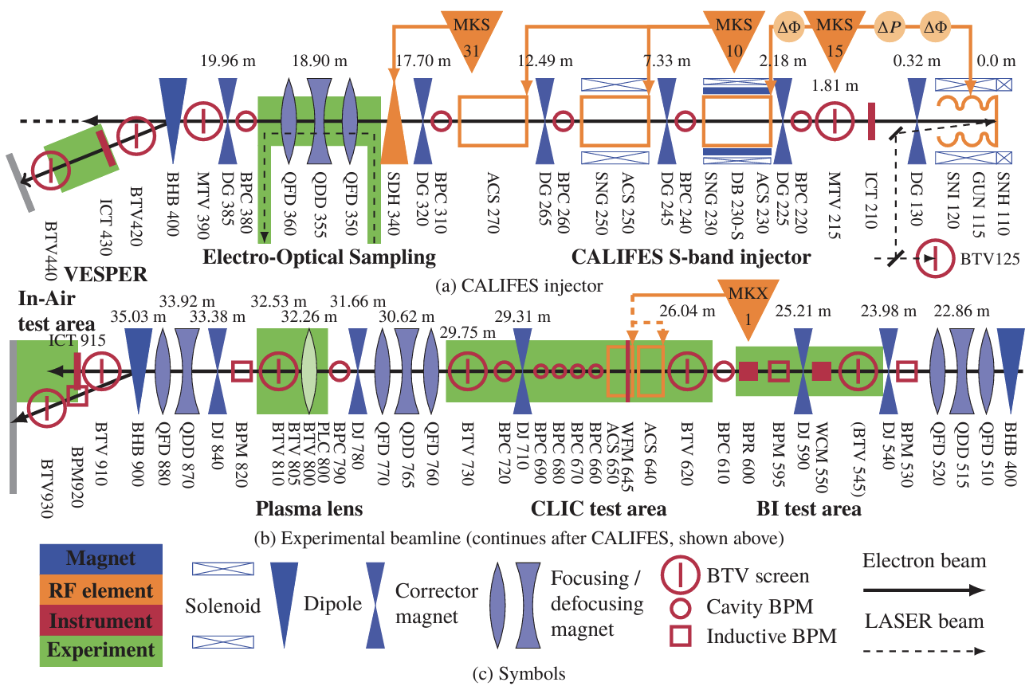
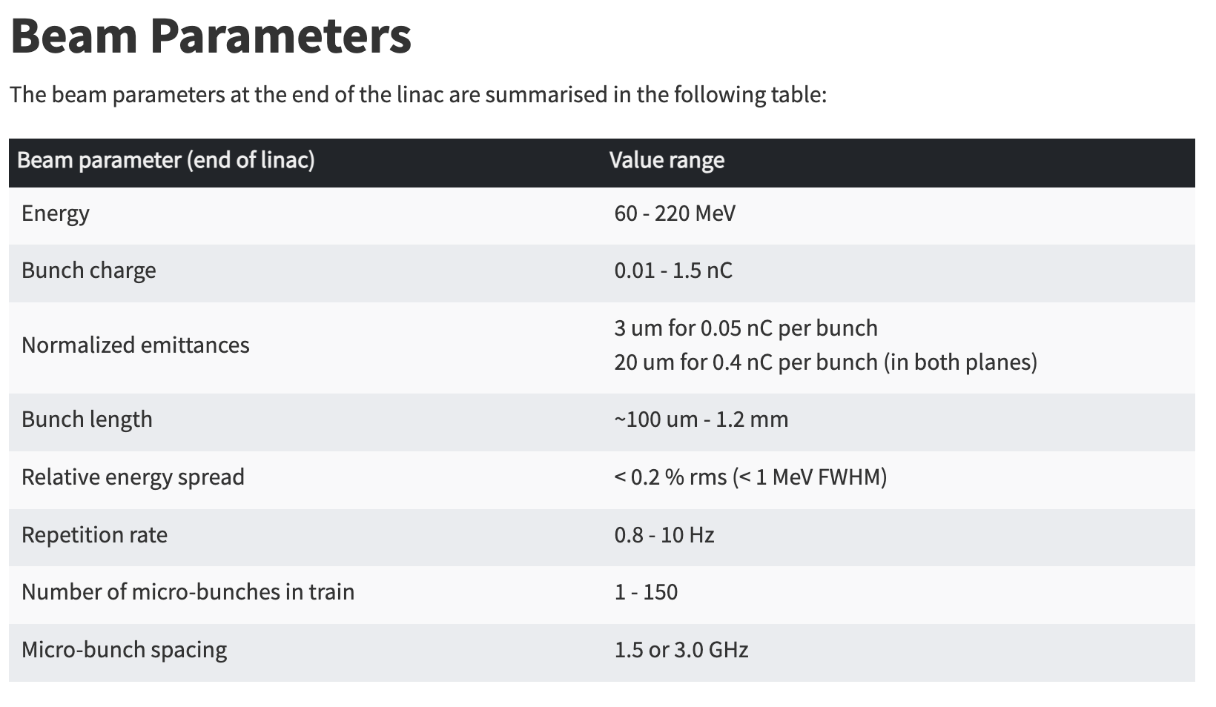
The Bonus Beam Strike Study
In discussions with CERN to write a proposal for beam strike study at CLEAR facility.
If approved, the beam time would be free. The only costs would be shipping samples and/or travel.
https://clear.cern/content/beam-line-description
K. Sjobak et al, "Status of the CLEAR Electron Beam User Facility at CERN", in proceedings of IPAC2019 (Melbourne), May 2019, MOPTS054, doi:10.18429/JACoW-IPAC2019-MOPTS054, https://cds.cern.ch/record/2695092.

Slide 18
Work Breakdown
Budget ($K) | Total | FY25
 | $292.4 | $292.4
Requested Budget for Effort by Investigator
Name of Investigator | Role (PI, Co-I, etc.) | FY25 Budget ($K) | FY25 Effort (% FTE) | Total Effort (%FTE)
Ryan Bodenstein | PI | 77.9 | 0.35 | 0.35
Kirsten Deitrick | Co-I | 20.4 | 0.10 | 0.10
Edith Nissen | Co-I | 45.9 | 0.20 | 0.20
Bamunuvita Gamage | Co-I | 58.7 | 0.30 | 0.30
Joseph Meyers | Support | 9.3 | 0.05 | 0.05
David Hamlette | Support | 10.9 | 0.05 | 0.05
Neil Wilson | Support | 9.4 | 0.05 | 0.05
Subtotal for effort |  | 232.5 | 1.1 | 1.1
Equipment | Non-capital | 10.6
 | Capital
Subcontracts | Person/ organization
Materials/ Supplies |  | 39
Travel |  | 10
Equipment | Justification | Projected Cost ($K in FY25)
Spare Teslameter Probe | Funds to replace and calibrate fragile Teslameter probe if it fails/breaks. | 10.6
Name of Material | Description | Cost per FY ($K) | Total Cost ($K)
Dosimetry | Area dosimeters, low & high-dose optichromic rods (through RadCon) | 28.7 | 28.7
3D Printing | Funds for printing or replacing mounts, etc… | 5.3 | 5.3
Misc. Supplies | Cables, connectors, safety equipment, power supplies, and other supporting items. | 5.4 | 5.4
Activity | Destination | Name of travelers | Estimated Cost ($K)
“Bonus” beam-strike studies at CLEAR/CERN (Days TBD, 1-2 weeks likely) | Meyrin, Switzerland (CERN) | TBD – up to two of the Co-Investigators | 10

Slide 19
Future Funding
As the FFA@CEBAF energy upgrade study continues, further hardware tests will likely follow.
FFA@CEBAF collaboration plans to apply for future FOA’s to further larger hardware tests.
If the FFA@CEBAF proposal is selected as the path forward for Jefferson Lab, the larger collaboration will likely move onto specifically allocated funds.
External parties (Cockcroft Institute, RHUL, BNL, etc…) have shown interest in future collaboration on this work, which may result in funding.

Slide 20
Concluding Statements
This LDRD directly addresses a JLAAC recommendation for the development of the FFA@CEBAF project.
By the end of this project, we expect to have a data-driven model capable of assessing the degradation various materials/grades/assemblies will experience during FFA@CEBAF operation.
In addition to furthering general knowledge of permanent magnet material behavior in multi-GeV environments, it develops measurement methods and techniques new to the lab.
The results of this project will further support the FFA@CEBAF concept and provide insight into Halbach permanent magnets for the wider community.
This work has already garnered broad attention and interest in the accelerator community.

