Slide 1
LD2413 Development of µRWELL-PICOSEC Detectors FY24 – Q3 meeting
Kondo Gnanvo
JLab Radiation Detectors & Imaging Group (RD & I Group)
JLab - RD & I Group
Wenze Xi, Jack McKisson, Brian Kross, Akash Pandey
Seung Joon Lee
Stony Brook university
Jaydeep Data
Nathan Shankman

Slide 2
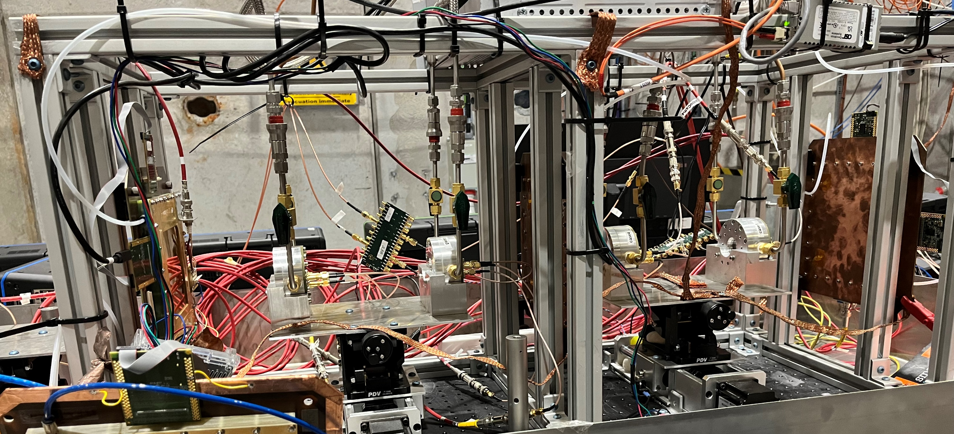
FY24 Q3 Meeting – Single-channel prototypes in April & July 2024 test beam @ CERN
µRWELL-PICOSEC telescope
PICOSEC telescope was operational, used in April and July test beam
4 × single-channel protos as well as up to 2 large prototypes
7 different µRWELL-PICOSEC prototypes tested in beam
MCP-PMT & 3 × GEM trackers for timing & tracking
DAQ: 10-ch custom preamplifier (or CIVIDEC) + Oscilloscope DAQ
A tracking software was developed to interface with CERN MATLAB analysis tool
More than 100 runs of 50k event each were taken ➔ analysis ongoing
GEM TRK2
GEM TRK3
GEM TRK1
MCP PMT
proto2
proto3
proto4
proto1
µRWELL-PICOSEC telescope with 4 single-channel prototypes in July 2024 test beam
μRWELL -PICOSEC PCB
Cerenkov crystal
Cathode-spacer
µRWELL-PCB
Outer board PCB
Prototype tested in LED setup
Assembly of the single-channel µRWELL-PICOSEC prototype

Slide 3
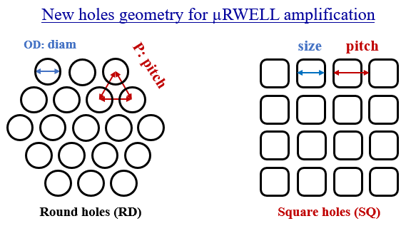
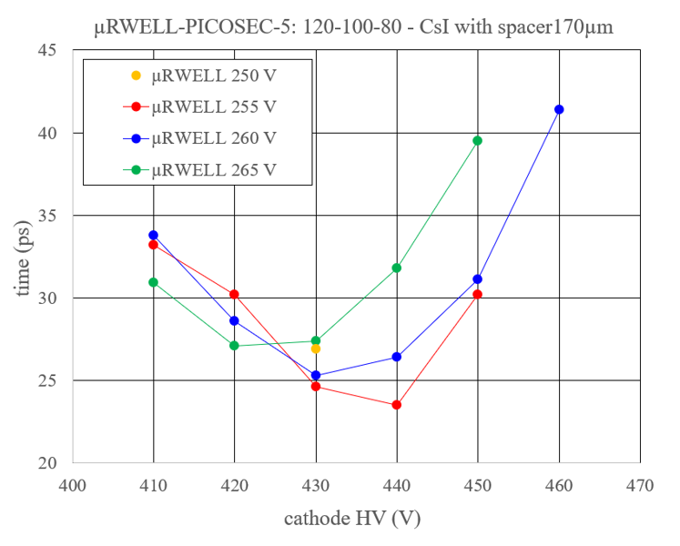
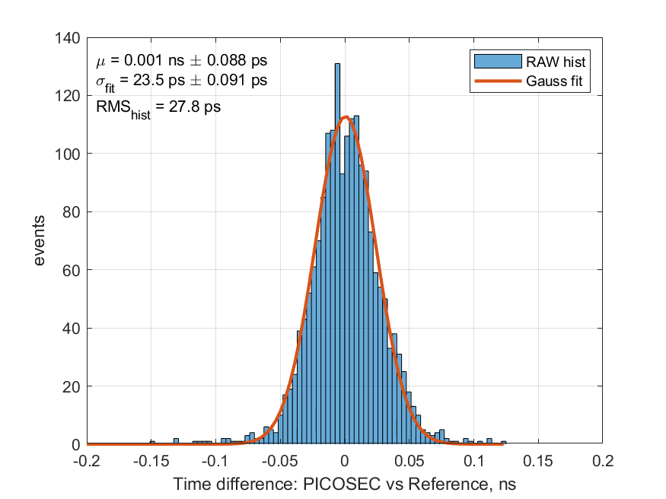
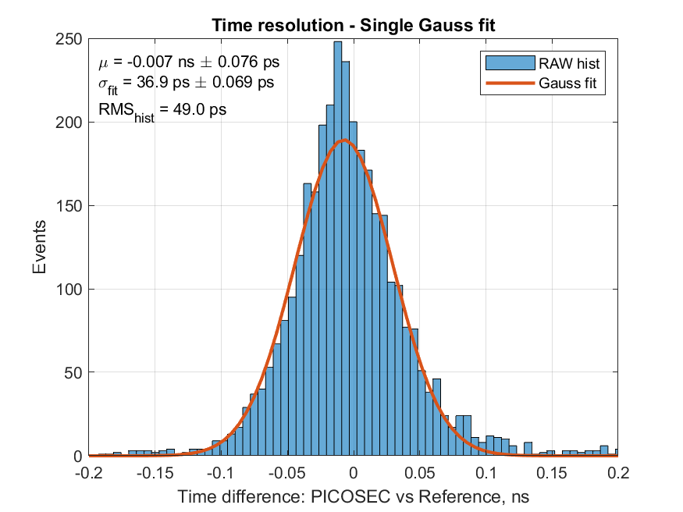
FY24 Q3 Meeting – Some preliminary results from April and July beam test
HV scan runs with the various prototypes with different holes and pad geometries
Tested with 2 photocathodes Cesium Iodide (CsI) and Diamond like Carbon (DLC)
Excellent timing response with both photocathodes (23.5 for CsI and 37 for DLC)
Data analysis ongoing
Single channel Prototypes | μRWELL hole Shape | μRWELL Pitch (µm) | μRWELL OD (µm) | μRWELL ID (µm) | Readout Pad
μRWELL 13 | Round | 80 | 60 | 40 | Plain
μRWELL 11&12 | Round | 100 | 80 | 60 | Hash
μRWELL 9&10 | Round | 100 | 80 | 60 | Plain
μRWELL 7&8 | round | 120 | 100 | 80 | Hash
μRWELL 5&6 | round | 120 | 100 | 80 | Plain
μRWELL 3&4 | square | 120 | 100 | 80 | Hash
μRWELL 1&2 | square | 120 | 100 | 80 | Plain
pad readout geometries
GND
Different single-channel μRWELL –PICOSEC prototypes fabricated
Plain electrode
Hash electrode
CsI photocathode
Npe ~7 ➔ excellent timing resolution 
Handling in vacuum x
Hygroscopic x
Ion bombardment x
High rate limitation x
DLC photocathode
Npe ~2-3 ➔ worse timing resolution x
Very stable material 
No hygroscopic 
Ion bombardment 
High rate 
σ = 37 ps
σ = 23.5 ps
HV scan

Slide 4
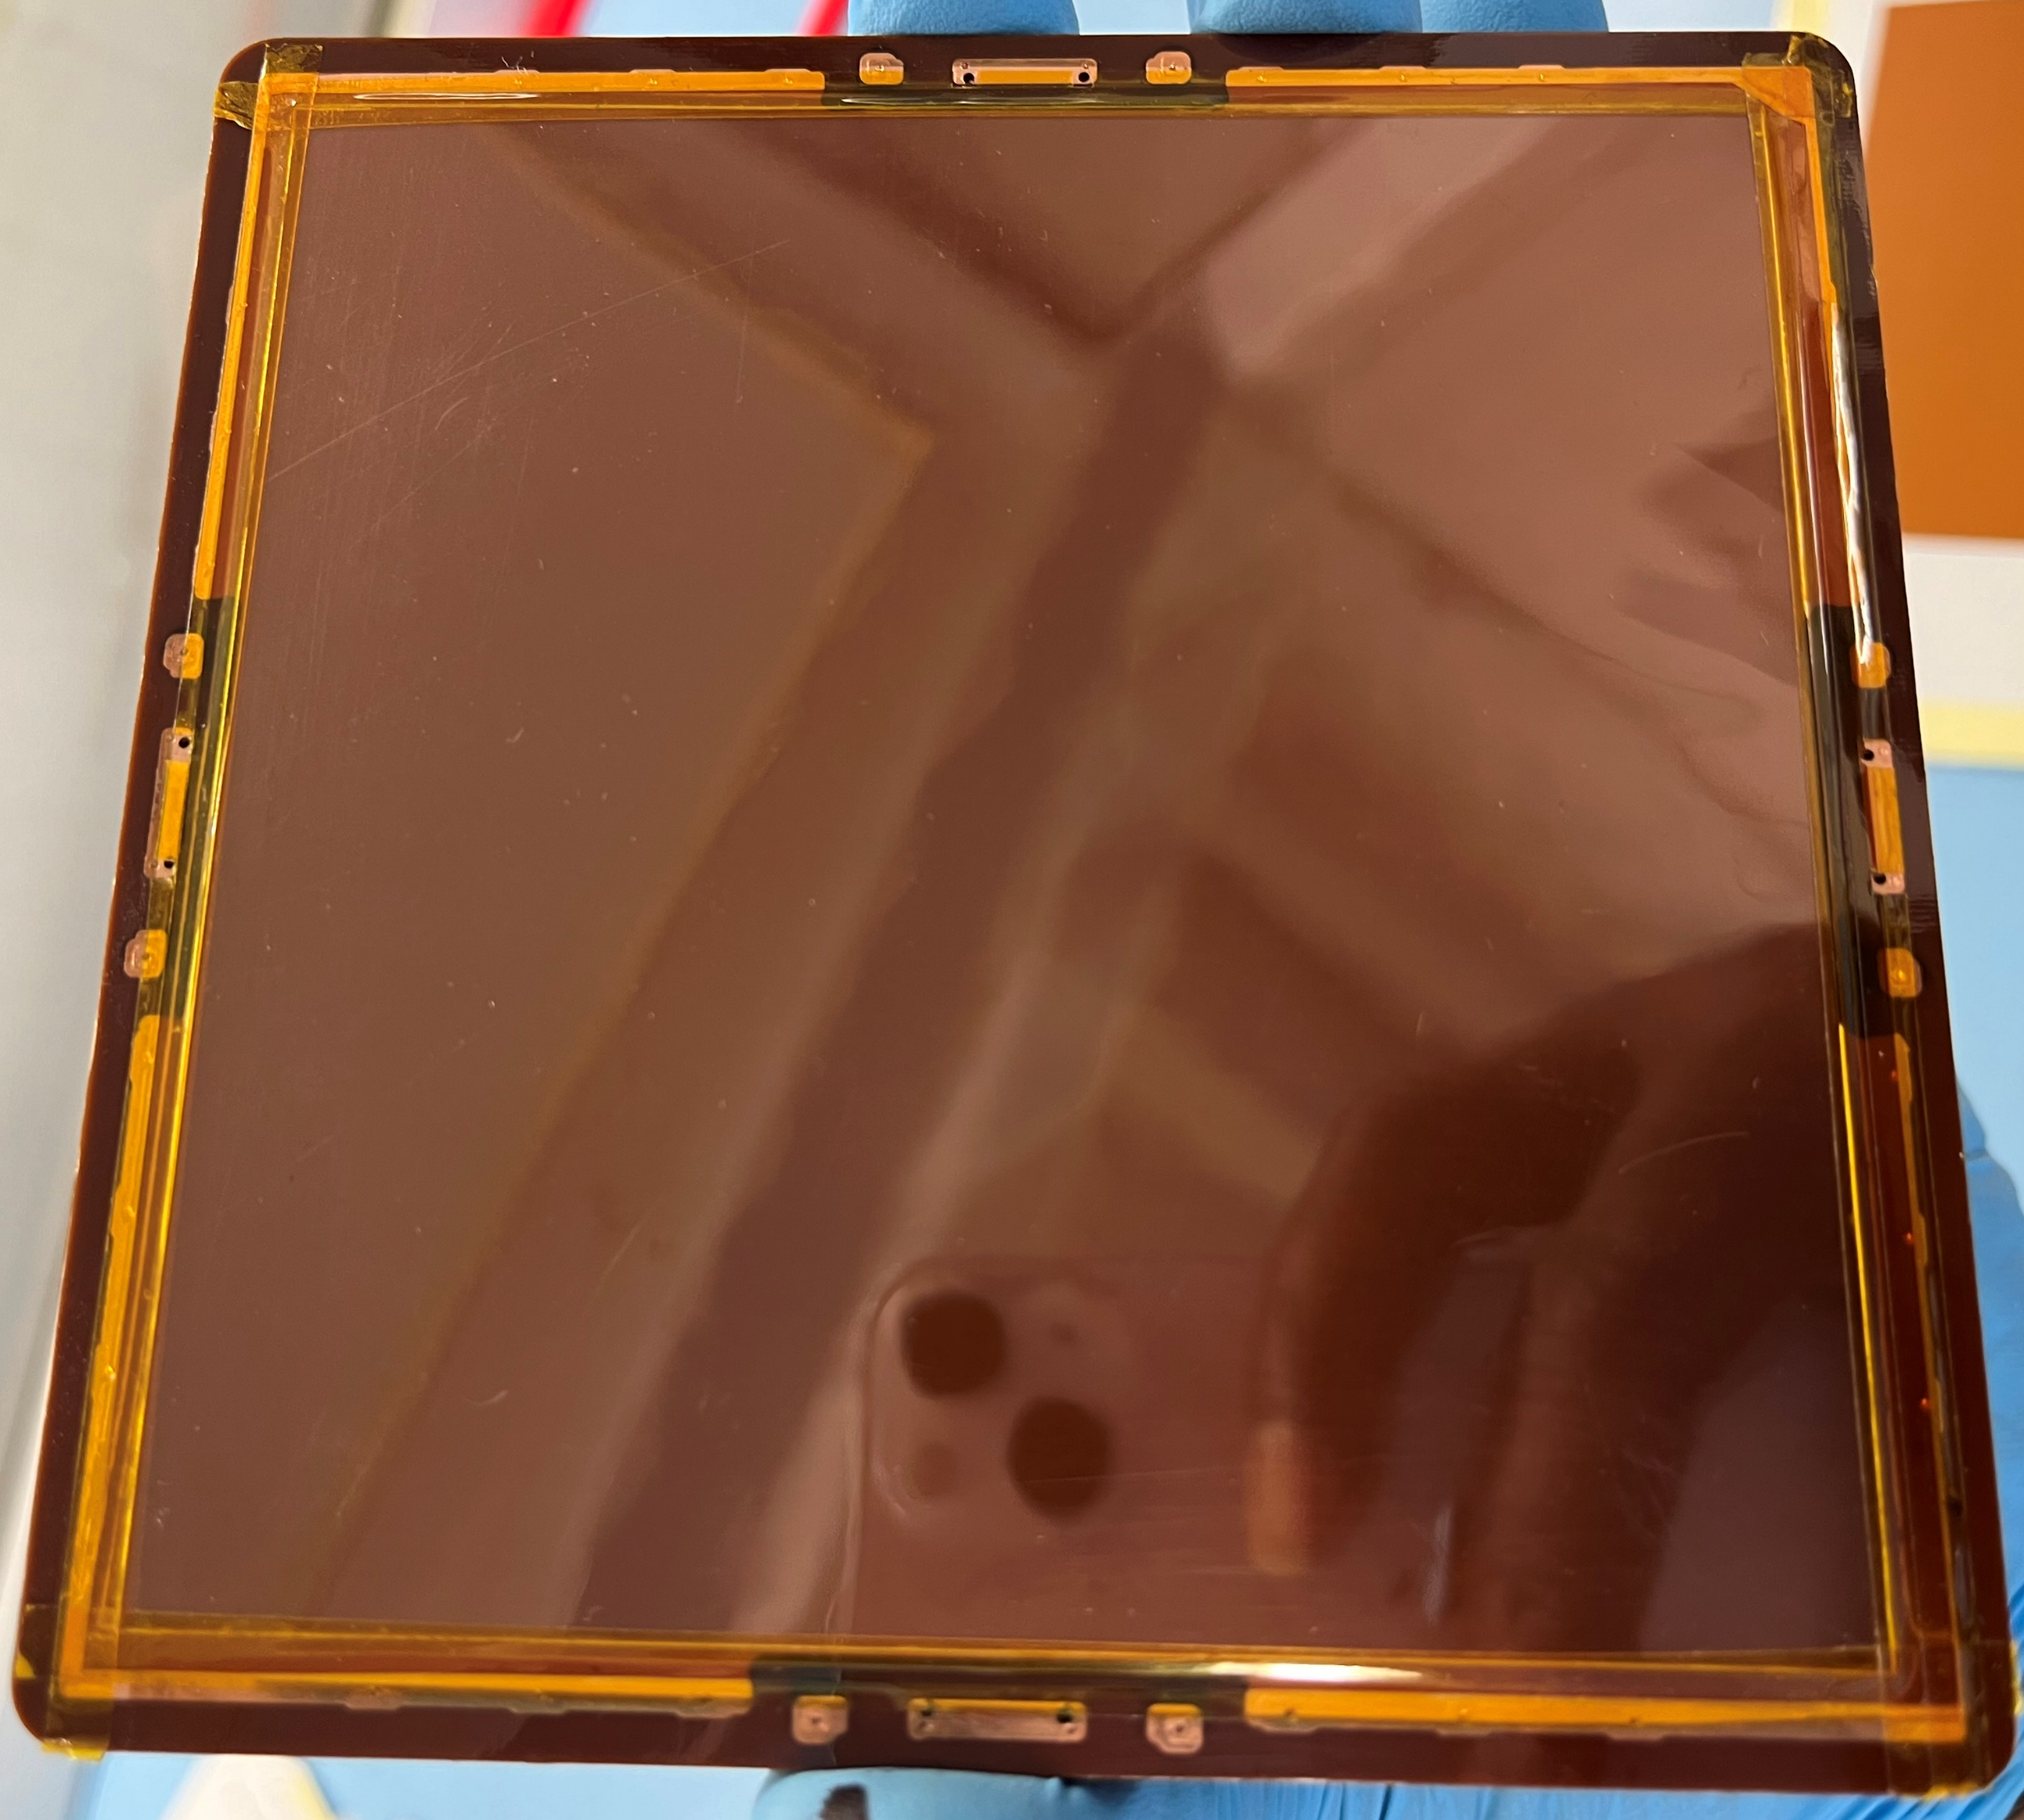
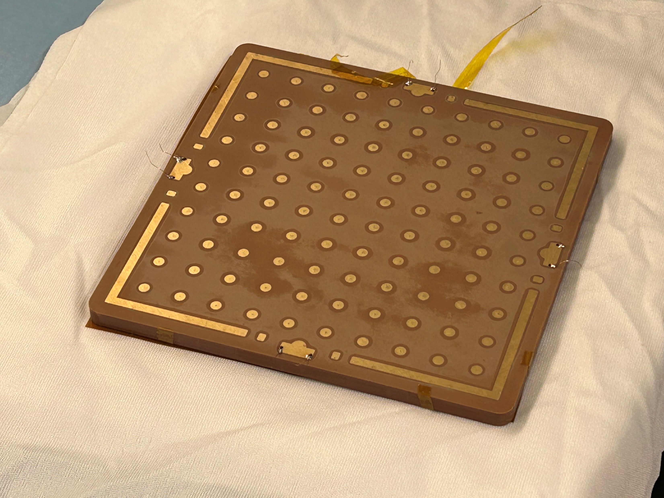
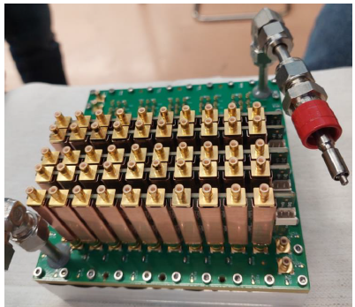
FY24 Q3 Meeting – Large (10cm × 10cm) 100-pads µRWELL-PICOSEC prototype
Back side of 100-pads µRWELL PCB
Aluminum housing
100-pads µRWELL PCB for PICOSEC
Outer PCB readout interface
Design of large (10 cm × 10 cm) 100-pads μRWELL PCB and fabrication of the PCB at CERN workshop were completed in time for test in beam the July 2024 DRD1-PICOSEC test beam at CERN
We procured all mechanical parts for the assembly into prototype including the outer PCB readout interface and the aluminum housing
For the multichannel readout system, we acquire:
a 64-channels SAMPIC waveform digitizer (TDC) board including the powered crate and controller ➔ can be scaled to up to 256 channels
Six 10-channels custom preamplifier boards developed within the DRD1-PICOSEC collaboration
10-ch custom preamplifier boards
64-channels SAMPIC crate

Slide 5
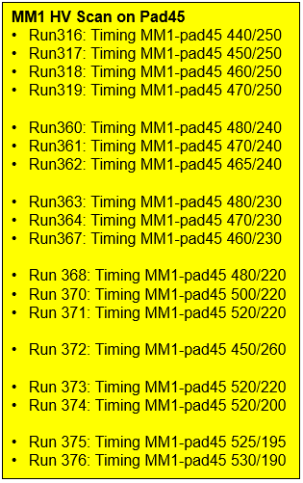
FY24 Q3 Meeting –100-pads μRWELL-PICOSEC in July 2024 test beam@ CERN
The large (10 cm × 10 cm) µRWELL-PICOSEC tested in beam July 2024
Runs with all 100 pads connected to custom preamp cards + SAMPIC digitizer
Position scan of full area (all 100 pads) ➔ dedicated SAMPIC runs
HV scan on pad45 to determine optimal voltage setting
Detector run flawlessly but planarity is poor ➔ will affect timing performance
SAMPIC Multichannel Digitizer crate
10-ch custom preamp cards
Coax signal cables
μRWELL-PICOSEC prototype
MM1 Pos Scan
Run361:Timing MM1-pad45 470/240
Run366:Timing MM1-pad67 470/240
Run391:Timing MM1-pad28 465/250

Slide 6
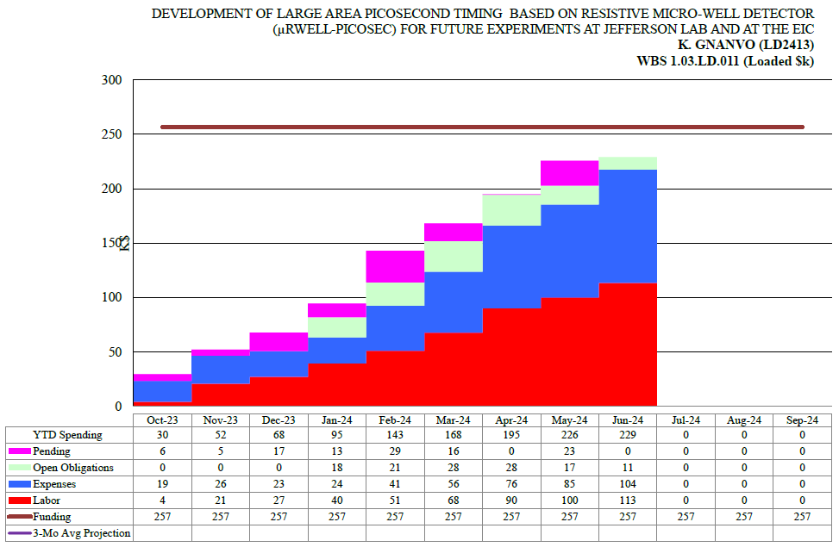
FY24 Q3 Meeting – R&D Summary, Budget & Spending Profile, Outstanding issues
LD2413 Development of μRWELL–PICOSEC summary:
Large (100-pads) μRWELL-PICOSEC prototype successfully tested in beam in July 2024
Lots of R&D on single-channel prototypes with excellent timing resolution of 23.5 ps achieved in beam
Final quarter of year II will be dedicated in test beam data analysis ➔ a lot of data and different configuration to explore
Dr Akash Pandey’s abstract on μRWELL PICOSEC accepted for oral presentation at the IEEE-NSS-MIC conference 2024
Budget and Spending profile - Variances anticipated:
Our spending trend slightly diverge from the projected profile
Material & fabrication cost higher than initially anticipated
all procurement is completed and no additional expense other than shipment of the material from CERN to JLab
Outstanding issues:
We will request supplemental financial support for the final months (August / September) of postdoc salary
Secure second year funding for postdoctoral Dr Akash Pandey
Projected spending profile for FY24
FY24 spending trend

Slide 7
backup

Slide 8
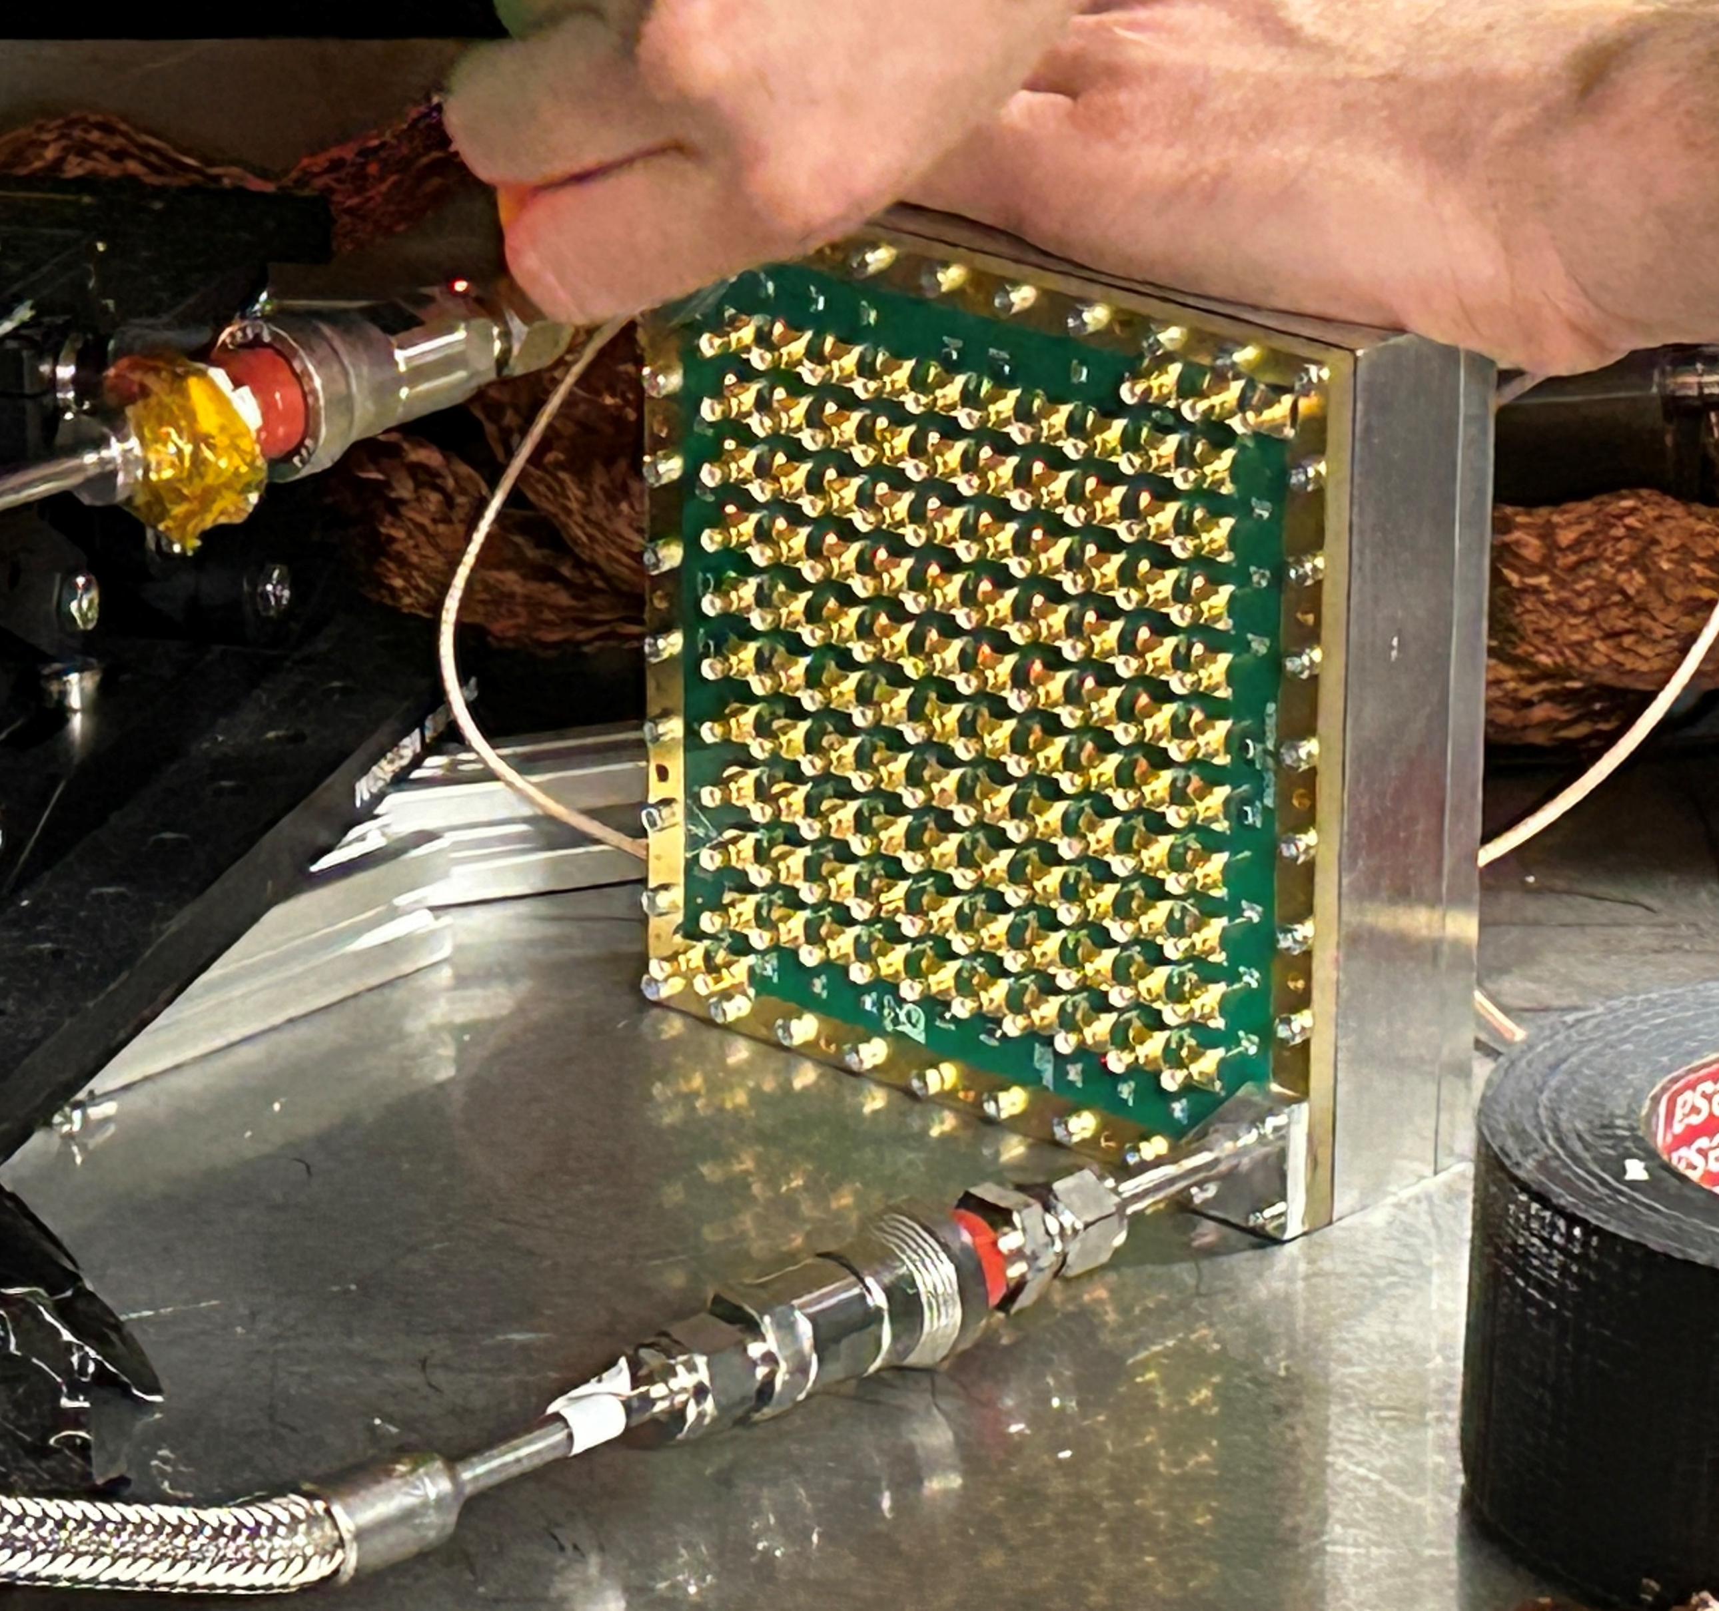
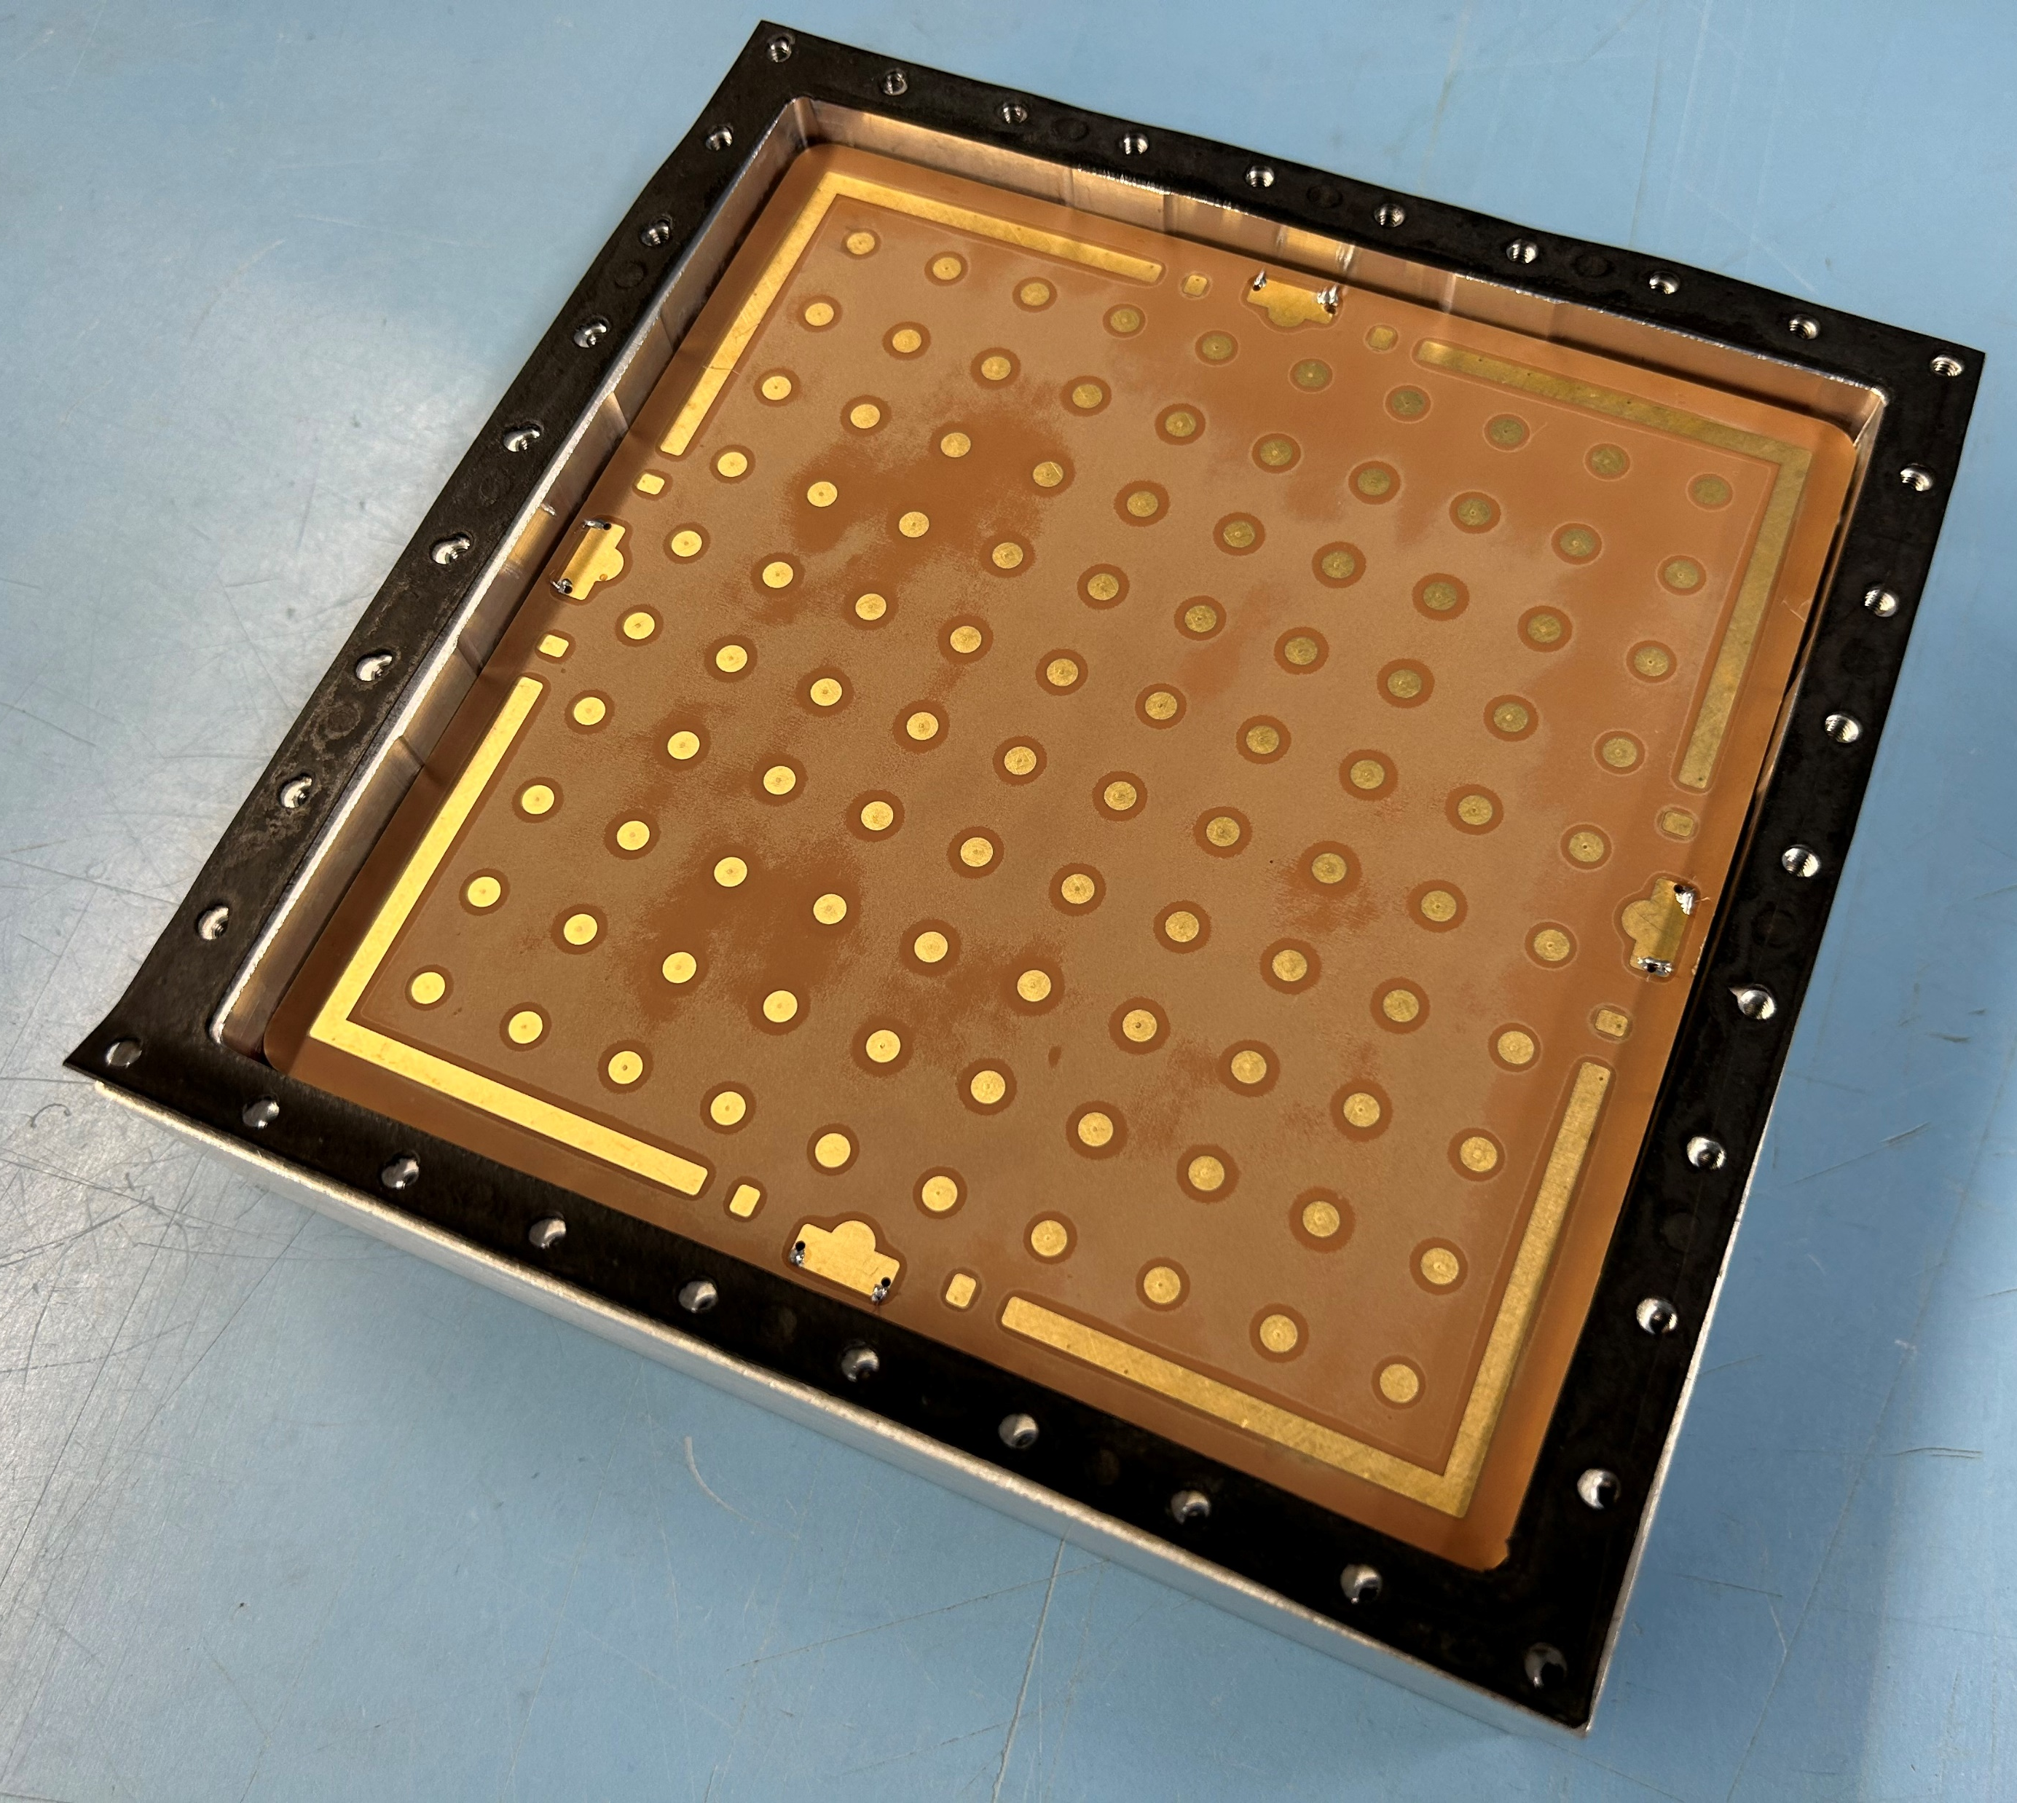
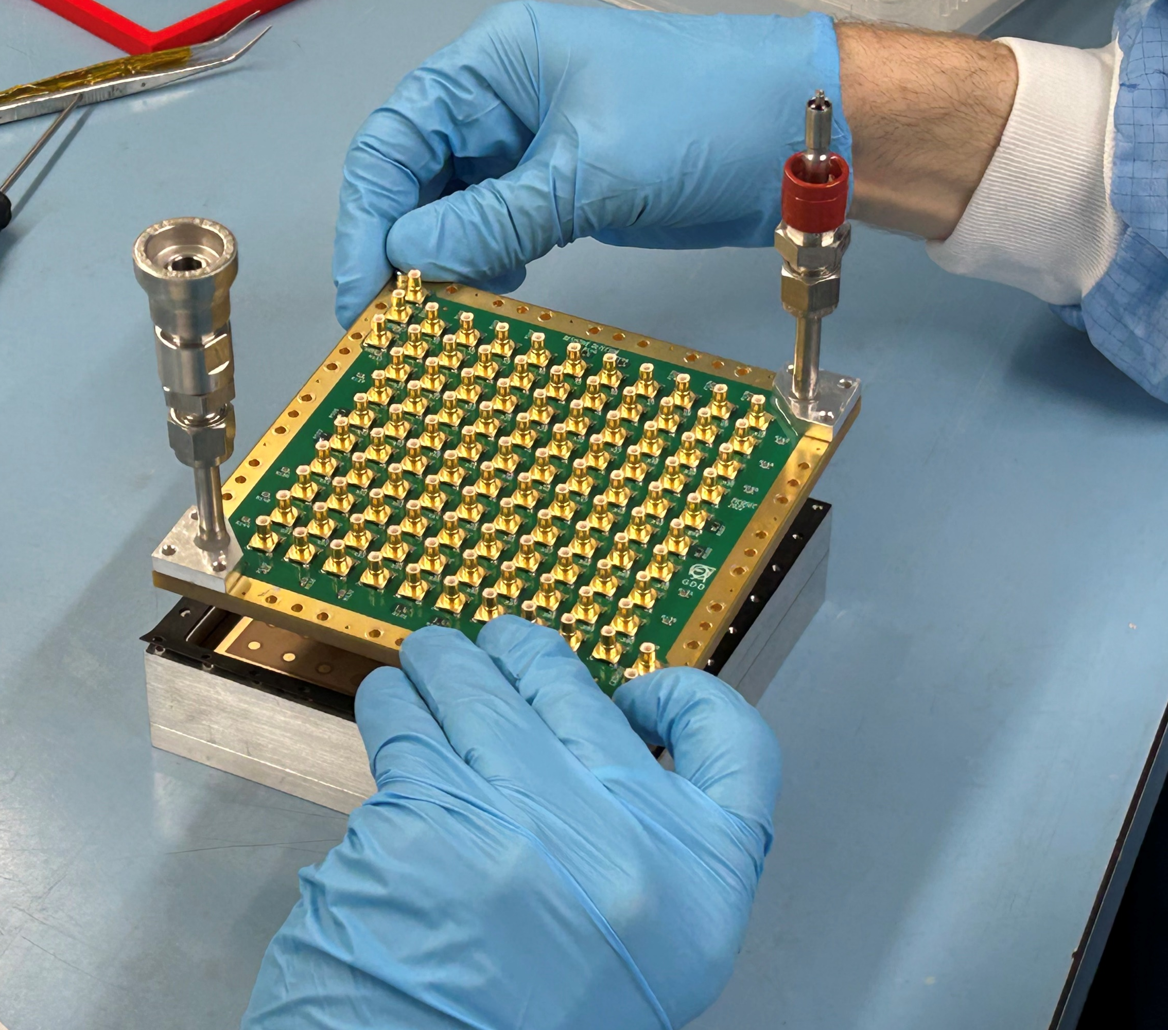
FY24 Q3 Meeting – Assembly of 100-pads μRWELL-PICOSEC
Outer readout PCB
Fused silica entrance window
Gasket for gas sealing
Al casing with MgF2 Crystal
μRWELL prototype
μRWELL-PICOSEC
Back side of the μRWELL prototype inserted in Al housing
Closing the prototype with outer readout PCB
Testing with LED setup in GDD lab

Slide 9
FY2413 µRWELL-PICOSEC – Q2 Progress & status
Optimization of single-channel µRWELL-PICOSEC prototypes
New µRWELL hole geometries: 3 main approaches under investigation
Minimize pitch to outer diameter ratio ➔ reduce e-field effect
Increase hole density ➔ Increase gain capability
Standard round holes vs. square holes ➔ mimic MM mesh pattern
Plain solid pad vs. hash pattern pad
Minimize detector capacitance ➔ improve S/N
Prototype | Shape | P (µm) | OD (µm) | ID (µm)
RD-T150-P80-D60 | round | 80 | 60 | 40
μRWELL#9 | round | 100 | 80 | 60
μRWELL#5 | round | 120 | 100 | 80
SQ-T150-P120-D100 | square | 120 | 100 | 80
Pad readout geometry
Contact
GND
Plain Cu electrode
Hash pattern Cu electrode

