Slide 1
DIDACT, The Digital Data Center Twin Project
LD2409, 2024 Q3
Bryan Hess (PI), bhess@jlab.org
Malachi Schram (Co-PI), scrham@jlab.org
Contributors: Laura Hild, Mark Jones, Diana McSpadden, Ahmed Mohammed, Wesley Moore and Mark Jones

Slide 2
Financials

Slide 3
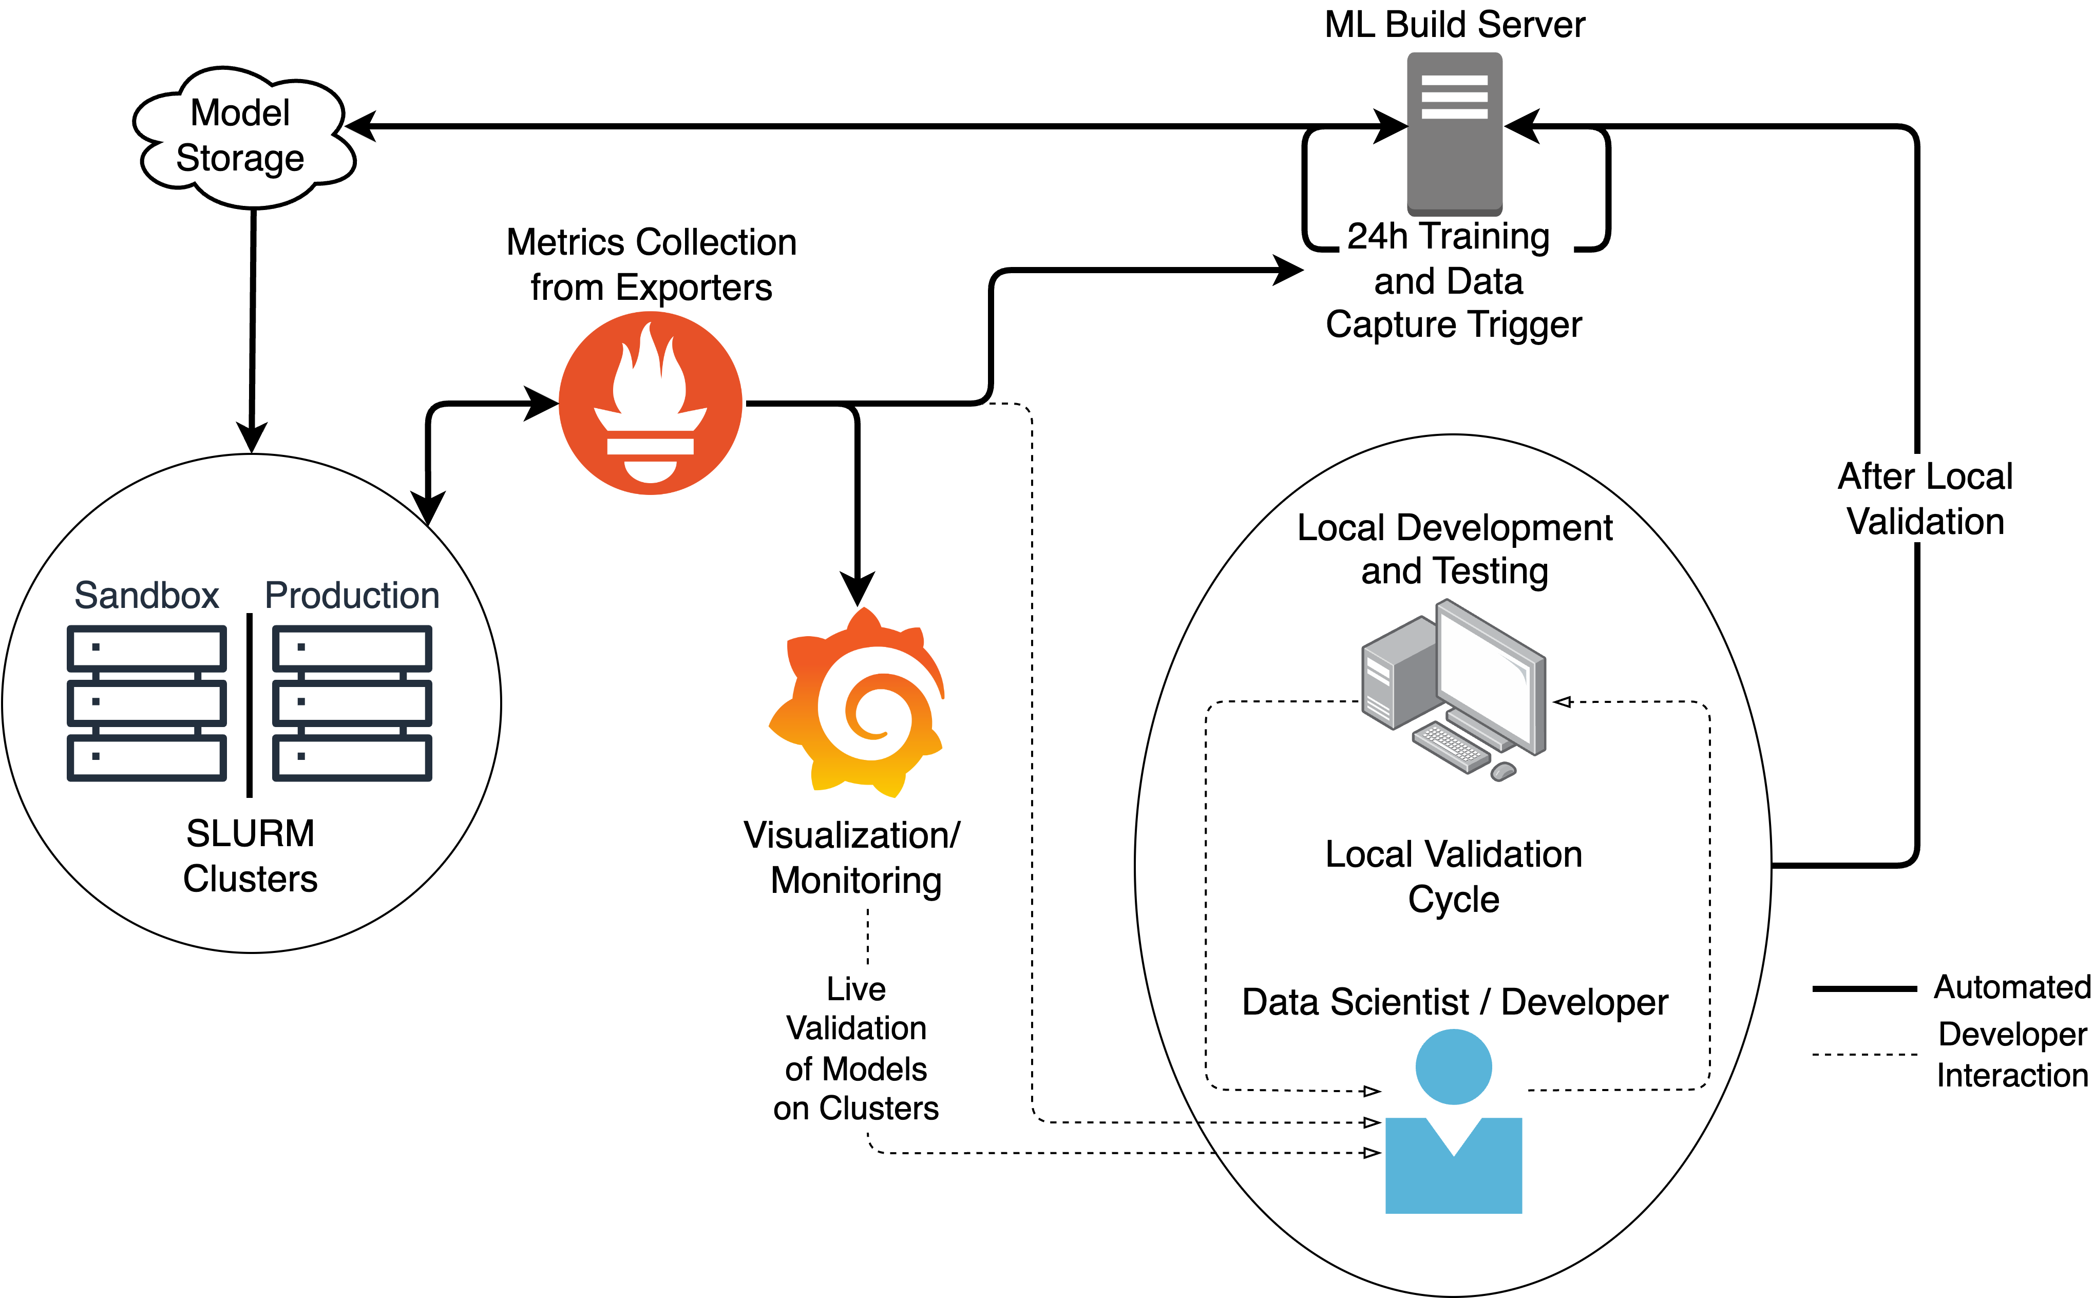
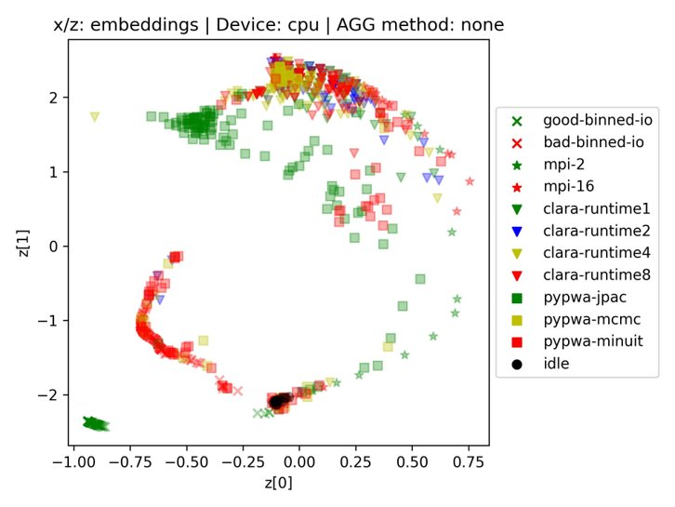
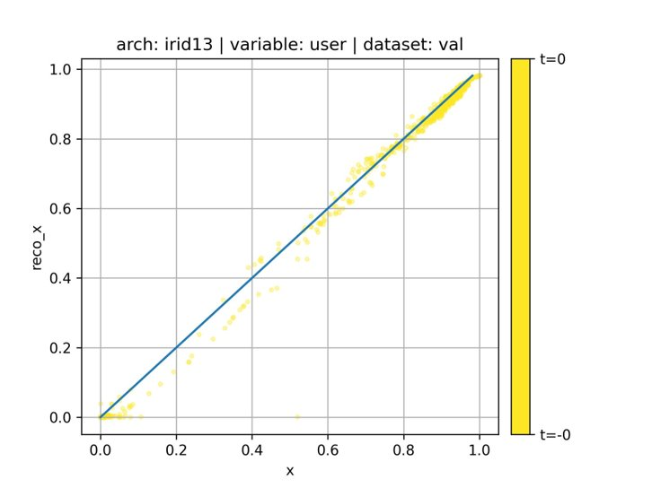
DIDACT 2024 Q3 Status – Digital Data Center Twin Project
Publications, Conferences, Proposals
Establishing MLOps for Continual Learning in Compute Clusters Accepted for upcoming issue of IEEE Software
Decode the Workload: Training Deep Learning Models for Efficient Compute Cluster Representation Accepted as poster for CHEP 2024
This MLOps capability Included in the current AI FOA
Item | Description | Progress Notes
✅ H1M1 | Summary and detail dashboards in Grafana | Completed, also includes MLFlow dashboards
✅H1M2 | Continuous learning process with daily updates | Completed
⚠️H1M3️ | Human in the loop to vet out-of-distribution events | Deferred/Linked to H2M2. Integral to the MLOps contunual learning framework
✅H1M4️ | Study the performance of Variational AutoEncoder and Graph Neural Network (GNN) models | AE performs better than VAE. GNN did not add signifcant value for these cases. BERT under study. Sampling rate issue.
✅H1M5 | Measure and characterize key timing characteristics to understand continuous learning cadence | Examples: Compared entire data set on GPU vs batch; offline data prep procedure; data storage
H2M1 | Cluster Model: Use embeddings on each node to feedback to continuous learning model to develop a cluster level model | To be studied
H2M2️ | Develop workflow to version, evaluate, and roll back models when needed | Tied to H1M3 and MLOps workflow above.
H3M3️ | Operationalize; make more robust; test with system administrators to gauge user experience and utility | Error handling in MLOps framework started; Integration with GitLab and CI/CD process TBD.
H4M4️ | Alternate scheduler and/or node level automatic controls | Node-level controls developed. Scheduling Mechanism to be studied

Slide 4
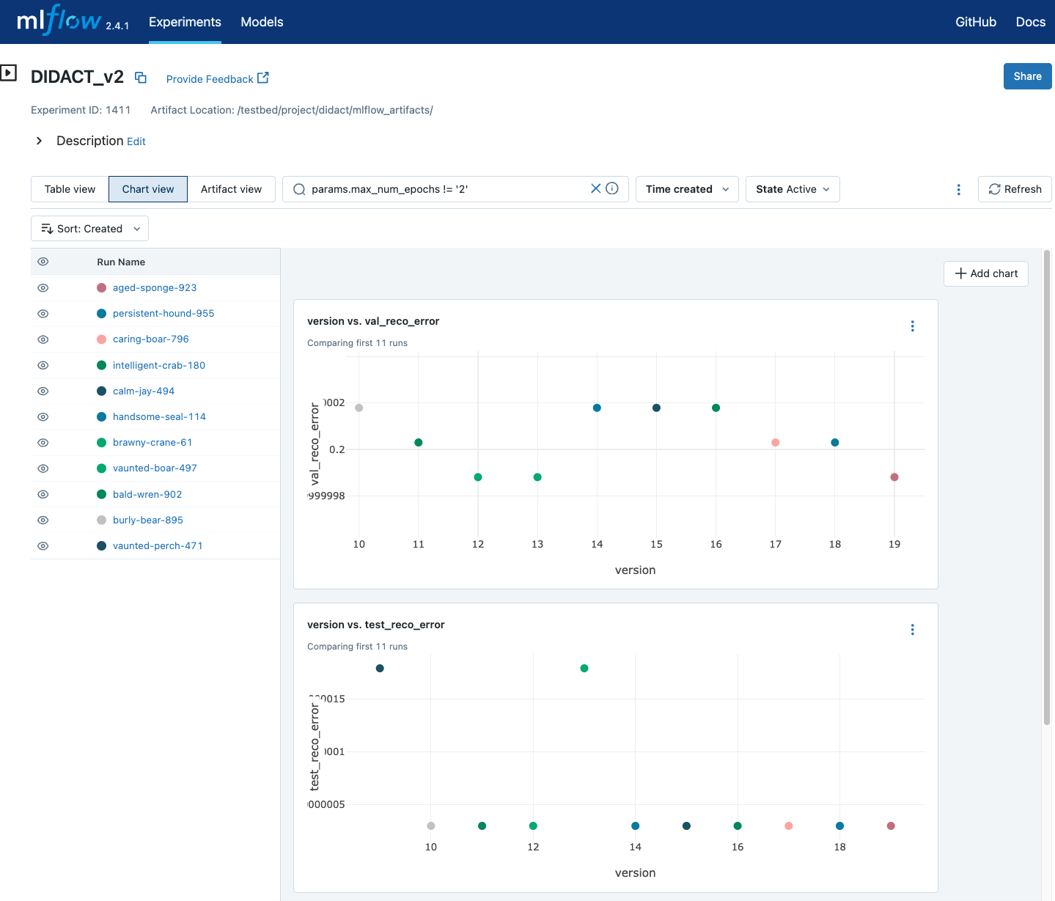
More Detail: DIDACT MLOps
We are building an MLOps (Machine Learning + DevOps) capability focused on the continual learning (CL) of a compute cluster
Why?
The CL pipeline saves model, metadata, and metrics to MLFlow
MLFlow maintains a versioned model archive, supports reproducibility
Near real-time diagnostics of the compute cluster can provide operational insight into the state of the system
MLOps stack: MLFlow -> Prometheus -> Grafana
How?
3 Nightly Jobs:
Save yesterday’s raw data from testbed nodes and farm
Pre-process (AI-ready) yesterday’s data and save
Load the current champion model and train on pre-processed data.
After training, the new champion model is registered and can be loaded for real-time inference.
New GPU-based Batch-Iterator loads all data onto GPU. Significantly decreased training time. (40% of training time with CPU features)

Slide 5
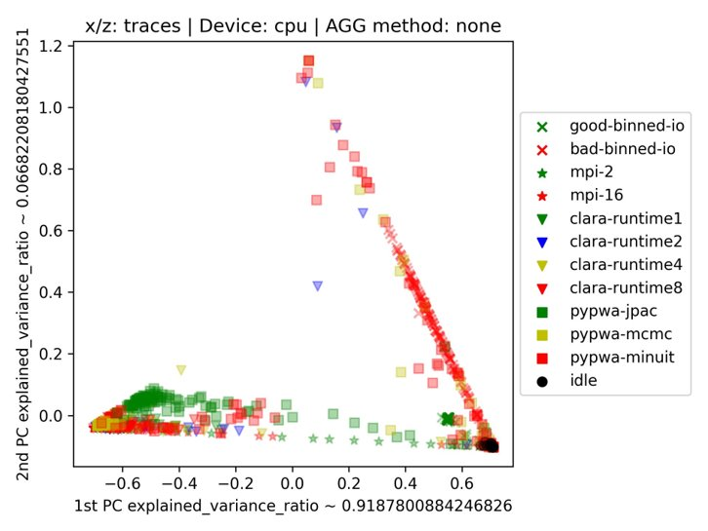
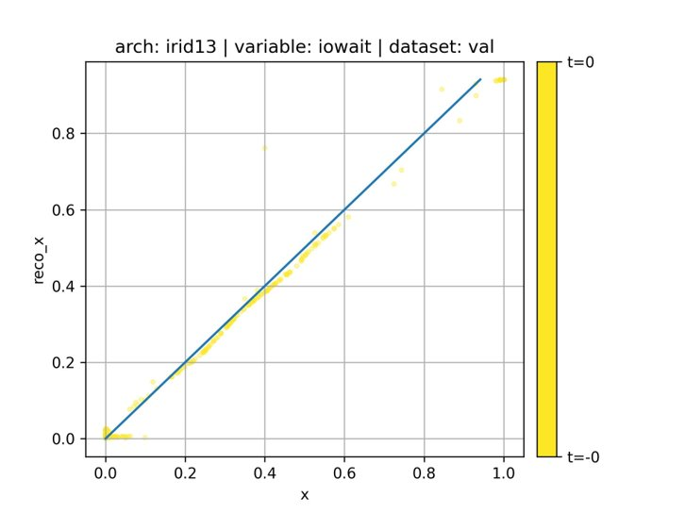
More Detail: Data & AutoEncoder (AE) model
Jobs:
IO Jobs: 2 flavors (Good-Bin, Bad-Bin)
MPI jobs: 2 flavors (MPI-2, MPI-16)
Clara-Runtime: 4 flavors (1, 2, 4, 8)
Pypwa: 3 flavors (jpac, mcmc, minuit)
Idle: Idle CPUs are considered as a distict "job"
AutoEncoder (AE) Model:
Unconditional AE (HW info is NOT used) with almost 40K trainable parameters / T = 1 / z_size = 2
Encoder: Considers only timestep of the variables [‘idle’, ‘iowait’, ‘system’, ‘user’, ‘other’] ==> Compresses into z of size 2.
Decoder: Reconstructs the variables back from the compressed z
Top right figure shows the ability of AE to preserve the clustering performed by Principal Component Analysis (PCA). For example, consider good-binned-io: AE keeps all the x points intact as they appear on PCA.
Bottom figures show the ability of the AE in capturing the salient features of the input.

Slide 6
Looking Ahead: Incorporating Data Center Power Modeling
What?
Server Power as aspect of node Modeling
Data Sources include
Networked power distribution units
System baseboard (e.g. Redfish)
Kernel-level power statistics
Why?
Modeling Systems to include power may illuminate efficiencies in power consumption
e.g. wall time vs power use
Power optimization data-center wide
Load shedding during peak periods
Current Exploration
Instrumenting Job Execution with power monitoring to test viability of the approach
Testing kernel-level controls to alter power consumption

