Slide 1
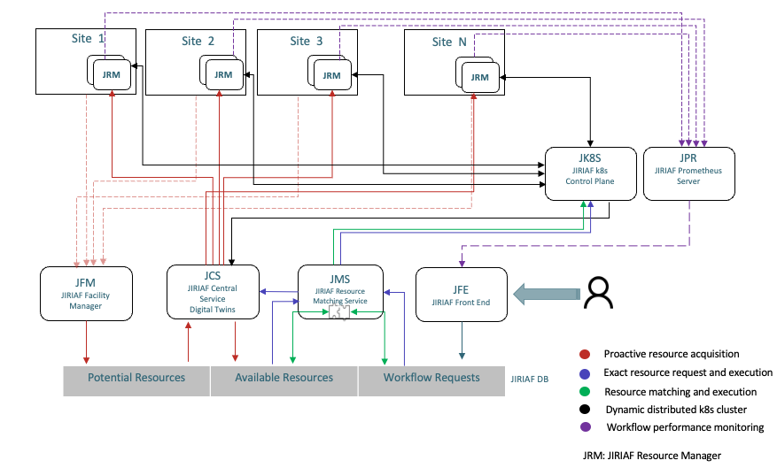
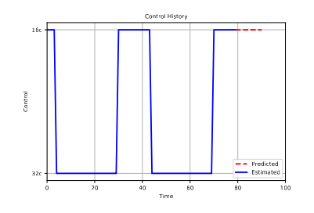
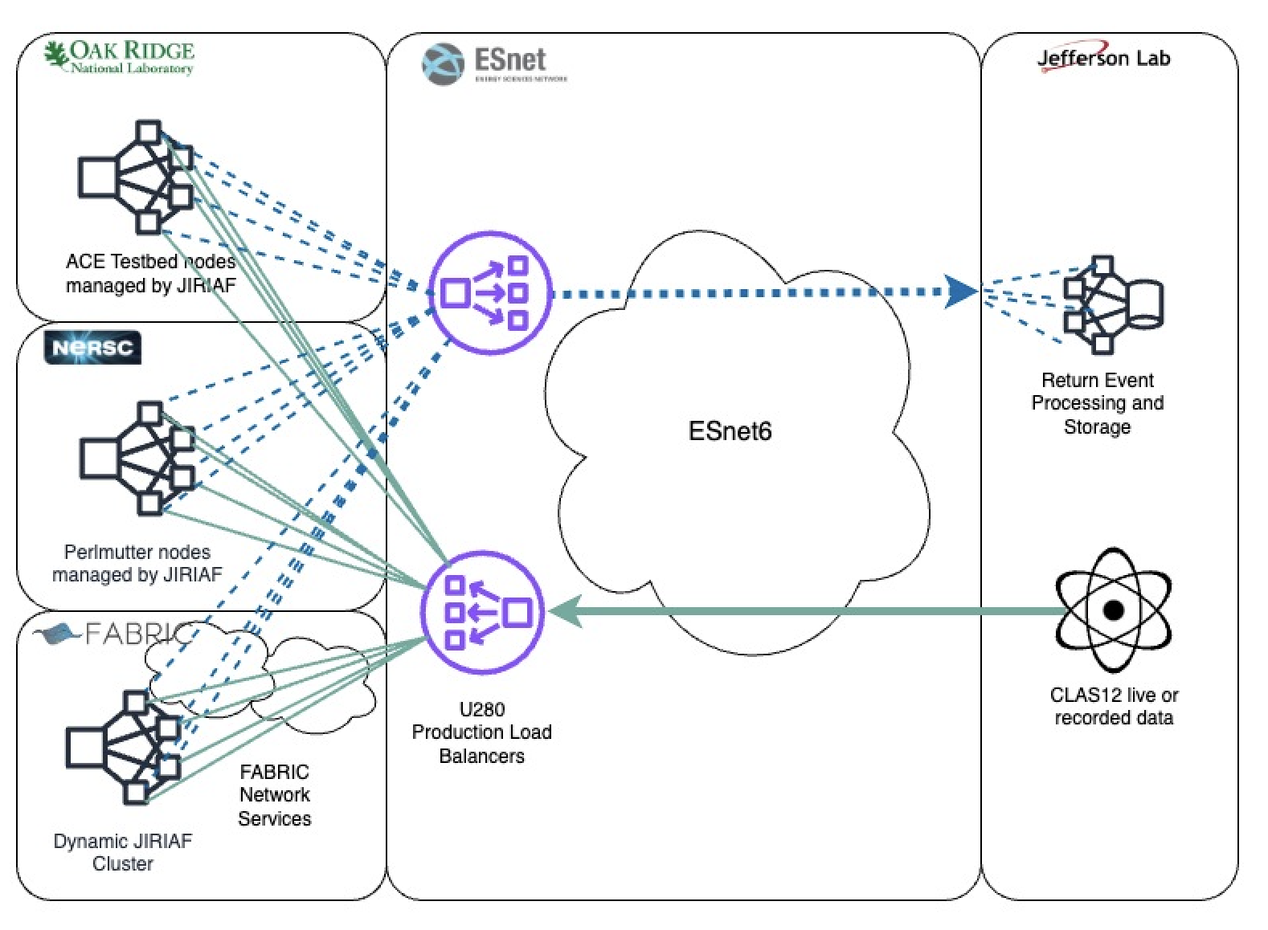
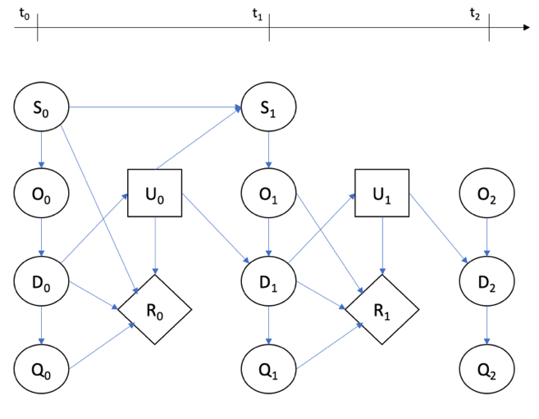
Architecture and Improvements
Q3 Milestones
Full-scale testing of the optimized JIRIAF-based system with real-world data streams.
Validation and optimization of the JIRIAF Digital Twin model, with additional features for mitigating predicted bottlenecks and latencies.
Testing, refinement, and optimization of the preliminary mathematical model of the data processing agent.
Digital Twin
Deployment Topology
Publications
1st paper is accepted for publication in the EPJ
2nd technical paper: ACAT conference proceedings (in progress).
Accepted presentation at CHEP24
IEEE/NIM paper titled “Abstract Data Processing Unit Digital Twin Based On Bayesian Probabilistic Graph Model” (in progress).
P (D₀…D_{t}, Q₀…Q_{t}, | O₀…O_{t}, U₀…U_{t}),
F_{t} = P ( D_{t} | D_{t-1}, U_{t-1} )
F^{QoI}_{t} = P ( Q_{t} | D_{t} )
F^{Control}_{t} = P ( U_{t} | D_{t}, Q_{t} )
F^{Assim}_{t} = P( O_{t} | D_{t} )

Slide 2
Research Leadership Team
Name | Personnel | Committed time [%]
Vardan Gyurjyan | PI | 25
Christopher Larrieu | Co-I | 13
Jeng-Yuan Tsai | Postdoc | 100
Patrick Meagher | Student | 50

