Slide 1
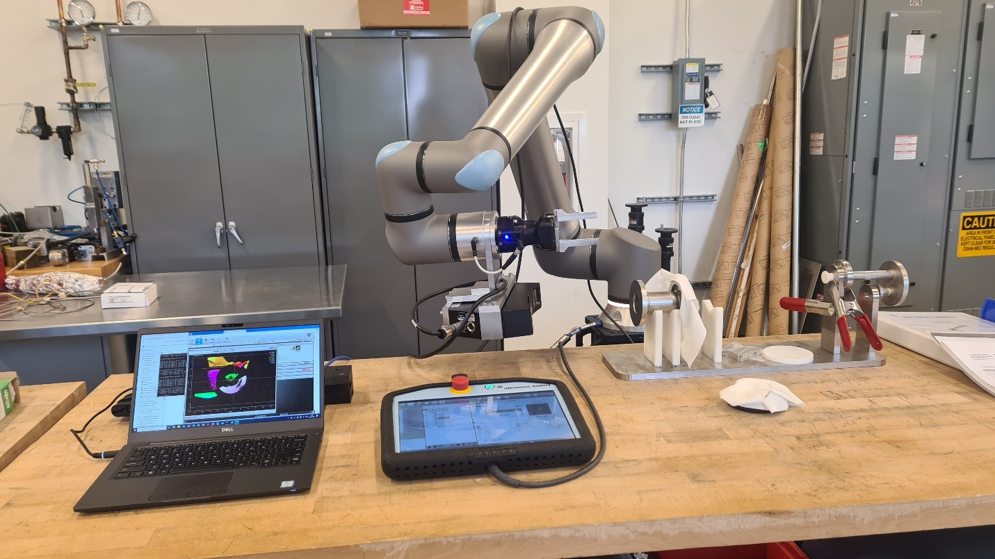
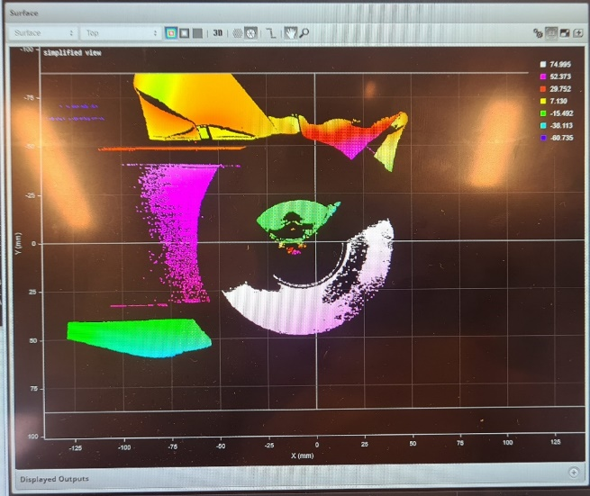
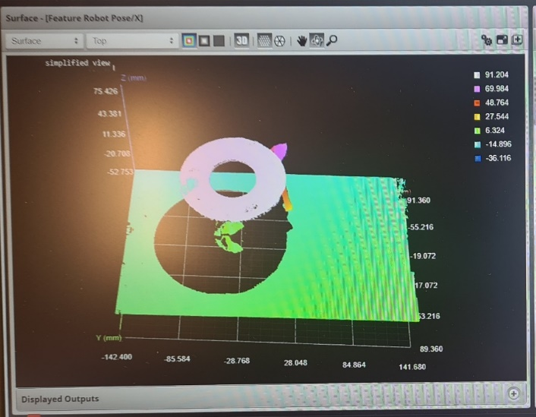
LD2401 Q3 Report - Robotic Collaboration for Particulate Free SRF Assembly
Progress
  all parts for robotic system delivered and assembled
  learned to move the robot arm in a controlled manner
  vision system software linked to the robot arm software
  can identify parts and send coordinates to the robot arm
Next Steps
  accurate positioning of parts
  test on mock-up of cavity and inner-adapter
  optimize gripper fingers
Issues
  have been low in personnel resource usage due to delivery delay,
  but working hard and catching up:
  186 hours up to 30 June; 121 hours 1-15 July

Slide 2
LD2401 Q2 Report - Robotic Collaboration for Particulate Free SRF Assembly
Financial Report

Slide 3
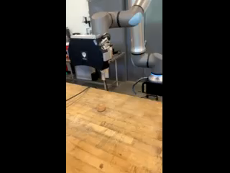
Video

