Slide 1
Spectroscopy opportunities at the EIC
Alessandro Pilloni & Derek Glazier
POETIC XI, Miami, February 27, 2025

Slide 2
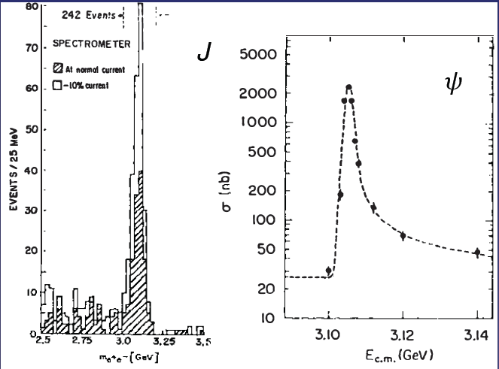
Quarkonium orthodoxy
$$Q$$
$$\overline{Q}$$
Potential models
(meaningful when $M_{Q}→∞$)
$$V\left(r\right)=−\frac{C_{F}α_{s}}{r}+σr$$
(Cornell potential)
$$α_{s}\left(M_{Q}\right)∼0.3$$
(perturbative regime)
OZI-rule, QCD multipole
Solve NR Schrödinger eq. → spectrum
Effective theories
(HQET, NRQCD, pNRQCD...)
Heavy quark spin flip suppressed by quark mass, approximate heavy quark spin symmetry (HQSS)
Integrate out heavy DOF
↓
(spectrum), decay & production rates
A. Pilloni – Spectroscopy opportunities at the EIC
Notes:
2 slides su Zc, a Bes e a Belle
2 slide su tetraquark model: dall’hamiltoniana di Jaffe al calcolo delle masse
1 slide su molecular models, dove sono i carichi? (non in Tornqvist, si in Hanhart, vedere Braaten, citare Nefediev)
2 slides su decay channels, dove si dovrebbe vedere, e a seconda del modello, vedere qualche plot
1 slide su Y(4260), tetraquark? C’è lo strano (si vede la f0)
1 slide su Zc a cleo (anche il neutro)

Slide 3
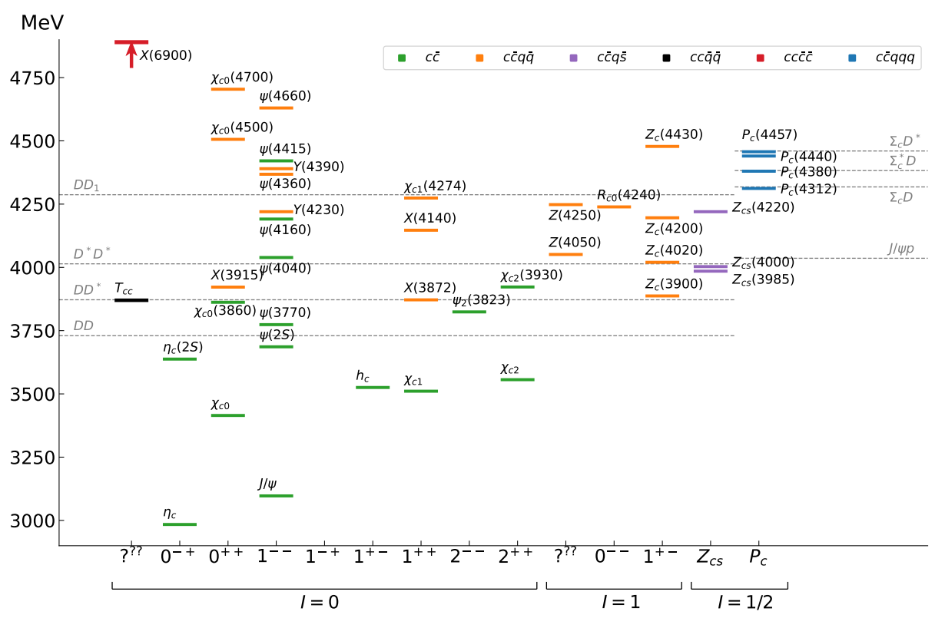
Exotic landscape in $c\overline{c}$
JPAC, PPNP
A host of unexpected resonances have appeared
decaying mostly into charmonium + light Hardly reconciled with usual $q\overline{q}$ pheno
Scarce consistency between various production mechanisms
A. Pilloni – Spectroscopy opportunities at the EIC
Notes:
2 slides su Zc, a Bes e a Belle
2 slide su tetraquark model: dall’hamiltoniana di Jaffe al calcolo delle masse
1 slide su molecular models, dove sono i carichi? (non in Tornqvist, si in Hanhart, vedere Braaten, citare Nefediev)
2 slides su decay channels, dove si dovrebbe vedere, e a seconda del modello, vedere qualche plot
1 slide su Y(4260), tetraquark? C’è lo strano (si vede la f0)
1 slide su Zc a cleo (anche il neutro)

Slide 4
Exotic landscape
Broad mesons seen in $b$ decay:
$X(4140)$, $Z(4430)$, $Z_{cs}(4000)$...
Narrow structures seen in $b$ decay:
$X\left(3872\right), P_{c}$, $(P_{cs})$
Scarce consistency between various production mechanisms
Narrow structures seen in $e^{+}e^{−}$:
$X(3872)$, $Y(4260)$, $Z_{c,b}^{(′)}$
A. Pilloni – Spectroscopy opportunities at the EIC

Slide 5
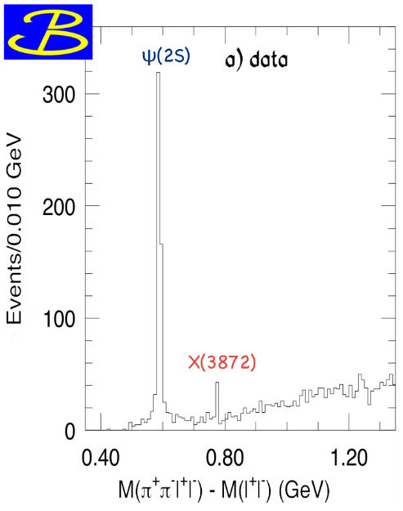
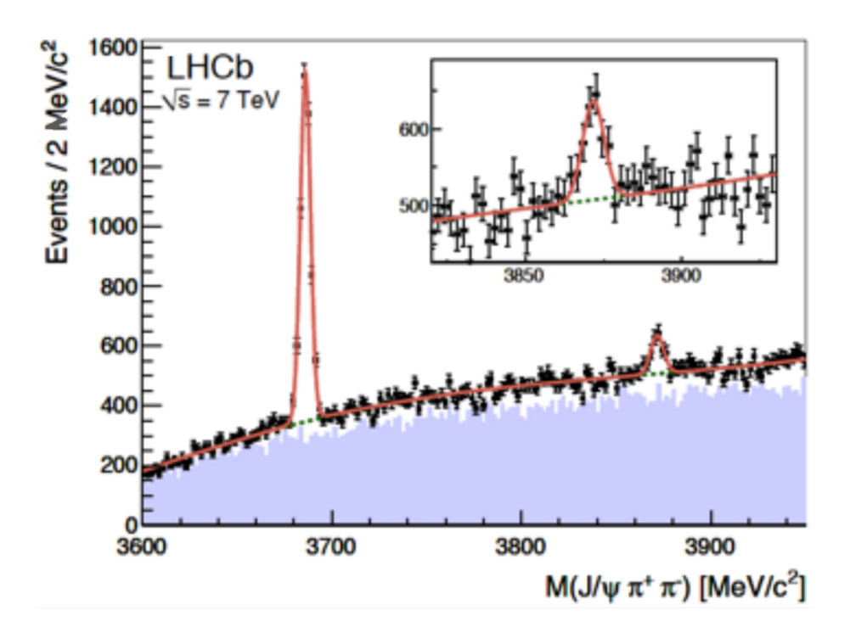
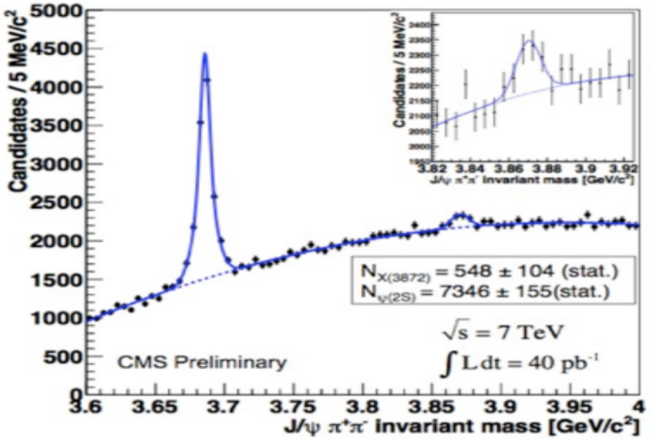
$X(3872)$
Discovered in $B→K X→K J/ψ ππ$
Quantum numbers $1^{++}$
Very close to $DD^{∗}$ threshold
Too narrow for an above-treshold charmonium
Isospin violation too big $\frac{Γ\left(X→J/ψ ω\right)}{Γ\left(X→J/ψ ρ\right)}\sim 1.1±0.4$
Mass prediction not compatible with $χ_{c1}(2P)$
$M=3871.65±0.06$MeV
$$M_{X}−M_{DD^{∗}}=−3±192 \text{keV}$$
$Γ=1.19±0.2\text{1 }\text{MeV}$
A. Pilloni – Spectroscopy opportunities at the EIC

Slide 6
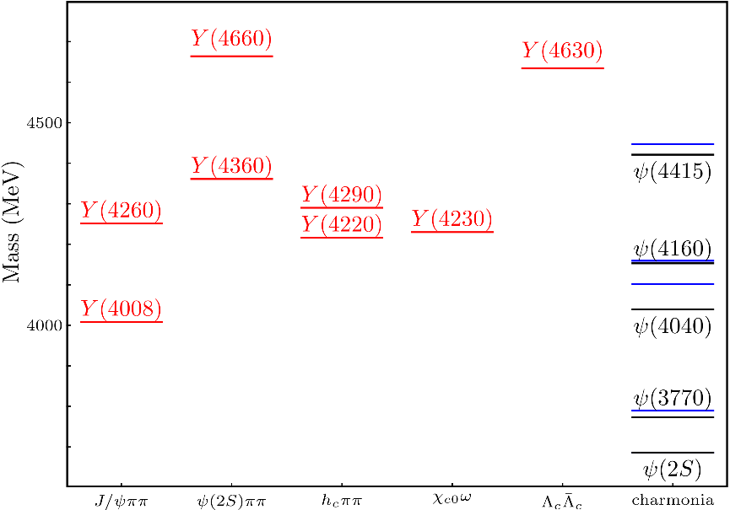
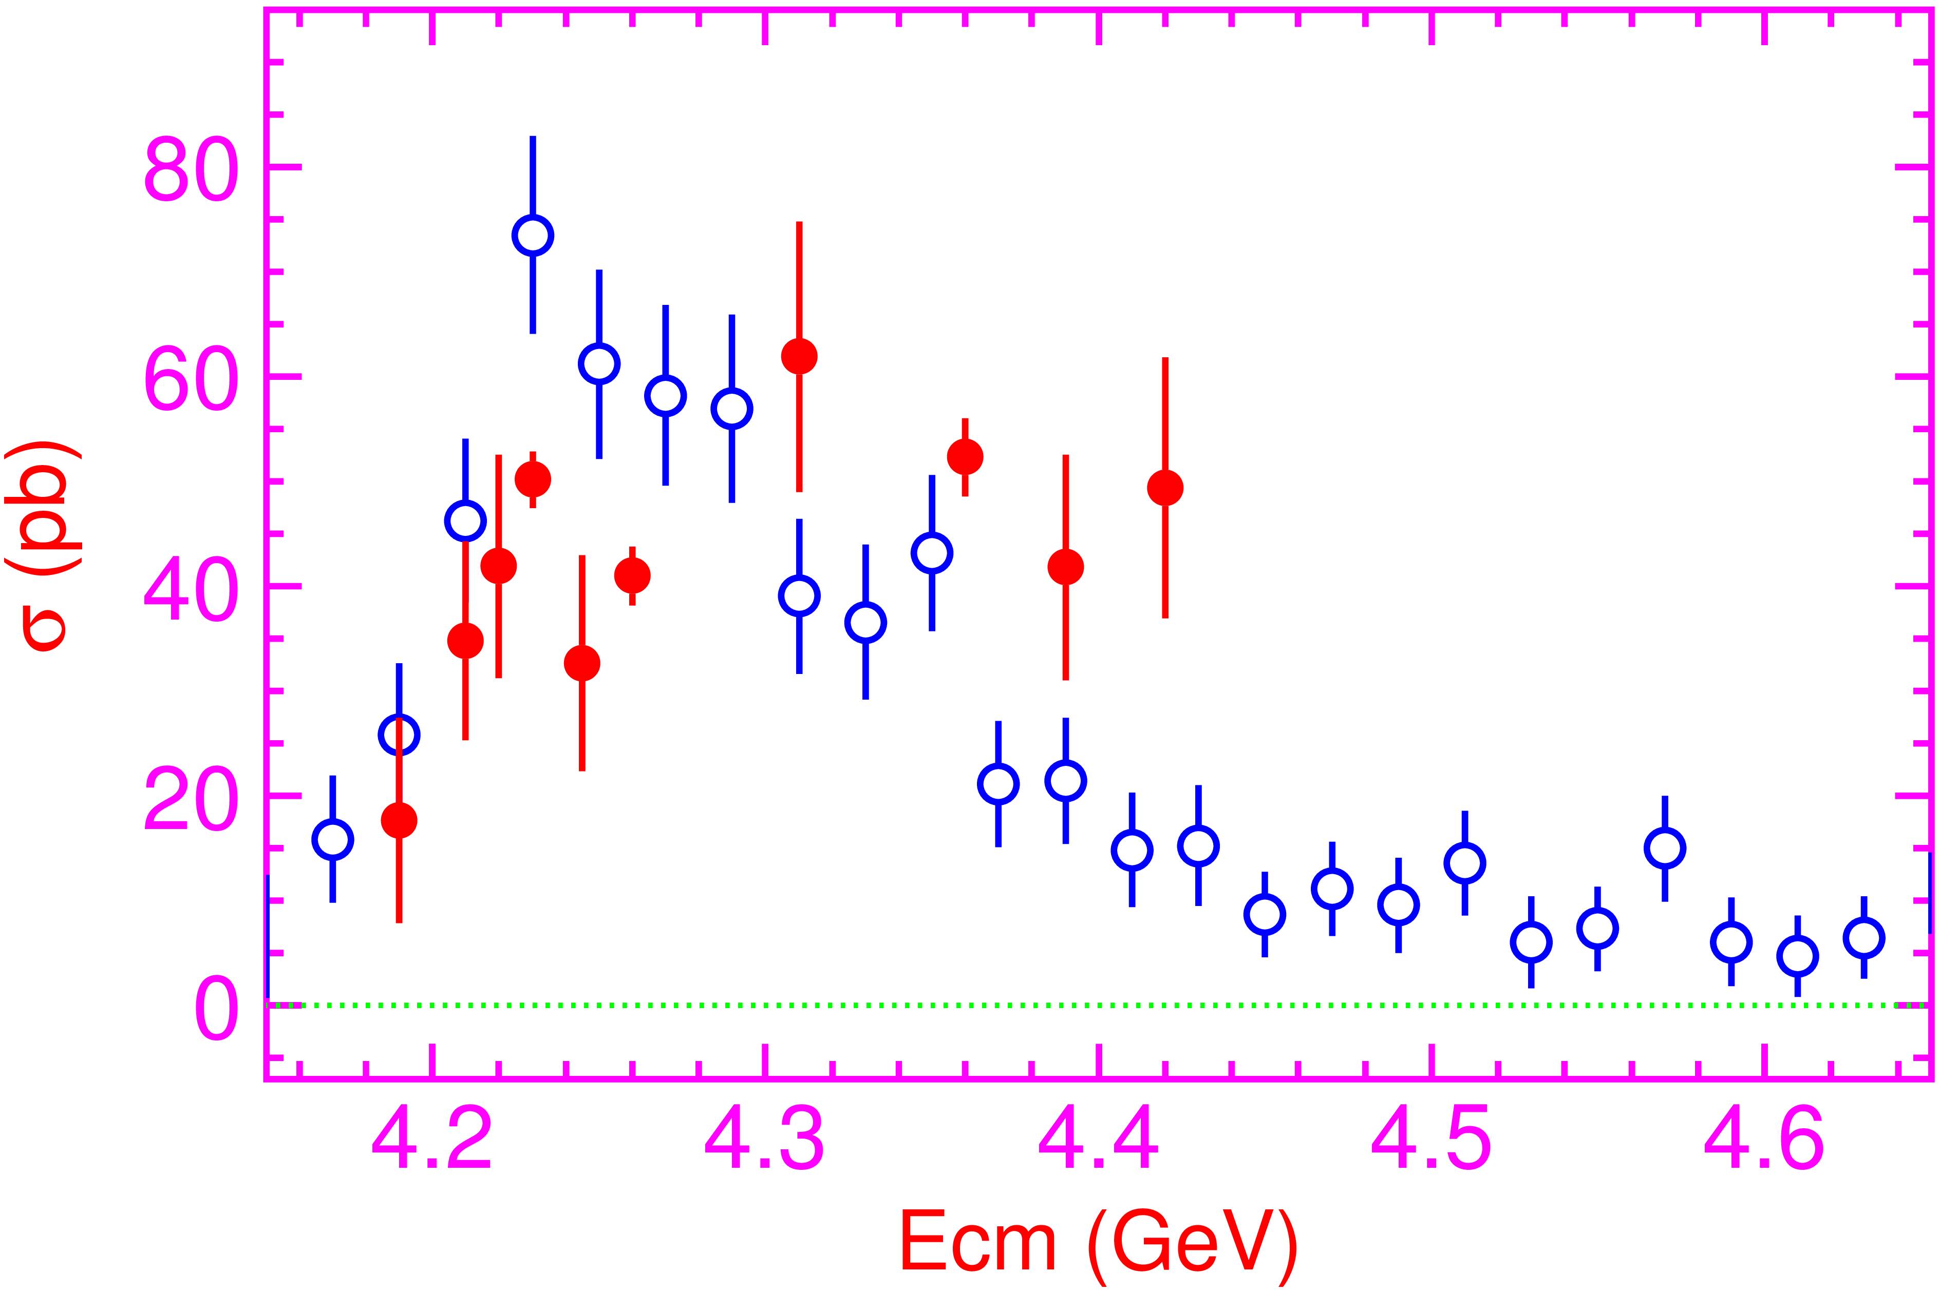
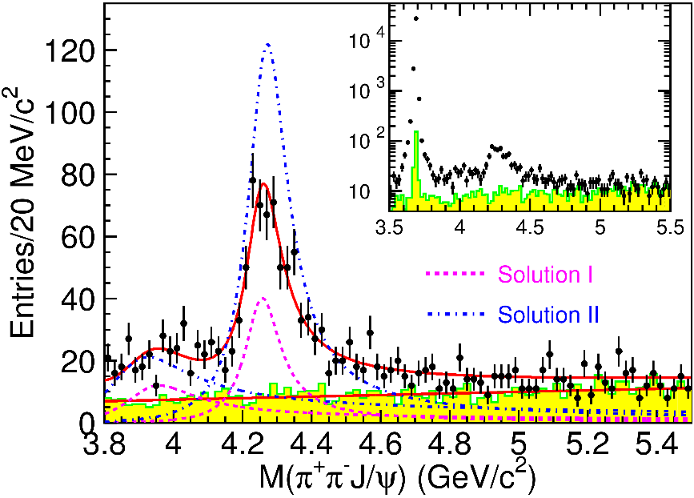
Vector $Y$ states
Lots of unexpected ${J^{PC}=1}^{−−}$ states found in ISR/direct production (and nowhere else!)
Seen in few final states, mostly $J/ψ ππ$ and $ψ\left(2S\right) ππ$
Not seen decaying into open charm pairs
Large HQSS violation
Belle $J/ψππ$
BES $h_{c}ππ$
A. Pilloni – Spectroscopy opportunities at the EIC
Notes:
Y(4260), M=4263 +- 5, Gamma = 95+-14
D_1(2420)^0, M=2421.3 ±0.6, Gamma =27.1 ±2.7
D_1(2420)^+-, M=2423.4 ±3.1, Gamma =25 ±6
I D_1 hanno J^P = 1^+
La molecola D_1 D sta 22 MeV sotto
Se la Y è D_1 D, il pione lega fortemente, come fa la Y a essere così larga?
Come funziona lo scambio del pione???

Slide 7
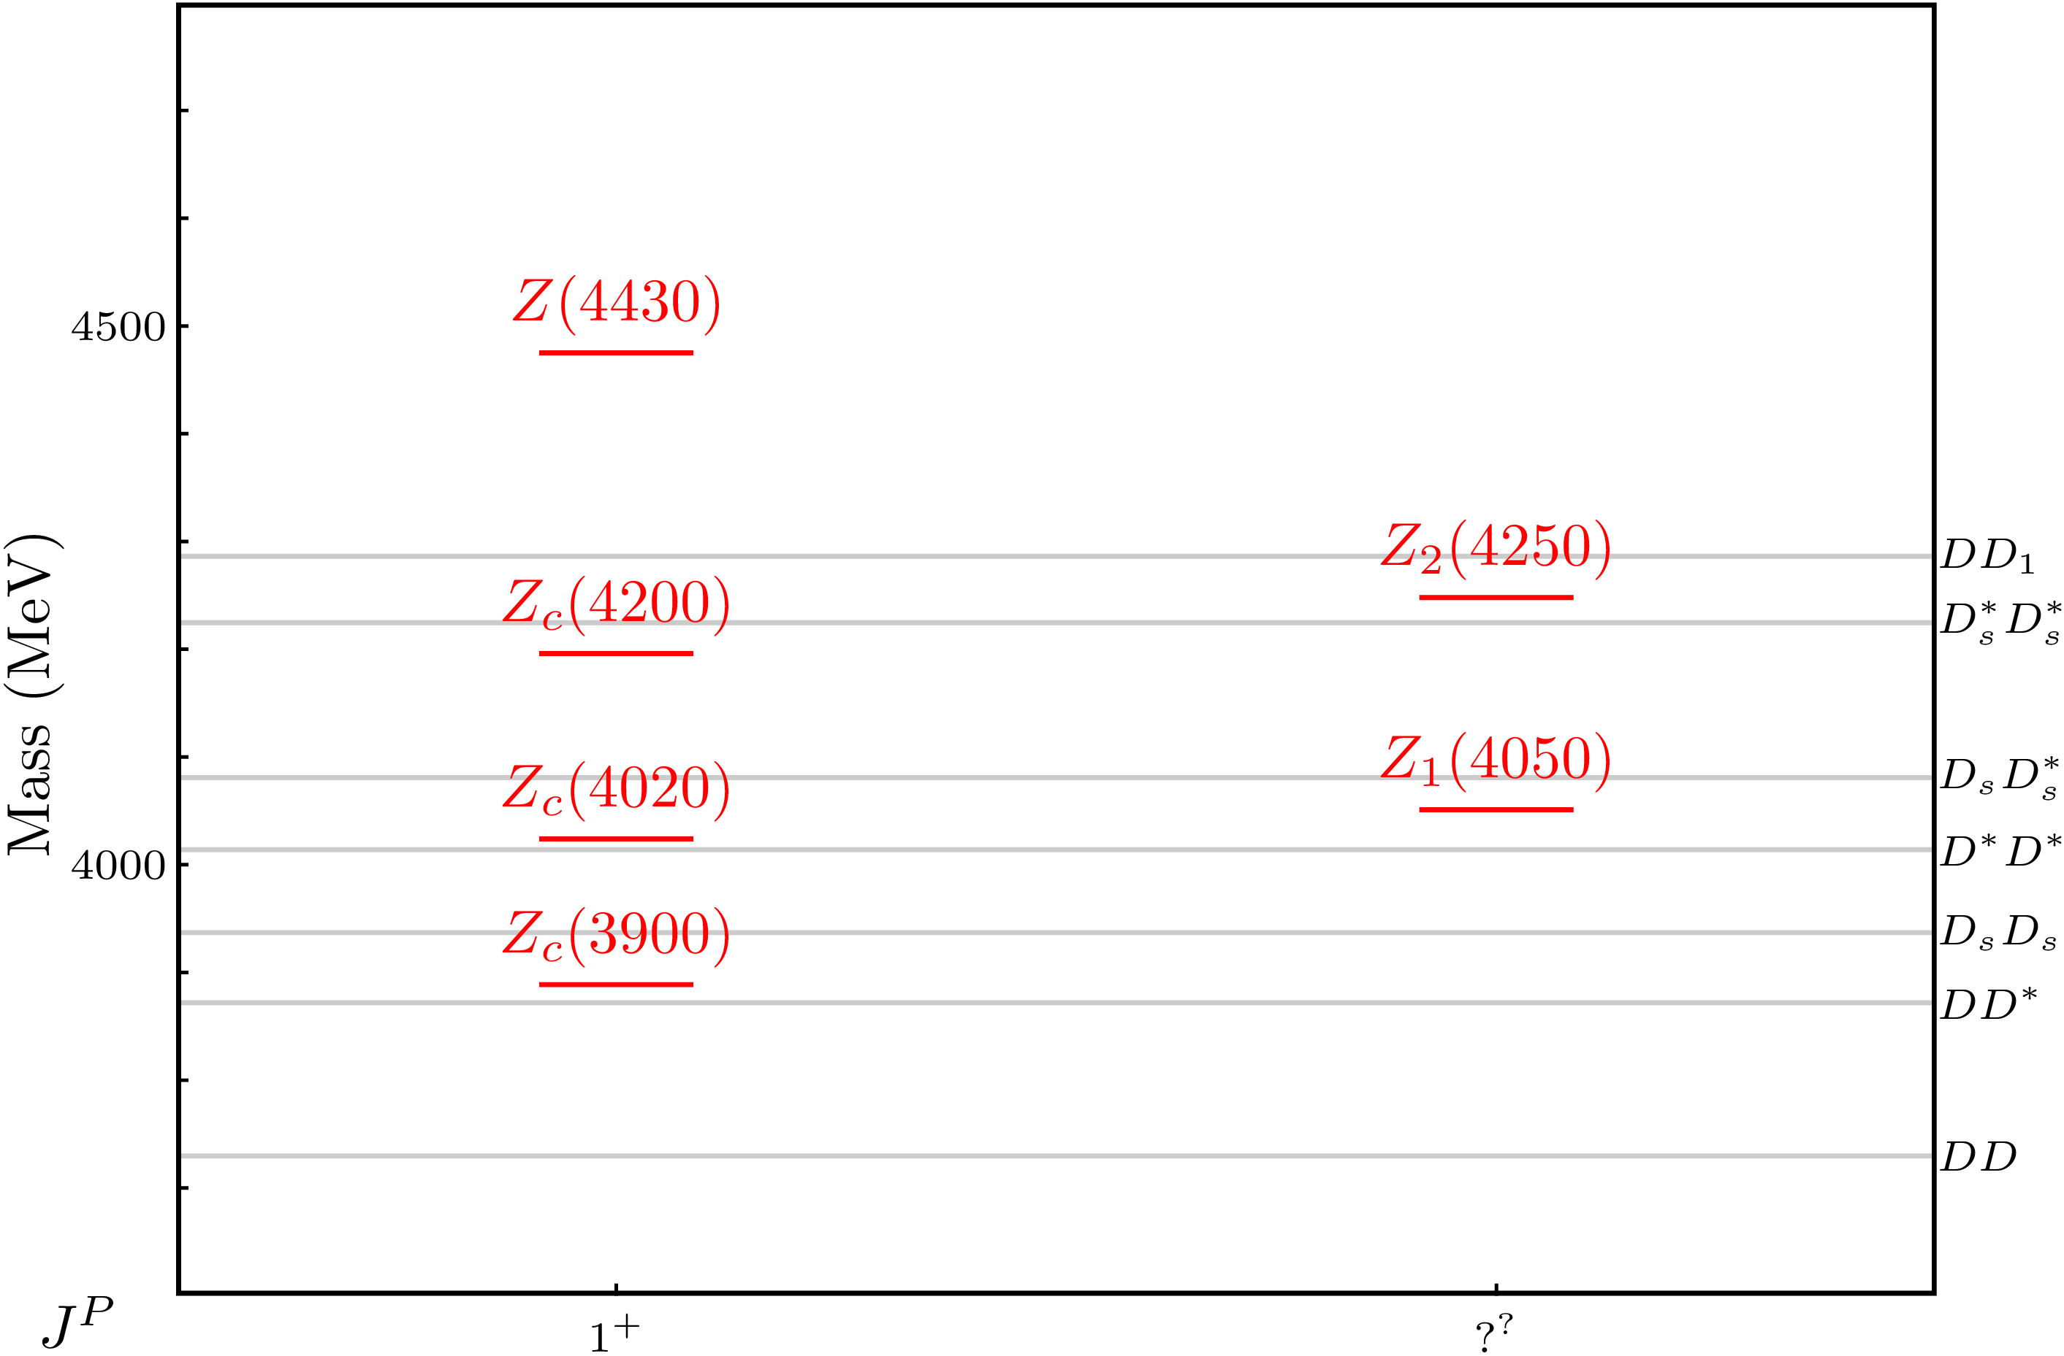
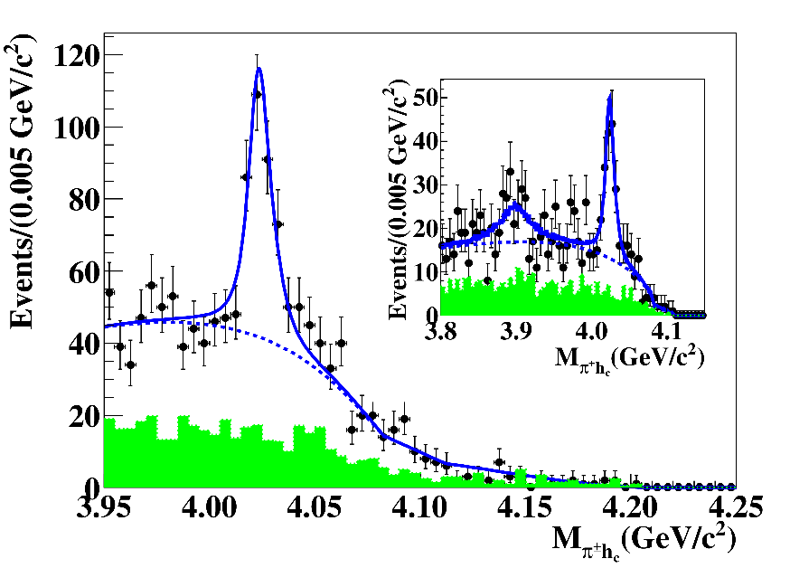
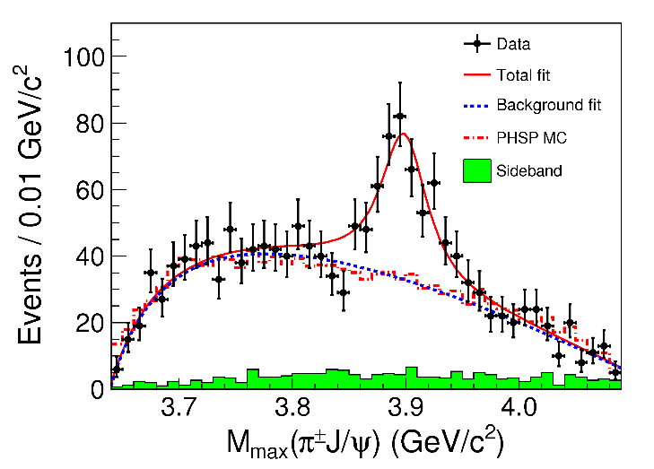
Charged $Z$ states: $Z_{c}\left(3900\right), Z_{c}^{′}(4020)$
Charged quarkonium-like resonances have been found, 4q needed
Two states $J^{PC}=1^{+−}$ appear slightly above $D^{(∗)}D^{∗}$ thresholds
$e^{+}e^{−}→Z_{c}{\left(3900\right)}^{+}π^{−}→J/ψ{ π}^{+}π^{−}$ and $→{\left(DD^{∗}\right)}^{+}π^{−}$ $M=3888.7±3.4$MeV, $Γ=35±7$ MeV
$e^{+}e^{−}→Z_{c}^{′}{\left(4020\right)}^{+}π^{−}→h_{c}{ π}^{+}π^{−}$ and $→{\overline{D}}^{∗0}D^{∗+}π^{−}$
$M=4023.9±2.4$MeV, $Γ=10±6$ MeV
A. Pilloni – Spectroscopy opportunities at the EIC
Notes:
Y(4260), M=4263 +- 5, Gamma = 95+-14
D_1(2420)^0, M=2421.3 ±0.6, Gamma =27.1 ±2.7
D_1(2420)^+-, M=2423.4 ±3.1, Gamma =25 ±6
I D_1 hanno J^P = 1^+
La molecola D_1 D sta 22 MeV sotto
Se la Y è D_1 D, il pione lega fortemente, come fa la Y a essere così larga?
Come funziona lo scambio del pione???

Slide 8
Why photoproduction?
It’s new: no XYZ state has been uncontroversially seen so far
Rescattering mechanisms that could mimic resonances in multibody decays can be controlled better (one can change the energy beam but not the $B$ mass…)
The framework is (relatively) clean from a theory point of view
Radiative decays offer another way of discerning the nature of the states: probing the short-range properties of the wave function and compare with model predictions
Once seen, $Q^{2}$ of transition form factors will give new observables crucial to assess the nature of these exotics
A. Pilloni – Spectroscopy opportunities at the EIC

Slide 9
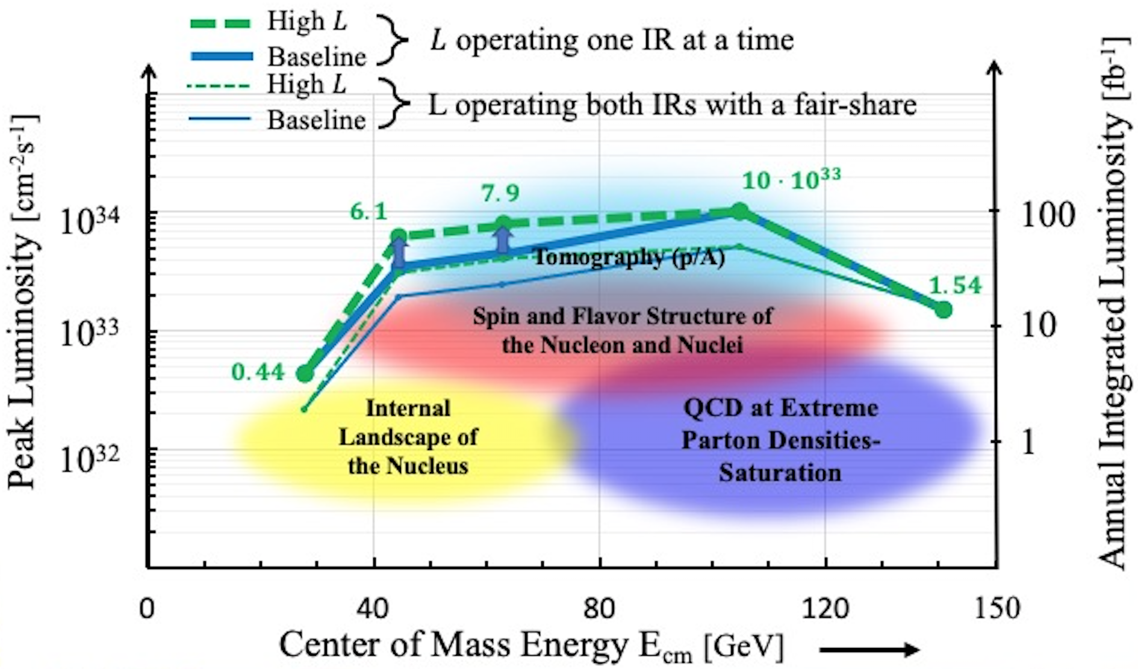
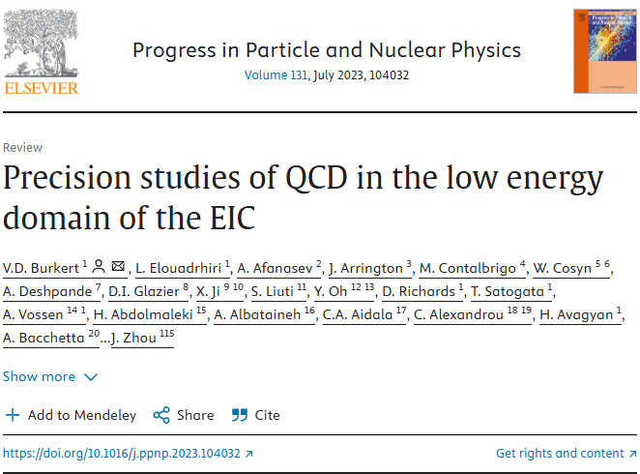
Production at EIC?
c,b quark spectroscopy
S quark spectroscopy
u,d quark spectroscopy
A. Pilloni – Spectroscopy opportunities at the EIC
Notes:
Click to add Notes

Slide 10
Quasi-real photoproduction
Virtual photon flux
+ form factor
e⁻
Photon flux rises rapidly as :
Q² → 0 ; W =√s → M(proton)
Leads to high production rates
e⁻
γ*
XYZ
p
p,n
$$\frac{d^{4}σ}{ds{dQ}^{2}dφdt}=\frac{d^{2}σ_{e,γ∗e′}}{{dsdQ}^{2}}\frac{d^{2}σ_{γ∗+p→V+p}\left(s,Q^{2}\right)}{dφdt}$$
$$\frac{d^{2}σ_{e,γ∗e′}}{{dsdQ}^{2}}=\frac{α}{2π}.\frac{K.L}{E}.\frac{1}{Q^{2}}.\frac{1}{\left(s−M^{2}+Q^{2}\right)}$$
$$K=\frac{W^{2}−M^{2}}{2M}=ν\left(1−x\right)=Ey\left(1−x\right)=ν−\frac{Q^{2}}{2M}$$
$$L=\frac{1+{\left(1−y\right)}^{2}}{y}−\frac{2m_{e}^{2}y}{Q^{2}}$$
A. Pilloni – Spectroscopy opportunities at the EIC
Notes:
Click to add Notes

Slide 11
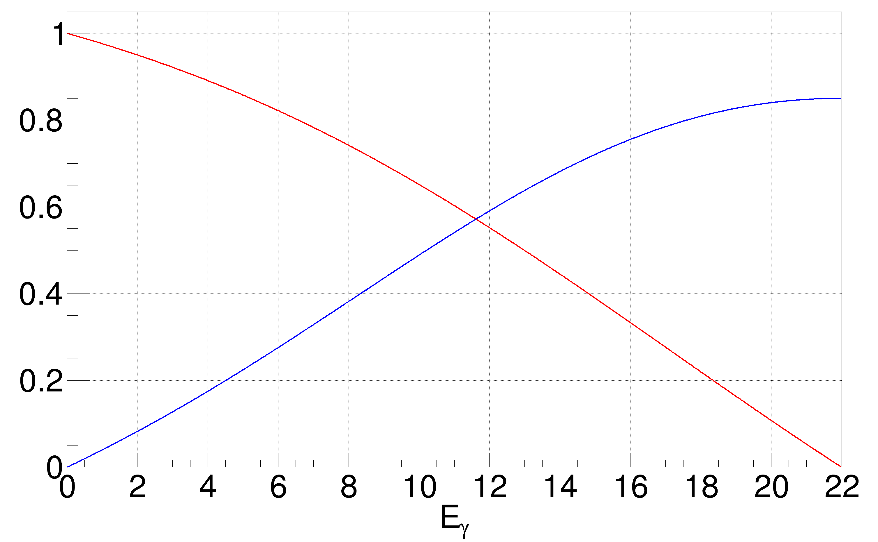
Virtual photon polarization
Photon density matrix as Q² → 0
ε = degree of virtual photon polarisation
Pbeam = degree of longitudinal e- beam polarisation
Φ = angle between scattering and production planes
Very similar to real photon
Requires determination of
ε (Ee’, θe) and Φ
i.e. full scattered e- momentum
Get event-by-event polarisation
A. Pilloni – Spectroscopy opportunities at the EIC
Notes:
Click to add Notes

Slide 12
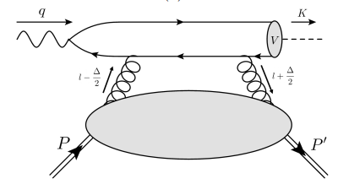
$J/ψ$ photoproduction at threshold
The common lore is that the study of vector quarkonium photoproduction at threshold is directly related to nucleon matrix elements
GPD
Assumptions:
Factorization proof for timelike DVCS can be extended at threshold as the heavy quark mass plays the role of a hard scale
The top vertex contains the trivial $γ$-$ψ$ coupling ${\left|ψ\left(0\right)\right|}^{2}$
The exchange of anything but gluons is (OZI-, mass-) suppressed
The exchange is dynamically dominated by gluons carrying $J=2$
Then one extracts matrix element of the energy momentum tensor $\left\langle p′ | T_{μν}(0) | p\right\rangle$
A. Pilloni – Spectroscopy opportunities at the EIC

Slide 13
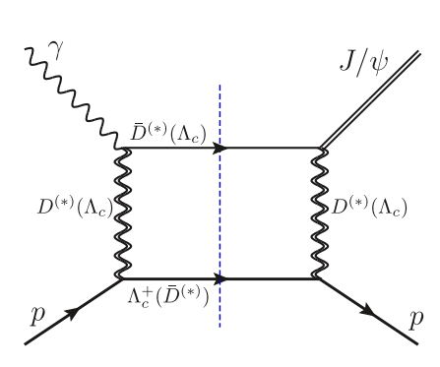
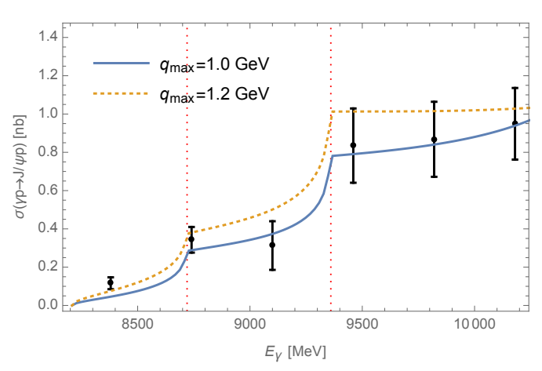
Role of open charm
Du et al. Eur.Phys.J.C 80, 11, 1053
The role of intermediate open charm thresholds has been pointed out,
Maybe «all that glitters is not glue» ….
Calculation based on EFT and known couplings, S-wave saturates the cross section
A. Pilloni – Spectroscopy opportunities at the EIC
Notes:
2 slides su Zc, a Bes e a Belle
2 slide su tetraquark model: dall’hamiltoniana di Jaffe al calcolo delle masse
1 slide su molecular models, dove sono i carichi? (non in Tornqvist, si in Hanhart, vedere Braaten, citare Nefediev)
2 slides su decay channels, dove si dovrebbe vedere, e a seconda del modello, vedere qualche plot
1 slide su Y(4260), tetraquark? C’è lo strano (si vede la f0)
1 slide su Zc a cleo (anche il neutro)

Slide 14
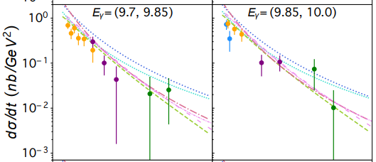
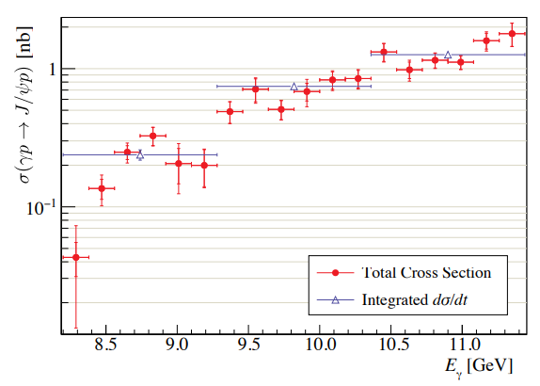
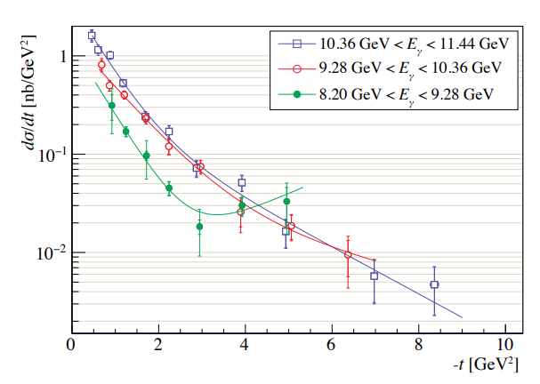
$J/ψ$ photoproduction at threshold
Nature 615, 813
Cusp at the $Λ_{c}\overline{D^{∗}}$ treshold
PRC108, 025201
A. Pilloni – Spectroscopy opportunities at the EIC

Slide 15
Unitary reanalysis
Winney et al. PRD 108, 054018
Differential and total cross sections are fitted with a unitary model
In lack of polarization observables and SDME, only orbital angular momentum is considered (spinless approx.)
Truncated sum of PWs, $ℓ≤3$
The dominant S-wave can include coupled channels, for higher waves cusps are suppressed and there is no point
A. Pilloni – Spectroscopy opportunities at the EIC

Slide 16
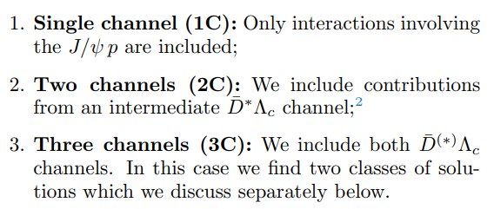
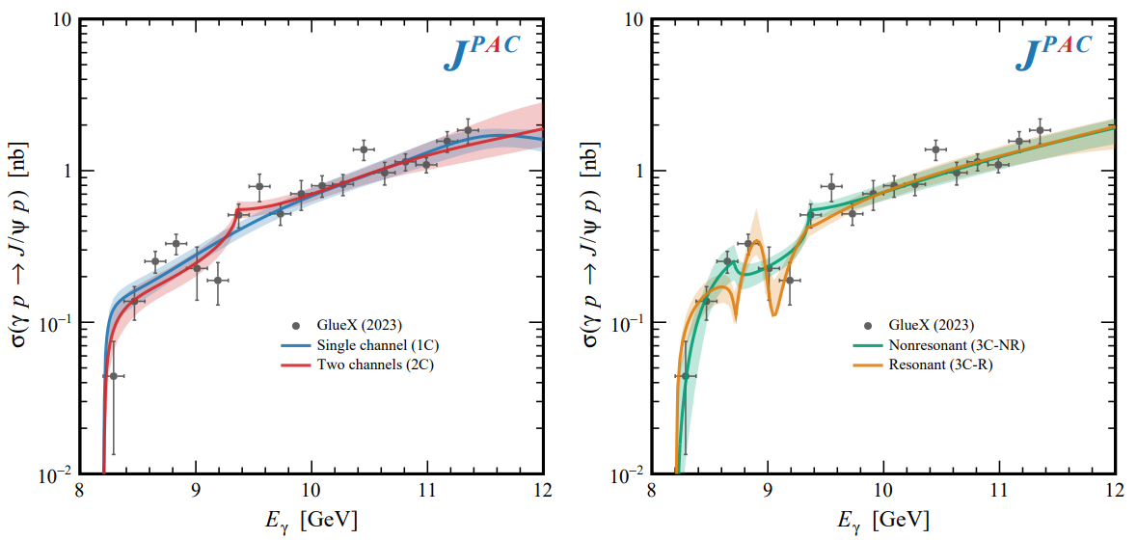
Total cross section
A. Pilloni – Spectroscopy opportunities at the EIC

Slide 17
Contribution of open charm
Naively Wilk’s theorem says the single channel is unfavored at $3.7σ$
(no look elsewhere etc.),
indication but not the end of the story
Contribution of open charm $>25\%$ at 90% CL
A. Pilloni – Spectroscopy opportunities at the EIC

Slide 18
Vector Meson Dominance
Since unitary model parametrize separately the production and scattering amplitude, one can compare with the predictions of VMD
$$γ$$
$$ψ$$
$$ψ$$
$$ψ$$
$$F\left(s,t\right)=$$
$=g_{γψ}×$
But $G\left(s_{\text{th}}\right)=0$
$$p$$
$$p$$
$$p$$
$$p$$
The value of the scattering amplitude at threshold is called scattering length
According to VMD, a small photoproduction cross sections implies a small scattering length O(1am)
With the unitary model, the value of the amplitude at threshold is an unrelated parameter, the scattering length enters with the energy dependence
A. Pilloni – Spectroscopy opportunities at the EIC

Slide 19
Vector Meson Dominance
VMD badly excluded, except for the poorly constrained 3C-R model
Scattering lengths generally of O(1fm), but smaller ones are not excluded
Crucial to constrain better these fits by measuring open charm final states
A. Pilloni – Spectroscopy opportunities at the EIC

Slide 20
jpacPhoto
We study near-threshold (LE) and high energies (HE) regimes with different formalisms
In lack of strong $s$-channel footprints (resonances, thresholds), production can be described by dual $t$-channel exchanges
Couplings extracted from data as much as possible, not relying on the nature of XYZ
Albaladejo et al., PRD 102, 114010
Winney et al., PRD 106, 094009
Winney et al., PRD 109, 114035
$$<λ_{𝒬}λ_{N}^{′}|T|λ_{γ}λ_{N}>=\underset{V,ℰ}{∑}\frac{ef_{V}}{m_{V}}𝒯_{λ_{V}=λ_{γ},λ_{𝒬}}^{α_{1}⋯α_{j}}𝒫_{α_{1}⋯α_{j};β_{1}⋯β_{j}}ℬ_{λ_{N}λ_{N}^{′}}^{β_{1}⋯β_{j}}$$
Bottom vertex from standard photoproduction pheno, exponential form factors to further suppress large t
VMD is used to couple the incoming photon to a vector quarkonium V
Top vertex from measured $𝒬→Vℰ$ decay width
A. Pilloni – Spectroscopy opportunities at the EIC

Slide 21
Threshold vs. high energy
Fixed-spin exchanges expected to hold in the low energy region
$t$ channel grows as $s j$, exceeding unitarity bound, Regge physics kicks in: Reggeized tower of particles with arbitrary spin at HE
$$s^{j}⟶s^{α_{0}+α^{′}t }$$
Holds at low energy, fixed spin
Holds at high energy, resummation of leading $s$ power
If $ε≠$IP, $α_{0}<1$, $dσ/dt$ decreases with energy
Exchange of heavy particles further suppressed
A. Pilloni – Spectroscopy opportunities at the EIC

Slide 22
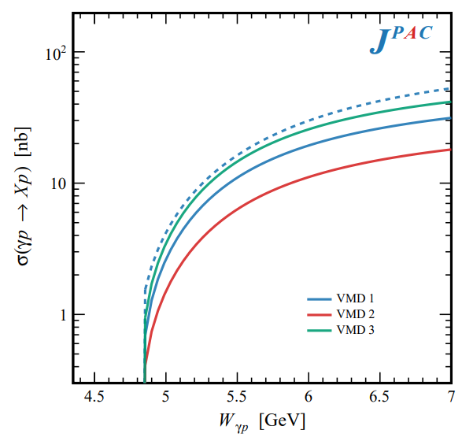
In defense of VMD
The weak point of the whole approach is the use of VMD While in the light sector it works reasonably, for heavy states is not justified There are hints that it fails badly for $J/ψ$ photoproduction
The X(3872) observed in purely hadronic and photonic modes gives us unique clue to efficacy of VMD
Belle extracted the coupling $X\left(3872\right)→γγ^{∗}$, that can be compared with the VMD predictions from $X\left(3872\right)→J/ψ γ$
Other estimates give results within a factor of 3
A. Pilloni – Spectroscopy opportunities at the EIC

Slide 23
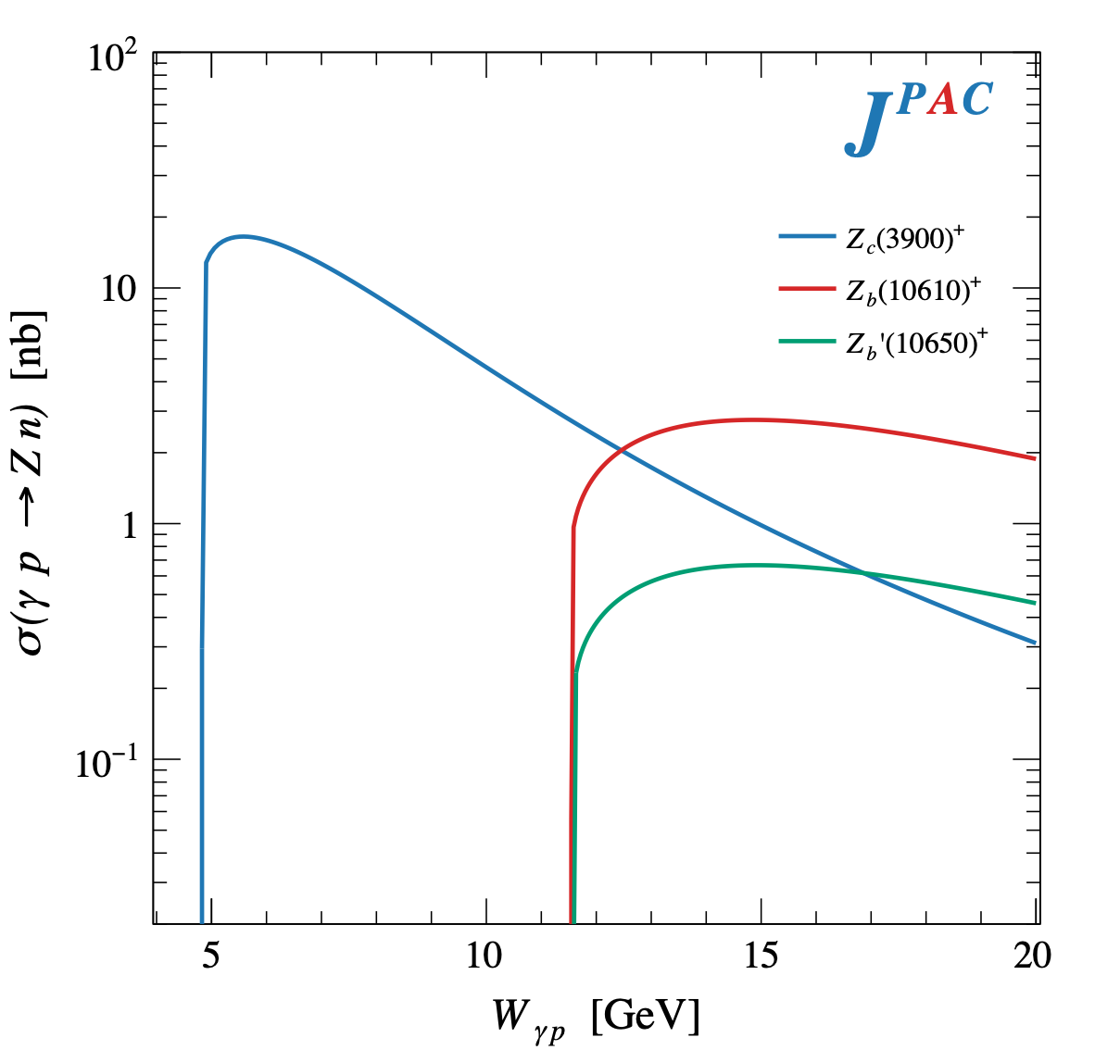
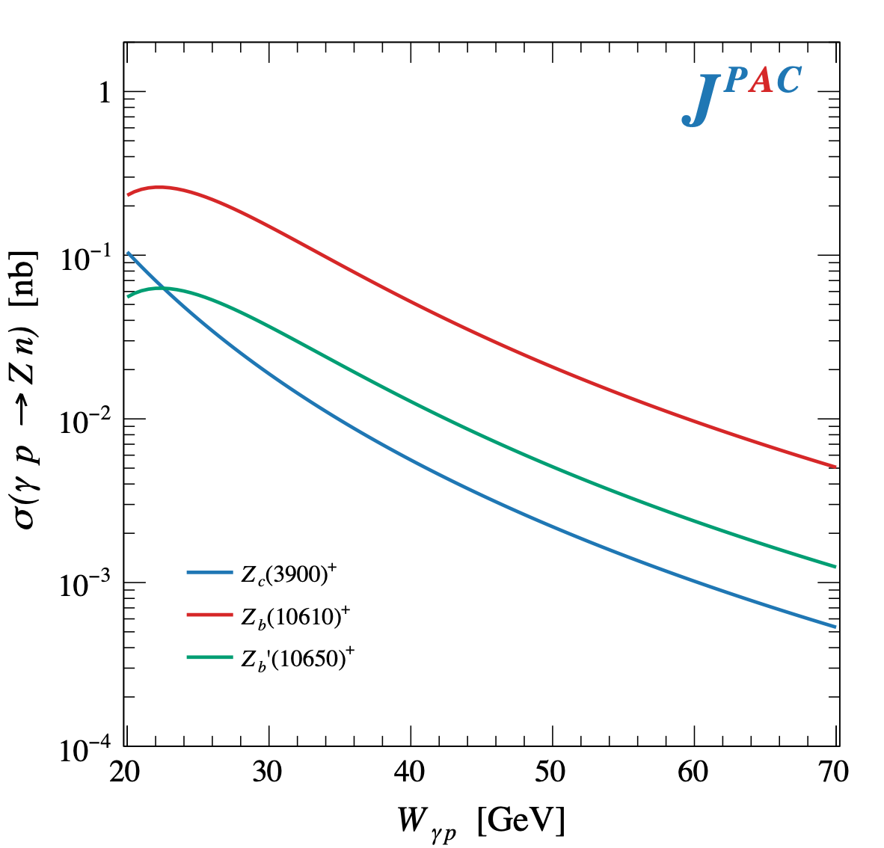
$Z$ photoproduction
The $Zs$ are charged charmoniumlike $1^{+−}$ states close to open flavor thresholds
Focus on $Z_{c}{\left(3900\right)}^{+}→J/ψ π^{+}$, $Z_{b}{\left(10610\right)}^{+},Z_{b}^{′}{\left(10650\right)}^{+}→Υ(nS) π^{+}$
The pion is exchanged in the $t$-channel
A. Pilloni – Spectroscopy opportunities at the EIC

Slide 24
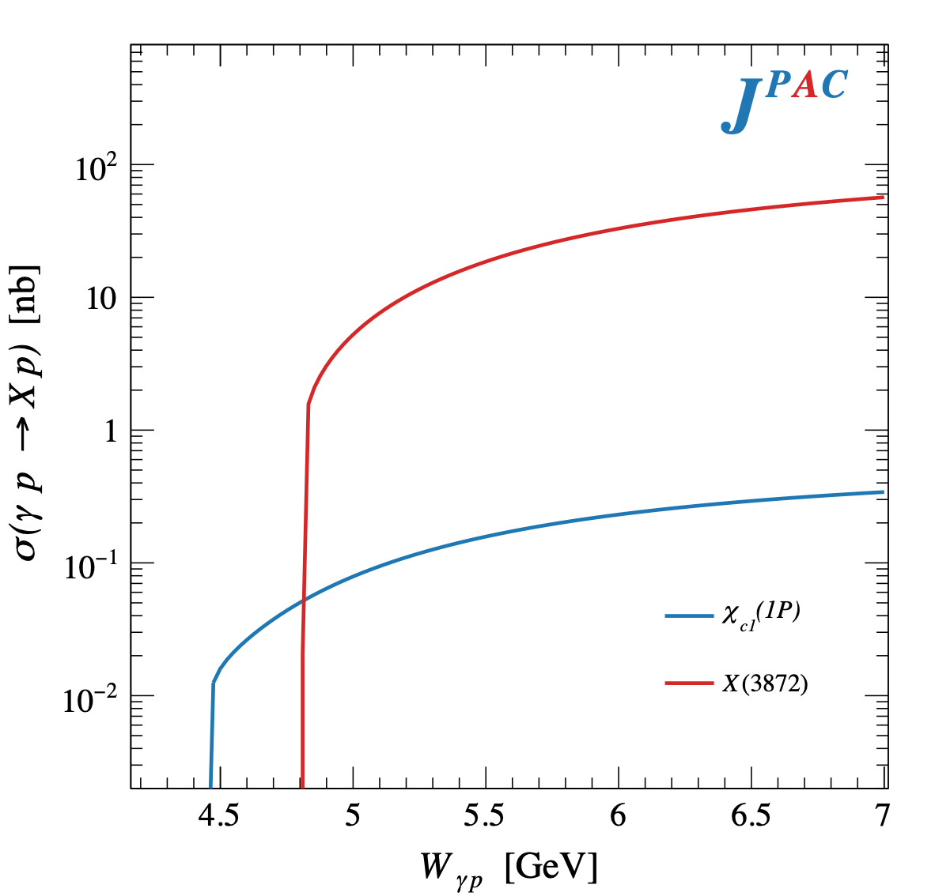
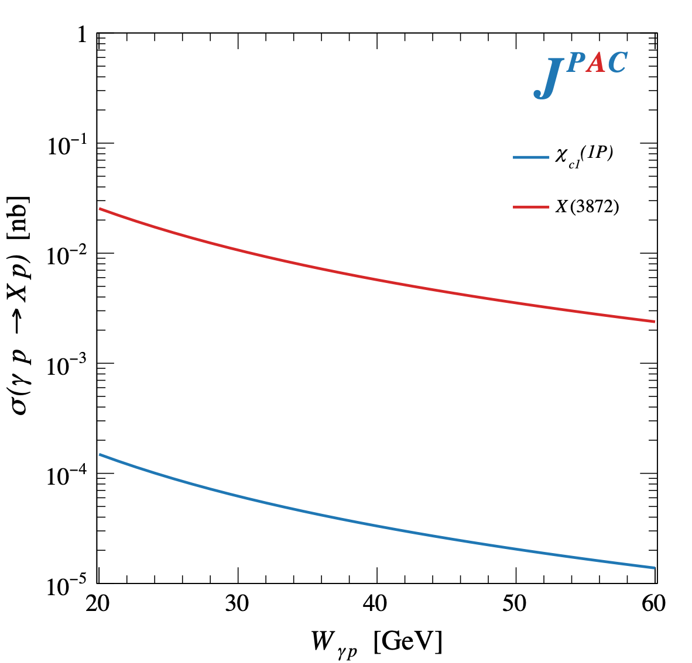
$X$ photoproduction
Focus on the famous $1^{++} X\left(3872\right)→J/ψ ρ,ω$
𝛚 and 𝛒 exchanges give main contributions:
Large theory uncertainty in the intermediate region
A. Pilloni – Spectroscopy opportunities at the EIC

Slide 25
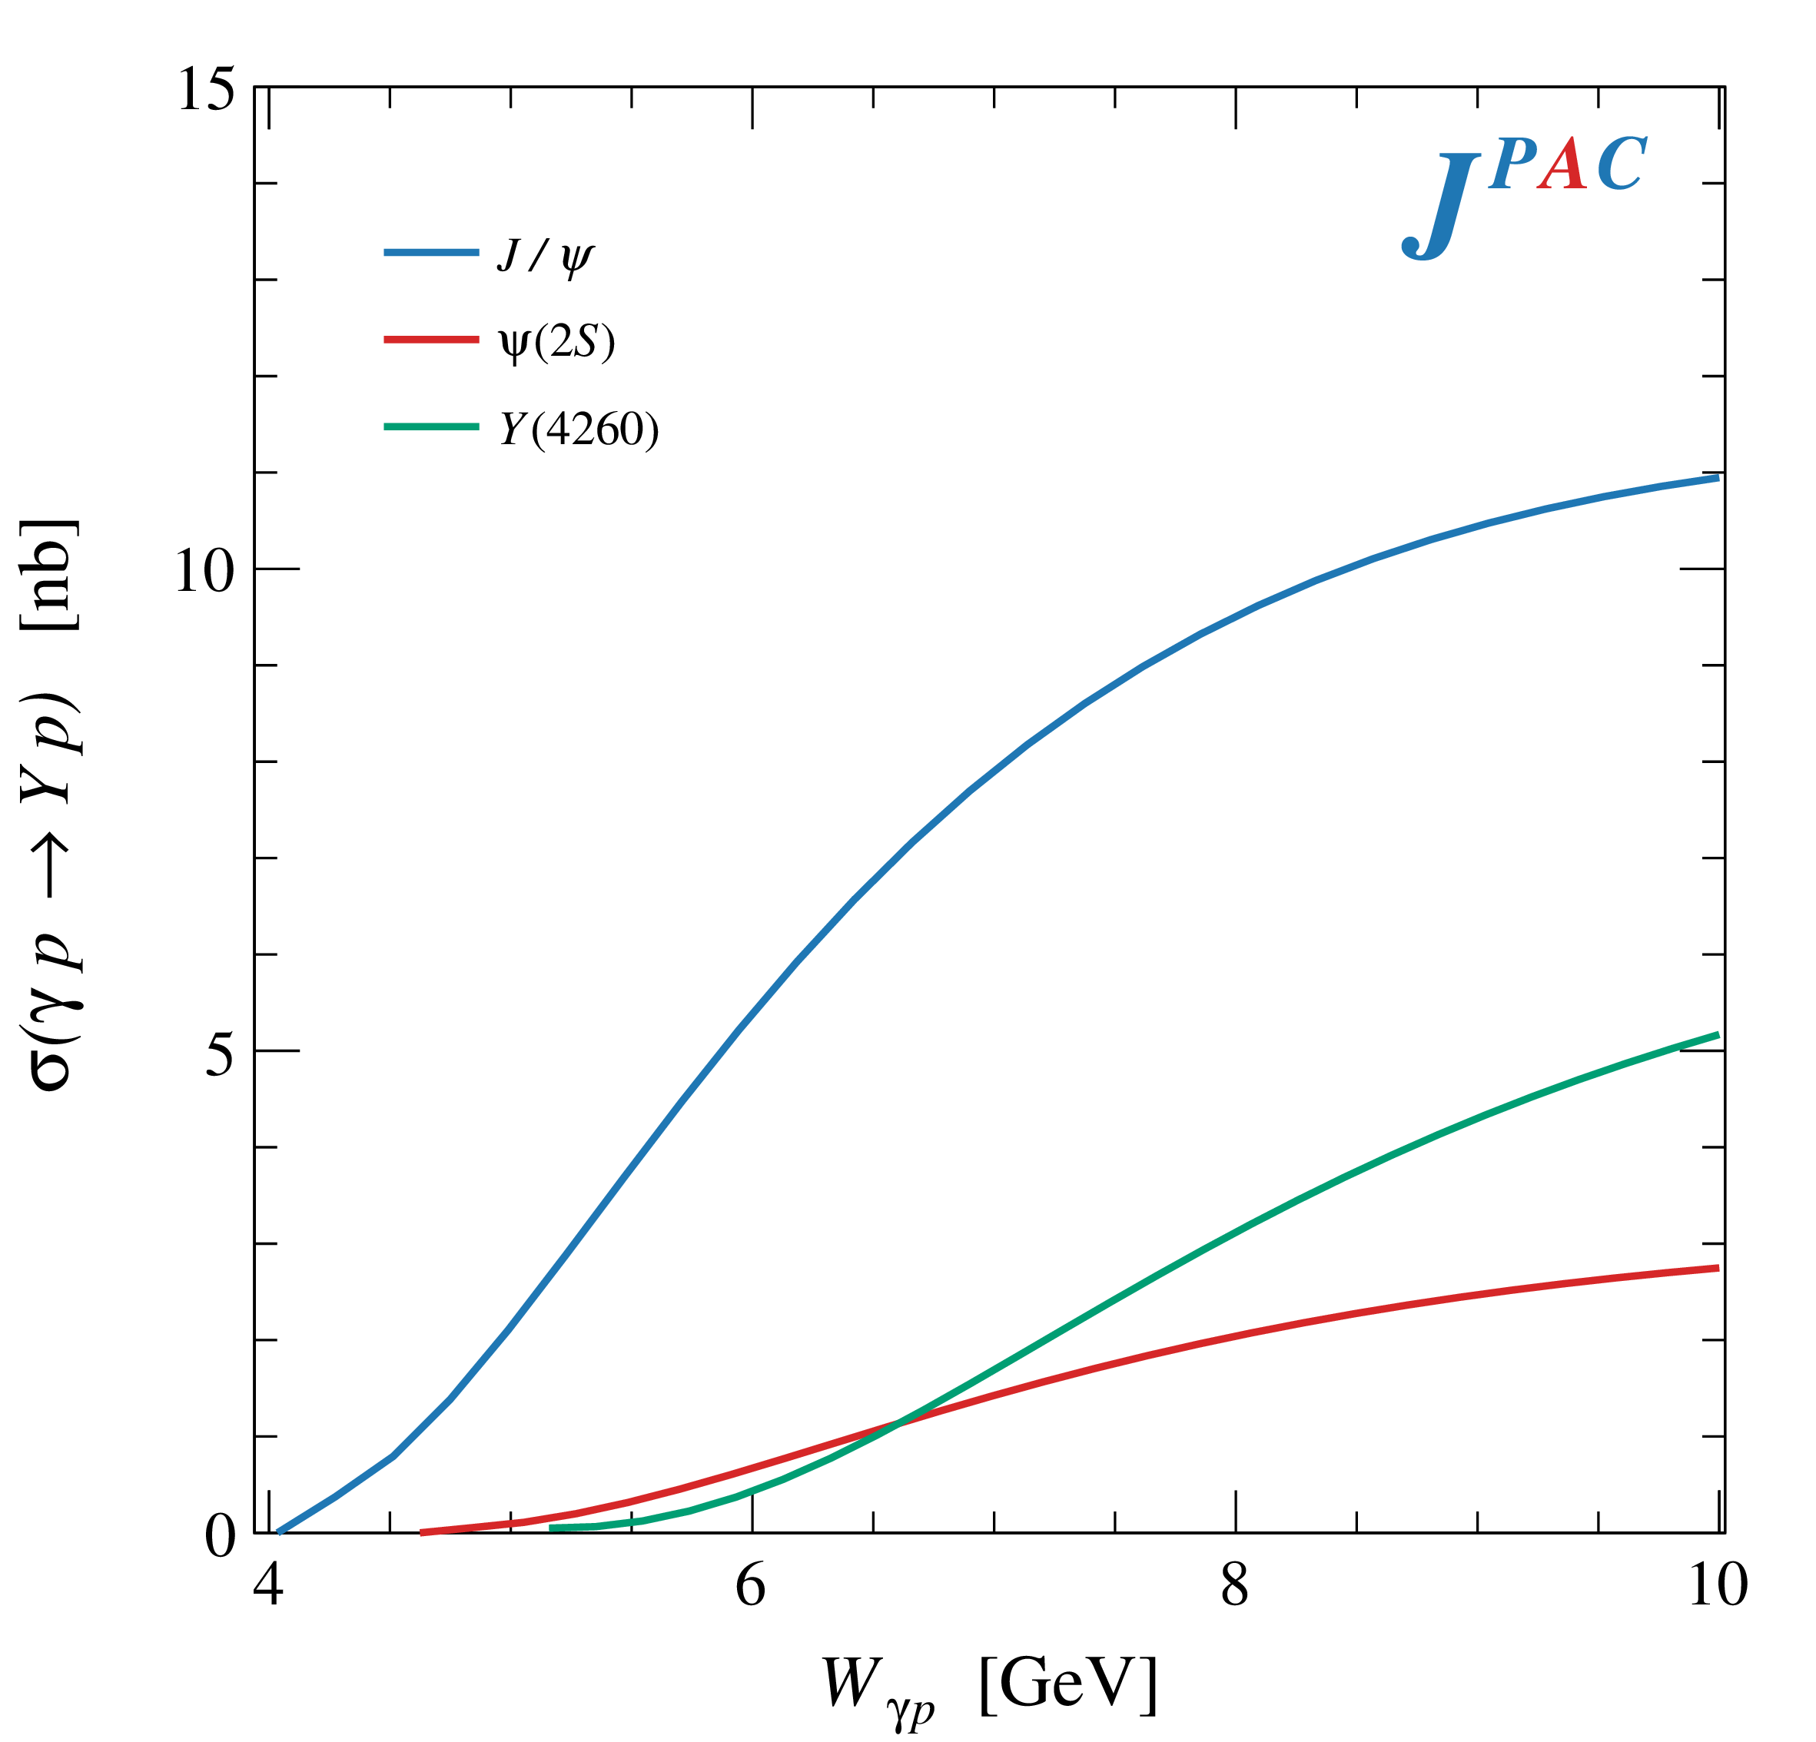
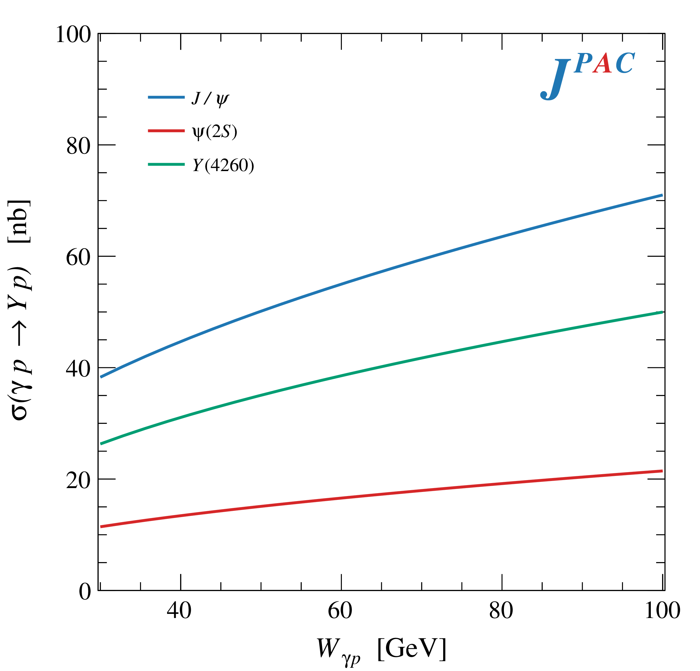
$Y$ (vector) photoproduction
Diffractive production, dominated by Pomeron (2-gluon) exchange
Existing data allow to put a 95% upper limit on the ratio of $ψ′/Y(4260)$ yields
Assuming previous formula, one gets: $Γ_{ee}^{Y}=930 eV$
(cfr. hep-ex/0603024, 2002.05641)
$BR\left(Y→J/ψππ\right)=0.96\%$
$R_{Y}=0.84$
$$R_{Y}=\frac{ef_{ψ}}{m_{ψ}}\sqrt{\frac{g^{2}(Y→ψππ)}{g^{2}(ψ→γgg)}\frac{g^{2}(ψ^{′}→ψgg)}{g^{2}(ψ^{′}→ψππ)}}$$
A. Pilloni – Spectroscopy opportunities at the EIC

Slide 26
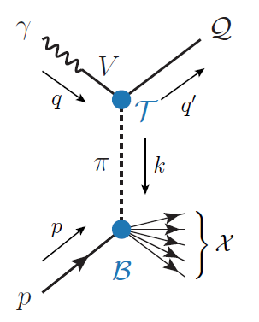
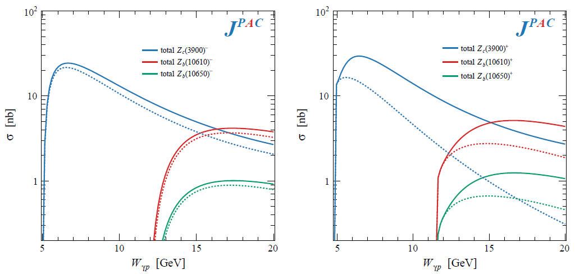
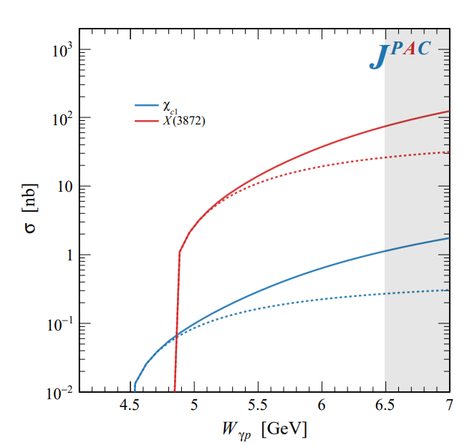
Semi-inclusive photoproduction
Semi-inclusive cross sections are typically larger
For small $t$ and large $x$, one can assume the process to be dominated by pion/vector exchange
The bottom vertex depends on the (known) total pion-nucleon cross section, or encoded in the PDFs at large $x$
$$π, ρ, ω$$
A. Pilloni – Spectroscopy opportunities at the EIC

Slide 27
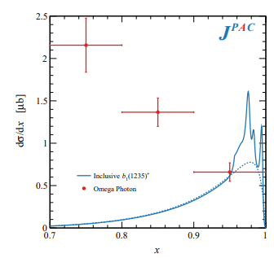
Semi-inclusive photoproduction (pion ex)
The bottom vertex depends on the (known) pion-proton total cross section
The pion is exchanged in the $t$-channel
Model benchmarked on $b_{1}$ production
Model underestimates lower bins, conservative estimates
The model is expected to hold in the highest bin
A. Pilloni – Spectroscopy opportunities at the EIC

Slide 28
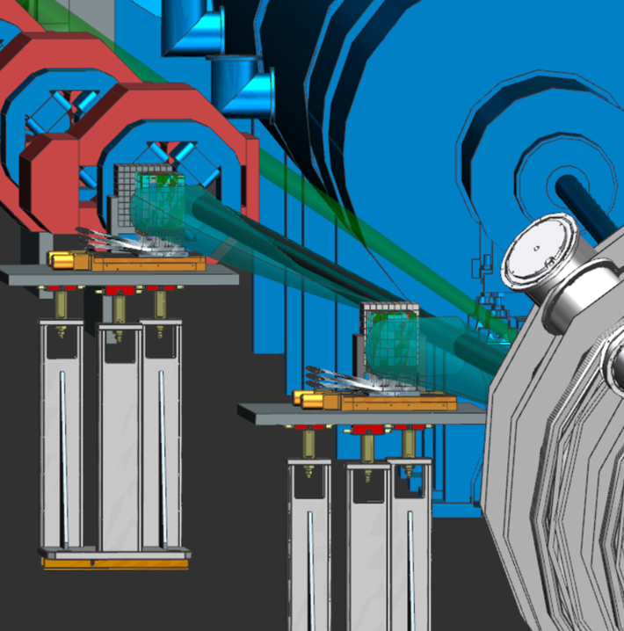
EIC Low $Q^{2}$ Tagger – Glasgow University
The ePIC Low-Q2 Tagger extends the reach of
the central detector down to effectively Q²=0.
Located after the first group of beamline steering and focusing magnets.
Scattered electrons follow deflected through the magnetic optics into tagger facilitating momentum reconstruction through tagger tracks.
Trackers consisting of 4 layers of Timepix4 pixel detectors (50μm pitch).
e-
Taggers
e-
Central Detector
A. Pilloni – Spectroscopy opportunities at the EIC
Notes:
Click to add Notes

Slide 29
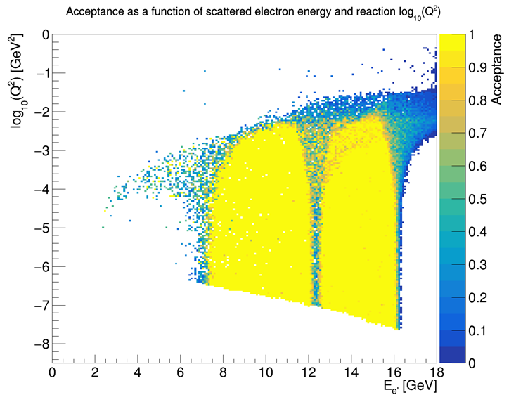
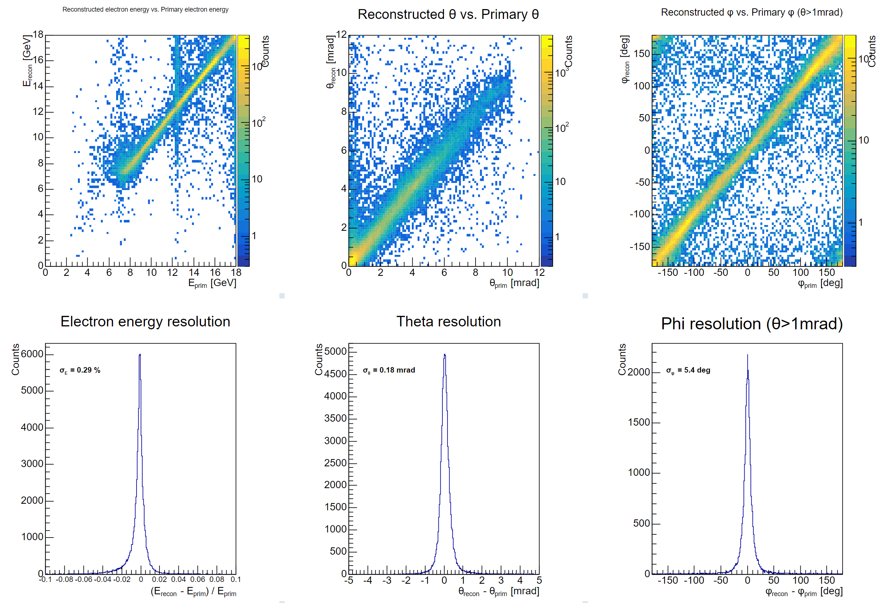
Idealistic Proposed Tagger
Acceptance
Resolutions
Preliminary
Preliminary
p
θ
φ
Low e- Energy acceptance limit
by magnets
High e- Energy acceptance limit
by beam
* Final design/performance dependent on beam pipe/vaccuum/integration
A. Pilloni – Spectroscopy opportunities at the EIC
Notes:
Click to add Notes

Slide 30
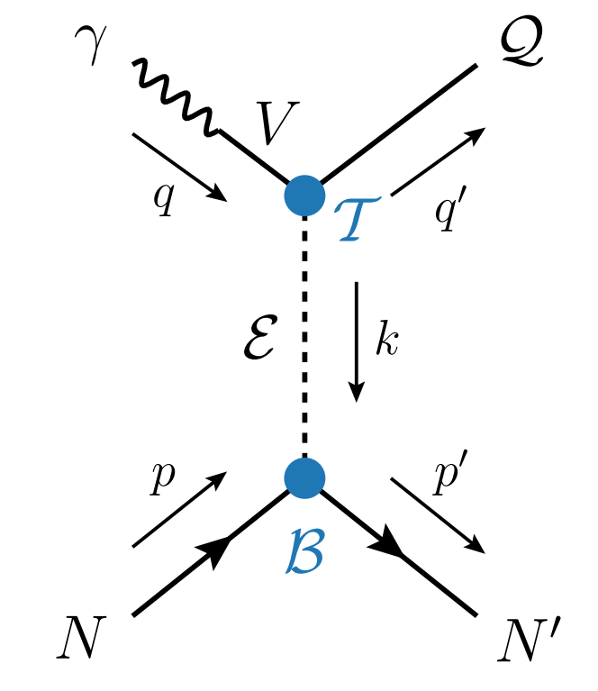
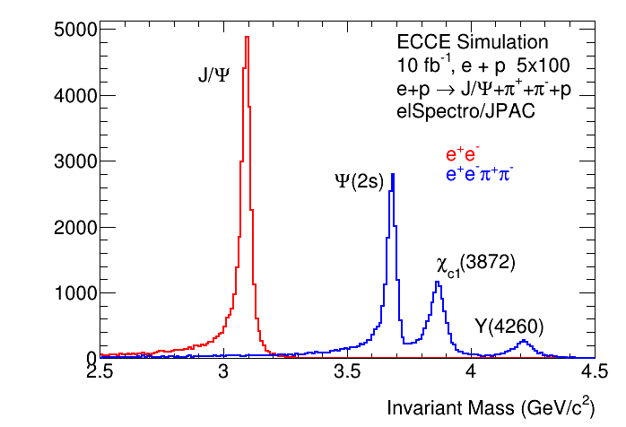
Exotics with EIC : ECCE
ePIC design/simulation/reconstruction in progress.
Can consider previous studies instead
But Tagger acceptance too high here (factor several)
ecce-note-phys-2021-12
*
X,Y,ψ(2s)
*
* only J/ψ from given Meson decays.
Many more actual J/ψ production.
* COMPASS measured 314 ψ(2s)
A. Pilloni – Spectroscopy opportunities at the EIC
Notes:
Click to add Notes

Slide 31
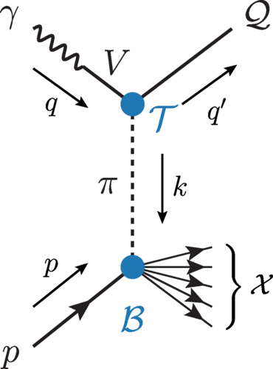
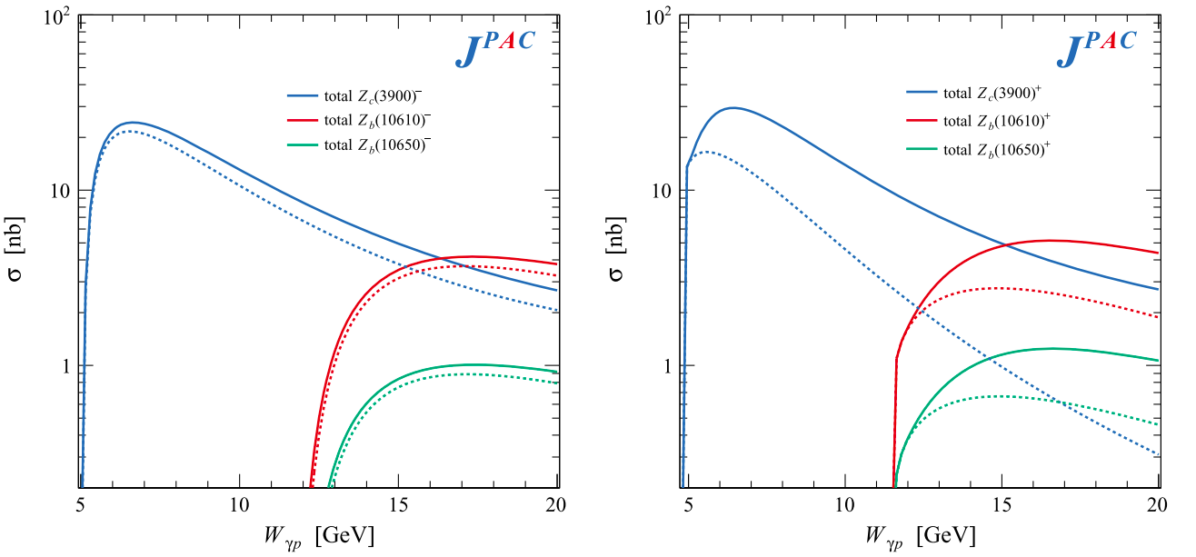
Semi-Inclusive Z production @EIC
= Z_{c}
Bottom vertex => SAID pion scattering
Z_{c}⁻
Z_{c}⁺
= pπ⁻
exclusive
Δ++
exclusive
neutron
Inclusive higher at high W =>
Better meson detection
- more transverse momentum
Better e-’ detection
- higher acceptance at lower P_{e’}
31
A. Pilloni – Spectroscopy opportunities at the EIC
Notes:
Click to add Notes

Slide 32
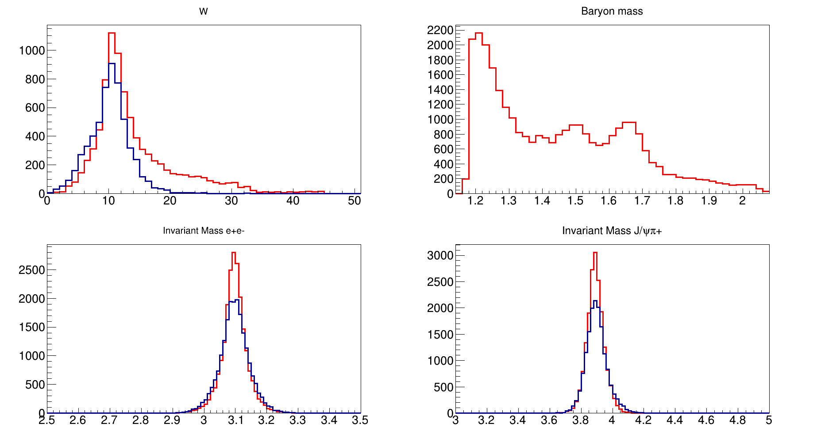
$Z_{c}^{+}$ production @EIC, beam 5 x 100 GeV
Δ⁰
Require e-’ detection
Quasi-real tagger
0.45 E₀< E <0.9 E₀
θ<6 mrad, σ_{E} = 1%
Z⁺n
Z⁺N*⁰
N*
“Simulations” with
Eic-smear fastmc
10fb-1 (~2 weeks)
Semi-inc σ 30% lower
But weighted to high W
=> better e- acceptance
better Z+ acceptance
Do not detect Δ⁰
W (GeV)
Mass N*
J/ψ
Z_{c}
Invariant Mass (e+e-)
Invariant Mass (e+e-π)
A. Pilloni – Spectroscopy opportunities at the EIC
Notes:
Click to add Notes

Slide 33
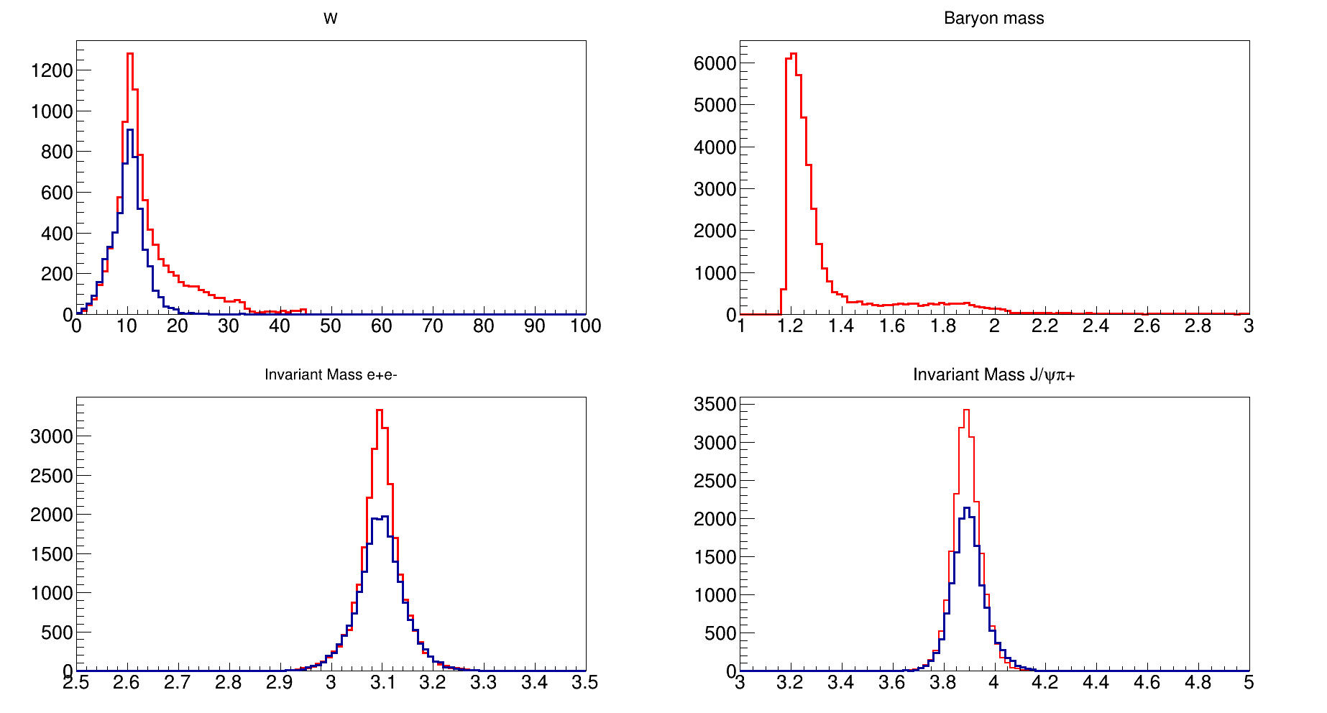
$Z_{c}^{−}$ production @EIC, beam 5 x 100 GeV
Require e-’ detection
Quasi-real tagger
0.45 E₀< E <0.9 E₀
θ<6 mrad, σ_{E} = 1%
Z⁺n
Z⁻X⁺⁺
Δ⁺⁺
“Simulations” with
Eic-smear fastmc
Semi-inc σ similar
Weighted to high W
=> better e- acceptance
better Z+ acceptance
Do not detect Δ⁺⁺
W (GeV)
Mass Δ*
J/ψ
Z_{c}
Invariant Mass (e+e-)
Invariant Mass (e+e-π)
Overall factor ~ 10 more events with inclusive channels
Notes:
Click to add Notes

Slide 34
Conclusions & prospects
(Quasi-real) Photoproduction of exotic charmonia can give invaluable information about their nature
Further studies on ordinary quarkonia are needed to assess whether they can be used as probes to extract nucleon structure observables
Predictions about backgrounds to XYZ searches are on the way
Thank you
A. Pilloni – Spectroscopy opportunities at the EIC
Notes:
2 slides su Zc, a Bes e a Belle
2 slide su tetraquark model: dall’hamiltoniana di Jaffe al calcolo delle masse
1 slide su molecular models, dove sono i carichi? (non in Tornqvist, si in Hanhart, vedere Braaten, citare Nefediev)
2 slides su decay channels, dove si dovrebbe vedere, e a seconda del modello, vedere qualche plot
1 slide su Y(4260), tetraquark? C’è lo strano (si vede la f0)
1 slide su Zc a cleo (anche il neutro)

Slide 35
Joint Physics Analysis Center
Code available on https://github.com/ dwinney/jpacPhoto
https://jpac-physics.org
A. Pilloni – Spectroscopy opportunities at the EIC

Slide 36
Backup

Slide 37
Definition of exotics
Despite it’s wrong, the vaste majority of hadrons obeys QM
Whatever is beyond $q\overline{q}$ for mesons and $qqq$ for baryons is exotic
Flavor exotics: e.g. doubly charged meson, baryon with positive strangeness Ex.: $T_{cc}^{+}$ with $cc\overline{u}\overline{d}$; if OZI rule enforced, $Z_{c,b}$ with $c\overline{c}u\overline{d}$, $P_{c}$…
Spin exotics: $J^{PC}$ not allowed in QM Ex.: $π_{1}(1600)$ has $J^{PC}=1^{−+}$
Criptoexotics: $J^{PC}$ allowed, but properties not compatible with QM expectations Ex.: $Y(4260)$, $Λ(1405)$, hybrid baryons, $X(3872)$
A. Pilloni – Spectroscopy opportunities at the EIC
Notes:
2 slides su Zc, a Bes e a Belle
2 slide su tetraquark model: dall’hamiltoniana di Jaffe al calcolo delle masse
1 slide su molecular models, dove sono i carichi? (non in Tornqvist, si in Hanhart, vedere Braaten, citare Nefediev)
2 slides su decay channels, dove si dovrebbe vedere, e a seconda del modello, vedere qualche plot
1 slide su Y(4260), tetraquark? C’è lo strano (si vede la f0)
1 slide su Zc a cleo (anche il neutro)

Slide 38
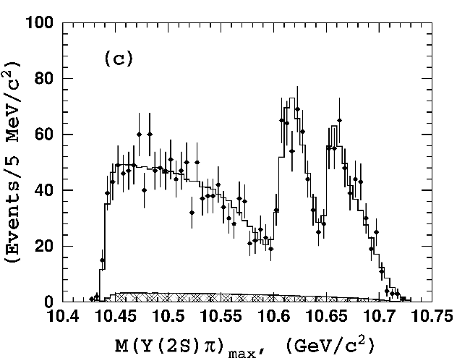
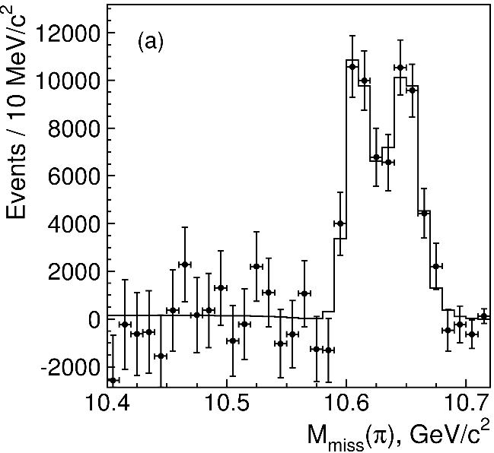
Charged $Z$ states: $Z_{b}\left(10610\right), Z_{b}^{′}(10650)$
Anomalous dipion width in $Υ\left(5S\right)$,
2 orders of magnitude larger than $Υ\left(nS\right)$
Moreover, observed $Υ\left(5S\right)→h_{b}\left(nP\right)ππ$ which violates HQSS
$Υ\left(5S\right)→Z_{b}{\left(10610\right)}^{+}π^{−}→Υ\left(nS\right){ π}^{+}π^{−},h_{b}\left(nP\right){ π}^{+}π^{−}$ and $→{\left(BB^{∗}\right)}^{+}π^{−}$ $M=10607.2±2.0$MeV, $Γ=18.4±2.4$ MeV
$Υ\left(5S\right)→Z_{b}^{′}{\left(10650\right)}^{+}π^{−}→Υ\left(nS\right){ π}^{+}π^{−},h_{b}\left(nP\right){ π}^{+}π^{−}$ and $→{\overline{B}}^{∗0}B^{∗+}π^{−}$
$M=10652.2±1.5$MeV, $Γ=11.5±2.2$ MeV
2 twin resonances!
A. Pilloni – A review of Exotic Hadron Spectroscopy
Notes:
Y(4260), M=4263 +- 5, Gamma = 95+-14
D_1(2420)^0, M=2421.3 ±0.6, Gamma =27.1 ±2.7
D_1(2420)^+-, M=2423.4 ±3.1, Gamma =25 ±6
I D_1 hanno J^P = 1^+
La molecola D_1 D sta 22 MeV sotto
Se la Y è D_1 D, il pione lega fortemente, come fa la Y a essere così larga?
Come funziona lo scambio del pione???

Slide 39
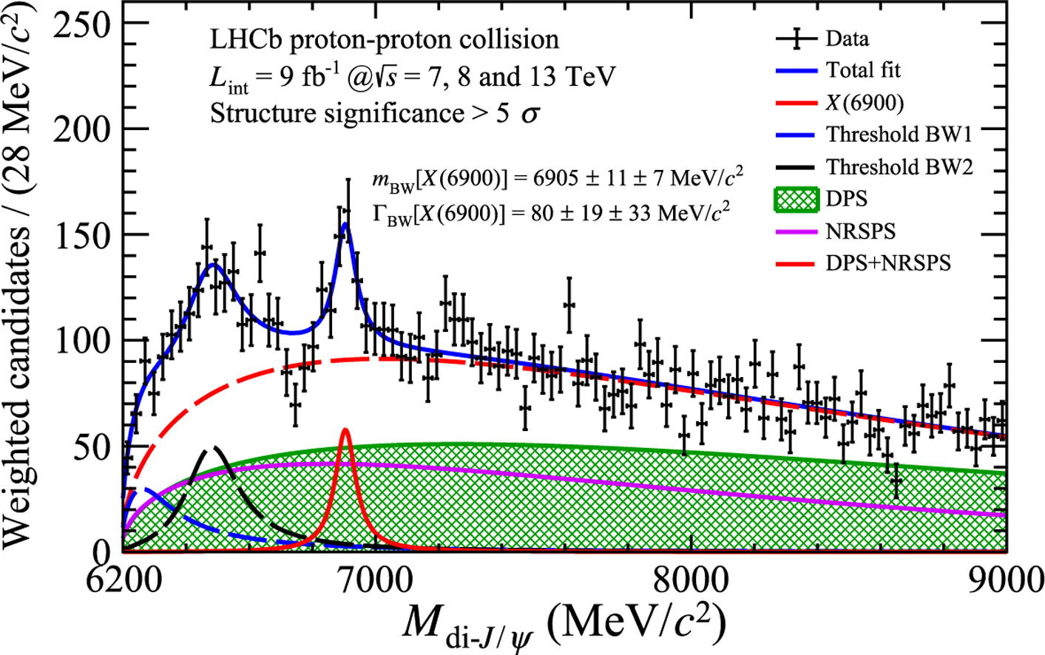
Fully charm: the $X(6900)$
Two structures are seen in the $J/ψ J/ψ$ spectrum
The heavier one is narrower and well assessed
The nature of the lighter one is unclear
A. Pilloni – A review of Exotic Hadron Spectroscopy
Notes:
Y(4260), M=4263 +- 5, Gamma = 95+-14
D_1(2420)^0, M=2421.3 ±0.6, Gamma =27.1 ±2.7
D_1(2420)^+-, M=2423.4 ±3.1, Gamma =25 ±6
I D_1 hanno J^P = 1^+
La molecola D_1 D sta 22 MeV sotto
Se la Y è D_1 D, il pione lega fortemente, come fa la Y a essere così larga?
Come funziona lo scambio del pione???

Slide 40
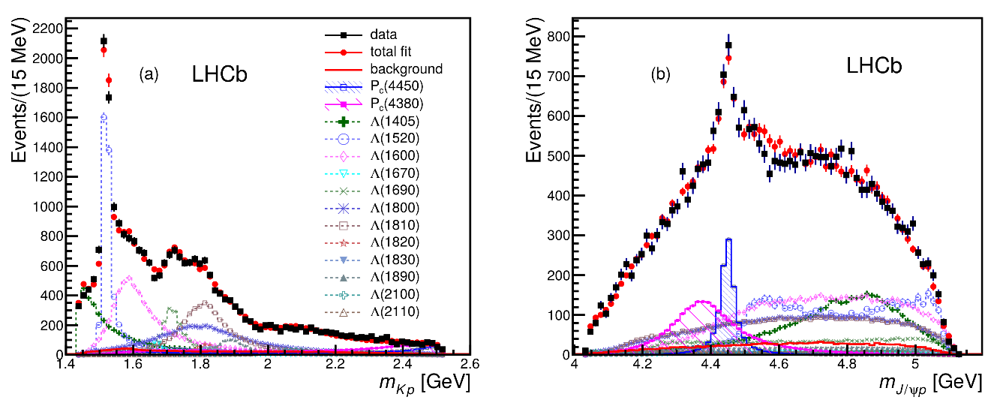
Pentaquarks!
LHCb, PRL 115, 072001
LHCb, PRL 117, 082003
Two states seen in $Λ_{b}→\left(J/ψ p\right) K^{−}$,
evidence in $Λ_{b}→\left(J/ψ p\right) π^{−}$
$$M_{1}=4380±8±29 \text{MeV} \\ Γ_{1}=205±18±86 \text{MeV}$$
$$M_{2}=4449.8±1.7±2.5 \text{MeV} \\ Γ_{2}=39±5±19 \text{MeV}$$
Quantum numbers $$J^{P}=\left({\frac{3}{2}}^{−},{\frac{5}{2}}^{+}\right) \text{or}\left({\frac{3}{2}}^{+},{\frac{5}{2}}^{−}\right)\text{or}\left({\frac{5}{2}}^{+},{\frac{3}{2}}^{−}\right)$$
Opposite parities needed for the interference to correctly describe angular distributions, low mass region contaminated by $Λ^{∗}$ (model dependence?)
No obvious threshold nearby
A. Pilloni – Spectroscopy opportunities at the EIC
Notes:
Y(4260), M=4263 +- 5, Gamma = 95+-14
D_1(2420)^0, M=2421.3 ±0.6, Gamma =27.1 ±2.7
D_1(2420)^+-, M=2423.4 ±3.1, Gamma =25 ±6
I D_1 hanno J^P = 1^+
La molecola D_1 D sta 22 MeV sotto
Se la Y è D_1 D, il pione lega fortemente, come fa la Y a essere così larga?
Come funziona lo scambio del pione???

Slide 41
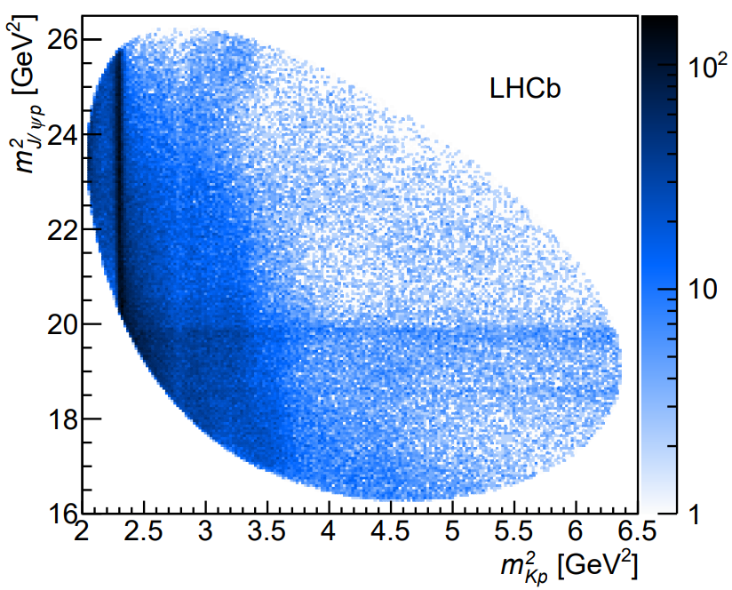
Pentaquarks
LHCb, PRL 115, 072001
LHCb, PRL 117, 082003
States seen in $Λ_{b}→\left(J/ψ p\right) K^{−}$,
Original analysis found a narrow and a broad states
The subsequent 1D update find 3 narrow ones
The lightest $P_{c}(4312)$ appears as an isolated peak at the $Σ_{c}^{+}{\overline{D}}^{0}$ threshold
A. Pilloni – A review of Exotic Hadron Spectroscopy
Notes:
Controlla la parte su Regge

Slide 42
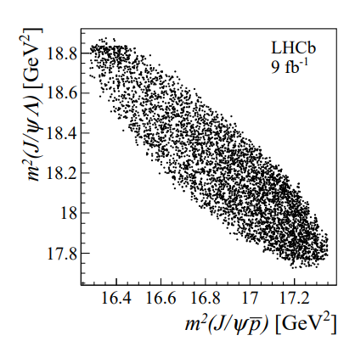
Strange pentaquarks
Can you search pentaquarks in meson decays? $B^{−}→J/ψ Λ^{0} \overline{p}$
Bingo! $P_{cs}$!
$$m=4338.2±0.7±0.4 \text{MeV}$$
$$Γ=7.0±1.2±1.3 \text{MeV}$$
It remains to be seen the connections with the nonstrange pentaquarks
No $K^{∗}$ expected in this $Λ^{0}\overline{p}$ mass region
None seen, mostly flat
A. Pilloni – A review of Exotic Hadron Spectroscopy
Notes:
Controlla la parte su Regge

Slide 43
Broad exotics in $B$ decays
Lots of new exotics have been seen by LHCb with multidimensional amplitude analyses of $B→$ 3+ body
Most of these are broad, and the precise determination can crucially depend on the amplitude model, so that the resonant nature cannot be assessed with the same strong statements as for the narrow guys
A. Pilloni – A review of Exotic Hadron Spectroscopy
Notes:
Y(4260), M=4263 +- 5, Gamma = 95+-14
D_1(2420)^0, M=2421.3 ±0.6, Gamma =27.1 ±2.7
D_1(2420)^+-, M=2423.4 ±3.1, Gamma =25 ±6
I D_1 hanno J^P = 1^+
La molecola D_1 D sta 22 MeV sotto
Se la Y è D_1 D, il pione lega fortemente, come fa la Y a essere così larga?
Come funziona lo scambio del pione???

Slide 44
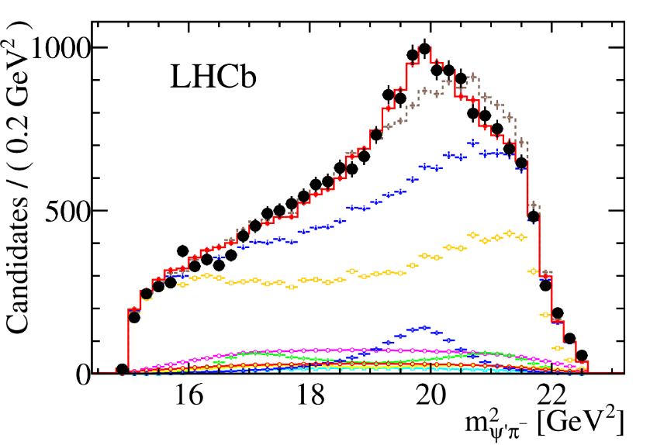
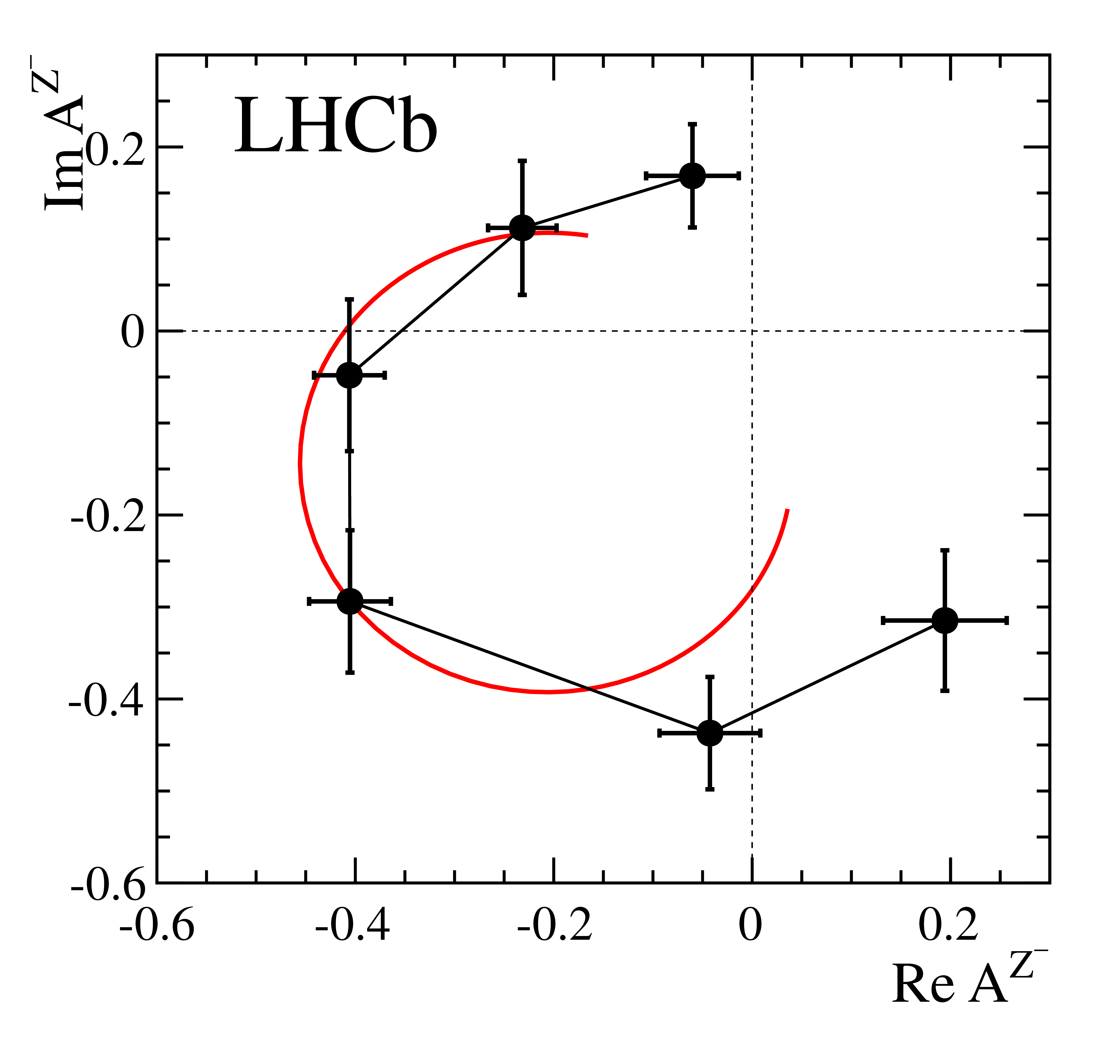
Charged $Z$ states: $Z(4430)$
$$Z{\left(4430\right)}^{+}→ψ(2S){ π}^{+} \\ {I^{G}J}^{PC}=1^{+}1^{+−}$$
$M=4475±7_{−25}^{+15}$MeV
$Γ=172±{13}_{−34}^{+37}$MeV
Far from open charm thresholds
If the amplitude is a free complex number, in each bin of $m_{ψ^{′}π^{−}}^{2}$, the resonant behaviour appears as well
A. Pilloni – A review of Exotic Hadron Spectroscopy
Notes:
Y(4260), M=4263 +- 5, Gamma = 95+-14
D_1(2420)^0, M=2421.3 ±0.6, Gamma =27.1 ±2.7
D_1(2420)^+-, M=2423.4 ±3.1, Gamma =25 ±6
I D_1 hanno J^P = 1^+
La molecola D_1 D sta 22 MeV sotto
Se la Y è D_1 D, il pione lega fortemente, come fa la Y a essere così larga?
Come funziona lo scambio del pione???

Slide 45
Tetraquarks: the $B^{+}→J/ψ φ K^{+}$ decay
$$\text{In} J/ψ φ: \left\{\begin{aligned}\text{1}× 1^{−+} \\ \text{2}× 0^{++} \\ 3× 1^{++}\end{aligned}\right.$$
$$In J/ψ K^{+}:2×1^{+}$$
Widths from 50 to 230 MeV
A. Pilloni – A review of Exotic Hadron Spectroscopy
Notes:
Y(4260), M=4263 +- 5, Gamma = 95+-14
D_1(2420)^0, M=2421.3 ±0.6, Gamma =27.1 ±2.7
D_1(2420)^+-, M=2423.4 ±3.1, Gamma =25 ±6
I D_1 hanno J^P = 1^+
La molecola D_1 D sta 22 MeV sotto
Se la Y è D_1 D, il pione lega fortemente, come fa la Y a essere così larga?
Come funziona lo scambio del pione???
Close propone che la Y è D_1 D^* col pione scambiato in onda S,
La Y però non va in Ds come se fosse tetraquark

Slide 46
Bound and virtual states
Decreasing the potential strength, the pole reaches threshold
The pole jumps on the 2nd sheet (dineutron), it becomes a virtual state
Example from $pn$ scattering Bound state on the real axis 1st sheet (deuteron)
$$V(r)$$
$$\text{Im} E$$
$$r$$
$$V$$
Deuteron
$$\text{Re} E$$
$${}_{}^{1}S$$
Deuteron pole
Dineutron pole
$${}_{}^{3}S$$
A. Pilloni – Spectroscopy opportunities at the EIC
Notes:
Controlla la parte su Regge

Slide 47
Minimal(istic) model for $P_{c}(4312)$
( data)
Fernandez-Ramirez, AP et al. (JPAC), PRL 123, 092001
Effective range expansion We can set $c_{ii}=0$ to reduce to the scattering length approximation
$$c_{ii}=0$$
Finite $c_{ii}$
A. Pilloni – Spectroscopy opportunities at the EIC
Notes:
2 slides su Zc, a Bes e a Belle
2 slide su tetraquark model: dall’hamiltoniana di Jaffe al calcolo delle masse
1 slide su molecular models, dove sono i carichi? (non in Tornqvist, si in Hanhart, vedere Braaten, citare Nefediev)
2 slides su decay channels, dove si dovrebbe vedere, e a seconda del modello, vedere qualche plot
1 slide su Y(4260), tetraquark? C’è lo strano (si vede la f0)
1 slide su Zc a cleo (anche il neutro)

Slide 48
Minimal(istic) model for $P_{c}(4312)$
Effective range expansion We can set $c_{ii}=0$ to reduce to the scattering length approximation
$$c_{ii}=0$$
Finite $c_{ii}$
A. Pilloni – Spectroscopy opportunities at the EIC
Notes:
2 slides su Zc, a Bes e a Belle
2 slide su tetraquark model: dall’hamiltoniana di Jaffe al calcolo delle masse
1 slide su molecular models, dove sono i carichi? (non in Tornqvist, si in Hanhart, vedere Braaten, citare Nefediev)
2 slides su decay channels, dove si dovrebbe vedere, e a seconda del modello, vedere qualche plot
1 slide su Y(4260), tetraquark? C’è lo strano (si vede la f0)
1 slide su Zc a cleo (anche il neutro)

Slide 49
Minimal(istic) model for $P_{c}(4312)$
Effective range expansion We can set $c_{ii}=0$ to reduce to the scattering length approximation
Points to a virtual state
$$c_{ii}=0$$
Finite $c_{ii}$
A. Pilloni – Spectroscopy opportunities at the EIC
Notes:
2 slides su Zc, a Bes e a Belle
2 slide su tetraquark model: dall’hamiltoniana di Jaffe al calcolo delle masse
1 slide su molecular models, dove sono i carichi? (non in Tornqvist, si in Hanhart, vedere Braaten, citare Nefediev)
2 slides su decay channels, dove si dovrebbe vedere, e a seconda del modello, vedere qualche plot
1 slide su Y(4260), tetraquark? C’è lo strano (si vede la f0)
1 slide su Zc a cleo (anche il neutro)

Slide 50
Minimal(istic) model with ANN
Ng, et al. (JPAC), PRD 105, L091501
Same conclusion reached if the analysis is performed with a Deep Neural Network
The peak region has the largest impact for the decision
Highest probability for a virtual state in the IV sheet
A. Pilloni – Spectroscopy opportunities at the EIC
Notes:
2 slides su Zc, a Bes e a Belle
2 slide su tetraquark model: dall’hamiltoniana di Jaffe al calcolo delle masse
1 slide su molecular models, dove sono i carichi? (non in Tornqvist, si in Hanhart, vedere Braaten, citare Nefediev)
2 slides su decay channels, dove si dovrebbe vedere, e a seconda del modello, vedere qualche plot
1 slide su Y(4260), tetraquark? C’è lo strano (si vede la f0)
1 slide su Zc a cleo (anche il neutro)

Slide 51
Dictionary – Quark model
$L=$orbital angular momentum
$S=$spin $q+\overline{q}$
$J=$total angular momentum
$=$ exp. measured spin
$I=$isospin $=$ 0 for quarkonia
$$q$$
$$L−S≤J≤L+S$$
$$P={\left(−1\right)}^{L+1}, C={\left(−1\right)}^{L+S}$$
$$G={\left(−1\right)}^{L+S+I}$$
$$\overline{q}$$
A. Pilloni – Spectroscopy opportunities at the EIC
Notes:
2 slides su Zc, a Bes e a Belle
2 slide su tetraquark model: dall’hamiltoniana di Jaffe al calcolo delle masse
1 slide su molecular models, dove sono i carichi? (non in Tornqvist, si in Hanhart, vedere Braaten, citare Nefediev)
2 slides su decay channels, dove si dovrebbe vedere, e a seconda del modello, vedere qualche plot
1 slide su Y(4260), tetraquark? C’è lo strano (si vede la f0)
1 slide su Zc a cleo (anche il neutro)

Slide 52
Multiscale system
Systematically integrate out the heavy scale,
$$m_{Q}≫Λ_{QCD}$$
$$m_{Q}≫m_{Q}v≫m_{Q}v^{2}$$
$$m_{b}∼5 \text{GeV}, m_{c}∼1.5 \text{GeV}$$
$$v_{b}^{2}∼0.1, v_{c}^{2}∼0.3$$
Full QCD
NRQCD
pNRQCD
Factorization (to be proved) of universal LDMEs
Good description of many production channels, some known puzzles (polarizations)
A. Pilloni – Spectroscopy opportunities at the EIC
Notes:
2 slides su Zc, a Bes e a Belle
2 slide su tetraquark model: dall’hamiltoniana di Jaffe al calcolo delle masse
1 slide su molecular models, dove sono i carichi? (non in Tornqvist, si in Hanhart, vedere Braaten, citare Nefediev)
2 slides su decay channels, dove si dovrebbe vedere, e a seconda del modello, vedere qualche plot
1 slide su Y(4260), tetraquark? C’è lo strano (si vede la f0)
1 slide su Zc a cleo (anche il neutro)

Slide 53
$X(3872)$
Large prompt production at hadron colliders
$$σ_{B}/σ_{TOT}=\left(26.3±2.3±1.6\right)\%$$
$$σ_{PR}×B(X→J/ψππ)=\left(1.06±0.11±0.15\right) \text{nb}$$
CMS, JHEP 1304, 154
A. Pilloni – Spectroscopy opportunities at the EIC

Slide 54
Differential cross section
This is realized with the interference of various waves, - constructive in the forward direction - distructive in the backward direction because of the Legendre polynomials
Good hierarchy between waves
A. Pilloni – Spectroscopy opportunities at the EIC

Slide 55
Semi-inclusive photoproduction
Semi-inclusive cross sections are typically larger
For small $t$ and large $x$, one can assume the process to be dominated by pion/vector exchange
The bottom vertex depends on the (known) total pion-nucleon cross section, or encoded in the PDFs at large $x$
$$π, ρ, ω$$
A. Pilloni – Spectroscopy opportunities at the EIC

Slide 56
Semi-inclusive photoproduction (pion ex)
For the $Z_{c}^{+}$, the inclusive cross section is sizably larger than the exclusive process
$$Z_{c}^{−}Δ^{++}$$
$$Z_{c}^{+}n$$
A. Pilloni – Spectroscopy opportunities at the EIC

Slide 57
Semi-inclusive photoproduction (pion ex)
At higher energies the triple Regge regime is reached, cross sections saturate
A. Pilloni – Spectroscopy opportunities at the EIC

Slide 58
Semi-inclusive photoproduction (vector ex)
PDFs encode the information about $γ p$ inclusive scattering for different photon polarizations
Using VMD, one can infer the $ρ p$ and $ω p$ inclusive cross sections
We use the phenomenological parametrization in the resonance region
Christy and Bosted, PRC
$$ρ, ω$$
Exclusive alone
A. Pilloni – Spectroscopy opportunities at the EIC

Slide 59
Vector Meson Dominance
Since unitary model parametrize separately the production and scattering amplitude, one can compare with the predictions of VMD
$$γ$$
$$ψ$$
$$ψ$$
$$ψ$$
$$F\left(s,t\right)=$$
$=g_{γψ}×$
But $G\left(s_{\text{th}}\right)=0$
$$p$$
$$p$$
$$p$$
$$p$$
The value of the scattering amplitude at threshold is called scattering length
According to VMD, a small photoproduction cross sections implies a small scattering length O(1am)
With the unitary model, the value of the amplitude at threshold is an unrelated parameter, the scattering length enters with the energy dependence
A. Pilloni – Spectroscopy opportunities at the EIC

Slide 60
Vector Meson Dominance
VMD badly excluded, except for the poorly constrained 3C-R model
Scattering lengths generally of O(1fm), but smaller ones are not excluded
Crucial to constrain better these fits by measuring open charm final states
A. Pilloni – Spectroscopy opportunities at the EIC

