Slide 1

Impact Study of the EIC Using the EpIC MC Event Generator for DVCS
Kemal Tezgin
Virginia Tech
02/27/2025
Physics Opportunities at an Electron-Ion Collider
Florida International University, Miami, FL
February 24 – 28, 2025

Slide 2
Outline
EpIC Monte-Carlo Event Generator
  Modular structure, automated tasks
  QED radiative corrections
EIC Impact Study
  Event generation with EpIC
  Detector simulations
  Nucleon tomography
  CFFs
Summary

Slide 3
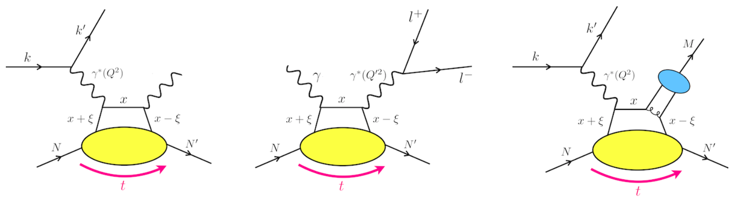
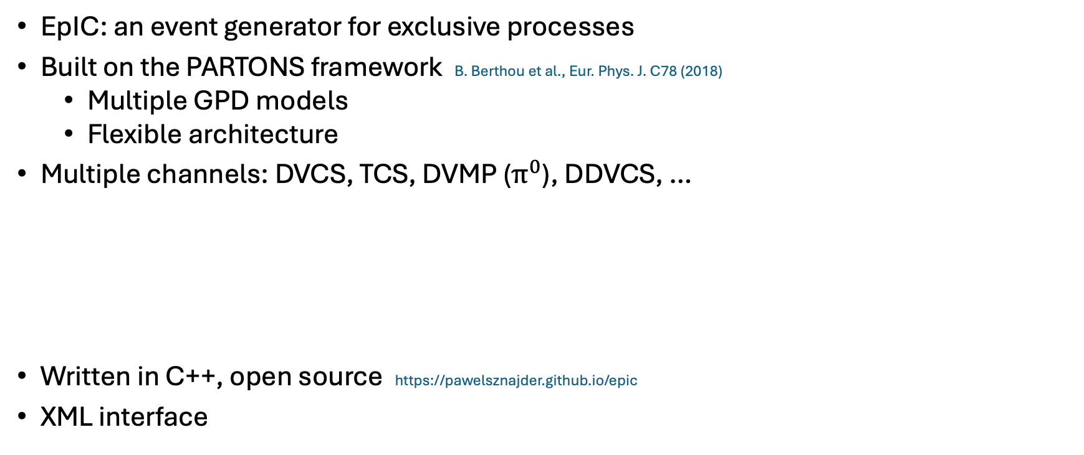
EpIC
EpIC: an event generator for exclusive processes
Built on the PARTONS framework B. Berthou et al., Eur. Phys. J. C78 (2018)
  Multiple GPD models
  Flexible architecture
Multiple channels: DVCS, TCS, DVMP ($π^{0}$), DDVCS, …
Written in C++, open source https://pawelsznajder.github.io/epic
XML interface
Aschenauer et al., Eur. Phys. J. C 82 (2022)

Slide 4
mFOAM
PARTONS
GPDs
CFFs
Observables
mFOAM
4-momenta
Kinematics
EpIC
EpIC uses the mini FOAM to generate kinematics randomly Jadach and Sawicki, Comput. Phys. Commun. 177 (2007)
Fully integrated with ROOT
Works for dimensions less than 20

Slide 5
EpIC – architecture

Slide 6
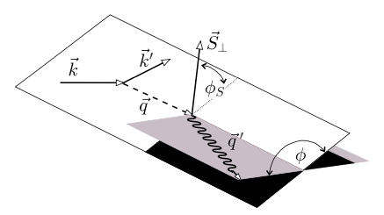
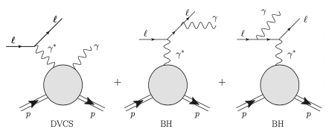
Leptoproduction of a real photon
Differential cross-section for the leptoproduction of a real photon
  Belitsky, Müller, Kirchner, Nucl. Phys. B 629 (2002)
  Kriesten et al., Phys. Rev. D 101 (2020)

Slide 7
EpIC
PARTONS
GPDs
CFFs
Observables
mFOAM
4-momenta
Kinematics
EpIC
Input file:
  GPD (or CFF) model
  Model parameters,
  Number of events, kinematic limits
  Beam – target type, beam helicity
  mFOAM parameters
  Radiative corrections
Output file:
  4 – vectors of all particles

Slide 8
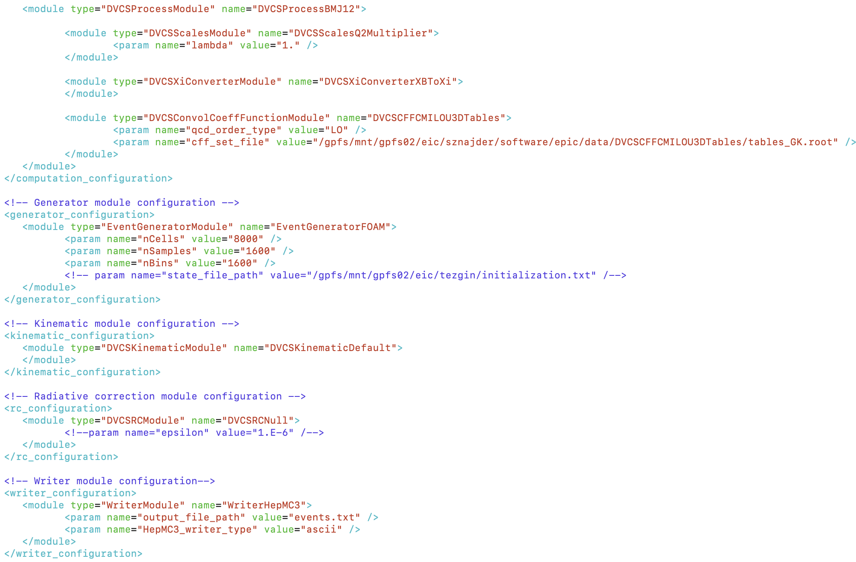

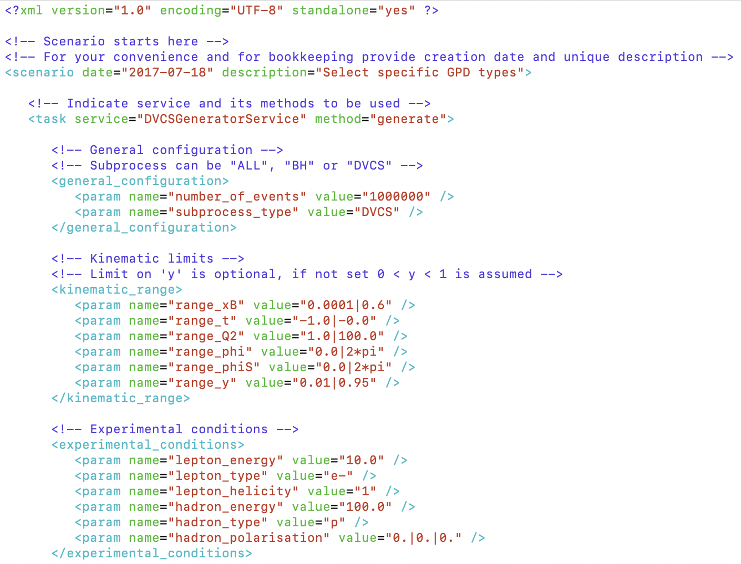
EpIC – input

Slide 9
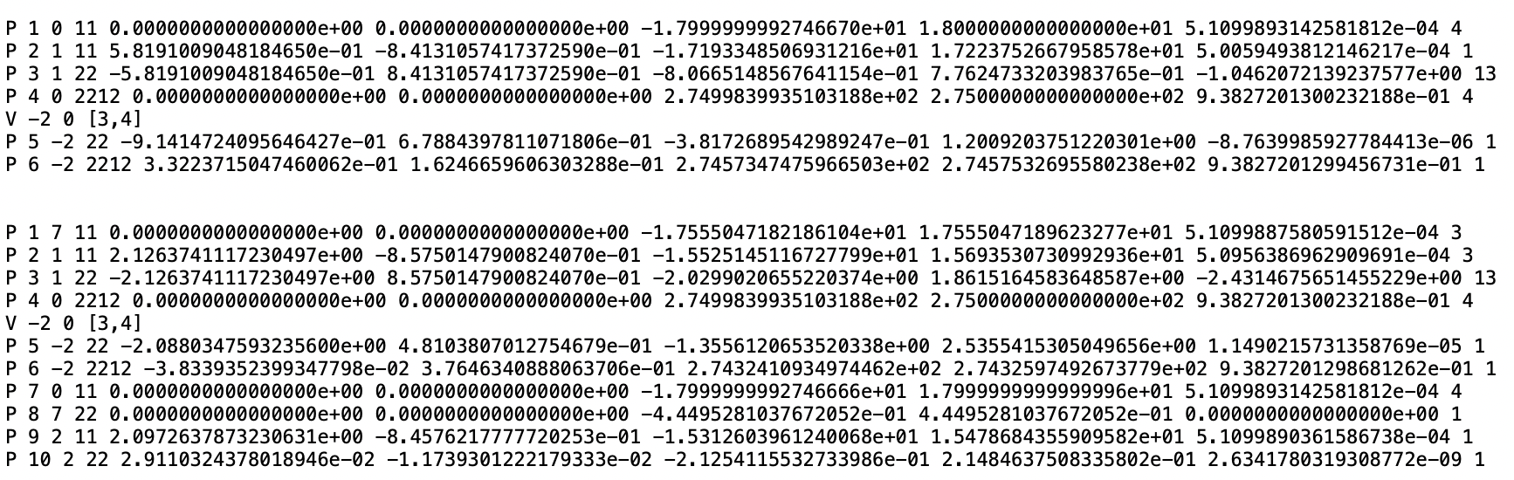
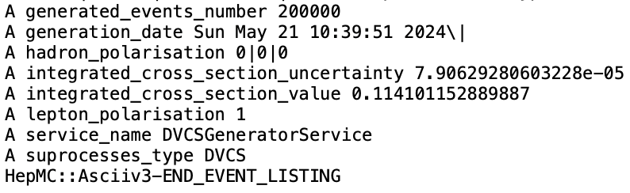


EpIC – output
p_{x}
p_{y}
p_{z}
E
p²
e
e’
$$γ∗$$
No RC
p
$$γ$$
p’
Born level
ISR
FSR

Slide 10
Radiative corrections
QED radiative corrections can have a significant impact on the interpretation of experimental data
Collinear approximation: Negligible transverse component of the 4-momenta of the emitted photon

Slide 11
Radiative corrections
DIS cross-section in collinear approximation
Kripfganz, Möhring, Spiesberger, Z. Phys. C 49 (1991)
DVCS cross-section:
The radiator function can be expanded as

Slide 12
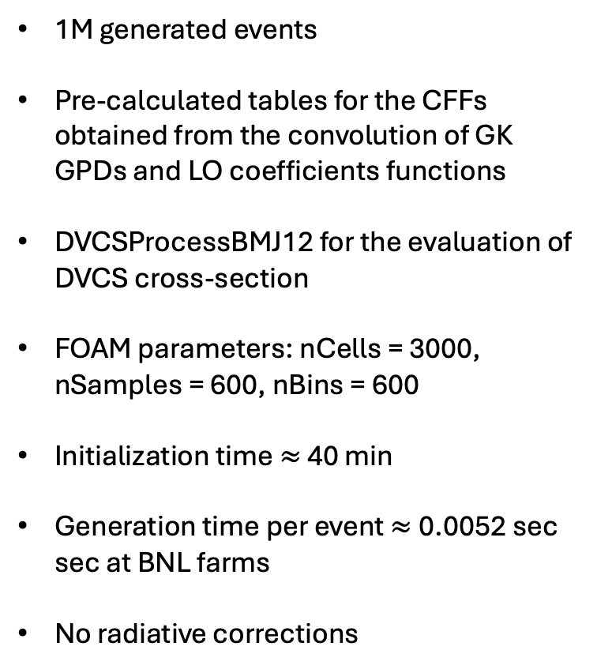
EpIC – DVCS
1M generated events
Pre-calculated tables for the CFFs obtained from the convolution of GK GPDs and LO coefficients functions
DVCSProcessBMJ12 for the evaluation of DVCS cross-section
FOAM parameters: nCells = 3000, nSamples = 600, nBins = 600
Initialization time $≈$ 40 min
Generation time per event $≈$0.0052 sec sec at BNL farms
No radiative corrections
Unpolarized target, E_{e} = 10 GeV, E_{p} = 100 GeV

Slide 13
EIC Impact Study
Simulate events using EpIC MC at EIC kinematics
  Produce pure DVCS, BH and DVCS+BH+INT events within the expected EIC kinematics
  Include 2nd order radiative corrections
Apply detector effects and reconstruct events
  Process simulated events through EICROOT to model detector response
  Use reconstruction algorithms to extract kinematics
Evaluate the impact of EIC data on nucleon tomography Aschenauer, Fazio, Kumerički, Müller JHEP 09 (2013)
  Assess how detector-corrected data improve the spatial imaging
  Quantify the precision of extracted CFFs

Slide 14
Event Generation Conditions
MC Events generated in kinematics:
Cuts at the analysis level:
DVCS CFFs obtained from convoluting the GK model GPDs with LO coefficient functions

Slide 15
Reconstructed events
Preliminary
Preliminary
Preliminary
Preliminary
Preliminary
Preliminary

Slide 16
Radiative corrections
Preliminary
Preliminary
Preliminary
DVCS subprocess only – no detector effects
RCs affect the edges of the y-spectra
Negligible shift of the mean kinematic variables <x_{Bj}> and <Q²> obtained in bins used in the extractions
The relative magnitude of this shift is at the order of 1%

Slide 17
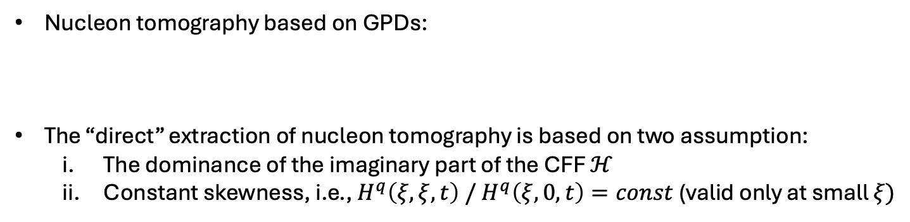
Nucleon tomography at EIC
Nucleon tomography based on GPDs:
The “direct” extraction of nucleon tomography is based on two assumption:
  The dominance of the imaginary part of the CFF $ℋ$
  Constant skewness, i.e., ${H^{q}\left(ξ,ξ,t\right) / H}^{q}\left(ξ, 0, t\right)=const$(valid only at small $ξ)$
Burkardt, Int. J. Mod. Phys. A 18 (2003)
Akhunzyanov et al. (COMPASS), Phys. Lett. B 793 (2019)
(LO/LT)

Slide 18
Nucleon tomography at EIC
Measure event distribution
Correct for detector acceptance
Subtract the BH contribution to isolate the DVCS part
GK model
Preliminary
Preliminary
Distribution of events corrected for acceptance and after subtraction of the BH contribution as a function of t (left)
Resulting tomographic picture (right)
E. Aschenauer, V. Batozskaya, S. Fazio, A. Jentsch, J. Kim, K. Kumerički, H. Moutarde, K. Passek-K., D. Sokhan, H. Spiesberger, P. Sznajder, KT: to appear soon

Slide 19
EIC impact on CFFs
CFFs extracted from the Beam Spin Asymmetry:
Preliminary
Preliminary
An ensemble of 200 NNs were trained:
Similar to analyses:
Small at EIC kinematics
No statistically significant effect
Preliminary
Kumerički, Müller, Schäfer, JHEP 07 (2011)
Moutarde, Sznajder, Wagner, Eur. Phys. J. C 79 (2019)
Preliminary
E. Aschenauer, V. Batozskaya, S. Fazio, A. Jentsch, J. Kim, K. Kumerički, H. Moutarde, K. Passek-K., D. Sokhan, H. Spiesberger, P. Sznajder, KT: to appear soon

Slide 20
Summary
EpIC: A MC event generator for exclusive processes utilizing a flexible architecture
Includes initial and final state QED radiative corrections
Supports impact studies and detector simulations
Enables precision tests of spatial imaging and CFFs (and GPDs) extraction
Acknowledgement: This presentation was partially supported by Virginia Tech Office of Research and Innovation Postdoc Travel Award

