Slide 1




New theoretical developments for hadron and jet production at the EIC
Ivan Vitev, LANL
Based primarily on:
2301.11940 [hep-ph]
2408.10310 [hep-ph]
2412.12250 [hep-ph]
Credit to:
Weiyao Ke, John Terry
POETIC XI, Florida International University, Miami FL, Feb. 24 – 28, 2025
Notes:
question->questions
“an” Appendix

Slide 2
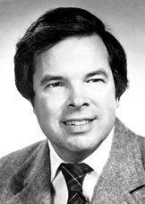
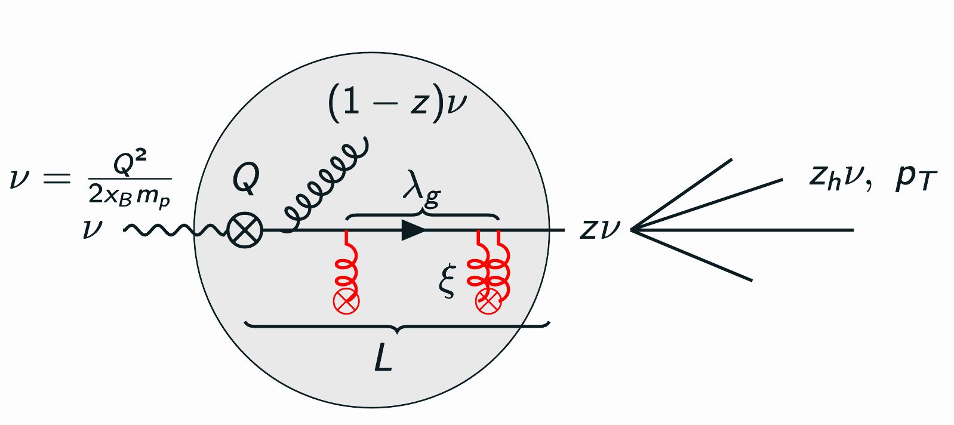
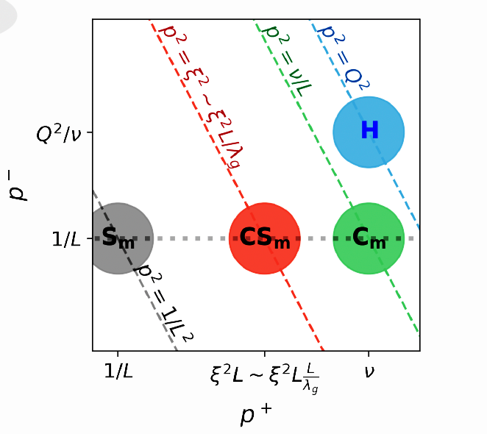
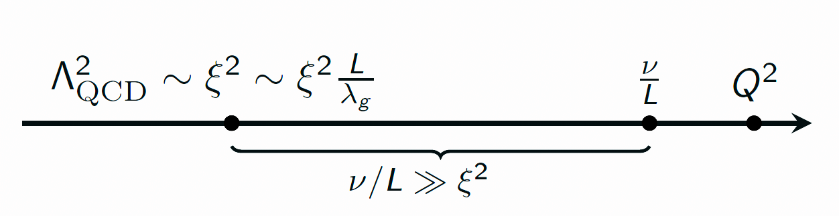
A renormalization group approach to multi-scale physics in eA and pA
The goal is to calculate collinear and TMD DIS and DY in eA and pA reactions. Understand analytically how cold nuclear matter effects can be obtained perturbatively (at least partly)
K. Willson (1982)
Nobel Prize speech
The renormalization group (RG) approach provides the theoretical foundation to connect physics at different scales. Applicable to “a number of problems in science which have, as a common characteristic, that complex microscopic behavior underlies macroscopic effects.”
The large separation of scales and appearance of divergences calls for renormalization group analysis. One encounters many ratios of scales in DIS on nuclei. We aim to resum large logarithms of Q/Qo and E/ξ²L

Slide 3
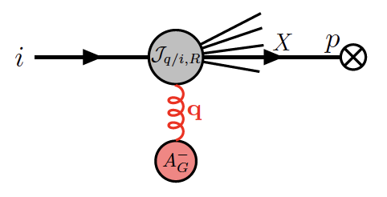
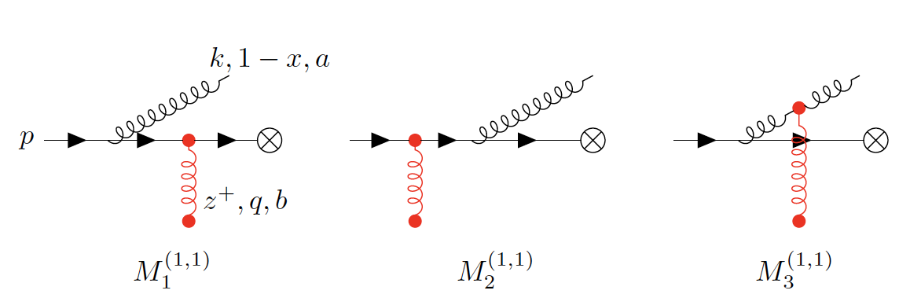
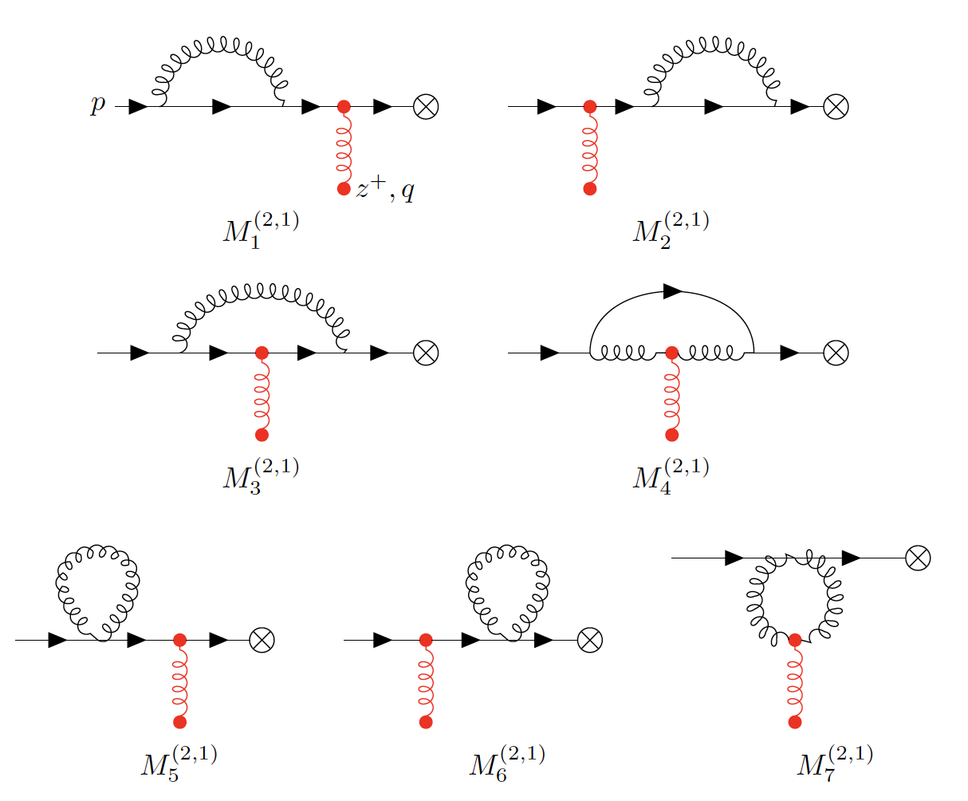
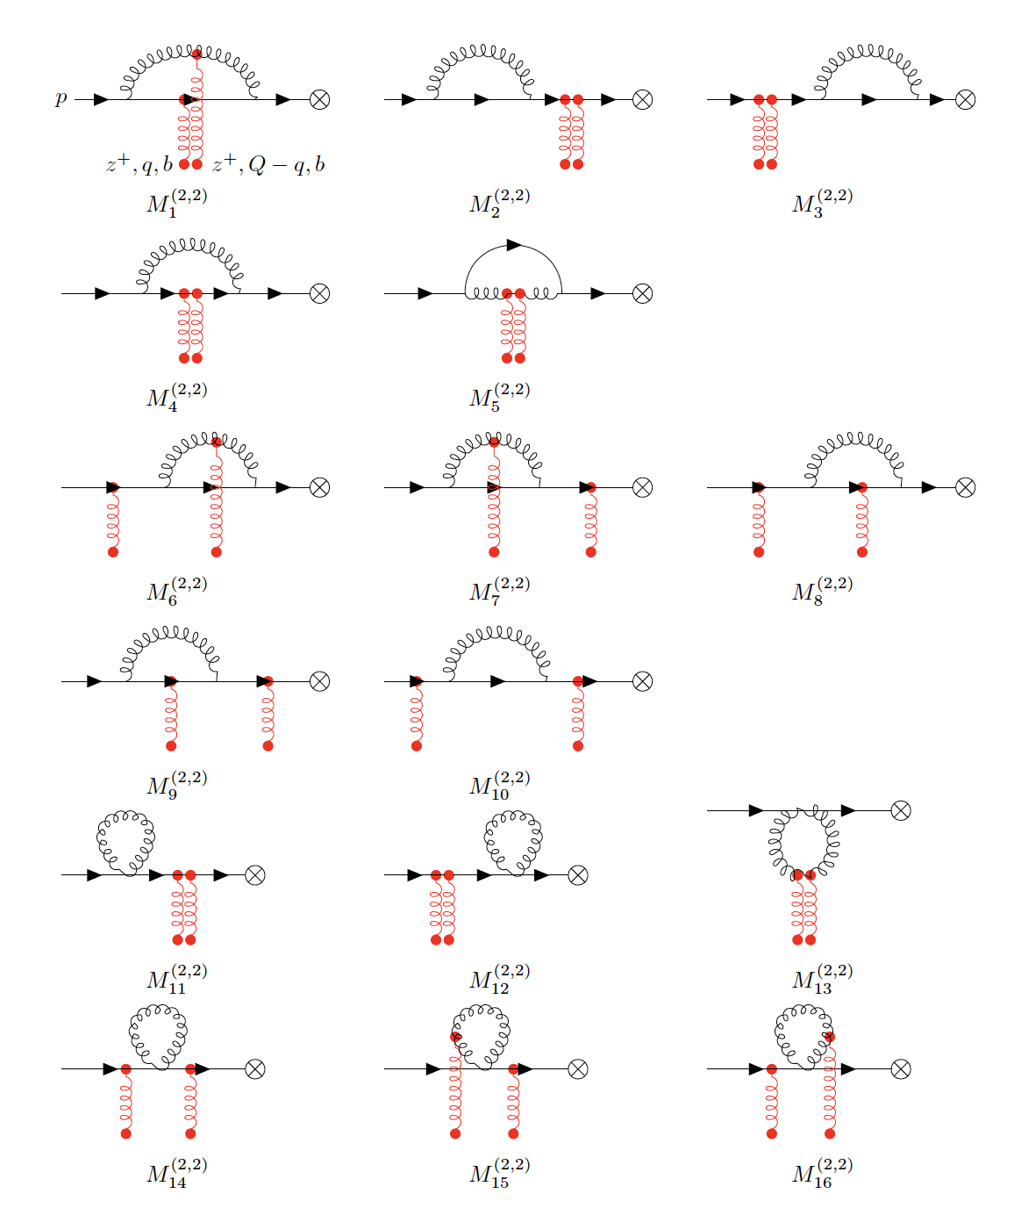
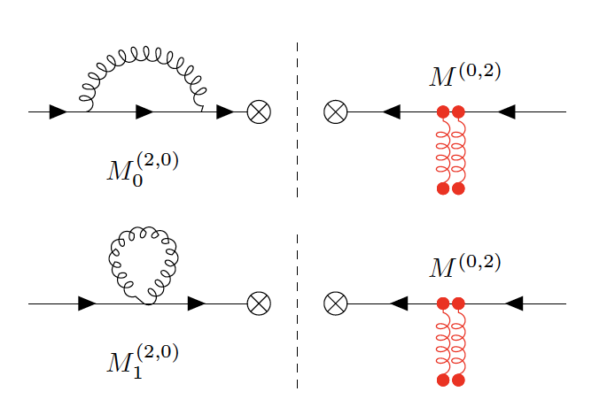
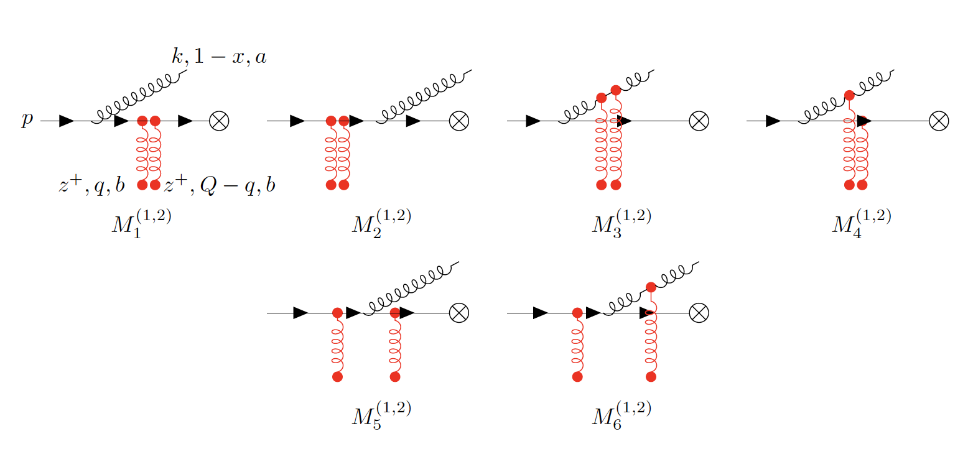
Diagrams for the collinear matching coefficient function
One needs to evaluate diagrams that change impart transverse and longitudinal momentum changes via collisions (Glauber gluons) or radiation
A. Idilbi et al. (2008)
G. Ovanesyan et al. (2011)
I. Rothstein et al. (2016)
Single Glauber, real radiation
Single Glauber, loop correction
Wavefunction renormalization
Vanishes to leading power
(scales integrals)
New direct calculation of loop diagrams
Double Glauber, loop correction
Double Glauber, real radiation
Disclaimers: a) the diagrams are drawn for DY, but they are essentially the same for DIS; b) for the collinear calculation we integrate over the transverse momenta

Slide 4
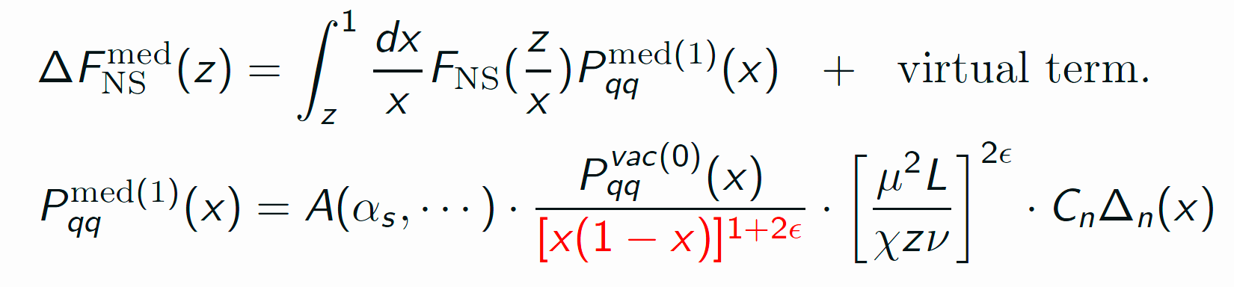
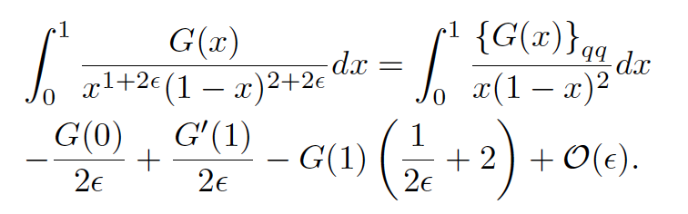
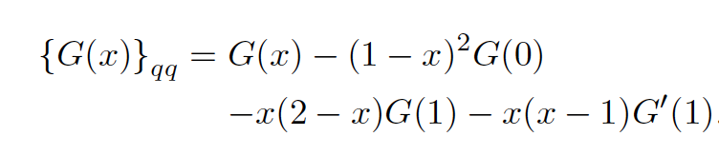
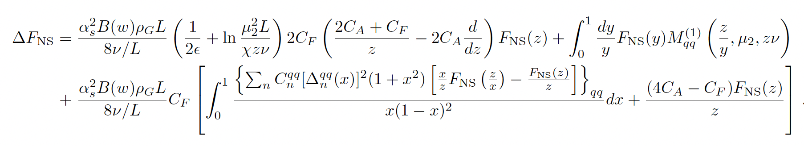
Generalized subtraction of divergences
The diagrams add to contributions proportional to the in-medium splitting functions. One important part here is the additional 1/x(1-x) divergence at the endpoints of the splitting function
Take the flavor non-singlet distribution for simplicity
One can define a “generalized + prescription” and a subtracted function so that the integral with endpoint divergences is finite
The large medium induced logarithms that need to be resummed
The 1/ε divergence and M⁽¹⁾ counter term that cancels it
Fixed order contribution - free of divergences, no large log enhancement

Slide 5
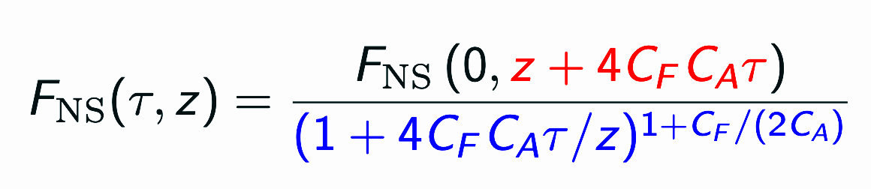
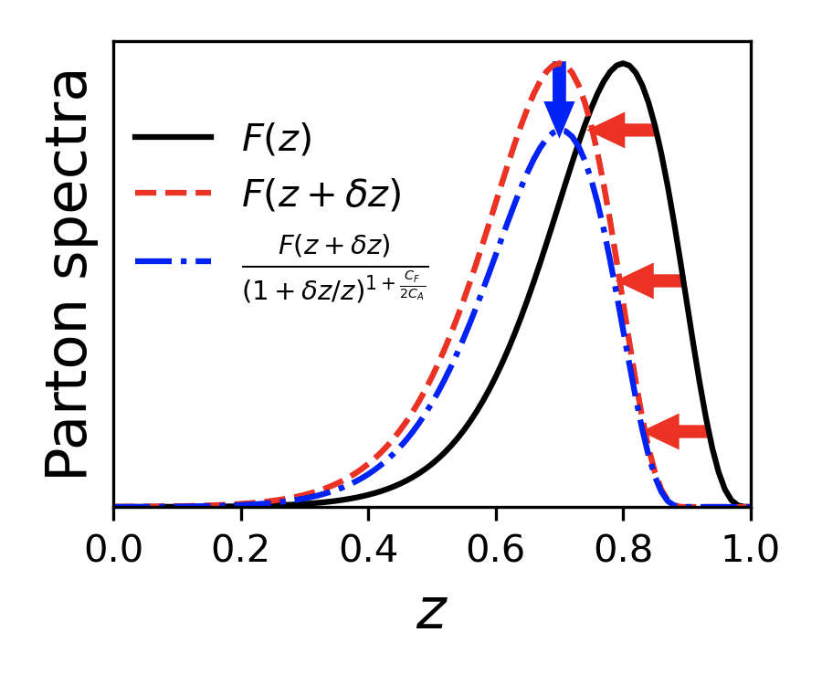

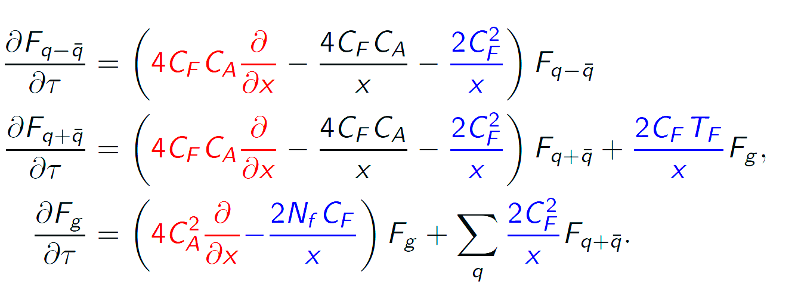
In-medium collinear RG evolution
Derived new set of RG evolution equations for the distribution of partons in the shower. The NS distribution has a very elegant traveling wave solution
Suitable change of variables. Also captures the density, path length and energy dependence
Flavor non-singlet (q-qbar)
Flavor singlet (q+qbar, g)
W. Ke et al. (2023)
Can directly identify parton energy loss, the nuclear size dependence of the modification, etc
Connection between RHIC/LHC (hadronic collisions) and EIC (DIS): The same in-medium RG evolution describes the suppression of hadron production in SIDIS on nuclei and DY in pA

Slide 6
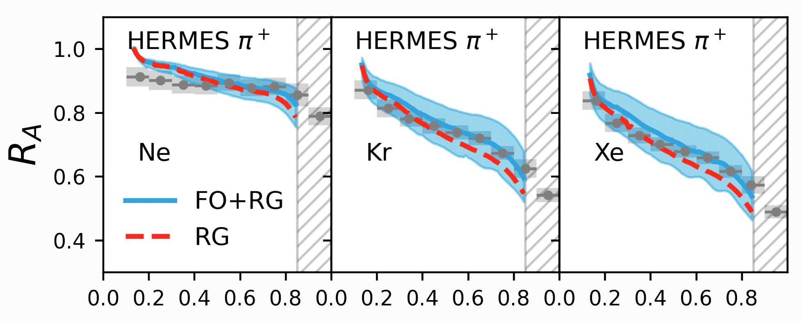
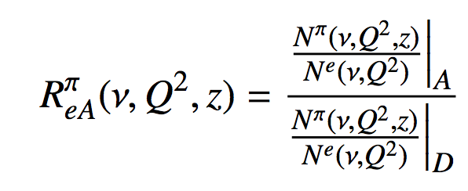
Phenomenological applications of the new RG analysis to HERMES
Revisiting the HERMES data
Observable chosen to eliminate initial-state effects
RG evolution gives a good description of the data at small to intermediate z_{h} .
Fixed order corrections improve the agreement at large z_{h}
z_{h}
RG evolution advantages
W. Ke et al. (2023)
The method is systematically improvable – both higher logarithmic accuracy and fixed order terms, if higher order splitting functions are available
Numerically, it is much faster to implement and solve in comparison to in-medium DGLAP evolution
The proper in-medium scale separation increases predictive power
At the level of cross sections one can identify the effects of “energy loss”
Practical concerns (not specific to the RG approach)
The scales of the medium (lower boundary) are small and the coupling strong

Slide 7
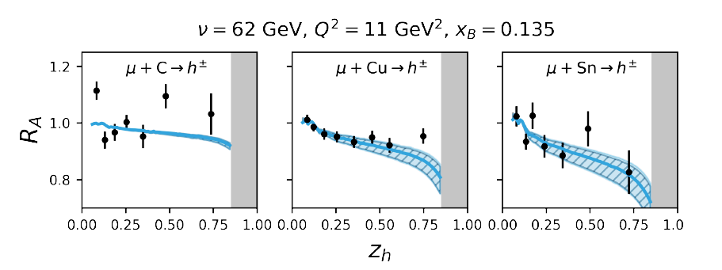
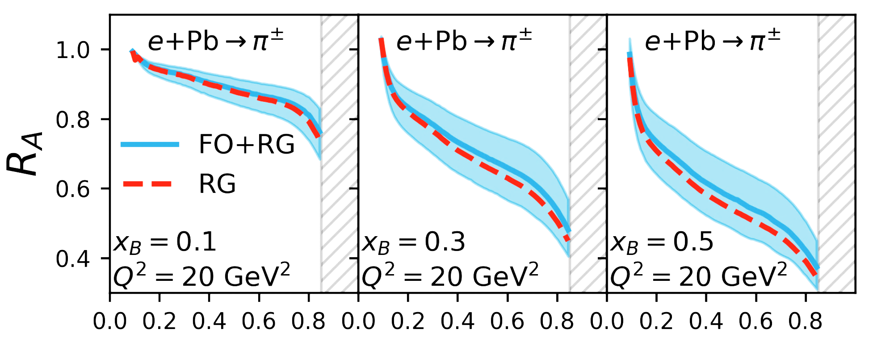
Validation and EIC results
Addressing EMC data
EMC measurement for C, Cu, and Sn nuclei at similar x_{B} much higher Q² ~ 11 GeV²
Same effective Glauber gluon density used
Predictions for the EIC
Fixed order (FO) + RG evolution compared to EMC data
The modifications to hadronization at EIC depends on kinematics x_{B},Q²
At large x_{B} and (forward rapidities) the modification can be very significant
W. Ke et al. (2023)
z

Slide 8
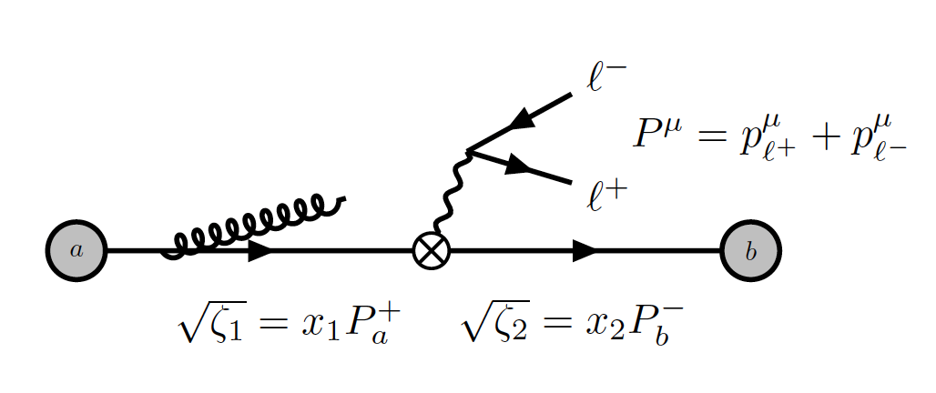
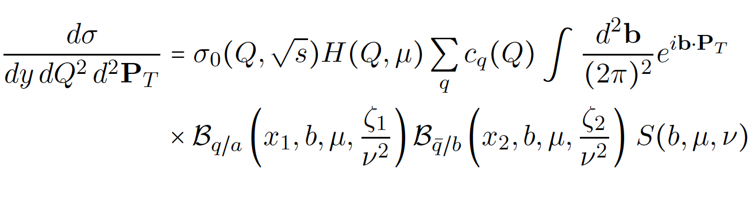
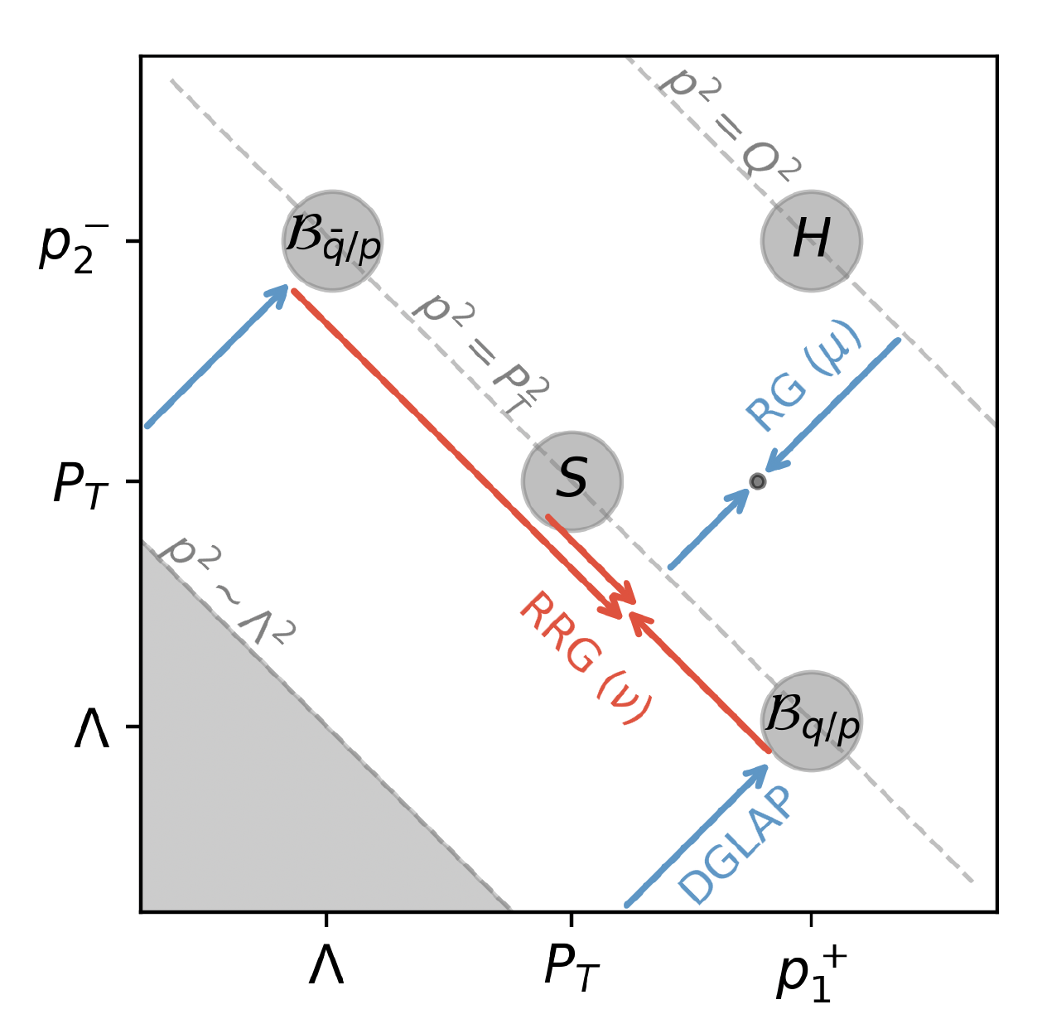
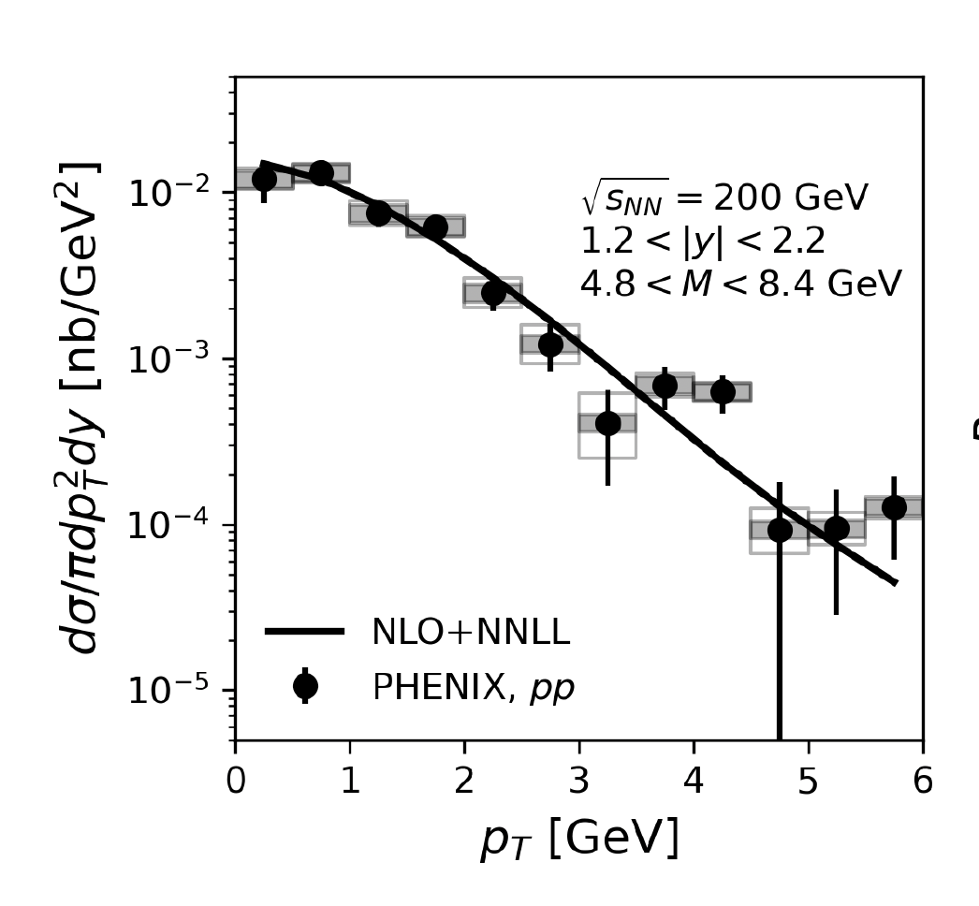
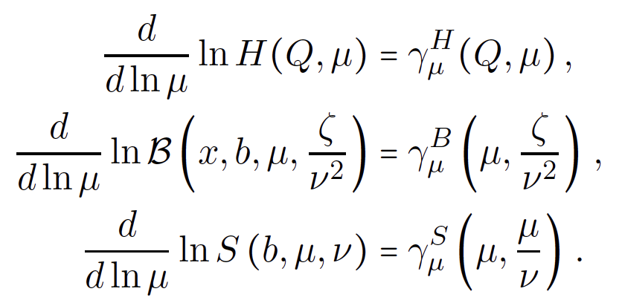
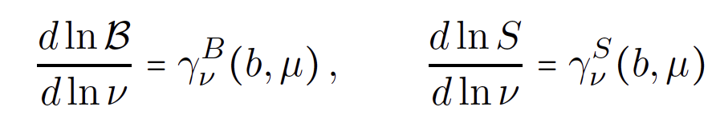
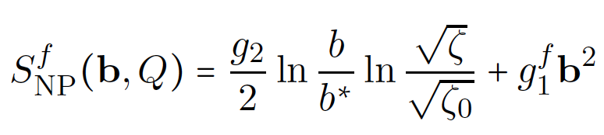
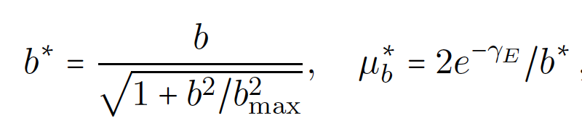
Factorization and evolution of TMD DY
SCET factorized expression, impact parameter space
R. Boussarie et al. (2023)
RG
RRG
J. Chiu et al. (2012)
Note the emergence of the Collins-Soper scales (CS)
Evolution is controlled by renormalization group (RG) and rapidity renormalization group (RRG) equations
Comparison to the PHENIX data
NLO+NNLL code with NP effects
M. Alrashed et al. (2021)
Note that as we go to high p_{T} we will underpredict the data. Not matched to collinear calculation (the “Y” term)

Slide 9
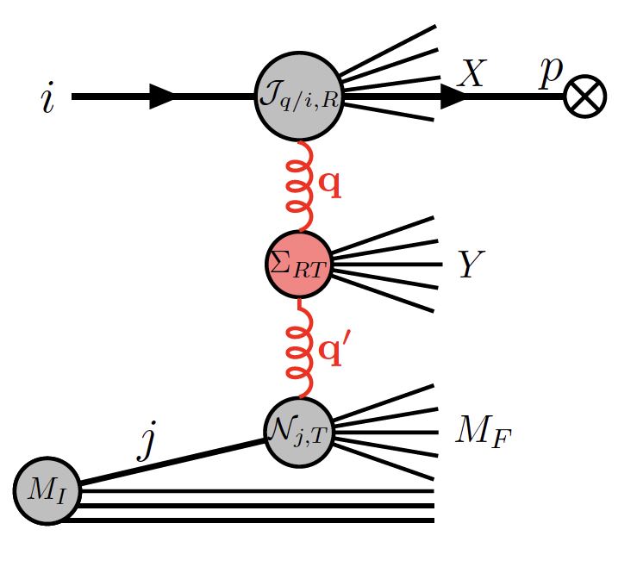
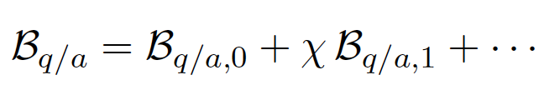
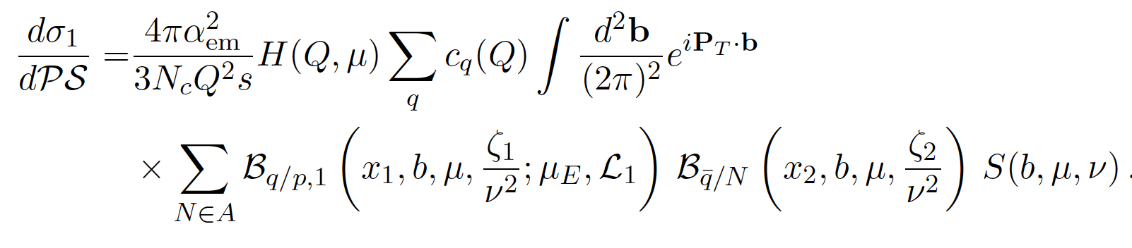
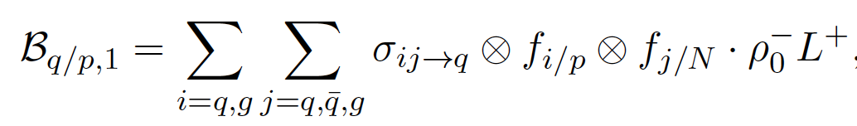
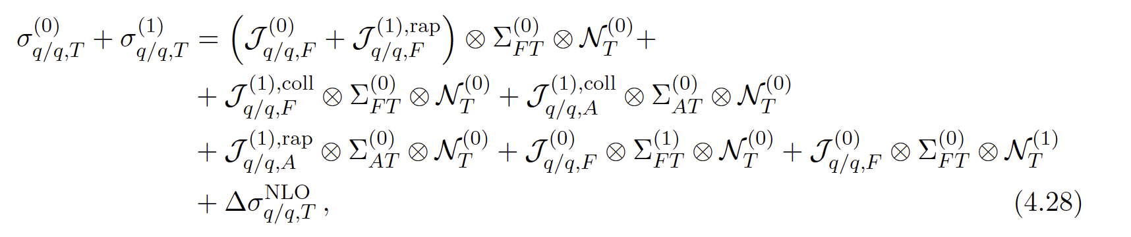
Structure of the calculation in matter
Take the opacity expansion approach and calculate the correction to the proton beam function
Factorized expression for the first order in opacity correction
M. Gyulassy et al. (2000)
We further isolate the effects in the partonic scattering cross section and effective Glauber gluon density
Tree level terms
Collinear divergences
Rapidity divergences
Soft radiation and anti-collinear
Structure of the partonic cross section (quark example)
Fixed order piece

Slide 10
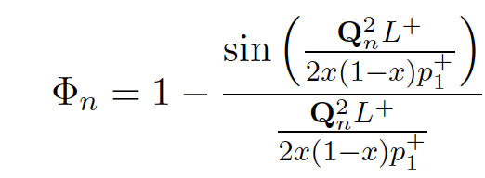
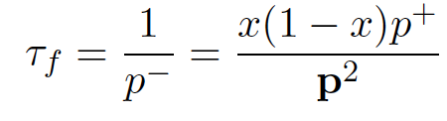




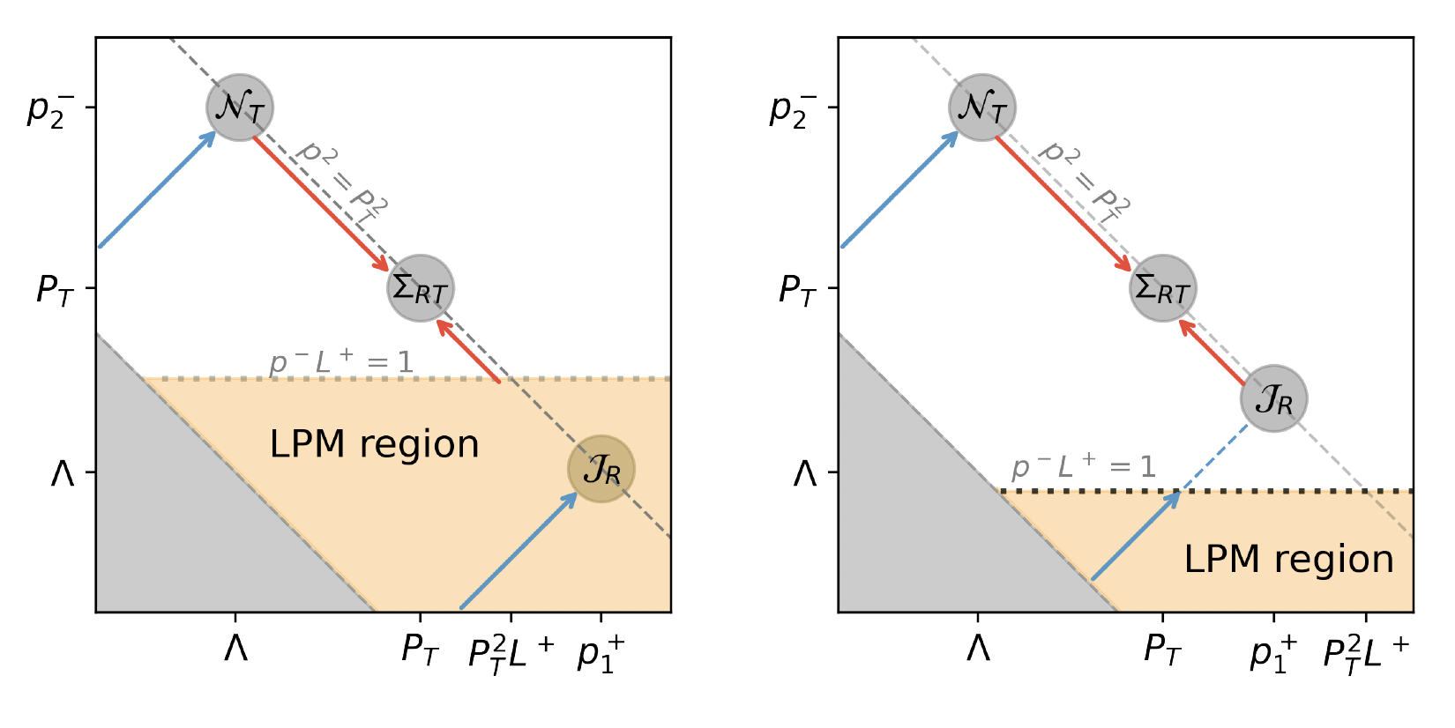


The Landau-Pomeranchuk-Migdal effect
To understand the results, one needs to consider coherence in the emission process on a nuclear target
L. Landau et al. (1953)
The non-trivial scales
A. Migdal (1956)
Long formation times
Short formation times
“Standard scale ordering”
Kinematics suggests that we have dominant contributions from the first scenario
We consider both and provide formulas that interpolate
Collinear emission is in the LPM region. Evolution space limited
Collinear emission is outside LPM region. Evolution space not limited

Slide 11
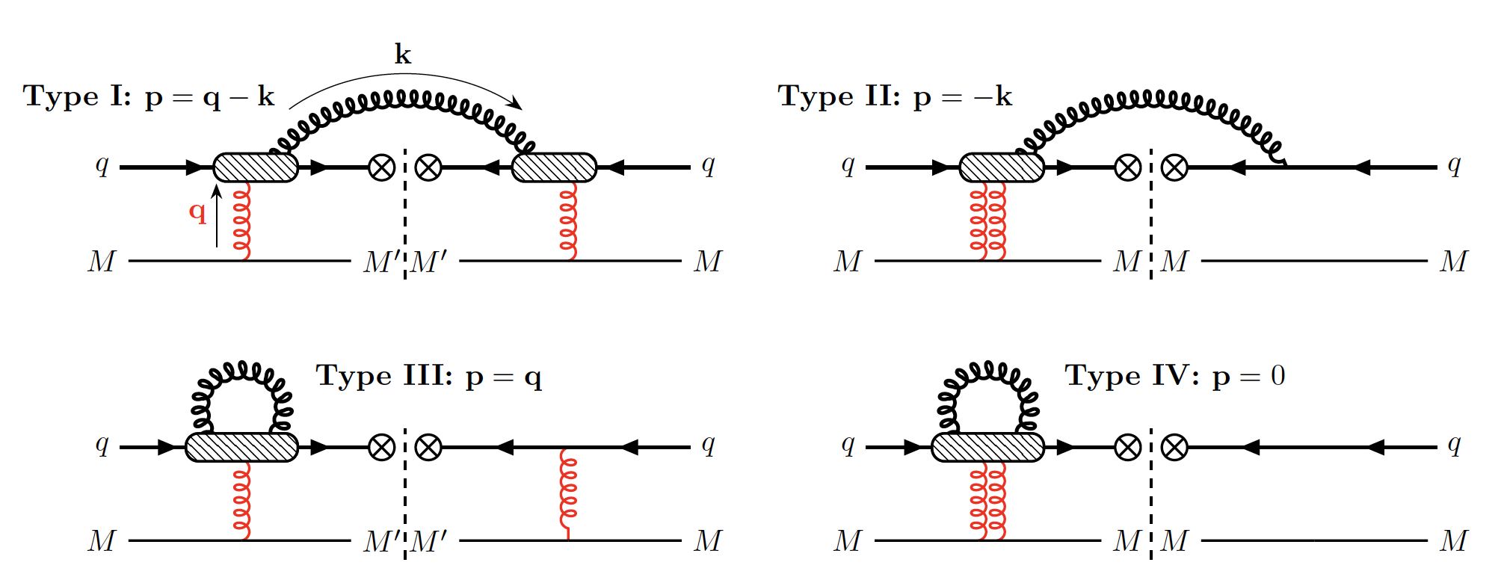
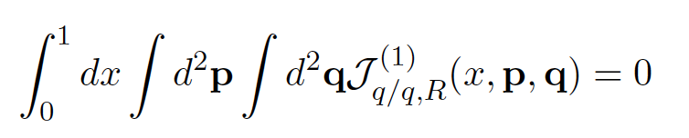
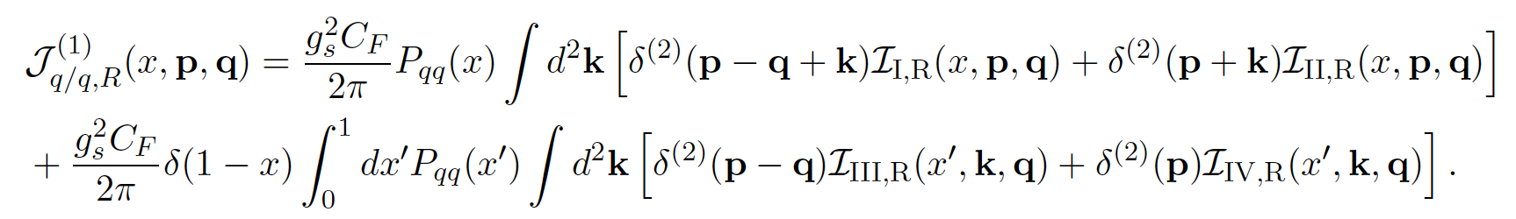
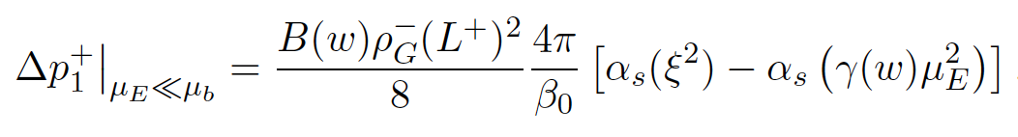
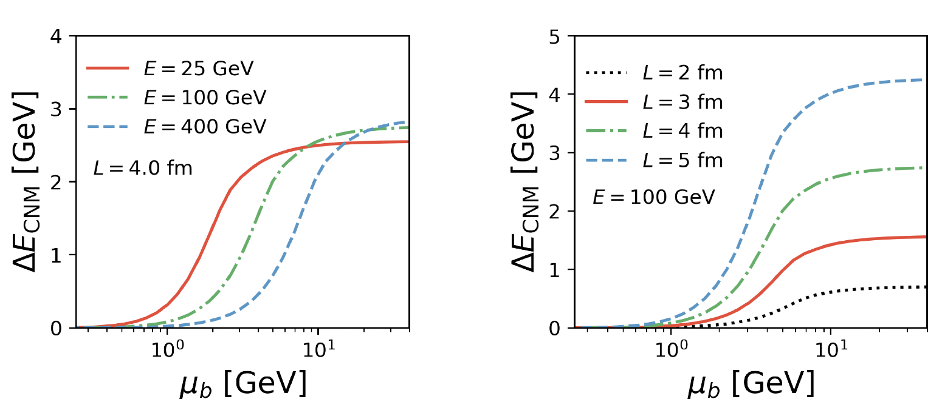
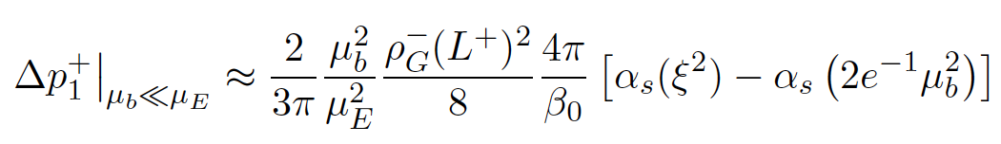
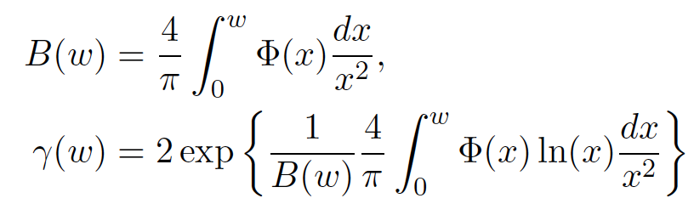
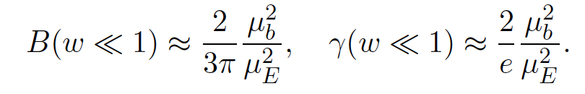
Collinear function results
The 4 classes of diagrams contribute differently to the longitudinal and transverse momentum flow in the DY the process
Flavor sum rule explicitly satisfied
Collinear and rapidity divergences lead to renormalization group equations. The same novel RG scale evolution as in DIS
We can identify the energy loss of the parton (driven by soft emissions)
Energy loss differs between collinear and TMD observables
Collinear (or unrestricted phase space case)
W. Ke et al. (2023)
TMD (or restricted phase space case)
W. Ke et al. (2024)
E-loss vs size

Slide 12
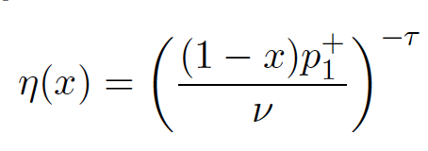
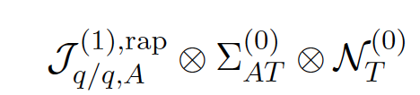
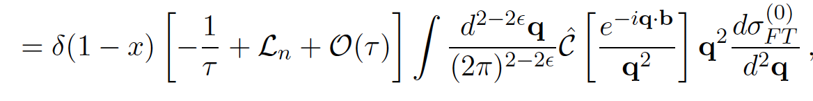

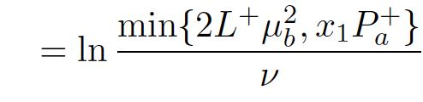
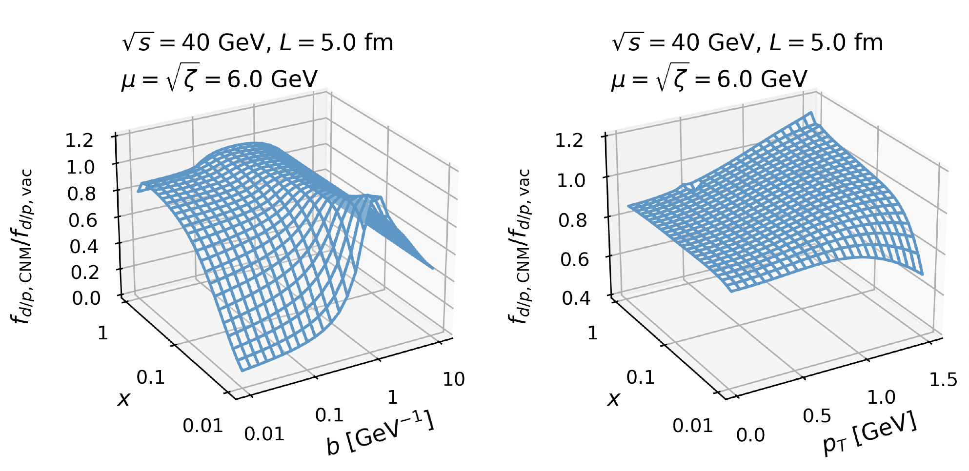

Rapidity divergences
Collinear radiation can also lead to rapidity divergences
Regulated by the 𝛈 regulator. Rapidity divergences appear as 1/𝛕 poles
𝛈 regulator
The LPM effect leads to the appearance of a new Collins-Soper (CS) scale ~ . The LPM effect on RG and RRG connected
The rapidity logarithm becomes
One sees the appearance of the BFKL kernel [with action defined on v(q²)]
By also including the soft emission form the Glauber scattering and the target anti-collinear sector we find that the 1/𝛕 poles cancel
Rich stricture appears from CNM effects in the 2D proton beam function.

Slide 13


Phenomenological results – fixed target energies and E866 data
Fixed target experiment data E866 provides ratios of nuclear targets
The calculation captures the mass dependence
The nuclear effects derived here are important for a better description of the transition from suppression to enhancement
Opens the door to phenomenology
M. Vasiliev et al. (1999)
Nuclear size dependence and uncertainties
Contribution of various effects

Slide 14



The need for azimuthally asymmetric jet substructure
Jet substructure provides novel ways to study QCD at the non-perturbative level, test high-precision theory, and improve resummation
Perturbative correction to jet direction
Hadronization
Jet substructure can be anisotropically modified by
Color flow
Spin correlation
Inhomogeneities in matter
Quark-gluon plasma flow
A. Larkoski et al . (2020)
A. Sadofyev et al . (2021)
Perturbative correction to jet shape
IRC safety for
In reactions with nuclei additionally
Jet broadening
A modern way of calculating jet observables is by using jet functions
Almeida et al . (2008)
Jet shape
T. Kaufman et al . (2015)
Z. Kang et al . (2016)
S. Ellis et al . (1991)

Slide 15

Illustrative example – the jet shape
Goal – to formally define substructure observables as a function of the azimuthal angle. Derive the corresponding sub-jet functions
Measure the energy going into a wedge within the jet. Azimuthal-dependent jet shape
Derived both the inclusive and semi-inclusive jet function
Obtained both standard jet axis (SJA) and winner take-all (WTA) results
Computed both the fixed order expression and evolution (the resumed region) at one loop
For the jet broadening and shape

Slide 16
Limits and bonus results
Results documented in the paper
W. Ke, J. Terry et al. (2024)
Checked the limit when the wedge goes to 2𝜋 we recover the azimuthally symmetric case
Checked the subjet functions satisfy the same evolution equations as the full jet functions
Any naïve IR divergences vanish in energy distributions
Azimuthal-dependent jet shape
Azimuthal-dependent jet broadening
Bonus result: for the azimuthally integrated case, several new results documented
Resummed (SJA)
Fixed order (SJA)
Resummed (WTA)
Fixed order (WTA)
Broadening
Becher-Bell 2012
Ke, Terry, Vitev 2024
Larkoski, Neill Thaler 2014
Ke, Terry, Vitev 2024
Jet shape
Kang, Ringer, Waalewijn 2017
Chien, Vitev 2014
Kang, Ringer, Waalewijn 2017
Kang, Ringer, Waalewijn 2017

Slide 17






Application to transversity in DIS
Measuring the collinear transversity function h₁(x) is challenging
The azimuthally asymmetric substructure provides a novel way to measure h₁(x), as transversity does not couple to chiral-even distributions in the final state
With the leading cross section contributions
Measurable final-state
transverse spin asymmetry
Based upon assumed 10 % non-perturbative spin-dependent contribution to jet broadening and transversity parametrized as in
Z. Kang et al. (2015)
Predicted asymmetry at the EIC for various kinematic conditions
W. Ke, J. Terry et al. (2024)

Slide 18
Conclusions
Hadronization and hadronic final states are an important part of the EIC program
Many of the CNM effects can be understood from the scattering and evolution of in-medium parton showers. Resummation of large nuclear matter-induced logarithms is essential to interpret the results from reactions with nuclei
An RG evolution approach was developed, provides unique analytic insights into this problem. It is fast, efficient, improvable, and resulted in a new set of evolution equations
It was first applied it to collinear factorization, exemplified by SIDIS. Understood analytically parton shower energy loss, and demonstrated applications to phenomenology – HERMES, EMC and EIC.
The in-medium RG formalism to TMD factorization on the example of DY, unifying broadening and radiative corrections
In addition to RG evolution, rapidity renormalization group equations (RRG) that take into account the LPM effect. It limits the BFKL growth of target density
The in-medium TMD formalism was applied to phenomenology. Good description of fixed target DY experiments with clear paths for improvement, e.g. matching onto collinear factorization at high p_{T}
There is growing interest in studying effects of spin correlations, medium inhomogeneities, and flow. To address this, the theory of azimuthal-dependent jet shape and jet broadening (SJA, WTA; (semi)inclusive; fixed-order, resummed) was developed
The new azimuthal anisotropic observables open possibilities to study QCD dynamics and nucleon/nuclear structure. Transversity h₁ couples to chiral-odd jet substructure, resulting in transverse spin asymmetries that can be measured ta the EIC

Slide 19






Hadron production – quarkonium physics for the EIC
Understanding hadronization is essential because most everything that we measure in QCD collider experiments (other than electroweak signals) is via hadronic final states
Uncertainties still remain - independent fragmentation / open heavy flavor, quarkonia/LDMEs, coalescence, and string or cluster fragmentation in event generators
Polarized J/𝜓 production at the EIC and TMD physics
Tom Mehen (1970-2024)
New results of quark fragmentation; dominance of photon-gluon fusion in the accessible Q² range; a new way to probe gluon TMDs
Unpolarized partons → longitudinally polarized J/𝜓
M. Copeland et al. (2023)
A comprehensive, theory driven case for quarkonium studies at the EIC. Polarization, diffractive production, relation to GPDs, cold nuclear matter dissociation
Example of the EIC discriminating power wrt LDMEs
D. Boer et al. (2024)

Slide 20


Event generators for eA at the EIC
The BeAGLE event generator
The eHIJING event generator
Typically start from a Pythia event (replacement for PHOJET)
Focuses on low energy nuclear physics, intranuclear cascade, evaporation, gamma de-excitation
Builds upon the very successful HIJING event generator in HI collisions
Extends to perturbative high Q processes in matter
W. Chang, M. Baker et al. (2022)
X.N. Wang et al. (1991)
Physics input into BeAGLE
While not aimed at precision physics, event generators are very useful in testing ideas and addressing complex final states
Workflow in the eHIJING event generator
W. Ke et al. (2023)

Slide 21



Interplay between event generators and perturbative theory
Centrality-dependent measurements emphasize the dynamical nature of nuclear effects, test parton energy loss frameworks, constrain the transport properties of nuclear matter
BeAGLE – centrality can be determined from the neutrons detected in the ZDC, <d>
Robust with respect to nuclear effects – shadowing, particle formation times
Illustration of the nuclear thickness seen by the struck quark
Builds upon recent developments in numerical evaluation of parton shower formation in matter
Generalization of DGLAP evolution to account for such medium-induced scaling violations
Sensitivity of light and heavy mesons modification to eA collision centrality
W. Chang et al. (2022)
H. Li et al. (2023)

Slide 22
The renormalization group
Much of the reported work is based on renormalization group (RG) analysis
The theory of how to connect physics at different scales. Applicable to “a number of problems in science which have, as a common characteristic, that complex microscopic behavior underlies macroscopic effects.”
Origins can be traced to:
Ideas of scale transformations in QED
Handling infinities in field theories
M. Gell-Man, I. Low (1954)
K. Willson (1982)
Nobel Prize speech
R. Feynman, J. Schwinger, S. Tomonaga, Nobel Prize (1965)
Hydrodynamics
Social networks
Low energy nuclear physics
Small-x physics
V. Yakhot et al. (1986)
M. Newman et al. (1999)
S. Bogner et al. (2007)
J. Jalilian-Marian et al. (1998)
In particle and nuclear physics – a way of making sense of inherently divergent theories

Slide 23





Technical aspect: the splitting functions
The diagrams add to contributions proportional to the in-medium splitting functions
In cold nuclear matter (uniform density) we can analytically integrate over the path length. We can can significantly simplify the propagator and phase structure that arises form in-medium interactions
Up to color and kinematic factors, the splitting functions have the same universal form
The remaining integration over the momentum exchanges with the can be performed using dim. reg. and by expanding the integrand
Final result
Slowly varying functions O(one/few)
One important part here is the additional 1/x(1-x) divergence at the endpoints of the splitting function

Slide 24



Factorization in SCET for the TMD DY
Factorized expression, impact parameter space
R. Boussarie et al. (2023)
Total cross section coefficient (Born level cross section)
Hard part and charge coefficient (only non-trivial when one reaches electroweak scales)
Beam function that matches on the collinear PDF in the perturbative region
Soft function (with a staple Willson line because of 2 directions)

Slide 25










Contributions with rapidity divergences
NLO correction to the Glauber cross section
We consider soft gluon emission
There are other diagrams that look like Glauber self energies and wavefunction renormalization. Do not contain rapidity divergences
Real and virtual diagrams that contain rapidity divergence
Observe the BFKL kernel, pole, and a different soft logarithm
NLO correction from the anti-collinear sector
Note that real emission diagrams contribute. These are not the partons in the large Q process. Double Glauber will not put them off-shell

Slide 26



Cancelation of the rapidity divergences
Putting all sectors together we find that
The 1/𝛕 poles have cancelled
The logarithms have combined to become
More thought should be given for phenomenological studies
We can write down the the BFKL-type evolution for the cross section components
Keep at their scales
Put all BFKL evolution in the 𝞢
A similar equation can be written in ν’ for the target

Slide 27




BFKL equations solver
Used our own numerical BFKL equation solver in impact parameter space
One needs to introduce separation parameter R as we have integration over b’
Can be shown that the result does not depend on R
Initial condition that interpolates beet the vacuum case and the medium case
W. Ke et al. (2024)
Matched to the DLA initial condition (y=0) at 𝛏b=0.35
Analytic solution comparison in the DLA approximation
Parameters
Matches well after a few units in rapidity. Looses memory of initial conditions
BFKL solution compared to the asymptotic case

Slide 28


The final result
Modified p beam function
Collinear evolution (RG) modifies the PDF in the proton (including LPM).
Multiple Glauber gluons exponentiate (including unitarity corrections)
Radiation enhances broadening, renormalizes (RRG) the forward scattering cross section.
There are finite contributions
Broadening
Rapidity evolution of the forward scattering in impact parameter space. Solid line is the boundary condition from tree level Glauber exchange, dashed – the physical boundary.

Slide 29
Effective modification of the TMD distribution in pA
Rich stricture appears from CNM effects in 3D proton beam function. Note that scales are set differently then in collinear factorization and reflected on results
Will affect significantly global extraction
M. Alrashed et al. (2021)
Impact parameter space
Momentum space
One has to be careful pushing to x ~ 0.01 and below as one enters a regime of coherent scattering with the target that we did not explicitly consider

