Slide 1

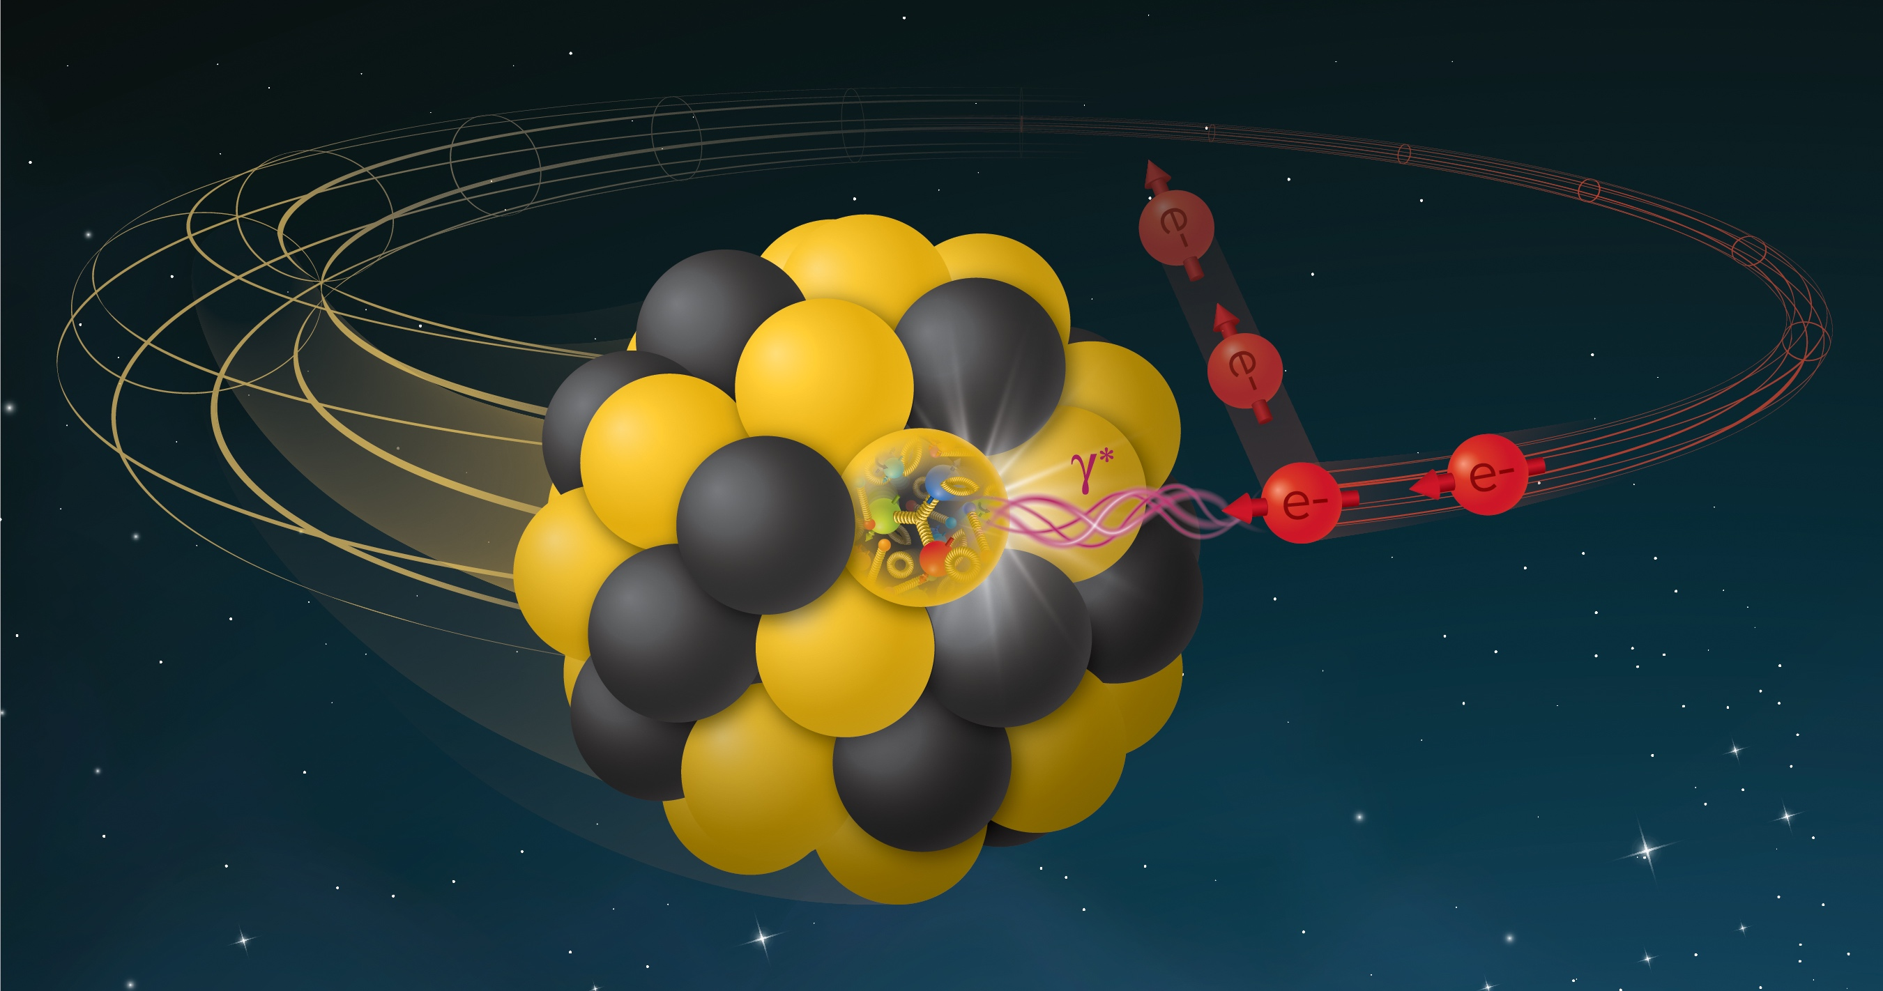
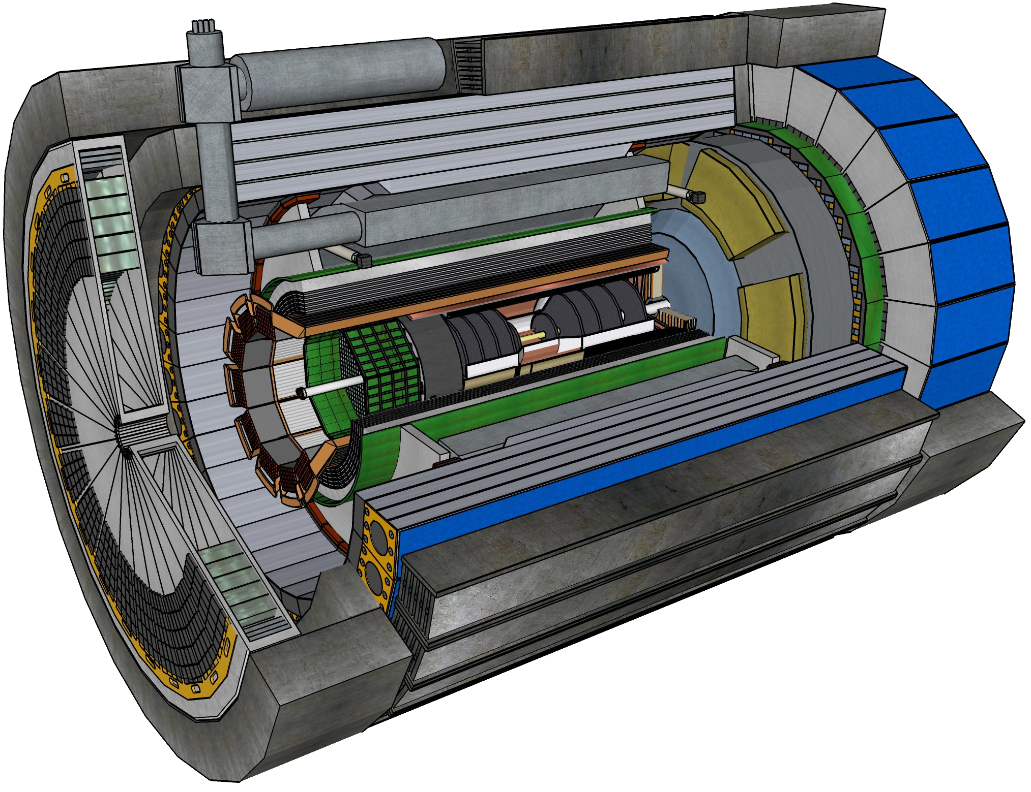
ePIC at EIC:
A Detector Designed for Precision QCD
Figures courtesy of BNL
Sylvester Joosten
POETIC 2025
Argonne National Laboratory
Monday, February 24, 2025

Slide 2
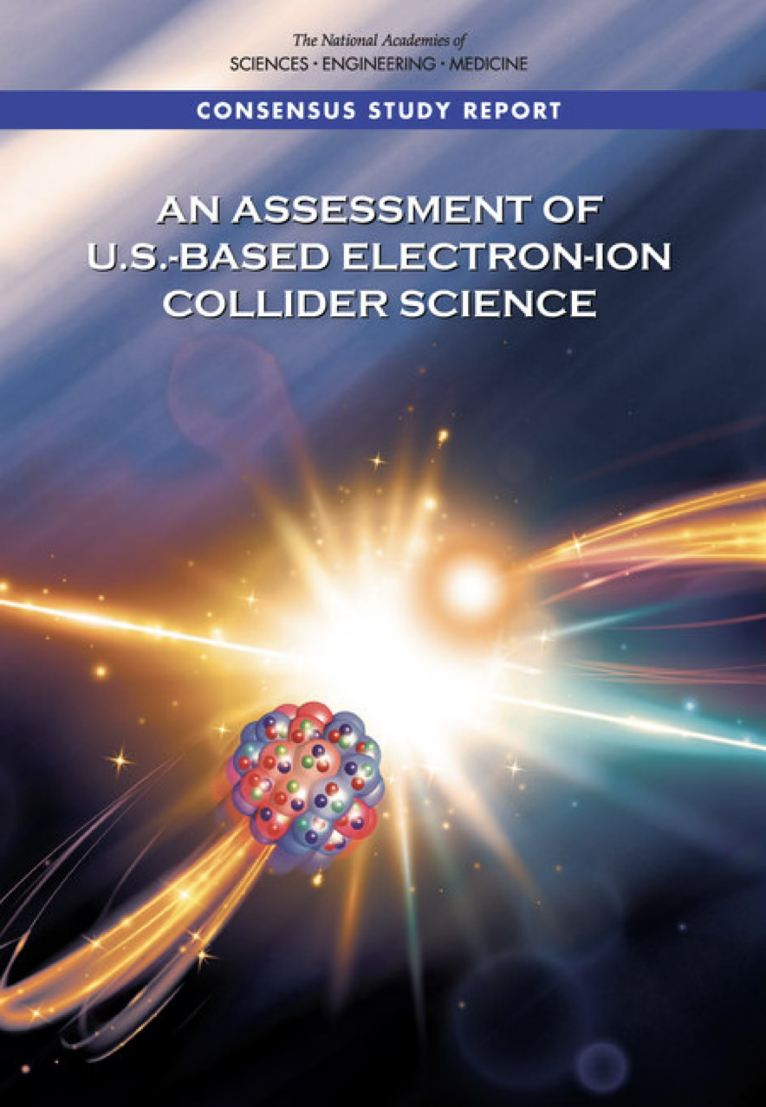
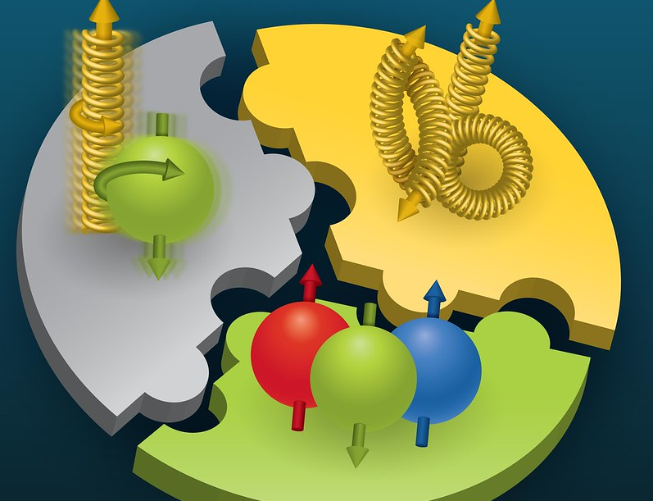
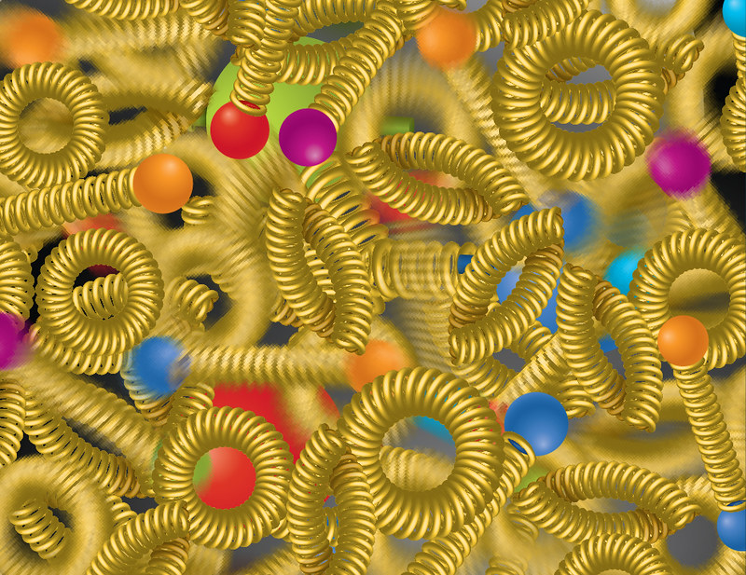
Nuclear Matter is Dynamical in Nature
An EIC can uniquely address three profound questions about nucleons and how they are assembled to form the nuclei of atoms
How does the mass of the nucleon arise?
How does the spin of the nucleon arise?
What are the emergent properties of dense systems of gluons?
Most of the visible matter in the universe is made of protons and neutrons
Basic properties, such as proton mass and spin, emerge from the complex dynamical structure of QCD itself
With the EIC, we will image quarks and gluons and their interactions to understand matter at its most fundamental level
Figures courtesy of BNL

Slide 3
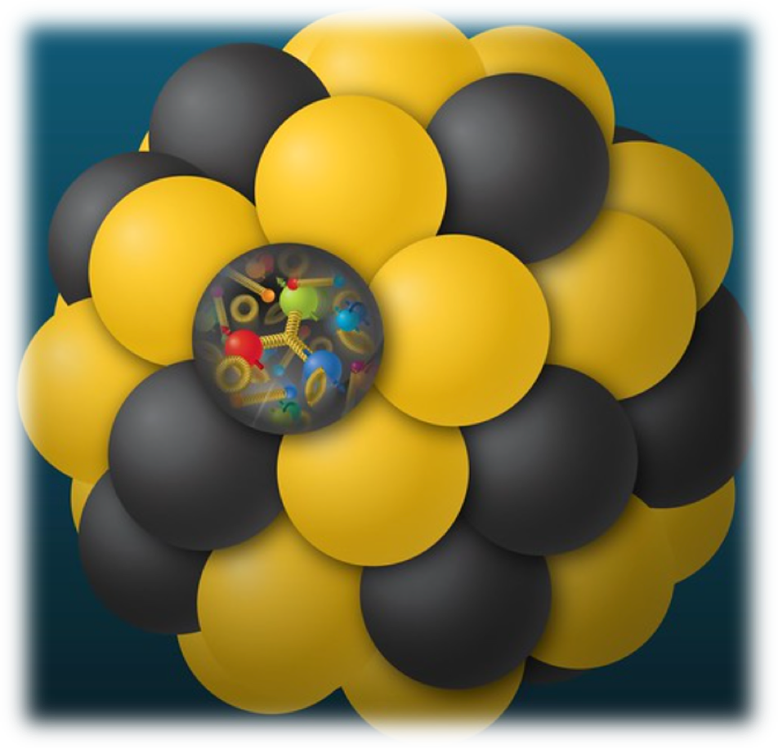
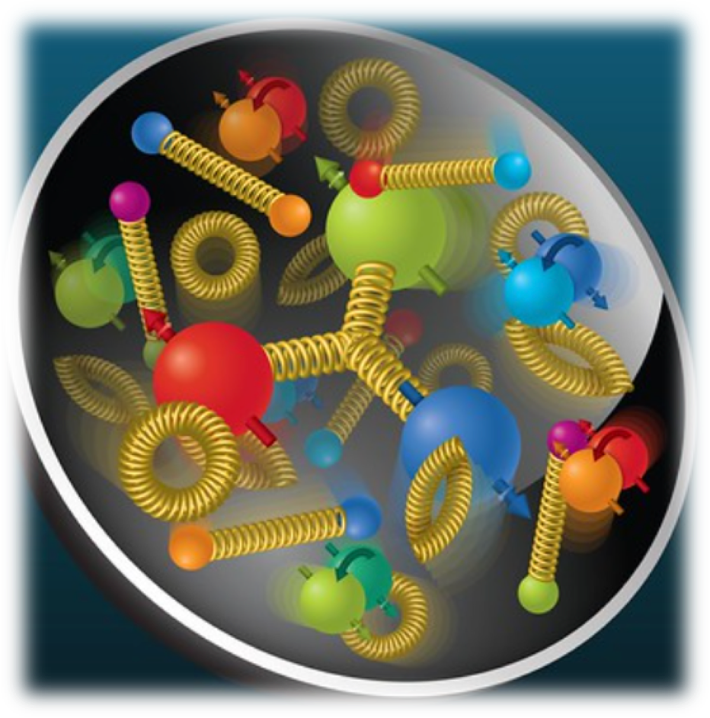
EIC Science is Impactful!
We are driving innovation to build a state-of-the-art experiment, leveraging breakthroughs in accelerator, detector, readout, and computing technologies
We will map the quark and gluon dynamics that generate over 99% of the mass of the visible universe!
EIC will provide transformational insights into the heart of nucleons and nuclei
Figures courtesy of BNL

Slide 4
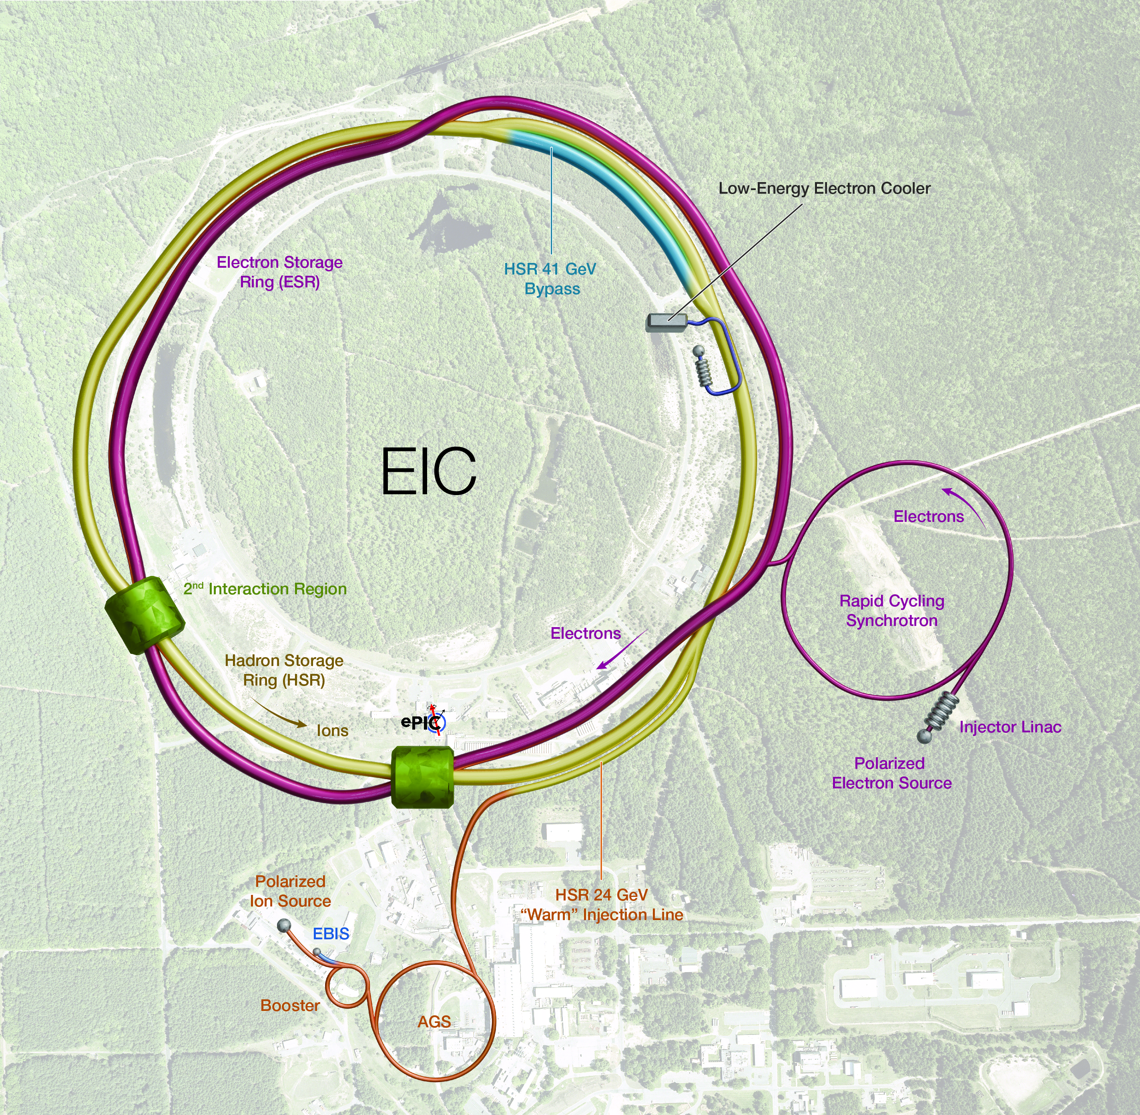
The Electron-Ion Collider
A Frontier Accelerator in the USA
World’s first collider of:
  Polarized electrons and polarized protons
  Polarized electrons and light ions (d, ³He)
  Electrons and heavy ions (up to Uranium)
A versatile machine:
  Beam polarizations up to 70%,
  Versatile range of beam species
  Versatile range of center of mass energies, E_{cm} = 29 – 140 GeV
A high luminosity machine
  up to L = 10³⁴ cm⁻² s⁻¹
  At peak luminosity, the e-p signal event rate will be about 500 kHz
Figure courtesy of BNL

Slide 5

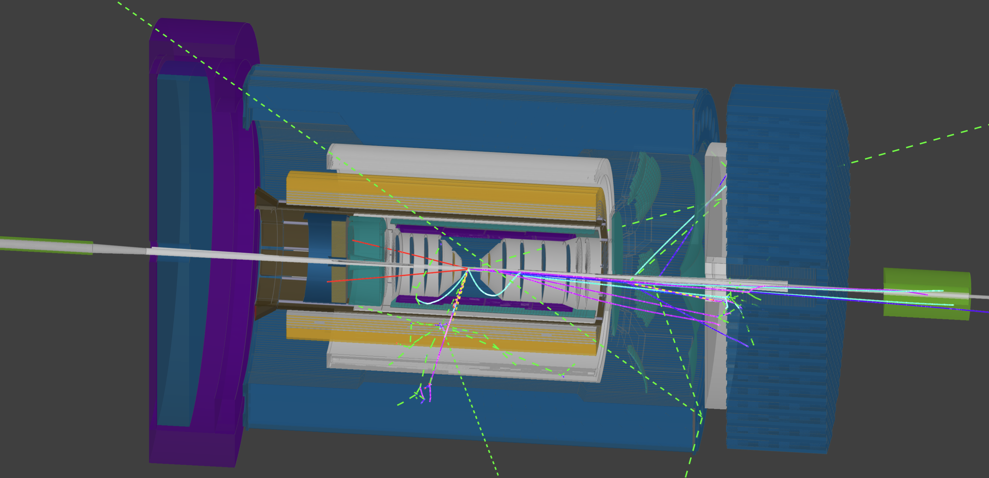
The ePIC Experiment
ePIC is the primary experiment at the EIC
It is a highly integrated, multi-purpose experiment
The experiment is being developed by the ePIC collaboration in partnership with the EIC Project
The collaboration was formed
in 2022, and is international in scope
Snapshot from the ePIC Firebrid event dislpay

Slide 6
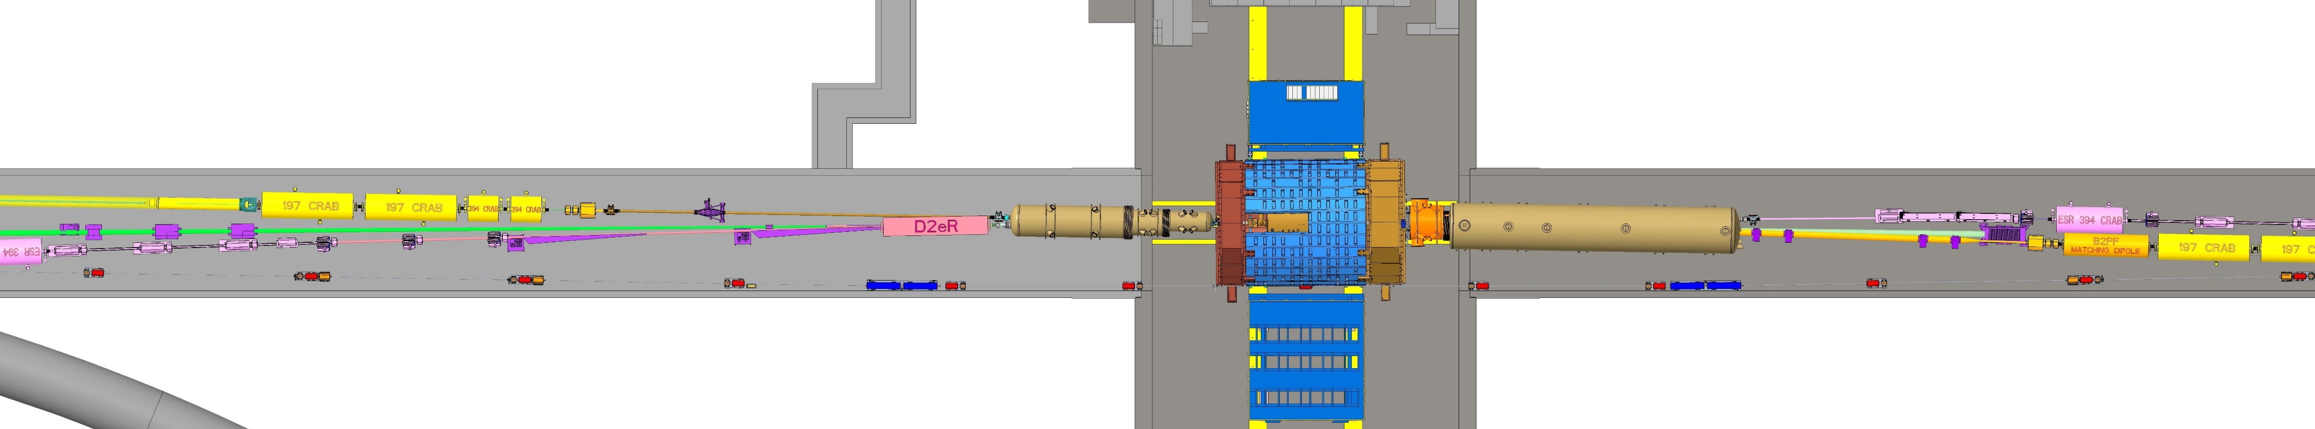
EIC Physics Needs Near-Full Acceptance
Integrated Interaction Region and Detector Design
Scattered electron
Experimental challenges:
  Beam elements limit forward acceptance.
  Central solenoid not effective for particles with small deflection angles
Incoming beam electron
Particles associated with initial ion
Incoming beam ion
Particles associated with struck quark
To achieve near-full acceptance :
  Beam crossing angle of 25mrad to create room for dipoles
  Dipoles act as spectrometers while creating space for detectors

Slide 7
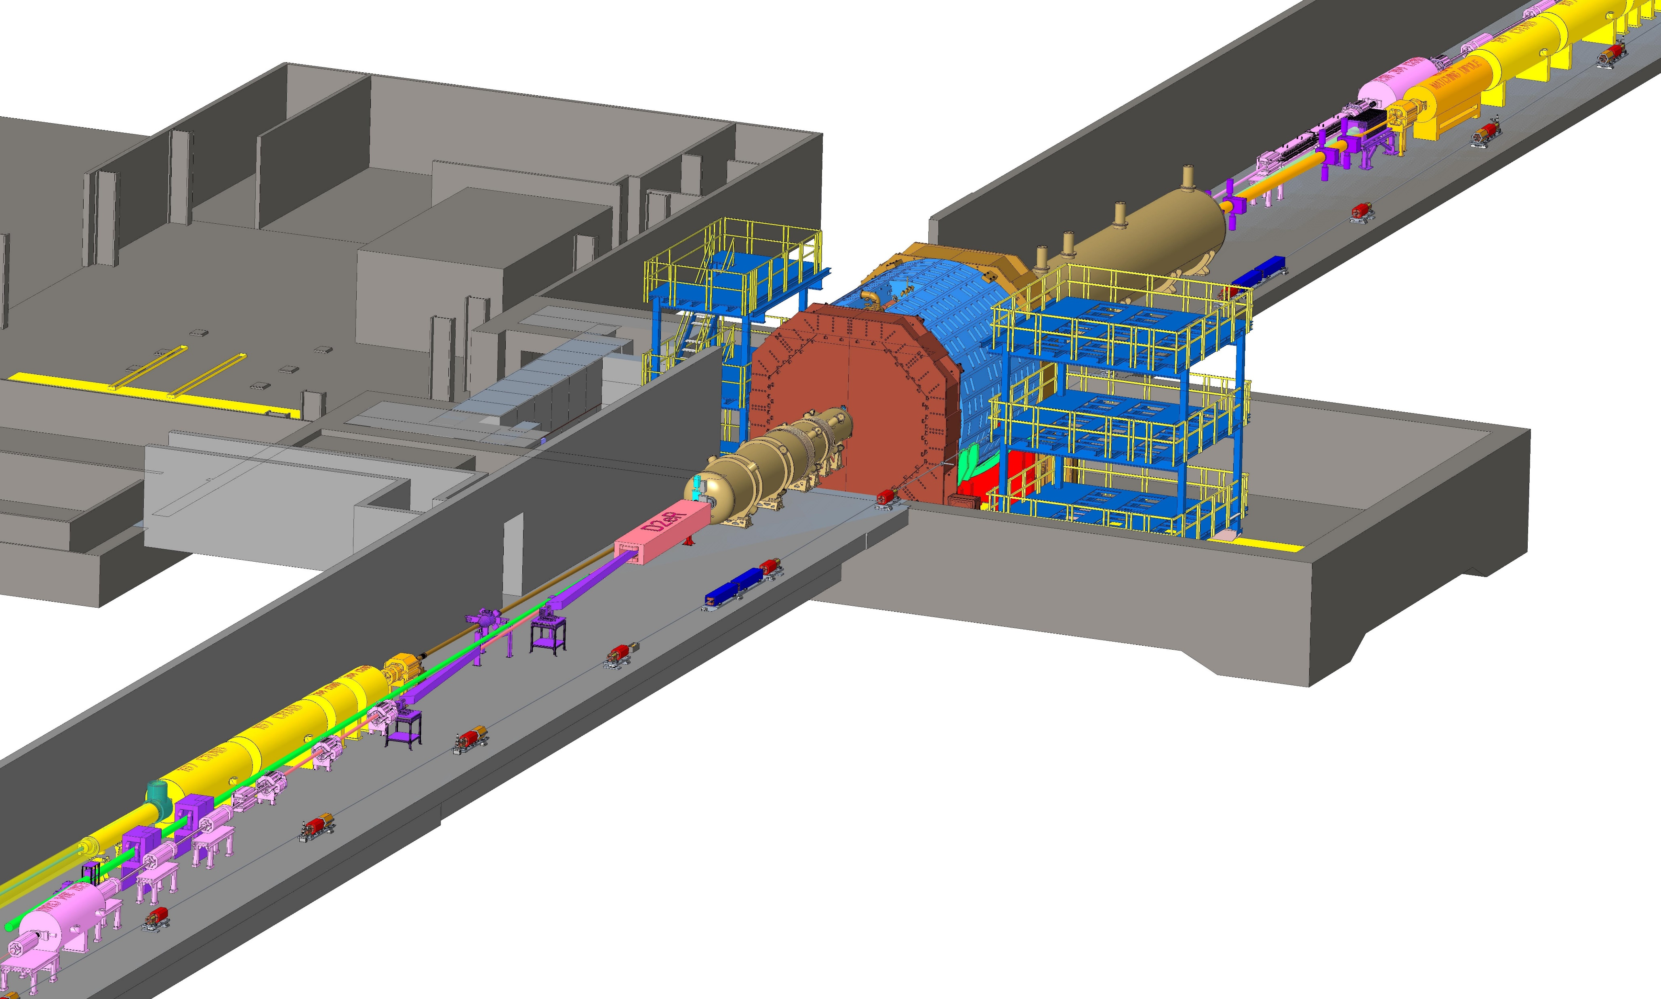
The ePIC detector is …
90 meter long!
7
Figure courtesy of BNL

Slide 8
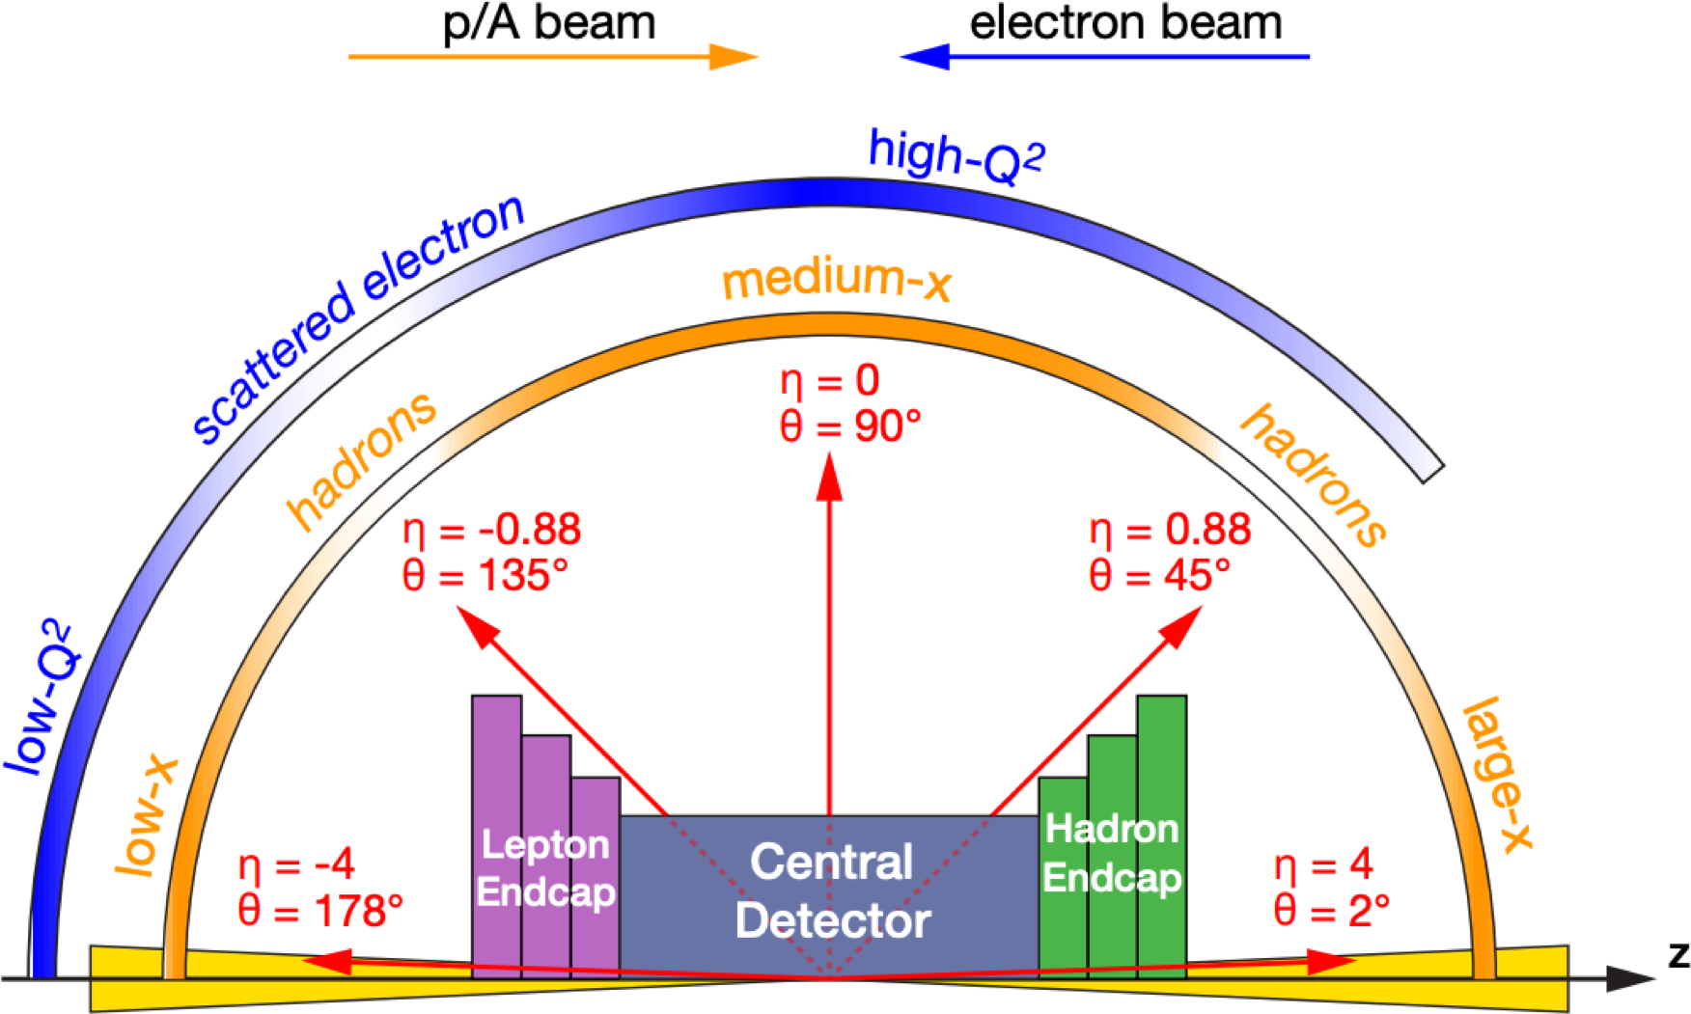
Physics-Driven Detector Design
Inclusive DIS requires fine binning in x_{B}, Q²:
  Large angular coverage for wide phase space reach
  Excellent EM-calorimetry with PID support for e/π separation, and good electron energy resolution
  Fine resolution tracking with low mass
Semi-inclusive DIS requires multidimensional binning in five or more variables (x_{B}, Q², z, p_{T}, φ_{h} , …):
  Fine p_{T} resolution
  Extended PID systems for hadron identification
  Hadron calorimetry to study physics with jets
Exclusive processes require multidimensional binning in four or more variables (x_{B}, Q², t, φ_{h} , …):
  Extend acceptance at extremely small scattering angles by far forward detectors
  Fine vertex resolution by tracking
  Highly granular EM-calorimeters to separate γ/π⁰

Slide 9
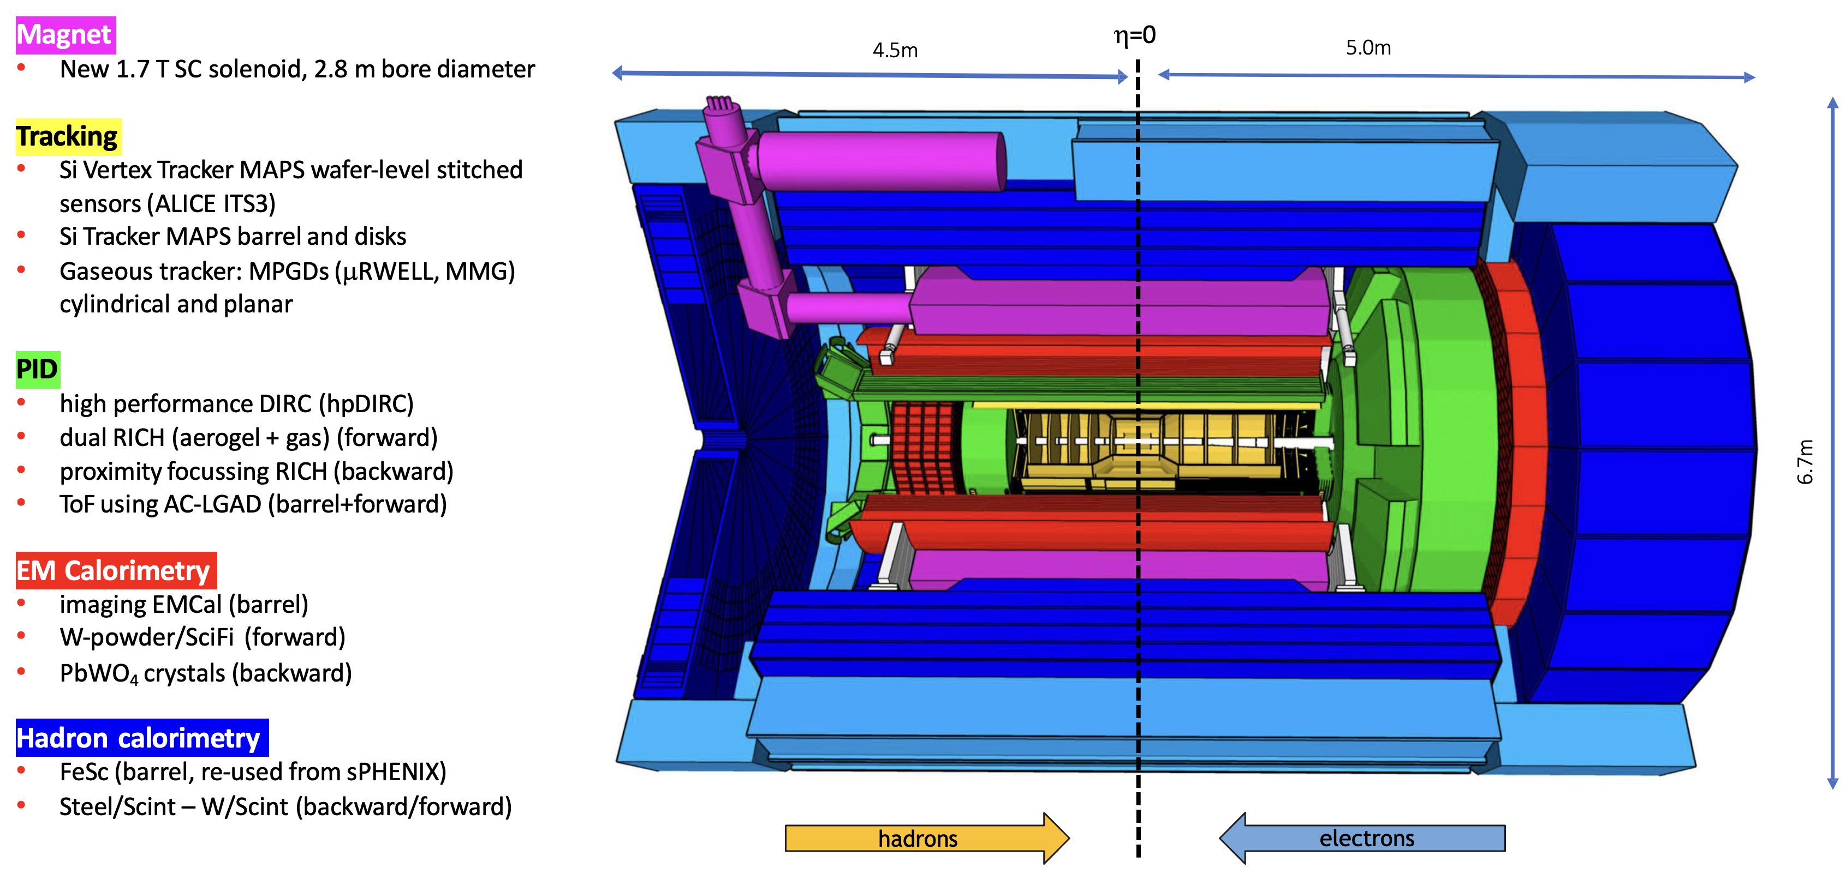
The Central ePIC Detector
Figure courtesy of BNL

Slide 10
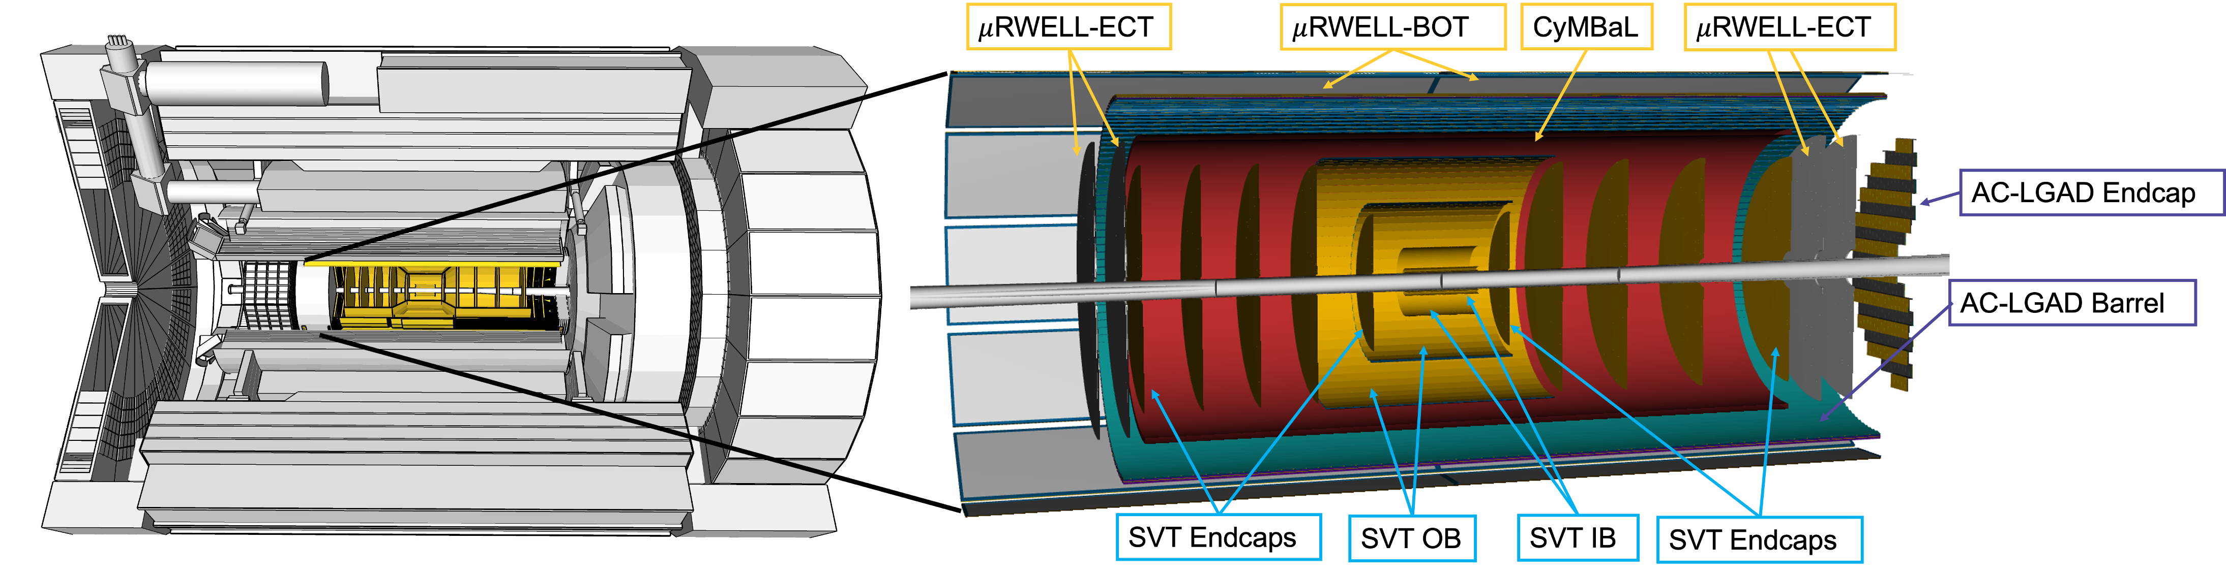
The Tracking System
Figure by the ePIC Collaboration
Figure courtesy of BNL
Tracking Requirements:
High spatial resolution 20μm/pT⊕ 5μm
Excellent momentum resolution 0.05%pT⊕0.5%
Low material budget
Good pattern recognition efficiency
Sufficient time resolution to resolve 10ns bunch crossing
Good angular resolution for the DIRC
Detector Solutions
Ultra-low-mass barrel vertex tracker using ALICE ITS3 curved MAPS technology, with 20µm pixel pitch and 0.05% X/X₀
Outer barrel and endcap silicon tracker using new ITS3-based EIC Large Area Sensors (LAS), with 20µm pixel pitch and 0.55% X/X₀
MicroMegas barrel tracker (CyMBaL) with X/X₀
GEM-µRWell barrel and endcap tracker with 10ns time resolution, 150µm spatial resolution and 1-2% X/X₀

Slide 11
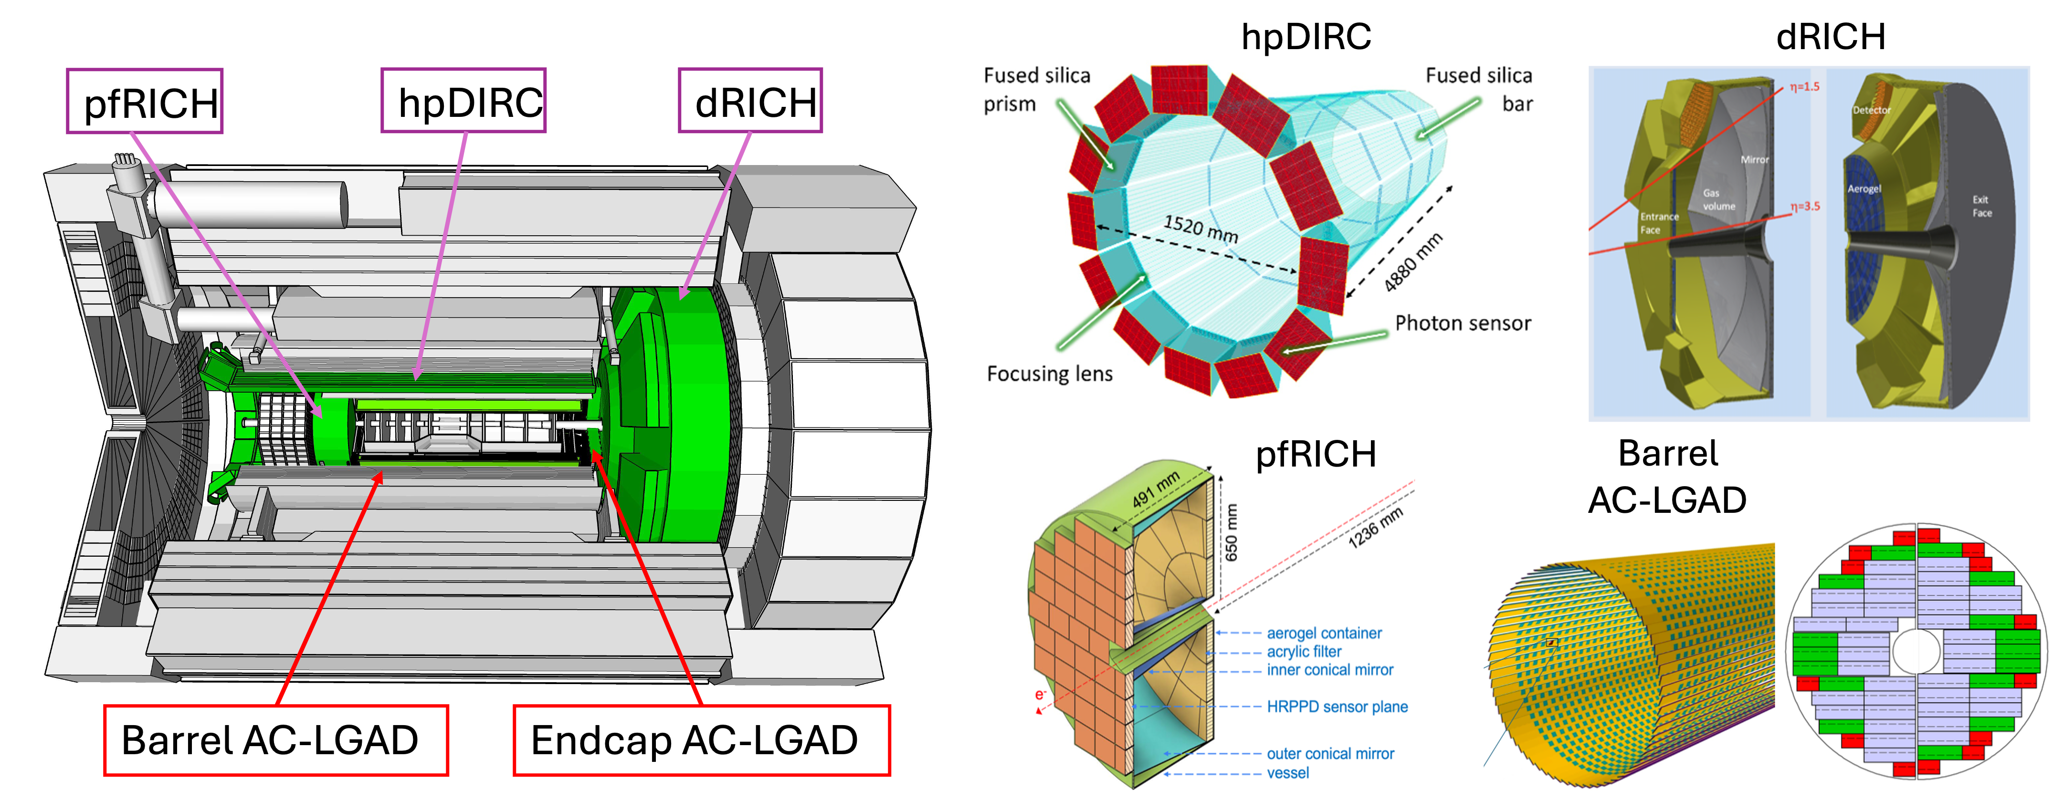
The PID System
Dual Radiator Ring Imaging Cherenkov (dRICH)
Aerogel + C₂F₆ gas for high-momentum PID up to 50 GeV/c
First-ever use of SiPMs in a RICH
Proximity Focusing RICH (pfRICH)
Aerogel for PID up to 9 GeV/c
First-ever use HRPPDs as photosensor → 30ps time resolution for ToF
High-Performance DIRC Detector (hpDIRC)
Quartz bar radiator for PID up to 6 GeV/c
Fully focused design with lens and large expansion volume
Uses pixelized MCP-PMTs as photosensors
Time-of-Flight Barrel and Forward Endcap (BTOF and FTOF)
AC-LGAD sensors give 20-35ps time resolution for ToF, for PID up to p_{T} < 1.5-2.5 GeV/c
500µm x 1 cm strips for BTOF (1% X/X₀) and 500µm pixel pitch for FTOF (2.5% X/X₀)
Additional accurate space point and timing for tracking
First-time use of AC-LGAD technology in a collider detector
Figure courtesy of BNL
Figures by the ePIC Collaboration

Slide 12
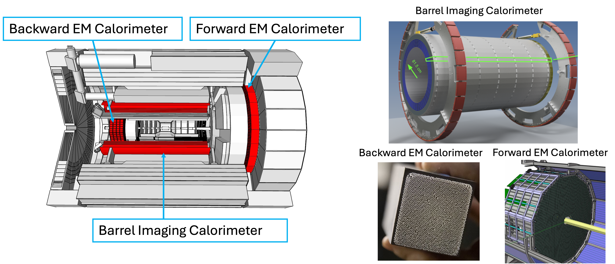
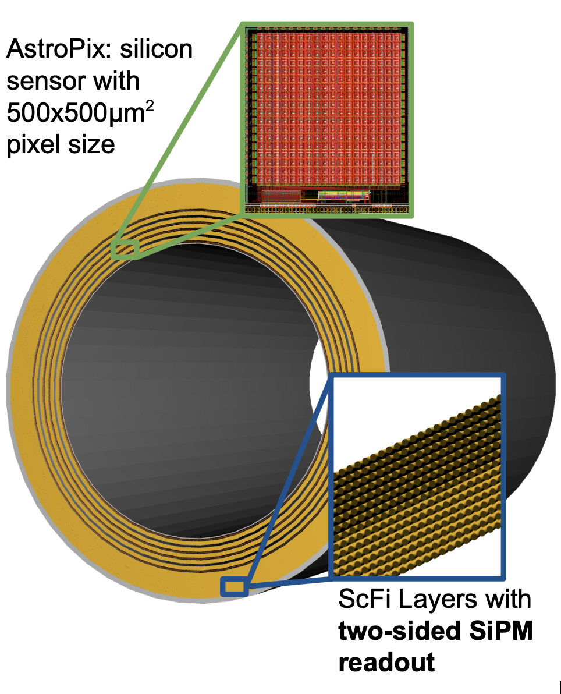
The Electromagnetic Calorimeter System
Forward Ecal
W-powder/SciFi SPACAL design developed through EIC R&D and used in sPHENIX
Figure by the ePIC Collaboration
Figure courtesy of BNL
Figure by the ePIC Collaboration
Backward ECAL (EEEMCAL)
High-precision PbWO₄ crystal calorimeter for precision scattered lepton measurements
First use of SiPMs in a crystal calorimeter
Barrel Imaging Calorimeter (BIC)
Hybrid imaging calorimeter: 6 layers of AstroPix sensors interleaved with 5 Pb/ScFi layers, followed by a large section of Pb/ScFi
Pb/ScFi technology based on the GlueX design, using SiPMs for readout at either end of the barrel
AstroPix: HV-MAPS sensor with 500µm pixel pitch and ~3.2ns time resolution developed for the NASA AMEGO-X mission.
Figure by the ePIC Collaboration

Slide 13
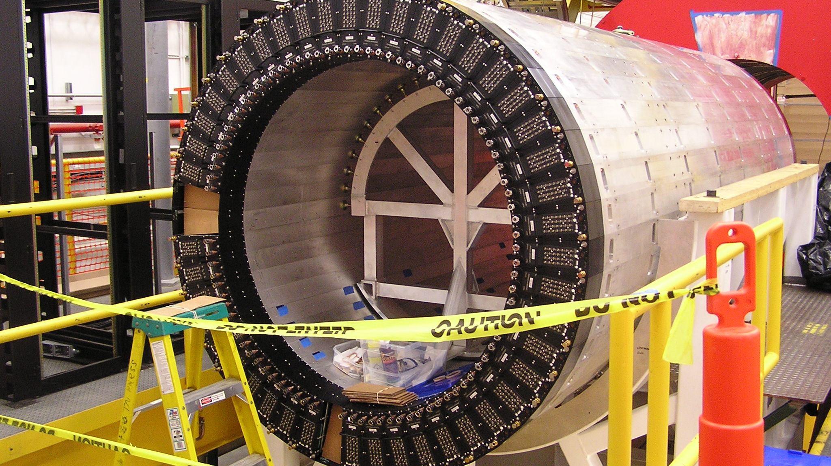
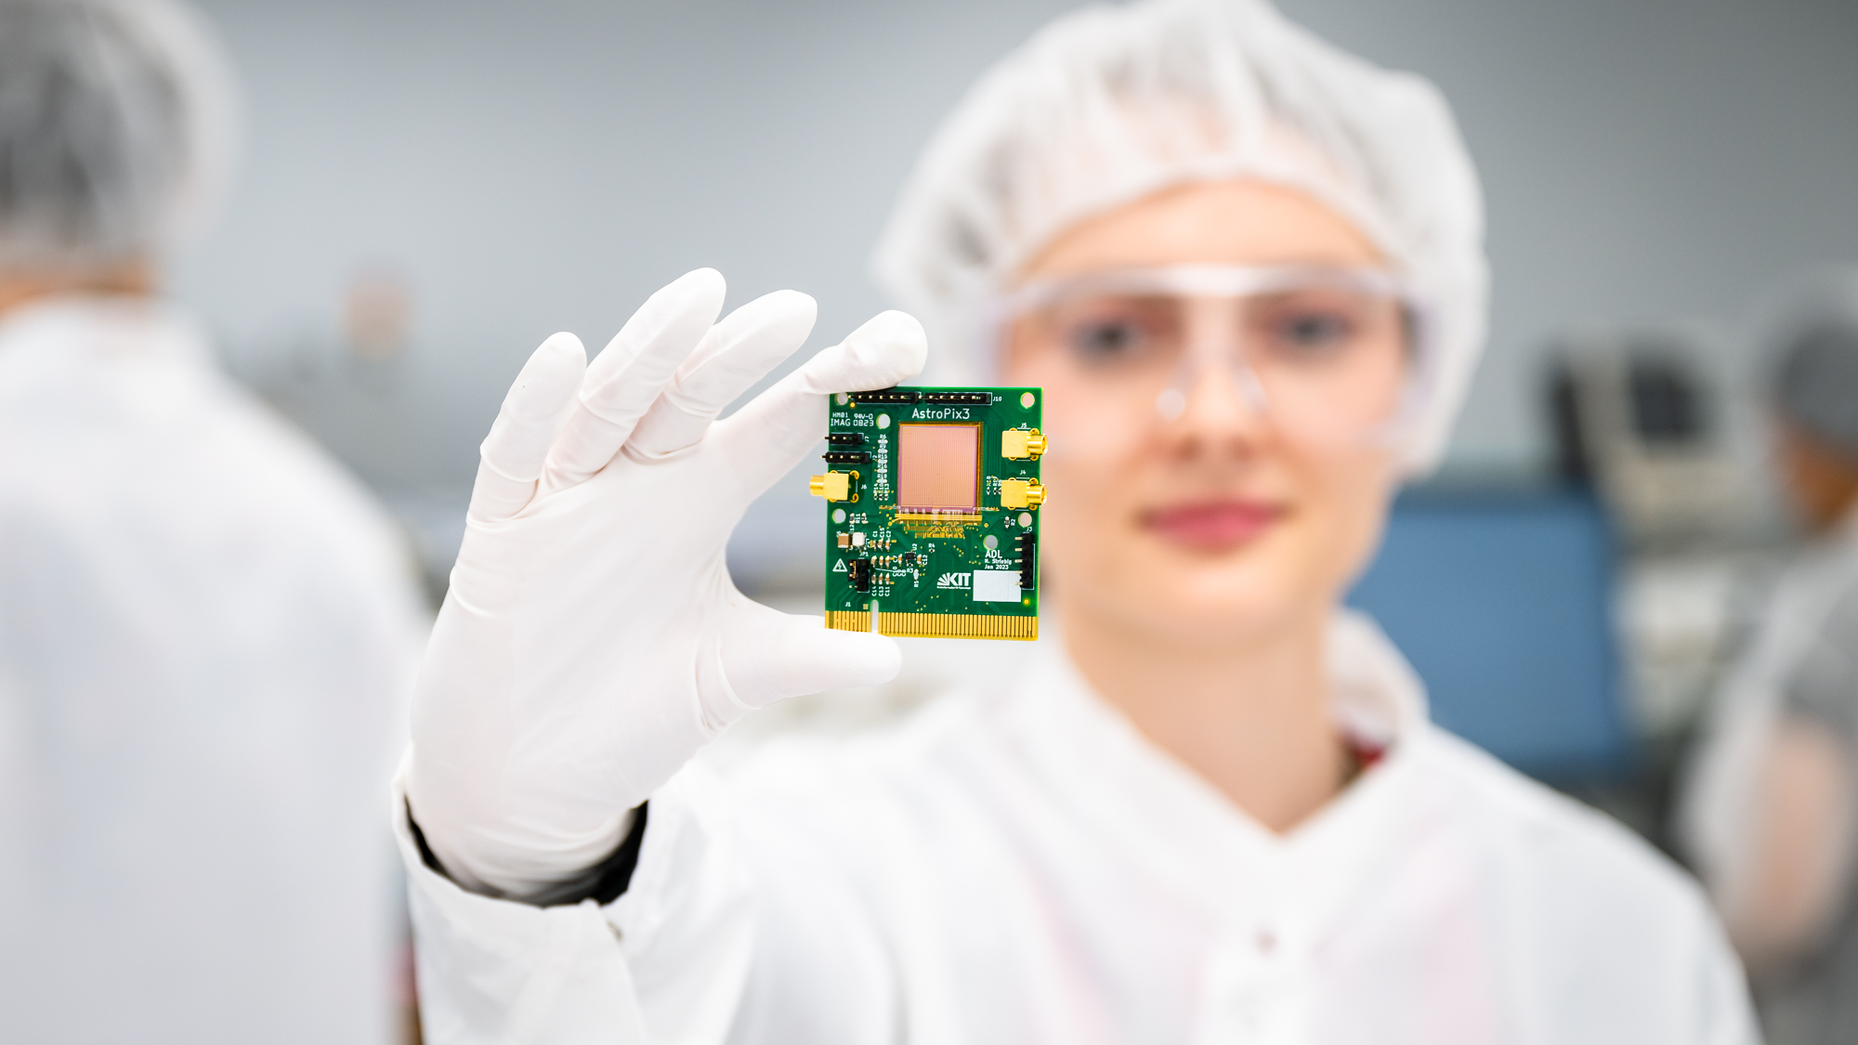
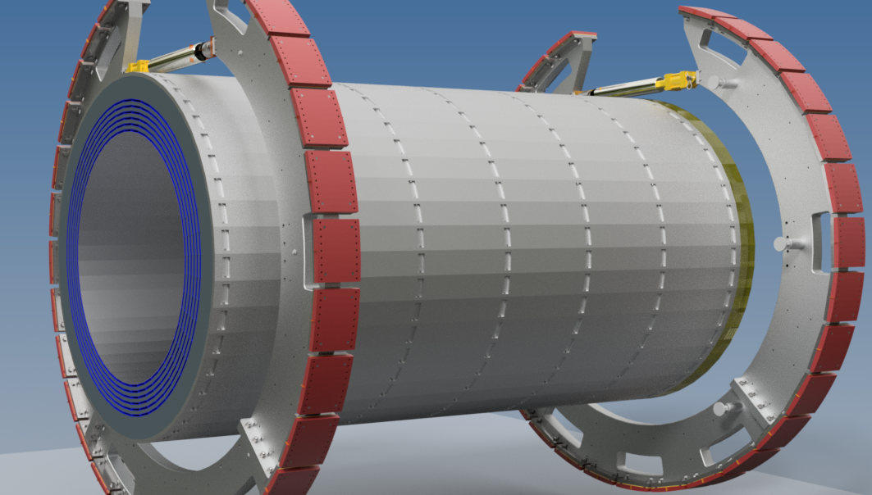
Zooming In: The Barrel Imaging Calorimeter
High-performance sampling calorimeter with cost-effective Si sensors for shower profiling
Electromagnetic calorimetry in the barrel is difficult:
  Prime detector for electron-pion separation
  Need pion suppression up to 10⁴ for inclusive physics
  Need good photon resolution and granularity to reject π⁰
  Need large dynamic range from 100 MeV/c to well over 10 GeV/c while being sensitive to MIPs
  Compact – needs to fit in limited space inside of solenoid
Figure courtesy of Jefferson Lab
The Barrel Imaging Calorimeter (BIC)
  The BIC is a novel imaging calorimeter designed to meet the stringent performance requirements essential for EIC science
  Combines mature, state-of-the-art Pb/SciFi sampling calorimetry with six layers of modern, ultra-low-power HV-MAPS AstroPix sensors
  The BIC will be one of the largest silicon detectors ever built, featuring over 100 m² of AstroPix sensors and marking the first large-scale deployment of HV-MAPS sensors for particle detection
Figure by the ePIC BIC DSC
Figure by the ePIC BIC DSC

Slide 14
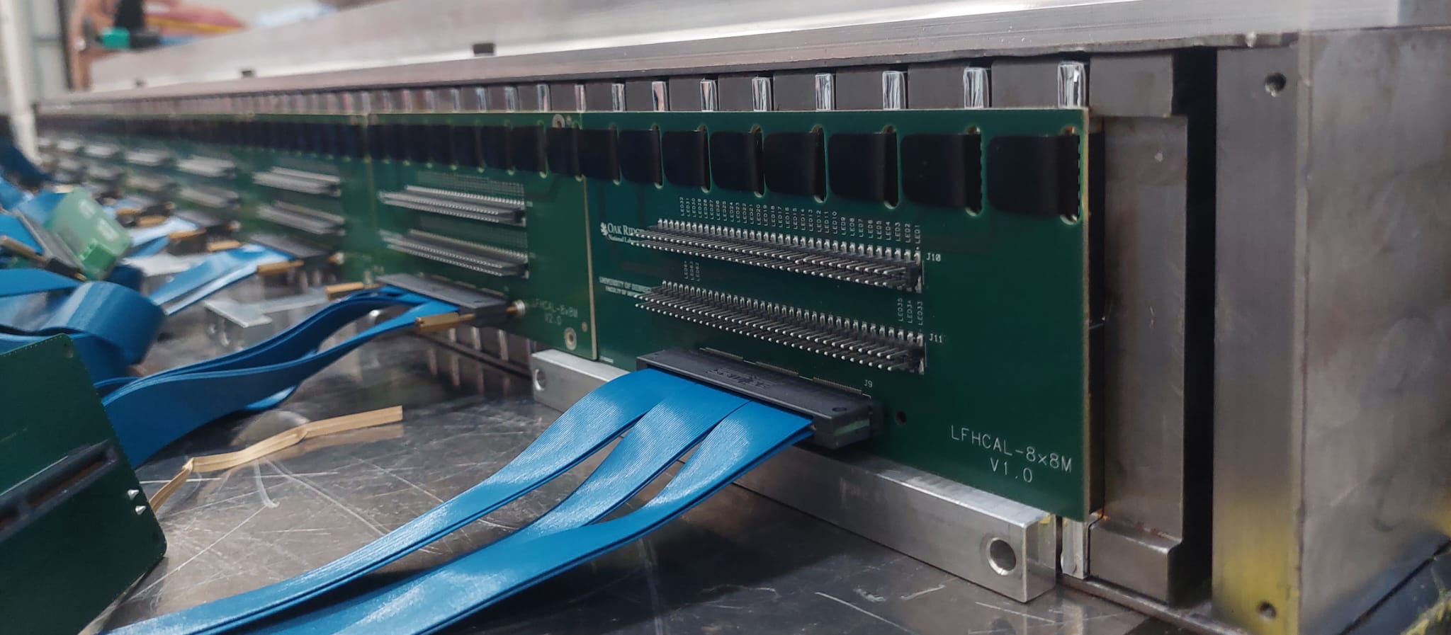
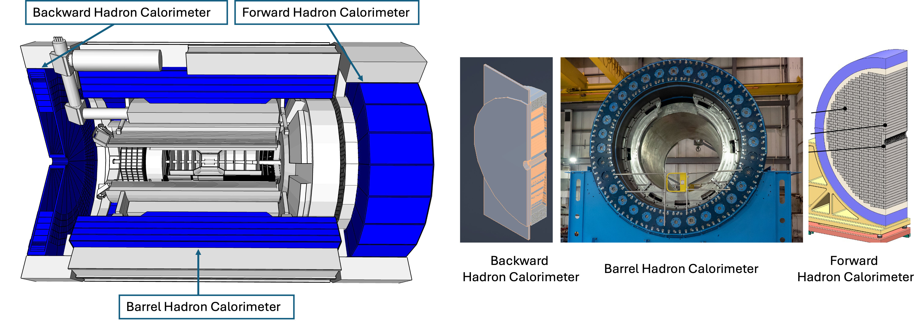
The Hadronic Calorimeter System
Picture by the ePIC LFHCAL DSC
Forward HCAL (LFHCAL)
Longitudinally segmented steel + scintillator SiPM-on-tile
High-resolution insert next to beam pipe
Optimized for particle-flow measurements, first full-size CALICE-like calorimeter in a collider experiment
Barrel HCAL
Steel + scintillator design, re-use from sPHENIX
Backward HCAL
Similar construction as LFHCAL, functions as tail catcher for EMCAL to improve jet energy reconstruction
Figure courtesy of BNL
Figures by the ePIC Collaboration

Slide 15
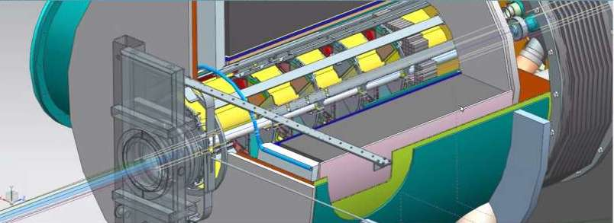
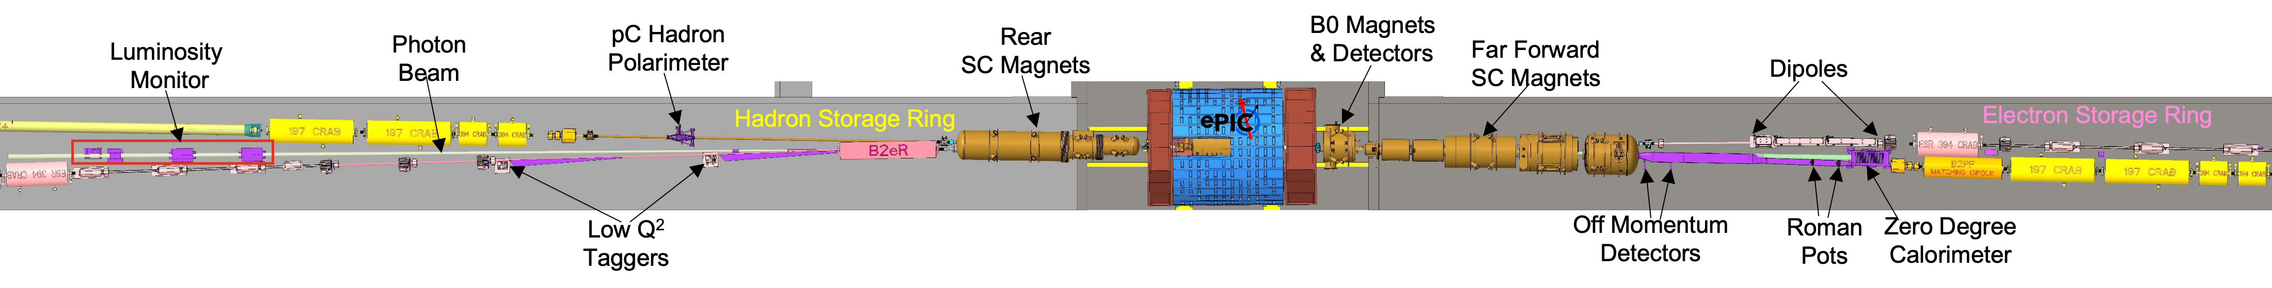
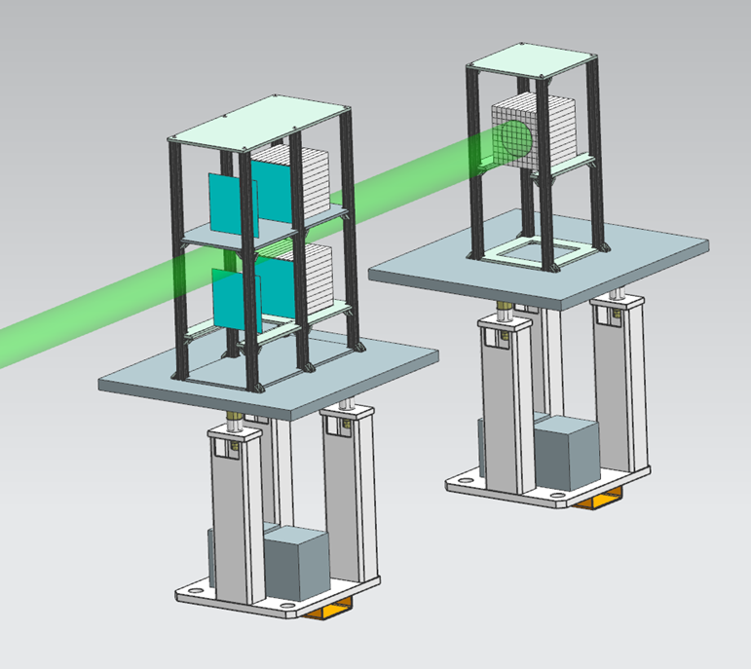
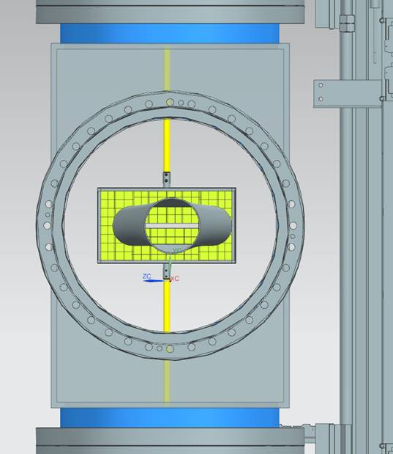
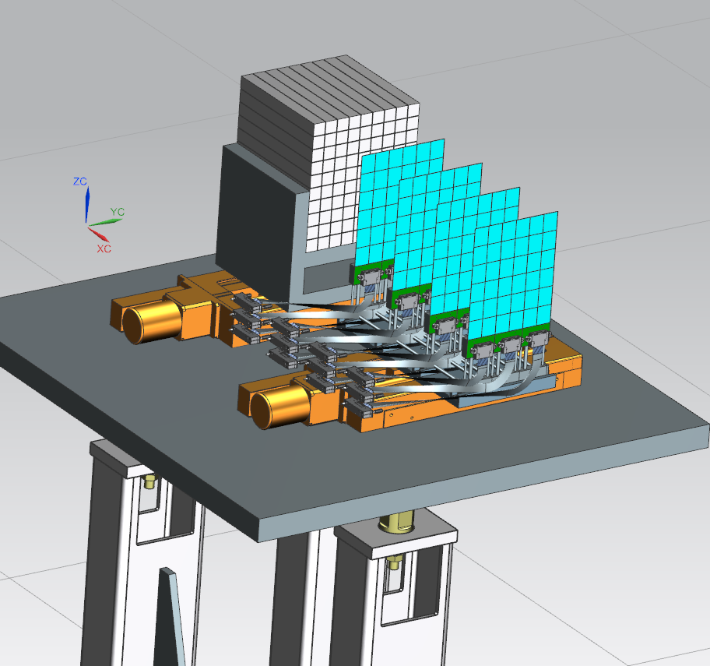
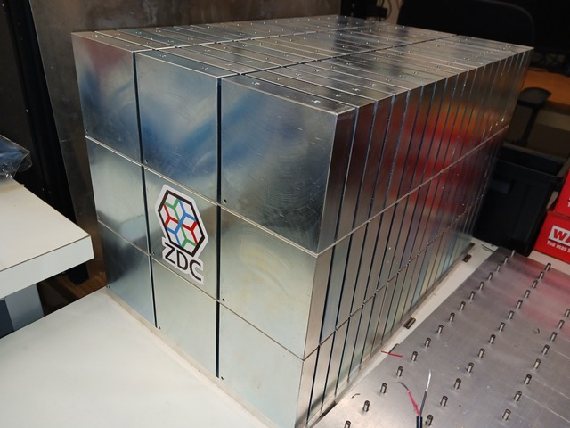
The Far-Forward/Far-Backward System
B0 Magnet Spectrometer
detection of forward scattered protons and and γ
4 tracking layers each of AC-LGAD / EICROC ( 500x500 μm² pixel) – Synergy with forward ToF
EMCAL: 2x2x20 cm³ PbWO₄ calorimeter – Synergy with backward ECal
Luminosity System
Measure bunch-by-bunch luminosity through Bethe-Heitler process
Pair-spectrometer: each with 2 tracking layers of AC-LGAD / FCFD – Synergy with Barrel-ToF
Calorimeter: Tungsten-powder + SciFi SPACAL – Synergy with forward ECal
Zero Degree Calorimeter
Detection of forward scattered neutrons and γ
EMCAL: 2x2x20 cm³ PbWO₄ calorimeter – Synergy with backward ECal
HCAL: Steel-SiPM-on-Tile – Synergy with forward HCal
Roman Pots and Off-Momentum Detectors
Detection of forward scattered protons and nuclei
2 stations with 2 tracking layers each
AC-LGAD / EICROC ( 500x500 μm² pixel) – Synergy with forward ToF
Low-Q² Taggers
detection of scattered electrons
2 stations with 4 tracking layers each (16x18cm²) Si / Timepix4
Calorimeter: Tungsten-powder + SciFi SPACAL – Synergy with forward ECal
Figures courtesy of BNL

Slide 16
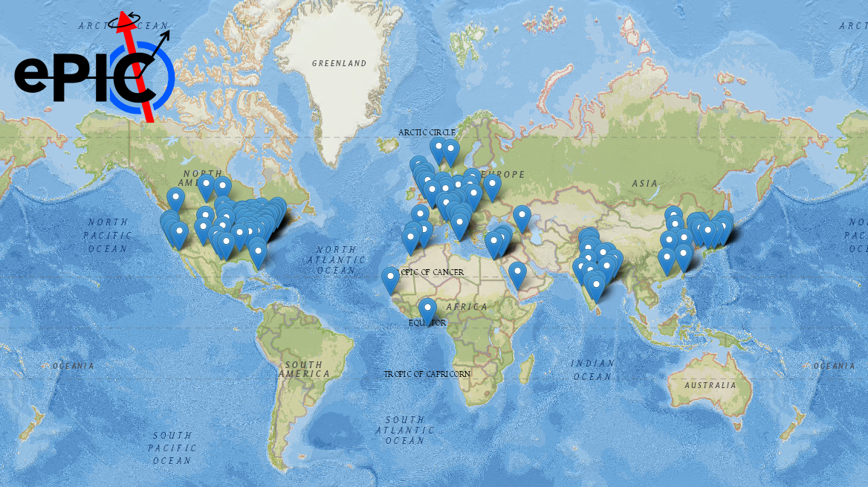
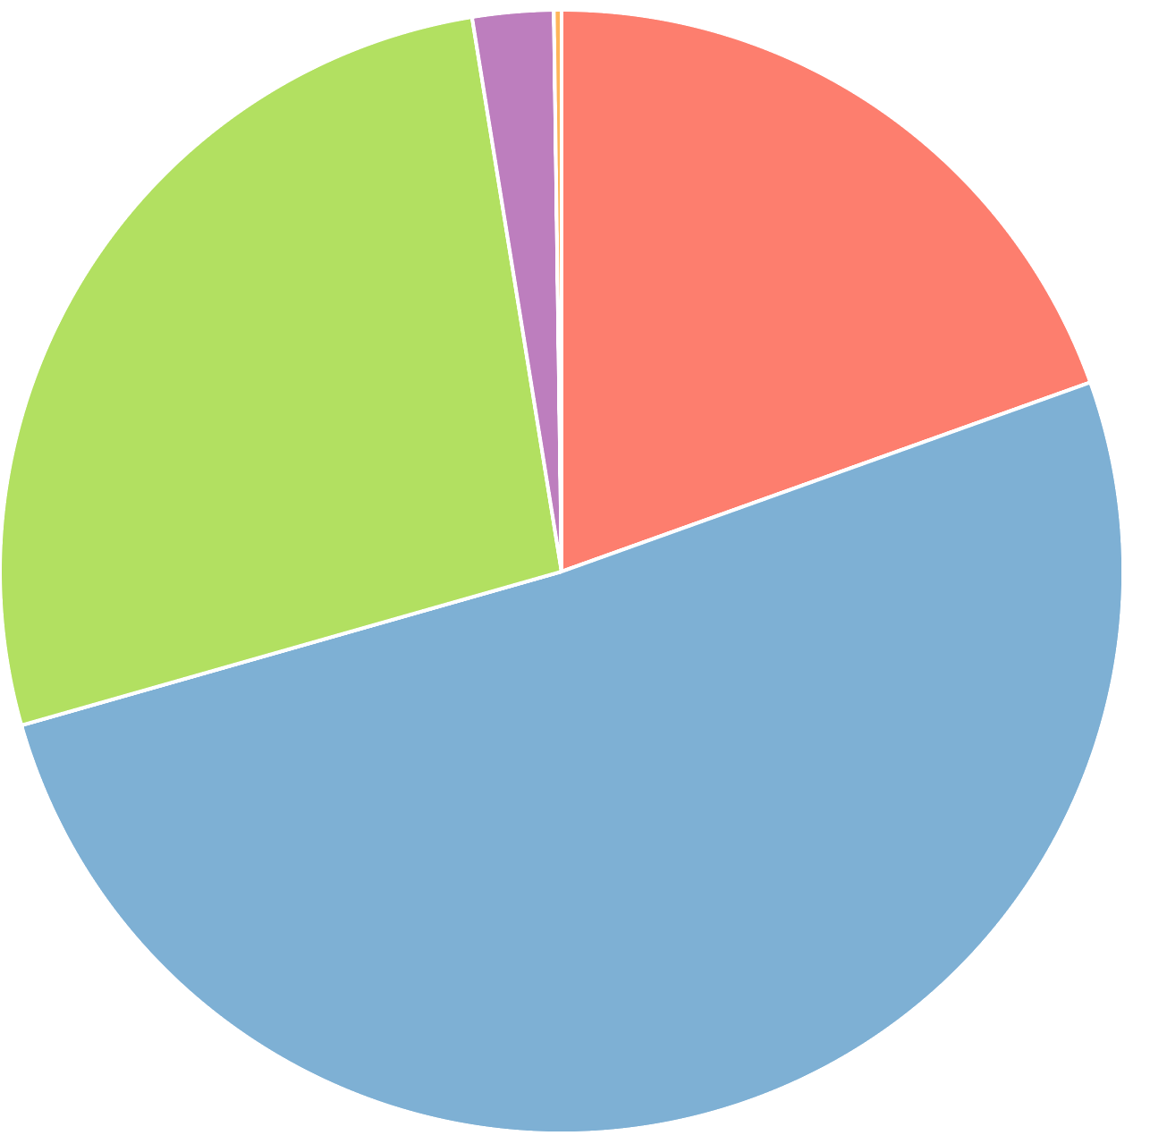
– A Large Collaboration!
Figures from the ePIC Phonebook
901 collaborators from 178 institutions from 25 countries

Slide 17
(pre)TDR Strategy and Publications
The EIC (pre)TDR is the top priority for the ePIC Collaboration
process design phase
structuring the
effort
draft ePIC pre-TDR
ePIC pre-TDR (CD-2)
writing
(TDR/notes)
Preparing papers for
publication
Mid Jan.24
Mid Mar.24
End Oct. 24
Late 2024
2025
Timeline driven by the EIC Project (CD-2/CD-3)
Extended versions of the sections on the detector, physics performance, and software & computing to be published in scientific journals

Slide 18
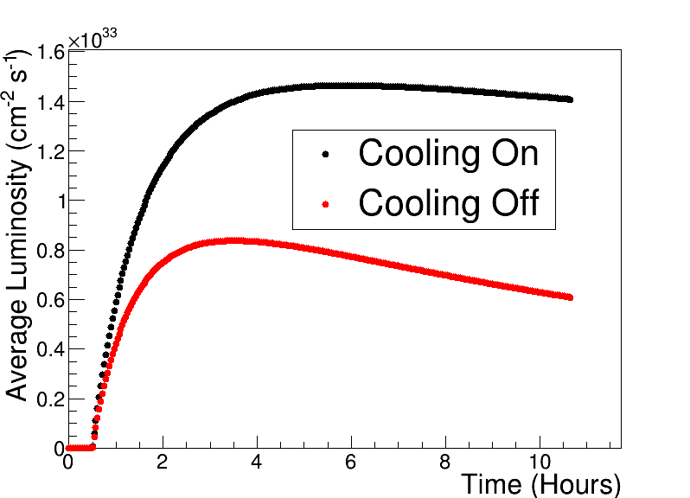
EIC Science During Commissioning
Ongoing ePIC + EIC Project Evaluation Based on Phasing EIC Operation
e-p Luminosity in EIC Phase I
Phase I: Under Discussion
  HSR: low-energy cooling up to injection energy, no 41-GeV bypass
  ESR: 5-10 GeV, 7 nC max (means fewer rf cavities and amps); maybe no crabs (may require lower proton bunch intensities)
  RCS: operates with a 7-nC (single bunch), 3 → 5 or 10 GeV, ramps at 1 Hz
Phase II: Under Discussion
  HSR: potentially add high-energy cooling, add 41-GeV bypass
  ESR: add rf cavities and power to operate at 28 nC and 18 GeV;
  RCS: upgraded to 28 nC and 3 → 18 GeV ramps (at 1 Hz);
Start science program while ramping up EIC capabilities is driven by:
  Start of EIC Science program.
  Alignment with expected order in commissioning the collider and ramp up of performance that comes with gain of operational experience.
  Having access to new physics results early to get high impact publications.
Luminosity w/wo SHC

Slide 19
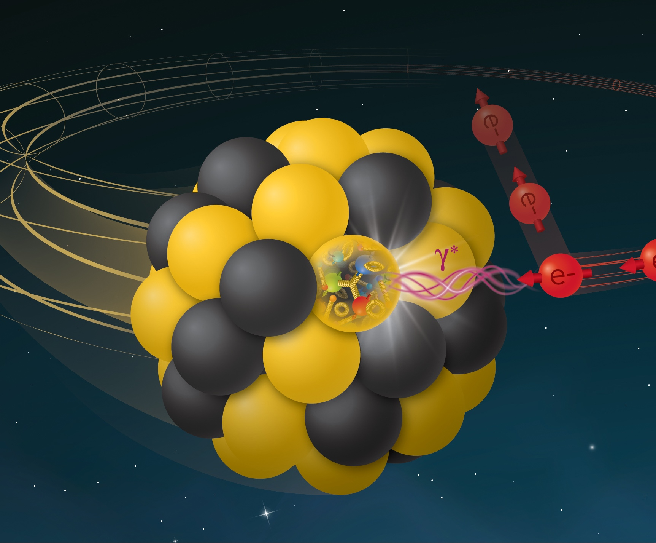
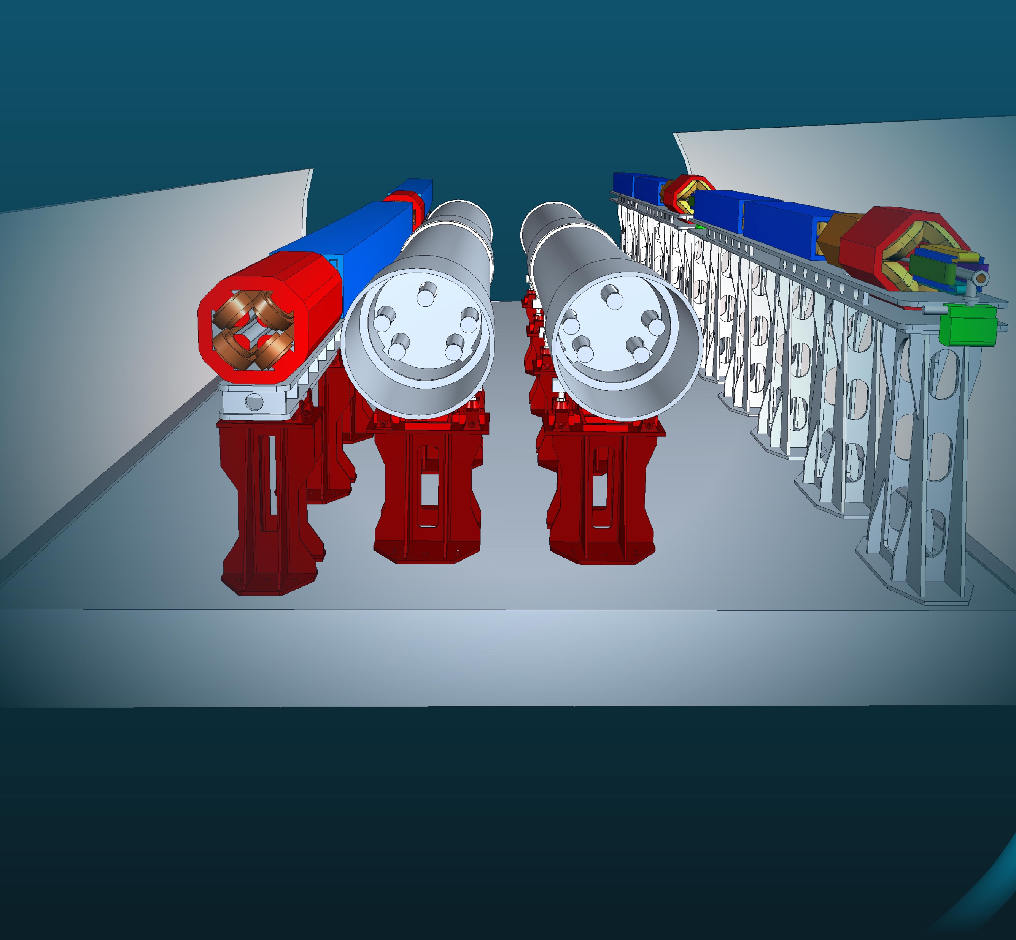
ePIC at EIC
This work is supported by the U.S. Department of
Energy, Office of Science, Office of Nuclear Physics,
under contract DE-AC02-06CH11357.
A Detector Designed for Precision QCD
ePIC at the EIC will enable us to explore nucleon structure and observed properties in terms of the quark and gluon dynamics.
The ePIC collaboration is large for NP: over 900 scientists from 178 institutions across 25 countries
The ePIC detector will be a highly integrated, multi-purpose detector:
State-of-the-art technologies and computing ensure that ePIC will deliver on EIC Science from its start
Detector design maximizes its physics reach
Figure courtesy of BNL
Figure courtesy of BNL
Snapshot from the ePIC Firebrid event dislpay

Slide 20
This work is supported by the U.S. Department of
Energy, Office of Science, Office of Nuclear Physics,
under contract DE-AC02-06CH11357.

