Slide 1




SIDIS Program at the EIC
Anselm Vossen
Research Supported by
20+5

Slide 2
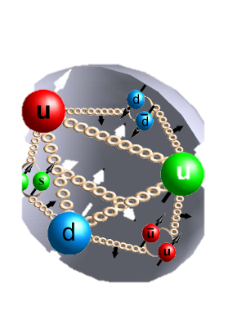
SIDIS is a premier tool to probe the quark and gluon degrees of freedom
h
q
FF_{q}
σ
PDF
X’
3D Spin-Momentum Structure
Sea Quark Polarization
Saturation Effects
Fragmentation Functions
Passage of color through nuclear matter (nFFs)

Slide 3
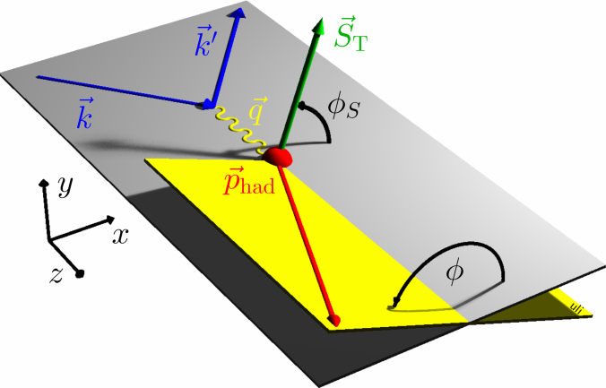
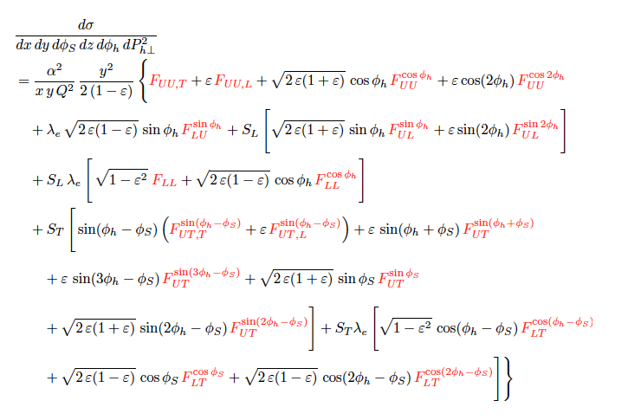
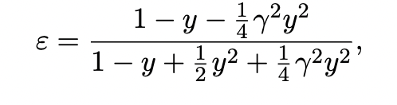
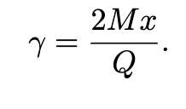
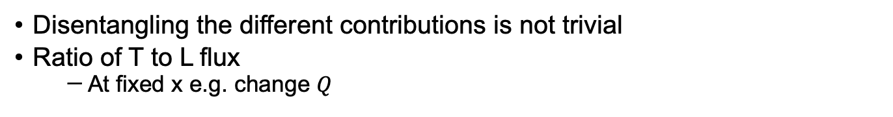
SIDIS cross-section
Disentangling the different contributions is not trivial
Ratio of T to L flux
  At fixed x e.g. change $Q$

Slide 4
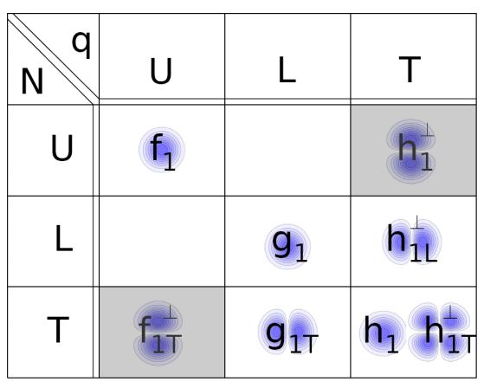
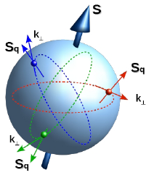
SIDIS X-section in the Parton Model
Massive simplification, Nontrivial assumptions for validity
  Power corrections, decays, targetFF, …
  Open questions
    transverse momentum spectrum
    TMD evolution
    …
Boer-Mulders
Unpolarized
Worm Gear
Transversity
Polarized target
Sivers
Pretzelosity
Polarzied beam and target
Worm Gear
S_{L} and S_{T}: Target Polarizations; λe: Beam Polarization
x: momentum fraction carried by struck quark, z: fractional energy of hadron
4

Slide 5
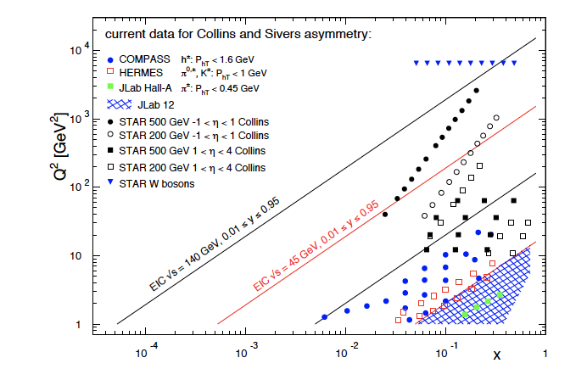
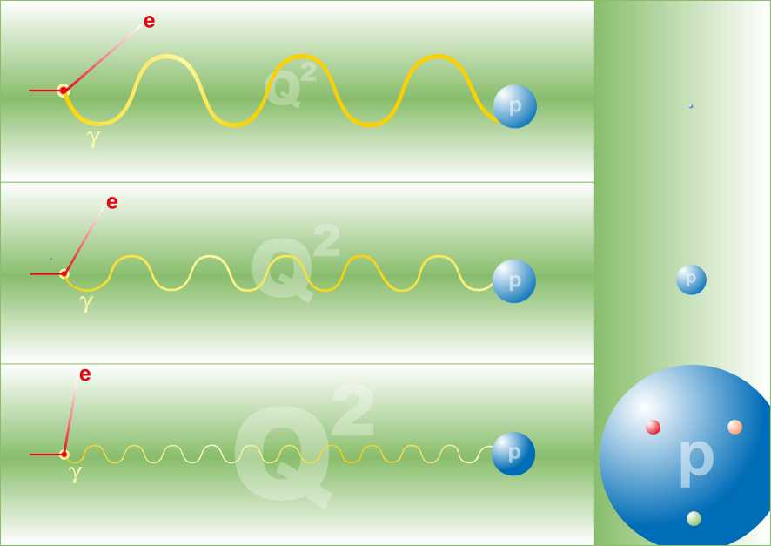
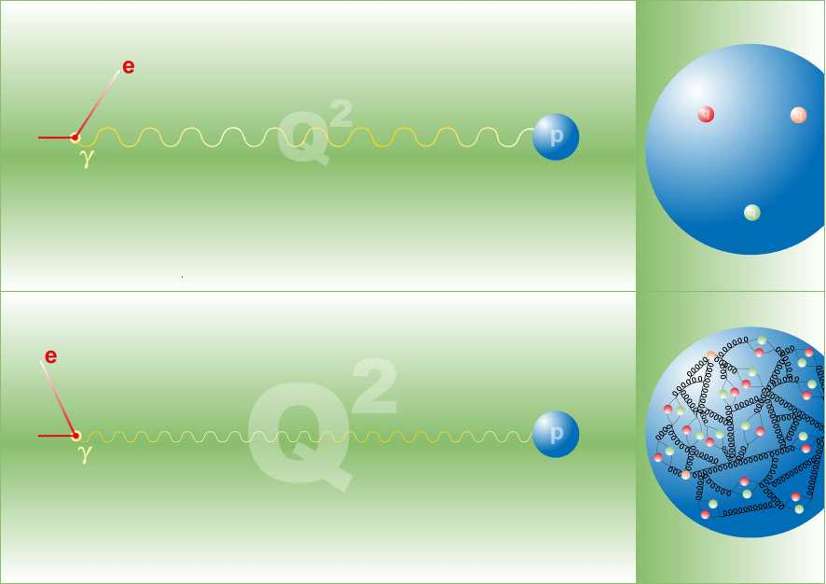
SIDIS physics at an EIC: Coverage
Common theme on EIC impact
  Extended kinematic coverage and precision, along with polarization
  and possible beam charge degrees of freedom allow multi-pronged approach →needed to extract multidimensional objects
  TMD factorization is valid
Large $Q^{2}$ lever arm: probe evolution, disentangle contributions to $σ$
Coverage to low $x:$ access sea and gluon distributions

Slide 6
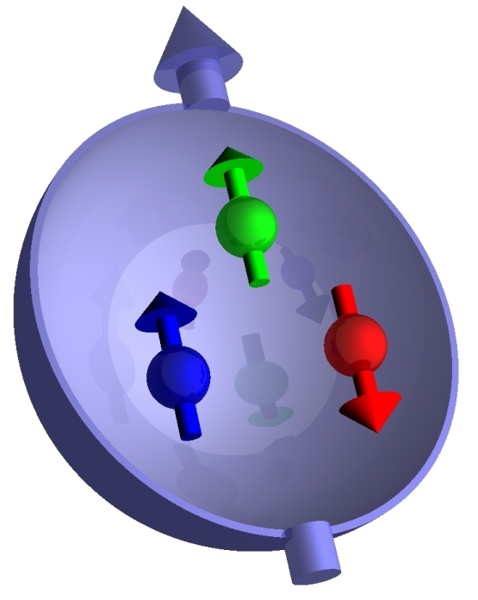
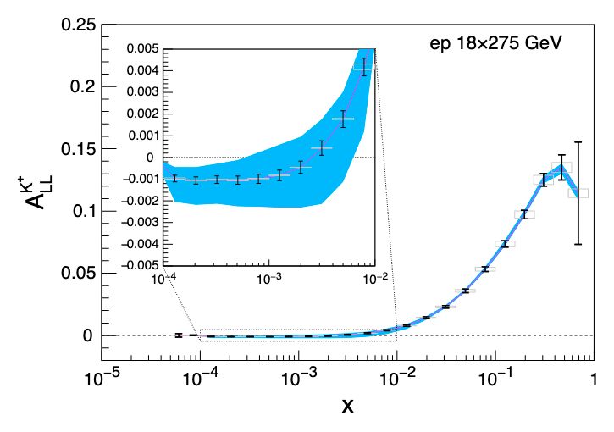
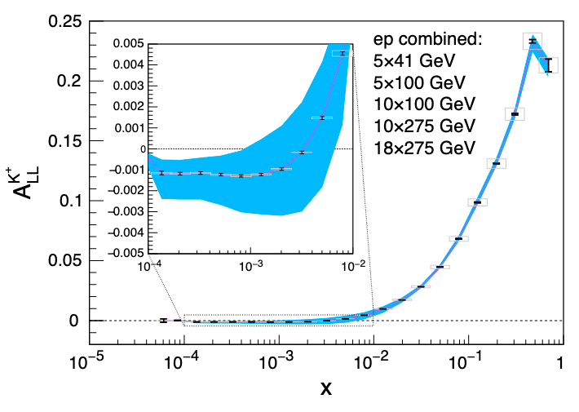

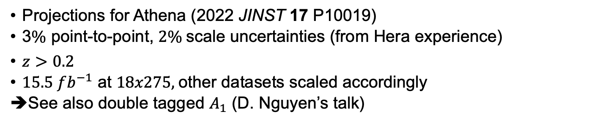
Longitudinal double spin asymmetries
$A_{LL}=\frac{σ^{↑⇑}−σ^{↑⇓}}{σ^{↑⇑}+σ^{↑⇓}}∝g_{1}$
Projections for Athena (2022 JINST 17 P10019)
3$\%$ point-to-point, $2\%$scale uncertainties (from Hera experience)
$z>0.2$
$15.5 fb^{−1}$ at $18x275,$other datasets scaled accordingly
➔See also double tagged $A_{1}$ (D. Nguyen’s talk)

Slide 7
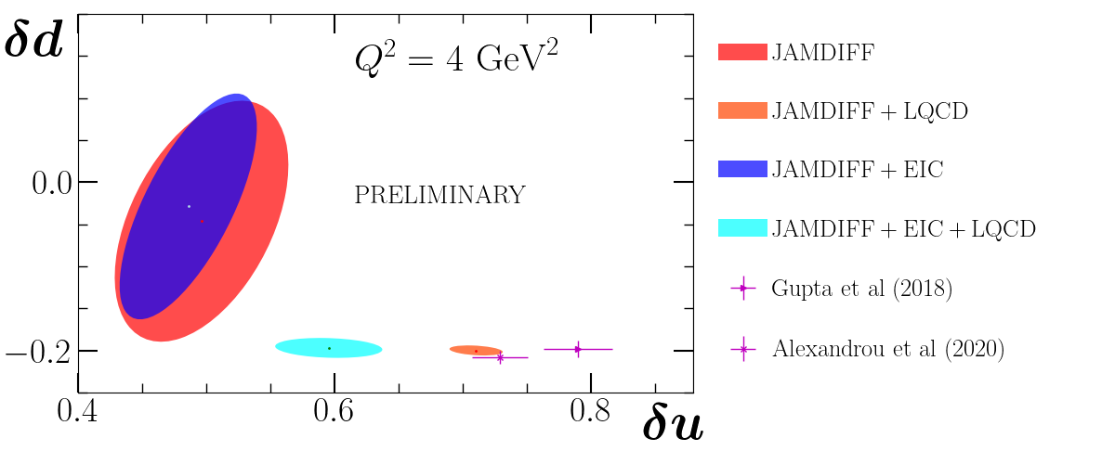
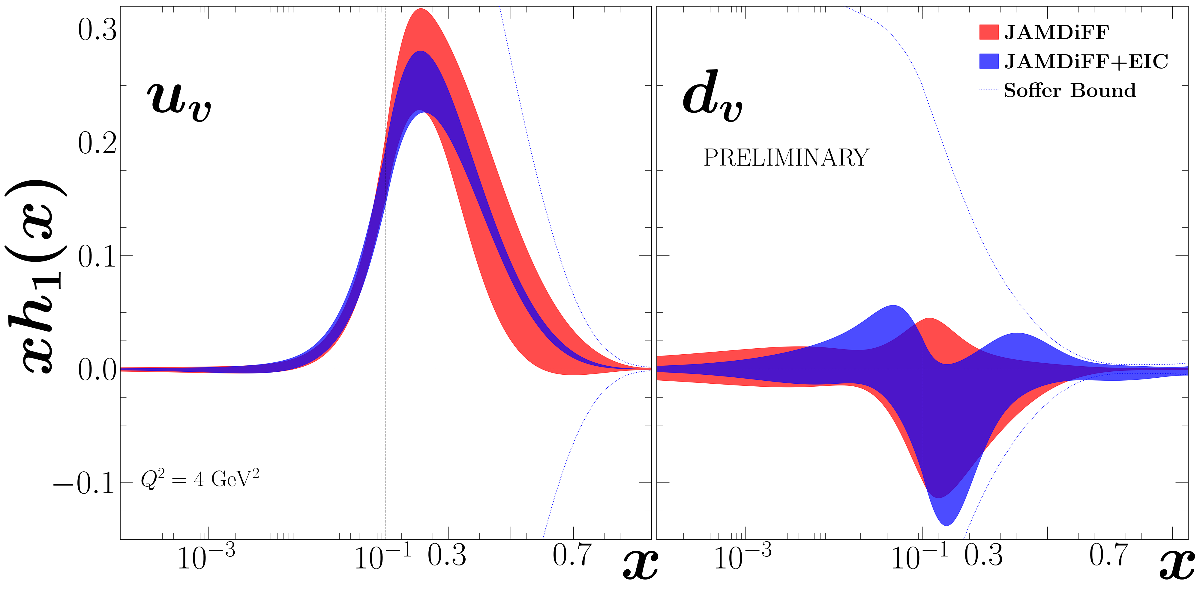
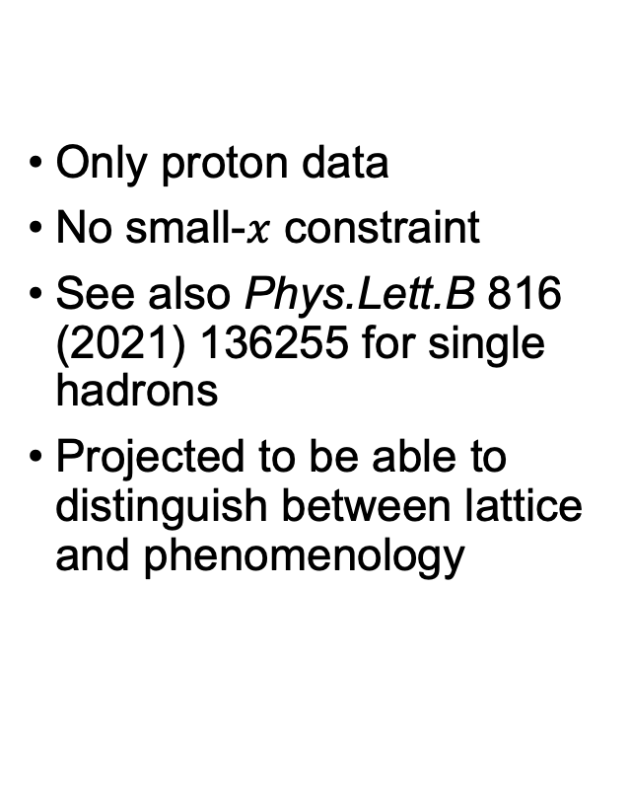
Example: Transversity Extraction from Di-hadrons
Only proton data
No small-$x$ constraint
See also Phys.Lett.B 816 (2021) 136255 for single hadrons
Projected to be able to distinguish between lattice and phenomenology

Slide 8
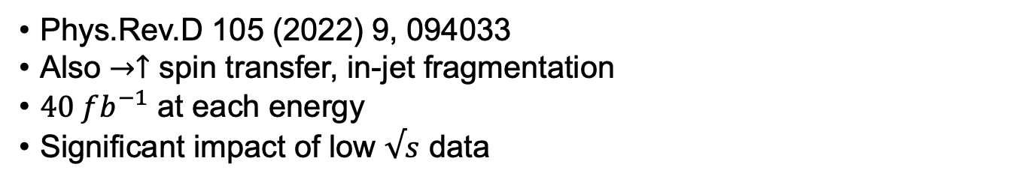

Precision $Λ$ physics at the EIC
Phys.Rev.D 105 (2022) 9, 094033
Also $→↑$ spin transfer, in-jet fragmentation
$40 fb^{−1}$ at each energy
Significant impact of low $√s$ data

Slide 9
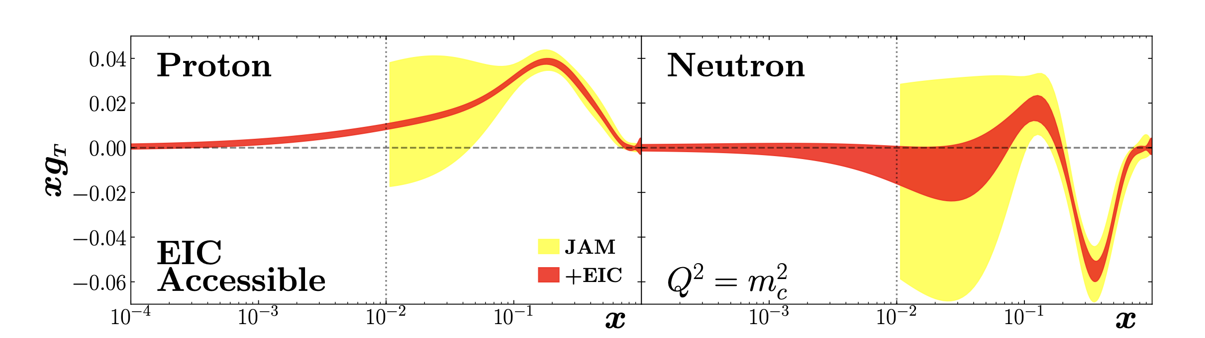
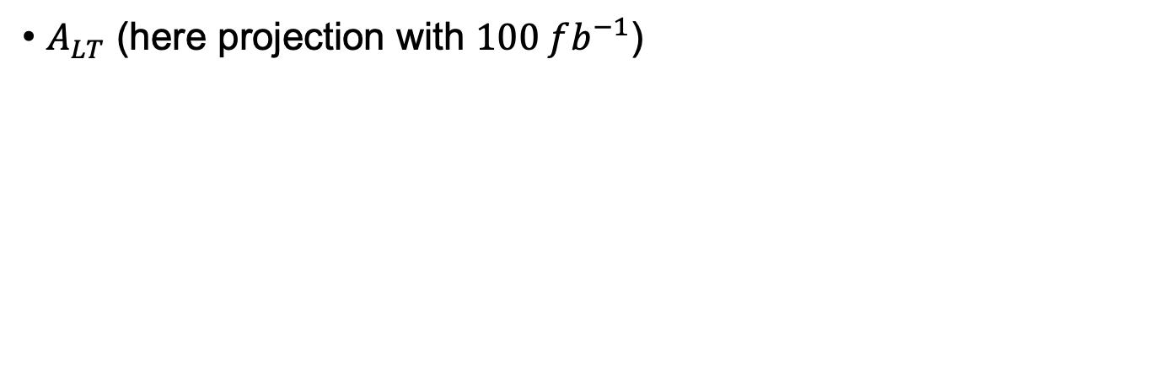

Impact Twist-3 PDF $g_{T}$
$A_{LT}$ (here projection with $100 fb^{−1}$)

Slide 10
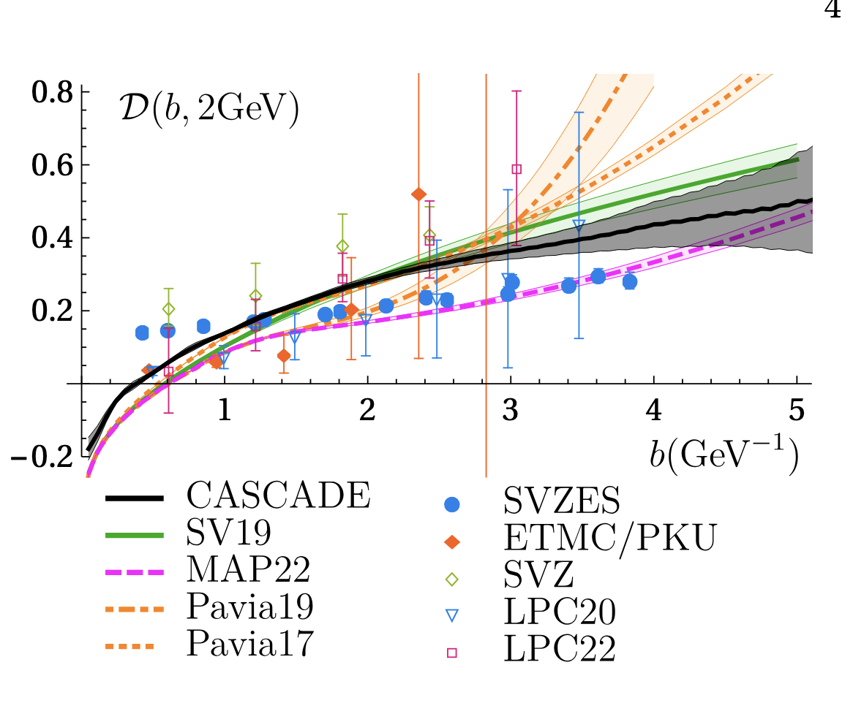
EIC kinematic leverarm provides Insight into Evolution
CS kernel sensitive to vacuum structure [Vladimirov 2020]
Significant uncertainties on extractions
Disagreement in different extractions and with lattice
From Bermudez-Martinez, Vladimirov , arxiv:2206.01105

Slide 11
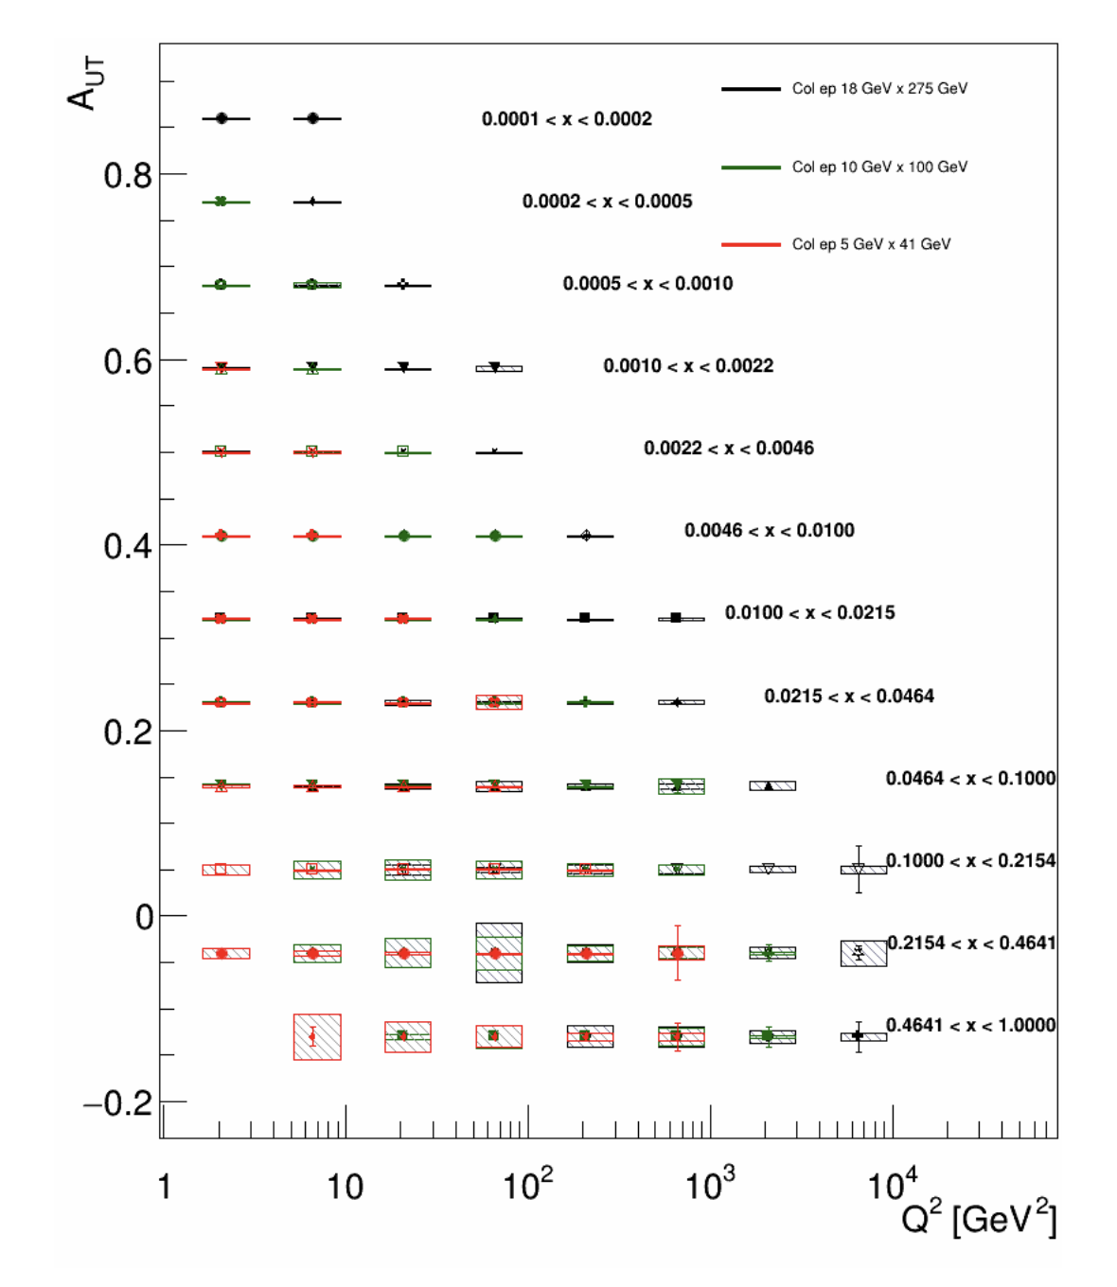
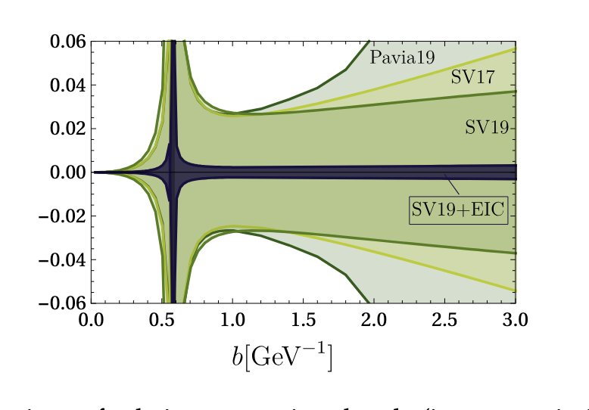
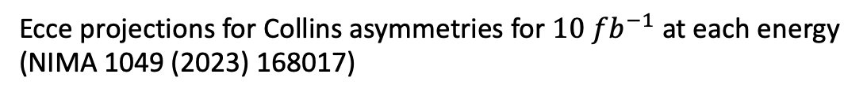
EIC kinematic leverarm provides Insight into Evolution
EIC Yellow Report
Ecce projections for Collins asymmetries for $10 fb^{−1}$ at each energy
(NIMA 1049 (2023) 168017)

Slide 12
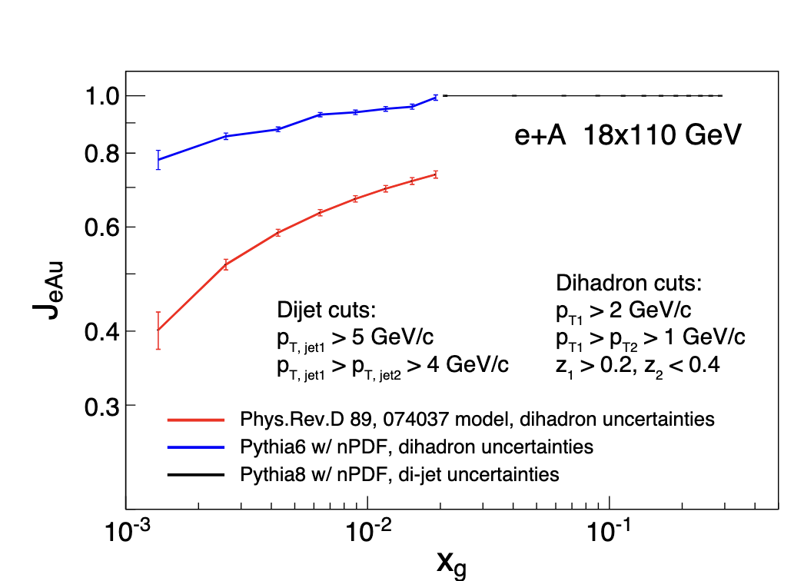
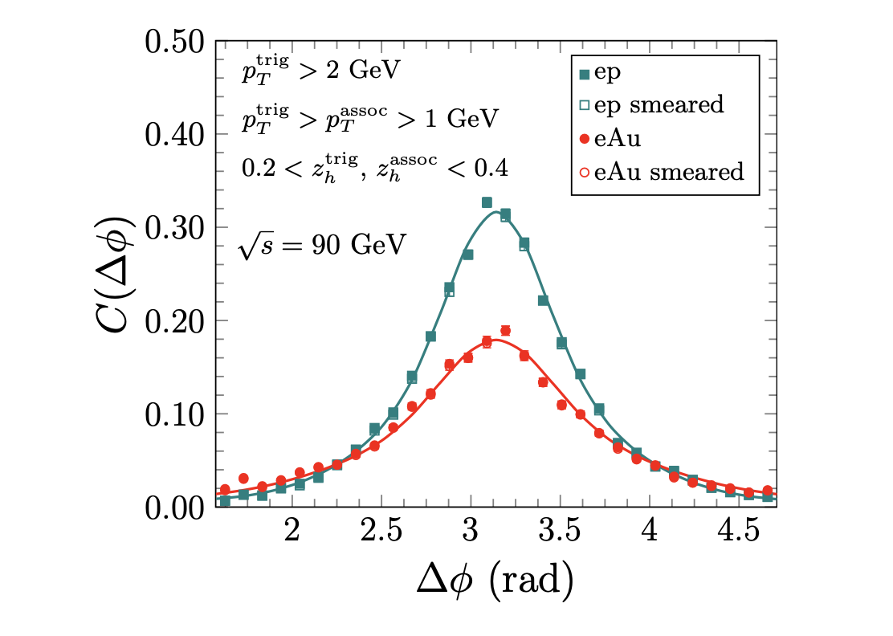
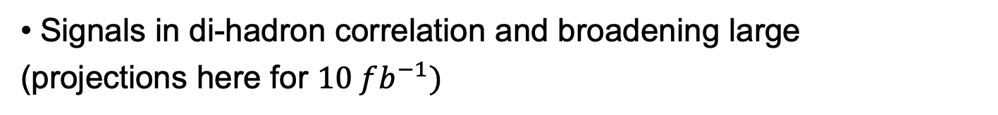
Di-hadrons to access saturation
Signals in di-hadron correlation and broadening large
(projections here for $10 fb^{−1})$

Slide 13
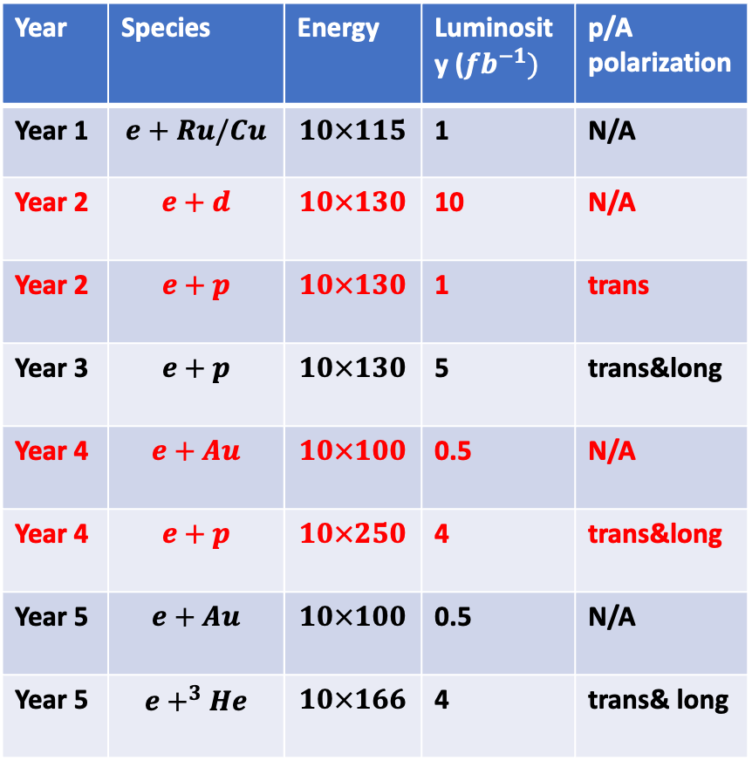
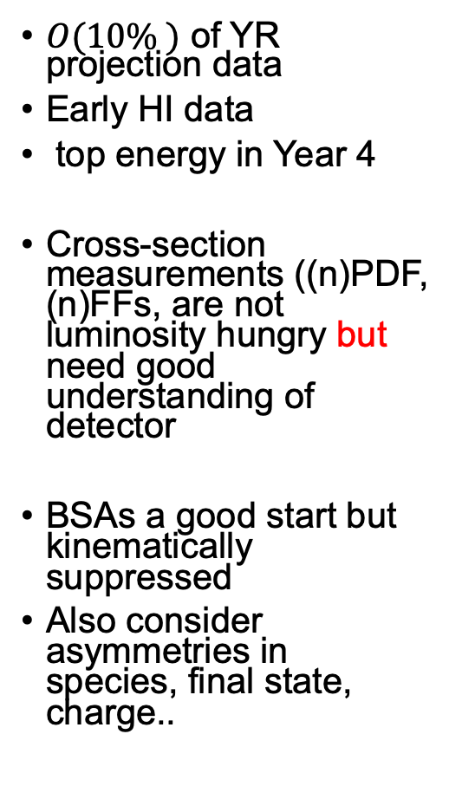
Early Running Constraints
Year | Species | Energy | Luminosity ($fb^{−1})$ | p/A polarization
Year 1 | $$e+Ru/Cu$$ | $$10×115$$ | 1 | N/A
Year 2 | $$e+d$$ | $$10×130$$ | 10 | N/A
Year 2 | $$e+p$$ | $$10×130$$ | 1 | trans
Year 3 | $$e+p$$ | $$10×130$$ | 5 | trans&long
Year 4 | $$e+Au$$ | $$10×100$$ | 0.5 | N/A
Year 4 | $$e+p$$ | $$10×250$$ | 4 | trans&long
Year 5 | $$e+Au$$ | $$10×100$$ | 0.5 | N/A
Year 5 | $$e+^{3}He$$ | $$10×166$$ | 4 | trans& long
$O(10\% )$ of YR projection data
Early HI data
top energy in Year 4
Cross-section measurements ((n)PDF, (n)FFs, are not luminosity hungry but need good understanding of detector
BSAs a good start but kinematically suppressed
Also consider asymmetries in species, final state, charge..

Slide 14
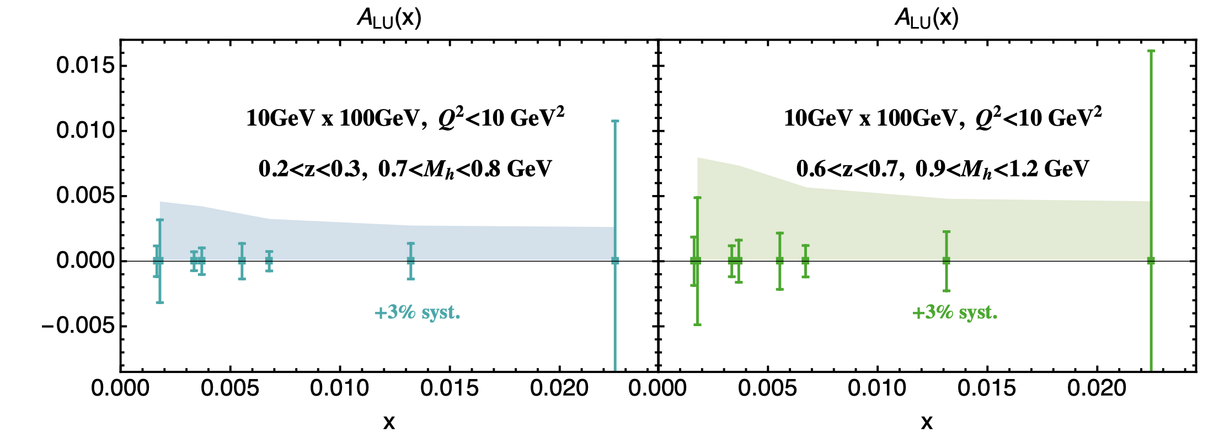
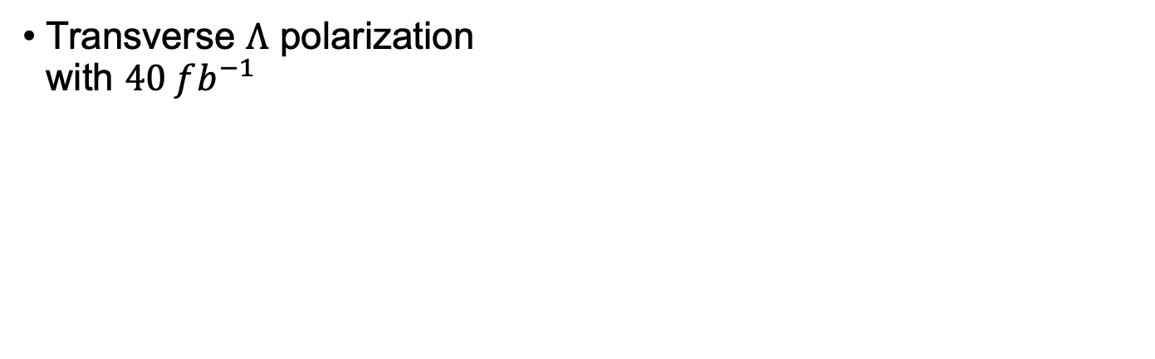

BSAs and Lambdas with early data
$A_{LU}$ for dihadrons(here projection with $10 fb^{−1}$)
Also: $g^{⊥}$ in jet $A_{LU}$ , $A_{LU}^{h}$
(but interpretation difficult)
Transverse $Λ$ polarization
with $40 fb^{−1}$

Slide 15
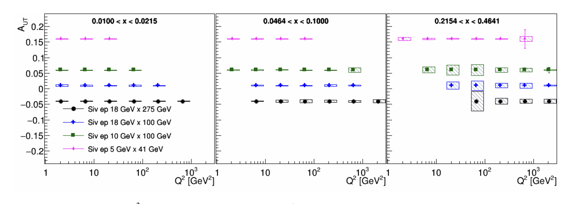


Transverse Single Spin Asymmetries at $10 fb^{−1}$
Uncertainties $≪$then expected asymmetries
Insights into TMD framework
Ecce projections for Sivers asymmetries
(NIMA 1049 (2023) 168017)

Slide 16
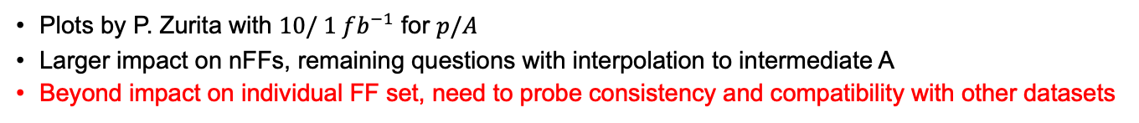
(nFF)
DSS14
nFF24
Plots by P. Zurita with $10/ 1 fb^{−1}$ for $p/A$
Larger impact on nFFs, remaining questions with interpolation to intermediate A
Beyond impact on individual FF set, need to probe consistency and compatibility with other datasets

Slide 17
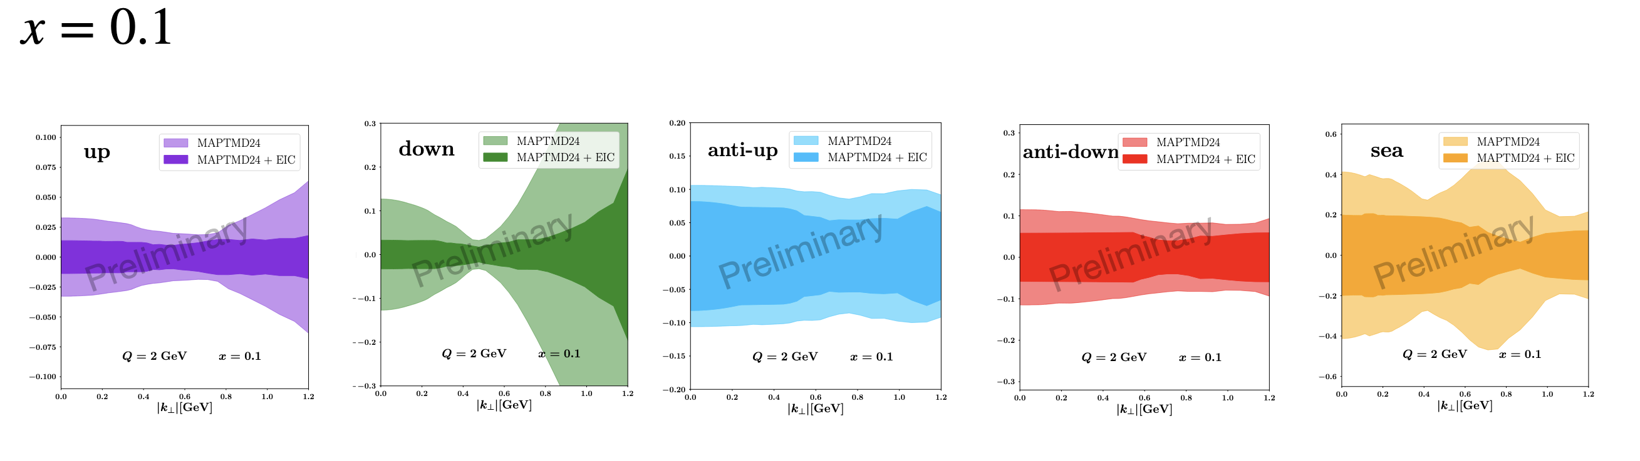
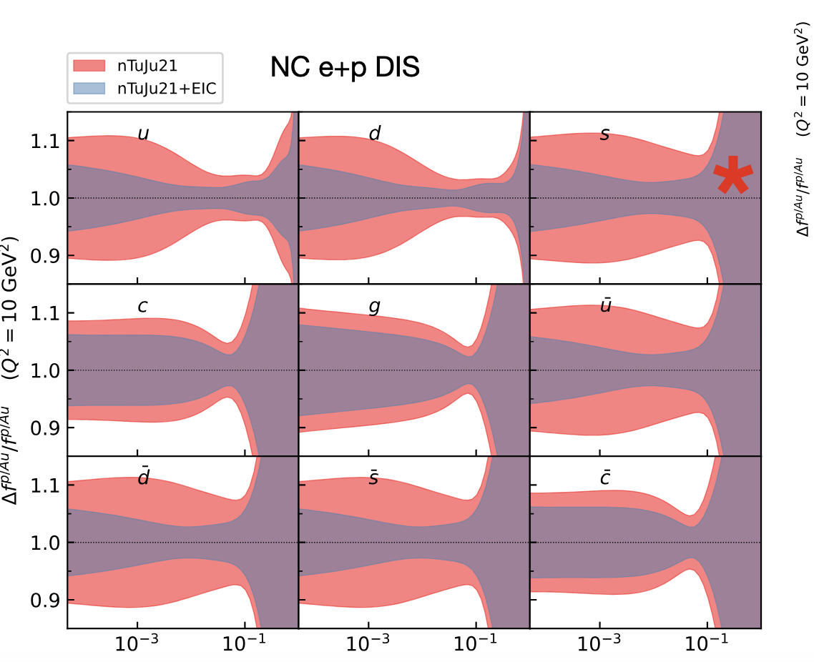
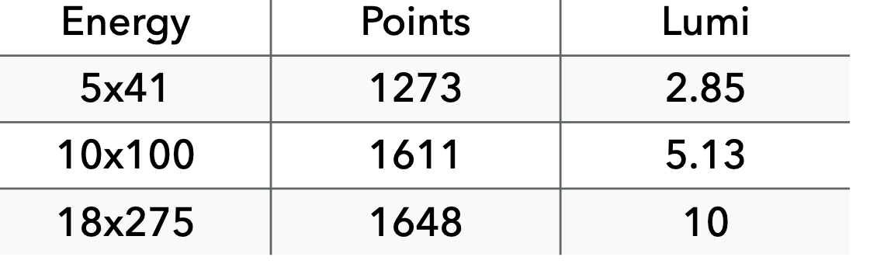

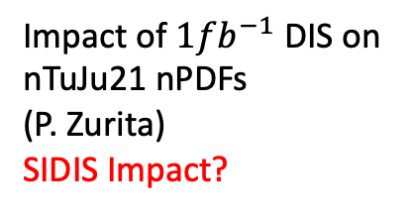
Unpolarized TMDs
$$x=0.1$$
Impact of $1fb^{−1}$ DIS on
nTuJu21 nPDFs
(P. Zurita)
SIDIS Impact?
MAP analysis (Bacchetta at ePIC collaboration meeting),
Simulated data by G. Matousek (Duke)
Significant impact, even with limited data
Absolute cross-sections will be challenging in the beginning
Nuclear PDFs/FF can also be measured as ratios to p/d

Slide 18
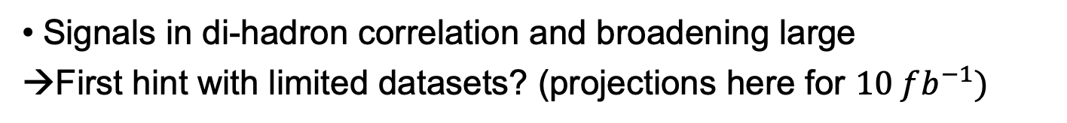
Di-hadrons to access saturation
Signals in di-hadron correlation and broadening large
→First hint with limited datasets? (projections here for $10 fb^{−1})$

Slide 19
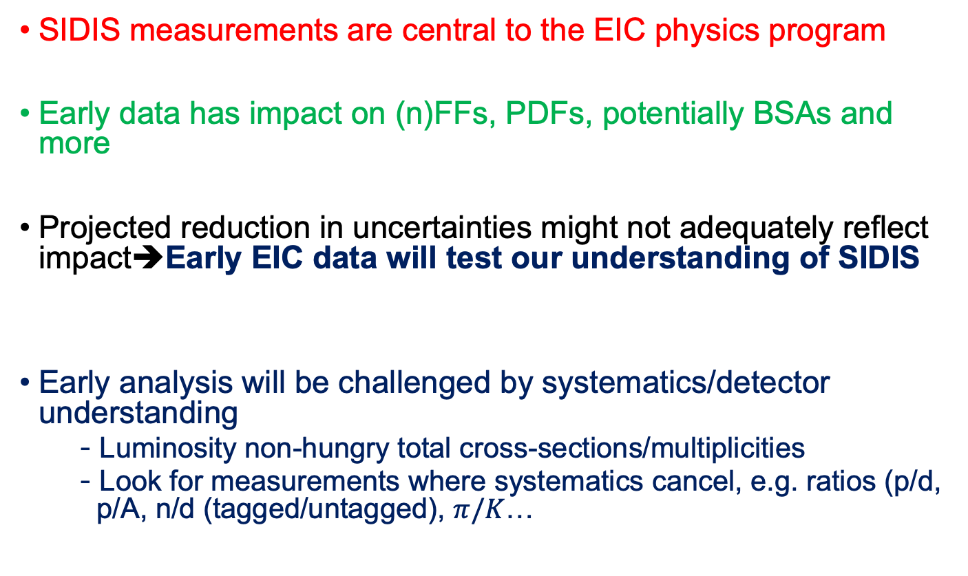
Summary & Conclusion
SIDIS measurements are central to the EIC physics program
Early data has impact on (n)FFs, PDFs, potentially BSAs and more
Projected reduction in uncertainties might not adequately reflect impact➔Early EIC data will test our understanding of SIDIS
Early analysis will be challenged by systematics/detector understanding
  Luminosity non-hungry total cross-sections/multiplicities
  Look for measurements where systematics cancel, e.g. ratios (p/d, p/A, n/d (tagged/untagged), $π/K$…

Slide 20
Backup

Slide 21
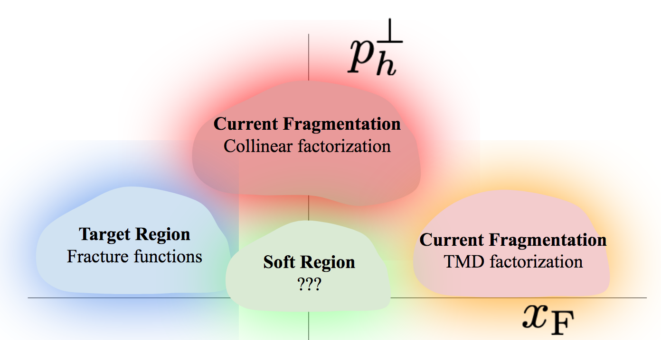
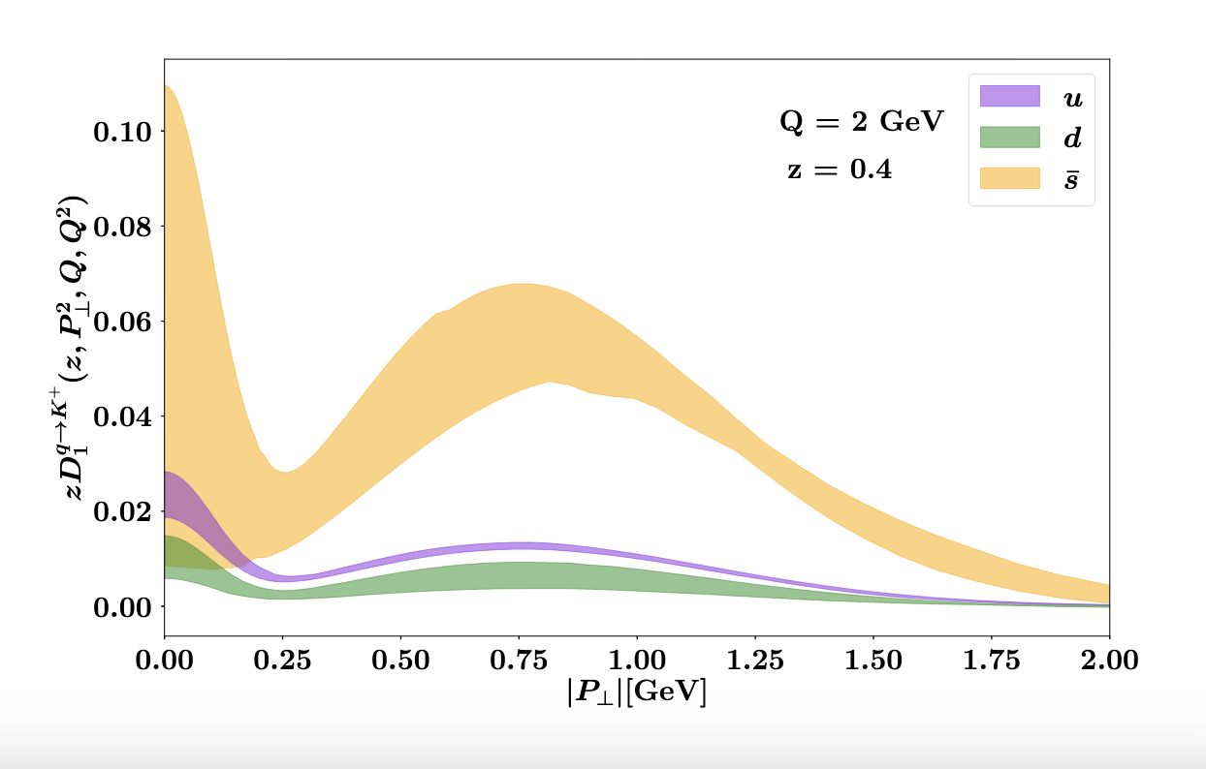
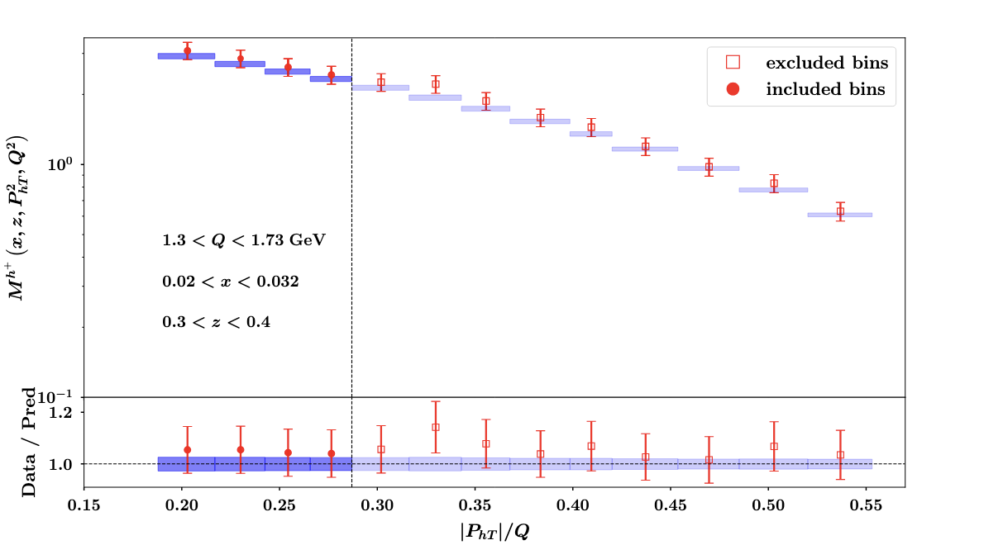
Validations of Theory Framework
TMD extraction is non-trivial
Higher Twist Contributions
Overlap of regions that are not captured by factorized TMD picture
VM Meson decays
Radiative corrections
Evolution (CS Kernel)
➔EIC will be critical test of our understanding (high lumi, leverarm in kinematics to disentangle various contributions)
MAP extraction of FFs
Expect corrections in powers ofδ ∼ PhT /z/Q
Plots from A. Bacchetta’s talk at ePIC Collaboration meeting

Slide 22
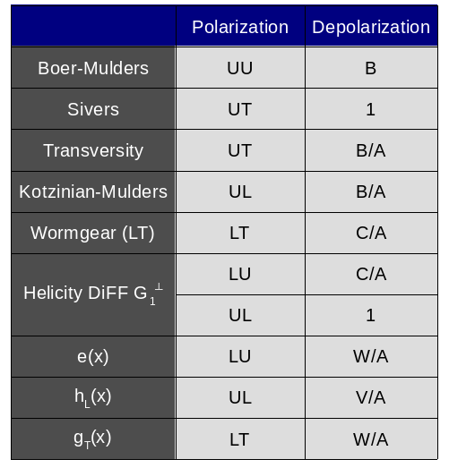
Access to TMDs: Kinematic factors
Twist 2
Twist 3
Notation from PRD90 (2014) 11, 114027,
Slide from C. Dilks

Slide 23
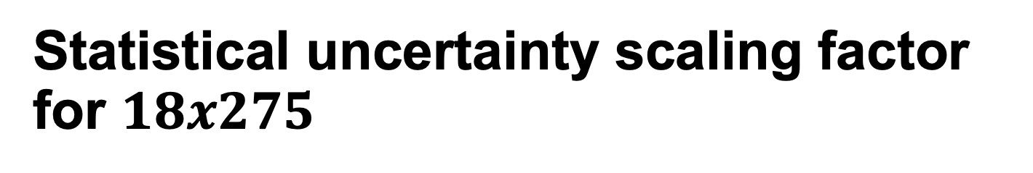
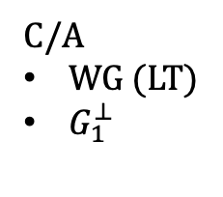

Statistical uncertainty scaling factor for $18x275$
C/A
WG (LT)
$G_{1}^{⊥}$
W/A
$e,$
$g_{T}$
Slide from C. Dilks

Slide 24
Depolarization Factors
Twist 2
Suppressed at EIC
Twist 3
Slide from C. Dilks

Slide 25


Slide 26


Slide 27

From PRD 110 (2024) 11, 114019

Slide 28
Unpolarized PDFs

Slide 29

Higher Twist PDFs
S. Diehl
twist-3 pdf
unpolarized PDF
twist-3 t-odd PDF
Boer-Mulders
Collins FF
twist-3 FF
unpolarized FF
29

Slide 30


Beyond the parton picture
Higher Twist Contributions
Overlap of regions that are not captured by factorized TMD picture
VM Meson decays
Radiative corrections
Assumption of suppressed long photon contributions
One persons ‘complication’ is another person's signal…
➔Need high lumi, leverarm in kinematics to disentangle various contributions

Slide 31





$He^{3}$Double Tagging at the EIC allows clean neutron measurement
Neutron is to $87\%$ polarized
Double tagged events thus
provide access to polarized
neutron beam
Reconstruction of initial neutron
momentum from tagged protons allows reduction of uncertainties
from nuclear corrections
Friščić, I, Nguyen, D, Pybus, JR, Jentsch et al

Slide 32


Example: transversity extraction from Jlab and the EIC
But careful with parametrization bias…
Phys.Lett.B 816 (2021) 136255

Slide 33

What makes the EIC era?
Valence Quarks
To extract 3D structure
Need luminosity
Exposure
Glue and sea-quarks
wavelength
Luminosity + DIS Kinematics $=$
Precision tests of QCD, 3D structure of the nucleon

Slide 34

Momentum structure in the parton model parametrized by TMDs (spin $½$)
In addition to the spin-spin correlations can have spin momentum correlations!
Spin-orbit correlations

Slide 35




Kinematic comparisons
COMPASS
HERMES/JLab24
JLab12
Plot by H. Avakian
JLab7/9/11
NB: Kinematic slice heavily biased towards Jlab

Slide 36


Lambda feed-down composition vs JLab20
EIC
JLAB12
Xiaoyan Zhao at SPIN
Study by M. McEneaney(Duke)
JLab22 similar
Possible to unfold at the EIC (not so much at Jlab)
ML methods might help

Slide 37
The TMD factorization formula receives corrections which enter in terms of powers of
δ ∼ PhT /z/Q.

Slide 38


Order of magnitude in luminosity depending on $\sqrt{s}$ (beware of projections with fixed $∫L$)

Slide 39


Wide Coverage

