Slide 1
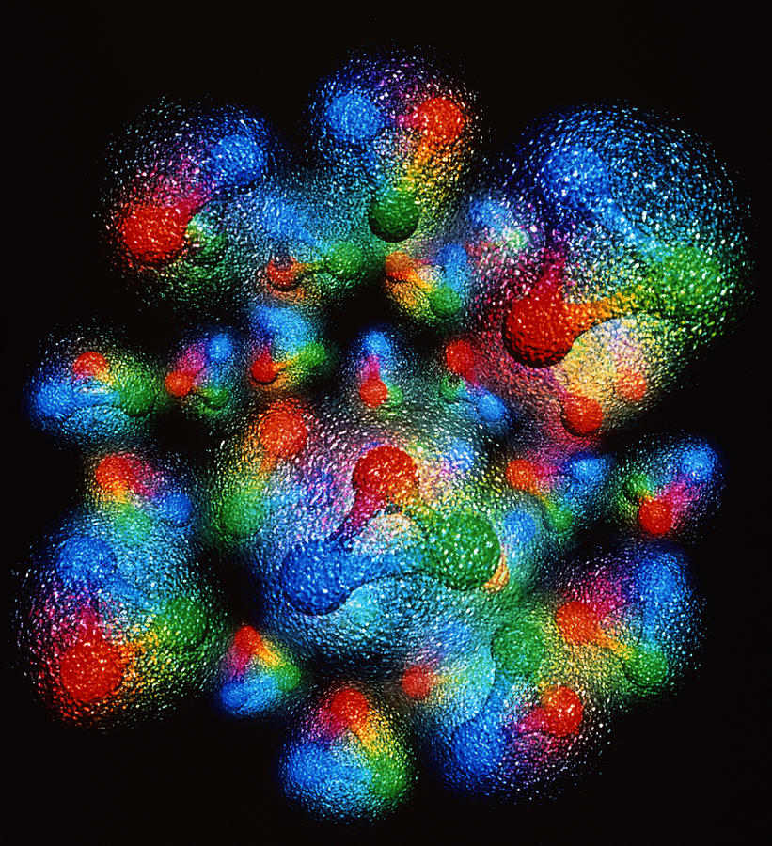
What physical information is in deeply virtual exclusive experiments and how do we get the picture?
Simonetta Liuti
Notes:
EIC have templates for that
UQ pointing at where to measure at EIC
Digital twins and lattice
Example: molecular dynamics, diffusion model, build the whole dynamics in ns, surrogate of very costly project. GiaWei: accuracy issue? For both stages: lattice configurations and correlators
Prasanna: when to use surrogate models, build cheaper yet accurate
Self-learning MC and non-abelian theory, like surrogate model
Kyle Cranmer P. Shanahan et al., Nature review paper,
Pseudo data + data based anaysis
Put in lattice component on digital twins at the observable level not gauge configurations, End-to-End: big survey of all GPD calculations from parameters to observables
Ensemble based analysis

Slide 2
“The EIC will be a particle accelerator that collides electrons with protons and nuclei to produce snapshots of those particles’ internal structure—like a CT scanner for atoms. The electron beam will reveal the arrangement of the quarks and gluons that make up the protons and neutrons of nuclei.”
https://www.bnl.gov/eic/
But what is the science that goes into imaging the proton, observing its spatial structure at 10⁻¹⁵ m?

Slide 3
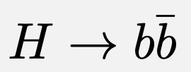
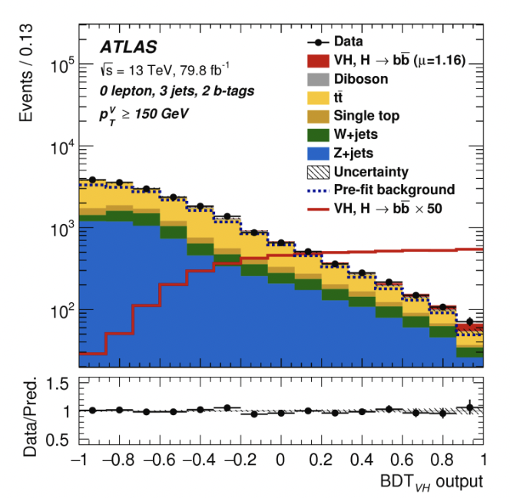
Standard Approach to ML/AI in Physics
Industrial Machine Learning (ML) tools are used/adapted to aid computation in Nuclear/Particle Physics
Example: Ensemble learning methods such as Boosted Decision Trees (BDT) invented for image recognition/object detection used in self-driving cars are used to identify b-hadrons
https://atlas.cern/

Slide 4
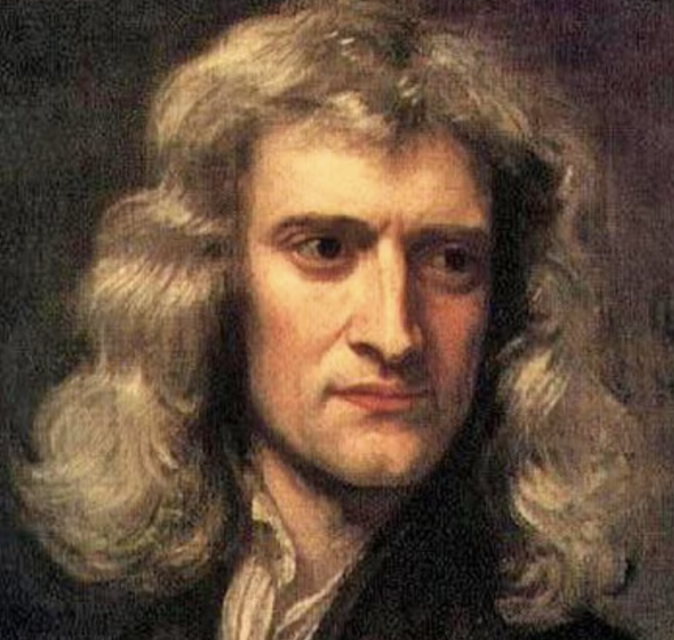
Can we address the “why” with AI?
Not just a set of advanced computational tools!
Finding a common language between physics and AI
Standard ML→ “what?”
Go beyond just a set of ML advanced computational tools
Explore a new AI based paradigm for physics discovery
Physics → “why ?”

Slide 5
From Standard Computational Paradigm → Explainable AI-based Paradigm
Experimental data
Suggest interpretation
Prediction/Analysis
Test
AI Model Learning and interpretation

Slide 6
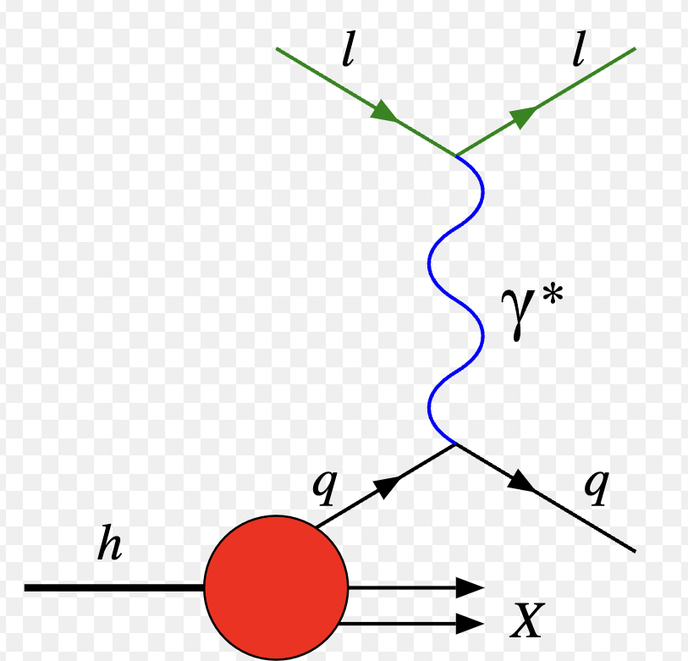
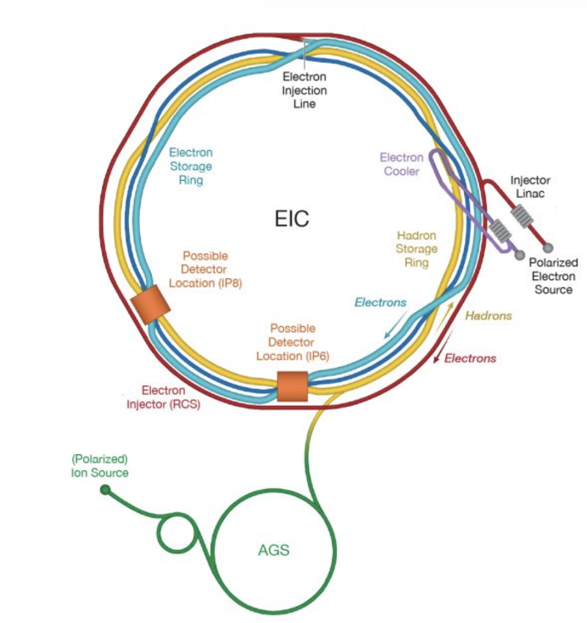
Forward Problem
QCD
quark field
gluon field
correlation functions
Observables
Form Factors
Structure Functions
Compton Form Factors
Fragmentation functions
…
Data/Measurements
Inverse Problem
Notes:
We want to merge ML and physics to use machines to generate interpretable understandable models which humans can understand, while solving inverse problems

Slide 7
Physics: Interpretability + predictions
The goal in physics is to extract information as accurately as possible from data and express it in concise understandable equations/generalizable
Machine Learning: Only Predictivity
The goal of ML is to obtain statistical models that can make predictions from the data/no interpretability
Physics+ML solve the Inverse Problem
To extract model information from data we need to define a bridge between CS experts and physicists centered on how we treat data uncertainty and correlations while being aware that their objective functions differ
An immense potential!
Through ML we will be able to uncover new physics relations/laws
ML emergent behavior is decades from being understood!
Notes:
to explore all the synergies - the common aspects - focusing on why any given method works

Slide 8
Physics Case: Extracting information from exclusive deeply virtual scattering
Notes:
On the LHS is the Feynman diagram for the DVCS scattering process. The virtual photon q (along z in previous page) scatters off a quark coming out of the proton. The quark probability/QCD matrix element for finding a quark with given momentum and spin is represented by the “blob”.
On the RHS we integrate over the quark (loop) momentum, which by Fourier transformation corresponds to taking the two photon-quark scattering vertices at the same point in the conjugate space coordinate. This is represents the QCD matrix element for a local operator. It measures a moment in the momentum fraction x. Particularly interesting are the second moments, x \times GPD, because they coincide with the Eneregy Momentum tensor (EMT) form factors

Slide 9
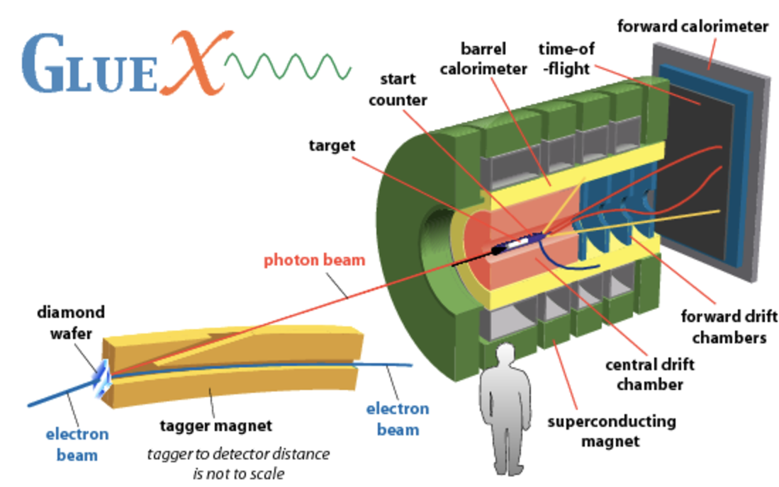
QCD matrix element
Experiment
q’
q
μ
ν
H,E, …
p’
p
Generalized Parton Distributions
Moments ➜ Energy Momentum Tensor Form factors
Angular momentum, Mass
Notes:
On the LHS is the Feynman diagram for the DVCS scattering process. The virtual photon q (along z in previous page) scatters off a quark coming out of the proton. The quark probability/QCD matrix element for finding a quark with given momentum and spin is represented by the “blob”.
On the RHS we integrate over the quark (loop) momentum, which by Fourier transformation corresponds to taking the two photon-quark scattering vertices at the same point in the conjugate space coordinate. This is represents the QCD matrix element for a local operator. It measures a moment in the momentum fraction x. Particularly interesting are the second moments, x \times GPD, because they coincide with the Eneregy Momentum tensor (EMT) form factors

Slide 10
Twist three GPD Physical interpretation at the core of spin puzzle
A. Rajan, M. Engelhardt and S. Liuti, Phys. Rev. D98, 074022 (2018)
A. Rajan, A. Courtoy, M. Engelhardt and S. Liuti, Phys. Rev. D94, 034041 (2016)
M. Rodekamp, M. Engelhardt, J.R. Green, S. Krieg, S. Liuti, S. Meinel, J.W. Negele, A. Pochinsky and S. Syritsyn, Phys. Rev. D 109, 074508 (2024)
*Twist 3 GPD notation from Meissner, Metz and Schlegel, JHEP(2009)

Slide 11
Transverse Angular Momentum Sum Rule
O. Alkassasbeh, M. Engelhardt, SL and A. Rajan,
https://arxiv.org/abs/2410.21604
Will we ever be able to test these relations?

Slide 12
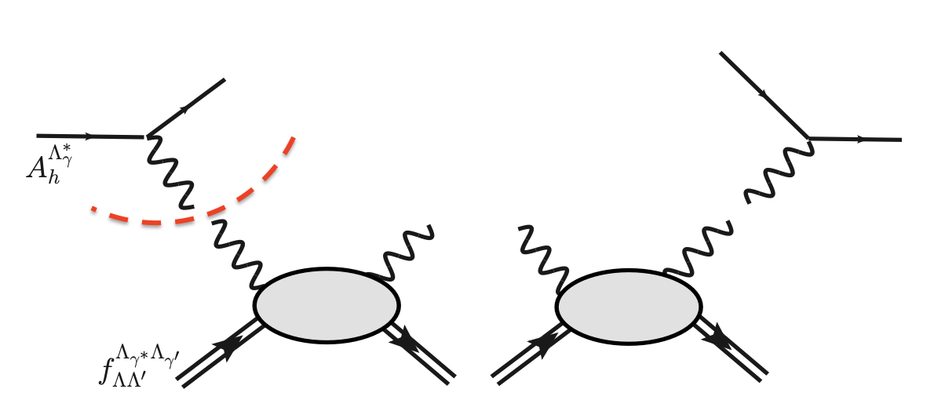
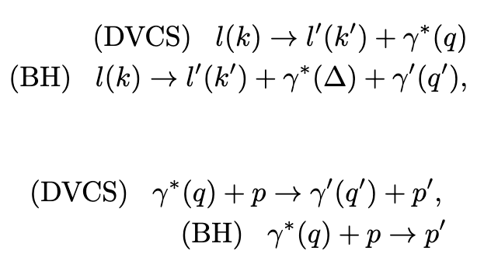
Step 1: Model Independent and Covariant Organization of Cross Section
lepton vertex
2-body scattering amp
Helicity amplitude

Slide 13
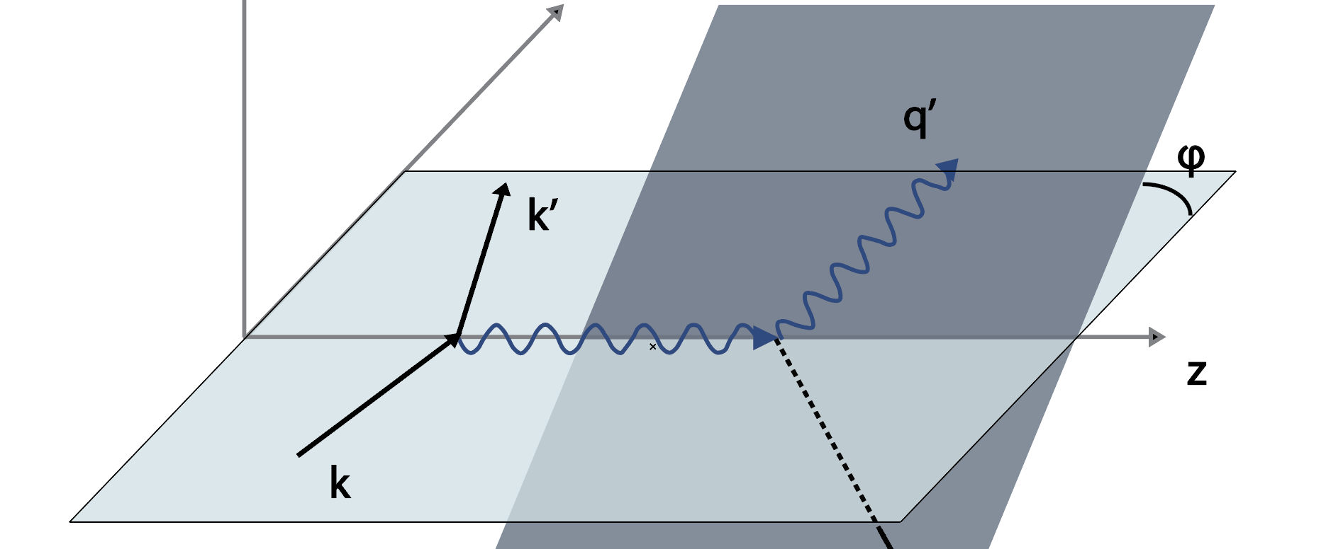
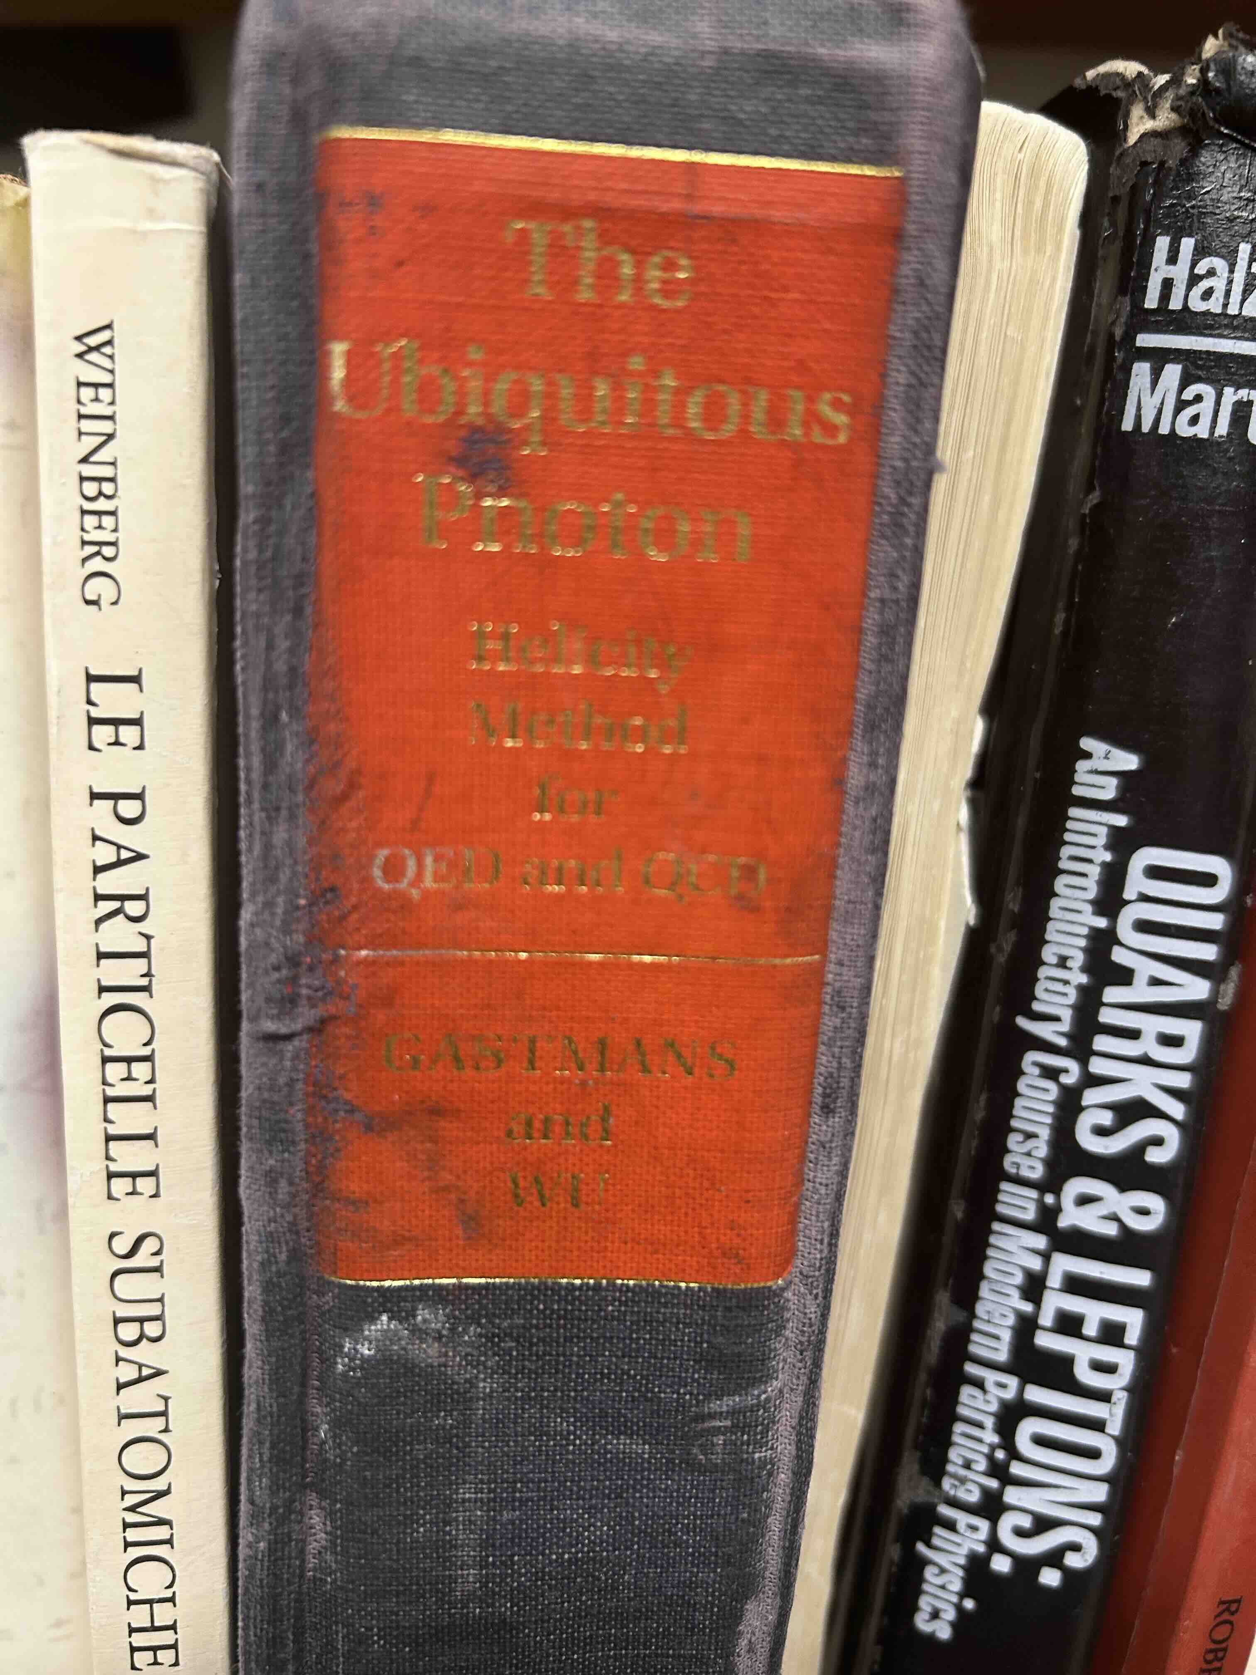
Extraction of Compton Form Factors from Experiment: role of phase
DVCS
y
y’
z
z’
x
x’
The hadronic tensor is evaluated in the rotated frame
Jacob and Wick (1959)

Slide 14
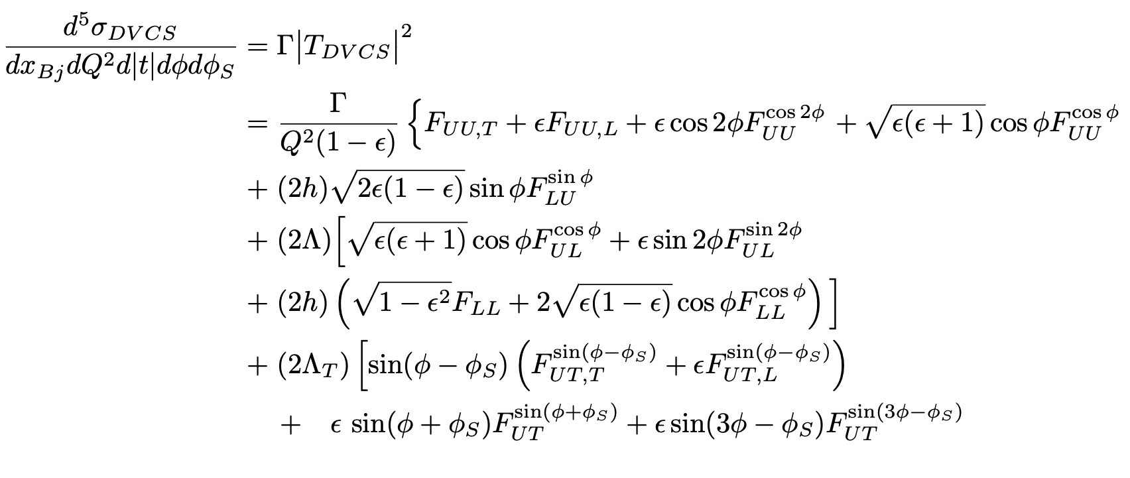
unpolarized
long. polarized
transv. polarized
B. Kriesten et al, Phys.Rev. D 101 (2020)
B. Kriesten and SL, Phys.Rev. D105 (2022), arXiv 2004.08890
B. Kriesten and SL, Phys. Lett. B829 (2022), arXiv:2011.04484

Slide 15
The analysis variables at a given kinematics are ε and ϕ
L
T
Fixed target (Jlab)
Collider (EIC)

Slide 16
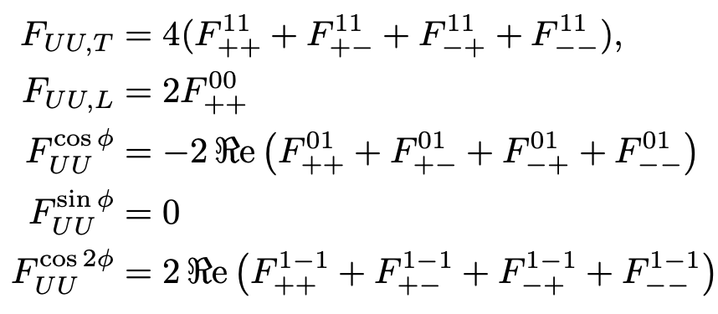
The analysis parameters at a given kinematics are the structure functions that depend on$(x, Q^{2},t)$
The helicity structure functions

Slide 17
Step 2: Assuming a QCD factorized scenario → CFFs → GPDs
Assume known
Second Inverse Problem!

Slide 18
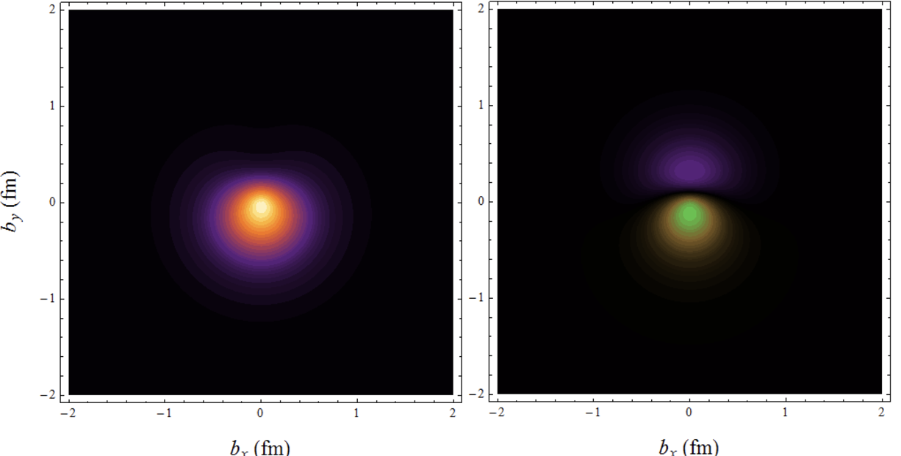
3D Coordinate Space Representation requires a Fourier transform
Observables from DVES matrix elements can be Fourier transformed from momentum space into coordinate space, providing insight into the spatial distributions of quarks and gluons inside the proton, besides matter and charge distributions.
Wigner phase space distribution
GPD
H-W Lin,
https://web.pa.msu.edu/people/hwlin/research.html

Slide 19
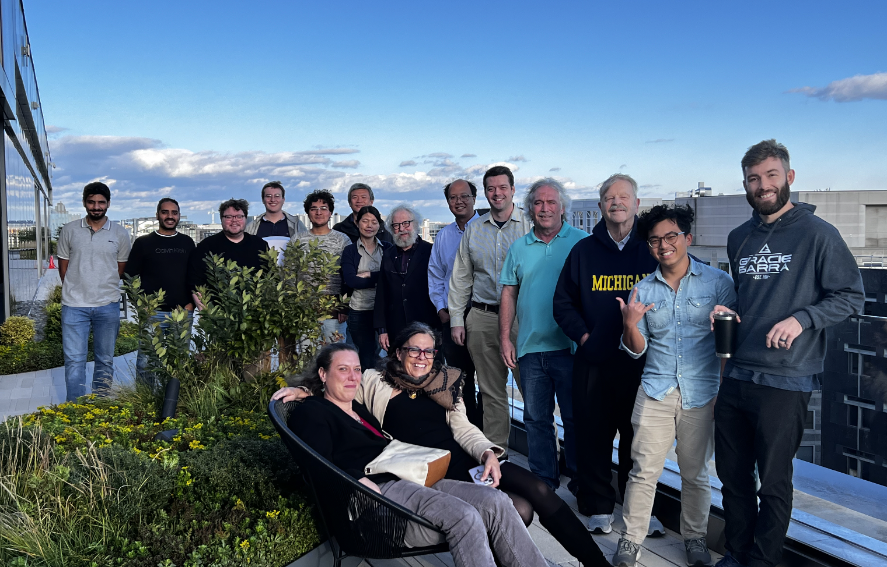
The EXCLAIM collaboration
https://willuhmjs.github.io/exclaim/
PIs: Marie Boer, Gia-Wei Chern , Michael Engelhardt, Gary Goldstein, Yaohang Li, Huey-Wen Lin, SL, Matt Sievert, (Dennis Sivers)
Funded Postdocs: Douglas Adams, Liam Hockley, Saraswati Pandey, Emanuel Ortiz, Kemal Tezgin
Graduate Students: Andrew Dotson, Carter Gustin, Jang (Jason) Ho, Fayaz Hossen, Adil Khawaja, Zaki Panjsheeri, Anusha Singireddy, Jitao Xu
Undergraduate: Will Faircloth

Slide 20
EXCLAIM Research Accomplishments
Fully constraining Likelihood analysis
Inverse Problem techniques: Variational Autoencoder Inverse Mapper (VAIM)
Symbolic Regression for Partonic Observables
All these methods share the common goal of going beyond simple regression by understanding the underlying correlations of the system

Slide 21
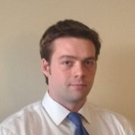
1. Fully Constraining CFFs : Likelihood Analysis
Graduate Students:
Joshua Bautista, Adil Khawaja, Zaki Panjsheeri
GOAL: Use DVCS data and comparing to cross section model to find CFFs
Curve fit: A bad result: Encounter a problem 1!
Definition of the likelihood: Try to fix the problem
Canonical Likelihood: Reproduces the problem in explainable way
Difference method Likelihood
Canonical Likelihood
Encounter a problem 2!: covariance
Results: Table of CFFs and errors
Douglas Adams

Slide 22
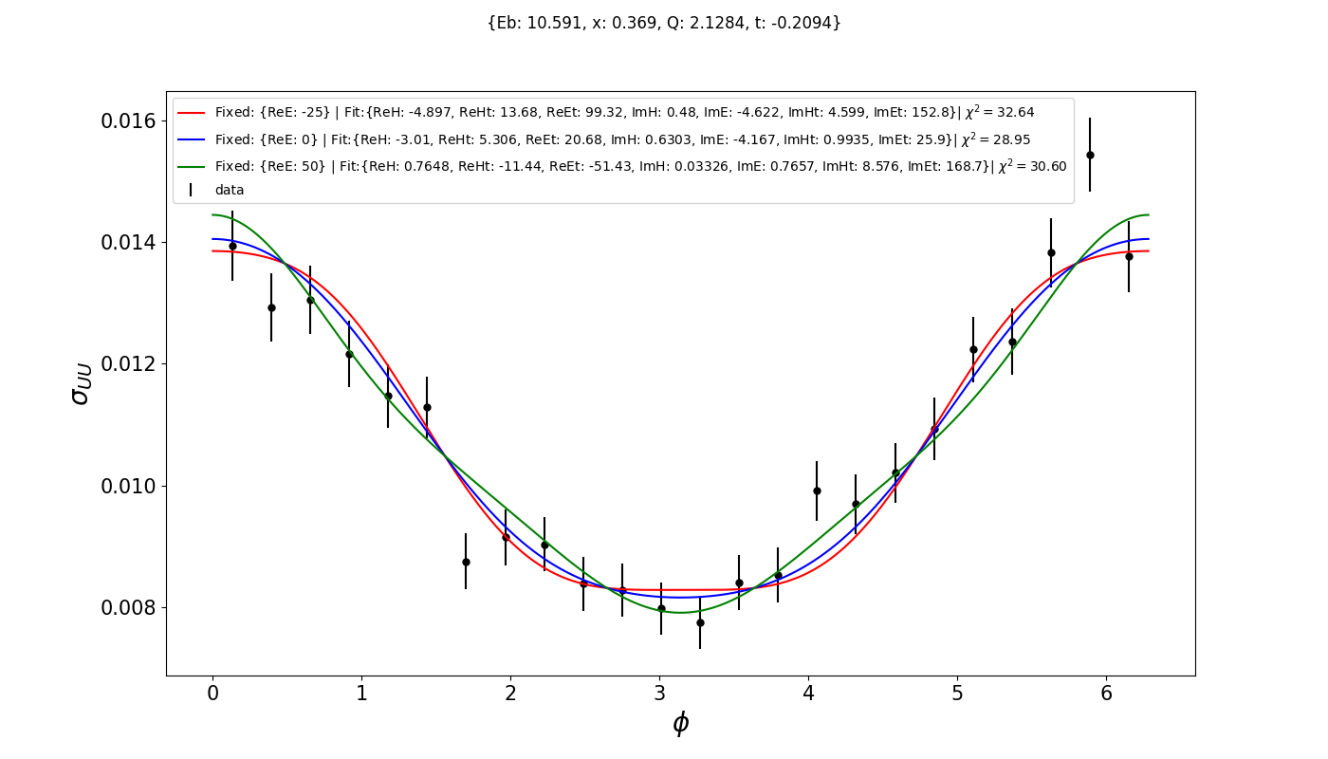
Degeneracy of Curve Fit Results

Slide 23
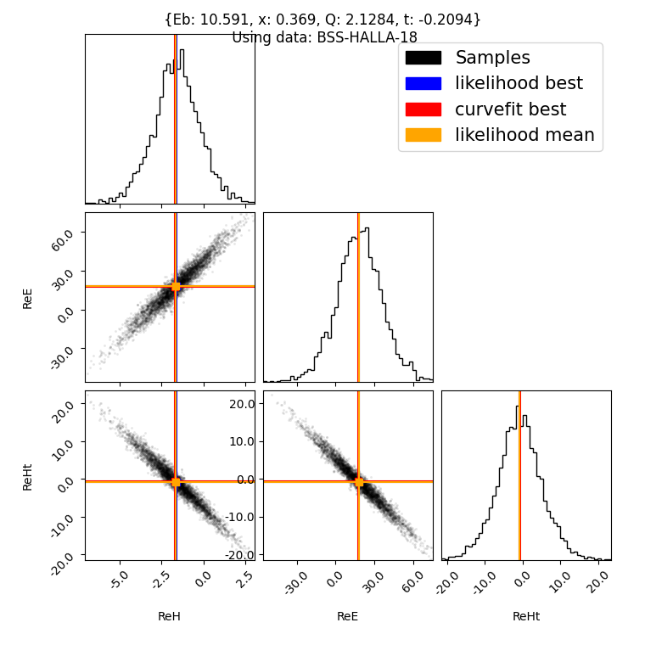
Covariance of CFF Results
Here the maximum likelihood is achieved allowing 3 CFFs to vary.
Only 23 combinations of 2 angles are used.
Notes:
Define Bayesian Likelihood

Slide 24
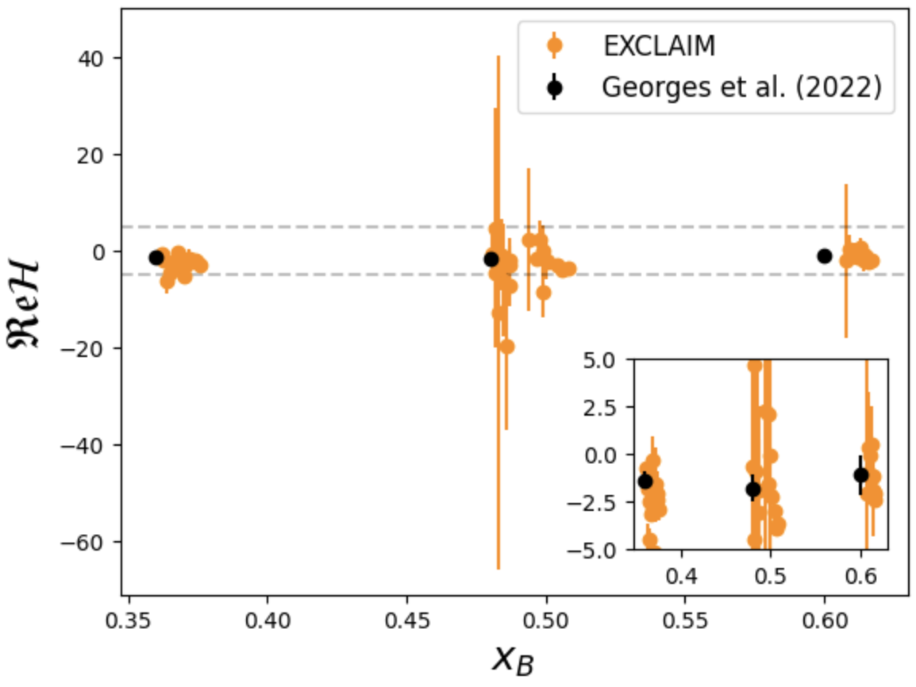
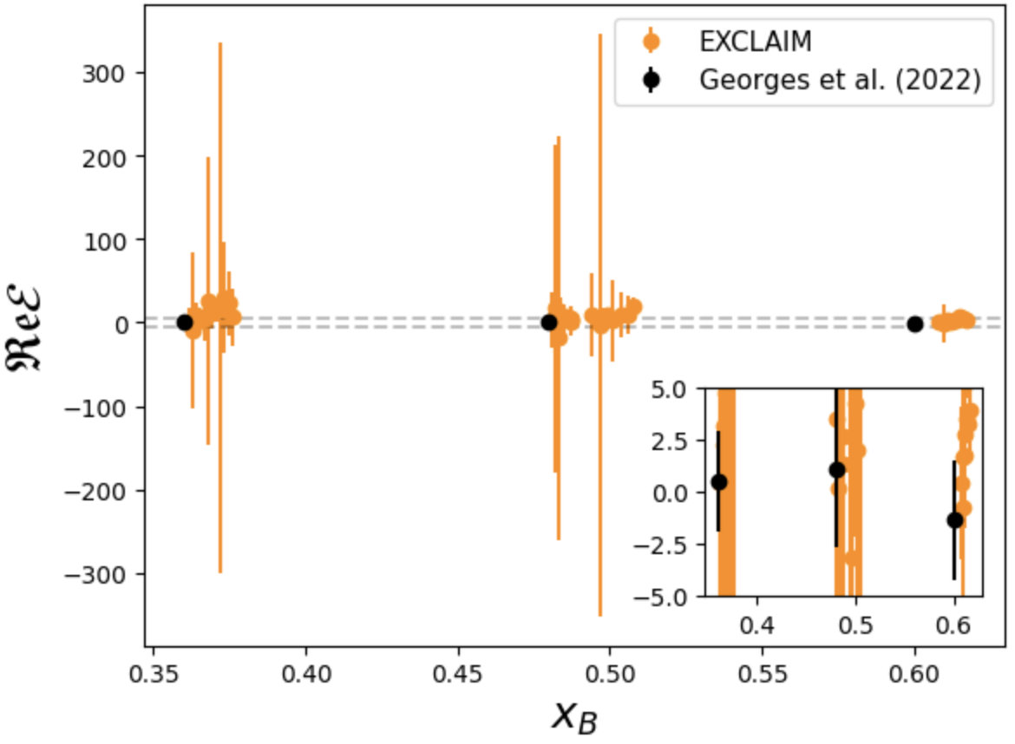
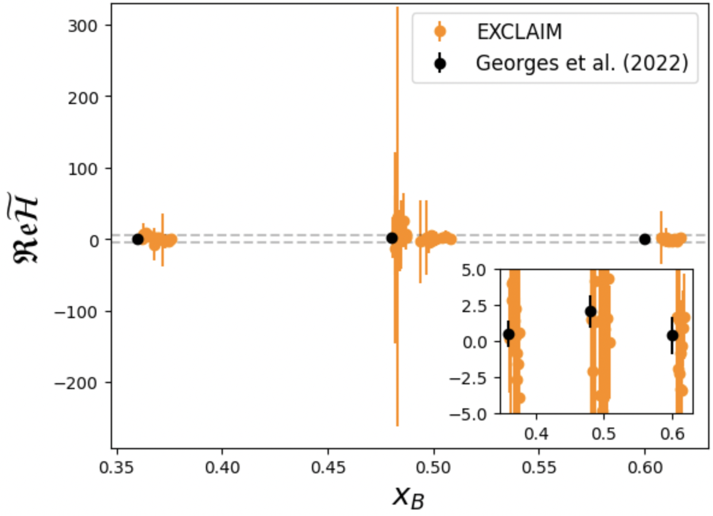
Marginal Posterior CFF Results
H
E
~
H

Slide 25
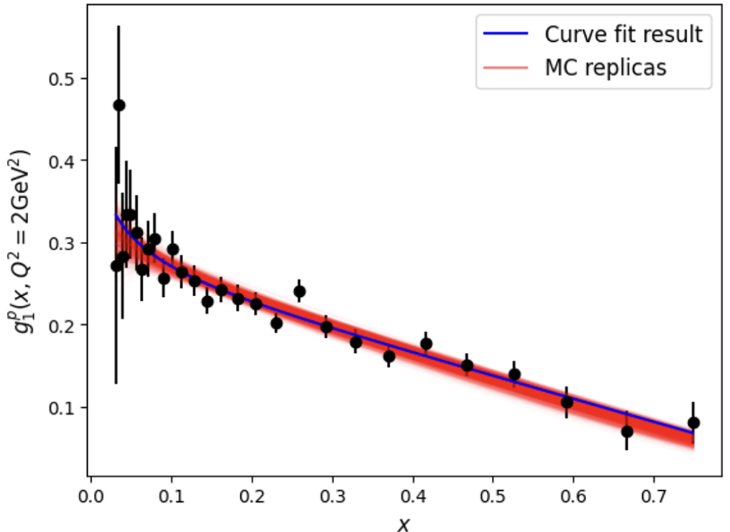
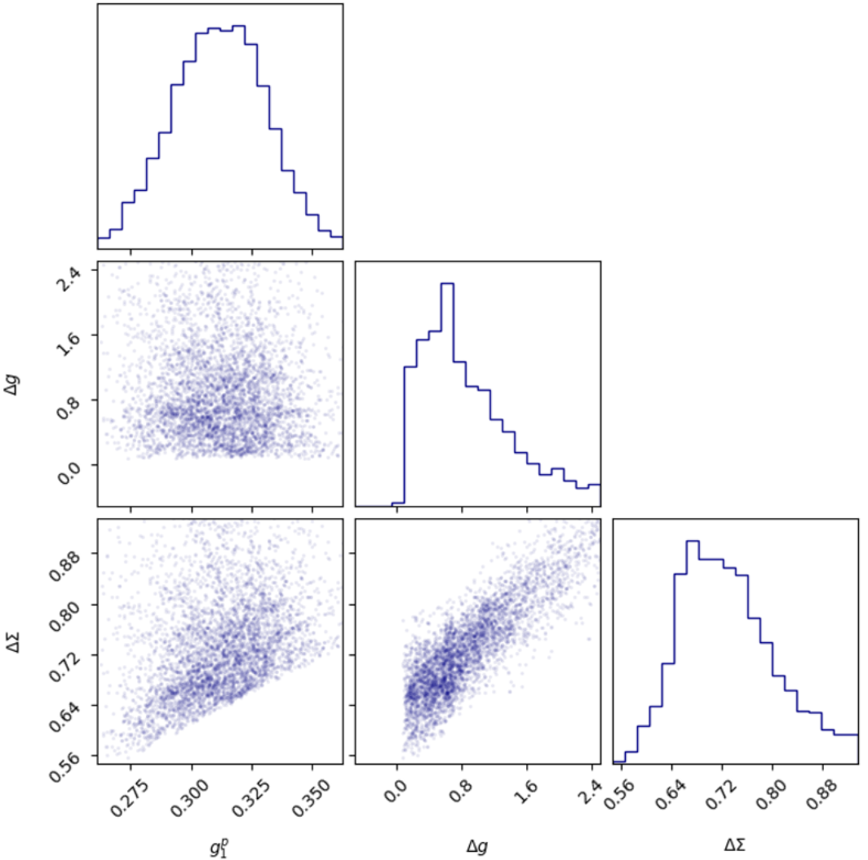
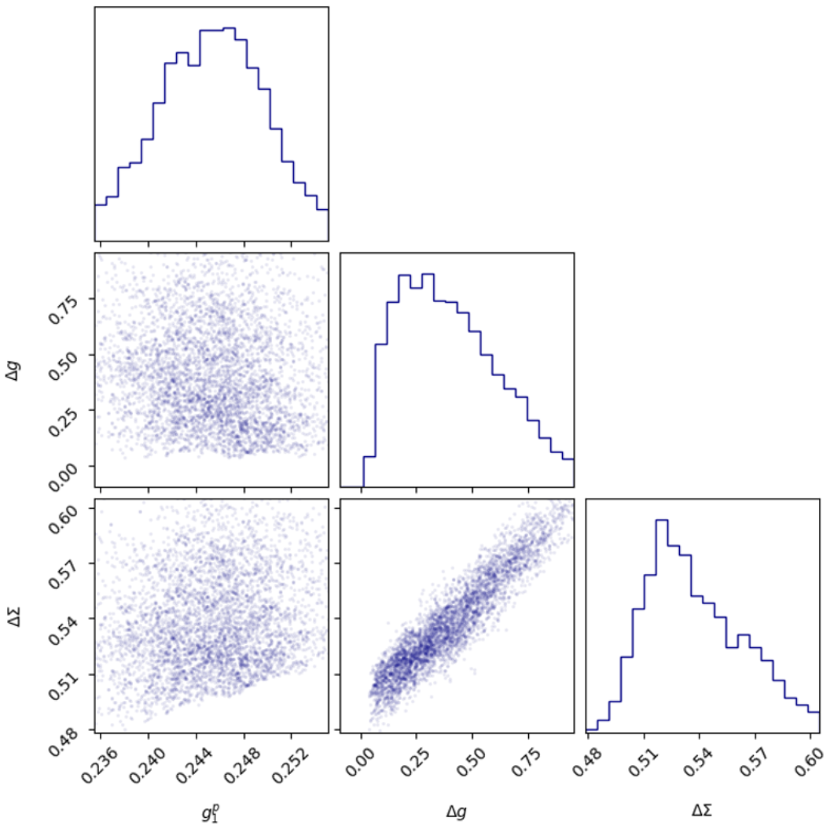
Next Step: use LL type data E.Seder et al. [CLAS], PRL114 (2015)
Meanwhile…
Saraswati Pandey
x=0.03
x=0.16
Compare to DSSV MCMC-based analysis PRD100 (2019), constraint: $\left|Δf\right|<f$

Slide 26
2. Inverse Problem Techniques: VAIM, C-VAIM, MCMC
Approaches to find parameters statistically in an underdetermined system:
Can quantify parameter uncertainty when more parameters than data
Techniques highly dependent on bounded parameter priors
These methods give us an initial way to perceive:
the correlation between parameters on a complicated model
what information is missing (latent space)

Slide 27
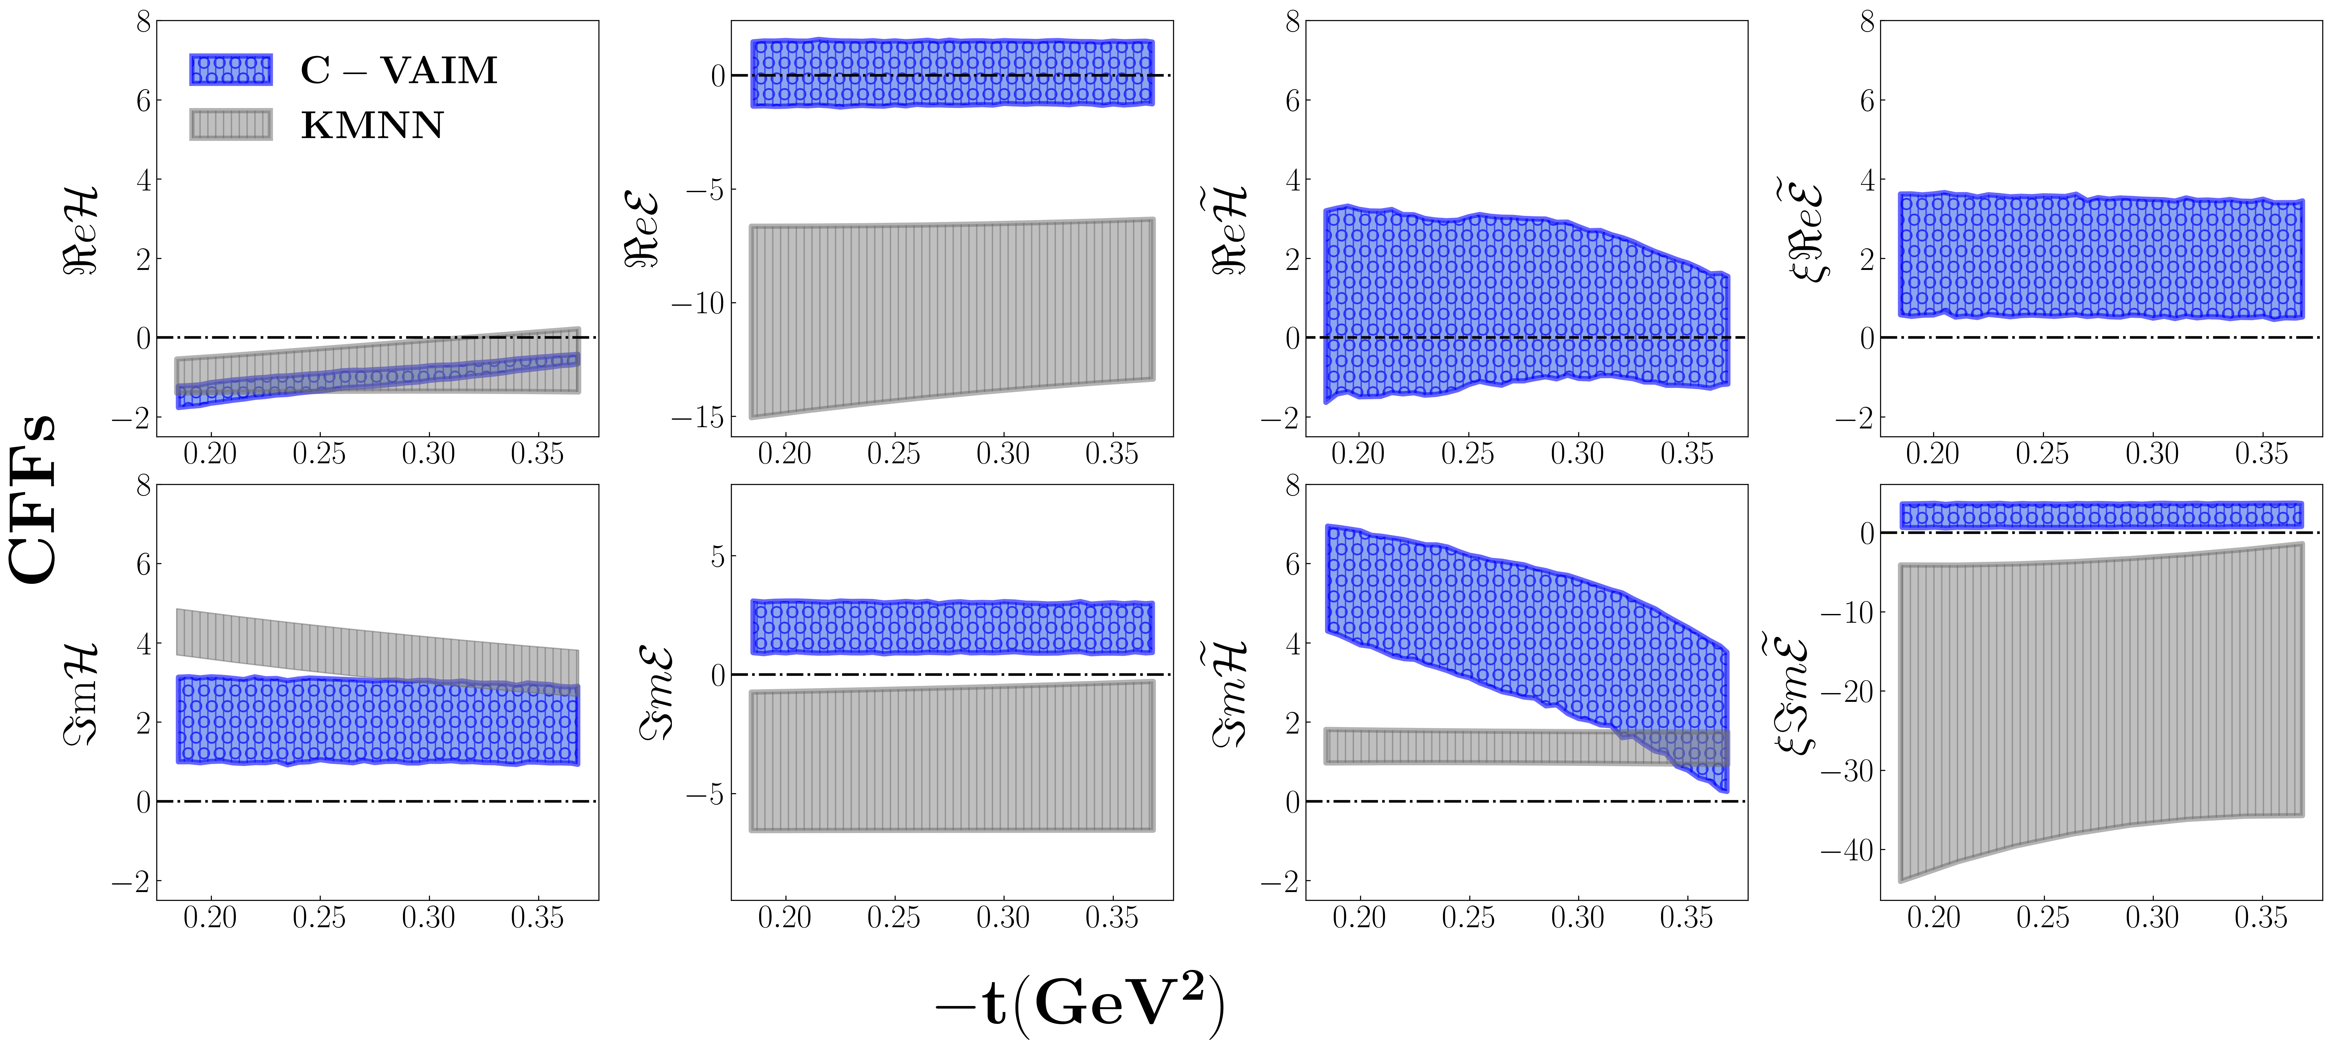
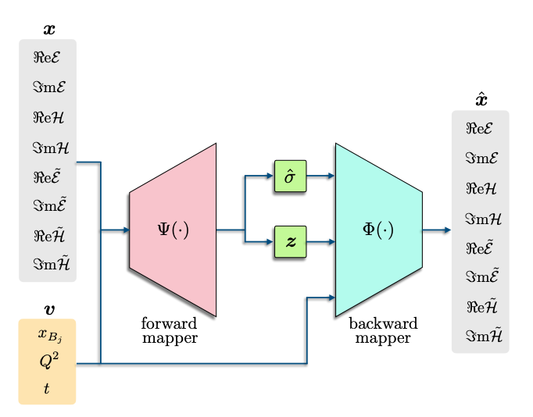
A variational autoencoder inverse mapper solution to Compton form factor extraction from deeply virtual exclusive reaction
arXiv:
2405.05826
t=0.34
Ht
Et
E
H
(2023)
KMNN, https://arxiv.org/abs/2007.00029
Notes:
The red dots on the RHS represent values from the analysis on the LHS in a similar kinematics

Slide 28
CFFs Analysis of Latent Space
H
E
Ht
Et
sign!!
periodicity/oscillation

Slide 29
Comparison of MCMC sampling/inverse mapper and VAIM
Notes:
Under constrained problems: VAIM
Same for MCMC

Slide 30
3. Symbolic Regression for Parton Research
What is symbolic regression and why do we care?
Spoiler: because then humans can read the answer
What are the existing tools out there?
Eureqa
GPlearn
AI Feynman
PySr
RL-SR
*Meijer-G-Function (very preliminary)
Douglas Q. Adams (UVA)
Andrew Dotson (NMSU) Anusha SingiReddy (ODU)
Zaki Panjsheeri (UVA)

Slide 31
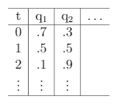
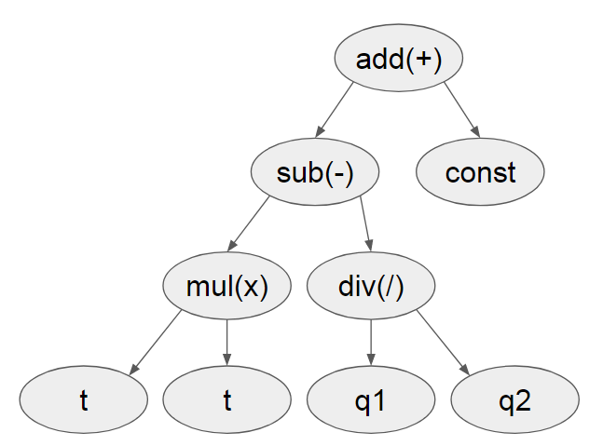
What is symbolic regression (SR)?
Goodness
Data Table
Fitness Metric
e.g. squared error
Symbolic Modification
e.g. mutation
Form Metric
e.g. #terms
Attempt an Expression
No
Good?
Yes
Done

Slide 32
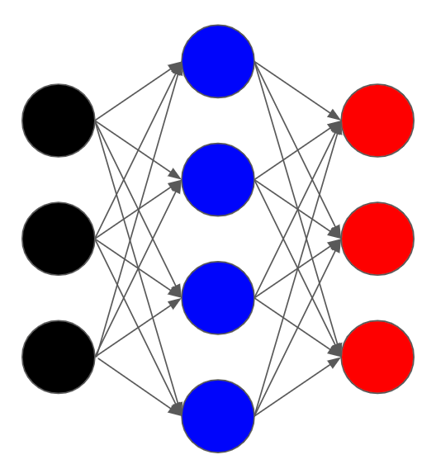
Why bother with SR when we have neural networks?
Which is easier to read? ( a.k.a interpretability of AI )
Black Box Regression
vs

Slide 33
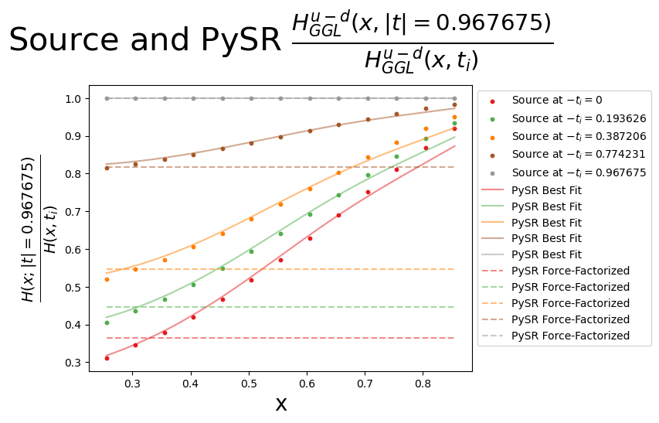
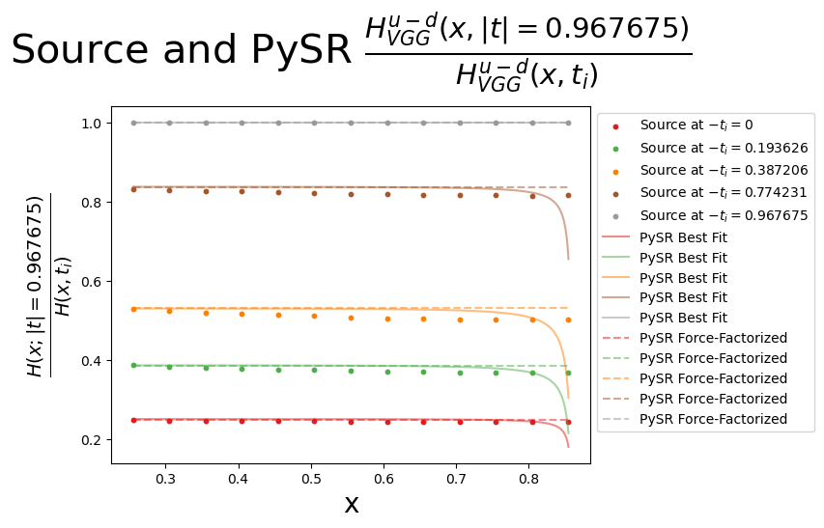
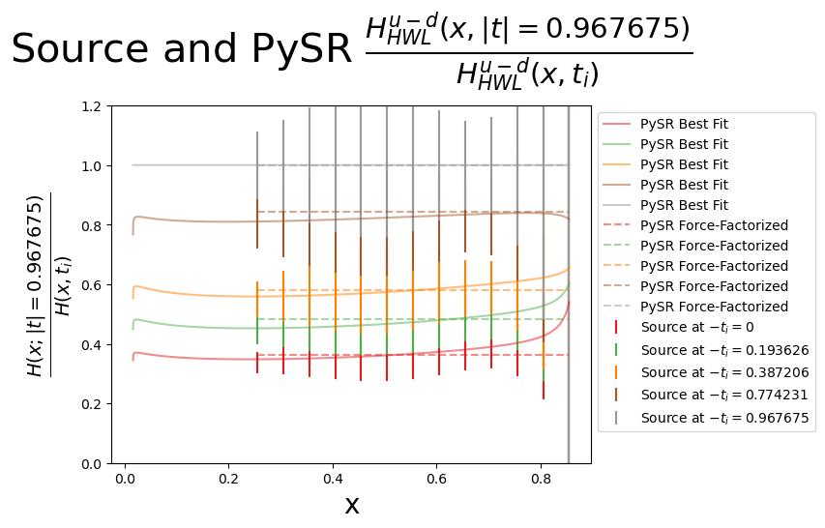
Testing x and t factorization (important for spatial configurations!)
lattice
phenomenology
J. Holligan and H-W Lin, Phys.Rev. D110, 034503 (2023)
H-W Lin, Phys. Lett. B824, 136821 (2022)
Example of a factorized in x and t form
(MSE constant power)

Slide 34
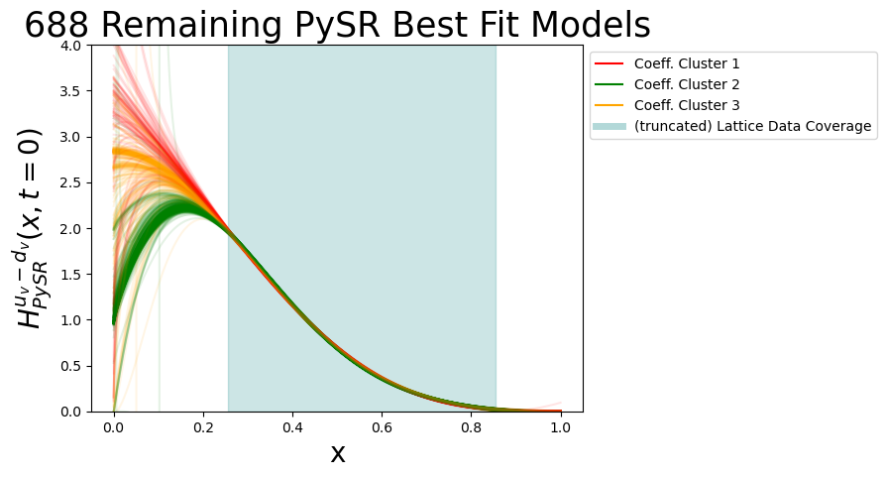
Novel SR Convergence Clustering
Extrapolation
Lattice Region

Slide 35
Why is it important to check x and t factorization? Consequences on the 3D Coordinate Space picture
gluon
GPDs can be Fourier transformed from momentum space into coordinate space, providing insight into the spatial distributions of quarks and gluons inside the proton, besides matter and charge distributions.
d-quark
Slice of Wigner phase space distribution
GPD
With Z. Panjsheeri and J. Bautista

Slide 36
Gluon and quark matter density radius
Compare to lattice and AdS/CFT integrated value
K. Mamo and I. Zaeed
PRD106, 086004 (2022)
LQCD: Detmold and Shanahan
$$\sqrt{\left\langle b_{T}^{2}\right\rangle }$$
Bautista, Panjsheeri, SL (2024)
UVA param
Quark radius
arXiv:2405.05842
LQCD gluon

Slide 37
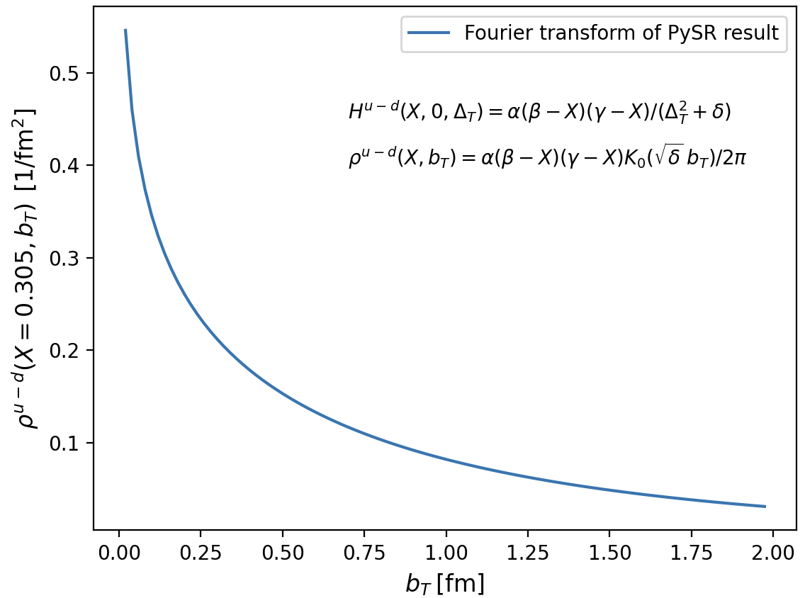
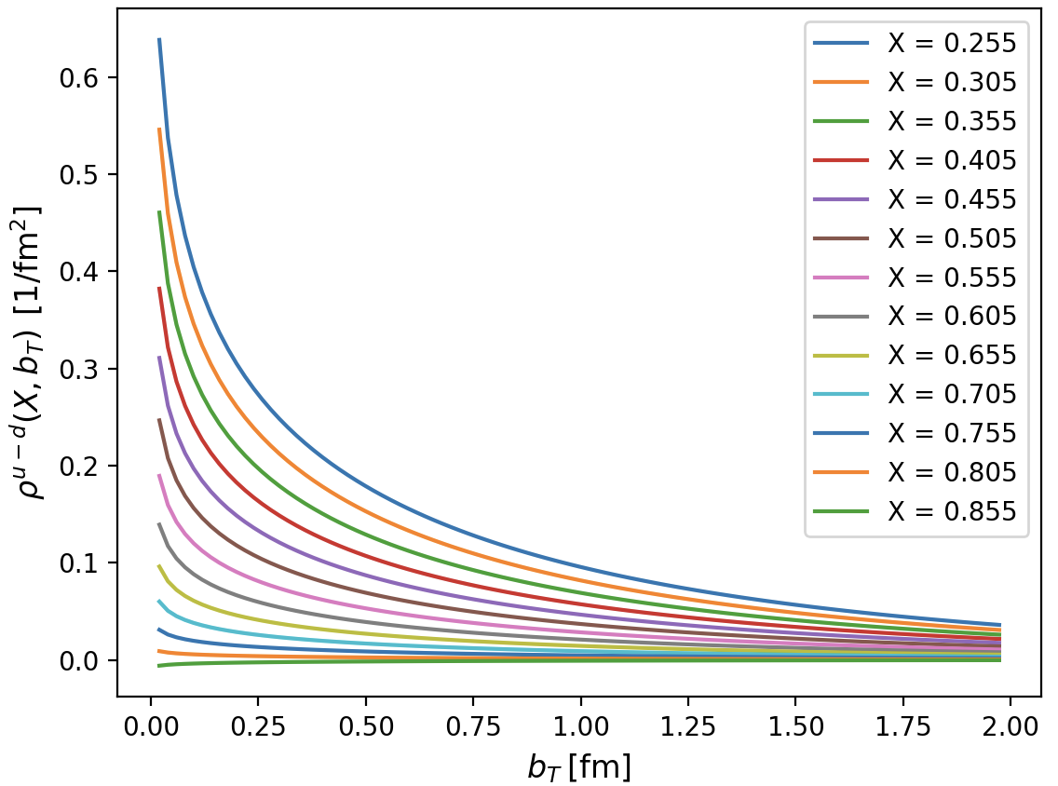
From SR Analysis
Notes:
Extrapolation and Fourier

Slide 38
What is next

Slide 39
Conclusions
Our path to AI&theoretical physics brings interpretability features in the computation and benchmarking of AI tools
A successful reconstruction of the spatial structure of the proton (and all of its mechanical properties) relies on our ability to understand the cross section for all the various DVES processes
This implies solving multiple inverse problems
We have defined a path to extract the observables from experiment that allows us to fully take into account UQ from data and ab initio QCD calculations
Obtaining spatial images of the proton including UQ is feasible using AI/ML to extend the momentum transfer reach for an accurate Fourier transformation
Notes:
UQ is a necessary and currently incomplete step in forming the 3D structure of the proton

Slide 40
Back up

Slide 41
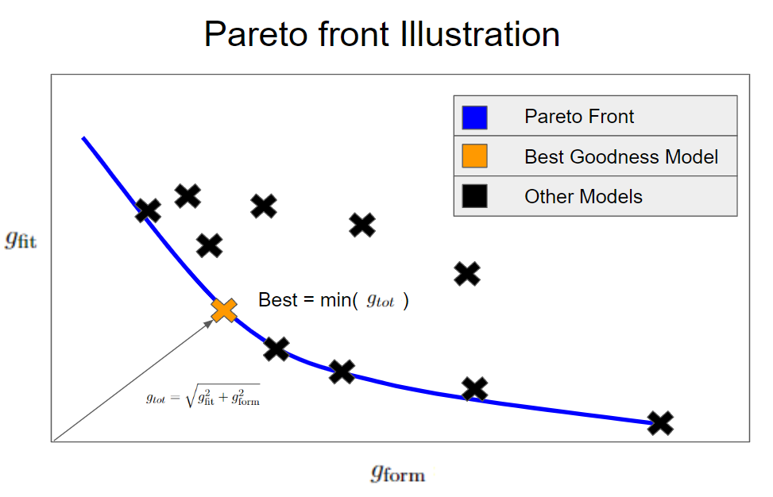
Using a pareto front to choose amongst forms
One must define a “metric” which balances fit vs. form to choose a best

Slide 42
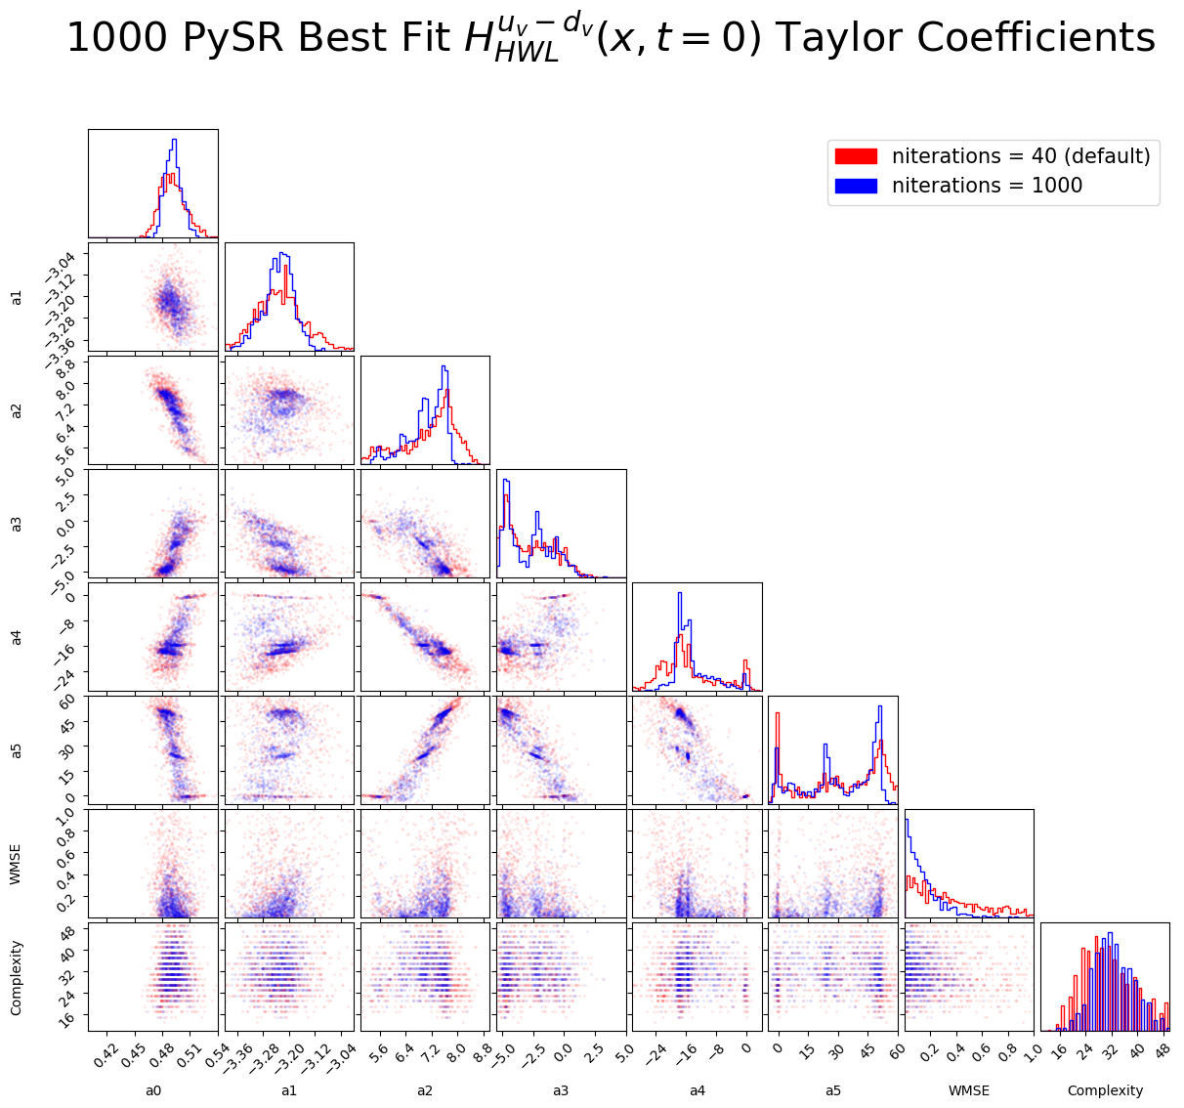
PySR convergence
Andrew Dotson

