Slide 1
EIC Project Overview
Abhay Deshpande for Jim Yeck
BNL Associate Director for Nuclear and Particle Physics
APS Group on Hadronic Physics
Business Meeting
March 16, 2025

Slide 2
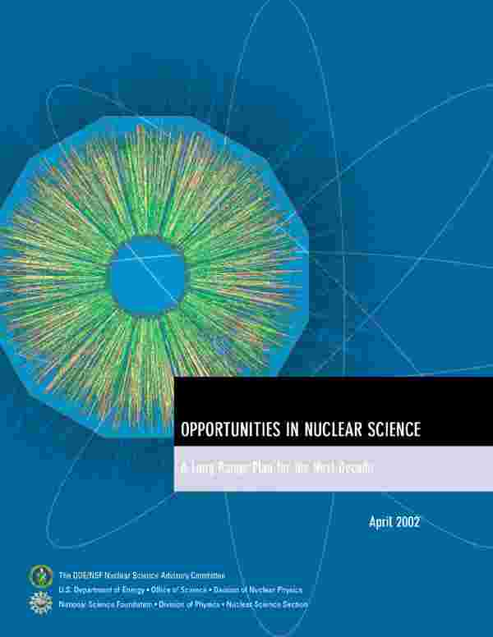
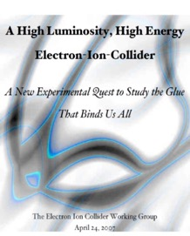
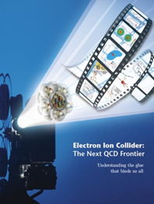

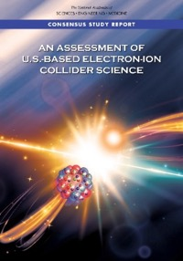

EIC Scientific Case Built Over Decades
2002
2007
2009
“We recommend the expeditious completion of the EIC as the highest priority for facility construction.” (2023)
2010
2012
Gluons and the Quark Sea at High Energies
2013
NSAC
2015
Major Nuclear Physics Facilities for the Next Decade
2018
2021
2023
March 14, 2013
“The science questions that an EIC will answer are central to completing an understanding of atoms as well as being integral to the agenda of nuclear physics today.” (2018)
arXiv:2103.05419
EIC will be the only operating particle collider in the U.S. and the only large collider
to be built in the world in the next 20-30 years.
2

Slide 3
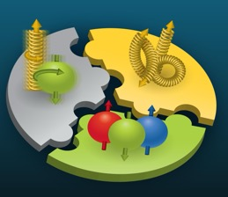

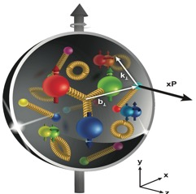
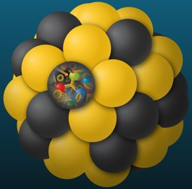
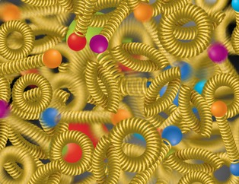
Compelling EIC Science (National Academy Report)
How do quarks, gluons, and orbital angular momentum contribute to proton spin?
Spin: a fundamental property of matter
All elementary particles,
but the Higgs carry spin
Spin cannot be explained by a static picture, rather the interplay between the properties and interactions of quarks and gluons inside
the proton
Does the mass of visible matter emerge from quark-gluon interactions?
Atom: Binding/Mass = 0.00000001
Nucleus: Binding/Mass = 0.01
Proton: Binding/Mass = 100
The EIC will determine an important term contributing to the proton mass, the so-called “QCD trace anomaly.
How can we understand the QCD dynamics and the relation to confinement?
EIC will image quarks and gluons in 3D in space and momentum inside the nucleon & nuclei
Uncover how the nucleon properties emerge from quarks and gluons and their interactions.
How do the quark-gluon interactions create nuclear binding?
Is the structure of a free and bound nucleon the same?
How do quarks and gluons, interact with a nuclear medium?
How do the confined hadronic states emerge from these quarks and gluons?
Does gluon density in nuclei saturate at high energy?
How many gluons can fit in a proton?
How does a dense nuclear environment affect the quarks and gluons, their correlations and interactions?
=
?
gluon
recombination
gluon
splitting
Nobel-Worthy Questions
All Nobel-Worthy Questions!
3

Slide 4
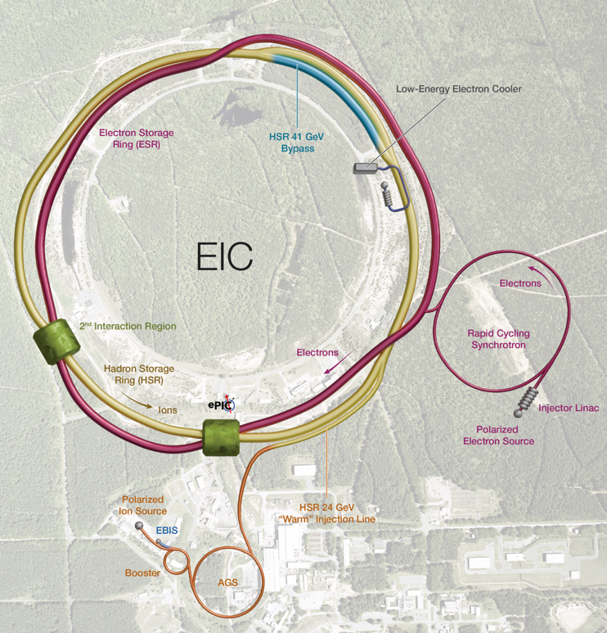
Facility Performance
High Luminosity: L= 10³³ – 10³⁴cm⁻²sec⁻¹
Highly Polarized Beams: 70%
Large Center of Mass Energy Range: E_{cm} = 20 – 140 GeV
Large Ion Species Range: protons – Uranium
Large Detector Acceptance and Good Background Conditions
Possibility to implement a Second Interaction Region (IR)
The EIC design, project scope, and performance parameters address the requirements established by the U.S. Nuclear Science Advisory Committee (NSAC) Long Range Plans (2015 & 2023) and endorsed by the U.S. National Academy of Sciences (2018).

Slide 5
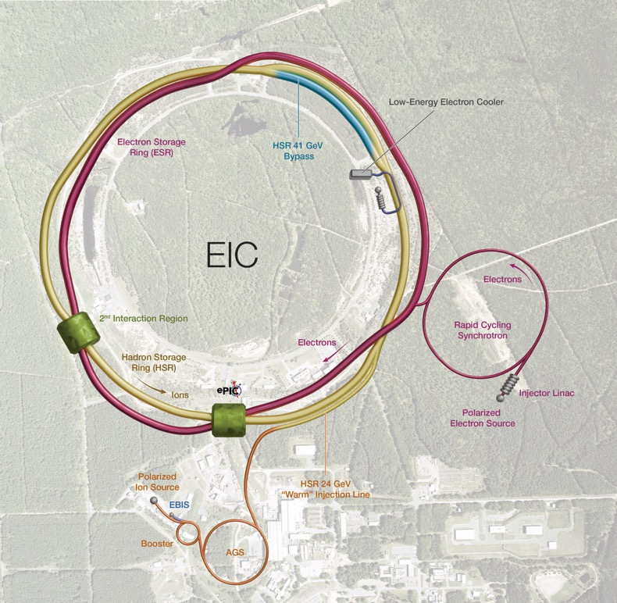


EIC Concept and Machine Parameters
Accelerator Status:
Polarized ion/proton source
Ion injection and initial acceleration systems:
  Linac (200 MeV)
  Booster (1.5 GeV)
  AGS (25 GeV)
Hadron Storage Ring (40-275 GeV)
Electron Pre-Injector (750 MeV linac)
Electron Rapid Cycling Synchrotron (0.75 GeV – top energy)
Electron Storage Ring (5 GeV – 18 GeV)
Interaction Region(s)
Hadron Injection Cooling System
5

Slide 6
2024 Highlights
Major Project Milestones
CD-3A LLP approved at ~$90M and initial contracts awarded! Examples:
  Accelerator superconducting strand, $163K
  Detector EMCal and HCal fibers, $2.3M
  Infrastructure electrical substations, $11.2M
CD-3B Final Design Reviews (FDRs) complete, one FDR repeated
Requirements/interfaces for CD-3B items complete
Project is benefiting from lessons learned on CD-3A.
Reviews, Board, and Advisory Committees
More than 20 design reviews
6 Advisory Committee Meetings
5 Advisory Board and two Resource Review Board Meetings
5 Reviews of “Off-Project” Scope
Interaction Region Superconducting Magnet Steering Group established
Annual Director’s Review in October
DOE CD-3B/Status Review in January
Accelerator
New Technical Director in January
Received and assessed Advanced Photon Source magnets at BNL and JLab
Optimized design and scope to mitigate risk
Electron injector modifications eliminate many risks and meet the Mission Need.
International EIC Accelerator Collaboration established
Detector
R&D nearly complete
ePIC Detector technical baseline defined
Preliminary Design Report in preparation
Plans are developing for the EIC Science Program
Infrastructure
$100M New York State Grant for EIC buildings in February
30% Detailed Design submission received in August
60% Detailed Design submission received in December
Significant Progress in 2024, Started Awarding Contracts for Long Lead Items.

Slide 7
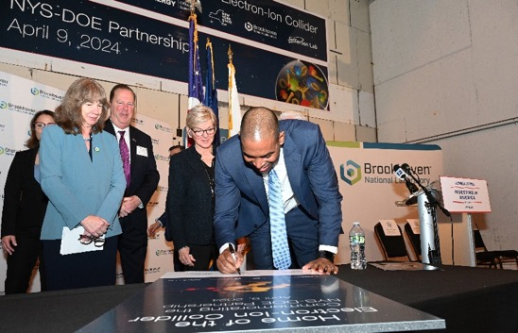
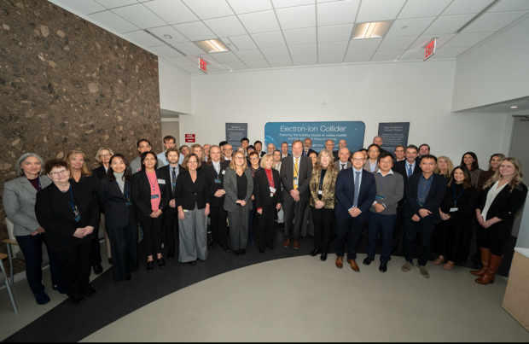

Strong Support from Partners & Collaborators
New York State committed $100M toward construction of EIC buildings and infrastructure.
EIC Accelerator Collaboration kicked off at the International Particle Accelerator Conference with over 150 participants expressing interest in contributing to the global EIC effort.
UK announced £58 million ($75M) for the EIC.
EIC Resource Review Board Meetings in Rome in May 2024 and at BNL in Oct. 2024. Strong participation from Canada, Czech Republic, France, India, Israel, Italy, Japan, Poland, South Korea, United Kingdom, and Taiwan. Next meeting to be held in Prague in June 2025.
In-kind contributions are planned for the Detector (~30%) and the Accelerator (5%).

Slide 8
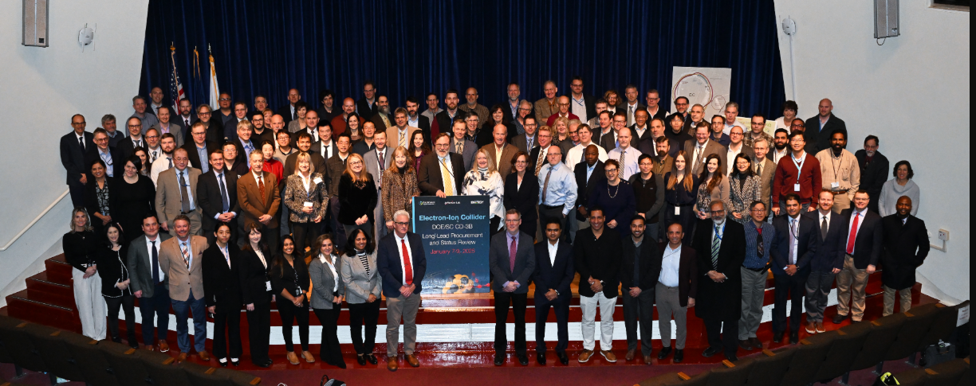
DOE CD-3B/Status Review Summary
Select DOE Independent Project Review (IPR) Committee Comments:
The project team has made excellent progress since the last review. There is an experienced team in place. A new Technical Director was recently hired and has already made a positive impact on the project.
The project has strong support from the BNL and JLab Directors. Communications between the labs are well established with bi-weekly meetings between the two lab Directors and Deputy Directors. This will be an excellent forum to facilitate constructive resolution of issues and risks as they arise.
Recommendations for EIC Project:
Proceed to CD-3B
Path to baseline
  In advance of the next IPR, document the scope of EIC project and gain alignment with the Program Office on mission need achievement.
  Develop details for the subproject strategy and work with the Program Office and FPD to conduct a focused IPR in 6 months.

Slide 9
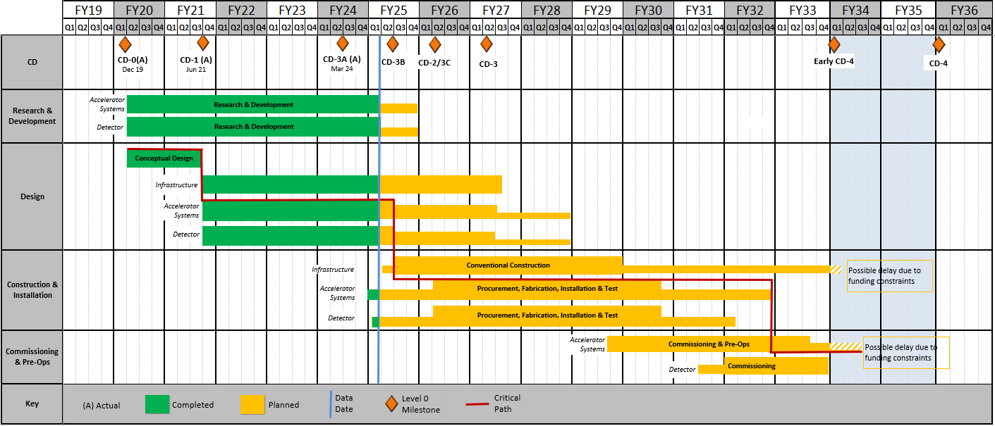
EIC Reference Schedule
EIC project is moving from R&D and design into the construction phase.
Goal is to baseline and start construction of the EIC Accelerator Rings in summer 2026.
RHIC Operations is planned for the end of CY2025
The EIC reference schedule will be revised to delineate subprojects and to address current annual funding projections (including FY2025).
9

Slide 10
Preparation of EIC Subprojects
Requirements:
EIC is a single, integrated line-item project.
Subprojects have well-defined deliverables and interfaces.
Subprojects enable start of the EIC science program.
Subproject plans consistent with DOE annual funding guidance.
EIC Line-Item Project Scope:
Accelerator Rings – Infrastructure, HSR, ESR
Electron Injector – Infrastructure, LINAC, RCS
Interaction Region (IR) Integration – SC Magnets, Crab Cavities, Integration
Detector – ePIC including In-Kind, Integration and Installation
Start Science Program (Early Science Program)
EIC Full Capabilities

Slide 11
EIC Subproject Plans
Project Office, CD-3A execution well underway
NYS Infrastructure underway
Accelerator Rings into construction in 2026
IR, ePIC, E-Injector baseline quality in 2026
Project Office Integrated Support, CD-3A, CD-3B, …. (L. Lari)
 | NYS Infrastructure Project (C. Folz)
First SP |  | Collider Rings – Infrastructure, HSR, ESR, Installation (C. Folz, SPM)
 |  |  | Electron Injector – Infras., LINAC, RCS, Install (Q. Wu, POC for April Review)
 |  |  | IR SC Magnets, Crab Cavities, Integration, Install (S. Nagaitsev, POC)
 |  |  | Detector, Integration, Install (R. Ent and E. Aschenauer, POCs)
Last SP |  |  |  |  |  |  |  | EIC Full Capabilities (K. Wilson, POC)
▲ DOE mini-IPR Jul/Aug 2025 to Assess Status, Tailoring Strategy, and Execution Plans
▲ DOE IPR in 2026 supports Critical Decision (CD) approvals
J. Yeck
11

Slide 12
EIC Priorities for 2025 and 2026
Priorities for 2025 include:
  Successfully execute the CD-3A and CD-3B long lead procurements.
  Prepare plans for addressing the “portfolio” of EIC related scope including the Removal and Repurposing (R&R) of RHIC facilities.
  Clarify scope of each of the proposed subprojects and prepare an initial pre-CD-2 quality performance baseline for the entire line-item project (all subprojects).
  Conduct reviews to assess status of CD-2 preparations for each subproject and prepare the collider subproject for DOE approvals in 2026 (documentation).
Start R&R work after RHIC run concludes in ~December 2025.
DOE reviews (IPR, ICR) required to start EIC construction will be completed in 2026:
  Demonstrate ePIC Detector, Interaction Region, Electron Injector, and Full Capabilities are baseline ready; and,
  Start construction of the Accelerator Rings subproject.

Slide 13
Thank you

Slide 14
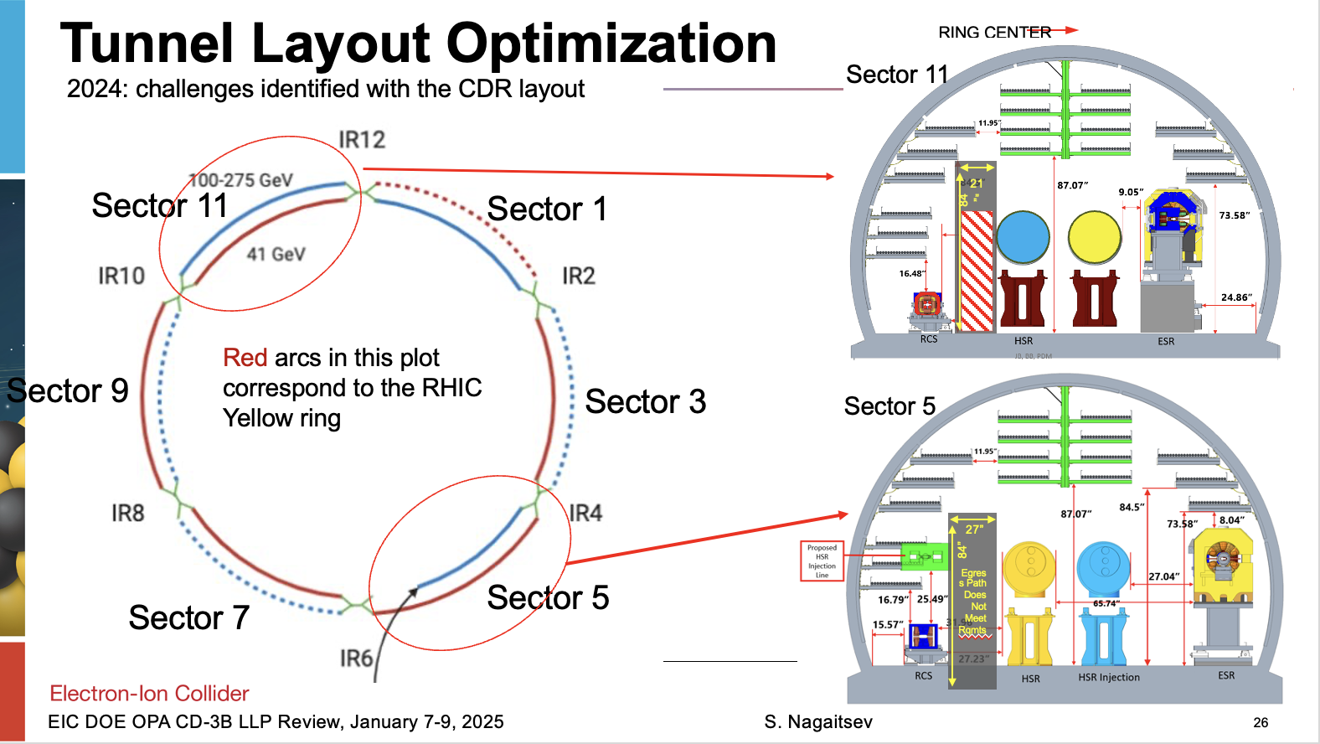

Slide 15
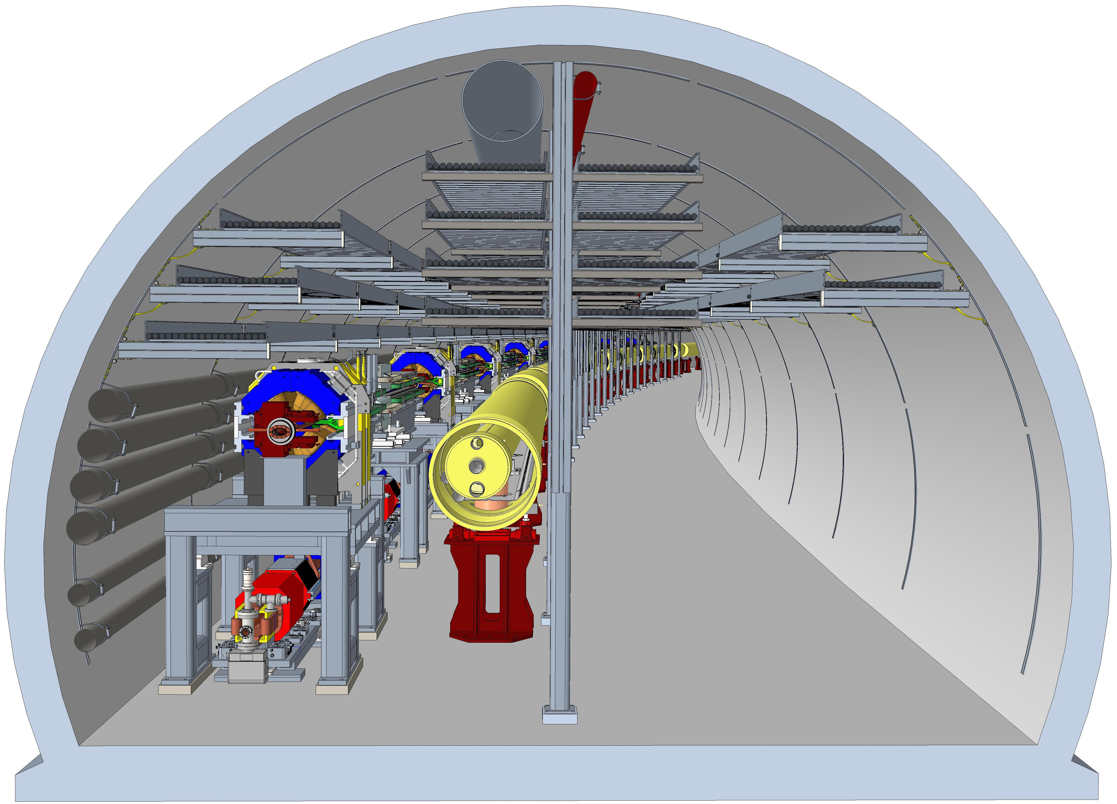
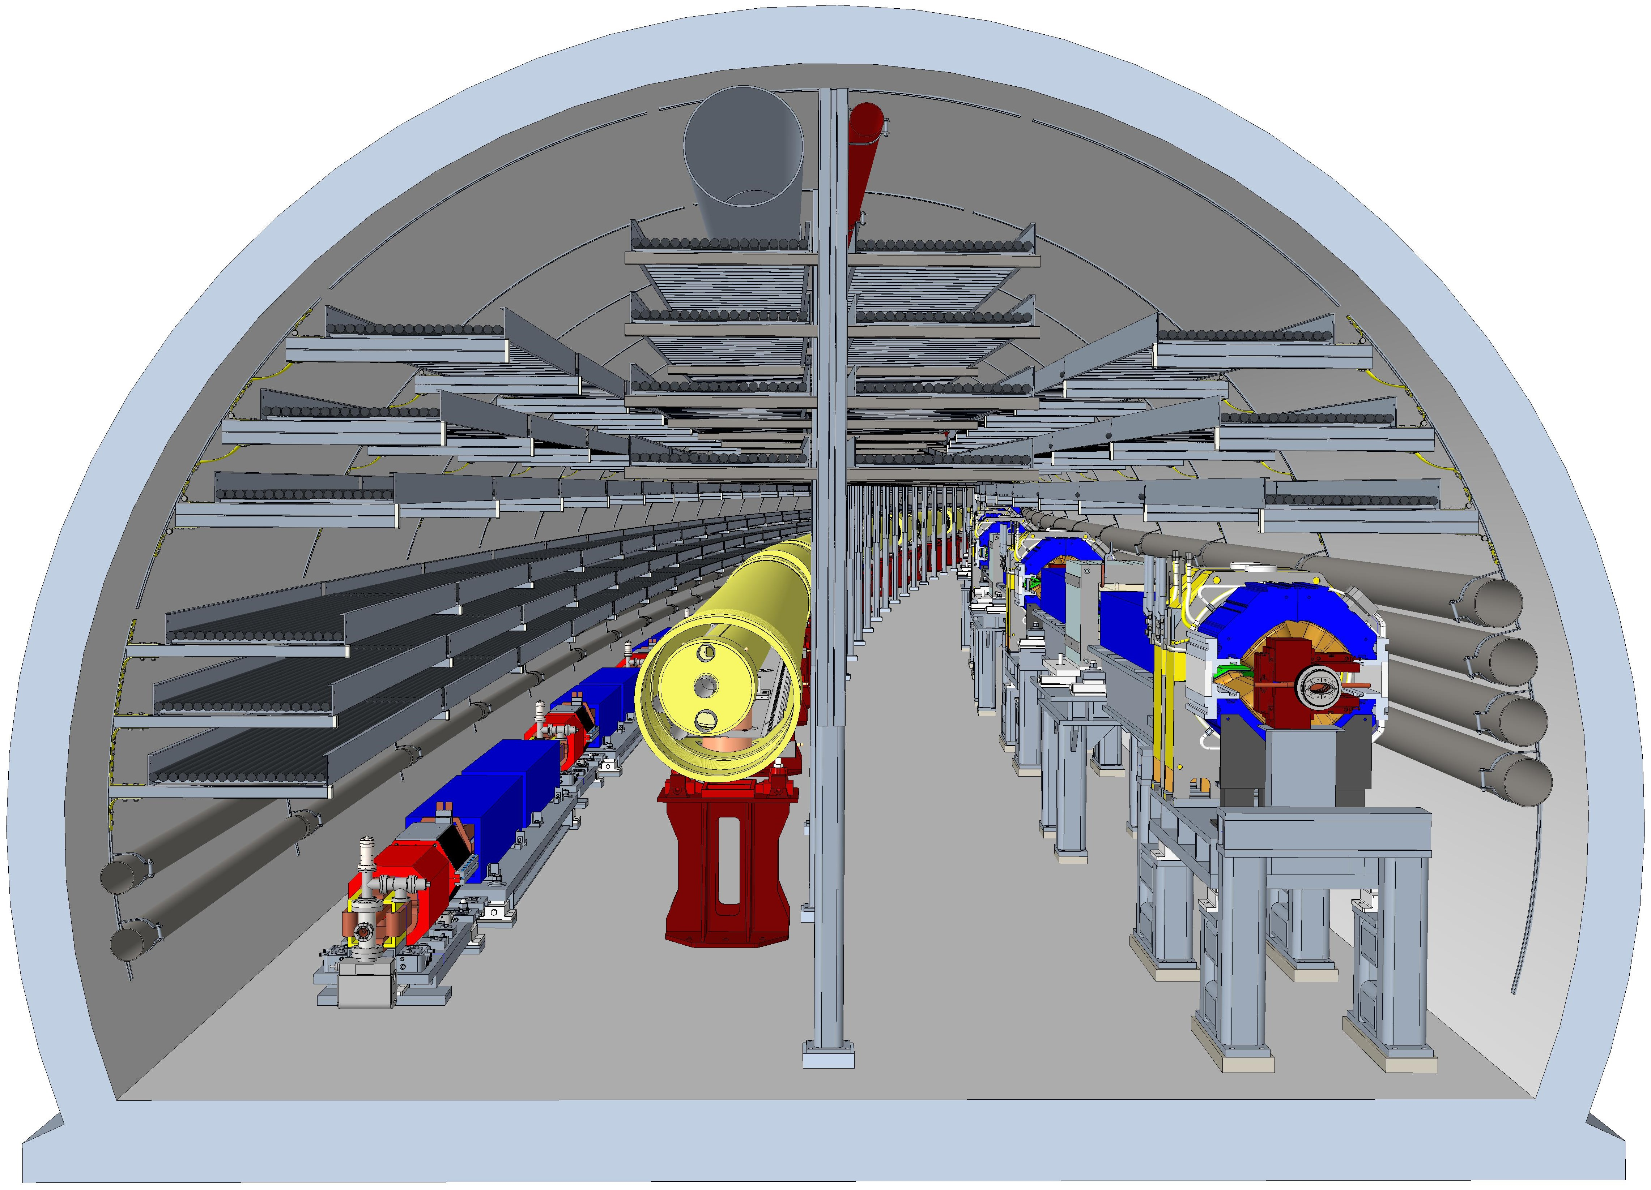
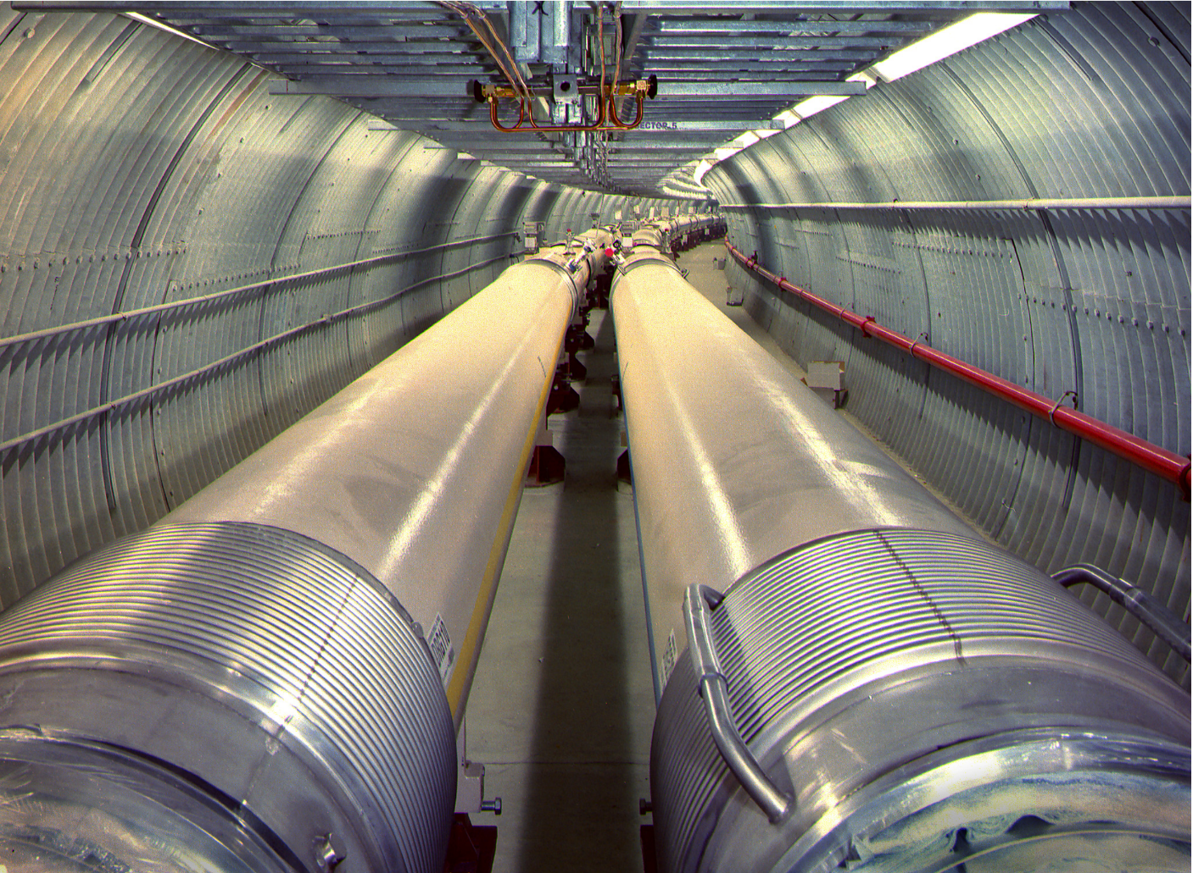
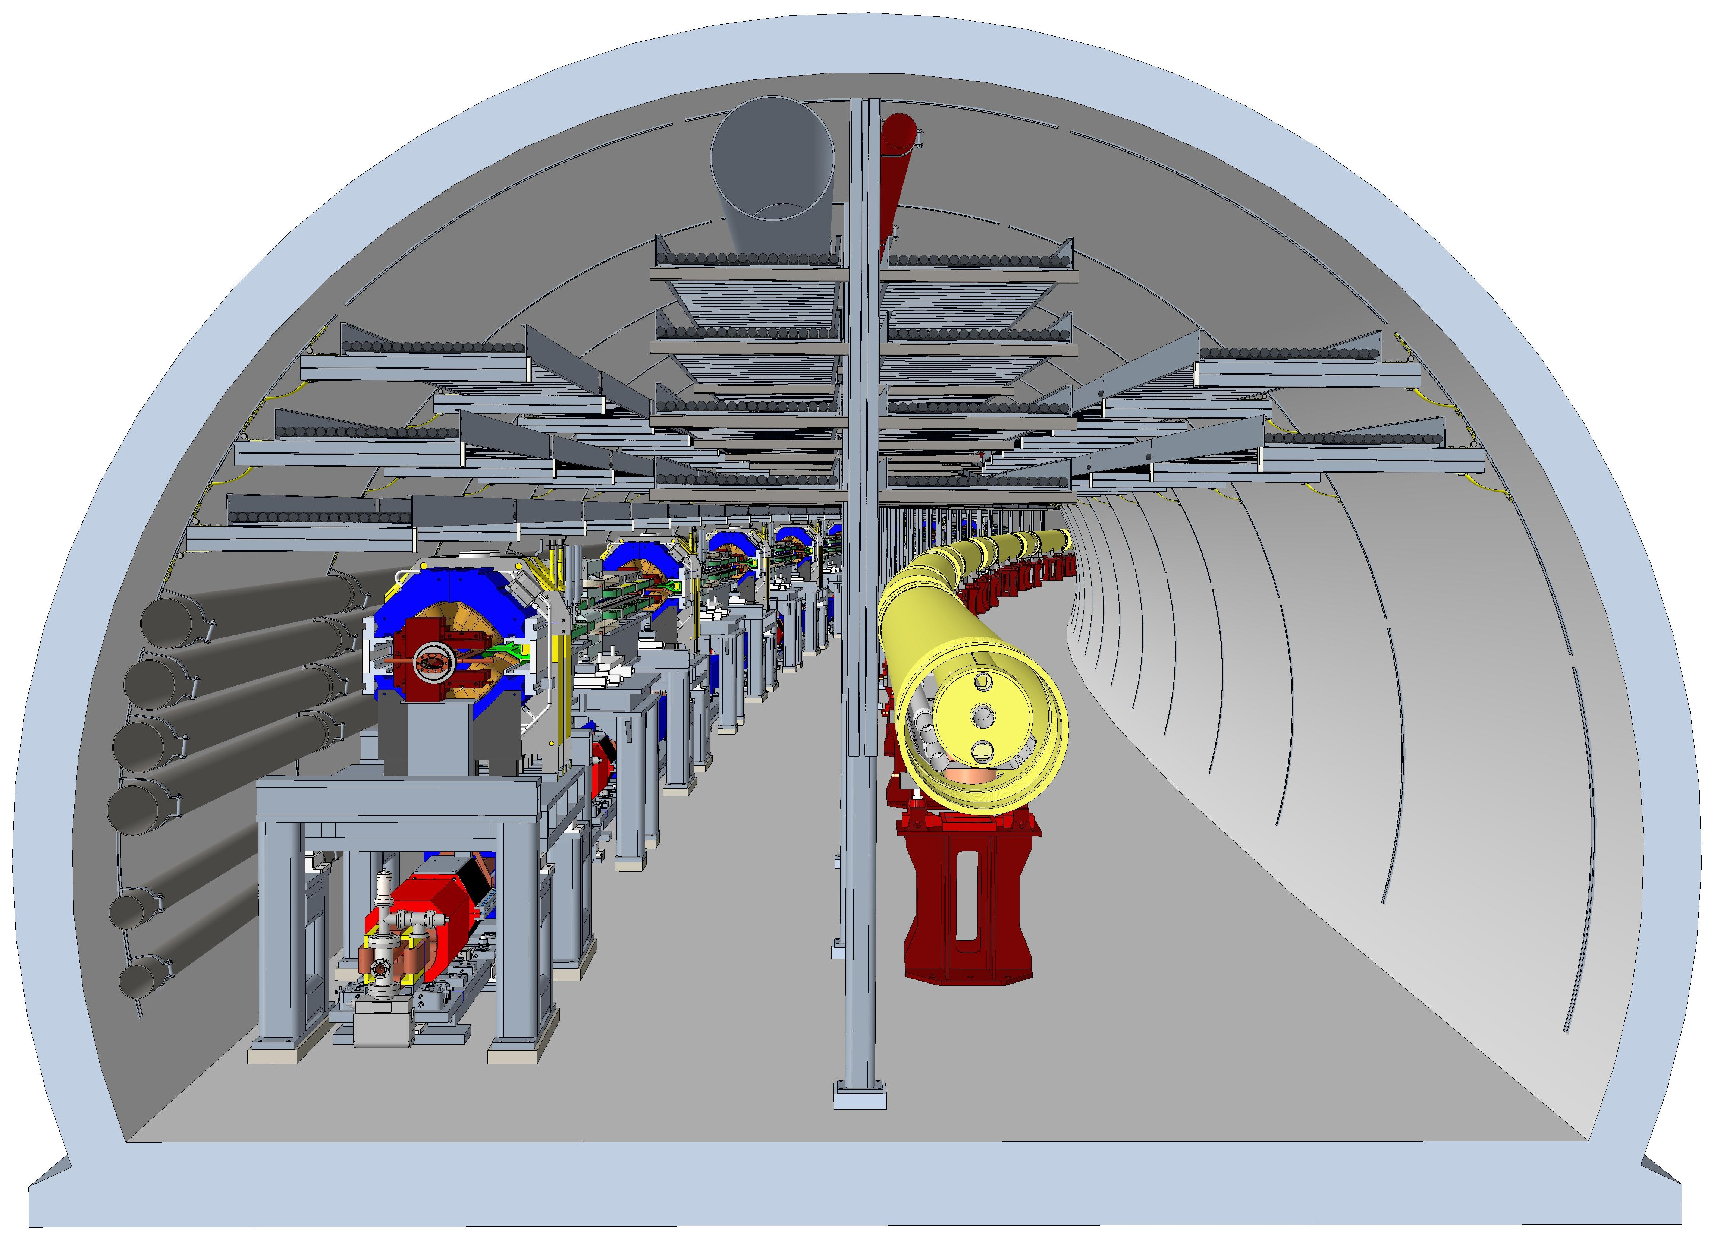
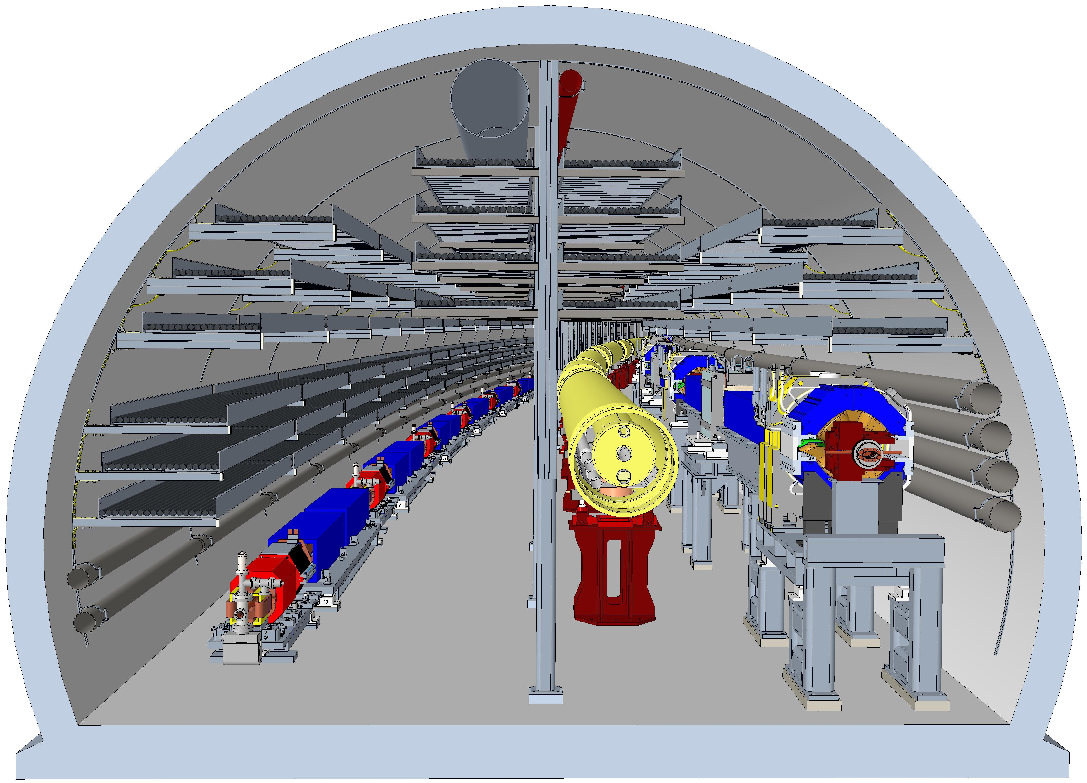
Arc Sections
Tunnel Integration Challenges:
Tight geometric constraints.
Cable Management
Magnet and girder Installation and maintenance.
Fire safety and egress.
EIC Arc Sector 1
EIC Arc Sector 9
EIC Arc Sector 3,7
EIC Arc Sector 11

Slide 16
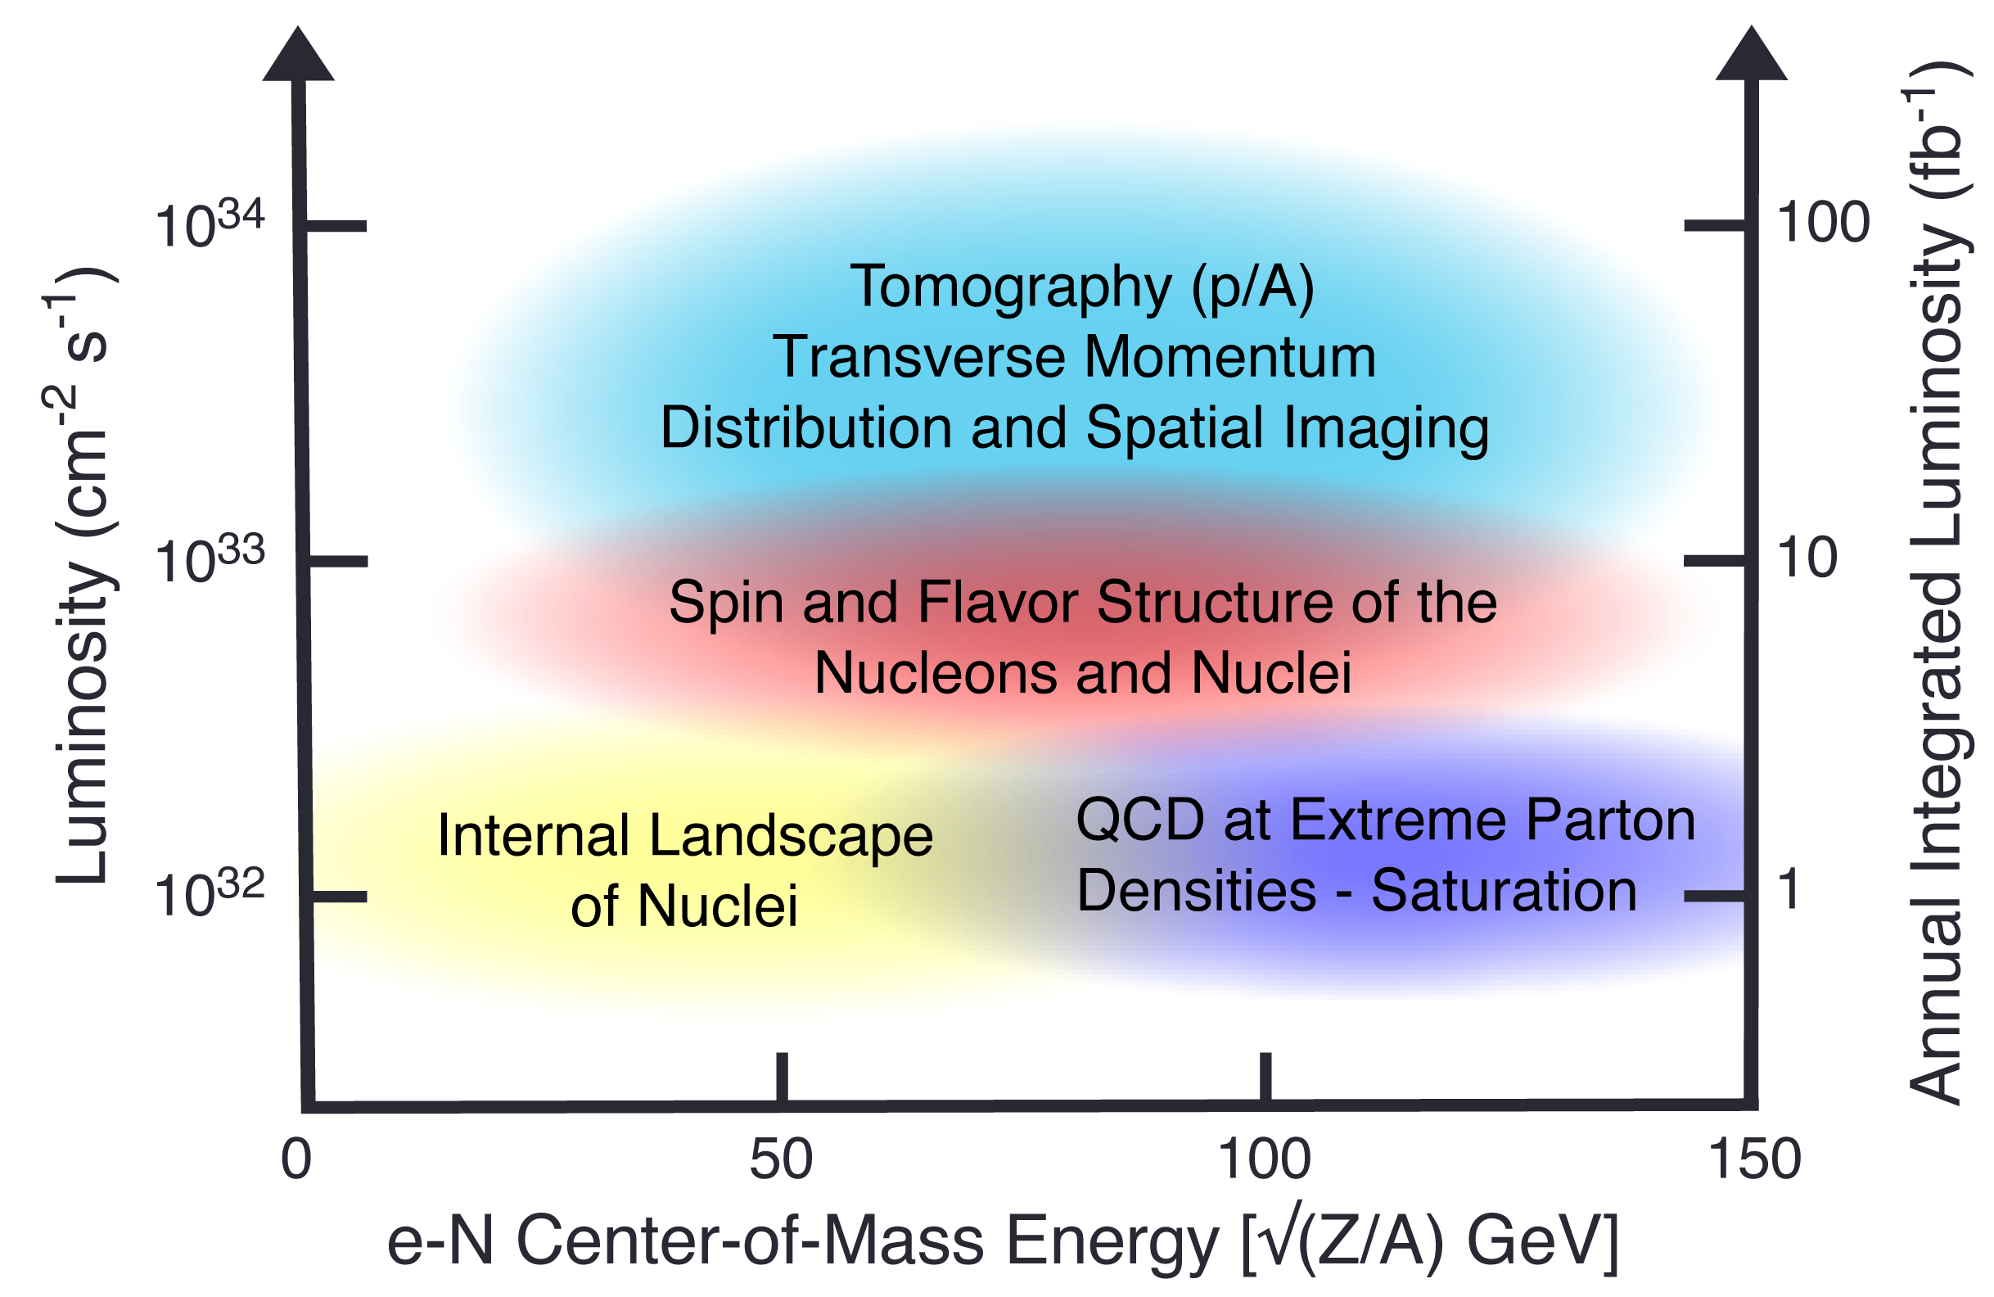
EIC Early Science Program Reach: Note all components of the NAS Report Science will start
1
2
Limit 1
Delay of hadron low-energy bypass
Early Science
Limit 2
Delayed RF for 18 GeV e
3
Limit 3
Delayed 28 nC and SHC
16

Slide 17
Planning Dates 2025 - 2026
Milestone | Date | Milestone | Date
DOE Independent Project Review (!PR) | Jan. 7-9, 2025 | DOE RHIC R&R/Injector Operations Review | Sep/Oct 2025
Start Developing Scope of Subprojects | January 10 | Accelerator Rings Scope Assessment | Sep/Oct
IR SC Magnet Steering Group Meetings in 2025 | January 17 | Infrastructure Construction Advisory Committee | October
Project Advisory Committee Meeting | February 11 | Internal Baseline Assessments for SPs IR and Detector SP(s) Accelerator Rings SP Full Capabilities SP | Sept/Oct/Nov 2025
EIC Advisory Board Meeting | February 25
DOE CD-3B ESAAB Approval-Proposed | March/April
Electron Injector Design and Cost Review | April 8-10 | Resource Review Board Meeting (BNL) | Nov 4-5, 2025
Infrastructure Construction Advisory Committee | April 16-17 | RHIC Operations Conclude | End of CY2025
Detector Advisory Committee Meeting | May/June | RHIC Removal and Repurposing (R&R) Starts | January 2026
Project Advisory Committee "Red Team" Review | June
Resource Review Board Meeting (Prague) | June 5-6, 2025 | DOE IPR and Independent Cost Review | Q2FY2026
DOE IPR Status Review (Project / 1st Subproject) | late Jul/early Aug
Machine Advisory Committee Meeting | September | DOE CD-2/3 Approval for Accelerator Rings | Q3FY2026

