Slide 1
From RHIC to EIC
Abhay Deshpande
Associate Laboratory Director (interim) for Nuclear and Particle Physics
March 16, 2025

Slide 2
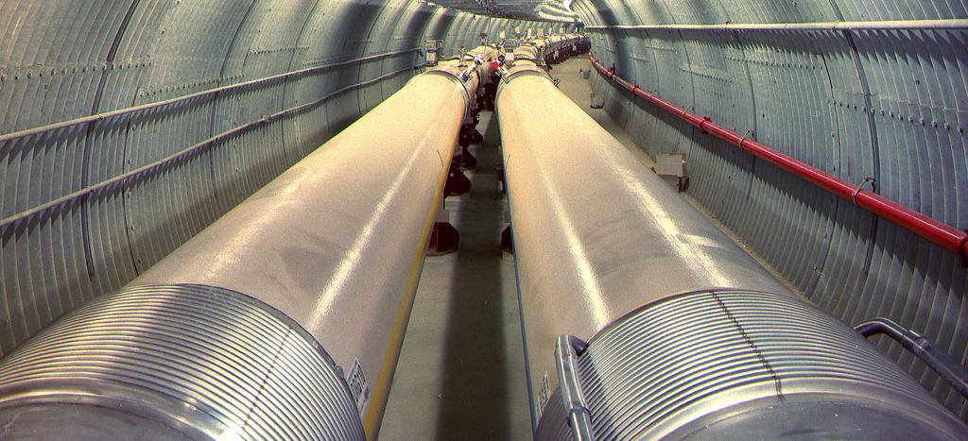
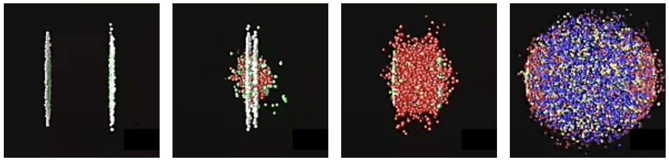
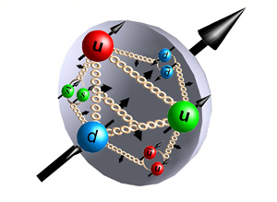
Research at the Relativistic Heavy Ion Collider
Heavy ion collisions at RHIC
  Discovered a new state of matter: Quark Gluon Plasma
  Detailed studies with collision of different ion species
Polarized proton collisions
  Only collider in the world of spin polarized protons to explore the internal spin structure of protons.
  How do protons get the property of “spin”? (used in MRI’s)
The most advanced & versatile accelerator to date
Hottest matter observed in
the Universe

Slide 3
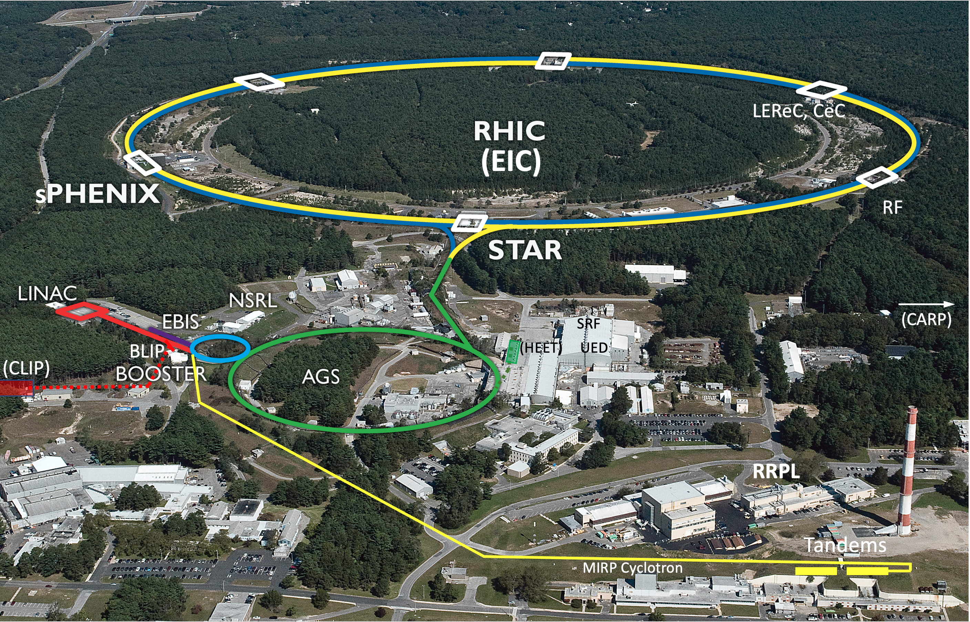
Relativistic Heavy Ion Collider (RHIC)
Basic scientific research woven with direct benefits to society
Uniquely flexible and
only hadron collider in
US for exploration of
Quark Gluon Plasma
and proton structure
Injectors also used for
application programs:
LINAC: Brookhaven Linear Isotope Producer: (medical and other Isotope production)
Booster NASA Space Radiation Lab for space radiation studies
Tandem for industrial/academic users
R&D for future facilities
and application
sources, beam cooling, polarized beams, …

Slide 4
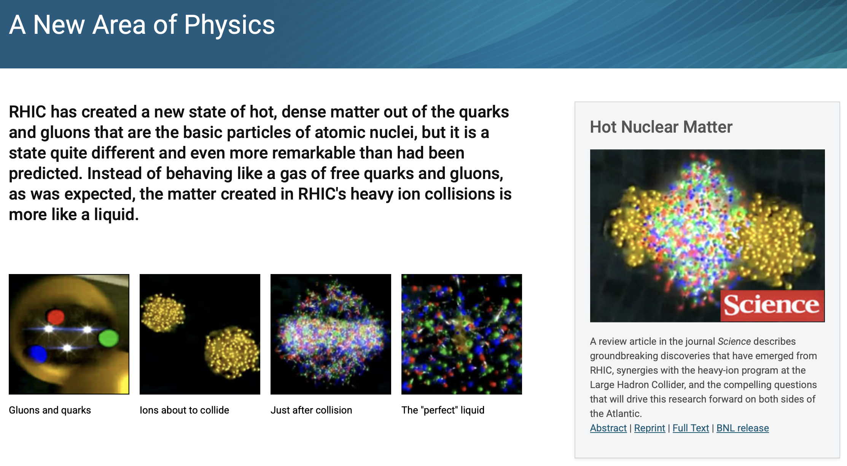

Slide 5
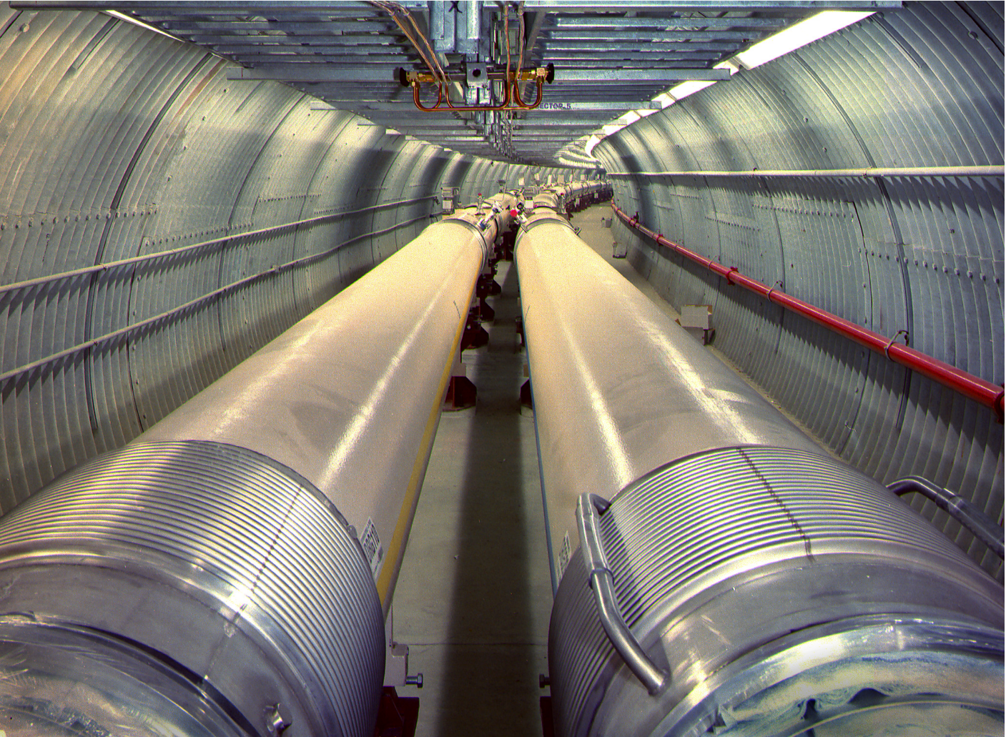
RHIC has operated phenomenally well and continues to be super-productive
Recent highlights from RHIC

Slide 6
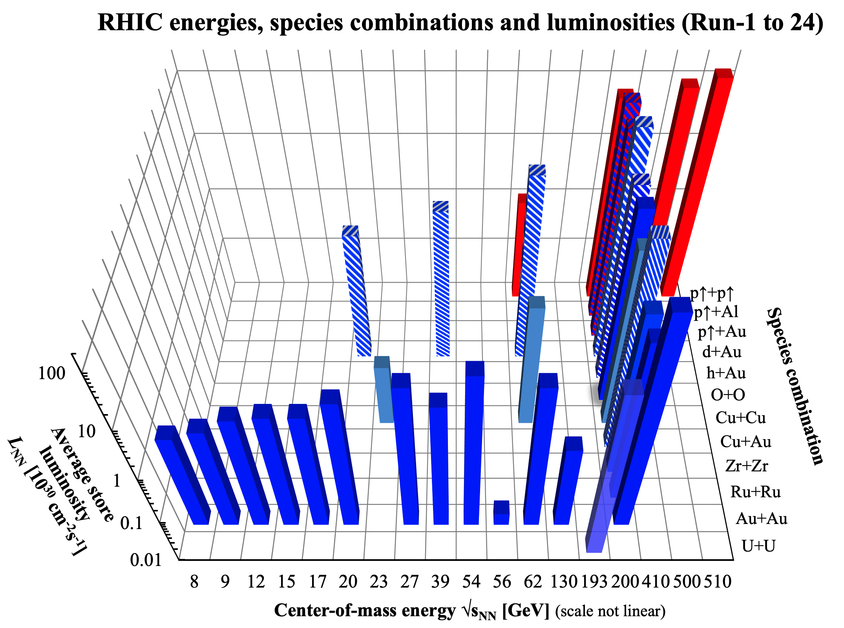

Slide 7
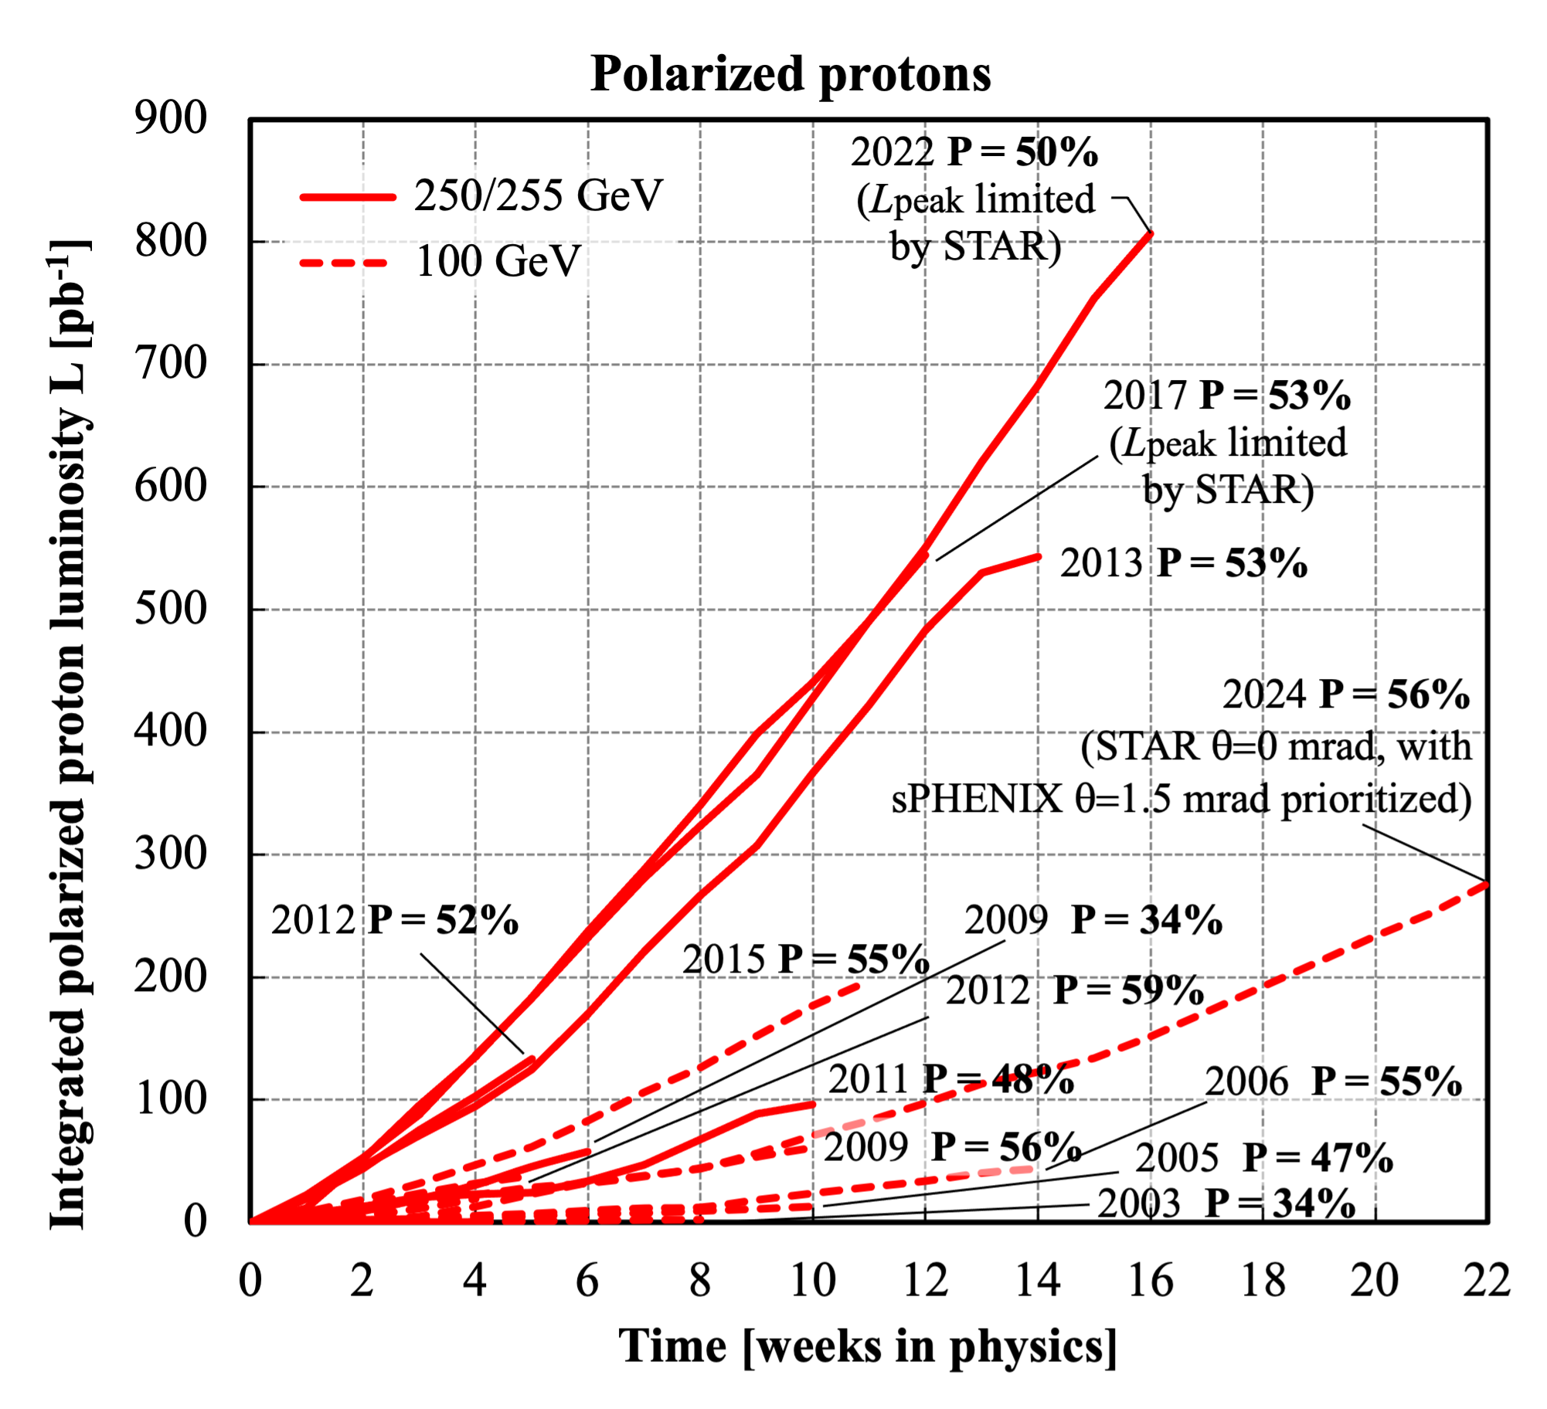
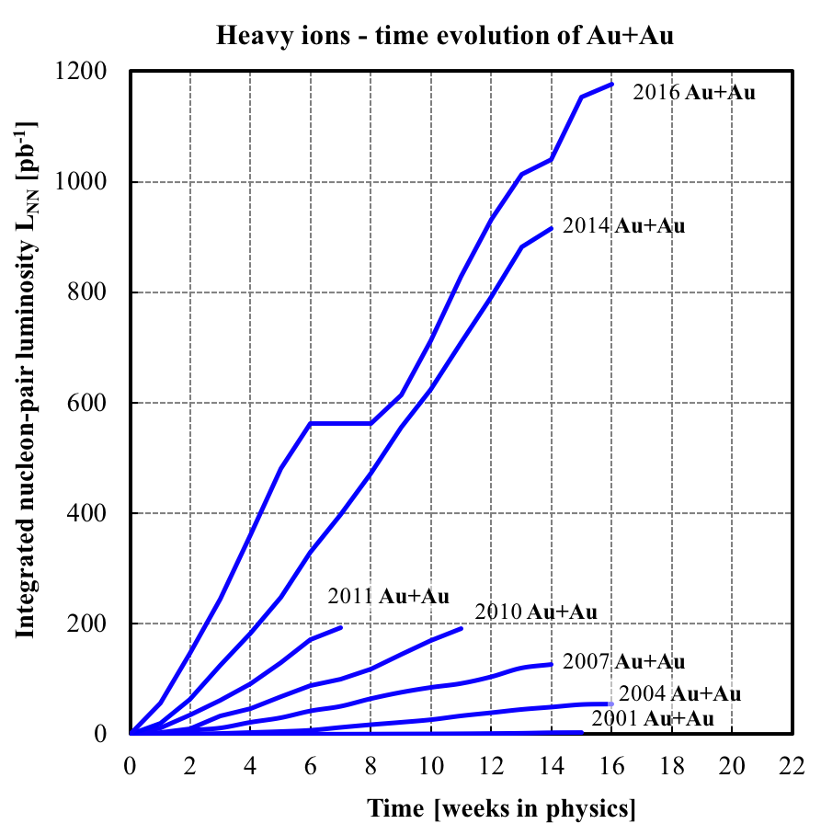
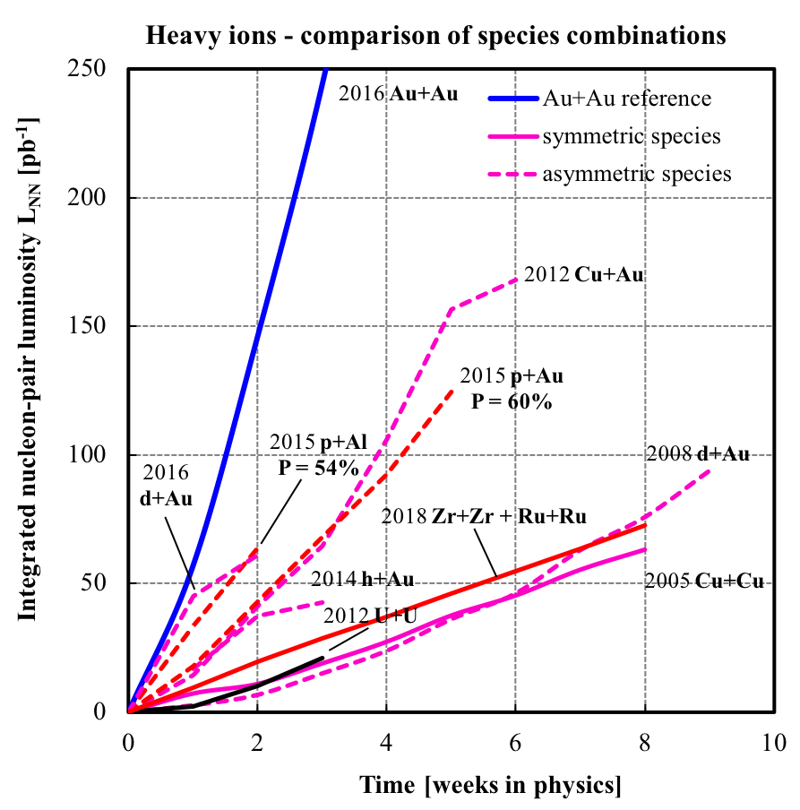
RHIC Integrated Luminosity
Dramatic increase of RHIC performance as a result of ongoing accelerator R&D, accelerator improvements, and replacement of obsolete technology

Slide 8
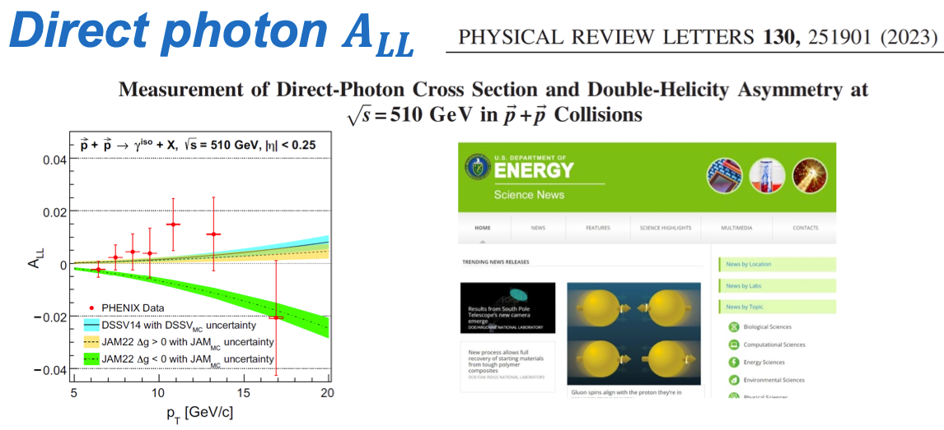
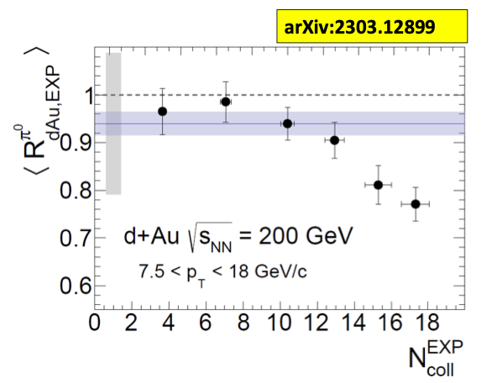
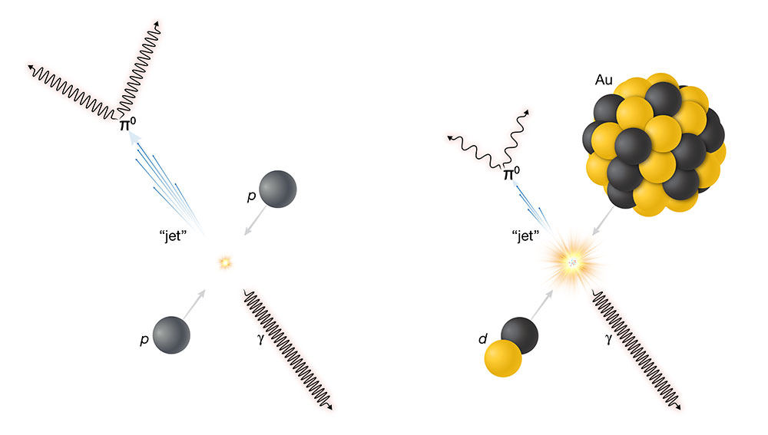
PHENIX Selected Science Highlights
One of the original motivations for RHIC SPIN program, (only) now established directly polarized gluon distribution is positive. Press releases at BNL and RIKEN and US DOE Science news (highlights)
π⁰ and direct photons (γ) in d-Au
π⁰ suppressed relative to γ
Evidence in most central collisions

Slide 9
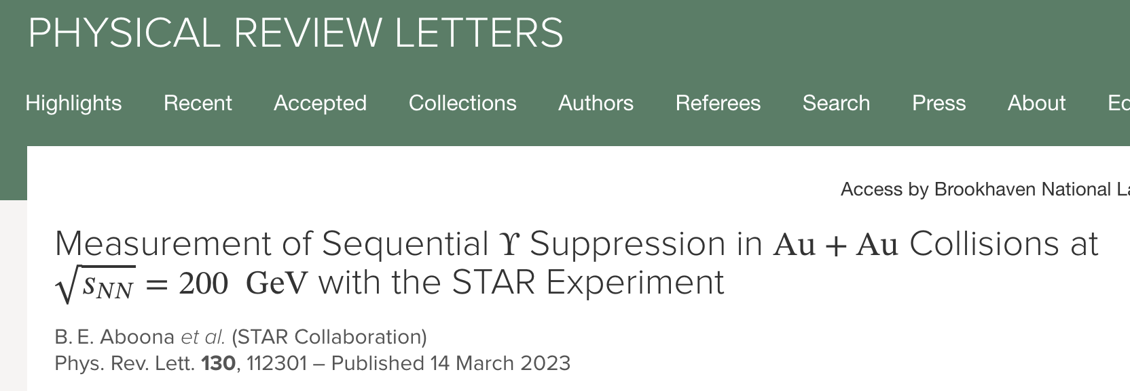
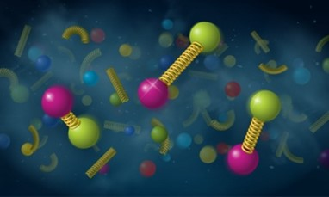
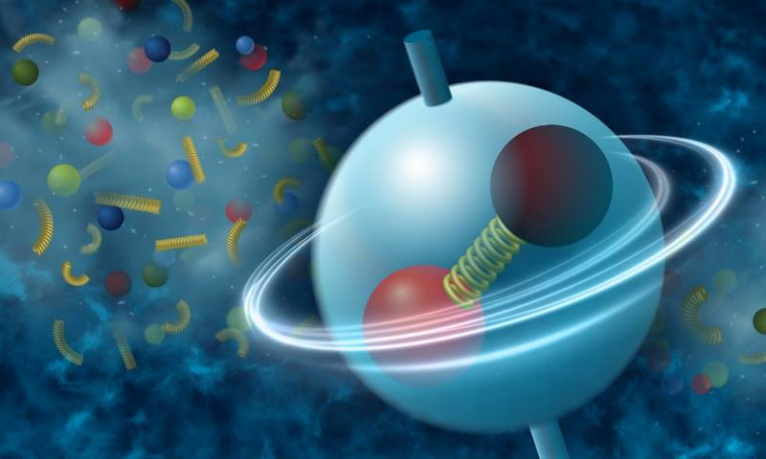
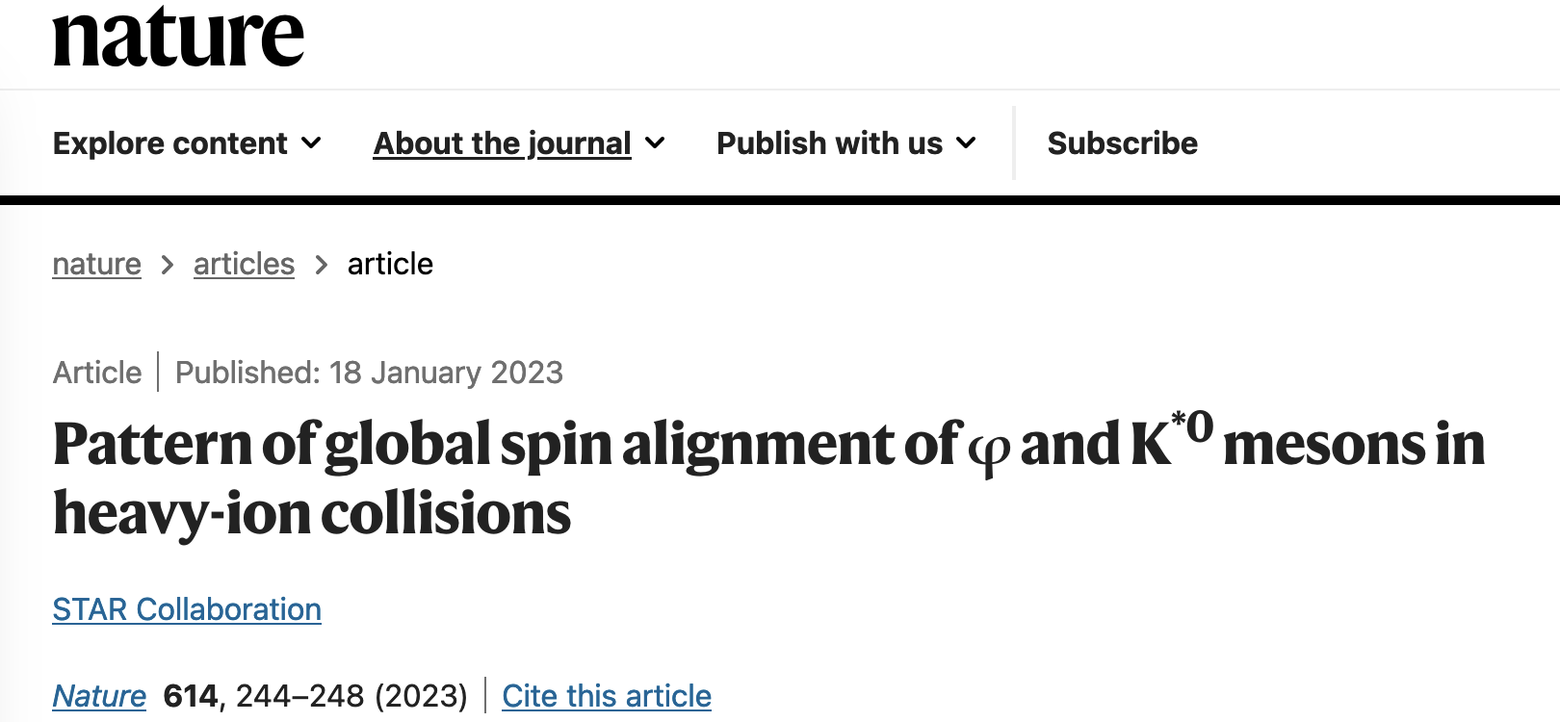
Recent Highlights from RHIC
Also accessible as DOE Highlights

Slide 10
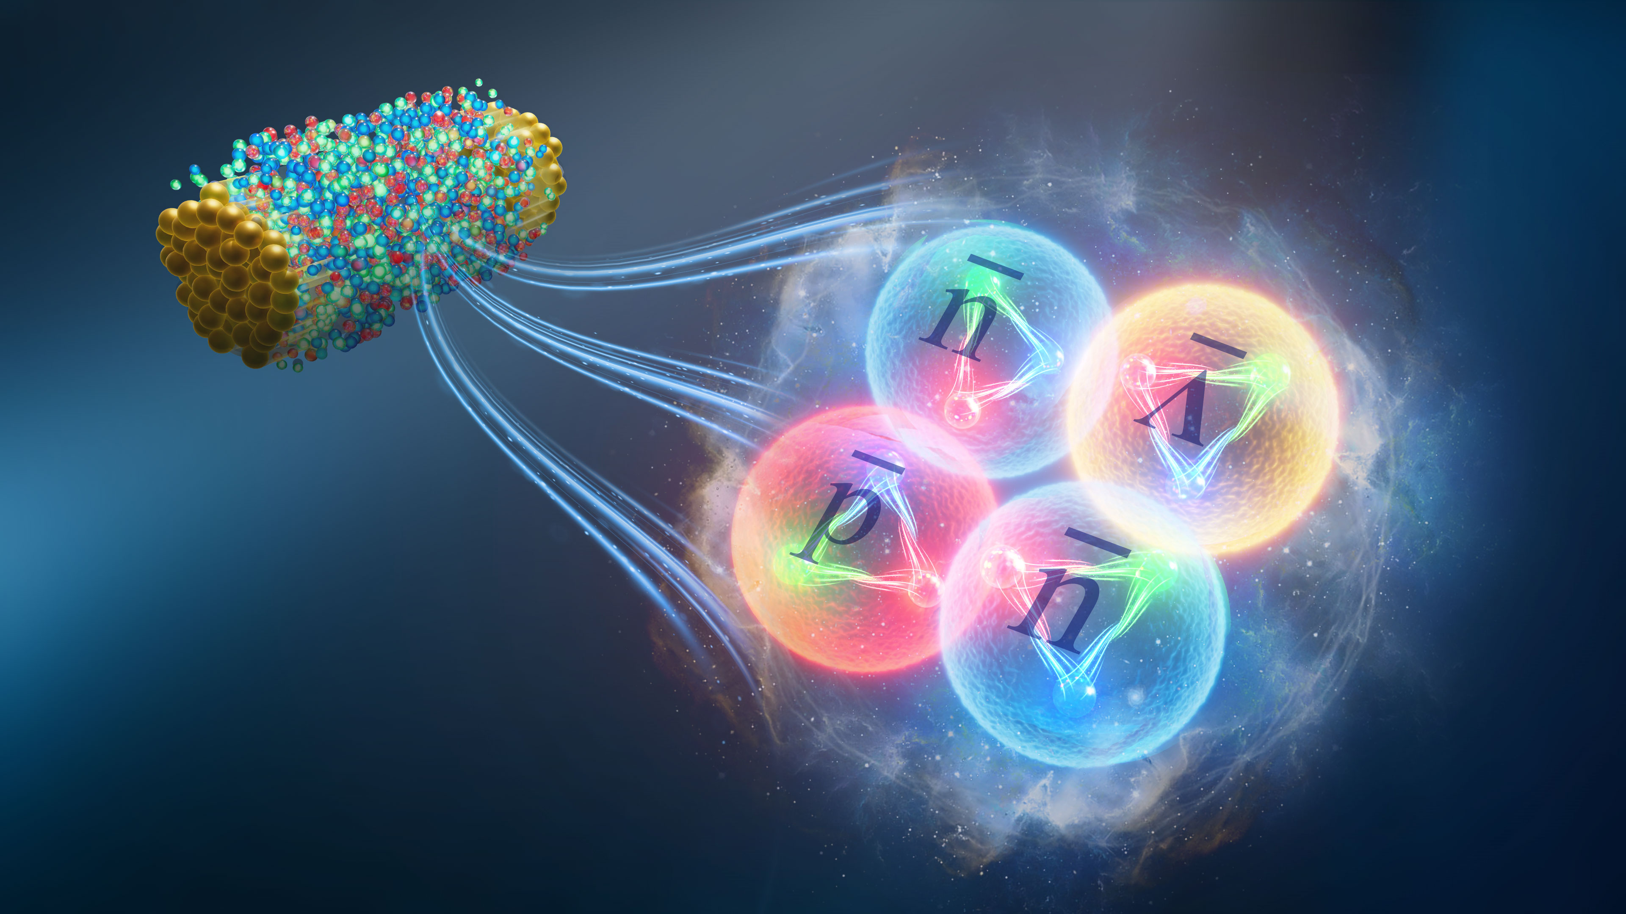
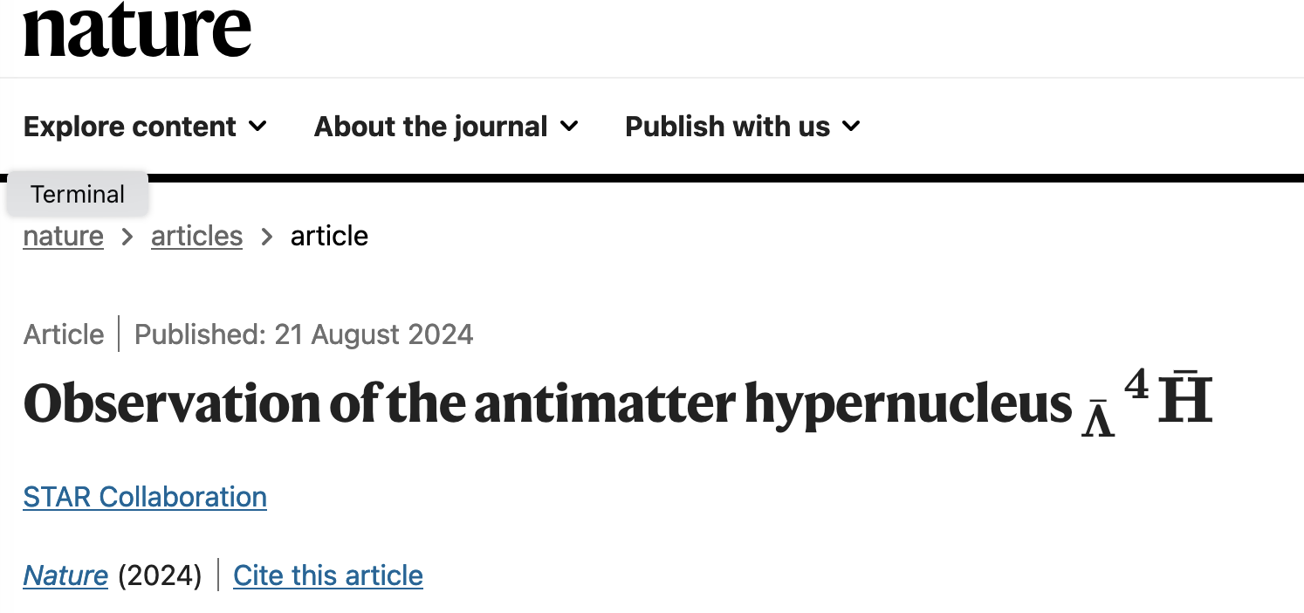
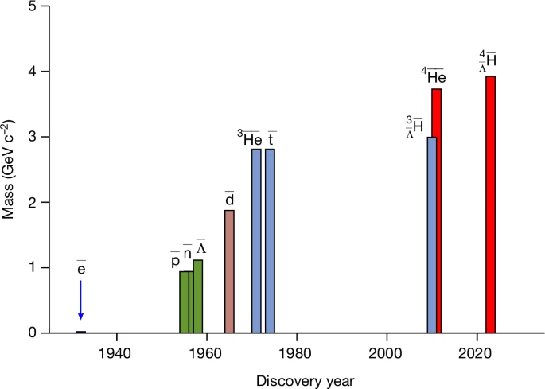
Observation of the heaviest antimatter nucleus to date
Relativistic Heavy Ion Collider:
  Also serves as an antimatter creation machine
  3 first observations to date
Enables fundamental tests of matter-antimatter symmetry by comparing properties such as lifetime
Fig. 1: Masses versus discovery years of selected antimatter particles.
First observed at RHIC

Slide 11
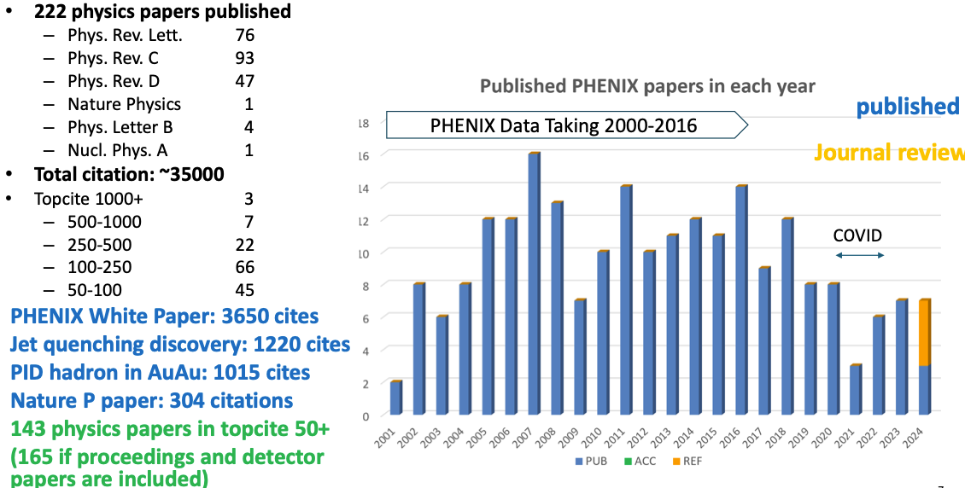
PHENIX Publications Summary
Data taking ended in 2016, but analyses & publications continue

Slide 12
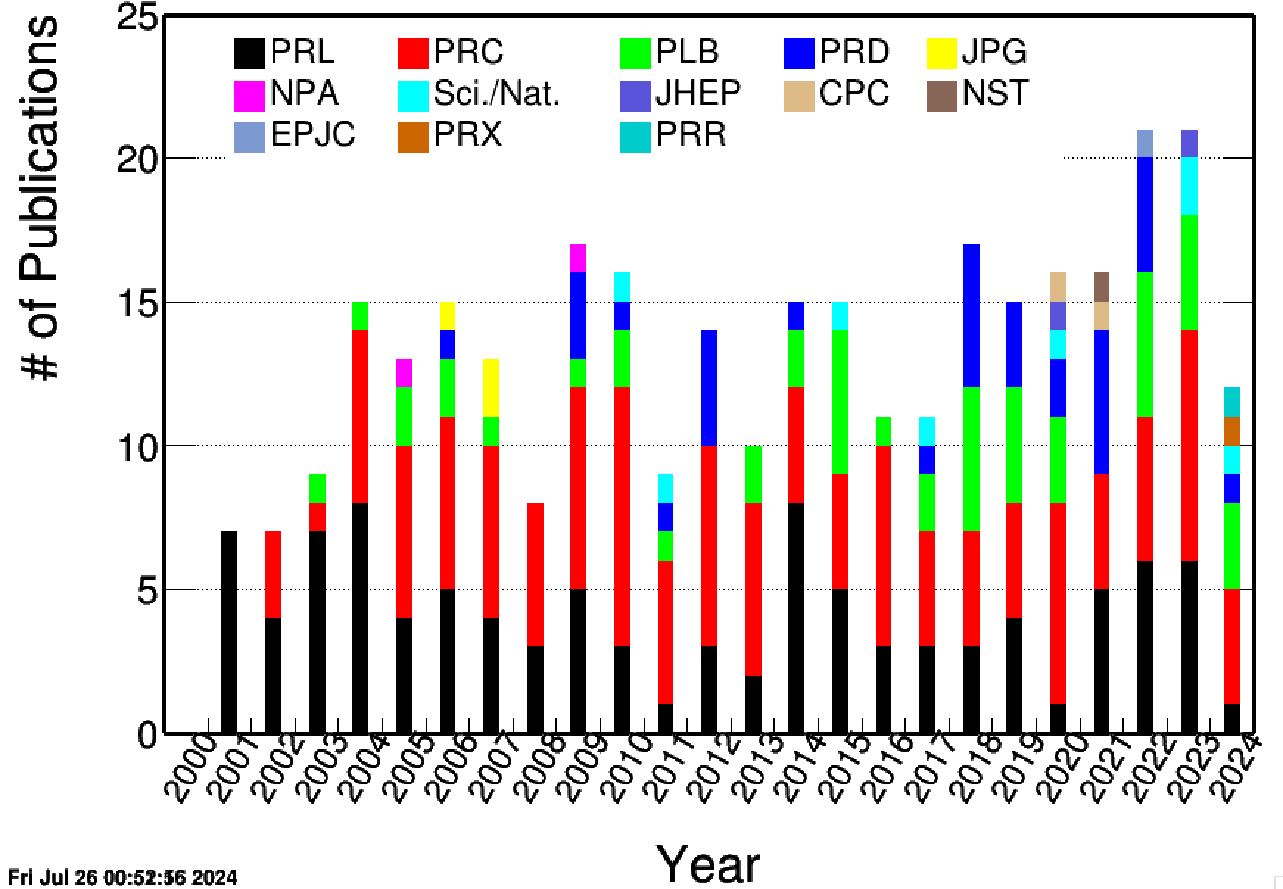
STAR Publication Summary
Continued strong publication and
presentation record across all
Physics Working Groups
Observation of Antihyperhydrogen-4 at RHIC, accepted for publication in Nature
Observation of the electromagnetic field effect via charge-dependent directed flow in heavy-ion collisions at the Relativistic Heavy Ion Collider, the first PRX paper in heavy ion physics.
2023: 21 published 6 PRL, 8 PRC, 4 PLB, 2 Sci/Nat, 1 JHEP
2024: 12 published + accepted: 1 PRL, 4 PRC, 3 PLB, 1 PRD, 1 Nat, 1 PRX, 1 PRR
Journal review: 13; Collaboration review: 3; Active GPCs: 30
99% of STAR papers uploaded to HEPData, remaining 2 papers are newer and on track to be uploaded soon
Continued steady growth in citations

Slide 13

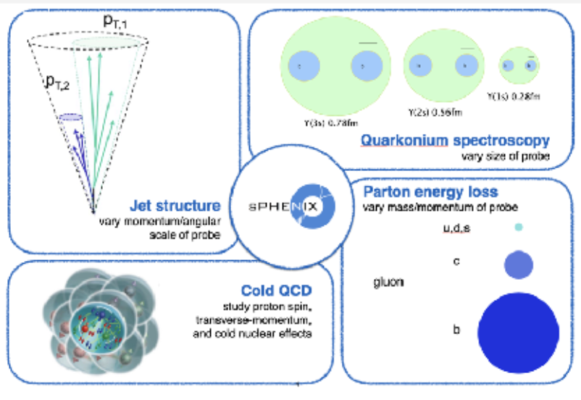
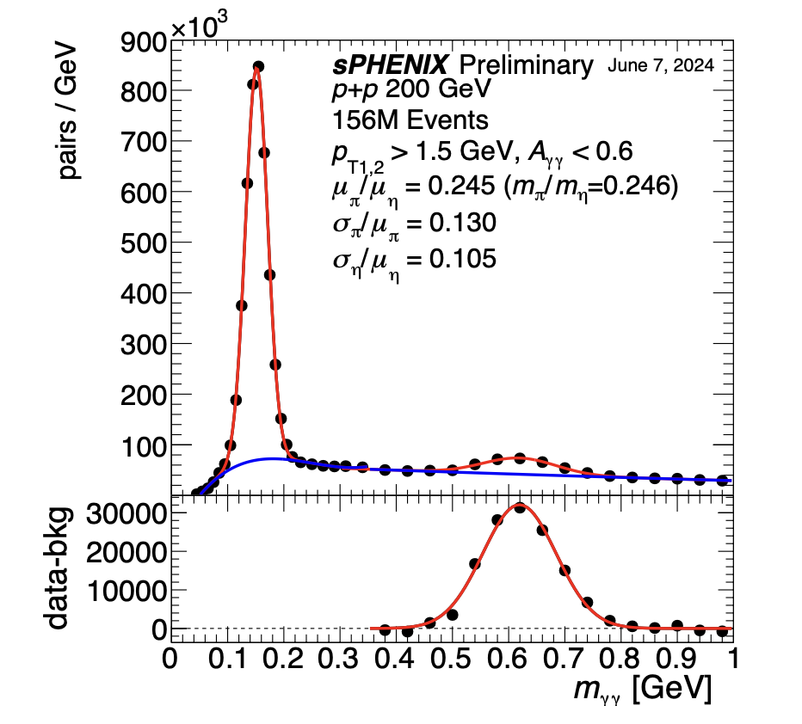
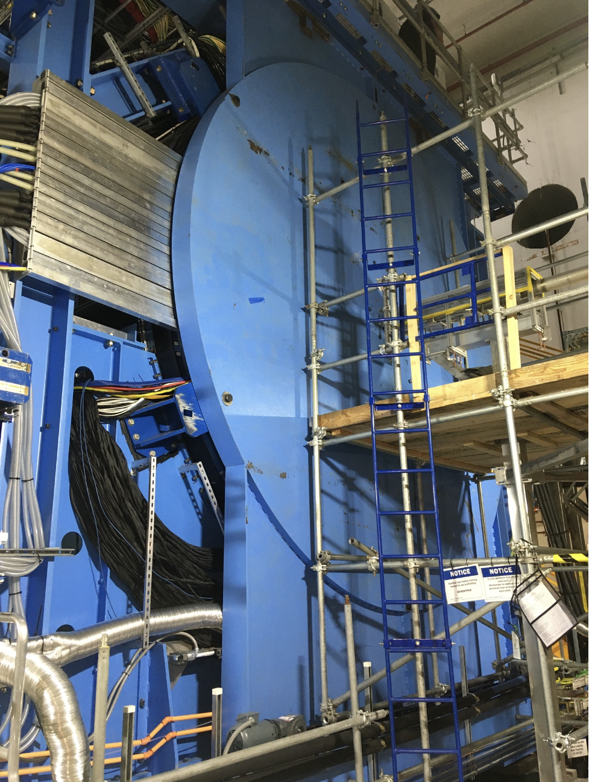
sPHENIX science, status and progress
The last remaining component of “finishing the RHIC mission” : 2023 LRP
Plan:
Commissioning & Au-Au run 2023
Operation with polarized (p-p) 2024
Operation with Au-Au 2025
Run 23: Commissioning & run cut short by DX magnet failure
Limited luminosity |z| < 10 cm
Time Projection Chamber unstable
Run 24:
  Late start of Run 24 requested
  Significant work MVTX, TPC
  Allowed 20 weeks of p-p and 5-weeks with Au-Au collisions
First physics results at QM2025
Detector completed in time for Run 23
Anticipating a large Au-Au data set in (FY25+FY26) in CY2025
π⁰ and 𝛈 invariant mass distributions
• 0.01% of collected data
Data analyses easily until ~2035

Slide 14
Priority and Run 25 & 26 Plan (PAC)
Complete RHIC Operations mission
Run 25 and 26 in calendar year 2025
FY25: Run 25 (18) weeks of Au+Au at 200 GeV
FY26: Potential Run 26 ~12 weeks
Dates of operation: March 24-June 30 and Sep 1-December 22, 2025
Aim: 1) To accumulate 7 nb⁻¹ integrated Au-Au data, 2) EIC (APEX ~3 weeks) and the if there is time: 3) p-p (? Weeks) 4) p-Au (~3-weeks) 5) O-O data 6) Space Radiation studies @ STAR (fixed tgt)
RHIC PAC meeting online planned June 17-18, 2025 to discuss the run status and give the best advice for the remaining RHIC operation

Slide 15
RHIC to EIC transition
NPP and EIC ALD’s and the directorate working closely
After successful completion of RHIC operations mission change from RHIC operations mode to EIC Construction.
During the transition years: 8-10 years,
Help finish RHIC data analyses and also, need to archive all data (PHENIX, STAR and sPHENIX) for 20+ years
Staff transition from C-AD/Physics (NPP) directorate to EIC directorate to realize the EIC/ePIC -- in partnership with JLab
RHIC/EIC Injector complex (source, LINAC, booster, AGS and many RHIC related hardware in that complex) to be maintained ready for EIC
NASA Space Radiation Lab & Isotope Program to continue
All this be done with the EIC Project plan, despite uncertainties in annual funding…

Slide 16
From RHIC to EIC: Outlook
RHIC operations mission expected to complete in 2025
Transition to EIC will start immediately: Removal & Repurposing (both for accelerator complex, interaction region and experiments)
Let us work together try minimize the RHIC to EIC “transition” as short as possible

