Slide 1
Recent GW activity in pion photoproduction experiments and analysis within the SAID Framework
Presenter: William Briscoe
Co Authors: Igor Strakovsky*, Axel Schmidt, Olga Cortes, Marshall Scott
GW Graduate Students: Phoebe Sharp, Sara Ratliff, Erin Seroka, Izzy Illari, Peter Solazzo, Chan Kim, Giovanni Angelini.
* Thanks for the help in preparing slides

Slide 2
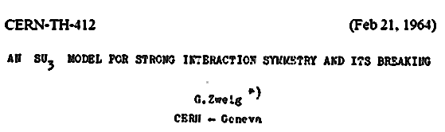
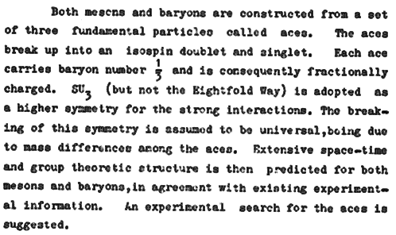

.
QCD and the Hadron Spectrum
• QCD gives rise to the hadron spectrum.
.
• Many & qqq states have been observed.
220 & 100.
Notes:
QCD gives rise to hadron spectrum.

Slide 3
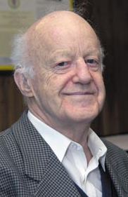
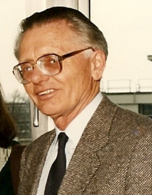
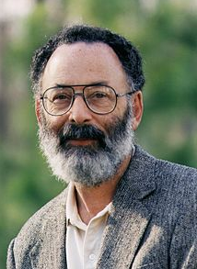
Hadron Spectroscopy
It is clear that we still need much more information about the existence and parameters of many baryon states, especially in the N=2 mass region, before this question of non-minimal SU(6) x O(3) super-multiplet can be settled.
Dick Dalitz, 1976
The first problem is the notion of a resonance is not well defined. The ideal case is a narrow resonance far away from the thresholds, superimposed on slowly varying background. It can be described by a Breit-Wigner formula and is characterized by a pole in the analytic continuation of the partial wave amplitude into the low half of energy plane. Gerhard Höhler, 1987
Why N*s are important – The first is that nucleons are the stuff of which our world is made. My second reason is that they are simplest system in which the quintessentially non-Abelian character of QCD is manifest. The third reason is that history has taught us that, while relatively simple, Baryons are sufficiently complex to reveal physics hidden from us in the mesons.
Nathan Isgur, 2000

Slide 4
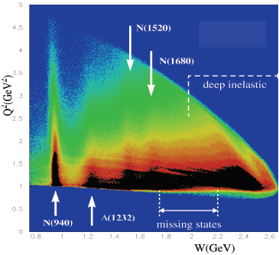
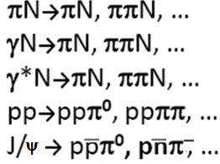

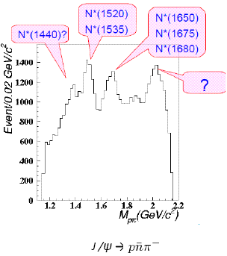

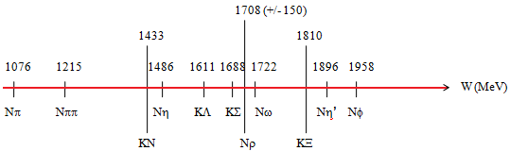

There are Many Ways to Study N*
• Prolific source of N* & Δ* baryons is to measure many
channels with different combinations of quantum numbers.
ep→epX
• Most of PDG Listings info comes from these sources.
• πN elastic scattering is highly constrained.
• Resonance structure is correlated.
• Two-body final state, fewer amplitudes.
Forum for MAX-IV Ring, Lund, Nov 2011

Slide 5
Where Are We Now…
Certain experiments provide unique info about resonance decay properties.
  helicity couplings A1/2 & A3/2 for γp and γn decays come only from pion photo- & electro-production measurements.
Helicity couplings normally extracted from full energy-dependent multipole amplitudes.
  Until recently, the only available multipole amplitudes were for single pion photoproduction.
Determination of A1/2 & A3/2 from meson photo- & electro-production requires knowledge of corresponding hadronic couplings.
  Photo- & electro-production alone determine only the product of couplings to the γN and
hadronic channels.
Every phenomenology group
[BnGa, EBAC, Gent, Giessen, JAW, Juelich, MAID, & SAID]
Uses the SAID πN results for constrain.
Most modern experimental efforts focus on photo- or electro-production experiments
  high-precision measurements with hadron beams (pions & kaons) are needed!
PWAs are best way to determine N* properties
  Multichannel approaches can help resolve inconsistencies.
Forum for MAX-IV Ring, Lund, Nov 2011

Slide 6
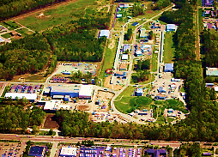
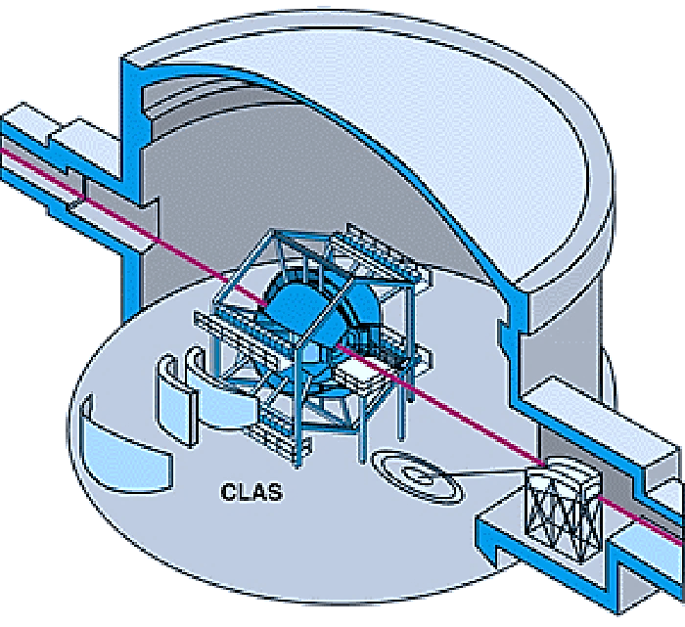
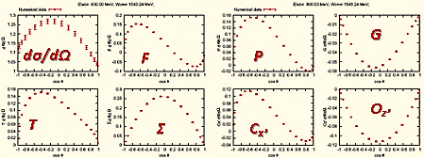
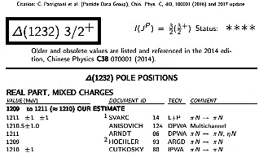
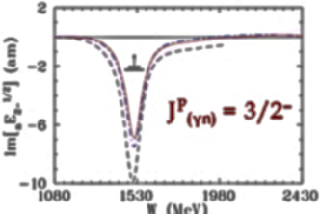
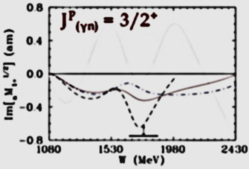
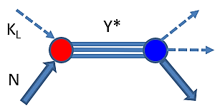
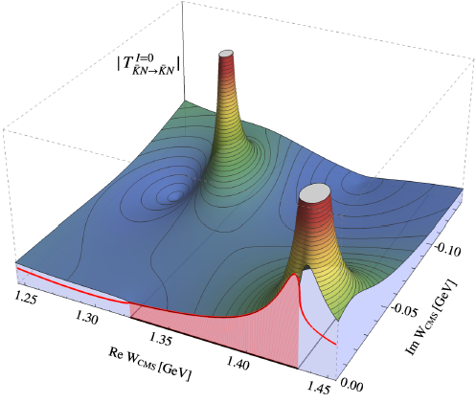
Road Map to Baryon Spectroscopy
• That is not hunting for bumps!
Facility
Experiment
QCD
LQCD
Data
PWA
PWA
Amplitudes
Resonances

Slide 7
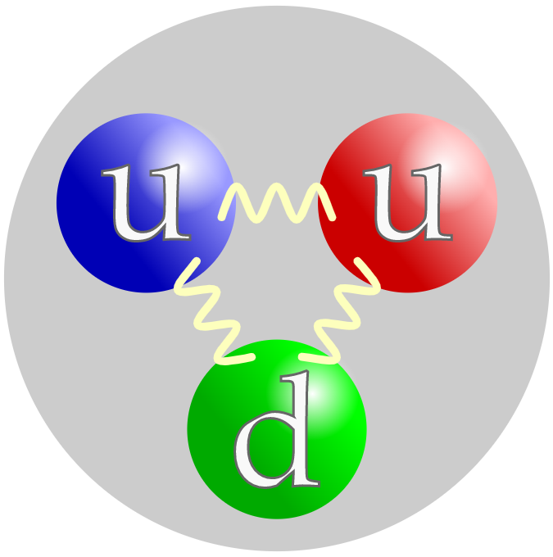
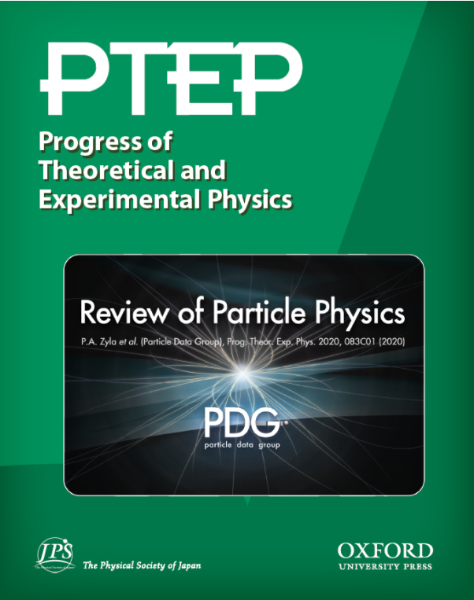






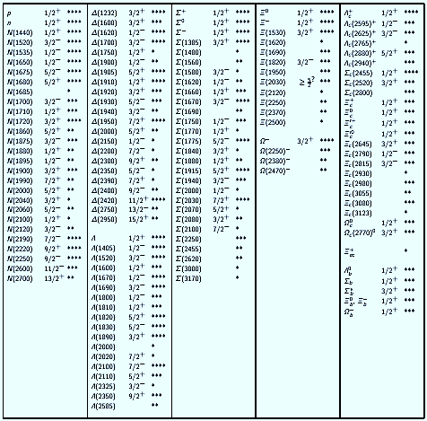






Baryon Sector @ PDG2025
GW Contribution
S. Navas et al, Phys Rev D 110, 030001 (2024)
Ξ
Δ
N
Σ
Ω
• PDG2024 has 133 Baryon
Resonances
(69 of them are 4* & 3*).
• In case of SU(6) x O(3),
434 states would be
present if all revealed
multiplets were fleshed out
(three 70 & four 56).
Λ
• First hyperon
was discovered
in 1950.
• LQCD results
are similar.
R. Koniuk & N. Isgur, Phys Rev Lett 44, 845 (1980)
• Pole position in complex energy plane
for hyperons has been made only in 2010.
V.D. Hopper & S. Biswas, Phys Rev 80, 1099 (1950)
Y. Qung et al, Phys Lett B 694, 123 (2010)
Notes:
Baron spectrum from PDG2024. Magenta bars show our SAID group contribution. The first hyperon (ground state) was discovered in 1950 while the first hyperon pole for Lambda(1520) was reported by our group in 2010 using Kaon electroproduction Hall A data. PDG2024 reported just a quarter of QCD model predictions and LQCD calculations.

Slide 8
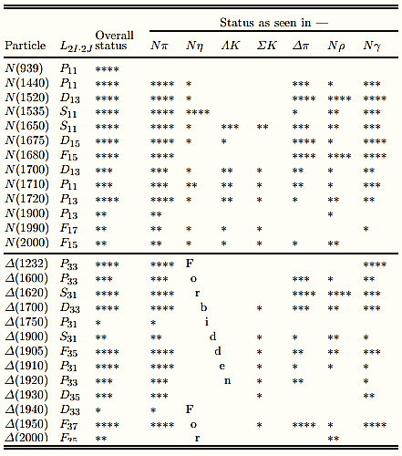
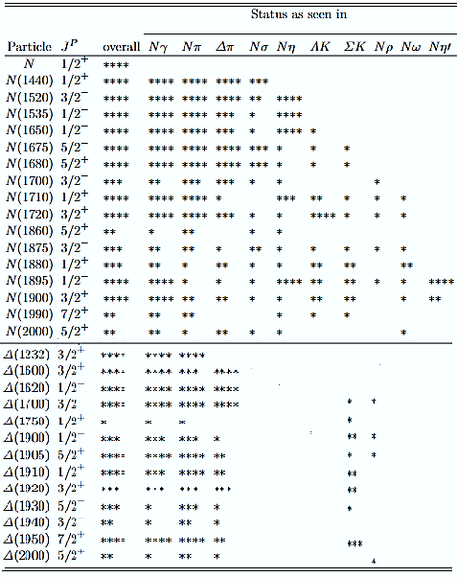
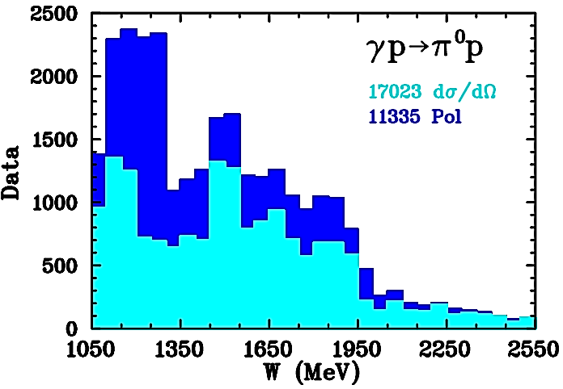
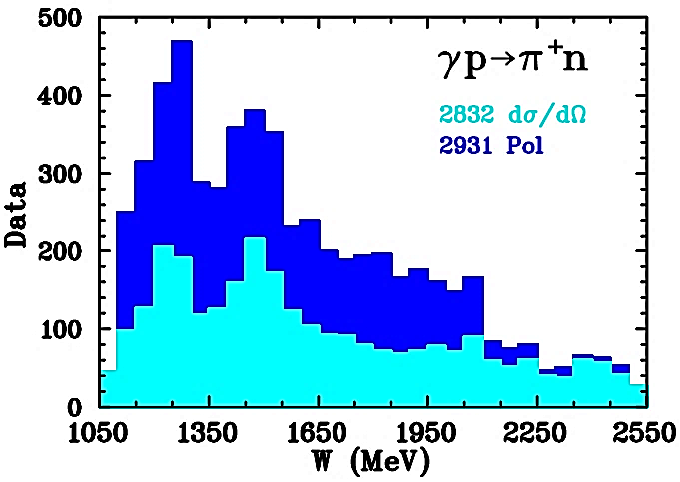
Complete Experiment for Pion PhotoProduction
2002
2020
1996-2018
Pol = 40%
F
o
r
b
i
d
d
e
n
Pol = 51%
π⁺n/π⁰p = 20%
• Lack of γp→π⁺n vs γp→π⁰p data does not allow us to be as confident about determination of neutron couplings.

Slide 9




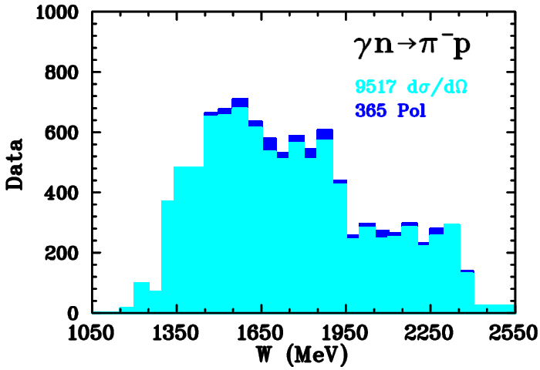
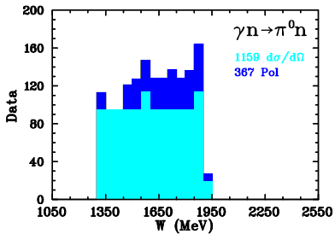
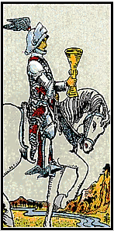
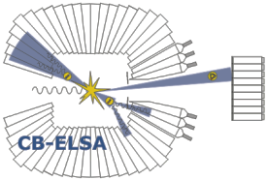

World Progress in Pion PhotoProduction
SAID: http://gwdac.phys.gwu.edu/
D. Ireland, E. Pasyuk, IIS, Prog Part Nucl Phys 111, 103752 (2020)
1996−2018
Pol = 40%
Pol = 51%
π⁺n/π⁰p = 20%
Pol = 4%
Pol = 24%
π⁻p/π⁰n = 15%
•There is disbalance between π⁰p & π⁺n data, 20%.
• Pion photoproduction on neutron much less known, 33%.

Slide 10
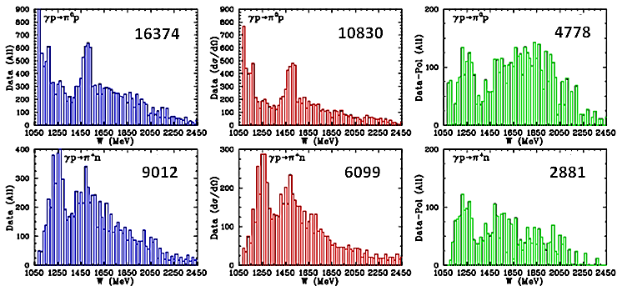
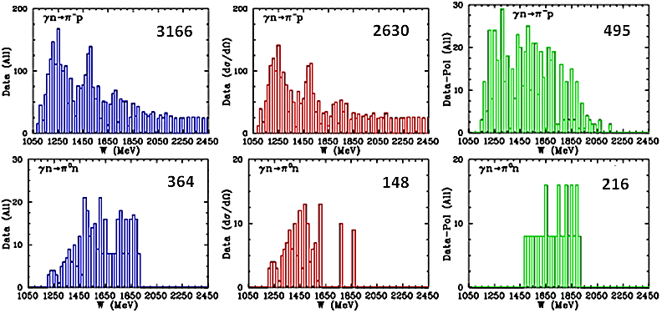
World Neutral & Charged PionPR Data
W.J. Briscoe, M. Doring, H. Haberzettl, M. Manley, M. Naruki, IS, E. Swanson, Eur Phys J A 51, 129 (2015)
Full
UnPol
Pol
2017
W < 2.5 GeV
25858−19768−6090
γp→π⁰p
γp→π⁺n
9859− 6078−3781
11856−11092− 764
γn→π⁻p
364− 148− 216
γn→π⁰n

Slide 11
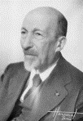
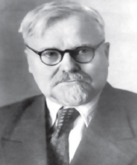
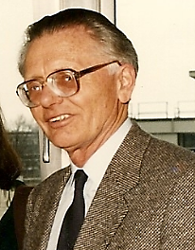
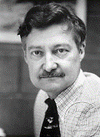



PWA for non-Strange Baryons
• Originally PWA arose as technology to determine amplitude of reaction via
fitting scattering data.
That is non-trivial mathematical problem – looking for solution
of ill-posed problem following to Hadamard & Tikhonov.
• Resonances appeared as by-product
[bound states objects with definite quantum numbers, mass, lifetime, & so on].
• Standard PWA
⇒ Reveals only wide Resonances, but not too wide (Γ < 500 MeV)
& possessing not too small BR (BR > 4%).
⇒ Tends (by construction) to miss narrow Res with Γ < 20 MeV.
Most of our current knowledge about bound states of three light quarks
has come mainly from πN→πN PWAs:
Karlsruhe-Helsinki,
Carnegie-Mellon-Berkeley,
& GW.
Main source of EM couplings is GW, BnGa, & JuBoWa analyses.

Slide 12



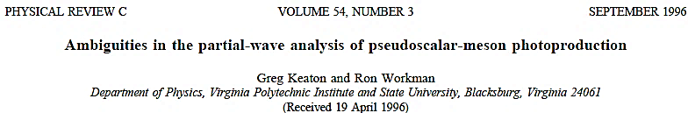
Direct Amplitude Reconstruction
in Pion Photo-Production
γ N → N π
spin: 1 ½ → ½ 0
• In particle physics, helicity is
projection of the spin onto
direction of momentum, :
helicities: 2 x 2 x 2 / 2 = 4
parity conservation
Therefore, there are 4 independent invariant amplitudes
• In order to determine pion photoproduction amplitude [4 modules and 3 relative phases],
one has to carry out 7 independent measurements at fixed (W, t) or (E, θ).
8
• This extra observable is necessary to eliminate sign ambiguity.
8

Slide 13
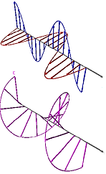
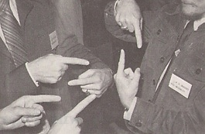
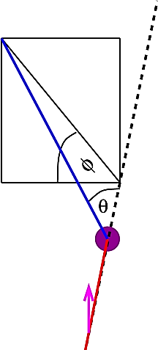
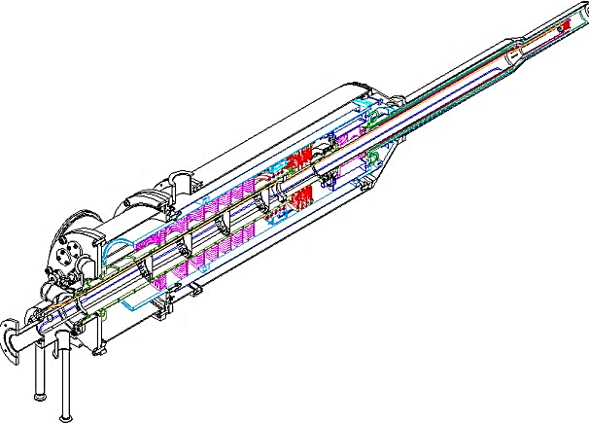


Complete Experiment for Pion PhotoProduction
• There are 16 non-redundant observables.
• They are not completely independent from each other.
Linear
Polarized
Beam
Nucleon Recoil
Polarization
Circular
Polarized
Beam
γ N → N π
1 un-pol measurement: dσ/dΩ
3 single pol measurements: Σ, T, P
12 double pol measurements: E, F, G, H, C_{x}, C_{z}, O_{x}, O_{z}, L_{x}, L_{z}, T_{x}, T_{z}
18 triple polarization asymmetries
[9 for linear pol beam]
[9 for circular pol beam]
13 of them are non-vanishing
Longitudinally Polarized Nucleon Target
Transverse Polarized Nucleon Target
A. Sandorfi et al. AIP Conf. Proc. 1432, 219 (2012)
K. Nakayama, private communication, 2014

Slide 14










Importance of Neutron Data
• EM interaction do not conserve isospin, so multipole amplitudes contain
isoscalar & isovector contributions of EM current.
Proton
Neutron
• Proton data alone does not allow separation of
isoscalar & isovector components.
Q: Can we avoid ? A: NO !
• Need data on both proton & neutron !
D. Drechsel & L. Tiator, J. Phys. G 18, 449 (1992)

Slide 15
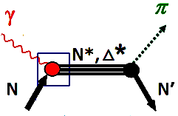


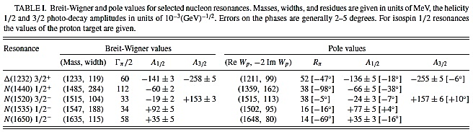


Photo-Decay Amplitudes in BW &
Pole Forms
• Pole is main signature of resonance.
Evaluated at
Res Energy
Evaluated at
Pole
R.L. Workman et al, Phys Rev C 87, 068201 (2013)
A. Svarc et al, Phys Rev C 89, 065208 (2014)

Slide 16
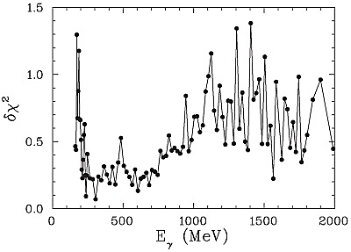

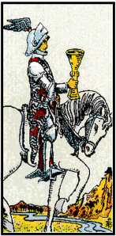
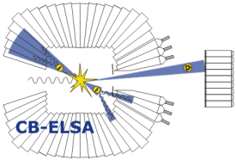



Single-Energy Solutions (SES)
R.L. Workman, M.W. Paris, W.J. Briscoe, IS, Phys Rev C 86, 015202 (2012)
• SAID has employed both single-energy (SES) & energy-dependent
(Global) solutions using least-squares technology over variety
of energy ranges in order to estimate uncertainties.
• SES: based on bin of data spanning
narrow E range [5 – 75 MeV] searches 2 to 29 prms.
110 SES have been generated with central
E = 147 to 2650 MeV.
# of data in bin varies from 80 to 1100.
• Systematic deviation between SES & Global fits is
indication of
⇒ Missing structure in global fit.
⇒ Possible problems with particular dataset.
• Diagonal Error Matrix generated in SES fits.
It can be used to estimate the overall uncertainties for Global solution.

Slide 17
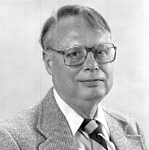

Single Pion PhotoProduction on
“Neutron” Target
• Accurate evaluation of EM couplings N*→γN & Δ*→γN from
meson photoproduction data remains paramount task in hadron physics.
• Only with good data on both proton & neutron targets, one can hope
to disentangle isoscalar & isovector EM couplings of various N*& Δ*
resonances,
as well as isospin properties of non-resonant background amplitudes.
• The lack of γn→π⁻p & γn→π⁰n data does not allow us to be as confident
about determination of neutron couplings relative to those of proton.
• Radiative decay width of neutral baryons may be extracted from
π⁻ & π⁰ photoproduction off neutron, which involves
bound neutron target & needs use of
model-dependent nuclear (FSI) corrections.
K.M. Watson, Phys Rev 95, 228 (1954); R.L. Walker, Phys Rev 182, 1729 (1969)
.
A.B. Migdal, JETP 1, 2 (1955); K.M. Watson, Phys Rev 95, 228 (1954)

Slide 18


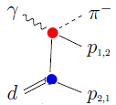
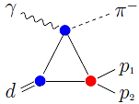

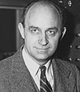
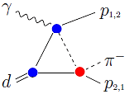





FSI for γd →πpN γn →πN
V. Tarasov, A. Kudryavtsev, W. Briscoe, H. Gao, IS, Phys Rev C 84, 035203 (2011)
V. Tarasov, A. Kudryavtsev, W. Briscoe, B. Krusche, IS, M. Ostrick, Phys At Nucl 79, 216 (2016)
• FSI plays critical role in state-of-the-art analysis of γn→πN data.
• For γn→πN, effect is 5% − 60%. It depends on (E,θ).
NN-fsi
vertex
IA
Fermi Smearing
πN-fsi vertex
Input: SAID: γN→πN, πN→πN, NN→NN
amplitudes for 3 leading terms.
  DWF: full Bonn NN Potential
  (there is no sensitivity to DWF).

Slide 19
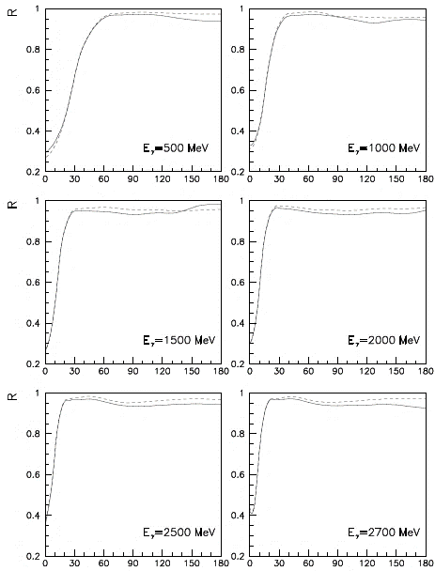

FSI for γd→π⁻pp γn→π⁻p
V. Tarasov, A. Kudryavtsev, W. Briscoe, H. Gao, IS, Phys Rev C 84, 035203 (2011)
.
• For CLAS data:
• FSI correction factor R < 1.
• Behavior is smooth vs. θ.
• Effect: Δσ/σ ≤ 10%.
Cuts:
p_{s} < 200 MeV/c
p_{f} < 200 MeV/c
CLAS g10 & g13:
E > 0.5 GeV
θ > 30 deg
- - [IA + NN_{fsi}] / IA
___ [IA + (NN+πN)_{fsi}] / IA
• There is no large sensitivity to cuts.
• There is sizeable FSI effect
from S-wave part of pp-FSI
at small angles.
• Region narrows as E increases.
.
• Previous estimation
of Glauber FSI
gave order of 15−30%.
W. Chen et al,
Phys Rev Lett 103, 012301 (2009)
Forward direction is
Terra incognita
θ(πp−CM)

Slide 20


FSI for γd→π⁰pn γn→π⁰n
V.E. Tarasov, A.E. Kudryavtsev, WJB, B. Krusche, IIS, M. Ostrick, Phys At Nucl 79, 216 (2016)
.
• For data:
· Behavior is smooth vs. θ.
• Effect: Δσ/σ ≤ 15%.
Cuts:
p_{s} < 200 MeV/c
p_{f} < 200 MeV/c
• There is no large sensitivity to cuts.
Forward direction is
Terra incognita.
There are no data for
validation.
• There is sizeable FSI effect
from S-wave part of pp-FSI
at small angles.
.
Assumption is
FSI for polarized measurements
is small.

Slide 21



FSI for γd →π⁰np γn →π⁰n & γp →π⁰p
V. Tarasov, A. Kudryavtsev, W. Briscoe, B. Krusche, IS, M. Ostrick, Phys At Nucl 79, 216 (2016)
• γn→π⁰n case is much more
complicated vs. γn→π⁻p
because π⁰ can come from
both γn & γp initial interactions.
.
Δ(1232)3/2+
N(1440)1/2+
• The corrections for both target
nucleons are practically identical
for π⁰ production in energy range
of Δ(1232)3/2⁺ due to
isospin structure of γN→πN
amplitude:
isoscalar isovector
N(1535)1/2−
• In general case,

Slide 22

Comparison of Previous & New SAID Fits
for g13
P. Mattione et al, Phys. Rev. C 96, 035204 (2017)
• Recent SAID PR15 applied to
g13 data
without &
with
FSI corrections.
• Νew SAID MA27 fit obtained
after adding new g13 data
with FSI corrections.
• Obviously, FSI plays important role in γn→π⁻p dσ/dΩ determination.

Slide 23

MAMI-B for γn→π⁻p around Δ
W.J. Briscoe, A.E. Kudryavtsev, P. Pedroni, IS, V.E. Tarasov, R.L. Workman, Phys Rev C 86, 065207 (2012)
• MAMI-B data for γn→π⁻p (including FSI corrections) &
previous hadronic data for π⁻p→nγ appear to agree well.
SAID-PE12
SAID-SN11
MAID07
FSI included
Data:
• − MAMI-B for γn→π⁻p sys=2%
Δ − CB@BNL for π⁻p→nγ sys=5%
o − TRIUMF, CERN, LBL, LAMPF for π⁻p→nγ
{
J. Ahrens et al, Eur Phys J A 44, 189 (2010)
• T-invariance is good as 2 x 10⁻³
A. Shafi et al, Phys Rev C 70, 035204 (2004)
Forum for MAX-IV Ring, Lund, Nov 2011

Slide 24



CLAS g13 for γn →π⁻p above 0.5 GeV
P. Mattione et al, Phys. Rev. C 96, 035204 (2017)
E = 445−2510 MeV
π⁻p: 8428 dσ/dΩ
• These data a factor of
nearly three increase
in world statistics for
this channel in
this kinematic range.
FSI included

Slide 25


→
→
New CLAS g14 E for γn→π⁻p
D. Ho et al, Phys Rev Lett 118, 242002 (2017)
E = 730−2345 MeV
π⁻p: 266 E
No FSI included

Slide 26



→
→
Recent CB@MAMI Ε for γn→π⁰n
``Proton”
``Neutron”
M.Dieterle et al Phys Let B 523, 770 (2017)
N(1680)5/2⁺→Nγ
pA^{3/2}=+133 ±12 pA^{1/2}=−15 ±6
nA^{3/2}=−33 ±9 nA^{1/2}=+29 ±10
• It couples weakly to neutron.
N(1675)5/2 ⁻→Nγ
pA^{3/2}=+20 ±5 pA^{1/2}=+19 ±8
nA^{3/2}=−85 ±10 nA^{1/2}=−60 ±5
• It couples strongly to neutron.
No FSI included

Slide 27


Comparison of Previous & New SAID Fits for
WJB et al, Phys Rev C 100, 065205 (2019)
• Recent SAID MA27 applied to
data
without &
with FSI corrections.
• New SAID MA19 fit obtained
after adding new data
with FSI corrections.
Obviously, FSI plays
important role in
γn→π⁰n dσ/dΩ
determination.
FSI included
WJB et al, Phys Rev C 100, 065205 (2019)
• data included in SAID fits.
P. T. Mattione et al, Phys Rev C 96, 035204 (2017)
D. Drechsel, S. S. Kamalov, & L. Tiator, Eur. Phys. J. A 34, 69 (2007)

Slide 28

Meson Production off ``Neutron” at CB@MAMI
WJB et al, Phys Rev C 100, 065205 (2019)
• Differential cross sections for γn→π⁰n.
• New data cover
broader angular rangy &
focus on low energies.
E = 290 – 813 MeV
W = 1195 – 1533 MeV
θ = 18 – 162⁰
π⁰n: 492 dσ/dΩ
systematics
PWA:
SAID MA19
SAID MA27
MAID2007
BnGa2002
• Data up to E = 1500 MeV are coming.
FSI included

Slide 29



Comparison of Previous & New SAID Fits for
C. Mulen et al, arXiv:2103.08400 [nucl-ex]
• Recent SAID MA19
MAID2007
applied to data
• Νew SAID MA19 fit obtained after
adding new data.
MUXX does not have any
γn→π⁰n data.
• New Σ data.
• E_{γ} = 155 to 1000 MeV
C. Mulen et al, arXiv:2103.08400 [nucl-ex]
WJB et al, Phys Rev C 100, 065205 (2019)
D. Drechsel, S. S. Kamalov, & L. Tiator, Eur. Phys. J. A 34, 69 (2007)

Slide 30

Meson Production off ``Neutron” at CB@MAMI
C. Mulen et al, arXiv:2103.08400 [nucl-ex]
E = 390 – 610 MeV
W = 1271 – 1424 MeV
θ = 49 – 148⁰
π⁰n: 189 Σ
• Σ beam asymmetry for γn→π⁰n.
• Systematic uncertainties
for each bin have been
added in quadrature.
• New data cover parts of Δ & Roper resonance regions.
• There are no significant changes in dominant multipoles
below 1 GeV.
PWA:
SAID MU22
SAID MA19
MAID2007
BnGa2002
C. Mulen et al, arXiv:2103.08400 [nucl-ex]
WJB et al, Phys Rev C 100, 065205 (2019)
D. Drechsel, S. S. Kamalov, & L. Tiator, Eur. Phys. J. A 34, 69 (2007)
E. Gutz et al, Eur Phys J A 50, 74 (2014)

Slide 31



D. Sokhan, 8th International
Conference on Quarks and Nuclear Physics 2018, Tsukuba, Japan
P. Mattione et al, Phys. Rev. C 96, 035204 (2017)
No FSI included
P R E L I M I N A R Y
G. Mandaglio et al. Phys. Rev. C 82, 045209 (2010)

Slide 32

Conclusions
We are all in it together!

