Slide 1
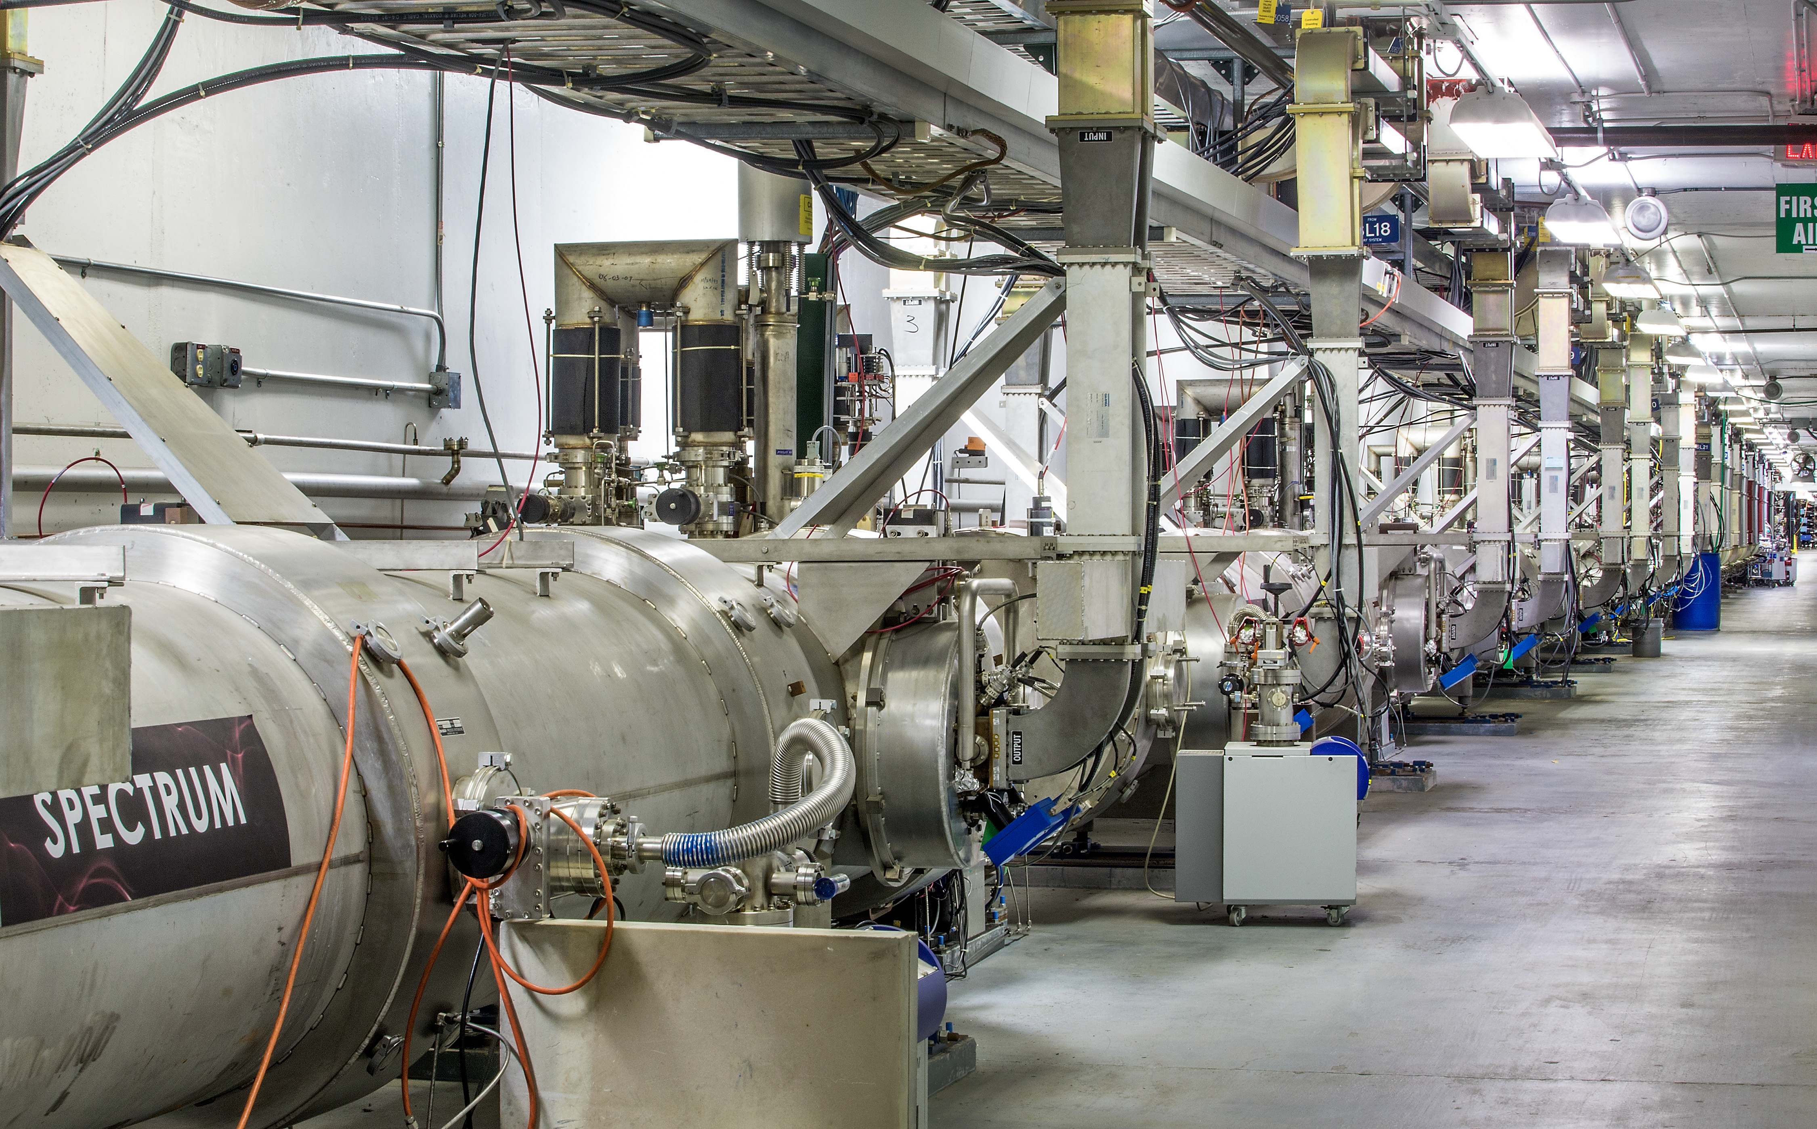
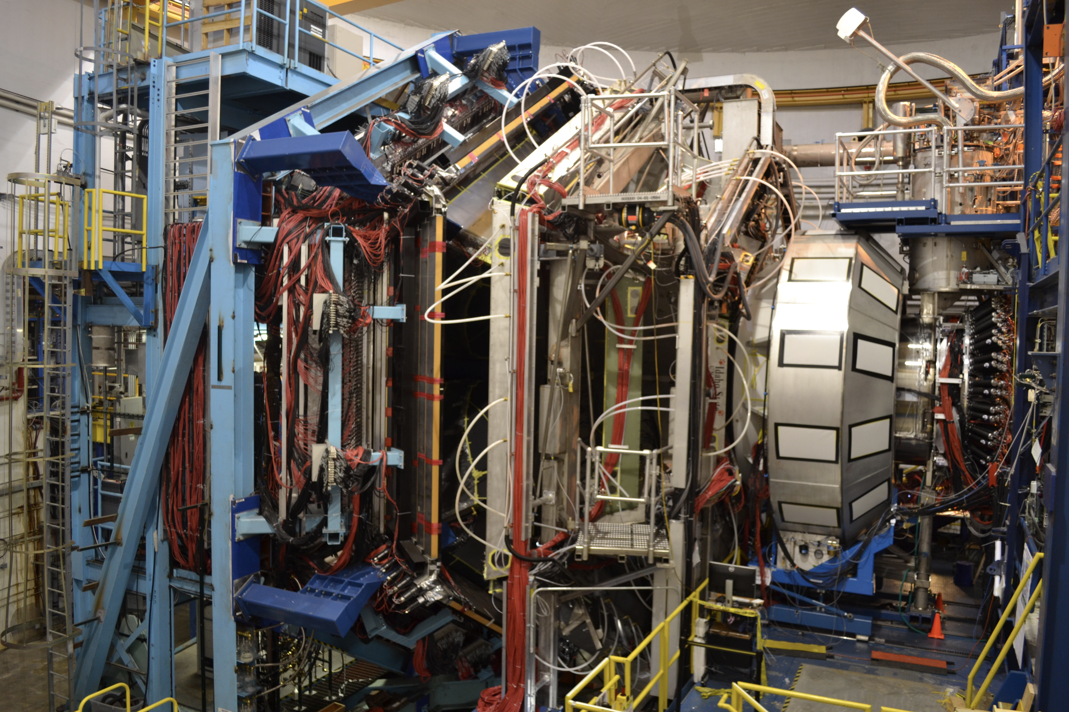

Gravitational Structure
of the Proton
Latifa Elouadrhiri
Jefferson lab

Slide 2
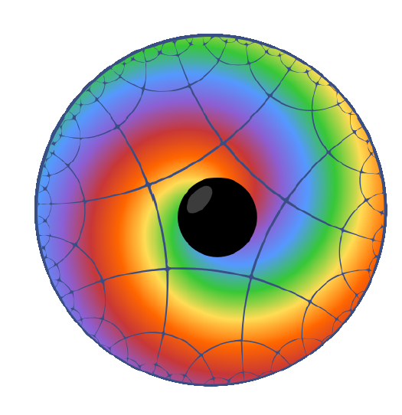
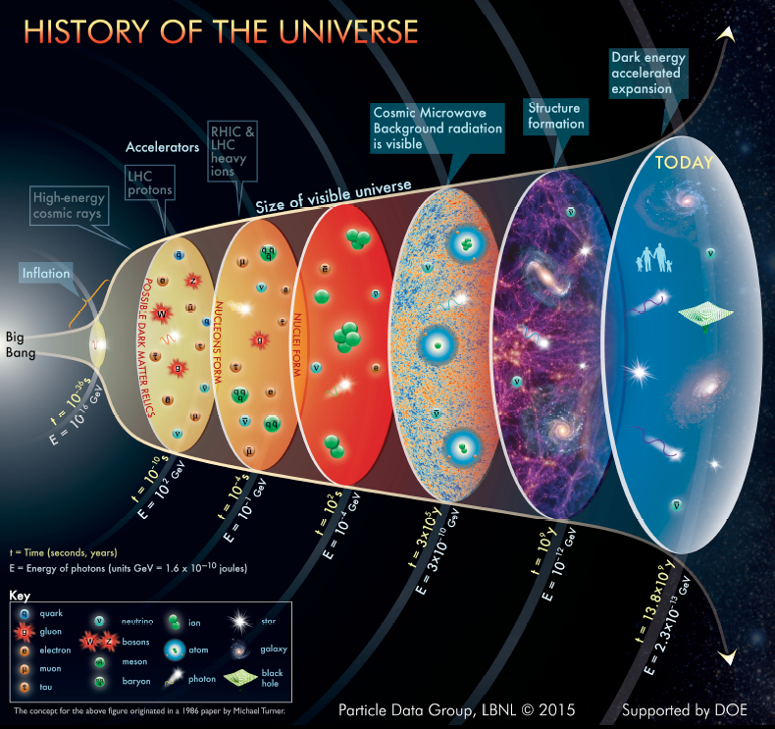
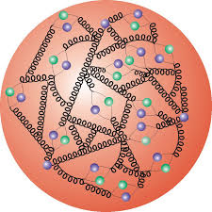
Basic questions about the proton
Proton’s make up nearly 90% of the (normal) matter in the universe. Elementary valence quarks contribute only few percent to the proton mass. What is the origin of its mass?
How did quarks hadronize and form protons as the universe cooled below the Hagedorn temperature? What is the origin of confinement ?
How are the strong forces distributed in space to keep quarks confined and make protons stable particles.

Slide 3
Probing gravitational properties of the strong interaction
The proton has been studied in its electromagnetic and weak properties.
proton
Electro-magnetism
Vector
Electric charge: Q
Magnetic moment: m
Axial
g_{A} g_{P}
Weak interaction
Notes:
After discussing aspects of the electromagnetic structure of the proton we now turn to another part of the hadron physics in the 2021 century, namely the gravitational structure of the proton.
What we know is that gravity is sensitive to mass/energy, angular momentum, and to a quantity that is generally called the D-term. Where the “D” stands for the Druck, the German word for “pressure”.
The D-term is equally fundamental as , e.g., anomalous magnetic moment of the proton, therefore knowledge of the D-term at t=0 would add new insight into the global properties of the proton.

Slide 4
Probing gravitational properties of the strong interaction
The proton has been studied in its electromagnetic and weak properties.
If we could use gravity to probe the structure of the proton,
what would we learn?
proton
Electro-magnetism
Gravity-like
Vector
Tensor
Electric charge: Q
Magnetic moment: m
Mass: M
Spin: J
Term: D
… what’s that?
Axial
g_{A} g_{P}
The D-term is equally fundamental as, for instance, the proton’s anomalous magnetic moment. But we know very little about it.
Weak interaction
Notes:
After discussing aspects of the electromagnetic structure of the proton we now turn to another part of the hadron physics in the 2021 century, namely the gravitational structure of the proton.
What we know is that gravity is sensitive to mass/energy, angular momentum, and to a quantity that is generally called the D-term. Where the “D” stands for the Druck, the German word for “pressure”.
The D-term is equally fundamental as , e.g., anomalous magnetic moment of the proton, therefore knowledge of the D-term at t=0 would add new insight into the global properties of the proton.

Slide 5
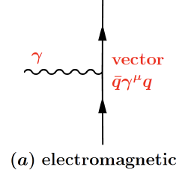
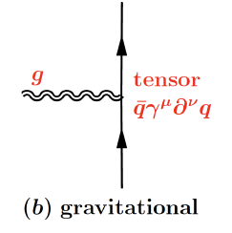
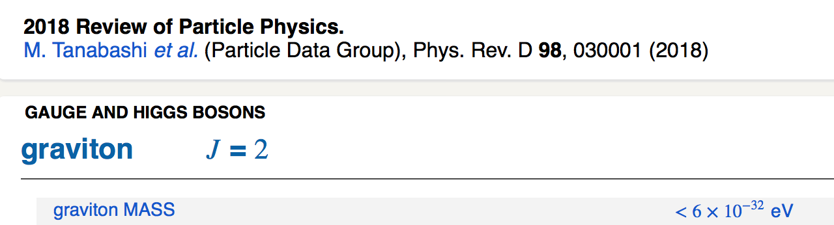
Probing basic properties of the proton
Electromagnetic properties: probed with photons
  Charge - electromagnetic form factors, inelastic structure functions, proton charge radius, charge densities and current densities for N & N*
  Magnetic moment - helicity densities
Gravitational properties: probed with gravitons
  - Mass: energy and mass densities
  Spin: angular momentum distribution
  D-term: dynamical stability, normal and shear forces, pressure distribution, mechanical radius.
F₁(t) F₂(t)
M₂(t)
J(t)
d₁(t)

Slide 6
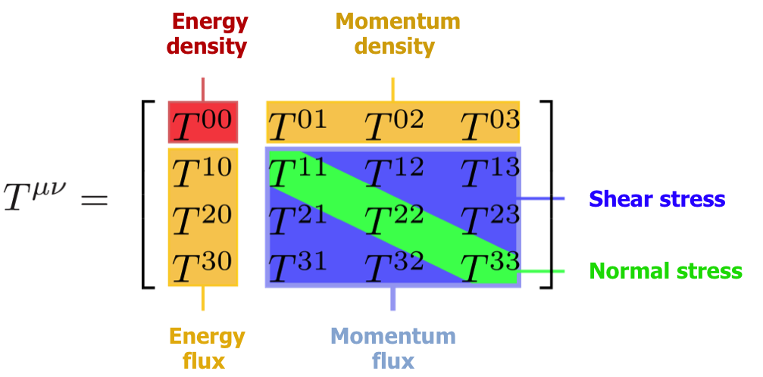

Probing mechanical properties of the proton?
Gravitational Interaction of Fermions
Yu. Kobzarev and L.B. Okun, JETP 16, 5 (1963)
Energy-Momentum Structure Form Factors of Particles Heinz Pagels, Phys. Rev. 144 (1966) 1250-1260
“….. , there is very little hope of learning anything about the detailed mechanical structure of a particle, because of the extreme weakness of the gravitational interaction” ( H. Pagels)

Slide 7
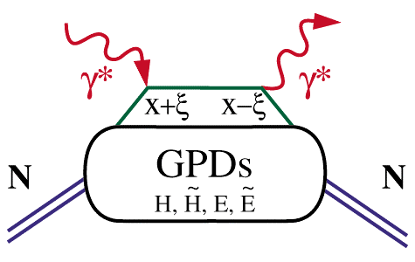
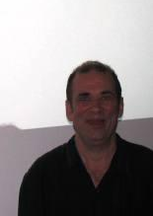


Generalized Parton Distributions (GPDs)
Deeply virtual Compton scattering (DVCS)
x_{B}
hard scattering
ξ =
2 - x_{B}
factorization
(in the Bjorken regime)
soft part
P
P
GPD: H(x,ξ, t), …
t
Proton stays intact
D. Müller (1994) X. Ji (1996) A.Radyushkin (1996)
D. Müller et al., F.Phys. 42,1994
X. Ji, PRL 78, 610, 1997
A. Radyushkin, PLB 380, 1996

Slide 8
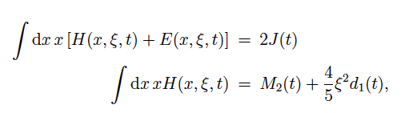
GPDs – GFFs Relations
Nucleon matrix element of the Energy-Momentum Tensor contains three scalar form factors and can be written as:
M₂(t) : Mass/energy distribution inside the nucleon
J (t) : Angular momentum distribution
d₁(t) : Forces and pressure distribution
Graviton – proton scattering
p
Gp => p
GPDs
GFFs
J=2
G
p
DVCS
p
γ
J=2
γγp => p
γ
X. Ji, Phys. Rev. D55, 7114 (1997)
p

Slide 9

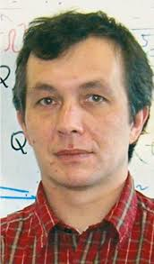
GPDs & Compton Form Factors
GPDs cannot directly be determined from current DVCS measurements alone.
We can determine the Compton Form Factor H(ξ, t)
H(ξ, t) is related to the corresponding GPD H(x,ξ,t) through an integral over the quark longitudinal momentum fraction x.
M. Polyakov (2003)
To determine the complex CFF H(ξ, t) we exploit the interference of the DVCS amplitude with the Bethe-Heitler amplitude that results in a polarized beam spin asymmetry.
M. Polyakov, Phys. Lett. B555 (2003) 57

Slide 10
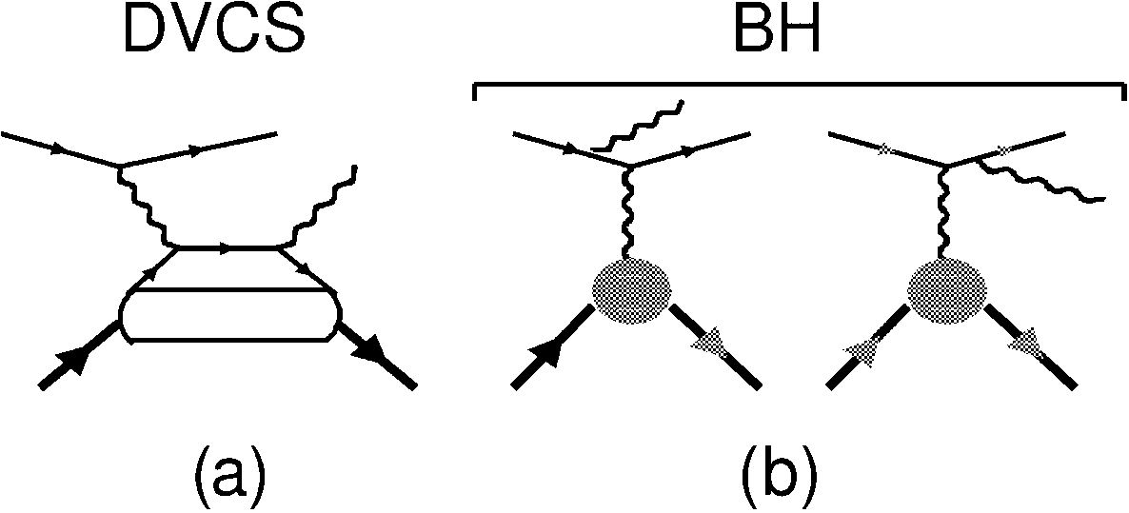
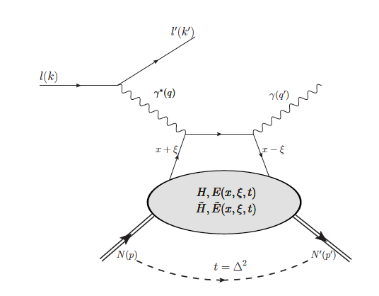
GPDs, DVCS, Compton Form Factors (CFFs)
D. Müller et al., F. Phys. 42,1994,
X. Ji, PRD 55 (1997) 7114
X. Ji, PRL 78 (1997) 610
A. Radyushkin, PRD 56 (1997) 5524
DVCS
In DVCS measurements the relevant quantities are not GPDs but complex valued integrals of GPDs, the Compton Form Factors (CFF).
hard scattering
Elastic Form Factors
factorization
x_{B}
ξ =
soft part
2 - x_{B}
p
p
4 chiral even GPDs describe soft part
H is essential for the parton spatial imaging
E is essential for imaging the parton spin distributions
Notes:
The basic process used to study the multi-dimensional nucleon/nuclear structure is Deeply Virtual Compton Scattering shown in this diagram. Here we assume that the upper part of the graph is a hard scattering process, while the bottom part contains the soft information, the GPDs,.
The GPDs do not appear directly in the DVCS observables, but only in integrated form as Compton Form Factors (CFFs). The CFFs are complex valued objects and depend only on ξ and t.
In addition, we have a competing process, the Bethe-Heitler amplitude, which interferes with the DVCS.. BH depends only on the e.m. form factors which are well known up to high Q². It can therefore be used to project out the imaginary part of the complex CFF.

Slide 11
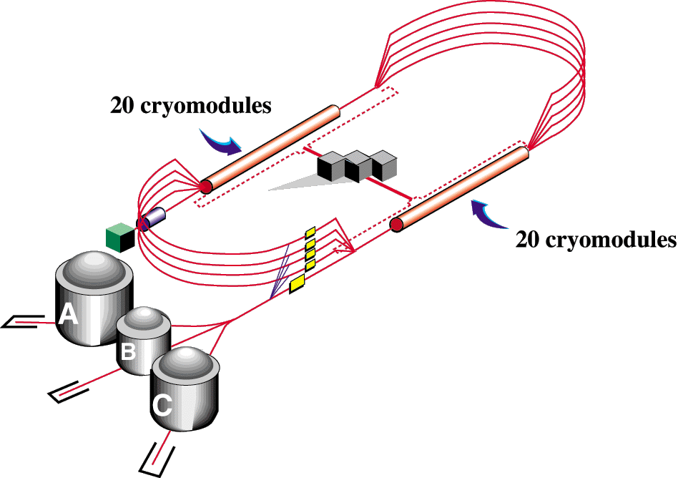

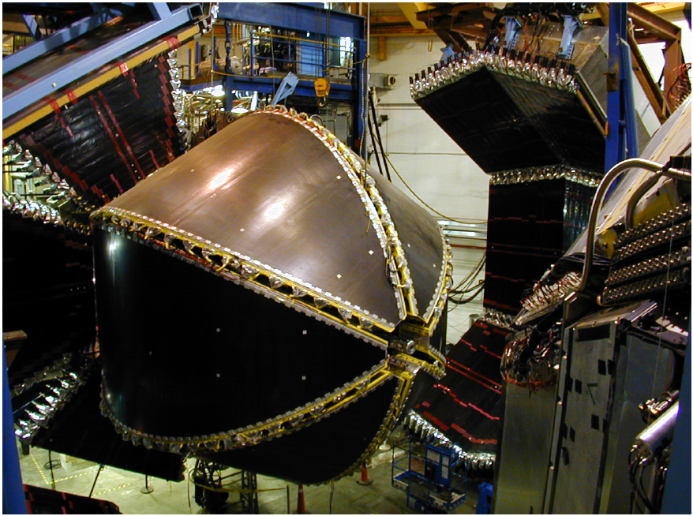
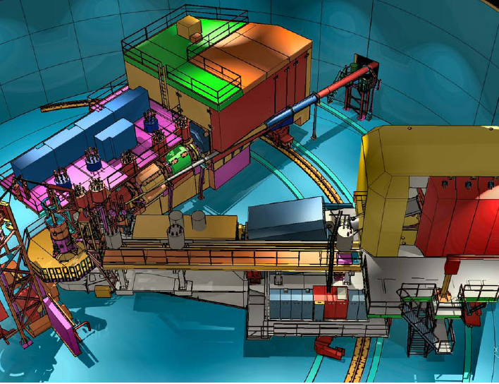
The original 6 GeV CEBAF with 3 experimental Halls
Racetrack design with two parallel linear accelerators each providing up to ΔE ~ 600MeV, with 5 re-circulations through the arcs.
arcs
Continuous beam with up to 6 GeV polarized electrons to 3 Halls.
Injector
HRS²
Transverse beam profile σ ~100μm
Photon energy tagging system in Hall B for the missing N* resonance program with CLAS.
CLAS
HMS
→ Focus on Hall B and the CLAS Detector
Notes:
Most of the results I will be discussing with you were obtained at Jefferson Lab at a maximum beam energies of 6 GeV.
The electron accelerator is based on a race-track design operating with two linear accelerators (linacs) based on superconducting rf technology. Each of the linacs boosts the beam by up to 600MeV resulting in 1200MeV per recirculation. After the 5th pass the beam energy of 6 GeV is reached.
The 3 experimental halls A,B,C can receive simultaneous beam at the same 5th pass energy, or at different but correlated energies extracted at different passes.
For the further discussion I will focus on the Hall B where most of the results of the what I will discuss where obtained.

Slide 12
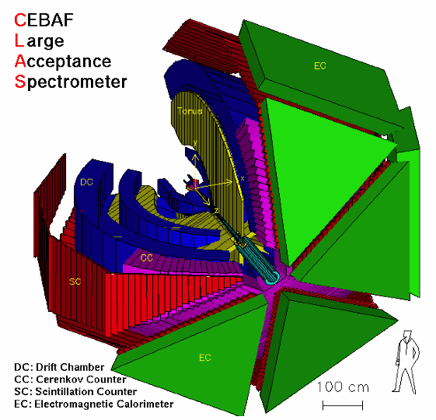
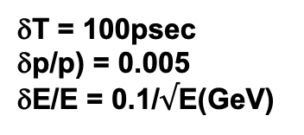
The CLAS Detector
Large acceptance
Momentum reconstruction
Charged particle identification
Photon and neutron detection
In operation from 1997 to 2012 in two modes:
Photon beams: Search for excited states of the proton
Electron beams: Structure of the nucleon and excited states
δT = 100psec
δp/p) = 0.005
δE/E = 0.1/$√$E(GeV)
Electron acceptance: θ_{e} = 10º – 45º
Charged Hadron acceptance: θ_{h} = 10º – 140º
Notes:
This graph shows the large acceptance detector CLAS. On the left is a cut-out version of detector model showing the major elements for tracking, particle identification with time-of-flight measurements with high time resolution detectors, plastic scintillators, and electromagnetic calorimetry.
At the core is a large superconducting toroidal magnet based on six large coils that partitions the space in six 60 deg. wide separate magnetic spectrometers fully equipped with tracking and particle identification.
The photo on the right shows CLAS in maintenance configuration. The CLAS is operated both with real energy-marked photon beam and with polarized electron beams.
When using real photon beams the energy of the photons is determined by means of a photon energy tagger system with good energy resolution of 0.1%.
Particle identification of charged particles , proton, pion, kaons is achieved by means of plastic scintillation counters with 100psec timing resolution, allowing pion and kaon separation up to 2.5 GeV/c momentum.
Electromagnetic calorimeters enable detection of high energy photons e.g. from π⁰ → γγ decays with energy resolution of ~ 10%/sqrt[E(GeV)]

Slide 13
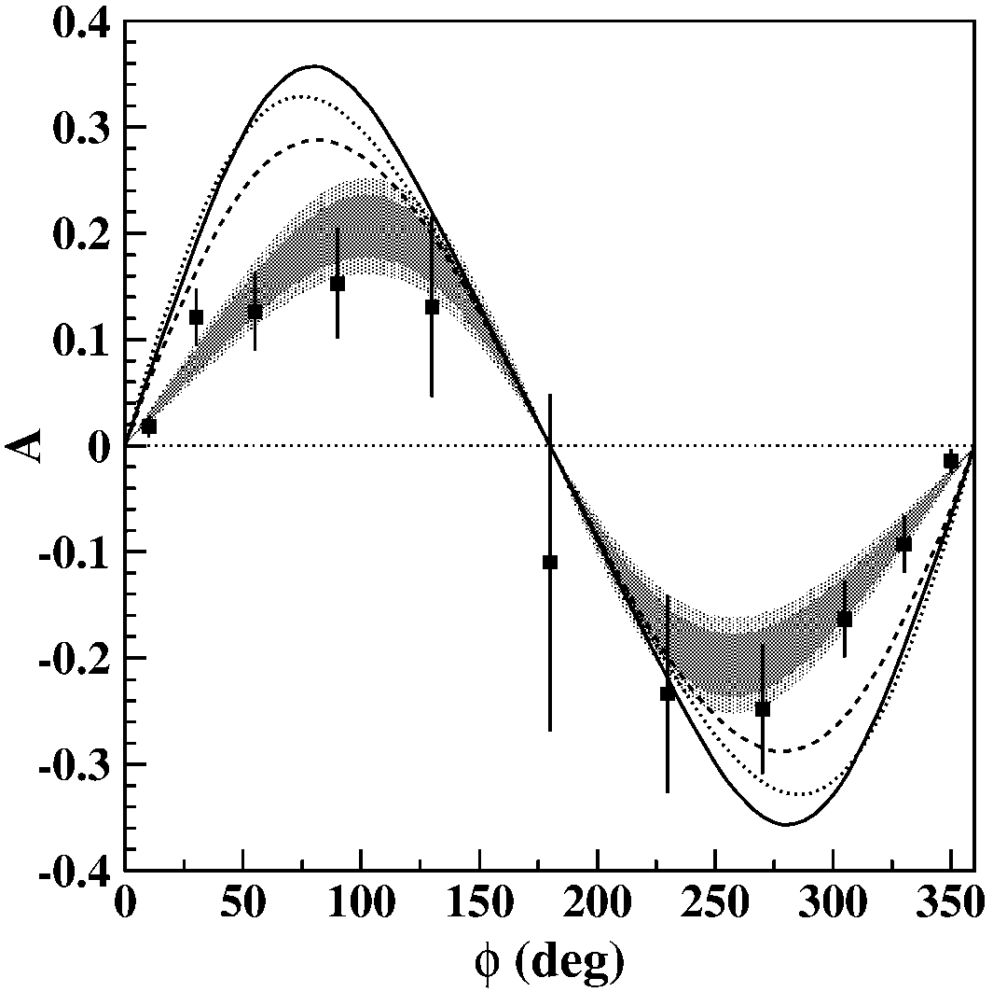
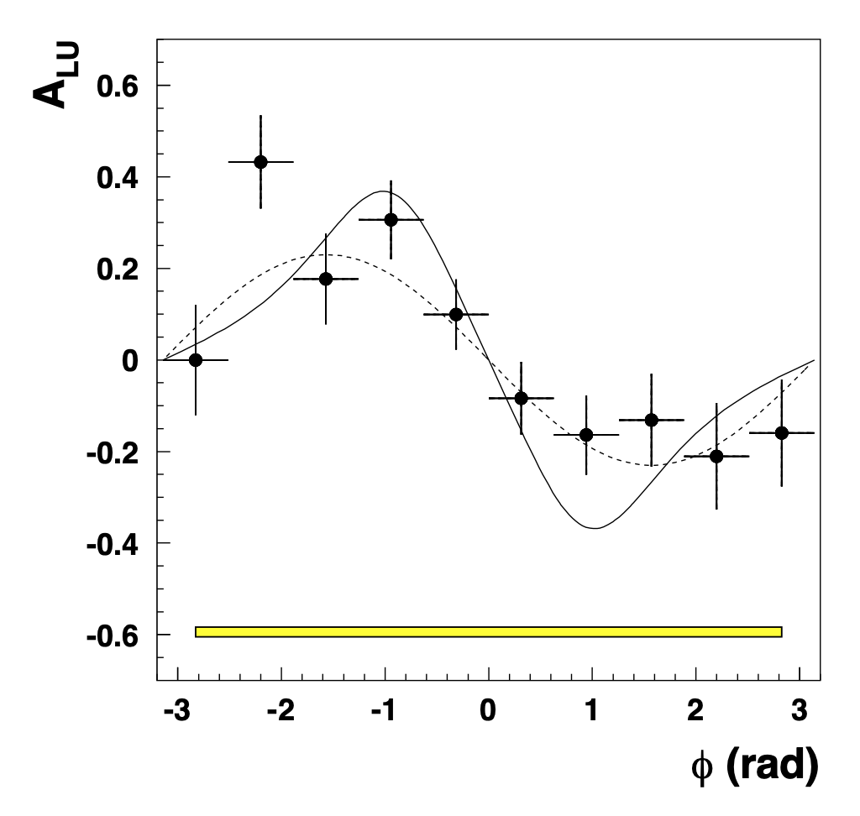

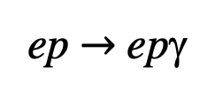
First DVCS-BH BSA observed in 2001
Observation of Exclusive Deeply Virtual Compton Scattering in Polarized Electron Beam Asymmetry Measurements
CLAS Collaboration
HERMES Collaboration
Phys.Rev.Lett. 87 (2001) 182002
Phys.Rev.Lett. 87 (2001) 182001
$$→$$
e⁻: 4.25GeV
e⁺: 27.6GeV
ep $→$ epγ
This opened a new era of hadron research in exclusive processes.
Beam Polarization Asymmetry
https://journals.aps.org/prl/pdf/10.1103/PhysRevLett.87.182002
https://journals.aps.org/prl/pdf/10.1103/PhysRevLett.87.182001
Notes:
The first observation of the DVCS- Bethe-Heitler interference occurred simultaneously at the HERMES experiment at DESY in Hamburg, Germany, and at Jefferson Lab. The experiments used very different values of beam energies.
They were taken with positrons at HERMES and with electrons at JLab, showing the expected opposite sign of the beam-spin asymmetry.
For me it was the opening of a new avenue of hadron physics at the beginning of the new century.

Slide 14
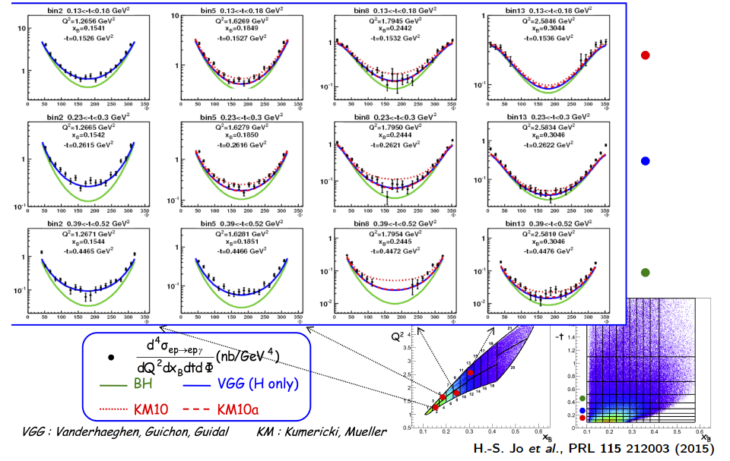
DVCS Unpolarized Cross-Sections Dedicated Experiment
H.S. Jo et al., Phys.Rev.Lett. 115 (2015)

Slide 15
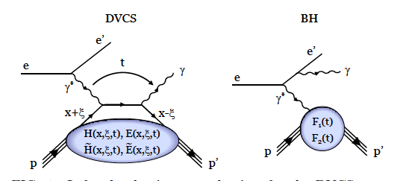
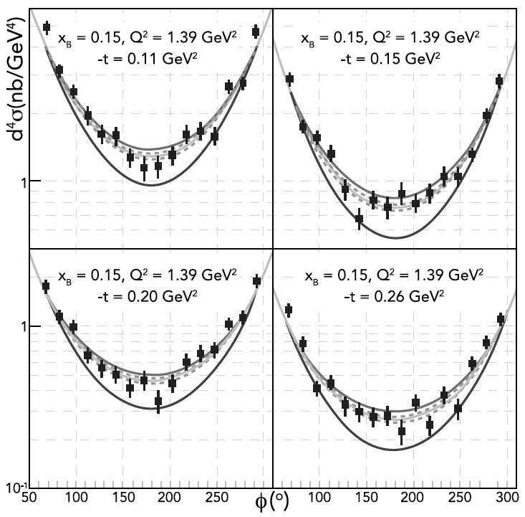
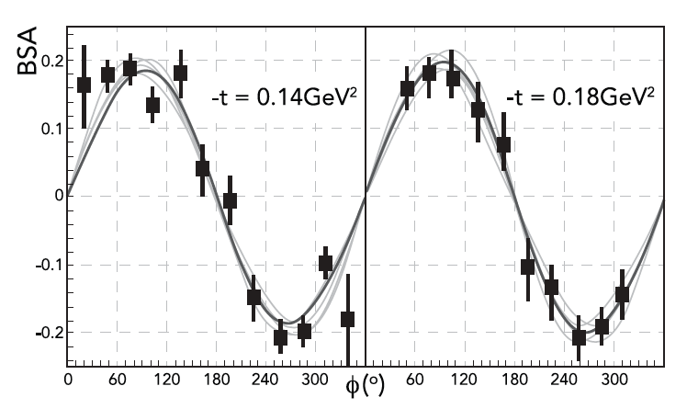
Fit to DVCS data to determine D-Term
Samples of differential cross sections with fits
Samples of Beam Spin Asymmetry
DVCS - BSA
F.X. Girod et al., Phys.Rev.Lett. 100 (2008) 162002 ; H.S. Jo et al., Phys.Rev.Lett. 115 (2015) 212003,

Slide 16
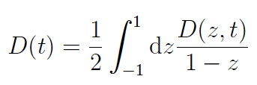
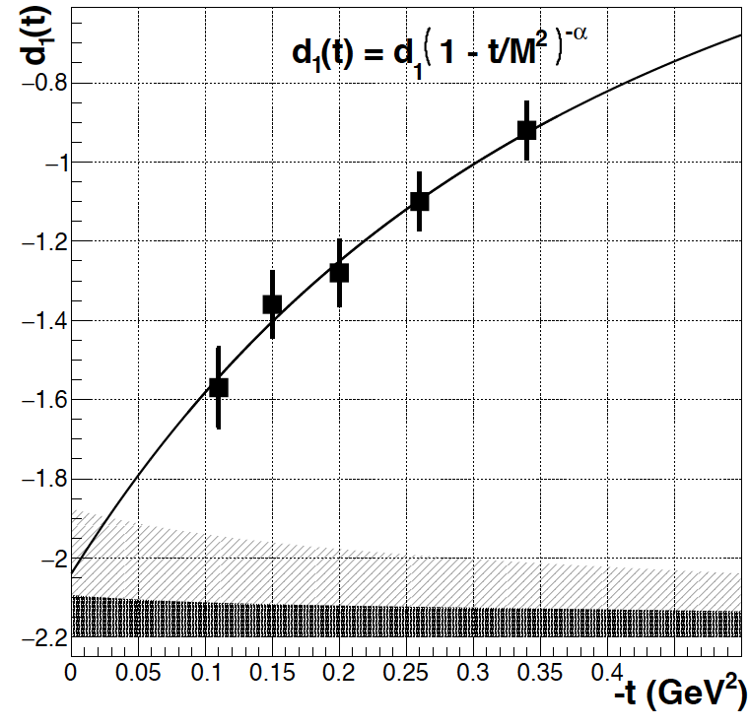
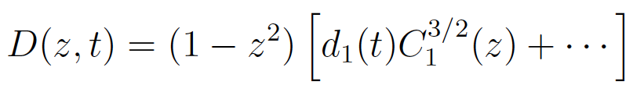
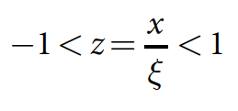
d^{Q}₁(t) - Gravitational Form Factor
Expansion in Gegenbauer polynomials
with
d₁(0) < 0 dynamical stability of bound state
d^{Q}₁(0) = -2.04 ± 0.14 ± 0.33
First determination of new fundamental quantity.

Slide 17
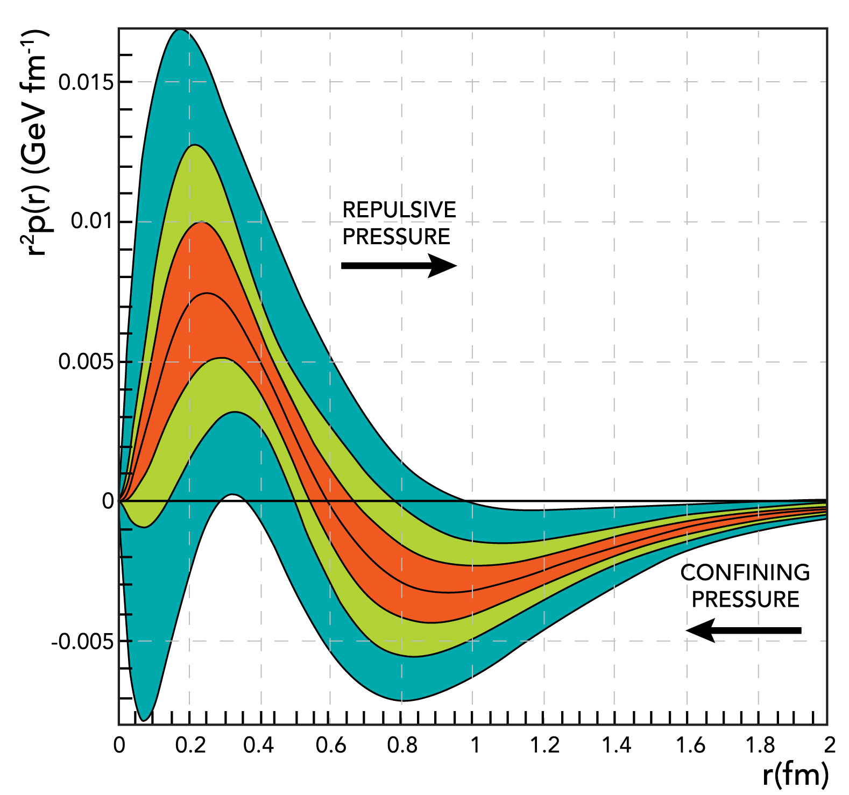
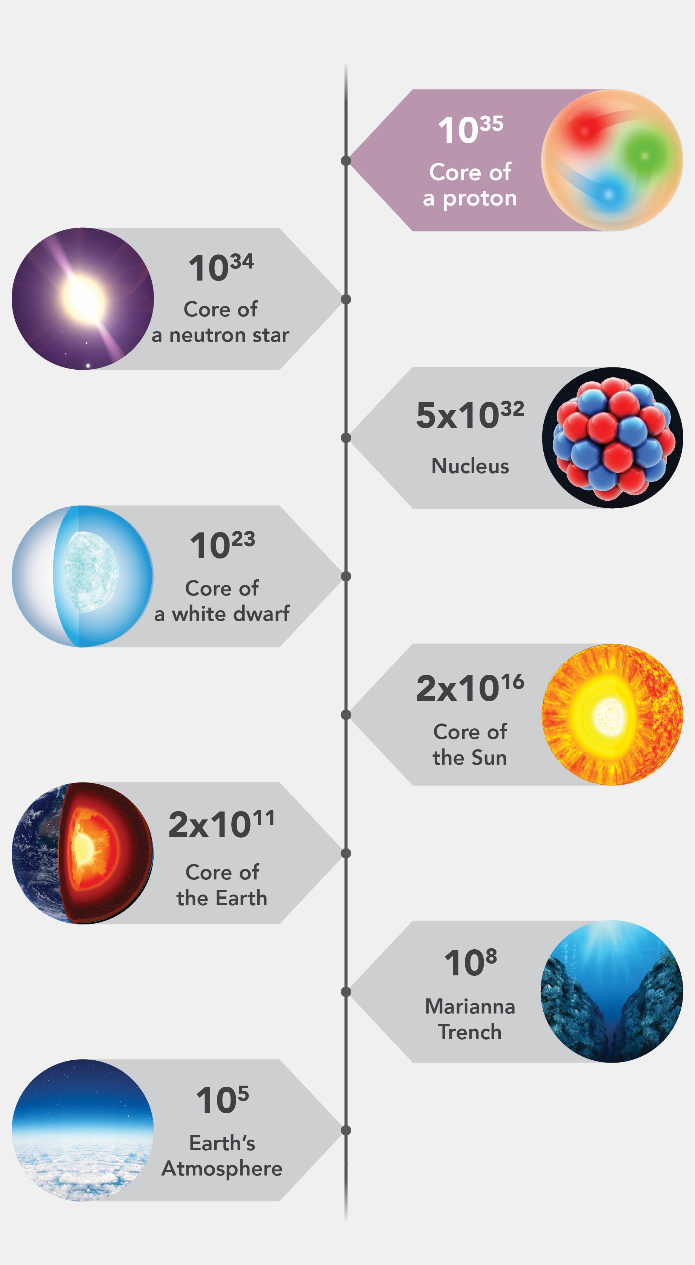

The pressure distribution inside the proton
World data
CLAS data
CLAS12 proj.
Repulsive pressure near center
p(r=0) = 10³⁵ Pa
Confining pressure at r > 0.6 fm
Atmospheric pressure: 10⁵ Pa
Pressure in the center of neutron stars ≤ 10³⁴ Pa
V. Burkert, L. Elouadrhiri, F.X. Girod
Nature 557 (2018) no.7705, 396-399

Slide 18

Shear Stress on quarks in proton
Shear stress r²s^{Q}(r)
Shear stress at r = 0.6fm:
4πr²s(r)= 0.238GeV/fm
~38$×$10³ Newton
systematic error band
4 metric tons
this result
χQSM
Notes:
Computing the shear stress or tangential forces on the quarks in the proton is now straight-forward and is shown in the graphics.
The different green shades indicate the systematic uncertainties from including with and without the CLAS data that we discussed earlier.
The maximum shear force was found near r=0.6fm from the center at about 4 metric tons.
There is a model calculations using the Chiral quark soliton model that comes close to the experimental results at larger distance to the center, but shows significant deviations at short distances to the center corresponding to large t values.
.

Slide 19
Normal & Tangential Stress on Quarks
Normal stress: F_{n}= 4πr²[2/3 s(r) + p(r)]
Tangential stress: F_{t}= 4πr²[-1/3 s(r) + p(r)]
Normal stress is positive at all r
Tangential stress changes direction near r ~ 0.45 fm
Notes:
In these graphs we present the 2-dimensional representation of the normal stress distribution and of the tangential stress distribution.
The normal stress is always perpendicular to a spherical surface. It is given by combining the pressure p(r) with the shear stress in this way, resulting in a normal stress pattern as shown in this graph. The normal stress is always positive and radially directed.
The tangential stress shows a more involved distribution. It is a combination of negative shear and pressure. At small r it points counter-clockwise, but It has a change in direction near r~0.45 fm, from where on it points in a clockwise direction.
Using the arrows may suggest that there is a movement in the direction of the arrow, which there is not. Everything is static.

Slide 20
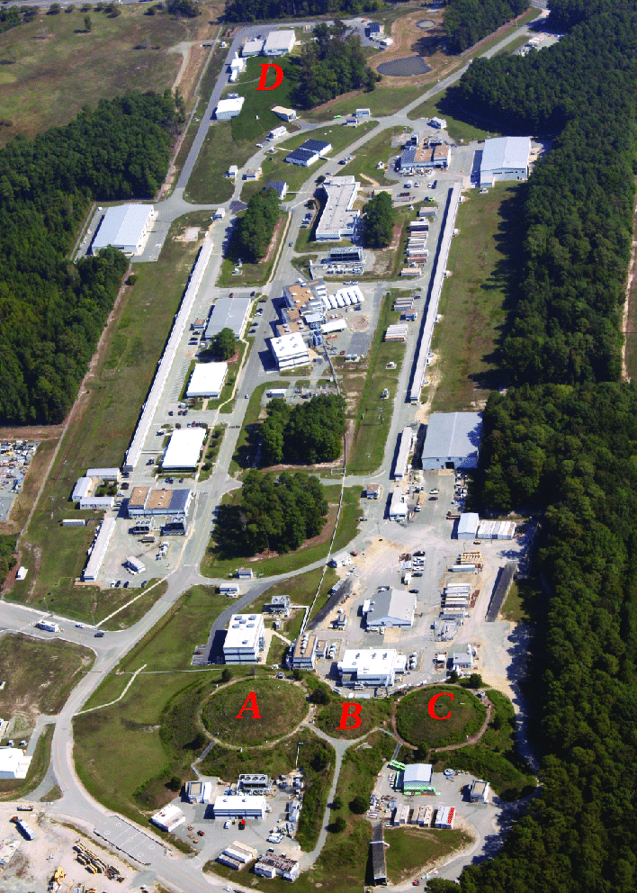
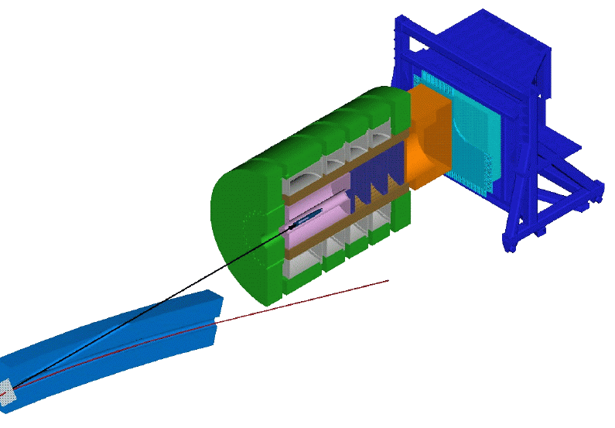
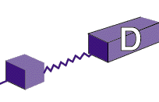
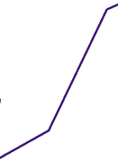


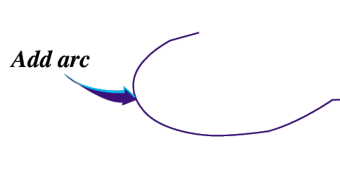
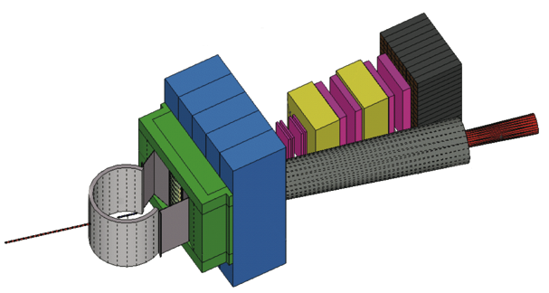

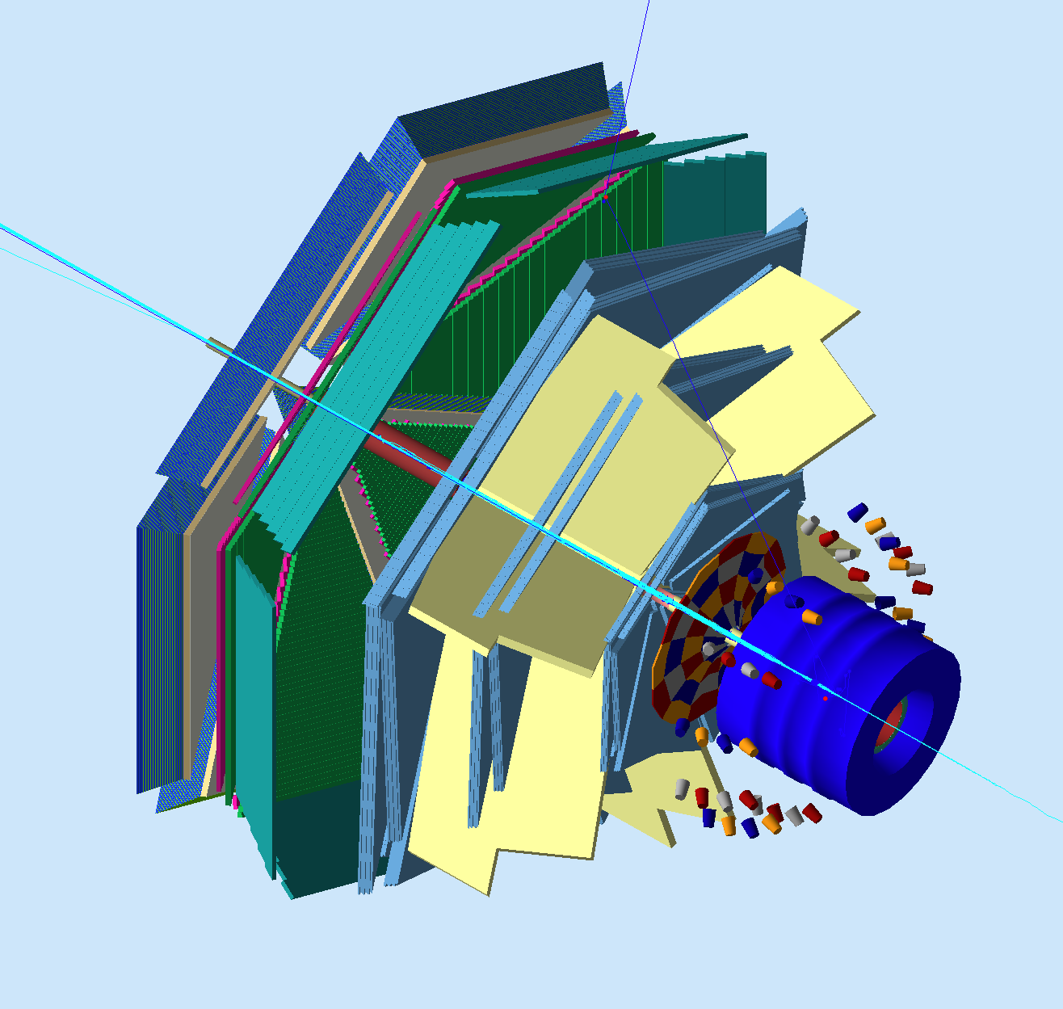
The Jefferson Lab Energy Upgrade
Maximum energy 12 GeV
New Experimental Hall D - GlueX
CLAS12 in Hall B
Upgrades to existing Halls A & C
GlueX
CHL-2
HRS² + SBS
CLAS12
HMS + SHMS
Notes:
Now, we want to change gears and briefly review the energy doubling from 6 to 12 GeV of the CEBAF at Jefferson Lab.
The energy upgrade was achieved primarily by adding new, higher performing acceleration cryomodules in available space.
In addition, a new arc was added to get 12 GeV beam to the new Hall D.
In Hall B the CLAS12 spectrometer was build, partially using detectors from CLAS and new spectrometers and other upgrades were added to the other Halls.

Slide 21

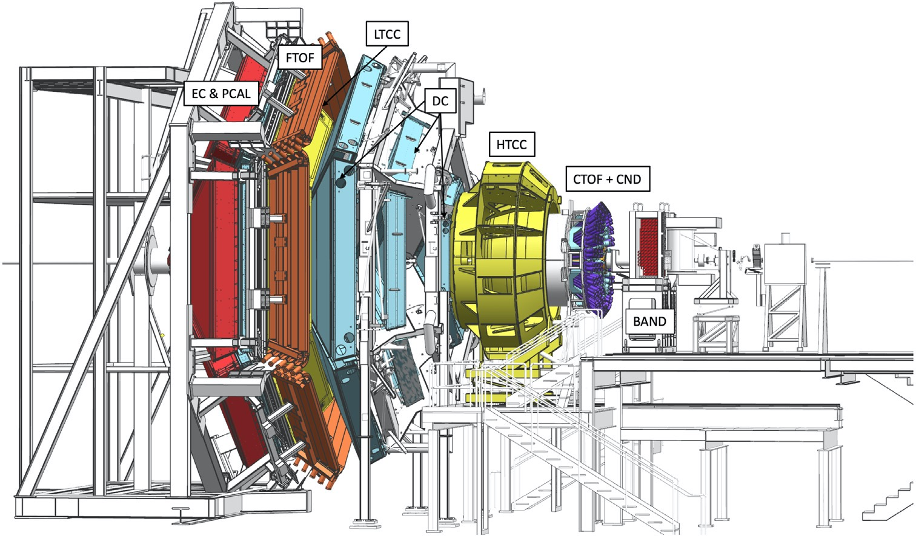

CLAS12
10 m
- Luminosity - 10³⁵cm⁻²s⁻¹
- Polarized target operation at 5T
- Charged particle tracking and ID
- Neutron and photon detection
- Data rate 1 Gigabyte/sec
- Charged Particle ID to 8 GeV/c
Notes:
In Hall B the CLAS12 detector has replaced the original CLAS detector. The main new features are:
- the increase of the operating luminosity by an order of magnitude, to 10^35cm-2s-1
- Polarized target operation with full polar angle and azimuthal angle coverage
- Neutron detection capability in nearly full polar angle range. .
- Charge particle tracking and identification in full momentum range in RICH detector
- High data rate of 1 Gigabyte/sec.

Slide 22

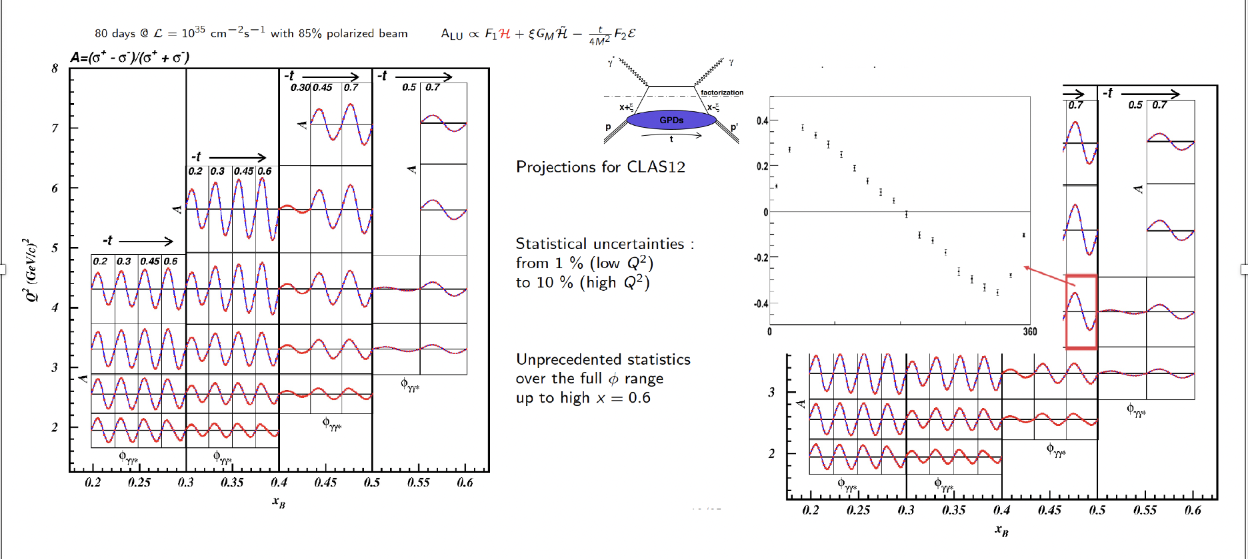
DVCS Experiment – Projections

Slide 23
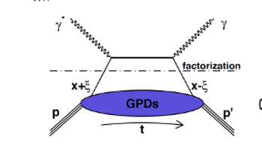
DVCS Beam Spin Asymmetry From CLAS12 12 GeV Data

Slide 24
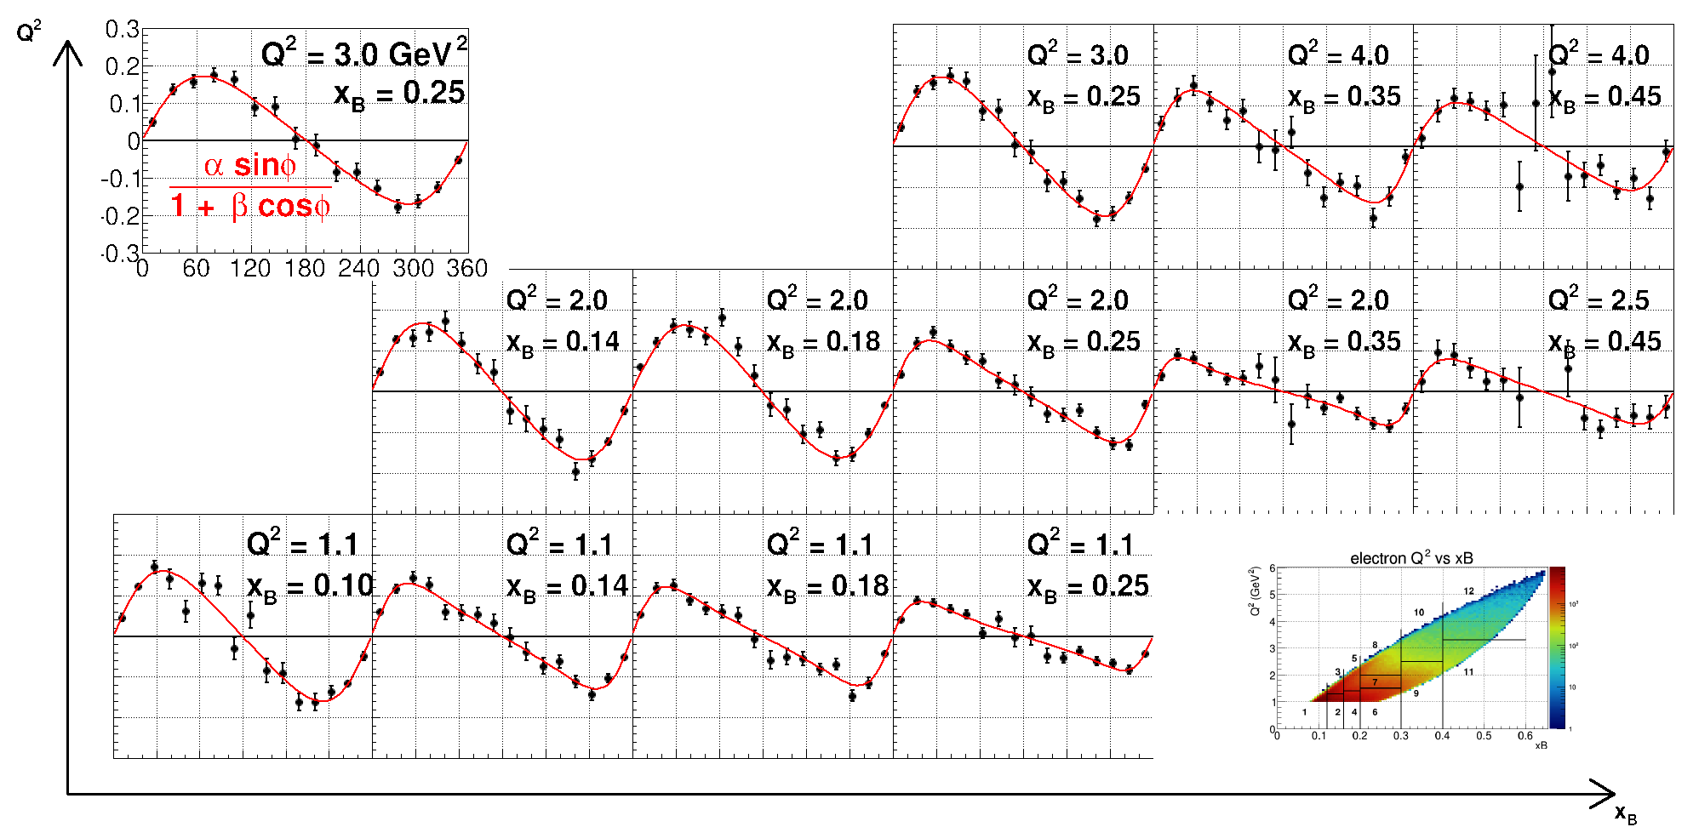
Preliminary DVCS BSA from CLAS12 7.5 GeV Data

Slide 25
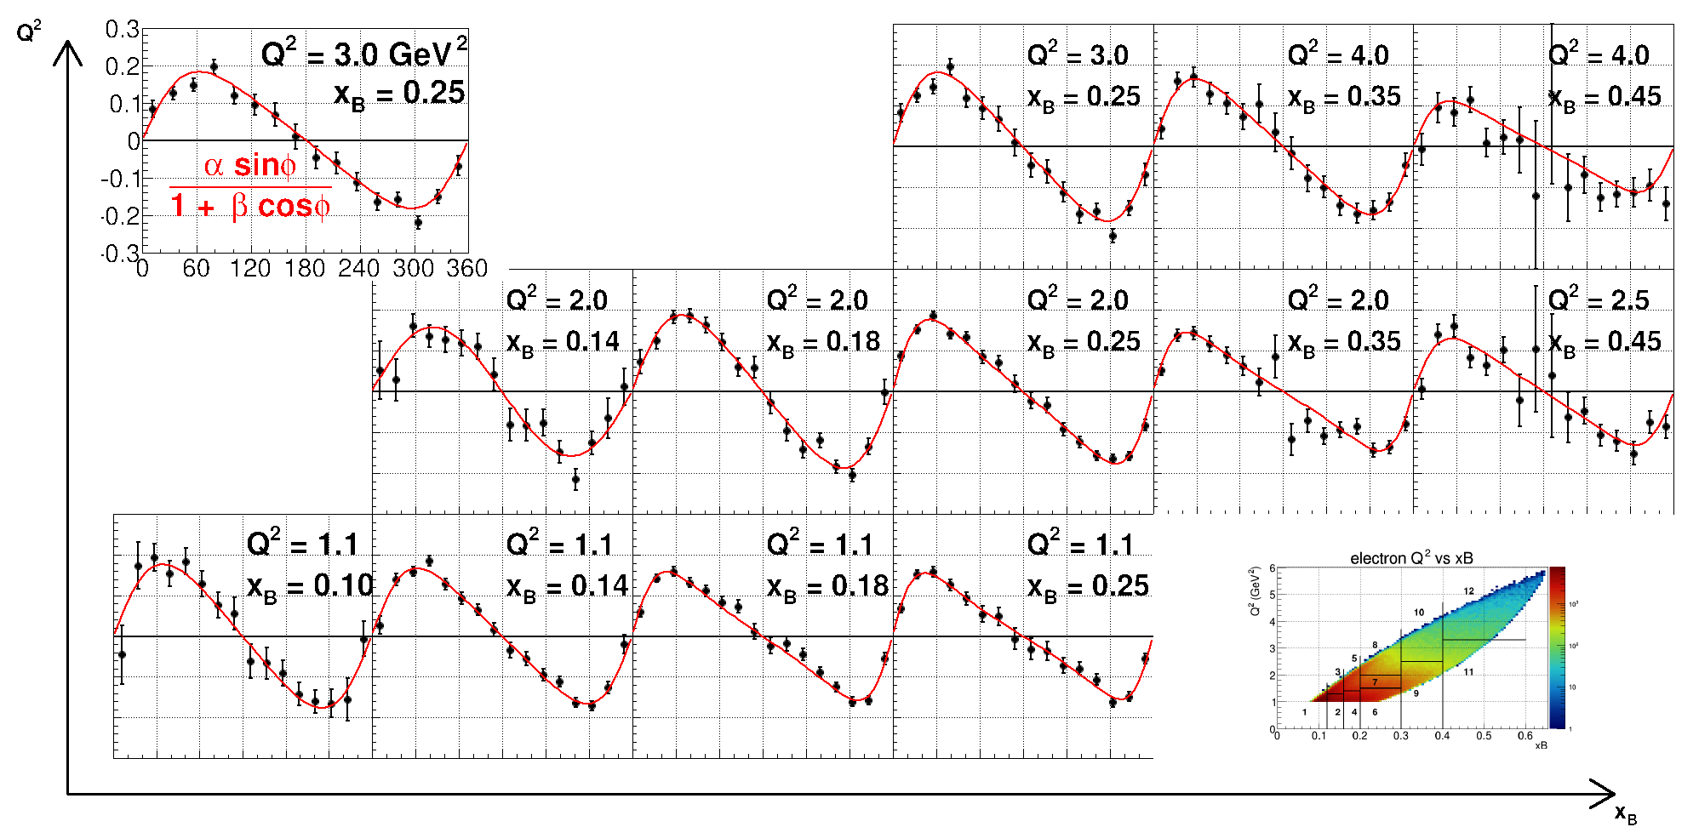
Preliminary DVCS BSA from CLAS12 Data 6.5 GeV Data

Slide 26
From GFF D_{q}(t) to Distribution of Forces (pressure)
Fitting the dispersion relation to ImH(ξ,t), ReH(ξ,t)
Fourier
transform
10⁻³
-t/Q² < 0.2
24 GeV
6 GeV
10.6 GeV
22 GeV required to cover sufficient range in t for extraction of mechanical properties.

Slide 27
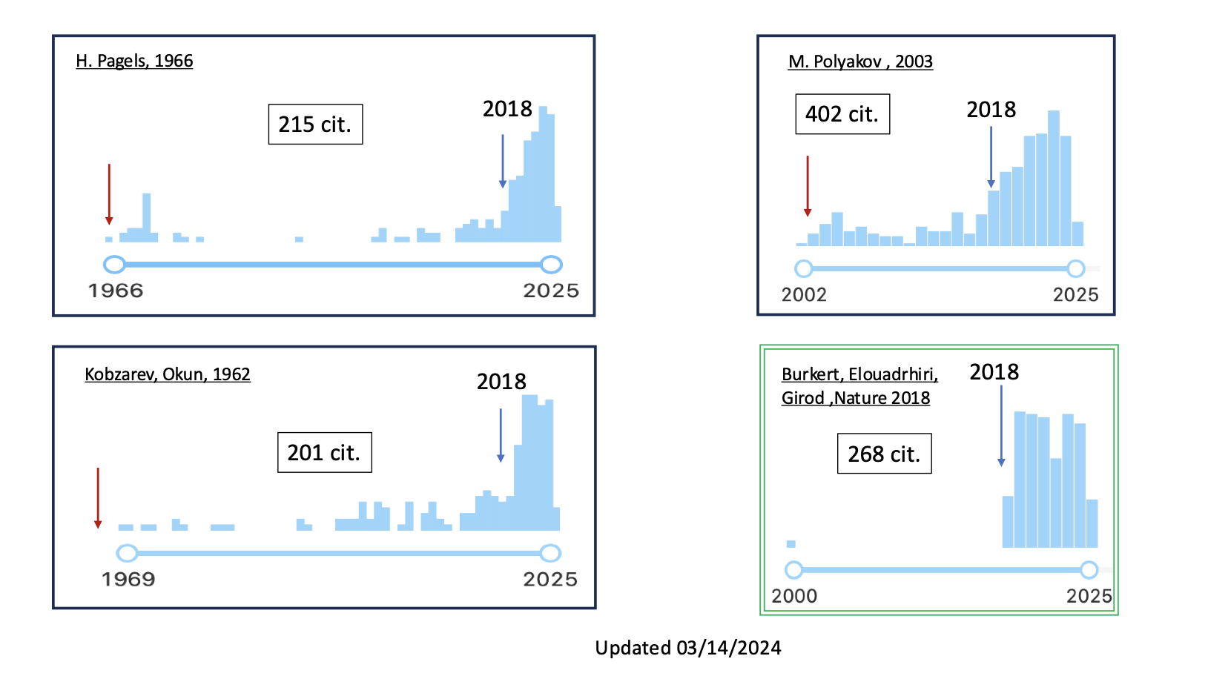
Citations of theory papers on gravitational proton FF, and BEG results

Slide 28
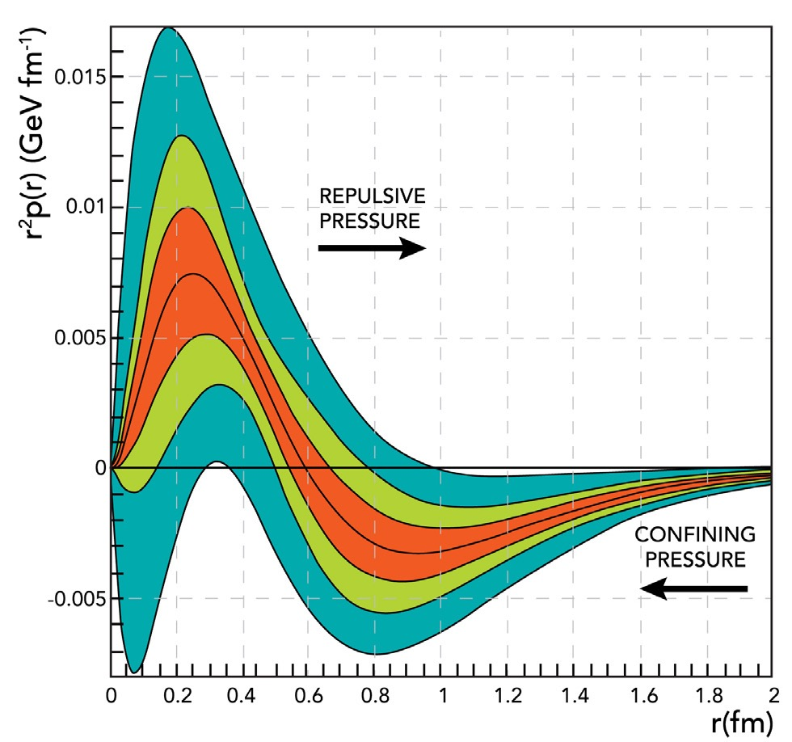
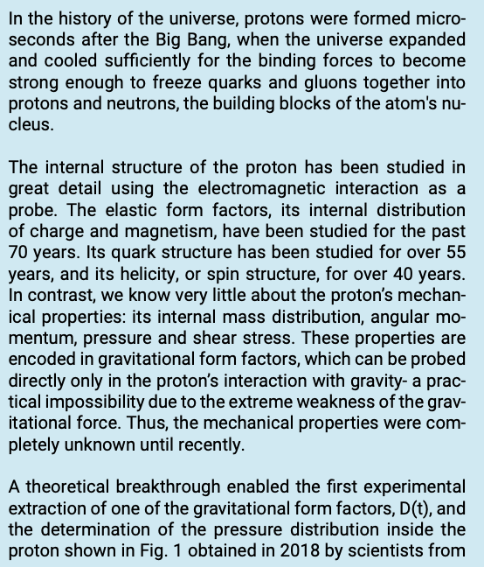
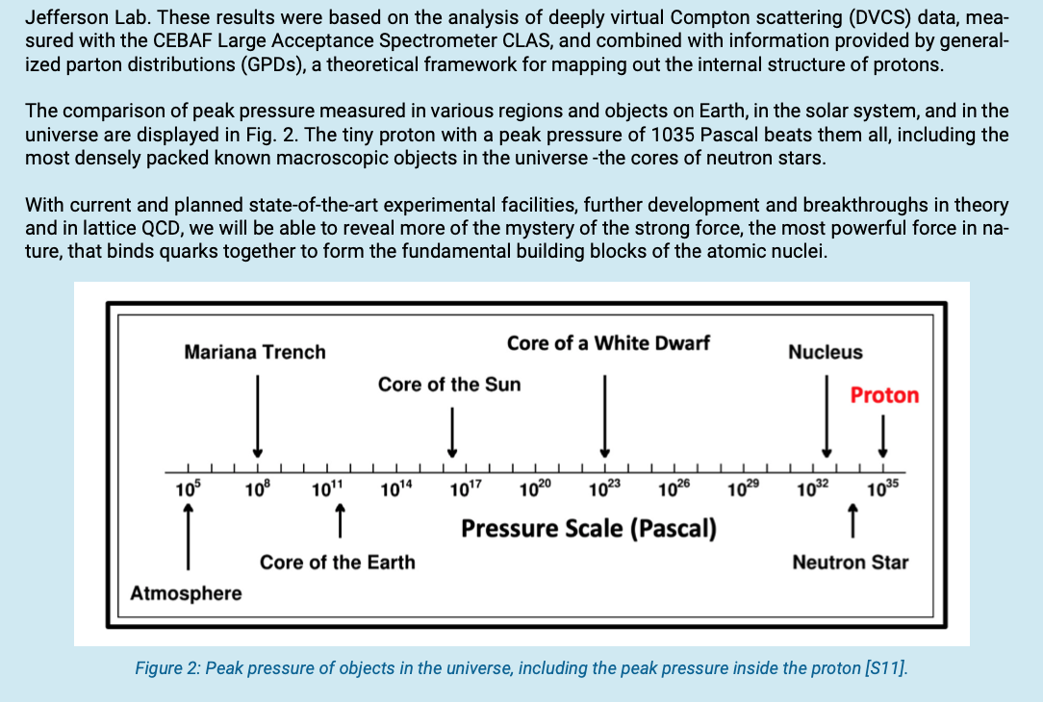
NSAC LRP 2023
Sidebar 3.2 The Pressure Inside the Proton
Figure 1: Pressure distribution in the proton weighted as r2 p(r). The peak pressure at r = 0 corresponds to 1035 Pascal. The green shaded bands represent uncertainties if only initial world data (dark) or more recent high statistics data (light) are included. The red band represent projections of future experiments [S10].
Notes:
The gravitational structure of particles is prominently included as a separate sidebar as shown here. .

Slide 29
Summary and Outlook
The first determination of the proton's Gravitational Form Factor DQ(t) marks a pioneering effort in extracting the internal pressure and force distributions within the proton.
Utilizing new CLAS12 DVCS (Deeply Virtual Compton Scattering) data, this research expands the kinematic range and enables measurements across various beam energies, target types, and beam polarizations.
This research program is a crucial component of the Jefferson Lab's 22 GeV and positron beam program.
This work opens-up a new frontier in hadron physics.

