Slide 1
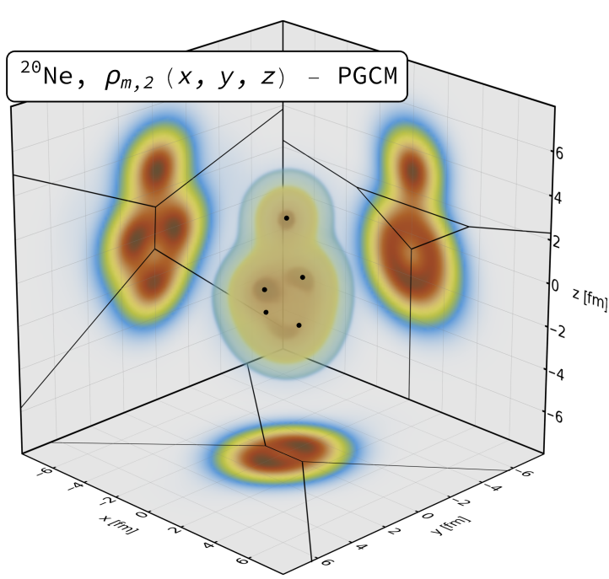
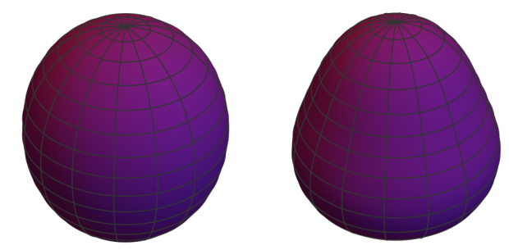
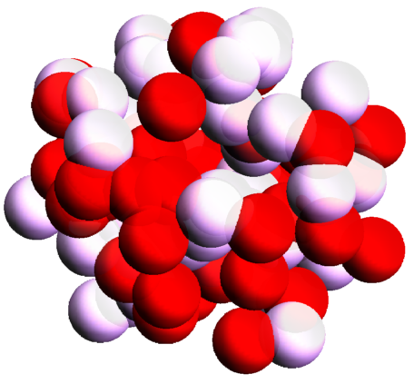
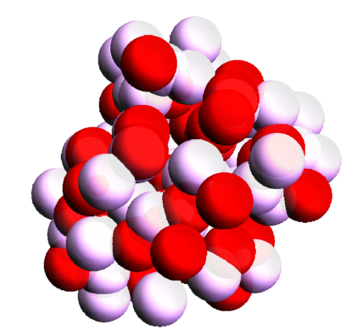
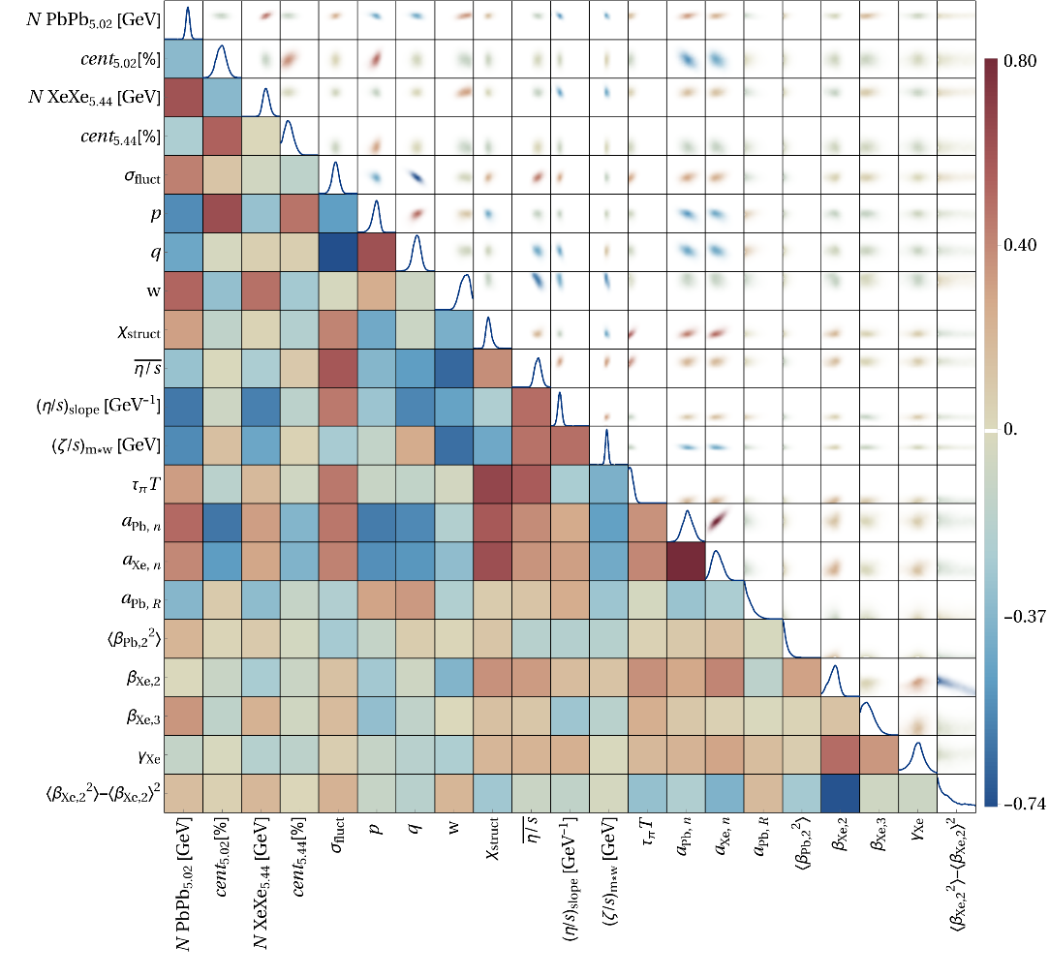
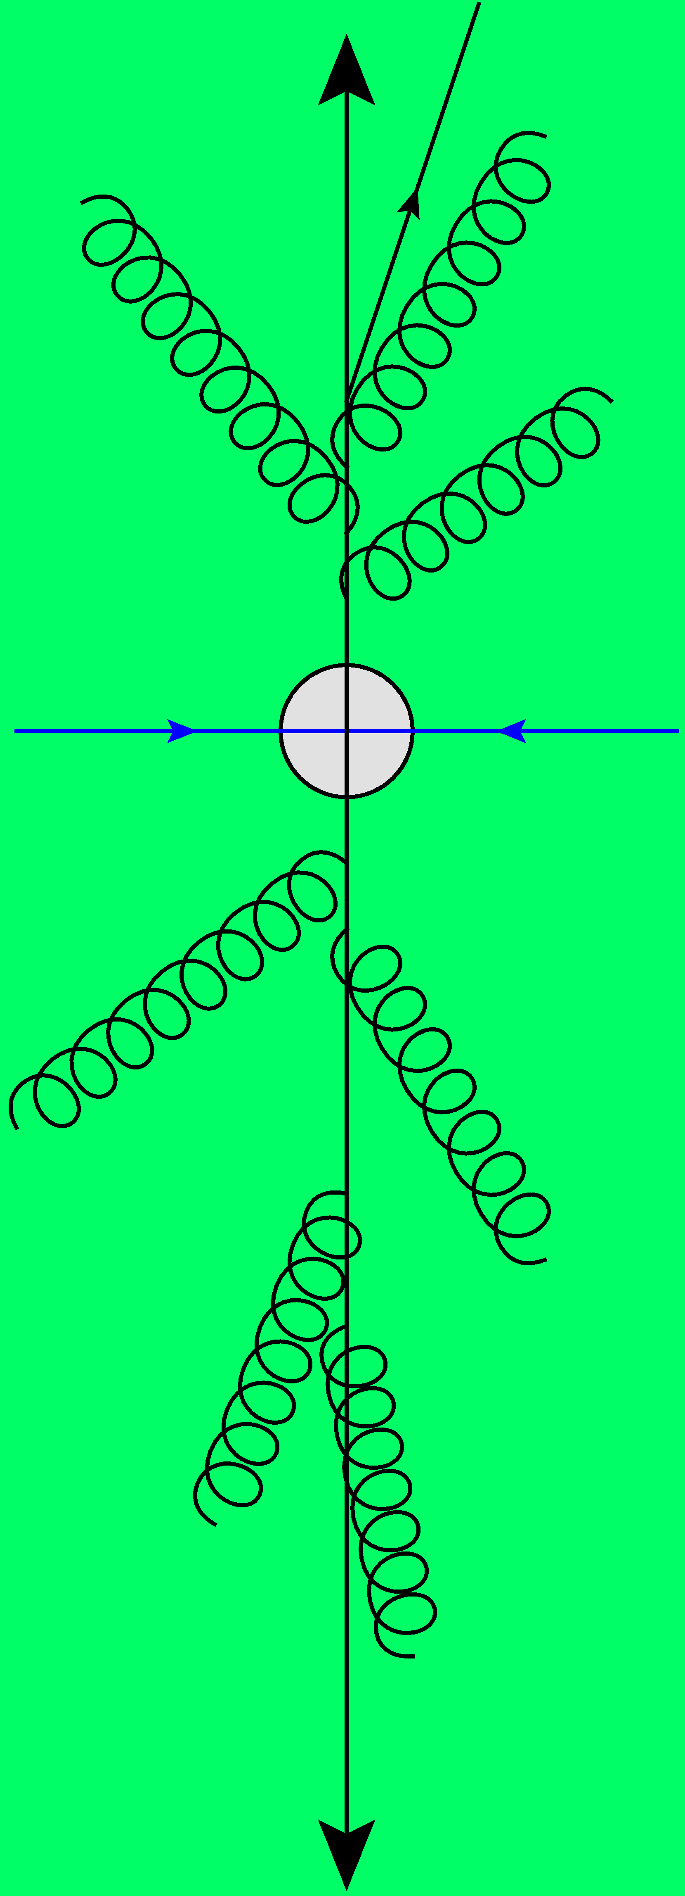
Correlations and collectivity from small to large systems
Towards a precision analysis of heavy ion collisions
Work mostly with Govert Nijs and Giuliano Giacalone
Wilke van der Schee
The 11th workshop of the APS Topical Group on Hadronic Physics
Los Angeles, 16 March 2025

Slide 2
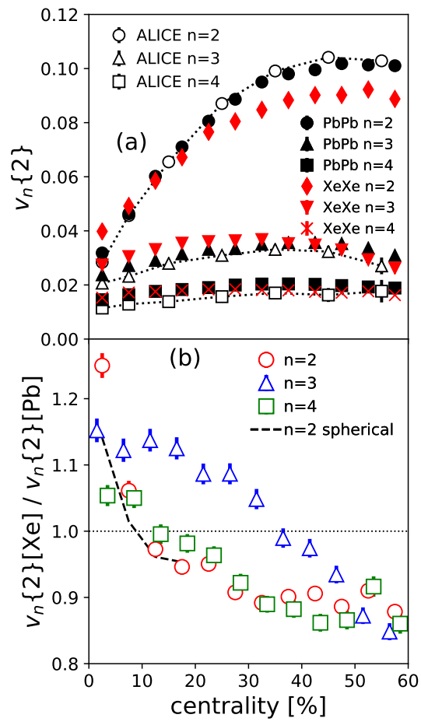
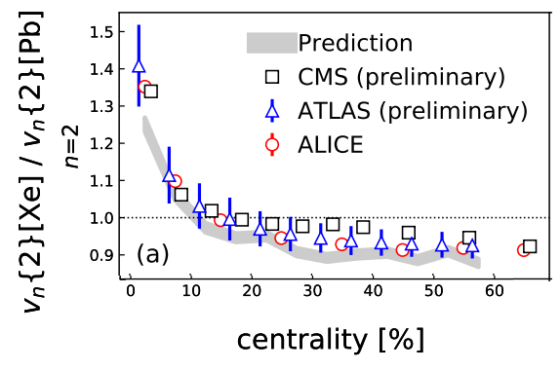
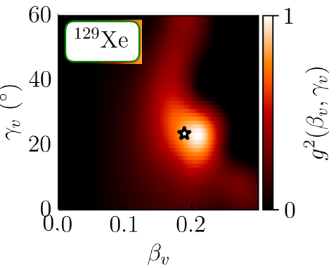
Prediction
Experiment
Xenon-129: a deformed nucleus
Elliptic deformation (β₂):
Was known from nuclear structure (0.16)
Prediction (MSc thesis Giacalone)
Xenon 6 (!) hour LHC run: slightly bigger effect
Sophisticated nuclear structure (PGCM) confirms slightly larger β₂ (0.19)
Improved theory
Giuliano Giacalone, Jacquelyn Noronha-Hostler, Matthew Luzum and Jean-Yves Ollitrault, Hydrodynamic predictions for 5.44 TeV Xe+Xe collisions (2017)
Giuliano Giacalone, Jacquelyn Noronha-Hostler, Matthew Luzum, Jean-Yves Ollitrault, Confronting hydrodynamic predictions with Xe-Xe data (2018) Benjamin Bally, Michael Bender, Giuliano Giacalone and Vittorio Soma, Evidence of the triaxial structure of ¹²⁹Xe at the Large Hadron Collider (2021)

Slide 3
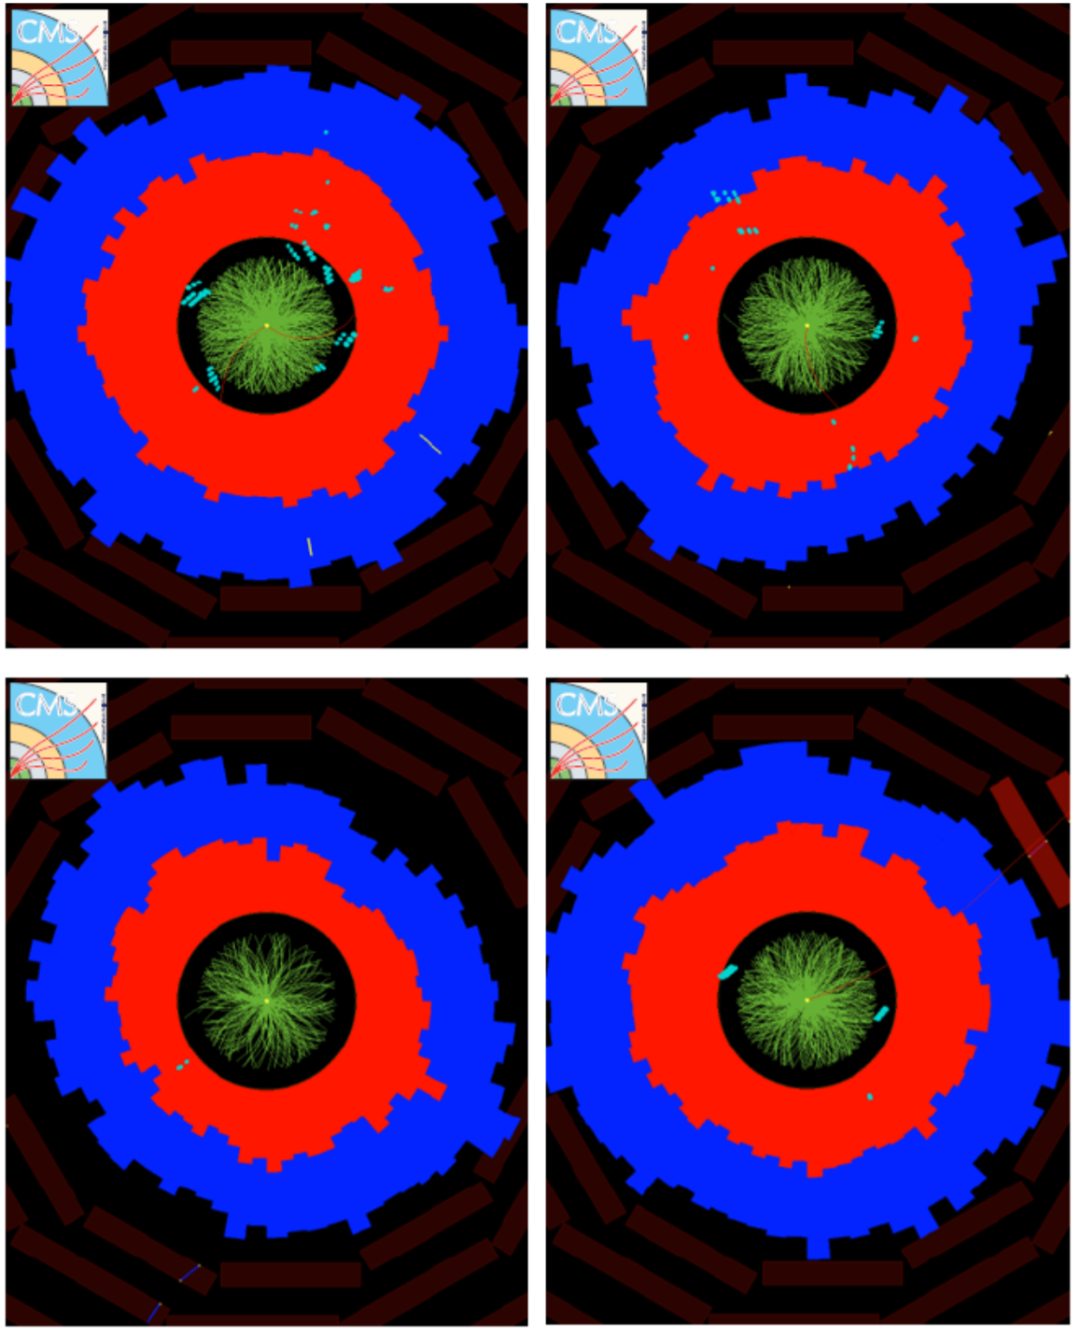
Quark-gluon plasma
Trajectum (Trento + hydro + freeze-out)
Parallelised: can analyse unlimited number of events
Two important features
Initial geometry determines momentum anisotropy: elliptic flow
Smaller droplets expand faster: higher mean p_{T}
http://sites.google.com/view/govertnijs/trajectum
http://wilkevanderschee.nl/trajectum

Slide 4
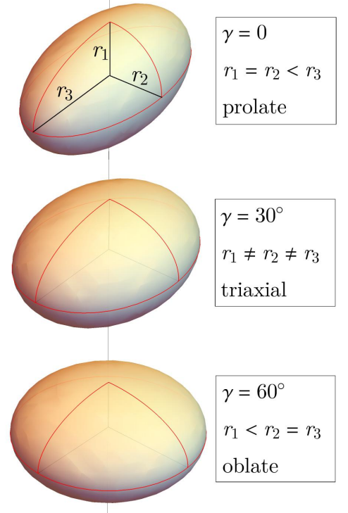
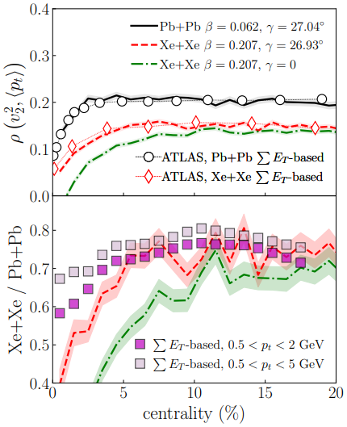
Xenon-129: a triaxial* nucleus and the ρ₂ (elliptic flow-mean p_{T} correlation)
Elliptic deformation (β₂):
Prolate or oblate: still has symmetry axis
Triaxial: all axis are independent
Curiously (?) especially ρ₂ observable sensitive
Measures correlation between elliptic flow and mean pt
What’s happening?
*rugby balls are prolate and not triaxial…
Benjamin Bally, Michael Bender, Giuliano Giacalone and Vittorio Soma, Evidence of the triaxial structure of ¹²⁹Xe at the Large Hadron Collider (2021)

Slide 5
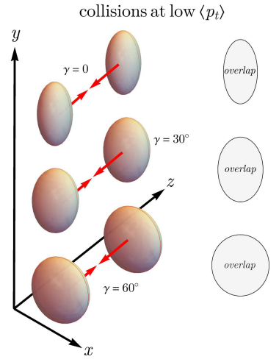
Xenon-129: a triaxial nucleus: what’s happening
Smart trick: two selections
Central and large (full overlap, low p_{T}) Prolate: large v₂ (negative ρ₂) Oblate: small v₂ (positive ρ₂) Conclusion ρ₂ determines γ
Alternatively:
Central and spherical (full overlap, low v₂) Prolate: small area, high p_{T} (negative ρ₂) Oblate: large area , low p_{T} (positive ρ₂) Conclusion ρ₂ determines γ
Note: just v₂ doesn’t work, β₂ gives v₂ in both cases (!)
Benjamin Bally, Michael Bender, Giuliano Giacalone and Vittorio Soma, Evidence of the triaxial structure of ¹²⁹Xe at the Large Hadron Collider (2021)

Slide 6
Outline
Correlations and collectivity from large to small
Beyond the simple picture: a global analysis
More about xenon and ρ₂
Light ion collisions

Slide 7
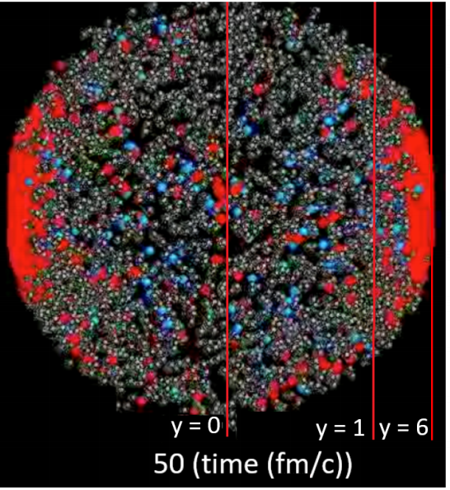
Standard model of heavy ion collisions
Wilke van der Schee, CERN/Utrecht
(# parameters)
Initial stage (15)
Viscous hydrodynamics (4)
Cascade of hadrons
SMASH
Subnucleonic structure? (6)
with hydrodynamised initial stage
Fluctuations? (1)
Shape (3 Pb, 5 Xe)
Shear viscosity (2)
Bulk viscosity (1)
Second order transports: 1
Jonah Bernhard, Scott Moreland and Steffen Bass, Bayesian estimation of the specific shear and bulk viscosity of quark–gluon plasma (2019)
Govert Nijs, WS, Umut Gursoy and Raimond Snellings, A Bayesian analysis of Heavy Ion Collisions with Trajectum (2020)

Slide 8
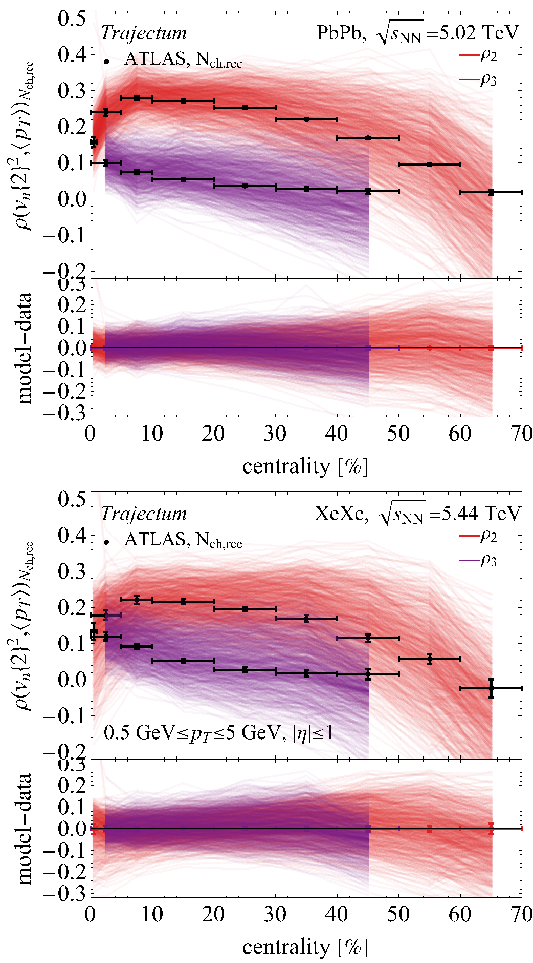
Lead and Xenon collisions and the ρ₂ observable
Run model at 750 semi-random points in parameter space
Relatively nice spread of model around ATLAS data
Relatively good statistics (oversampling ultracentral)
Xenon a bit wider if looking carefully (0-1%)

Slide 9
Xenon/Lead ratio, all observables, all parameters
See talk by Wenbin Zhao
Ratio: mostly sensitive to nuclear structure parameters
Central ρ₂ observable uniquely sensitive to γ parameter
Xenon a bit wider if looking carefully (0-1%)

Slide 10
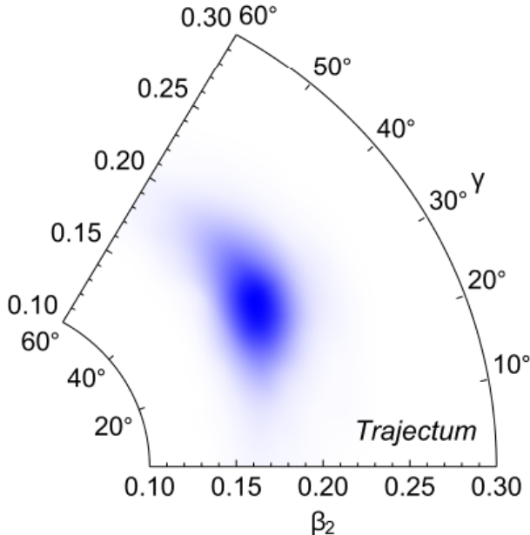
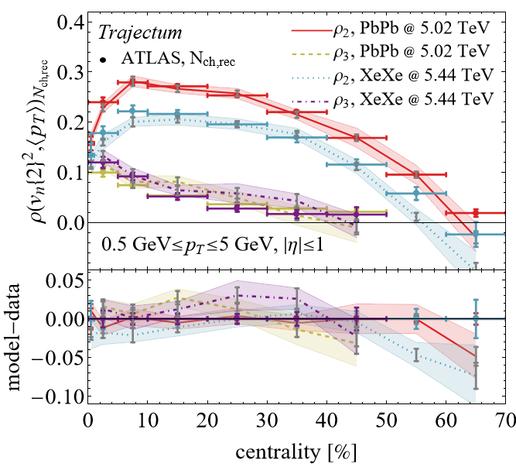
Posterior distribution
Three fits to data:
All observables (red), agrees with PGCM nuclear structure
All observables except ρ₂ (green): g unconstrained
All observables except 0-1% bin (purple): β₂ too small
More difficult to fit symmetric cumulants and neutron skin

Slide 11
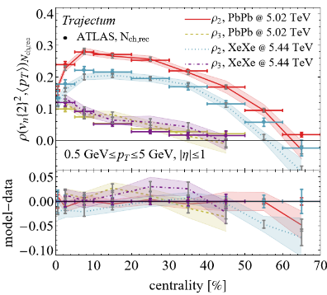
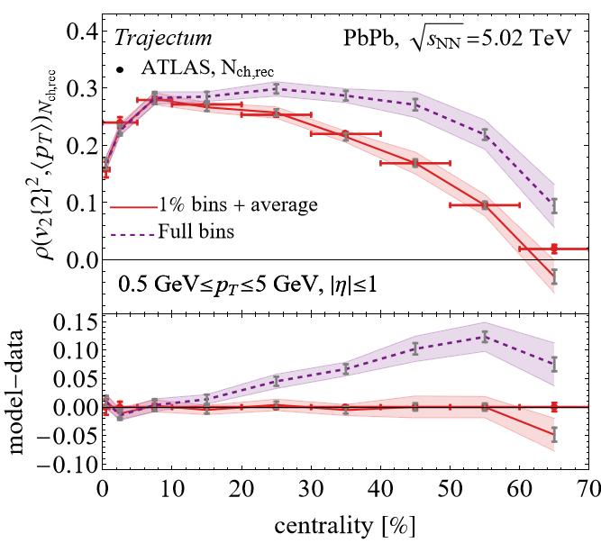
Centrality selection: details matter?
I skipped an important detail
The correlator is done in small centrality bins (1% for us)
Obtain larger bins by averaging
Relatively big effect (up to 0.1, exp uncert. is 0.01)
How to define centrality?
Impact parameter is old-fashioned
Event activity; but how and where?

Slide 12
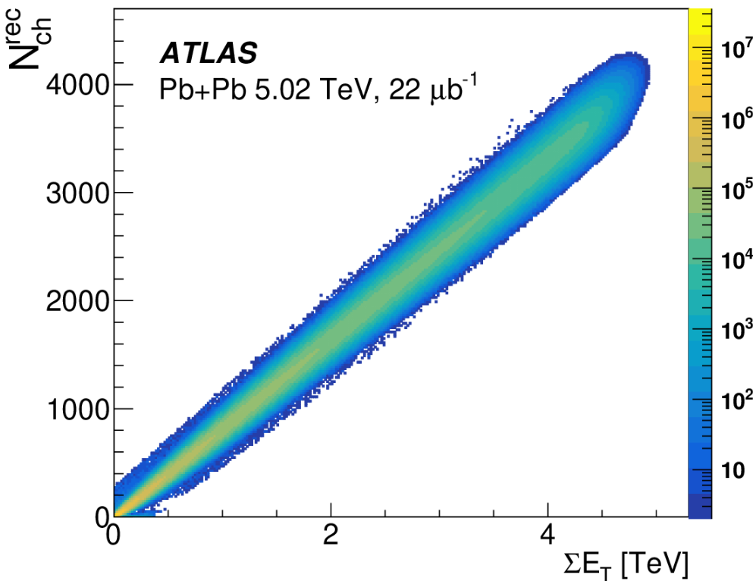
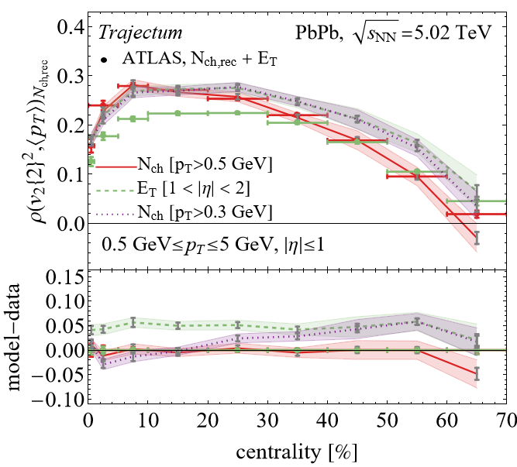
Centrality selection: details matter?
Forward (E_{T}) versus mid-rapidity (Nch)
Forward considered `better’ (ATLAS, lower spread)
Mid-rapidity closer to model (boost invariant)
Credit to ATLAS: HEPdata has 445 tables (!) that allows to figure these things out
Somewhat ironic:
ATLAS sees big effect at central collisions
Trajectum has big effect at peripheral collisions
Trajectum: big effect p_{T} cut on N_{ch} (purple)
ATLAS, Correlations between flow and transverse momentum in Xe+Xe and Pb+Pb collisions at the LHC with the ATLAS detector: a probe of the heavy-ion initial state and nuclear deformation (2022)

Slide 13
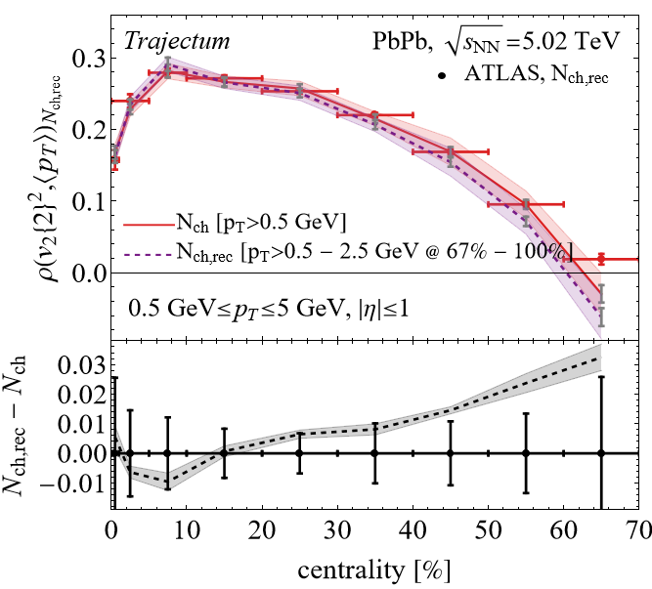
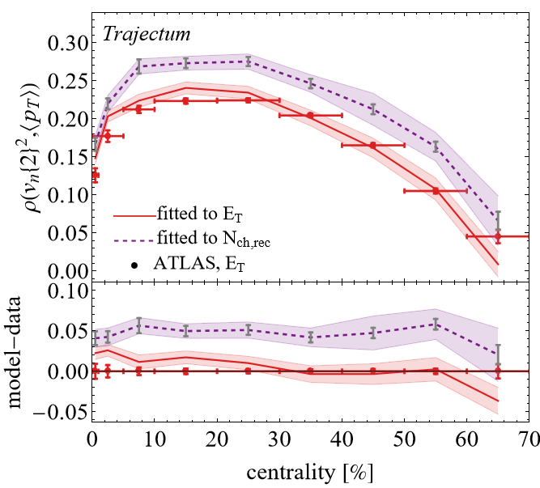
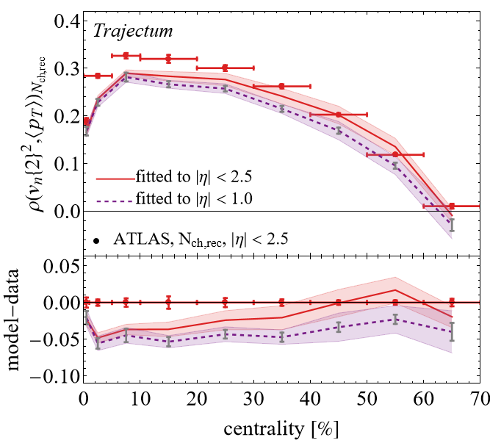
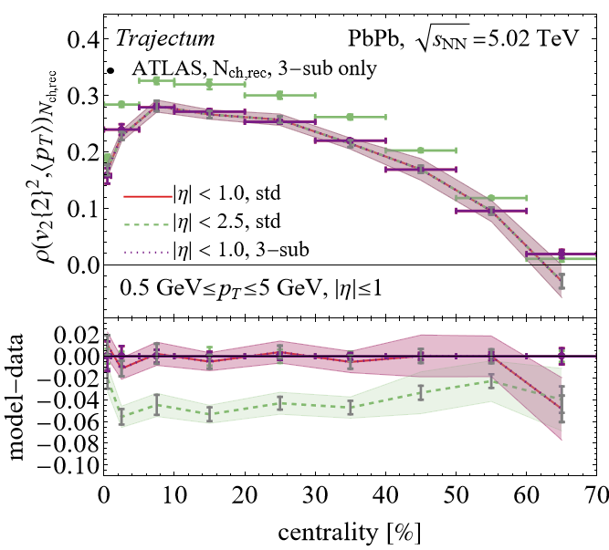
More details (ask me later if interested)
Detector effects potentially important (N_{ch} versus N_{ch,rec})
Refitting model to ET selected (works) or eta range 2.5 (does not work)
Standard versus 3-sub event method: equal for Trajectum, fits better for ATLAS 3-sub (less non-flow at peripheral)

Slide 14
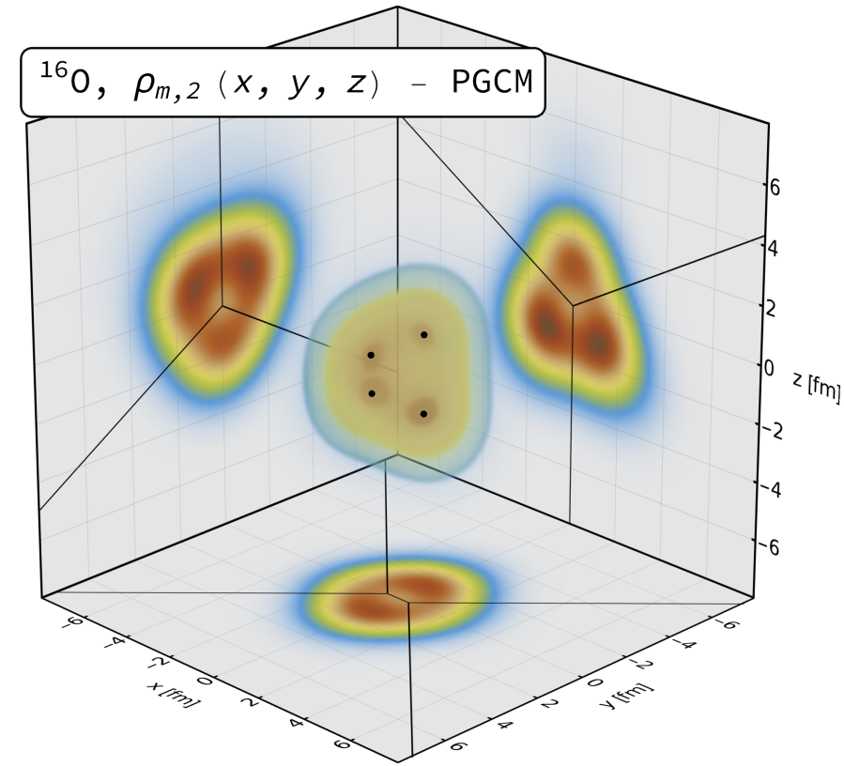
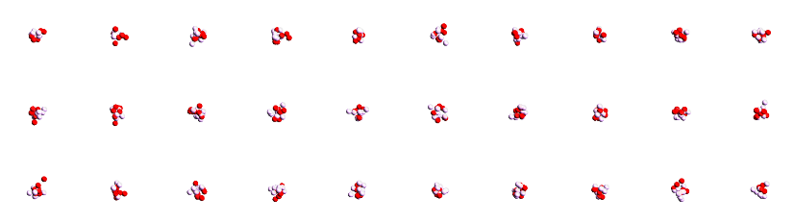
¹⁶Oxygen and ²⁰Neon nuclear structure
Do we understand and/or need to understand the shape of O and Ne?
Seems so, need precision understanding of anisotropic flow
Interesting by itself: combination of 4 or 5 alpha particles
Studied using two complementary nuclear structure methods:
State-of-the-art Projected Generator Coordinate Method (PGCM)
`Pinhole’ configurations from Nuclear Lattice Effective Field Theory (NLEFT)
Giuliano Giacalone, Benjamin Bally, Govert Nijs, Shihang Shen et al,The unexpected uses of a bowling pin: exploiting 20Ne isotopes for precision characterizations of collectivity in small systems (2024)

Slide 15
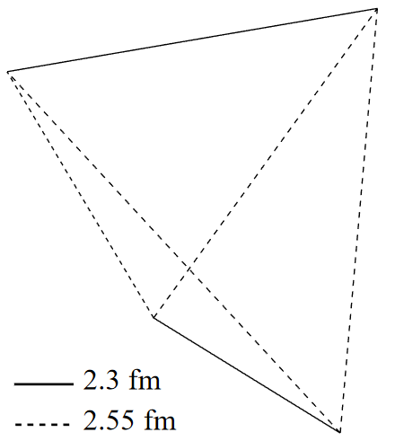
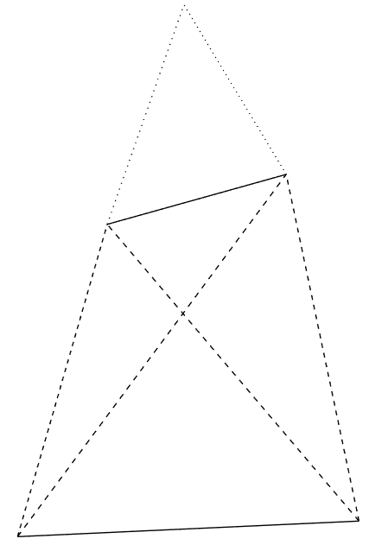
Alphas from nuclear structure
Two big surprises (at least to me ☺)
¹⁶O alphas do not form a regular tetrahedron (!) → more like two coupled rods Similar results in NLEFT
²⁰Ne alphas do not form a bipyramid (!) → seemingly randomly placed on top… (was a challenge to find due to breaking of symmetry, credit to Benjamin Bally)
Of course the intuition of alphas as point particles with interaction energy is really quite naïve…
Giuliano Giacalone, Benjamin Bally, Govert Nijs, Shihang Shen et al,The unexpected uses of a bowling pin: exploiting 20Ne isotopes for precision characterizations of collectivity in small systems (2024)

Slide 16
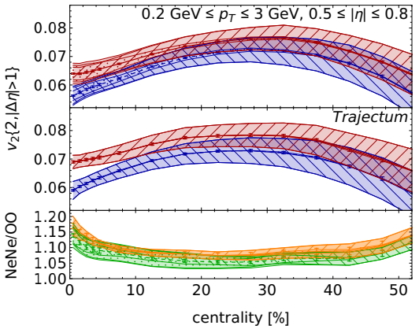
Anisotropic flow in light ions and nuclear structure
What are the theoretical systematic uncertainties?
Parameters such as viscosities are highly correlated
Take random sample of `probable’ parameter settings
Compute one standard deviation systematic uncertainty
Heavy ion and nuclear structure have comparable syst. unc.
Characteristic difference between O and Ne
Many systematics cancel when studying ratio
Giuliano Giacalone, Benjamin Bally, Govert Nijs, Shihang Shen et al,The unexpected uses of a bowling pin: exploiting 20Ne isotopes for precision characterizations of collectivity in small systems (2024)

Slide 17
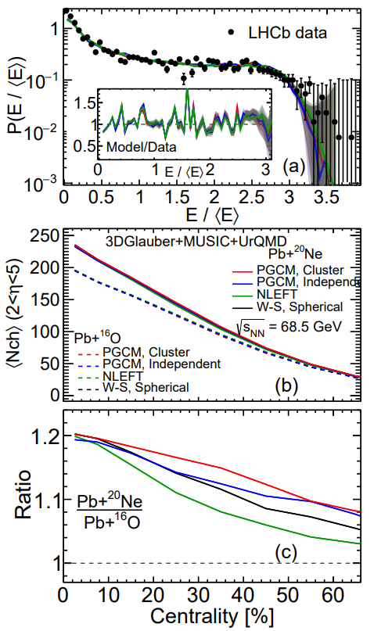
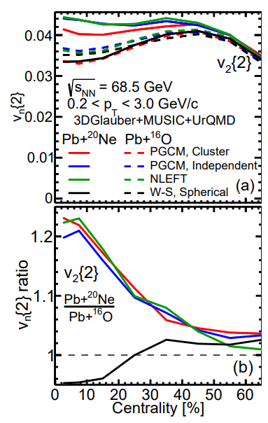
Light ions at lower energies: SMOG2 and RHIC
Exciting: first fits of LHCb Pb-Ne energy distribution
Anisotropic flow data coming soon(ish) ☺
Clear v₂ enhancement similar to collider mode
Giuliano Giacalone, Wenbin Zhao et al, Anisotropic flow in fixed-target ²⁰⁸Pb+²⁰Ne collisions as a probe of quark-gluon plasma (2024)
LHCb, Centrality determination in heavy-ion collisions with the LHCb detector (2021)

Slide 18
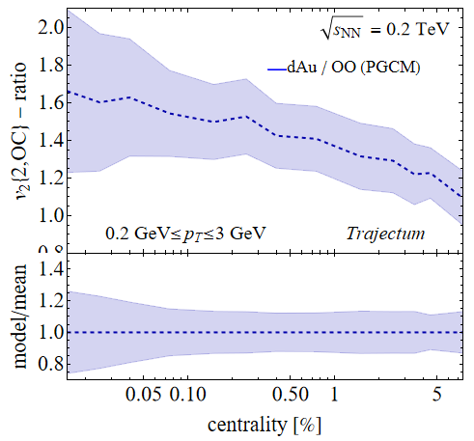
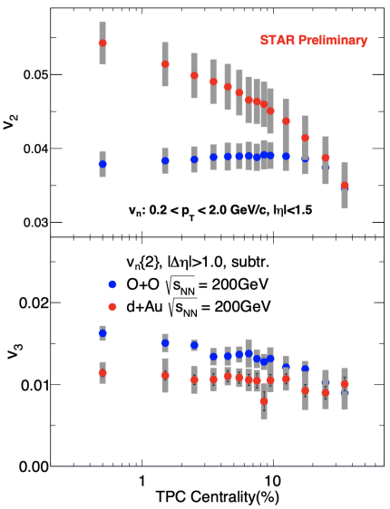
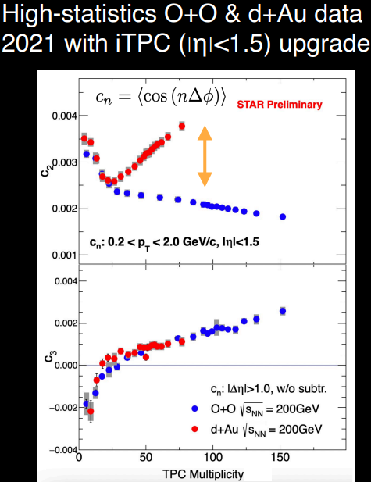
Light ions at lower energies: SMOG2 and RHIC
See talk by Prithwish Tribedy
Oxygen at RHIC and LHC, dAu
Potential for non-flow (small system)
Qualitative trend dAu/OO towards central
Giuliano Giacalone, Wenbin Zhao et al, Anisotropic flow in fixed-target ²⁰⁸Pb+²⁰Ne collisions as a probe of quark-gluon plasma (2024)
LHCb, Centrality determination in heavy-ion collisions with the LHCb detector (2021)

Slide 19
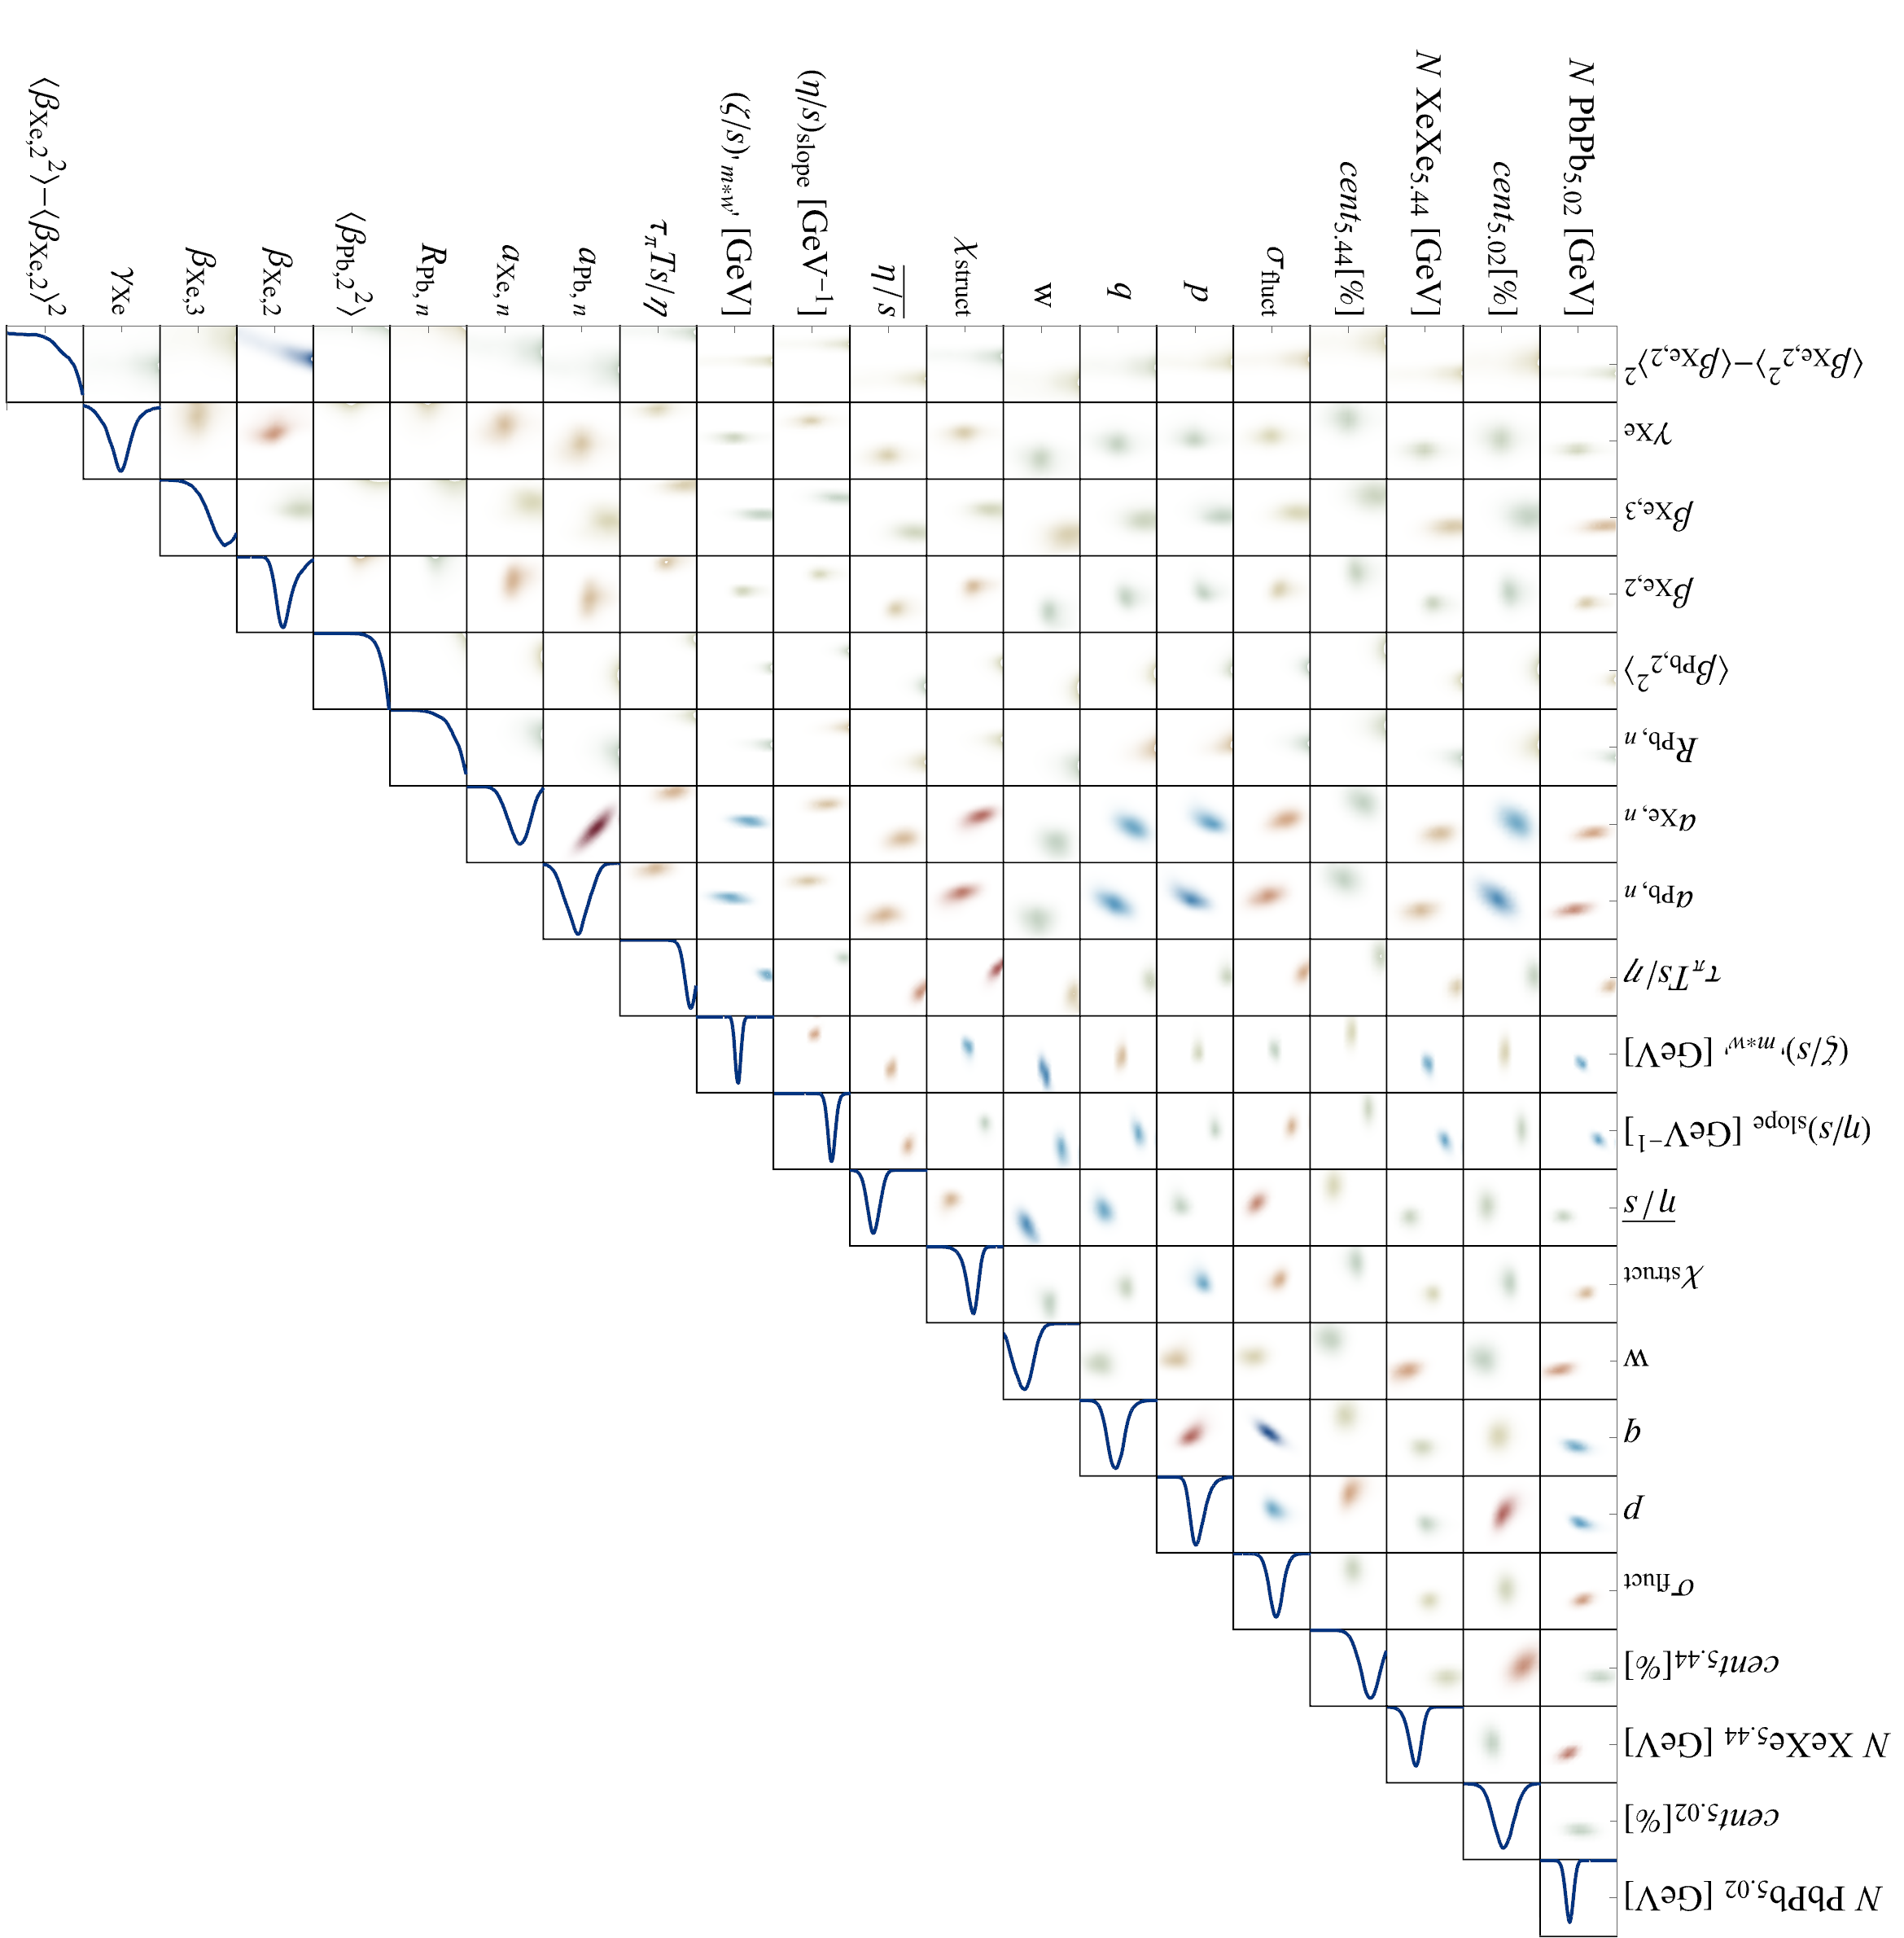
Discussion
Exciting progress using global analyses
Heavy ion collisions towards percent level precision
Nuclear structure becoming relevant and interesting
¹⁶Oxygen & ²⁰Neon collisions to be performed at the LHC summer 2025!
Much better control over small system `flow’
Can we understand nuclear structure? Alphas?
Parton energy loss?
nPDF modifications verus A?

Slide 20
Back-up

Slide 21
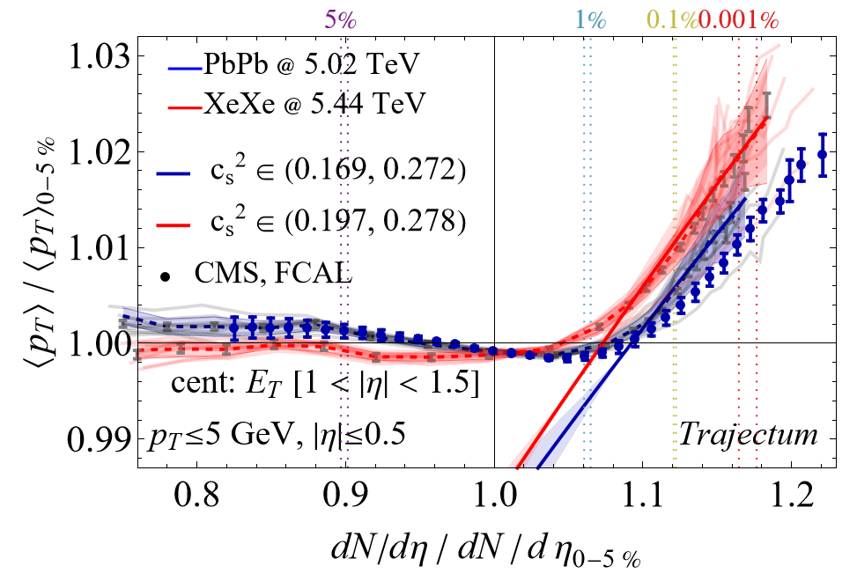
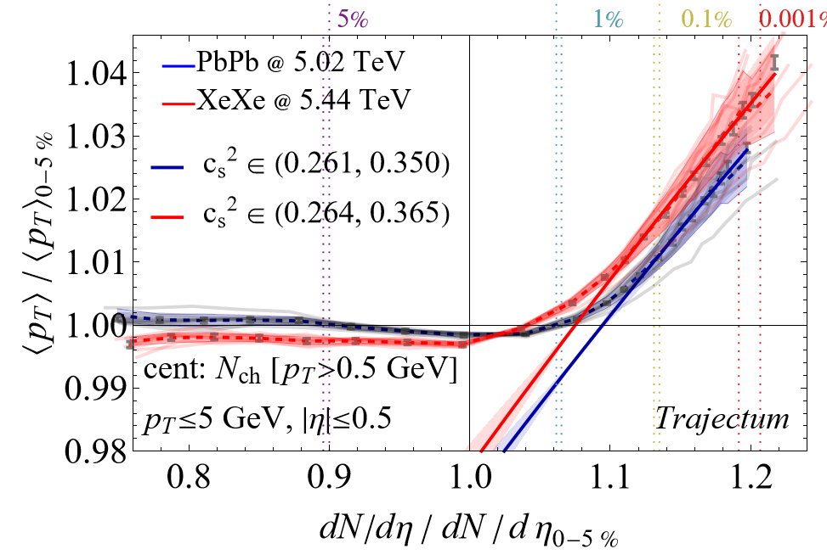
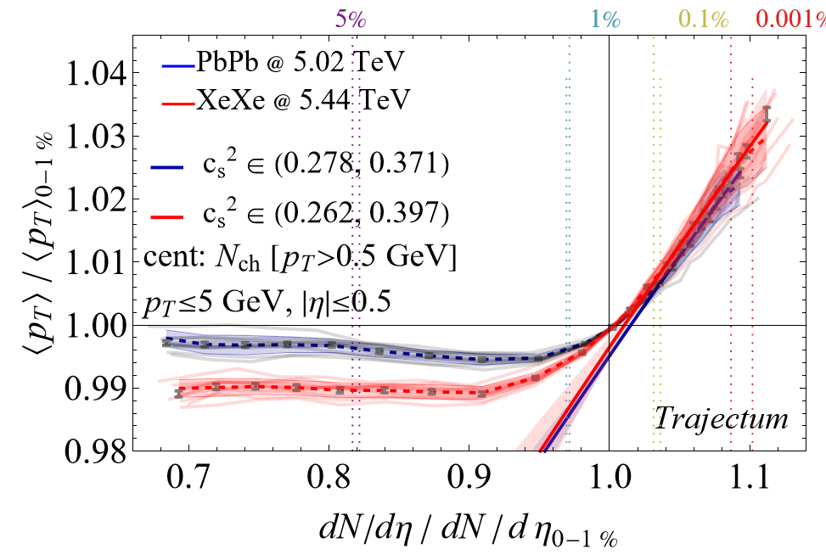
Ultracentral mean transverse momentum

Slide 22
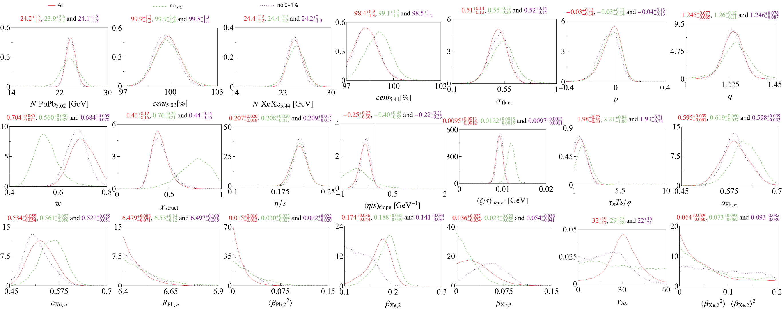
Full posterior

Slide 23
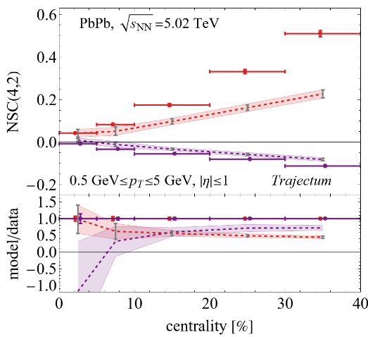
All observables fitted (except SC(2,4))

Slide 24
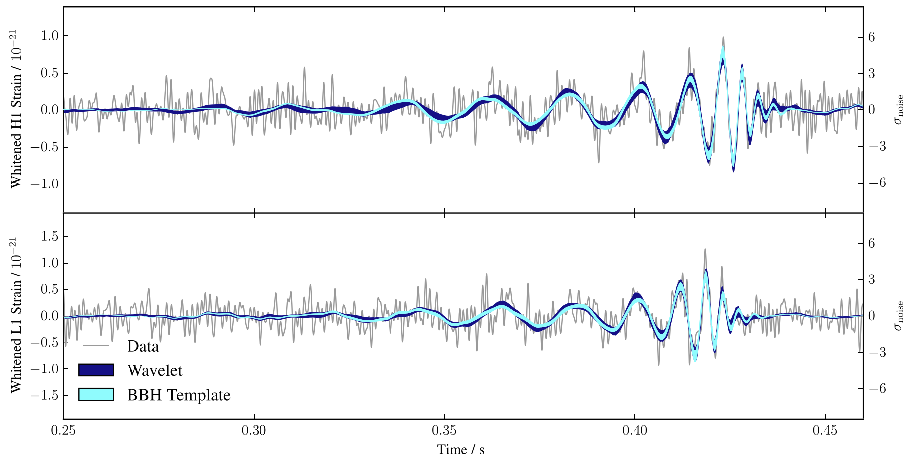
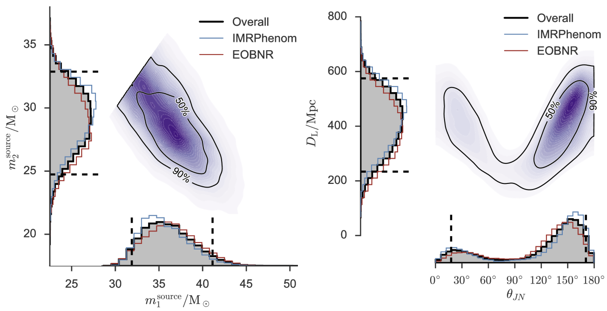
Performing a global analysis
Wilke van der Schee, CERN/Utrecht
Bayes theorem:
Same technique: gravitational waves
Model depends on parameters non-linearly
Run model on 3000 `design’ points
Use an emulator for any point in parameter space (GP)
Markov Chain Monte Carlo
653 data points
Obtain posterior probability density of parameters
Compare posterior with data
Can include high statistics run
LIGO, Properties of the Binary Black Hole Merger GW150914 (2016)
Notes:
Parameters influence observables in complex and non-linear way
Global analysis needed
Run on design points + emulate
MCMC with Bayes theorem and over 500 datapoints
Verify that high probability parameter set works well with other observables
Similar to gravitational waves with for instance waveform determines correlation between distance and inclination

Slide 25
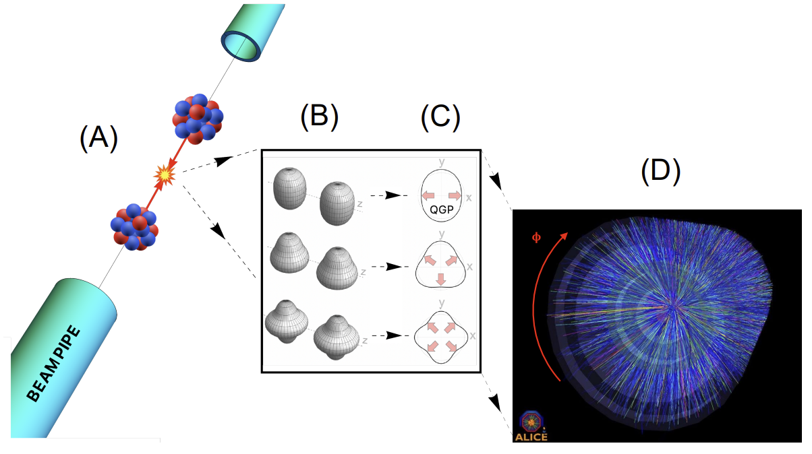
The shape of nuclei
Benjamin Bally, James Daniel Brandenburg, Giuliano Giacalone, Ulrich Heinz, Shengli Huang, Jiangoyng Jia, Dean Lee, Yen-Jie Lee, Wei Li, Constantin Loizides, Matthew Luzum, Govert Nijs, Jacquelyn Noronha-Hostler, Mateusz Ploskon, WS, Bjoern Schenke, Chun Shen, Vittorio Somà, Anthony Timmins, Zhangbu Xu and You Zhou
Imaging the initial condition of heavy-ion collisions and nuclear structure across the nuclide chart (2022)

