Slide 1
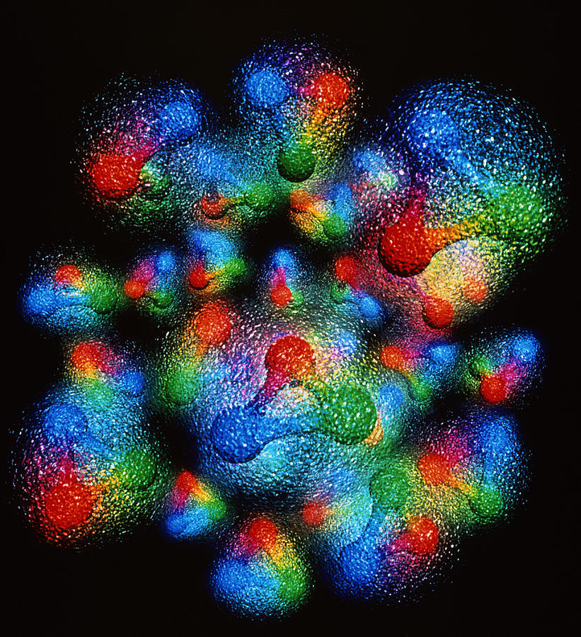





What physical information is in deeply virtual exclusive experiments and how do we get the picture?
Simonetta Liuti
Notes:
EIC have templates for that
UQ pointing at where to measure at EIC
Digital twins and lattice
Example: molecular dynamics, diffusion model, build the whole dynamics in ns, surrogate of very costly project. GiaWei: accuracy issue? For both stages: lattice configurations and correlators
Prasanna: when to use surrogate models, build cheaper yet accurate
Self-learning MC and non-abelian theory, like surrogate model
Kyle Cranmer P. Shanahan et al., Nature review paper,
Pseudo data + data based anaysis
Put in lattice component on digital twins at the observable level not gauge configurations, End-to-End: big survey of all GPD calculations from parameters to observables
Ensemble based analysis

Slide 2
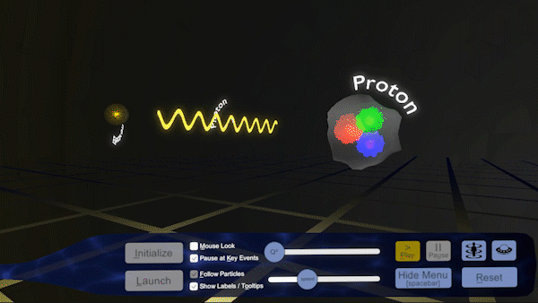
But what is the science that goes into imaging the proton, observing its spatial structure at 10⁻¹⁵ m?
“The EIC will be a particle accelerator that collides electrons with protons and nuclei to produce snapshots of those particles’ internal structure—like a CT scanner for atoms. The electron beam will reveal the arrangement of the quarks and gluons that make up the protons and neutrons of nuclei.”
https://www.bnl.gov/eic/

Slide 3
I will argue that in order to make any progress towards extracting scientifically sound information from the EIC, a change of paradigm is needed in the way we coordinate experimental, theoretical and computational/statistical methods.
The change of paradigm involves:
A comprehensive view of statistics
Integrating AI methods in the development of theory
Uncertainty quantification

Slide 4
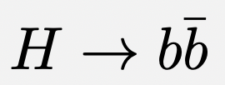
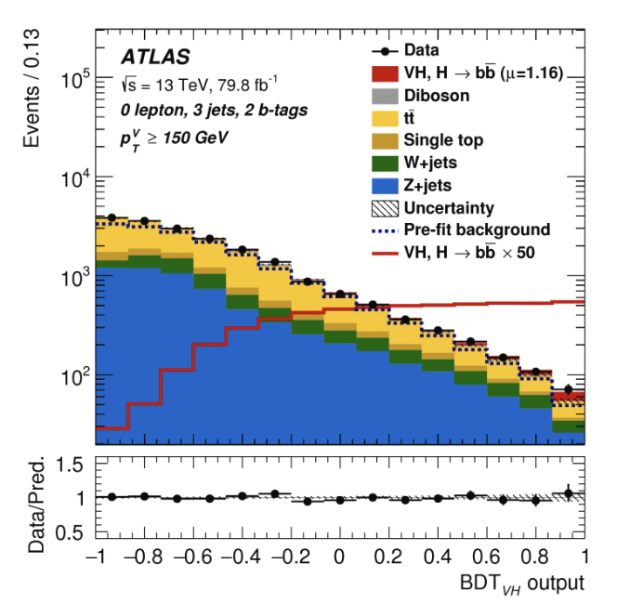
Standard Approach to ML/AI in Physics
Example
Industrial Machine Learning (ML) tools are used/adapted to aid computation in Nuclear/Particle Physics
Ensemble learning methods such as Boosted Decision Trees (BDT) invented for image recognition/object detection used in self-driving cars are used to identify b-hadrons
https://atlas.cern/

Slide 5
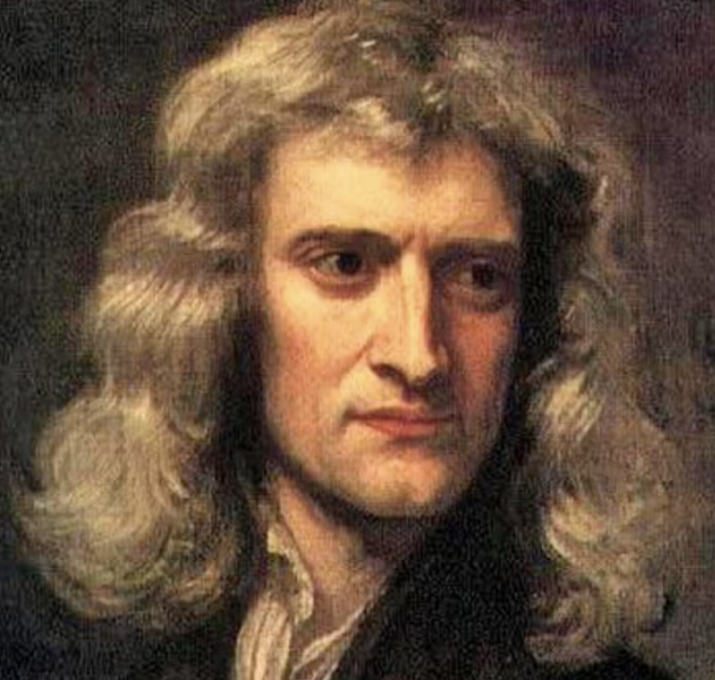
Can we address the “why” with AI?
Not just a set of advanced computational tools!
Finding a common language between physics and AI
Standard ML→ “what?”
Go beyond just a set of ML advanced computational tools
Explore a new AI based paradigm for physics discovery
Explainable AI/Physics → “why ?”

Slide 6

From Standard Computational Paradigm → Explainable AI-based Paradigm
Experimental data
Suggest interpretation
Prediction/Analysis
Test
AI Model Learning for interpretation

Slide 7
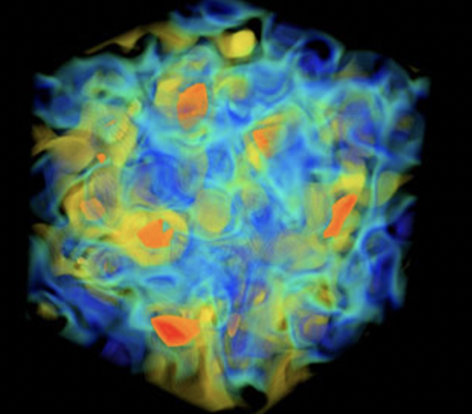
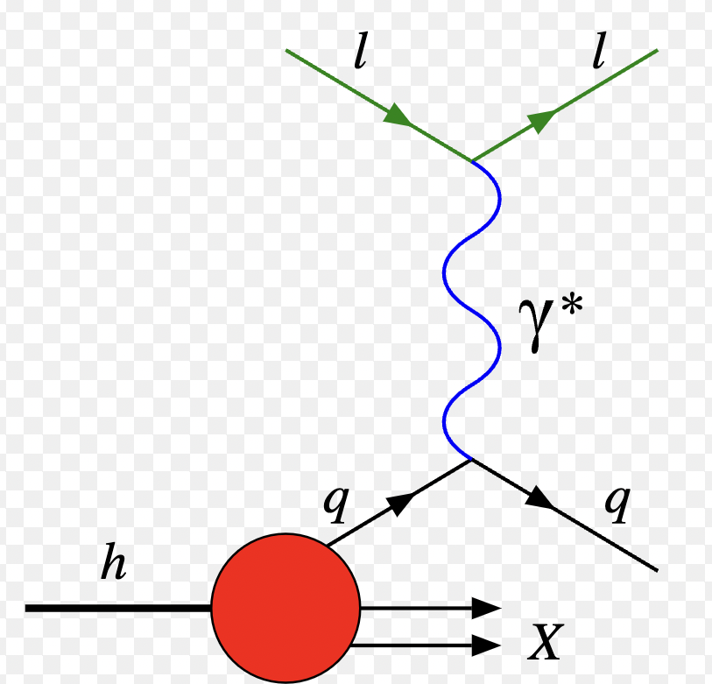
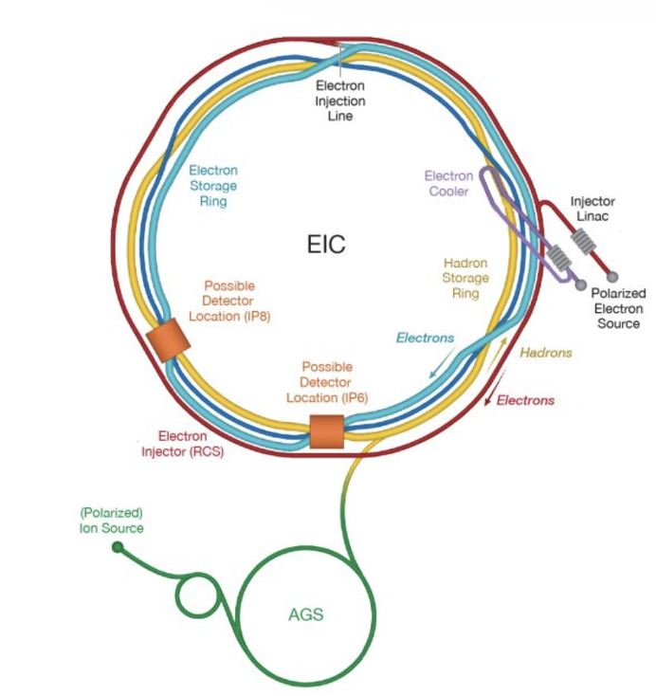
Forward Problem
QCD
  quark field
  gluon field
  correlation functions
Observables
  Form Factors
  Structure Functions
  Compton Form Factors
  Fragmentation functions
  …
Data/Experiment
Inverse Problem
Notes:
We want to merge ML and physics to use machines to generate interpretable understandable models which humans can understand, while solving inverse problems

Slide 8
Hadronic Physics Case
Focus here on two outstanding problems in QCD:
  Angular Momentum and Mechanical Properties
  Tensor and Scalar Charges
Extracting information on AM and tensor charge from experiment (DVES)
Interpreting the information obtained from experiment
Notes:
On the LHS is the Feynman diagram for the DVCS scattering process. The virtual photon q (along z in previous page) scatters off a quark coming out of the proton. The quark probability/QCD matrix element for finding a quark with given momentum and spin is represented by the “blob”.
On the RHS we integrate over the quark (loop) momentum, which by Fourier transformation corresponds to taking the two photon-quark scattering vertices at the same point in the conjugate space coordinate. This is represents the QCD matrix element for a local operator. It measures a moment in the momentum fraction x. Particularly interesting are the second moments, x \times GPD, because they coincide with the Eneregy Momentum tensor (EMT) form factors

Slide 9
Angular momentum enters unpolarized matrix element with an unpolarized initial proton and vector interaction (think about Pauli FF, F₂)
p
p’
Ji (1997)

Slide 10
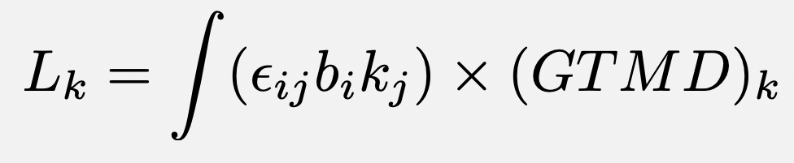
Orbital angular momentum
L_{z}
L_{T}
k_{T}
k_{T}
L_{T}
k_{T}
L_{z}
k_{z}
b
P
b
P
Lorce and Pasquini (2012)

Slide 11
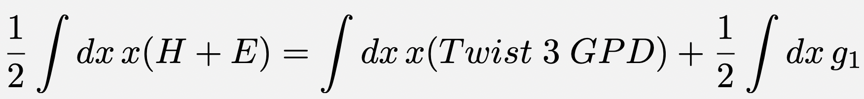
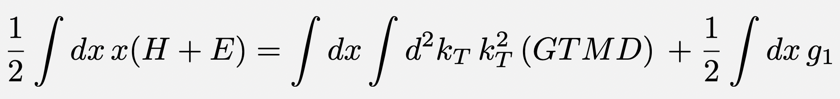
Longitudinal Angular Momentum Sum Rule
J_{z}
=
L_{z}
+
S_{z}
From OPE
M. Polyakov, PLB555 (2003),
D. Kiptily and M. Polyakov, EPJC 37 (2004)
From QCD Equations of Motion
A. Rajan, M. Engelhardt and S. Liuti, Phys. Rev. D98, 074022 (2018)
A. Rajan, A. Courtoy, M. Engelhardt and S. Liuti, Phys. Rev. D94, 034041 (2016)
M. Rodekamp, M. Engelhardt, J.R. Green, S. Krieg, S. Liuti, S. Meinel, J.W. Negele, A. Pochinsky and S. Syritsyn, Phys. Rev. D 109, 074508 (2024)

Slide 12
x-Moments
F₁ + F₂
M₀
M₁
M₂
M₀ → Normalization of OAM “twist-3 GPD” is -G_{M} !!

Slide 13
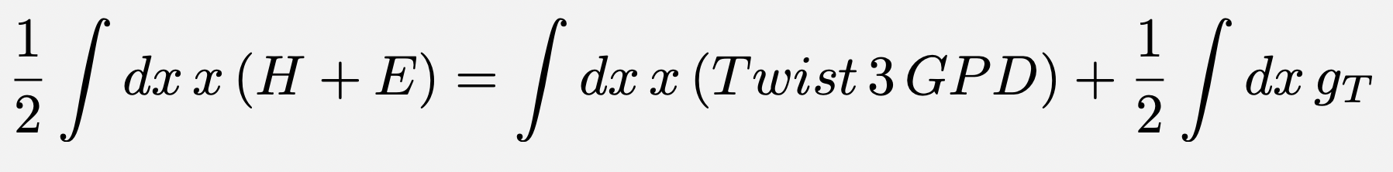
Transverse Angular Momentum Sum Rule -> Pauli-Lubanski vector
O. Alkassasbeh, M. Engelhardt, SL and A. Rajan,
https://arxiv.org/abs/2410.21604, submitted to PLB
W_{T}^{J}
=
W_{T}^{L}
+
W_{T}^{S}
From OPE
M. Polyakov, PLB555 (2003),
D. Kiptily and M. Polyakov, EPJC 37 (2004)
From QCD Equations of Motion
Different from using angular momentum tensor:
X. Ji, X. Xiong, and F. Yuan, Phys. Rev. Lett. 109, 152005 (2012),
X. Ji and F. Yuan, Phys. Lett. B810, 135786 (2020)

Slide 14
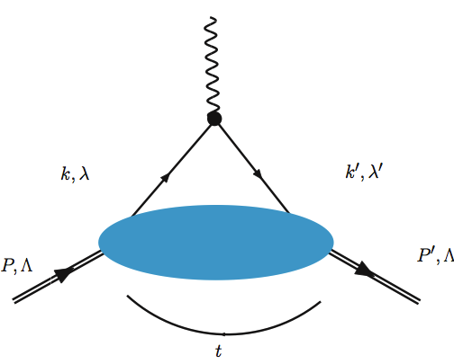
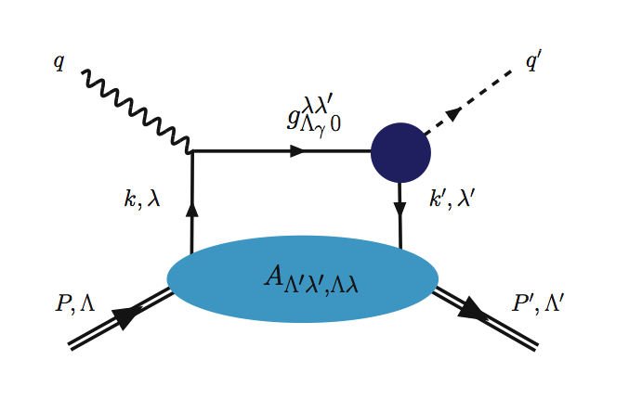
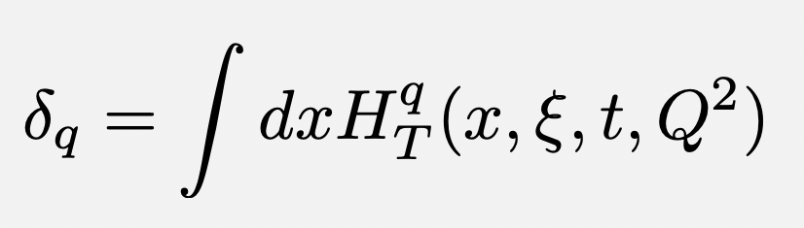
Tensor Charge
The tensor charge is not “fundamental” in the SM
A “tensor form factor” cannot be measured in elastic scattering type processes mediated by either one or two photons
Deeply virtual pseudoscalar meson production
Process first suggested in S. Ahmad, G. Goldstein and SL, Phys.Rev. D79 (2009) 054014, to measure chiral-odd/transversity GPDs
H_{T}
→ H_{T}
14

Slide 15

We need the hadronic matrix element, to extract BSM fundamental tensor charge!
Fundamental tensor charge
Fundamental tensor charge vs. hadronic ratio
pheno
lattice
Courtoy, Baessler, Gonzalez-Alonso and SL, PRL 115 (2015)
|ε_{T} g_{T}|<6.4x10⁻⁴
From DVMP
neutron beta decay
M. Beck, W. Heil, Ch. Schmidt, S. Baeßler, F. Gluck, G. Konrad, and U. Schmidt: arXiv 2308.16170 (PRL)
superseded now: Pattie et al, PRC88 (2013)

Slide 16
Twist three GPD Physical interpretation at the core of spin puzzle
Tensor charge
Partonic spatial structure
.
.
.
Will we ever be able to test these relations?

Slide 17
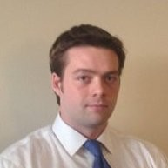
1. Fully Constraining CFFs : Bayesian Likelihood Analysis
GOAL: Use DVCS data and compare to cross section model to find CFFs
Curve fit: A bad result: Encounter a problem 1!
Definition of the likelihood: Try to fix the problem
Canonical Likelihood: Reproduces the problem in explainable way
  Difference method Likelihood
  Canonical Likelihood
Encounter a problem 2!: covariance
Results: Table of CFFs and errors
arXiv:2410.23469
Douglas Adams
Graduate Students:
Joshua Bautista, Adil Khawaja, Zaki Panjsheeri
D.Q. Adams et al: arXiv:2410.23469

Slide 18
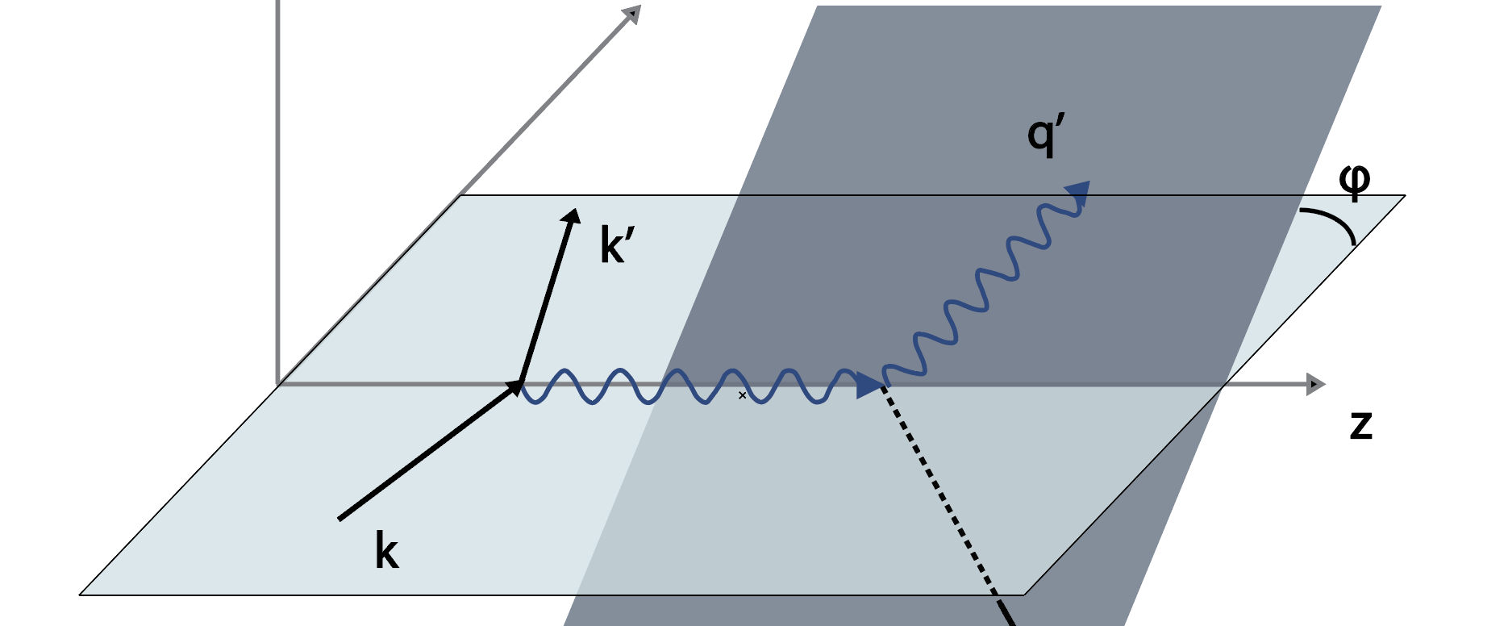
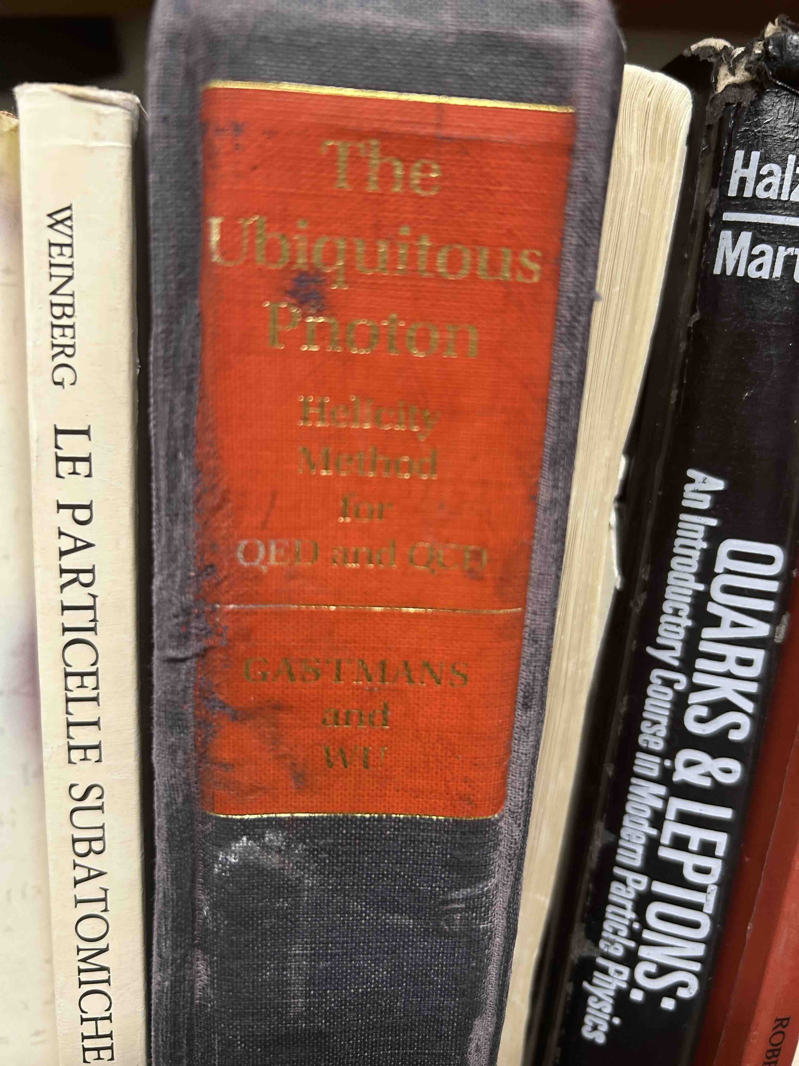
Extraction of Compton Form Factors from Experiment
DVCS
y
y’
z
z’
x
x’
The hadronic tensor is evaluated in the rotated frame
Jacob and Wick (1959)

Slide 19
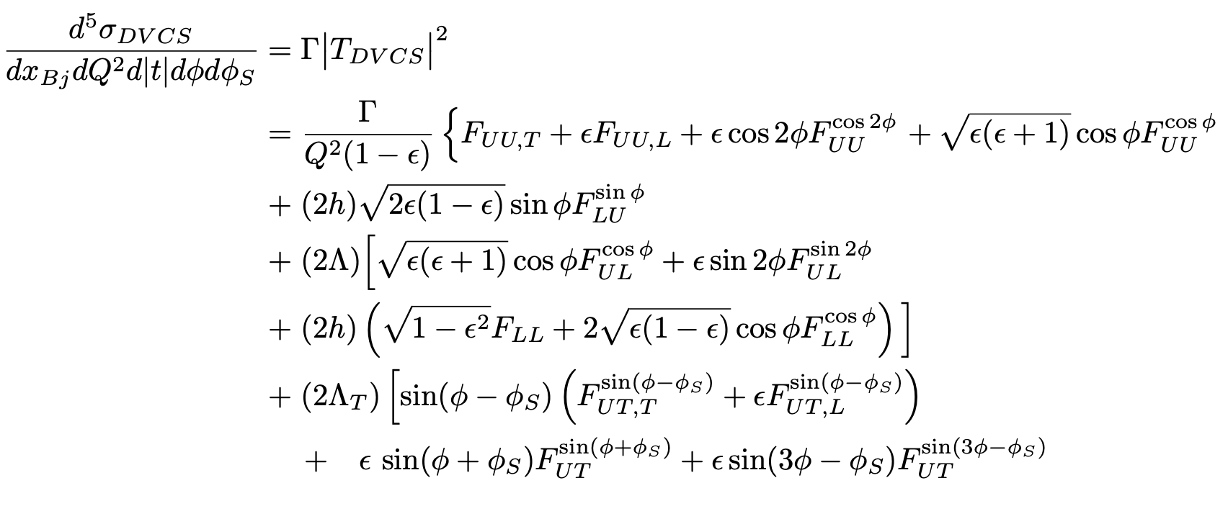
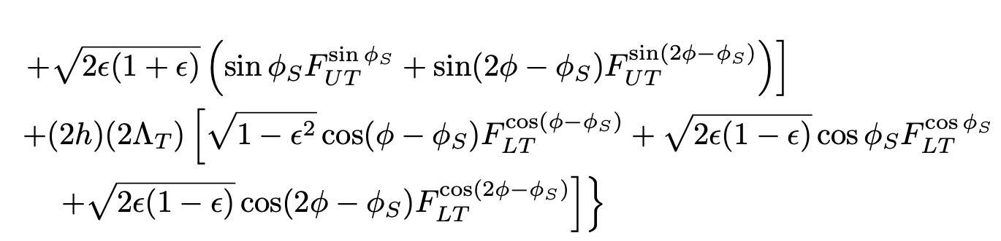
There is only one way to write the cross section
unpolarized
long. polarized
transv. polarized
B. Kriesten et al, Phys.Rev. D 101 (2020)
B. Kriesten and SL, Phys.Rev. D105 (2022), arXiv 2004.08890
B. Kriesten and SL, Phys. Lett. B829 (2022), arXiv:2011.04484

Slide 20
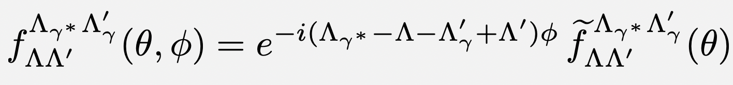
Role of phase ϕ
hadron plane
ϕ
two-body scattering in hadron plane
p’
q
p
q
lepton plane
q’
Virtual photon phase not measured: this ambiguity generates the x-sec. phase dependence!

Slide 21
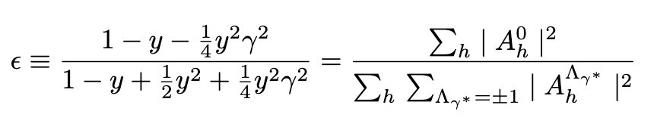
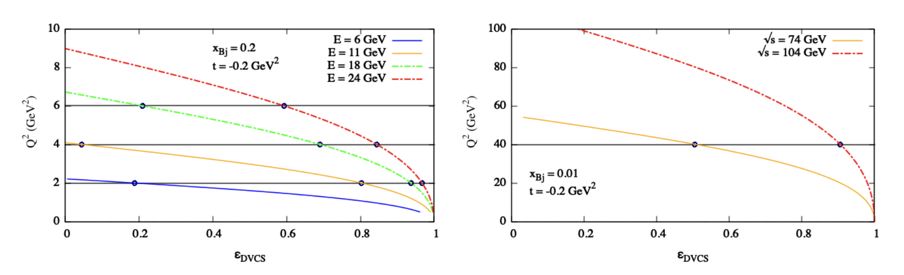
ε
L
T
Fixed target (Jlab)
Collider (EIC)

Slide 22
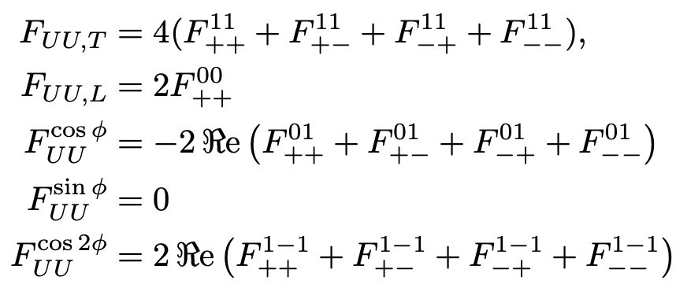
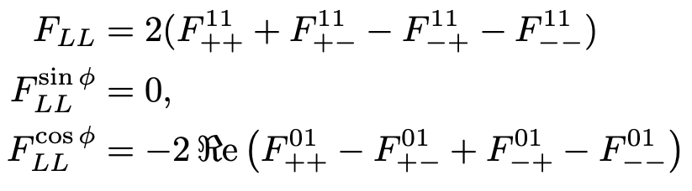
Step 1: determine the structure functions at$(x, Q^{2},t)$
The helicity structure functions
No QCD factorization involved at this stage
First Inverse Problem!

Slide 23

Step 2: If QCD factorized scenario holds: SFs → Compton Form Factors → GPDs
Assume known
Second Inverse Problem!

Slide 24
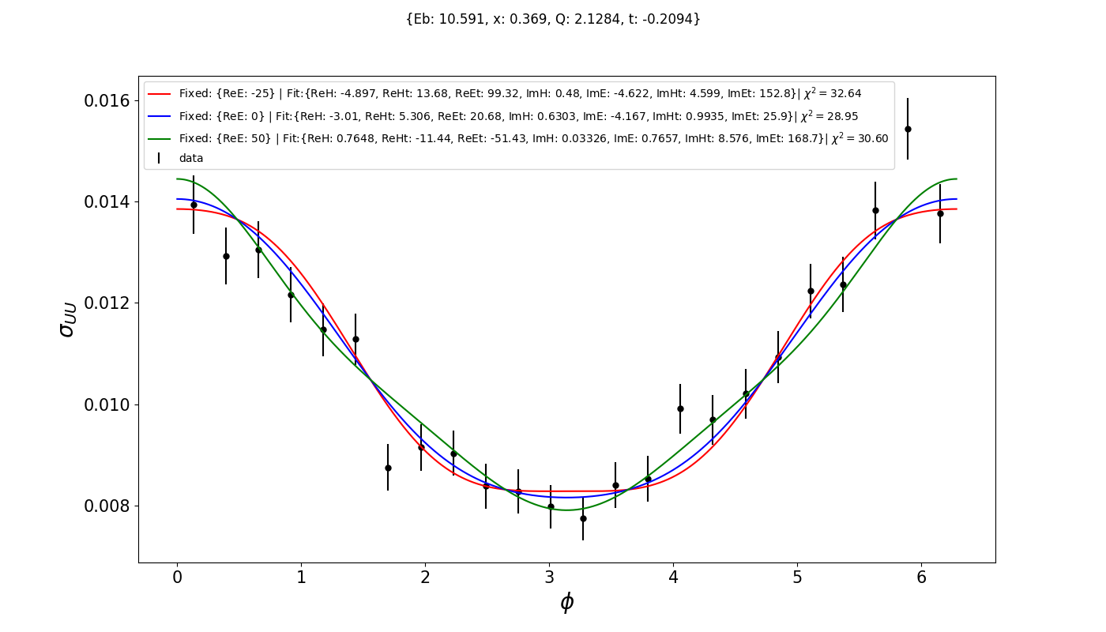
Degeneracy of Curve Fit Results
arXiv:2410.23469

Slide 25
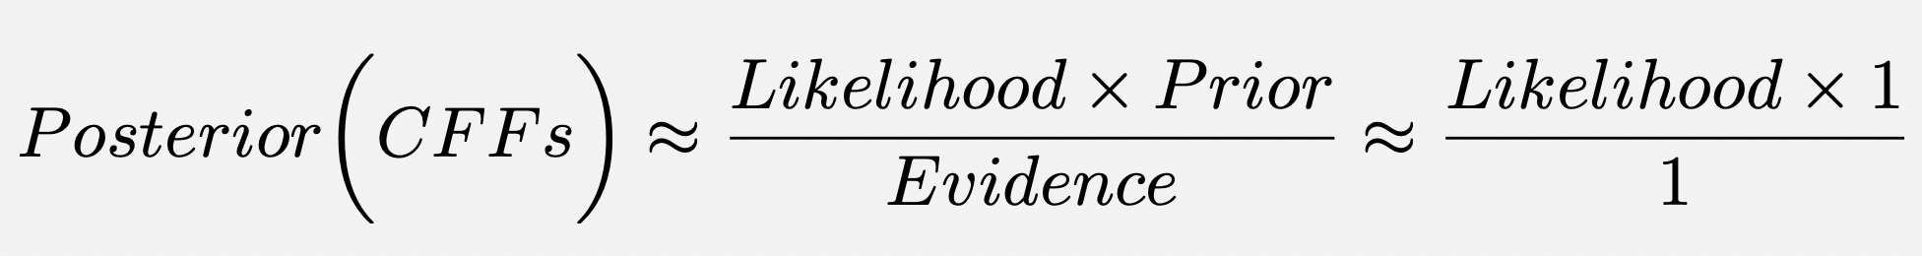
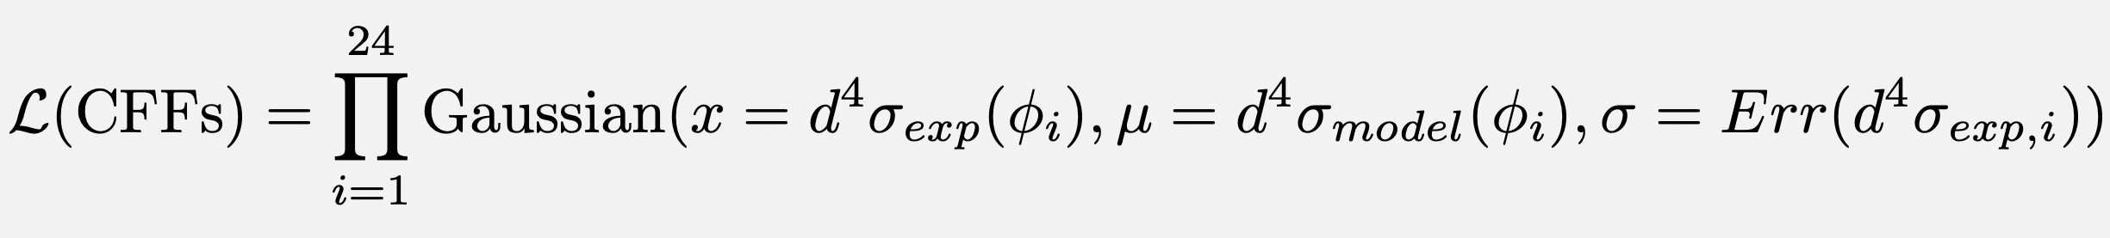
Bayesian Analysis
1. Define Likelihood
2. Use Markov-Chain-MonteCarlo (MCMC) to generate samples from the posterior distribution draw samples where the next sample is dependent on the existing sample, called a Markov Chain. This allows the algorithms to narrow in on the quantity that is being approximated from the distribution, even with a large number of random variables.
3. Once we have samples from the posterior distribution, we can use them to approximate the marginal distribution of any specific CFF by looking at the values in the MCMC samples and treat them as a sample from the marginal distribution.

Slide 26
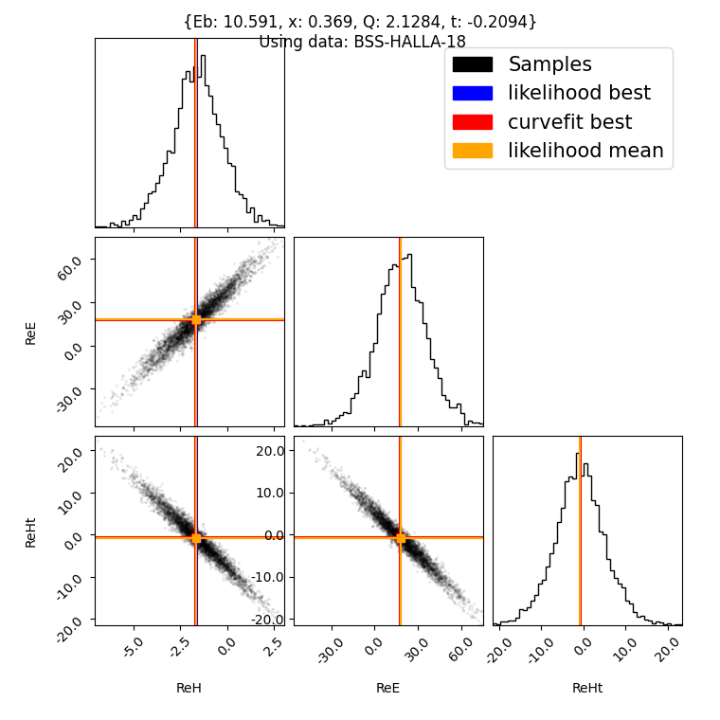
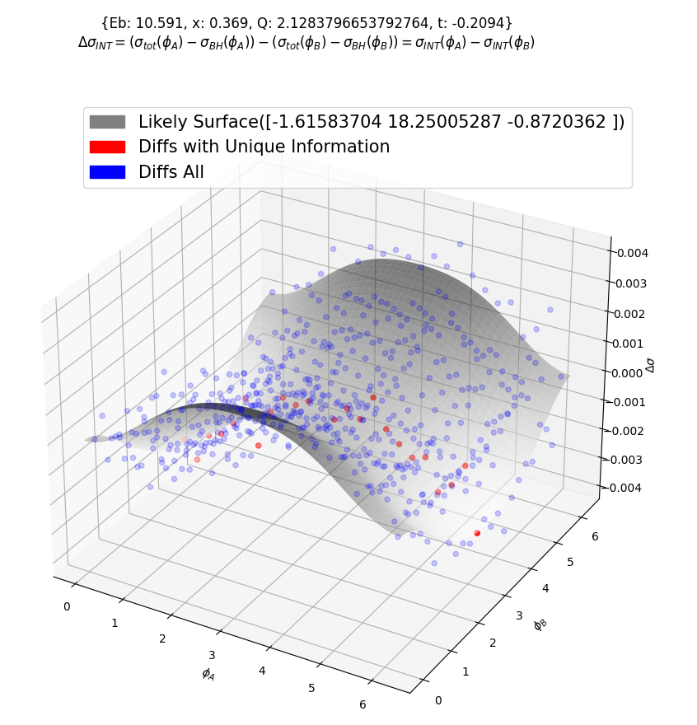
Covariance of CFF Results
arXiv:2410.23469
The analysis uses separation of variables ε and ϕ from (x,Q²,t)
Only 3 CFFs are non-degenerate
Notes:
Define Bayesian Likelihood

Slide 27
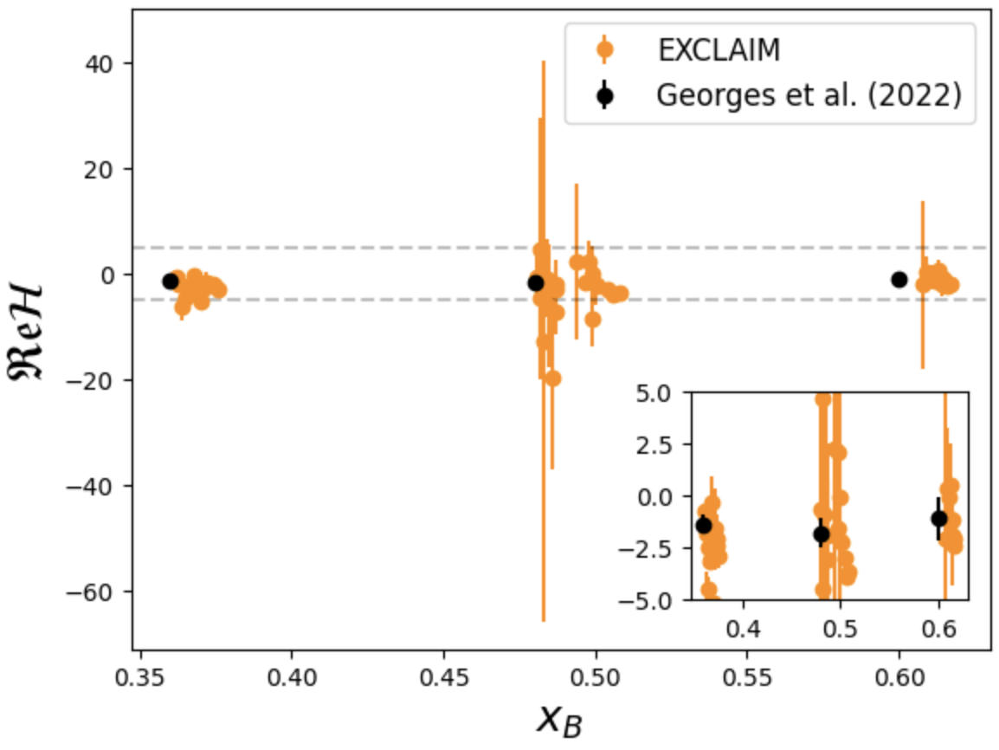
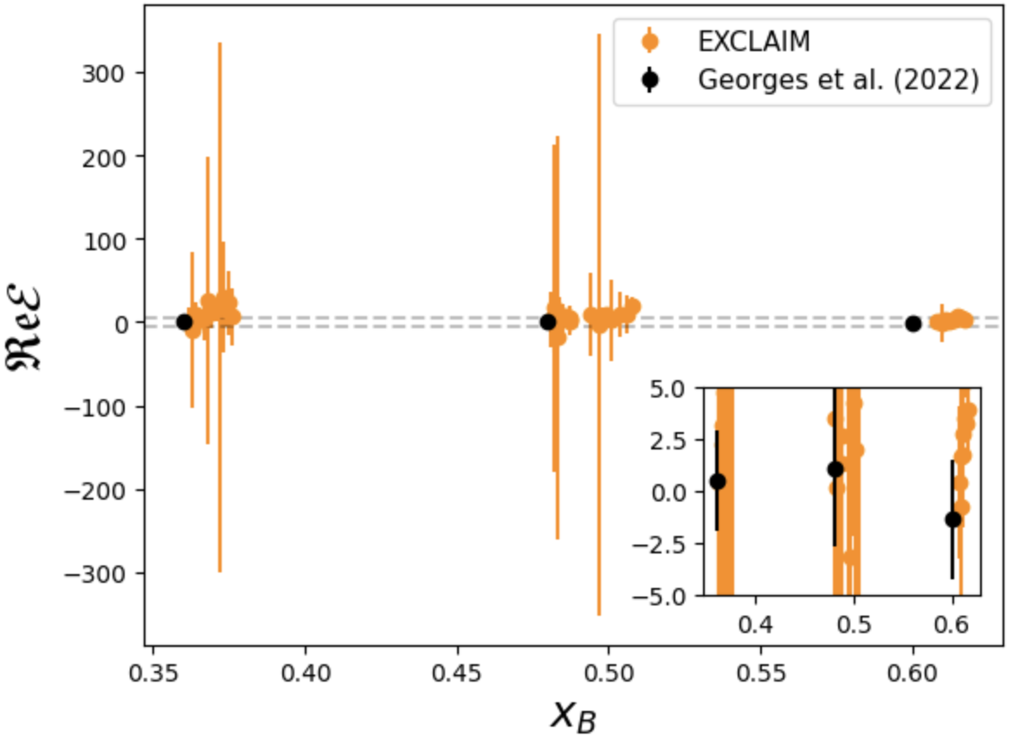
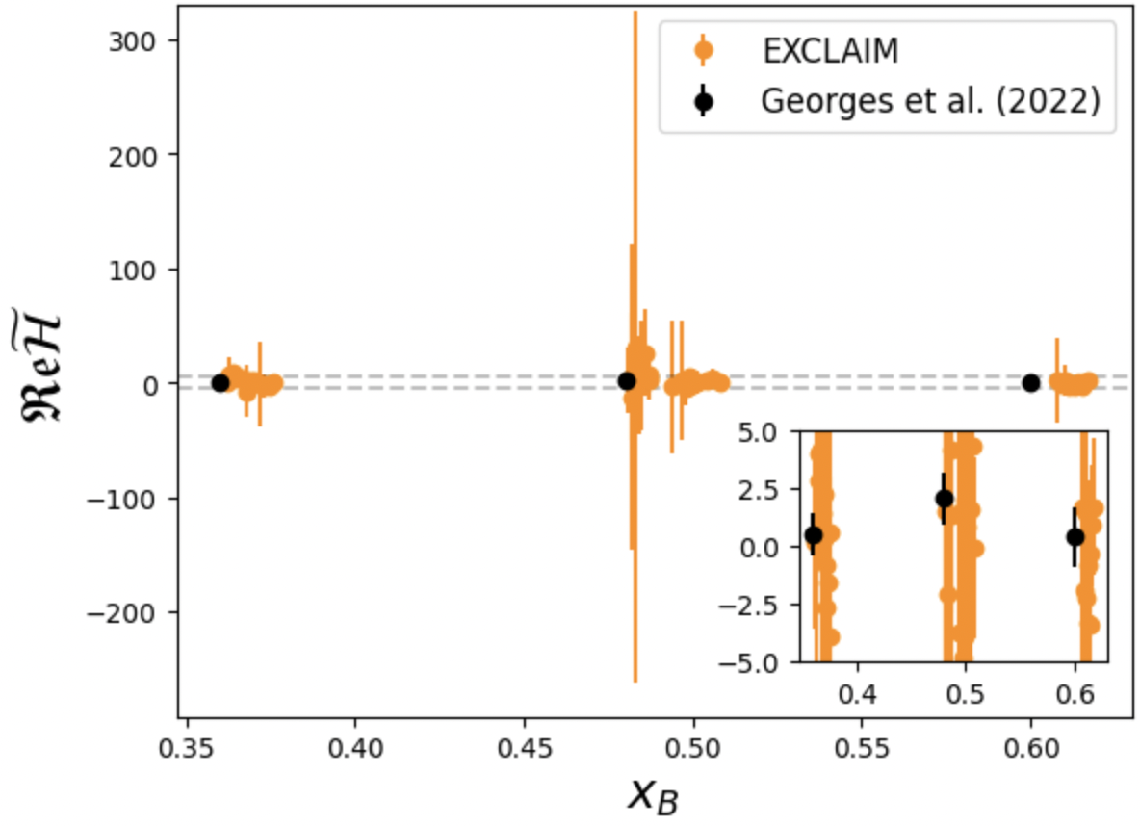
Marginal Posterior CFF Results
H
E
~
H

Slide 28
What causes the big spread in the CFFs?
Longitudinally polarized data and unpolarized data need to be analyzed simultaneously → Positivity constraints
Is QCD factorization holding? Analysis should be performed on structure functions before assuming QCD factorized scenario. (Results on analysis on AI-based validation of factorization in DVCS soon on erXiv)
Do other observables behave similarly if treated with Bayesian analysis?

Slide 29
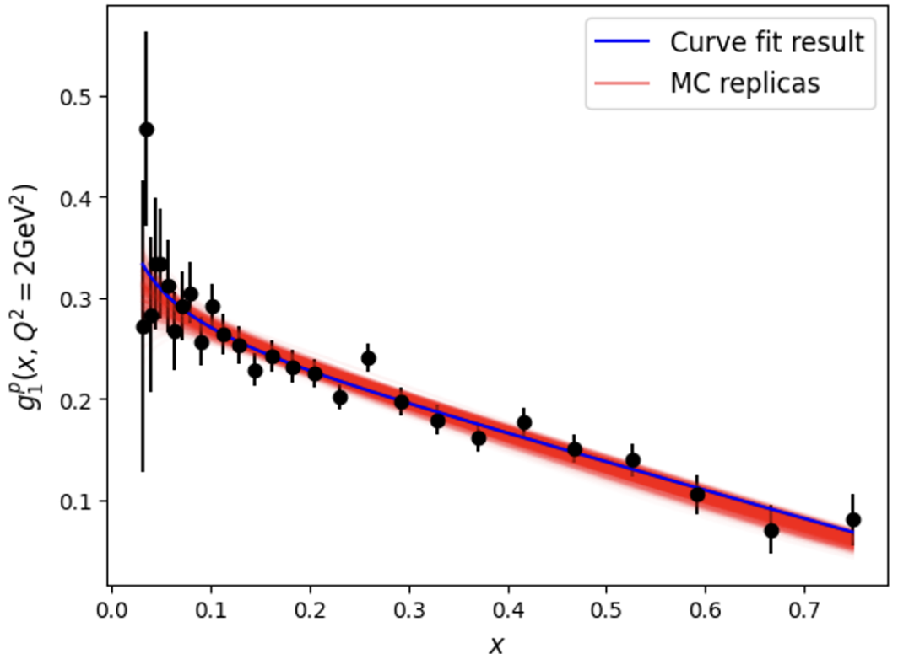
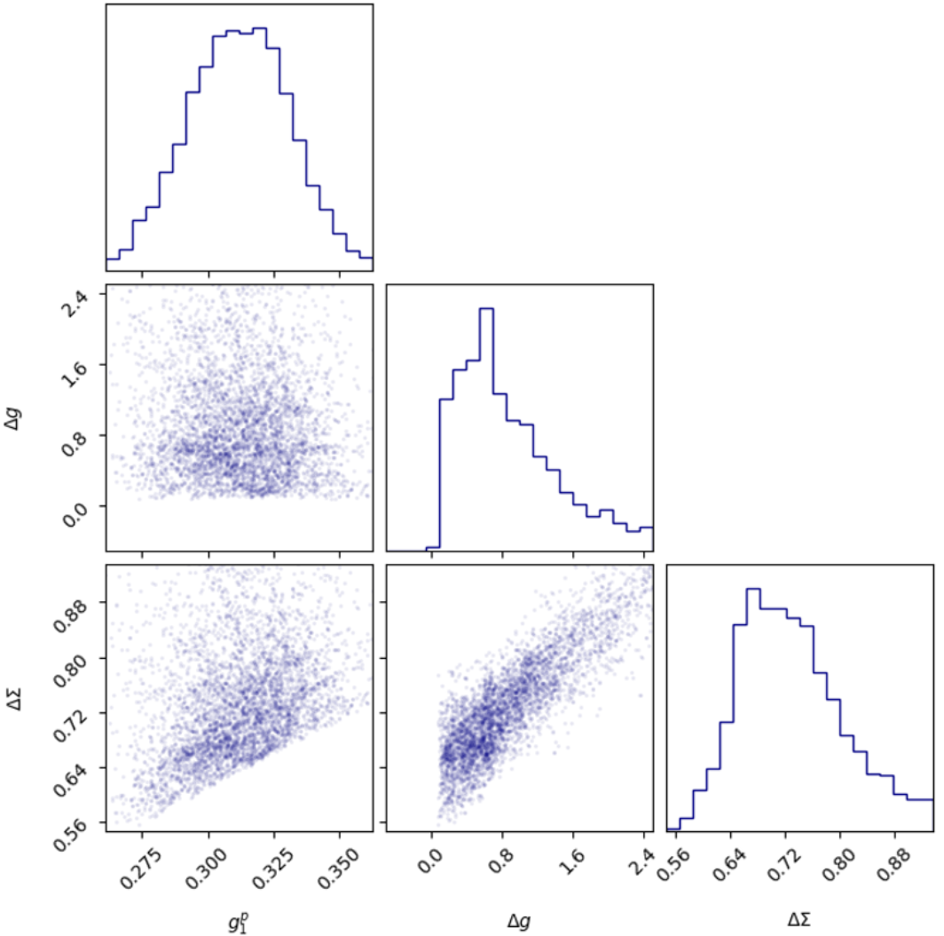
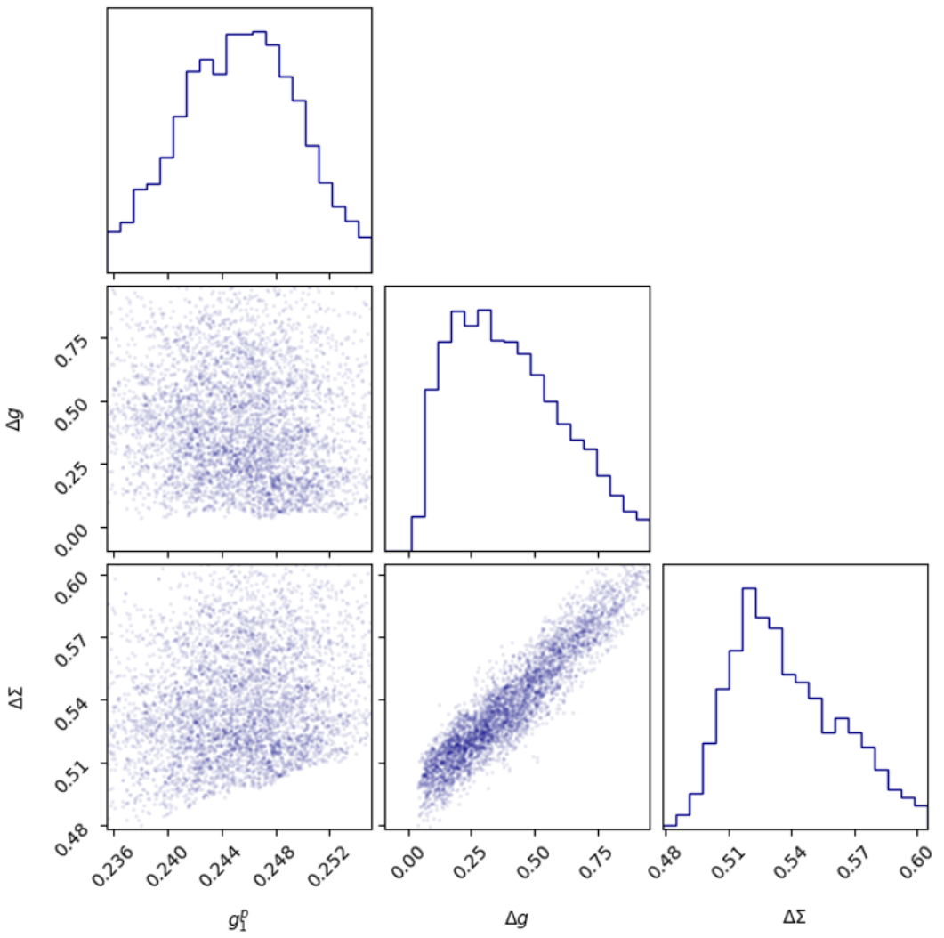

Extraction of of polarized PDFs
Saraswati Pandey
x=0.03
x=0.16
Preliminary
Compare to DSSV MCMC-based analysis PRD100 (2019), constraint: $\left|Δf\right|<f$

Slide 30
Inverse Problem Techniques: VAIM, C-VAIM, MCMC
F. Hossen, D.Adams, et al.,'' [arXiv:2408.11681] submitted to PR Research
M. Almaeen, B. Kriesten, D. Adams et al, 2207.10766 TBP in EPJC
Approaches to find parameters statistically in an underdetermined system:
Can quantify parameter uncertainty when more parameters than data
Techniques highly dependent on bounded parameter priors
These methods give us an initial way to perceive:
  the correlation between parameters on a complicated model
  what information is missing (latent space)
All these methods share the common goal of going beyond simple regression by understanding the underlying correlations of the system

Slide 31
Interpretable AI: Symbolic Regression for Parton Research
Douglas Q. Adams (UVA)
Andrew Dotson, Matt Sievert(NMSU)
Anusha SingiReddy, Yaohang Li (ODU)
Zaki Panjsheeri (UVA)

Slide 32
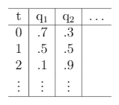

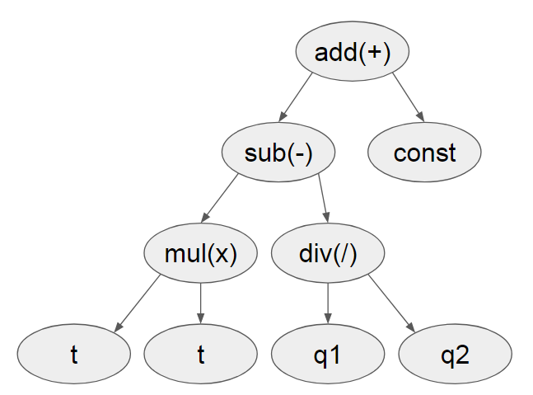

What is symbolic regression (SR)?
Goodness
Data Table
Fitness Metric
e.g. MSE
Symbolic Modification
e.g. mutation
Form Metric
e.g. #terms
Attempt an Expression
No
Good?
Yes
Done
Slide from Douglas Adams
Notes:
is a machine-learning technique which generates and adapts symbolic mathematical
expressions to fit a given data set. Through a recursive process, a string of mathematical operations is generated
and adapted to optimize the fit to the data.

Slide 33
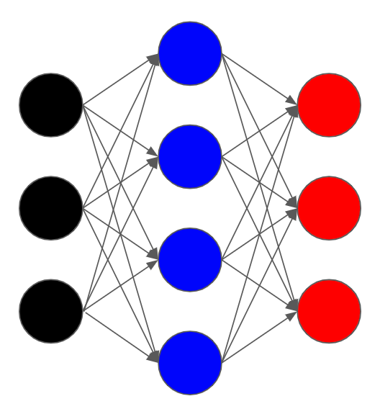

Why bother with SR when we have neural networks?
Which is easier to read? ( a.k.a interpretability of AI )
Black Box Regression
vs
Slide from Douglas Adams

Slide 34
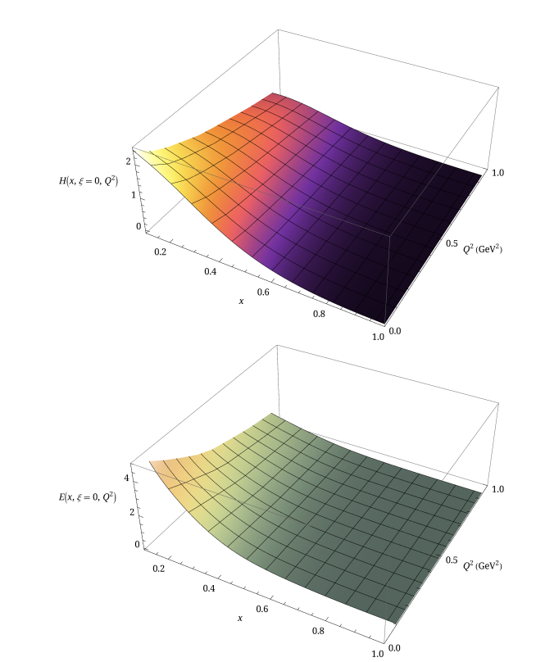
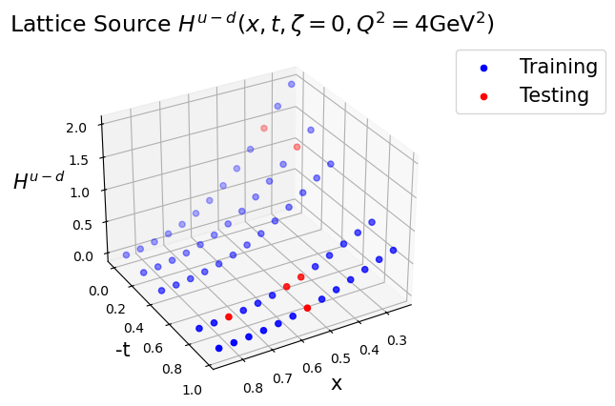

How do lattice results on GPDs depend on (x,t)?
?
$$H\left(x,t\right)=f\left(x,Q^{2}\right)F\left(t\right)$$
|t|
x
J. Holligan and H-W Lin, Phys.Rev. D110, 034503 (2023)
H-W Lin, Phys. Lett. B824, 136821 (2022)

Slide 35
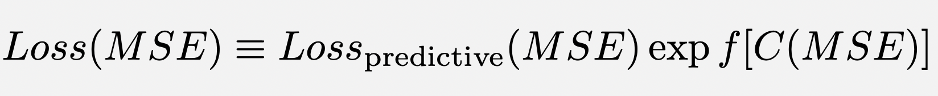
Many algorithms for SR are available. We use PySR
Standard Loss
Complexity Loss
frecency= “adaptive parsimony” allowing for flexibility penalizing complex expressions based on both the frequency and recency of models considered by the genetic algorithm.

Slide 36
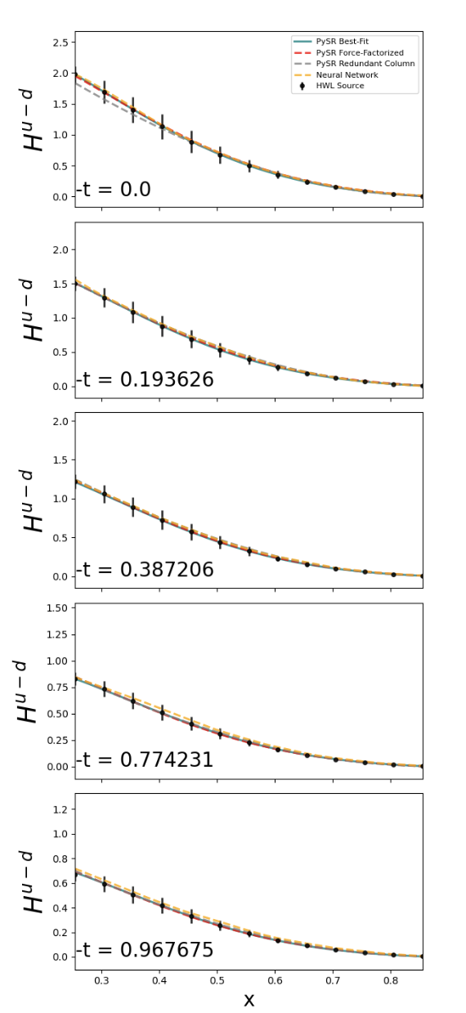
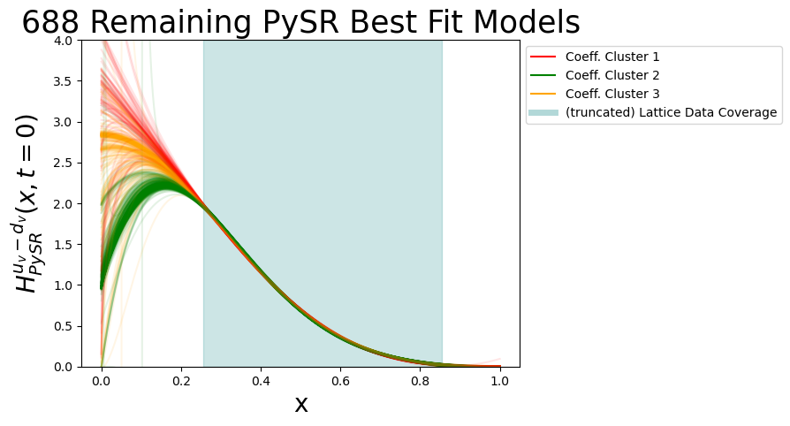
Novel SR Convergence Clustering
Extrapolation
Lattice Region

Slide 37
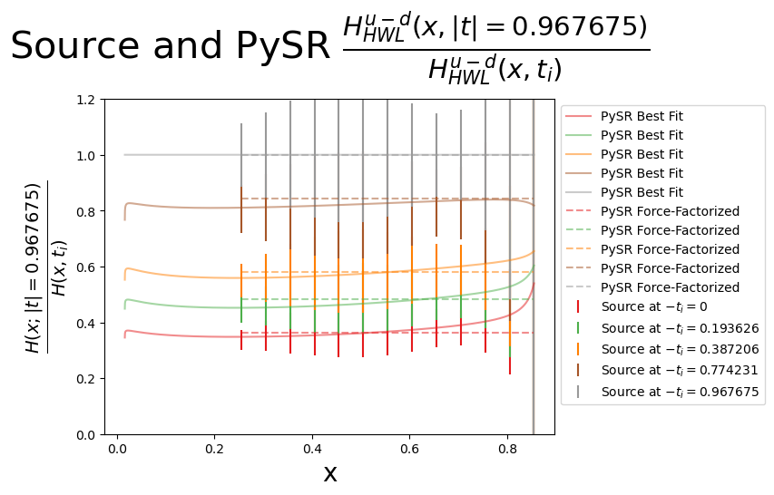
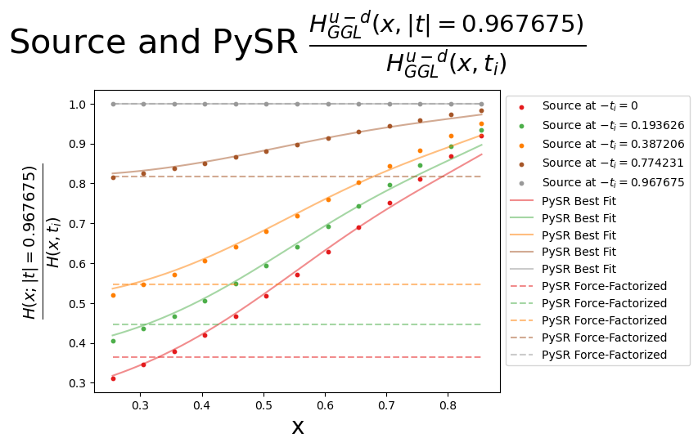
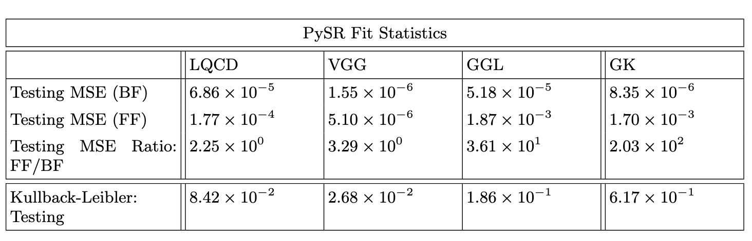
Testing x and t factorization
LQCD
phenomenology
|t|
KL testing on MSE distributions

Slide 38
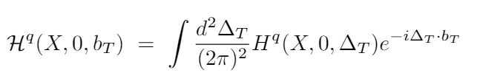
Why is it important to check x and t factorization?
Consequences on the 3D Coordinate Space picture
gluon
GPDs can be Fourier transformed from momentum space into coordinate space, providing insight into the spatial distributions of quarks and gluons inside the proton, besides matter and charge distributions.
d-quark
Slice of Wigner phase space distribution
GPD
With Z. Panjsheeri and J. Bautista

Slide 39
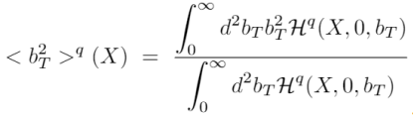

Gluon and quark matter density radius
Compare to lattice and AdS/CFT integrated value
K. Mamo and I. Zaeed
PRD106, 086004 (2022)
LQCD: Detmold and Shanahan
$$\sqrt{\left\langle b_{T}^{2}\right\rangle }$$
Bautista, Panjsheeri, SL (2024)
UVA param
Quark radius
arXiv:2405.05842
LQCD gluon

Slide 40
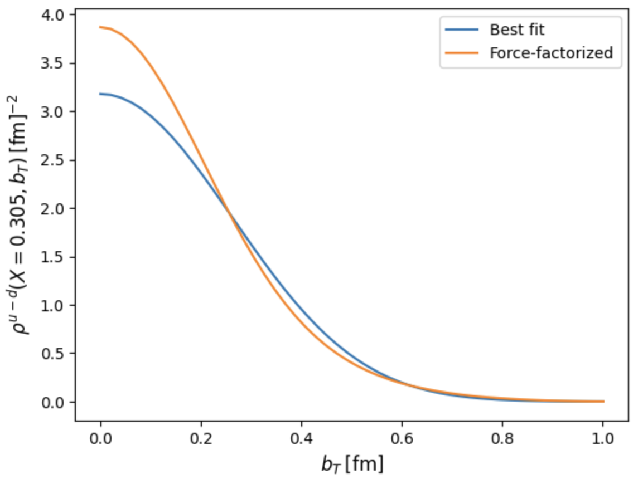

From SR Analysis: a must needed avenue towards making qg imaging concrete
Z. Panjsheeri
Notes:
Extrapolation and Fourier

Slide 41
What is next
NNGPD
End-to-end analysis: from CFFs to GPD Moments

Slide 42

The EXCLAIM collaboration
https://willuhmjs.github.io/exclaim/
PIs: Marie Boer, Gia-Wei Chern , Michael Engelhardt, Gary Goldstein, Yaohang Li, Huey-Wen Lin, SL, Matt Sievert, (Dennis Sivers)
Funded Postdocs: Douglas Adams, Liam Hockley, Saraswati Pandey, Emanuel Ortiz, Kemal Tezgin
Graduate Students: Andrew Dotson, Carter Gustin, Jang (Jason) Ho, Fayaz Hossen, Adil Khawaja, Zaki Panjsheeri, Anusha Singireddy, Jitao Xu
Undergraduate: Will Faircloth

Slide 43
Conclusions
Our path to AI&theoretical physics brings interpretability features in the computation and benchmarking of AI tools
A successful reconstruction of the spatial structure of the proton (and all of its mechanical properties) relies on our ability to understand the cross section for all the various DVES processes
This implies solving multiple inverse problems
We have defined a path to extract the observables from experiment that allows us to fully take into account UQ from data and ab initio QCD calculations
Obtaining spatial images of the proton including UQ is feasible using AI/ML to extend the momentum transfer reach for an accurate Fourier transformation
Notes:
UQ is a necessary and currently incomplete step in forming the 3D structure of the proton

Slide 44
Back up

Slide 45

Using a pareto front to choose amongst forms
One must define a “metric” which balances fit vs. form to choose a best

Slide 46

PySR convergence
Andrew Dotson

