Slide 1
Bottomonium suppression in p+Pb collisions at LHC energies
Sabin Thapa
Kent State University
Primary references: M. Strickland, S. Thapa, & R. Vogt (2024). Bottomonium suppression in 5.02 and 8.16 TeV p-Pb collisions, arXiv:2401.16704.
S. Thapa, R. Vogt, M. Strickland, R. Rapp, B. Wu, & J. Boyd (In Prep). Semi-classical treatment of bottomonium suppression in p-Pb collisions.
GHP2025, 16 March 2025

Slide 2
Outline
INTRODUCTION & MOTIVATION
COLD NUCLEAR MATTER EFFECTS
Nuclear Modification of Parton Distribution Functions (nPDFs)
Energy Loss & Momentum Broadening
HOT NUCLEAR MATTER EFFECTS
Quantum & Semi-Classical Transport Models
RESULTS
CONCLUSION & OUTLOOK

Slide 3
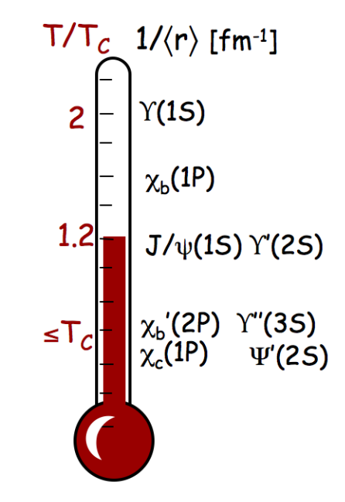
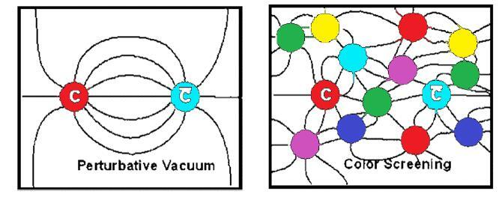
INTRODUCTION & MOTIVATION
Asymptotic freedom of QCD: deconfined phase of QCD matter at high temperature / density, Quark Gluon Plasma (QGP), glimpse of early universe shortly after Big Bang, recreated in HIC at RHIC and LHC
Quarkonia as Probe of QGP
Static screening (Matsui, Satz, 1986): inside QGP, color attraction in Quarkonia suppressed due to Debye Screening, different mass/binding energies, Sequential melting at High T
QGP thermometer
Mocsy, Petreczky, and Strickland, 1302.2180

Slide 4
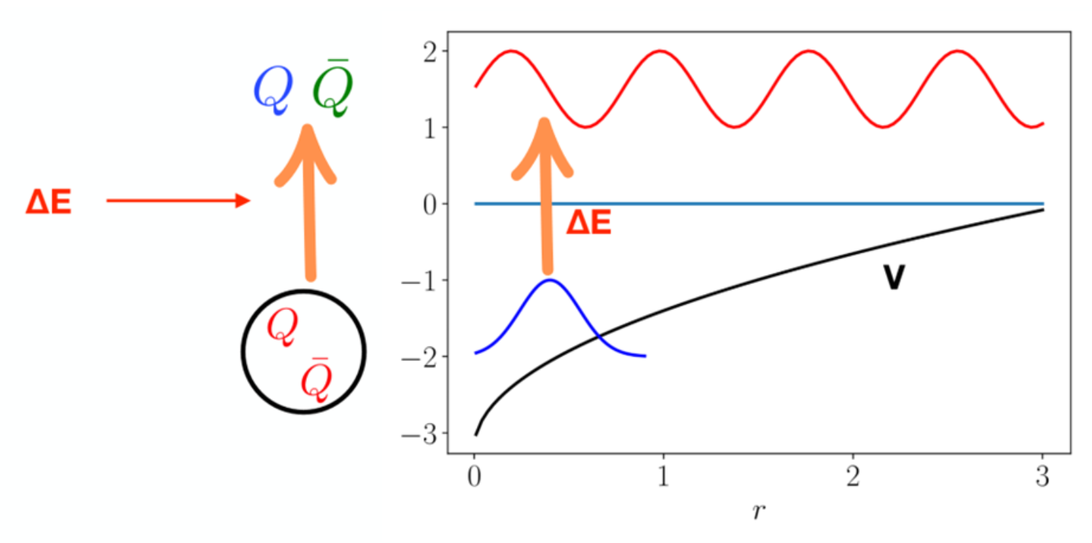
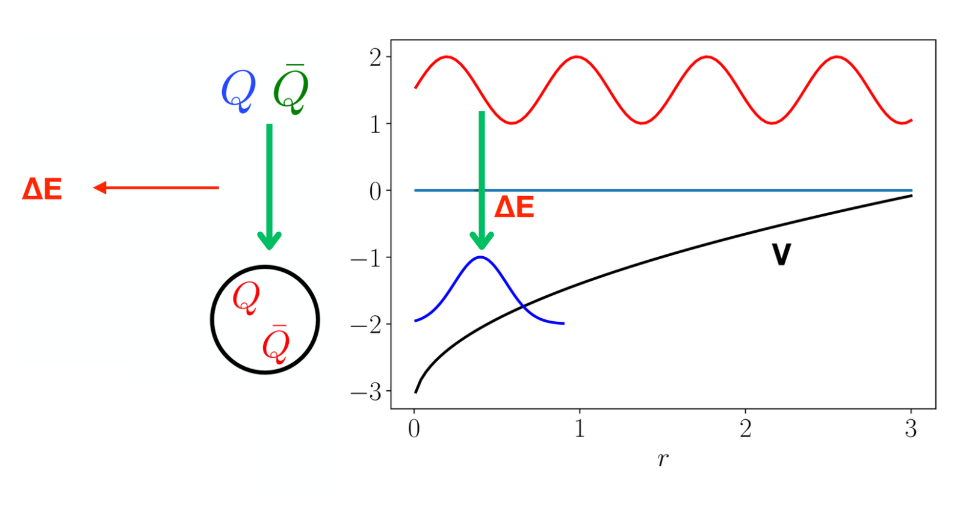
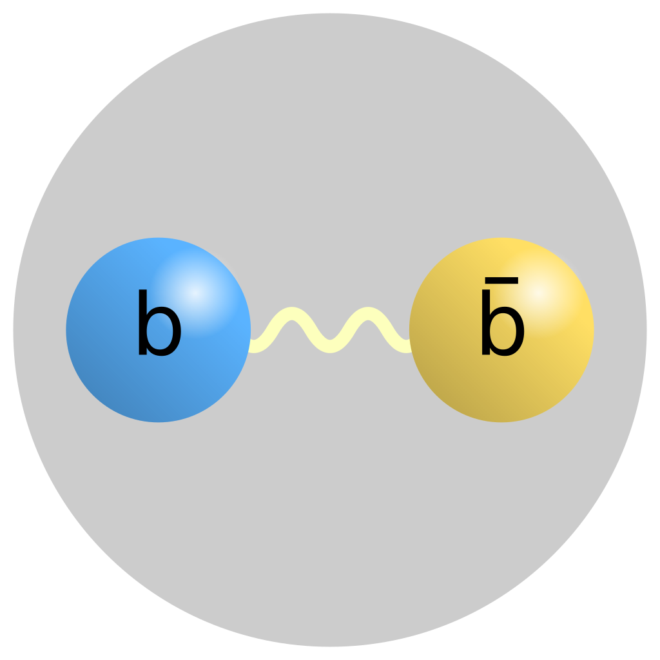
Quarkonia (Bottomonia) as Probe of QGP
Dynamical screening: quarkonia dissociation induced by dynamical process in the QGP, imaginary potential
Recombination: unbound heavy quark pair (re)combine into bound quarkonium state, can happen below melting temperature
Thews, Schroedter, Rafelski, PRC 63, 054905 (2001), arXiv:hep-ph/0007323
Dynamical screening
Recombination
Bottomonium
Heavy m ~ 10 GeV
Produced early (has history of QGP)
Non-relativistic (v << 1, v_{b}~ 0.1)
Scale separation (EFTs like pNRQCD)
No (/less) regeneration
Xiaojun Yao, 2020
E. Emerick, X. Zhao, and R. Rapp, 1111.6537

Slide 5
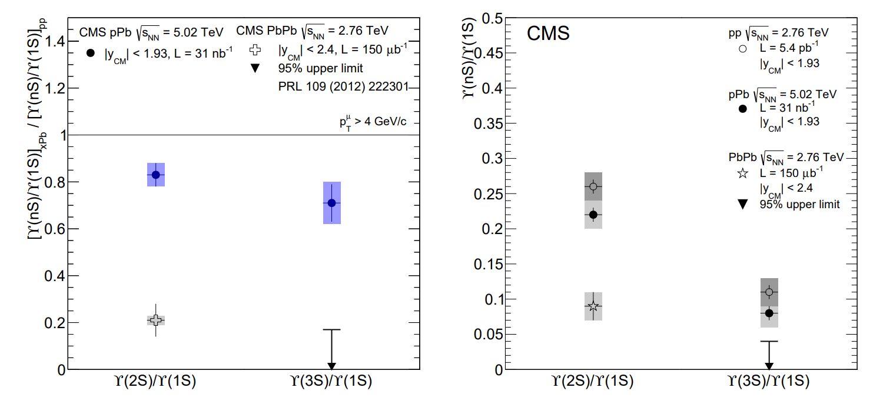
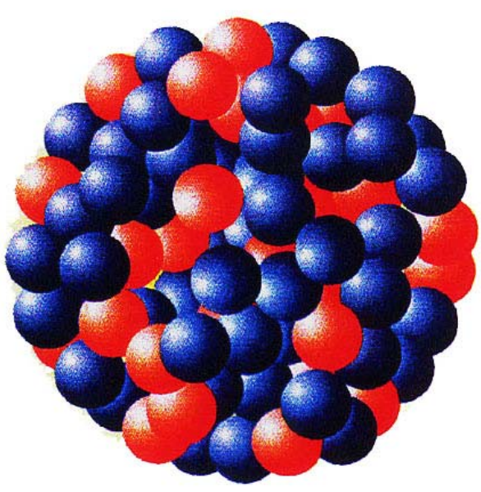
INTRODUCTION & MOTIVATION
Observables at RHIC and LHC reveal a smooth transition between proton-proton, proton-nucleus, and nucleus-nucleus collisions
In LHC p-Pb collisions, excited bottomonium states 𝚼(2S) and 𝚼(3S) are suppressed more than the ground state 𝚼(1S), a pattern that cannot be explained solely by CNM effects.
Short-Lived QGP? The differential suppression of excited 𝚼 states indicates that final-state interactions—potentially due to a transient QGP in small systems—play a significant role, necessitating further investigation of 𝚼 in p-Pb collisions at LHC energies
N. Armesto (2024), EPJ Web of Conferences 171, 11001 (2018)
CMS Collaboration, 1312.6300, 2202.11807

Slide 6
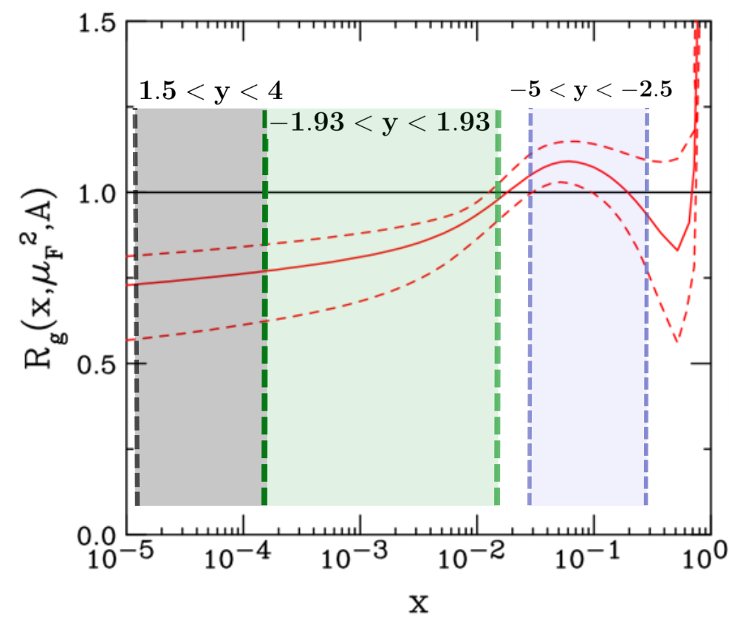
CNM EFFECT: Nuclear Modification of Parton Distribution Functions (nPDFs)
The parton densities / structure functions of bound nucleons modified from those in free nucleons
NLO EPPS21 (24 params, 49 total sets, 1 central and 48 error sets) nPDFs used
𝚼 production cross section in p+p and p+A by Color Evaporation Model (CEM) given by,
Eskola et al. (2021). 2112.12462
R. Vogt et al hep-ph/9502270, 1508.01286, 1609.06042
R. Vogt (2023), 2304.09356

Slide 7
CNM EFFECT: Energy Loss & Momentum Broadening
While passing through a medium (hot QGP, cold nucleus, …):
a parton can lose energy due to collisions (Bjorken, 1982)
and / or via induced gluon radiation (Gyulassy, Wang (1993) nucl-th/9306003)
The produced 𝚼 states lose energy and undergo momentum broadening in the cold QCD matter, encoded in Quenching weight
In terms of the rapidity shift δy & transverse momentum broadening δp_{T}, the quarkonium double differential cross section:
$\hat{q}$= transport coefficient,
L_{A} = effective path length of nucleus A
Arleo, Kolevatov, Peigne, Rustamova (2013), 1304.0901
Arleo & Peigne, Rustamova (2013), 1212.0434
5

Slide 8
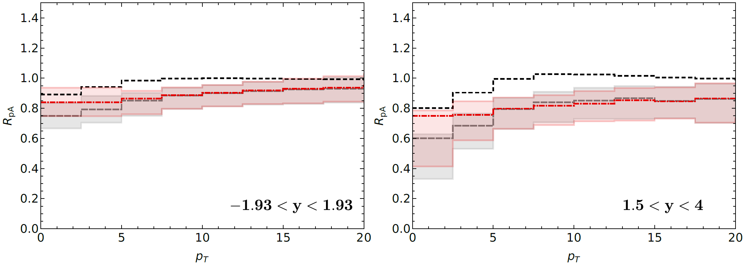
Modification of $Υ$ Production due to CNM EFFECTs at 8 TeV p+Pb
6

Slide 9
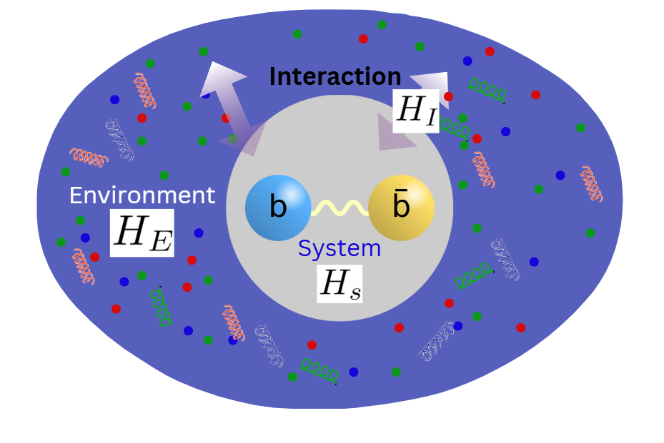
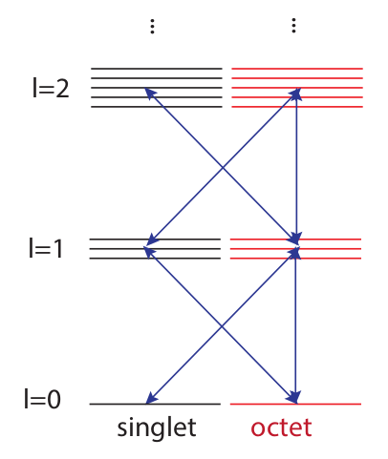
HNM EFFECT: KSU-Munich Approach
Open Quantum System (OQS) + pNRQCD
Following the hierarchy of scales, M >> 1/a₀ >> (π) T ∼ m_{D} >> E_{b}, at NLO pNRQCD [1] in E_{b} / T, we obtain Lindblad Master Equation [2], evolution of system density matrix:
Bottomonia as an Open Quantum System
[1] Brambilla et al (2022/23), 2205.10289, 2302.11826 , Strickland & Thapa (2023) 2305.17841, QTRAJ 1.0 (2021), 2107.06147
[2] G. Lindblad, Commun. Math. Phys. 119, 48 (1976); V. Gorini, A. Kossakowski, and E.C. Sudarshan, J. Math. Phys. 17, 821 (1976)
Six collapse operators:
1. singlet → octet
2. octet →singlet
3. octet →octet
Jump/Collapse Operators:
➔ Effect of the medium causing transition between singlet & octet states

Slide 10
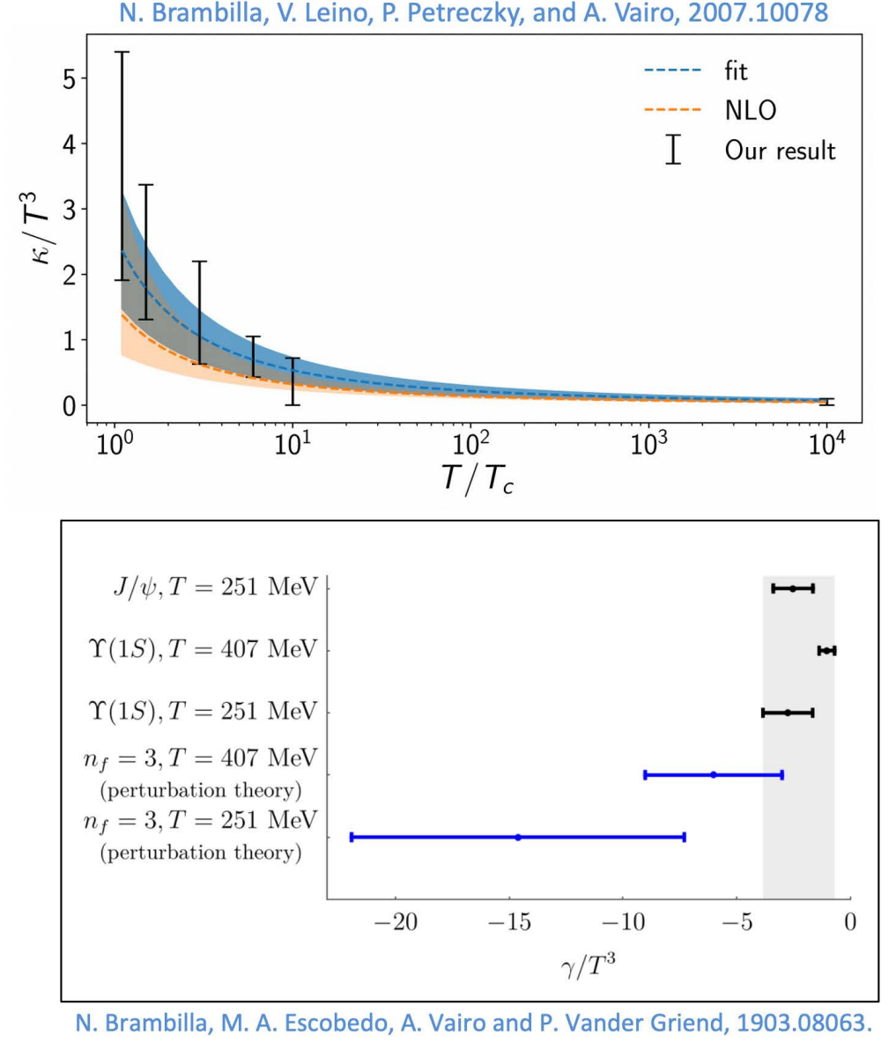
KSU-Munich Input Parameters: Transport Coefficients of Bottomonia
The imaginary part of the potential responsible for the decay of the 𝚼 states in the medium (dynamical screening from QGP medium), and depend on the transport coefficients, kappa ($κ$) and gamma (γ).
Larsen, Meinel, Mukherjee, Petreczky (2019) 1908.08437
Bala, Kaczmarek, Larsen, Mukherjee, Parkar, Petreczky, Rothkopf, Weber (2022) 2110.11659
The effect of the QGP medium in the quarkonia states (𝚼(nS)) are encoded in the heavy quark transport coefficients) [constrained by the Lattice QCD calculations]
$κ$(T): heavy quark momentum diffusion coefficient responsible for the large thermal width in the QGP medium, extracted from NLO fits to recent lattice measurements, {5,6,7} for pA at LHC energies
γ(T): dispersive, responsible for the thermal mass shift (= 0 for 𝚼 states), less constrained
Additional input ➔ QGP Temperature from aHydro

Slide 11
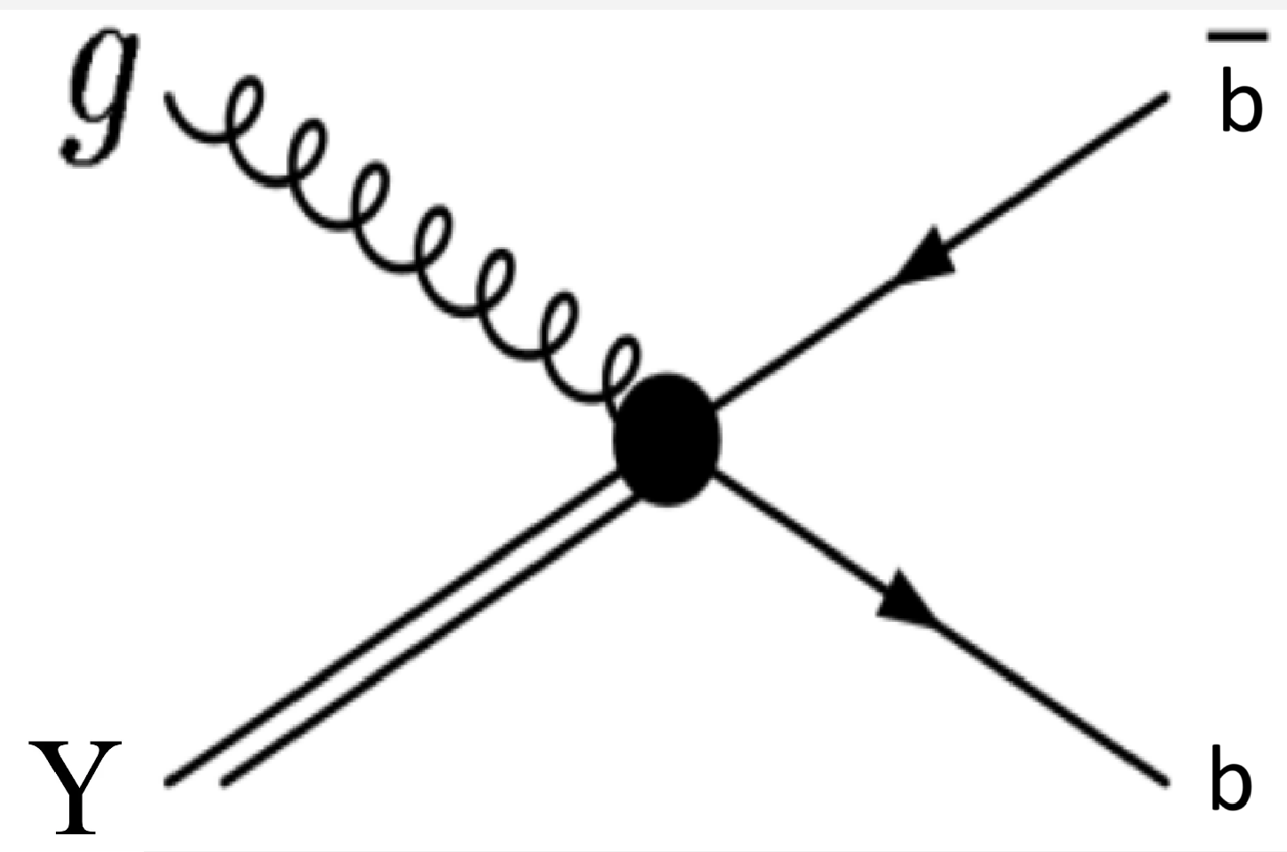
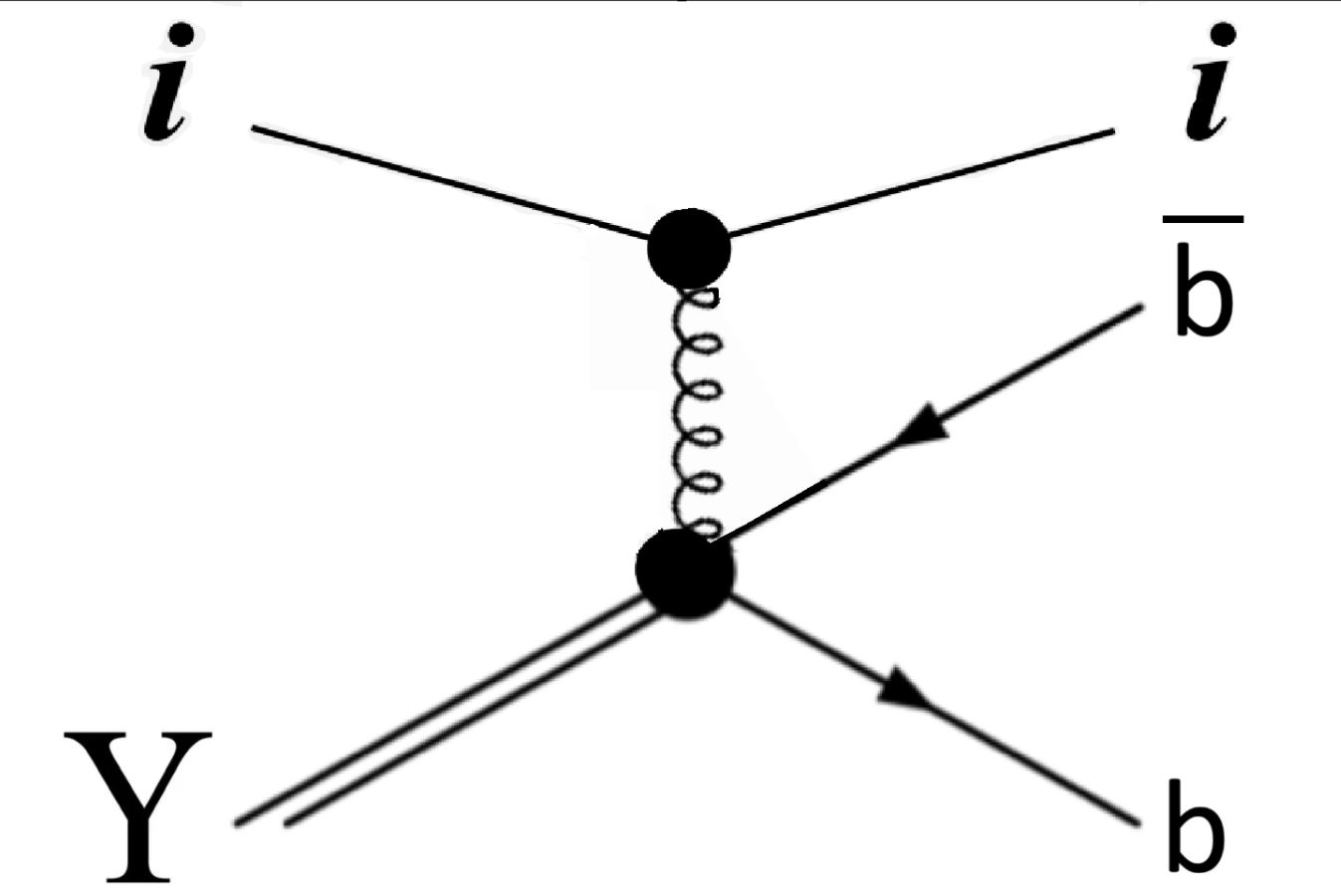
HNM EFFECT: TAMU (semi-classical transport model)
Kinetic Rate Equation, describes the evolution of number of quarkonia states in the QGP in terms of loss and gain terms:
Equilibrium Limit: depends on $b\overline{b}$ cross section and the thermal environment (QGP fireball)
Reaction Rate: medium effect on bound Υ states (cause decay of bound states into unbound $b\overline{b}$ pairs)
Primordial Suppression:
Regeneration:
Rapp, Zhao, Emerick (2012) 1111.6537, Du, He (2017/18), 1706.08670, 1808.10014
Rapp, Wu (2024) 2404.09881
Primordially produced Υ states that survive the QGP fireball expansion:
Solution of this equation gives the number of regenerated Υ states:
Notes:
Here, we discuss the semi-classical approach used to model the suppression and regeneration of the quarkonia states in the QGP medium. The key equation is the kinetic rate equation given below which governs the time evolution of the number of upsilon states, through a competition between the dissociation (loss term) and the regeneration (gain term) process. The dissociation rate (or reaction rate) depends on the temperature of the medium (thermal properties of the QGP). The dissociation can occur via two processes (gluo dissociation and quasi-free dissociation). The energetic gluon from the medium can excite the bound state into high energy octet state dissociating it into unbound b-b-bar pair. This dominates the states with high binding energy. For the weakly bound states, such as 2S and 3S, the dissociation is driven by the interaction with the thermal partons (quarks and gluons) in the medium. These partons effectively break apart the bound bb-bar pairs. Overall dissociation rate is temperature and transverse momentum dependent that integrates microscopic mechanisms, with the contribution of each process based on the binding energy and the QGP temperature.
The total rate equation has two parts: primordial suppression and the regeneration.
Primordial part describes how initially (primordially) produced quarkonia states (Upsilon) decay due to the interaction with the medium. Surviving primordial states can be calculated using the exponential decay factor integrated from the initial time to final time (this initial time can either be the formation time of the upsilon states, or initial time), but we vary the formation times to obtain the bands.
On the other hand, the regeneration part arises when unbound bb-bar pairs recombine to form bound states.. This is driven by the thermal equilibrium number which depends on the volume of the fireball, fugacity of bottom quarks, and the thermal density of the bound states. The fugacity factor depends on the bb-bar cross section and the QGP environment.
Finally, interplay between dissociation and regeneration yield the total observed suppression of the quarkonia staets as described by TAMU’s transport model. This approach captures the microscopic dissociation processes with the binding energy determining the sensitivity of different upsilon states to the QGP.

Slide 12
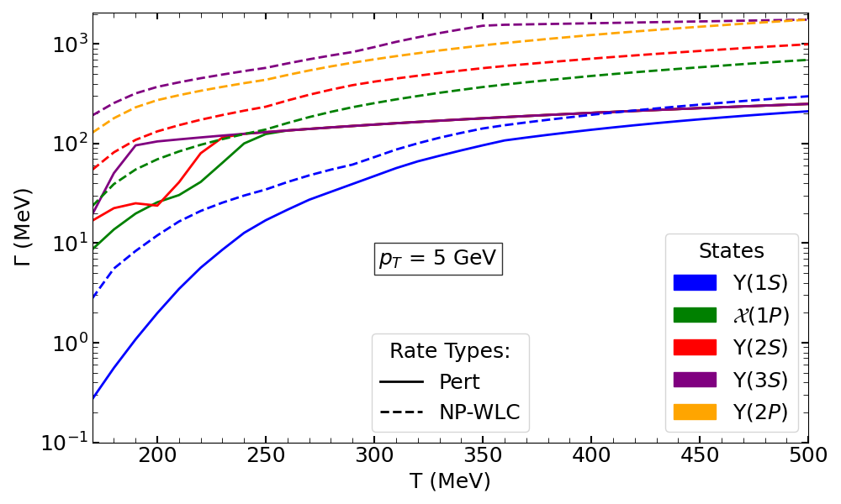
Reaction Rates of Bottomonia in TAMU Approach
Calculated in two different scenarios, both evaluated within the thermodynamic T-matrix approach by TAMU,
TAMU-P: treats only 1S, 2S, 1P, 3S states separately, 2P & 3S states have same rates (Reik, Rapp (2010), 1005.0769) | TAMU-NP: treats all bottomonium states (1S, 2S, 1P, 3S, 2P, …)
Z Tang, B Wu, A Hanlon, S Mukherjee, P Petreczky, R Rapp (2025), 2502.09044
Notes:
In the both quantum and semi-classical approaches, we have parameters related to the transport of the quarkonia in the qgp.
On the left side, is the transport coefficients involved in the TAMU approach. Reaction rates are calculated in two different scenarios, both evaluated within the thermodynamic T-matrix approach by TAMU group.
The figure shows the reaction rates as a function of temperature calculated from the first approach, perturbative method. In the plot, the solid lines are for the total reaction rates, while the dashed lines are for the gluo-dissociation rates. At low temperature, the gluo-dissociation contributes in the total rates, but you can see at high temperature, the reaction rates have more contribution from the quasi-free dissociation.

Slide 13
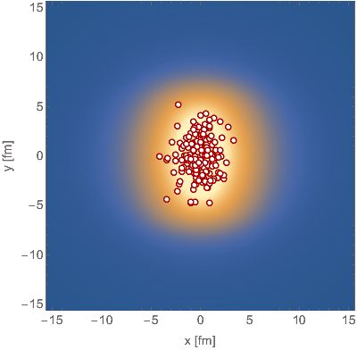
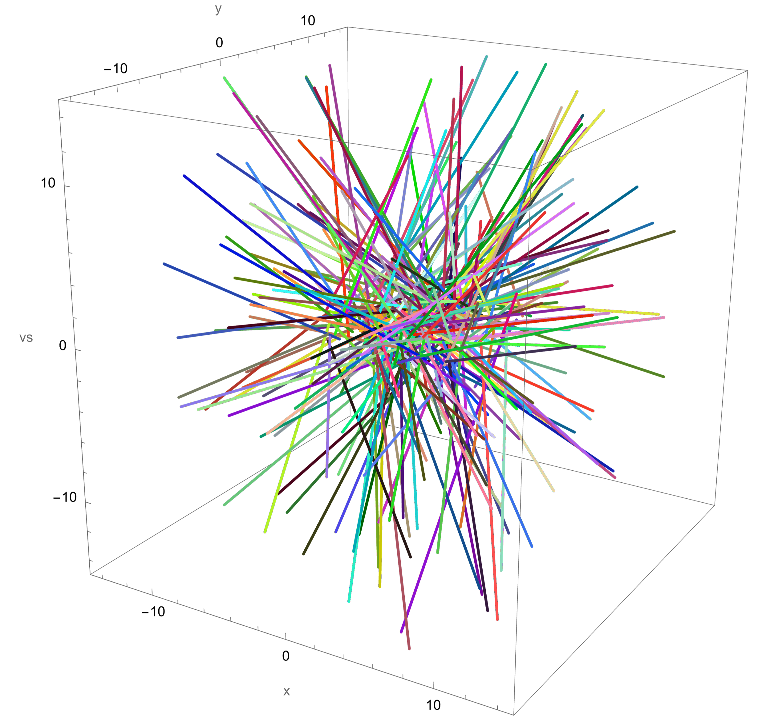
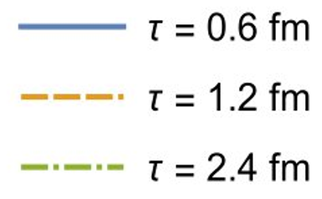
QGP Background Evolution: (3+1)D aHydro
Backgroud Temperature evolution of QGP provided by anisotropic hydrodynamics.
Quasiparticle anisotropic hydrodynamics (aHydroQP): good description of identified hadron spectra.
Alqahtani, Nopoush, Strickland (2015), 1509.02913, (2017), 1712.03282

Slide 14
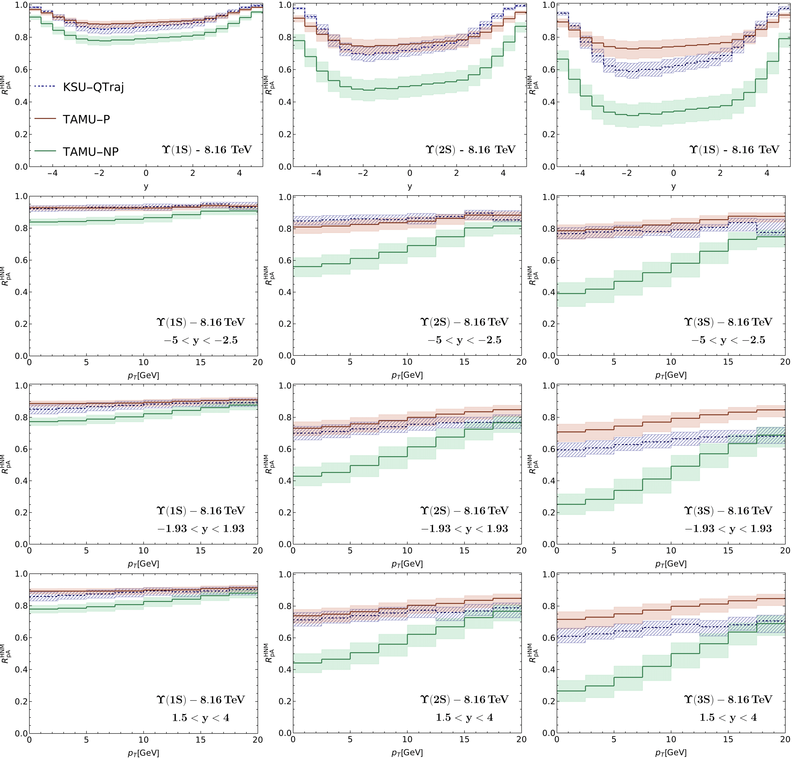
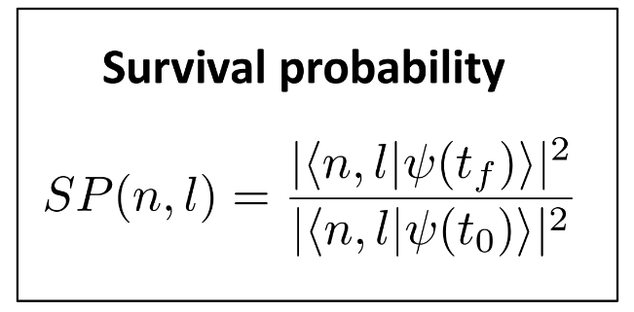
$Υ$ Suppression due to HNM EFFECTs at 8.16 TeV p+Pb

Slide 15
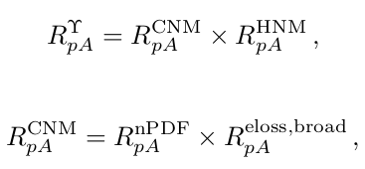
Combining All Effects
The total suppression of the Bottomonia states coming from different contributions (CNM and HNM),

Slide 16
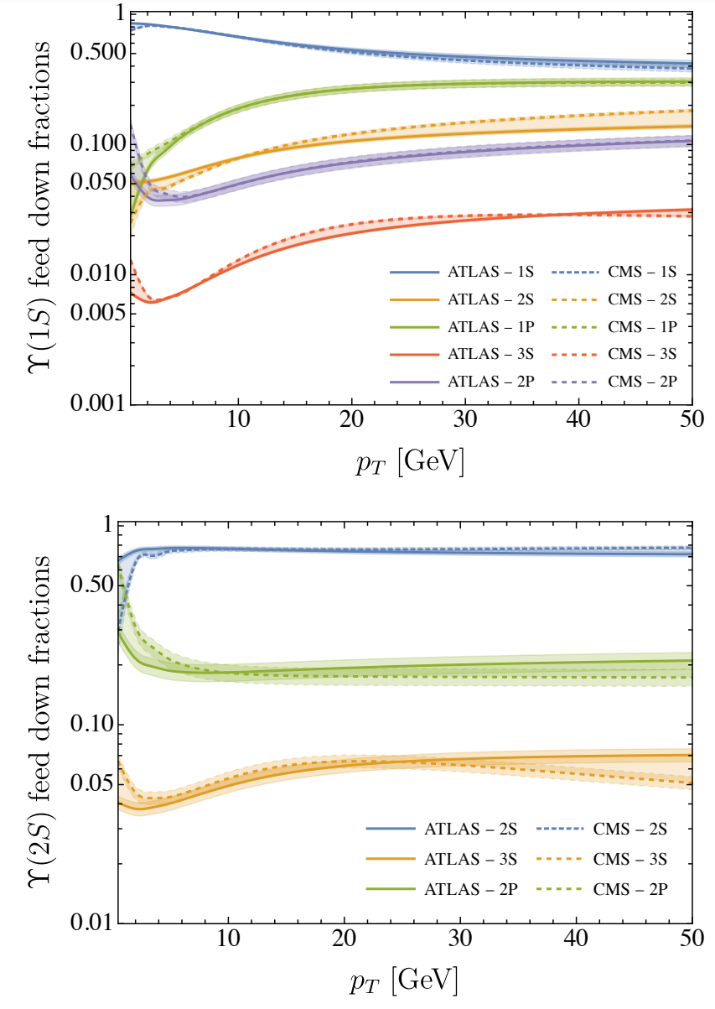
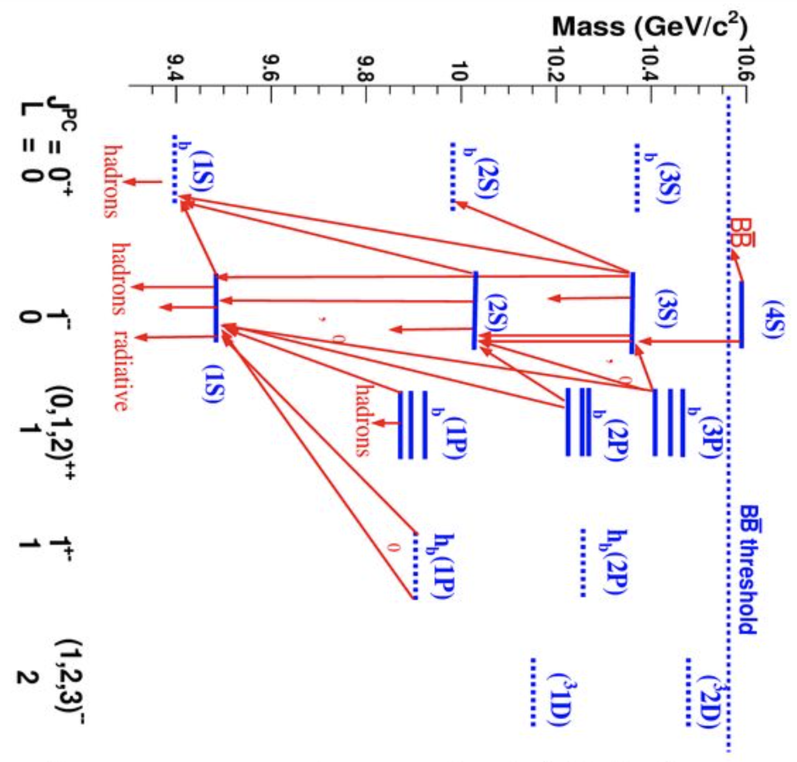
Feed-down Contribution
Around 75% of 𝚼(1S) and 𝚼(2S) yield from direct production, but important feed-down contributions from the 1P and 2P states
All known excited state feed-down channels included as,
Boyd, Thapa, and Strickland (2023), 2307.03841

Slide 17
RESULTS: R_{pA} vs y (top row), vs p_{T} (bottom row, 5.02 TeV p+Pb, Midrapidity)

Slide 18
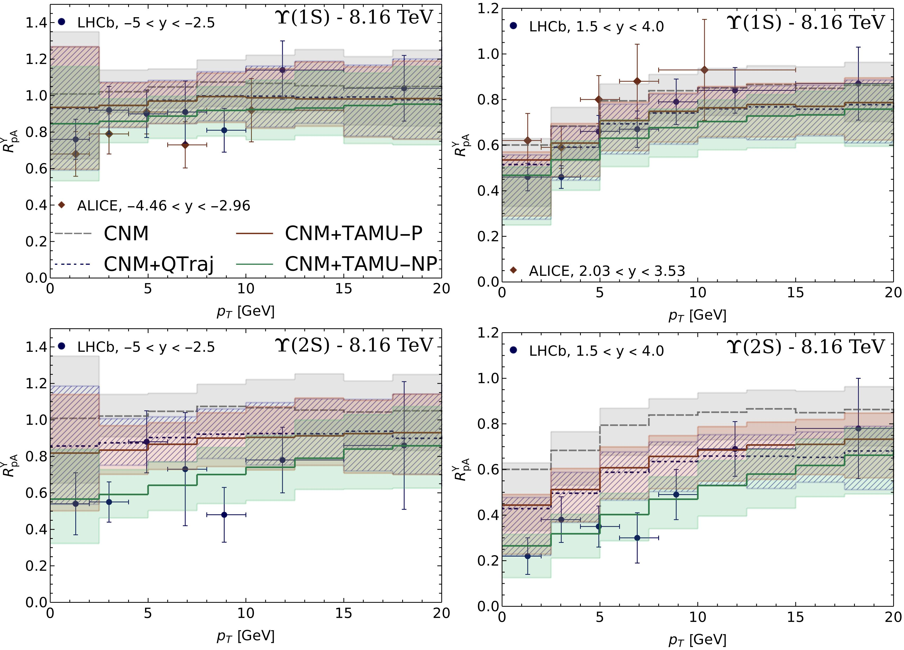
RESULTS: R_{pA} vs p_{T} (8.16 TeV p+Pb, Forward & Backward Rapidity)

Slide 19
CONCLUSION & OUTLOOK
Including all the effects (CNM and HNM effects) provides reasonable description of available data given current experimental and theoretical uncertainties.
For 𝚼(1S), final state interactions with QGP gives a small correction to the CNM effects (nPDF, Coherent Energy Loss, and Transverse Momentum Broadening).
But for the 𝚼(2S) and 𝚼(3S) states, including QGP-induced suppression together with the CNM effects is essential to explain the experimental data.
Provides further evidence for the production of a hot, but short-lived QGP in the p-Pb collisions.
Examined the reaction rates from TAMU in small collision systems, consistent predictions from both KSU-Munich & TAMU approaches.
Next, study charmonia suppression and regeneration in p+Pb and d+Au collisions. Systematic understanding of pA collision helps to understand AA collisions.
In AA collisions QGP-induced suppression is the dominant effect, but CNM effects are needed for quantitative understanding.

Slide 20
Thank you!
sthapa3@kent.edu

Slide 21
Backup slides

Slide 22
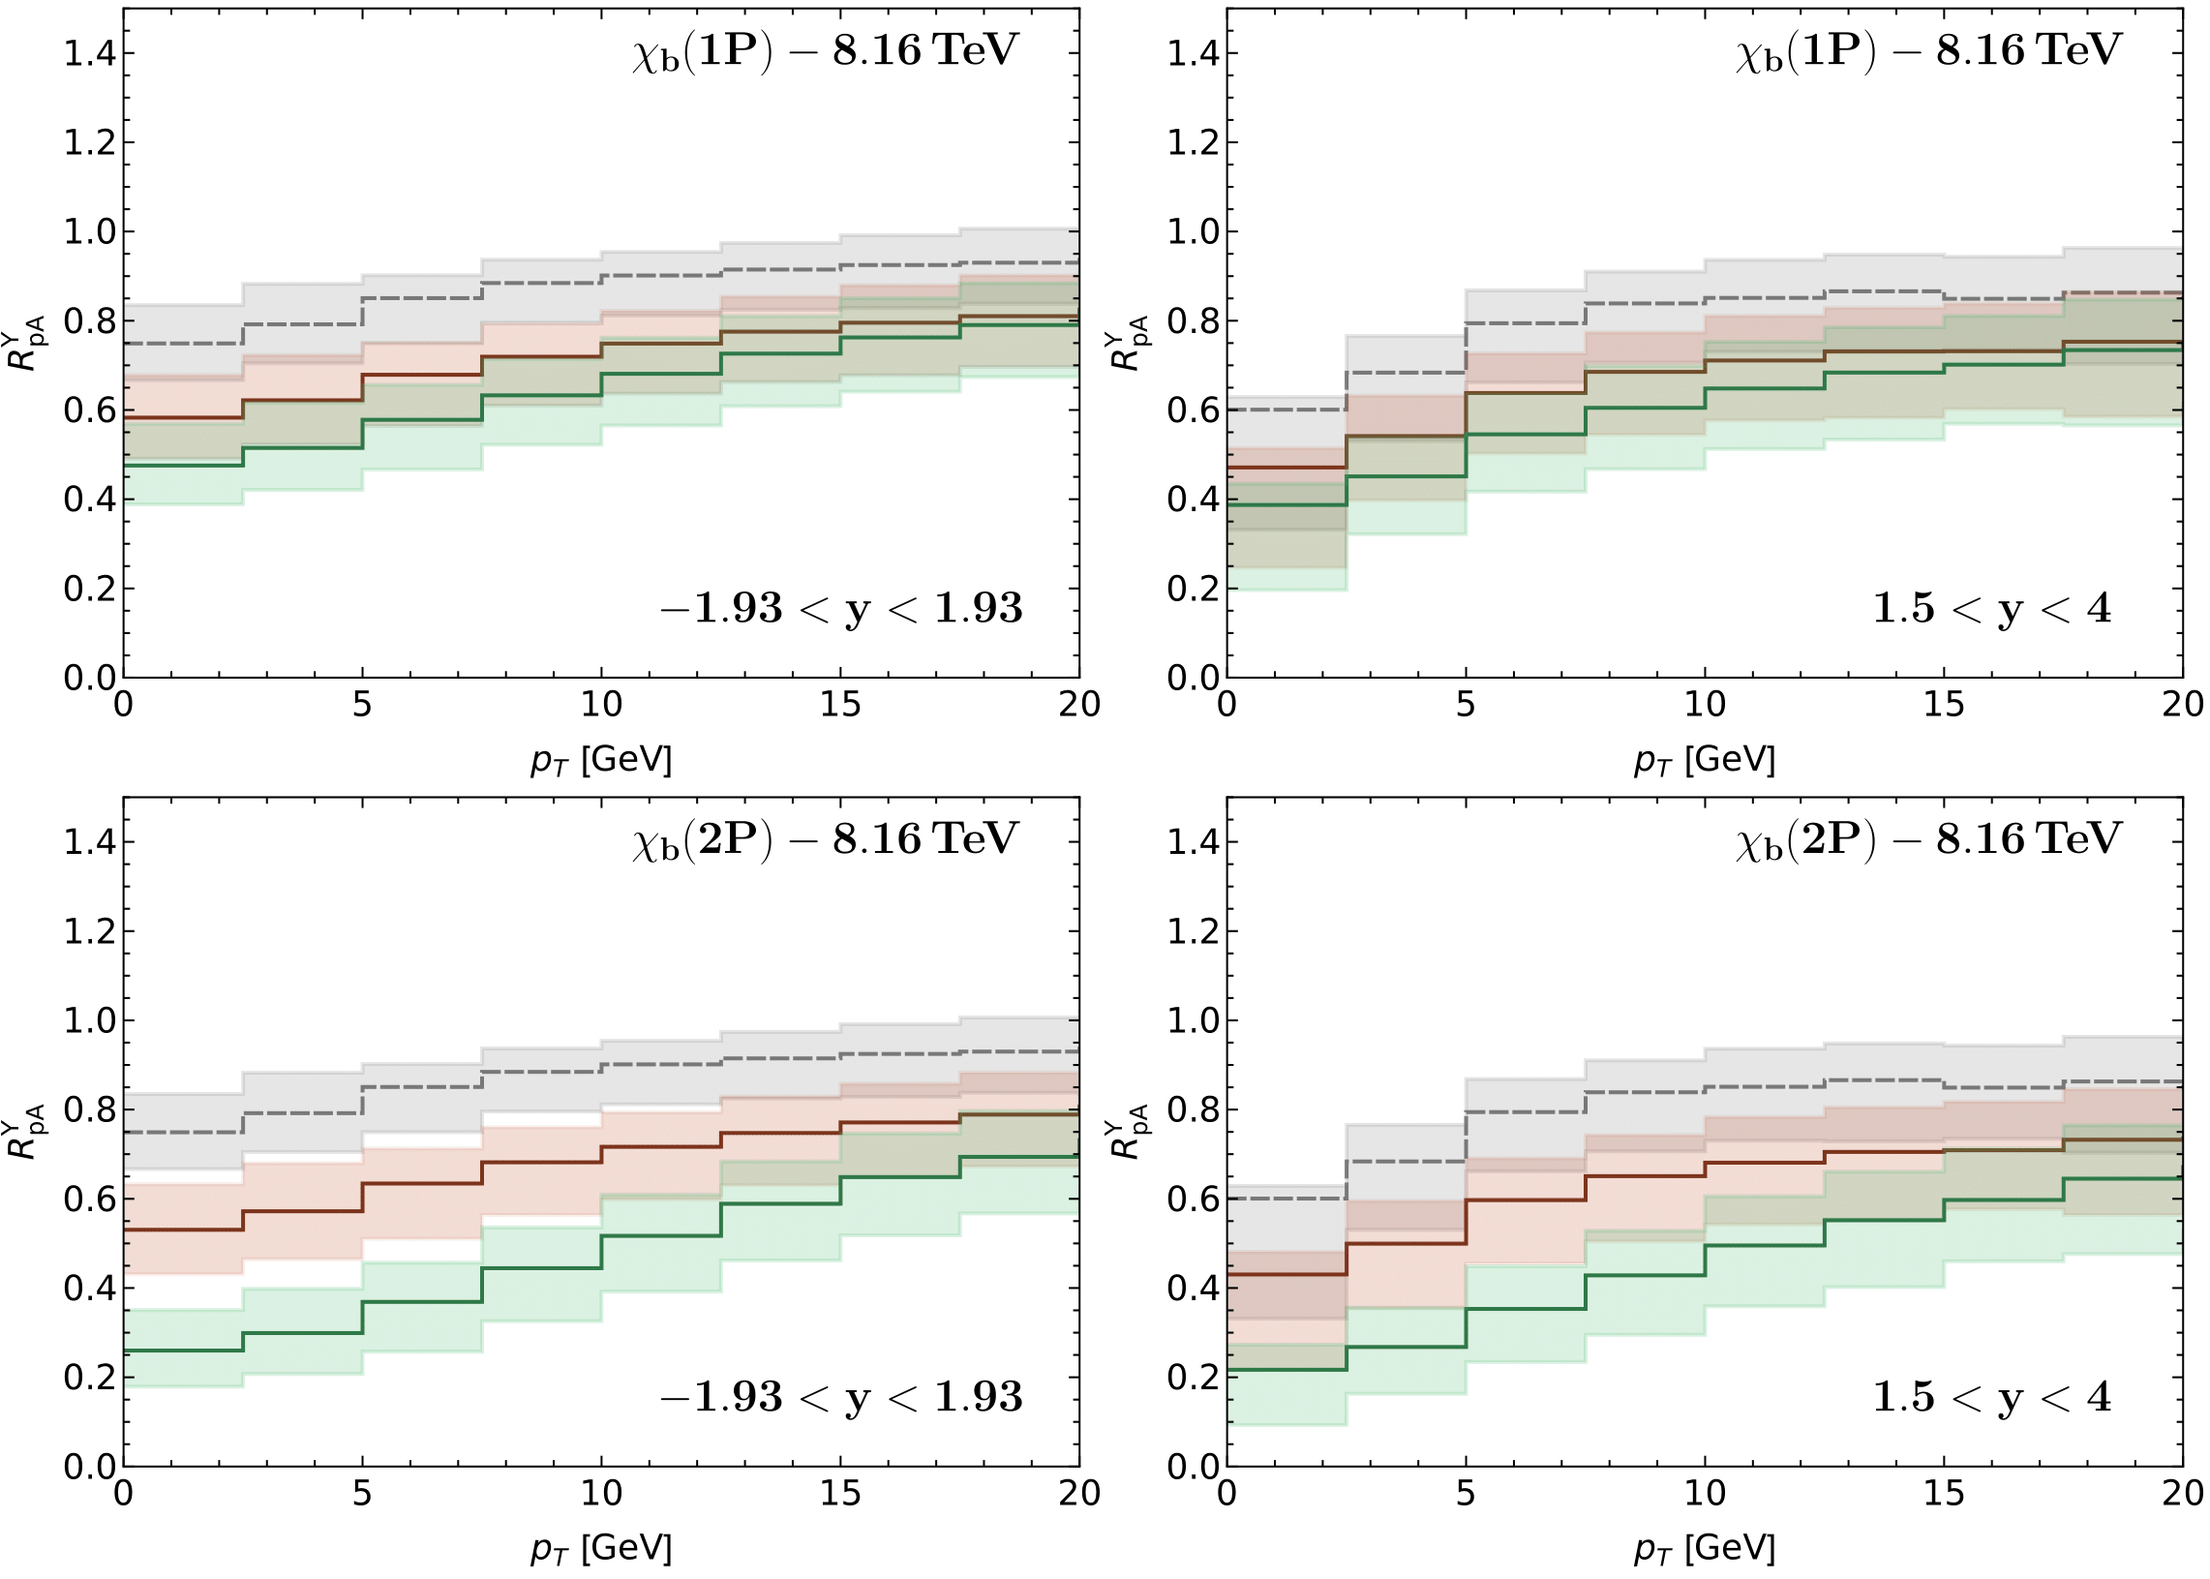
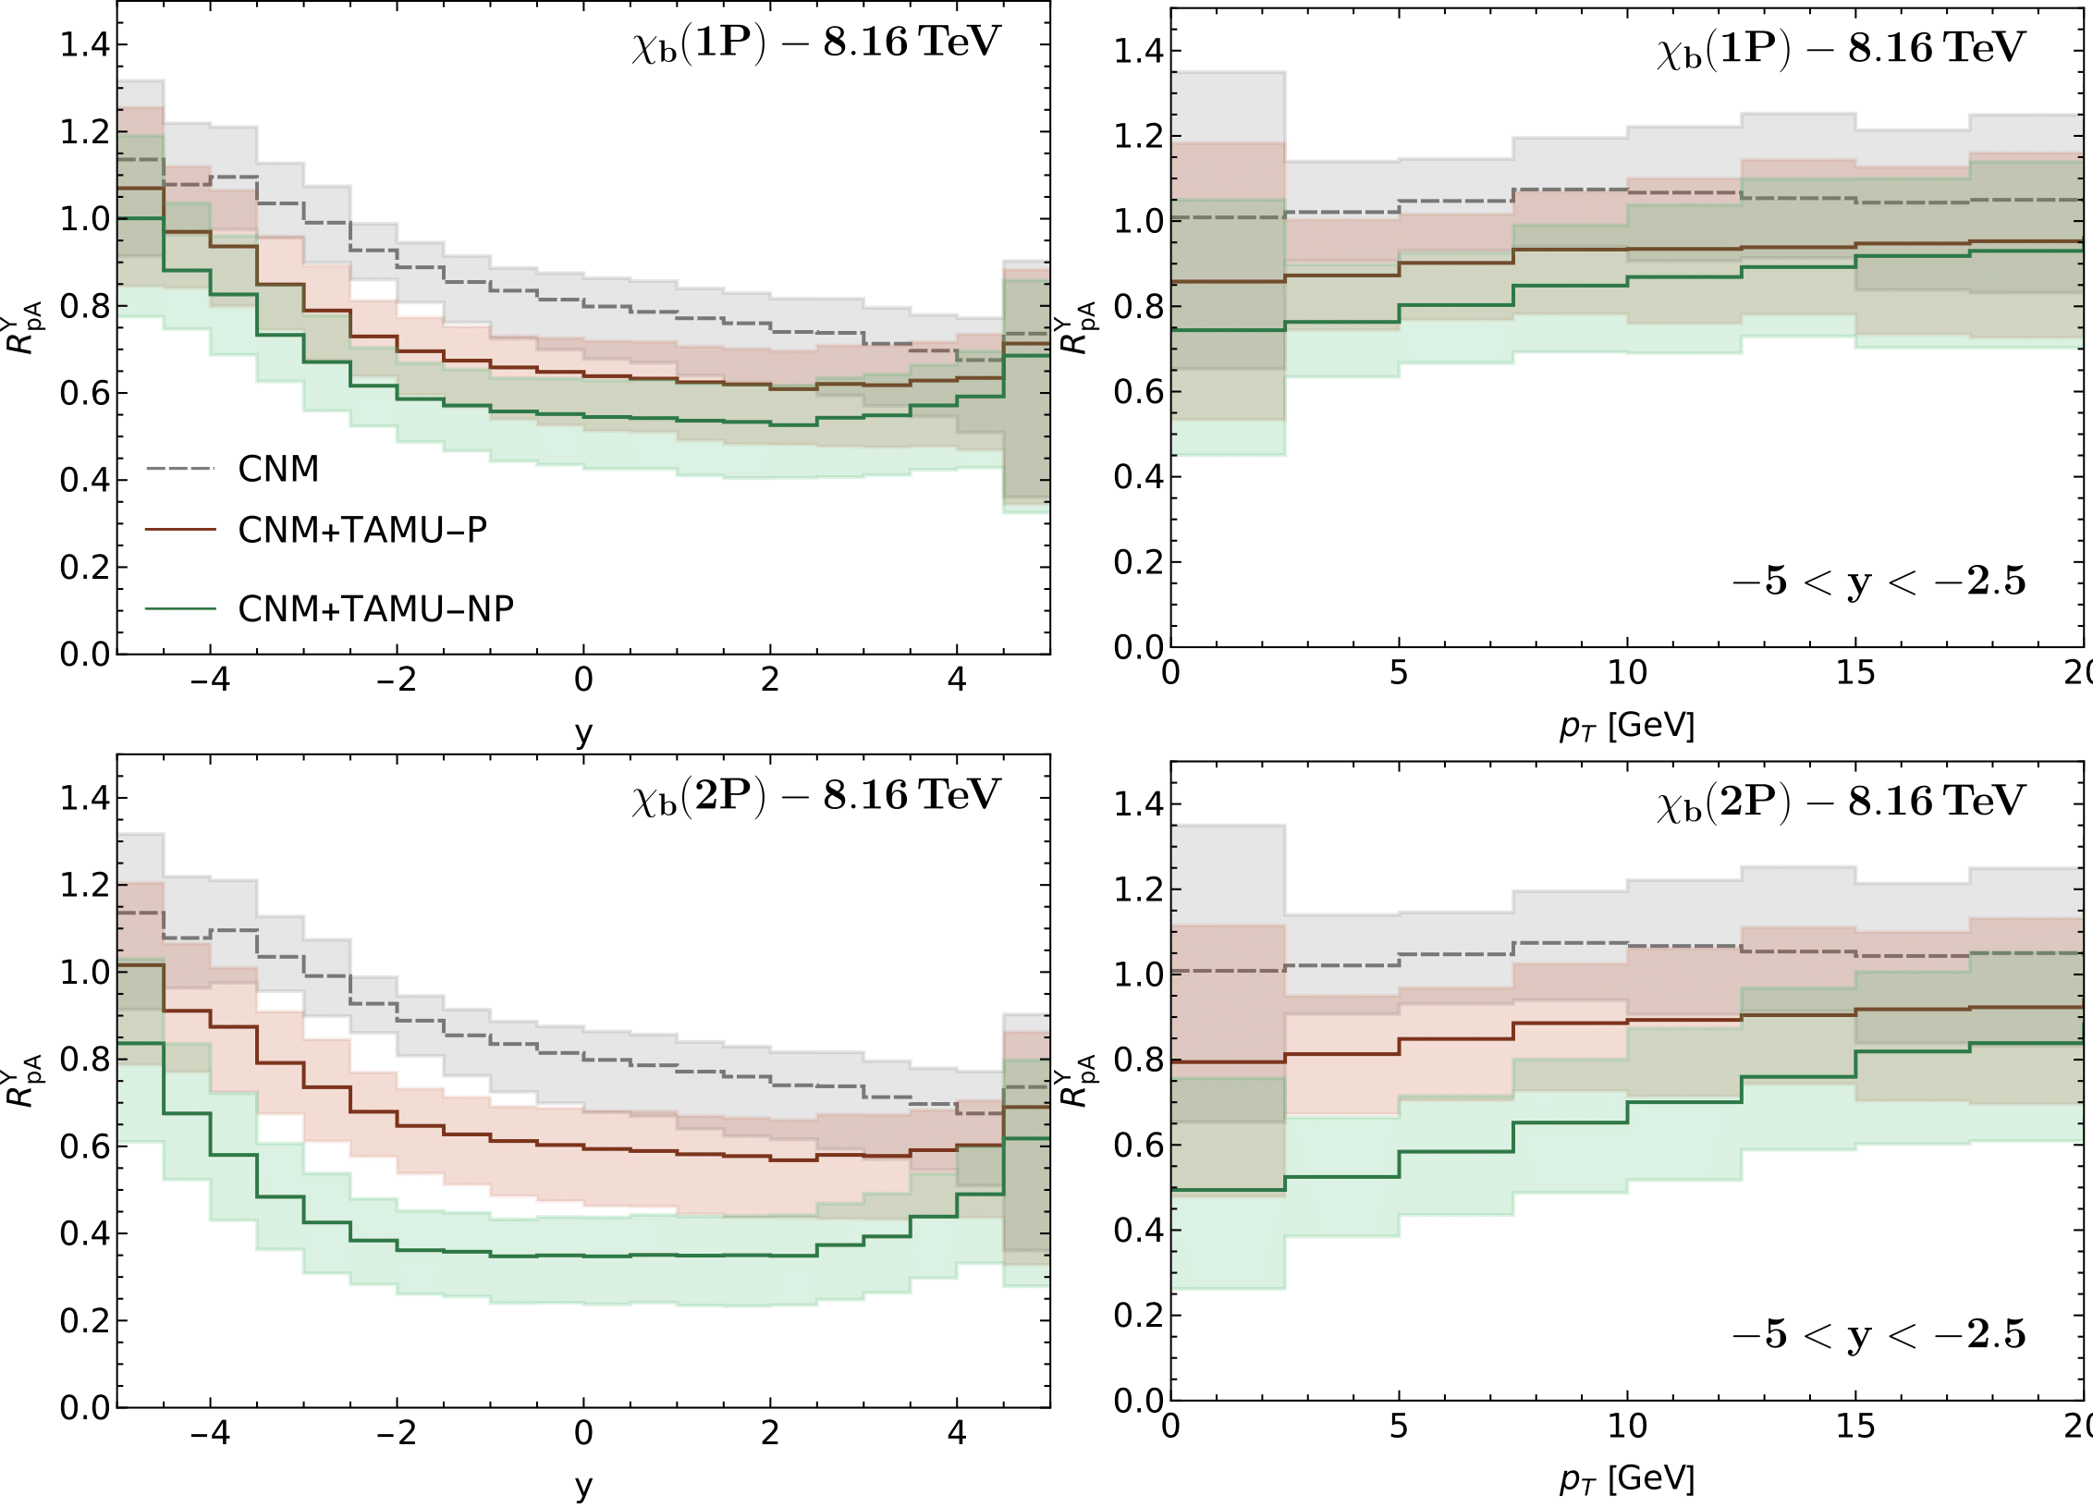
$$PREDICTIONS FOR χb(nP)$$

Slide 23
Bottomonia: pNRQCD
Separation of Scales
Separation of scales in vacuum: M >> Mv >> Mv²
 | QCD
 | NRQCD | G.Bodwin, E.Braaten, G.Lepage, hep-ph/9407339
 | potential-NRQCD | N.Brambilla A.Pineda, J.Soto, A.Vairo hep-ph/9907240
M
Perturbative matching
Mv ∼ 1/r
Non-perturbative matching (long-range quarkonium)
Perturbative matching (short-range quarkonium)
Mv² ∼ E
Markovian Process
(During system relaxation, environment correlation has lost)
Medium relaxation time / Environment correlation time: τ_{E} ∼ 1/T
Intrinsic Time Scale of System: τ_{S} ∼ 1/ (Mv²) ∼ 1/ (w_{i} – w_{j})
System relaxation time: τ_{R} ∼ 1/self-energy [<p(t)> ∼ e^{−t / t_rel} ]
Inside QGP: thermal scales: T
Case 1: MV >> T Quantum Optical Limit (τ_{R}>> τ_{E} & τ_{R}>> τ_{S} )
Case 2: T >> Mv² Quantum Brownian Motion (τ_{R}>> τ_{E} & τ_{S}>> τ_{E} )
System = Quarkonium (Bottomonium)

Slide 24
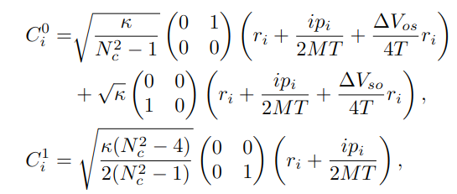
KSU-Munich Approach: OQS + pNRQCD
Reduced density matrix of the bottomonium (system) evolves by Lindblad equation
DoF: singlet and octet states
System density matrix & Hamiltonian decomposed into singlet & octet
The imaginary part of the potential causing the decay of the 𝚼 states in the medium (dynamical screening from QGP medium), and depend on the transport coefficients, kappa and gamma.
Jump/Collapse Operators:
QTRAJ-NLO 2205.10289, QTRAJ 1.0 2107.06147

Slide 25
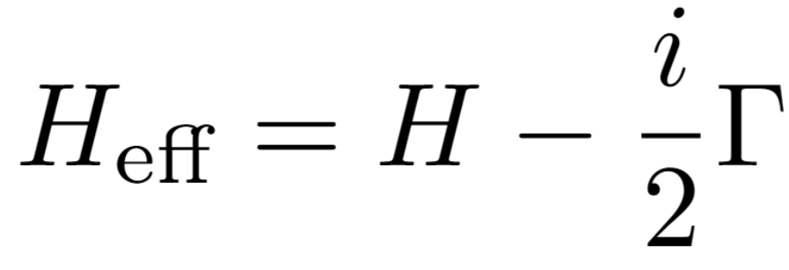
KSU-Munich Numerical Solution: Quantum Trajectories (QTraj)
Partial and Total decay widths:
Reorganize Lindblad equation by defining
Sampled 3D trajectories for bottomonium states → Monte Carlo (MC) Sampling
Initial transverse positions for the bottomonium production in p-Pb sampled using MC using binary collision overlap profile of proton and Pb nucleus.
Initial transverse momentum and momentum rapidities → MC sampled using distribution function (used in pp-parametrization).
Temperature evolution ➔ 3+1D aHydroQP
Quantum Dynamics of each sampled physical trajectories → Using NLO Qtraj → Solve the real-time 3D Schrödinger equation with a complex potential and stochastically sampled jumps →Lindblad equation\
Then find the survival probability of S-and P-wave states
Non-unitary “no jump” evolution
Can treat this “quantum jump” term stochastically
Can be reduced to the solution of a large set of “quantum trajectories” in which we solve a 1D Schrödinger equation with a non-Hermitian Hamiltonian 𝑯_{𝐞𝐟𝐟}, subject to stochastic quantum jumps.
Jump Operators (also called Collapse/Lindblad operators) encode transitions between different color/angular momentum states (obeying selection rules)
The evolution with the non-Hermitian 𝐻_{eff} preserves the color and angular momentum state of the system (but not norm).
For each physical trajectory (path through the QGP), we average over a large set of independent quantum trajectories
Embarrasingly Parallel
L = 40 GeV⁻¹
Points: 2048
Physical Trajectories: 160,000
20 Quantum Trajectories,Per physical Trajectory

Slide 26
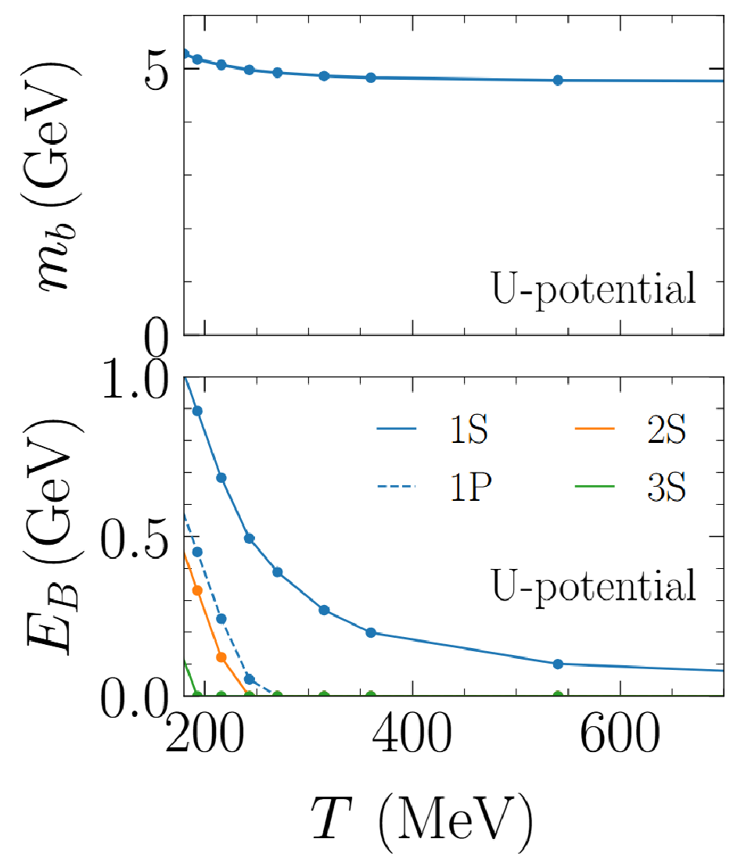
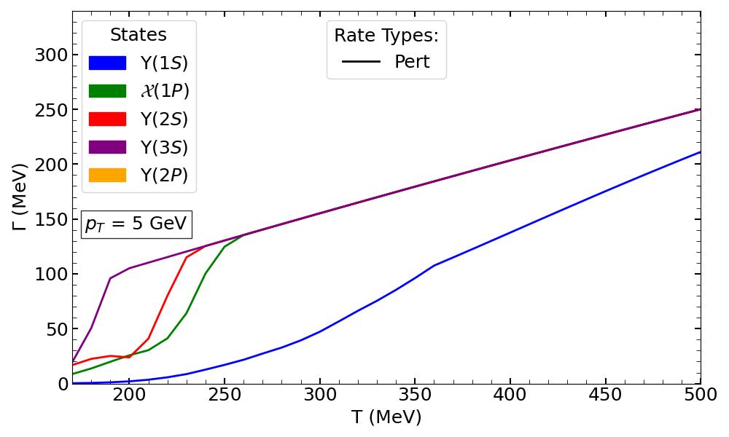
TAMU Approach (Perturbative Rates, TAMU-P Case)
Uses finite-temperature internal-energy (U) potential from lQCD constraints
Quasi-free approximation with perturbative coupling to QGP, includes inelastic scattering and gluon dissociation
Predicts moderate in-medium, screening and dissociation rates, treats 1S, 1P, 2S and 3S states only (rates for 2P = 3S)
X. Du, M. He, R. Rapp (2017), 1706.08670, F. Riek & R. Rapp (2018), 1005.0769

Slide 27
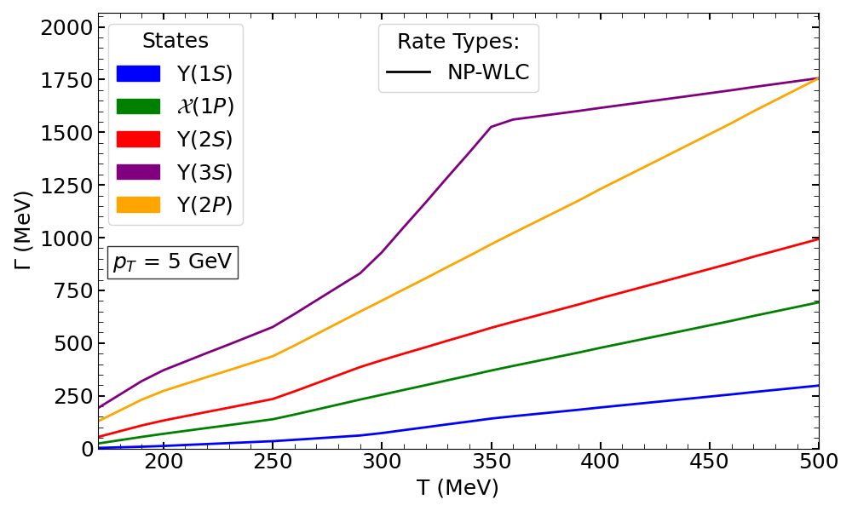
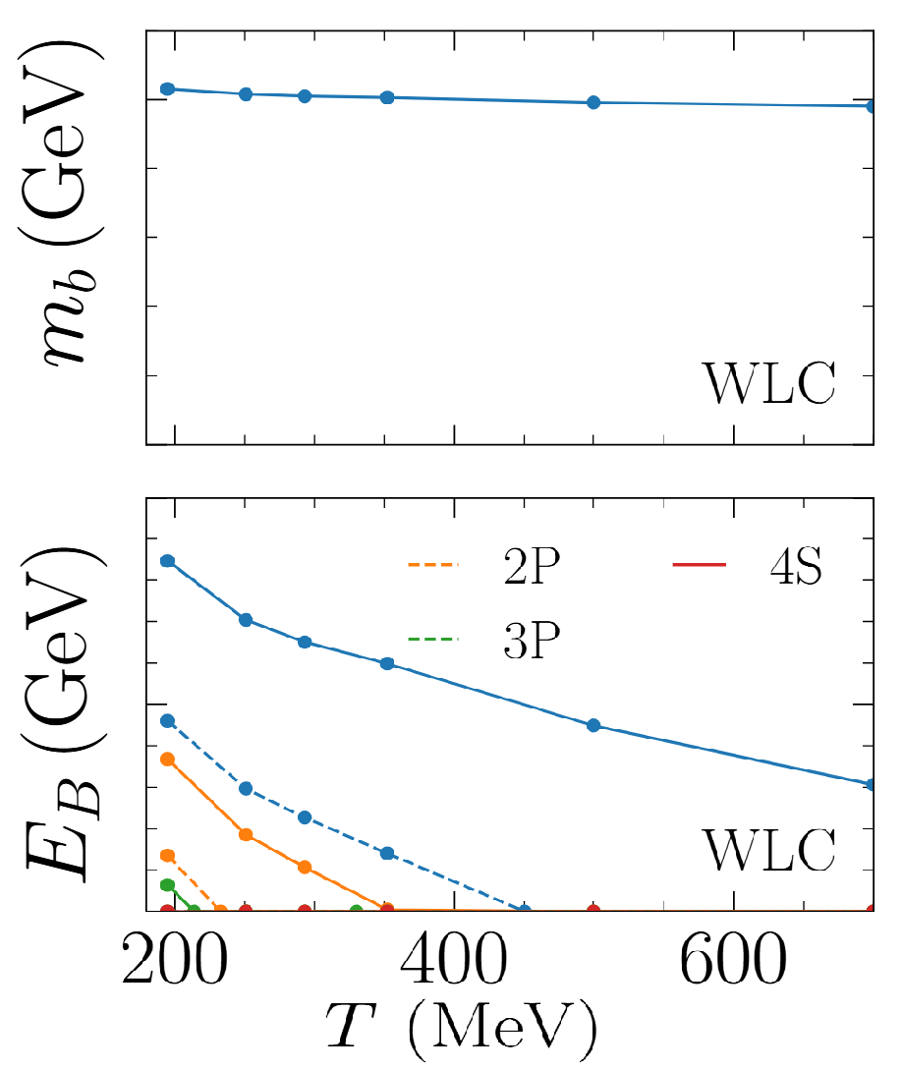
TAMU Approach (Non-Perturbative Rates, TAMU-NP Case)
Recent approach using in-medium potential constrained by nonperturbative Wilson line correlators (WLC)
Weakly screened potential → substantial bottomonium binding in QGP
Dissociation rates from T-matrix poles in the complex energy plane
Predicts high in-medium dissociation rates
Treats multiple states: 1S, 2S, 1P, 3S, 2P, …
Z Tang, B Wu, A Hanlon, S Mukherjee, P Petreczky, R Rapp (2025), 2502.09044
Z Tang, R Rapp (2023), 2304.02060

Slide 28
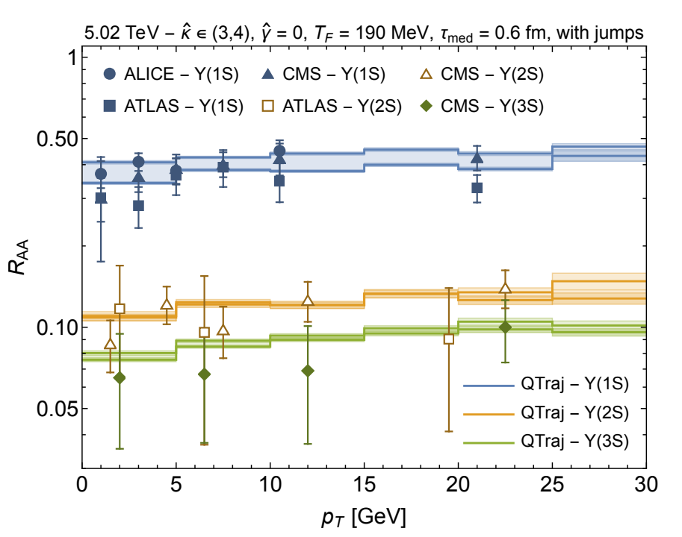
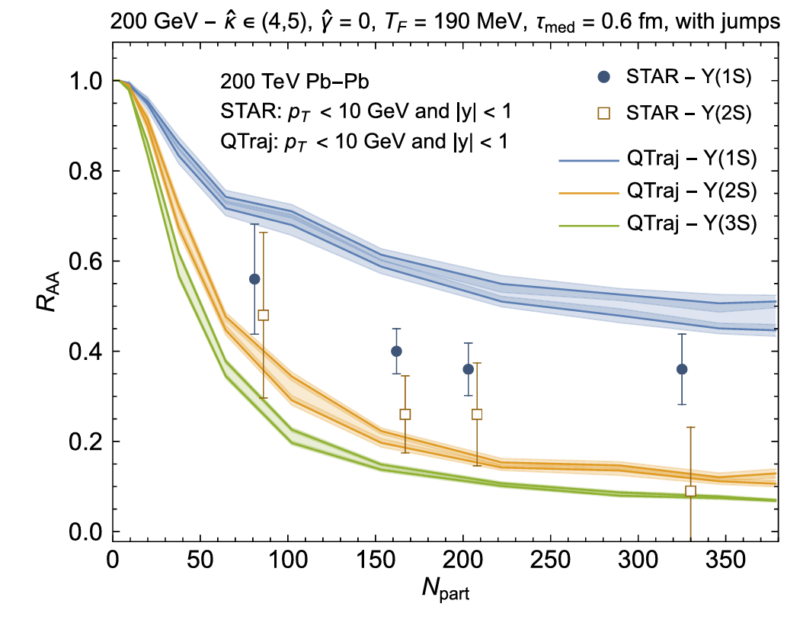
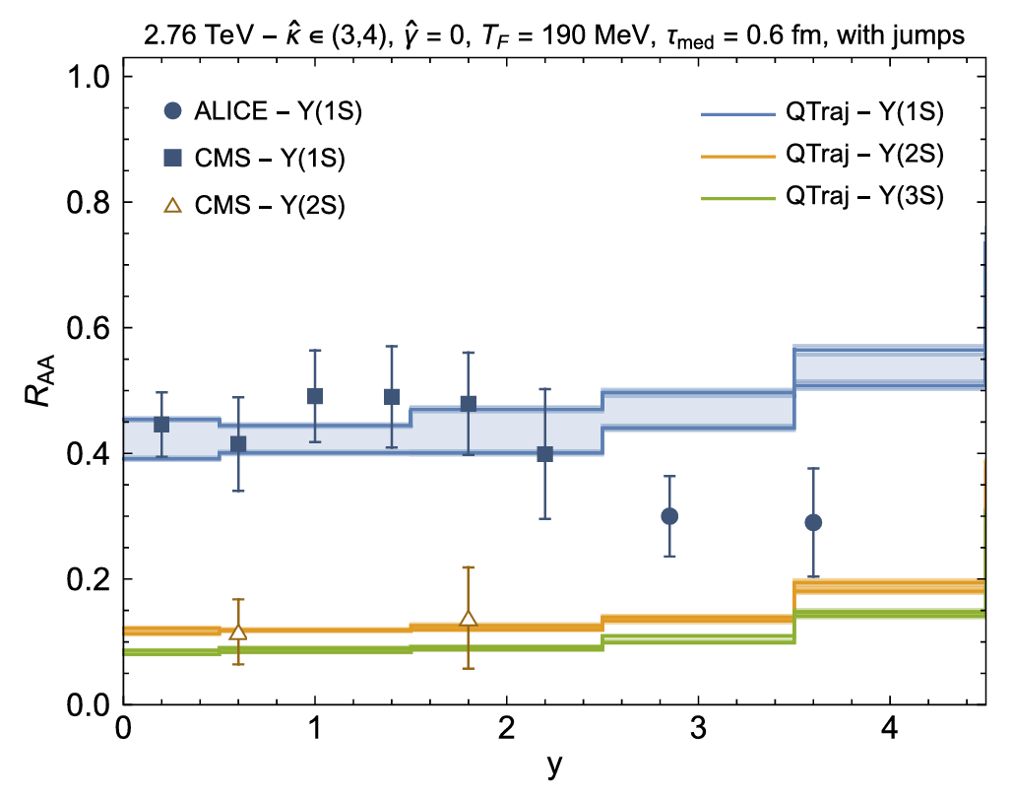
Future: AA Collision
In AA collision at RHIC & LHC, the forward and backward rapidities, some additional effects needed!
M. Strickland & S. Thapa (2023) 2305.17841

