Slide 1

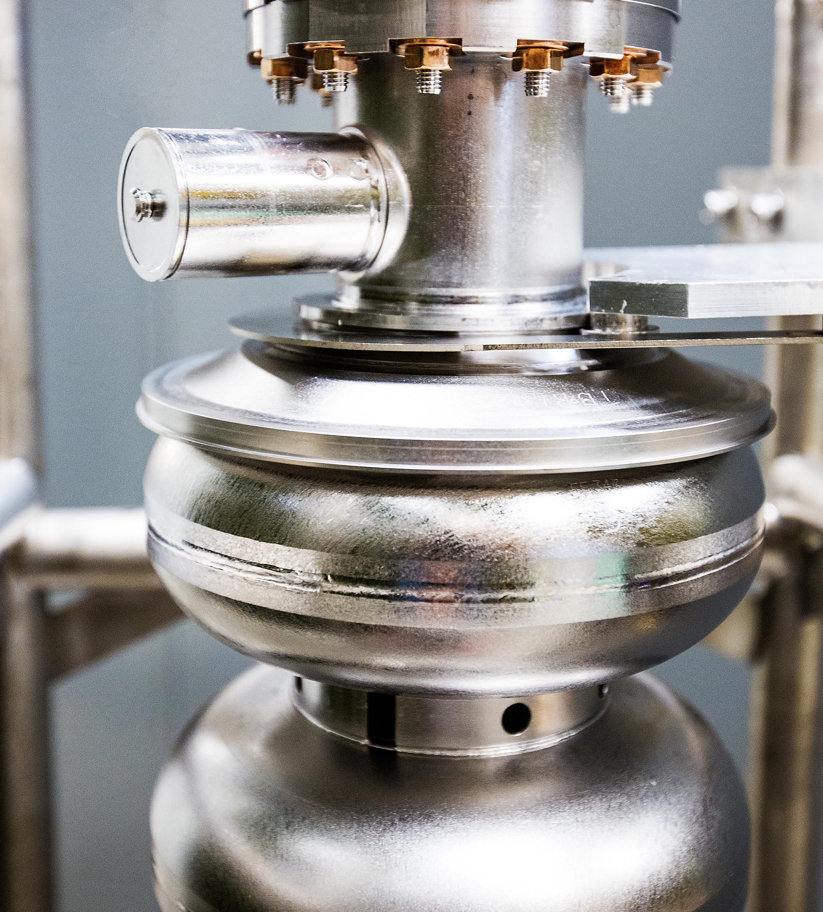



The CEBAF Experimental Program and Possible Future Upgrades
Douglas Higinbotham, Ph.D.
Physics Division Operations Director
Thomas Jefferson National Accelerator Facility
14 March 2025
Notes:
Let me introduce myself, I am Kim Sawyer, the new Director of Jefferson Lab. I am excited to meet with you today. Ultimately, our user community is what Jefferson Lab is all about - collaboration, cooperation, and innovation across institutions, across state and national boundaries – to deliver the best science in our field in a safe and efficient way.

Slide 2
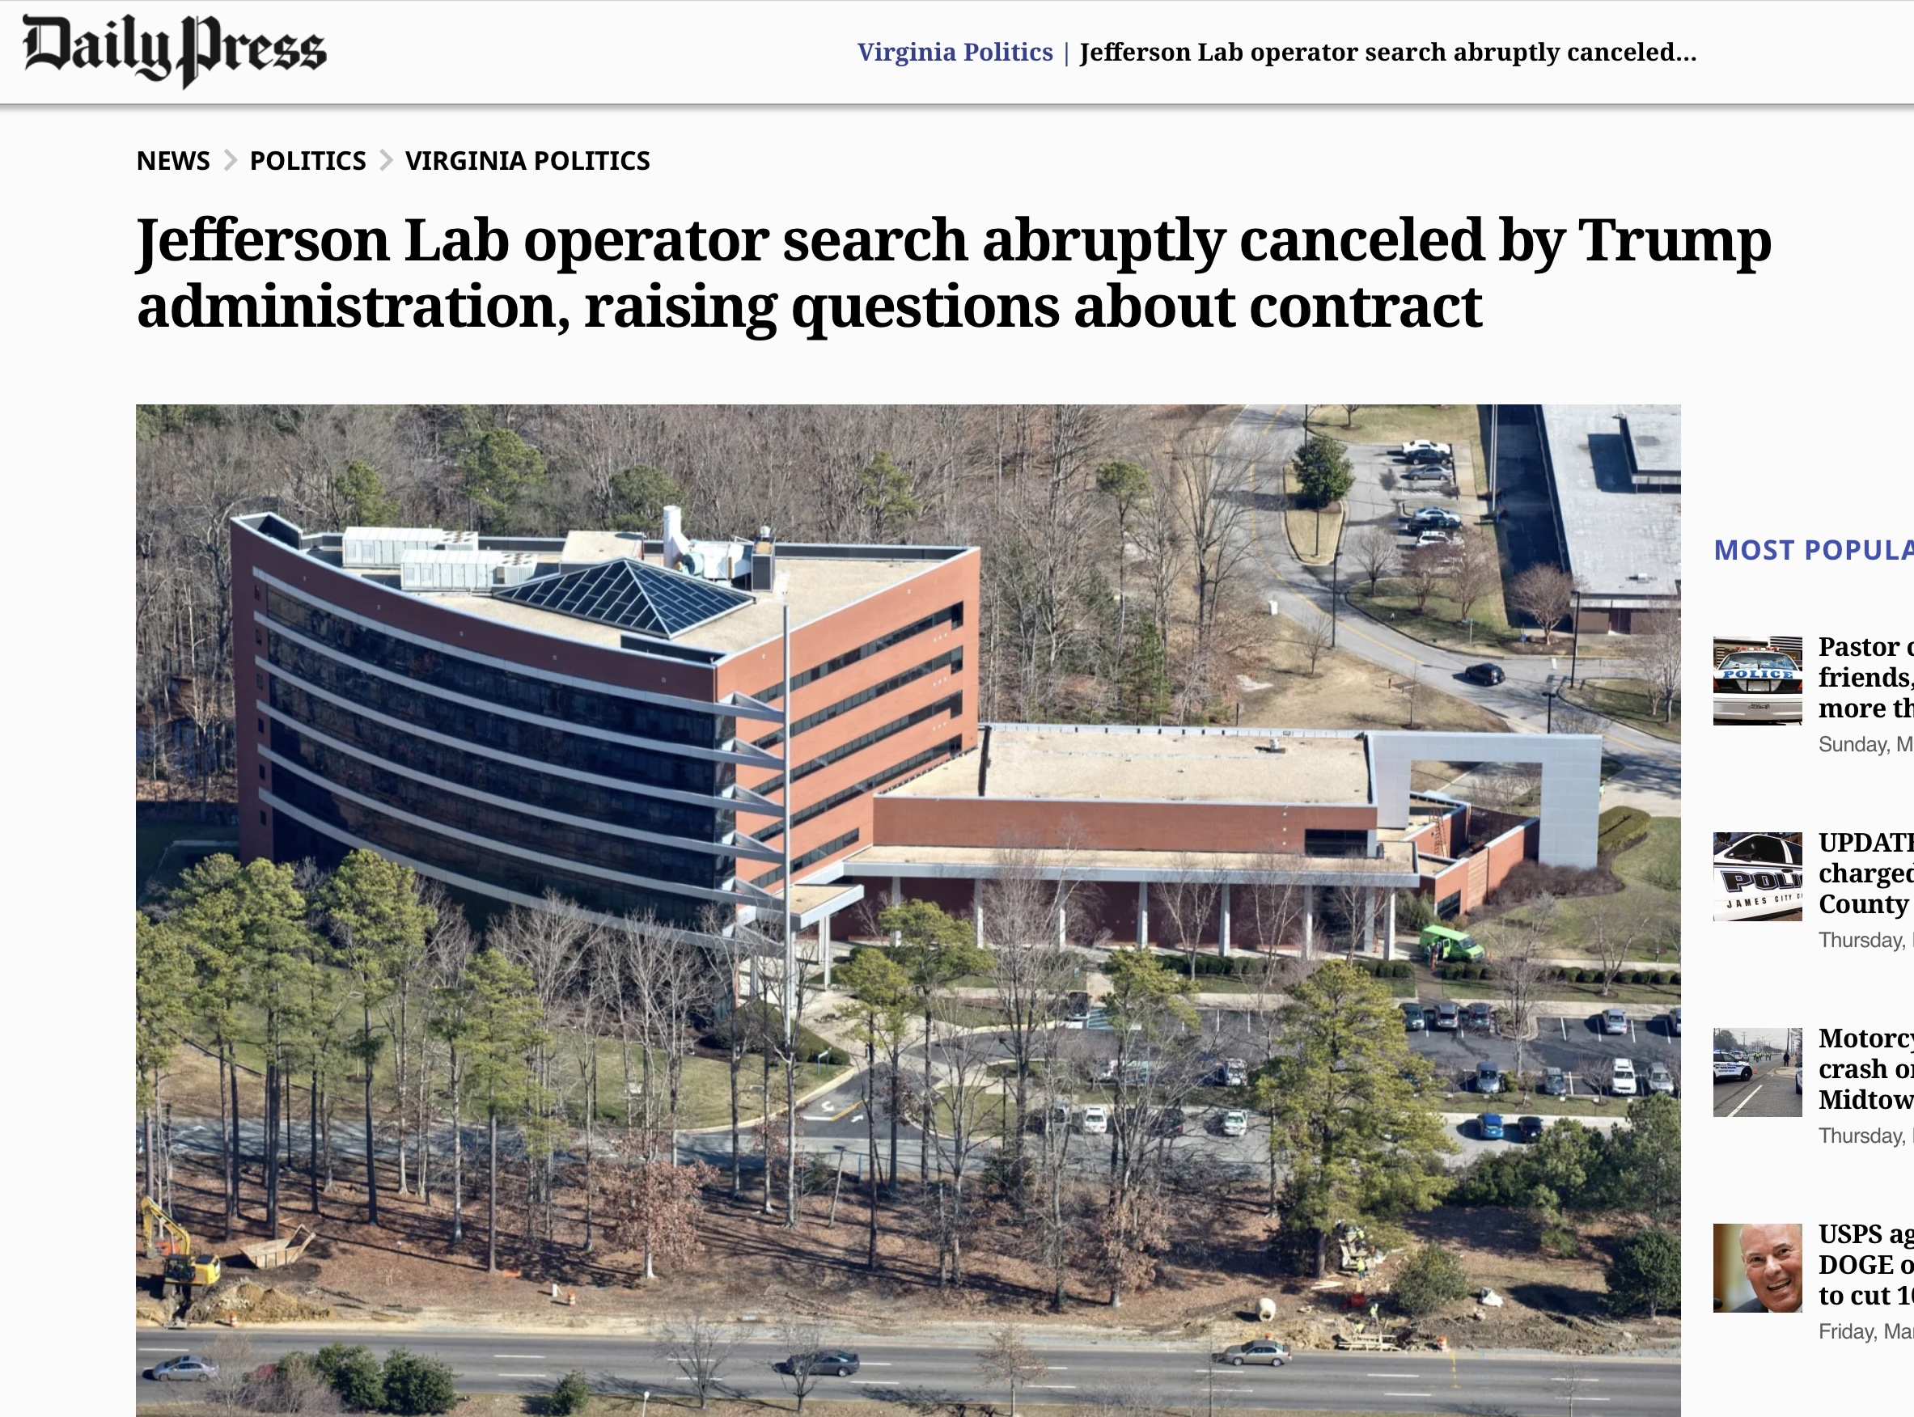

Slide 3
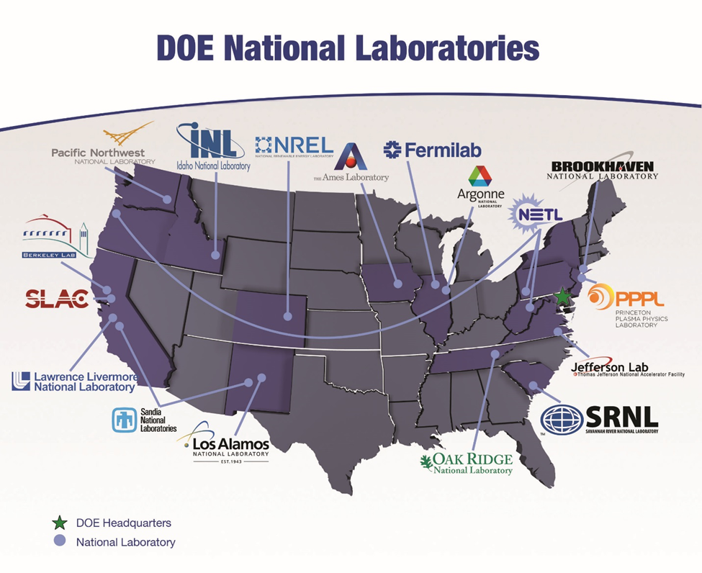
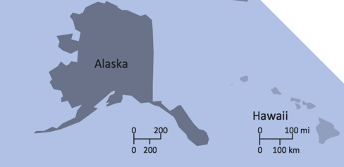
Total of 17 DOE National Labs:
16 Government Owned and Contractor Operated &
1 Government Owned and Government Operated

Slide 4
Recent M&O Bid Processes
LANL (Los Alamos)
  On 9 June 2018, Los Alamos National Laboratory acquired a new industrial firm administration (Triad National Security, LLC).
  Between June 2006 and June 2018, Los Alamos National Laboratory was administered by Los Alamos National Security, LLC. Prior to June 2006, the administrator was the University of California.
SRNL (Savanna River)
  On 22 December 2020, Savannah River National Laboratory acquired a new nonprofit administrator, Battelle Savannah River Alliance, LLC.
  The previous administrator, Savannah River Nuclear Solutions, continues to administer the Savannah River Site.
FNAL (Fermi)
  Just completed the process and on 1 January 2025 the new contractor: Fermi Forward Discovery Group, LLC will be running the lab.
  New LCC led by the University of Chicago and Universities Research Association (URA) and two industrial partners, Longenecker & Associates and Amentum
TJNAF (Jefferson Lab)
  Announcement was just made that NONE of the bids were accepted.
  Likely, though hasn’t happened yet, that JSA Contract will be renewed for a year.
  JSA has been on one-year renewals since 2014.
Reference: https://science.osti.gov/Acquisition-Management/M-and-O-Competitions
Notes:
Talking points
How bid teams organize are wildly different (SNL took off top layer of execs, LANL was a mix)
DOE went through a period of recompeting, seems to be backing off now
Every M&O contract is different (an often creates challenges in working or moving between labs)

Slide 5
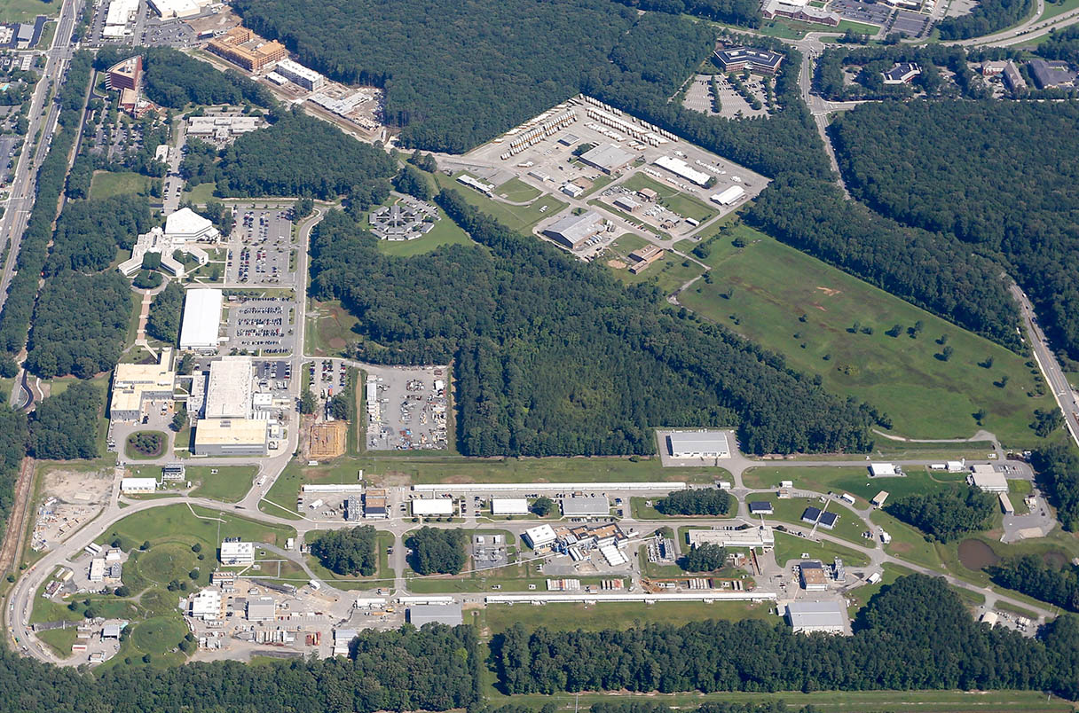
CEBAF: Race-track design to send polarized electrons at different energies and different currents to multiple halls simultaneously with up to 1.1 Megawatt of power.

Slide 6
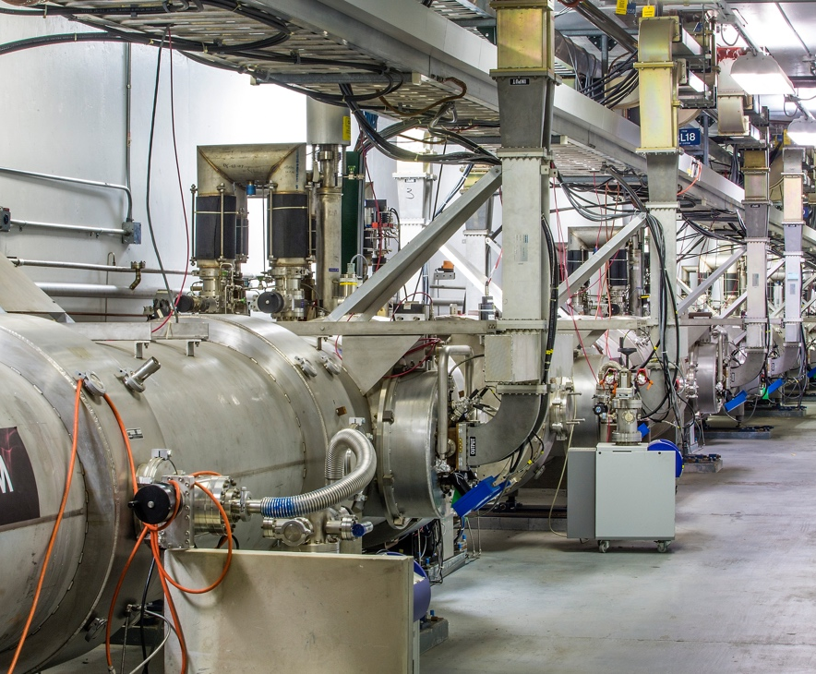
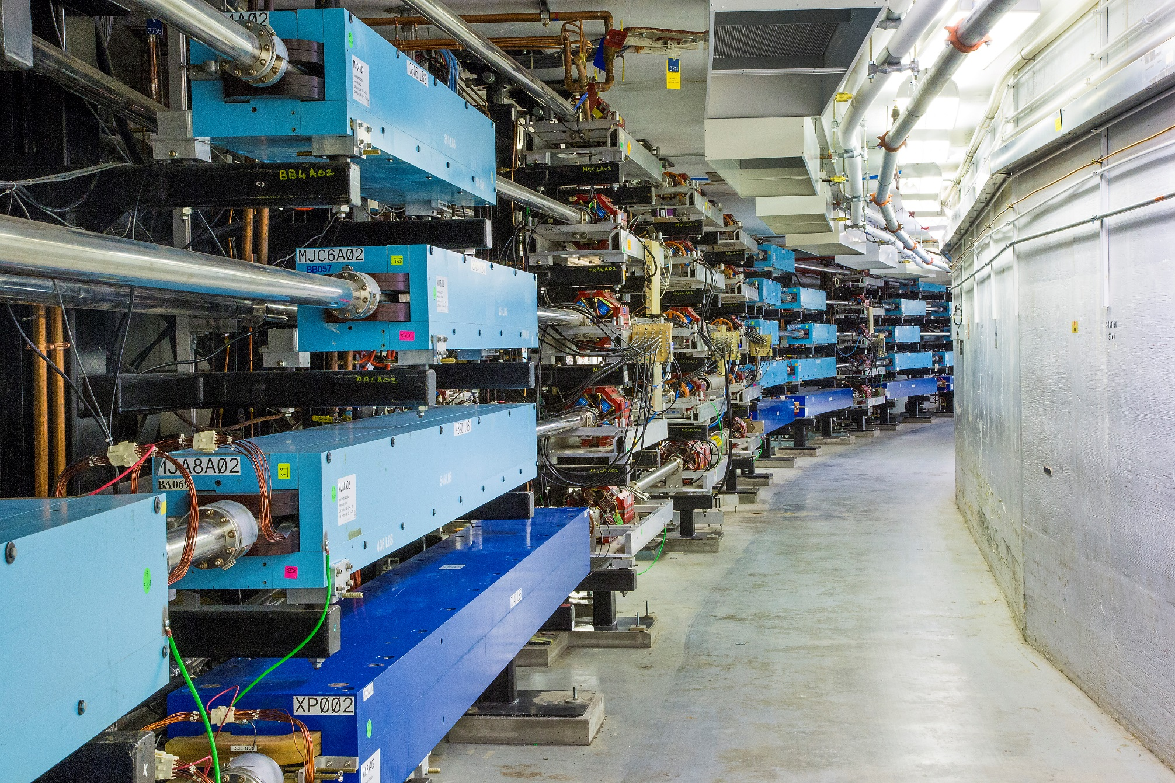

Slide 7
CEBAF Accomplishments During Last Year’s Period
Hall A
  39 PAC Days Completed with major reconfirmation from pol. ³He to cryo-target during run
  Completed Polarized ³He GEN Experiment (E12-09-016)
  Completed GEN Recoil Polarization Experiment (E12-17-004)
  Completed K_{LL} Experiment (E12-20-008)
  Unfortunately, due to beam dump problems the short, A_{LL} experiment (E12-20-008) was canceled.
Hall B
  104 PAC Days Completed
  Completed Run Group D (E12-06-106 and A). [ color transparency & TMD measurements ]
  Partially Completed Run Groups K (E12-16-010, A, and B) and E (E12-06-117)
Hall C
  116 PAC Days Completed
  Partially Completed Neutral Particle Spectrometer (NPS) Run Group (E12-13-010, E12-13-007, E12-22-006, E12-23-014)
Hall D
  4 opportunistic calendar days
  Installation of new calorimeter during most of the run period
  Opportunistically extracted beam to Hall D for short beam test in March ‘24
  Test went very smoothly, checking out beamline and detector performance
TOTAL OF 259 PAC DAYS RUN, 5 Experiments Completed, and 8 Experiments Partially Completed
HUGE THANK YOU TO LEADERSHIP FOR RUNNING 30 WEEKS INSTEAD of 27 WEEKS

Slide 8
Upcoming Schedule
CEBAF has now run at an energy of 1047 MeV/linac for two run periods
Next run will hopefully increase to 1060 MeV/linac plus the ~100 MeV from the injector thus:
    10.7 GeV to Halls A, B, C
    11.8 GeV to Hall D
Budget expectation was for ~25 weeks of physics running in FY25&F26
Full year CR that is voted on today likely means less.
Beam is being tuned up right now and currently we expect beam for physics starting March 21st
CEBAF schedule: https://www.jlab.org/physics/experiments/schedule

Slide 9
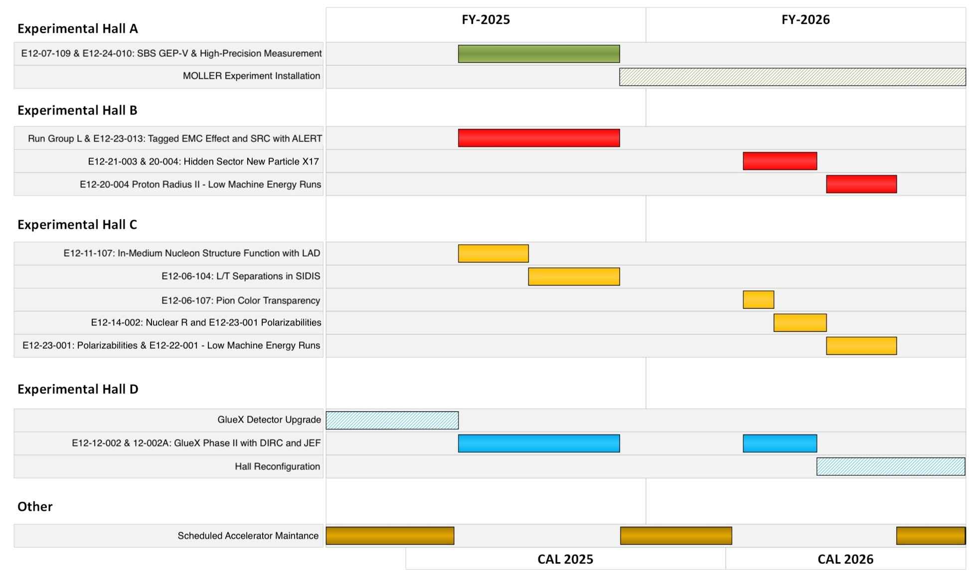

Slide 10
Notional CEBAF and Projected EIC Efforts on One Chart
This is to get an overall sense of what is planned, please do not take the dates too seriously!!
Activities | Fiscal Year
 | 24 | 25 | 26 | 27 | 28 | 29 | 30 | 31 | 32 | 33 | 34 | 35 | 36 | 37 | 38 | 39 | 40 | 41 | 42
Moller Project and Experiment
SoLID
Positron Source (R&D)
CEBAF Upgrade preCDR/preplan
Positron Project (potential)
Positron Physics
22 GeV Development (R&D)
22 GeV Project (potential)
EIC Project (partner with BNL)
CEBAF Up
NOTE: Jefferson Lab is responsible for a significant fraction of EIC accelerator & detector scope.

Slide 11
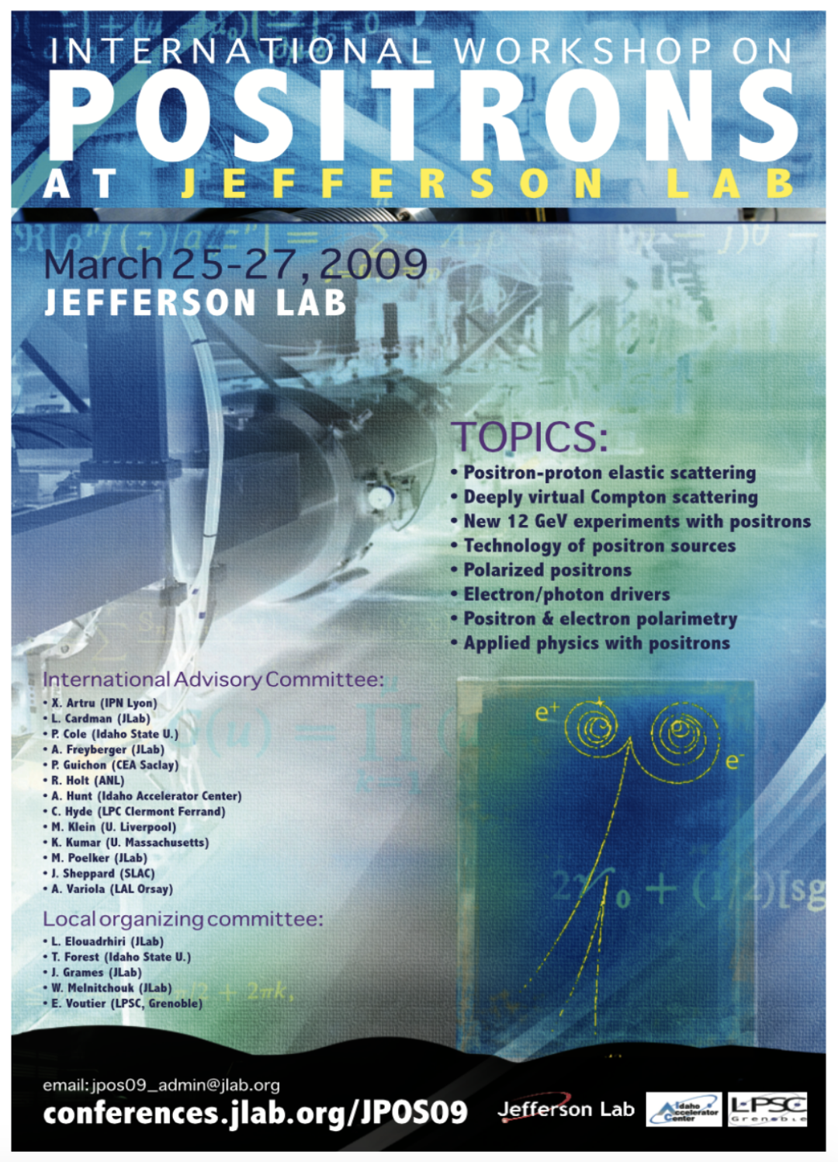
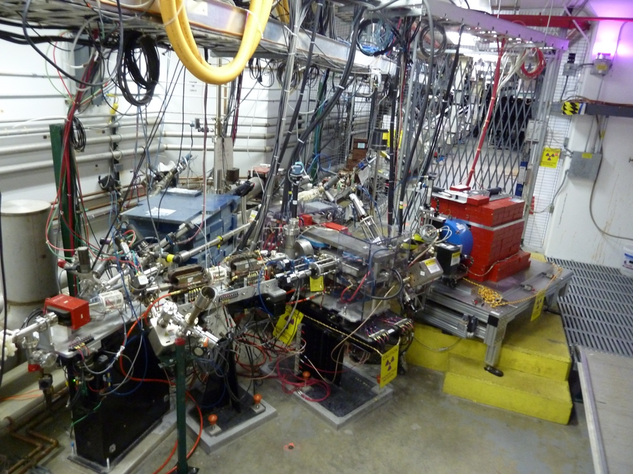
Polarized Electrons for Polarized Positrons (PEPPo)
https://doi.org/10.1103/PhysRevLett.116.214801
Photo of the PEPPo setup in the injector area of CEABF.

Slide 12
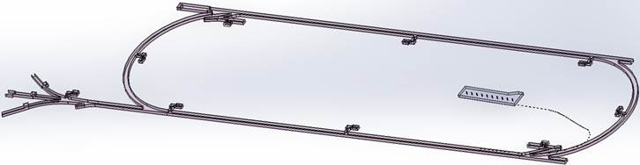
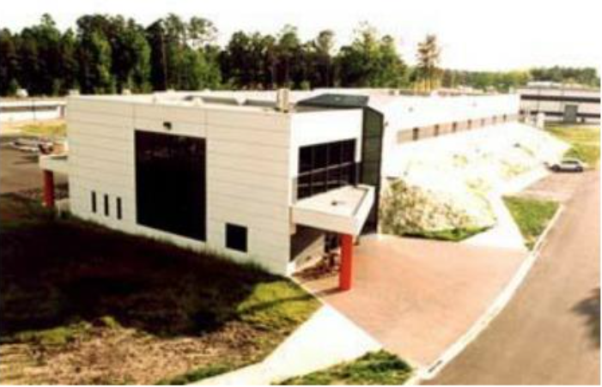
Low Energy Recirculator Facility (LEFRF) As The New Injector Facility for CEBAF
123 MeV e+
(650 MeV e-)
Inject e⁺ into North Linac to usual 12 GeV (w/ magnets reversed)
Build e⁺ injector at the LERF
Build new LERF to CEBAF tunnel
123 MeV e+
(650 MeV e-)
Build new transport line along South Linac and West Arc
12

Slide 13
Current List of Conditionally Approved Positron Experiments
NUMBER | TITLE | CONTACT PERSON | HALL | DAYS REQUESTED | DAYS AWARDED | SCIENTIFIC RATING | PAC DECISION
PR12+23-002 | Beam Charge Asymmetries for Deeply Virtual Compton Scattering on the Proton at CLAS12 | Eric Voutier | B | 100 | 100 | A- | C1
PR12+23-003 | Measurement of Deep Inelastic Scattering from Nuclei with Electron and Positron Beams to Constrain the Impact of Coulomb Corrections in DIS | Dave Gaskell | C | 9.3 | 9.3 | A- | C1
PR12+24-005 | A Dark Photon Search with a JLab positron beam | Bogdan Wojtsekhowski | B | 55 | 55 | A- | C1
PR12+23-006 | Deeply Virtual Compton Scattering using a positron beam in Hall C | Carlos Munoz Camacho | C | 137 | 137 | A- | C1
PR12+23-008 | A Direct Measurement of Hard Two-Photon Exchange with Electrons and Positrons at CLAS12 | Axel Schmidt | B | 55 | 55 | A | C1
PR12+23-012 | A measurement of two-photon exchange in unpolarized elastic positron–proton and electron–proton scattering | Michael Nycz | C | 56 | 56 | A- | C1
C1 = Conditionally Approved w/Technical Review by the Lab
Already Approved 210 days Hall B & 202 days in Hall C for 412 total PAC days
PAC day = two calendar days as already a few years of positron physics

Slide 14
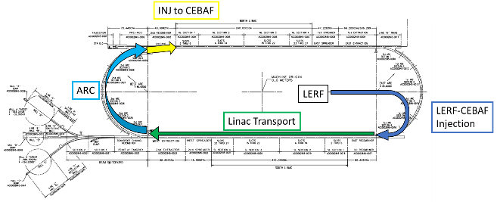
A CEBAF Energy upgrade is technically feasible: 22GEV Upgrade
Capitalizing on recent science insights and US-led accelerator science and technology innovations, develop a staged program at the luminosity frontier
Injection energy Upgrade for 650 MeV Electron (e-) in LERF
Replace arcs on each side with new Fixed Field Alternating-gradient (FFA) magnets arcs to upgrade to 22 GeV for Halls A, B and C.
It will be possible to also send this beam to Hall D though details being worked out.

Slide 15
Permanent Magnet Design – Open Mid-plane Geometry
10 cm
10 cm
10 cm
10 cm
Focusing Magnet
Defocusing Magnet

Slide 16
Summary
Jefferson Lab’s electron program already extends well into the mid-2030’s.
Positron source will be developed in the JLab LERF/FEL building and connected to CEBAF. This source will be future upgraded to provide the source for 22 GeV beams.
Ideals are being developed to use strong permanent magnets to allowed 22 GeV electrons in the current CEABAF tunnels.
A demo experiment for 22 GeV is being considered for the Hall C line BSY dump.

Slide 17
Thank you!

