Slide 1
Exploring the Transition Region of QCD with the Proton’s g₂ Structure Function
-
APS Topical Group on Hadronic Physics
14 March, 2025
David Ruth

Slide 2
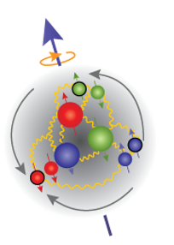
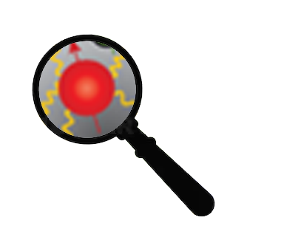
QCD
?
Low
Q²
High
Partons Combine to Form Nucleon
Confinement
Effective Theories: χPT
Can’t use Twist Approx.
Quark/Gluon Correlations
Lattice QCD
Higher Twists
Individual Partons
Asymptotic Freedom
Perturbative QCD
Leading Twist

Slide 3
How to study QCD and higher twist in the transition region?
In unpolarized systems, F₁ and F₂ structure functions describe the quark-gluon distribution of a hadron in inelastic scattering:
In a spin-½ polarized system, two additional structure functions describe the spin distribution of the hadron:
Nucleon Spin Structure
Quark-Gluon Correlations

Slide 4
g₂ Structure Function enables direct tests of QCD and higher twist
Higher Twist:
Benchmarking (Lattice) QCD:
Small
$$g_{2}\left(x,Q^{2}\right)=g_{2}^{WW}\left(x,Q^{2}\right)−\int_{x}^{1}{\frac{∂}{∂y}\left[\frac{m_{q}}{M}h_{T}\left(y,Q^{2}\right)+ζ\left(y,Q^{2}\right)\right]\frac{dy}{y}}$$
Proton
Twist-3
Function of g₁
B-Field
Weighted integrals (moments) of the spin structure functions can be directly calculated by effective theories:
These polarizabilities describe the nucleon’s ensemble response to an external field
$$\overline{d_{2}}= \int_{0}^{x_{th}}{x^{2}[{2g}_{1}\left(x,Q^{2}\right)+{3g}_{2}\left(x,Q^{2}\right)]dx}$$
Proton

Slide 5
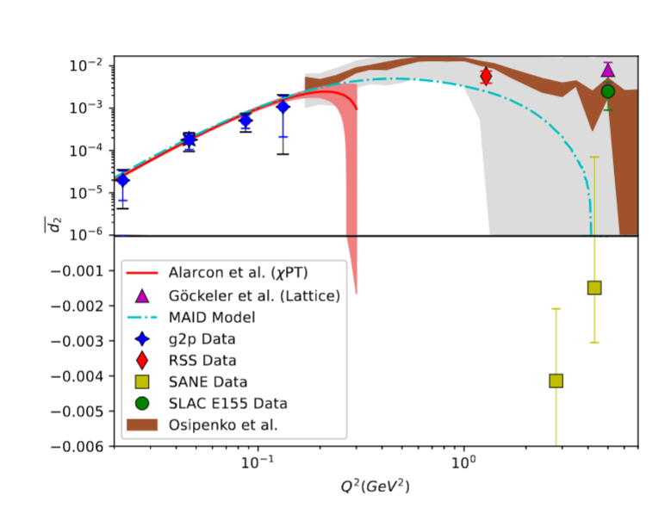
“Color Polarizability” d₂
$$\overline{d_{2}}= \int_{0}^{x_{th}}{x^{2}[{2g}_{1}\left(x,Q^{2}\right)+{3g}_{2}\left(x,Q^{2}\right)]dx}$$
At high Q², identified as a color polarizability or “color Lorentz force”
Interesting negative result from SANE motivates further study at high Q²
Maxima and zero crossing of d₂ are in the unmeasured region
Upcoming lattice predictions in this region need an experimental benchmark!

Slide 6
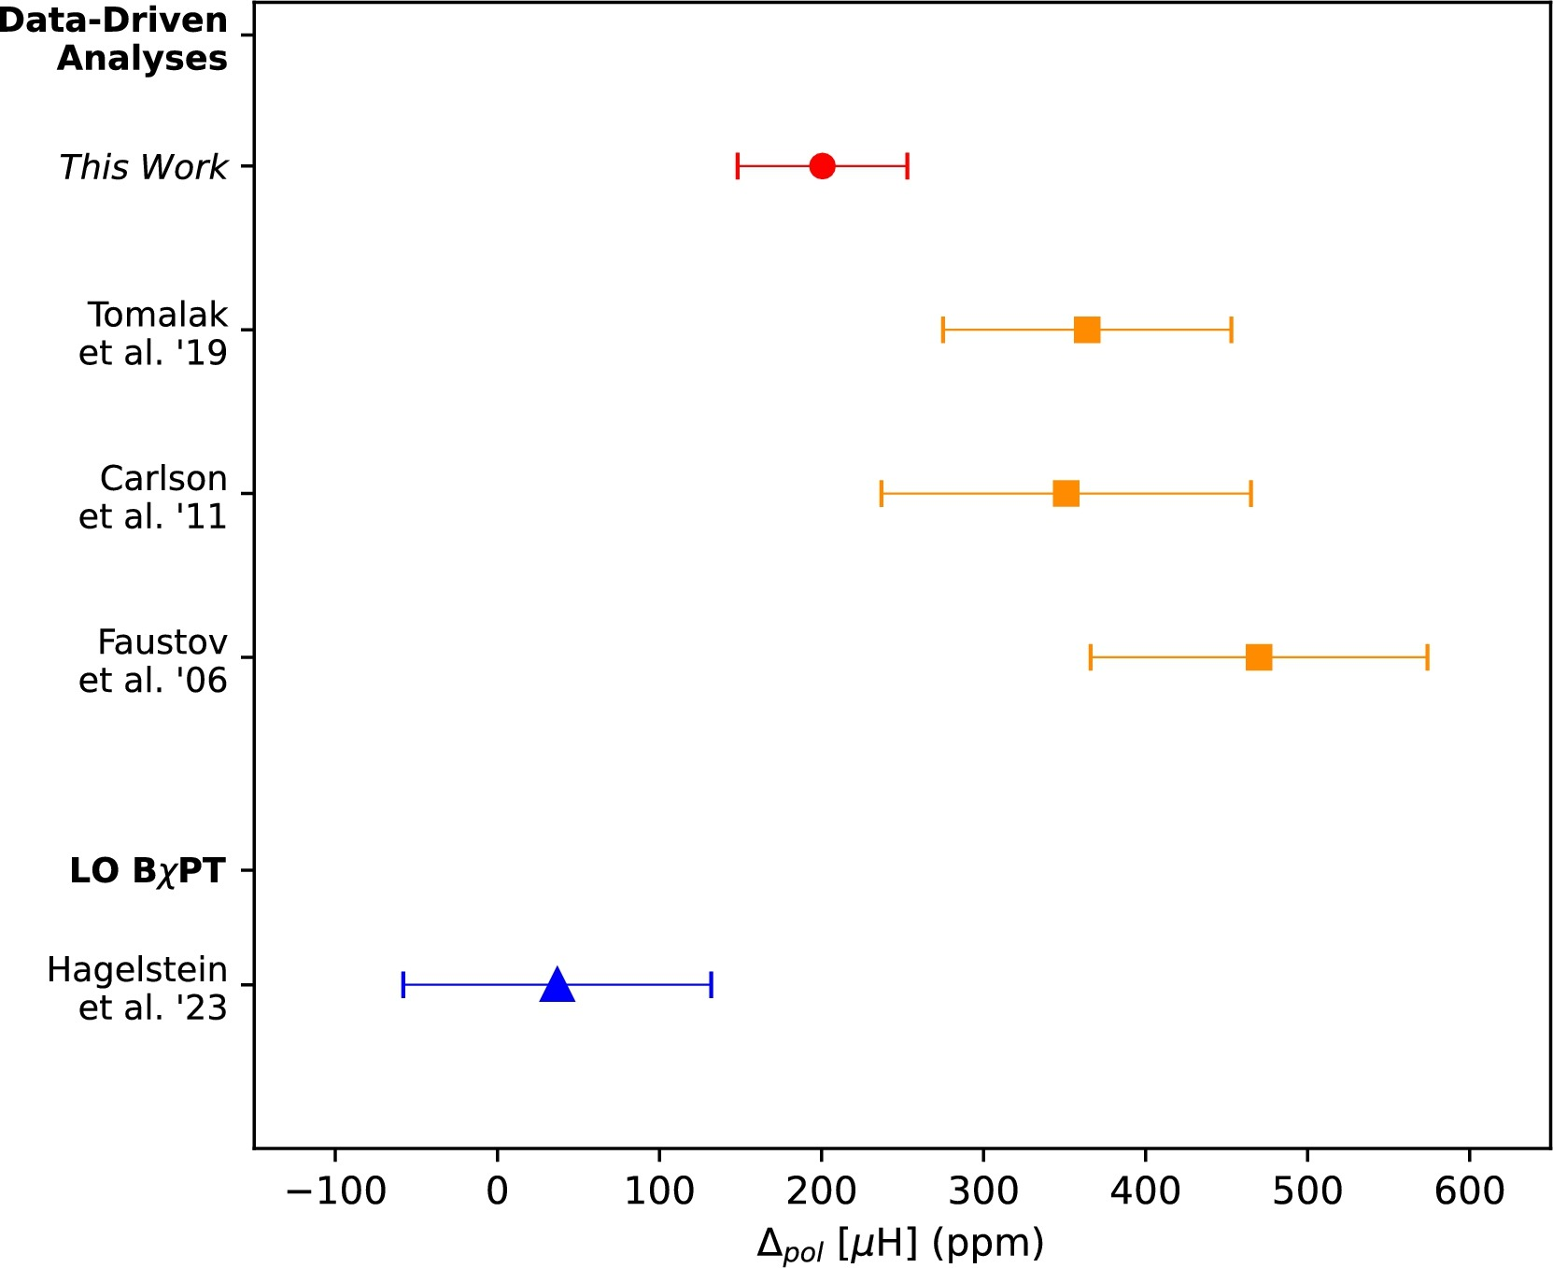
Hyperfine Contribution
$$Δ_{pol}= \frac{α m_{l}}{2π \left(1+ κ_{P}\right)M_{p}}({Δ_{1}+Δ}_{2})$$
Ruth
et al. ‘24
$$Δ_{2}=−24M_{p}^{2}\int_{0}^{∞}{\frac{dQ^{2}}{Q^{4}}}\int_{0}^{x_{th}}{\tilde{β_{2}}\left(x , Q^{2}\right)g_{2}\left(x , Q^{2}\right)dx}$$
The leading error in theoretical calculations of the hydrogen HFS comes from these spin-structure function dependent integrals!
The subject of an ongoing tension between theory and experiment
The transition region accounts for ~30% of the integral!

Slide 7
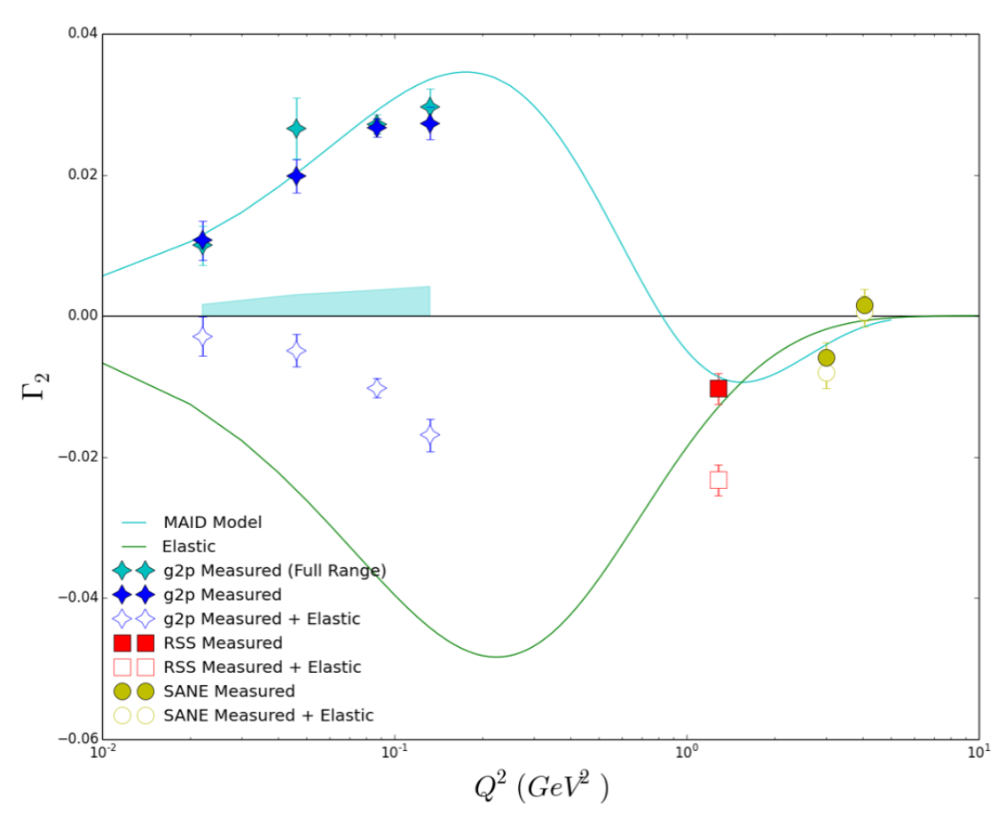
Γ₂ Moment & Burkhardt-Cottingham (BC) Sum rule
$Γ_{2}= \int_{0}^{x_{th}}{g_{2}\left(x,Q^{2}\right)dx}$ = 0
Resonance part of moment crosses zero in transition region
More transition data needed to understand low-x contribution as leading twist starts to fail

Slide 8
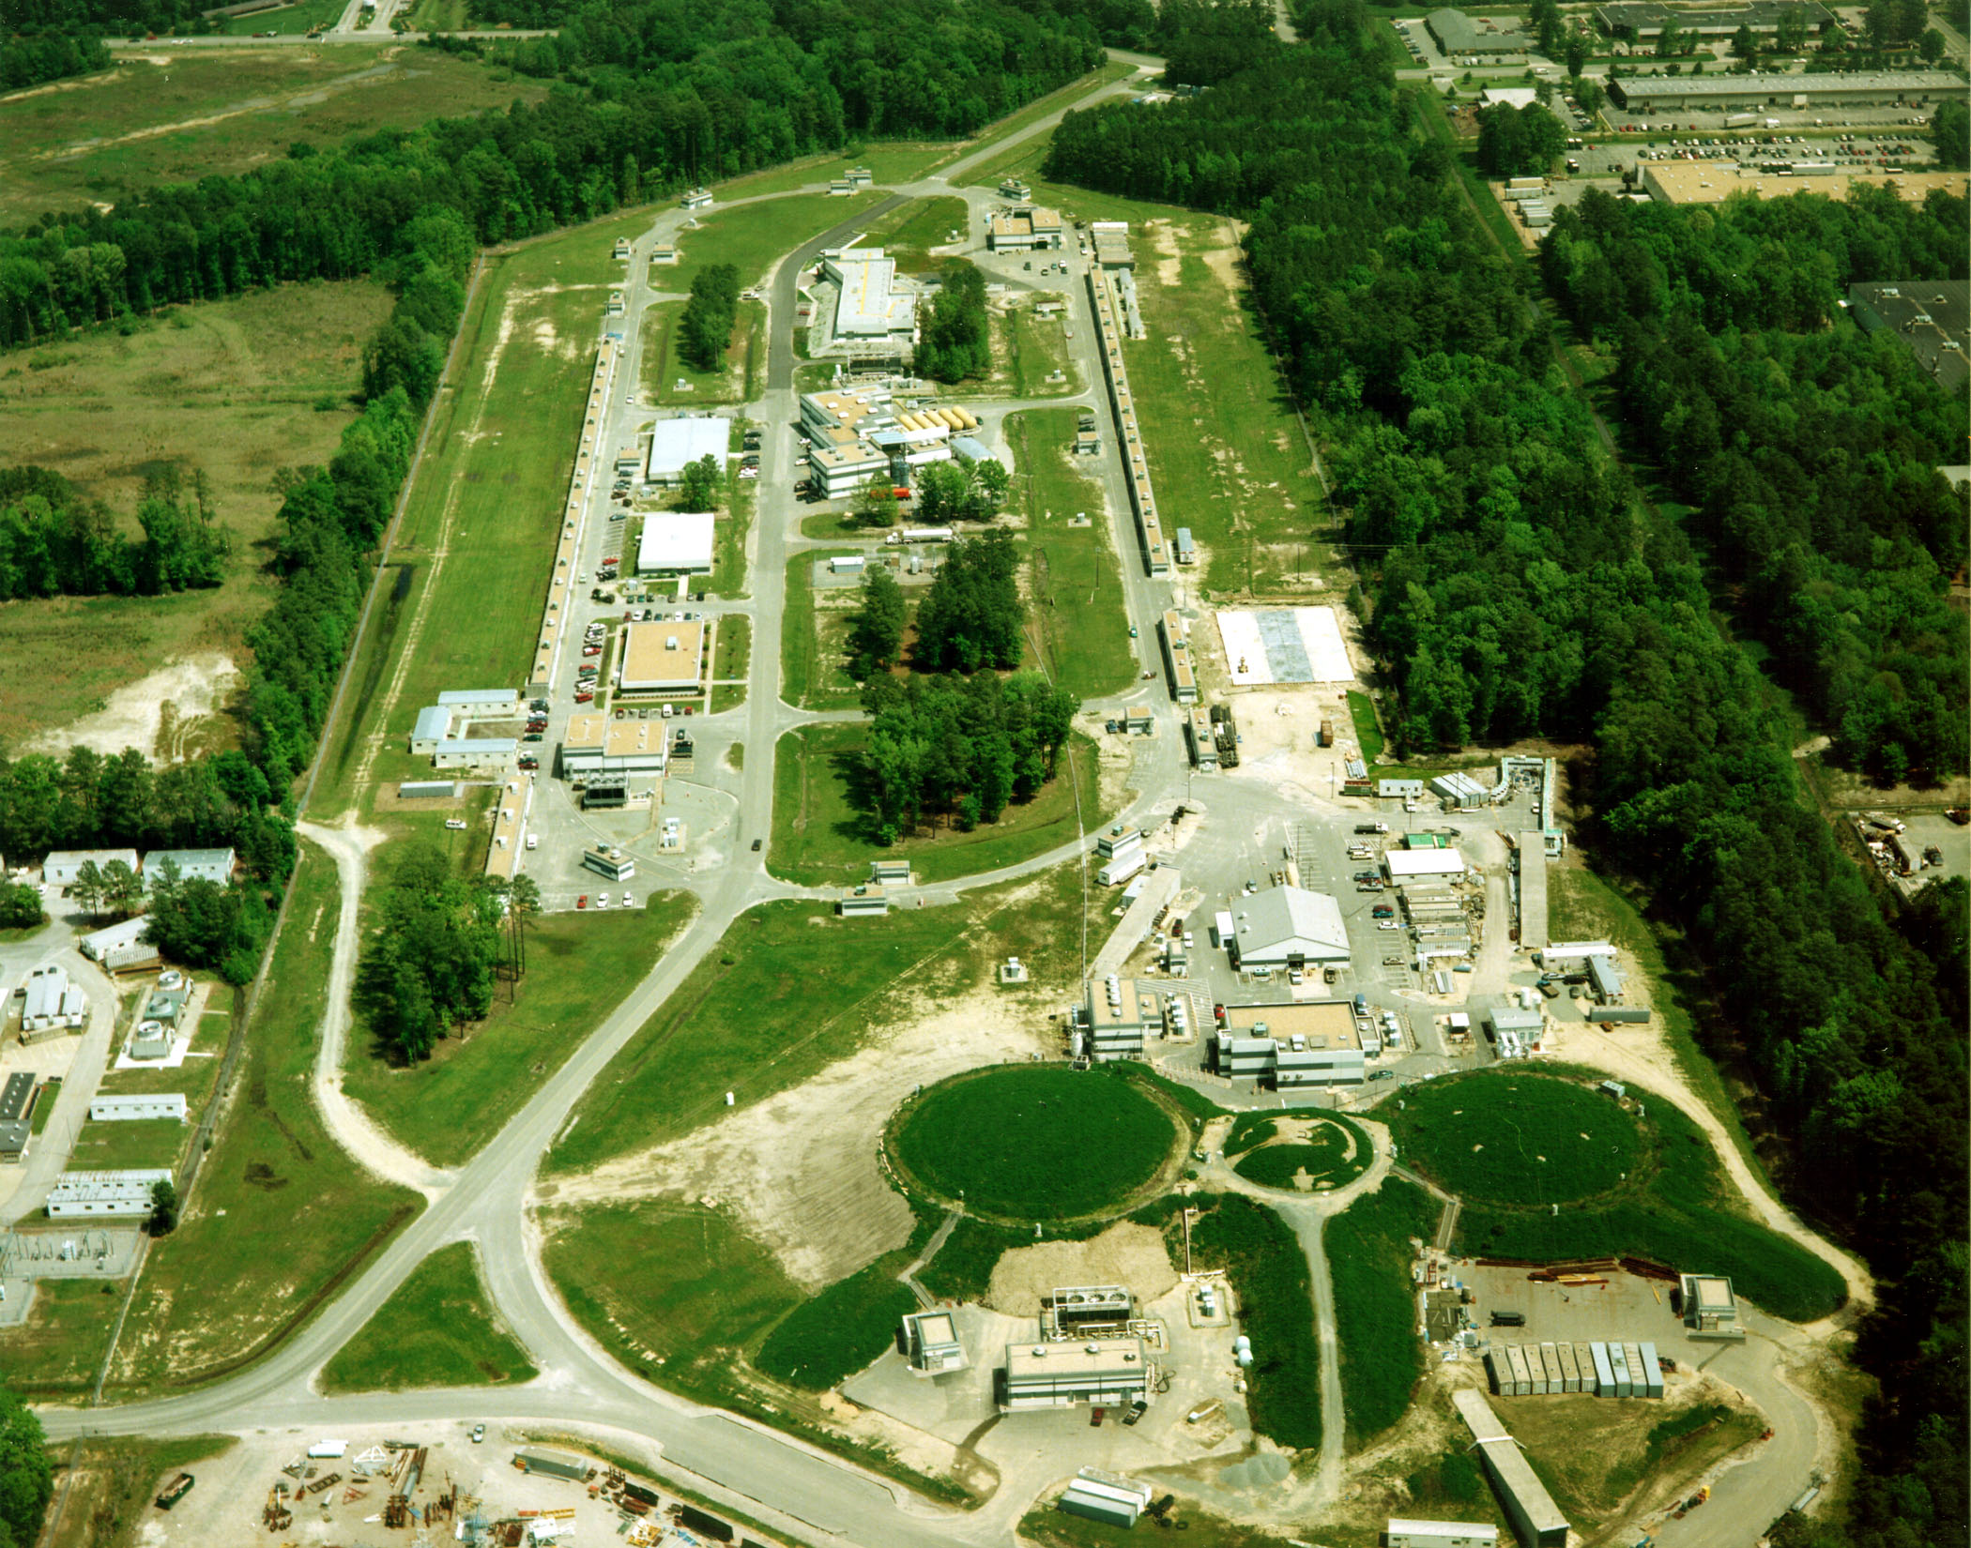
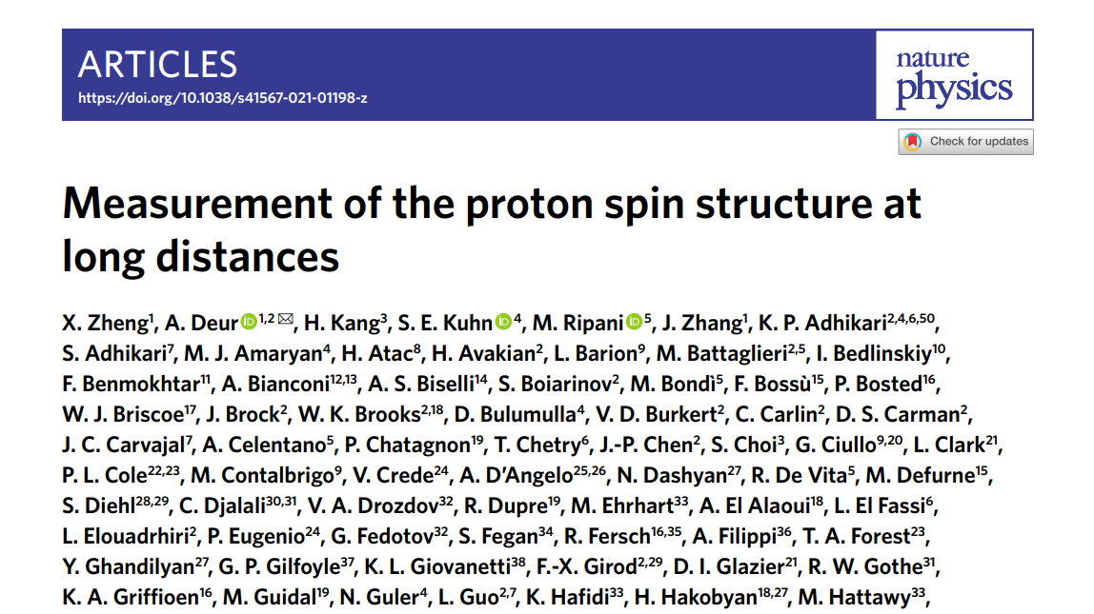
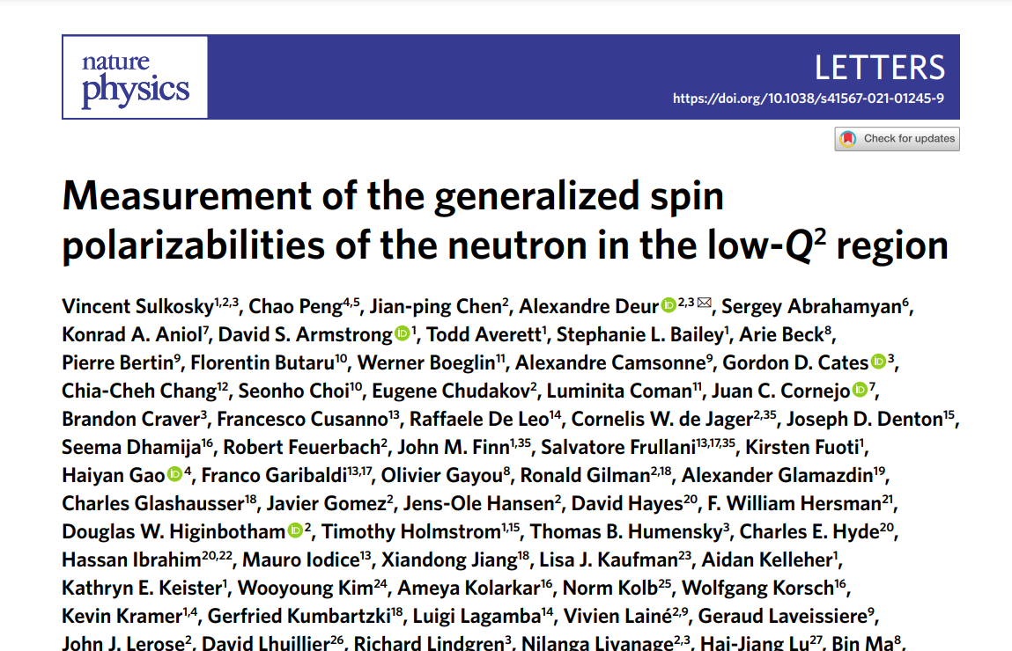
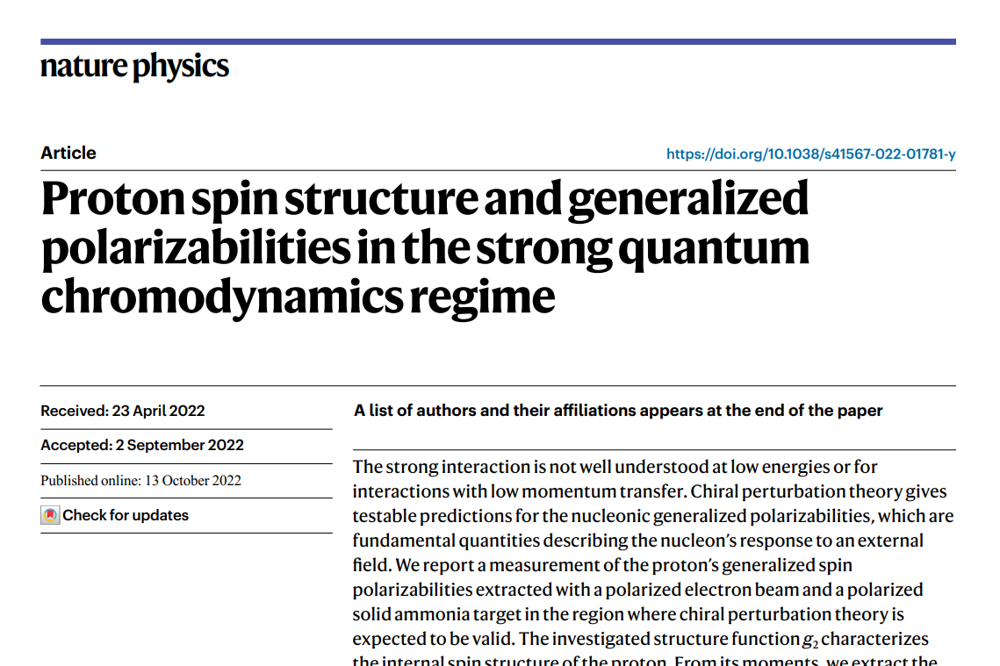
Highly Successful Program Measuring SSF at the Thomas Jefferson National Accelerator
JLab has led a highly successful program to measure the spin structure functions (SSF) for both nucleons over a broad kinematic range
Three different experiments published recent SSF results in Nature Physics
DOE Milestone to “measure g₁ and g₂ over an enlarged range of x and Q²”

Slide 9
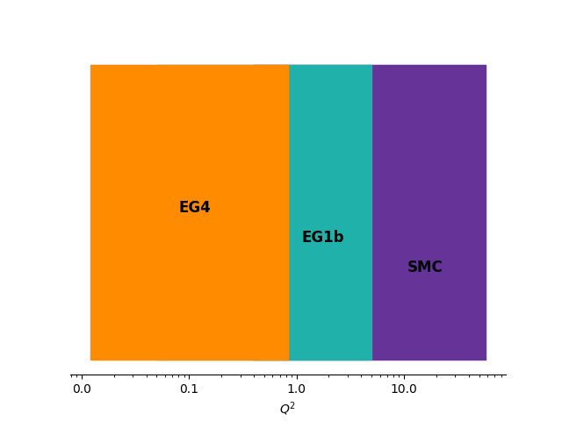
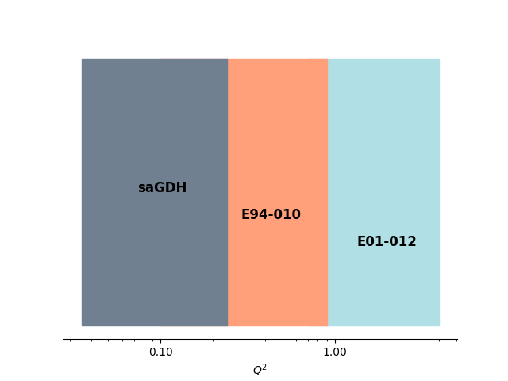
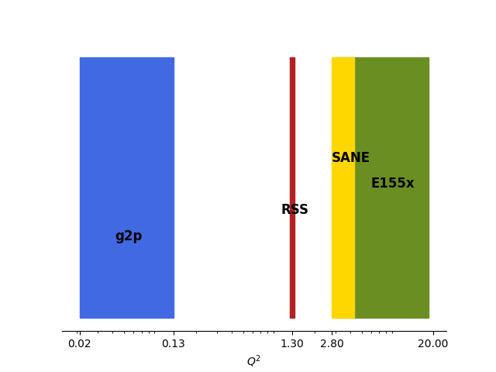
Existing Coverage
Proton
Neutron
g₁
g₂

Slide 10
“Low Hanging Fruit”
Much higher rates than the higher Q² experiments
No need for a septum magnet as was used in the low Q² g2p experiment in Hall A
Smaller out-of-plane angle than the low Q² data
Ripe with scientific motivation:
Necessary Benchmark for Lattice QCD
Unique Sensitivity to Twist-3 Effects
Significant contribution to Theoretical Hydrogen Hyperfine Splitting Uncertainty
Study sum rules and transition from perturbative QCD to effective theories
g₂
New
JLab
Experiment

Slide 11
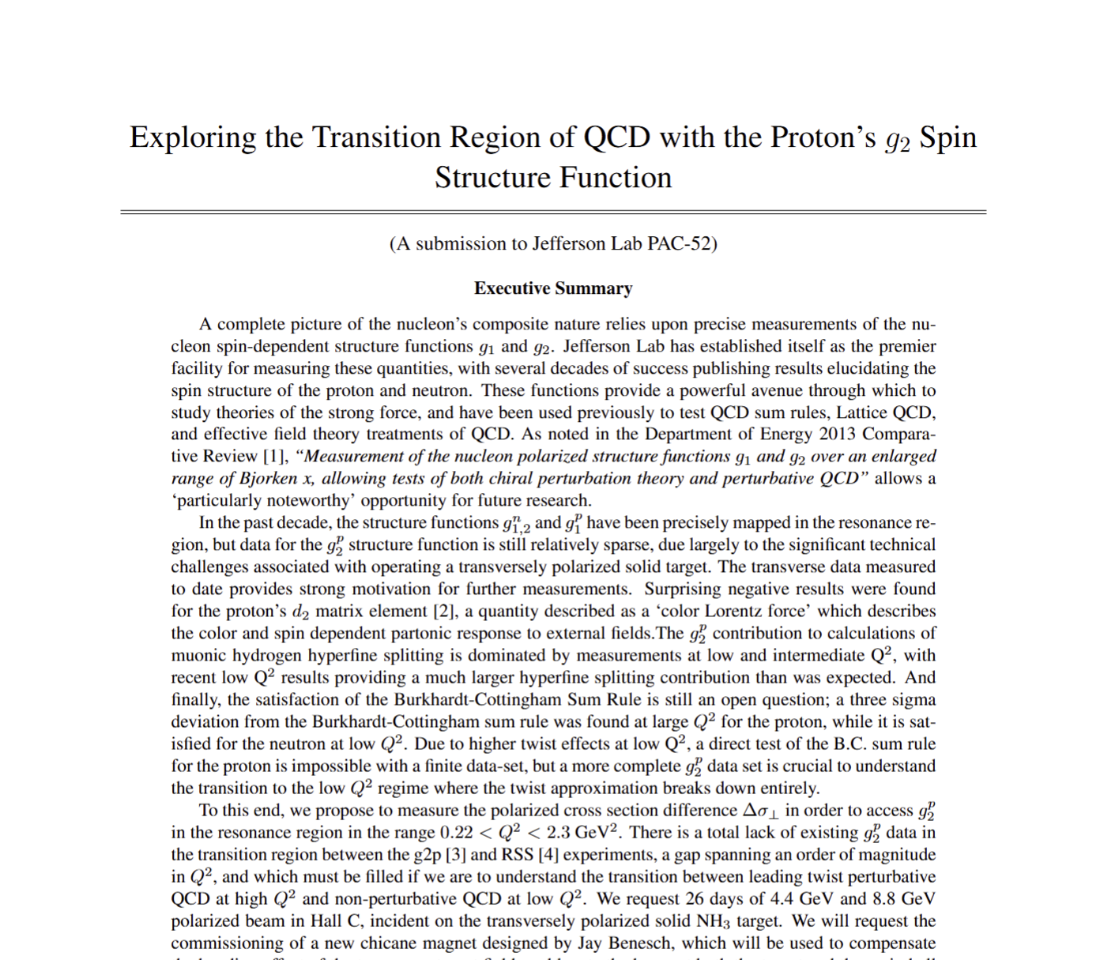
PR12-24-002 Approved in 2024
Approved with C2 Status
Further simulations work was needed to remove the conditional
We expect the new simulation results will be sufficient to remove the conditional this July
Conditionally
Approved

Slide 12
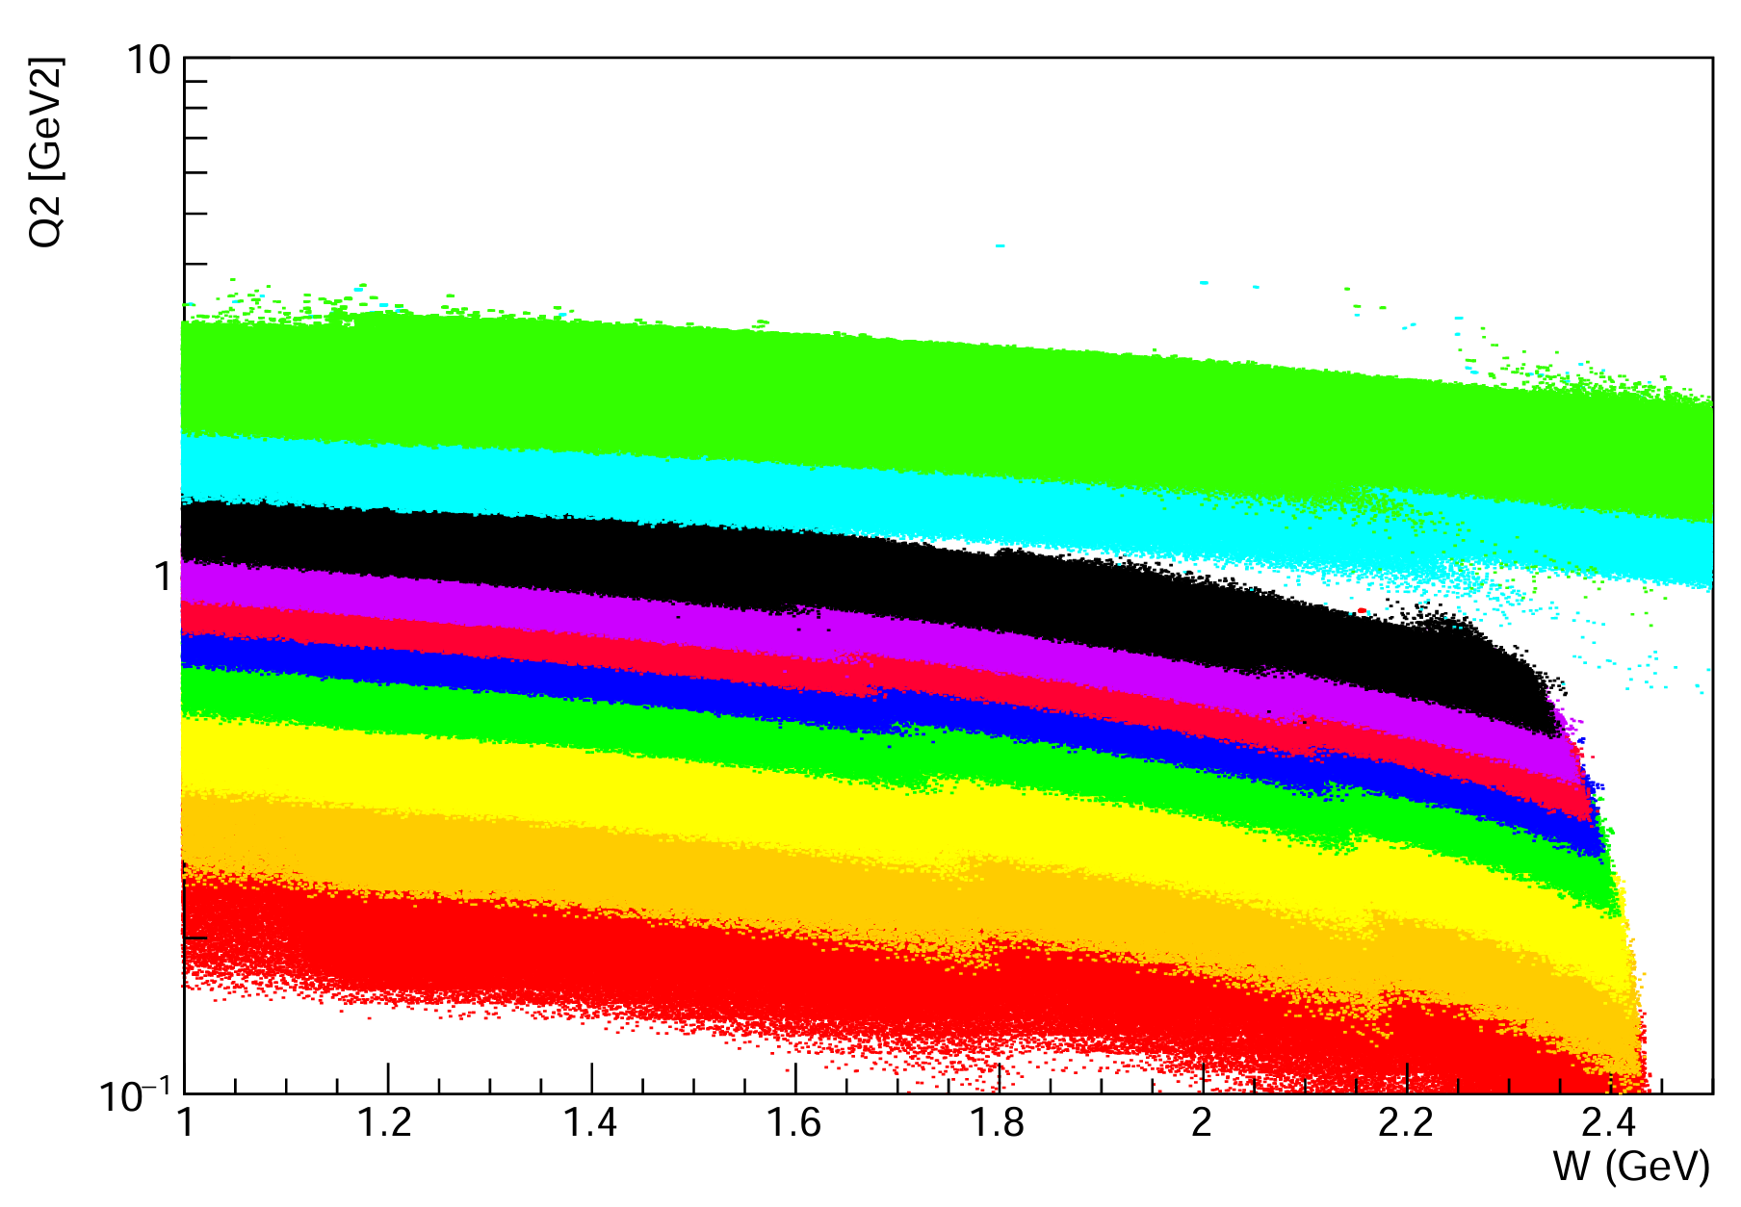
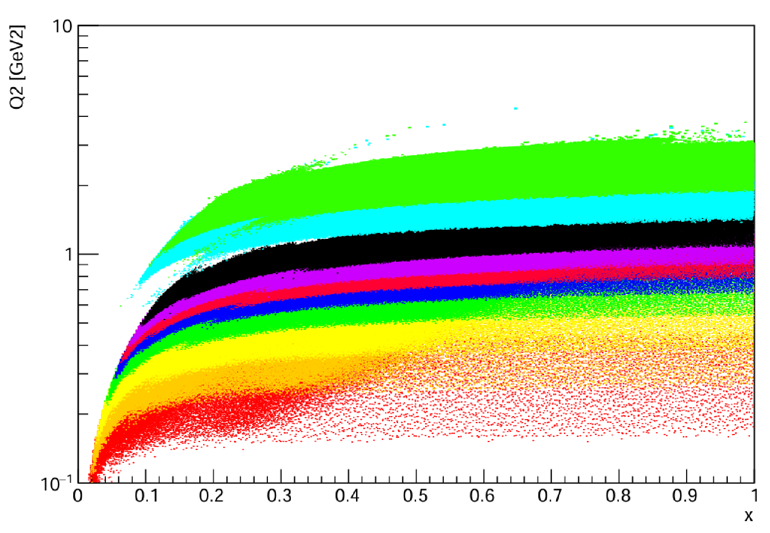
Proposed Hall C Experiment
e⁻
SHMS
Moller
Polarimeter
Fast Raster
Slow
Raster
Slow
Raster
Chicane
1
Chicane
2
BPMs/Harps
5T Transverse
Target
BCMs
Dump

Slide 13
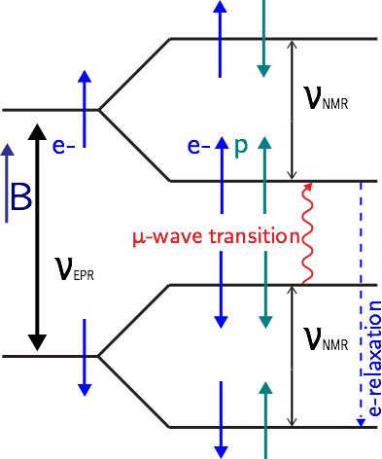
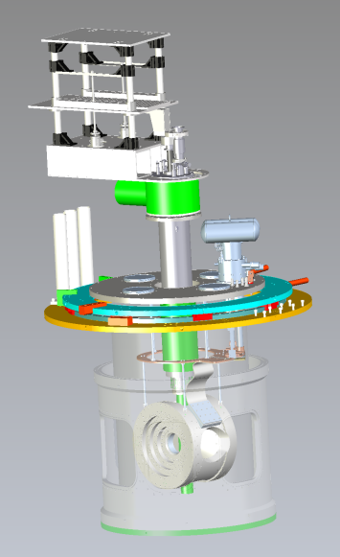
Transverse Polarized Target
g₂ Measurement needs a (Transversely) polarized target and polarized beam
Ammonia (NH₃) target polarized with Dynamic Nuclear Polarization:
5 T magnetic field
1 K temperature
Microwaves stimulate easily polarizable electrons to couple with more difficult to polarize protons
Since target is polarized transverse to the beam direction, we need to “pre-bend” the beam with a chicane magnet
Chicane Magnet 1
Chicane Magnet 2

Slide 14
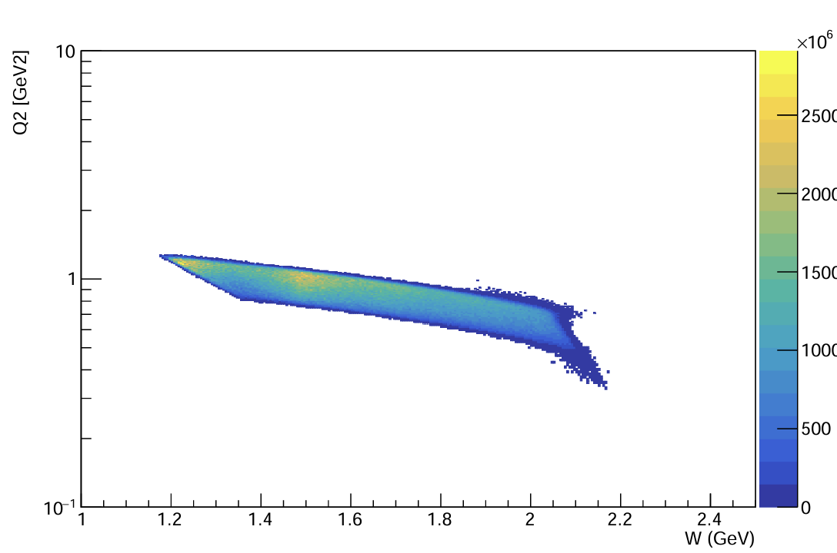
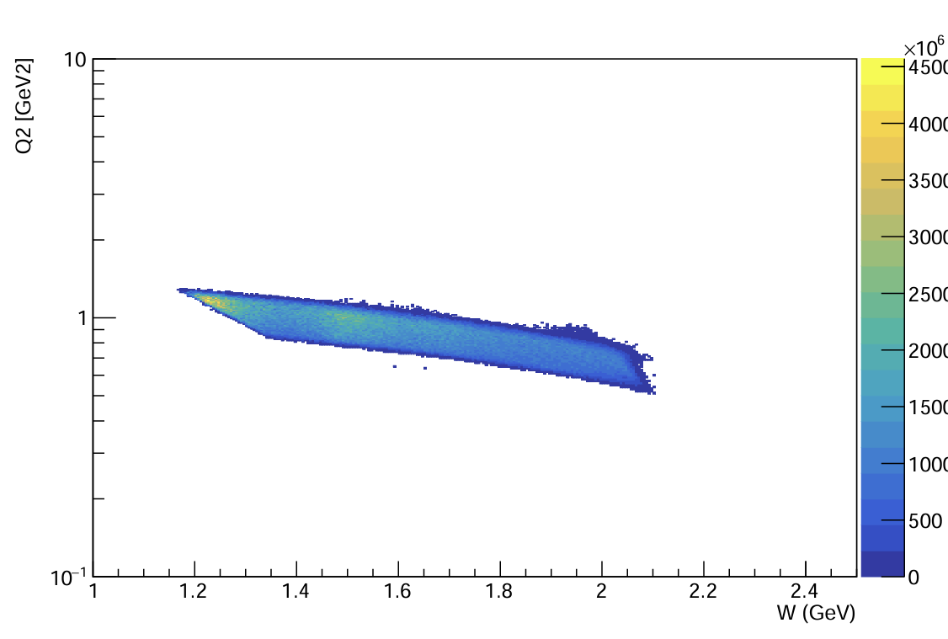
Single-Arm Monte-Carlo Simulation
No target field
With target field and chicane magnets
Extremely minimal impact on the kinematic coverage
Equivalent simulation used frequently by other Hall C experiments
Out-of-plane scattering angle is significant, but has been easily corrected for in previous similar experiments

Slide 15
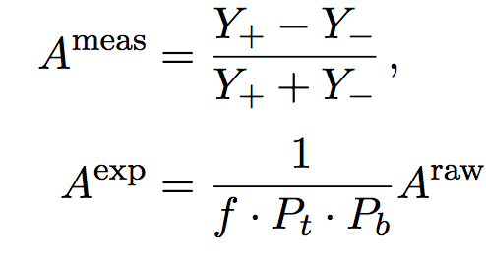
g₂ Extraction Method
Measure Asymmetry and Cross Section:
Form Polarized XS Difference:
Extract g₂
$$A_{⊥}^{Raw}=\frac{σ^{↑⇒}−σ^{↓⇒}}{σ^{↑⇒}+σ^{↓⇒}}$$
$$\frac{d2σ}{dΩdE′}=\frac{(ps)N}{N_{in}ρ(LT)ε_{det}}\frac{f}{ΔΩΔE′ΔZ}$$
Spin-Dependent Effects
Unpolarized
Scattering
$${∆σ}_{⊥} =2A_{⊥}^{exp}σ_{0}$$
Input from
Hall B Data
$$g_{2}\left(x,Q^{2}\right)= \frac{K_{1}y}{2}\left[Δσ_{⊥}\left(K_{2}+\tan{\frac{θ}{2}}\right)\right]+ \frac{g_{1}\left(x,Q^{2}\right)y}{2}$$

Slide 16
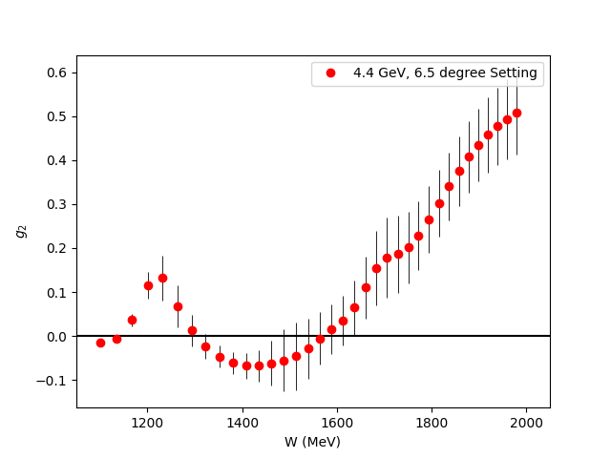
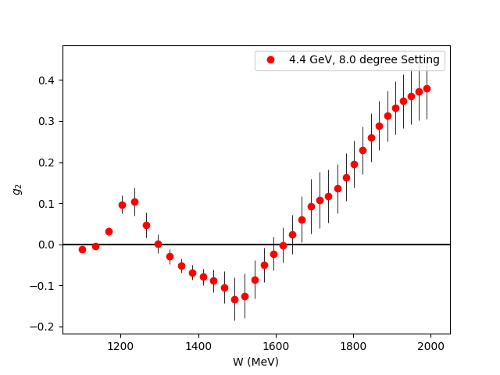
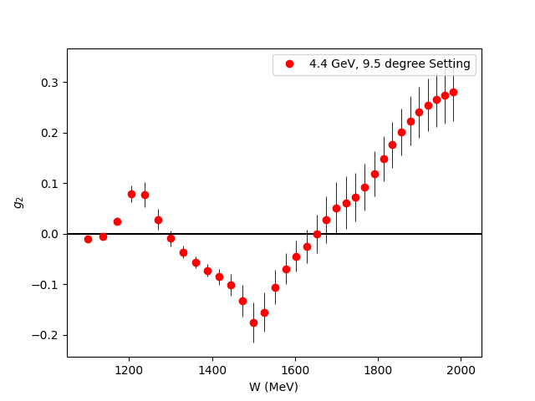
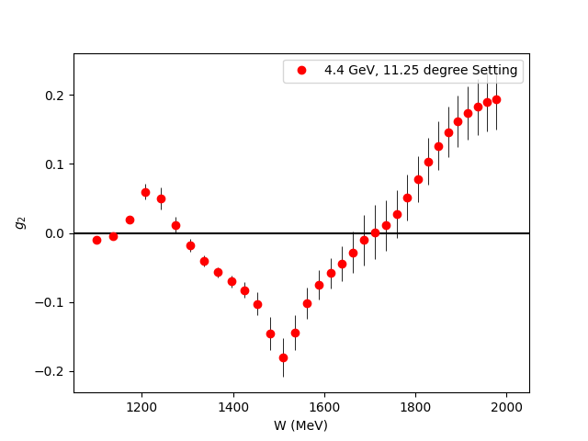
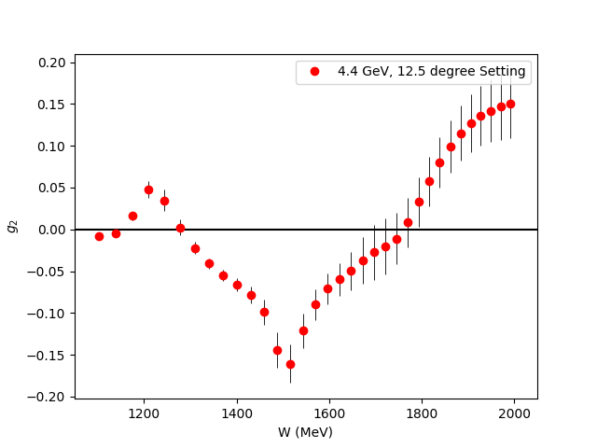
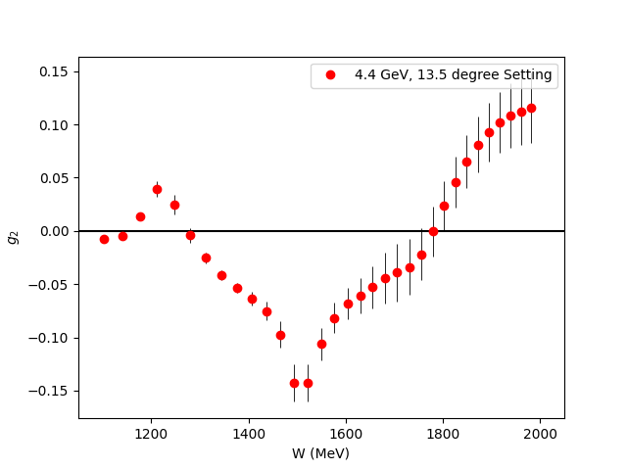
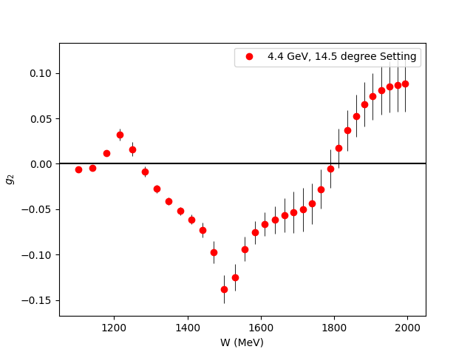
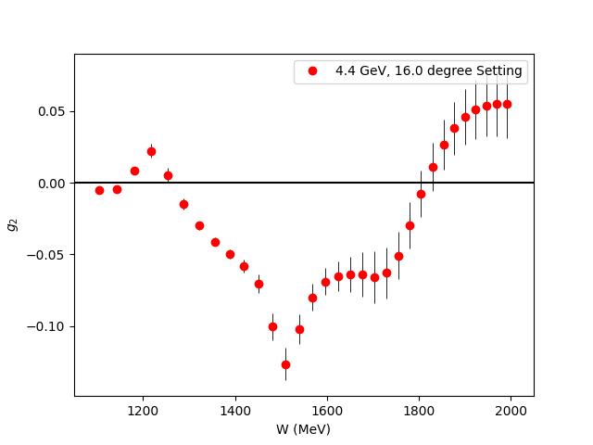
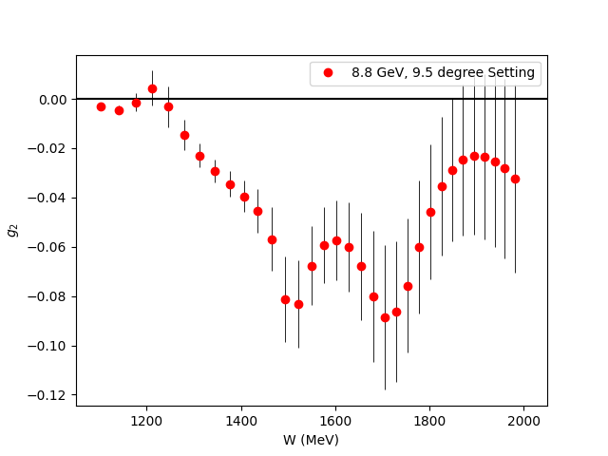
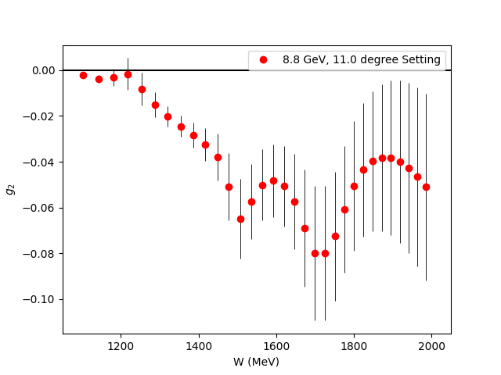
Projected g₂ Uncertainties
Fills the last major Q² spectrum gap for the nucleon spin structure functions
Covers almost the entire transition region

Slide 17
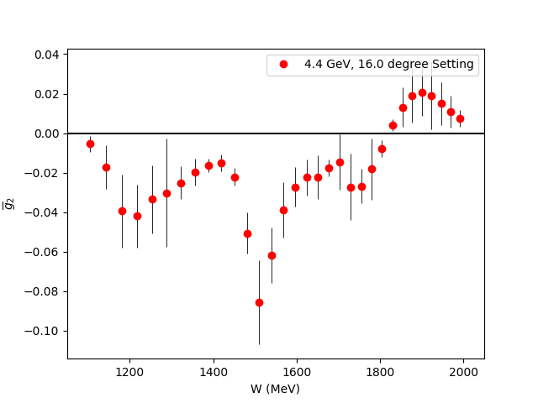
$\overline{g_{2}}$ (Twist 3 Extraction)
Small
$$g_{2}\left(x,Q^{2}\right)=g_{2}^{WW}\left(x,Q^{2}\right)−\int_{x}^{1}{\frac{∂}{∂y}\left[\frac{m_{q}}{M}h_{T}\left(y,Q^{2}\right)+ζ\left(y,Q^{2}\right)\right]\frac{dy}{y}}$$
$\overline{g_{2}}$ (Twist-3)
Utilize CLAS Hall B Results
for g₁ in same regime
Direct extraction of Twist 3 effects
in the regime they contribute most significantly

Slide 18
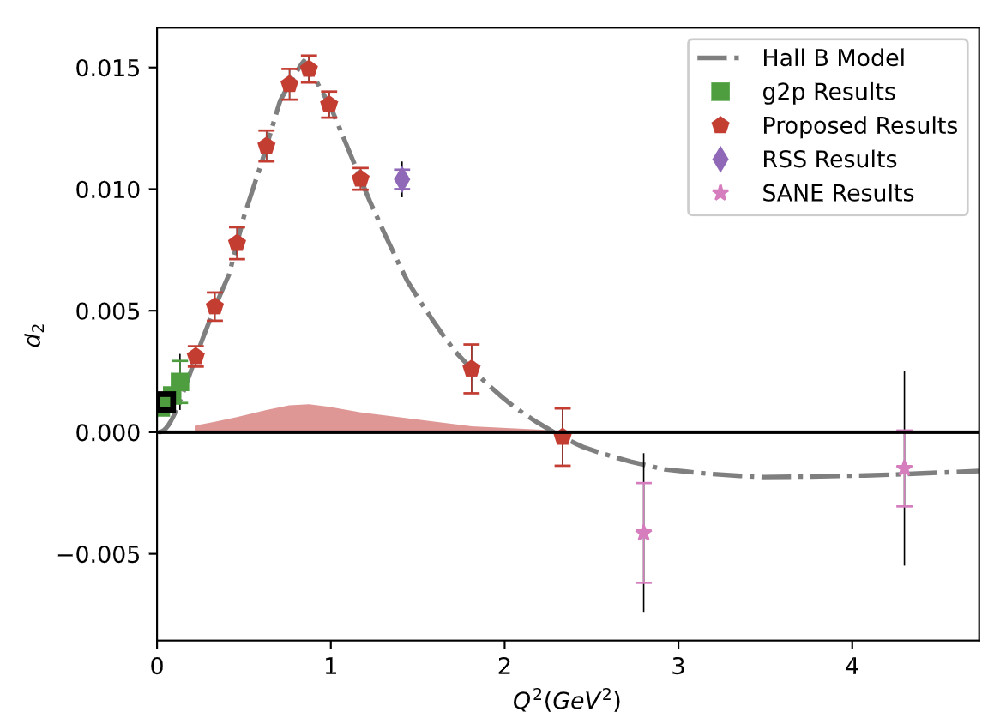
Projected $\overline{d_{2}}$ Uncertainties
Can benchmark Lattice QCD in the regime where Perturbative QCD starts failing
New Lattice calculations expected in next few years!
Results should discover maximum and zero crossing of this unique polarizability!

Slide 19
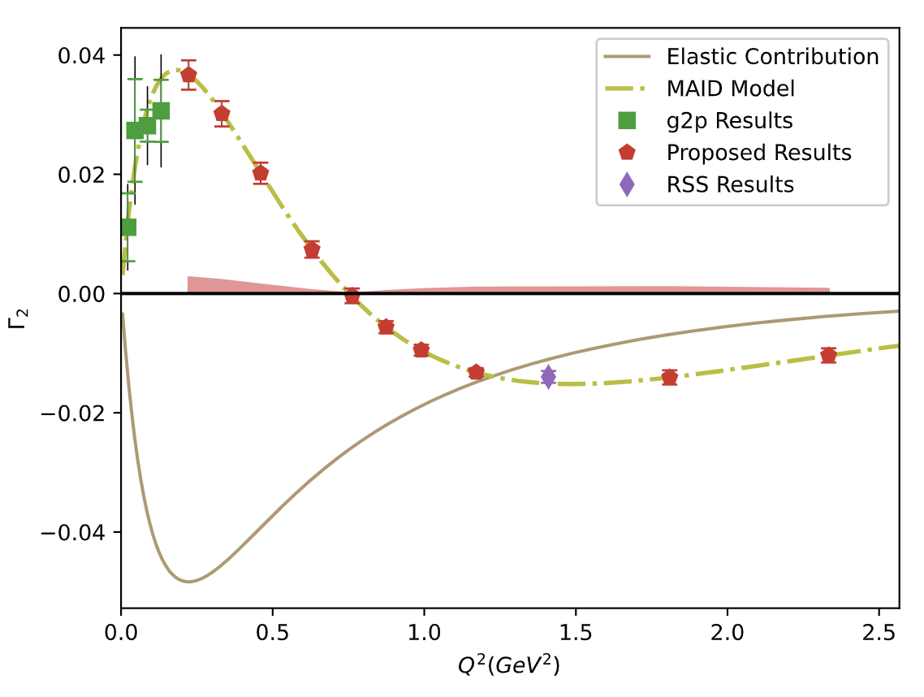
Projected $Γ_{2}$ Uncertainties
Having data in the regime where twist-2 assumption fails helps us better understand the small-x regime
If B.C. Sum Rule is followed, then we directly measure how the low-x part transitions from $g_{2}^{WW}$into a more complex form!

Slide 20
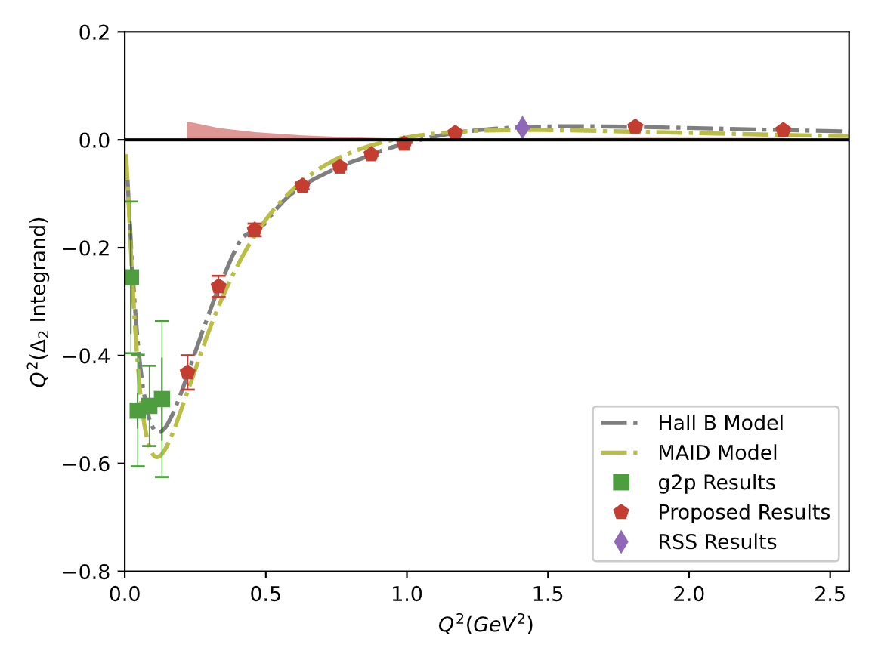
Projected $Δ_{2}$ Uncertainties
Transition region accounts for 30% of $Δ_{2}$
These results can cut the error in this region to $1/6$ of the current error
$Δ_{pol}={c(Δ}_{1}+Δ_{2})$ accounts for 81% of the current two-photon Hyperfine Splitting uncertainty
Opportunity to study or maybe eliminate a long-standing tension between theory and experiment for $Δ_{pol}$!

Slide 21
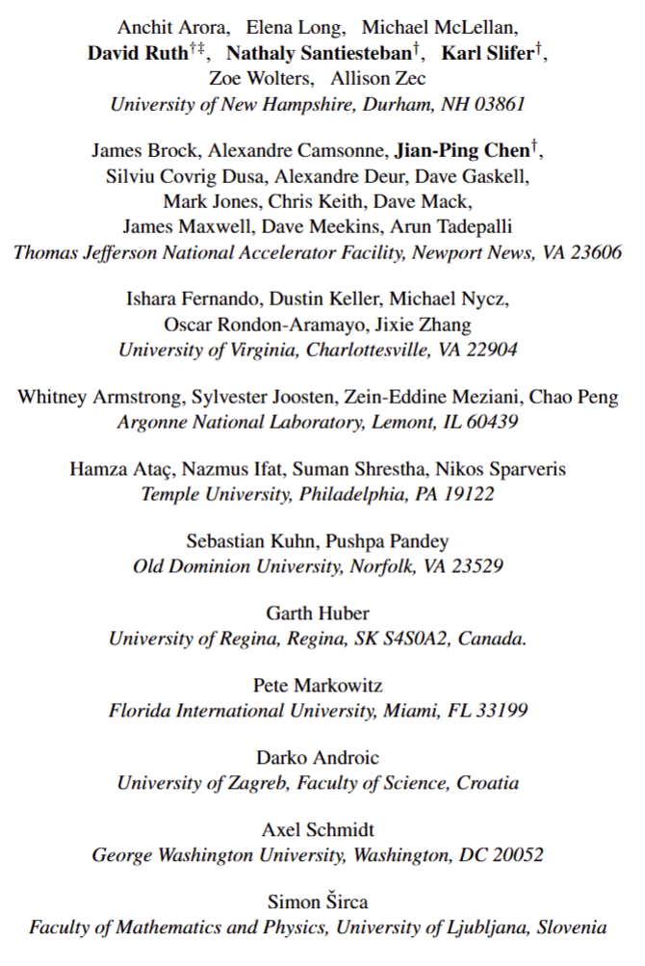
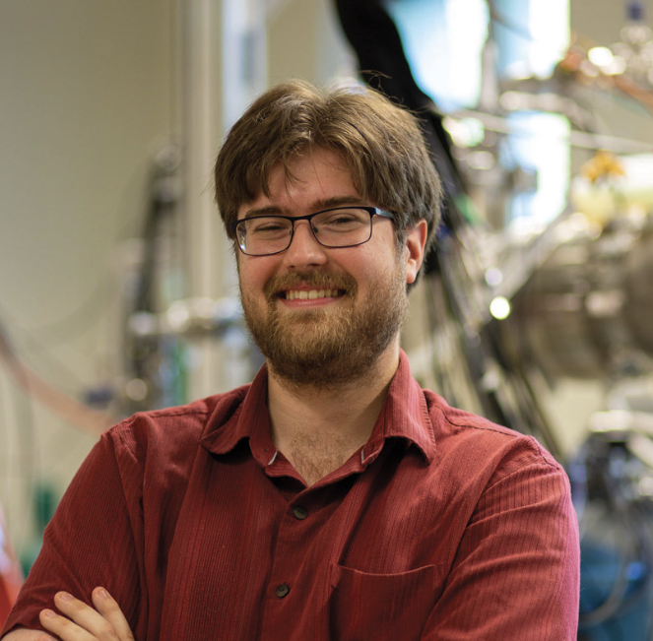
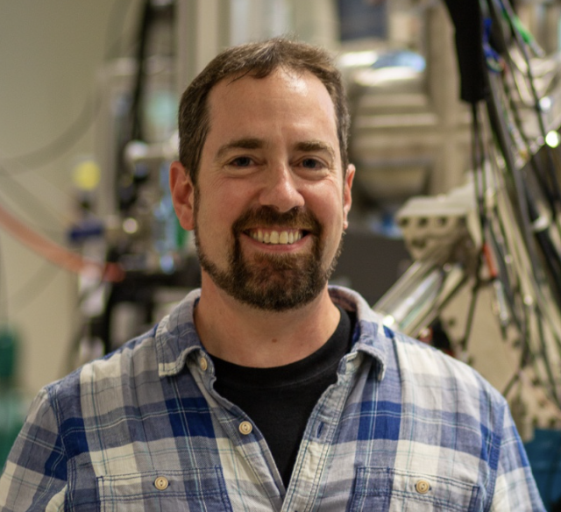
Collaboration
David Ruth†
Karl Slifer
Jian-Ping Chen
Nathaly Santiesteban
+ You…??
Your Institution Goes Here
Notes:
.

Slide 22
Conclusion
g₂ and its moments provide unique power for testing QCD and probing the transition region
The first experiment measuring g₂ in the transition region (PR12-24-002) has been conditionally approved at Jefferson Lab
We expect soon the conditional will be removed and we can prepare to run the experiment and:
Further steps towards a continuous QCD are coming soon!
Study Twist-3 with $\overline{g_{2}}$
Reduce error on the leading uncertainty in Hydrogen Hyperfine Splitting and study a long-standing tension
Fill the last major gap in the nucleon spin structure function Q² spectrum
Benchmark Lattice QCD with $\overline{d_{2}}$
Enable a better understanding of the B.C. Sum Rule in the nonperturbative regime

