Slide 1
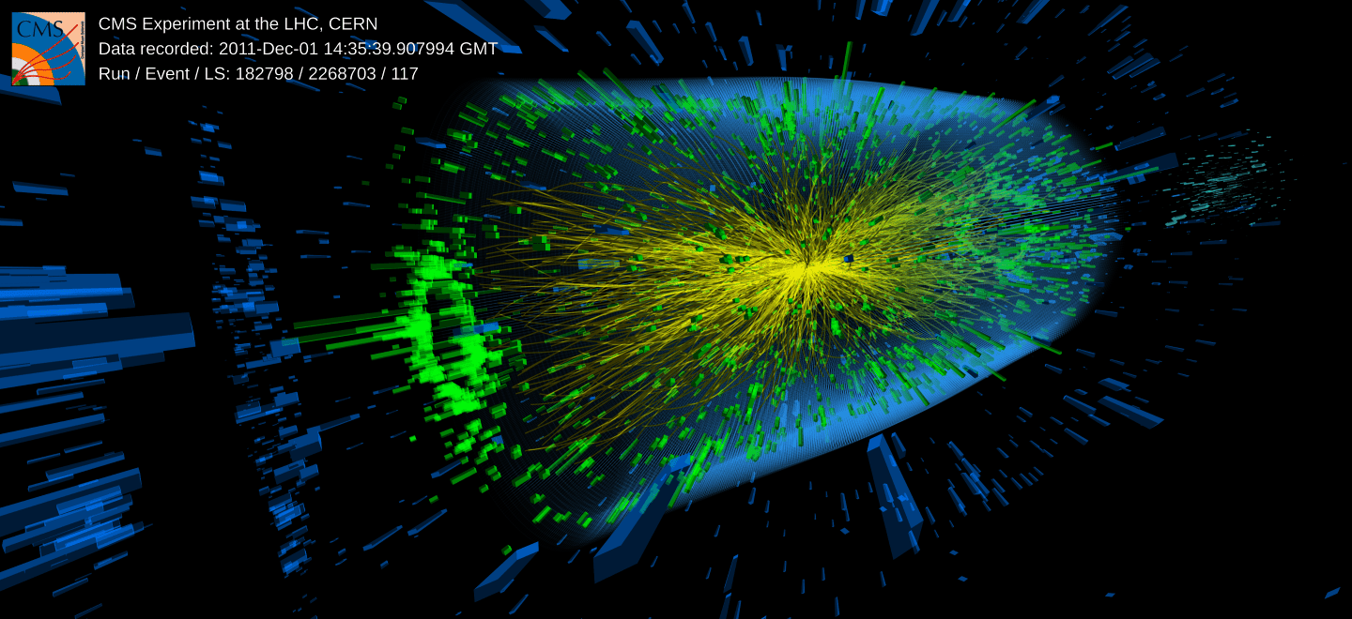




First Evidence of Medium Response to Hard Probes with Z⁰-tagged Hadrons in Lead-Lead Collisions
Yen-Jie Lee
For the CMS Collaboration
The 11th Workshop of APS Topical Group on Hadronic Physics
March 14, 2025
MIT HIG group's work was supported by US DOE-NP

Slide 2
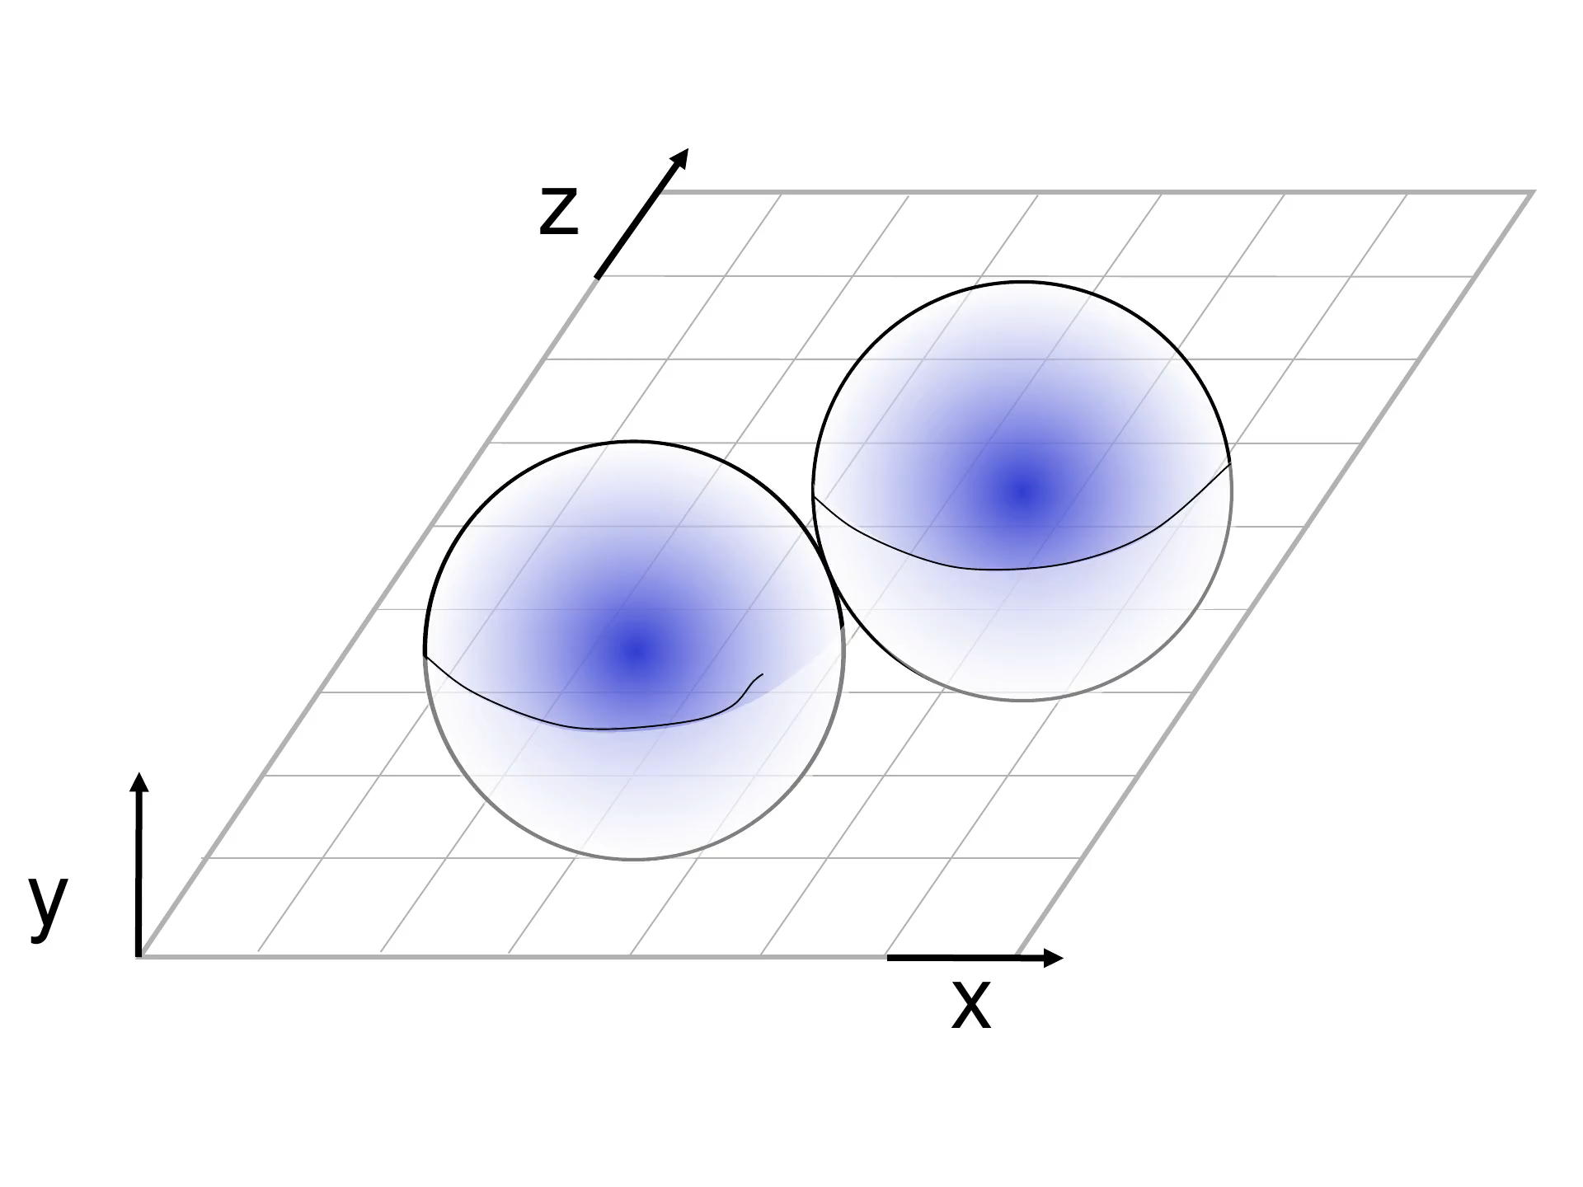
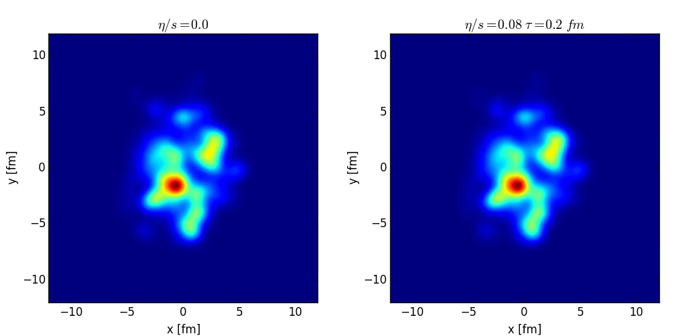
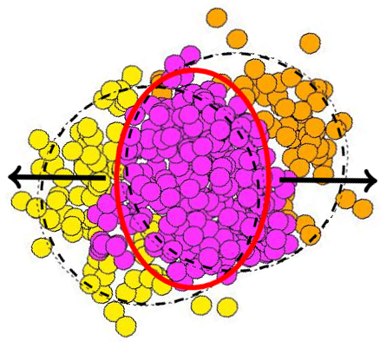
Effect of Shear Viscosity in Simulation
Ideal hydrodynamics
Viscous hydrodynamics
η/s = 0
η/s = 0.08
Alver and Roland (MITHIG)
“Collision geometry fluctuation”
PRC82 (2010) 039903
Animation from L. G. Peng
Evidence of Medium Response to Hard Probes with Z⁰-tagged Hadrons in PbPb at 5.02 TeV

Slide 3

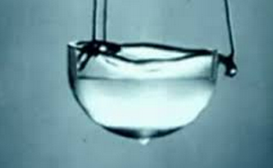
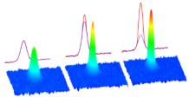
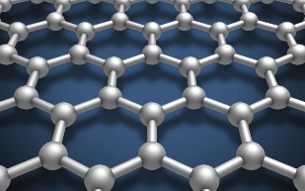
Near Perfect Fluid
Specific Shear Viscosity
MIT cold atom group
Calculation from
Annals Phys.326:770-796,2011
Electron fluid
in Graphene
PRL103,025301 (2019)
String theory
QGP: extracted from flow correlation and particle spectra at low p_{T}
Extracted from hydrodynamics models
How can we cross-check this result?
Bayesian Analysis on Data (Duke)
PRC94 (2016) no.2, 024907
Evidence of Medium Response to Hard Probes with Z⁰-tagged Hadrons in PbPb at 5.02 TeV

Slide 4
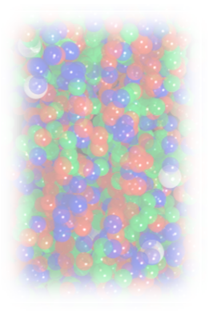
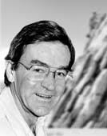

Hard Probes of Quark Gluon Plasma
Lifetime O(10⁻²⁴s)
James Bjorken (1982)
FERMILAB-PUB-82-059-T
Quark
Jet Quenching
QGP
Use Energetic Quarks to reveal
QGP structure at various length scales
Evidence of Medium Response to Hard Probes with Z⁰-tagged Hadrons in PbPb at 5.02 TeV

Slide 5
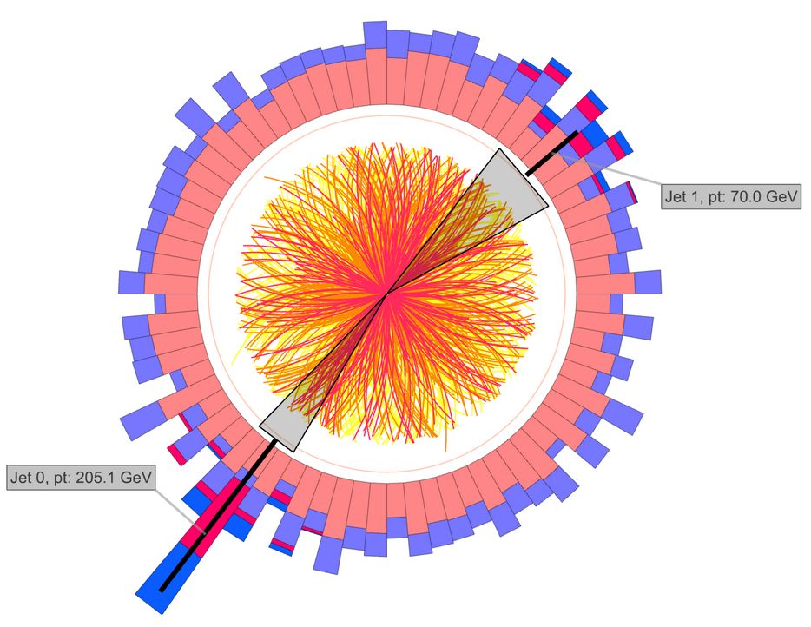
Probe the QGP with High Energy Quarks and Gluons
!!!
Proton+Proton
Lead+Lead
Direct observation of jet quenching: Asymmetric dijets in Lead+Lead collisions
The stopping power (dE/dx) of the QGP is Strong
medium
PRC 84 (2011) 024906
PLB 712 (2012) 176
Evidence of Medium Response to Hard Probes with Z⁰-tagged Hadrons in PbPb at 5.02 TeV

Slide 6
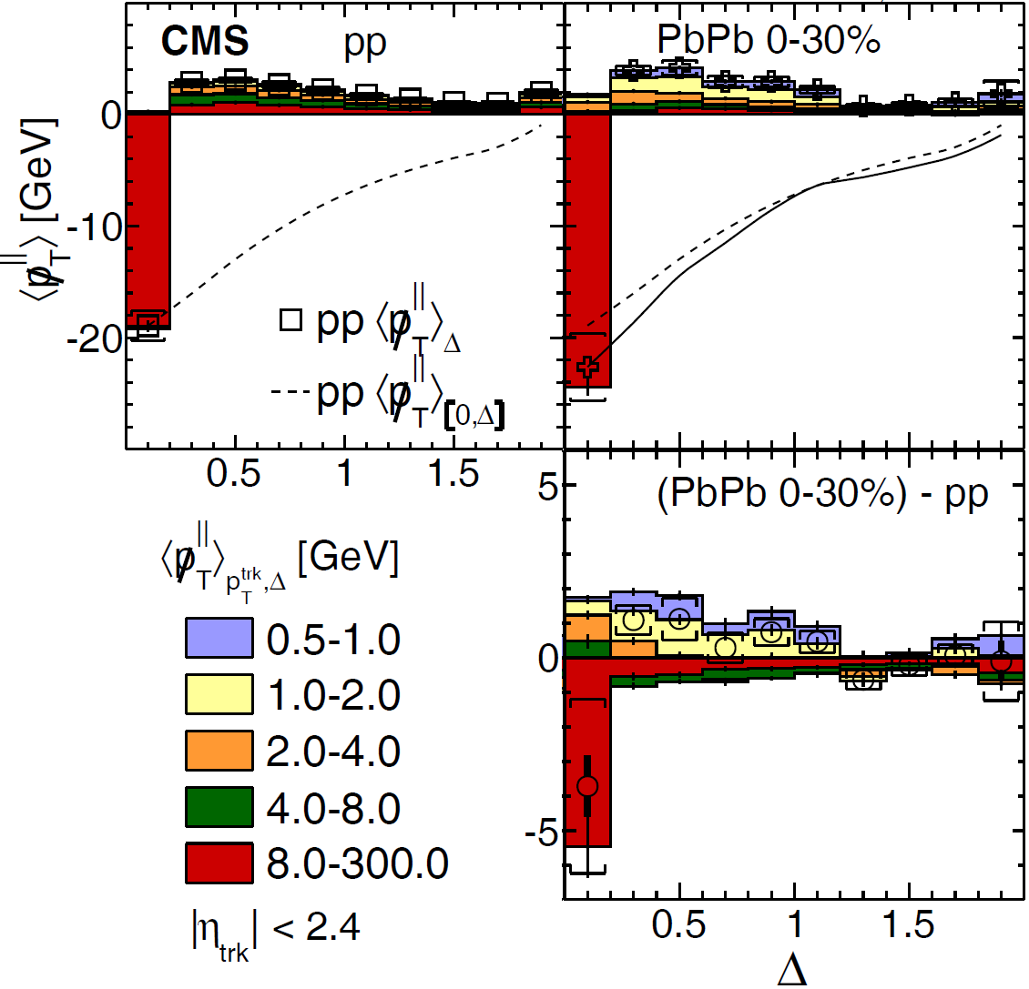
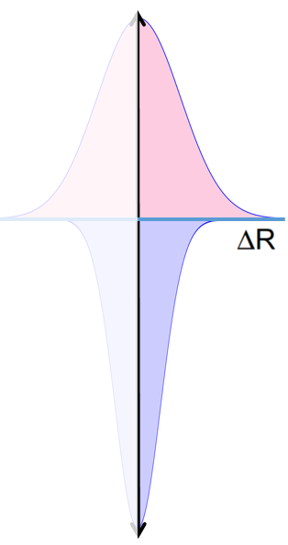
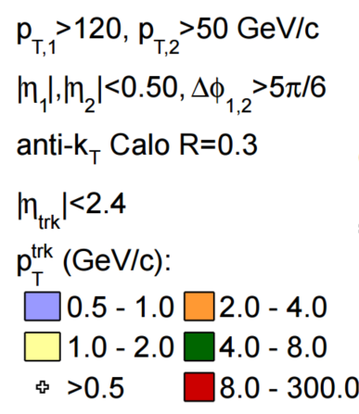

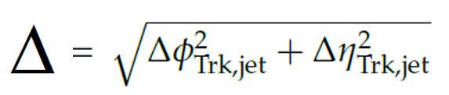
The First Indication of Medium Response: Missing p_{T}||
Subleading jet direction
Slight modification of the cumulative energy flow
High p_{T} imbalance
at small Δ
Leading jet direction
PRC 84 (2011) 024906
JHEP 01 (2016) 006
Study momentum balance parallel to dijet axis
Quenched energy fully recovered via low p_{T} particles
p_{T}< 2 GeV
They are distributed from near to far away from the (di)-jet axis (up to ΔR~1-2)
Balanced by low p_{T} particles in subleading jet direction
Extends upto large Δ
Evidence of Medium Response to Hard Probes with Z⁰-tagged Hadrons in PbPb at 5.02 TeV
6

Slide 7
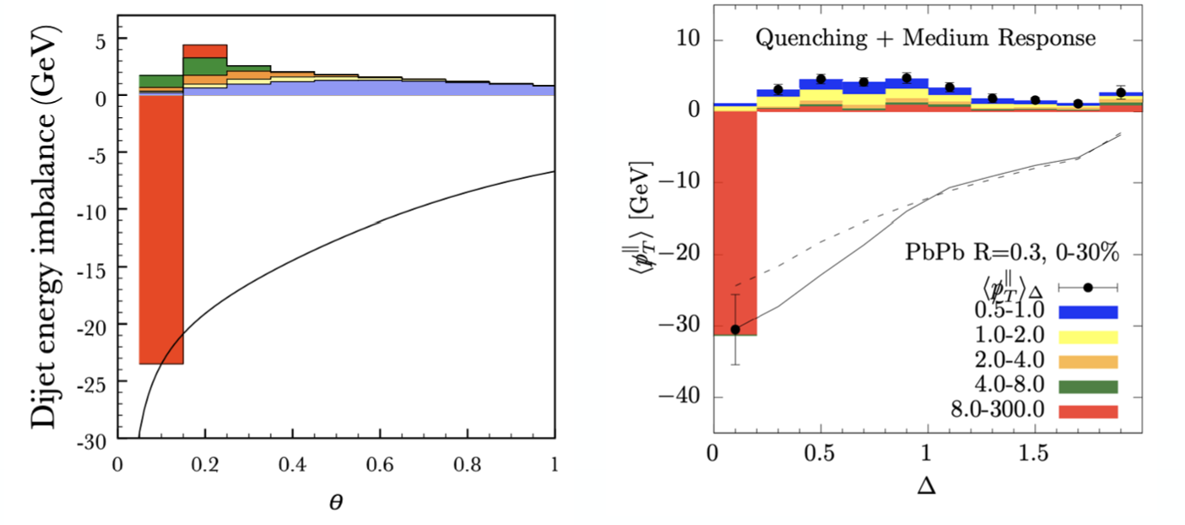
Interpretation of Missing p_{T}||
Subleading jet direction
Compiled by Dani Pablos
Leading jet direction
Medium-induced Parton Cascade
Blaizot & Mehtar-Tani
Int.J.Mod.Phys.E 24 (2015) 11, 1530012
Hydrodynamic wake
Casalderrey-Solana, Gulhan, Milhano, Pablos, Rajagopal
JHEP 03 (2017) 135
However, the interpretation includes both Medium-induce Parton Cascade and Hydrodynamic Wake.
Since then, a lot of focus on the observables involving fully reconstructed jets (See Yi Chen’s talk)
Evidence of Medium Response to Hard Probes with Z⁰-tagged Hadrons in PbPb at 5.02 TeV
7

Slide 8

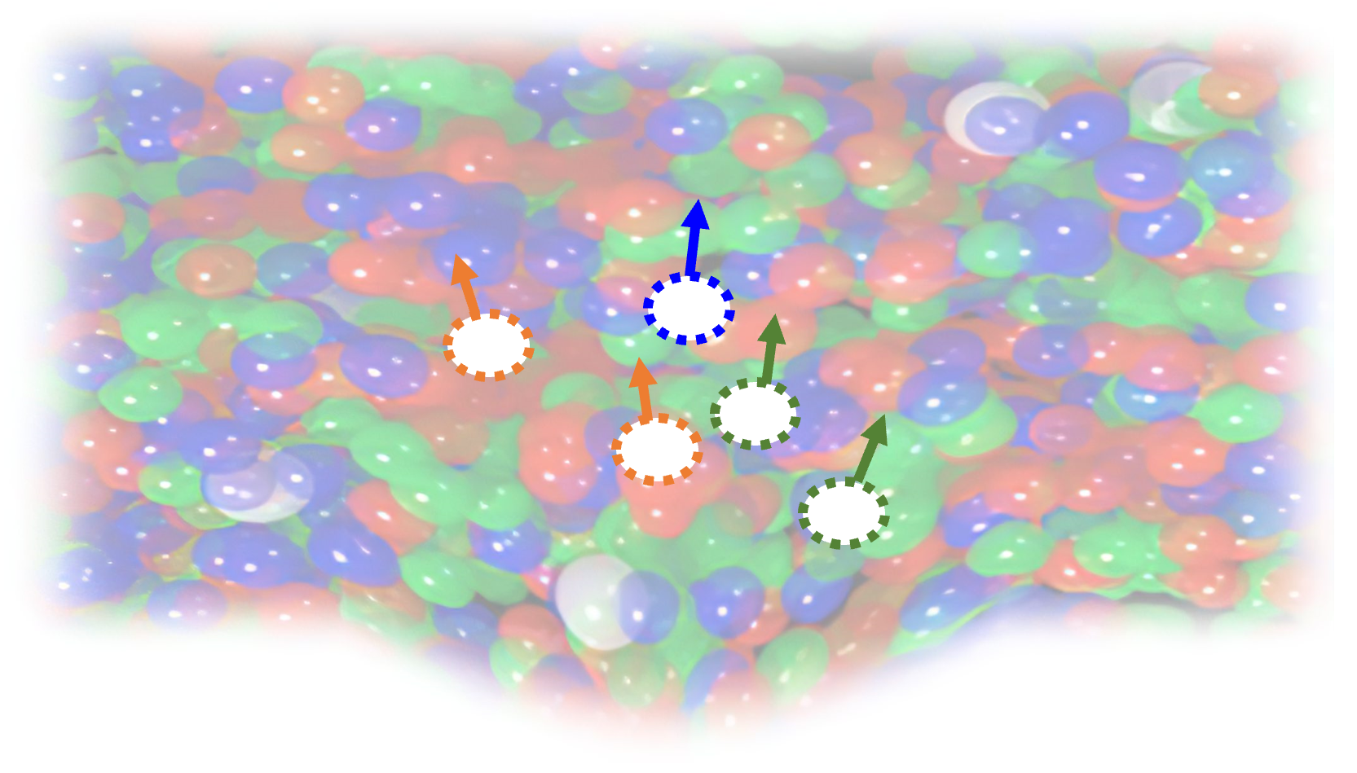
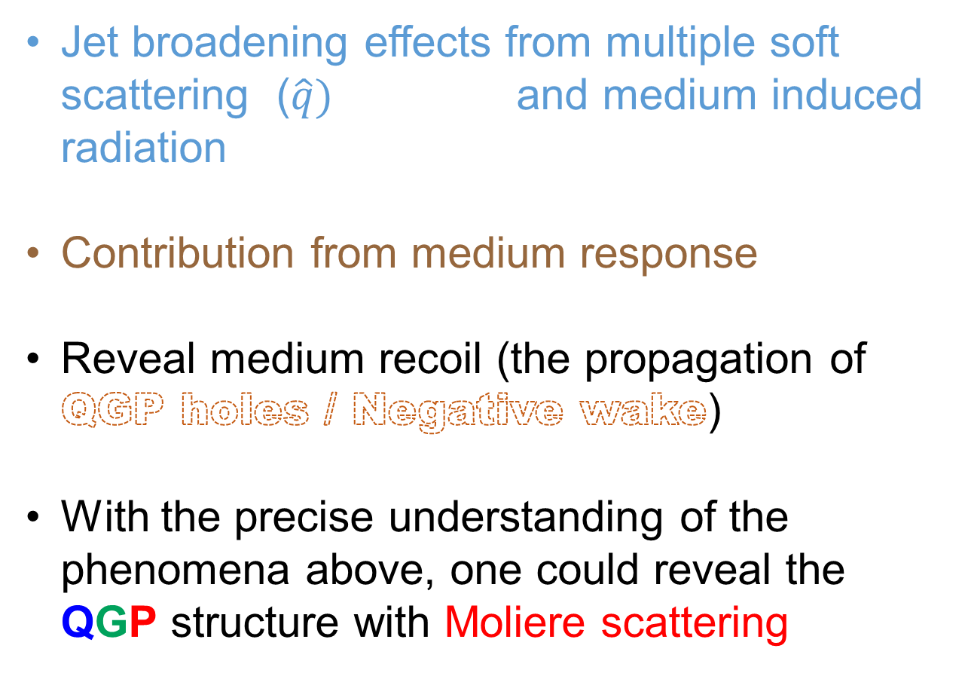
QGP Transport Properties and Structure with Jets
Artist’s impression
Jet broadening effects from multiple soft scattering ($\hat{q})$ and medium induced radiation
Contribution from medium response
Reveal medium recoil (the propagation of QGP holes / Negative wake)
With the precise understanding of the phenomena above, one could reveal the QGP structure with Moliere scattering
Jet
“Hole”
In pQCD-based calculations

Slide 9
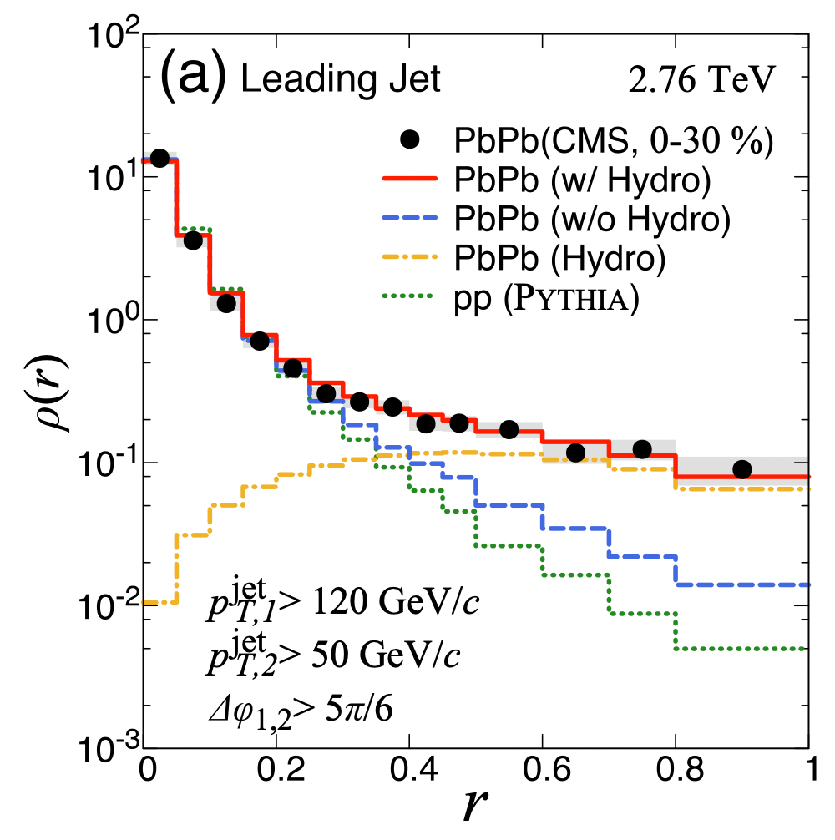
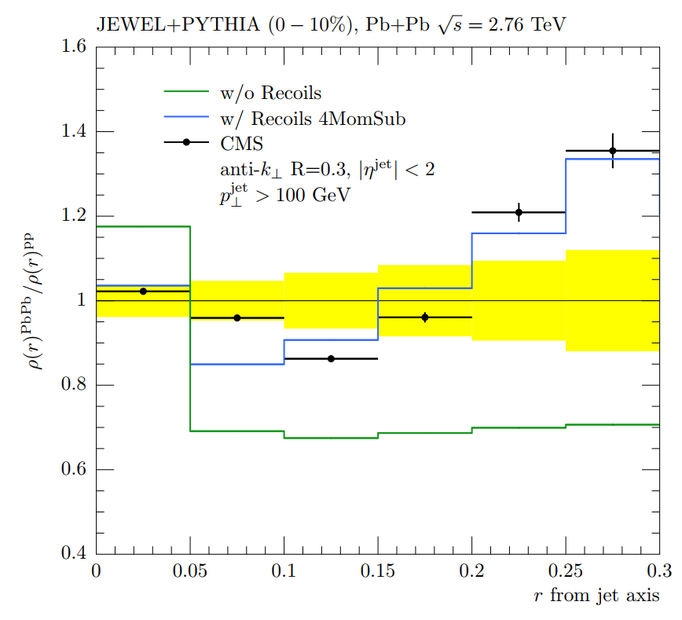
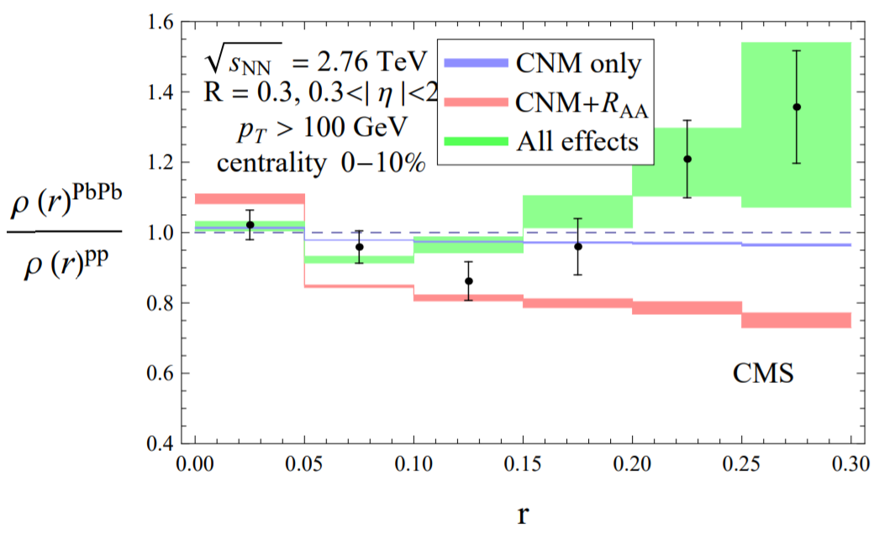
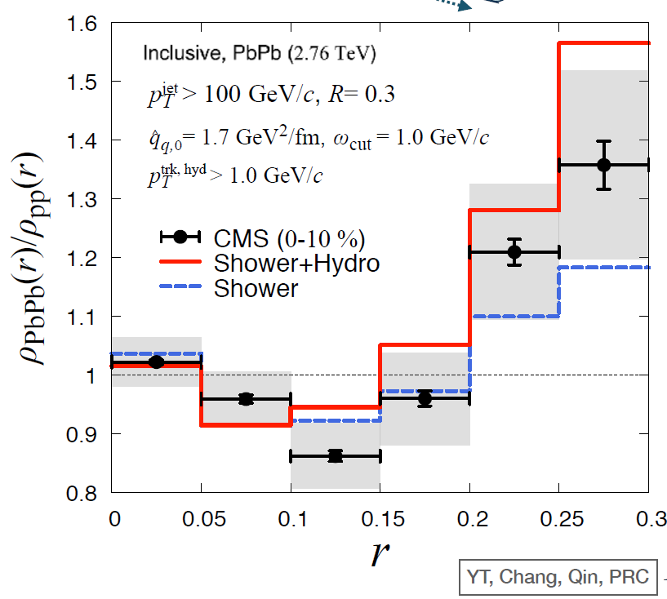
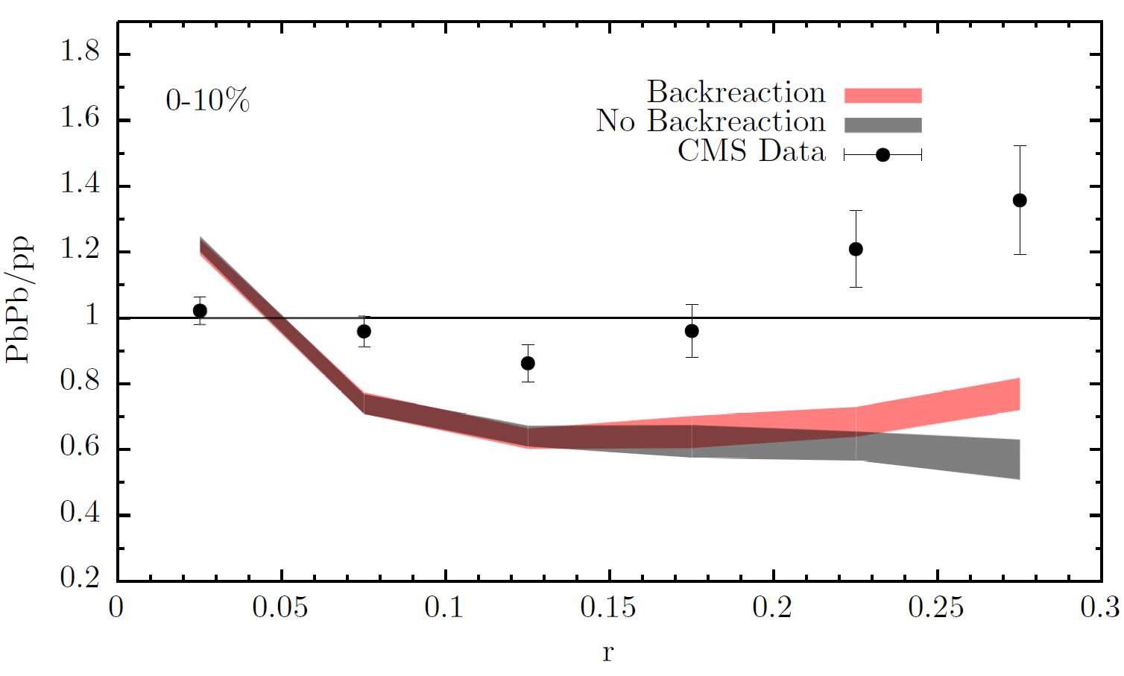
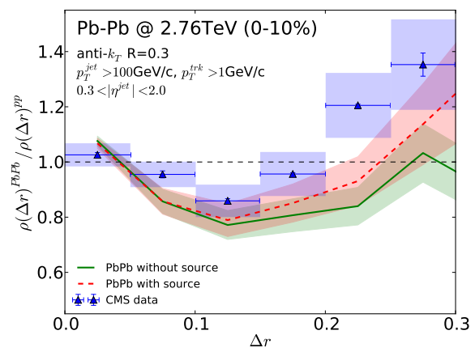
Interpretation of the CMS Jet Shape
SCET_{G}
None!
JEWEL
JHEP 07 (2017) 141
Jet-Fluid
HYBRID
Jet-Fluid
arXiv:1701.07951
Modifications of the shower
JHEP 11 (2016) 055
PRC 95 (2017) 4, 044909
Medium Recoil and Response
Models with different mechanisms give reasonable description
of the inclusive jet shape and many other observables
How do we make more progress?
Martini
Evidence of Medium Response to Hard Probes with Z⁰-tagged Hadrons in PbPb at 5.02 TeV
9

Slide 10
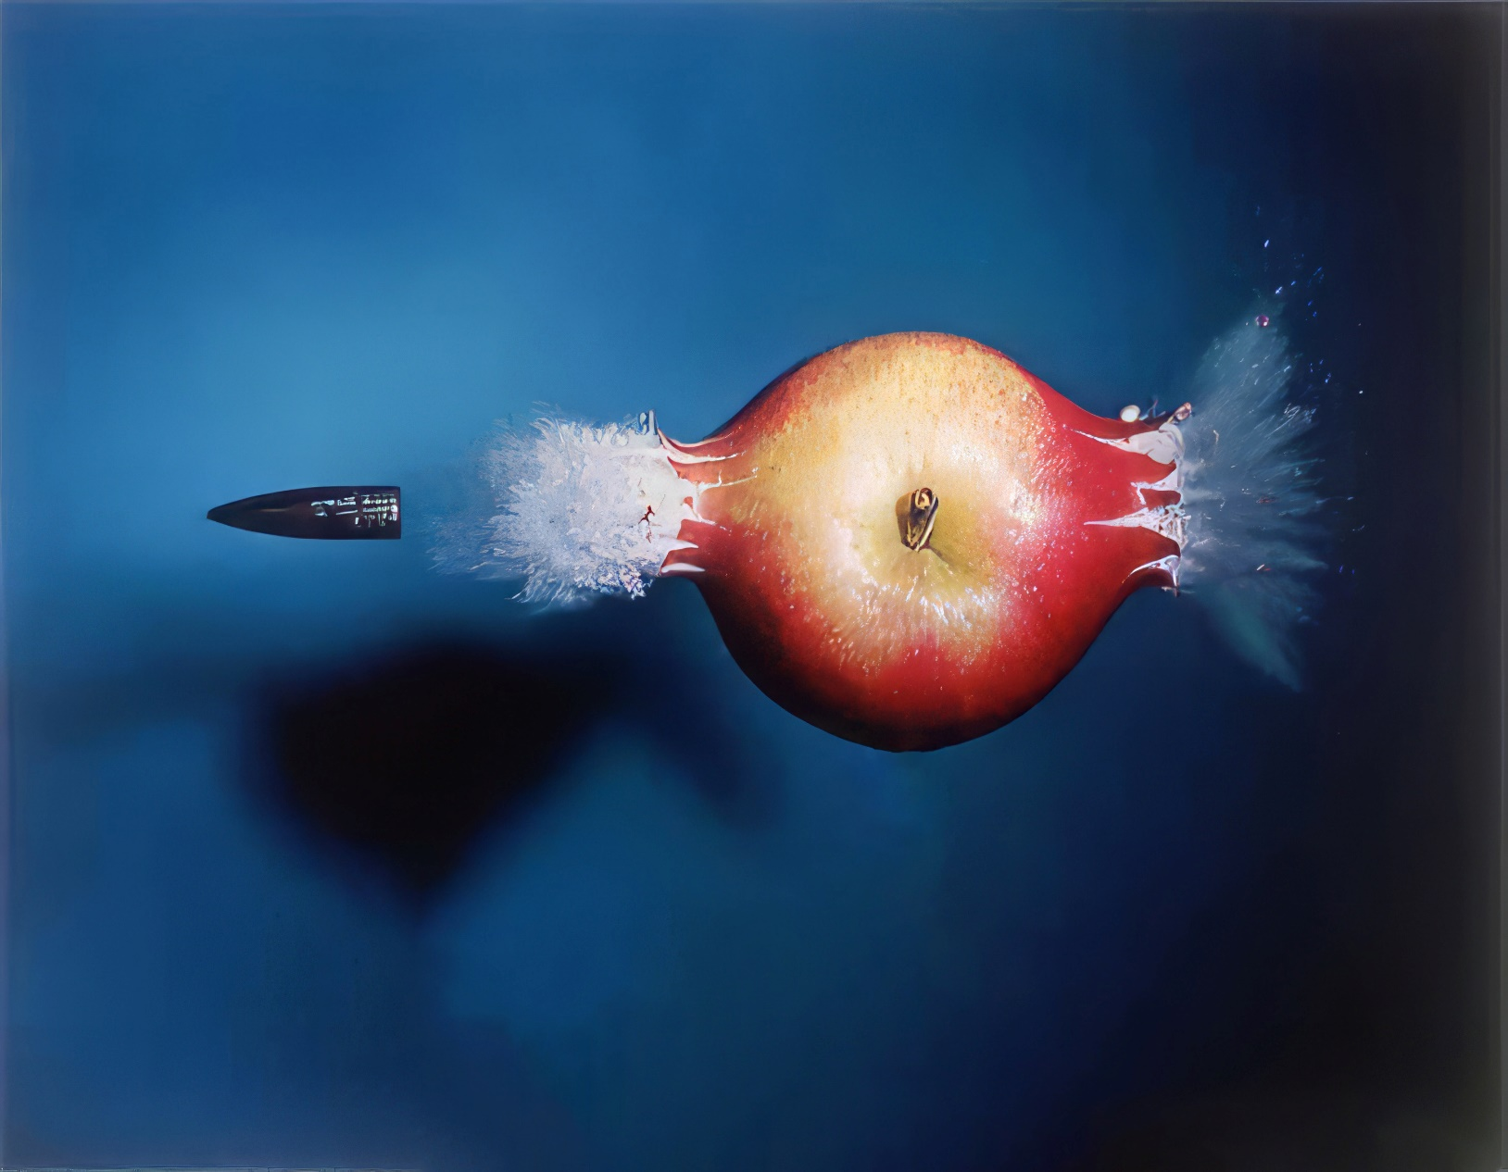

Inspiration: Medium Response to Hard Probes in QED
Bullet plowing through an apple
Duck swimming through water
Apple Hole
Apple Jet
Bullet
Originally from Harold Eugene Edgerton
Wikimedia::Daderot
More apple going in the bullet direction
More water going in the duck direction
In Position Space
10

Slide 11
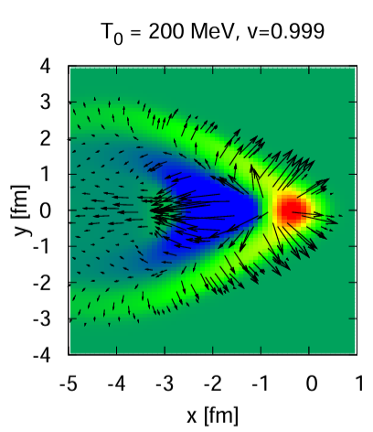
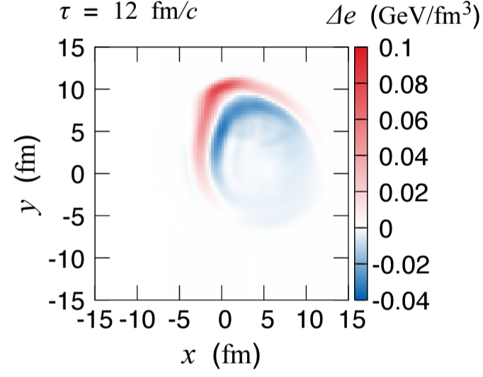
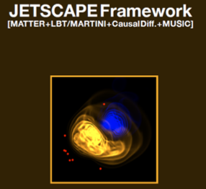
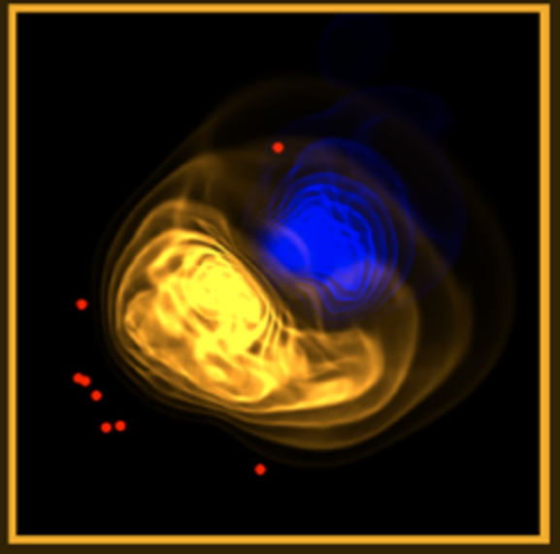
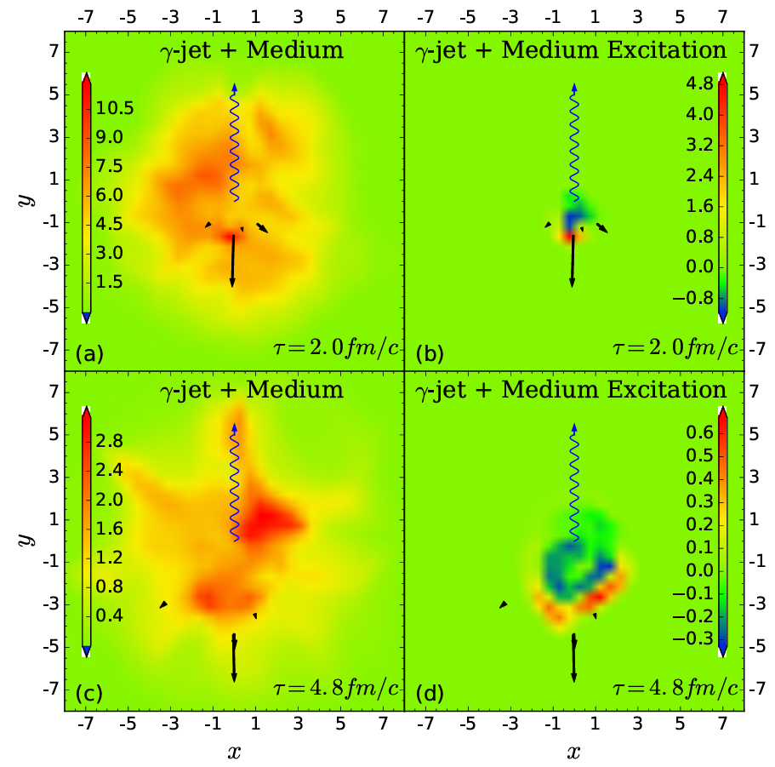
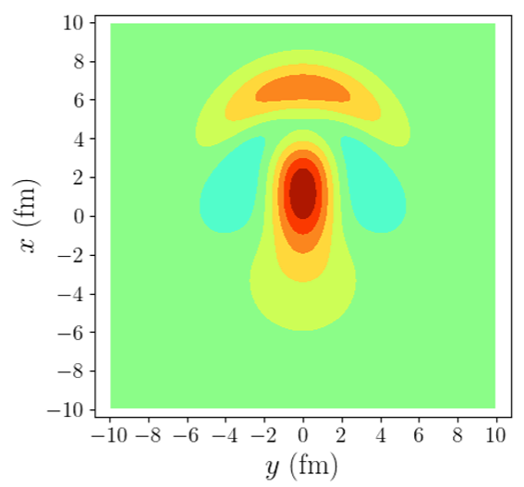
Medium Response to Hard Probes in QGP
Quark plowing through the QGP
Duck swimming through water
Jet-Fluid Yasuki, Chang, Qin
PRC 95 (2017) 4, 044909
JETSCAPE framework
Tachibana, Shen, Majumder
PRC 106 (2022), L021902
Betz, Noronha, Torrieri, Gyulassy, Mishustin, Rischke
PRC 79 (2009) 034902
CoLBT Chen, Cao, Luo, Pang, Wang
PLB 777 (2018) 86-90
Casalderrey-Solana, Milhano,
Pablos, Rajagopal Yao
JHEP 05 (2021) 230
Wikimedia::Daderot
More QGP going in the jet direction
More water going in the duck direction
In Position Space
11

Slide 12
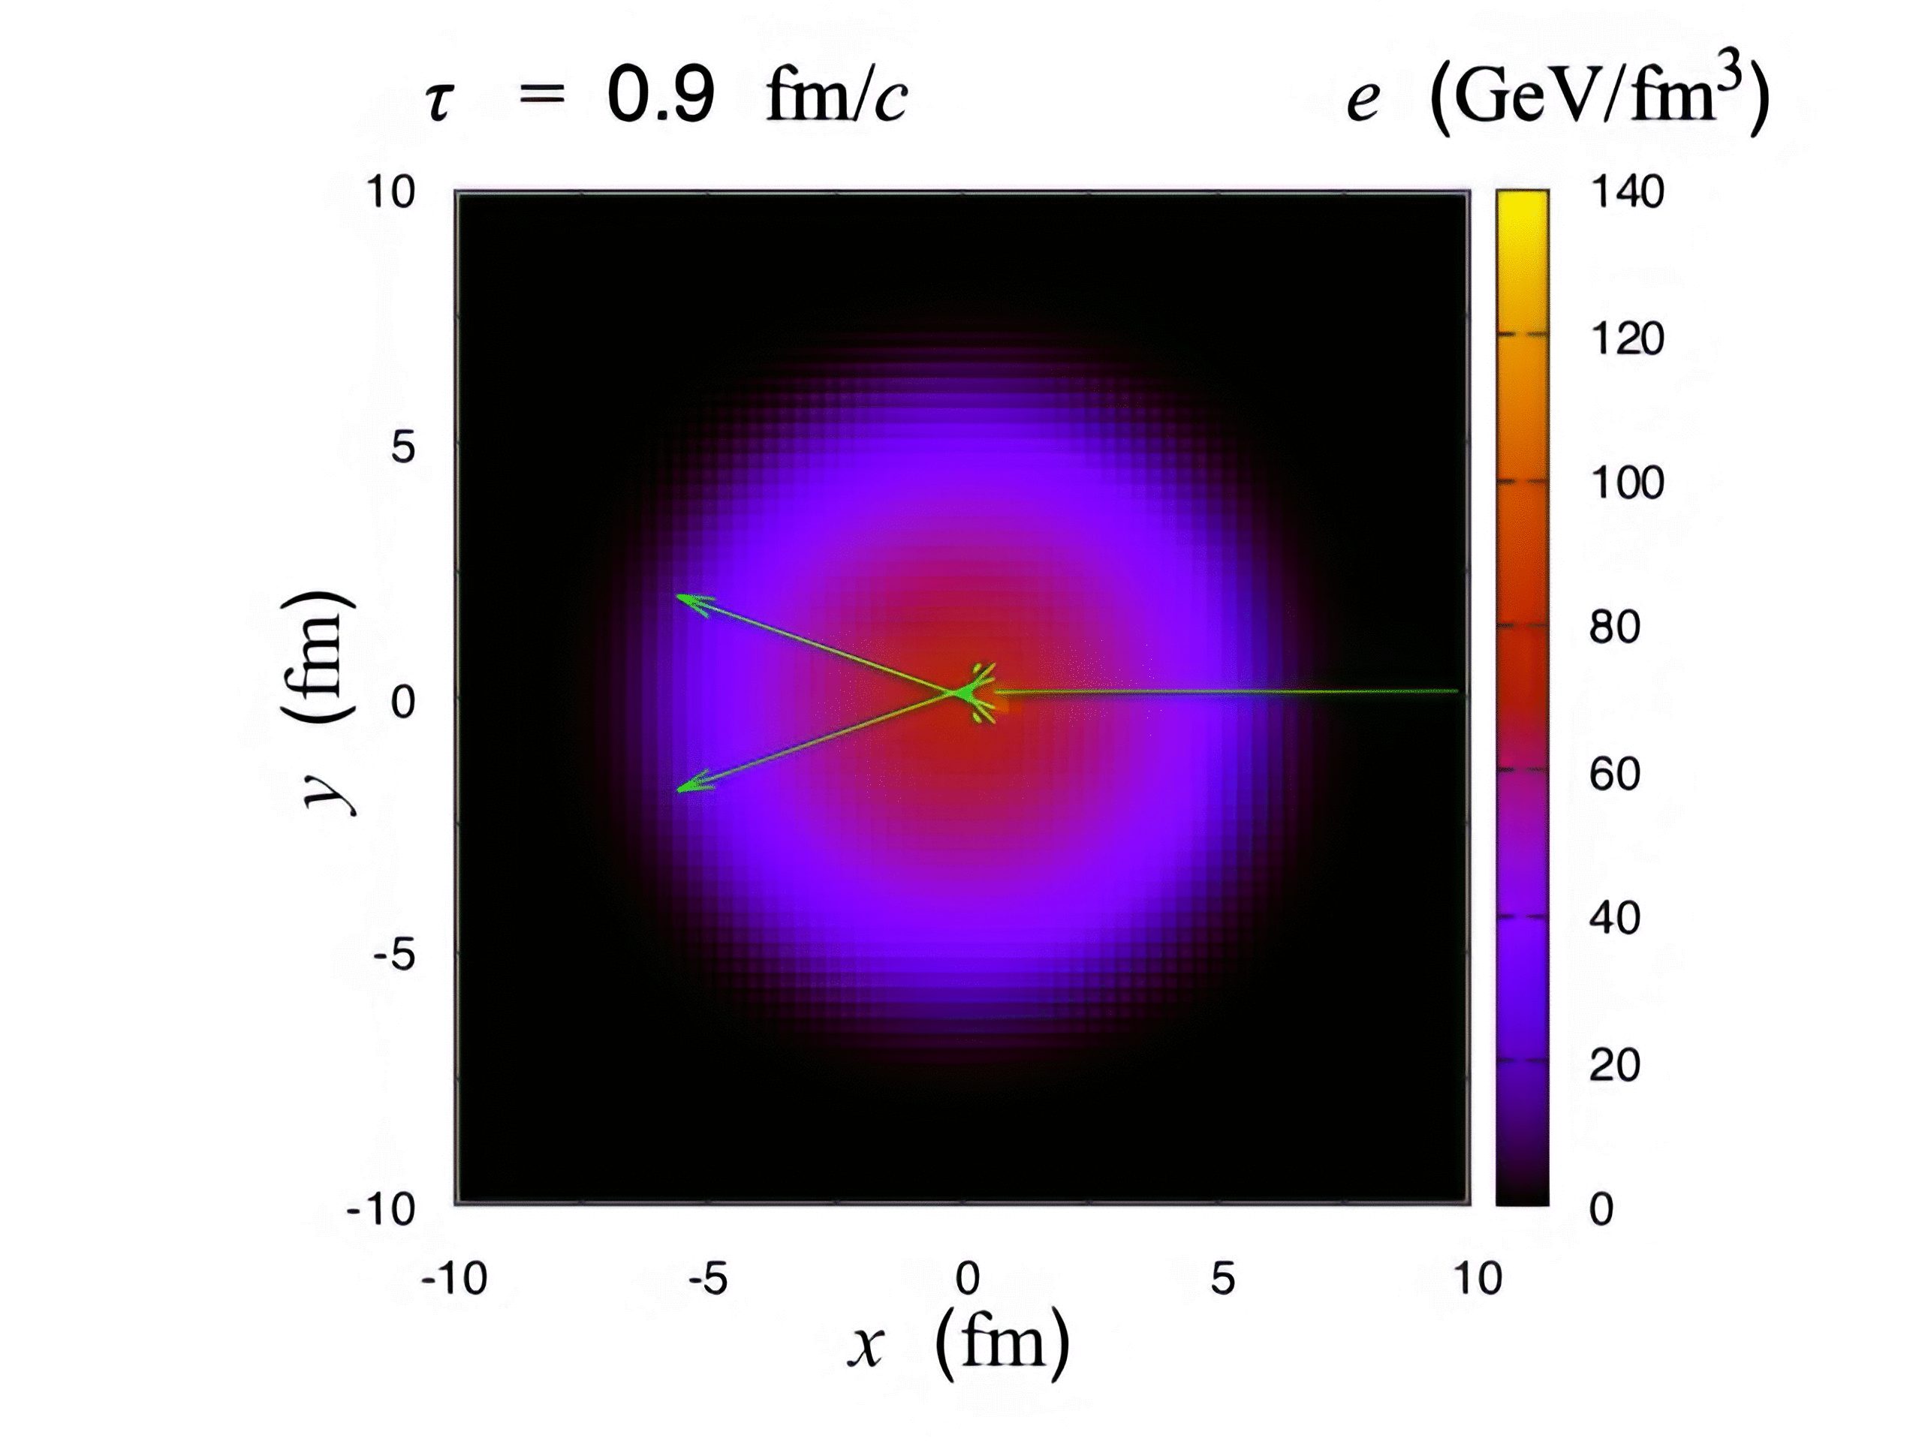
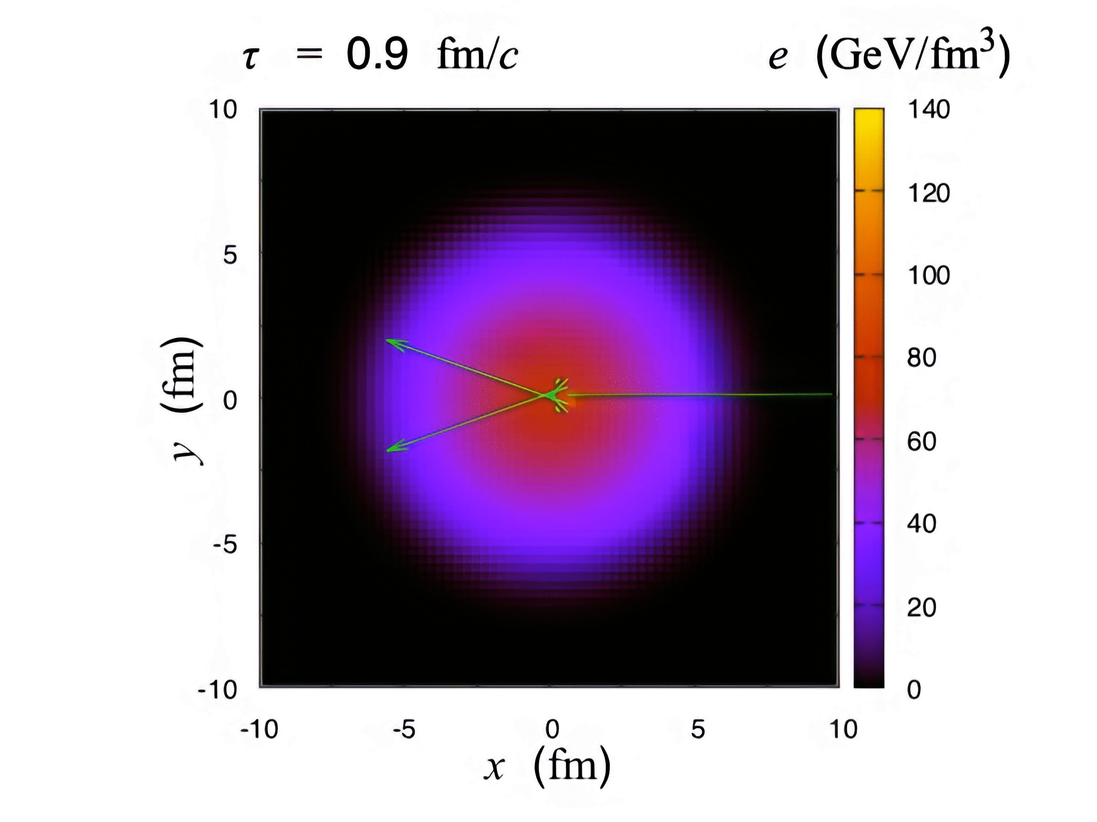
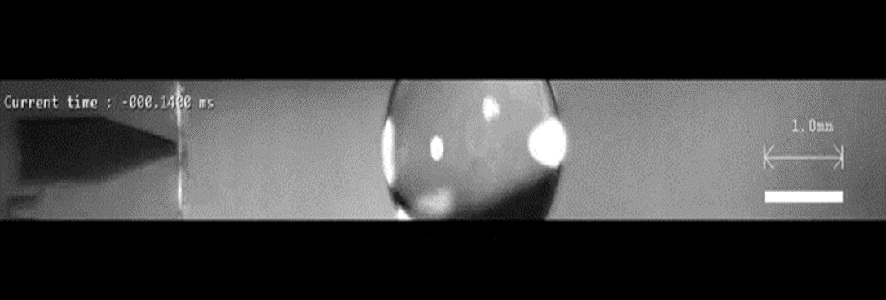

Medium Response to Hard Probes
Quark plowing through the QGP
Microfluidic Jet against viscoelastic droplet
LBT Model
David Fernandez
https://www.youtube.com/watch?v=TPRur72FGyk
More QGP going in the jet direction
More water going in the jet direction
In Position Space
12

Slide 13
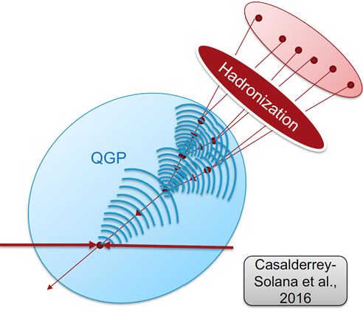
Theoretical Models
Jewel Model
(Jet Evolution with Energy Loss)
pQCD-based energy loss model
High-energy partons scatter with medium particles; Recoiled partons
and holes do not re-scatter with QGP constituents.
CoLBT Hydro Model
(Coupled Linear Boltzmann Transport and Hydrodynamics)
Based on pQCD. Integrates the Boltzmann transport equation with QGP hydrodynamic simulations.
Introduces reheating, where parton energy loss could heat and modifies the QGP.
Hybrid Model
(Hybrid Strong/Weak Coupling Approach)
Based on the AdS/CFT, combining
pQCD shower and strong-coupling dynamics.
Lost energy deposits a hydrodynamic wake in the QGP via 4-momentum conservation.
Reheating or Cooling
Jet
Parton
Energy loss
Medium
Hydro evolution
“Hole”
Elastic scattering and Radiation
13

Slide 14
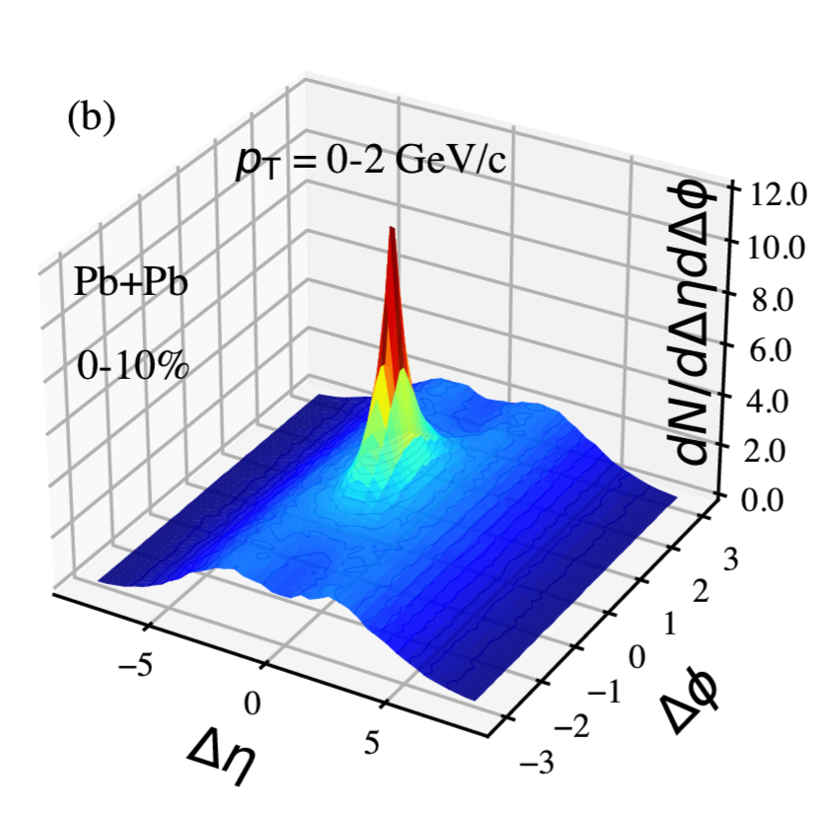
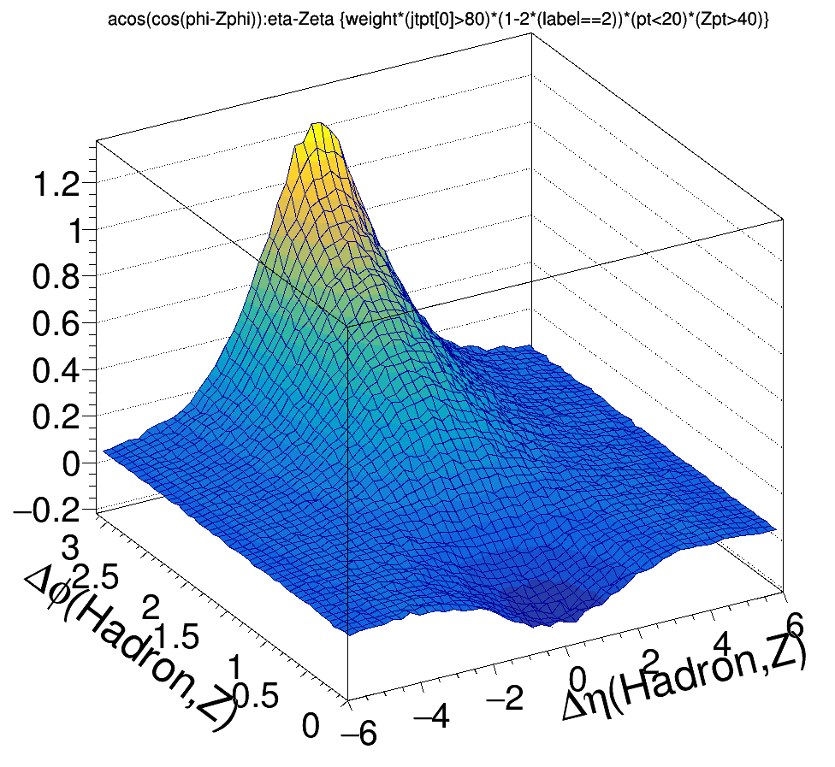
Medium Response to Hard Probes in Momentum Space
Jet and Hadron correlation in Photon-Jet event
QGP wake in CoLBT
PRL 130, 052301 (2023)
Z⁰ and Wake Hadron correlation in Hybrid model
Daniel Pablo, Krishna Rajagopal, YJL
Zhong Yang, Tan Luo, Wei Chen,
Longgang Pang, and Xin-Nian Wang
Jet
Positive Wake
MPI
More QGP going in the jet direction, however, with complication from induced radiation
In Momentum Space
14

Slide 15
Measure the “Depletion” due to Medium Recoil
Jet and Hadron correlation in Photon-Jet event
QGP wake in CoLBT
PRL 130, 052301 (2023)
Z⁰ and Wake Hadron correlation in Hybrid model
Daniel Pablo, Krishna Rajagopal, YJL
Zhong Yang, Tan Luo, Wei Chen,
Longgang Pang, and Xin-Nian Wang
Jet
Positive Wake
MPI
Negative Wake
More QGP going in the jet direction, however, with complication from induced radiation
Less QGP left behind in the opposite direction of the jet!!!
Negative Wake
→ Measure the Boson-side associated yield with Z⁰-Jet
In Momentum Space
15

Slide 16
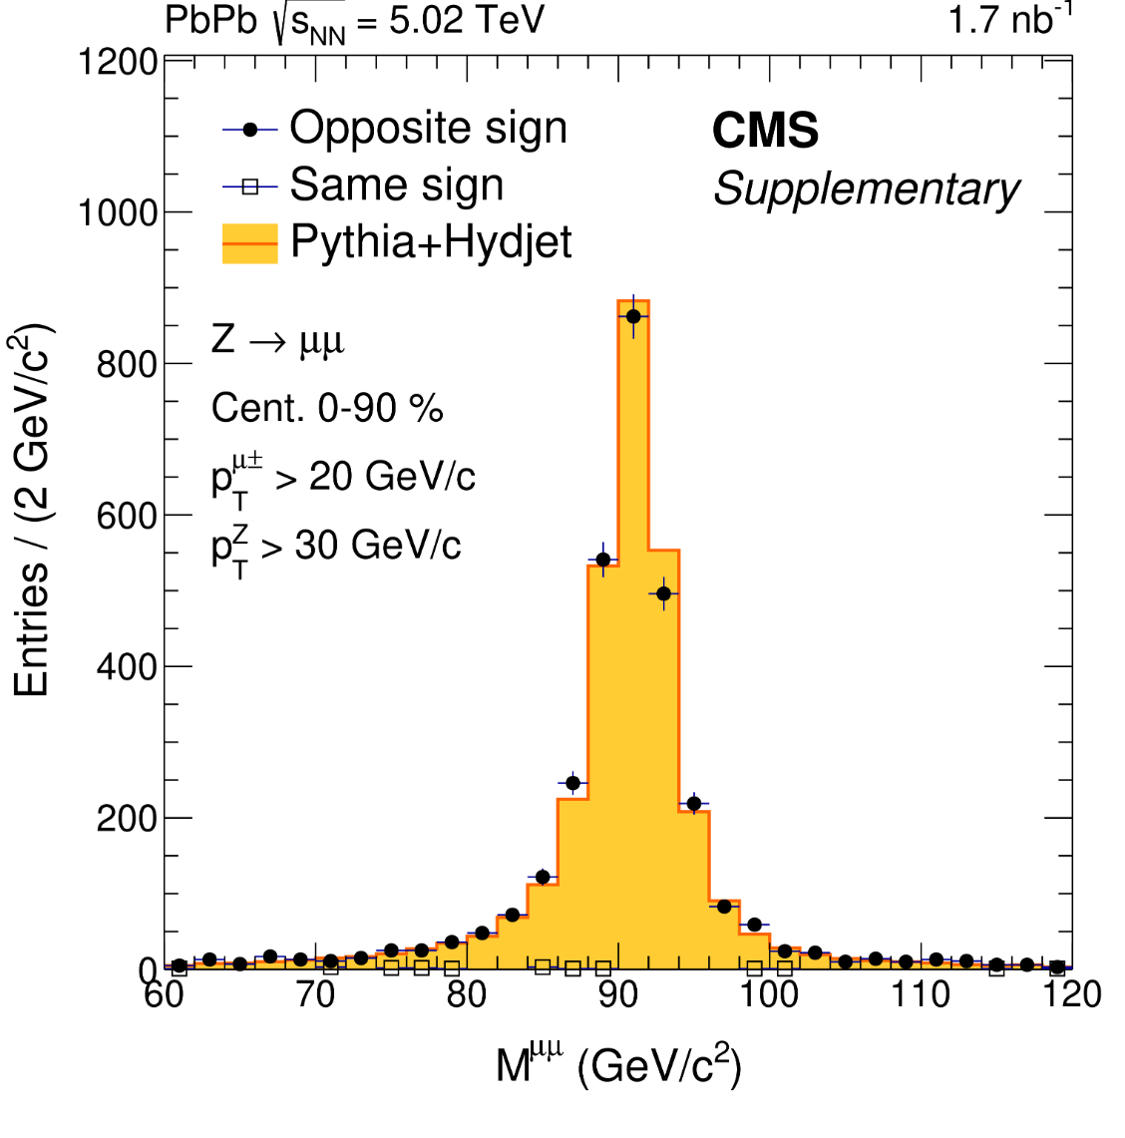
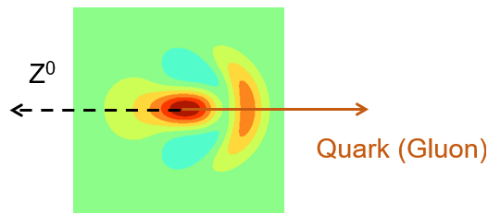
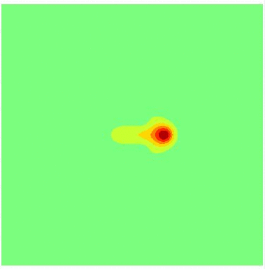
Z⁰ Boson and Charged Hadron Track Selection
Z⁰→μ⁺μ⁻ selections:
  Muons: |η_{µ}| < 2.4, |p_{T,µ}| > 20 GeV/c,
  Z⁰ Bosons:
    60 GeV/c² <M_{µµ}< 120 GeV/c²
    40 GeV/c <|p_{T}^{Z}| < 350 GeV/c
    |y_{Z}| < 2.4
Charged hadron selections:
  |η_{ch}| < 2.4, 1 < p_{T}^{ch} < 10 GeV/c.
  Muon rejection: ΔR_{ch,μ} > 0.0025 between
  Muon candidates and charged hadron tracks
Z⁰
Quark (Gluon)
CMS HIN-19-006
PRL 128 (2022) 122301
16

Slide 17
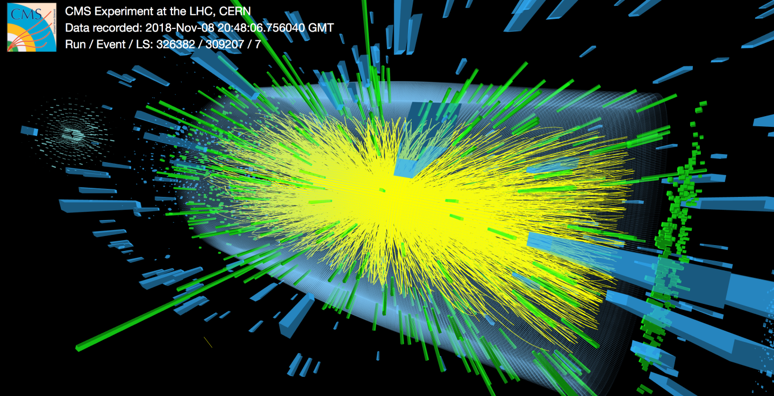
Is it possible to identify the absence of a few particles caused by the medium response
in events involving tens of thousands of particles?
17

Slide 18
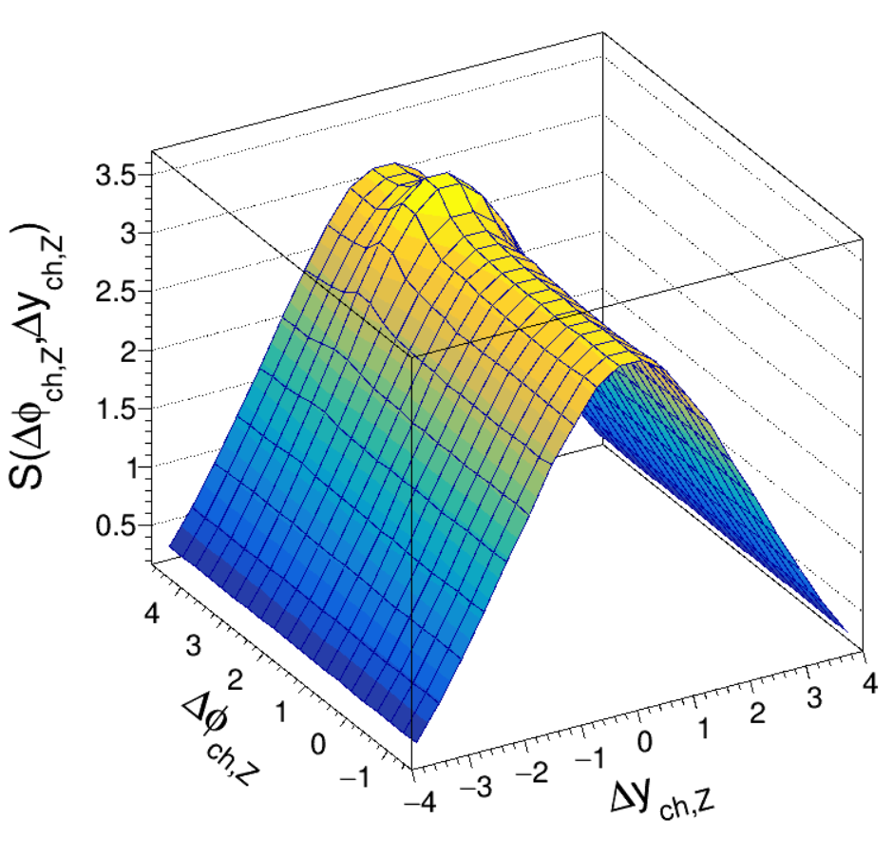
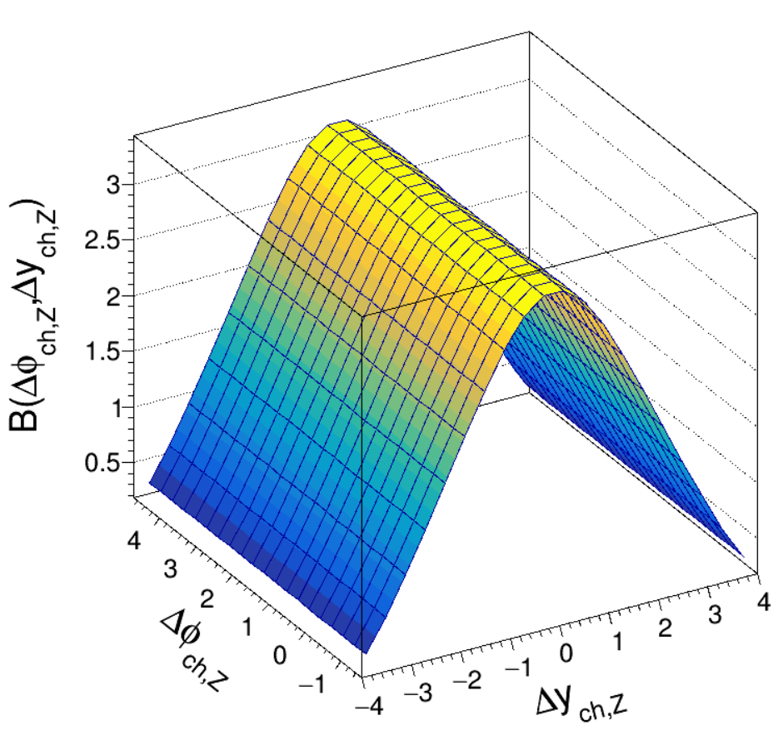
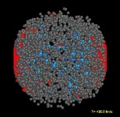
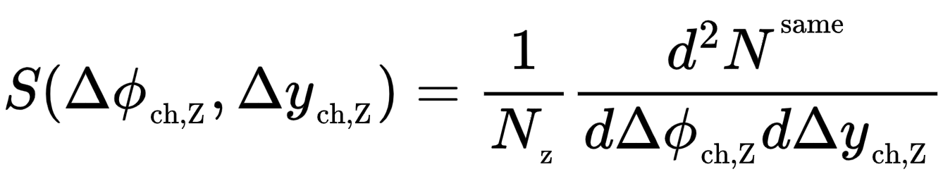
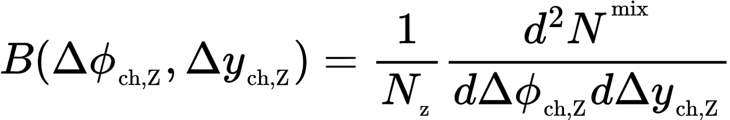
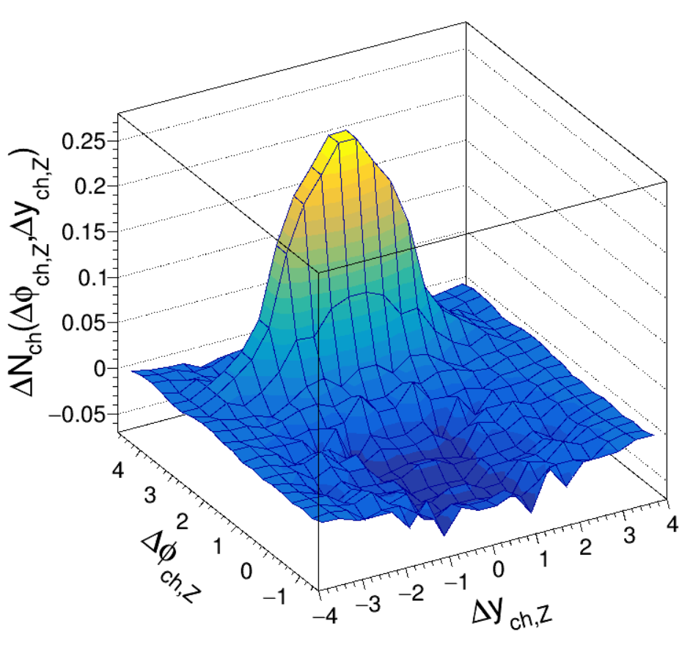

Z⁰-Hadron Correlation Function: Event Mixing
Average Signal pair distribution:
Average Background pair distribution:
same event pairs
Z⁰ Event 1
mixed event pairs
Z⁰ Event 2
Δy_{ch,Z} = y_{z}-η_{ch}
Δφ_{ch,Z} = φ_{z}-φ_{ch}
Demonstration with PYTHIA+HYDJET
(Generator level events)
Integral of the ΔN_{ch} correlation function will be ~0
Evidence of Medium Response to Hard Probes with Z⁰-tagged Hadrons in PbPb at 5.02 TeV
18

Slide 19
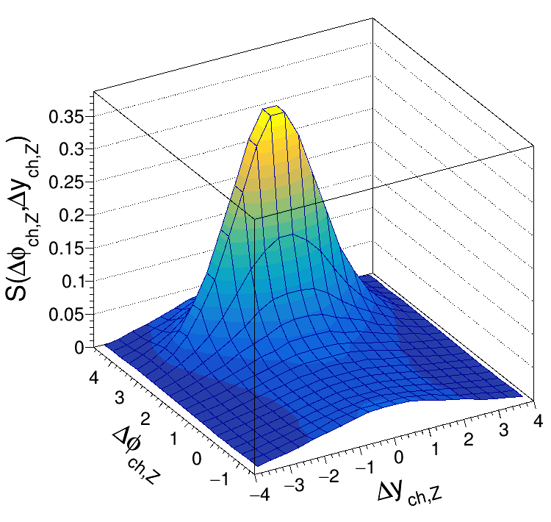
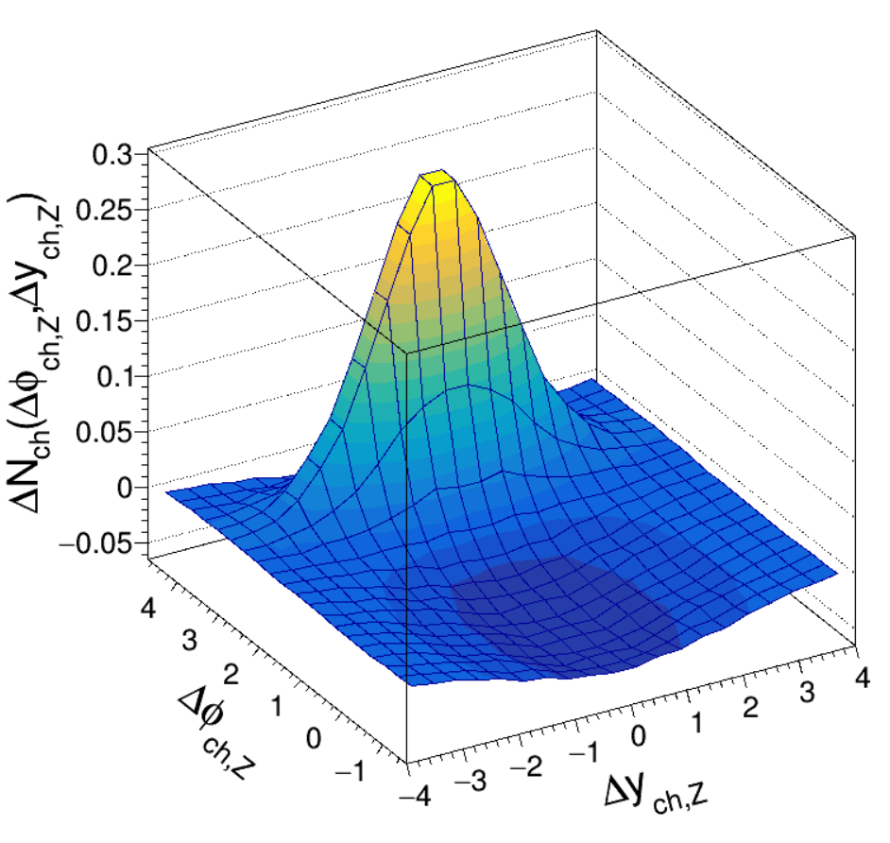
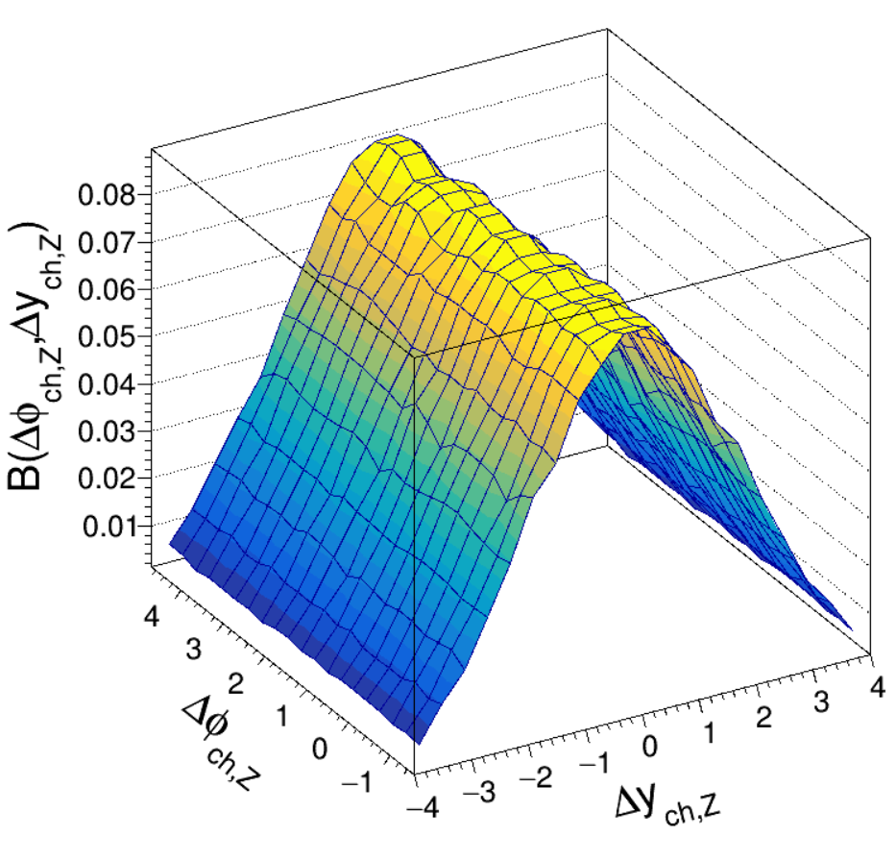
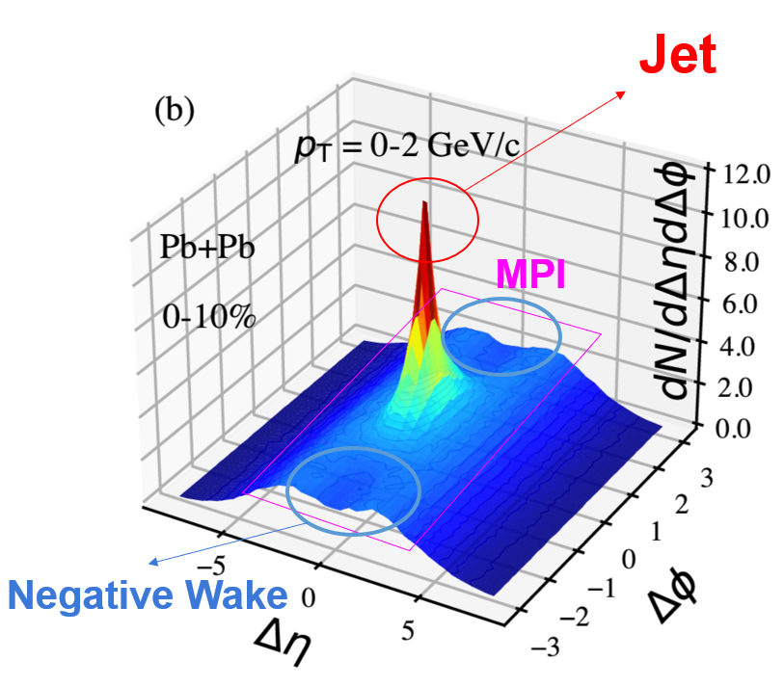
Mixed Event Subtraction in PYTHIA8 pp Events
MPI
Mixed event subtraction is also performed in pp analysis
Tight correlation between charged hadron in jet and Z⁰ not
only in Δϕ but also Δy due to Z⁰ p_{T} and rapidity selection
The procedure suppresses the uncorrelated
“Multi-Parton Interaction (MPI) ridge” at fixed Δη (Δy)
19

Slide 20






1D Projections of the Theoretical Predictions
Projection onto Δϕ axis
Hybrid Model
Projection onto Δy axis
Evidence of Medium Response to Hard Probes with Z⁰-tagged Hadrons in PbPb at 5.02 TeV
20

Slide 21


Results
?
Can we see an unambiguous evidence of the QGP wake created by a fast moving quark?
Evidence of Medium Response to Hard Probes with Z⁰-tagged Hadrons in PbPb at 5.02 TeV
21

Slide 22


Azimuthal Angle Distributions in pp and 50-100% PbPb
50-100%
CMS-PAS-HIN-23-006
Low Charged Hadron p_{T}
High Charged Hadron p_{T}
50-100% PbPb and pp reference are consistent within experimental uncertainties
The QGP is relatively small, resulting in a less pronounced jet quenching effect
Evidence of Medium Response to Hard Probes with Z⁰-tagged Hadrons in PbPb at 5.02 TeV
22

Slide 23
Azimuthal Angle Distributions in pp and 30-50% PbPb
30-50%
!!!
CMS-PAS-HIN-23-006
Low Charged Hadron p_{T}
High Charged Hadron p_{T}
PbPb: Clear relative depletion in Z⁰ side (Δϕ=0)
PbPb: Jet side peak (Δϕ=π) reduced due to jet quenching at high hadron p_{T}
Evidence of Medium Response to Hard Probes with Z⁰-tagged Hadrons in PbPb at 5.02 TeV
23

Slide 24
Azimuthal Angle Distributions in pp and 0-30% PbPb
0-30%
!!!
CMS-PAS-HIN-23-006
Low Charged Hadron p_{T}
High Charged Hadron p_{T}
PbPb: Clear depletion in Z⁰ side (Δϕ=0) and enhancement in jet side (Δϕ=π)
PbPb: Effect reduced in the intermediate p_{T} region (2-4 GeV)
PbPb: Jet side peak (Δϕ=π) reduced due to jet quenching at high hadron p_{T}
Evidence of Medium Response to Hard Probes with Z⁰-tagged Hadrons in PbPb at 5.02 TeV
24

Slide 25
Azimuthal Angle Distributions in pp and 0-30% PbPb
0-30%
!!!
CMS-PAS-HIN-23-006
Now we have seen a deeper dip structure at Δϕ~0
How about rapidity distributions?
Evidence of Medium Response to Hard Probes with Z⁰-tagged Hadrons in PbPb at 5.02 TeV
25

Slide 26
Azimuthal Angle Distributions in pp and 0-30% PbPb
0-30%
CMS-PAS-HIN-23-006
Now we have seen a deeper dip structure at Δϕ~0
How about rapidity distributions?
Let’s focus on the Z⁰ side (Δϕ< π/2) and then look at the Δy spectra
Evidence of Medium Response to Hard Probes with Z⁰-tagged Hadrons in PbPb at 5.02 TeV
26

Slide 27

Rapidity Distributions in pp and 50-100% PbPb
50-100%
CMS-PAS-HIN-23-006
Low Charged Hadron p_{T}
High Charged Hadron p_{T}
Evidence of Medium Response to Hard Probes with Z⁰-tagged Hadrons in PbPb at 5.02 TeV
27

Slide 28
Rapidity Distributions in pp and 30-50% PbPb
30-50%
0-30%
CMS-PAS-HIN-23-006
PbPb: Indication of depletion around the Z (Δy=0)
Evidence of Medium Response to Hard Probes with Z⁰-tagged Hadrons in PbPb at 5.02 TeV
28

Slide 29
Rapidity Distributions in pp and 0-30% PbPb
0-30%
CMS-PAS-HIN-23-006
!!!
PbPb: Clear depletion around the Z (Δy=0) and the effect reduces at higher Δy
PbPb: Effect reduced in the intermediate p_{T} region (2-4 GeV)
Evidence of Medium Response to Hard Probes with Z⁰-tagged Hadrons in PbPb at 5.02 TeV
29

Slide 30
Comparison with Theoretical Models: Reminder
Jewel Model
(Jet Evolution with Energy Loss)
pQCD-based energy loss model
High-energy partons scatter with medium particles; Recoiled partons
and holes do not re-scatter with QGP constituents.
CoLBT hydro Model
(Coupled Linear Boltzmann Transport and Hydrodynamics)
Based on pQCD. Integrates the Boltzmann transport equation with QGP hydrodynamic simulations.
Introduces reheating, where parton energy loss could heat and modifies the QGP.
Hybrid Model
(Hybrid Strong/Weak Coupling Approach)
Based on the AdS/CFT, combining
pQCD shower and strong-coupling dynamics.
Lost energy deposits a hydrodynamic wake in the QGP via 4-momentum conservation.
Reheating or Cooling
Jet
Parton
Energy loss
Medium
Hydro evolution
“Hole”
Elastic scattering and Radiation
30

Slide 31


Azimuthal Angle Distribution in 0-30% PbPb vs. Theory w/o Medium Response
Hybrid without wake and
Jewel without recoil (dashed lines) underpredict magnitude at low hadron p_{T}
PYTHIA8 lower p_{T} Z⁰ events: can approximate jet quenching (similar to no-wake/recoil models with only the jet shower). It fails to describe data for hadron p_{T} < 4 GeV.
CMS-PAS-HIN-23-006
(Another test on magnitude of negative ΔN_{ch} near Z⁰ without recoil/wake)
Evidence of Medium Response to Hard Probes with Z⁰-tagged Hadrons in PbPb at 5.02 TeV
31

Slide 32


Azimuthal Angle Distribution in 0-30% PbPb vs. Theory
Hybrid without wake and
Jewel without recoil (dashed lines) underpredict magnitude at low hadron p_{T}
Hybrid with wake, Jewel with recoil and CoLBT with wake
(solid lines) agree better with the
data with hadron p_{T} < 4 GeV
CoLBT Z⁰+hadron
CMS-PAS-HIN-23-006
Zhong Yang, Xin-Nian Wang
32

Slide 33

Rapidity Distribution in 0-30% PbPb vs. Theory without Medium Response
Hybrid without wake and
Jewel without recoil (dashed lines) underpredict magnitude at low hadron p_{T}
Lower p_{T} Z⁰ tagged PYTHIA8 events also fails to describe
data with hadron p_{T}< 4 GeV.
CoLBT Z⁰+hadron
CMS-PAS-HIN-23-006
Zhong Yang, Xin-Nian Wang
33

Slide 34


Rapidity Distribution in 0-30% PbPb vs. Theory
Hybrid without wake and
Jewel without recoil (dashed lines) underpredict magnitude at low hadron p_{T}
Hybrid with wake, Jewel with recoil and CoLBT (solid lines)
agree better with data
CMS-PAS-HIN-23-006
With Δy and Δϕ spectra at low charged hadron p_{T}:
The first evidence of negative QGP wake!
34

Slide 35

Implication and Outlook
Unambiguous evidence of the QGP wake created by a fast moving quark
Evidence of Medium Response to Hard Probes with Z⁰-tagged Hadrons in PbPb at 5.02 TeV
35

Slide 36


Implications from the Z-hadron Signal
HYBRID
JEWEL
CoLBT
Receive back reaction effect
from the away side jet
Receive partial back reaction
from the away side jet
Challenge the calculations / models based on independent jet shower
Could change the way we compare Photon / Z+jet and dijet measurements
Could impact the comparison of inclusive / dijet measurements with different R and η acceptance
…
HYBRID model
Daniel Pablo, Krishna Rajagopal, YJL
Evidence of Medium Response to Hard Probes with Z⁰-tagged Hadrons in PbPb at 5.02 TeV
36

Slide 37
Effect of Shear Viscosity in Hydro Simulation
Ideal hydrodynamics
Viscous hydrodynamics
η/s = 0
η/s = 0.08
Alver and Roland (MITHIG)
“Collision geometry fluctuation”
PRC82 (2010) 039903
Animation from L. G. Peng
Evidence of Medium Response to Hard Probes with Z⁰-tagged Hadrons in PbPb at 5.02 TeV

Slide 38


Effect of Shear Viscosity in Medium Response
Ideal hydrodynamics
Viscous hydrodynamics
η/s = 0
η/s = 0.08
Krishna Rajagopal et al.
Fluid velocity field
Evidence of Medium Response to Hard Probes with Z⁰-tagged Hadrons in PbPb at 5.02 TeV

Slide 39




Sensitivity to Specific Shear Viscosity and EoS
Jet and Hadron correlation in Photon-Jet event
QGP wake in CoLBT
PRL 130, 052301 (2023)
Zhong Yang, Tan Luo, Wei Chen,
Longgang Pang, and Xin-Nian Wang
39

Slide 40

QGP Transport Properties and Structure with Jets
Jet broadening effects from multiple soft scattering ($\hat{q})$ and medium induced radiation
Contribution from medium response
Reveal medium recoil (the propagation of QGP holes / Negative wake)
With the precise understanding of the phenomena above, one could reveal the QGP structure with Moliere scattering
Jet
“Hole”
Evidence of Medium Response to Hard Probes with Z⁰-tagged Hadrons in PbPb at 5.02 TeV

Slide 41



Summary
The first direct evidence of medium response in QGP
High statistics analysis with Run3+4 data in the near future
This phenomenon marks the beginning of a new era in studying QGP properties using hard probes
Hybrid Model
Co-LBT
Jet-Fluid
JETSCAPE
CMS-PAS-HIN-23-006
41

Slide 42

Thank You!
YJL + DALL-E + Topaz
42
Notes:
15:27

Slide 43
Backup Slides
YJL + DALL-E + Topaz
43

Slide 44
What We Still Want to Learn from Experimental Data
How correlated is the negative wake with the jet axis?
The precise angular and p_{T}
spectra of medium recoil / negative wake hadrons
How does the medium response vary with jet shower shape and the p_{T} of the hard probe?
What is the correlation between medium response and hydrodynamic flow?
What is the correlation between negative and positive wakes?
…
Evidence of Medium Response to Hard Probes with Z⁰-tagged Hadrons in PbPb at 5.02 TeV
44

Slide 45

2D Results (PYTHIA+HYDJET 0-90% - PYTHIA )
Charged Hadron p_{T} =1-2 GeV
2-4 GeV
4-10 GeV
Δy = y_{z} - η_{track}
Δy = y_{z} - η_{track}
Δy = y_{z} - η_{track}
Embed PYTHIA8 in HYDJET event (model the underlying event in PbPb collisions at 5.02 TeV)
The background subtracted results with and without PbPb underlying event agrees well:
  →The subtraction method removes the uncorrelated UE.
45

Slide 46


Predictions from Models in pp for Charged Hadron p_{T} 1-2 GeV
PYTHIA8+MADGRAPHaMC@NLO
Hybrid pp
(PYTHIA8)
NLO event generator gives a slightly broader jet peak than PYTHIA8
Identical subtraction procedure applied to both MC model results and the data analysis
Evidence of Medium Response to Hard Probes with Z⁰-tagged Hadrons in PbPb at 5.02 TeV
46

Slide 47

Predictions from Models for Charged Hadron p_{T} 1-2 GeV
Hybrid
Hybrid No Wake
PbPb 0-30%
Hybrid: QGP wake creates a Z-side dip structure and significantly enhance the jet peak
(pQCD parton shower + AdS/CFT drag + hydro medium response)
Evidence of Medium Response to Hard Probes with Z⁰-tagged Hadrons in PbPb at 5.02 TeV
47

Slide 48
Predictions from Models for Charged Hadron p_{T} 1-2 GeV
Hybrid
Jewel
PbPb 0-30%
Hybrid: QGP wake creates a Z-side dip structure and significantly enhance the jet peak
Jewel: recoil partons are responsible for the effects (pQCD with no re-scattering)
Evidence of Medium Response to Hard Probes with Z⁰-tagged Hadrons in PbPb at 5.02 TeV
48

Slide 49
Possible Path Forward
Jet broadening effects from multiple soft scattering ($\hat{q})$ and medium induced radiation
Contribution from medium response
Reveal medium recoil (the propagation of QGP holes / Negative wake)
With the precise understanding of the phenomena above, one could reveal the QGP structure with Moliere scattering
Extract from γ/Z+Jet and hadrons at low p_{T} +…
Evidence of Medium Response to Hard Probes with Z⁰-tagged Hadrons in PbPb at 5.02 TeV

Slide 50
Possible Path Forward
Jet broadening effects from multiple soft scattering ($\hat{q})$ and medium induced radiation
Contribution from medium response
Reveal medium recoil (the propagation of QGP holes / Negative wake)
With the precise understanding of the phenomena above, one could reveal the QGP structure with Moliere scattering
Extract from EEEC, h+jet
+…
Extract from γ/Z+Jet and hadrons at low p_{T} +…
Evidence of Medium Response to Hard Probes with Z⁰-tagged Hadrons in PbPb at 5.02 TeV

Slide 51
Possible Path Forward
Jet substructure, jet and hadron R_{AA}
g→ccbar + …
Jet broadening effects from multiple soft scattering ($\hat{q})$ and medium induced radiation
Contribution from medium response
Reveal medium recoil (the propagation of QGP holes / Negative wake)
With the precise understanding of the phenomena above, one could reveal the QGP structure with Moliere scattering
Extract from EEEC, h+jet
+…
Extract from γ/Z+Jet and hadrons at low p_{T} +…
Evidence of Medium Response to Hard Probes with Z⁰-tagged Hadrons in PbPb at 5.02 TeV

Slide 52
Possible Path Forward
Jet substructure, jet and hadron R_{AA}
g→ccbar + …
Jet broadening effects from multiple soft scattering ($\hat{q})$ and medium induced radiation
Contribution from medium response
Reveal medium recoil (the propagation of QGP holes / Negative wake)
With the precise understanding of the phenomena above, one could reveal the QGP structure with Moliere scattering
Extract from EEEC, h+jet
+…
Extract from γ/Z+Jet and hadrons at low p_{T} +…
Sub-jet multiplicity, jet substructure
γ/Z+hadron at intermediate p_{T}
+…
We have a clear path forward!
Evidence of Medium Response to Hard Probes with Z⁰-tagged Hadrons in PbPb at 5.02 TeV

Slide 53

2D Distribution (pp PYTHIA)
Track = 1-2 GeV
2-4 GeV
4-10 GeV
Delta eta = eta_ch - y_Z
Low Track p_{T}
High Track p_{T}
53

Slide 54
Systematics
Systematics related to associated yield
  Tracking efficiency: 2.4% for pp and 5.0% for PbPb (of the associated yield)
  PU (pp only): Difference between nPV = 1 and inclusive sample
  Centrality (PbPb only): max absolute difference between nominal and varied (up and down) hiBin definition provided by global observable group
  Muon efficiency: vary the Z selection efficiency correction by 12 different variations in PbPb and 4 in pp, as defined by Dilepton / Muon mini-POG
  Muon-track matching: turn on or off the muon track - charged particle angular matching rejection (negligible)
54

Slide 55
Analysis Workflow: Event-Mixing
MC: embedded
Data: PbPb
MC: embedded
Data: PbPb
Correlated with Z1
Uncorrelated with Z1
Uncorrelated with Z1
– =
Uncorrelated with Z1
“Excess correlation” with Z
Event 1
Event 2
Correlated with Z in event 2, but
not correlated with Z in event 1
Normalize to 0 by construction
Shape of correlation function across measurement range
  e.g. small Δɸ vs large Δɸ
Combining with expected number of particles reproduces event mixing result
Apply same procedure on pp data to quantify effect from QGP
Same population of events
55

Slide 56
Results: Azimuthal Angle Distribution
Open markers are the same as filled data points but reflected to show the full range
Low track P_{T}: clear relative depletion in Z side and enhancement in jet side
High track P_{T}: jet quenching effect suppresses jet peak
Effect disappears in 50-90%
0-30%
30-50%
50-90%
56

Slide 57

Results: Rapidity Distributions
Focus on the Z side: |ΔΦ_{ch,Z}| < π/2
Integral not zero since this is not full range of ΔΦ
Low track p_{T}: clear depletion observed
High track p_{T}: PbPb shallower shape
57

Slide 58
Theory Comparison on Δϕ Spectra
58

Slide 59

Theory Comparison on Δy Spectra
59

Slide 60

Theory Comparison: Azimuthal Angle Distribution in 0-30% PbPb
Hybrid without wake and
Jewel without recoil (dashed lines) underpredict magnitude at low hadron p_{T}
PYTHIA8 lower p_{T} Z-tagged events, can approximate jet quenching (similar to no-wake/recoil models with only
the jet shower). It fails to describe data for hadron p_{T} < 4 GeV.
PYQUEN, (no 4-momentum conservation), fails to describe generally the data
CMS-PAS-HIN-23-006
60
Notes:
12:29 (0:17)
We can also compare the results to a toy model PYQUEN which was tuned to describe hadron RAA. It has no energy momentum conservation. Generally pyquen failed to describe the data.

Slide 61

Theory Comparison: Rapidity Distribution in 0-30% PbPb
Hybrid without wake and
Jewel without recoil (dashed lines) underpredict magnitude at low hadron p_{T}
PYQUEN fails to describe the data in all p_{T} intervals
Lower p_{T} Z tagged PYTHIA8 events also fails to describe data with hadron p_{T}< 4 GeV.
CMS-PAS-HIN-23-006
61

Slide 62
Predictions from Models for Charged Hadron p_{T} 1-2 GeV
HYBRID
JEWEL

Slide 63

Predictions from Models for Charged Hadron p_{T} 1-2 GeV
HYBRID
HYBRID No Wake

Slide 64


Particle Azimuthal Anisotropy
Magnitude
v₂
“Data”
ψ₂
+
ψ₃
v₃
+
ψ₄
v₄
ϕ
Fourier Decomposition:
…
+
v_{n}
Alver and Roland (MITHIG)
“Collision geometry fluctuation”
PRC82 (2010) 039903
…

Slide 65

The First Indication of Medium Response at LHC: Missing p_{T}||
Subleading jet direction
ΔR < 0.8
ΔR > 0.8
Leading jet direction
Quenched energy fully recovered via low p_{T} particles p_{T}< 2 GeV
They are distributed from near to far away from the (di)-jet axis (ΔR>0.8)
PRC 84 (2011) 024906
Evidence of Medium Response to Hard Probes with Z⁰-tagged Hadrons in PbPb at 5.02 TeV
65

Slide 66



Excess in Jet-Hadron Correlation
Depletion of high p_{T} charged particles at large Δr
Enhancement of low p_{T} charged particles at large Δr
Interpretations of the low p_{T} enhancement at large ΔR include
medium response, medium induce radiation / splitting, and
vacuum-like emissions out of the medium
Evidence of Medium Response to Hard Probes with Z⁰-tagged Hadrons in PbPb at 5.02 TeV
66

Slide 67



PYTHIA8 Z⁰+Jet Event with Different Z⁰ p_{T} Thresholds
ΔN_{ch} Spectra with Charged Hadron 4 < p_{T} < 10 GeV
Z⁰ p_{T} > 20 GeV
Z⁰ p_{T} > 40 GeV
Z⁰ p_{T} > 60 GeV
Tighter correlation between charged hadron in jet and Z⁰ not only in Δϕ
but also Δy with higher Z⁰ p_{T} selection

Slide 68

Azimuthal Angle Distributions in pp vs. Theory
Low Charged Hadron p_{T}
High Charged Hadron p_{T}
PYTHIA8+MADGRAPH5aMC@NLO gives the best description of the data
PYTHIA6 (8) based calculations predicts a sharper jet peak
Evidence of Medium Response to Hard Probes with Z⁰-tagged Hadrons in PbPb at 5.02 TeV
68

Slide 69

Rapidity Distributions in pp vs. Theory
CMS-PAS-HIN-23-006
Low Charged Hadron p_{T}
High Charged Hadron p_{T}
Generally, PYTHIA6 (8) and PYTHIA8+MADGRAPH5aMC@NLO describe the pp data very well.
Evidence of Medium Response to Hard Probes with Z⁰-tagged Hadrons in PbPb at 5.02 TeV
69

Slide 70
Theory Comparison: Azimuthal Angle Distribution in 0-30% PbPb
Hybrid without wake and
Jewel without recoil (dashed lines) underpredict magnitude at low hadron p_{T}
PYTHIA8 lower p_{T} Z⁰ events, can approximate jet quenching (similar to no-wake/recoil models with only the jet shower). It fails to describe data for hadron p_{T} < 4 GeV.
PYQUEN, a model without
4-momentum conservation, fails to describe generally the data
CMS-PAS-HIN-23-006
Evidence of Medium Response to Hard Probes with Z⁰-tagged Hadrons in PbPb at 5.02 TeV
70

Slide 71
Theory Comparison: Rapidity Distribution in 0-30% PbPb
PYQUEN fails to describe the data in all p_{T} intervals
CoLBT Z⁰+hadron
CMS-PAS-HIN-23-006
Zhong Yang, Xin-Nian Wang
Evidence of Medium Response to Hard Probes with Z⁰-tagged Hadrons in PbPb at 5.02 TeV
71

