Slide 1
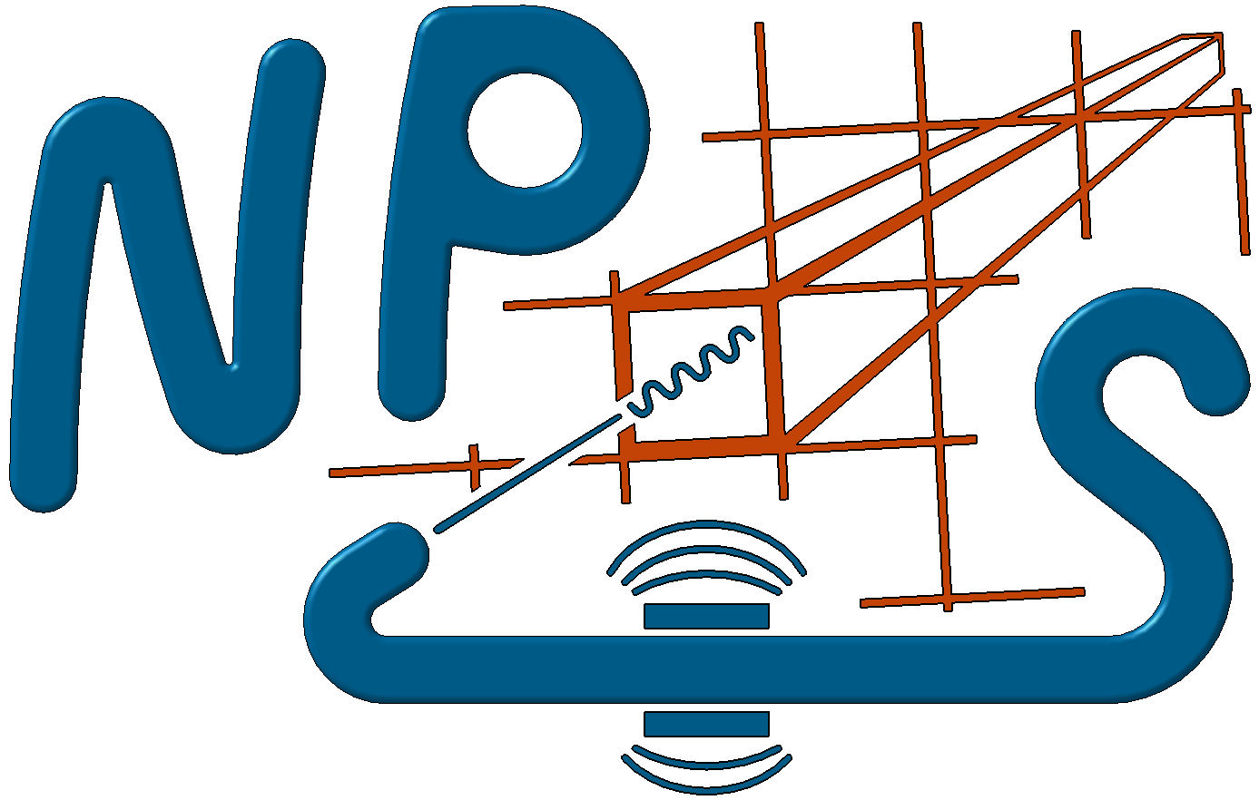

NPS Calorimeter Refurbishment
Discussion points, not recommendations
Charles Hyde
17 July 2024
NPS Collaboration Meeting

Slide 2
Calorimeter Status
At end of experiment, Calorimeter was working very well!
  No sign of PMT failure
  Crystal darkening manageable
Calorimeter “mothballed” in EFB
  Calorimeter intact with all FEE
Next NPS experiment (likely?)
  WACS (unpolarized) +¿E12-14-118 DVCS?
  Put the calorimeter back on the platform, recable, and take data
  No refurbishment necessary?

Slide 3
Some issues of concern
PMT lifetime
Temperature sensor interface
HV distribution boards
Mechanical access to Crystal assemblies
Ease of longitudinal motion (on platform cable bundle)

Slide 4
HAMAMATSU R4125
PMT Lifetime
Fermilab study:
  https://lss.fnal.gov/archive/1997/pub/
  Pub-97-092.pdf, or NIM A v406 (1998) 103—116
  12 PMTs tested, illumination level: 100 𝛍A anode current
  Gain stable up to anode charge of 100 Coulomb.
  Gain decrease to 50% after anode charge of 1000 Coulomb.
NPS, Crystals closest to Calorimeter (very rough estimate)
  (8 months) ⊗ (60%) ⊗ (10 𝛍A) ≈ 115 Coul
    Get exact recorded anode charge.
Probably could run another 100 PAC days without catastrophic failure
  Ran 3 generations of DVCS experiments in Hall A and only replaced 16 (out of 200) PMTs

Slide 5
PMT options
Test ~10 NPS PMTs to > 100 Coul
Buy ~100 spare PMTs (3 columns)
Do nothing.
Other PMT issues/options
Rebuild bases with improved low-voltage filtering
  Or just leave alone, everything is fine with LV regulators removed

Slide 6
Temperature Sensors
Crystal temperature stability monitoring
  Gain variation –2% / °C
~most of front face sensors failed
  Sensors are fine, interface-card between sensors and Keysight has active electronics—NOT rad hard. Solutions:
    Long lead wires to move interface to more shielded location:
    Noise? Calibration Drift?
    Find a Rad-Hard interface (CERN?)
    Buy lots of spares

Slide 7
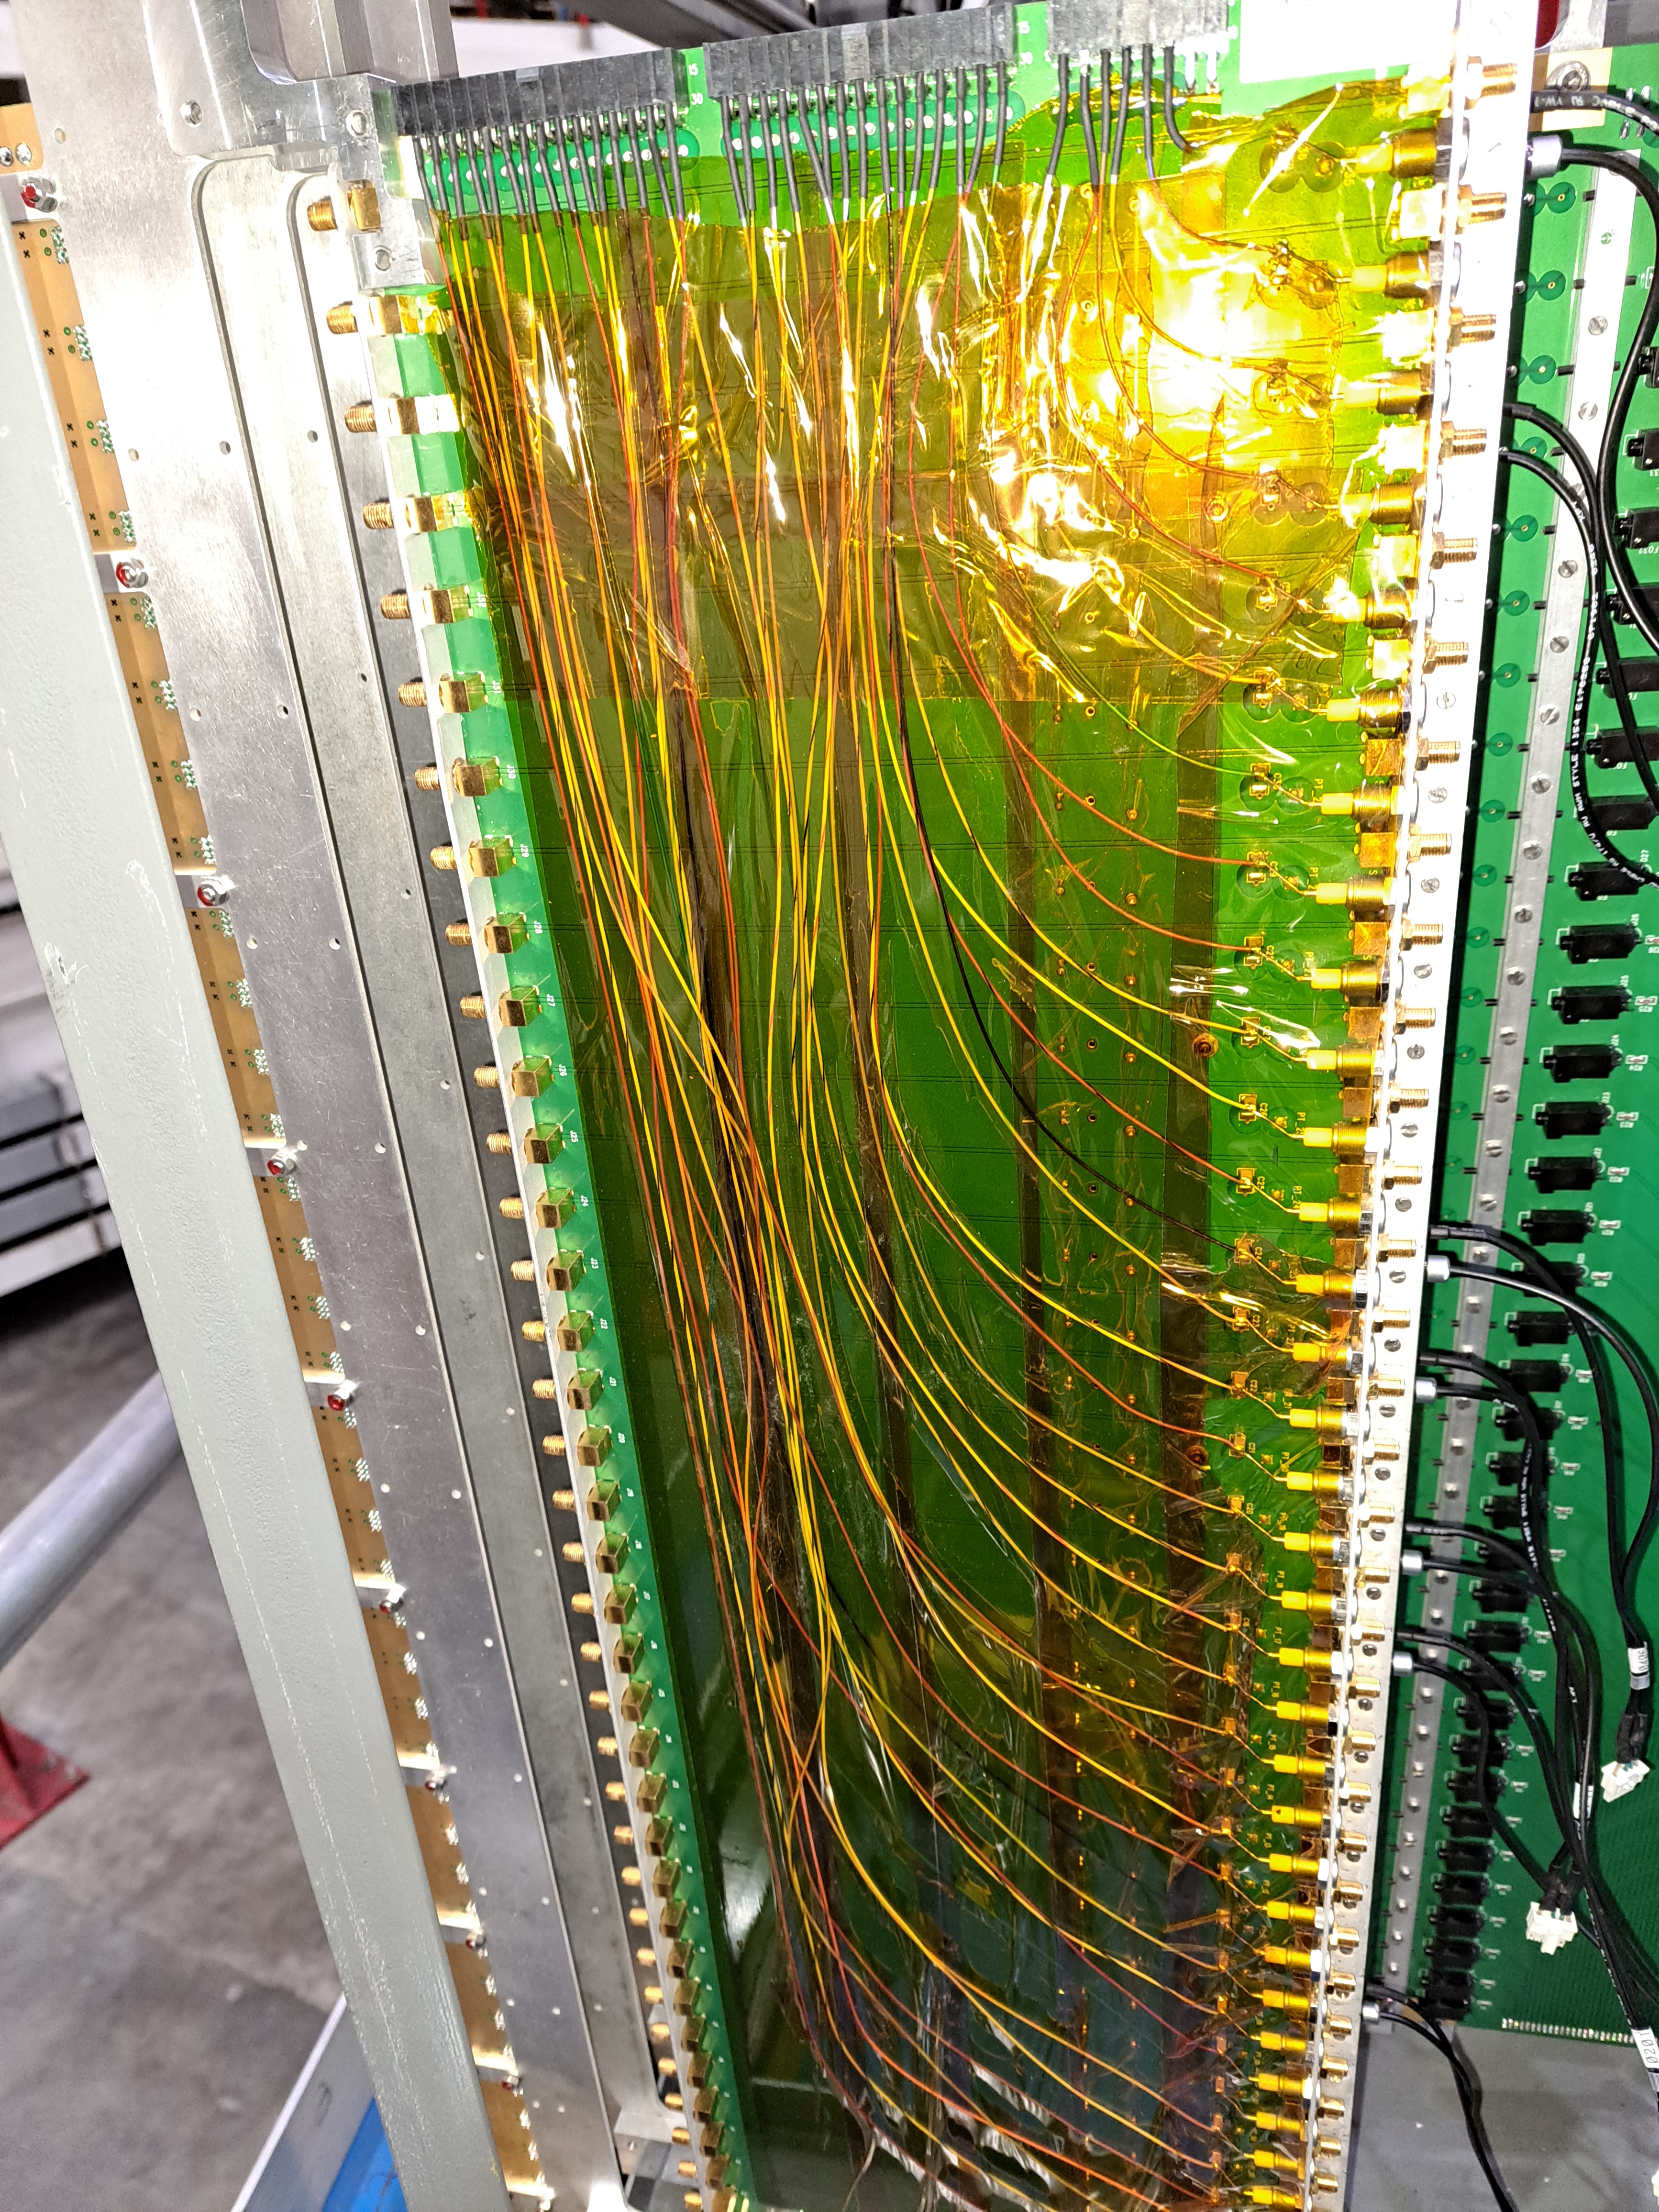
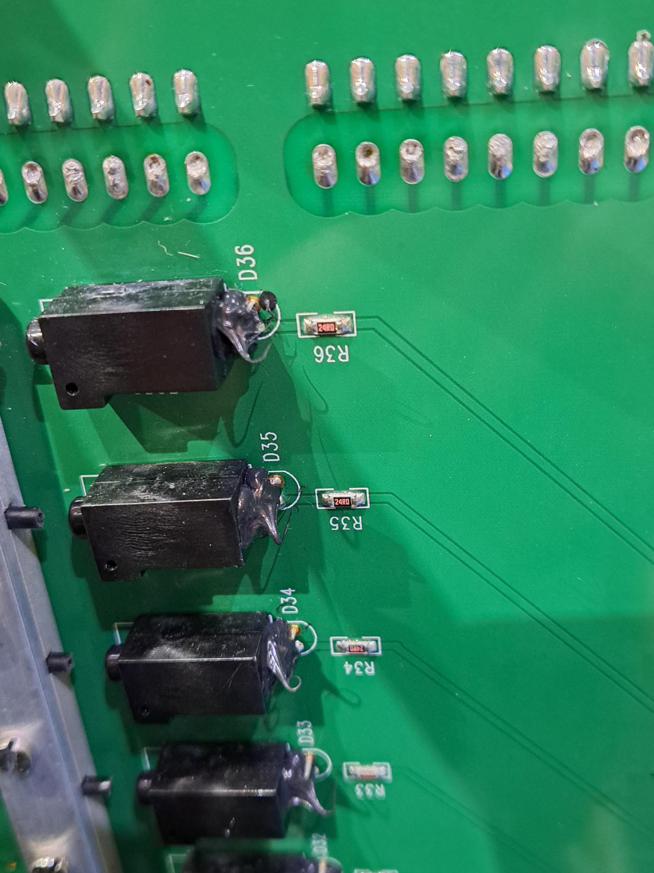
Distribution Boards,
Patch cables to PMTs
HV Issues
  HV connections shorted (Boards too thin…)
  All HV connections bypassed
  Many of isolation capacitors fell off, trapped in cover
Patch cables had many failures (displacement of central pin on SMC connectors).
  All is well after ~first month of operations
LED/Fiber system
  Delicate, (only) 70% of connections operational
Redesign/Rebuilt signal, HV, LV, LED connection and mechanics or leave well-enough alone?
LED

Slide 8
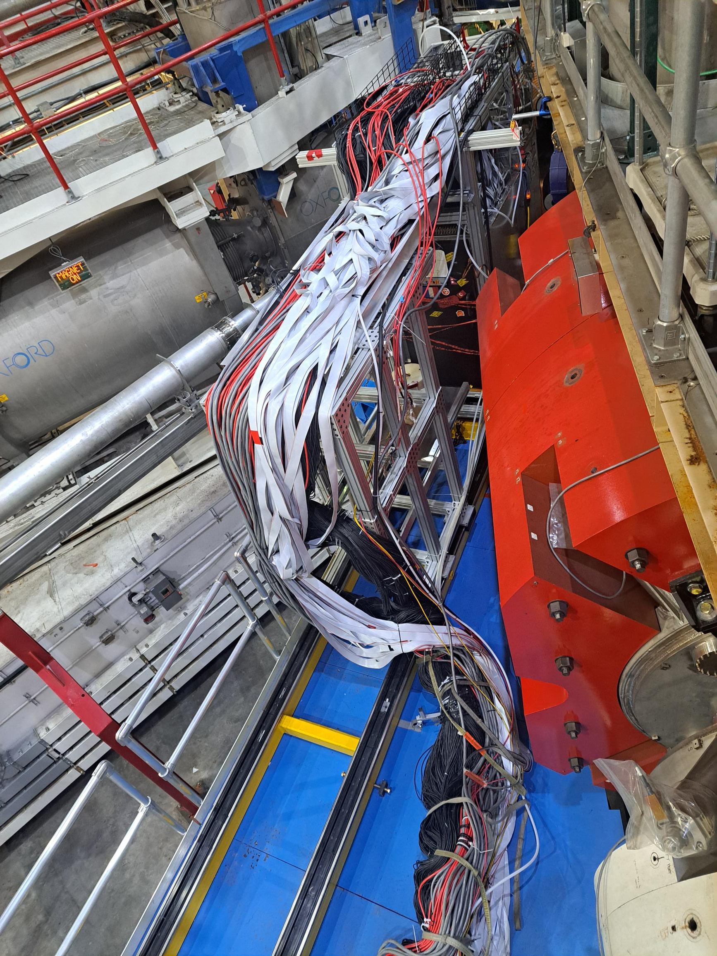
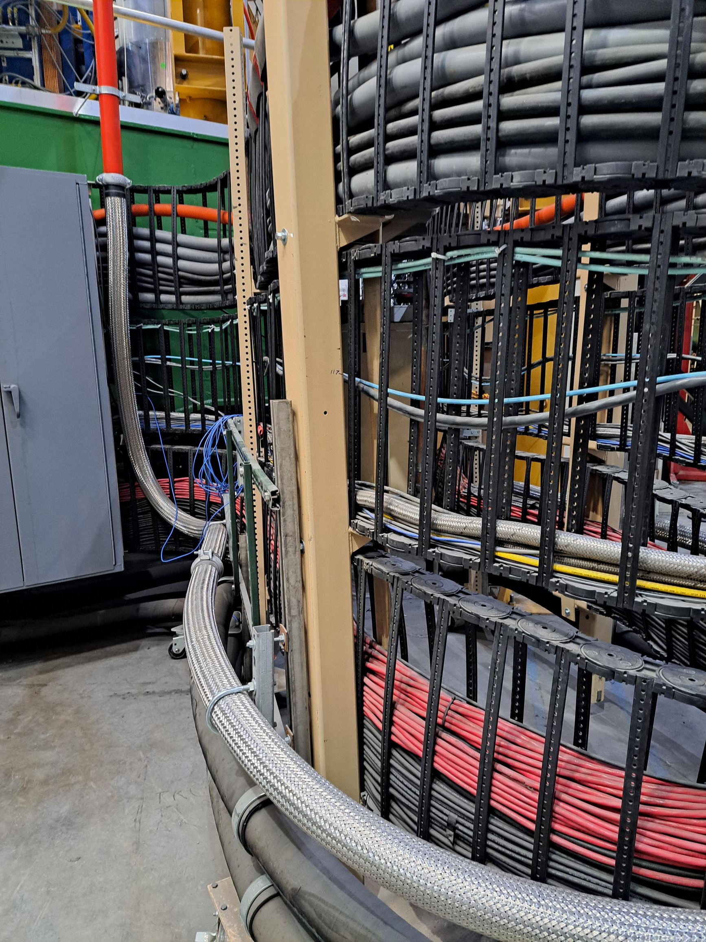
Mechanics
Distribution boards, PMT+Crystal repair/replacement
Cable bundle
  Required crane to move Calo forward/back.
  Scheduling challenges.
Build a vertical axis cable tray?
Hall C Pivot

Slide 9
No Conclusions, Just Questions
What is Truly Necessary?
Who Will Do the Work?

Slide 10
My original list
Crystals
  Bleach with blue lights?
  Measure transparency?
PMTs
  Test ~10 at high anode current (e.g. 10 μA until death)
  Replace?
PMT Base Redesign?
  No LV regulators, replace with LC filter.
  Find certified rad-hard components for pre-amps
  Replace signal and HV connectors with pigtails?
  “True” DC monitoring?
  Heating system for Base when HV off, to stabilize calo temperature.
Calo-mounted distribution boards
  Redesign/replace for proper HV isolation
    Replace boards with guided cable bundles?
  Revise connections to PMT bases
  Any mechanical suggestions (expand lateral movement beyond size of Calo)
  Low Voltage distribution
  HV connectors?
Optical Fibers
  LED system / driver
  Coupling to crystals
  Put microLEDs directly on crystal
Cabling
  Build/buy a moving cable tray (stacked vertically) to allow easier motion on platform
Sweep Magnet
  Reconsider placement, rotation with respect to crystal axis
Calorimeter Mechanics
  Any way to simplify repairs?
    Expanded lateral movement of distribution boards
  Improve temperature sensor reliability, radiation hardness

