Slide 1
HMS Calibrations for NPS: Optics
Optics Optimization at high momentum for the NPS Experiment
Christine Ploen
NPS Collaboration Meeting July 17-18, 2024

Slide 2
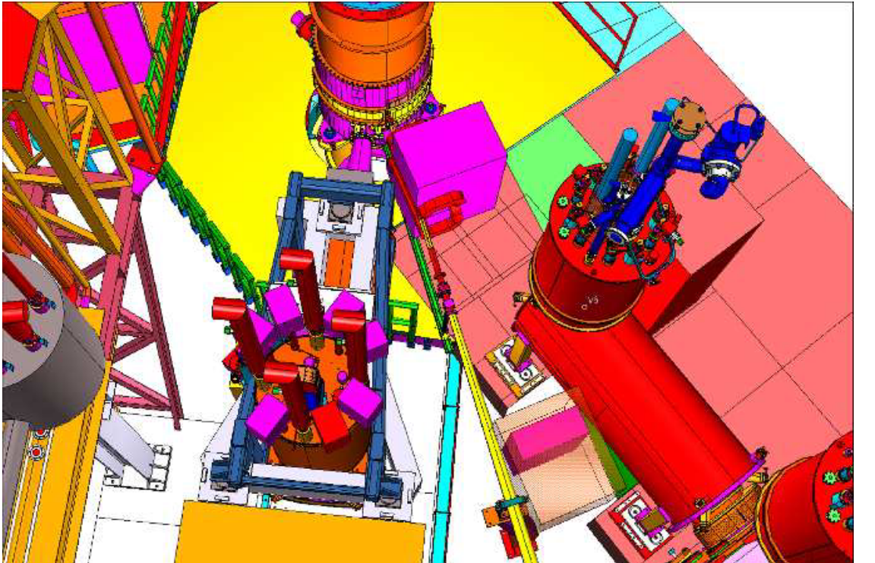
Experimental Setup – top view
Target
Sweeper Magnet
HMS
NPS Calorimeter on SHMS carriage
NPS Collaboration Meeting July 17-18, 2024

Slide 3
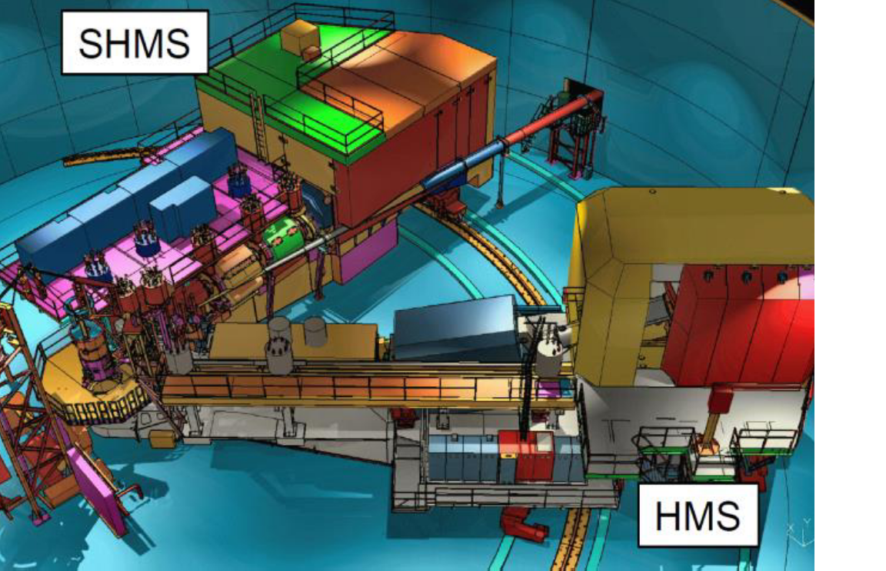
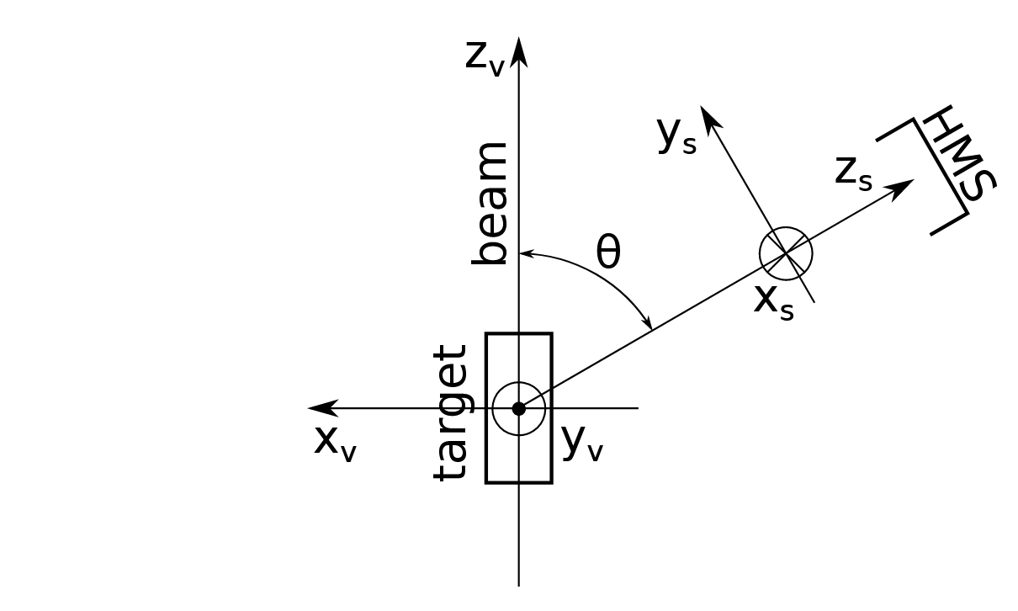
Experimental Setup
e beam
Coordinates rotated to mimic the orientation of the CAD rendering
NPS Collaboration Meeting July 17-18, 2024

Slide 4
HMS Magnets and Parameters
6 mSr acceptance
25 deg vertical bend
Delta = (P-P0)/P0 better than 0.1%
Momentum range 0.5 to 7.5 GeV
Rotates from 12.5 to 90 deg
Saturation effects in both quads and dipole>4.8 GeV
NPS Collaboration Meeting July 17-18, 2024

Slide 5
HMS saturation in dipole and quadrupoles
B/I versus set current
Dipole and quad saturation over 4.8 GeV, or ~1500 A
This effect also reflected in LH2 data (Szumila-Vance)
Field to momentum relationship must be clear to set the dipole.
1.5 3.3 4.8 6.1 6.9 7.5
Approximate Central P (GeV)
NPS Collaboration Meeting July 17-18, 2024

Slide 6
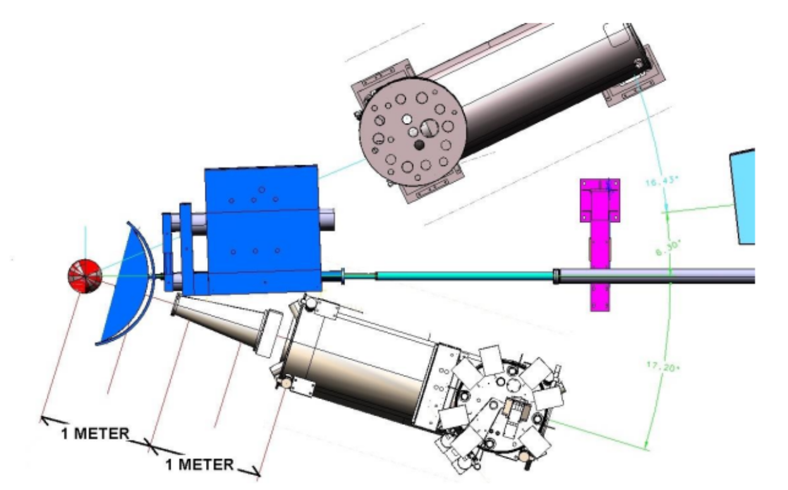
Experimental Setup – NPS and HMS at small angles
Sweeper magnet field = 0.3 T*m
NPS fringe field may be relevant before HMS Q1, near the HMS vacuum snout
Target
NPS Sweeper Magnet
Schematic from Paulos Medieros
Collimator/Sieve
NPS Collaboration Meeting July 17-18, 2024

Slide 7
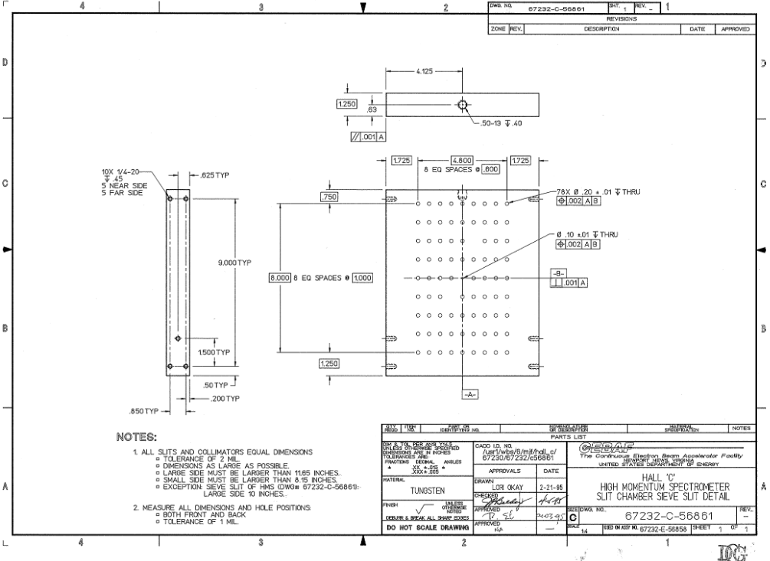
Schematic of sieve slit array
NPS Collaboration Meeting July 17-18, 2024

Slide 8
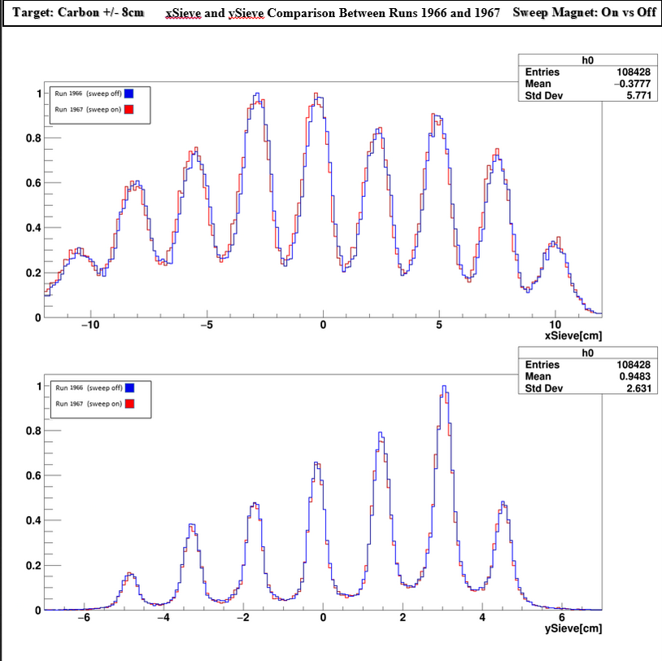
Preliminary Look at Effect of Sweeper Magnet
Simulations from R. Ent indicated any effects from the fringe field will be small vertical offset
Can be corrected within matrix optimization
X and Y sieve plots for the -6.117 GeV setting, comparing sweep magnet on and off
NPS Collaboration Meeting July 17-18, 2024

Slide 9
Matrix optimization with sieve slit measurements
4 basic parts:
Event reconstruction with existing matrix
Determining “True” initial values
Setting up the Singular Value Decomposition (SVD) problem
Calculating the new matrix
NPS Collaboration Meeting July 17-18, 2024

Slide 10
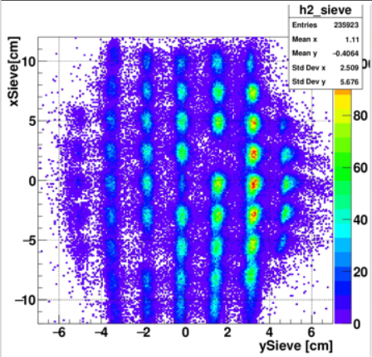
Matrix optimization and sieve slit measurements
Sieve slit measurements are taken with extended carbon foil targets:
1/ Carbon foil at z = 0 cm
2/ Carbon foil at z = +/- 3 cm
3/ Carbon Foil at z = +/- 8 cm
X, Y sieve reconstruction with unoptimized matrix from 2018
Schematic of sieve slit array
NPS Collaboration Meeting July 17-18, 2024

Slide 11
NPS Momentum Settings to Optimize
Lower rates in March runs → the statistics of the +/-3 cm target setting set the limit on the others
P = -6.667 GeV/c: x50_2
+/-3 cm carbon foil/ sweeper mag ON
+/- 8 cm carbon foil /sweeper mag ON and OFF
Carbon 0.5% at z=0/ sweeper mag ON
P = -6.117 GeV/c: x36_3
+/-3 cm carbon foil/ sweeper mag ON
+/- 8 cm carbon foil/ sweeper mag ON
Carbon 0.5% at z=0/ sweeper mag ON
P = -5.878 GeV/c: x60_3
+/-3 cm carbon foil/ sweeper mag ON
+/- 8 cm carbon foil/ sweeper mag ON
Carbon 0.5% at z=0/ sweeper mag ON
P = -5.639 GeV/c: x25_3’
+/-3 cm carbon foil/ sweeper mag ON
+/- 8 cm carbon foil/ sweeper mag ON
Carbon 0.5% at z=0/ sweeper mag ON and OFF
Christine Ploen
Josh Crafts
TBD
Josh/Christine
Julio Gil Gutierrez & Abhyuday Sharda (XEM)

Slide 12
NPS Momentum Settings Status
P = -6.667 GeV/c: x50_2
1st pass angular opt (ang. matrix elements) DONE
Delta Optimization In Progress
Sweeper Magnet studies TBD
P = -6.117 GeV/c: x36_3
Angular optimization in progress
Delta Opt TBD
Sweeper Magnet studies TBD
P = -5.878 GeV/c: x60_3
Angular optimization in progress
Delta Opt TBD
Sweeper Magnet studies TBD
P = -5.639 GeV/c: x25_3’
Onboarding with NPS Software
Angular optimization TBD
Delta Opt TBD
Sweeper Magnet studies TBD
Christine Ploen
Josh Crafts
TBD
Josh/Christine
Julio Gil Gutierrez & Abhyuday Sharda (XEM)

Slide 13
Sieve Slit Calibration Runs at -6.667 GeV for angular optimization
Run | HMS Angle (deg) | Sweeper Magnet | Target
1537,1538 | 12.490 | OFF | Carbon 0.5%
1543, 1544 | 12.490 | ON | Carbon 0.5%
1539 | 12.490 | OFF | Carbon +/-8 cm
1540 | 12.490 | ON | Carbon +/-8 cm
5162 | 15.195 | ON | Carbon 0.5%
5156-5160 | 15.195 | ON | Carbon +/-3 cm
5161,5163 | 15.195 | ON | Carbon +/-8 cm
5164 | 15.195 | OFF | Carbon +/-8 cm

Slide 14
Step 1: event reconstruction within HallC analysis software, nps_replay
Matrix elements are specified in a parameter file at runtime which contains the angular and delta coefficients up to sixth order
i + j + k +l + m ≤ 6

Slide 15
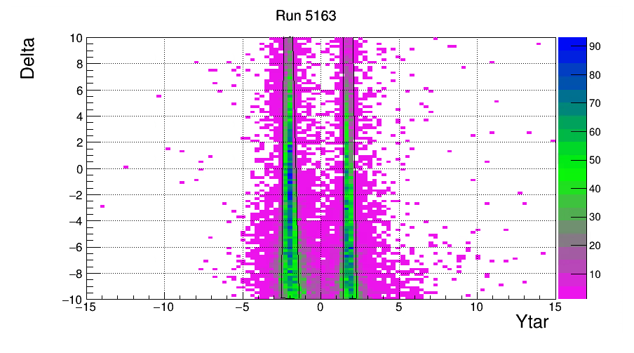
Step 2: Calculating true initial values on +/- 8 cm target
Cutting event on foils, along with foil and beam positions, gives us the central y target position
Ztar = target foil position
Xbeam = beam horizontal position from the fast raster
Ymis = horizontal mis-pointing from survey data

Slide 16
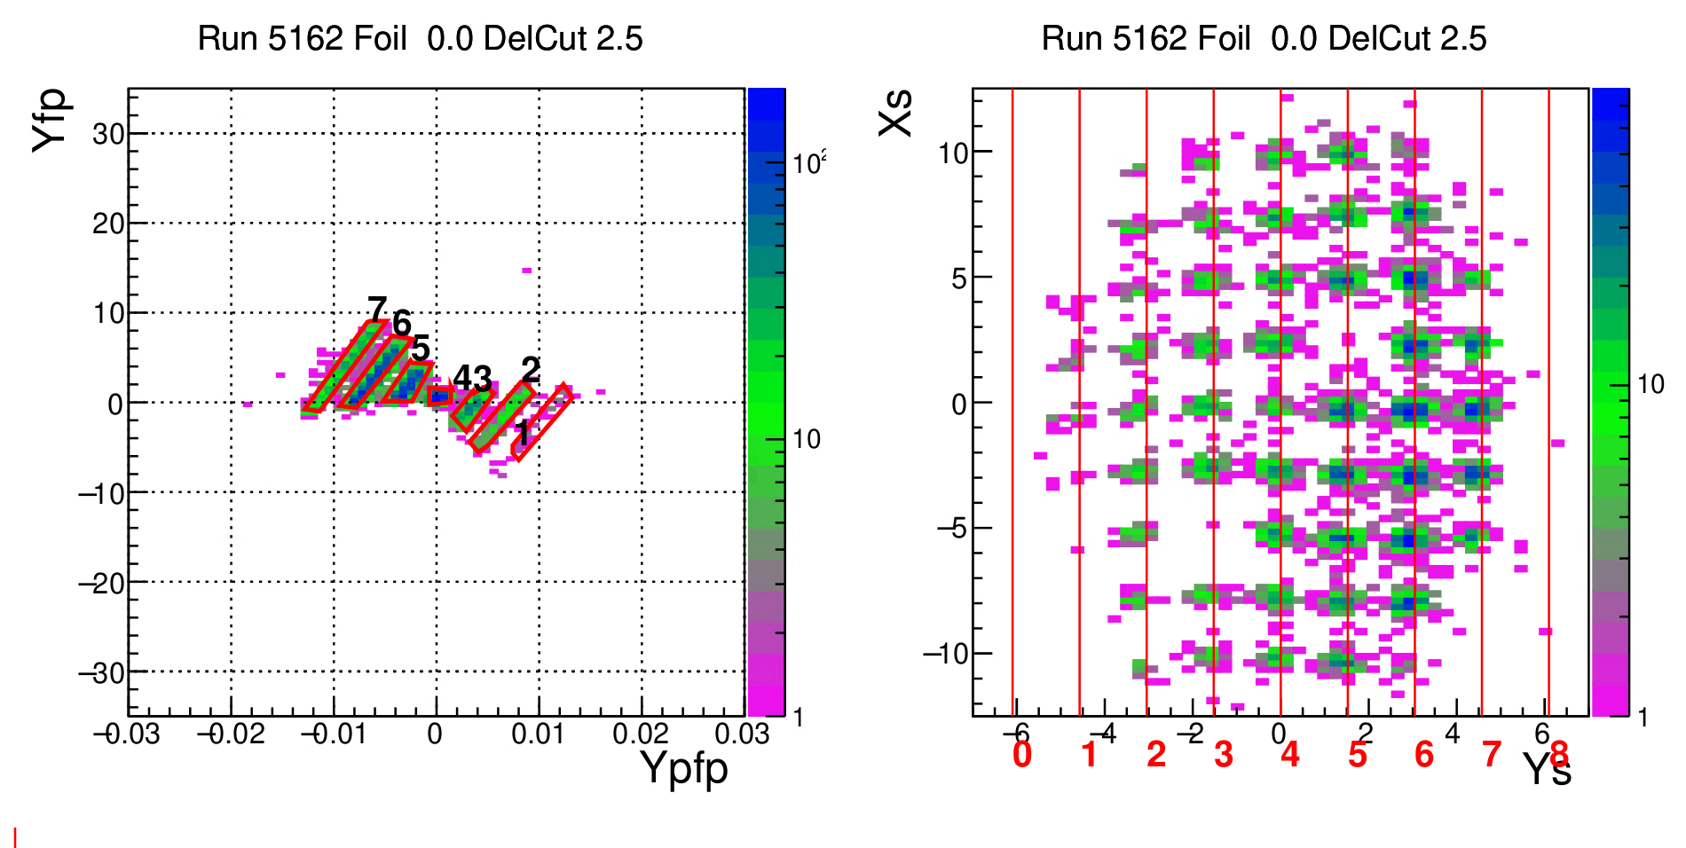
Step 2: Calculating true initial values
Graphical cuts in the focal plane correlate events to each sieve hole (red polygons)
Cuts in delta assist in resolving the sieve pattern
Cuts here are labeled by their midpoints, and are delineated at delta = (-10%, -8%, -5 %, 0%, 5%, 10%)

Slide 17
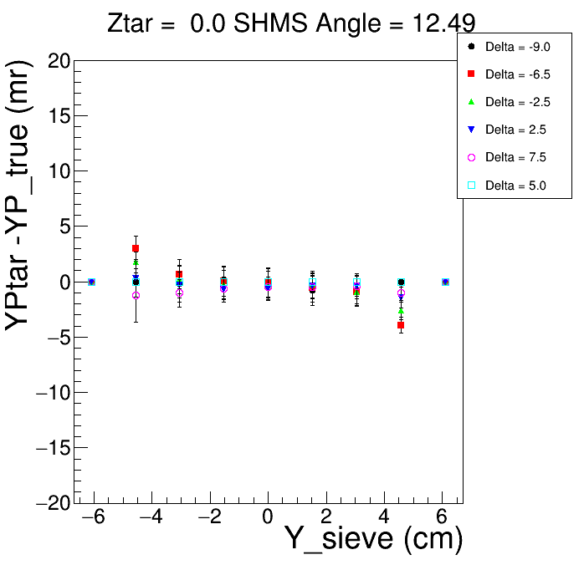
Results of angular optimization Yptar
Previous (optimized for -6.59 GeV)
New Optimized Matrix for -6.667 GeV

Slide 18
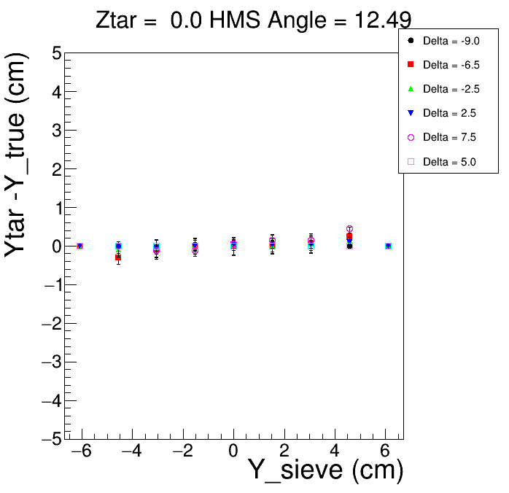
Results of angular optimization in ytar

Slide 19
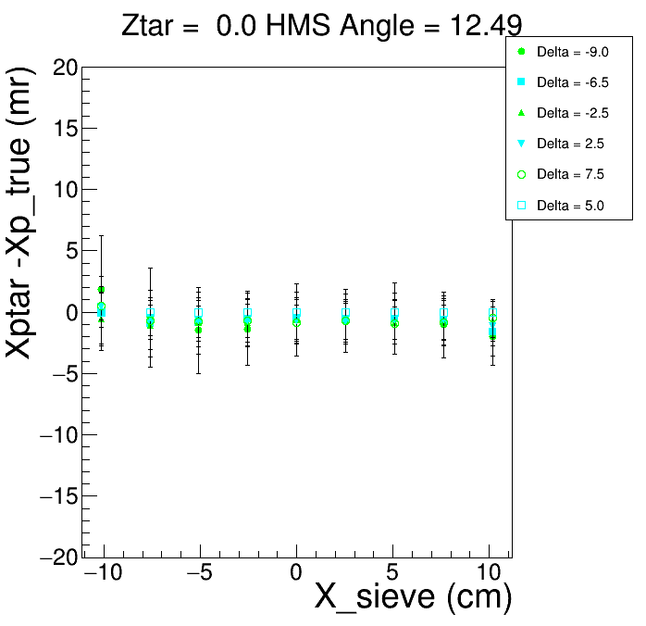
Results of angular optimization in xptar

Slide 20
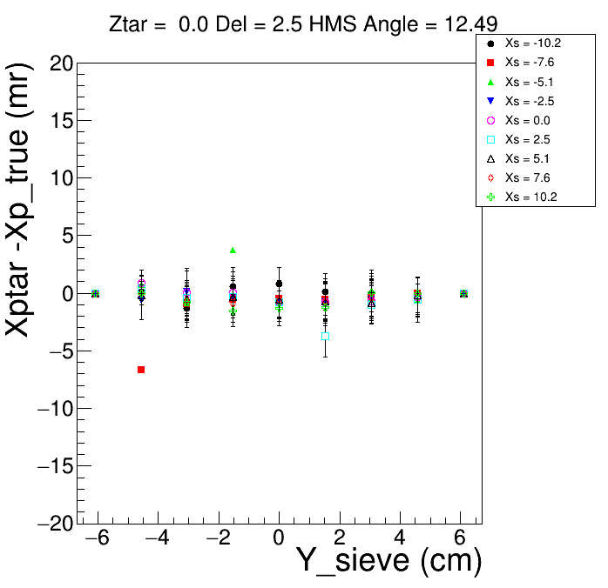
Results of angular optimization in xptar, del2.5

Slide 21
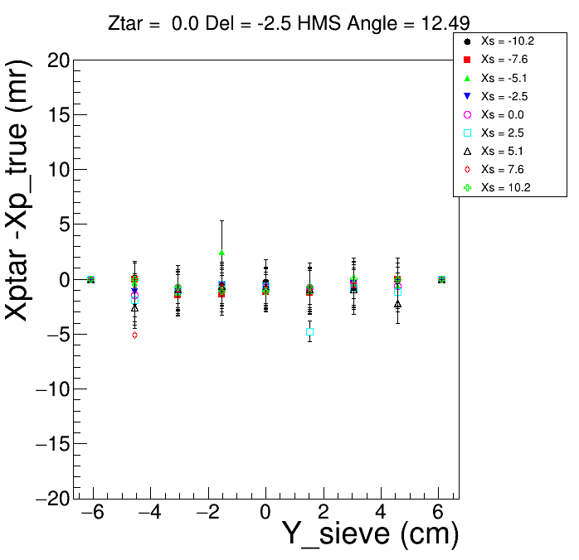
Results of angular optimization in xptar, del -2.5

Slide 22
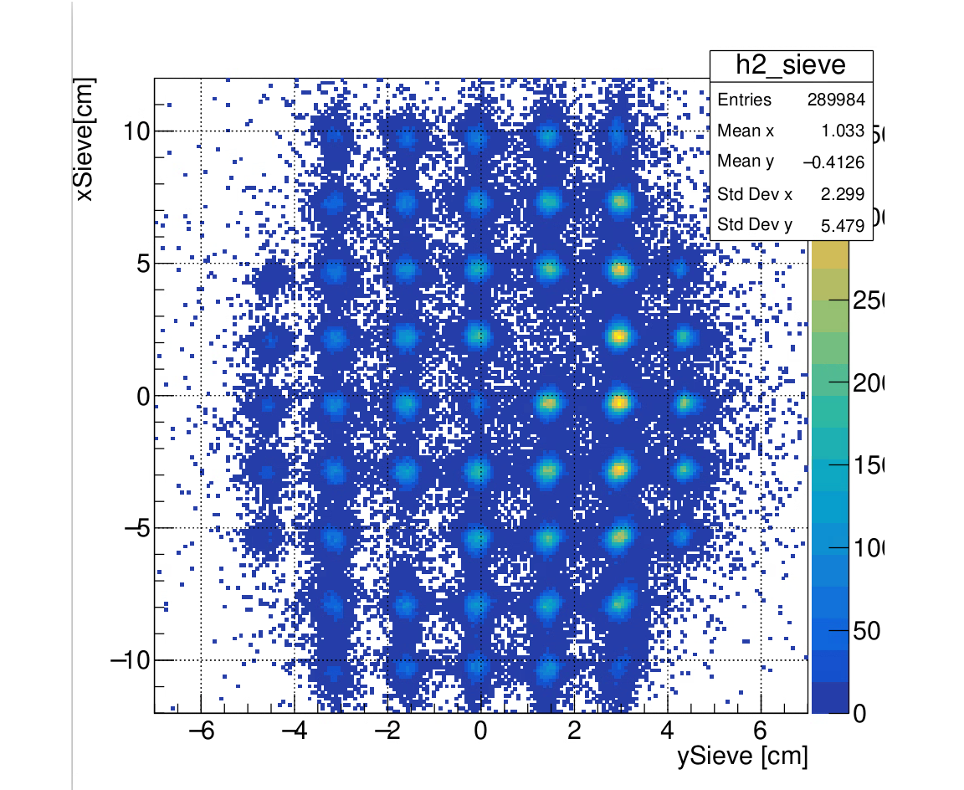
Results – sieve slit plots for 2018 matrix and 6.667
Low P Matrix
-6.667 GeV NEW Matrix
(only angular optimization)
Using the replay’s current matrix!!

Slide 23
Next steps –
Immediate
Delta Optimization – x50_2 (-6.667 GeV/c) and upload fully optimized matrix to replay
1st Pass angular elements for 3 other settings, then delta optimization
- This means at least one run for each optics target for one angle per high-mom kinematic
1st Pass sweeper magnet studies at 4.64 GeV/c
(would be nice?) Afterburner script for existing replays
Fine Tune
Utilize all possible runs for angular optimization, fine-tune cuts
2nd look at delta optimization
Sweeper magnet studies at other P, theta

Slide 24
Location in nps_replay:
g_ctp_parm_filename = "DBASE/NPS/general_coin.param"
g_ctp_kinematics_filename = "DBASE/NPS/standard_coin.kinematics"
g_ctp_det_calib_filename = "DBASE/HMS/default_det_calib_nps23.param"
g_ctp_bcm_calib_filename = "PARAM/GEN/gscalers.param"
g_ctp_optics_filename = "PARAM/HMS/GEN/hcana_fa22.param"
g_ctp_map_filename = "MAPS/HMS/DETEC/STACK/hms_stack_nps.map"
g_ctp_trig_config_filename = "PARAM/TRIG/thms_nps23.param"

Slide 25
Questions?

Slide 26
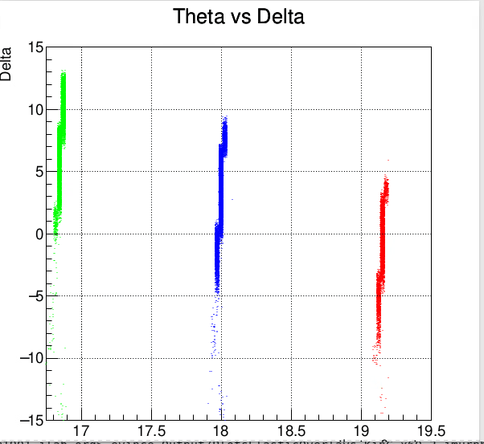
Next Steps – Delta Optimization of Elastic Calibration Runs at -6.667 GeV
Run | HMS Angle (deg) | Sweeper Magnet | Target
1534 | 19.145 | OFF | LH2
1547 | 19.150 | ON | LH2
1548 | 19.150 | ON | LH2
1535 | 17.995 | OFF
1546 | 18.005 | ON | LH2
1536 | 16.850 | OFF
1545 | 16.850 | ON

