Slide 1
Overview and Use of SIMC
Dave Gaskell
NPS Collaboration Meeting
July 17-18, 2022
SIMC overview
Basics of using SIMC

Slide 2
What is SIMC?
SIMC is the standard Hall C Monte Carlo for coincidence reactions (similar to MCEEP) → written in FORTRAN (now gfortran compatible …)
Features:
→ Optics (COSY) and “aperture checking” Monte Carlos of spectrometers
[HMS, SOS, SHMS, HRS’s, BigCal,…]
→ Includes radiative effects, multiple scattering, ionization energy loss, particle decay
→ Simple prescriptions available for FSIs, Coulomb Corrections, etc.
Reactions implemented:
Elastic and quasielastic → H(e,e’p), A(e,e’p)
Exclusive pion production
→ H(e,e’π⁺)n, A(e,e’π^{+/-}) [quasifree or coherent]
Kaon electroproduction → H(e,e’K⁺)Λ,Σ, A(e,e’K^{+/-})
H(e,e’π^{+/-})X, D(e,e’π^{+/-})X [semi-inclusive]
H(e,e’K^{+/-})X, D(e,e’K^{+/-})X [semi-inclusive]
H(e,e’ρ→π⁺π⁻)p, D(e,e’ρ→π⁺π⁻) [diffractive ρ]
H(e,e’π⁰)p, D(e,e’π⁰)p/n, (e,e’π⁰)X
Peter’s updates underway

Slide 3
What SIMC is NOT…
SIMC is NOT a full detector response simulation a la GEANT
SIMC does NOT simulate a large class of processes simultaneously to generate backgrounds (like Pythia for example)
SIMC is not a generic event generator → processes are generated over a limited phase space with the specific purpose of being “thrown” into a spectrometer
SIMC is not hard to modify → if you want it to do something else (different cross section model, add new spectrometer, etc.) it is pretty easy to update + I can help

Slide 4
Overview
Initialization
Choose reaction, final state (if appropriate)
Disable/enable implementation of (or correction for) raster, eloss …
Event generation
Select vertex based on target size, position, raster size, beam spot size
Determine energy, angle generation that will populate 100% of the acceptance (accounting for radiation, energy loss, …)
Physics Processes
Event-by-event multiple scattering, radiative corrections, particle decay, coulomb corrections
Acceptance
Can apply geometric cuts or spectrometer model. Default spec. models include target/spec. offsets, model of magnetic elements, apertures at front, back, middle of magnets, collimators, detector active area
Event Reconstruction
Tracks are fitted in the focal plane and reconstructed to the target. Apply (average) energy loss, fast raster corrections. Calculate physics quantities for Ntuple/Root tree

Slide 5
Example: Exclusive Pion Electroproduction
Initialize limits:
Generate vertex:
Generate scattering kinematics:
H(e,e’π): Generate θ_{e}, φ_{e,} θ_{π}, φ_{π}, p_{e} – calculate p_{π}
D(e,e’π): Generate θ_{e}, φ_{e,} θ_{π}, φ_{π}, p_{e,} θ_{Ν} φ_{Ν}, p_{N} → calculate p_{π}
Modifications to kinematics:
Follow particles:
Apply cross section weighting (use model for free proton/neutron in γ-N center of mass)
Simulate particle decay
→ Decay the meson and follow the decay product(s)
Calculate Normalization Factors:
Bound nucleon momentum/direction

Slide 6
Spectrometer Models (HMS, SHMS, HRS ...)
Magnetic elements simulated using COSY
Real apertures
collimators, vacuum pipes
magnet apertures (front, middle, and back)
Fiducial cuts for detectors (depends on analysis, trigger)
Sequential transformations for magnetic elements, continuous drift for field free regions (important for decay)
Reconstruct track
Use smeared position at drift chamber
Fit track at focal plane
Reconstruct to target using matrix elements fit from MC data
Can easily disable spectrometer, apply geometric cuts, add new spectrometer/detector (for example, NPS)

Slide 7
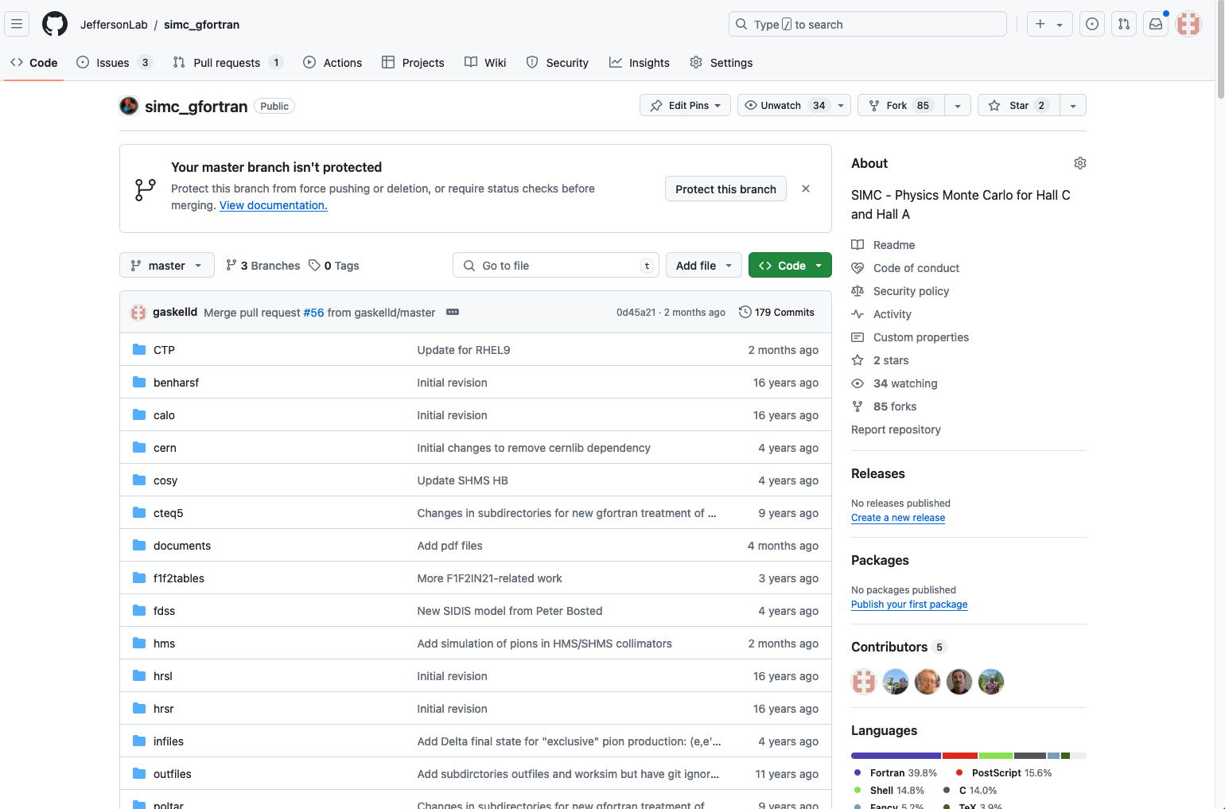
Getting SIMC
https://github.com/JeffersonLab/simc_gfortran

Slide 8
SIMC Basics
Compiling: just type “make” in the main directory
Important directories
infiles → where the input files for your simulation live
worksim → SIMC event-by-event output (root trees)
outfiles → where the *.hist file lives → need this for normfac
util → “helper” applications to generate output
Helper applications
SIMC default output is a FORTRAN binary file
Helper applications in util directory convert to root trees or paw ntuple
util/ntuple and util/root_tree → must be compiled separately
Choose appropriate Makefile (Makefile.rhel9 or Makefile.rhel7)

Slide 9
SIMC: structures → derived types
Long ago – had to convert from “structures” to ”derived types”
structure /double_arm/
structure /arm/ e
real*8 delta, yptar, xptar, z
end structure
structure /arm2/ p
real*8 delta, yptar, xptar, z
end structure
end structure
type arm
sequence
real*8 delta, yptar, xptar, z
end type
type arm2
sequence
real*8 delta, yptar, xptar, z
end type
type double_arm
sequence
type(arm)::e
type(arm2)::p
end type
Use as variables, like:
recon.e.delta
vertex.p.xptar
Use as variables, like:
recon%e%delta
vertex%p%xptar

Slide 10
SIMC RHEL9/Alma9 updates: derived types in modules
First try to transition to Alma9 – all the derived types were broken
After lots of googling found a helpful web page that described the problem
Compilers can handle derived types in 2 different ways
Name equivalence: two types are equal if they have the same name
Index equivalence: each time a type is declared/defined, it’s given a unique index, even if they have the same name!
Old compiler used first option, new gfortran uses second
How to fix/deal with this?
Put the derived types in a module and load the module in each relevant subroutine
All the derived types that were in “structures.inc” are now in “modules.f”
MODULE structureModule
! Define some BASIC record structures and associated parameters
! ... generic cut --> initialized with MAX large and MIN small
type cutstype
sequence
real*8 min, max
end type cutstype
…
…
…
In each relevant subroutine, added this statement:
USE structureModule

Slide 11
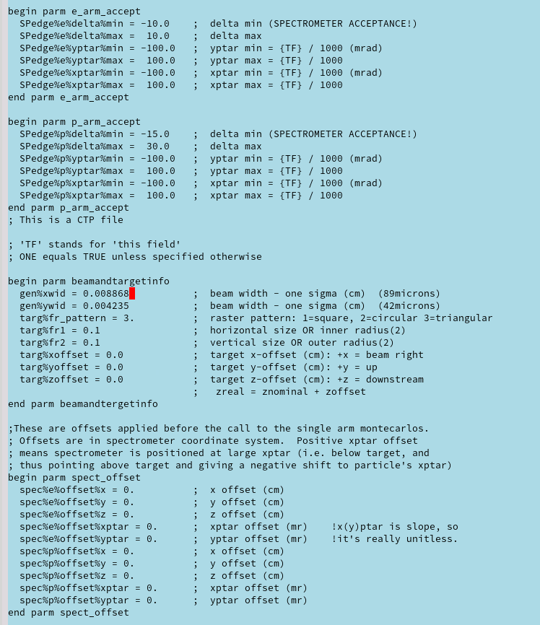
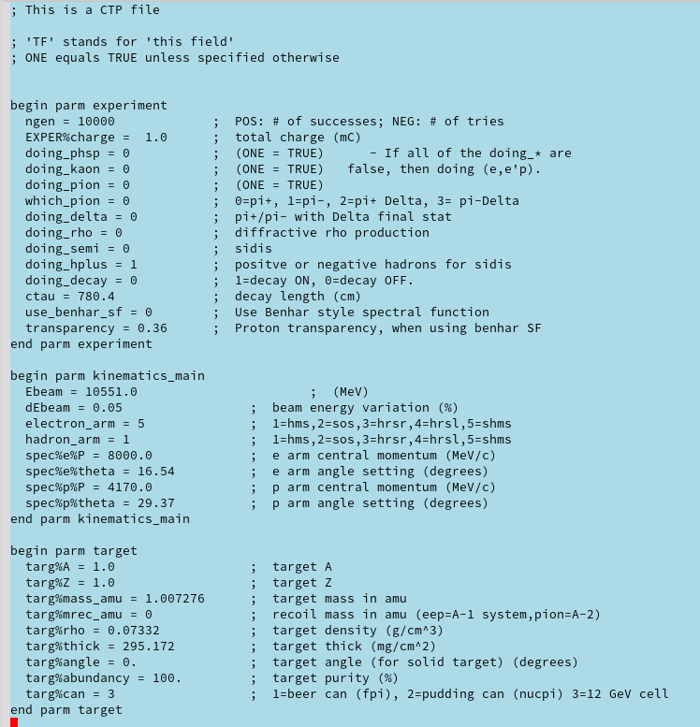
SIMC Input File

Slide 12
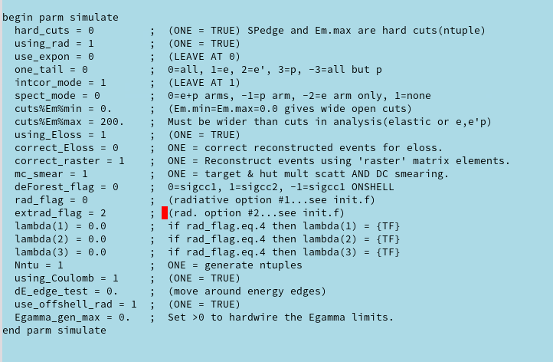
SIMC Input File
These parameters should not change much in general
”using_Eloss” should always be on to simulate ionization energy loss, but “correct_Eloss” should be off since hcana does not apply a correction
Don’t change the radiation flags, except maybe “one_tail” → might want to turn off proton radiation for neutral particles

Slide 13
Input File Notes
Kinematics
Units are in MeV
No need to account for ionization energy loss – that’s in simulation
Include synchrotron energy loss in beam energy (if relevant)
If you find offsets to nominal kinematics in your analysis – apply those to the SIMC kinematics → will impact the model cross section calculation
Make sure to include contraction of target cell at low temperatures in target information
Target info mixes units, density in g/cm³, but thickness in mg/cm²
Generation volume: must be larger than nominal acceptance to get correct yield and cross sections. You can easily check in the *.hist file if the “found” values are too close to the generation limits
Despite the names, “targ%yoffset” and “targ%xoffset” are beam position offsets

Slide 14
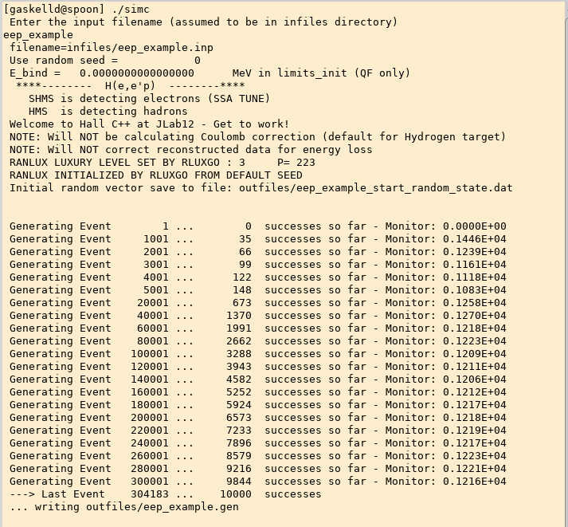
Running SIMC and Generating Output
Create your input file: eep_example.inp
run SIMC

Slide 15
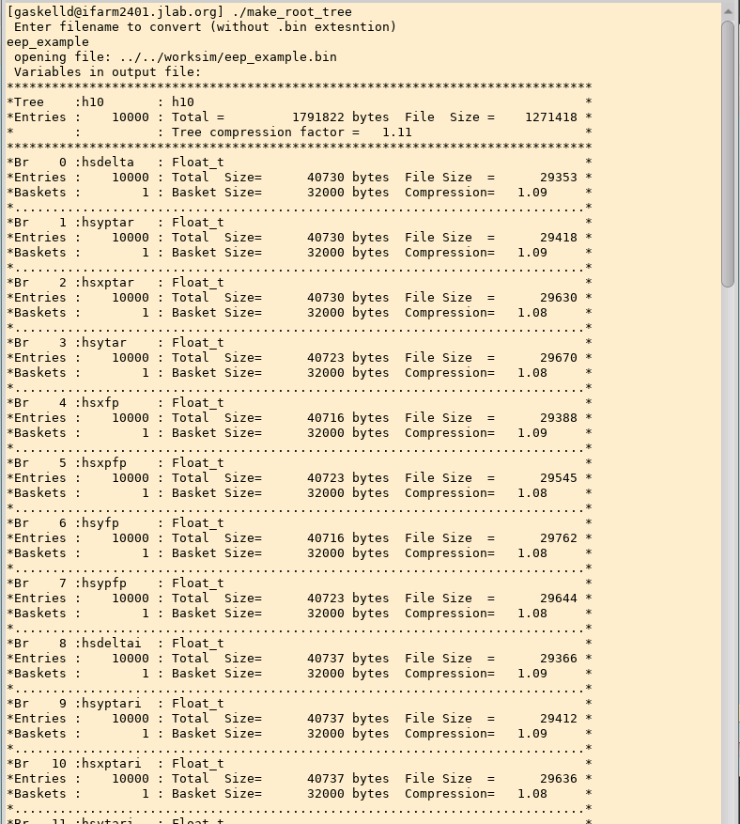
Running SIMC and Generating Output
Go to util/root_tree directory
./make_root_tree

Slide 16
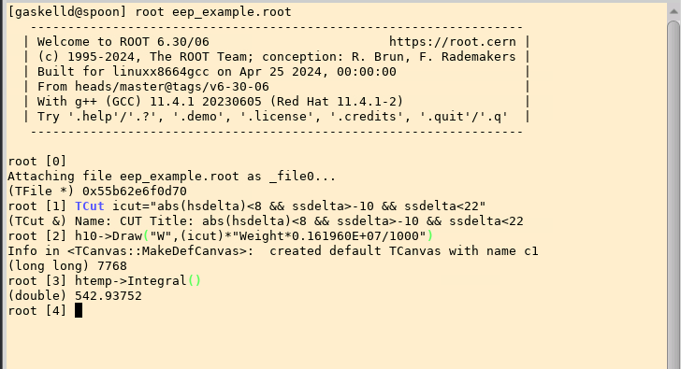
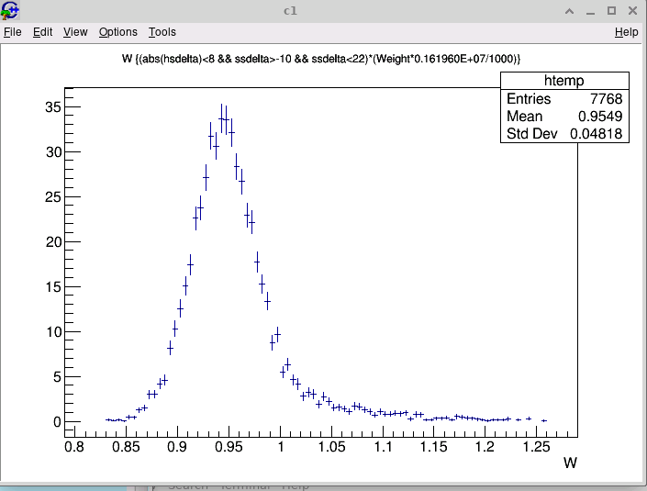
Make some plots and get some yields
Normalized yield by applying “Weight” from tree
Includes cross section, radiative corrections, small jacobian
What’s this 0.161960E+07 thing?
“normfac” from eep_example.hist file
Includes target thickness, simulated charge, generation volume
Also need to divide by number of events in tree
Result from this simulation (with these cuts) was:
Yield = 542.9 counts/mC

Slide 17
Reconstructed Quantities in SIMC
Calculation of reconstructed quantities (W, x, Q2, etc.) may not match how these quantities are calculated in hcana
Reconstruction was originally intended to match calculations in Hall C 6 GeV fortran analyzer
Found to be a problem for H(e,e’p) analysis for KaonLT/PionLT → definitions of missing momentum components weren’t even consistent
Ideally, we should make calculations in simc match hcana
In the short term, should use stand-alone scripts to make comparable output
Richard Trotta has done this for H(e,e’p) and exclusive Kaon production:
https://github.com/trottar/simc_gfortran/tree/fall_2023_kaon_xsects/recon_hcana

Slide 18
Updates for NPS
Peter B. has done most of the work needed to make SIMC work for NPS
Adding event generation for exclusive and semi-inclusive π⁰ is straightforward → same as π⁺ and π⁻
Additional complication is decay of π⁰ into 2 photons (extra subroutine)
DVCS event generation same as exclusive mesons, just changing mass to zero!
Physics models needed for cross sections:
SIDIS π⁰ → average of π⁺ and π⁻
Exclusive π⁰
Large W (>2 GeV): Average of π⁺ and π⁻, removing pion pole contributions
Low W (<2 GeV): MAID model
NPS calorimeter can just be an aperture for checking acceptance. Simple resolution smearing can be added later if desired
I’m working on incorporating Peter’s updates into the main branch on version on github

Slide 19
SIMC Summary
SIMC is a pretty simple tool in many ways, but powerful
If full GEANT4 simulations are needed (e.g. for NPS) SIMC can be combined with those simulations
SBS is doing this for d(e,e’N) simulations
Main drawback is that it’s fortran
Modern cross section models are usually in C++, etc.
Easy work-around is to use look-up tables → Peter has done this for the MAID model of pion electroproduction for example
Peter has already implemented many of the needed updates, integration underway

