Slide 1
$p\overline{p}$ Electroproduction off Protons in CLAS12
Leonel Martinez
Supported by: DE-SC0013620

Slide 2
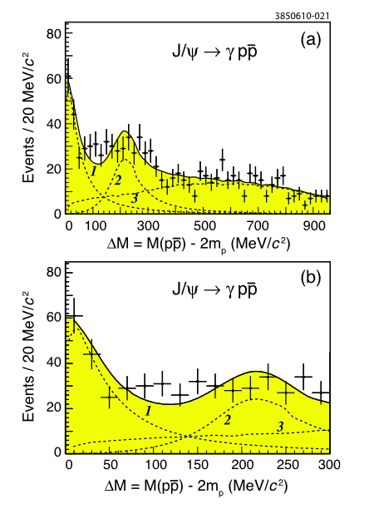
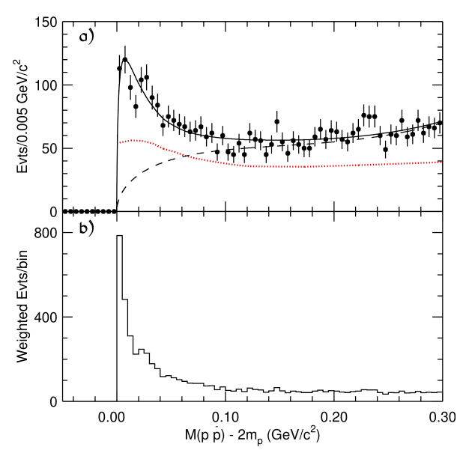
CLEO
Near Mass Enhancement
BES
BES-II:
$J/ψ→γp\overline{p}$
Near mass threshold enhancement
Peak Mass: $M={1859}_{−10}^{+3} MeV/c^{2}$
Width: $Γ=0±21 MeV/c^{2}$
CLEO
$J/ψ→γp\overline{p}$
Corroborated near mass threshold enhancement
Looked into extended mass range
Peak Mass: $M={1861}_{−6}^{+16}MeV/c^{2}$
Width: $Γ=0_{−0}^{+32}MeV/c^{2}$
J Z Bai et al. 2003 Phys. Rev. Lett. 91 022001
J. P. Alexander et al. Phys. Rev. D 82, 092002
2

Slide 3
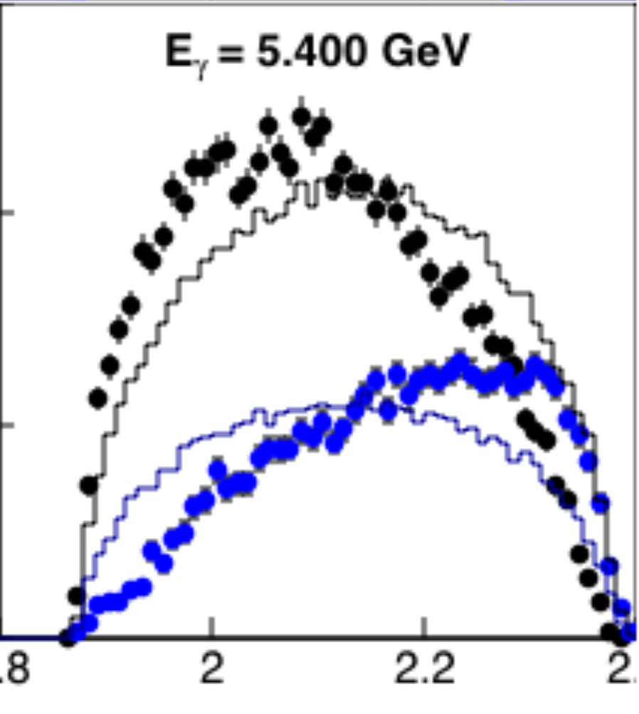
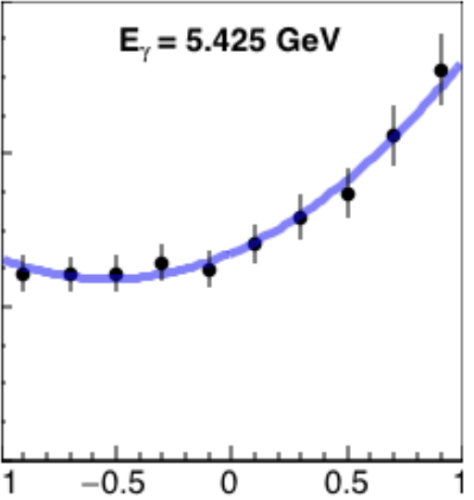
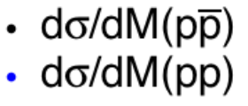
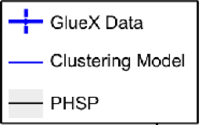
Photoproduction of $p\overline{p}$
CLAS
Measured differential cross sections
Angular distribution
Invariant Mass
Combinatorial background from two final state protons
Figure 3: Differential cross sections of $p\overline{p}$ and $pp$ showing the mass distributions.
Phelps W. “Antibaryon Photoproduction using CLAS at Jefferson Lab”
Figure 4: Differential cross sections for $γp→pp\overline{p}$ showing the angular distribution of the antiproton in the CM frame.
Phelps W. “Antibaryon Photoproduction using CLAS at Jefferson Lab”
GlueX
Measured differential cross sections
Invariant Mass
Mandelstam-t
Broader threshold enhancement observed
Phenomenological model for enhancement
$\frac{dσ}{dm}≈\exp\left[−\frac{m_{12}−m_{threshold}}{c_{m}}\right]$
Figure 5: Differential cross sections of $p\overline{p}$ invariant mass measurements.
Li, Hao. “Baryon Anti-Baryon Photoproduction off the Proton”
3

Slide 4
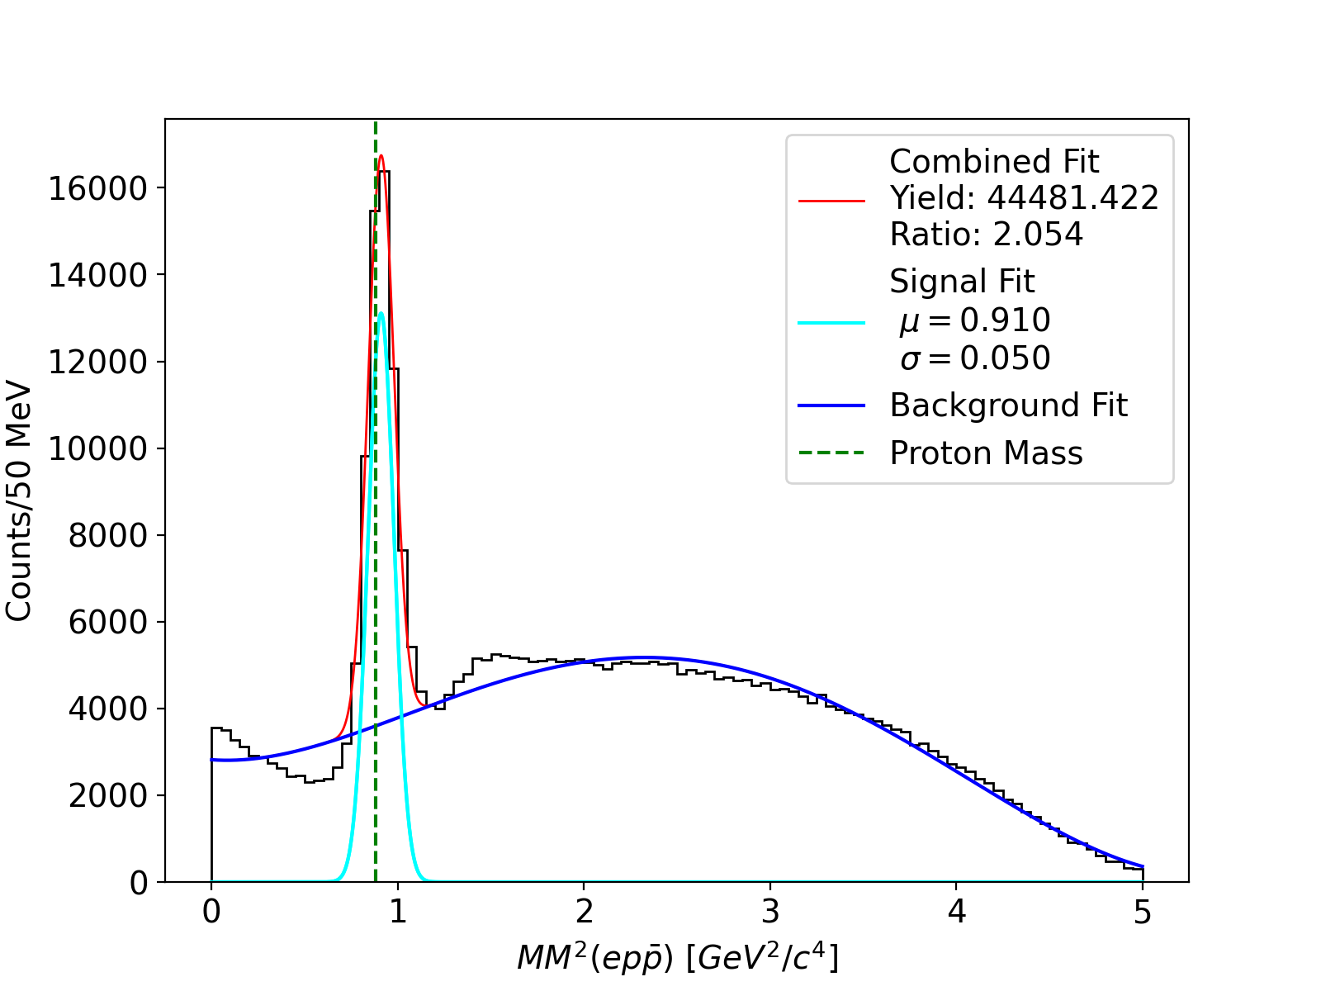
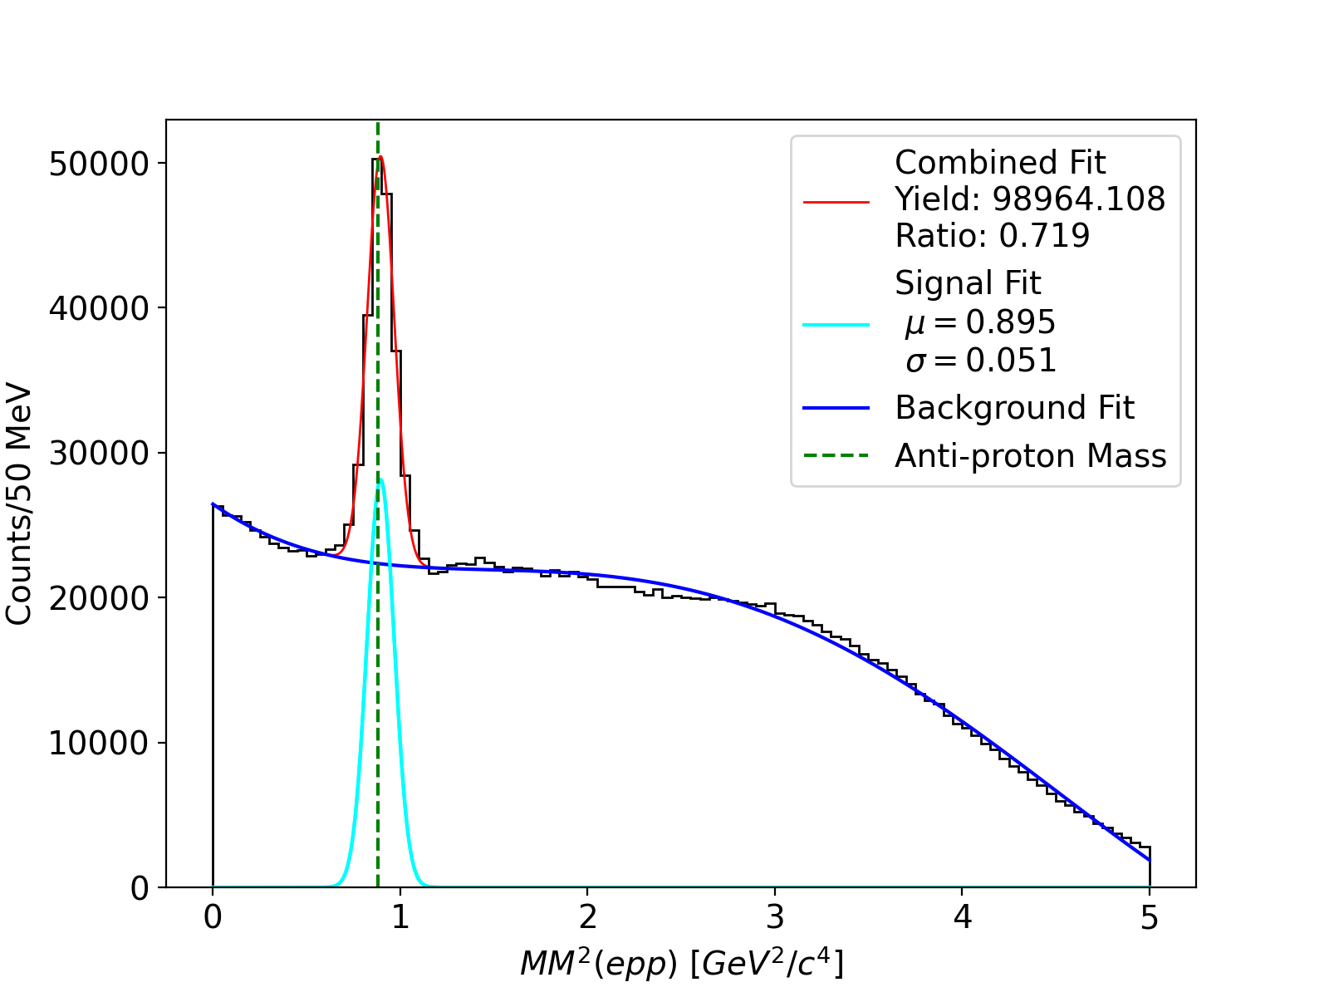
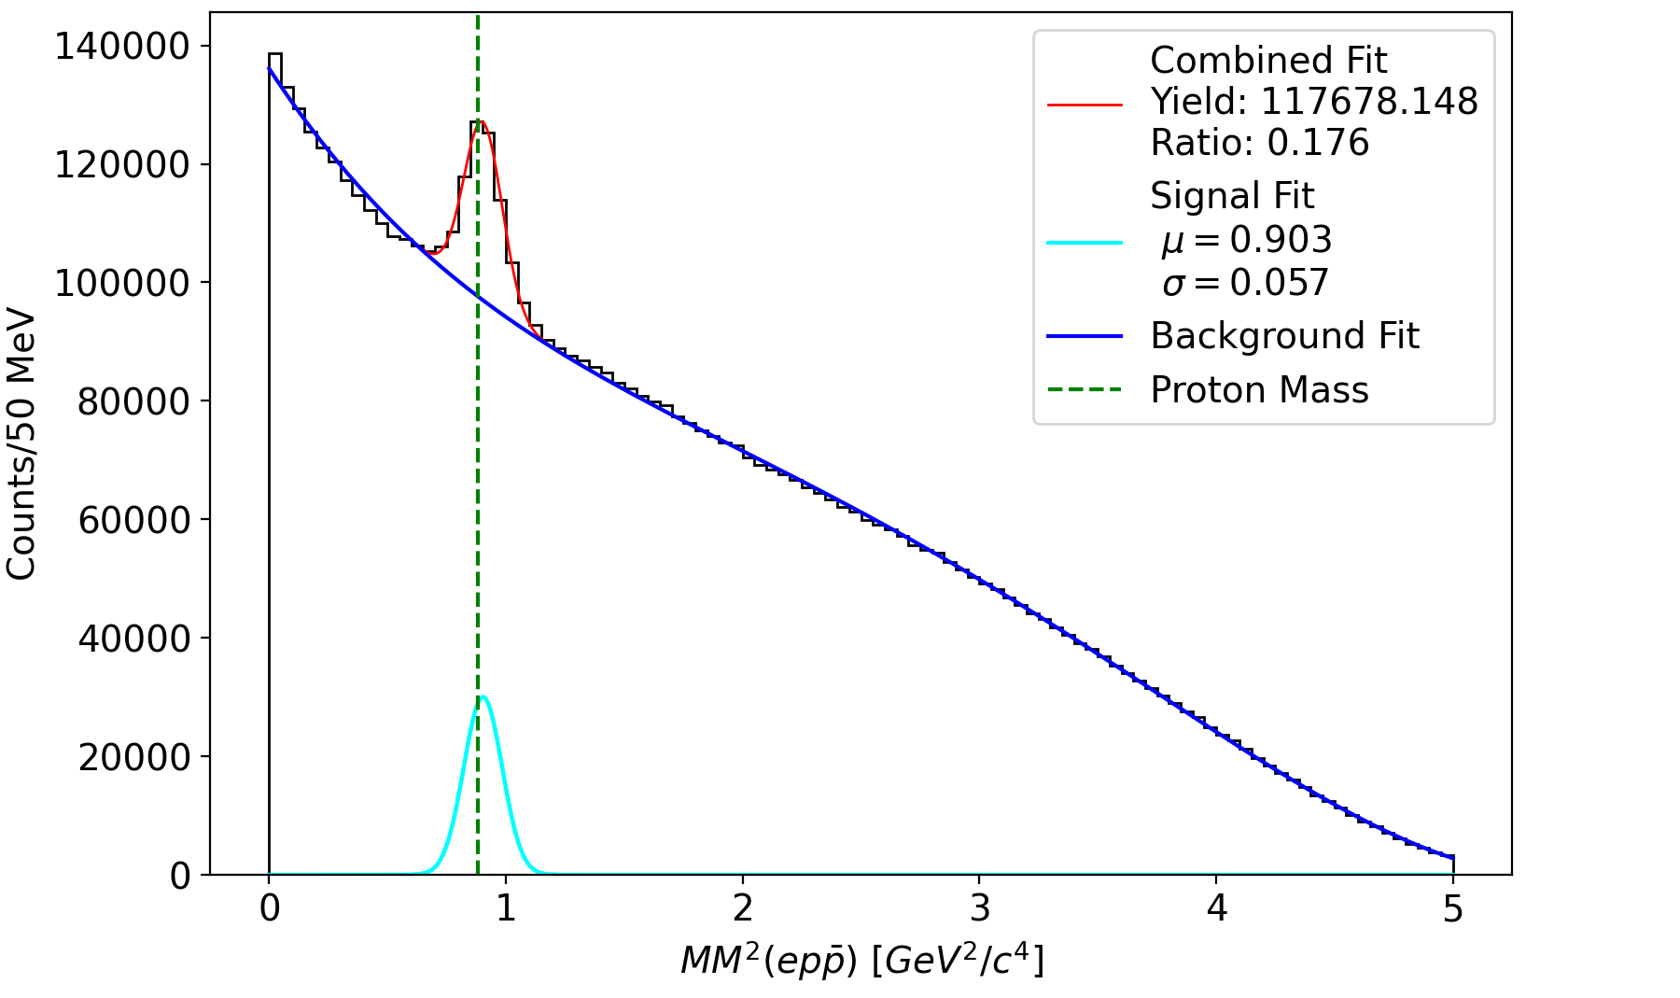
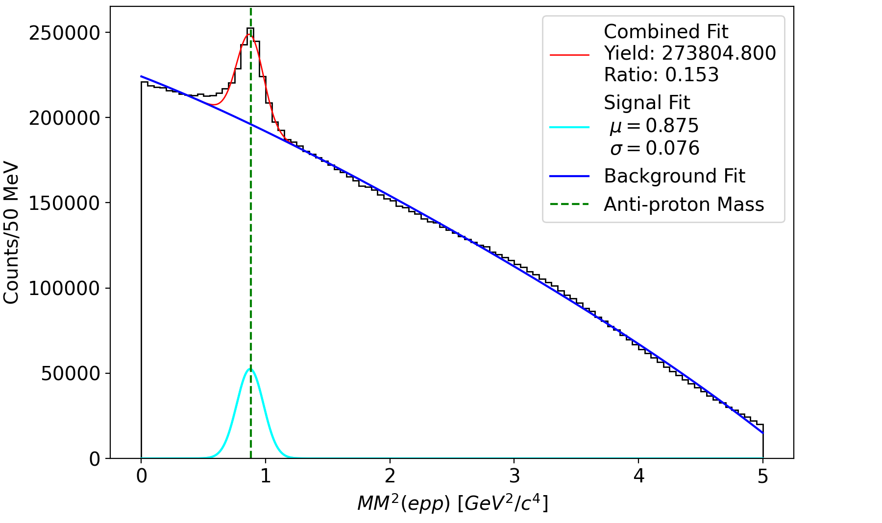
CLAS12 RGA: Spring 2019 in-bending Pass 2
$$ep→ep\overline{p}(p)$$
$$ep→epp(\overline{p})$$
Looking at two different topologies for FT electron
$ep→ep\overline{p}\left(p\right)$
$ep→epp(\overline{p})$
Missing mass technique
Reconstruct missing proton
Reconstruct missing anti-proton
Statistics are promising
~50% of files in RGA Spring 2019 Pass 2 data set
Cuts $p\overline{p}$
Momentum
Timing
Chi2pid
Vertex
Cuts $pp$
Momentum
Timing
Chi2pid
Vertex
4

Slide 5
Future Work
Subtract the combinatorial background due to the produced and recoil proton
Find $Q^{2}$ dependance for electro-produced $p\overline{p}$
First time $p\overline{p}$ electroproduction cross section measurement off a proton target
Implement Kinematic Fitting
Supported by: DE-SC0013620, This work was supported by the US Department of Energy Office of Science, Office of Nuclear Physics, under contract no. DE-SC0013620.
5

