Slide 1
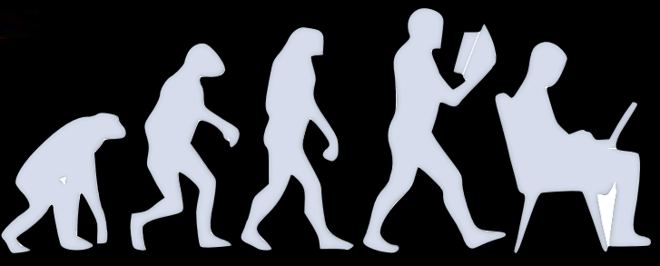
The A(i)DAPT program AI for Data Analysis and Preservation
Tommaso Vittorini
on behalf of A(i)DAPT Working Group
Tommaso Vittorini
The A(i)DAPT program

Slide 2
Overview
Motivation and advantages of the deployed techniques
Generative Adversarial Network overview
Our approach towards reproducing experimental data
Work in progress
Conclusions
1 - Tommaso Vittorini
The A(i)DAPT program

Slide 3
Data collected by NP/HEP experiments are (always) affected by the detector’s effects
Before starting physics analysis the detector’s effect unfolding is required
Traditional observables may not be adequate to extract physics in multidimensional space (multi-particles in the final state)
At High-Intensity frontiers, data sets are large and difficult to manipulate/preserve
Should AI support NP/HEP experiments to extract physics from data in more efficient way?
Develop AI – supported procedures to:
Accurately fit data in multiD space
Unfold detector effects
Compare synthetic (AI-generated) to experimental data
Quantify the uncertainty (UQ)
Collaborative effort (regular meeting)
ML experts (ODU, Jlab)
Experimentalists (Jlab Hall-B)
Theorists (JPAC, JAM)
2 - Tommaso Vittorini
The A(i)DAPT program

Slide 4
Detector unfolding
Detector effects make measured observables (detector-level) different from the ‘true’ observables (vertex level)
Acceptance: Any measurement can access only a limited portion of the phase space. What can we say about these unmeasured regions?
Resolution: Any measurement has an experimental resolution that may modify cover up effects that we’re looking for
Interpolation: deal with the holes in the phase space
Extrapolation: extend our coverage from the borders of measured regions
Spikes may be concealed behind the detector resolution
Measurements could be extended to unphysical regions
Mitigation strategy:
Acceptance: ‘Fiducial volumes’ to exclude unmeasured regions and extend the covered measured of the phase space
Resolution: build and validate ML-models to unfold resolution effects
3 - Tommaso Vittorini
The A(i)DAPT program

Slide 5
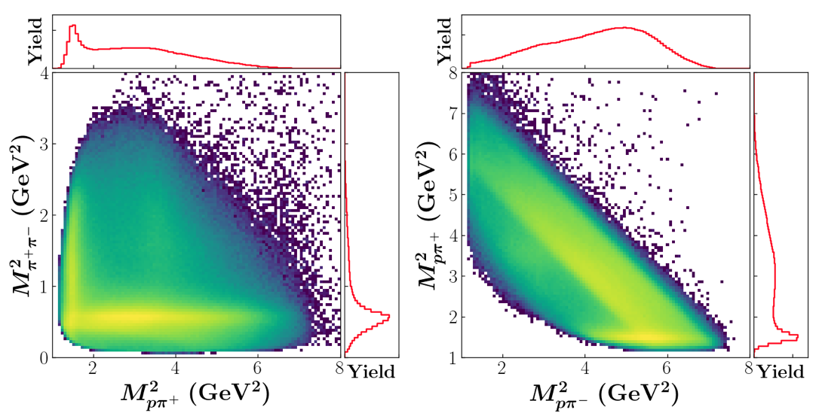
Exlusive reactions: $2→3$
$γp→π^{+}π^{−}p$ (unpolarized)
Initial state: Fully known
Final state: 3x3 indipendent variables
Indipendent variables: (3x3) – 4 = 5 ($E_{γ}$ fixed)
Many possible choices, such as $M_{ππ}^{2}, { M}_{pπ}^{2} θ_{π}, α, φ$
CLAS g11 $2π$ photoproduction
$E_{γ}=(3 −3.8) GeV$
Dataset analyses on $γp→pπ^{+}(π^{−})$ with small contamination from $γp→pπ^{+}($more than a single missing $π^{−})$
Complicated dynamics due to the overlap of $(pπ)$ to form $Δ$ baryon resnoances and $(ππ)$ to form meson resonances
AI could provide a new way to look at data and to extract observables and physics interpretation
Credit: Y.Alanazi Awadh, , P..Ambrozewicz, G. Costantini A.Hiller Blin, E. Isupov, T. Jeske, Y.Li, L.Marsicano W. Menlnitchouk, V.Mokeev, N.Sato, A.Szczepaniak, T.Viducic
4 - Tommaso Vittorini
The A(i)DAPT program

Slide 6
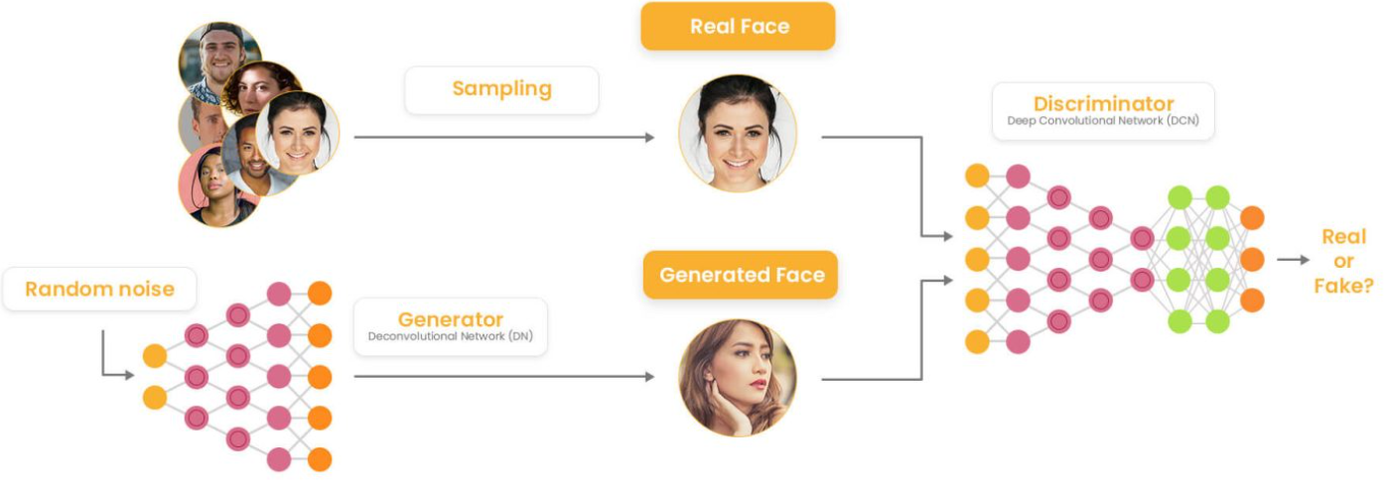
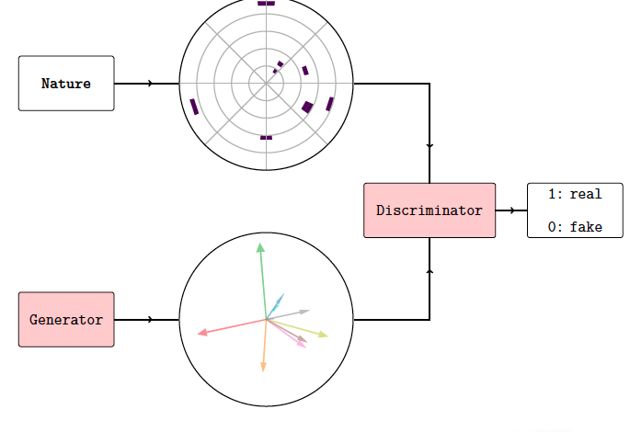
Generative Adversarial Networks (GANs)
Generative model based on the competition between two Neural Networks: Generator vs Discriminator
Generator produces synthetic data which progressively reproduce realistic data and the Discriminator has to distinguish between synthetic and realistic data
Generator can be used to retain high dimensional correlations (detector proxies)
Generator can be used to provide highly realistic pseudo-data in an extremely fast way
5 - Tommaso Vittorini
The A(i)DAPT program

Slide 7
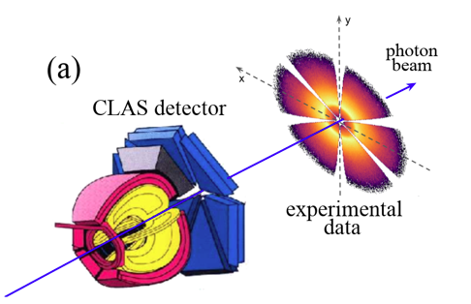
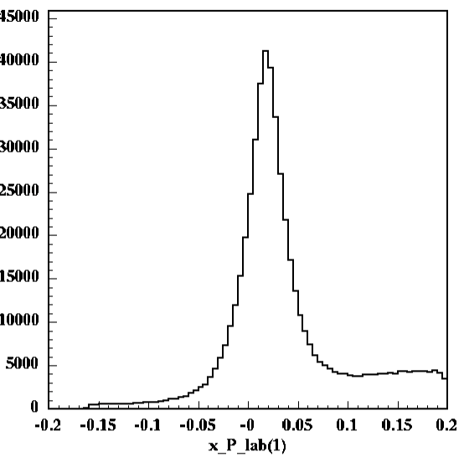
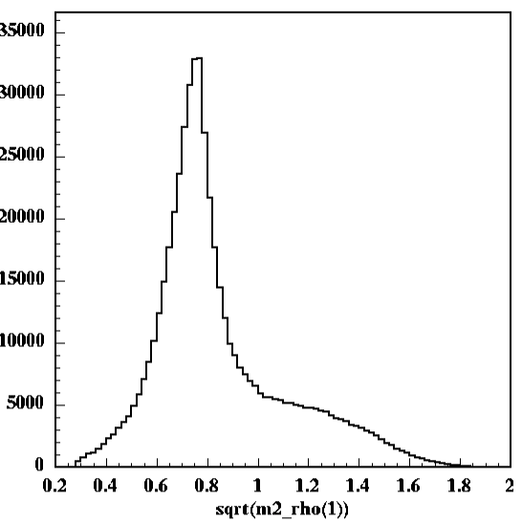
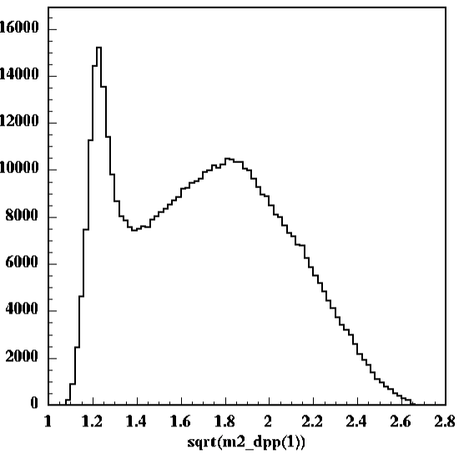
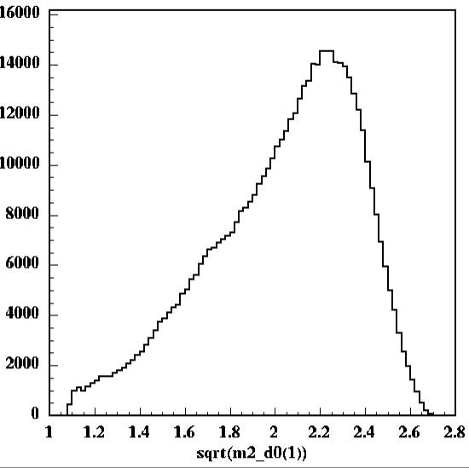
M. Battaglieri et al. (CLAS Collaboration) Phys. Rev. Lett. 102, 102001
Multi-d cross-section: exclusive $2π$ photoproduction
M. Battaglieri et al. (CLAS Collaboration) Phys. Rev. D 80, 072005
CLAS g11 kinematics
Dataset used by CLAS Collaboration for many publications
Fiducial cuts $(p, θ, φ)$ as used in published analyses
Focus on $γp→pπ^{+}\left(π^{−}\right)$
Final exclusive $2π$ state identified by missing mass technique (variables are reconstructed by energy/momentum conservation)
Multi-pion backgound comes from $γp→pω^{0}→pπ^{+}π^{−}π^{0}$
At $E_{γ}=\left(3−4\right)GeV$ reaction dynamics are dominated by $ρ^{0}$ photproduction through $γp→pρ^{0}$ and $Δ^{++}$ resonance excitation through $γp→Δ^{++}π^{−}$
M(γ p → p π⁺ X)
M(ππ)
M(pπ⁺)
M(pπ⁻)
M(missing π)
ρ⁰(770)
Δ⁺⁺(1232)
M(missing ππ ..)
6 - Tommaso Vittorini
The A(i)DAPT program

Slide 8
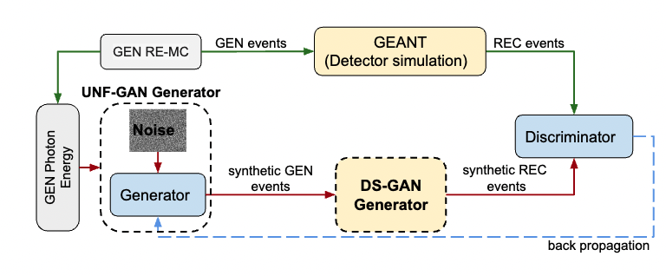
$2π$ photoproduction closure test
CLOSURE TEST:
Demonstrate that GANs reproduce ‘true’ multi-d correlations, unfolding CLAS detector effects, comparing vertex-level (GEN) events with GAN GEN SYNT events, trained at detector-level and unfolded with a (GAN-based) detector proxy
Generate events with a (realistic) Monte Carlo $2π$ photoproduction model (RE-MC GEN pseudodata)
Apply detector effects (acceptance and resolution) via GSIM-GEANT (RE-MC REC pseudodata)
Deploy a secondary GAN (DS-GAN) to learn detector effects using an indipendent MC event generator (PS-MC) + GSIM-GEANT (GEN and REC pseudodata)
Deploy the unfolding GAN (UNF-GAN) that includes the DS-GAN, and train it with RE-MC REC pseudodata
Compare UNF-GAN GEN SYNT data to RE-MC GEN pseudodata
Replace RE-MC REC pseudo data with CLAS data in the training to unfold the vertex-level experimental distributions
Credit: T. Alghamdi et al. Phys. Rev. D 108, 094030
7 - Tommaso Vittorini
The A(i)DAPT program

Slide 9
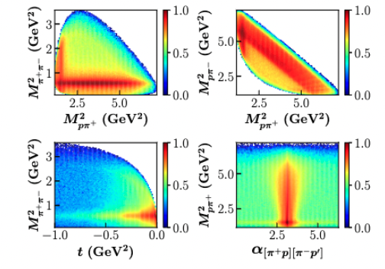
$2π$ photoproduction closure test
Generate events with a (realistic) Monte Carlo $2π$ photoproduction model (RE-MC GEN pseudodata)
RE-MC realistic Monte Carlo event generator to mimic real data. Includes measured cross-sections, angular distributions and decay of dominant mechanisms $(ρ^{0},Δ^{++}, Δ^{0}$ + a contact term$)$
GEN events
8 - Tommaso Vittorini
The A(i)DAPT program

Slide 10
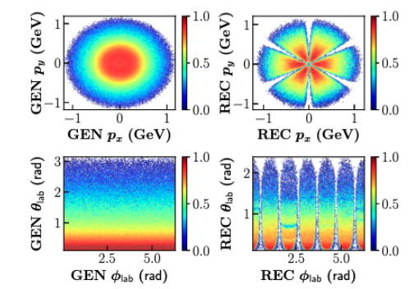
$2π$ photoproduction closure test
Apply detector effects (acceptance and resolution) via GISM-GEANT (RE-MC REC pseudodata)
GSIM: detector simulation package to simulate CLAS detector effects based on GEANT3
GEN events
RE-MC REC $π^{+}$events
9 - Tommaso Vittorini
The A(i)DAPT program

Slide 11
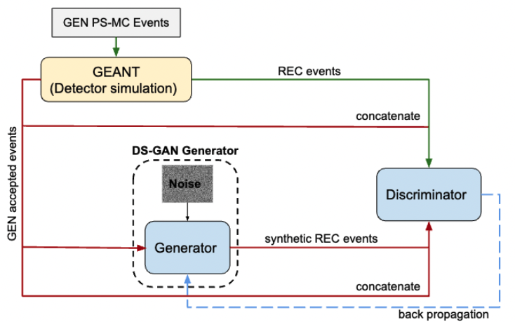
$2π$ photoproduction closure test
Deploy a secondary GAN (DS-GAN) to learn detector effects using an indipendent MC event generator (PS-MC) + GSIM-GEANT (GEN and REC pseudodata)
DS-GAN
10 - Tommaso Vittorini
The A(i)DAPT program

Slide 12
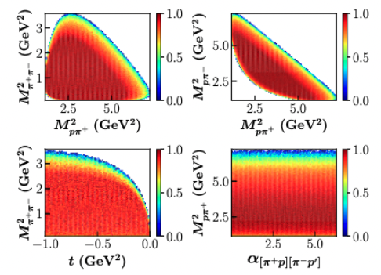
$2π$ photoproduction closure test
PS-MC GEN events
Deploy a secondary GAN (DS-GAN) to learn detector effects using an indipendent MC event generator (PS-MC) + GSIM-GEANT (GEN and REC pseudodata)
PS-MC: Phase space Monte Carlo event generator
DS-GAN
11 - Tommaso Vittorini
The A(i)DAPT program

Slide 13
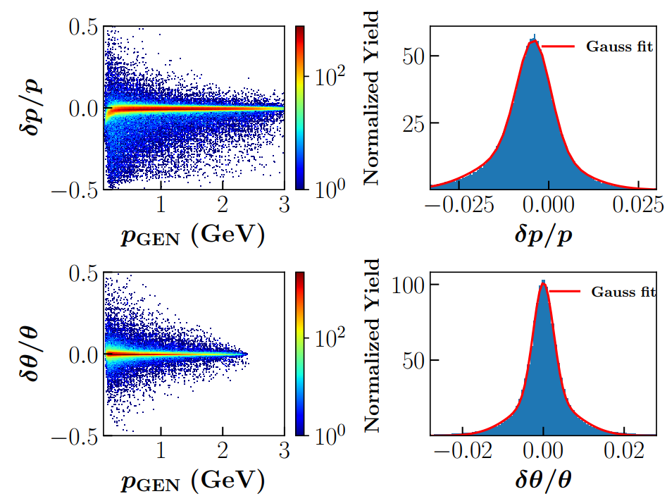
$2π$ photoproduction closure test
PS-MC GEN events
Deploy a secondary GAN (DS-GAN) to learn detector effects using an indipendent MC event generator (PS-MC) + GSIM-GEANT (GEN and REC pseudodata)
GSIM-GEANT to simulate CLAS acceptance and resolution
DS-GAN
CLAS resolution on $π^{+}$ kin. variables
12 - Tommaso Vittorini
The A(i)DAPT program

Slide 14
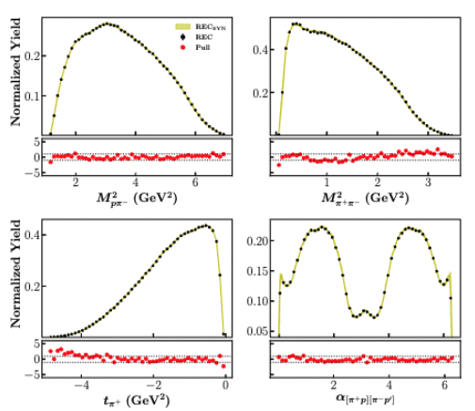
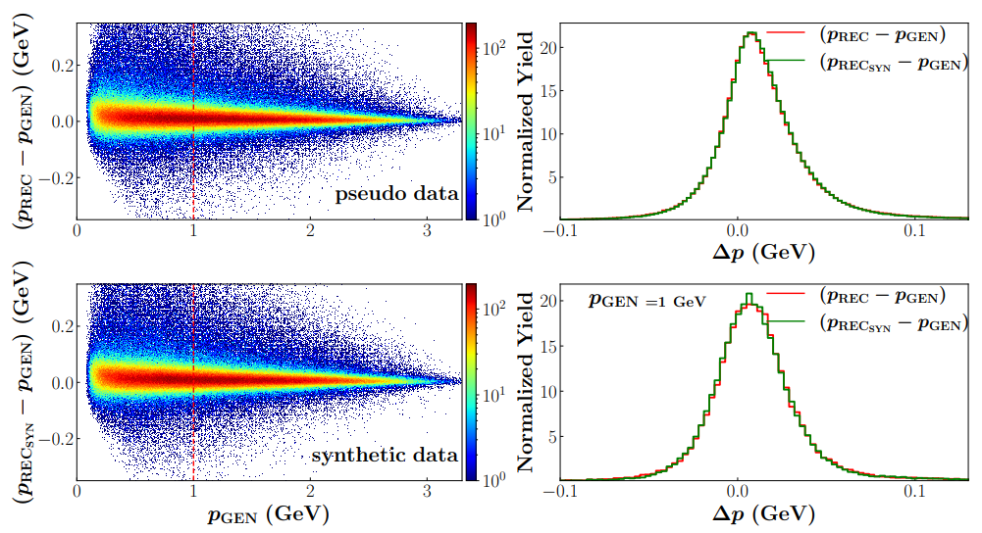
$2π$ photoproduction closure test
MC REC pseudodata vs. DS-GAN synthetic data
Deploy a secondary GAN (DS-GAN) to learn detector effects using an indipendent MC event generator (PS-MC) + GSIM-GEANT (GEN and REC pseudodata)
GSIM-GEANT to simulate CLAS acceptance and resolution
DS-GAN
CLAS resolution
pseudodata
Uncertainty quantification via pull calculation: Bootstrap with 20 indipendently trained GANs
synthetic data
DS-GAN learned the CLAS detector effects!
13 - Tommaso Vittorini
The A(i)DAPT program

Slide 15
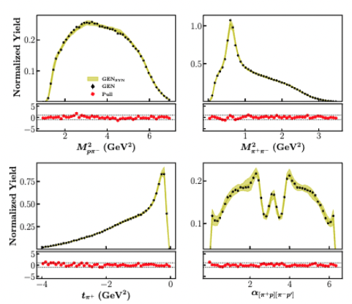
$2π$ photoproduction closure test
UNF-GAN trained with REC-MC pseudodata (experimental data proxy)
DS-GAN used to unfold CLAS detector effects (within acceptance)
RE-MC GEN pseudodata vs. UNF-GAN SYN data
Compare UNF-GAN GEN SYNT to RE-MC GEN pseudodata
Systematic of the full procedure (two-GANs) estimated by bootstrap with 20+20 independently trained GANs
Good agreement ($±1σ$) for vertex-level training variables!
14 - Tommaso Vittorini
The A(i)DAPT program

Slide 16
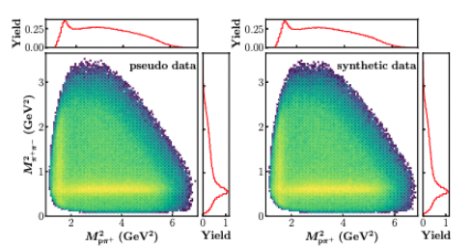
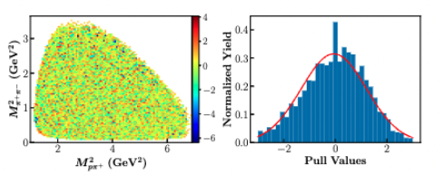
$2π$ photoproduction closure test
Deploy the unfolding GAN (UNF-GAN) that includes the DS-GAN and train it with RE-MC REC pseudodata
UNF-GAN trained with REC-MC pseudodata (experimental data proxy)
DS-GAN used to unfold CLAS detector effects (within acceptance)
RE-MC GEN pseudodata vs. UNF-GAN SYN data
2D pulls
Compare UNF-GAN GEN SYNT to RE-MC GEN pseudodata
Good agreement ($±1σ$) for 2D distributions (correlations)
15 - Tommaso Vittorini
The A(i)DAPT program

Slide 17
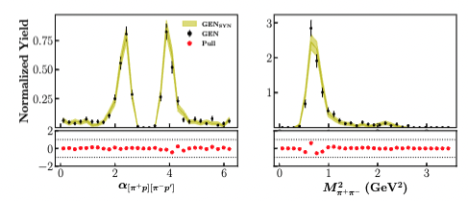
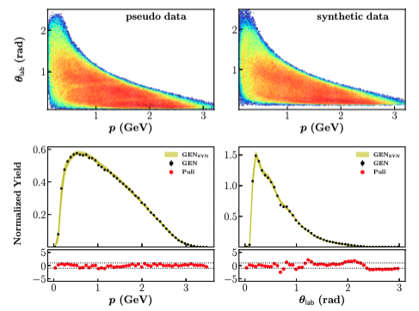
$2π$ photoproduction closure test
Deploy the unfolding GAN (UNF-GAN) that includes the DS-GAN and train it with RE-MC REC pseudodata
UNF-GAN trained with REC-MC pseudodata (experimental data proxy)
DS-GAN used to unfold CLAS detector effects (within acceptance)
Distribution in 4D bins
RE-MC GEN pseudodata vs. UNF-GAN SYN data
Compare UNF-GAN GEN SYNT to RE-MC GEN pseudodata
Good agreement ($±1σ$) for lab variables and in 4D bins
16 - Tommaso Vittorini
The A(i)DAPT program

Slide 18
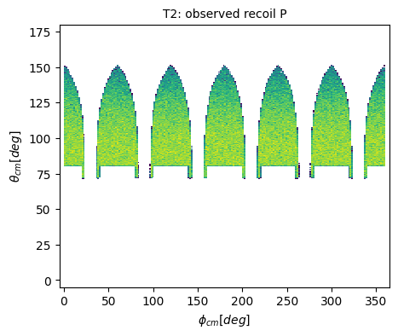
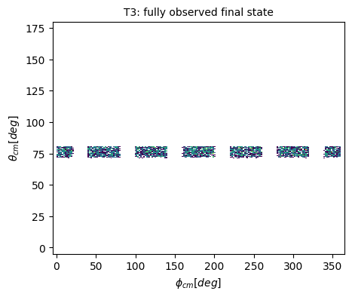
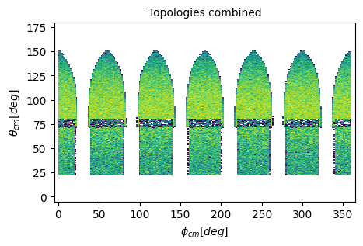
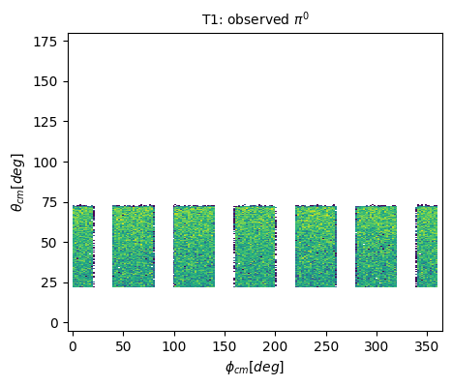
Moving forward: Acceptance
Simple 2-body process: $γp→Δ^{+}\left(1232\right)→π^{0}p$
Two independent variables (at fixed energy): $θ_{cm}$ and $φ_{cm}$
Monte Carlo eventgenerator
Simple model: Breit-Wigner with two parameters: mΔ and ΓΔ
Detector acceptance (CLAS) implemented via fiducial cuts (coils, minimum proton momentum and angle in the lab frame)
topology 1: γ p → (p) π⁰ (proton missing)
topology 2: γ p → p (π⁰) (π⁰ missing)
topology 3: γ p → p π⁰ (all detected)
[topology 0: unmeasured]
topology II
topology III
Build a single Network able to generate in the full phase space according to the correct distributions
topology I
Credit: T.Vittorini , T.Alghamdi,Y. Li
17 - Tommaso Vittorini
The A(i)DAPT program

Slide 19
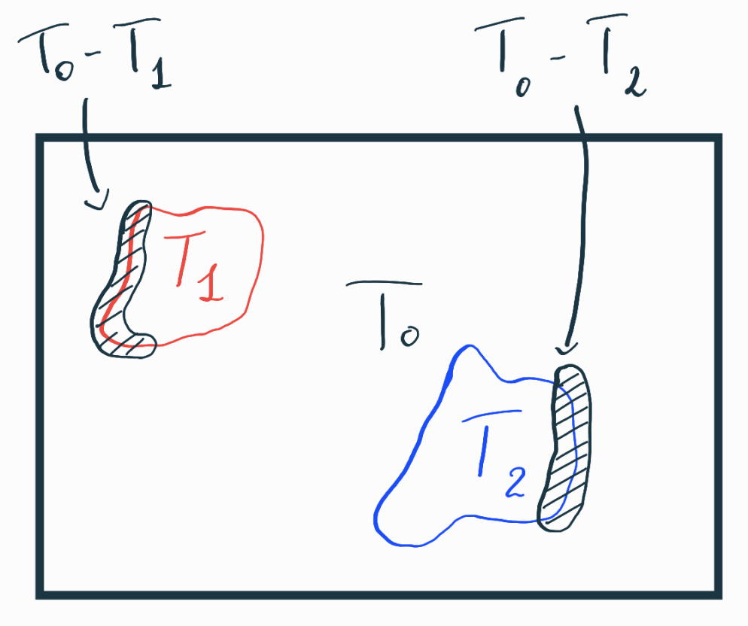
Moving forward: Detector inefficiencies
Some evets may sometimes be classified in the wrong category:
- Defective paddles can lead to missing events ($T_{1}$ which become $T_{0}$)
- Reconstructed events can get missclassified ($T_{1}$ which become $T_{2}$ and viceversa)
Existence of regions where a given generated event can go into different topologies with a given probability: Mixed events
Inner GAN:
Distinguishes topologies
Applies the correct smearing
$\left(T_{1}\right)$Smeared event classified as $T_{1}$ 80% of times
Generator
Un-smeared event classified as $T_{0}$ 20% of times
Credit: T.Vittorini , T.Alghamdi,Y. Li
18 - Tommaso Vittorini
The A(i)DAPT program

Slide 20
Moving forward: Comprehensive inner GAN
Here we are assuming that the smearing applied to mixed events is similar: We will apply a common smearing to all the events being classified with multiple topologies
The process of generating training $P_{i}$ will be carried out outside of the dataset training
Each PS-event will be associated with different probabilities
The inner GAN training dataset will consist of $θ$ and $φ$ values to identify the event + the probabilities of being classified into a given topology
The output of the $P_{i}^{G}$ could be distribution peaked around the expected value
Inner GAN
$$PS−dataset$$
Geant4 detector proxy
$(\overline{θ},\overline{φ}, P_{T_{0}}, P_{T_{1}}, P_{T_{2}}$)
Generator
$(\overline{θ_{G}},\overline{φ_{G}}, P_{T_{0}}^{G}, P_{T_{1}}^{G}, P_{T_{2}}^{G}$)
Discriminator
Credit: T.Vittorini , T.Alghamdi,Y. Li
20 - Tommaso Vittorini
The A(i)DAPT program

Slide 21
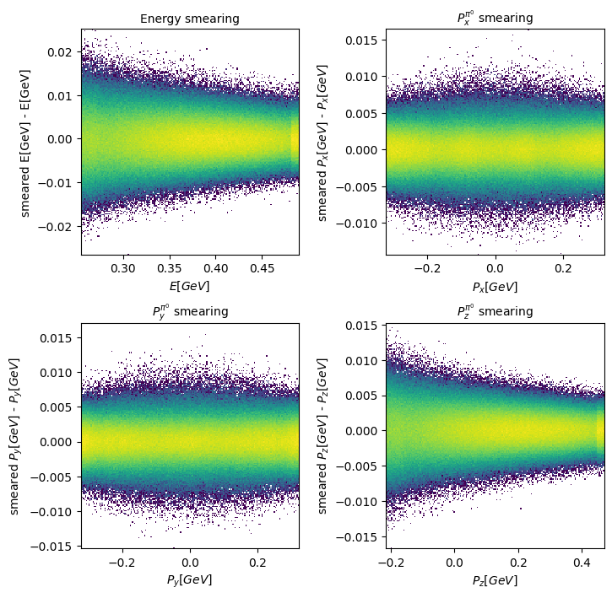
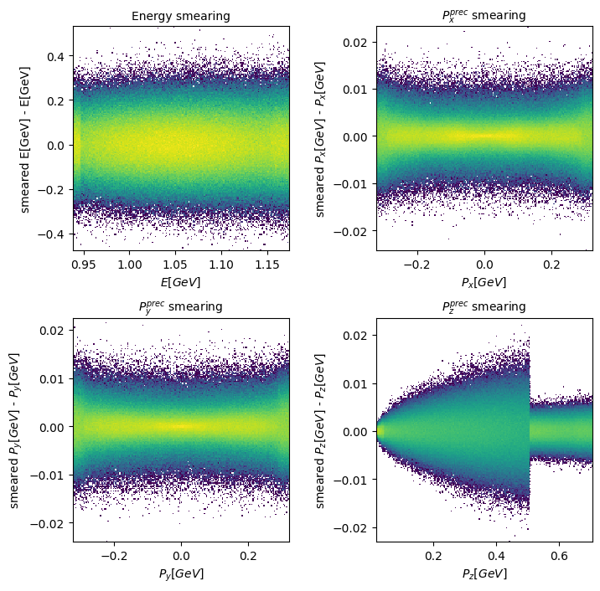
Moving forward: inner GAN results
Reasonable smearing applied to the training variables:
$π^{0}$ 4-momenta
Recoil proton 4-momenta
Credit: T.Vittorini , T.Alghamdi,Y. Li
21 - Tommaso Vittorini
The A(i)DAPT program

Slide 22
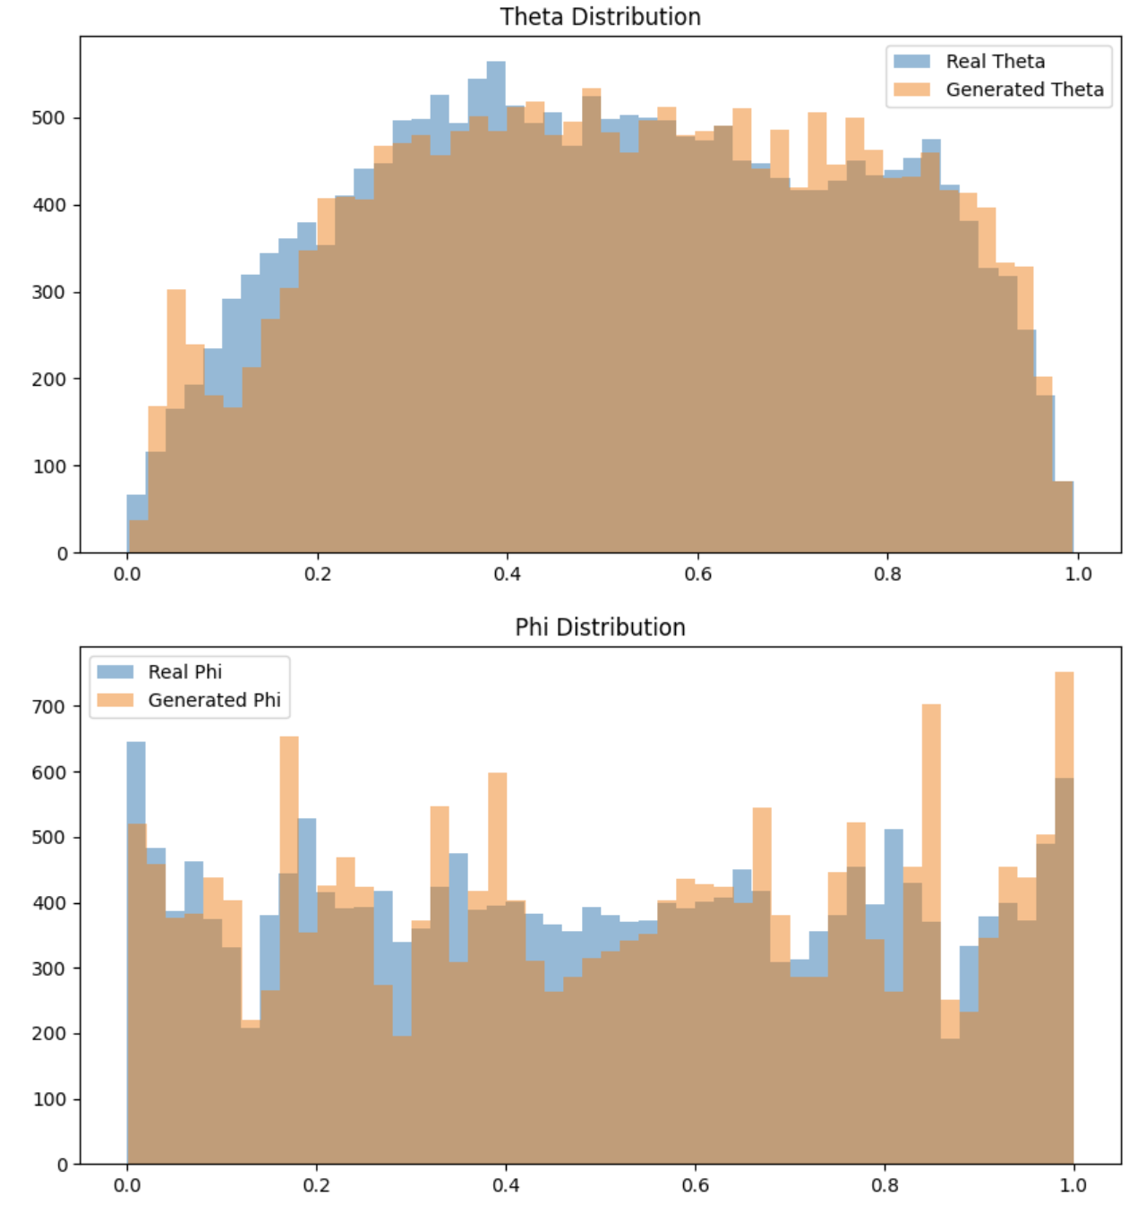
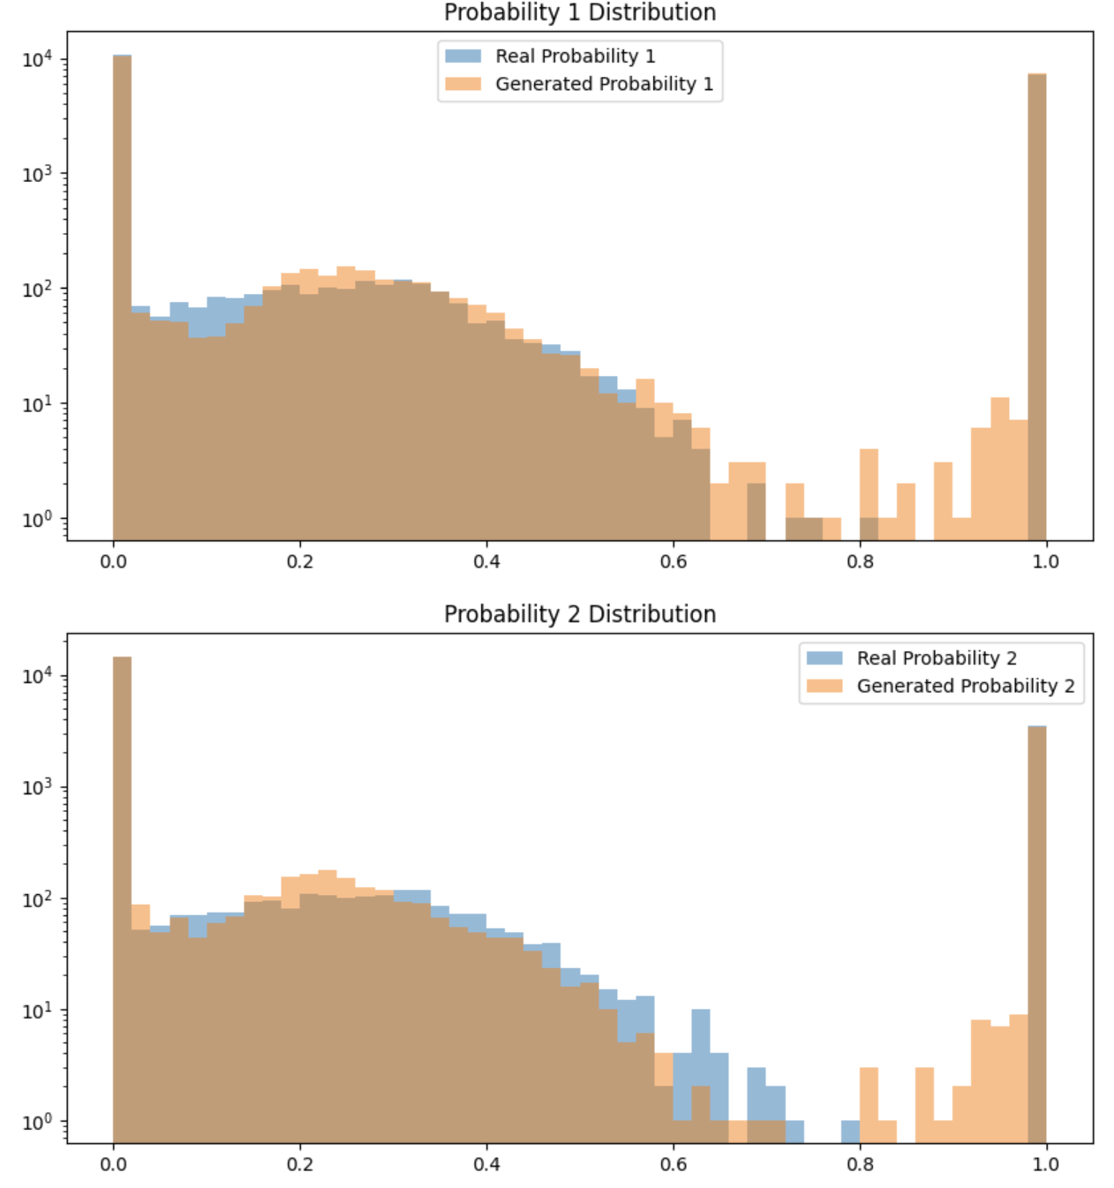
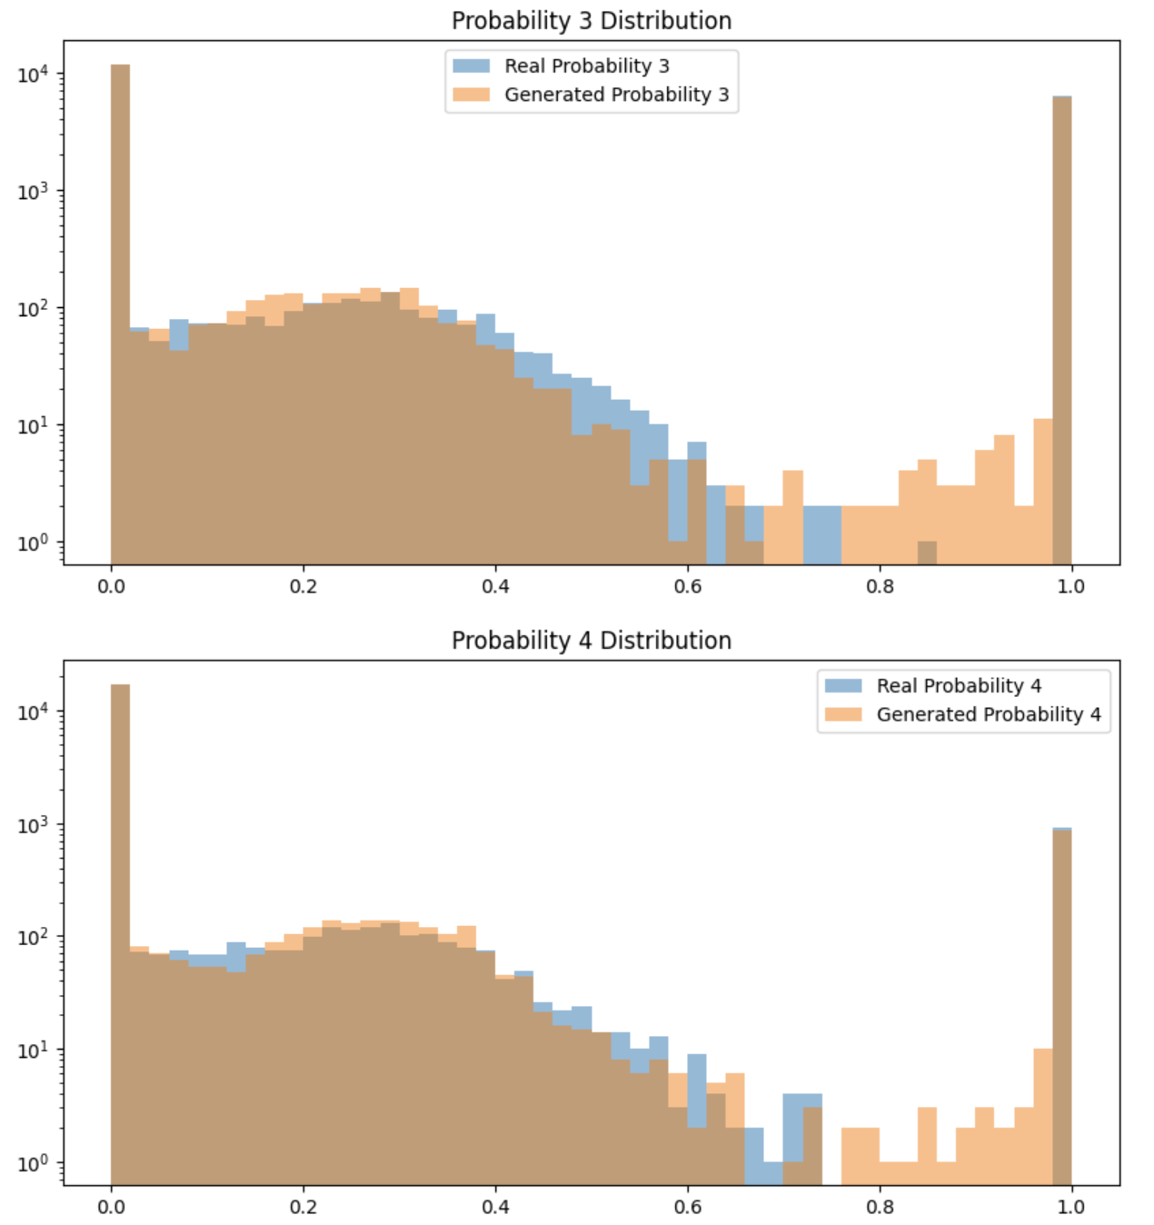
Moving forward: inner GAN results
Credit: T.Vittorini , T.Alghamdi,Y. Li
22 - Tommaso Vittorini
The A(i)DAPT program

Slide 23
Moving forward: Comprehensive outer GAN
Here we are assuming that the smearing applied to mixed events is similar: We will apply a common smearing to all the events being classified with multiple topologies
Outer GAN
Training dataset
$(\overline{θ},\overline{φ}, P_{T_{0}}, P_{T_{1}}, P_{T_{2}}$)
Generator
$$(θ, φ)$$
Pre-trained Inner GAN
$(\overline{θ_{G}},\overline{φ_{G}}, P_{T_{0}}^{G}, P_{T_{1}}^{G}, P_{T_{2}}^{G}$)
Discriminator
The outer GAN trained generator will be able to generate vertex level events in the full phase space, with the relative distributions derived according to experimental data (in the measured regions) and some realistic model (in the unmeasured region)
Credit: T.Vittorini , T.Alghamdi,Y. Li
23 - Tommaso Vittorini
The A(i)DAPT program

Slide 24
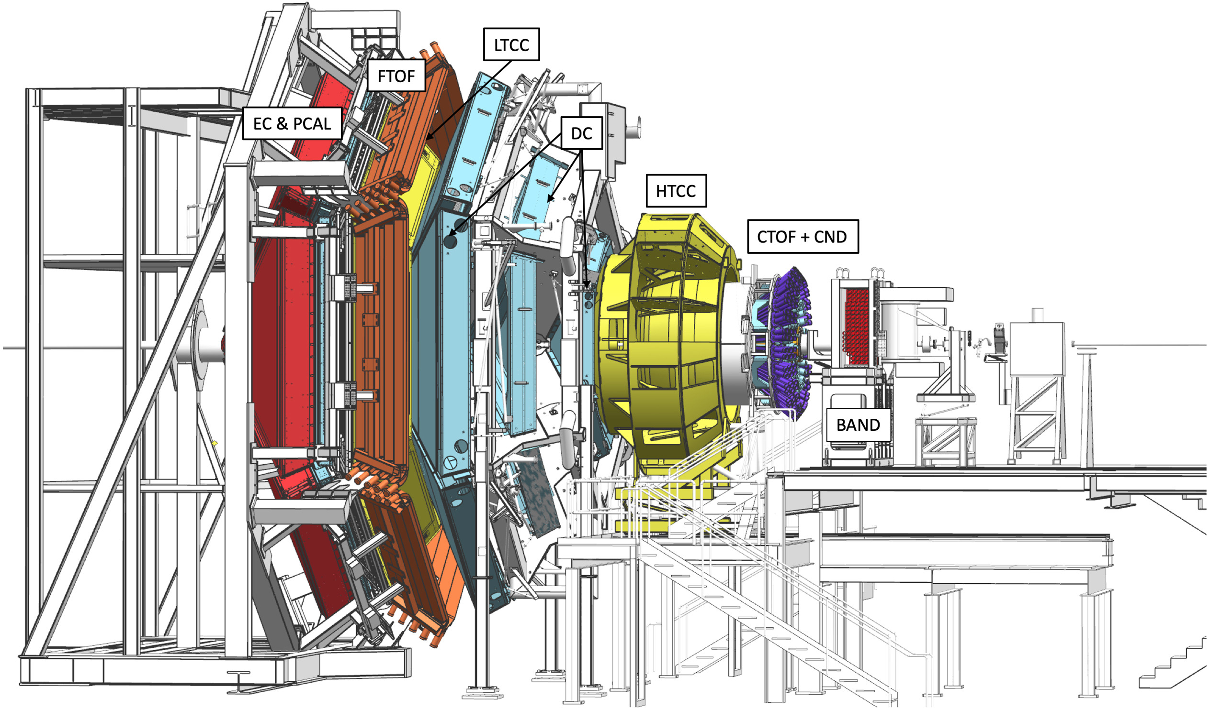
Moving forward: CLAS12 application
Working towards the application of the developed machinery to CLAS12 pseudodata
Pseudo-data for the reaction $ep→e^{′}p π^{+}π^{−}$
Focus on the topology with final state $e^{′}p π^{+}(π^{−})$
Test the inner – GAN architecture on CLAS12 detector
If this procedure works well on CLAS and CLAS12 data the architecture robustness is guaranteed
We can put together in a coherent way information from different kinematic regions
Credit: D. Glazier, T. Alghamdi, M. Spreafico
24 - Tommaso Vittorini
The A(i)DAPT program

Slide 25
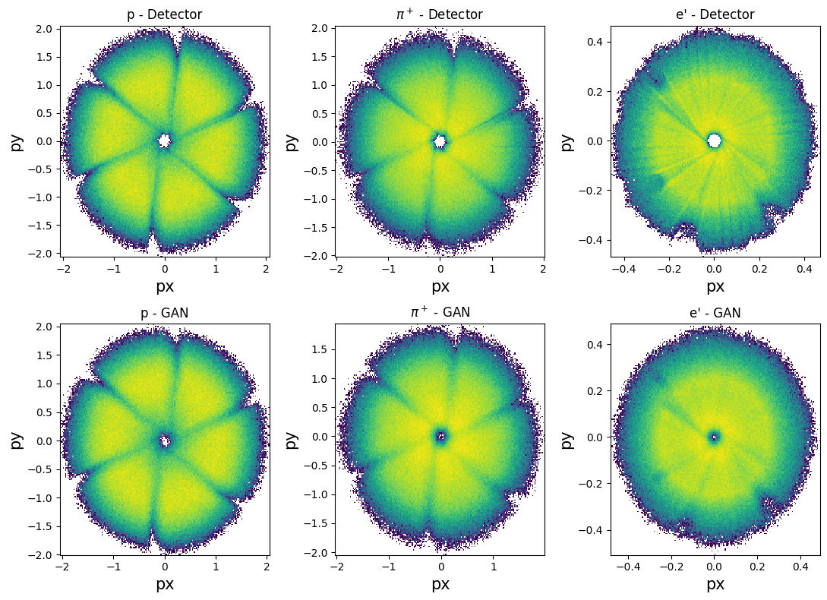
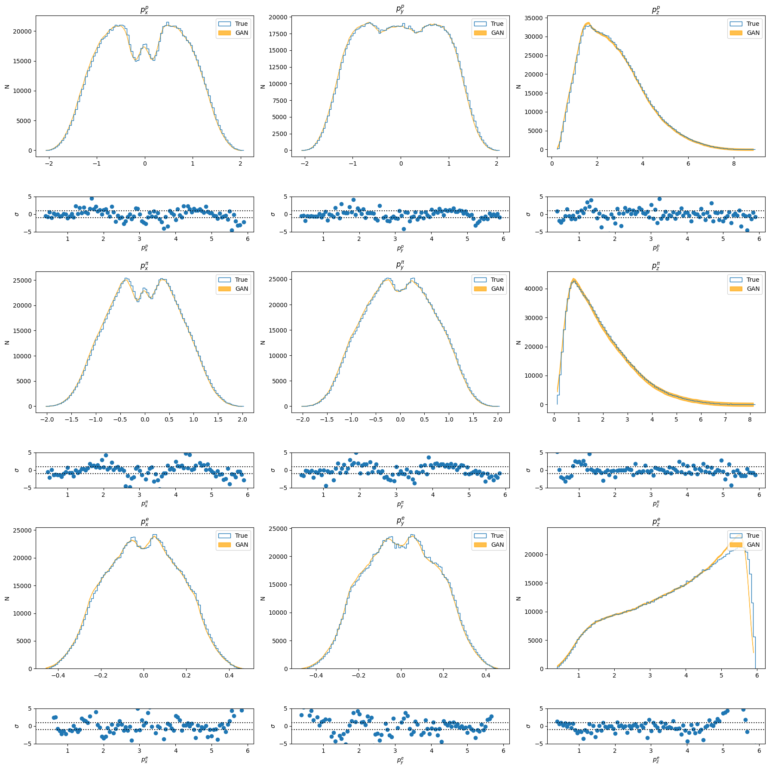
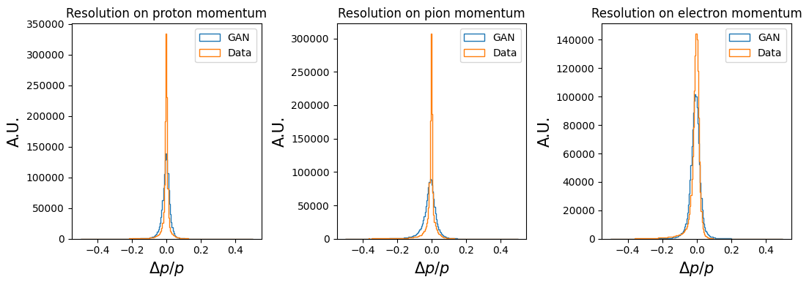
Moving forward: CLAS12 application
$P_{x}$ vs $P_{y}$ comparison
Smeared training variables comparison
Resolution comparison
Credit: D. Glazier, T. Alghamdi, M. Spreafico
25 - Tommaso Vittorini
The A(i)DAPT program

Slide 26
Summary
A(I)DAPT program aims to demonstrate a novel way to extract and interpret physics observables
Multi-step program
We performed a positive closure test on $2π$ photoproduction
We demonstrated that GANs are a viable tool to unfold detector effects (smearing) to generate a synthetic copy of data
We demonstrated that the original correlations are preserved
Preserve data in alternative compact and efficient form
We are working on:
Quantifying the systematic error introduced by the detector acceptance
Implementing this architecture into jlab software in order to make it easily available to everyone
Further verify that this procedure is well defined confronting the results obtained analysing CLAS data with traditional analysis
Make this procedure an efficient way to analyse CLAS12 $2π$ data
There is still a long way to go to be able to use AI to extract physics from data in an efficient way, but we are moving towards the right direction!
26 - Tommaso Vittorini
The A(i)DAPT program

Slide 27
Thank you!
Tommaso Vittorini
The A(i)DAPT program

Slide 28
Moving forward: Detector inefficiencies
How do we define these Mixed events?
- We generate a dataset of vertex level events in all the phase space
- We pass each event in our dataset through a realistic geant4 proxy of our detector multiple times (for example 100)
Vertex | $$\#T_{0}$$ | $$\#T_{1}$$ | $$\#T_{2}$$
event 0 | $$20$$ | 80 | 0
… | … | $$…$$ | $$…$$
event N | $$30$$ | $$0$$ | $$70$$
$P_{i}$ is the probability of a given event to end up in a specific topology
Each event can then be defined as $(θ, φ, P_{T_{0}}, P_{T_{1}}, P_{T_{2}}$)
Event 0 would look like $(θ, φ, 0.2, 0.8, 0$)
An event which always belongs to $T_{1}$ will look like this: $(θ, φ, 0, 1, 0$)
Credit: T.Vittorini , Y.Alanazi, T.Alghamdi,Y. Li
19 - Tommaso Vittorini
The A(i)DAPT program

