Slide 1
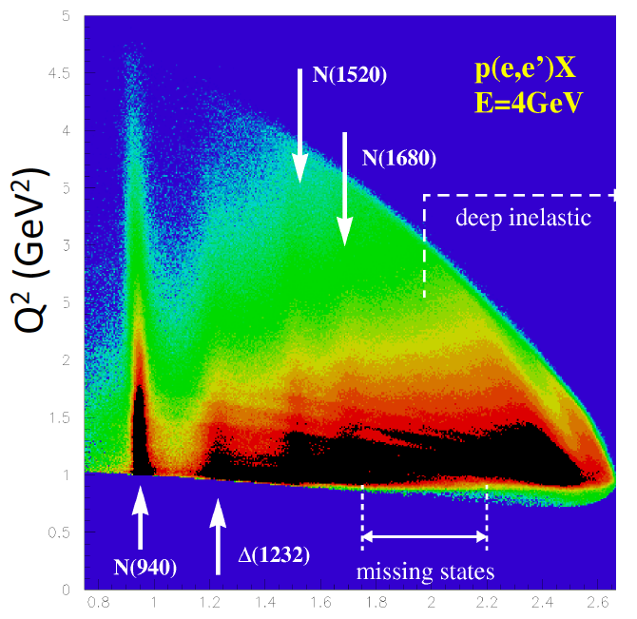
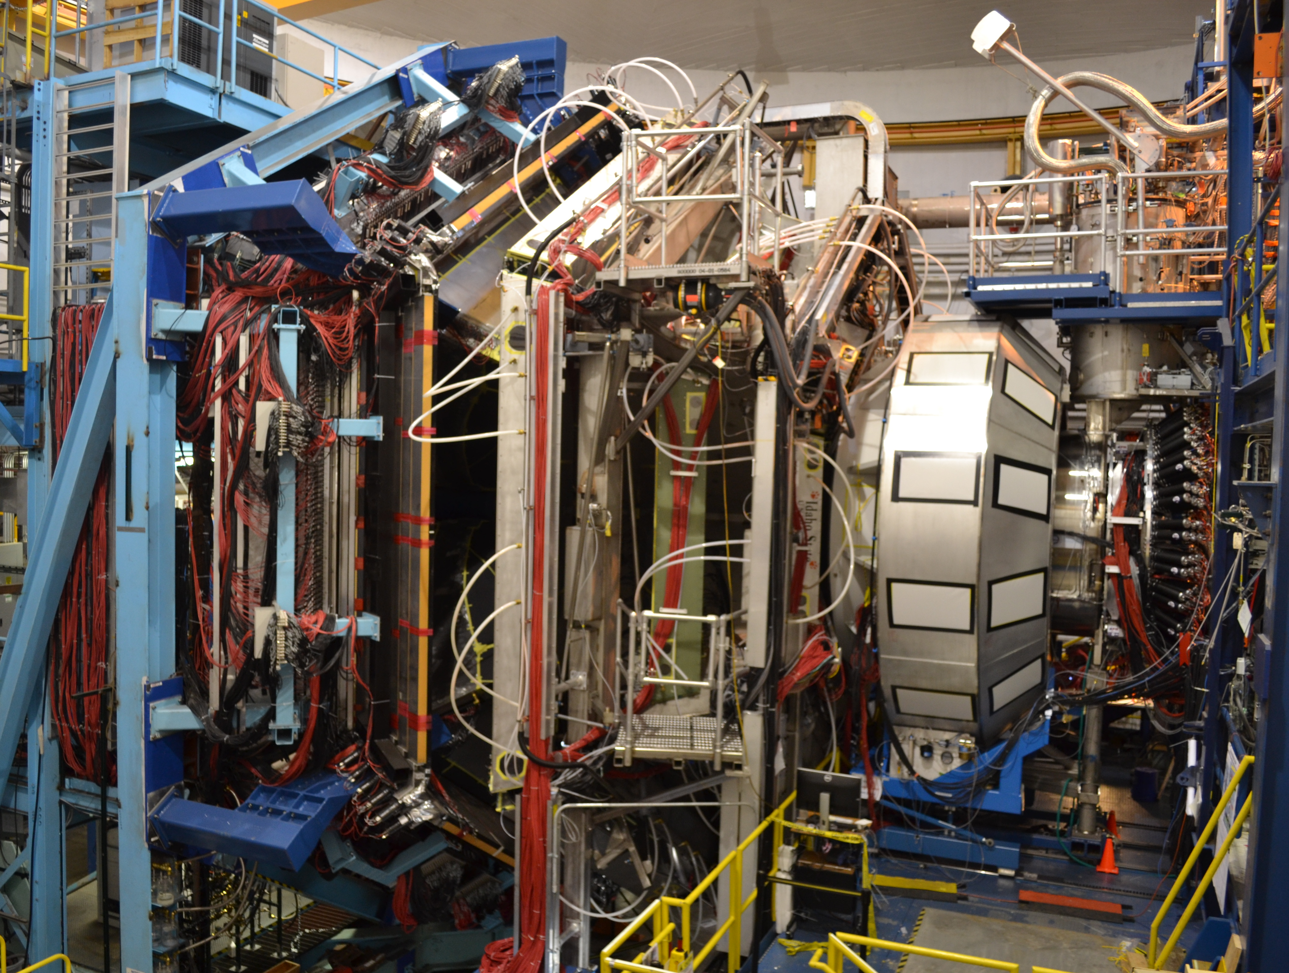
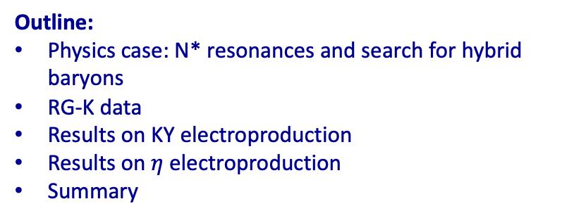
Hall B - Run Group K
Color Confinement and Strong QCD
Exclusive Channels Analysis Update
Search for Hybrid Baryons
Annalisa D’Angelo
University of Rome Tor Vergata & INFN Rome Tor Vergata Rome – Italy
Outline:
Physics case: N* resonances and search for hybrid baryons
RG-K data
Results on KY electroproduction
Results on $η$electroproduction
Summary
W (GeV)

Slide 2
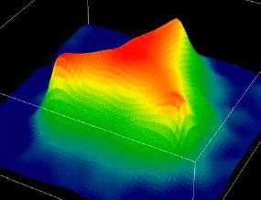
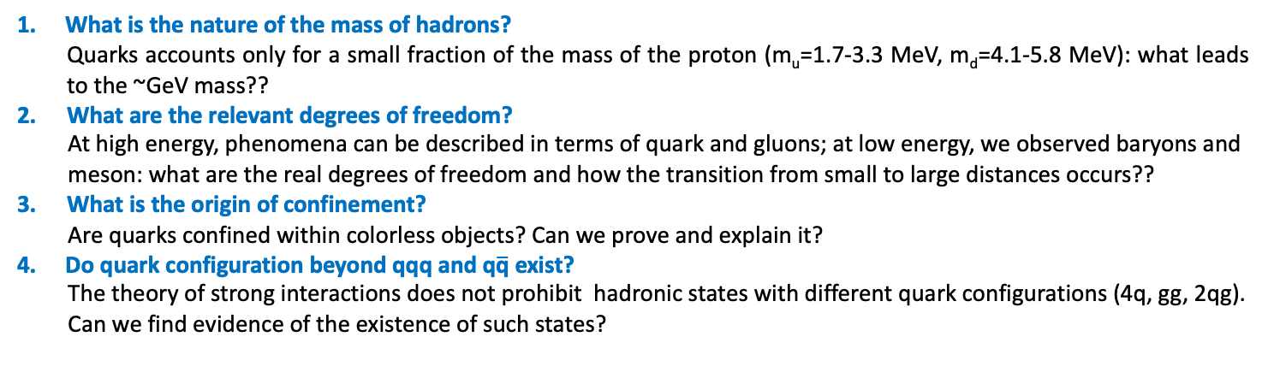
Critical QCD Questions Addressed
What is the nature of the mass of hadrons?
Quarks accounts only for a small fraction of the mass of the proton (m_{u}=1.7-3.3 MeV, m_{d}=4.1-5.8 MeV): what leads to the ~GeV mass??
What are the relevant degrees of freedom?
At high energy, phenomena can be described in terms of quark and gluons; at low energy, we observed baryons and meson: what are the real degrees of freedom and how the transition from small to large distances occurs??
What is the origin of confinement?
Are quarks confined within colorless objects? Can we prove and explain it?
Do quark configuration beyond qqq and q$\overline{\text{q}}$ exist?
The theory of strong interactions does not prohibit hadronic states with different quark configurations (4q, gg, 2qg). Can we find evidence of the existence of such states?
<< 0.1 fm
0.1 – 1 fm
> 1 fm
π
p
Quarks and Gluons
Effective Degrees of Freedom
Mesons & Baryons

Slide 3
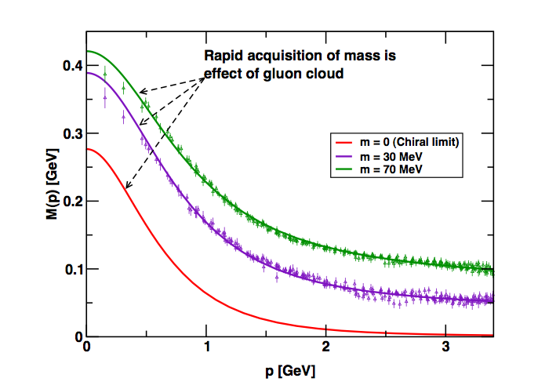
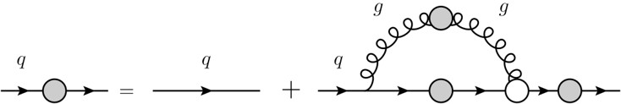
Critical QCD Questions Addressed
How do massless quarks acquire mass?
Effective quark mass depends on its momentum
numerical simulations
of unquenched lattice QCD
(Bowman et al.)
M=M(p)
m₀=m_{HM}
Dyson-Swinger equation
(Bhagwat et al.)
dressed quark
bare quark
dressing kernel
mass composition
<2% Higgs mechanism
>98% non-perturbative strong interaction
Measure the Q² dependence of electrocoupling amplitudes

Slide 4
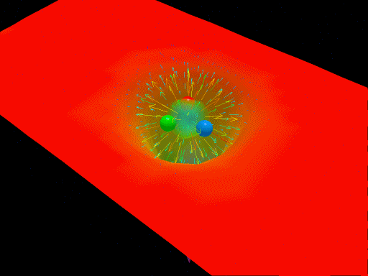
Baryon Spectroscopy
The light N* spectrum: what is the role of glue?
“Nucleons are the stuff of which our world is made.
As such they must be at the center of any discussion of why the world we actually experience has the character it does.”
Nathan Isgur, NStar2000, Newport News, Virginia
Derek B. Leinweber – University of Adelaide
Search for new baryon states

Slide 5
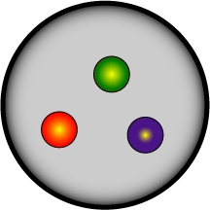
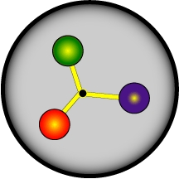
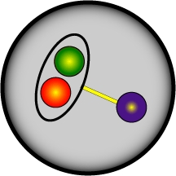

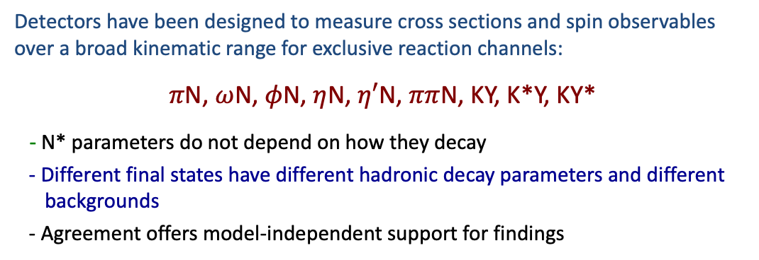
N* Program Overview
The N* program is one of the key physics foundations of CLAS and CLAS12
Detectors have been designed to measure cross sections and spin observables over a broad kinematic range for exclusive reaction channels:
$π$N, $ω$N, $φ$N, $η$N, $η′$N, $ππ$N, KY, K*Y, KY*
- N* parameters do not depend on how they decay
- Different final states have different hadronic decay parameters and different backgrounds
- Agreement offers model-independent support for findings
CLAS12@JLAB
The program goal is to probe the spectrum of N* states and their structure
- Probe the underlying degrees of freedom of the nucleon through studies of photoproduction and the Q² evolution of the electro-production amplitudes.
N* degrees of freedom??

Slide 6
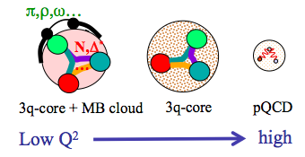
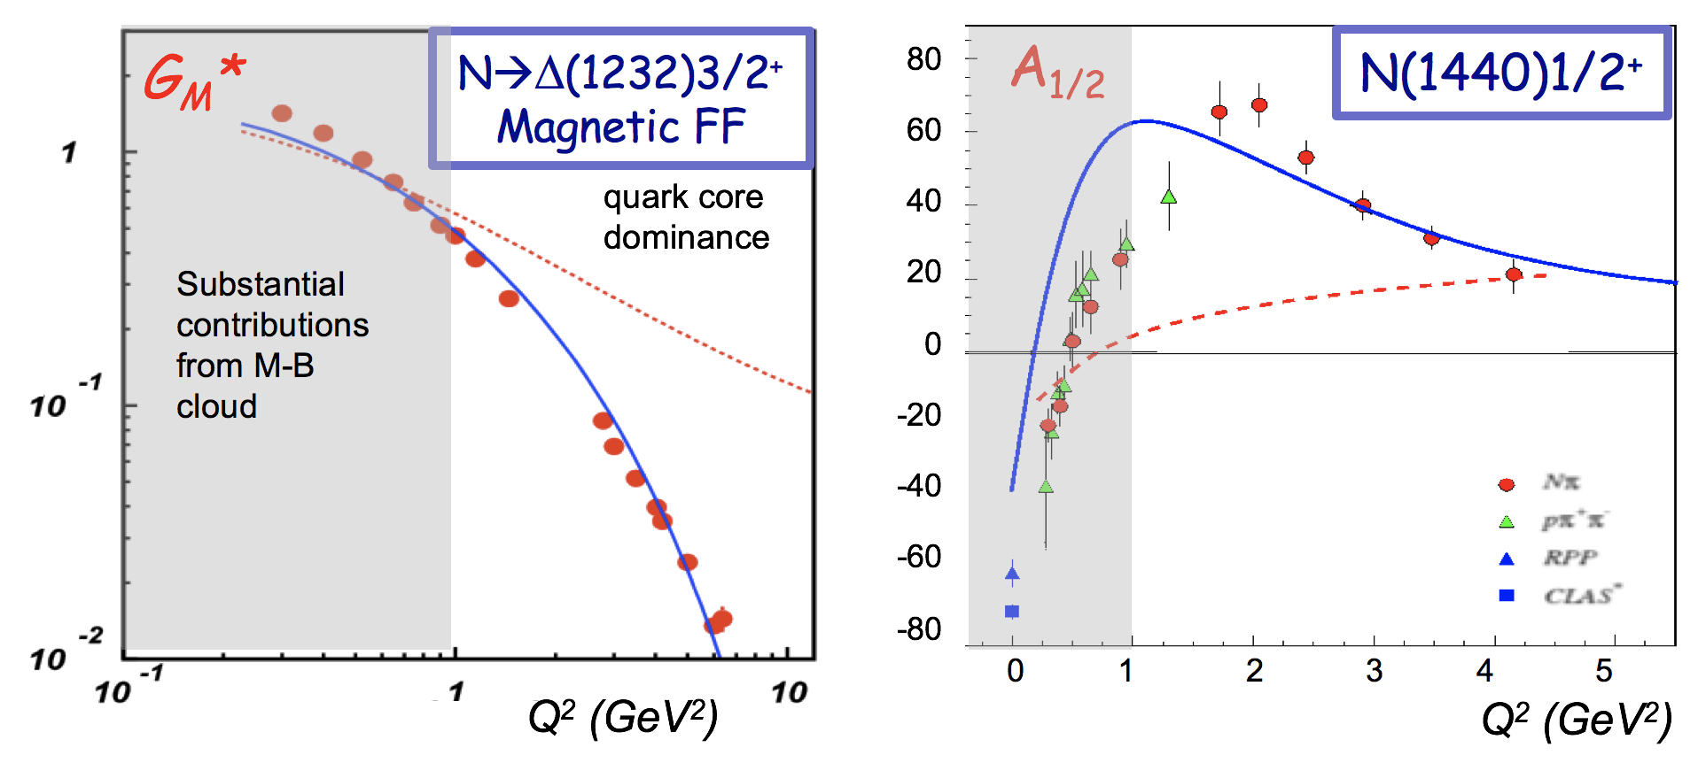
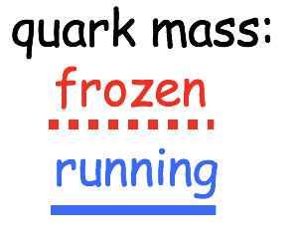
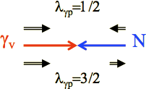
Excited Nucleon Structure
Nucleon structure is more complex than what can be described accounting for quark degrees of freedom only
  - Low Q²:
  High Q²:
  structure well described by adding an external meson cloud to inner quark core
  quark core dominates; transition from confinement to pQCD regime
(Q² < 5 GeV²)
3q core + meson cloud 3q core pQCD
low Q² high Q²
(Q² > 5 GeV²)
Calculations of form factors and electrocoupling amplitudes are sensitive to the underlying quark mass distribution
e’
M
γ_{v}
e
N*,△*
Q²
N
B
A_{1/2}, A_{3/2}, S_{1/2}
helicity amplitudes
DSE calculations
A_{1/2} , A_{3/2} – transverse
S_{1/2} - longitudinal
CLAS results vs. QCD expectations with running quark mass

Slide 7
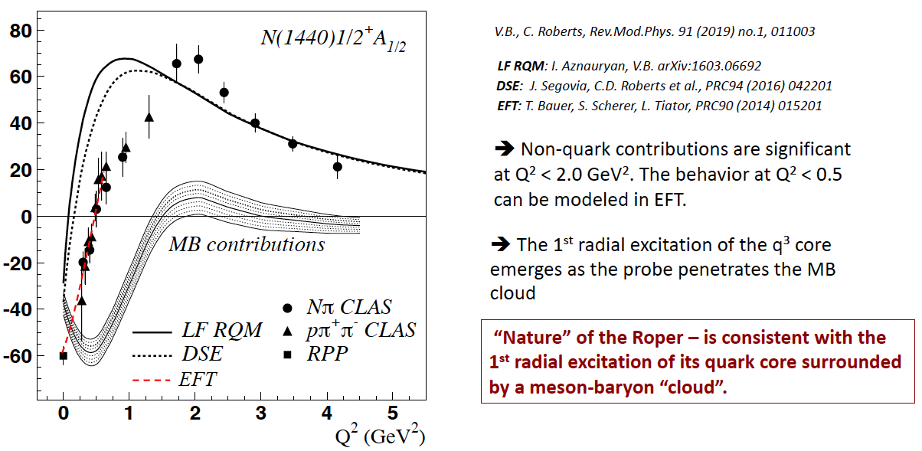
Roper - 1st nucleon radial excitation?

Slide 8
Hybrid Hadrons: Hadrons with Explicit Gluonic Degrees of Freedom
Hybrid hadrons with dominant gluonic contributions are predicted to exist by QCD.
Experimentally:
Hybrid mesons |qqg> states may have exotic quantum numbers J^{PC} not available to pure |qq> states GlueX, MesonEx, COMPASS, PANDA ….
Hybrid baryons |qqqg> have the same quantum numbers J^{P} as |qqq> electroproduction with CLAS12 (Hall B).
Theoretical predictions:
        MIT bag model - T. Barnes and F. Close, Phys. Lett. 123B, 89 (1983).
        QCD Sum Rule - L. Kisslinger and Z. Li, Phys. Rev. D 51, R5986 (1995).
        Flux Tube model - S. Capstick and P. R. Page, Phys. Rev. C 66, 065204 (2002).
        LQCD - J.J. Dudek and R.G. Edwards, PRD85, 054016 (2012).

Slide 9
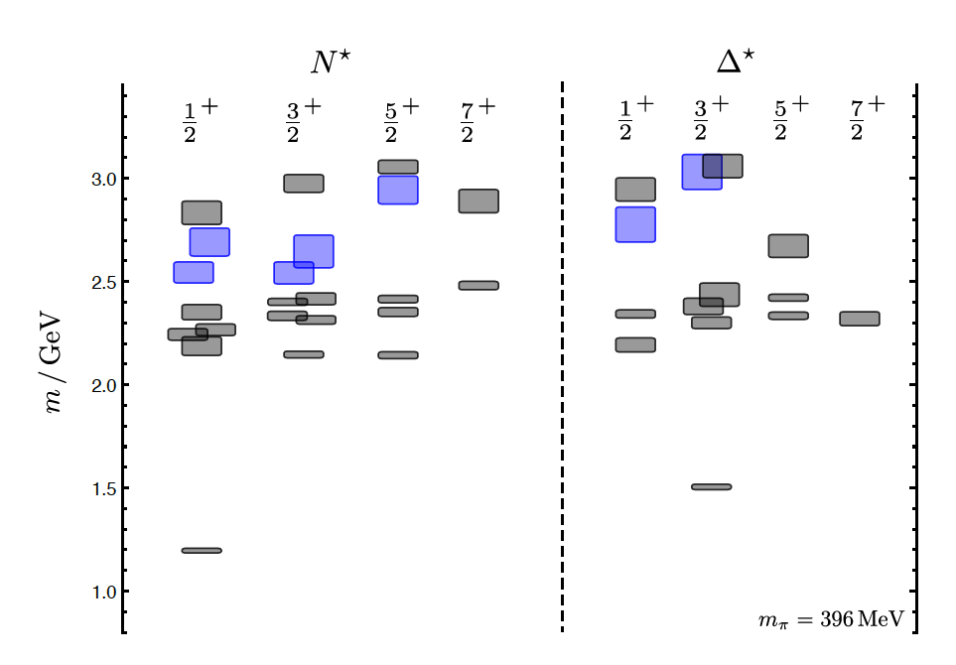
Hybrid Baryons in LQCD
J.J. Dudek and R.G. Edwards, PRD85, 054016 (2012)
regular states
clustered
in mass
hybrid states
LQCD
1.3GeV
The nucleon mass is shifted ~300 MeV to higher masses
Hybrid states have same J^{P} values as qqq baryons. How to identify them?
Overpopulation of N 1/2⁺ and N 3/2⁺ states compared to QM projections. ?
A_{1/2} (A_{3/2}) and S_{1/2} show different Q² evolution.

Slide 10
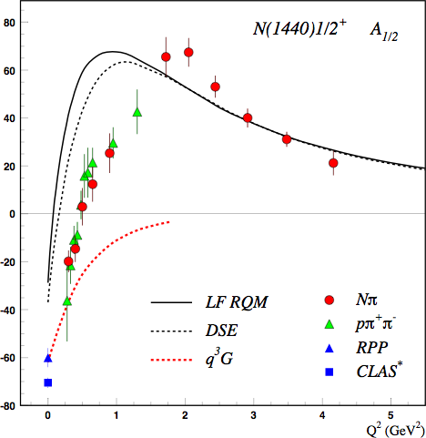
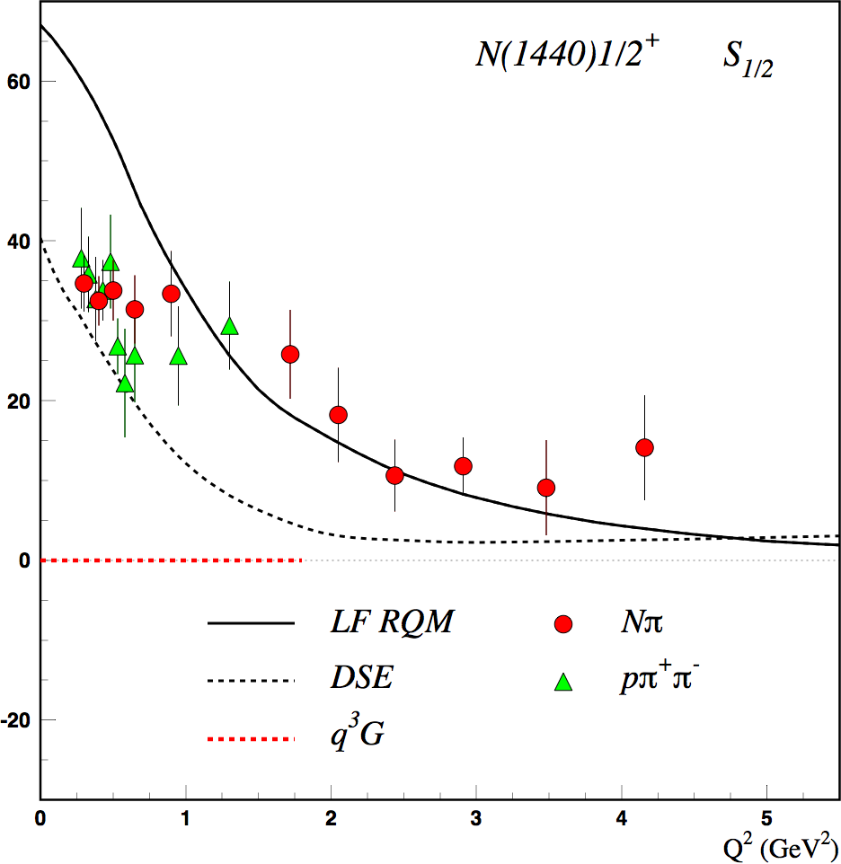
Separating q³g from q³ states ?
CLAS results on electrocouplings clarified nature of the Roper.
Will CLAS12 data be able to identify gluonic contributions ?
q³
q³
q³g
q³g
q³
For hybrid “Roper”, A_{1/2}(Q²) drops off faster with Q² and S_{1/2}(Q²) ~ 0.

Slide 11
Hybrid Baryon Signatures
Based on available knowledge, the signatures for hybrid baryons consist of:
• Extra resonances with J^{p}=1/2⁺ and J^{p}=3/2⁺, with masses > 1.8 GeV and decays into Nππ or KY final states.
•A drop of the transverse helicity amplitudes A_{1/2}(Q²) and A_{3/2}(Q²) faster than for ordinary three quark states, because of extra glue-component in valence structure.
•A suppressed longitudinal amplitude S_{1/2}(Q²) in comparison with transverse electro-excitation amplitude (J^{P}=1/2⁺).
The RG-K proposal focused on: e p $→$e K⁺Λ, e K⁺Σ⁰
The study also includes other single meson channels ($πp$, $ηp$, KY…) and $ππp.$

Slide 12

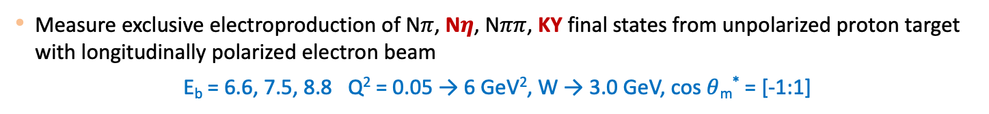
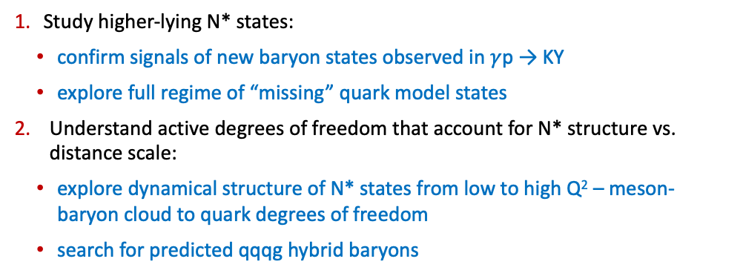
CLAS12 – RG-K N* Program
Measure exclusive electroproduction of N$π$, N$η$, N$ππ$, KY final states from unpolarized proton target with longitudinally polarized electron beam
E_{b} = 6.6, 7.5, 8.8 Q² = 0.05 → 6 GeV², W → 3.0 GeV, cos $θ$_{m}* = [-1:1]
E12-16-010 | A Search for Hybrid Baryons in Hall B with CLAS12
E12-16-010A | N* Studies Via KY Electroproduction at 6.6 and 8.8 GeV
By Dan Carman
Study higher-lying N* states:
confirm signals of new baryon states observed in $γ$p → KY
explore full regime of “missing” quark model states
Understand active degrees of freedom that account for N* structure vs. distance scale:
explore dynamical structure of N* states from low to high Q² – meson-baryon cloud to quark degrees of freedom
search for predicted qqqg hybrid baryons
Probe quark dressing effects and di-quark correlations in N* structure:
important aspect of N* structure and electrocoupling amplitudes
provide insight into emergence of hadron mass vs. Q²
N* states of different structure allow study of different qq correlations

Slide 13
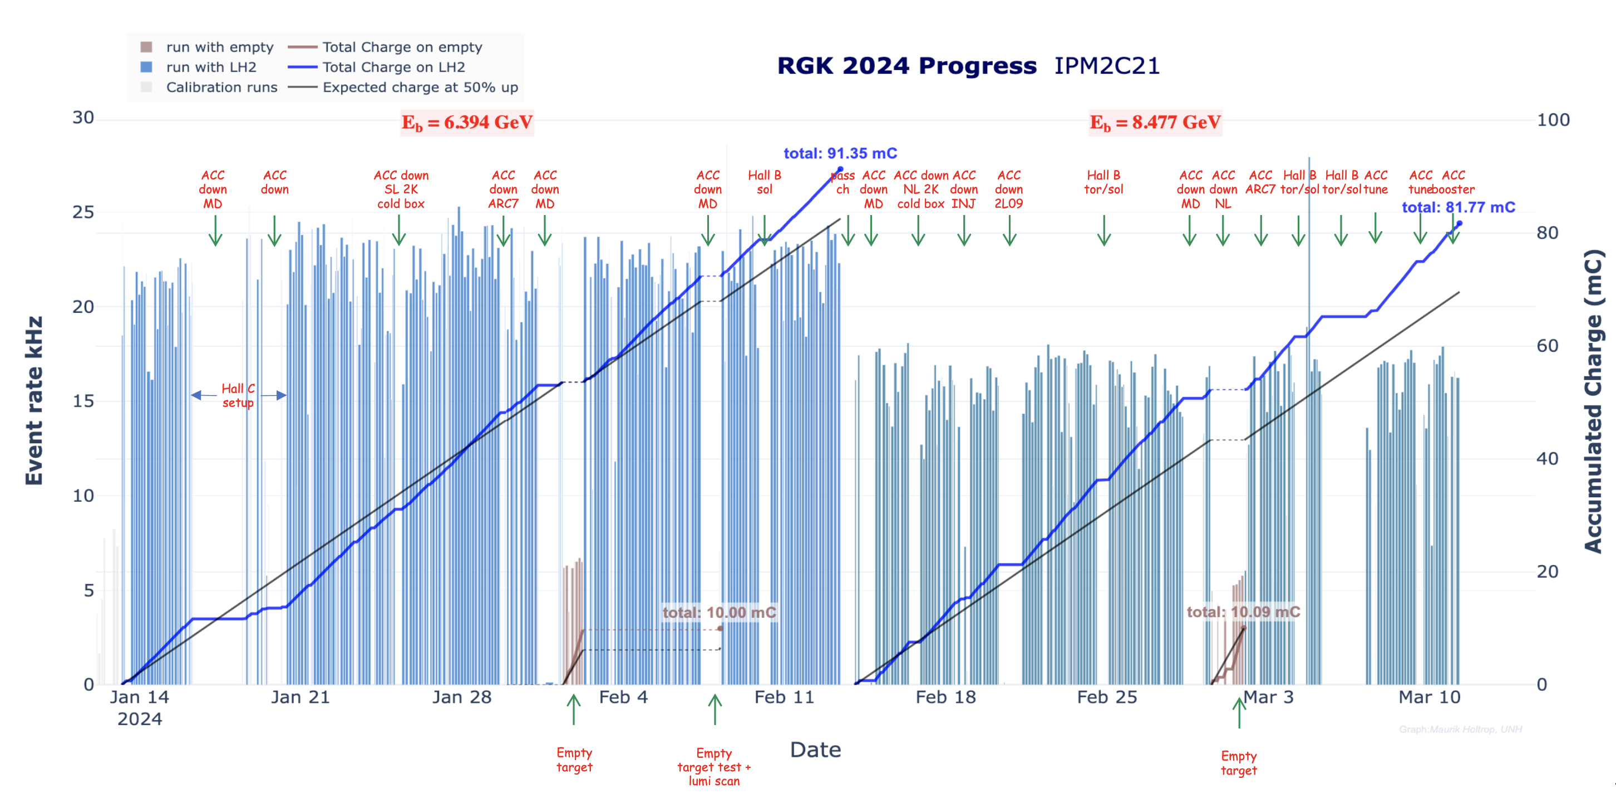
Run Group K Production
Fall 2018
SPRING 2024
FT- OFF
E=7.5GeV
E=6.5GeV
FT- ON
Machine down
FT-OFF
FT- OFF
E=6.4 GeV
E=8.5 GeV
45mC of accumulated charge
Fall 2018
Beam Energy | Beam Current | Collected Events
7.5 GeV | 35 nA | 3.5 G
7.5 GeV | 45 nA | 4.3 G
6.5 GeV | 60 nA | 7.8 G
193mC of accumulated charge
EVENTS
15.6 G
EVENTS
60 G
Spring 2024
Beam Energy | Beam Current | Collected Events
6.4 GeV | 65 nA | 38.3 G
8.5 GeV | 75 nA | 21.7 G
Fall 2018
SPRING 2024
X4 more statistics: 50% of total assigned

Slide 14
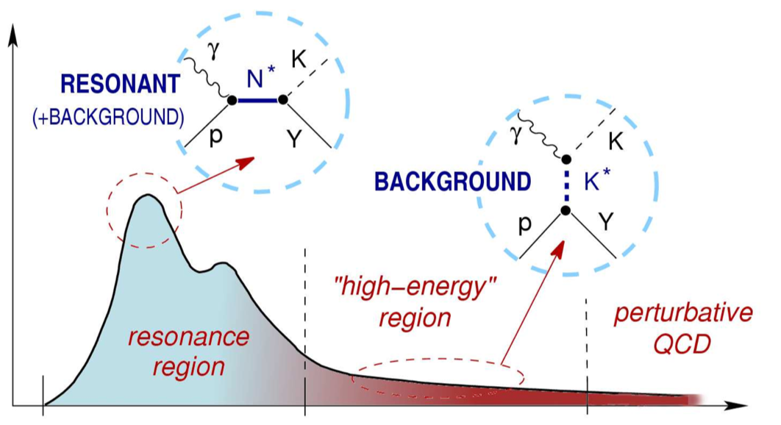
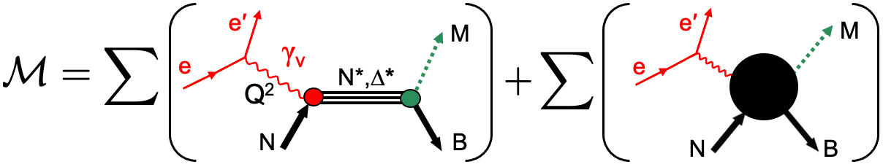
KY Reaction Models
A model that describes the KY data is necessary to extract the g_{v}pN* electrocouplings from the existing lower Q² CLAS data and the higher Q² CLAS12 data
No single channel (isobar type) model has yet been shown to adequately describe the KY electroproduction data in the resonance region
By Dan Carman
cross section
Single Channel:
Unitary Isobar Model and Fixed-t Dispersion relation approaches (Kaon-MAID)
Regge + Resonance model (Ghent)
Isobar models (T. Mart, O. Maxwell, P. Bydžovský)
Multi-Channel:
Bonn-Gatchina multi-channel PWA
Jülich-Bonn-GWU coupled-channel framework
Argonne-Osaka dynamically coupled-channel model
Dubna-Mainz-Taipei dynamical model
Non-Resonant Amplitudes
Resonant Amplitudes
W
But there has been some recent progress!
D.S. Carman, K. Joo, V.I. Mokeev, FBS 61, 29 (2020) M. Mai, Eur. Phys. J. A 59, 286 (2023)
Y.-F. Wang et al, arXiv:2404.17444, (2024)
Cross sections of resonance r of mass M_{r}, width $Γ$_{tot}(M_{r}), and spin J_{r}:
The EM decay widths (N*→ N$γ$) at W=M_{r} are given by:
N

Slide 15
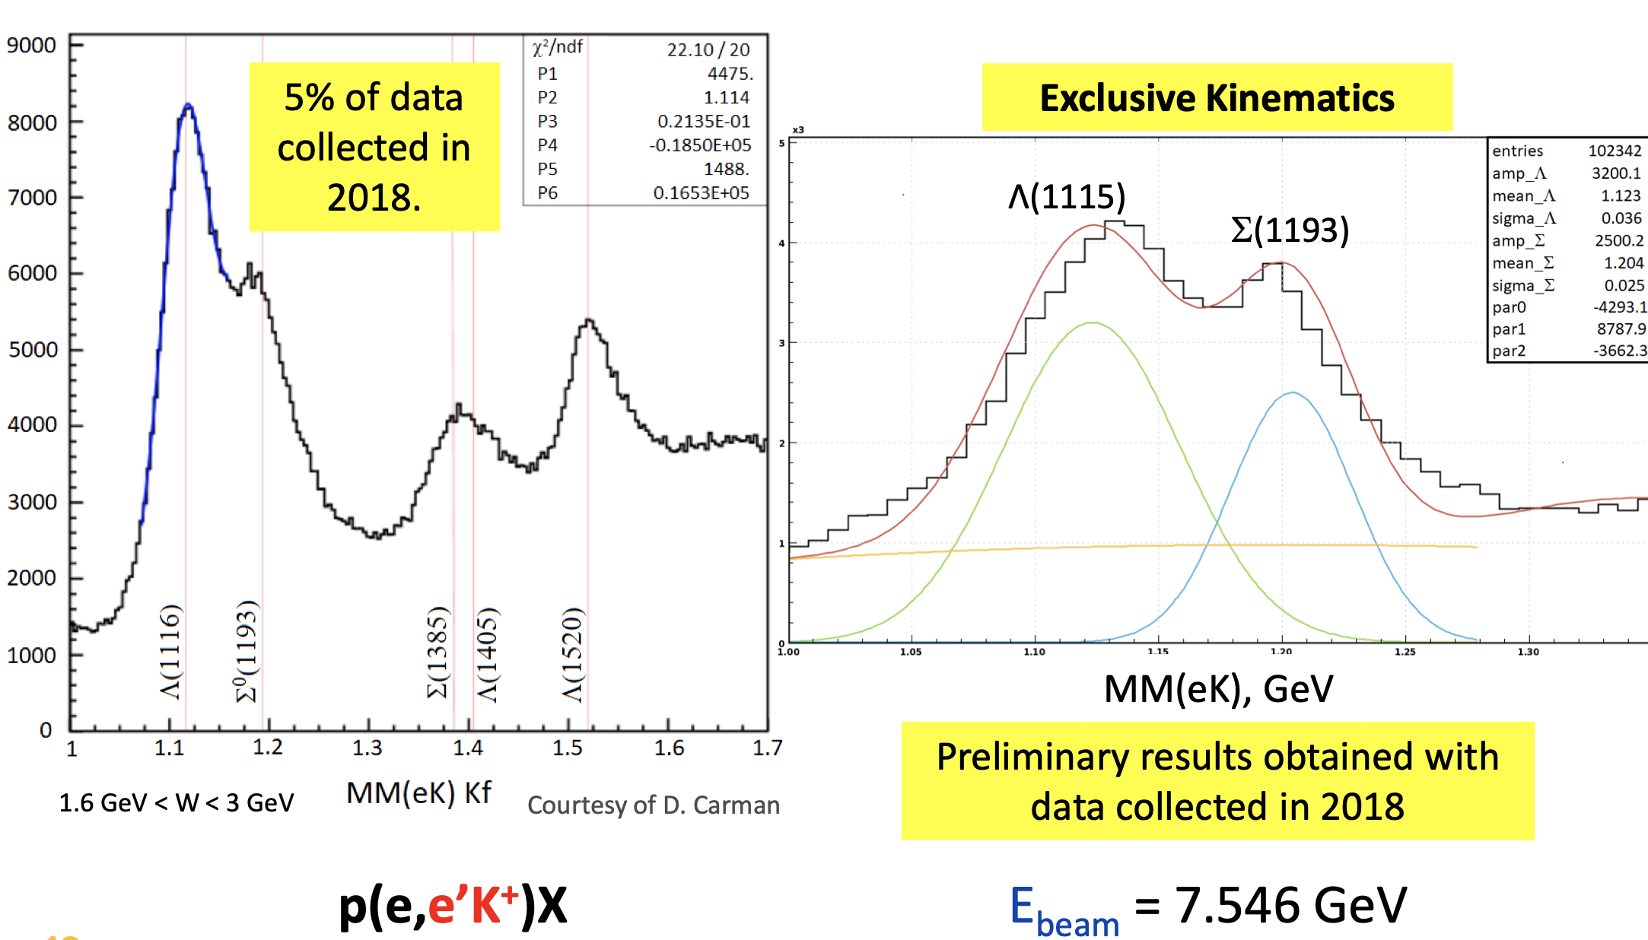
KY Events selection: electron in the FD(CLAS)/FT
FD
FT
Notes:
In this slide you can see the electron K+ missing mass, showing several structures. The main difficulty with this study has been distinguishing the two peaks of lambda and sigma.

Slide 16
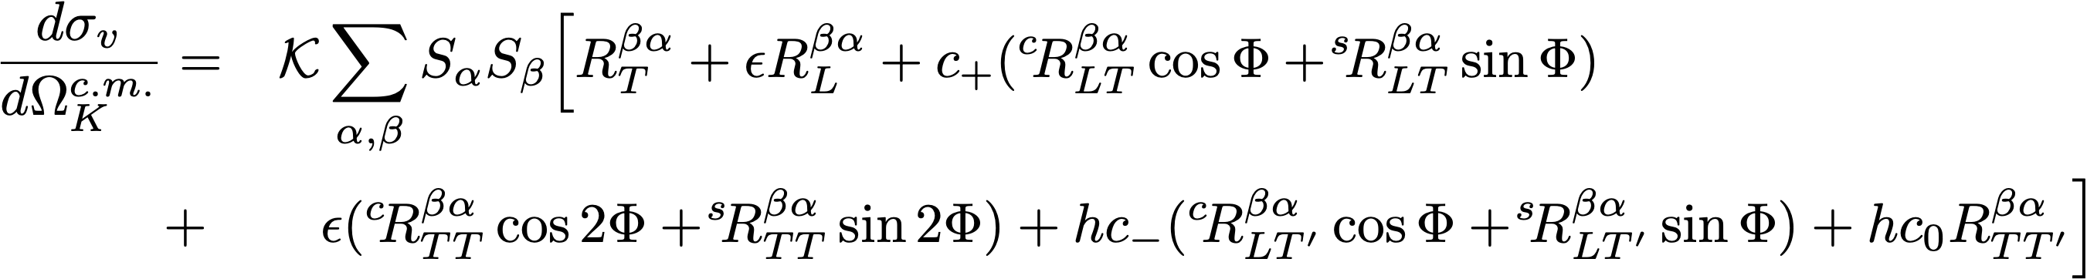
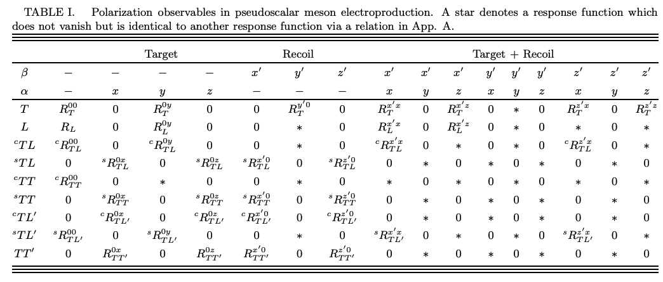

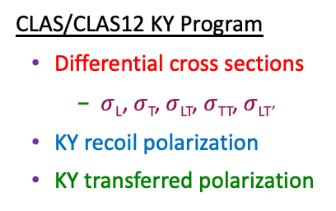
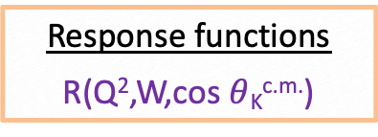
Pseudoscalar Meson Electroproduction Formalism
G. Knöchlein, D. Drechsel, L. Tiator, Z. Phys. A 352, 327 (1995)
By Dan Carman
Response functions
R(Q²,W,cos $θ$_{K}^{c.m.})
CLAS/CLAS12 KY Program
Differential cross sections
  $σ$_{L}, $σ$_{T}, $σ$_{LT}, $σ$_{TT}, $σ$_{LT’}
KY recoil polarization
KY transferred polarization

Slide 17
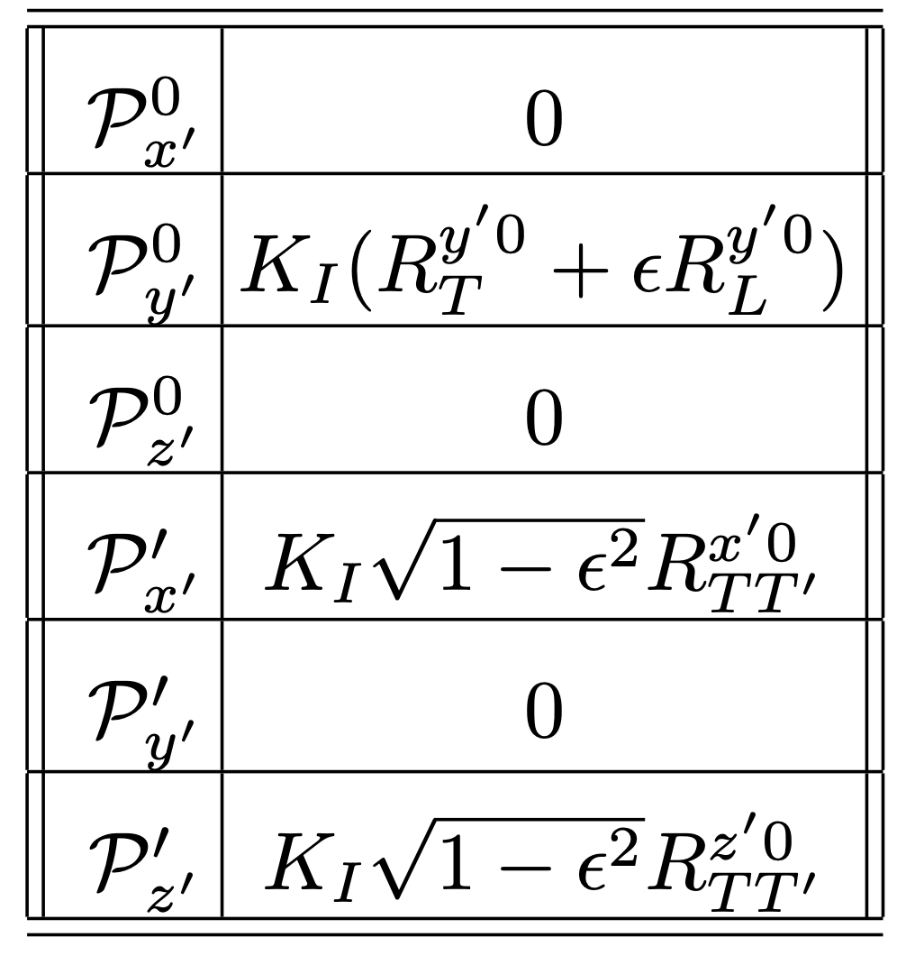
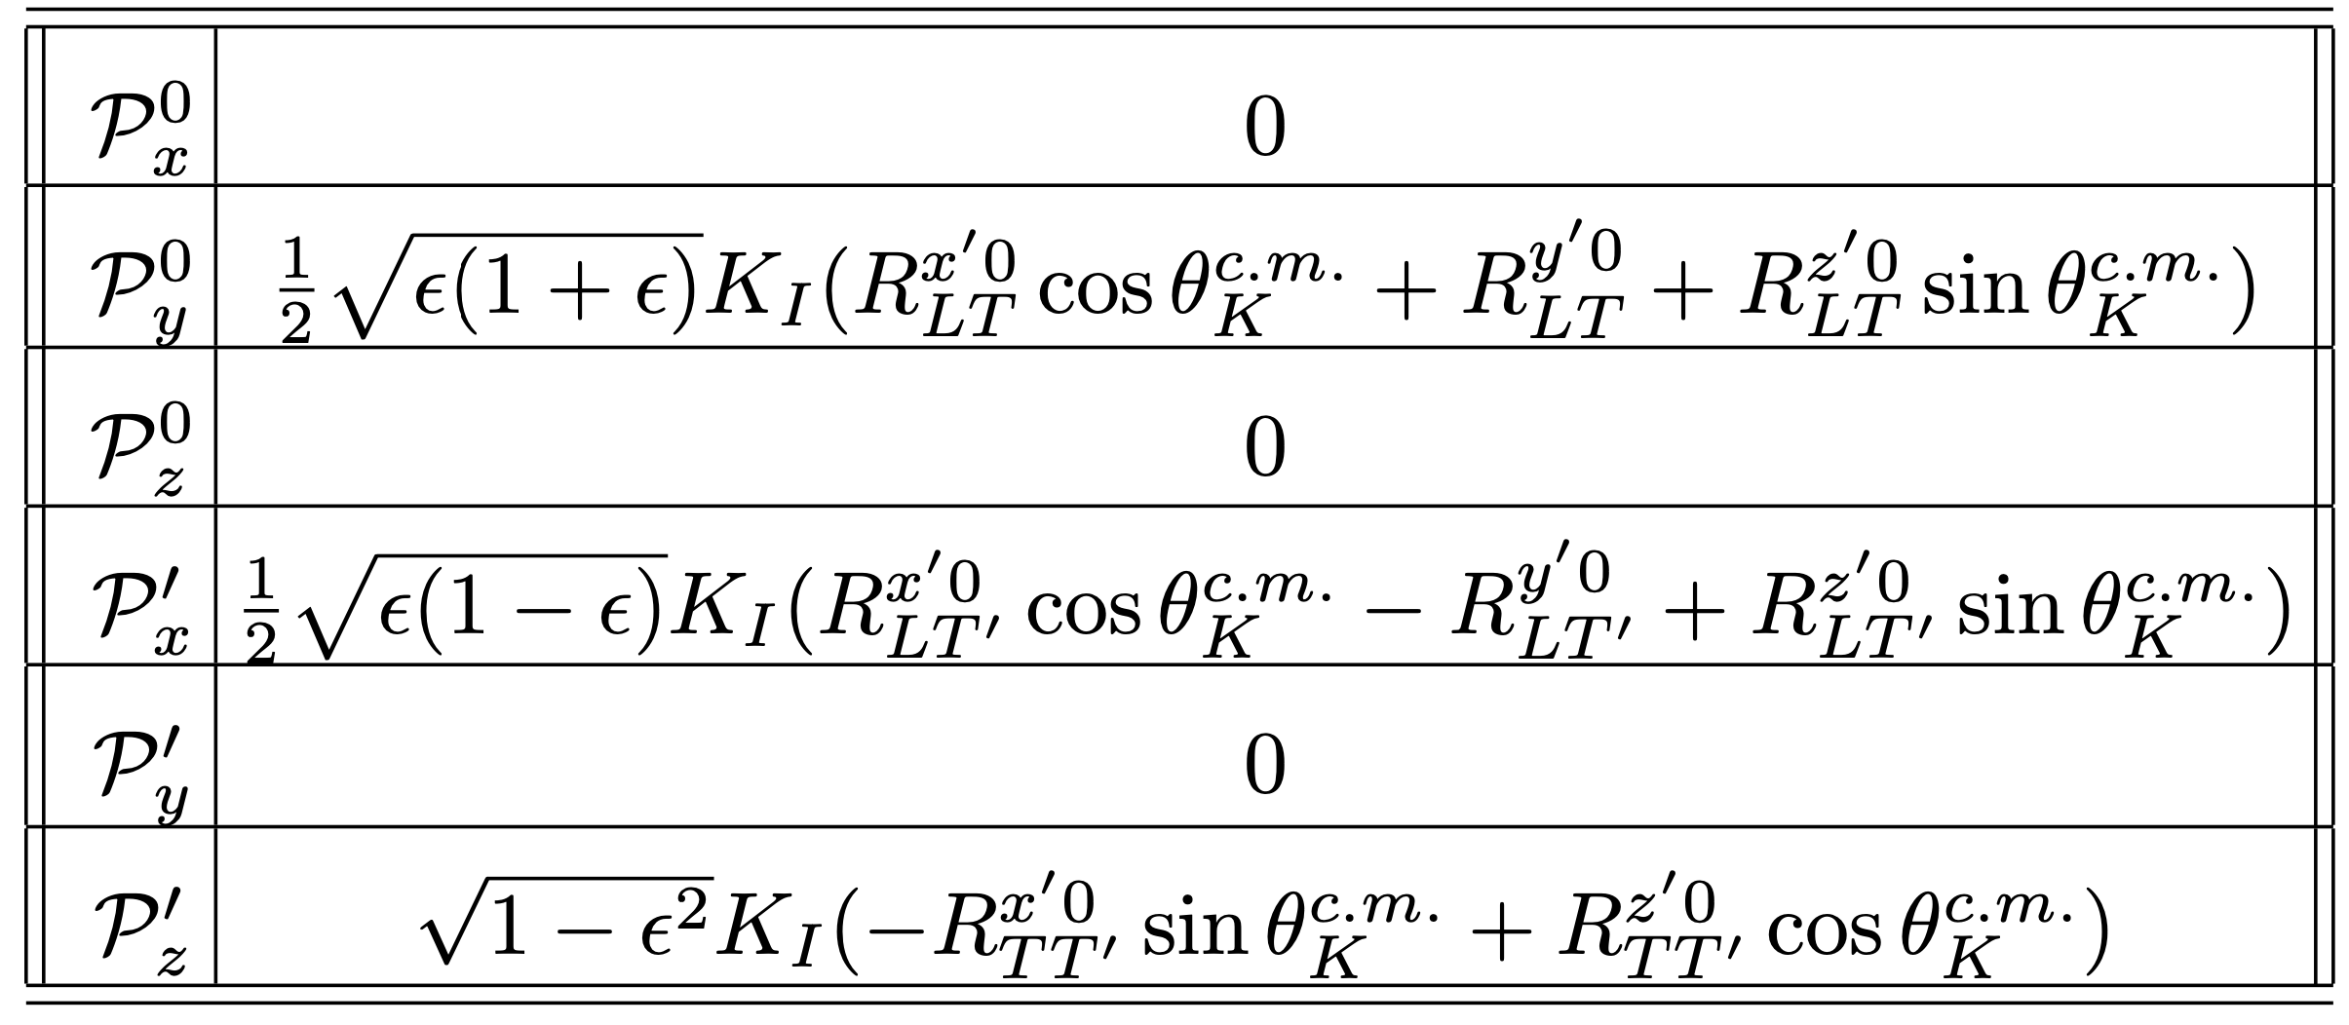
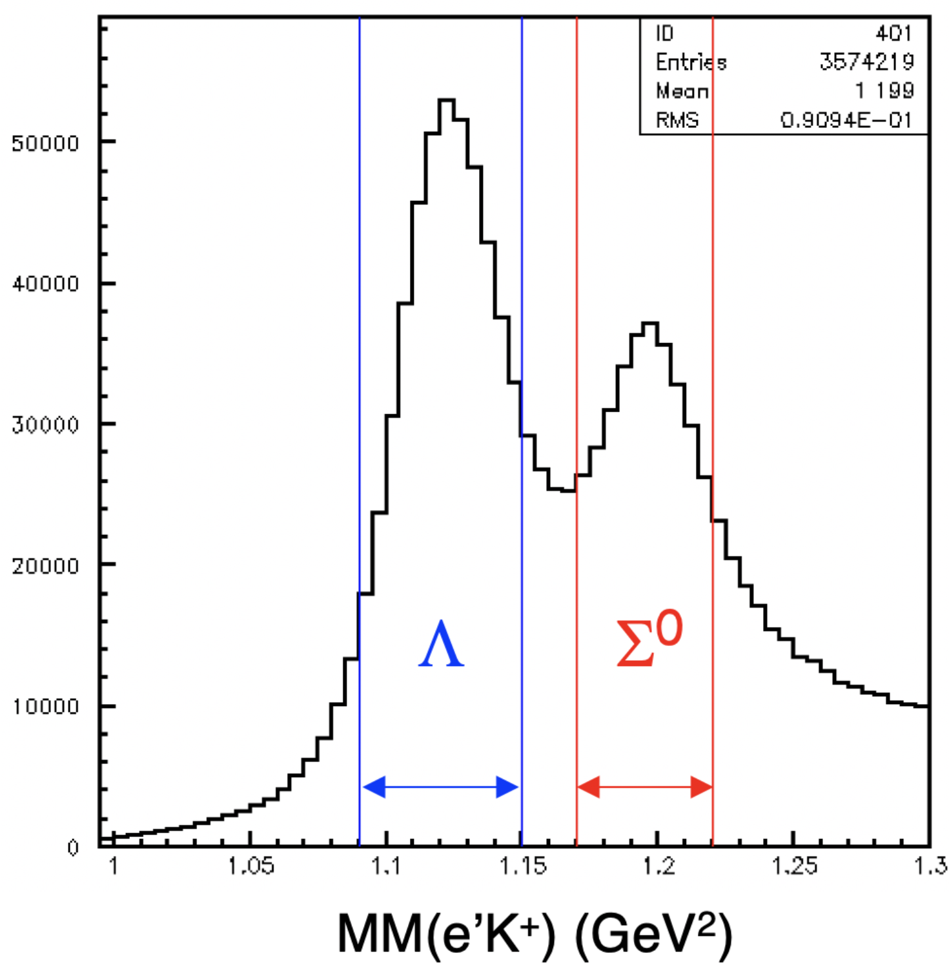
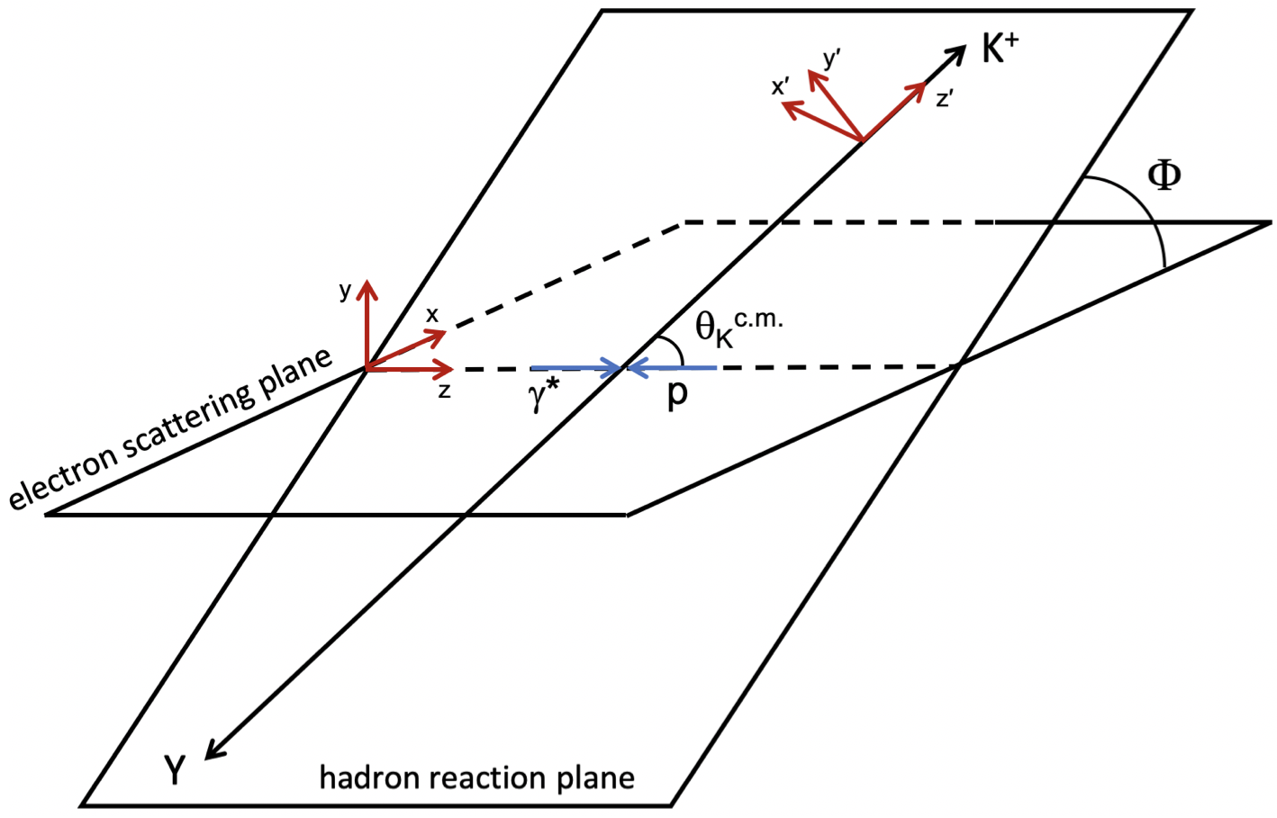
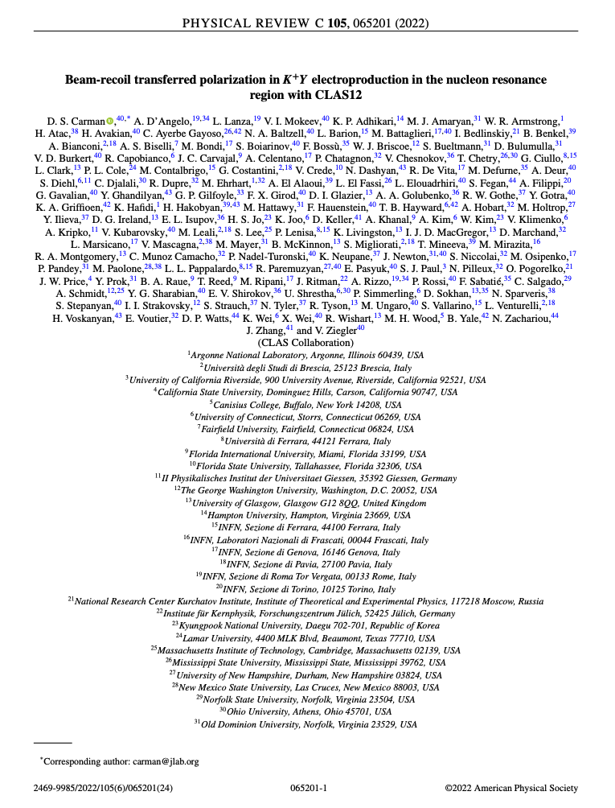
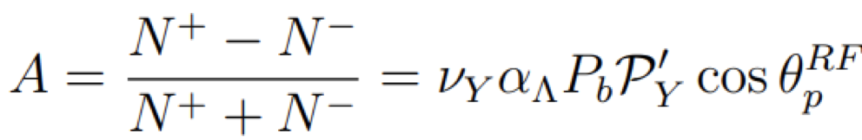

KY Polarization Formalism
RG-K Fall 2018 pass1 data
(x′,y′,z′)
$φ$-integrated
(x,y,z)
By Dan Carman
= recoil polarization
= transferred polarization
ep → e’K⁺Y
D.S. Carman, A. D’Angelo, L. Lanza V. Mokeev (CLAS Collaboration)
“Beam-Recoil Transferred Polarization in K+Y Electroproduction in the Nucleon Resonance Region with CLAS12”
Phys. Rev. C 105, 065201 (2022)
CLAS12 @ 6.5 GeV
MM(e′K⁺) (GeV)

Slide 18
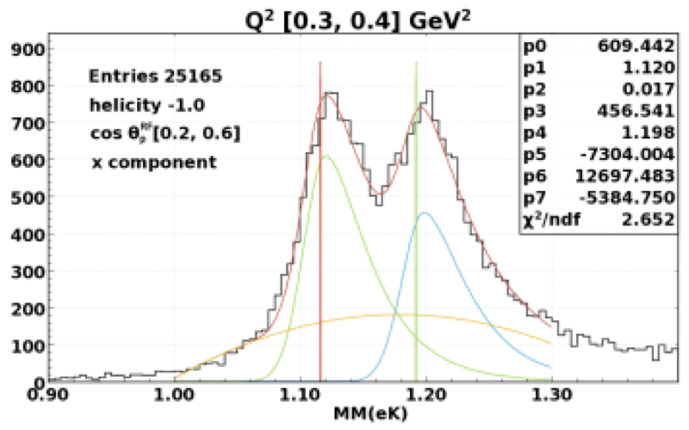
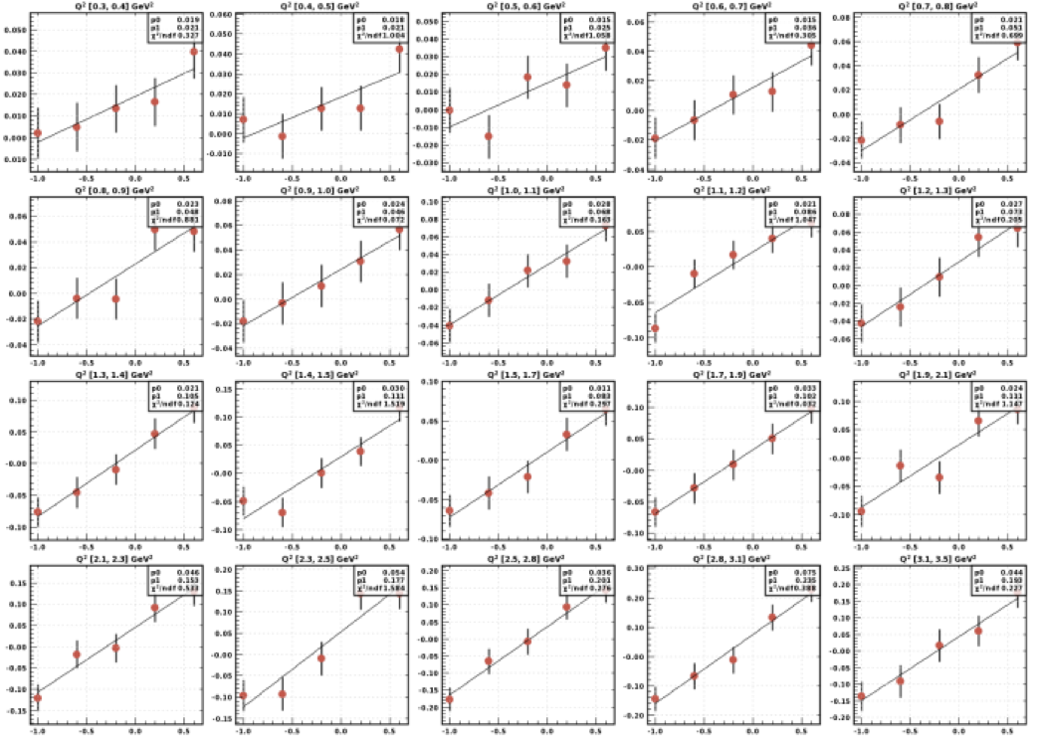
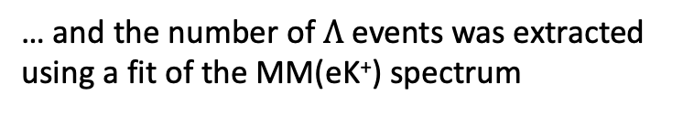
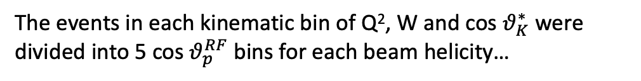
Beam-Recoil Transferred Polarization in K⁺Y Electroproduction
The independent analysis consists of the direct exploitation of equation
By Lucilla Lanza
The events in each kinematic bin of Q², W and cos $θ_{K}^{∗}$ were divided into 5 cos $θ_{p}^{RF}$ bins for each beam helicity…
… and the number of $Λ$ events was extracted using a fit of the MM(eK⁺) spectrum
Notes:
Data collected during this first 10 PAC days already have produced a publication that has been just described in Daniel Carman’s talk. The analysis that has been published has been realized using two different and independent approaches that showed a high compatibility.

Slide 19
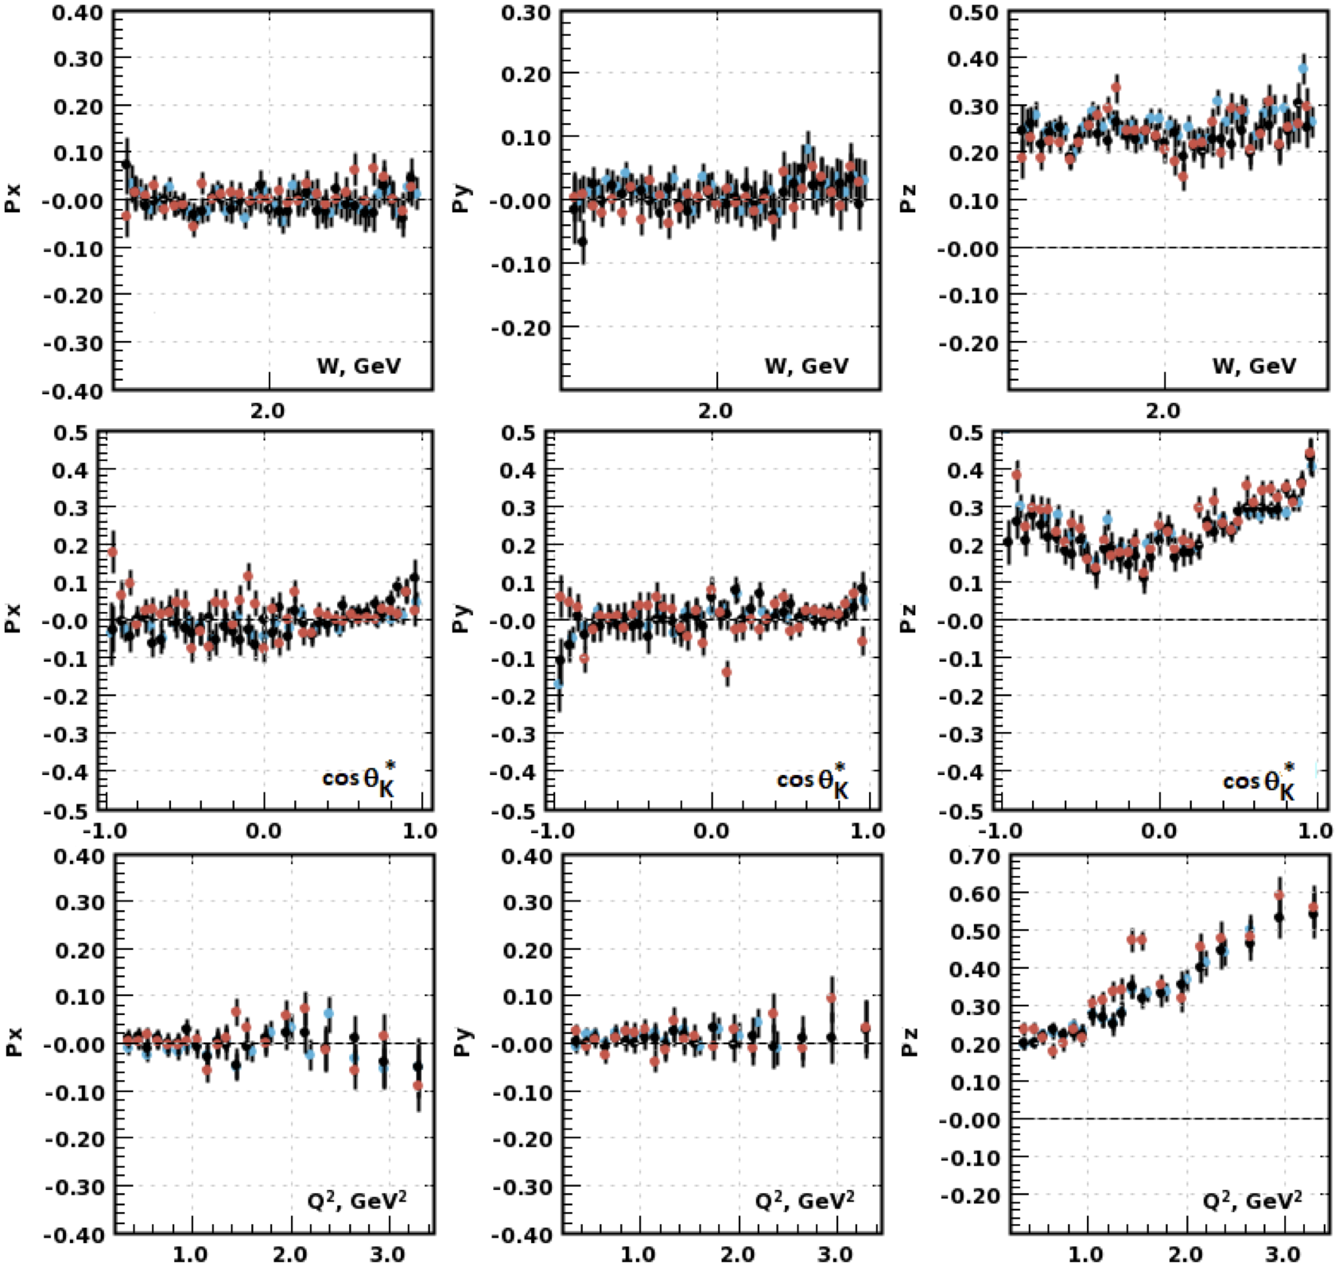

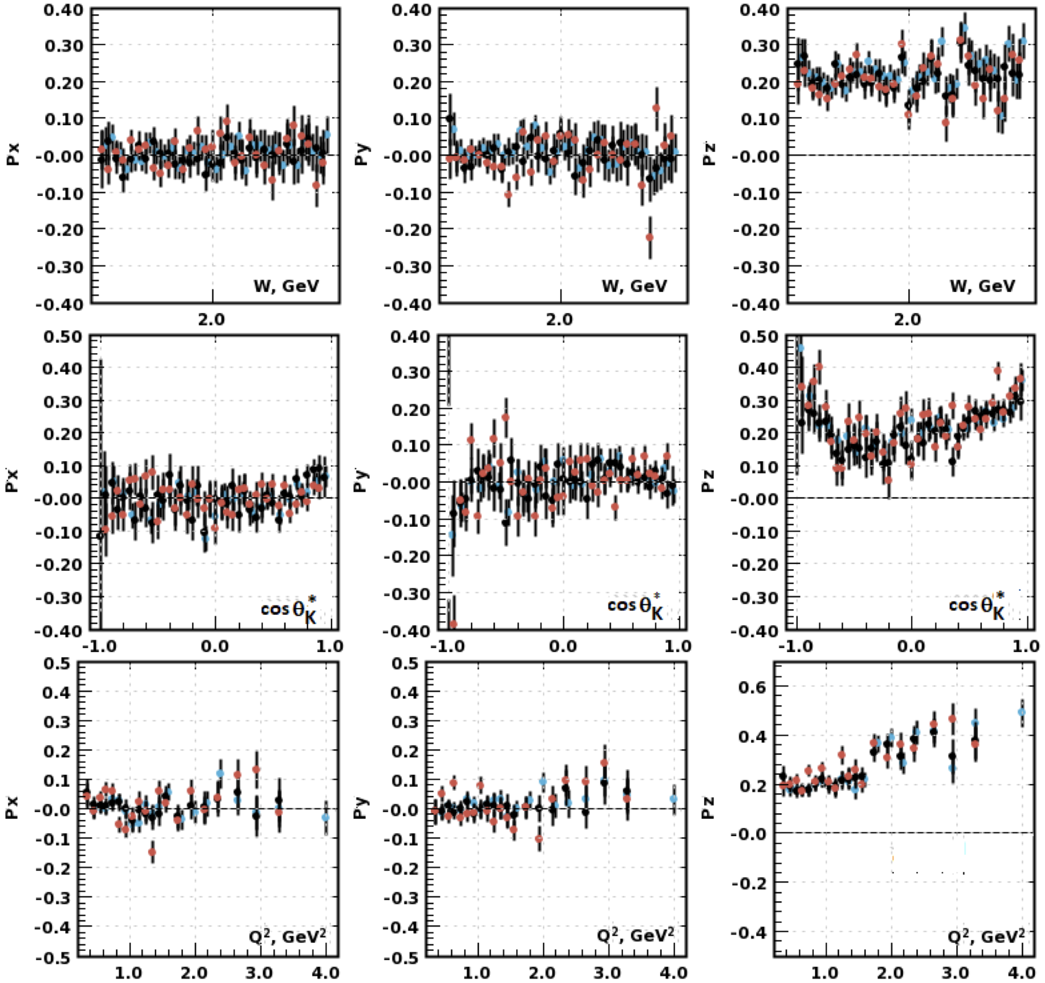
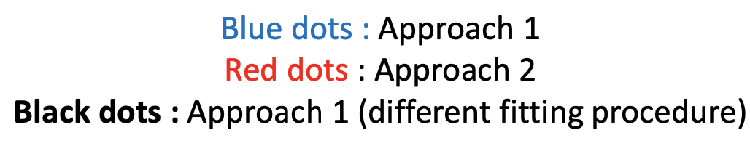
Beam-Recoil Transferred Polarization in K⁺Y Electroproduction
By Dan Carman and Lucilla Lanza
6.5 GeV
7.5 GeV
Notes:
Data collected during this first 10 PAC days already have produced a publication that has been just described in Daniel Carman’s talk. The analysis that has been published has been realized using two different and independent approaches that showed a high compatibility.

Slide 20


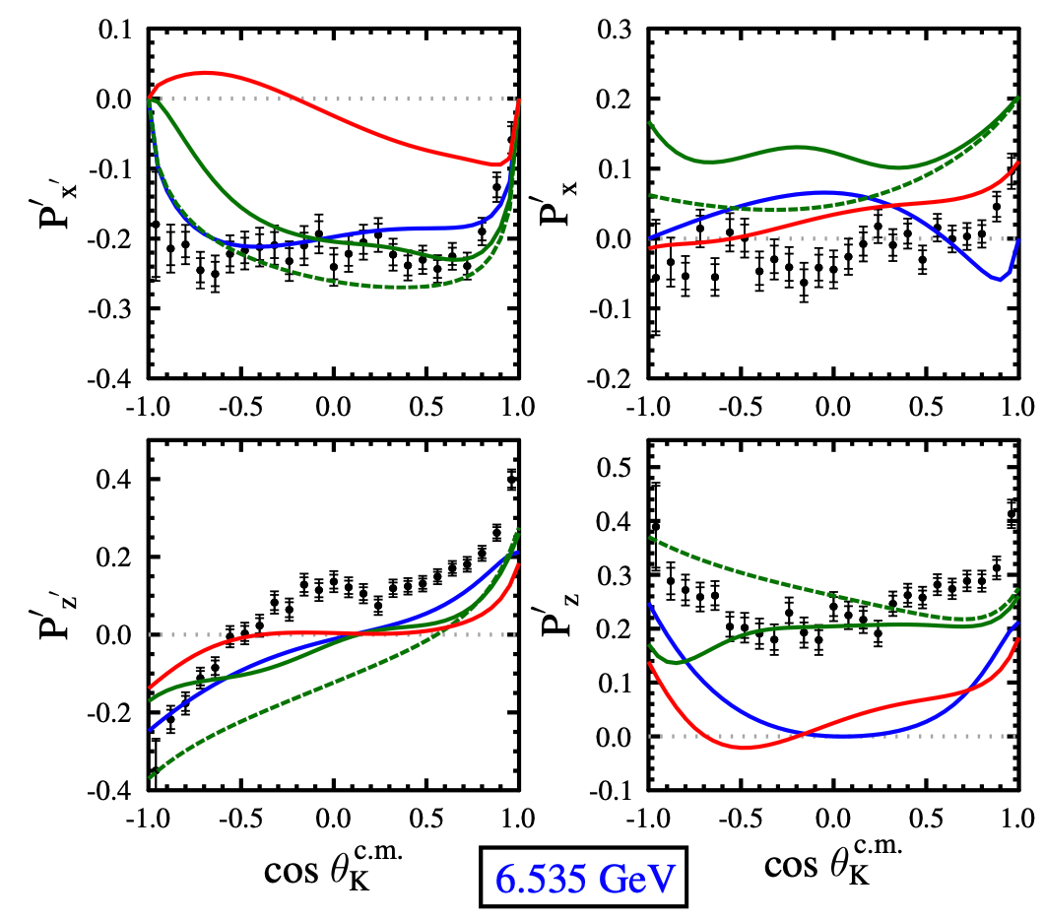
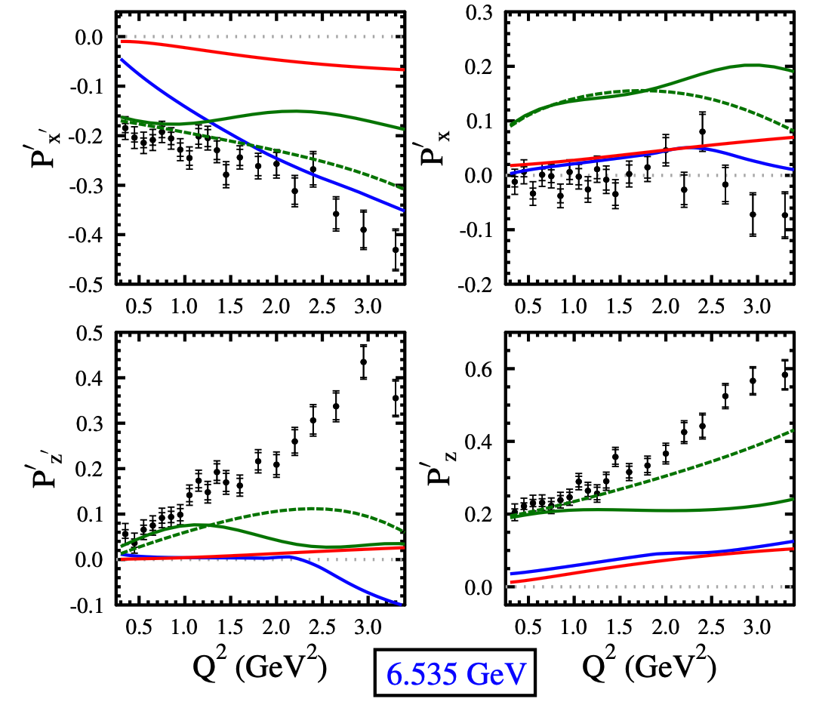
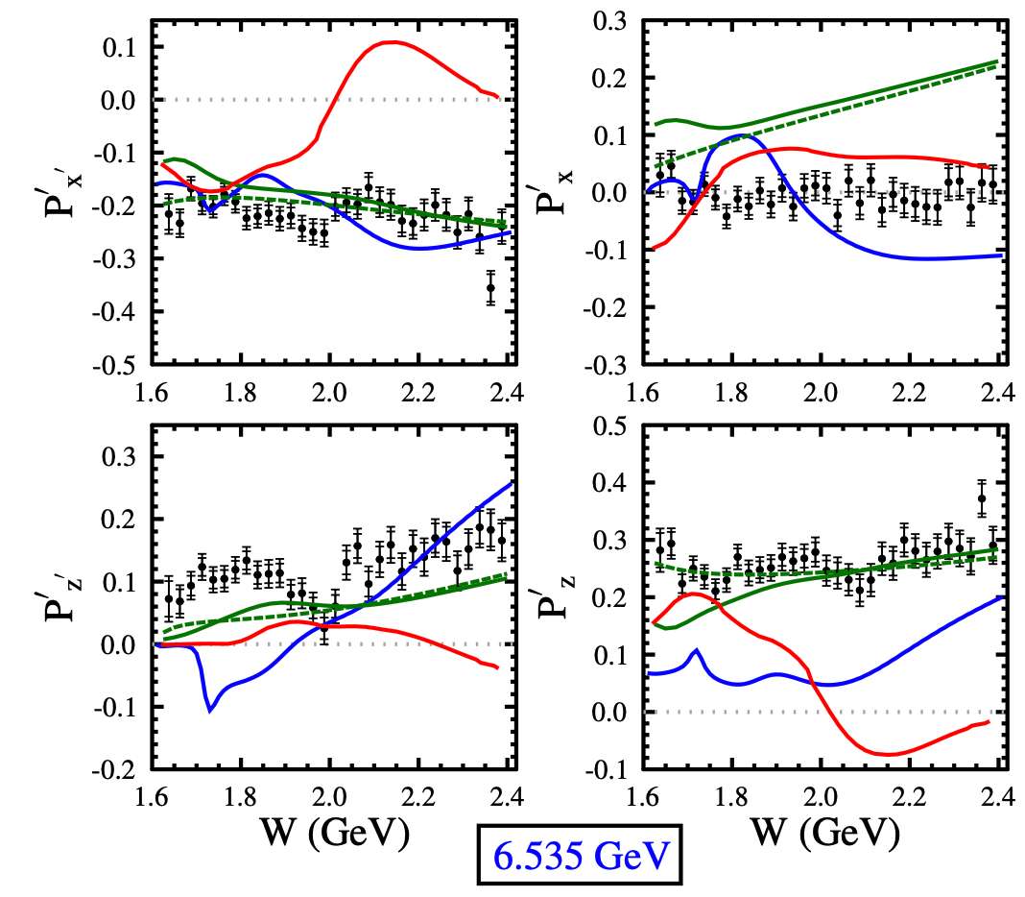


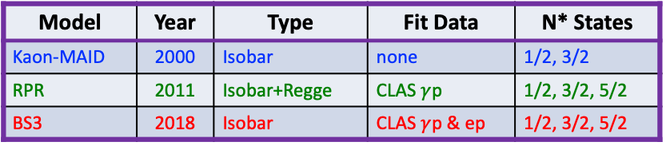
CLAS12 Beam-Recoil $Λ$ Transferred Polarization
Model | Year | Type | Fit Data | N* States
Kaon-MAID | 2000 | Isobar | none | 1/2, 3/2
RPR | 2011 | Isobar+Regge | CLAS $γ$p | 1/2, 3/2, 5/2
BS3 | 2018 | Isobar | CLAS $γ$p & ep | 1/2, 3/2, 5/2
D.S. Carman et al. (CLAS12), PRC 105, 065201 (2022)
Development of reaction models in progress:
T. Mart
M. Döring, M. Mai
P. Bydžovský, D. Skoupil
By Dan Carman

Slide 21
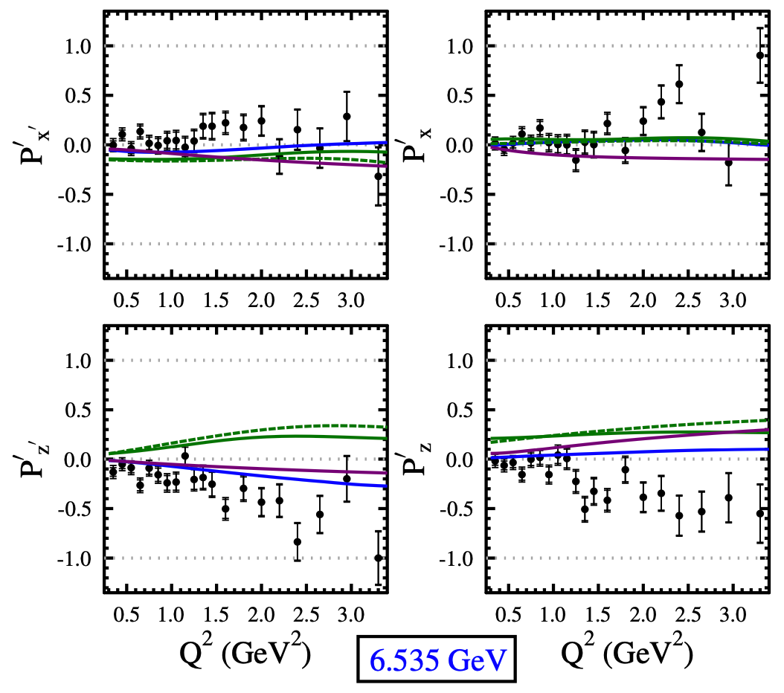
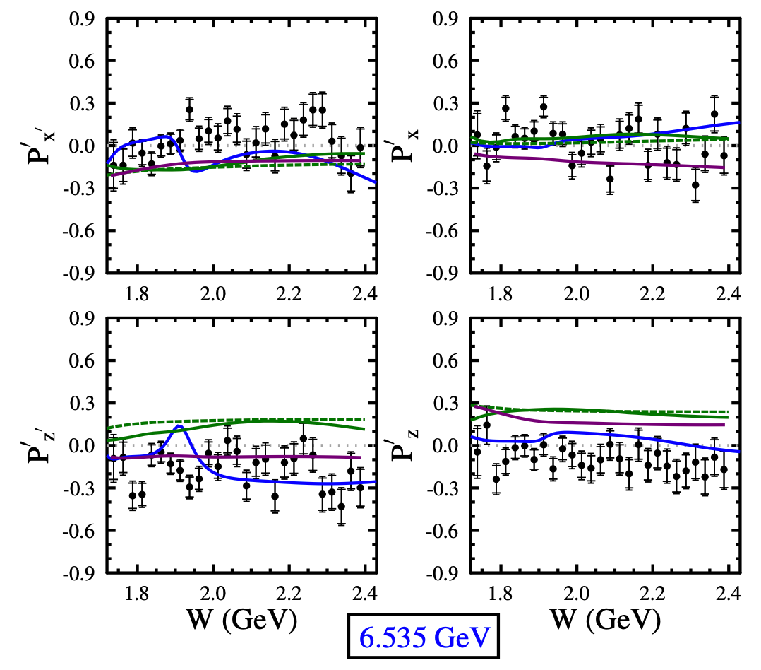
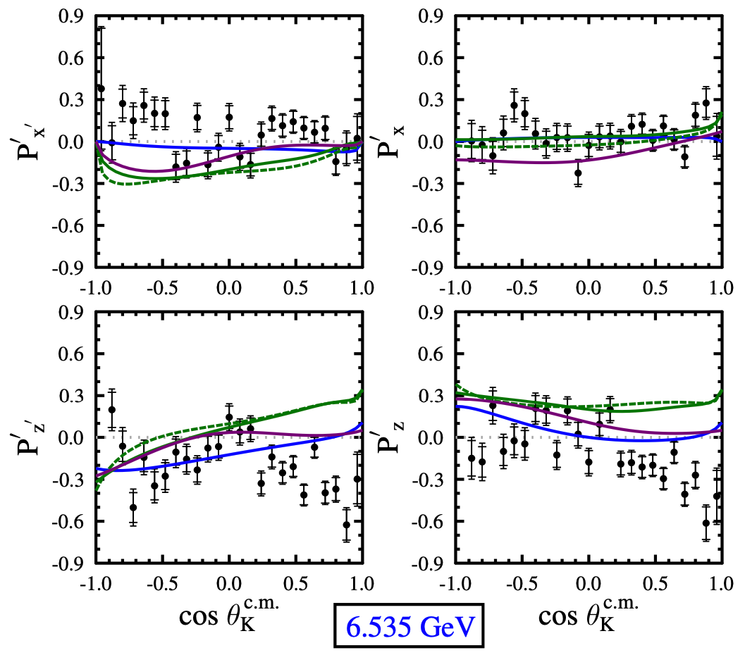



CLAS12 Beam-Recoil $Σ$⁰ Transferred Polarization
Model | Year | Type | Fit Data | N* States
SL | 1996 | Isobar | none | 1/2, 3/2
Kaon-MAID | 2000 | Isobar | none | 1/2, 3/2
RPR | 2007 | Isobar+Regge | CLAS $γ$p | 1/2, 3/2, 5/2
D.S. Carman et al. (CLAS12), PRC 105, 065201 (2022)
K⁺$Σ$⁰ final state has sensitivity to both N* and$Δ$* resonances ⇒ more isospin states compared to K⁺$Λ$ final state

Slide 22
















CLAS12 L/T from Transferred Polarization
$φ$-integrated
W: 1.6-1.7 GeV
W: 1.7-1.8 GeV
W: 1.8-1.9 GeV
W: 1.9-2.0 GeV
At
R_{sm}
W: 2.0-2.1 GeV
W: 2.1-2.2 GeV
W: 2.2-2.4 GeV
W: 2.4-2.6 GeV
⇒
cos $θ$_{K}^{c.m.}
cos $θ$_{K}^{c.m.}
Define:
Extrapolate R_{sum} to to extract R vs. W
PRELIMINARY
Fit function:
B.A. Raue and D.S. Carman, PRC 71, 065209 (2005)
D.S. Carman et al. (CLAS), PRC 79, 065205 (2009)
By J. Landwersiek, FIU

Slide 23


K⁺Y Induced Polarization CLAS12
‘
‘
‘
x and z components still not fully compatible with 0
as expected from theory
The analysis will be improved once the Spring 2024 data will be available for analysis
Preliminary
‘
‘
‘
Preliminary
‘
‘
‘
Preliminary
By Lucilla Lanza
Notes:
We expect that the statistics will improve and also the data quality due to new HV calibrations.

Slide 24





$Λ$(1520)
kFWD pFWD
Other channels could be exploited as final states for possible new resonances..
The existence of several non-strange N∗ resonances with significant (∼5%) branching ratios into the $K^{+}Λ$(1520) decay channel has been predicted
$$Λ(1116)$$
$$Σ(1193)$$
$$Σ(1385)$$
$$Λ(1405)$$
$ep→eK^{+}Λ(1520)→eK^{+}$ $K^{−}p$
$$Λ(1520)$$
→ S. Barrow et al., CLAS Coll., Phys.Rev.C64:044601,2001
→ Simon Chapstick and W. Roberts, Phys. Rev. D 58 074011
$Λ(1520) a$rises as a separate structure
Notes:
Lambda fifteen twenty.

Slide 25




$Λ$(1520)
kFWD pFWD
kCTRL pFWD
Preliminary
Preliminary
Preliminary
By Lucilla Lanza
$ep→eK^{+}Λ(1520)→eK^{+}$ $K^{−}p$
Notes:
Lambda fifteen twenty.

Slide 26









$Λ$(1520)
6.5 GeV full dataset
$${\text{x}10}^{3}$$
150K events extimated - gaussian integral
It is possible to isolate $Λ(1520)$ also in events with an electron detected in the FT
Preliminary
Fall18+Spr24 statistics 5x
7.5 GeV dataset
Preliminary
Preliminary
$ep→eK^{+}Λ(1520)→eK^{+}$ $K^{−}p$
By Lucilla Lanza
Notes:
Lambda fifteen twenty.

Slide 27


Unique Opportunity of Nη Final States
Key Idea: Nη final states provide a cleaner probe of nucleon resonances compared to Nπ final states
η is isospin singlet (I = 0) → “isospin filter” (Nη final states access only I = 1/2 nucleon resonances)
Complements Nπ studies in a coupled-channel approach
Particle | J^{p} | Fraction $Γ_{i}/Γ$ for Decay Modes
 |  | N$π$ | N$η$
N(1440) | 1/2⁺ | 55-75 % | <1%
N(1520) | 3/2 ⁻ | 55-65% | 0.07-0.09 %
N(1535) | 1/2⁻ | 32-52 % | 30-55%
N(1650) | 1/2⁻ | 50-70 % | 15-35%
N(1675) | 5/2⁻ | 38-42 % | <1%
N(1680) | 5/2⁺ | 60-70 % | <1%
N(1700) | 3/2⁻ | 7-17 % | 1-2%
N(1710) | 1/2⁺ | 5-20 % | 10-50%
N(1720) | 3/2⁺ | 8-14 % | 1-5%
N(1875) | 3/2⁻ | 3-11 % | 3-16%
N(1880) | 1/2⁺ | 3-31 % | 1-55%
N(1895) | 1/2⁻ | 2-18 % | 15-45%
N(1900) | 3/2⁺ | 1-20 % | 2-14%
N(2060) | 5/2⁻ | 7-12 % | 2-38%
N(2100) | 1/2⁺ | 8-32 % | 5-45%
Notes:
First, let's start the talk by discussing why we use eta mesons in our research. Eta is a convenient tool because it acts as an isospin filter. This means that eta only accesses specific nucleon resonances with isospin 1/2, which are the N* resonances. However, when we study the eta decay channel, it knocks out all the Delta* resonances, leaving only the N* resonances in the spectrum. This is advantageous because it helps to reduce the complexity of the spectrum and enhance the extraction of resonance properties.
Most of the world database focuses on pion decays, which have access to both N* and Delta* resonances. While this is useful for studying the complete resonance spectrum, it can sometimes make it difficult to disentangle specific resonances due to their complicated overlapping behavior.
Eta, on the other hand, not only eliminates the Delta* resonances but also doesn't decay strongly to all nucleon resonances. As shown in this table, the channels with large decay rates for eta are the N(1535), N(1650), N(1710), and N(1895) resonances. This allows us to focus on these specific resonances, as eta preferentially decays to them.
By using eta as a probe, we can effectively reduce the complexity of the resonance spectrum and simplify the process of extracting the properties of individual resonances. However, it's important to note that studying eta decays alone is not sufficient for a comprehensive understanding of nucleon resonances. To achieve a complete picture, we need to complement eta studies with pion studies in a coupled-channel approach.
By combining information from multiple decay channels, we can disentangle the contributions of individual resonances and extract reliable information about their properties. This is why our research on eta electroproduction plays a crucial role in the broader context of nucleon resonance studies.
In summary, the unique properties of eta as an isospin filter make it a valuable tool for studying nucleon resonances. It reduces complexity, enhances resonance extraction, and complements pion studies in a coupled-channel approach. This is the main reason why we have chosen to focus on eta electroproduction in our research.
########################################
Using CLAS12 data we can investigate the electroproduction of the η mesons, which will provide a useful tool to study nucleon resonances N*. Due to the fact that η has isospin I = 0 this provides an “isospin filter” that allows us to access nucleon resonances where I = ½. This work is in contrast to the bulk of the current world database, which focuses on πN final states.
Outside of the S11(1535) I’d like to highlight N(1710), which is listed in the PDG as having a branching ratio of
“A prominent peak in the total cross section is seen for η production at W = 1.535 GeV in both γN and πN experiments…This state has a branching ratio to ηN of 45-60% compared to at most a few percent [9, 10] for other states. This is a very interesting and unusual pattern.” (Denizli, 2007) Threshold for eta at ~1.49(1.4856) GeV and threshold for eta’ at ~1.75 GeV
There is only one resonance N(1895) that has possibly a large Eta' coupling. The science could then be to extract the transition form factor for that resonance by isolating this state in N-eta' decay.
Re N(1895) not strongly coupled to the pion, only 1 star
N*: Nucleon excited states with isospin I = 1/2
Δ*: Delta excited states with isospin I = 3/2

Slide 28

η Electroproduction Kinematics
Key Idea: The η electroproduction reaction is studied in the center-of-mass frame, with key kinematic variables W, Q², cos(θ*), and φ*.
Center-of-mass frame: resonance is at rest
ep → e'p'η
By Izzy Illari
Notes:
In this slide, we introduce the key kinematic variables and the reaction framework for studying eta electroproduction. It's crucial to establish a common language and understanding of these variables as they form the basis for our analysis.
The reaction we are studying is ep → e'p'η, where an electron (e) interacts with a proton (p) target, resulting in a scattered electron (e'), a recoil proton (p'), and an eta meson (η). To simplify the analysis, we work in the center-of-mass frame, where the resonance is at rest.
The diagram on the slide illustrates the geometry of the reaction. The electron beam and the scattered electron define the scattering plane, while the virtual photon, the target proton, the recoil proton, and the produced eta meson define the reaction plane.
Now, let's discuss the key kinematic variables:
W is the center-of-mass energy, which is the invariant mass of the virtual photon and the target proton system. It is calculated as the magnitude of the sum of the four-momenta of the virtual photon and the target proton.
Q^2, often referred to as the photon virtuality, represents the negative square of the four-momentum transfer from the electron to the proton. It quantifies the energy and momentum carried by the virtual photon.
cos(θ*) is the cosine of the polar angle of the eta meson in the center-of-mass frame, defined relative to the virtual photon momentum direction.
φ* is the azimuthal angle of the eta meson in the center-of-mass frame, defined relative to the electron scattering plane.
These four variables—W, Q^2, cos(θ*), and φ*—fully describe the kinematics of the eta electroproduction reaction. They allow us to probe different aspects of the reaction and extract information about the underlying physics, such as the structure of the proton and the properties of nucleon resonances.
########################################
Q2 photon virtuality
W sqrt(s) center of mass energy
The reaction is depicted in the center of mass system, where the resonance is at rest. The meson decay polar angle (theta) is defined relative to the virtual photon momentum, and the azimuthal angle (phi) is defined relative to the the electron scattering plane.

Slide 29
Beam Spin Asymmetry (A_{LU}) in η Electroproduction
Key Idea: First ever measurement of the beam spin asymmetry in exclusive η electroproduction in a previously unexplored kinematic region (1.6 ≤ W ≤ 2.2 GeV).
Longitudinally polarized electron beam on unpolarized stationary proton target
Complements existing cross section and polarization observable measurements
Polarized cross sections:
Beam Spin Asymmetry A_{LU}:
A_{LU}
Sin φ* Moment:
N± = η signal yield for (±1) helicity
P_{b} = beam polarization (= 0.8517)
By Izzy Illari
Notes:
Now that we've established the importance of using eta mesons in our research, let's dive into the specific objective of our study. Our goal is to measure the beam spin asymmetry, denoted as ALU, in exclusive eta electroproduction in a previously unexplored kinematic region.
This is the first-ever measurement of ALU in eta electroproduction for the W range between 1.6 and 2.2 GeV. By focusing on this specific kinematic region, we aim to complement existing cross section and polarization observable measurements, providing new insights into nucleon resonances in this energy range.
To achieve this, we utilize a longitudinally polarized electron beam incident on an unpolarized stationary proton target. The beam spin asymmetry, ALU, is defined as the ratio of the difference and sum of the eta signal yields for positive and negative beam helicities, normalized by the beam polarization.
As shown in the equation, ALU is proportional to the sine moment of the differential cross section, which is expressed as the difference between the eta signal yields for positive and negative helicities, divided by their sum and the beam polarization factor.
In our experiment, the beam polarization, Pb, is 0.8517, which is taken into account when calculating the beam spin asymmetry.
By measuring ALU in this unexplored kinematic region, we aim to shed light on the contributions of specific nucleon resonances, such as the N(1710) and N(1895), which have significant branching ratios to the eta decay channel.
These measurements will provide valuable data to constrain theoretical models and improve our understanding of the nucleon resonance spectrum and their properties. The results of this study will contribute to the ongoing efforts in the field of hadron spectroscopy and the exploration of the strong interaction dynamics in the non-perturbative regime.

Slide 30


Event Selection and η Identification
Key Idea: η mesons are identified using the missing mass technique in the ep → e'p'X reaction (e and p in the FD)
Reconstruct the missing mass squared (MM²) of the undetected particle X
η signal appears as a peak around MM² = 0.3 GeV²
Apply analysis cuts:
  W < 2 GeV (nucleon resonance region)
  0.15 GeV² < MM² < 0.45 GeV² (η peak region)
Implement standard RGK fiducial cuts and cuts developed for analysis
Proton in FD
η
Event Selection
ω/ρ⁰
π⁰
PRELIMINARY
PRELIMINARY
Missing Mass² of X [GeV²]
By Izzy Illari
Missing Mass² of X [GeV²]

Slide 31

Signal Extraction and Background Fit
Key Idea: Extracting the η signal yield requires fitting the missing mass squared distribution with a combination of signal and background fits.
Signal: Fitted using a Gaussian function
Background: Fitted using polynomial functions of various orders (pol2, pol3, pol4)
pol3 chosen as the "benchmark" fits, balancing bias and variance
Systematic uncertainty analysis is preliminary
  Dominant source considered is the yield extraction procedure, estimated by comparing different background fits (pol2, pol3, pol4)
pol3 as “benchmark”
PRELIMINARY
PRELIMINARY
PRELIMINARY
By Izzy Illari

Slide 32


Representative Fit to Beam Spin Asymmetry
Key Idea: The BSA is extracted by fitting the asymmetry as a function of φ* with a sine function.
Data are binned over W and φ*, integrated over Q² and cosθ*
A_{LU}
A_{LU}
PRELIMINARY
PRELIMINARY
PRELIMINARY
PRELIMINARY
A_{LU}
A_{LU}
By Izzy Illari

Slide 33

Sine Moment of the Beam Spin Asymmetry (A_{LU}^{sinφ*})
Key Idea: The sine moment of the asymmetry, A_{LU}^{sinφ*}, is extracted to study the dependence on the center-of-mass energy W.
Data binned over W and φ*, integrated over Q² and cosθ*
Error bars represent statistical uncertainties
Grey histograms around zero line indicate systematic uncertainties
Red lines: selected nucleon resonances
Blue lines: selected meson production thresholds
Vertical lines suggest interesting physics at specific W values but do not definitively explain the observed behavior
PRELIMINARY
PRELIMINARY
By Izzy Illari

Slide 34

Q² Dependence of the Sine Moment (A_{LU}^{sinφ*})
Key Idea: Binning the data over Q² allows for investigating the dependence of A_{LU}^{sinφ*} on the four-momentum transfer squared.
PRELIMINARY
PRELIMINARY
PRELIMINARY
PRELIMINARY
PRELIMINARY
PRELIMINARY
By Izzy Illari

Slide 35

Full Kinematic Dependence of the Sine Moment
Key Idea: A comprehensive study of the sine moment's dependence on the kinematic phase space.
Limited by Fall 2018 statistics
PRELIMINARY
PRELIMINARY
PRELIMINARY
PRELIMINARY
X4 Statistics is available from Spring 2024 data
PRELIMINARY
PRELIMINARY
PRELIMINARY
PRELIMINARY
PRELIMINARY
PRELIMINARY
PRELIMINARY
PRELIMINARY
PRELIMINARY
PRELIMINARY
PRELIMINARY
PRELIMINARY
By Izzy Illari

Slide 36

Comparison with Theoretical Models: An Example
Key Idea: The beam spin asymmetry data has the potential to constrain and improve theoretical models of η electroproduction.
Data binned over W, φ*, and Q² and integrated over cosθ*
Jülich-Bonn-Washington (JBW)
EtaMAID
Illustrative example of the potential for this data to constrain and improve theoretical models
Limitations in the models (small Nη datasets, lack of polarization observables) prevent definitive conclusions at this stage
PRELIMINARY
PRELIMINARY
By Izzy Illari

Slide 37
Summary of Key Findings and Impact
Key Idea: The beam spin asymmetry measurements in η electroproduction offer valuable data for theoretical models and could be provide new insights into nucleon resonances.
Findings:
  Consistently negative A_{LU}^{sinφ*} values across the W range
  Dip-like structure near N(1710)
  Cusp-like behavior near N(1895)
Impact:
  Expands kinematic reach in η electroproduction BSA measurements
  Provides new data to evaluate and constrain theoretical models
Next Steps and Path to Publication:
  Perform Fast MC simulations to determine acceptances
  Prepare a CLAS12 Analysis Note
  Explore collaborations with Eta-MAID and JBW
PRELIMINARY
PRELIMINARY
By Izzy Illari

Slide 38

Summary and Outlook
^{Summarizing:}
The study of N* states is one of the crucial topics of the CLAS and CLAS12 physics programs:
-CLAS has produced a huge amount of data up to Q² $<$5 GeV²
-CLAS12 was designed to extend these studies for 0.05 $<$ Q² $<$12 GeV²
The first results of the CLAS12 N* program have been obtained with the analysis of KY polarization transfer data and $η$p A_{LU} asymmetries from the RGK Fall 2018 Run
-The RGK available dataset is 5x larger than the analyzed one
-Only 10% of expected full statistics has been analyzed.
    On going analyses:
      -First paper on KY electroproduction has been published on PRC
      -Other analyses based on the existing RG-K data are in progress ($ππp,$ K$Y,$ $ηp$, DVCS, $π0p$)
      -All analysis channels will benefit from Spring 2024 collected data in the short time
^{And in the future…}
Future work with these data is expected to face up he most challenging problems of the Standard Model on the nature of hadron mass, confinement, and the emergence of N* states from quarks and gluons
Stay tuned for further updates…
Notes:
Summarizing, the study of N* states is one of the crucial topics of CLAS and CLAS12physics programs:
-CLAS has produced a huge amount of data up to Q2< 5 GeV2
-CLAS12 is designed to extend these studies to the 0.05 12 GeV2 range
The first results of the CLAS12 N*/ program have been obtained with the analysis of KY polarization transfer data from the RGK Fall 2018 Run:
-The RGK dataset is 5 ties larger than the available KY world data in the resonance region
-Only 10% of expected statistics has been analized
About the on-going analises:
-A first paper has been published on KY electroproduction on PRC
-Other analises based on existing data are in progress
-Moreover we have collected a new amount of data in the last few months
Therefore in prospective we expect to exploit these data to face up the most challenging problems of the Standard Model on the nature of hadron mass, confinement and the emergence of N* states from quarks and gluons
So stay tuned for further updates!

