Slide 1

Hall-B Status Report
Intro
News from Hall-B Group
Status of Hall-B Operations
Hardware Developments
Publications
Outro
Patrick Achenbach
25 June 2024

Slide 2
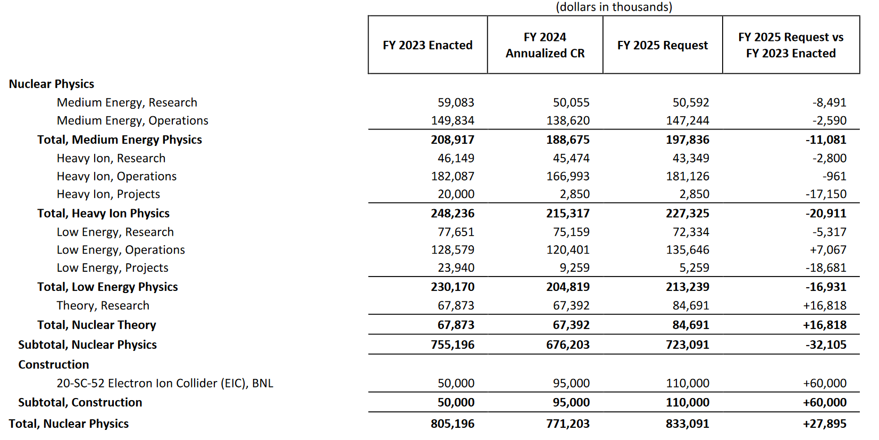
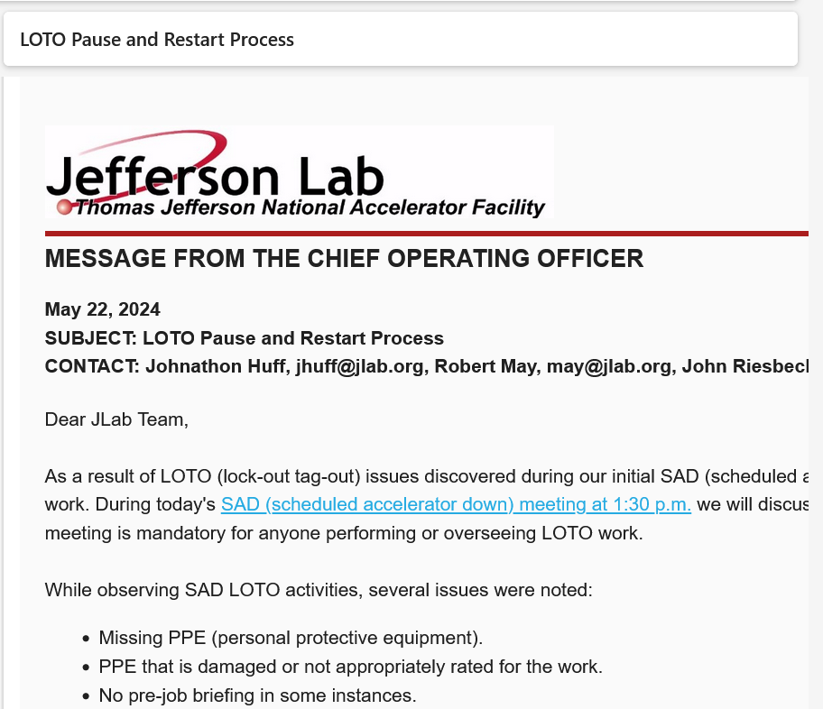
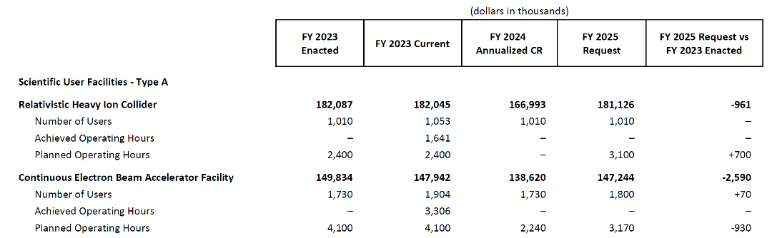
Intro: What I am Not Talking About
Budget
Safety Pause
[DOE FY 2025 Budget Justification, https://www.energy.gov/cfo/articles/fy-2025-budget-justification, 11 March 2024]
Operation
Management Change
- Kim Sawyer introduced herself yesterday

Slide 3
News from Hall B Group

Slide 4

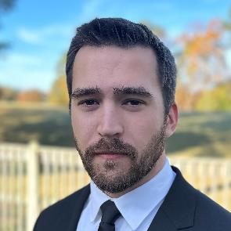
Hires & Positions in Hall-B Group
LDRD & Hall-B Postdoc Sara Liyanaarachchi started May 1
  Develop a new high-rate micropattern gaseous detector for high-luminosity experiments
  PhD from Hampton U (supervisor Michael Kohl), years of experience with GEM detectors
Spin-Polarized Fusion & Hall-B Systems Engineer Phillip Dobrenz started May 1
  Design and commission cryogenic equipment and contribute to Hall B target systems
Hall-B Administrative Support Chris Ross started June 17
  Contact person for Hall-B-related visitors and travelers
  Please be patient as we train the new support personnel and get them up to speed
Spin-Polarized Fusion & Hall-B Technician has been posted and applications are screened
  Machine and commission cryogenic equipment and contribute to Hall B target systems
Hall-B Postdoc Pierre Chatagnon accepted an offer for a permanent position at CEA in Saclay
  Work on CLAS12 and the EIC; Congratulations, Pierre!

Slide 5
Status of Hall-B Operations

Slide 6
Timeline Since SAD 2023
SAD or scheduled Run Group |  |  |  |  |  | Scheduled Calendar Days | Remaining PAC Days Before Run | Scheduled PAC Days | Actual PAC Days from ABUs | Remaining PAC Days After Run
 | Setup / Status | Target | Beam Energy | Start Date | End Date
RG-D |  | liq. D2 & nuclear | 11 | 2023-10-01 | 2023-12-15 | 75 | 30 | 38 | 40 | 0
RG-K |  | liq. H2 | 6,4 | 2023-12-15 | 2023-12-18 | 3 | 88 | 2 | 2 | 86
 | winter break | change |  | 2023-12-18 | 2024-01-10 | 23
RG-K |  | liq. H2 | 6,4 | 2024-01-11 | 2024-02-12 | 32 | 86 | 16 | 19 | 67
RG-K |  | liq. H2 | 8,4 | 2024-02-12 | 2024-03-11 | 28 | 67 | 14 | 16 | 51
 |  | change |  | 2024-03-11 | 2024-03-15 | 4 |  | 2
RG-E |  | liq. D2 & nuclear | 11 | 2024-03-15 | 2024-05-20 | 66 | 60 | 33 | 27 | 33
SAD 2024 |  |  |  | 2024-05-20 |  |  | sum: | 104 | 104
March 11, RG-K finished data-taking after two months with ℓH₂ at lower-pass beam energies and reached highest momentum resolutions in CLAS12 for baryon spectroscopy (new DC settings)
May 19, RG-E ended data-taking for what amounted to 27 of 33 PAC days that were scheduled
4.5 Weeks FY22 and 30 Weeks FY23: 50% efficiency for PAC days wrt. calendar days (+/- 20%)

Slide 7
Hadrons and Cold Nuclear Matter
Proposal | Physics | Exp. Contact | Rating | PAC | Jeop. | Group Days | Equipment | Energy | Group Contact | Target | Complete
E12-06-106 | Color transparency in exclusive vector meson production | L. El Fassi | B+ | 30 | 48 | 30 | CLAS12 | 11 | RG-D L. El Fassi | Nuclear & liquid D₂ | 40 d 100%
E12-06-106A | Nuclear TMDs | R. Dupre |  | 48
E12-06-117 | Quark propagation and hadron formation | W. Brooks | A- | 30 | 48 | 60 | CLAS12 | 11 | RG-E H. Hakobyan | Nuclear & liquid D₂ | 27 d 45%
E12-06-117A | Dihadron measurements in electron-nucleus scattering | M. Arratia |  | 48
RG-D used out-bending torus polarity and 3 different solid target materials separated from ℓD₂
RG-E used in-bending torus polarity and 5 different solid target materials simultaneously with ℓD₂
RG-E needs factor 2 more statistics to access hadrons that are produced with smaller cross-section
Together, a large fraction of data-taking for Hadrons and Cold Nuclear Matter program completed

Slide 8
Run Group D Preliminary Results
Color Transparency T_{A} data, theory, projections:
PRELIMINARY
Four solid RG-D targets:
- Cu x Sn : 182 mC
- C x C : 30 mC
- ℓD2 cryo-target: 32 mC
π⁺ π⁻ invariant mass for solid targets + ℓD₂:
𝜌⁰(770)
[Matthew Maynes, APS April Meeting 2024]
~15% of data set for carbon target analyzed
Cuts on kinematics for exclusive diffractive and incoherent 𝜌⁰ electroproduction off nuclei
After initial alignment and online calibration
PRELIMINARY
PRELIMINARY
RG-D analysis is well on track despite waiting long for new alignment procedures

Slide 9
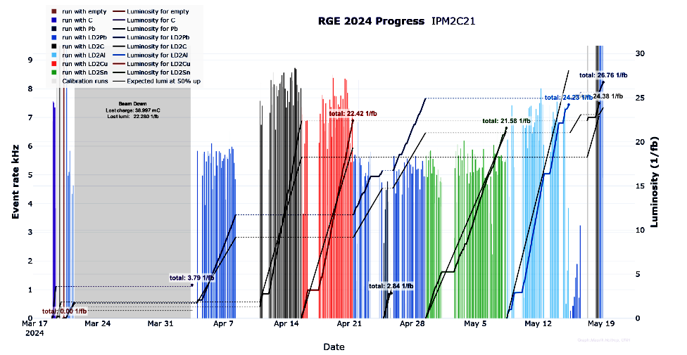
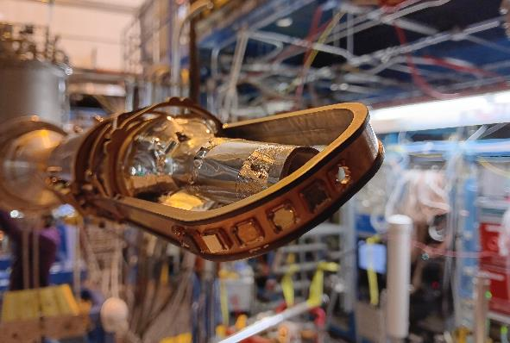
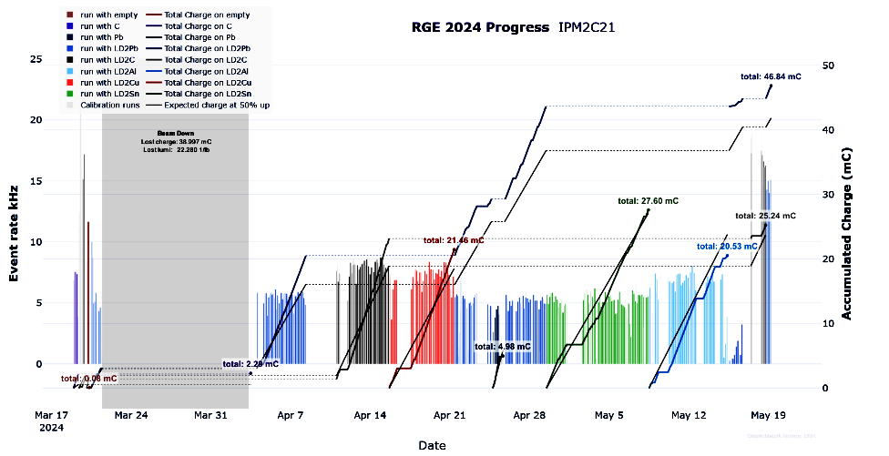
Run Group E Data-Taking Summary
Data-taking on five solid RG-E targets with comparable luminosity:
C x ℓD₂ : 23 1/fb
Al x ℓD₂ : 24 1/fb
Cu x ℓD₂ : 22 1/fb
Sn x ℓD₂ : 22 1/fb
Pb x ℓD₂ : 26 1/fb
ℓD₂
foil
Double-target system performed excellent with fast solid-target changes along with stable & robust operation
Major downtimes of 50 + 270 hours due to
two vacuum events / beam strikes in the accelerator
Completed necessary calibration and extra runs (e.g., empty, luminosity scans, in- vs. out-bending polarity)

Slide 10
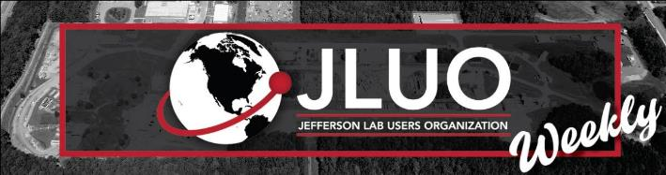
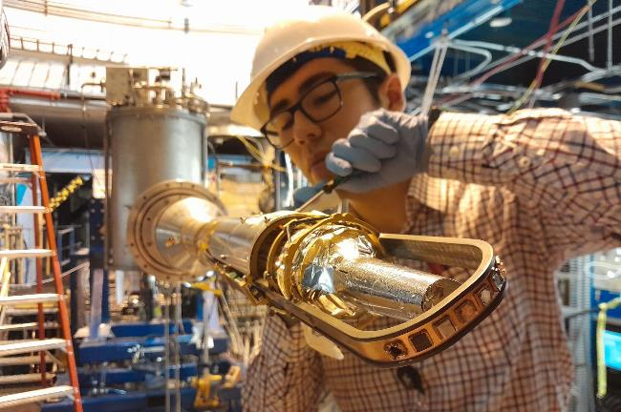
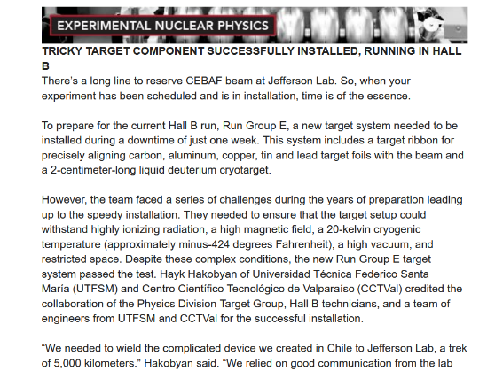
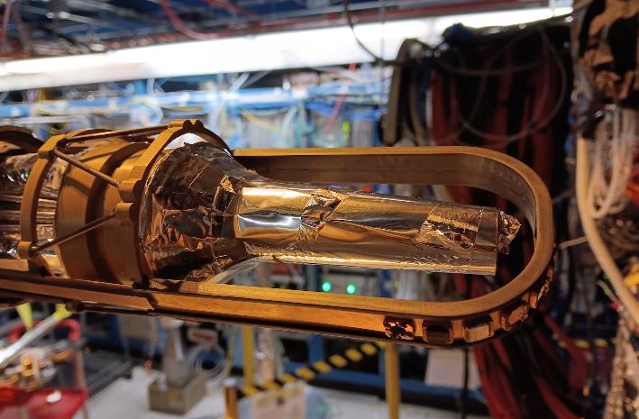
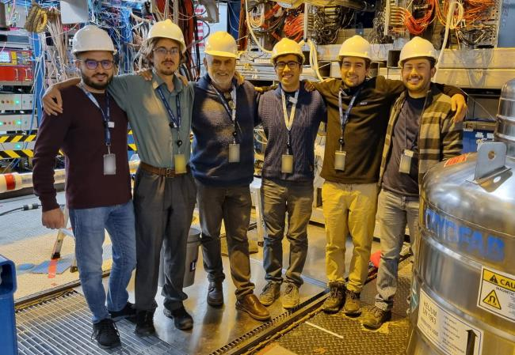
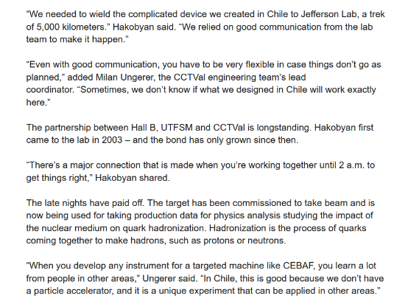
The Chilean Target Story
WEDNESDAY, APRIL 3, 2024
Brief feature appeared in JLab Weekly
Another feature will appear as part of the new “Mission Critical” series

Slide 11
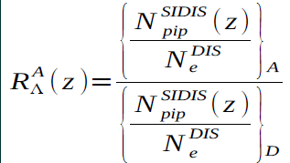
Run Group E Online Analysis
PRELIMINARY
PRELIMINARY
PRELIMINARY
Data quality and statistics seem good enough for high-level physics output
Comprehensive study of impact of the nuclear medium on quark hadronization
A multidimensional kinematical analysis of hadrons in DIS
Simultaneous data from ℓD₂ and nuclear targets to cancel of systematic uncertainties
Extends CLAS6 EG2 with …
Higher luminosity
Different nuclei
Higher beam energy
Polarized beam
[Matias Lopez, Milan Ungerer Muñoz, Antonio Radic]
[Independently Uditha Weerasinghe, May 2024]

Slide 12
Near-Term Schedule 2024-25
SAD or scheduled Run Group |  |  |  |  |  | Scheduled Calendar Days | Remaining PAC Days Before Run | Scheduled PAC Days = Cal. Days/2 | Actual PAC Days from ABUs | Remaining PAC Days After Run
 | Setup / Status | Target | Beam Energy | Start Date | End Date
RG-L | ALERT | high pressure gas | 11 | 2025-02-10 | 2025-05-31 | 110 | 55 | 55 |  | 0
RG-T | ALERT | high pressure gas | 6,6 | 2025-05-31 | 2025-07-04 | 34 | 17 | 17 |  | 0
SAD 2025 | reconfigure | change |  | 2025-07-04 |  |  | sum: | 72
Low-pass run with ALERT was awarded 17 PAC days by last year’s PAC51
Begin of run tentatively scheduled for February 2024
With only 24 weeks of physics operation, planned RG-E and RG-K runs are cancelled
By next SAD, ALERT will be finished even if there are some unscheduled downtimes

Slide 13
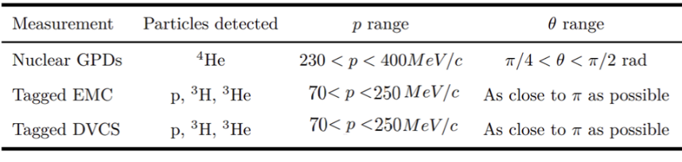
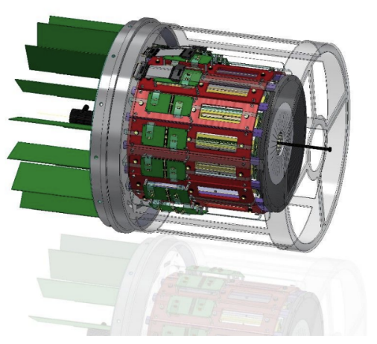
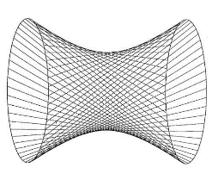
ALERT Run Groups
Proposal | Physics | Exp. Contact | Rating | PAC | Group Days | Equipment | Energy | Group Contact | Target
E12-17-012 | Partonic structure of light nuclei | Z. Meziani | A- | 45 | 55 | CLAS12; ALERT | 11 | L R. Dupre | High pressure gaseous H, D, ⁴He
E12-17-012A | Tagged EMC measurements on light nuclei | R. Dupre |  | 45
E12-17-012B | Spectator-tagged DVCS on light nuclei | W. Armstrong |  | 45
E12-17-012C | Other physics opportunities with ALERT | M. Defurne |  | 45
E12-23-013 | Measuring short-range correlations with ALERT | F. Hauenstein | A | 51 | 17
E12-23-013 | Measuring short-range correlations with ALERT | Hauenstein | A |  | 17 |  | 6.6 | T
A Low Energy Recoil Tracker (ALERT)
– Hyperbolic drift chamber
– Time-of-Flight array
– Target straw for H₂, D₂, and ⁴He
30 cm active length, 6 mm Ø
Collaborative effort within CLAS12
– ANL, IJCLab, JLab, New Mexico SU, MSU, ODU and Temple
ALERT Collaboration Meeting at JLab March 18-19, 2024
ALERT is effectively replacing the CVT detector similarly to the BONuS12 experiment

Slide 14
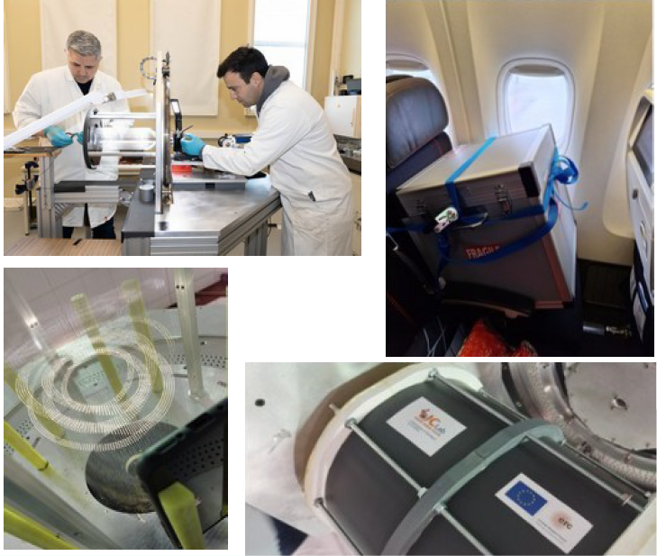
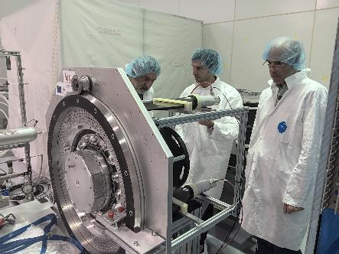
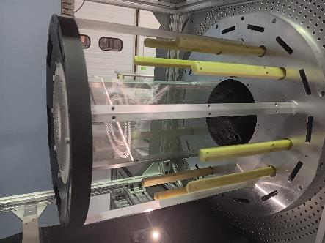
ALERT Drift Chamber (AHDC)
DC: 30 cm active length, 576 signal + 2450 guard wires = 3026 wires, Al 30 µm diameter, 20° stereo angle, operating gas He₄ - CO₂
JLab
IJCLab, France
Stringing of ALERT wire chamber
– Sept. 2023 to early March 2024
Delivered to JLab in April 2024
– No problems detected after transportation
– All wires except one produce correct signals
– Gas systems are operating
– Data-taking with cosmic rays in EEL building
[Raphaël Dupré, May 2024]

Slide 15
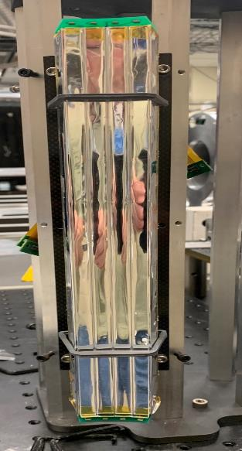
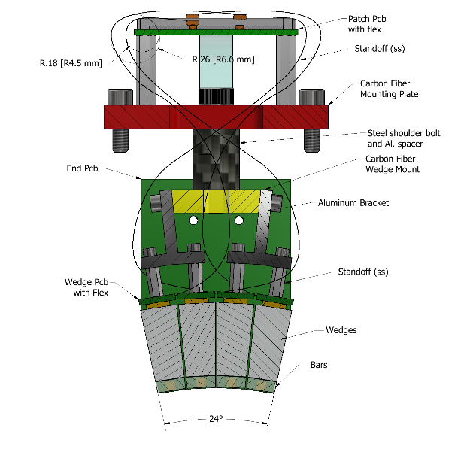
ALERT Time-Of-Flight (ATOF)
TOF: Two layers of scintillators with
SiPM readout, 28 cm length, 15 sub-assemblies: 600 wedges, 60 bars
– Provides PID for light ions through TOF and topology (inner bar vs. outer wedges)
– All 15 modules assembled
Electronics
– 19 PETIROC boards from JLab
– One NALU board from ANL for checks
– Power supplies and cabling in progress
[Raphaël Dupré, May 2024]

Slide 16
Conditional Schedule 2025-26
SAD or scheduled Run Group |  |  |  |  |  | Scheduled Calendar Days | Remaining PAC Days Before Run | Scheduled PAC Days | Actual PAC Days from ABUs | Remaining PAC Days After Run
 | Setup / Status | Target | Beam Energy | Start Date | End Date
Assuming ~ 100 PAC days in this period and successful Experiment Readiness Review in 2024
RG-O | PRad-II | gas jet | 0,7; 2,1; 3.5 | 2025-26 |  | 80 | 40 | 40 |  | 0
 | reconfigure | change |  |  |  | 7 |  | 4
RG-Q | X17 search | Ta foil | 2,2; 3,3 | 2025-26 |  | 120 | 60 | 60 |  | 0
SAD 2026 |  |  |  |  |  |  | sum: | 104
The π⁰TFF experiment requires additional 67 PAC days and full HyCal readout:
cannot run with the other experiments, can possibly be combined with future DRad
PRad-II and X17 can run without outer HyCAL; PRad-II will cover the proposed Q²-range with a higher beam energy in the awarded number of PAC days
Hall-B staff are providing additional support
Experiments need to pass ERR this year

Slide 17
Conditional Schedule 2026-27
SAD or scheduled Run Group |  |  |  |  |  | Scheduled Calendar Days | Remaining PAC Days Before Run | Scheduled PAC Days | Actual PAC Days from ABUs | Remaining PAC Days After Run
 | Setup / Status | Target | Beam Energy | Start Date | End Date
Assuming ~ 100 PAC days in this period and successful Experiment Readiness Review in 2025
RG-C |  | long. pol. NH3/ND3 | 11 | 2026-27 |  | 80 | 40 | 40 |  | 0
RG-G |  | long. pol. 7LiD | 11 | 2026-27 |  | 110 | 55 | 55 |  | 0
SAD 2027 | reconfigure | change |  |  |  |  | sum: | 95
The centerpiece, the longitudinal polarized target, has been constructed and used
RG-C will have to return for 40 days to complete its approved 120 PAC day program
Consecutive execution of RG-C and RG-G would minimize substantial overhead
RG-G no longer requests a double target but will alternate between NH₃ and ⁷LiD, so no modifications to the polarized target will be necessary
For producing paramagnetic radicals needed for DNP, irradiation using 8 MeV beam from injector and a variable temperature cryostat, commissioning expected 2024-25
Well aligned with the Spin-Polarized Fusion Project (new engineer, technician, …)

Slide 18
Conditional Schedule 2027-28
SAD or scheduled Run Group |  |  |  |  |  | Scheduled Calendar Days | Remaining PAC Days Before Run | Scheduled PAC Days | Actual PAC Days from ABUs | Remaining PAC Days After Run
 | Setup / Status | Target | Beam Energy | Start Date | End Date
Assuming ~ 100 PAC days in this period and new SVTs for HPS being ready
RG-E |  | liq. D2 & nuclear | 11 | 2027-28 |  | 66 | 33 | 33 |  | 0
 | reconfigure | change |  |  |  | 7 |  | 4
RG-I | HPS | nuclear | 4,4 | 2027-28 |  | 120 | 105 | 60 |  | 45
SAD 2028 |  |  |  |  |  |  | sum: | 97
Completion of RG-E with CLAS12
Setup change between CLAS12 and HPS should be quick (possibly in winter break)
The remaining 105 PAC days of HPS are split into two-pass and one-pass runs with 60 PAC days to run 2027-28 with ≃ 4 GeV and the rest with ≃ 2 GeV in the future

Slide 19
Scheduling Aspects
PRad-II: HyCAL installation and operation, hydrogen gas jet target installation and operation, use of tagger & HyCAL transporter, layout and construction of new beamline elements, design and construction of new veto counter
RG-G: availability, irradiation, polarization, and relaxation of ⁷LiD target material
HPS: New silicon microstrip vertex trackers (SVT)
RG-L | ALERT | 2024-25
Experiment readiness
Beam availability
RG-O | PRad-II | 2025-26
RG-Q | X17 search | 2025-26
100 PAC days =
30 weeks physics =
33 weeks operation
Later blocks could come earlier if scheduled experiments are delayed
RG-C | pol. NH3/ND3 | 2026-27
RG-G | pol. 7LiD | 2026-27
RG-E | LD2 & nuclear | 2027-28
RG-I | HPS | 2027-28
Except for RG-E, none of the experiments is fully ready-to-go

Slide 20
Hardware Developments

Slide 21
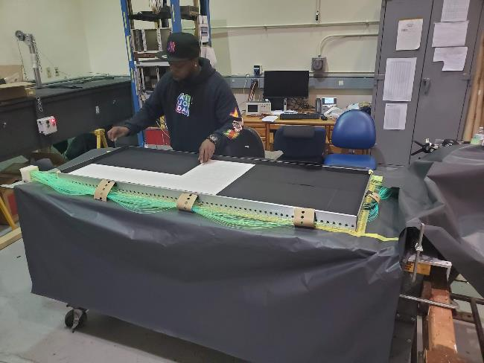
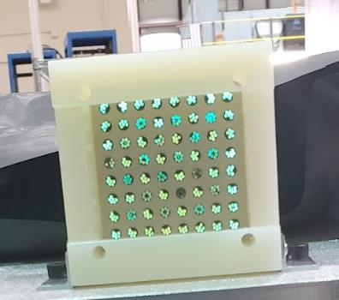
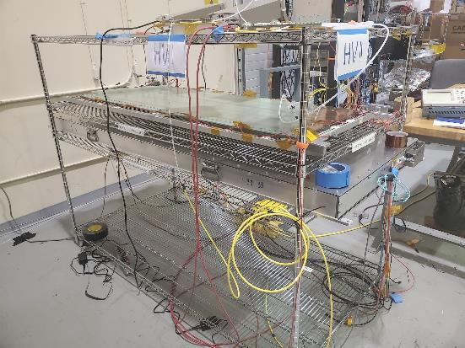
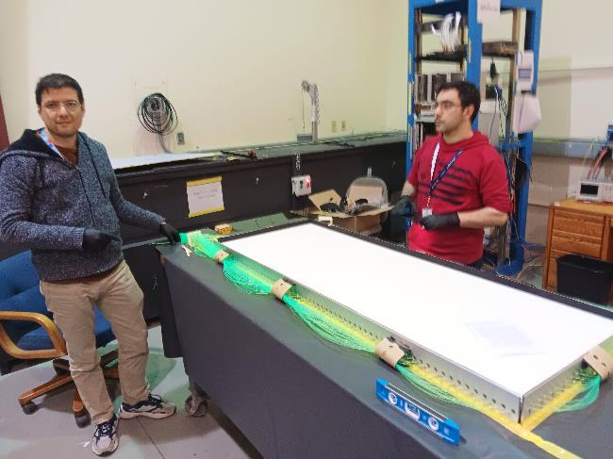
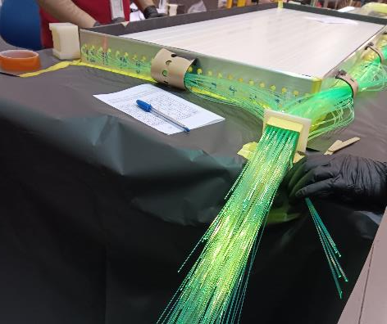
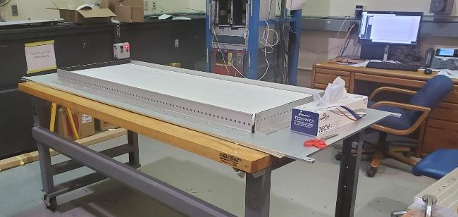
Hodoscopes for µRWELL Characterization

Slide 22
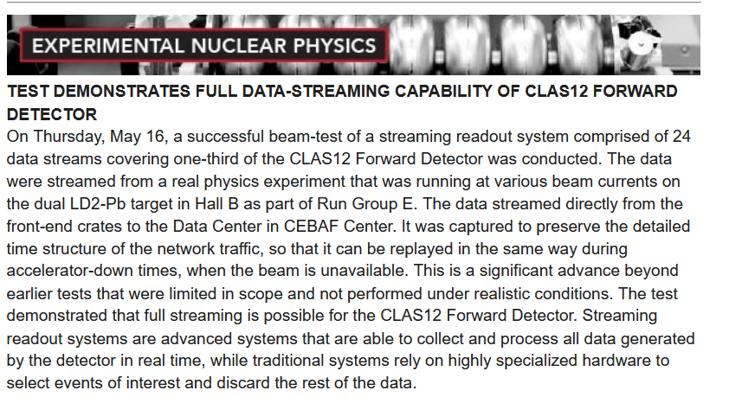
Streaming Readout Developments
Planning started on a new Hall-B Task Force to implement automatic detector calibrations
  - Part of Streaming Grand Challenge coordinated between Hall B and EPSCI Group
  - Raffaella De Vita will chair the Task Force
  - Work will start later this year using a small and well-calibrated data set such as RG-K Winter 2018
  - First milestone will be the automated calibration of one small detector system e.g., CTOF or CND
Successful beam-test of streaming readout system with 24 data streams from two CLAS12 sectors including ECAL, PCAL, FTOF, LTCC and DC to Hall-B counting room and data center
Data rate of 2.3 GByte/sec with lifetime of ~100%
Data streamed from a real physics experiment running with 70 nA beam current on target, in contrast to earlier tests that were limited in scope and were not performed under realistic conditions
WEDNESDAY, JUNE 5, 2024

Slide 23
Recent Publications

Slide 24
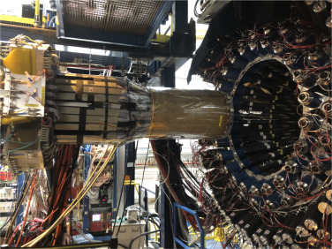
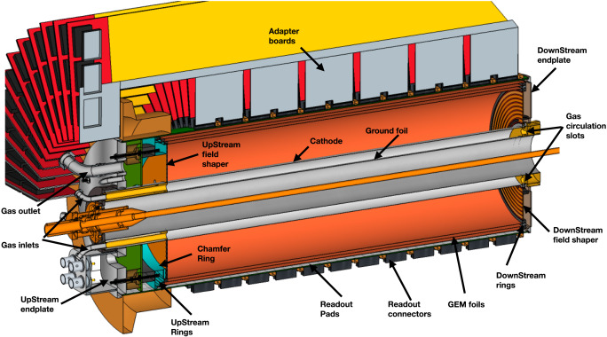
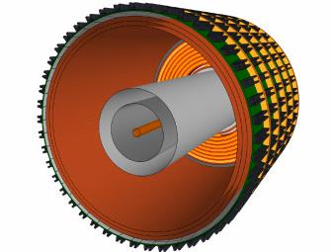
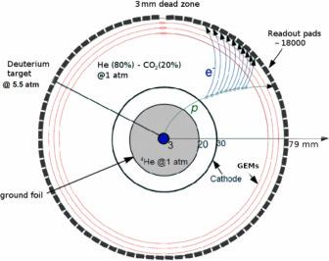
Design, Construction, Performance of RTPC for BONuS12
[I. Albayrak et al., Nucl. Instrum. Meth. A 1062, 169190 (May 2024)]

Slide 25
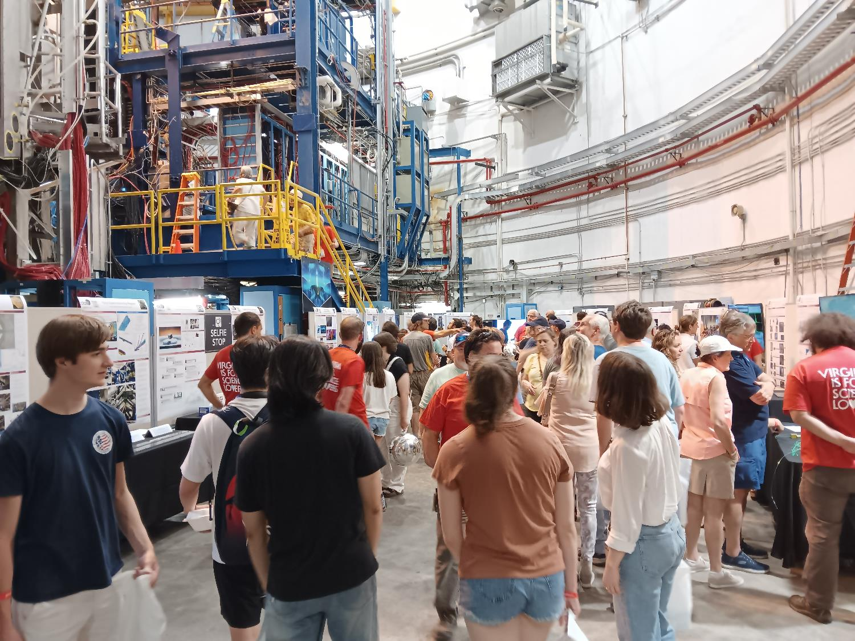
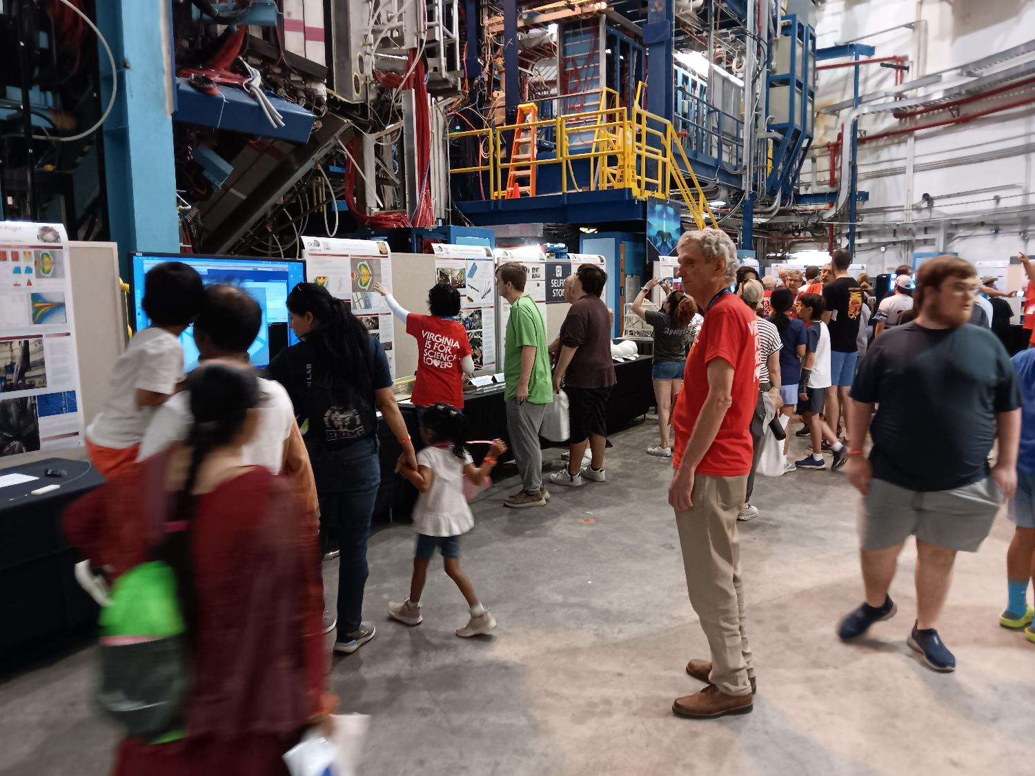
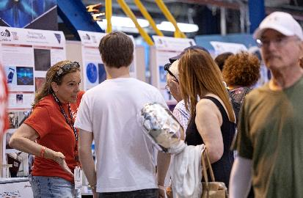
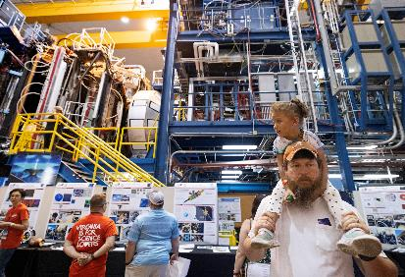
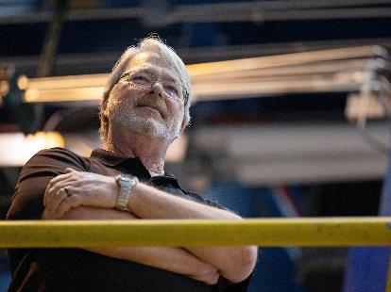
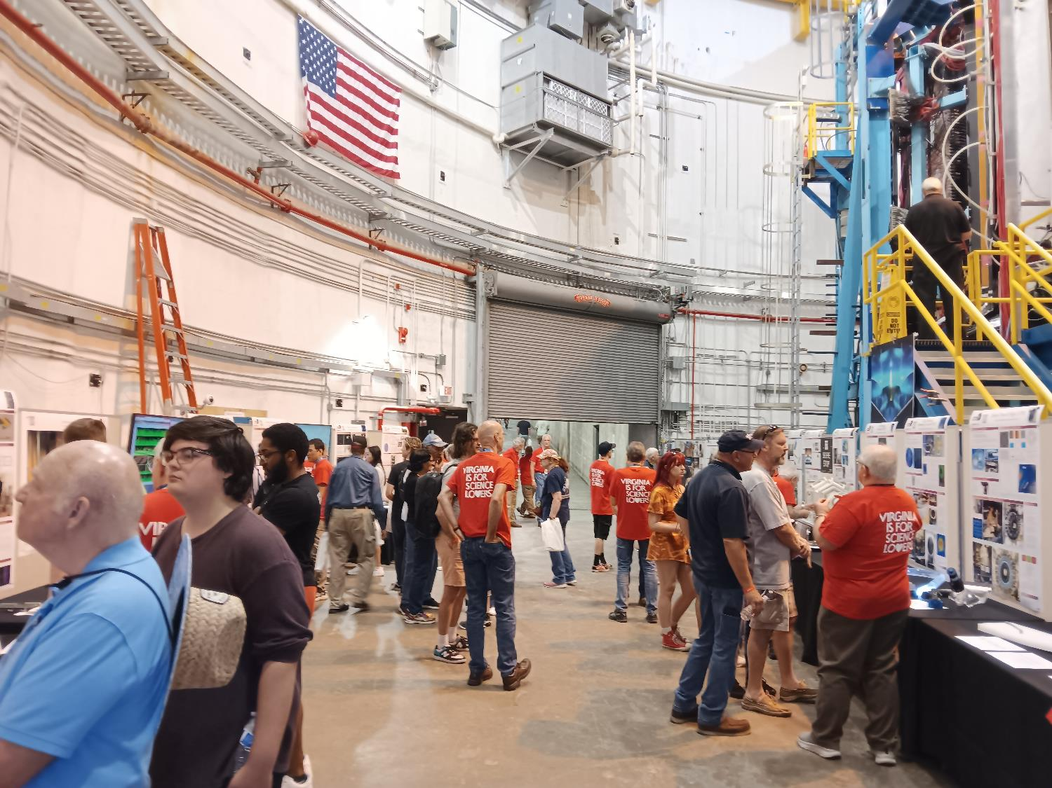
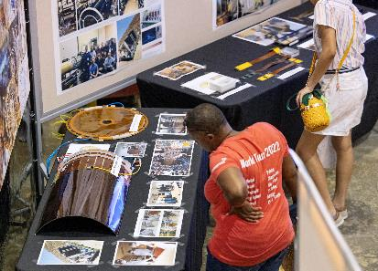
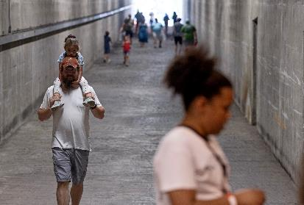
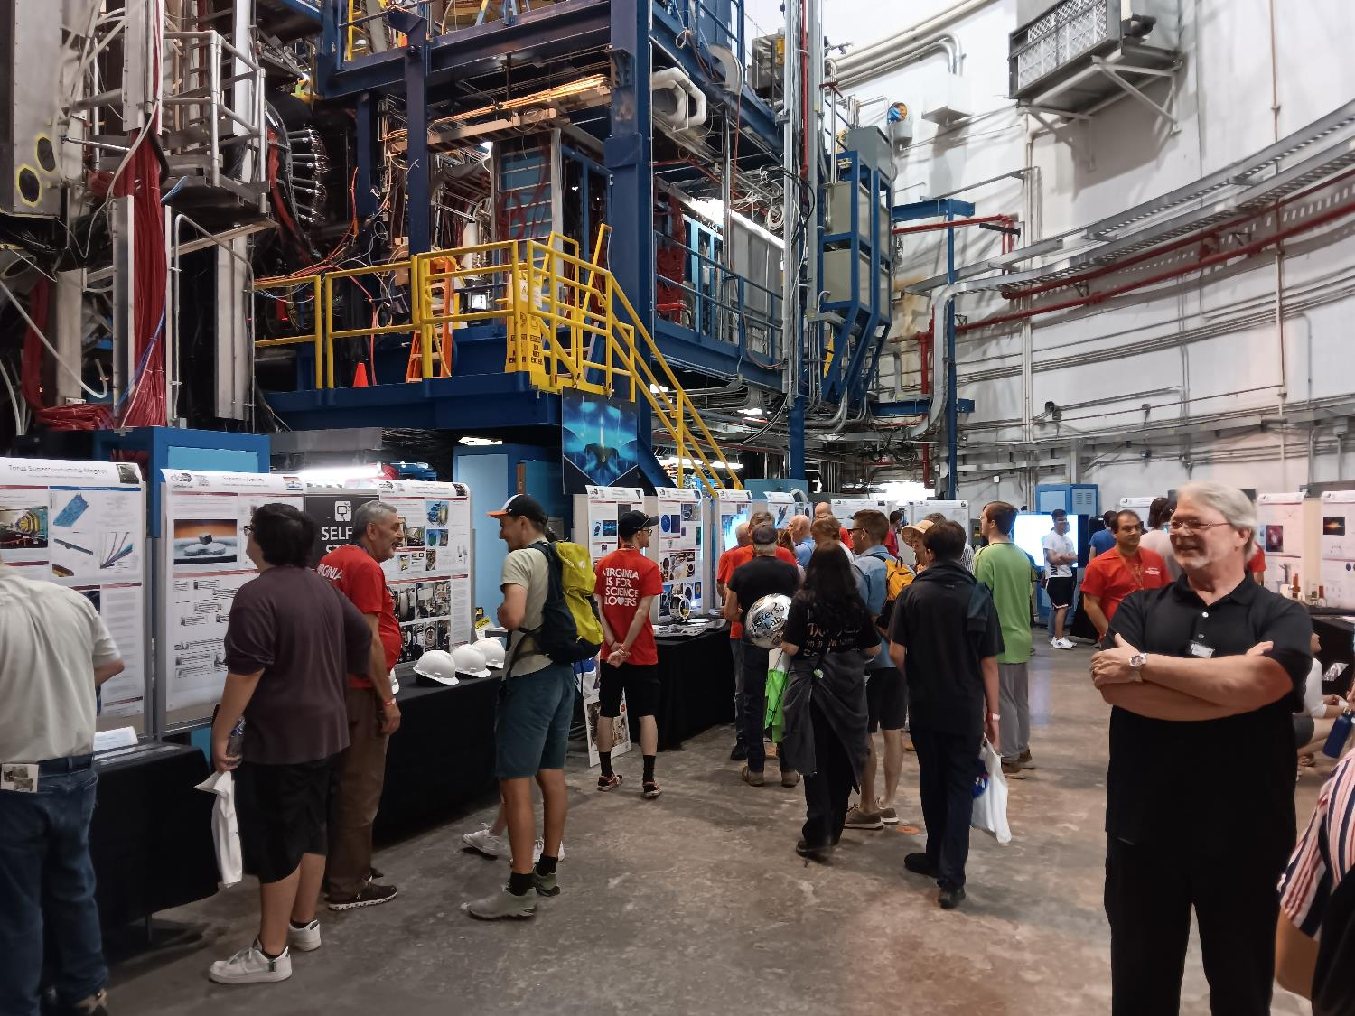
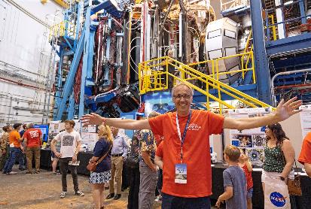
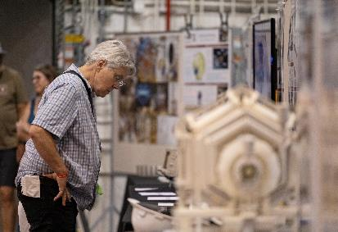
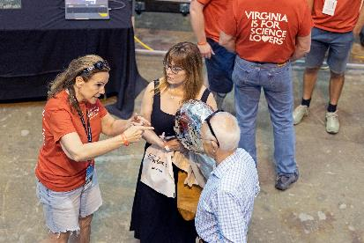
Outro: Impressions from the Open House

Slide 26
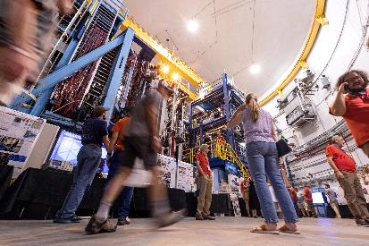
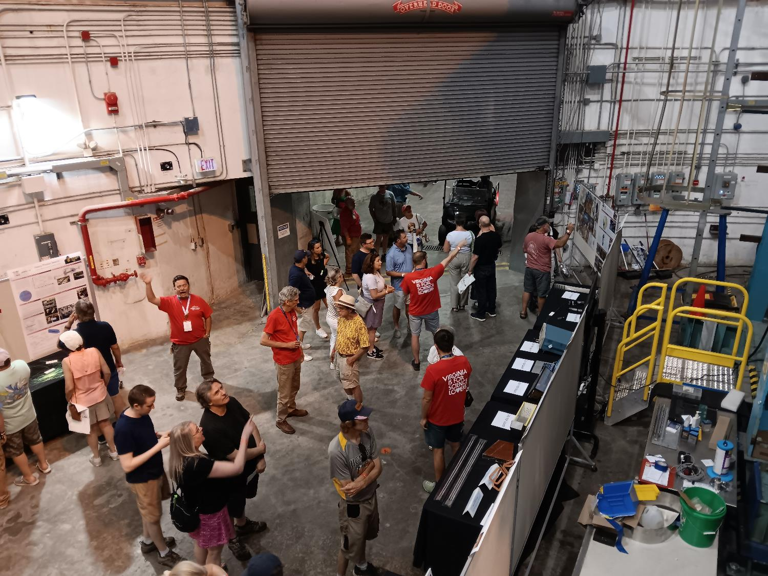
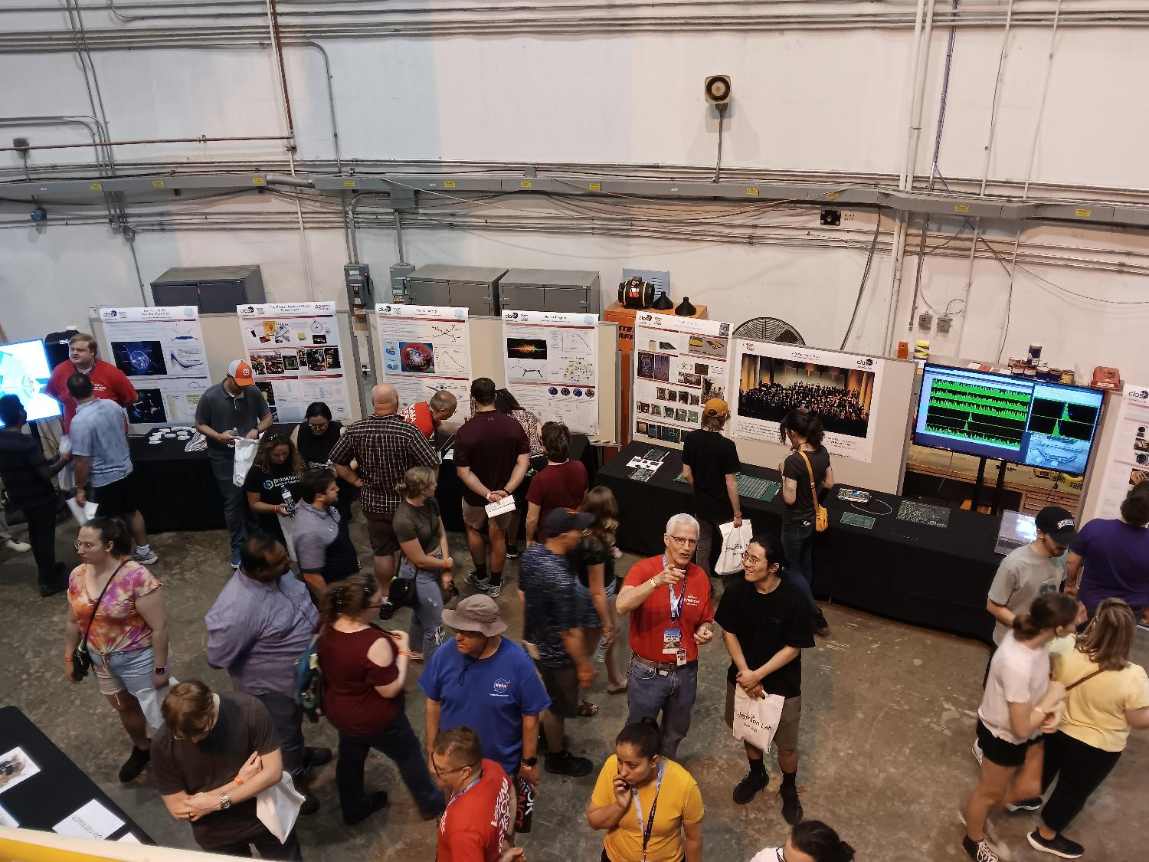
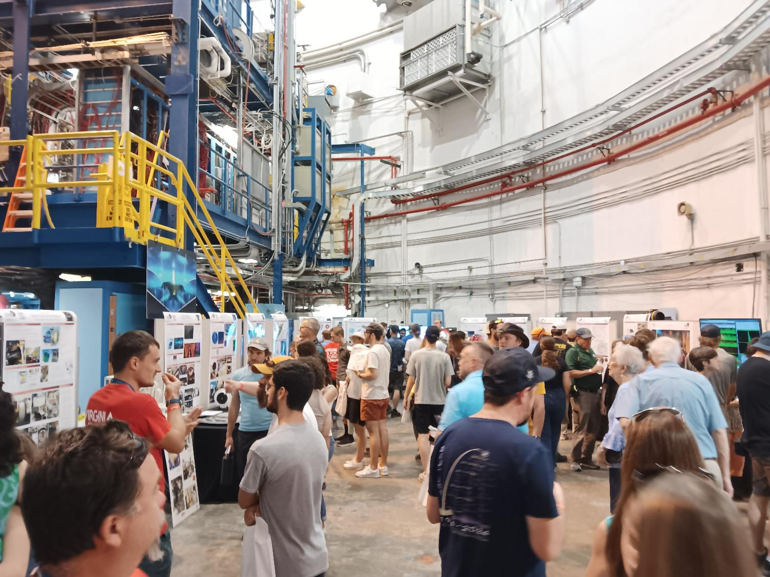
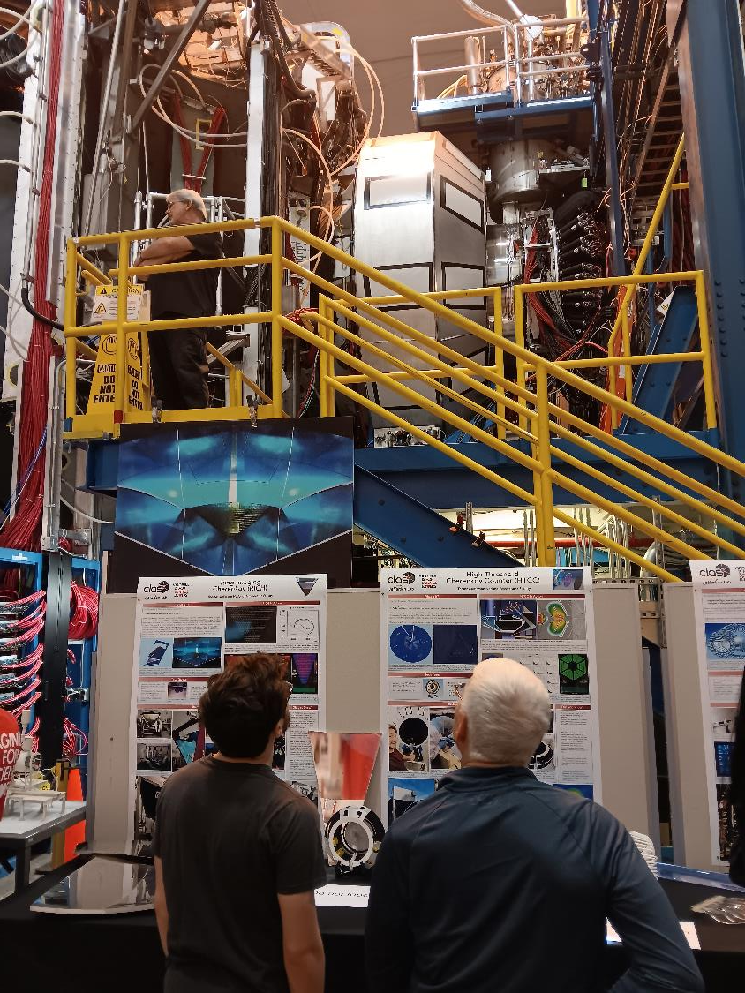




Outro: Impressions from the Open House

Slide 27
Thank You For Your Attention

