Slide 1
HPS in Hall-B

Slide 2
HPS in Hall-B
Forward carriage
Beamline viewer and beam dumps
CLAS12
2H02
2H01
2H00
HPS
$$e^{−} beam$$
Tagger dipole

Slide 3
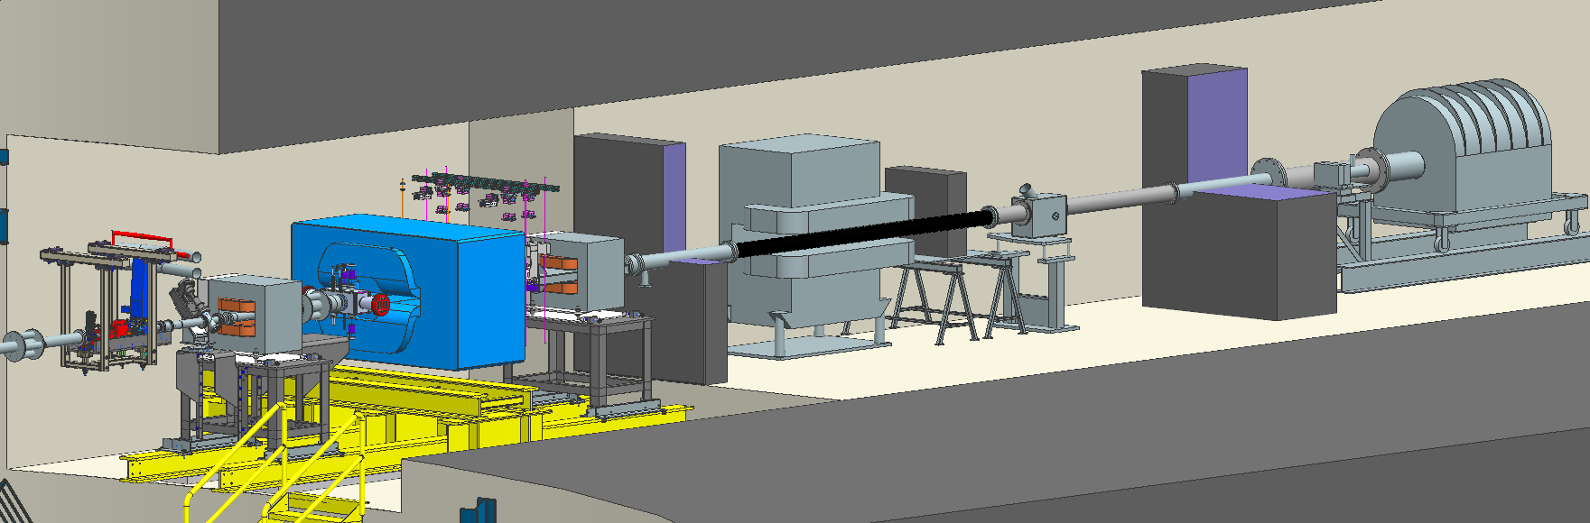
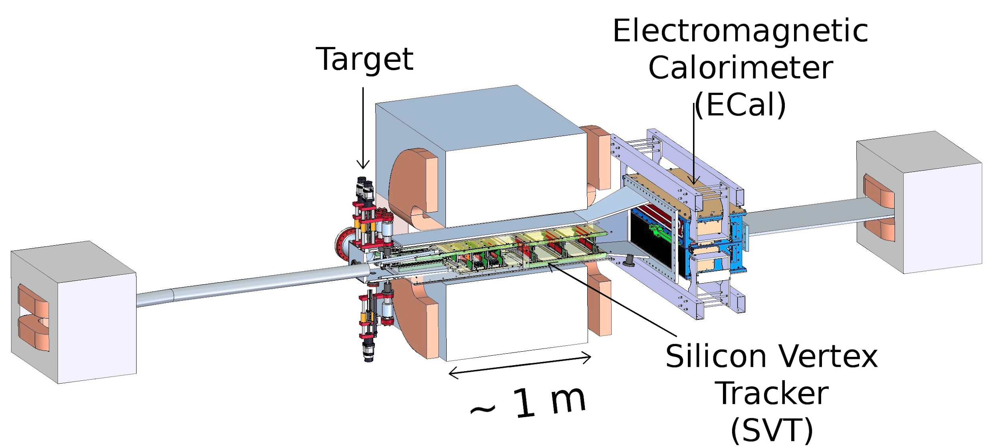
HPS in Hall-B
Faraday cup
Photon Dump
2H02A Harp
Downstream Viewer
2H02A
Scintillation hodoscope

Slide 4
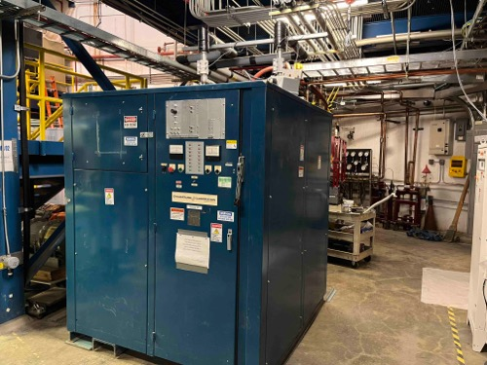
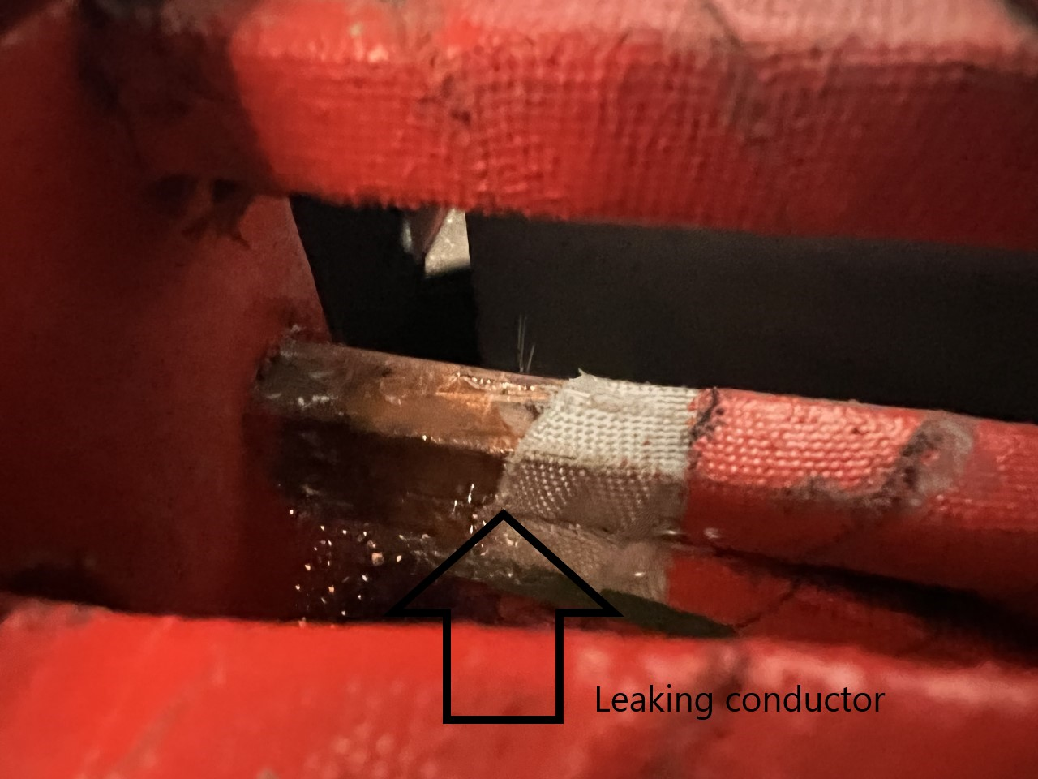
Repairs and changes to the HPS chicane
Old power supply for the Moller polarimeter quad have been moved, repurposed for HPS chicane.
Refurbishment of Frascati magnets are ongoing (acc. magnet group).
Moller-quad
Mini-T

Slide 5
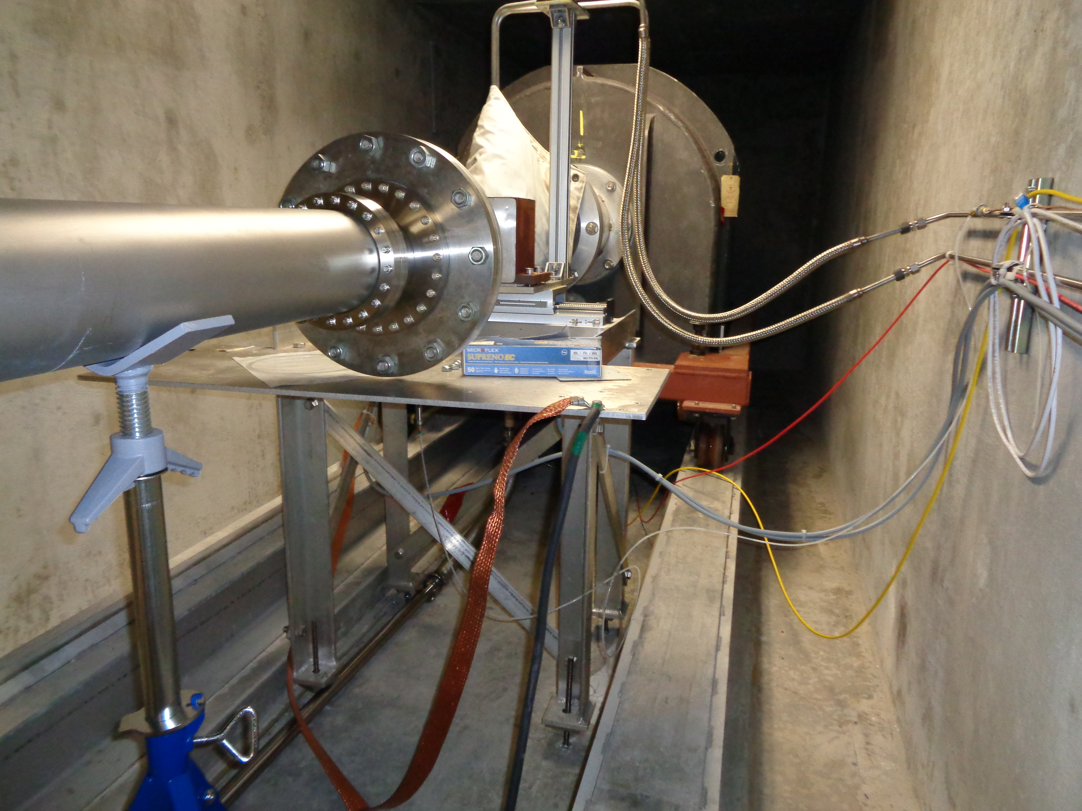
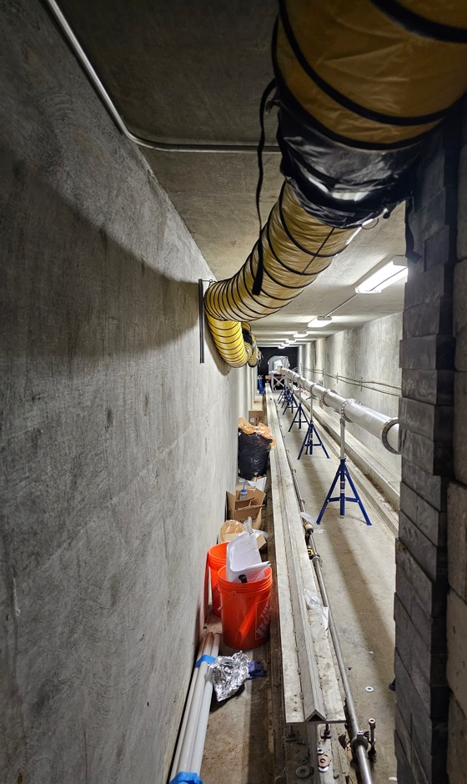
Beamline upgrade
FC moved downstream by about 21 metrs.
FC is approved for 1 kW beam power
Beam blocker is approved for 15 kW beam power

Slide 6
What do we need for the next run
A new chiller for Ecal.
Coolant for SVT: 5 bottles of 7000, 11 bottles of 7100 and 4 bottles of 7500.
Repairs to Ecal (minor).
Repairs to SVT and SVT-DAQ, ongoing.
Runs for calibrations – changes to setup or to the trigger.
Another target ~10 am upstream of the nominal target.
0-field run, with only the first magnet on.

