Slide 1
HPS Cluster Reconstruction
Collaboration Meeting, 6/4/24
Rory O’Dwyer

Slide 2
Outline
Introduction (3-10)
Time Error Weighted Cluster Times (11-17)
Cluster Splitting and Merging Studies (18-26)
Back Layers and Cluster Thresholds (27-32)
The V Splitting Algorithm (33-43)
Conclusion (44)

Slide 3
An Introduction To The Clustering Algorithm
Step 1: You begin by mapping hits to channel. After this, you get a mapping like shown below. The dead channel at 5 is drawn with a red X.
Channel Mapping of Hits, With Dead Channel at Channel 5.

Slide 4
An Introduction To The Clustering Algorithm
Step 2: You put all the channels above some seeding threshold into the seed collection (shown in yellow)
Channel Mapping of Hits, With Dead Channel at Channel 5.

Slide 5
An Introduction To The Clustering Algorithm
Step 2: You put all the channels above some neighbor threshold into the clusterable collection (shown in yellow+green)
Channel Mapping of Hits, With Dead Channel at Channel 5.

Slide 6
An Introduction To The Clustering Algorithm
Step 3: You now loop over all seeds. For each seed, you create an unchecked collection (pink), and put the seed into it
Channel Mapping of Hits, With Dead Channel at Channel 5.

Slide 7
An Introduction To The Clustering Algorithm
Step 4 (repeats until unchecked is empty). You remove an element of unchecked and put it into the cluster. You check if its neighbors are clusterable. If they are you put them into unchecked.
Channel Mapping of Hits, With Dead Channel at Channel 5.

Slide 8
Fix For Dead Channels.
Channel 4 is a dead channel, whose hit was split on either side of channel 5. As of right now, 4 becomes a single hit with much less charge as 6 and 7 are excluded.
Channel Mapping of Hits, With Dead Channel at Channel 5.

Slide 9
Fix For Dead Channels.
To Fix this, we jump over the dead channel. Now we will create a cluster with 4, 5 , and 6 in it.
Channel Mapping of Hits, With Dead Channel at Channel 5.

Slide 10
Methodology of Study.
As for hit reconstruction, we systematically study clustering with run 14552 from 2021.
From the clustering algorithm, here’s what we study:
cluster seed/neighbor thresholds.
timing information.
cluster splitting and NTD (next to dead) merging
To evaluate any chance, we use these plots:
T0 resolution
Hit Position Residuals
Track Momenta Resolution
Cluster Sharing (vs. hit position changes, etc)

Slide 11
Evaluating Time Error Weighted Cluster Times

Slide 12
Cluster Amplitude vs. T0 Error Calculation
Old Way (Amplitude Weighting):
The cluster time is weighted by hit amplitude.
You add new hits to cluster if they are some max time away from current time.
New Way (Time Error Weighting):
The cluster time is weighted by inverse time error.
You add new hits to cluster if they are some max number of errors away.
Hit failing the old algorithm
Hit failing the new algorithm

Slide 13
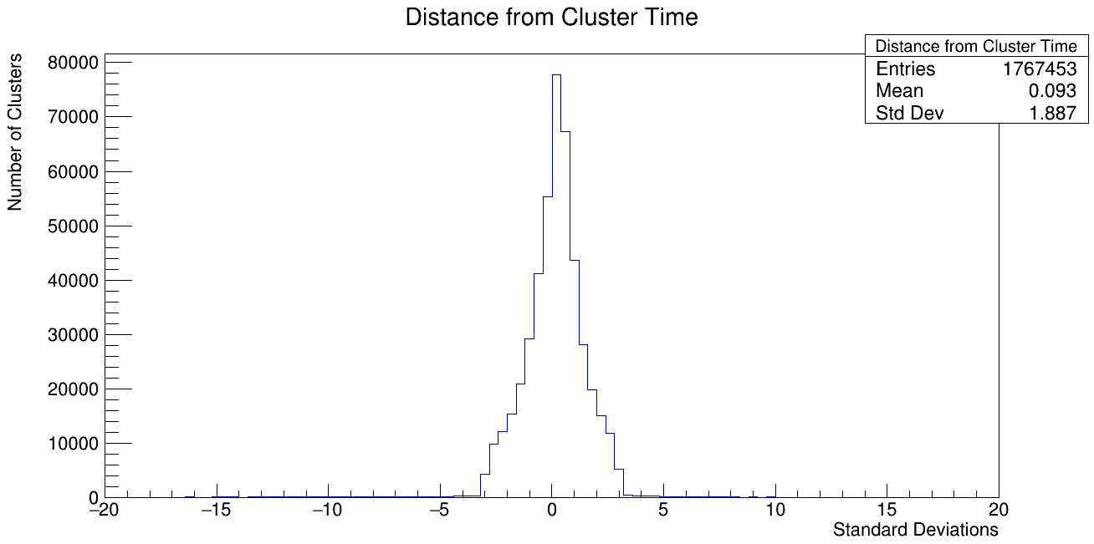
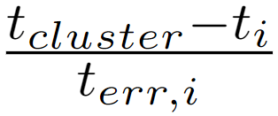
Some Diagnostic Plots:
Here is a useful diagnostic plot.
When we are making a cluster, for each added hit plot the following:
Here t_{cluster} denotes the moving error weighted time.
This is the condition whereupon we add an additional hit to a cluster; you can see that this is being done correctly.
Distance of added hits from moving cluster time average. The standard deviation cut is 3.

Slide 14
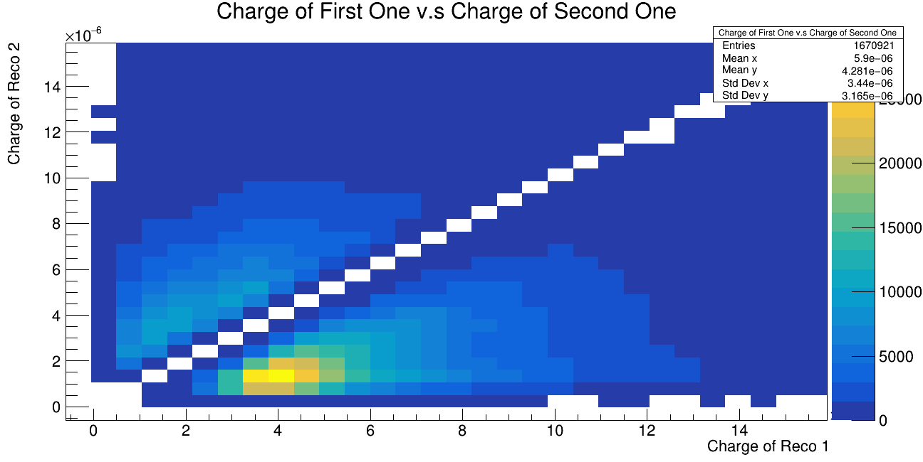
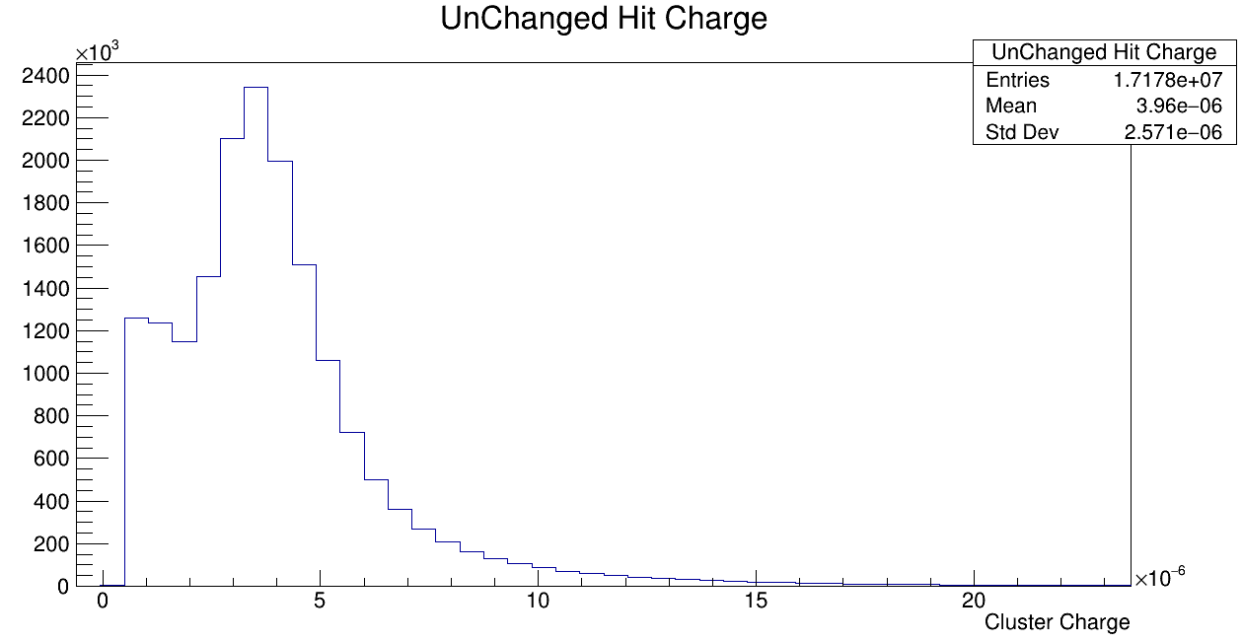
How Many Clusters Are Changed
Before we move to performance estimates, it’s important to qualify how big a change this will be.
In these plots we look event by event for the different reconstruction algorithms and plot events based on seed matching.
We define, in the above plot, a `changed’ cluster if its charge moved by 1e⁻⁷ nC. There are 18e⁶ seed matched clusters, 1.6e⁶ matched unchanged, there are 19e⁶ in reco 1 and 20e⁶ in reco 2 total.
If we take `changed’ to be any difference, we instead see ~1/10 of matched clusters moved instead of unchanged; i.e. most 2 hit clusters change but very minutely
2D Histo of Charges for 2 algorithms
Unchanged Hits for Seed Matched Clusters.
Notes:
The strip spacing is roughly .06 mm. The peaks of the distribution shown below are .021 mm and .023 mm. So certainly less than a whole spacing, but this is definitely possible in an amplitude weighting scheme.

Slide 15
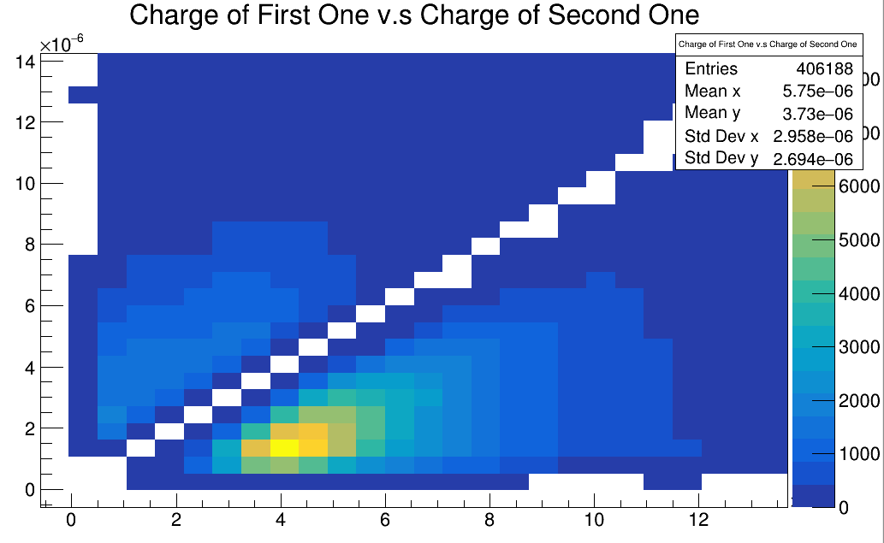
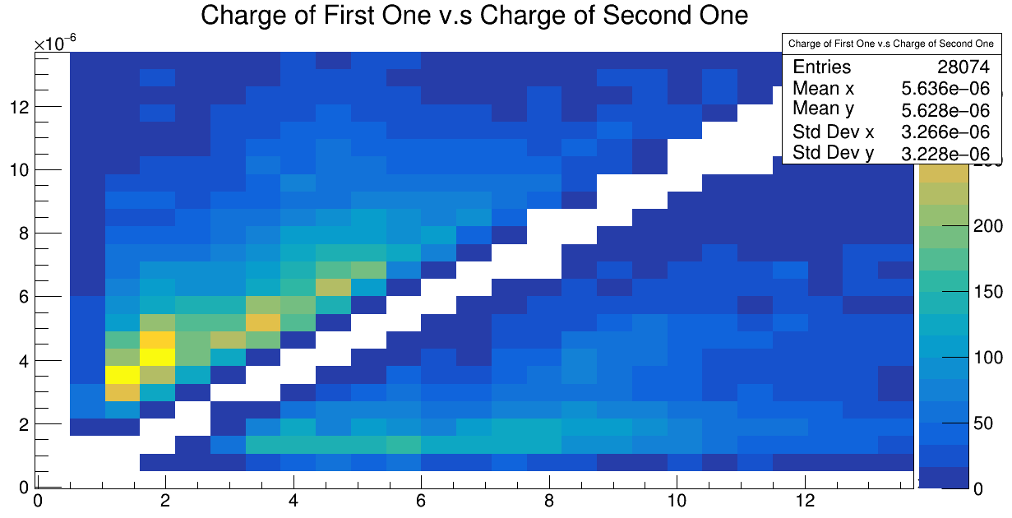
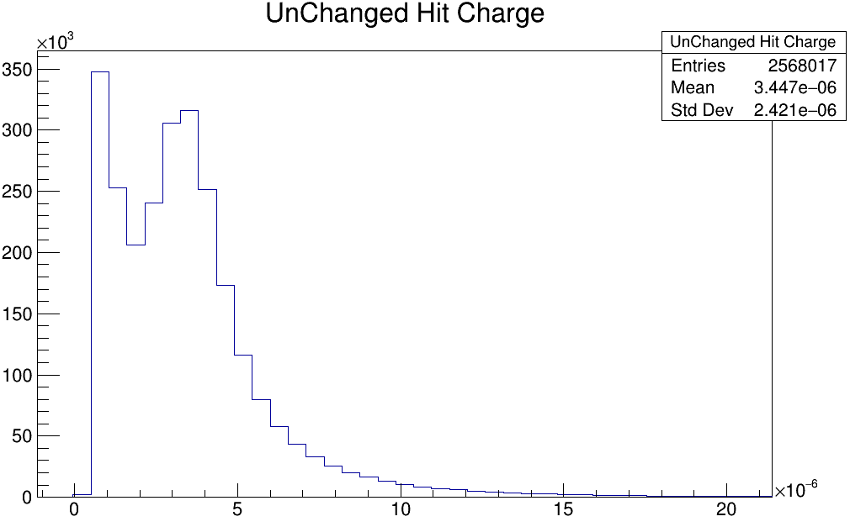
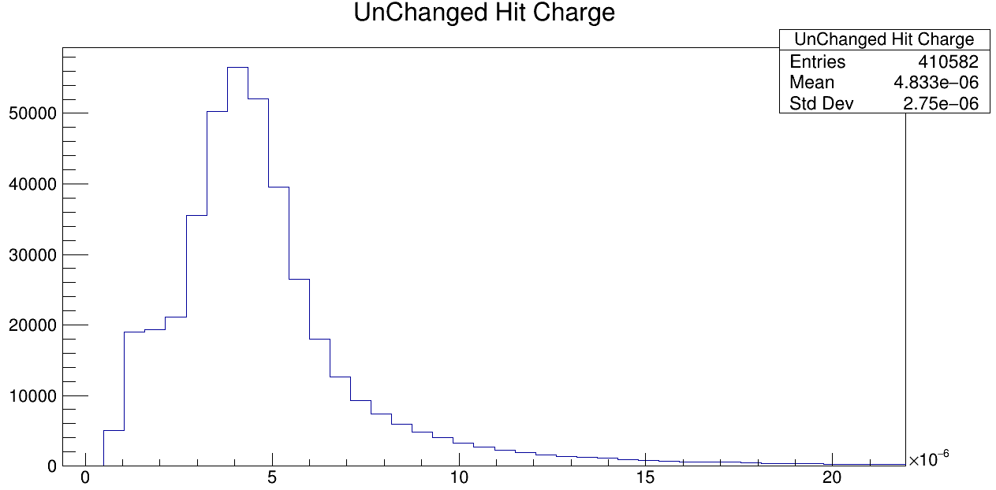
L0M0 L7M0
Notes:
Discussion to have here: In the forward layers, you are primarily making new hits because alot of your hits are losing charge magnitude due to not adjoining. In later layers it actually serves more to merge hits.

Slide 16
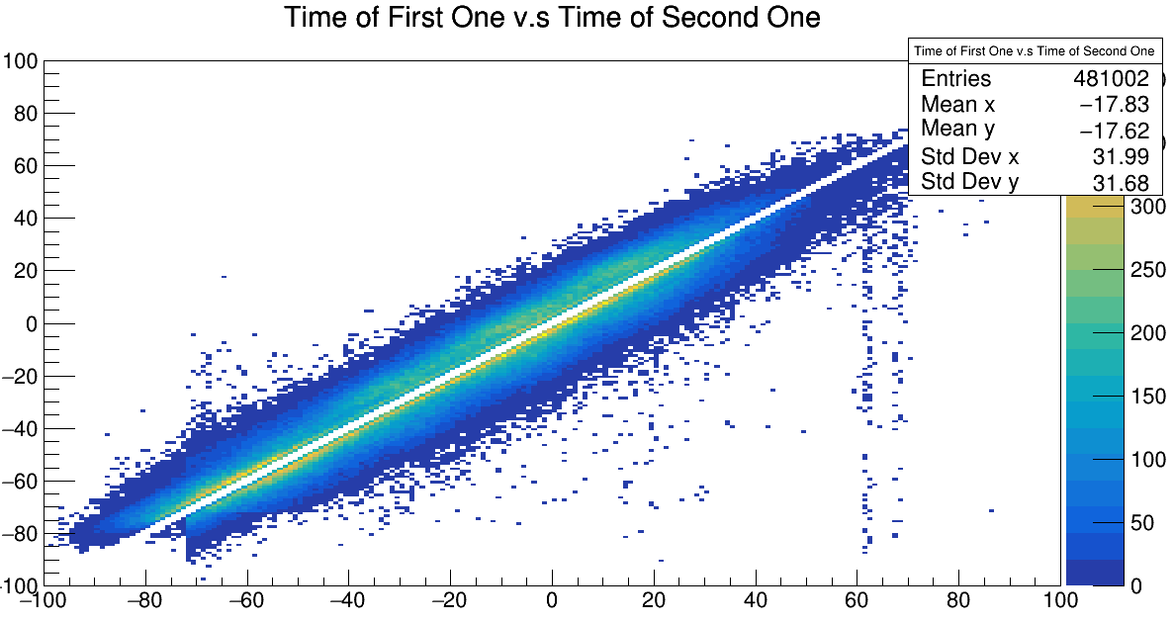
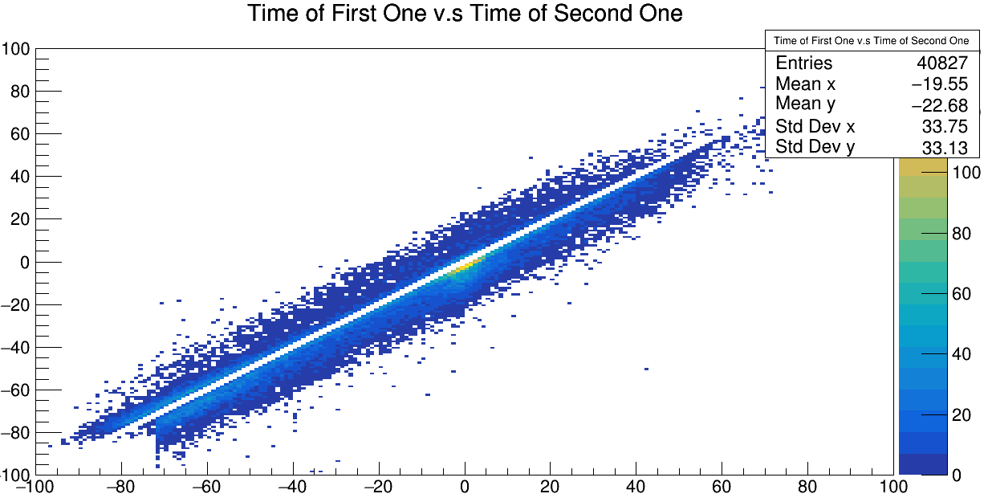
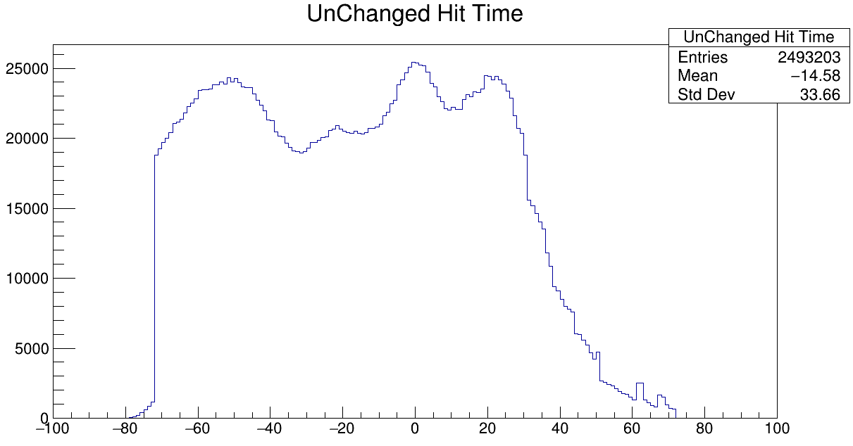
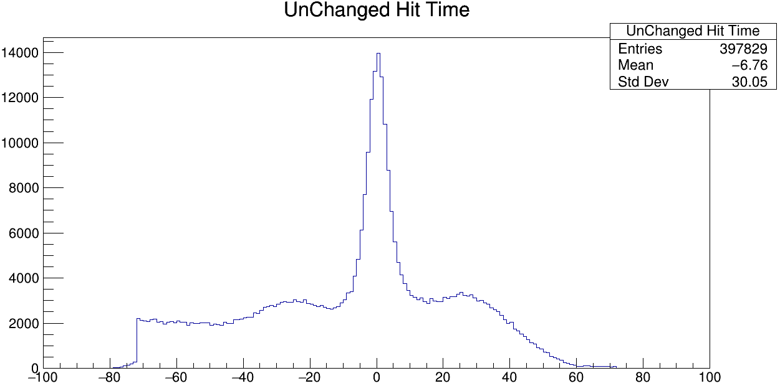
L0M0 L7M0

Slide 17
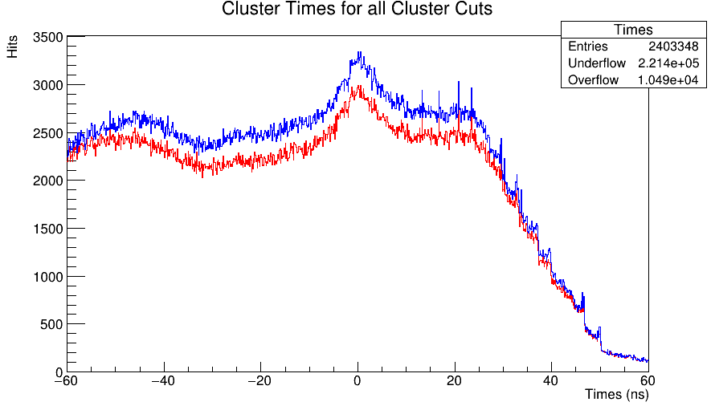
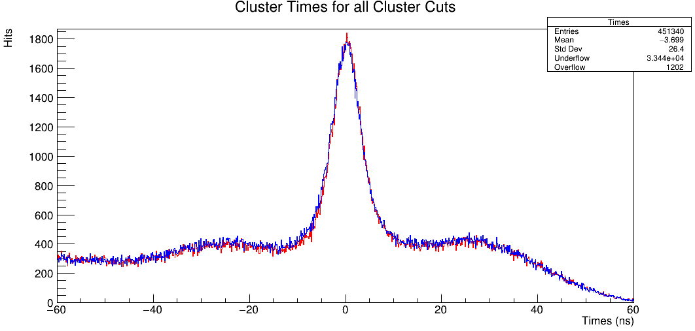
What Does It Do To Cluster Times?
Red is Amp Weighted, Blue is Time Error Weighted.
In Layer 1, we have 10% increase in clusters with error weighting
When we require clusters to be on track, this reduces to a 3% increase in number of clusters (refer to next slide)
We see 2% increase in clusters in Layer 7 on track, though this is visually difficult to tell.
Layer 1 Module 0
Layer 7 Module 0

Slide 18
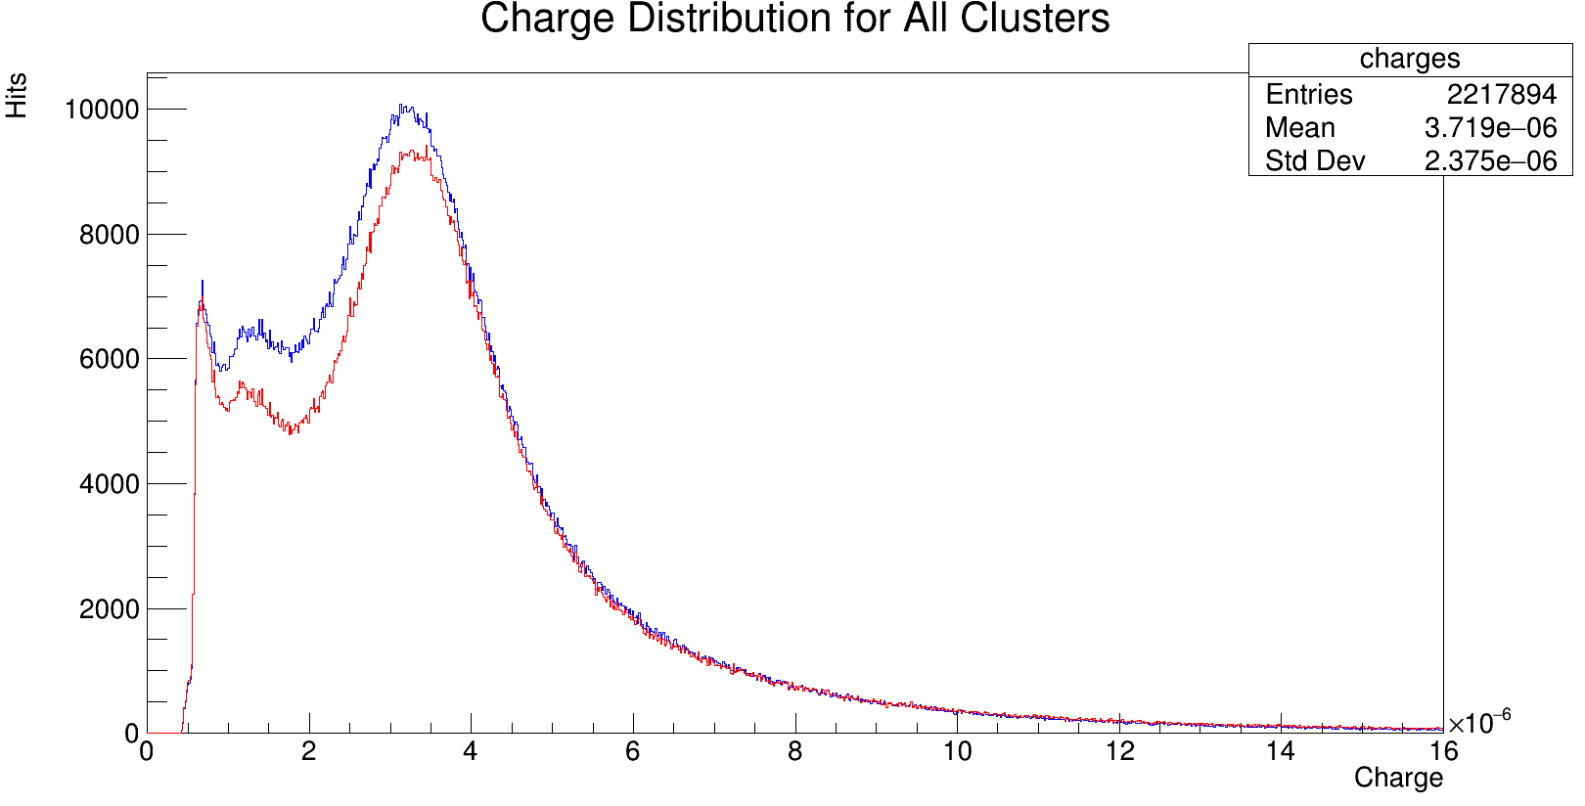
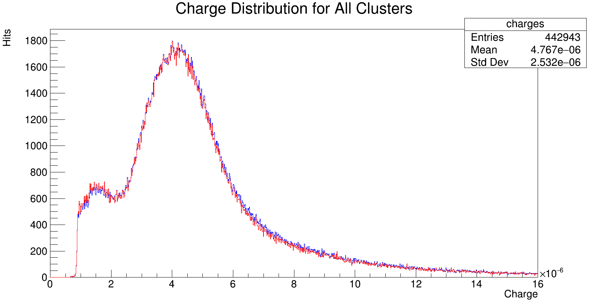
What Does It Do To Cluster Amplitudes?
Left: All Clusters Charge L1M0, Right: All Clusters Charge L7M0

Slide 19
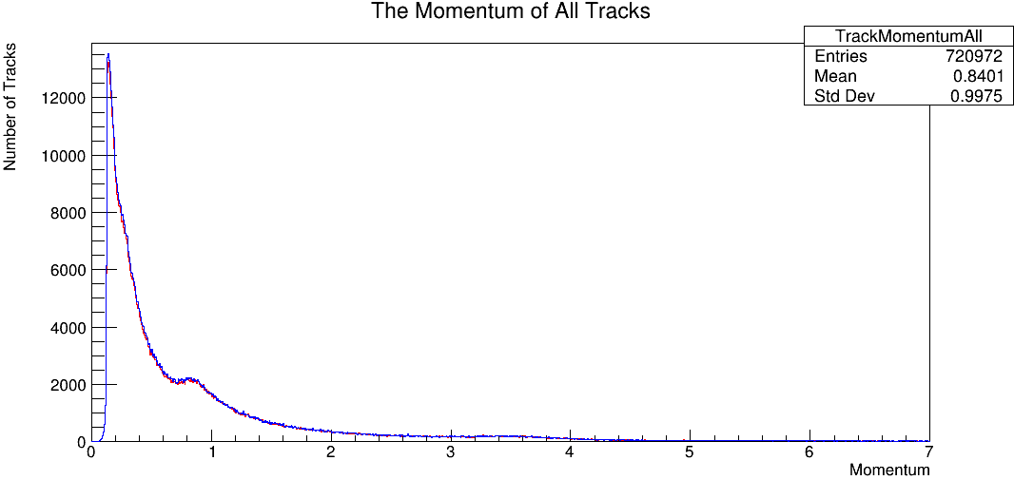
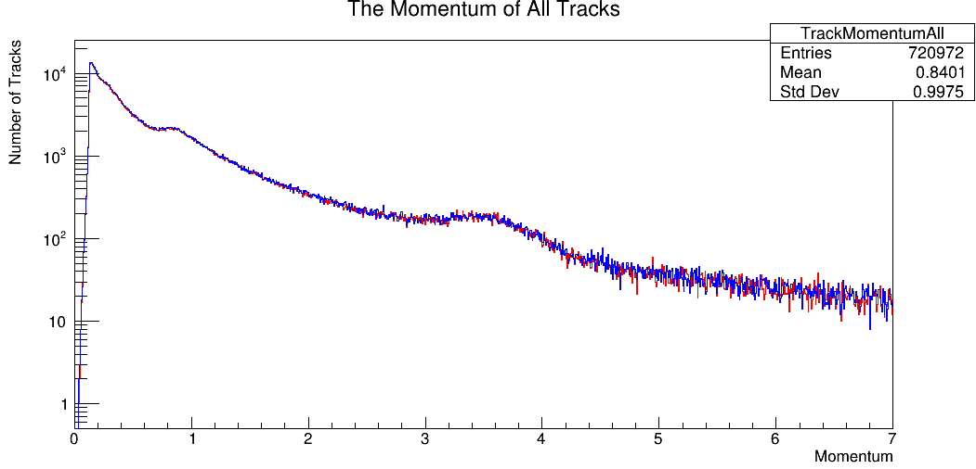
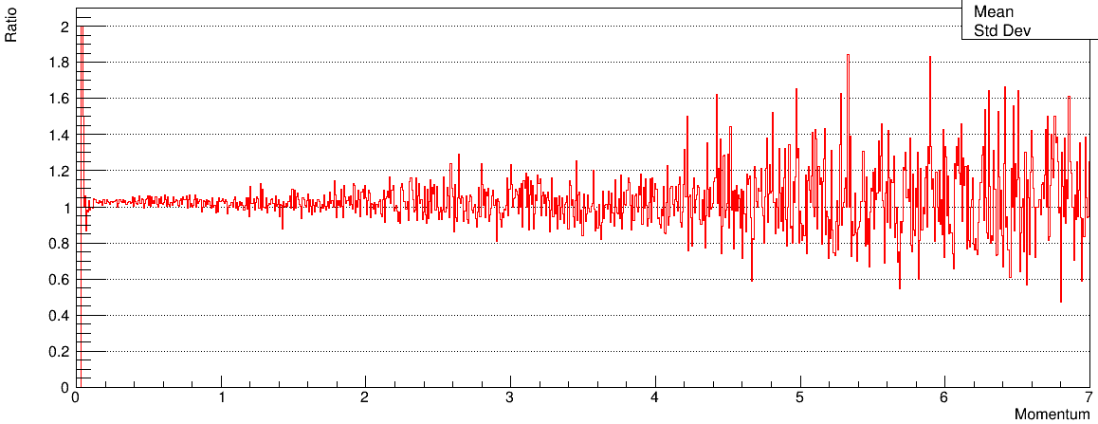
What Does It Do To Track Momentum
For all tracks, it increases the track number by ~3 percent (from 7.21e5 to 7.39e5).
Taking the log plot, we can see the prominence corresponding to 4GeV electrons.
The momentum spectra doesn’t seem to change much on this.
We just get more tracks total.

Slide 20
Cluster Splitting and Merging

Slide 21
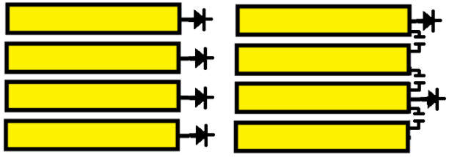
Anatomy of SVT Layers.
To motivate some of our splitting studies, it’s important to understand the SVT wiring differences between layers.
Forward layers are predominantly 1 strip clusters, with 1/10 being 2 strip.
Backward layers are significantly more 2 strip layers, due to charge sharing via capacitive coupling. We expect larger clusters here.
Finally, dead channels always serve to split clusters, as the clustering algorithm does not jump between clusters. Both of these effects are important when evaluating splitting and merging clusters.
Forward Layer Back Layer
Strip circuit diagram
Cluster Splitting Across Dead Channels

Slide 22
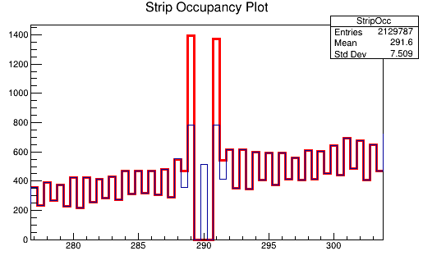
Strip Metric
A first metric we used to evaluate the merging algorithm was plotting strip location for single hit clusters and half strip locations for double.
Every integer is a single hit, every half integer is double. Hence high bins are single hit clusters.
We could then evaluate the strips adjacent to a dead channel before and after merging.
In the plot to the right, red is before merger and blue is after.
Layer 1 Module 0 with dead channel at strip no 290.
Notes:
Note for non seed matching no need to redo because you used axact position.

Slide 23
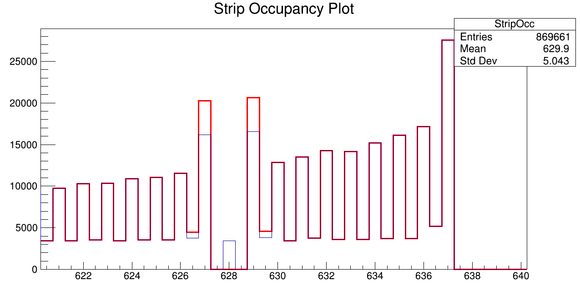
Strip Cross-check
It is clear that an abundance of hits from the dead channel are placed into adjacent bins.
Our merging procedure fixes much of this issue with the hit distribution.
The fix is more evident in the forward layers, but it is, in any case, an improvement in hit position.
Layer 5 Module 0 with dead channel at strip no 628.

Slide 24
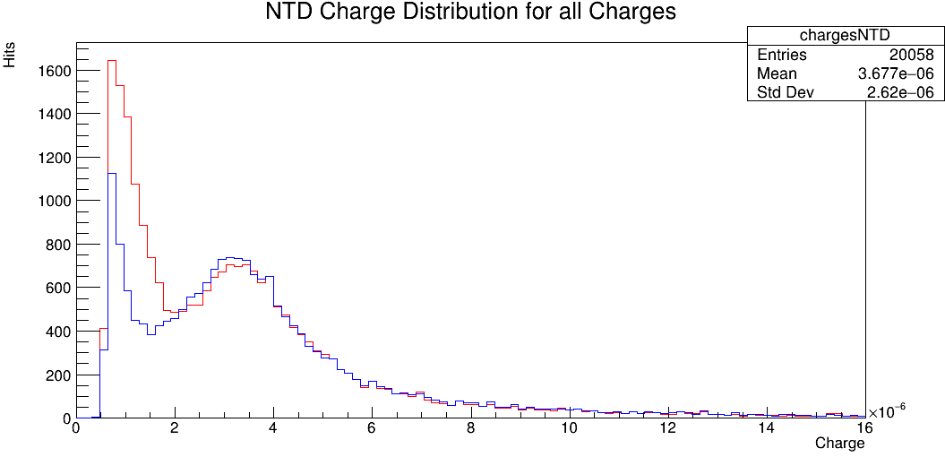
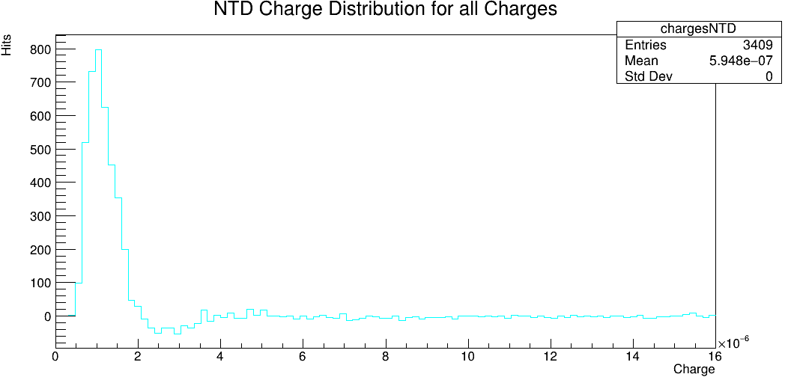
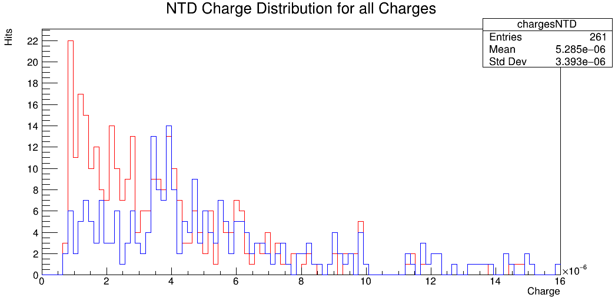
Inspection of Cluster Charges
With the dead fix change, you see 3000 less clusters when you apply the change (>10%). This translates to a similar rate for on cluster charges NTD, but these are very rare.
The same trend occurs in the back-most layers as well.
You are removing many clusters with low cluster charge.
Layer 0 Module 0
Layer 13
Module1

Slide 25
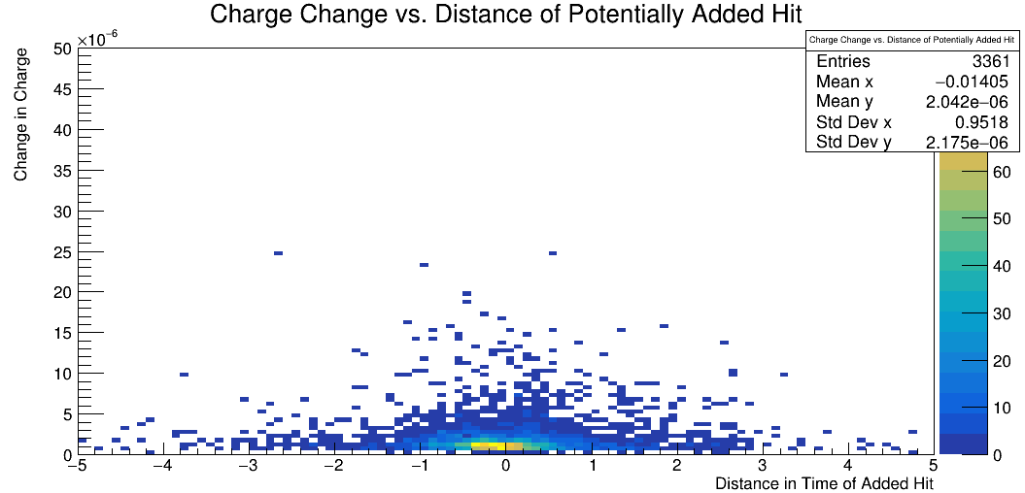
What is happening?
If we were combining every hit on either side every time, the positive area of that last pilot should be twice the negative.
But its not: we aren’t combining every time
The only thing that would prevent you from combining now is the timing cuts; is that what is happening?
Yes. Look to the right. We get ~6000 merging out of 23000. Rest are far out in time.
Plot of time difference between left and right hit versus change in charge of the nearest hit post reco method 2. This is seed matched (and its 2 to one).

Slide 26
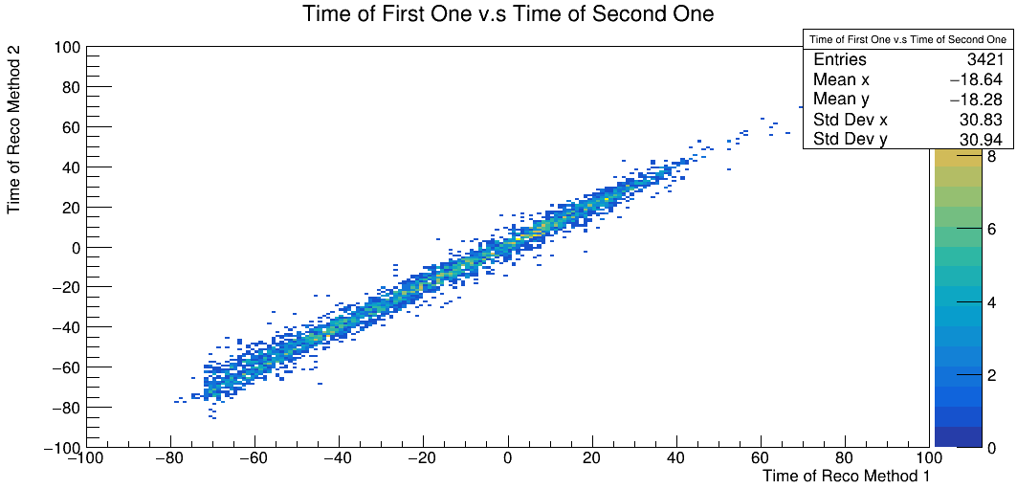
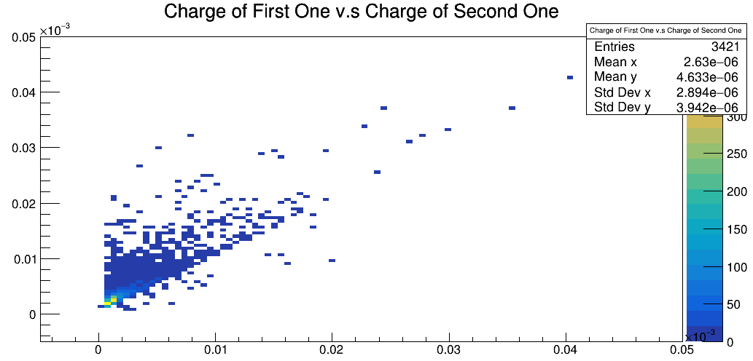
Seed Matched Times and Charges
The times and charges of the two hit reconstruction methods are included here.
Its seed matched, and it should be apparent most times do not change.
The contributed charge does not change much as well.

Slide 27
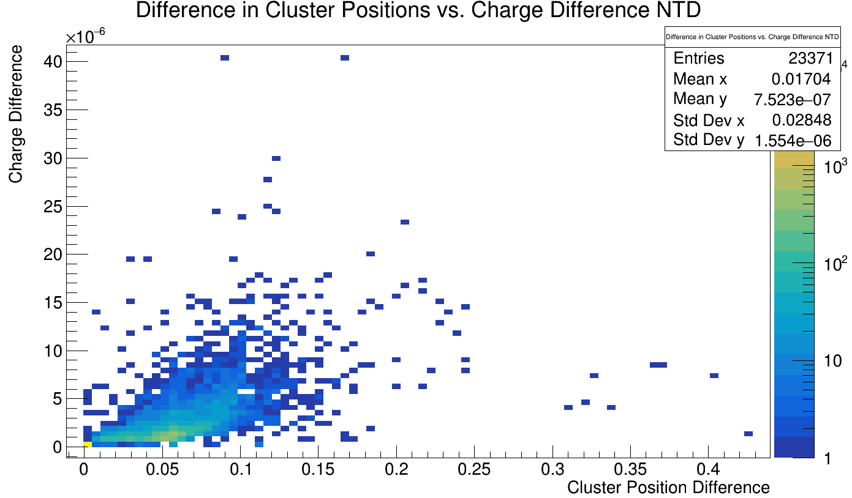
A 2D Plot of Points Of Difference in Charge vs. Position.
The number of changed hits (not in the (0,0) bin) is 6164.
The way this plot works is that each of our two split hits is mapped to the closest hit.
This should be nearer to the dead channel, shown by the average change in position of .05 mm.
The average charge change is roughly 3 tiks on the previous graph.
The number of hits in the gap on the previous page is ~3000, meaning that we have a precise 2 to 1 mapping.
Plot of how the charge and position of next to dead hits change in l0m0. The peak is at (.055, .8*10^-6). Position is in mm, charge in nC.
Notes:
This means it almost always jumps a full strip AND adds a tiny charge: most small hits combine to make another small hit.

Slide 28
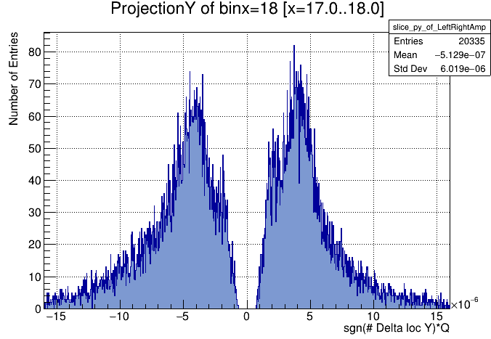
Hit Amplitude Left and Right of A Dead Channel
It was observed that every time a hit was made left of a dead channel, a cluster was also made right of it.
In the plot to the left, we plot the amplitude of hits left of a dead channel conditioned on seeing a hit right of it (and visa versa).
Amplitudes from leftwards strips is negative.

Slide 29
Back Layers and Cluster Thresholds

Slide 30
Cluster Threshold Scans
In previous work, it seemed reconstruction was insensitive to the cluster thresholds→ Need to verify if this true for all layers
Outer layers are capacitively coupled; we expect cluster thresholds to matter more for cluster reconstruction
Outer Layers
Inner Layers

Slide 31
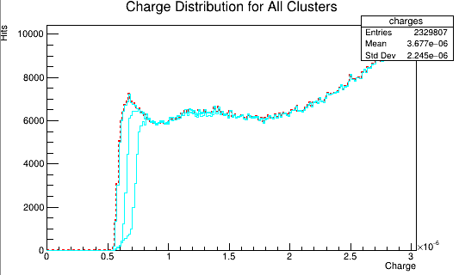
Getting Close to (4,3) On Either End
After applying the timing and dead channel fix, we can plot the charge distribution for clusters for various seed and neighbor thresholds.
Here red is the default distribution.
The blue distributions are (left to right) (2.5,1.5),(3.5,2.5),(4.5,3.5), and (5.0,4.0). The first two lower thresholds don’t change anything: we will not gain anything by lifting our cut. Almost immediately afterwards it removes hits.

Slide 32
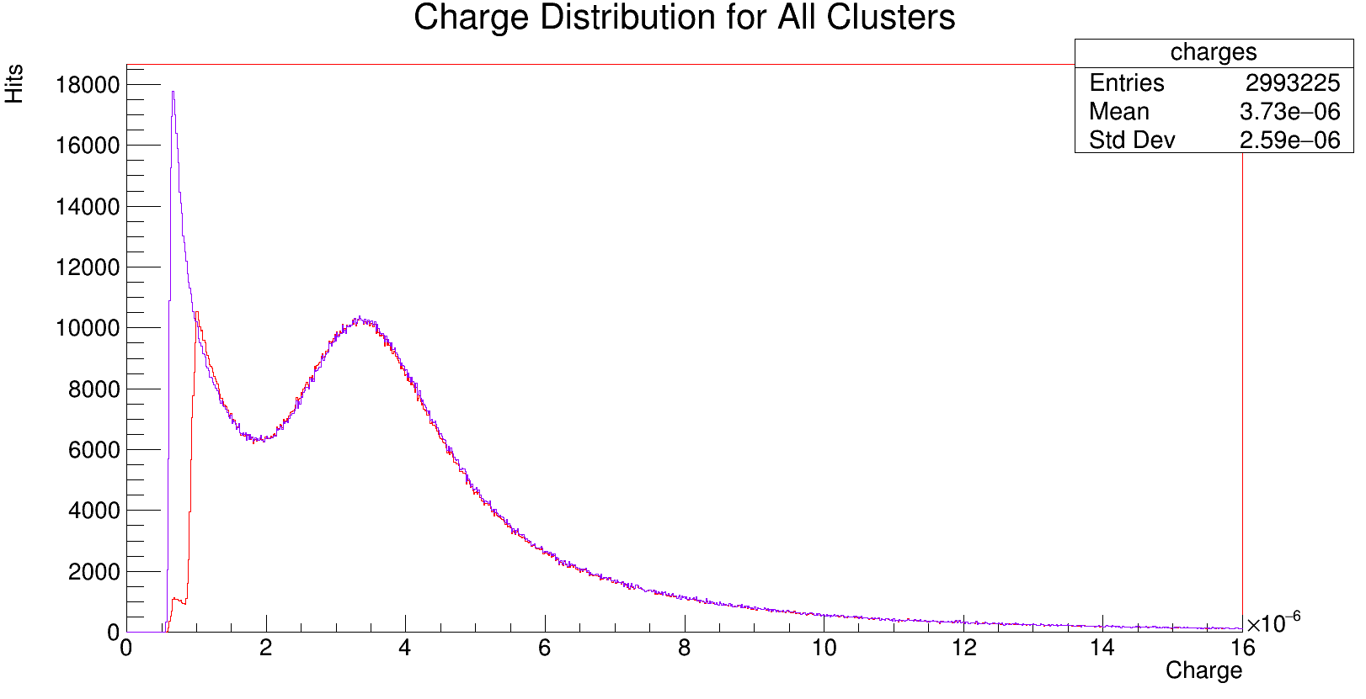
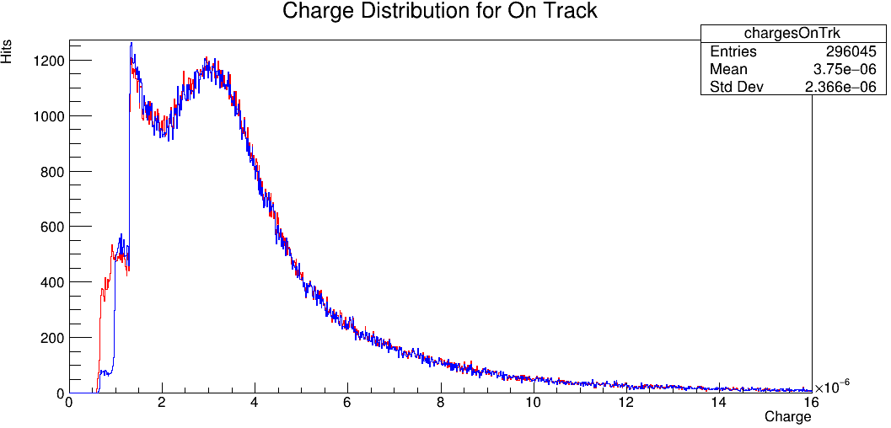
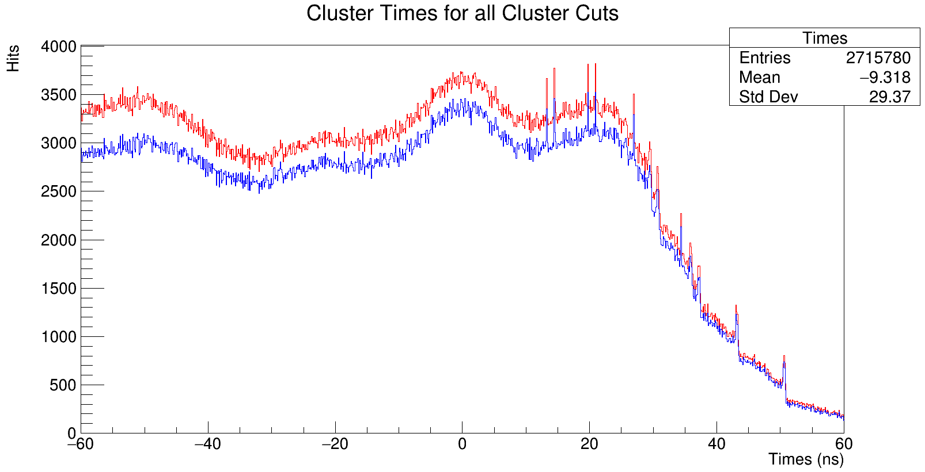
First Layers Thresh Increase
You see a %7 percent decrease (3% for on track) in clusters from (seed,neighbor)=(4𝛔,4𝛔) blue to (6𝛔,6𝛔) red in L0M0
This implies that higher sigma than what we see now removes alot of clusters.
These clusters are seemingly all at the low cluster threshold.
This does not seem to change the timing profile at all.

Slide 33
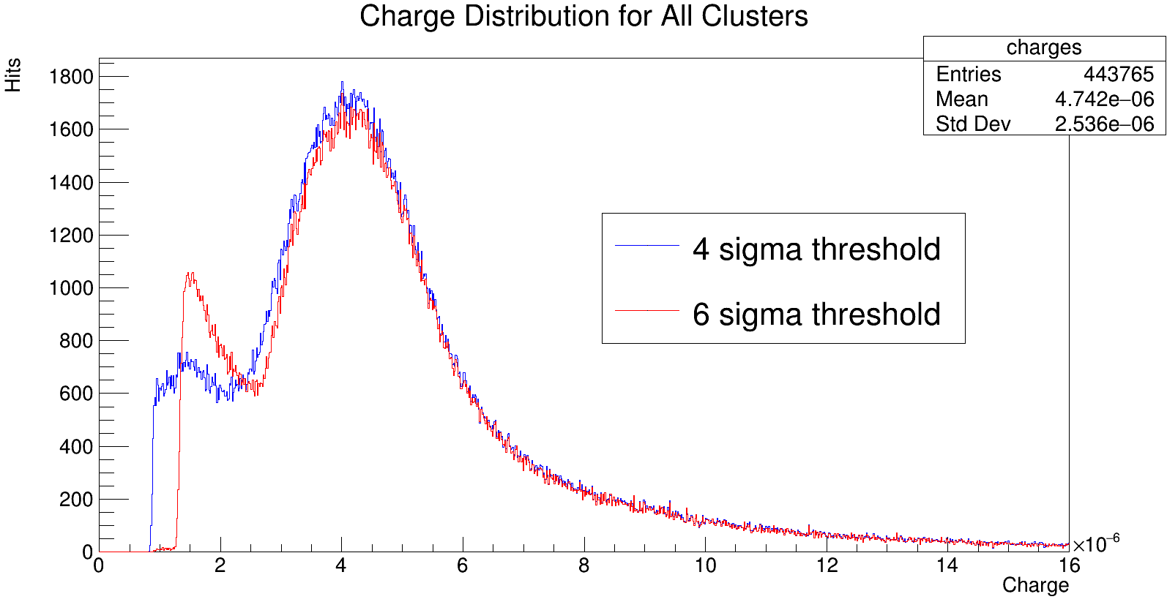
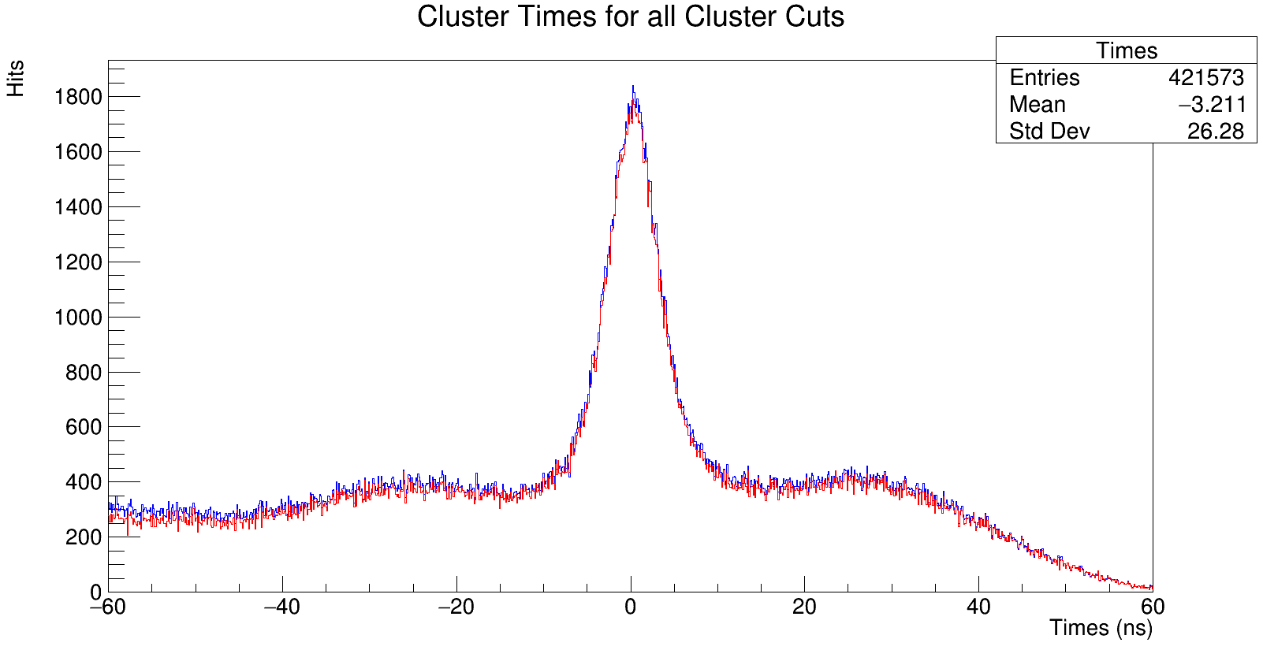
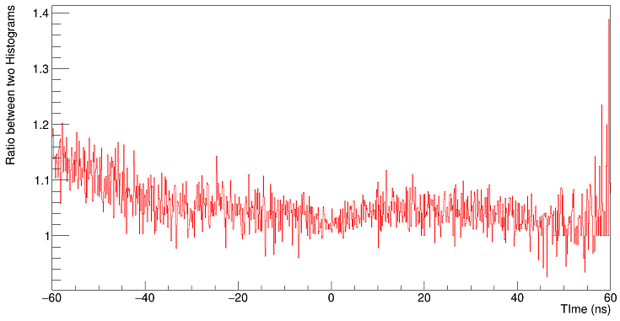
Later Layers Thresh Increase
You see a %5 percent decrease in clusters from (seed,neighbor)=(4𝛔,4𝛔) blue to (6𝛔,6𝛔) red in L7M0
This implies that higher sigma than what we see now removes alot of clusters.
These clusters are seemingly all at the low cluster threshold.
This does not seem to change the timing profile at all.
Notes:
I am orally now saying what I am sensitive to. I did a full scan of the triangular set of points (i.e. nghrThresh<seedThresh). The changes to nghrThresh were inconsequential compared to seed threshold; like the seed cluster if your threshold was less than 3 sigma it didnt change much of anything at all and IF you increased it it was only more destructive.

Slide 34
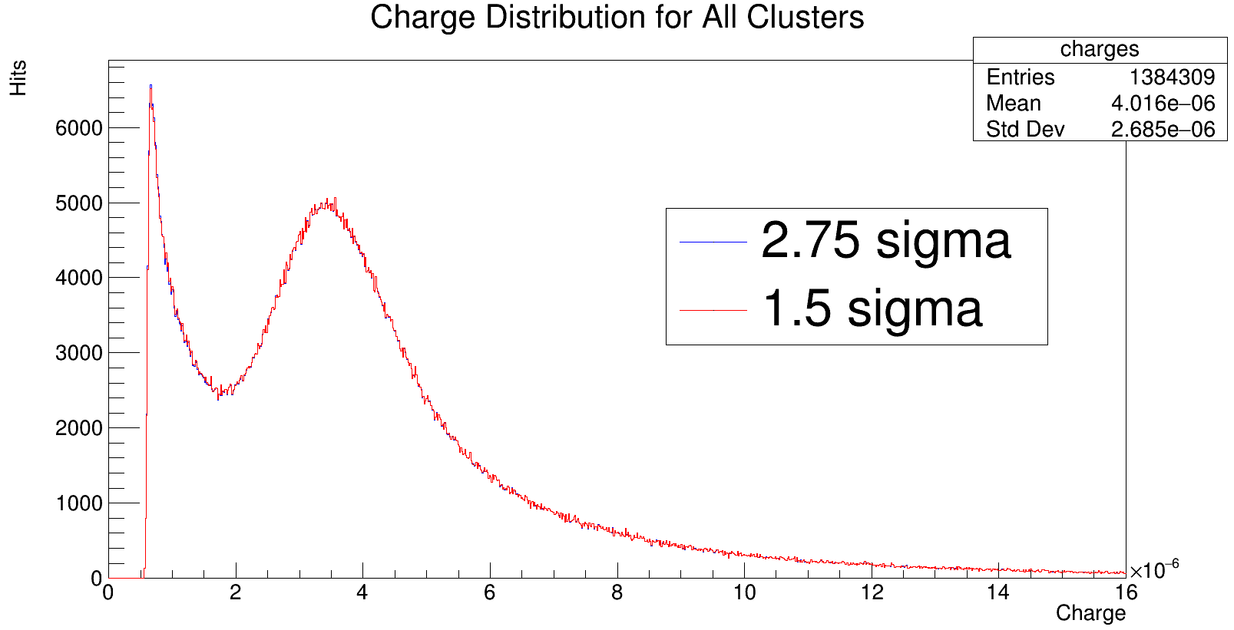
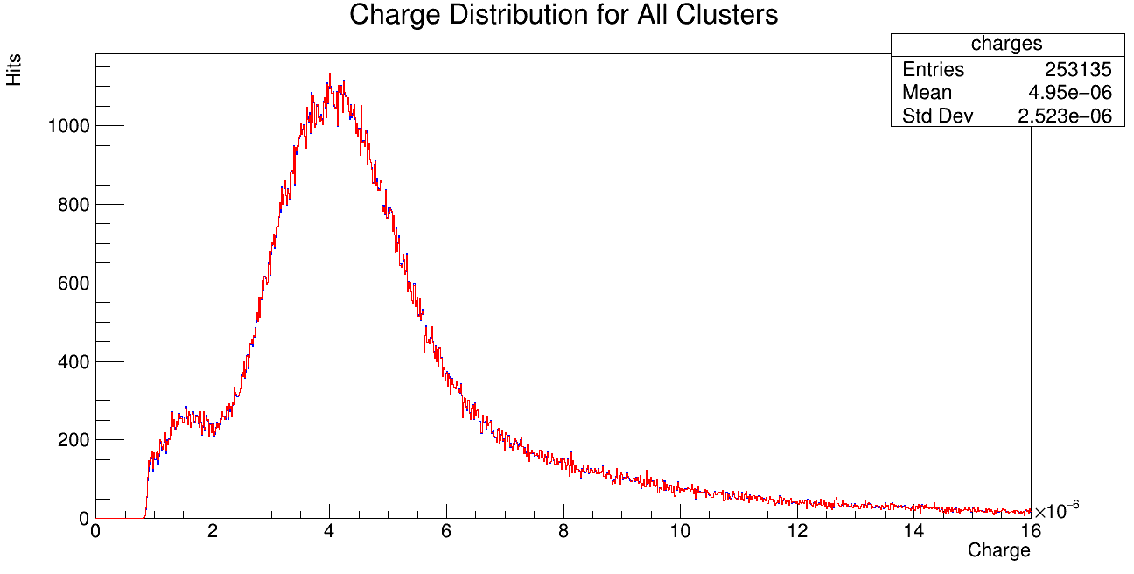
Trying lower thresholds: 1.5 To 2.75 𝛔.
In front layers, this changes the number of clusters by .07%.
In the back layers it changes things by .04%.
It makes it quite clear that amplitude threshold cuts below 4 sigma are not meaningful.
It seems that 4 sigma must be related to some physical cut on amplitudes taken online.
Earlier studies demonstrate lower amplitudes are truly unchanging.
l0m0
l7m0

Slide 35
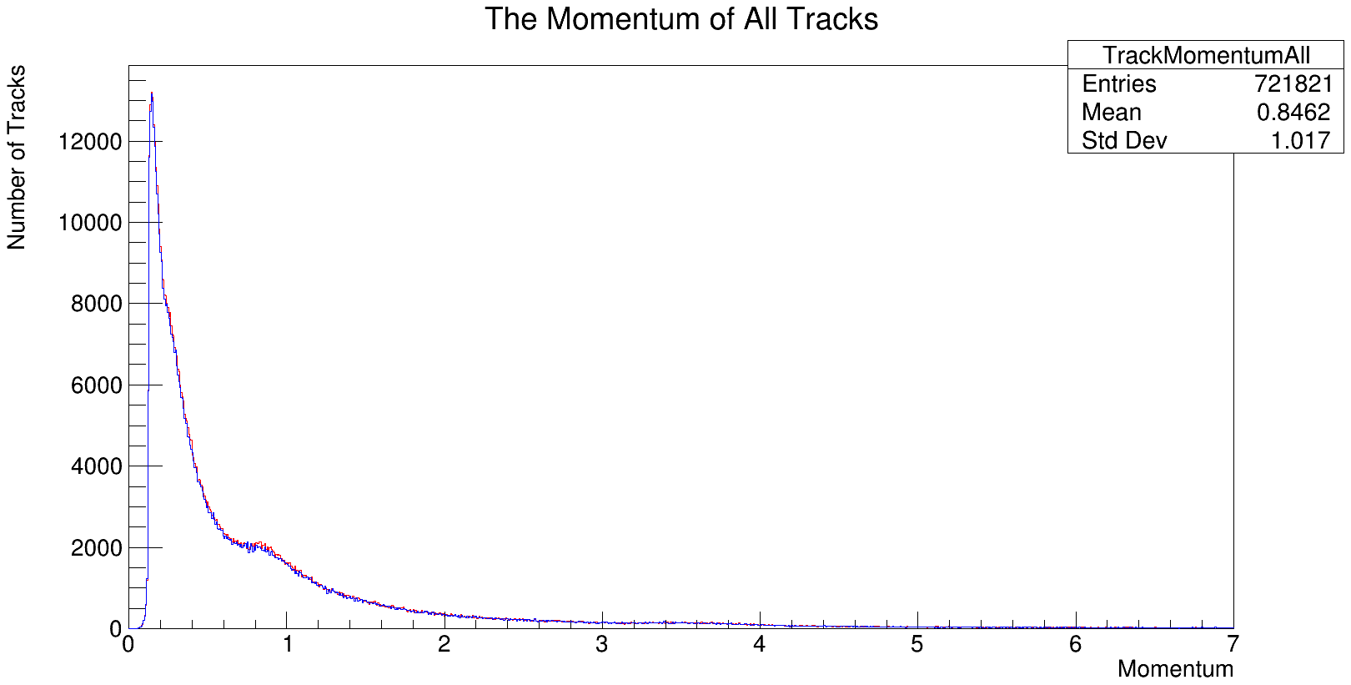
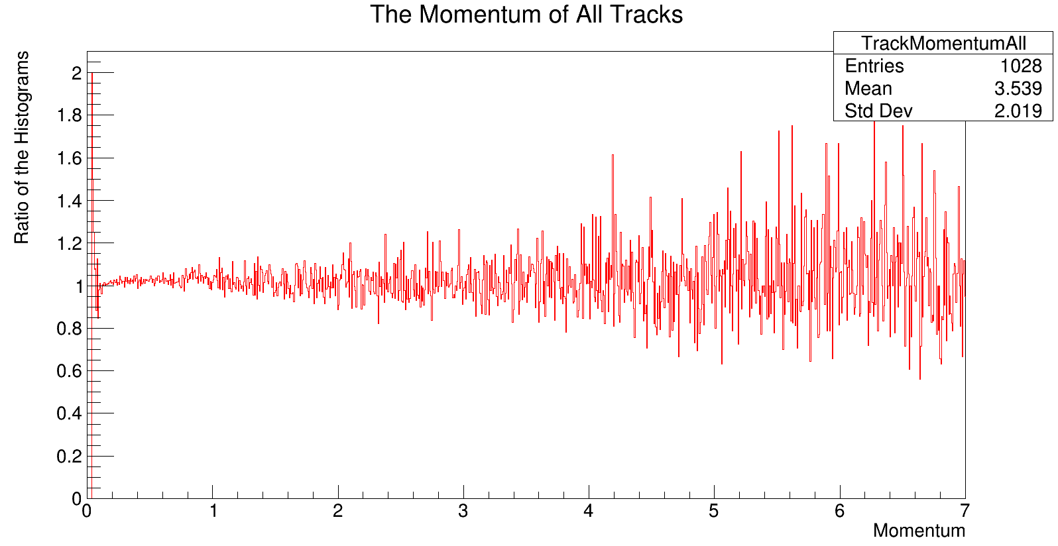
Performance Metrics For 𝛔~4-6
The change in number of tracks from 4 sigma (same across both) to 6 sigma is a 1.8% decrease in tracks
This does not, from direct observation, change the momentum profile of the tracks.
It seems the current choice of our seeding and neighboring thresholds is optimal, with lowering cuts insignificantly changing reconstruction.
Increasing the cuts only serve to remove tracks (and seemingly lower efficiency)

Slide 36
The V Splitting Algorithm.

Slide 37
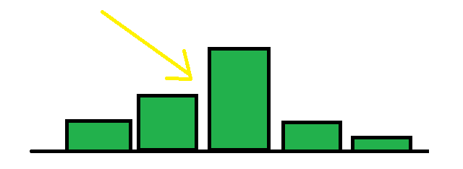
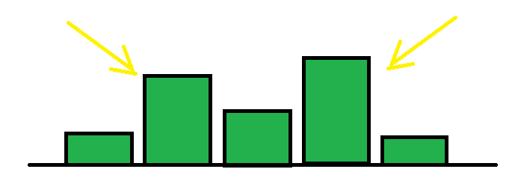
What is V Splitting?
This was something Tim implemented in other clustering algorithms.
It is non-physical for a genuine hit to induce a non-concave charge deposition (at least if channel gains are equal).
In our set-up, what happens to create this is coincident hits.
Therefore if we see a cluster with a ‘V’, we should split it.
Charge deposition characteristic of a single hit.
Coincident electrons; a physical explanation for the ‘V’

Slide 38
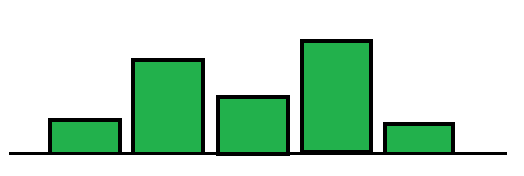
How Will We Perform V Splitting?
We will look at an original cluster which would be obvious to split into smaller clusters:

Slide 39
How Will We Perform V Splitting?
You go in ascending order of channels, and use the first two channels you see to establish the direction of monotonicity (in this case increasing).

Slide 40
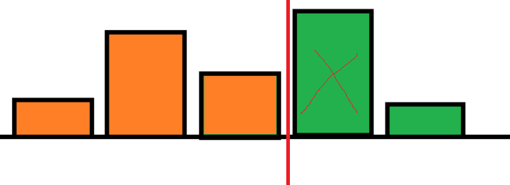
How Will We Perform V Splitting?
You still continue appending clusters should they start decreasing, but now if you notice a change you cut off these hits. These hits (in orange) become a new cluster.

Slide 41
How Will We Perform V Splitting?
You continue until you have <=3 channels left. You make these last channels a last cluster and finish.

Slide 42
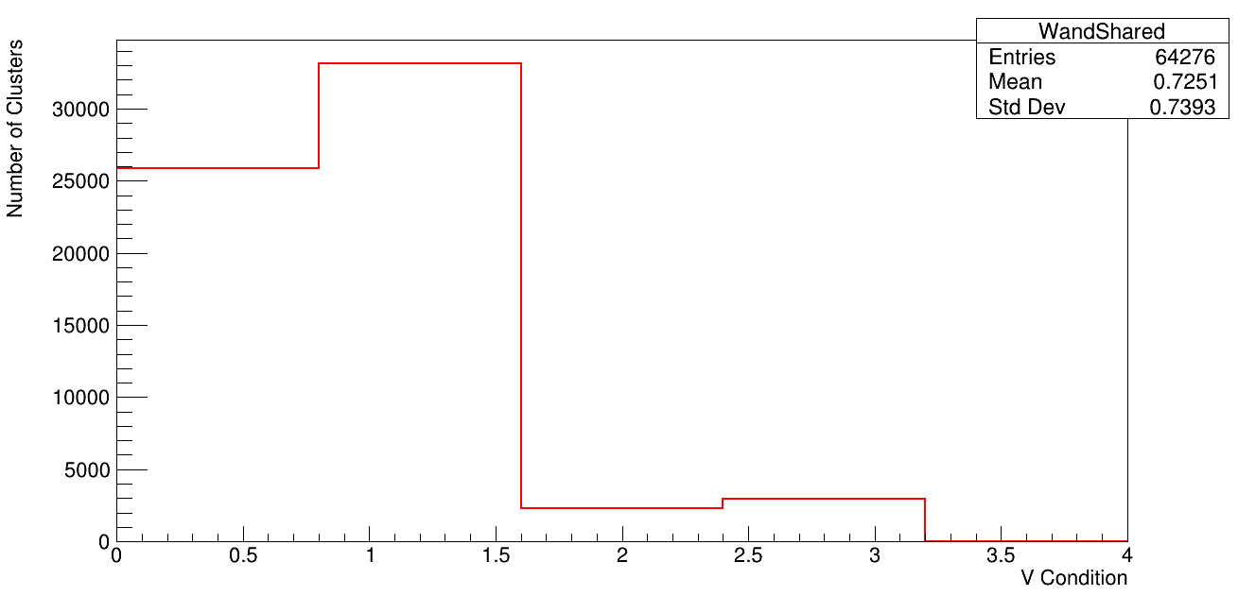
Do we need V splitting?
In order to see non-concavity, you need at least 4 hit clusters.
We can condition on 4 hit clusters and make a simple metric: +1 if it has a v +2 if its shared by 2 tracks.
So 1 and 3 have v, 2 and 3 are in shared clusters.
In 4 hit clusters, the number of clusters which are shared is more among those with a v, but v is just more prevalent in 4 hit clusters anyways.
Plot of our simple metric for four hit clusters.

Slide 43
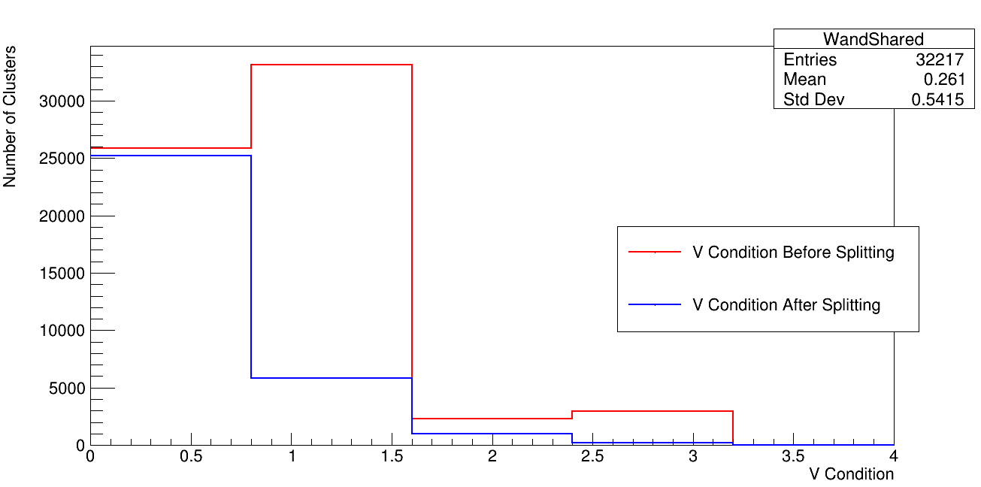
Was the code implemented correctly?
Metric from before before and after implementation.
Clearly some ‘v’s are being kept and some hits which aren’t ‘v’s are being changed.
I believe that because somewhere there is a small mismatch in logic between my analysis and algorithm.
I trust my analysis more bc I have thought about it more.
We do see a significant reduction in shared clusters!

Slide 44
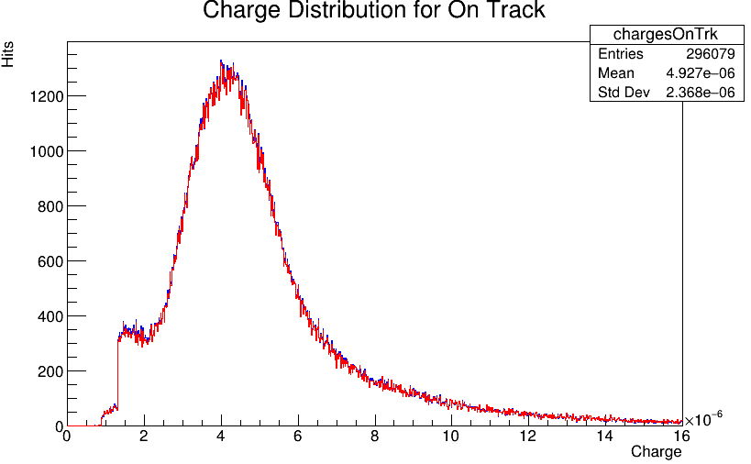
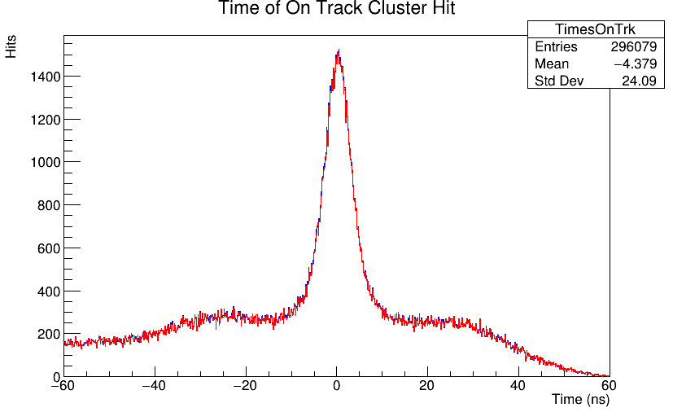
What Does It Do In The Back Layers?
With this fine bining, it is difficult to tell, but we get an increase of hits on track for L7M0.
This increase amounts to a 1% increase in the number of hits on track.
The amount of hits generally increases (by a few percent points more).
Note that the same convention (as adopted in slide 39) of blue after the fix is incorporated here.

Slide 45
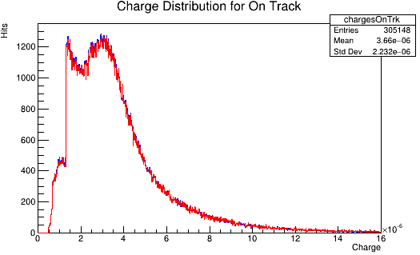
What does it do in L0m0
In L0m0 you also see a uniform increase in the number of hits on track.
This also occurs on the order of 1%.
Not a significant difference in improvement between the forward and back layers, despite significantly reducing shared hits.
Shapes generally the same, just more clusters total.

Slide 46
How about the Z0 Error?
In this plot we take the Z0 Error histograms for our tracks w/ and w/out splitting.
We then subtract them.
What's left is a distribution with an integral off the extra tracks we have that captures the ‘difference’ between the two profiles.
The main difference, then, is we get a lot of tracks with really low Z0 Error (i.e. a performance increase)
Subtraction of Z0 Error before histogram from after histogram.
Notes:
This is meant to address what it does to residuals.

Slide 47
What About Track Quantities.
There is a .5% increase in the total number of tracks.
There is a .6% increase in the total number of in time tracks.
This is a very small effect, but it does increase our performance and does not affect the momentum spectrum.
It marginally increases the run time (by like 5-7% in my estimation for the usual 10 hour run).

Slide 48
Conclusion
We have demonstrated that the time error weighted cluster time as well as the scaled time cut significantly improved our reconstruction.
While merging over dead channels represents a marginal increase in big-picture reconstruction performance, we have demonstrated that it is the “correct” way to treat dead channels.
Manipulating clustering thresholds still proves low cuts are inconsequential past 4 sigma. It seems 4 sigma is the optimal amplitude cut for seeding and thresholding.
The V Splitting Algorithm seems to do what it’s advertised to do.
With these studies completed, and those considered in previous work, we have extensively explored the optimization of our clustering algorithm.

Slide 49
BACKUP

Slide 50
On Track Cluster Times
L1 M0 L7 M0

Slide 51
An Introduction To The Clustering Algorithm
For hit in rawhits:
Put hit and channel into map
if signal/noiseRMS>nghbrThresh:
Add to clusterable set
if signal/noiseTMS>seedThresh:
Add to seeding set
What We Change w/ Dead Channels:
Don’t add to either of these if the channels in question are dead
for seed hit in seed_clusters:
Remove seed from clusterable
Add seed to unchecked
Instantiate a cluster object
What We Change w/ Dead Channels:
In this step, we just skip over the dead channels and add the channel 1 or 2 over to this list.
while(unchecked unempty):
pop unchecked;
if(unchecked>thresh, is in neighbor, and in time):
addtocluster
put its neighbors into unchecked

Slide 52
Cluster Amplitude vs. T0 Error Calculation
The original cluster time was weighted by charge amplitude with the pictured time cut.
We will evaluate weighting instead by inverse time errors, and scaling the time cut by the time error of the added hit.
These changes refocus on good hits rather than large ones in establishing the time of a cluster.
The scaled time cut now works in number of standard deviations away a hit is from the cluster time.
The delta sigma cut is 3, time is 24 ns.

Slide 53
A More Granular Binning on the First Plot
A concern was voiced w.r.t. the last plot.
Sure we were removing low amp hits across the dead channel, but they should be moving hits into higher amplitudes.
This second fact wasn’t immediately evident from the plot on the previous page.
Setting a lower granularity for the binning made this more evident, however.
It is moving hits to higher amplitudes.

Slide 54
Hit Amplitude Left and Right of A Dead Channel
In the earlier plots, it was shown that not all clusters are merged when you make the merge fix.
This means that, while we always see clusters on both sides of a dead strip, the hits involved must not always satisfy the timing cut.
This, I expect, may actually be a good thing as while we always see both; hit timing seems to automatically see when some hits ought not to be merged
Plot of Amplitudes of hits left (negative) and right (positive) of a dead channel.

Slide 55
A 2D Plot of Points Of Difference in Charge vs. Position.
The number of changed hits (not in the (0,0) bin) is 6164.
The way this plot works is that each of our two split hits is mapped to the closest hit.
This should be nearer to the dead channel, shown by the average change in position of .05 mm.
The average charge change is roughly 3 tiks on the previous graph.
The number of hits in the gap on the previous page is ~3000, meaning that we have a precise 2 to 1 mapping.
Plot of how the charge and position of next to dead hits change in l0m0. The peak is at (.055, .8*10^-6). Position is in mm, charge in nC.
Notes:
This means it almost always jumps a full strip AND adds a tiny charge: most small hits combine to make another small hit.

Slide 56
How Many Clusters Are Changed
Before we move to performance estimates, it’s important to qualify how big a change this will be.
In these plots we look event by event for the different reconstruction algorithms and plot the closest cluster in Rec 2 to a cluster in Rec 1.
This means that ~1/10 of the clusters moved; this is consistent with the number of 2 cluster hits we see in a layer.
Layer 1 Module 0
2D Histo of Charges for Reco 1 and 2.
Layer 7 Module 0
Notes:
The strip spacing is roughly .06 mm. The peaks of the distribution shown below are .021 mm and .023 mm. So certainly less than a whole spacing, but this is definitely possible in an amplitude weighting scheme.

Slide 57
Splitting Up That Last Plot By Strip No

Slide 58
Another Metric Characterizing How Charge Moves
We can consider the following metric.
Say two channels across a dead channel merged.
We plot the greater amplitude cluster of them on the x-axis.
We then plot the merged cluster on the y-axis.
This is the plot to the right; it characterizes how charges charge when we perform this merging procedure.
Most charges are left along, and of those that aren’t they are evenly split (hence we are concentrated on diagonal). Many of these are two small charges becoming another small charge.

