Slide 1
Effective git use
GSPDA Mini-Software Workshop
May 24, 2024
Stephen Wood
(These slides from June 2018, Hall A/C Software Workshop)

Slide 2
Why version control?
$ git log --oneline –reverse
…
a0de8a6 Add figure captions
decea72 Final proofing, ready for advisor
3ce5c28 Make advisor’s corrections
69c0f4c Address advisor’s comments
152d0f5 Deal with advisor’s corrections
e093339 Why did I come to grad school?
$ git diff decea72 e093339
Collection of links to information about git: https://hallcweb.jlab.org/wiki/index.php/Git_Howto
YouTube video series:
”Git and GitHub for Poets”
https://youtu.be/BCQHnlnPusY
"Piled Higher and Deeper" by Jorge Cham,

Slide 3
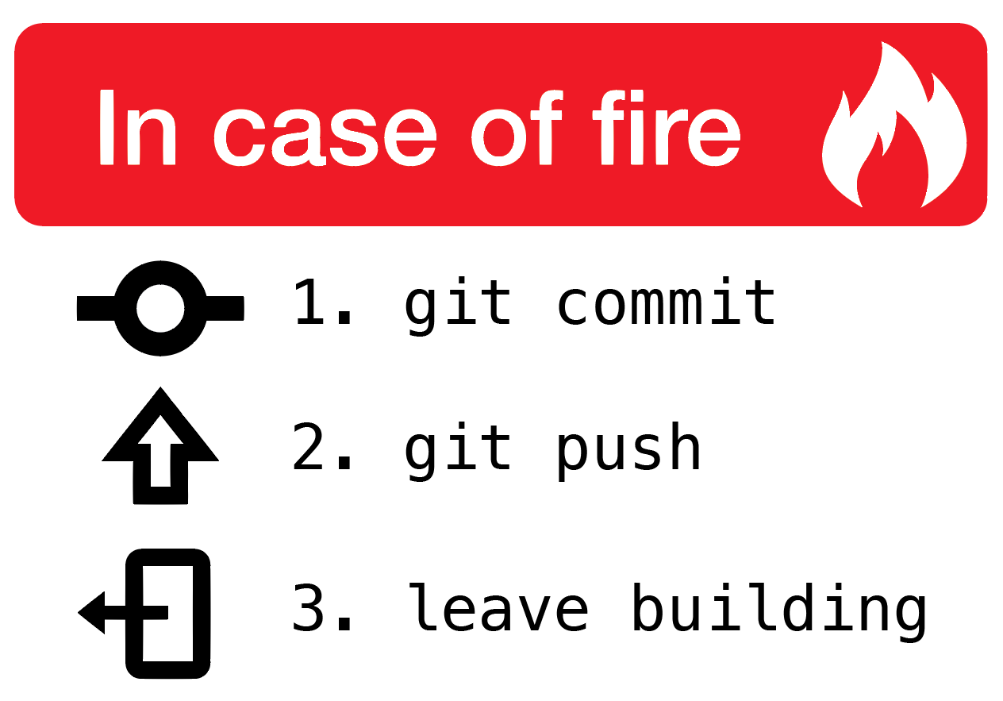
Advice
Use git for everything
Don’t need a server (GitHub) for personal projects
Text/Tex, Web pages, poetry, configuration files, Reports, publications, theses
Don’t work in the ”master” (“develop” in case of hcana) branch
Keep master branch in sync with main server
Keep crap out of repository with .gitignore
(intermediate files, binaries, emacs junk, latex junk, root files, …)
Use branches liberally
Commit early and often – commitment is not forever!
First line of commit comment should summarize the changes
Rewrite your commit history before putting in public repository
Make development process look logical, improve commit comments
Learn how to resolve conflicts when merging and rebasing
Learn and follow “rules” of projects you join
Read online git tutorials, practice

Slide 4
GitHub.com -
github.com is a git server with many added features
GitHub != git -- GitHub not needed for personal projects without collaborators
By default, projects on GitHub are public
JeffersonLab has a corporate account. Allows private repositories, most are public.
(private projects still visible to JLab users)
Anyone can setup unlimited projects repositories.
Price = all your stuff is public
There are many other free and $ git servers. We just happen to use GitHub.
More on JLab GitHub use, see Tyler Hague’s:
https://redmine.jlab.org/attachments/download/185/TritiumAnalysisOrganization.pdf
JLab now migrating to locally hosted git server GitLab:
https://code.jlab.org

Slide 5
Contributing to typical Hall A/C project
https://github.com/JeffersonLab/project
https://github.com/yourgithubaccount/project
A1: fork
master
master
B3: Pull Request
mybranch
C1: fetch/merge
A2: git clone
C2: git push
B2: git push
master
A: Initial setup
B: Contributing
C: Keeping things up to date
B1: git checkout –b mybranch
mybranch
My Computer

Slide 6
GitHub.com – collaboration
– Details will differ with GitLab
To collaborate on a Jlab GitHub project (e.g. analyzer, hcana, hallc_replay, …) get your own GitHub account.
Install your public ssh key on GitHub (or give password on git push)
Visit project page – e.g. https://github.com/JeffersonLab/hallc_replay
Fork the project (top right)
Clone the “fork”
git clone git@github.com:YOURUSERNAME/hallc_replay.git
cd hallc_replay
git remote add --track master upstream https://github.com/JeffersonLab/hallc_replay
Git checkout –b myaddedfeatures
Do stuff
git push origin myaddedfeatures
On hallc_replay project page on GitHub, select “myaddedfeatures” branch and click “New pull request”. Wait for project manager to merge changes. Update your “master” branch.
See https://hallcweb.jlab.org/wiki/index.php/Analyzer/Git for detailed “hcana” information

Slide 7
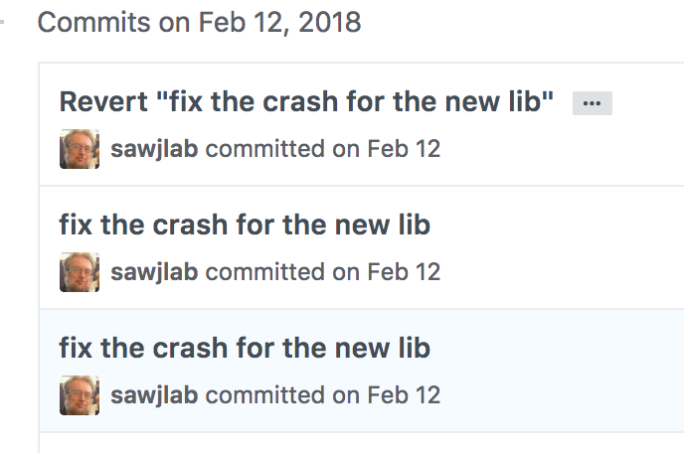
git – Authorship
Sample commits from Hall C analyzer hcana
$ git log
…
commit d6e15d1667932495ec1c3e7e4723314cc496838d
Author: Carlos Yero <cyero002@fiu.edu>
…
commit 4254664d54055f61046ed90d1a0e901d3f980342
Author: hallc-online <hallconline@gmail.com>
…
commit d3c4f8c1938f408968443d977f141981dd9f1d15
Author: hallc-online <hallconline@gmail.com>
…
commit f26d1d0dde44da558e67940950b9c1d00548269c
Author: hallc-online <hallconline@gmail.com>
I didn’t make these commits to HallA-Online-Tritium.
Who made these commits?
Commits were made on counting house analysis accounts.
How to show proper authorship with out making other authors show up as yourself?

Slide 8
git – Overriding authorship
1. Override default author with:
$ git commit –author=“Susan B. Anthony <dollar@treasury.com>” {files}
Need to remember to use “—author” every commit. If you forget, can do:
$ git commit –author=“Susan B. Anthony <dollar@treasury.com>” --amend
(if done before commit is pushed to GitHub)
2. Or set author for personal clone on analysis account:
cd directorywiththepersonalclone
git config user.name “your name”
git config user.email xxx@jlab.org
cat .git/config
3. Or set environment variables:
GIT_AUTHOR_NAME
GIT_AUTHOR_EMAIL

Slide 9
The “.gitignore” file
Avoid including ”derived” files and editor junk in git repository.
.o files, executables, log files, intermediate files, etc.
Create a file ”.gitignore” with one line for each thing to ignore.
*~
\#*\#
*.o
*.root
ROOTfiles/
…
git add .gitignore
git commit .gitignore
Or edit “.git/info/exclude”
If for whatever reason you don’t want to edit .gitignore:
Add lines to
.git/info/exclude
with the same syntax as .gitignore

Slide 10
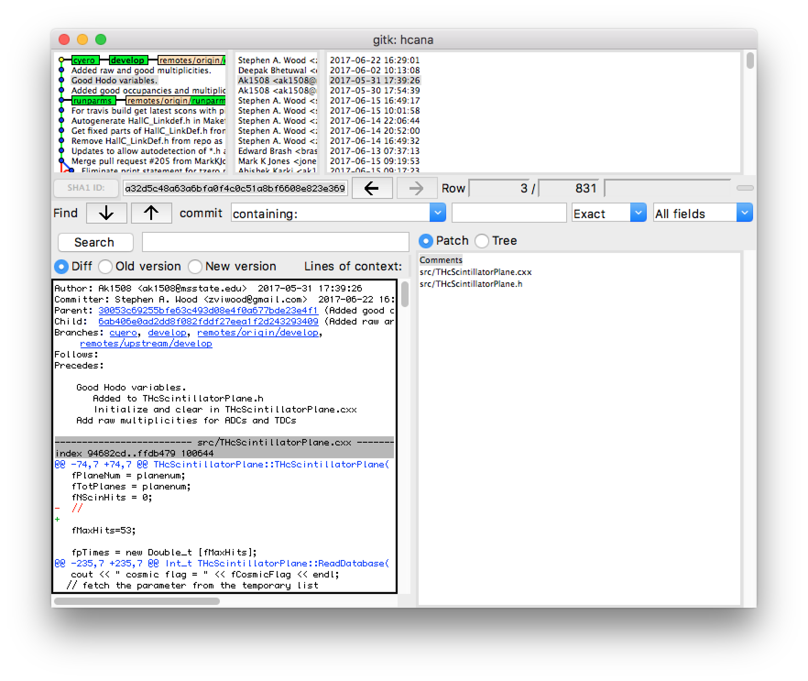
gitk – a useful utility
Graphical display of commit history and changes.
gitk
Or “tig”, similar but without Xwindows.
On your virtual machine
yum install tig
Or “gitx” on MacOSX

Slide 11
git – setting defaults – Exercise 0
git config --global user.name “your name”
git config --global user.email xxx@jlab.org
git config --global core.editor ”emacs” (or nano or vim)
git config --global push.default simple
cat ~/.gitconfig

Slide 12
Rebasing / Editing history
Starting from “master branch”
git checkout –b workbranch
Do some work, lots of commits
git rebase –i master
Edit the list and save
git log --oneline
078c9b0 Create filec
b64f990 Create fileb
b3a7efc Create filea
5376520 Initial commit
git checkout master
git merge workbranch
pick d8f7fa2 Start working on file a.
pick ae17be0 Start working a fileb
pick 082c27e More work on filea, didn't finish, had to go home
pick 2ee43df More work on file b
pick 393b333 Fix typo in file b
pick d5a2c39 Finish filea
pick d8df357 Something else
pick d8f7fa2 Start working on file a.
squash 082c27e More work on filea, didn't finish, had to go home
squash d5a2c39 Finish filea
pick ae17be0 Start working a fileb
squash 2ee43df More work on file b
squash 393b333 Fix typo in file b
edit d8df357 Something else

Slide 13
Rebasing – Exercise 1 – page 1
Start a new git project
mkdir hello ; cd hello ; git init ; git status
Create “README.md” file, “add” and “commit” it
emacs README.md
git add README.md
git commit README.md
git status
Create a working branch
git checkout –b workingbranch
Create program “hello.c“
emacs hello.c; cc -o hello hello.c ; ./hello
git add hello.c ; git commit hello.c
git log
Add a Makefile
emacs Makefile
Add and commit
git status
/* hello.c */
#include ”stdio.h”
Main(){
printf(“Hello World\n”);
}
# Makefile
hello: hello.o
hello.o: hello.c
Should see commits for README, hello.c and Makefile.

Slide 14
Rebasing – Exercise 1 – page 2
Add a line after the printf, but with a compile bug
git commit hello.c
make - Observe that it doesn’t compile
Fix the bug
git commit hello.c
Add a .gitignore file
git status
emacs .gitignore ; commit .gitignore
git status
Observe the history
git log
printf(“Hello Sunshine\n”):
Use colon instead of semi-colon
# .gitignore
*.o
hello
﻿$ git log --oneline
8e00f82 (HEAD -> work) Add a git ignore file
5b591b8 Fix the sunshine bug
e9aed89 Add some sunshine
e5075c2 Add a Makefile
c8bfc82 First program
4718615 (master) First commit

Slide 15
Rebasing – Exercise 1 – page 3
A more complicated Change the history to look like:
Create .gitignore
Create Makefile
Create Working hello.c (with sunshine)
git rebase –i master
Edit list to look like this
Save rebase list
Rewrite hello.c commit when prompted
If you mess up, delete all the pick, etc. lines in the buffer and save. This will abort the rebasing.
11. Merge ”workingbranch” into master (or make pull request for collabortive project.)
git checkout master
git merge workingbranch
git log
git branch –d workingbranch
﻿﻿pick c8bfc82 First program
pick e5075c2 Add a Makefile
pick e9aed89 Add some sunshine
pick 5b591b8 Fix the sunshine bug
pick 8e00f82 Add a git ignore file
﻿﻿pick 8e00f82 Add a git ignore file
pick e5075c2 Add a Makefile
pick c8bfc82 First program
squash e9aed89 Add some sunshine
squash 5b591b8 Fix the sunshine bug

Slide 16
Rebasing – Exercise 2 – page 1
In this exercise, we have developed two independent features in parallel in a series of commits. Before merging with master (or pull requesting), we wish to rebase into a single commit for each feature, hiding our messy development process.
There are two problems:
1. After branching to “features_branch”, a change that conflicts with our changes has been made.
On one commit we made include changes related to both features. We need to split this commit into separate commits for each feature before squshing related commits together.
Start a new git project
git clone https://github.com/sawjlab/rebase_exercise rebase
cd rebase
git checkout features_branch
Resolve the conflict
git rebase master
emacs justcode.c
(Or use “git mergetool” if configured)
This will show “CONFLICT” error
<<<<<<< HEAD
printf("This is a program to compute prime …
printf("Sieve of Eratosthenes\n);
=======
/* Sieve of Eratosthenes */
>>>>>>> justcode: add a comment

Slide 17
Rebasing – Exercise 2 – page 2
(continued)
Usually choose code before or after =====
Here, keep it all
Remove <<<<<, =====, and >>>>> lines.
git rebase –continue
Split the combined commit
git rebase –i master
Replace “pick” with “edit”
Save buffer
git reset HEAD~
git commit justcode.c
git commit printfs.c
git rebase --continue
Reorder and squash
git rebase –i master
Reorder the commits.
For each feature, squash extra commits.
Merge into master (or make pull request)
git checkout master
git merge features_branch
<<<<<<< HEAD
printf("This is a program to compute prime …
printf("Sieve of Eratosthenes\n);
=======
/* Sieve of Eratosthenes */
>>>>>>> justcode: add a comment
pick 239792e justcode, declare i
pick 2a9192a justcode: add a comment
edit ca1ddcb justcode: bug fixes, printfs: print more numbers
pick a39322d justcode: Print out the primes
pick 53e26c1 justcode: Finally got it working
pick c174bac printfs: Add computation of Lucas Numbers
﻿pick 239792e justcode, declare i
squash 2a9192a justcode: add a comment
squash 7a6adb1 justcode: bug fixes
squash c053fdf justcode: Print out the primes
squash 1c7674c justcode: Finally got it working
pick 0e5858d printfs: print more numbers
squash a38eb3d printfs: Add computation of Lucas Numbers

