Slide 1
GIT and Version Control Systems
by Dmitry Romanov 05/18/2023

Slide 2
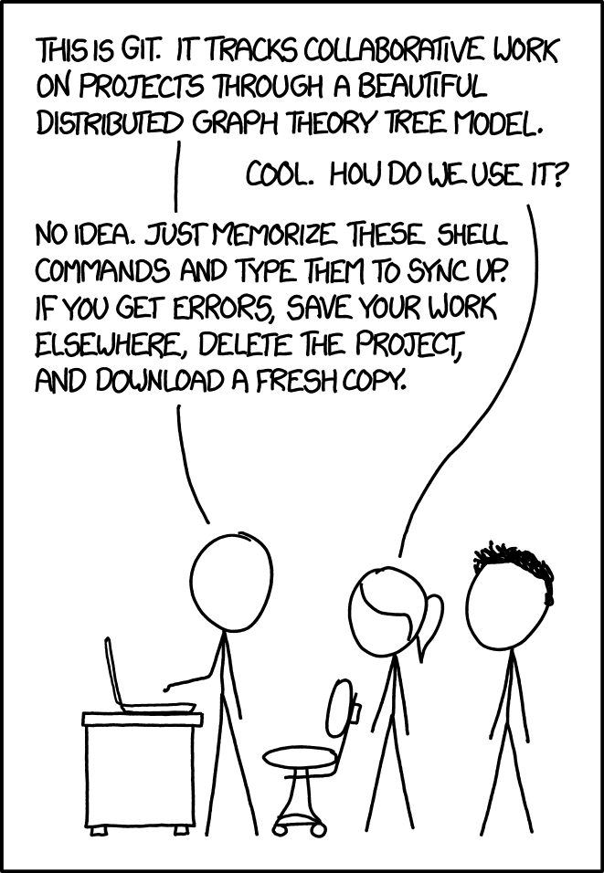
What this talk is about?
How to use GIT?

Slide 3
What this talk is about?
Why we ended up with GIT?
What you require from Version Control System?
Why is it so complex or flexible?
When to use GIT(always)?
What are some advanced features?

Slide 4
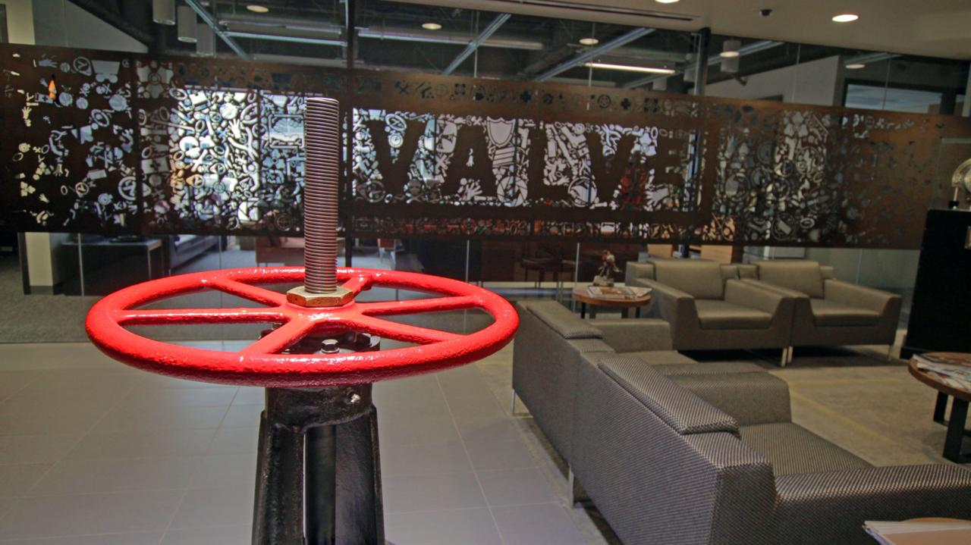
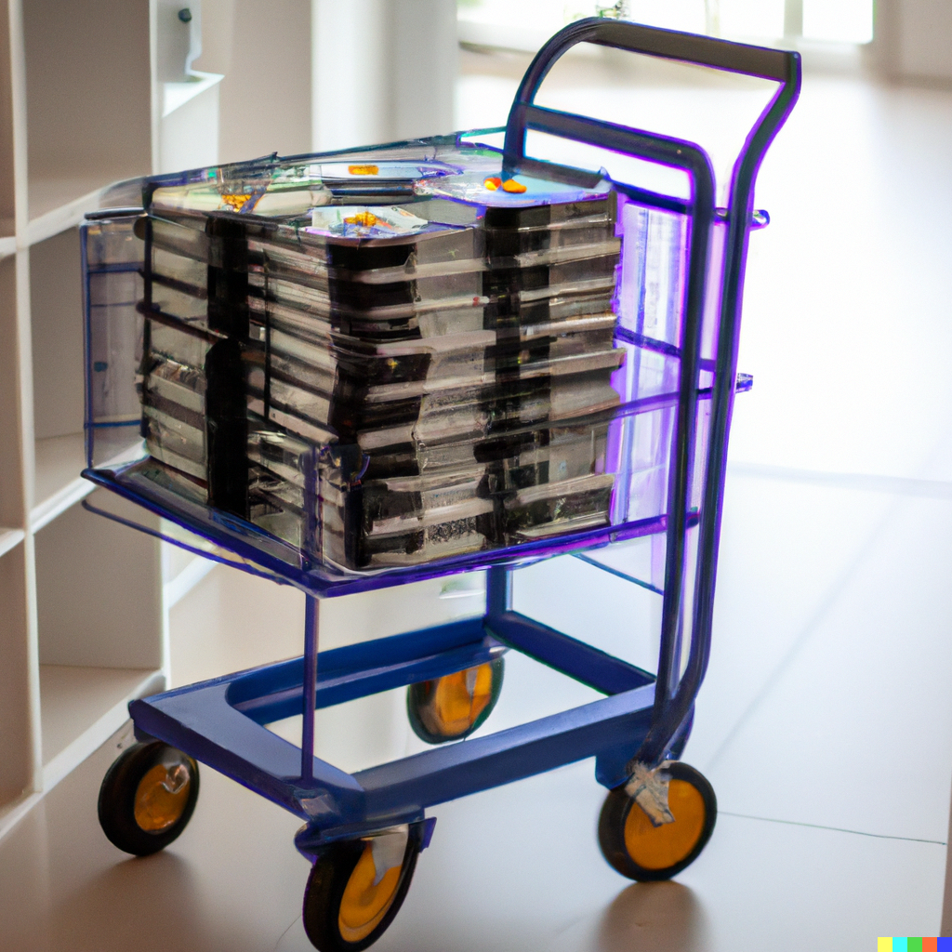
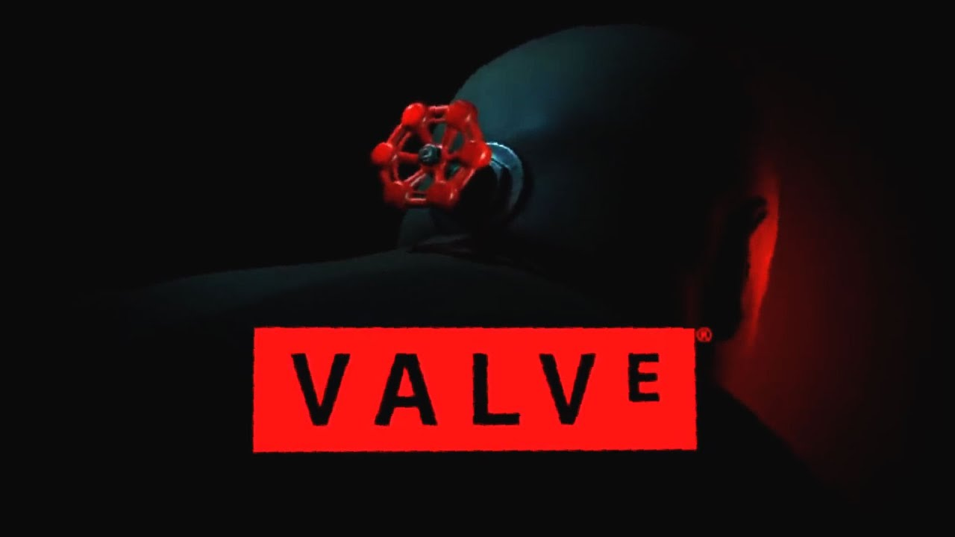
Valve office of 1996
Same story but in 1993
GoldSource
In the early days, Valve didn't have a version control system, so the developers would copy their work to a floppy disk at the end of each day and then give it to the next person in line. This process was called "the daily sync" and it was a very inefficient way to work. Hired Michael Abrash in 1998. In 1999 they started to use Subversion

Slide 5
Imagine we have a central server
Central server
Initial code
time

Slide 6
User takes code, makes changes and put it back to server
Central server
Code changes
time

Slide 7
Terminology. Get from server – checkout, put to server - commit
Central server
Checkout
Code changes
Commit
More changes
Commit
time

Slide 8
Terminology. Get from server – checkout, put to server - commit
Central server
Checkout
You can go back and forth in history
Code changes
Commit
More changes
Commit
time

Slide 9
Central server
Code changes
More changes
time

Slide 10
Central server
Code changes
Code changes
More changes
Merge
Commit
time

Slide 11
1
Central server
time

Slide 12
Central server
Code changes
More changes
Main branch
Feature branch
time

Slide 13
Central server
Code changes
More changes
Main branch
Feature branch
time

Slide 14
Central server
Code changes
More changes
Tag Version 1.0.0
time

Slide 15
VCS requirements
Change tracking and history. The ability to track and record changes to files over time, allowing users to see who made changes, when, and why. This is the core functionality of any VCS.
Branching and merging. The ability to create branches, allowing multiple versions of a project to coexist and evolve independently, and merge those branches back into the main codebase when needed. This feature supports parallel development efforts and makes it easier to manage large projects.
Conflict resolution: A mechanism for handling conflicts that arise when multiple users make changes to the same files simultaneously. Modern VCS should provide tools to help users resolve conflicts and merge changes effectively.

Slide 16
VCS requirements
Change tracking and history. The ability to track and record changes to files over time, allowing users to see who made changes, when, and why. This is the core functionality of any VCS.
Branching and merging. The ability to create branches, allowing multiple versions of a project to coexist and evolve independently, and merge those branches back into the main codebase when needed. This feature supports parallel development efforts and makes it easier to manage large projects.
Conflict resolution. A mechanism for handling conflicts that arise when multiple users make changes to the same files simultaneously. Modern VCS should provide tools to help users resolve conflicts and merge changes effectively.
Access control and permissions. The ability to control who can access and modify a project's files. This is essential for managing team collaboration and maintaining security.
Tagging and versioning. The ability to mark specific points in the project's history with tags or version numbers, making it easier to manage releases and track the evolution of a project.
Collaboration tool and Integration with other tools

Slide 17
Let’s review the architecture we have
Central server
We came up with an architecture of older Version control systems such as SVN (Subversion)
Checkout
Checkout
Code changes
Code changes
Commit
More changes
Commit
Commit
Merge
time

Slide 18
“Classical” old generation VCS ideas like SVN
Central server
Single point of failure: All of the data is stored on a single server. If that server goes down, then everyone who is working on the project will lose access to their work. This is a major security risk, as well as a major inconvenience.
User has single version of code
Limited access: In a centralized VCS, only users who have access to the server can work on the project. This can make it difficult to collaborate with others, especially if they are not located in the same place.
Slow performance: In a centralized VCS, all changes to the code must be submitted to the server before they can be seen by other users. This can slow down development, especially if there are a lot of users working on the project at the same time.
Difficult to manage: In a centralized VCS, it can be difficult to keep track of all of the changes that have been made to the code
Checkout
Checkout
Code changes
Code changes
Commit
More changes
Commit
Commit
Merge
time

Slide 19
Version control history
Year Introduced | Name | Centralized/Decentralized
1986 | RCS (Revision Control System) | Centralized
1990 | CVS (Concurrent Versions System) | Centralized
2000 | BitKeeper | Decentralized
2000 | Perforce | Centralized
2000 | Subversion (SVN) | Centralized
2005 | MS TFS (Team Foundation Server ) | Centralized
2005 | Git | Decentralized
2005 | Mercurial | Decentralized
2005 | Bazaar | Decentralized
2008 | Fossil | Decentralized
2013 | Plastic SCM | Distributed, Cent.features

Slide 20
Imagine we have a server
server
ORIGIN server
time

Slide 21
Imagine we have a central server
server
server
Clone
Local server
ORIGIN remote server
time
time

Slide 22
The servers are equal. If configured properly someone can clone from you
server
server
Clone
server
ORIGIN server
Local server
time
time
time

Slide 23
One can init local server first and then decide to move code online
server
Local server
time

Slide 24
One can init local server first and then decide to move code online
server
Local server
server
ORIGIN remote server
time
time

Slide 25
Imagine we have a central server
server
server
Clone
ORIGIN server
Commit 1
Commit 2
time
time

Slide 26
Imagine we have a central server
server
server
Clone
ORIGIN server
Commit 1
Commit 2
PUSH
time
time

Slide 27
Imagine we have a central server
server
server
Clone
ORIGIN server
PUSH
time
time

Slide 28
Imagine we have a central server
server
server
Clone
ORIGIN server
> git rebase -i origin/main
A way to squash commits
time
time

Slide 29
Imagine we have a central server
server
server
Clone
ORIGIN server
PUSH
time
time

Slide 30
Deploy code via push to a server
server
server
Clone
ORIGIN server
server
Commit 1
Deploy website by pushing code to
Commit 2
PUSH to Origin
PUSH to another remote
time
time
time

Slide 31
Imagine we have a central server
server
server
Clone
ORIGIN server
Push
time
time

Slide 32
Imagine we have a central server
server
server
Clone
ORIGIN server
Push
> git pull
Pull
time
time

Slide 33
Imagine we have a central server
server
server
1 > git clone 2 > git add 3 > git commit
4 > git checkout
5 > git push 6 > git pull
- Copy repo 1st time - What changes to commit - Create the commit
- Switch between commits
- Check changes on remote - Download remote changes
Clone
ORIGIN server
Push
Pull
time
time

Slide 34
Commits (what are those orange dots?)
server
?

Slide 35
Git commits vs SVN commits
server
All commits are immutable snapshots of your project at a specific point in time
Each commit is a snapshot of the entire project
at the time

Slide 36
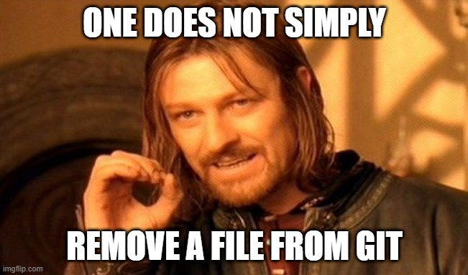
You can’t remove file from GIT repository
In Git, fully removing a file from the repository is not straightforward because the system is designed to preserve history; even deleted files can still be retrieved from the commit history.
server
Consequences: - Be careful with files you commit
- Don’t commit large files
time

Slide 37
Git commits vs SVN commits
server
Each commit is a snapshot of the entire project
at the time
Each commit is identified by a hash (Part of hash can be used to get a commit as far as it is unique)
4716ca912495c805b94a88ef6dc3fb4aff46bf3c
de20247992af0f949ae8df4fa9a37e4a03d7063e
Identified by unique SHA-1 hash git checkout de2024

Slide 38
Can it be simpler?

Slide 39
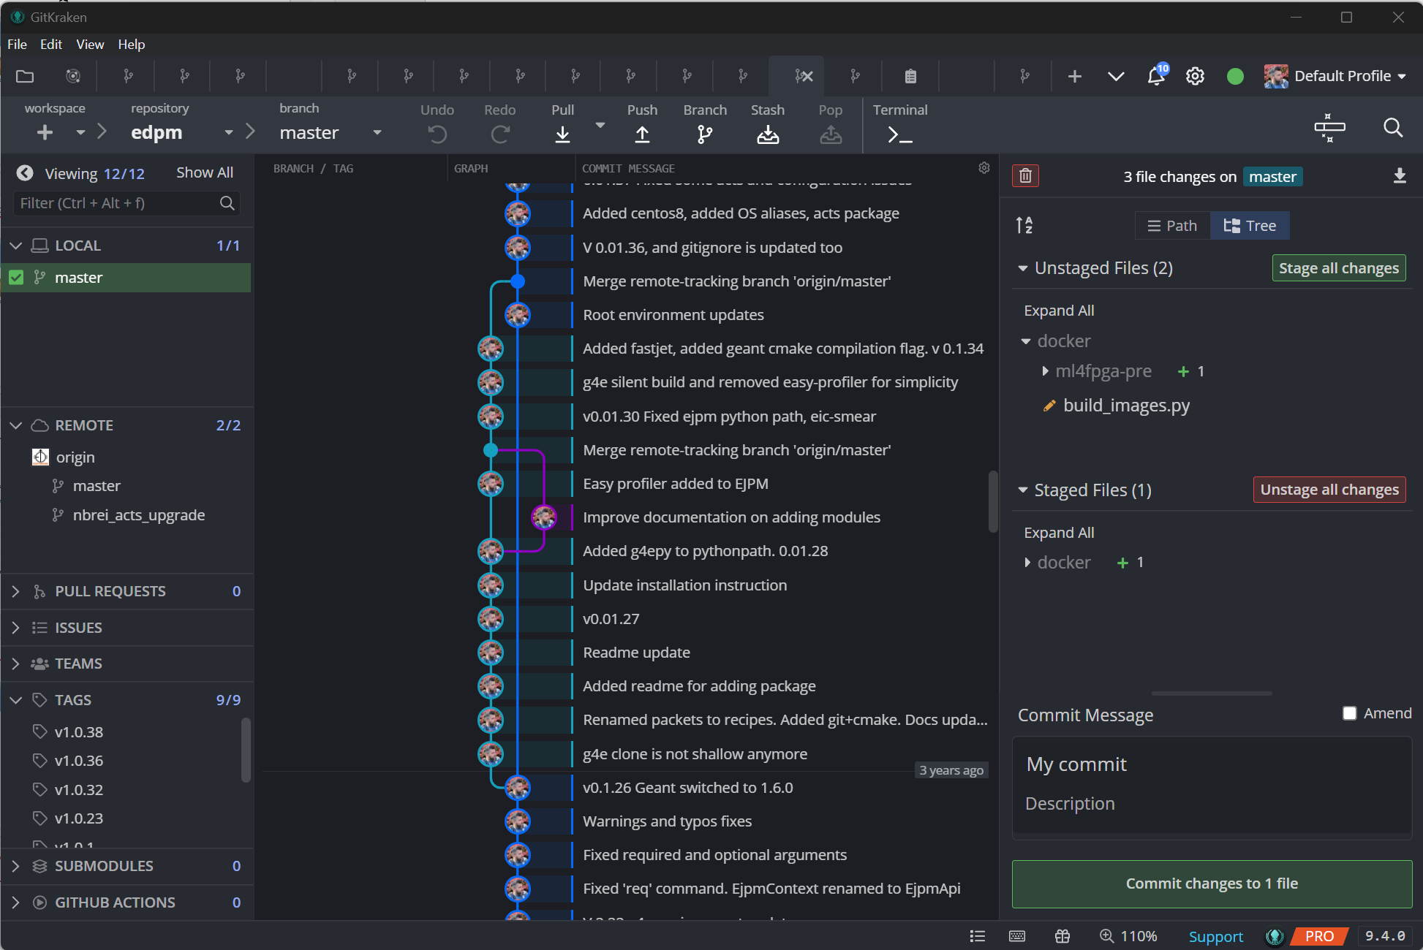
Console vs GUI?
Git projects
Pull / Push and other interactions
Files currently changed
Existing Branches
Easy to create new commits
https://git-scm.com/downloads/guis
History visualization

Slide 40
Let's create a new project?

Slide 41
Let's create a new project… But do we need to?

Slide 42
Two things to optimize
The performance of a single developer
The performance of a team

Slide 43
Two things to optimize
The performance of a single developer
The performance of a team

Slide 44
To create new project use

Slide 45
SAAS platforms GitHUB, GitLAB
Everything your code may need
Web-based hosting service for Git repositories + additional features. Key features:
Issue Tracking, Discussions
Wiki, Pages, Documentation tools
Pull Requests, Code Review Tools
Continuous integration
Forking
Security and Access Control
Social Coding and Team/task management

Slide 46
Best practices
Consistent Commits: Make small, atomic commits that encapsulate a single feature or fix.
Clear Commit Messages: Write clear, meaningful commit messages that describe what changes were made and why.
Sync Frequently: Pull and push changes from the remote repository frequently to avoid major conflicts and backup your code
Use branches for different features or fixes, it helps in isolating changes and managing the workflow.
Master/Main Branch: The master or main branch should always be deployable. Avoid pushing unstable code to it.
Merge Conflicts: Resolve merge conflicts as soon as they occur. The longer they stay, the harder they are to resolve.
Tagging: Use tags to mark specific points in your repository's history, like software version releases.
Ignore Unnecessary Files: Use a .gitignore file to avoid tracking unnecessary or sensitive files.
Understand Git: Take time to understand how Git works underneath, it makes problem-solving easier when things go wrong.

Slide 47
Thank you!

Slide 48
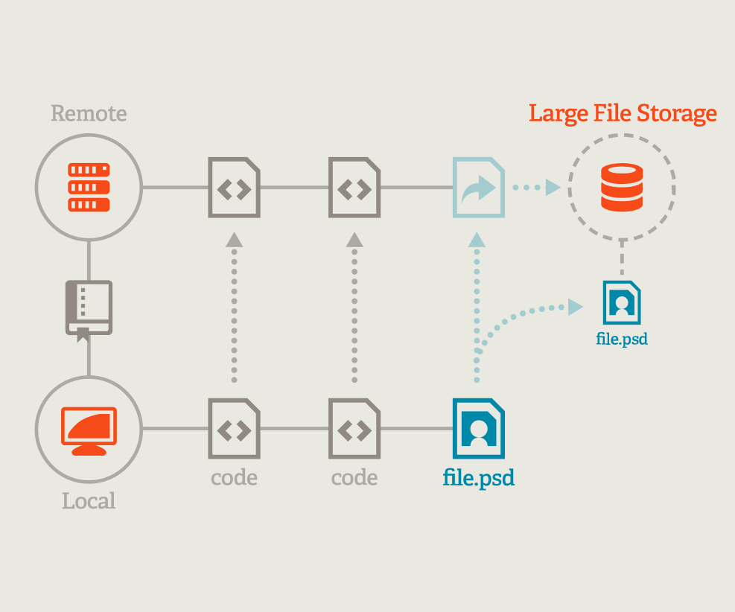
GIT LFS – Large File Support
Git LFS: Git extension for versioning large files.
Problem Statement: Traditional Git struggles with large files, slowing down operations like cloning and fetching.
The Solution - Git LFS: Git LFS stores pointers to large files in the Git repository, and the file contents themselves in a separate LFS store.
Benefits of Git LFS: Git LFS improves performance and reduces cloning and fetching times for repositories with large files.
Conclusion: Git LFS extends the capability of Git, making it possible and efficient to version large files.

Slide 49
Git Submodules
Separate Repositories: Submodules allow you to embed one repository inside another as a subdirectory and yet keeps the commit history of both these repositories separate.
Tracking Specific Commits: A submodule is linked to a specific commit in the nested repository. This is helpful if you want to include external libraries or other projects and want to pin to a particular version or commit.
Project Organization: Submodules can be useful for separating different parts of large projects into distinct repositories for better organization and management.
Collaboration: They can also help when working on multiple projects with different teams, where each team can work on their own repository and later it can be included as a submodule in the main project.
Backend
Frontend
Desktop GUI
MATH Libraries

Slide 50
Git Submodules
Separate Repositories: Submodules allow you to embed one repository inside another as a subdirectory and yet keeps the commit history of both these repositories separate.
Tracking Specific Commits: A submodule is linked to a specific commit in the nested repository. This is helpful if you want to include external libraries or other projects and want to pin to a particular version or commit.
Project Organization: Submodules can be useful for separating different parts of large projects into distinct repositories for better organization and management.
Collaboration: They can also help when working on multiple projects with different teams, where each team can work on their own repository and later it can be included as a submodule in the main project.
Backend
Frontend
Desktop GUI
MATH Libraries
Web Site
Desktop GUI
Backend
Frontend
MATH Libraries
MATH Libraries

Slide 51
What is pull requiest
server
server
Clone
ORIGIN server
foo
foo
Commit 1
Commit 2
bar
bar
PUSH
main
main

Slide 52
Pull requests
A Pull Request (PR) is a method of submitting contributions to an open development project. Developer asks for changes committed to a branch to be considered for inclusion in a project's main branch. It initiates a code review and discussion process among project contributors before the changes are approved and merged. This is GitLAB GitHUB feature Git just technically allows to organize it
server
server
Clone
ORIGIN server
foo
foo
Commit 1
Commit 2
Pull request
bar
main
main

Slide 53
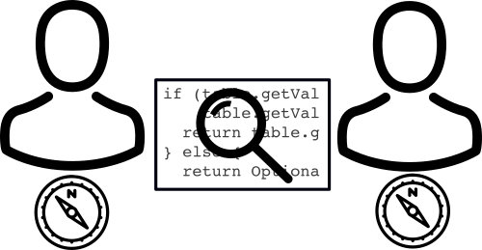
Pull requests
server
server
ORIGIN server
Pull
foo
foo
bar
Code review
Run TESTS
main
main

Slide 54
What about branching
server
ORIGIN server
foo
main

Slide 55
What about branching
server
server
Clone
ORIGIN server
foo
foo
main
main

Slide 56
What about branching
server
server
Clone
ORIGIN server
foo
foo
Commit 1
Commit 2
bar
main
main

Slide 57
What about branching
server
server
Clone
ORIGIN server
foo
foo
Commit 1
Commit 2
bar
bar
PUSH
main
main

Slide 58
Git vs SVN comparison
Aspect | Git | SVN
Repository model | ▲ Distributed | ▼ Centralized
Network performance and speed | ▲ Fast locally, ▼ slower clone | ▼ Slower overall ▲ Fast for differences,
Working with branches | ▲ Fast and flexible | ▼ Slower and more cumbersome
Data redundancy | ▲ Full repository on each local copy | ▼ Central repository, potential for data loss
Storage space | ▼ Large local repositories | ▲ Only current version stored locally
Security | ▲ SHA-1 file change tracking | ▼ No built-in integrity checks
Ease of use | ▼ Steeper learning curve | ▲ Simpler, easier for beginners
Community and support | ▲ Large, active community | ▼ Lesser adoption

