Slide 1
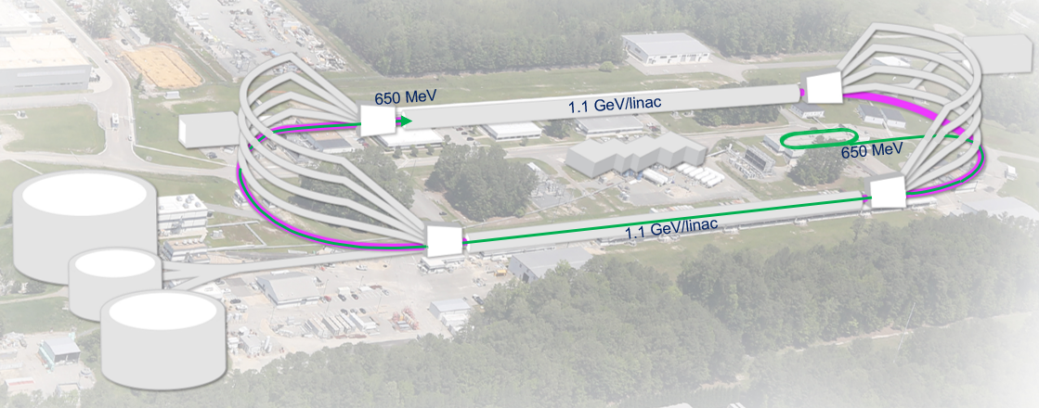
The 22 GeV Upgrade of CEBAF
Developing a pre-conceptual design for additional FFA* racetrack in the existing CEBAF tunnel to reach the top energy of about 22 GeV
*FFA (Fixed Field Alternating-Gradient)
  Recirculate 4 + 6.5 times to get to 22 GeV
  Alternative staging scenario:
    4 + 5.5 passes with 1.1 GeV/linac to get to 20 GeV
    Upgrade linac energy to 1.21 GeV/linac to get to 22 GeV
Alex Bogacz
Accelerator Physics Group Leader
JLUO Meeting
June 12, 2024

Slide 2
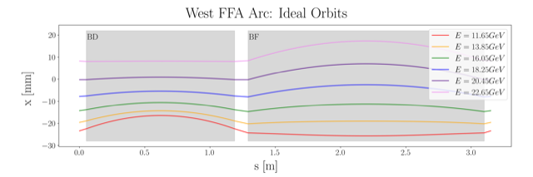
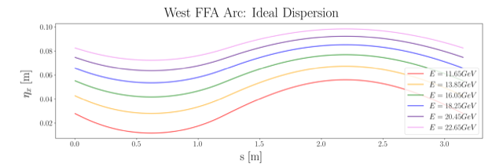
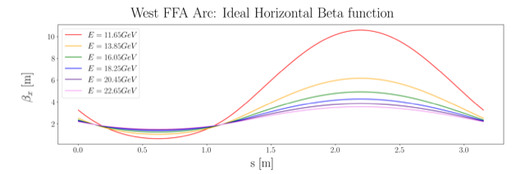
Non Scaling FFA Arc − Compact FODO Cell
orbits
Large momentum acceptance FFA cell, configured with combined function magnets capable of transporting six beams with energies spanning a factor of two
Arc composed of 75 cells, L_{cell} = 3.15 m
Closely spaced orbits for all six beams (~ 4 cm)
Low betas (~ a few m)
Extremally low dispersions (a few cm) - Virtue of combined function FFA magnets
dispersions
beta functions

Slide 3
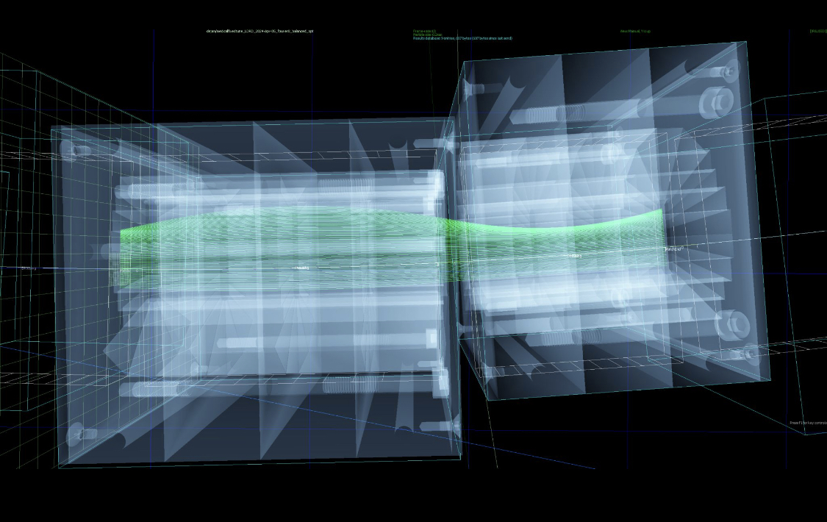
Non Scaling FFA Arc − Compact FODO Cell
Stephen Brooks
Imported a vendor's magnet mechanical design and overlaid it on the beam orbits to make sure there is clearance

Slide 4

Permanent Magnet Design
Very compact compared to conventional electro magnets
Allows for accommodating 6 additional passes in CEBAF tunnel
Provides power and cost savings
Concept successfully tested at
Open mid-plane geometry
Focusing Magnet BF
G_{F}= -41.13 T/m
L_{QF}= 1.67 m
B_{F}= -0.812 T
Defocusing Magnet BD
G_{D}= 43.44 T/m
L_{BD}= 1.24 m
B_{D}= -0.593 T
12 cm
12 cm
13 cm
13 cm

Slide 5
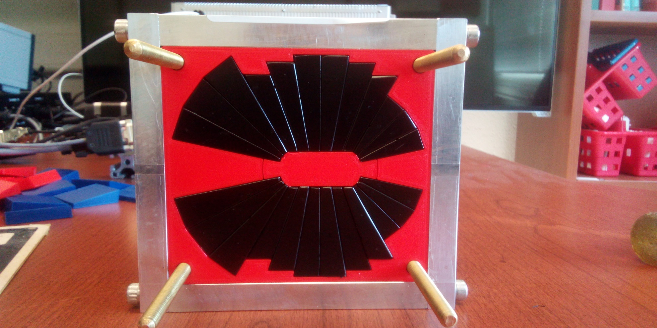
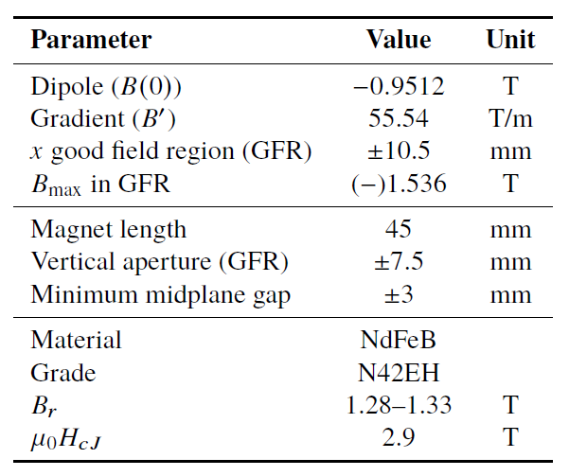

Prototype Magnet
Prototype open-midplane BF magnet successfully built and evaluated for mechanical integrity
>1.5 Tesla measured in good field region
Field accuracy of ${10}^{−3}$
Testing magnetic materials for radiation resilience at CEBAF - LDRD project started Oct. 1, 2023

Slide 6
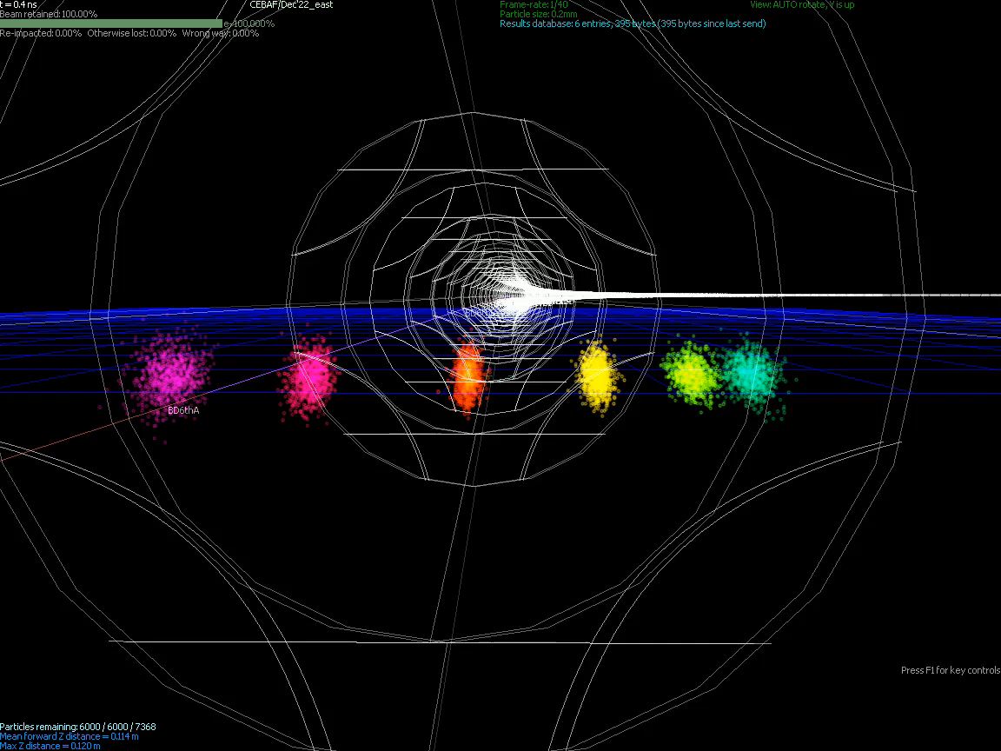
Stephen Brooks

Slide 7
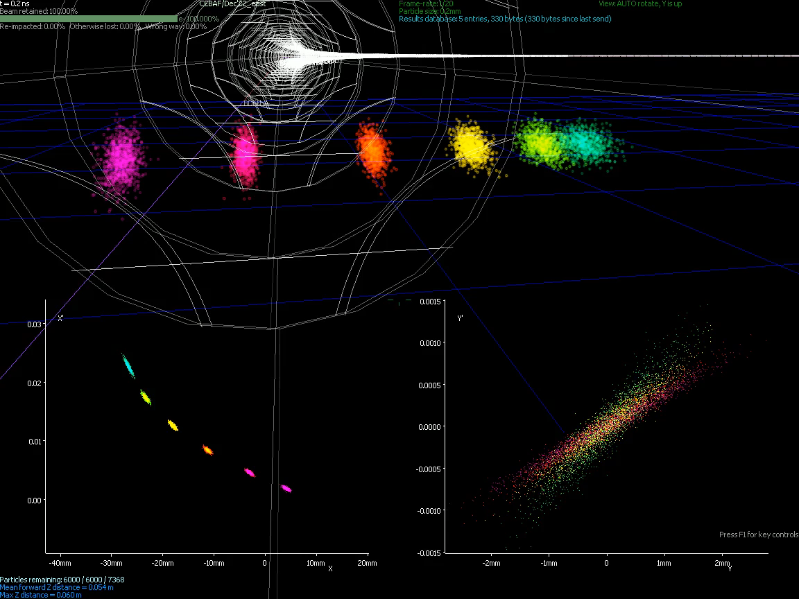
Stephen Brooks
Stephen Brooks

Slide 8
FFA Arc Error Sensitivity Studies
Machine Errors (misalignments and field errors)
Error studies, diagnostics, correction schemes
6-pass Orbit Excursions in FFA Arcs
0.016
0
-0.016
Orbit Excursion (m)
0
12
s (m)
Survey (positioning) errors were taken from a normal distribution but capped at a misalignment magnitude of 0.1 mm
Field and gradient errors were capped at 1% of the intended field.
12

Slide 9
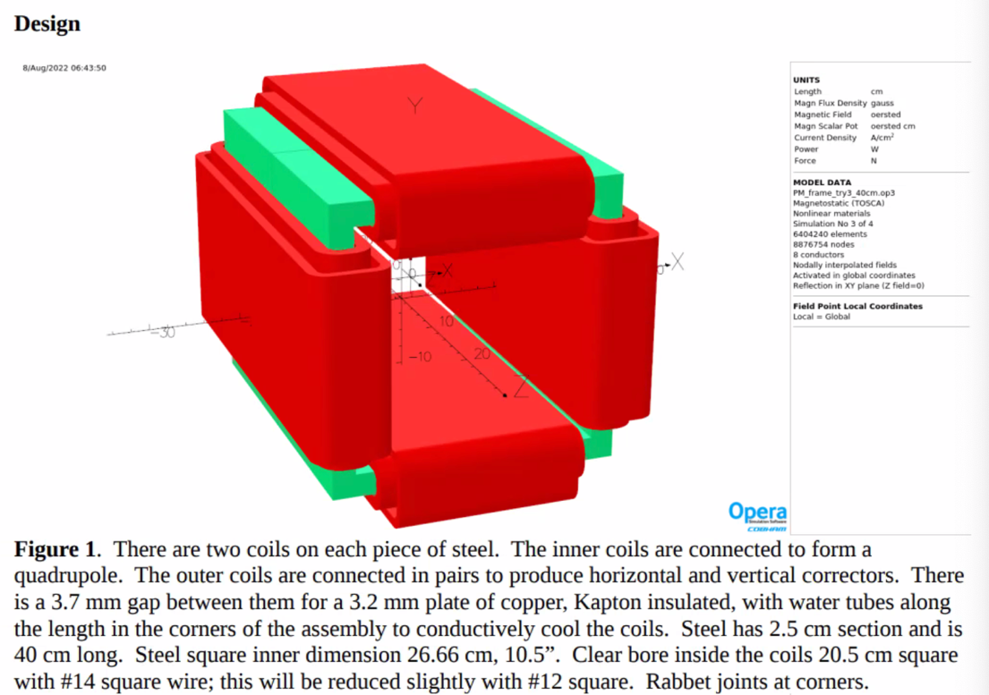
Panofsky Quad Window Corrector
Corrections and Error Resilience
Jay Benesch
Correction studies are underway (PhD Thesis project of Alex Coxe)
Stability of the beam dynamics not too demanding to error tolerances…
Currently under study…
  Requirements for beam position and Twiss at the transition to the recombiner
  Understanding of beam quality tolerances at the arc’s exit

Slide 10
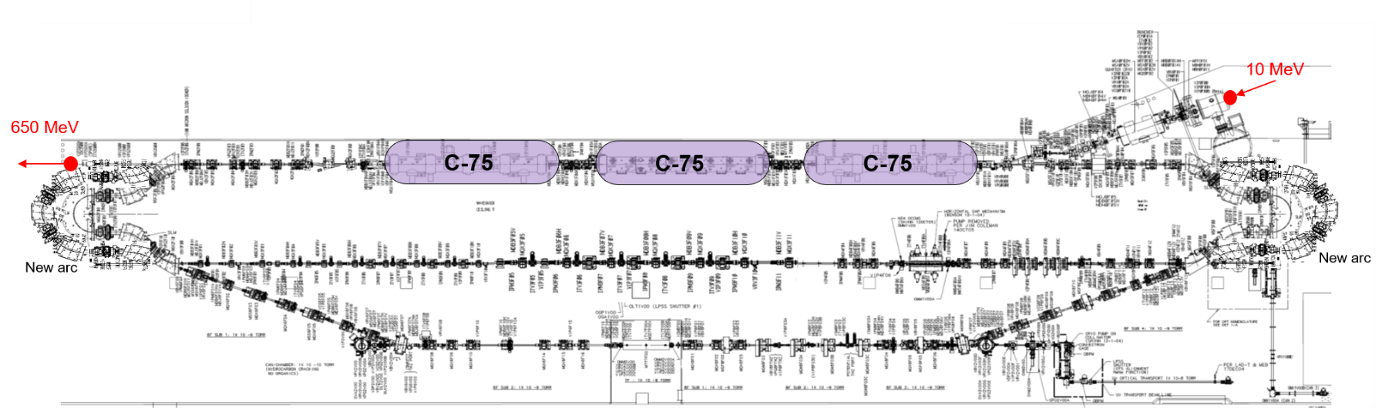
Injector Upgrade − 650 MeV Recirculating Injector
With the present 123 MeV injector, the difference in the first and final pass energies in the North Linac is too large (1:175) to effectively control the beam.
650 MeV recirculating injector (3-pass) based on LERF will allow a manageable difference in energies (1:33)

Slide 11
Multi-pass Linac Optics (11 passes, 1:33 Energy Ratio)
Present FODO linac offers periodic optics only for the lowest energy pass with large beta beating for higher passes (beta ~1000 m), which is not compatible with small betas (~5 m) in the FFA arcs.
Replacing FODO (alternating singlets) with alternating triplets – more uniform beam envelope
30
Triplet Cells, phase advance: 150⁰ per cell
pass 1
0.65 GeV
BETA_X&Y[m]
0
0
BETA_X
BETA_Y
DISP_X
DISP_Y
243.507
0
pass 4
60
7.25 GeV
BETA_X&Y[m]
0
0
BETA_X
BETA_Y
DISP_X
DISP_Y
243.507
0

Slide 12
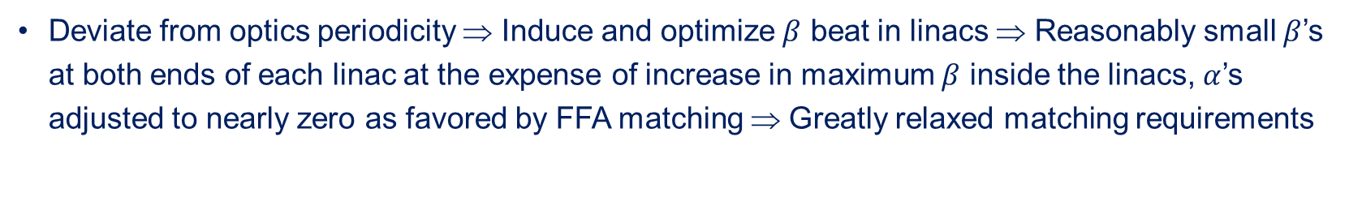
Transition to weakly focusing ‘Beta Beat’ Linac Optics for FFA Passes
Deviate from optics periodicity ⇒ Induce and optimize $β$ beat in linacs ⇒ Reasonably small $β$’s at both ends of each linac at the expense of increase in maximum $β$ inside the linacs, $α$’s adjusted to nearly zero as favored by FFA matching ⇒ Greatly relaxed matching requirements
180
5
pass 6
11.6 GeV
BETA_X&Y[m]
0
0
BETA_X
BETA_Y
DISP_X
DISP_Y
0
.
.
.
284.877
pass 10
240
5
20.5 GeV
BETA_X&Y[m]
0
0
BETA_X
BETA_Y
DISP_X
DISP_Y
0
284.877

Slide 13


Energy loss, Emittance dilution and Energy spread
  Doubling the energy, while staying within current CEBAF footprint, makes the synchrotron radiation effects of paramount importance.
  Quantum nature of a ‘recoil’ effect on electrons due to photon emission makes significant impact on both the transverse and longitudinal beam dynamics, leading to cumulative emittance growth (transverse and longitudinal).
Energy loss
Emittance dilution
Natural energy spread
Maximize $ρ$, minimize H
  Cumulative emittance dilution (transverse and longitudinal) at 22 GeV (4 CEBAF + 6 FFA passes)
Projected value from the Spr/Rec contribution

Slide 14






Hall Lines (A and C) – Beam Occupancy at 21 GeV
$\frac{∆p}{p}$ = 1.2×10⁻³
$σ_{x}$= $D_{x}$ $\frac{∆p}{p}$
Challenge: Transporting beam of through a 22 mm ID beam tube
Jay Benesch
120
5
120
5
D_{max} = 4 m
D_{max} = 1.8 m
BETA_X&Y[m]
DISP_X&Y[m]
BETA_X&Y[m]
DISP_X&Y[m]
-5
0
-5
0
SLI
0
BETA_X
BETA_Y
DISP_X
DISP_Y
150
0
BETA_X
BETA_Y
DISP_X
DISP_Y
150
8 × 3.8 m bends
$σ_{x}$= $D_{x}$ $\frac{∆p}{p}$
$σ_{x}$= $2.2 mm$
‘beam stay clear’:
${6σ}_{x}±$ $1 mm$= $13±1 mm= 15 mm$
12 × 2.4 m bends?
90
2
D_{max} = 0.7 m
BETA_X&Y[m]
DISP_X&Y[m]
${6σ}_{x}±$ $1 mm$= $5±1 mm=7 mm$
0
0
BETA_X
BETA_Y
DISP_X
DISP_Y
39.9
-2
16 × 1.8 m bends
The 22 GeV Upgrade of CEBAF

Slide 15
Increasing Linac Energy Flexibility, ΔE/E - Alternative Staging
  FFA permanent magnets, as presently designed, are at limit of their aperture and strength, to accommodate 6 orbits of different energy within energy acceptance from about 11 GeV to 22 GeV
    Changing the linac energy by more than 1%, either the top or bottom pass will fall out of the range
    This would not allow for flexibility to reduce energy (e.g. cavities de-rated, or one of the cryomodules bypassed)
    Adding a sextupole component to permanent magnets extends the energy acceptance (currently under study)
  Assuming only 5 FFA passes (to about 20 GeV) the linac energy flexibility is greatly enhanced
2.2
E [GeV]
11.6
21.7
E [GeV]
2.2
E [GeV]
2.2
  Increasing linac energy from 1.1 to 1.21 GeV boosts the lowest pass energy by 1.1 GeV (5×0.22 GeV) and brings the final energy back to about 22 GeV with adequate linac energy flexibility
19.4
11.6
19.4
11.6
2.42
E [GeV]
12.7
21.7

Slide 16
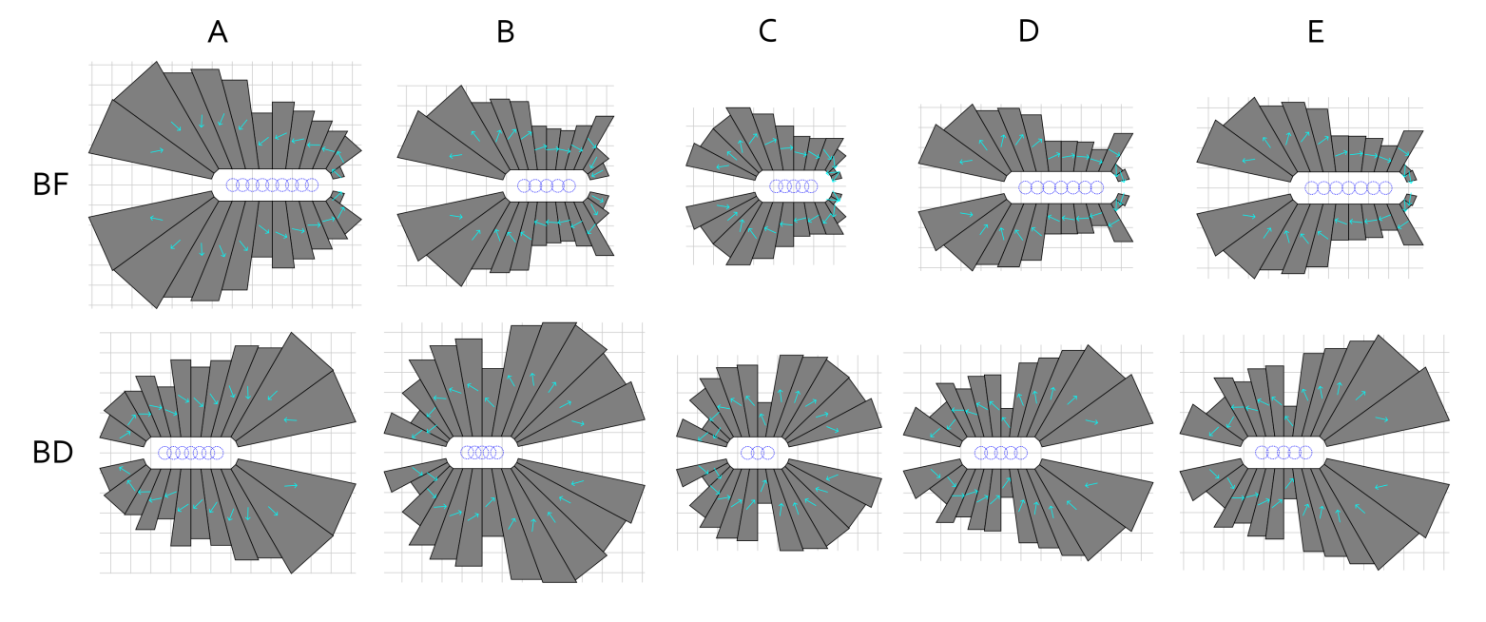
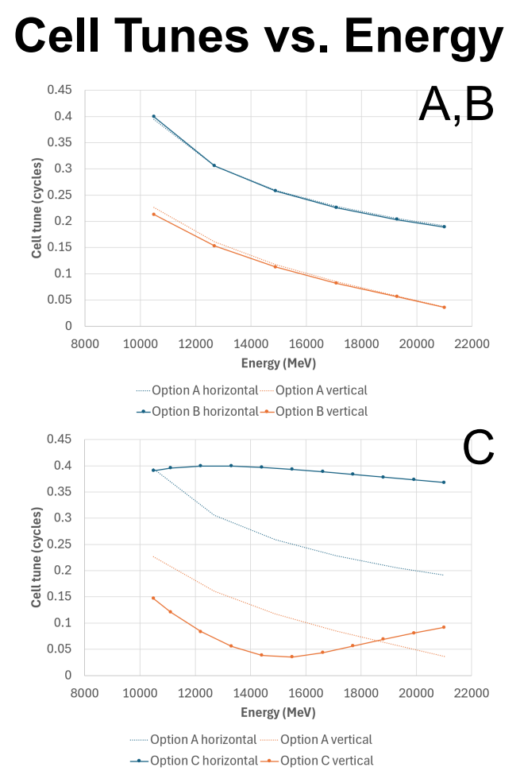
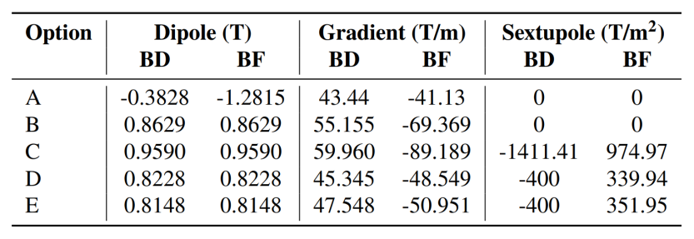
Adding Sextupole Component to Permanent Magnets

Slide 17


Summary
Present Baseline (1.1 GeV per linac):
  650 MeV Recirculating Injector (additional three C-75 cryomodules)
  Recirculate 4 passes with the current CEBAF
  Plus Additional 6 passes via a single FFA: 10 – 22 GeV
Non Scaling FFA Arc Architecture configured with compact FODO cells
  Beta and dispersion matching to the linacs through cell-by-cell variation (length, bend)
  Open mid-plane permanent magnet design: B-field ≤ 1 T, Gradient ≤ 50 T/m
Synchrotron Radiation impact on beam quality:
  Net transverse normalized emittance:
  Net natural energy spread: 1.5×10⁻³
  Net synchrotron radiated energy: 1 GeV
$$σ=\sqrt{β\frac{ε_{N}}{γ}}$$
$$ε_{N}=\text{80 }\text{mm} \text{mrad}$$
at 22 GeV, β = 20 m → σ = 175 microns
at 22 GeV → ΔE = 33 MeV

Slide 18




The FFA@CEBAF Collaboration
R. M. Bodenstein, S.A. Bogacz, A.M. Coxe, K.E. Deitrick, B.R. Gamage, R. Kazimi, D. Khan, E.A. Nissen, S. Ogur, K.E. Price, Y.R. Roblin, R. Ruber, T. Satogata, A. Seryi, Jefferson Lab
J.S. Berg, S.J. Brooks, D. Trbojevic, Brookhaven National Lab
V.S. Morozov, Oak Ridge National Lab
G.H. Hoffstaetter, Cornell University

Slide 19
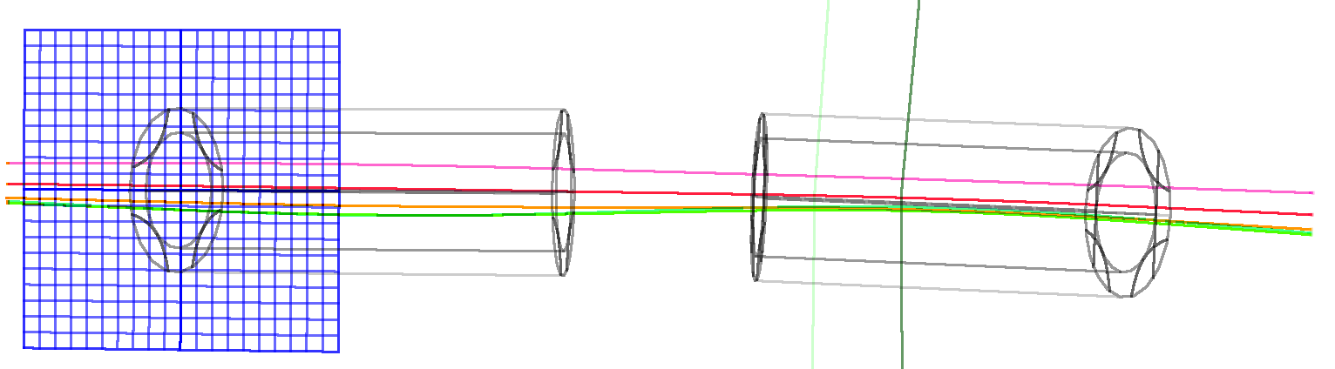

Thanks for your attention!
The 22 GeV Upgrade of CEBAF

Slide 20
Backup Slides

Slide 21
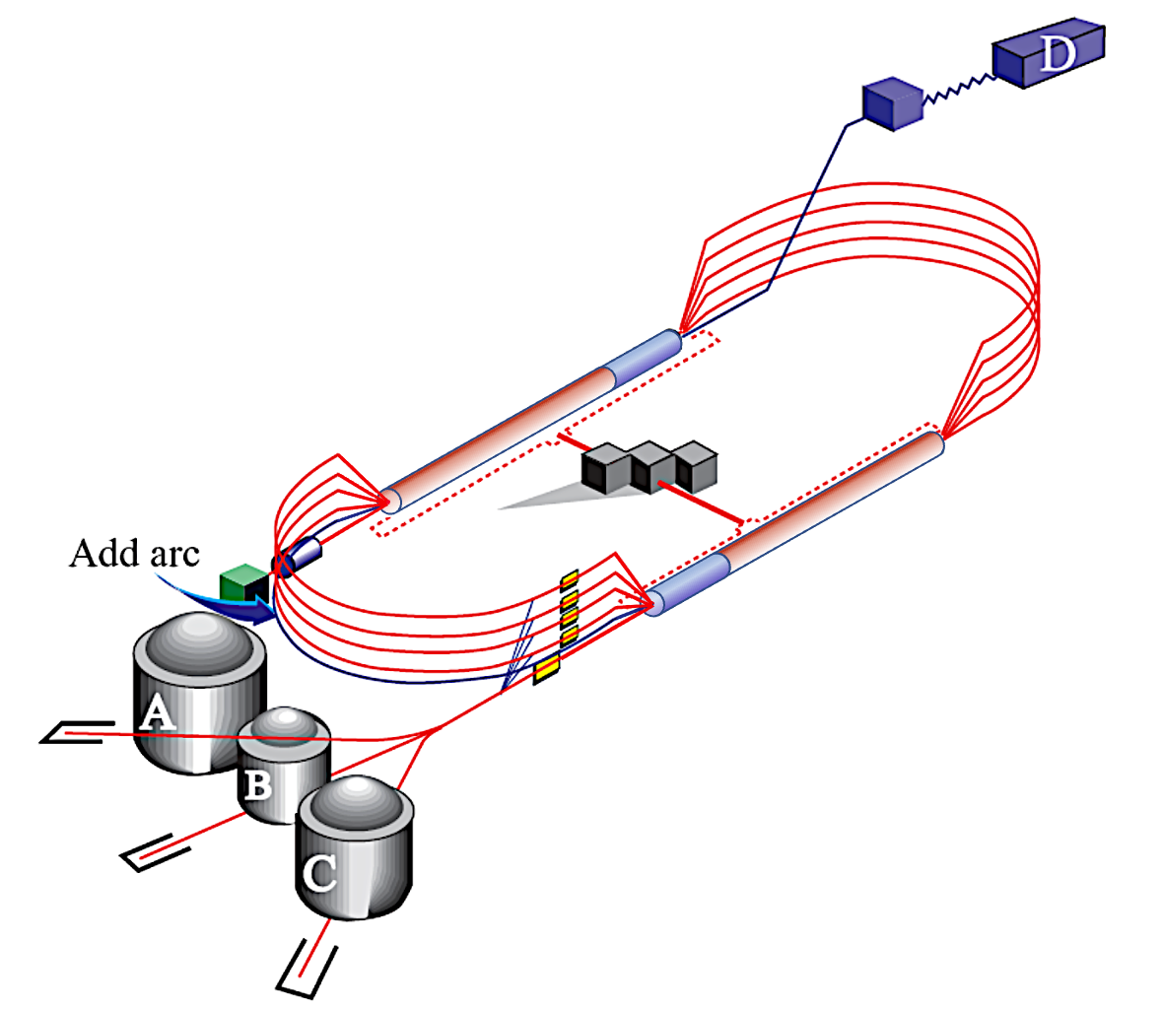
CEBAF Energy Upgrade 10.55 → 23.75 GeV
4 existing lines + 6 FFA turns
12 GeV
23.75 GeV
Injector at 650 MeV
1.75 GeV
3.95 GeV
6.15 GeV
23.75 GeV
8.35 GeV
EAST FFA
Energy range
80.6 m
#1-10.55 GeV
#2-12.75 GeV
#3-14.95 GeV
#4-17.15 GeV
#5-19.35 GeV
#6-21.55 GeV
1.75
3.95
6.15
1.1 GeV
8.35
0.65 GeV
2.85 GeV
5.05 GeV
7.25
1.75 GeV
9.45
1.1 GeV
0.650
80.6 m
2.85 GeV
Energy range
5.05 GeV
7.25 GeV
22.65 GeV
9.45 GeV
WEST FFA
#1-11.65 GeV
#2-13.85 GeV
#3-16.05 GeV
#4-18.25 GeV
#5-20.45 GeV
#6-22.65 GeV
The 22 GeV Upgrade of CEBAF
21

Slide 22
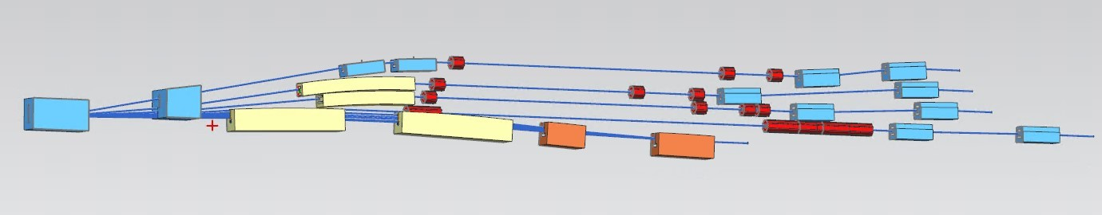
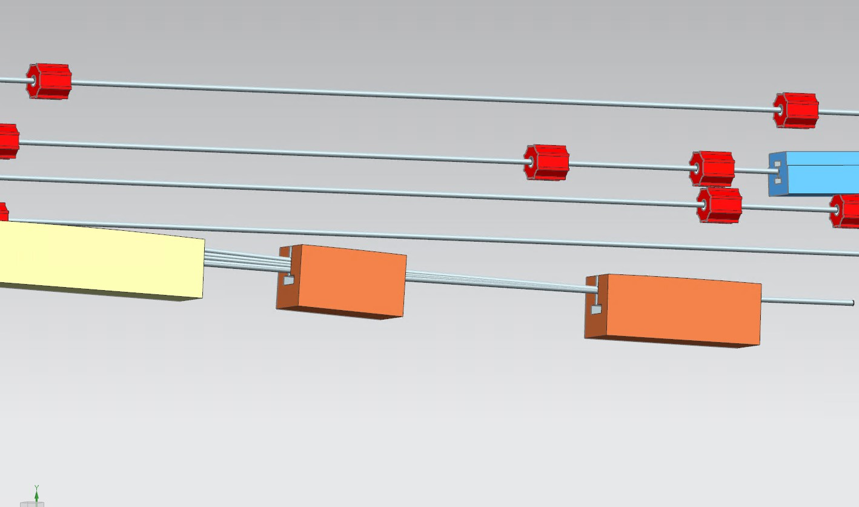
Modified Switchyard to Accommodate Six FFA Passes
pass 1
pass 2
pass 3
pass 4
FFA passes 5-10
FFA passes 5-10

Slide 23
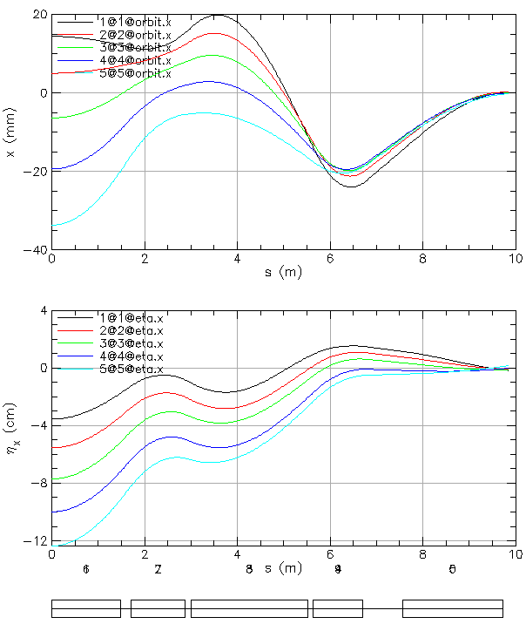
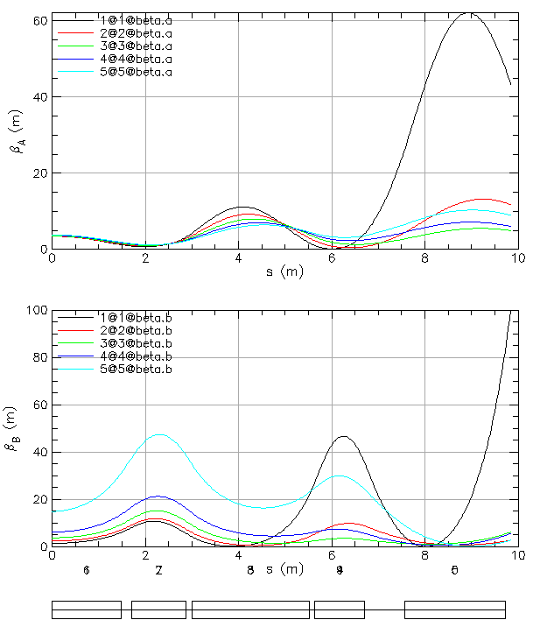
FFA Arc to Straight – Compact Merger
Breaking cell symmetry by altering (length, bend) of a few magnets to merge different energy orbits at arc ends.
Simultaneously, the dispersion and its derivative are suppressed at arc ends.
Furthermore, small beta functions (~5 m) need to be matched to higher-bets of the linacs (~90 m).
This simplifies switchyard and reduces its functionality to pathlength and momentum compaction adjustment.

Slide 24
Synergy Between the Positron Source and 650 MeV Injector
Joe Grames
Positron program ends prior to 22 GeV FFA, so LERF can be repurposed for 650 MeV electrons.
Compact 10 mA P-Gun, Wien filter, 10 MeV e- injector
SRF to accelerate e⁻ to 120 MeV
SRF to accelerate e+ to 123 MeV

Slide 25
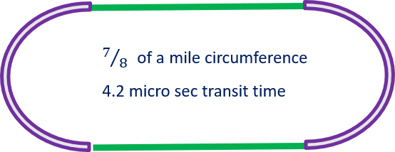
Distinguishing multi-pass beams - BPM multiplexing scheme at CEBAF
Measuring distinct energy orbits in the FFA arcs by employing beam time structure to multiplex BPMs (currently used in our linacs - 5 beams).
To measure orbits for different linac passes we use ‘tune beam’ with the following time structure (repeating at 60 Hz):
  250 micro sec of continuous beam
  followed by a 100 micro sec gap
  and then 4 micro sec ‘trail’ of continuous beam.
The transit time around the machine is 4.2 micro sec, so appropriately gated electronics can distinguish, from which pass the 4 micro sec ‘trailing’ pulse is coming from. The same, or similar scheme could be extended to the FFA arcs.
at 60 Hz
The 22 GeV Upgrade of CEBAF
25

Slide 26
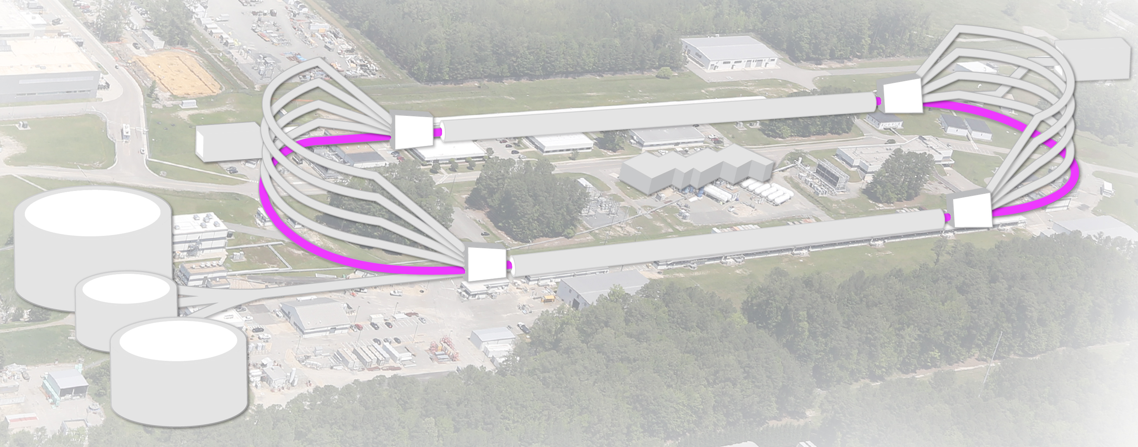

Distinguishing multi-pass beams - BPM multiplexing scheme at CEBAF
650 MeV
1.1 GeV/linac
650 MeV
1.1 GeV/linac
The 22 GeV Upgrade of CEBAF
26

