Slide 1
Nuclear Science at FRIB
Artemis Spyrou
spyrou@frib.msu.edu

Slide 2
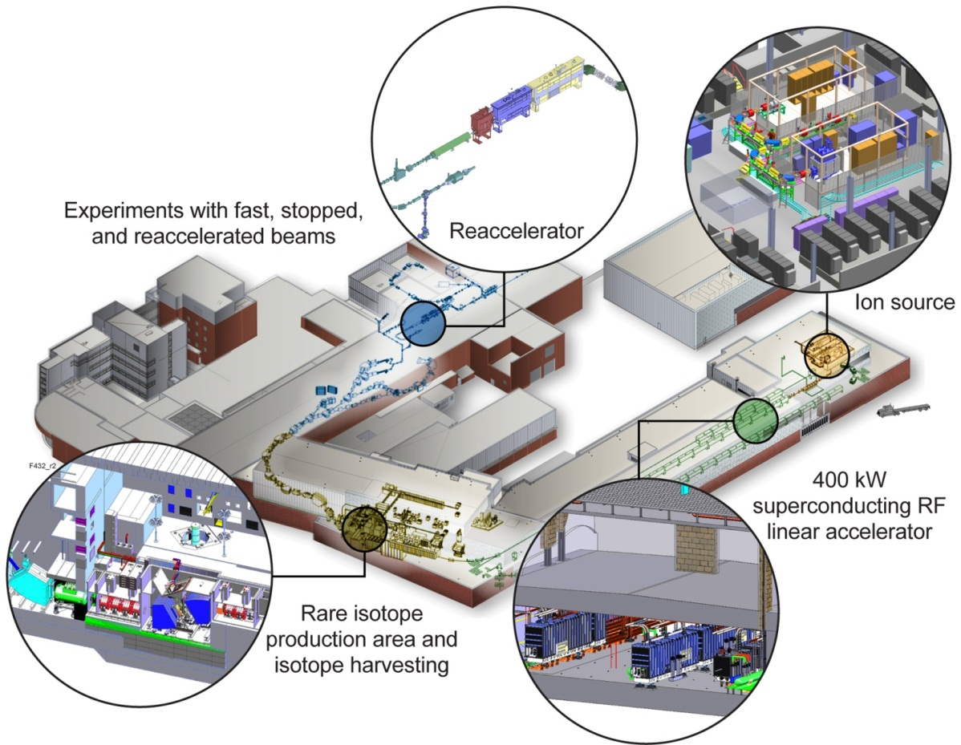
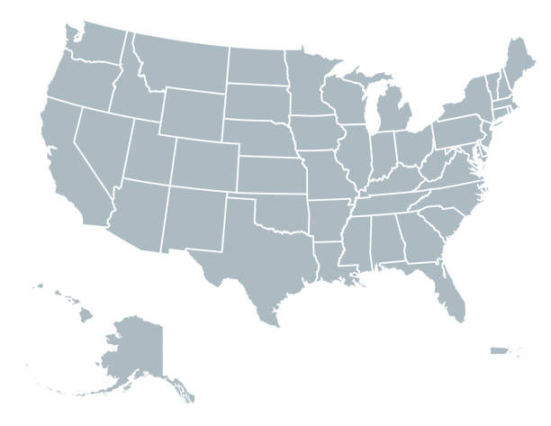
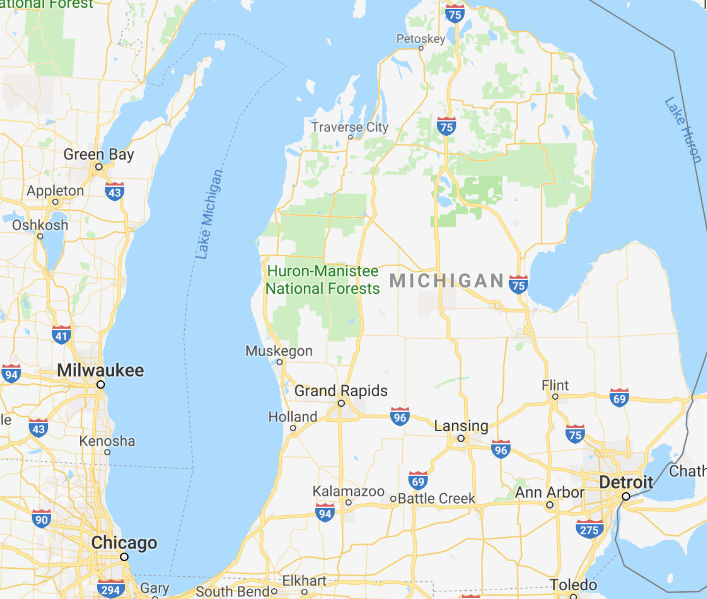

FRIB

Slide 3
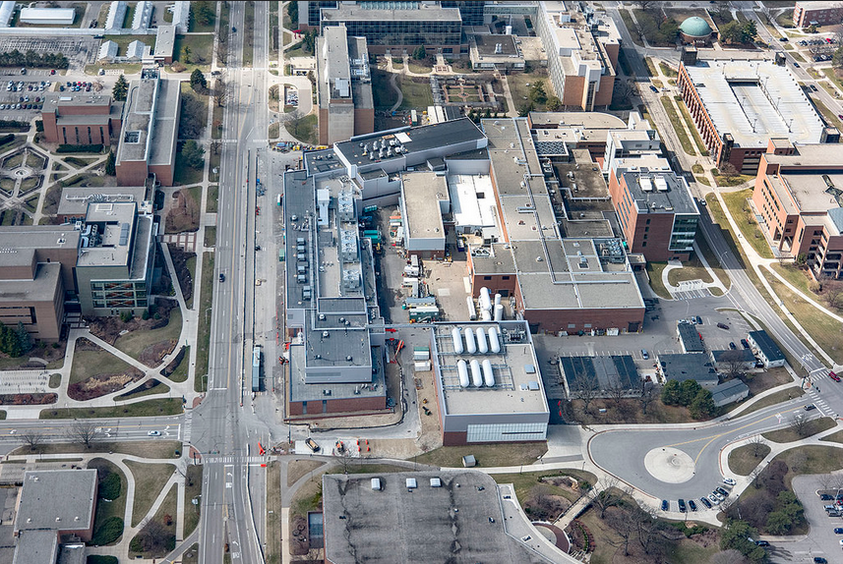
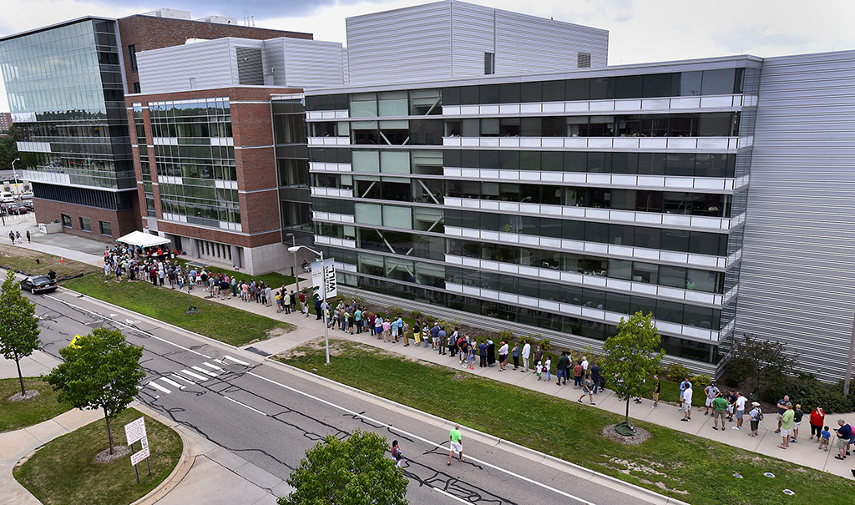


… in the middle of MSU Campus
Physics
Bio Chem
Chemistry
Plant Sciences
Law
~ 650 employees
> 45 faculty
~ 120 graduate students
~ 110 undergraduate students
~60 years of beam (NSCL/NSF)
FRIB project completed
First experiment May 2022
Vet School
Performing Arts

Slide 4
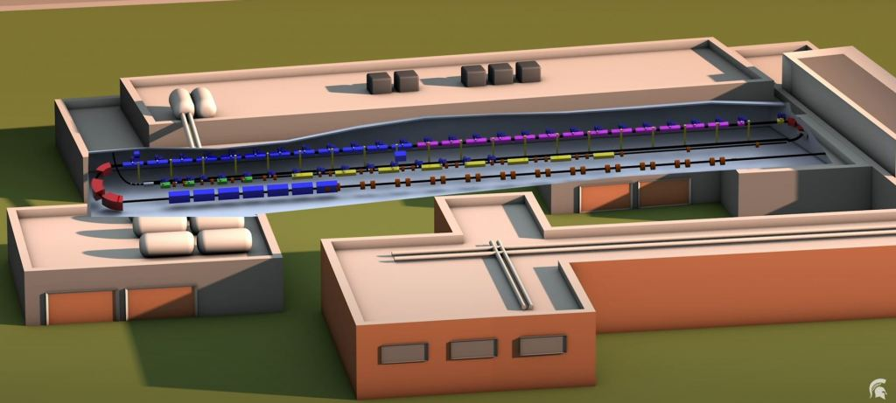
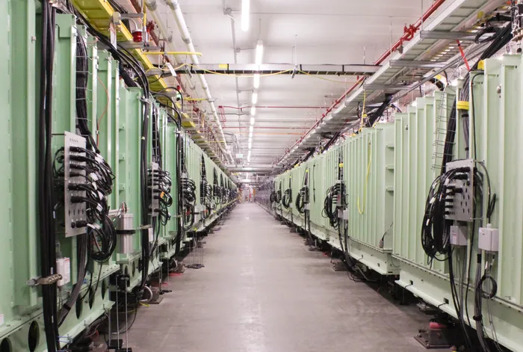
FRIB Accelerator
Superconducting Linear Accelerator
Primary beams: Any stable isotope from oxygen to uranium
Energy: ~ 200 MeV/u

Slide 5
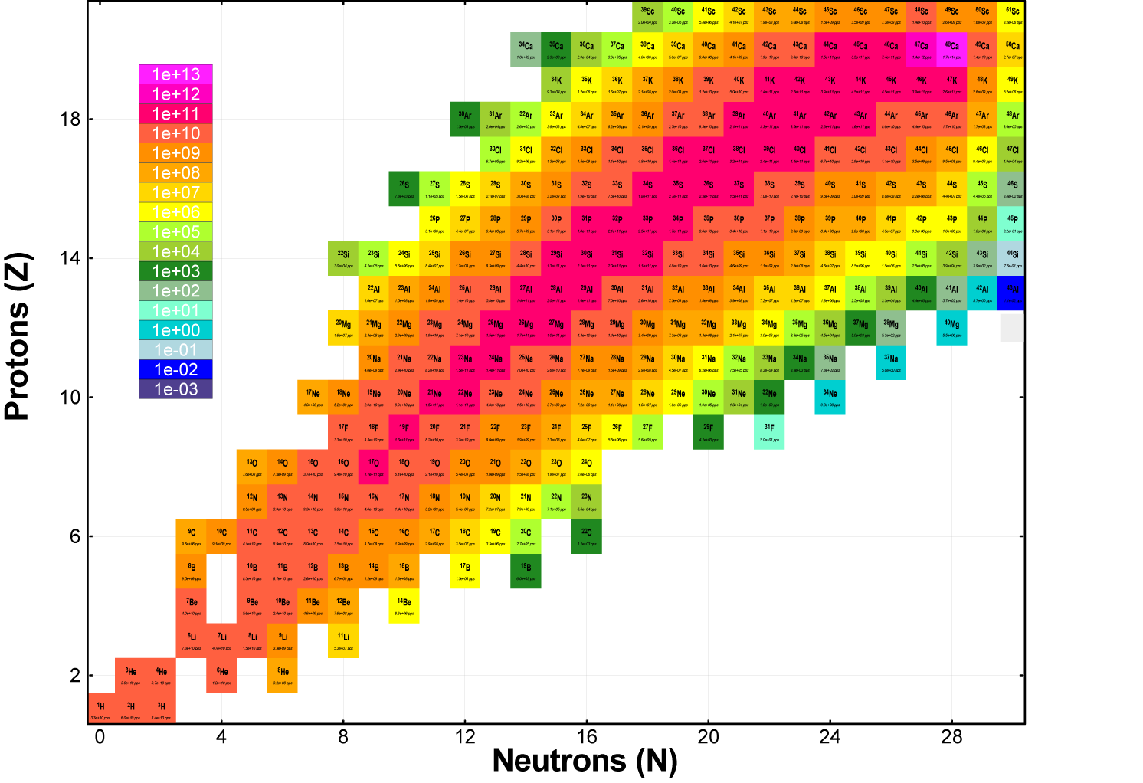
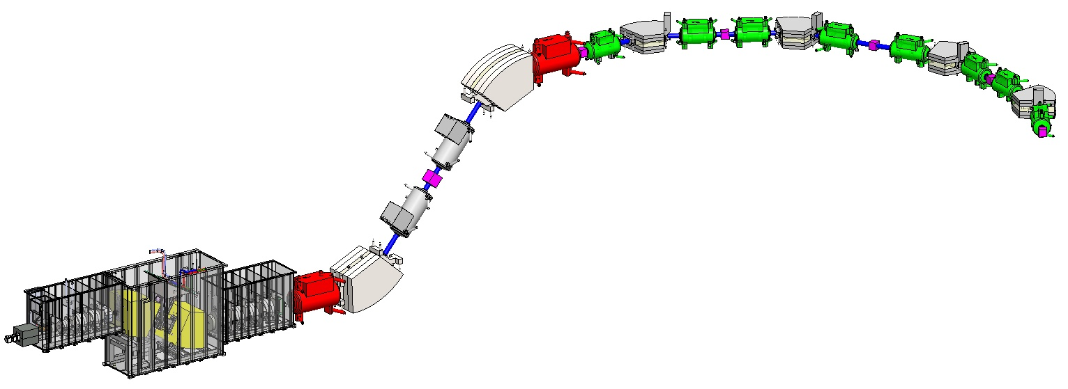
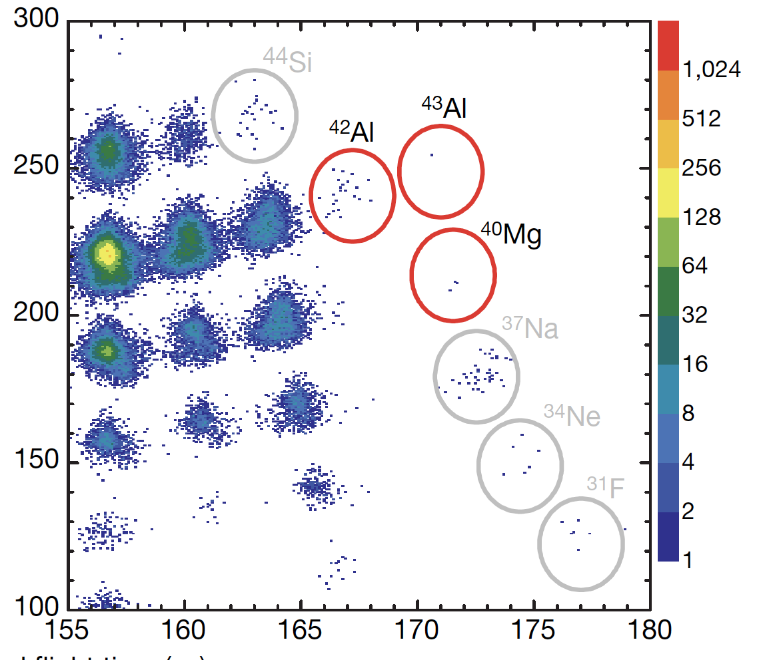
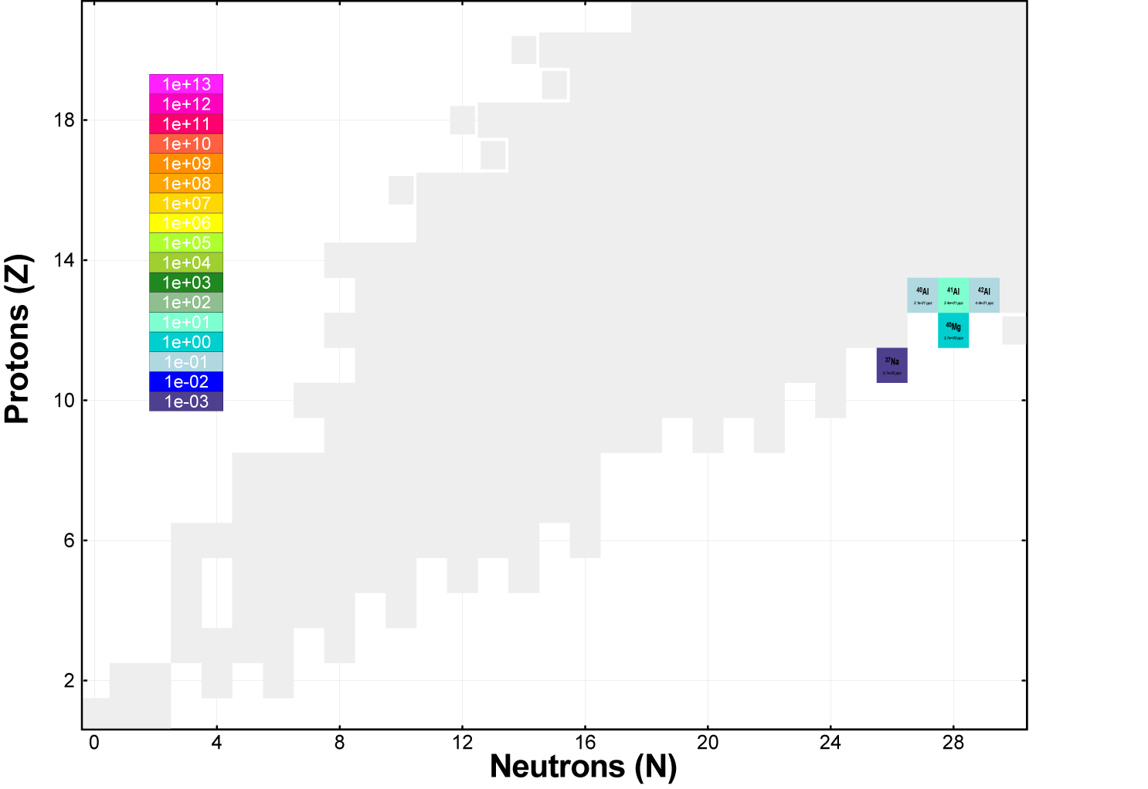
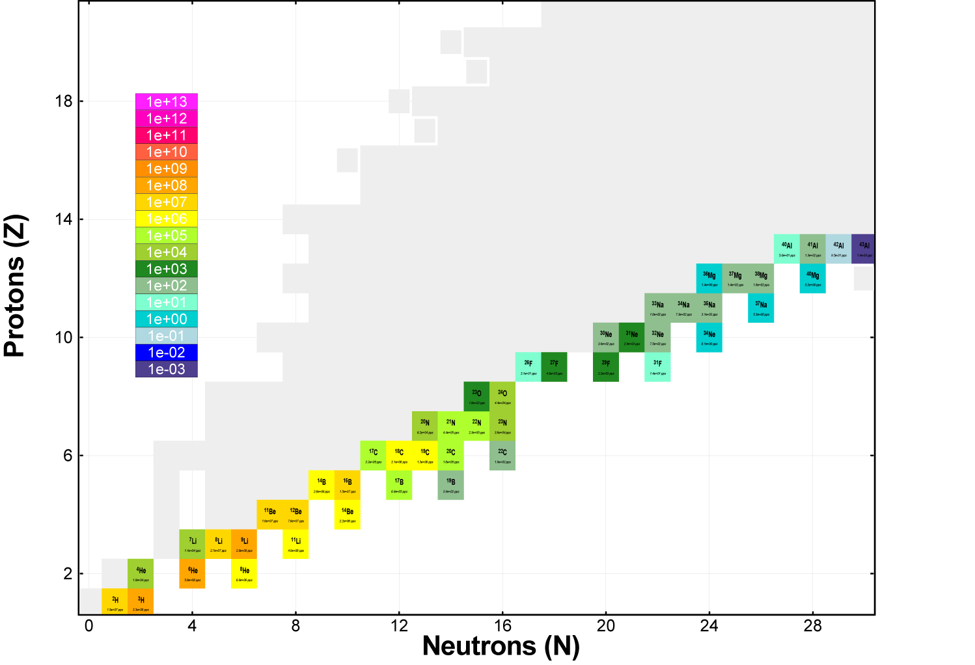
FRIB beam production and delivery
ARIS Separator
⁴⁸Ca
@ NSCL
Two ⁴⁰Mg events in 7 days
⁴⁰Mg
Primary
beam
⁴⁰Mg
Same experiment @ FRIB
Today: 10 min
FRIB full power: 20 sec
Baumann et al., Nature 2007
⁴⁰Mg

Slide 6
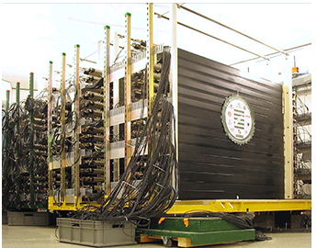
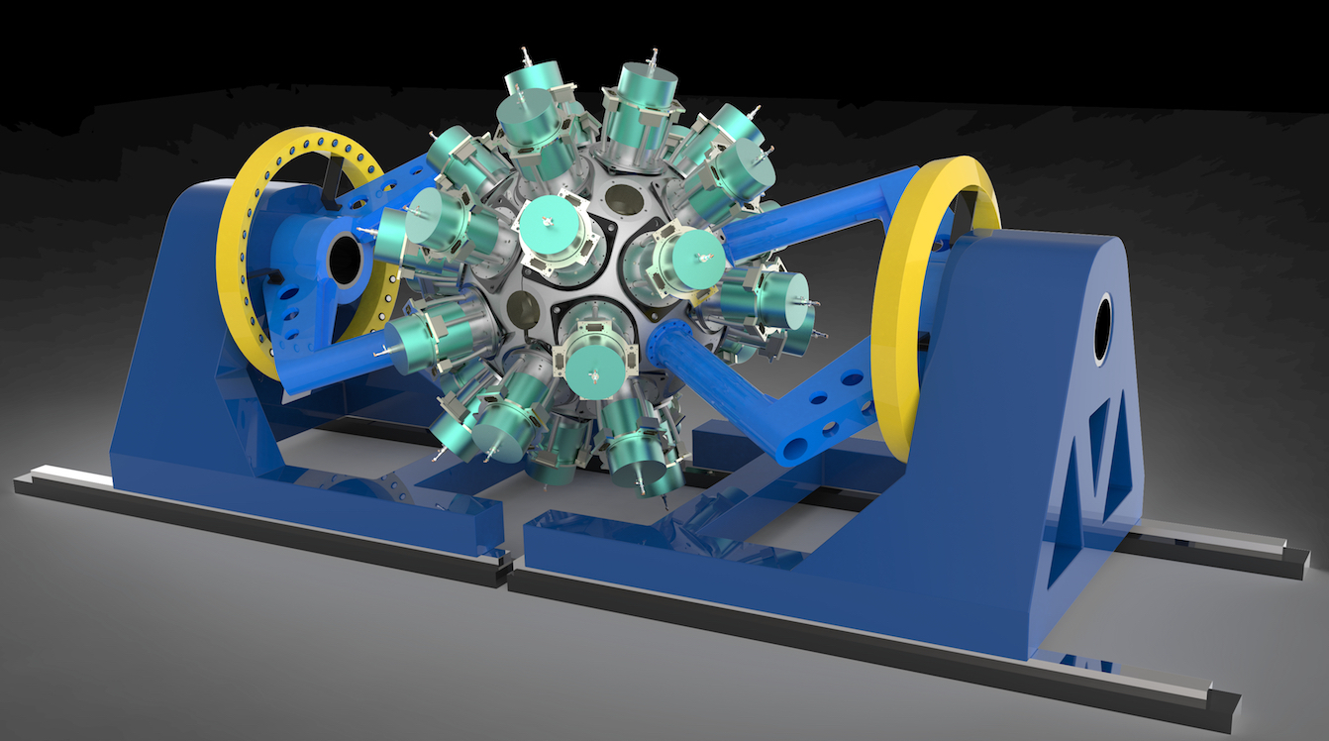
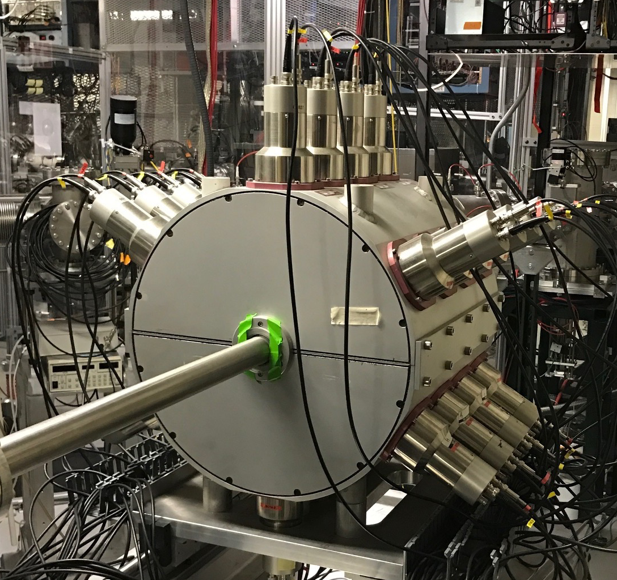
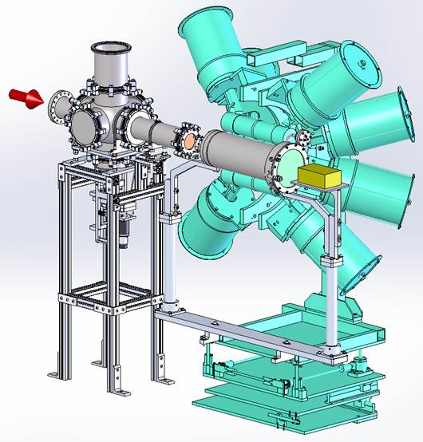
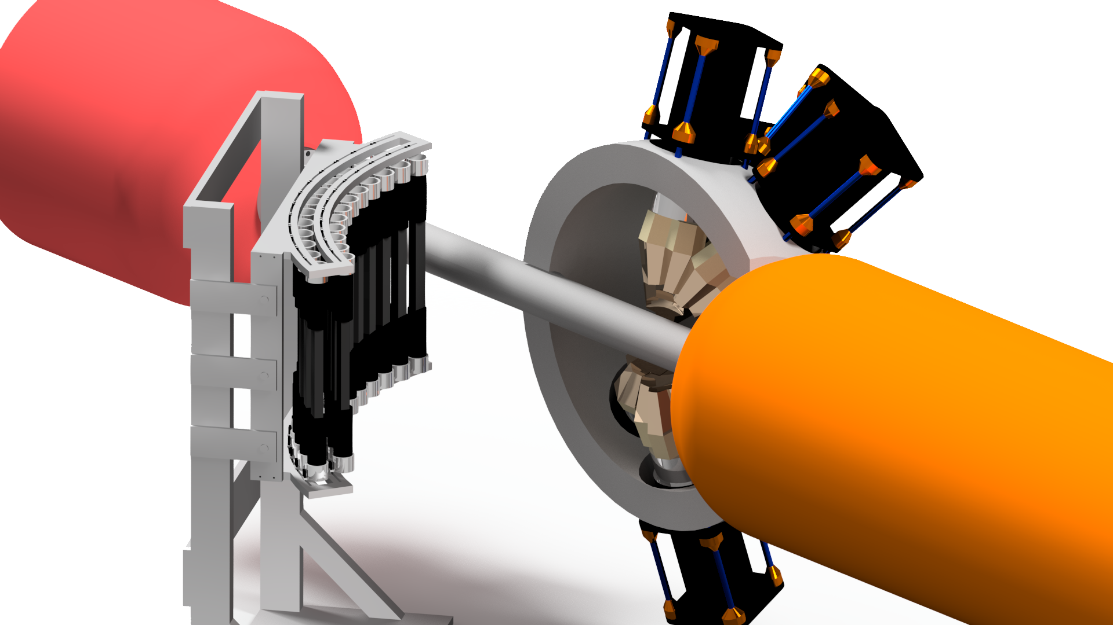
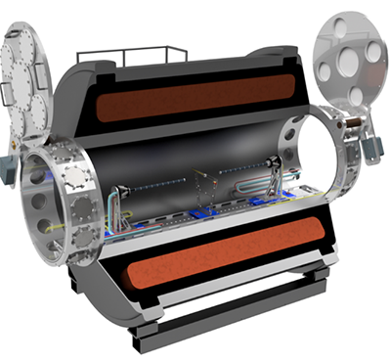
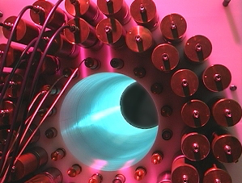
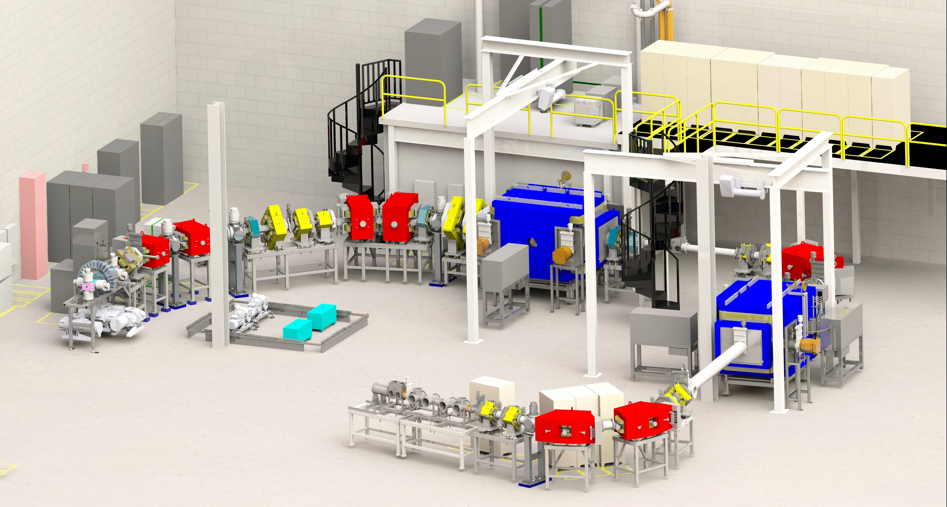
Experimental equipment
neutrons
MoNA-LISA
GRETA
SuN
γ rays
γ rays
Charged particles
γ rays
GADGET
NERO
LENDA
neutrons
Charged particles
SOLARIS
neutrons
Charged particles
SECAR

Slide 7

FRIB Science
Properties of nuclei
  Develop a predictive model of nuclei and their interactions
  Determine the limits of elements and isotopes
Societal applications and benefits
  Isotope harvesting for medicine and a variety of fields
  Surrogate reactions: nuclear security
Astrophysical processes
  Origin of the elements in the cosmos
  Explosive environments: novae,
  supernovae, X-ray bursts …
  Properties of neutron stars
Tests of fundamental symmetries
  Effects of symmetry violations are
  amplified in certain nuclei

Slide 8

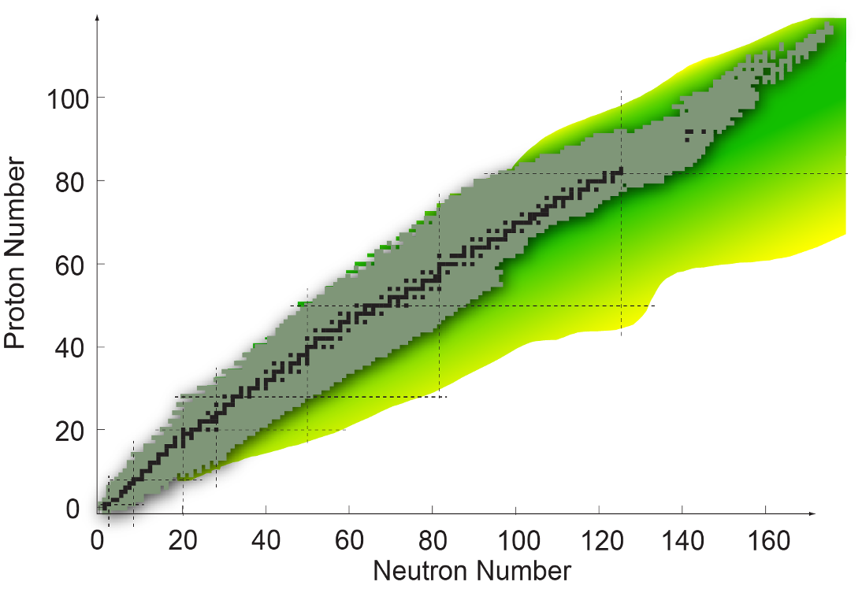
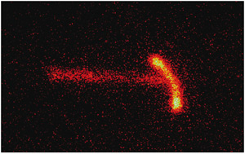
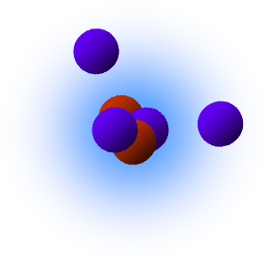
The limits of nuclear existence
Proton halos
Diproton decay
High Z
Superheavies
Island of stability?
Nuclear Landscape
256 “Stable” – no decay observed
More than 3300 in the NNDC Database
Over 7000 predicted to exist
Large Z/N
Large N/Z
Neutron halos
Neutron skins
Dineutron decay
New Magic Numbers

Slide 9
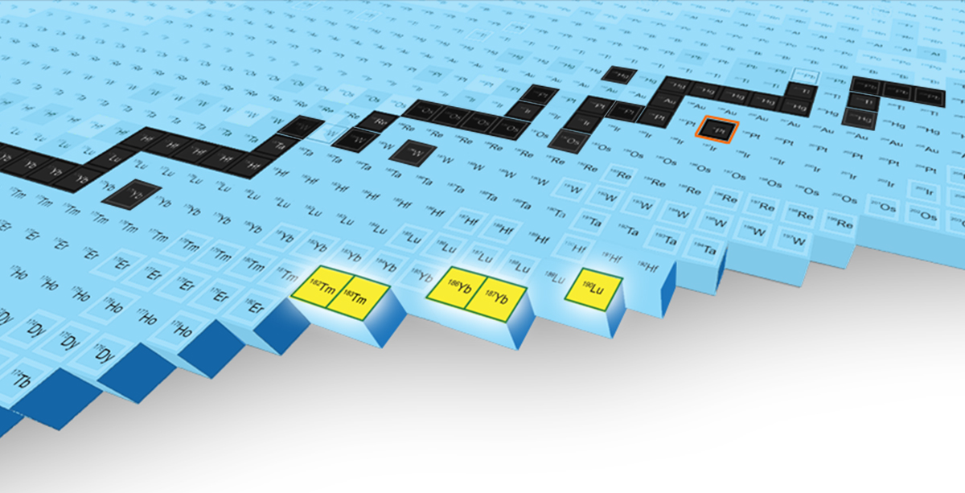
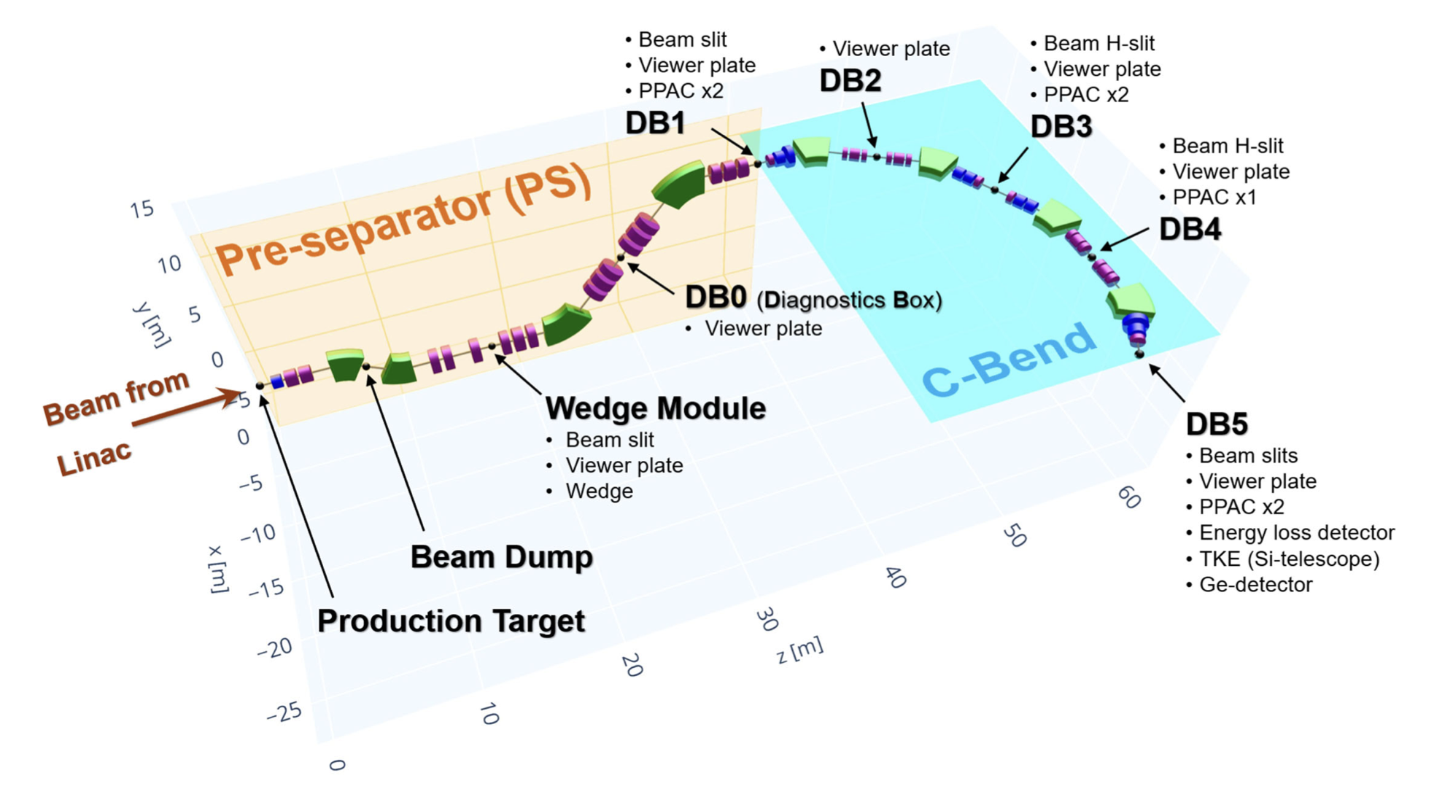
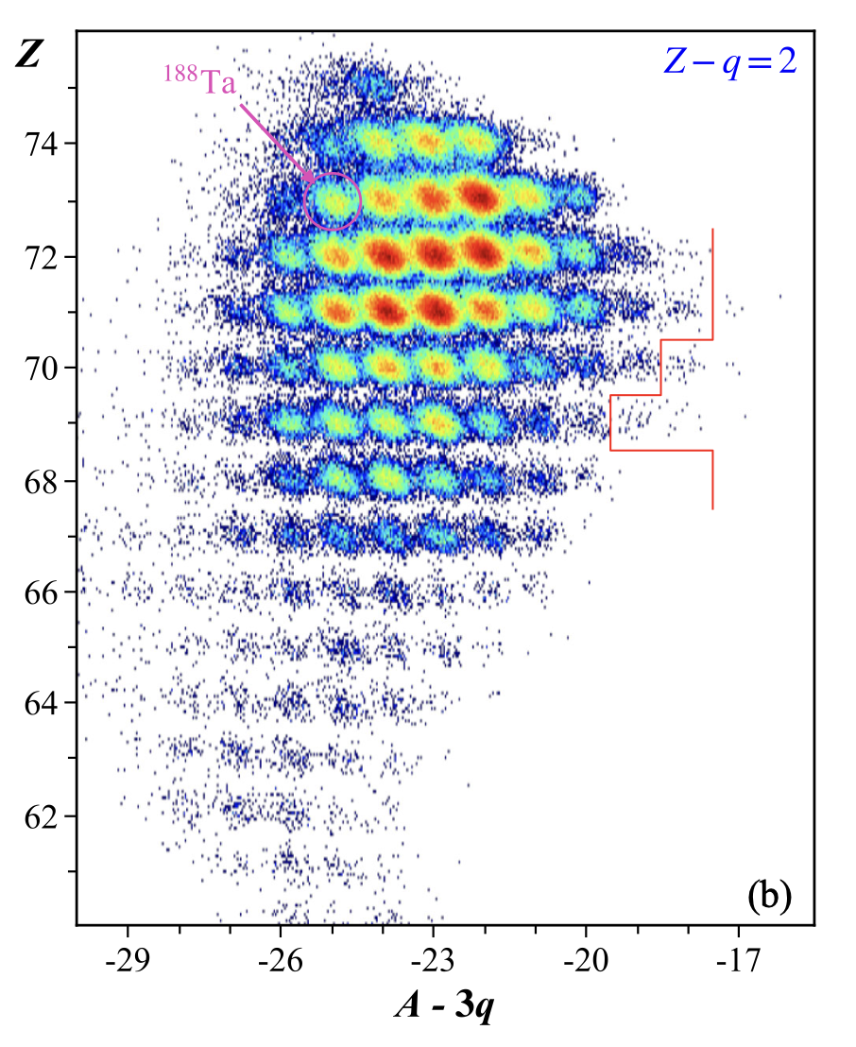
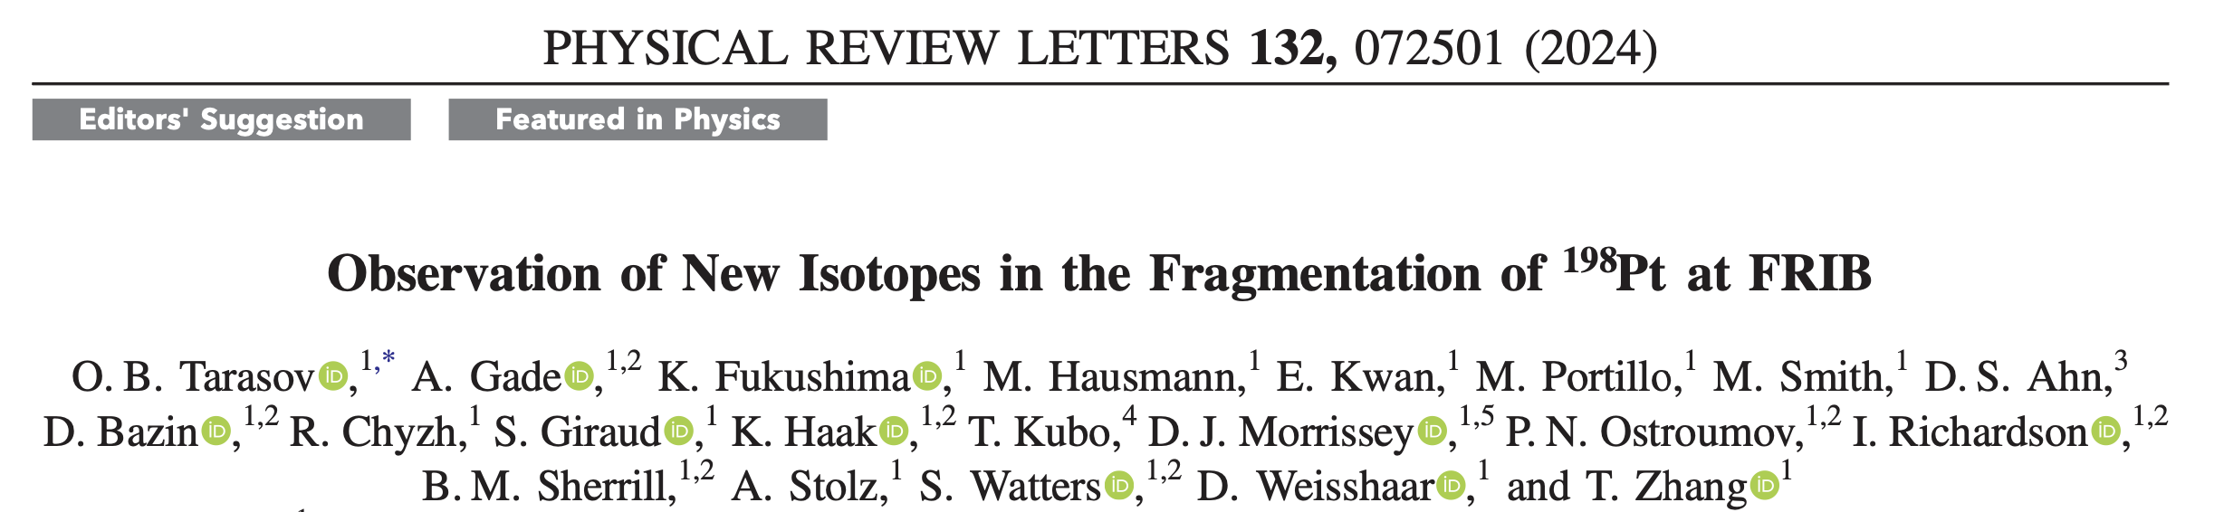
FRIB discovers five new isotopes
Five previously unknown isotopes (^{182,183}Tm, ^{186,187}Yb, ¹⁹⁰Lu) were produced, separated, and identified for the first time at FRIB using the Advanced Rare Isotope Separator (ARIS)

Slide 10
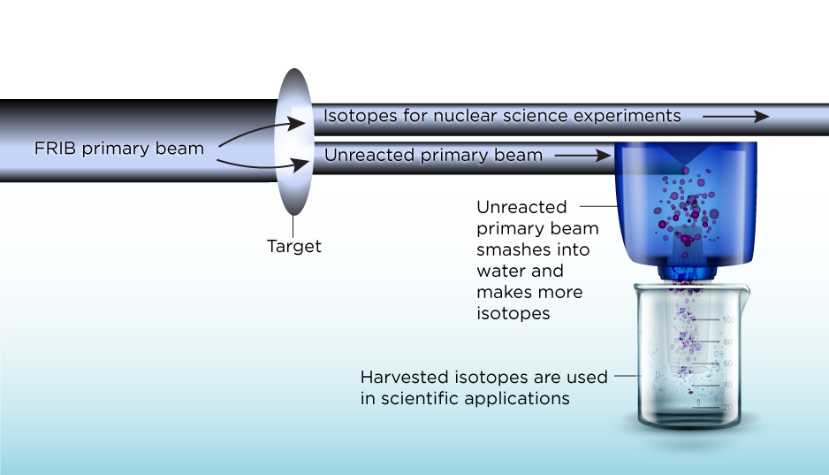
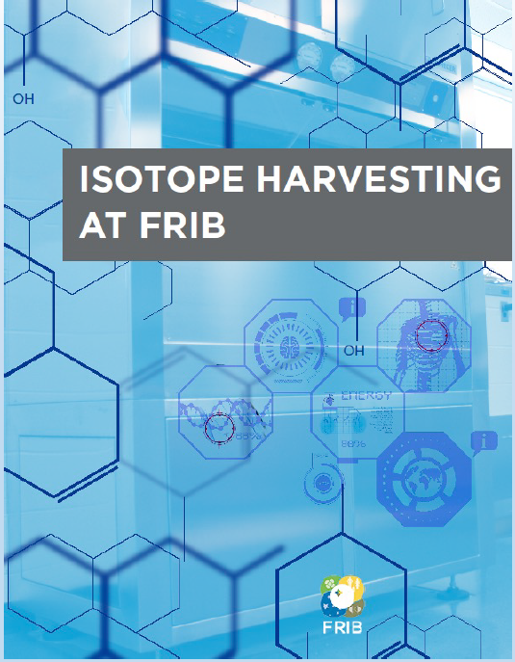
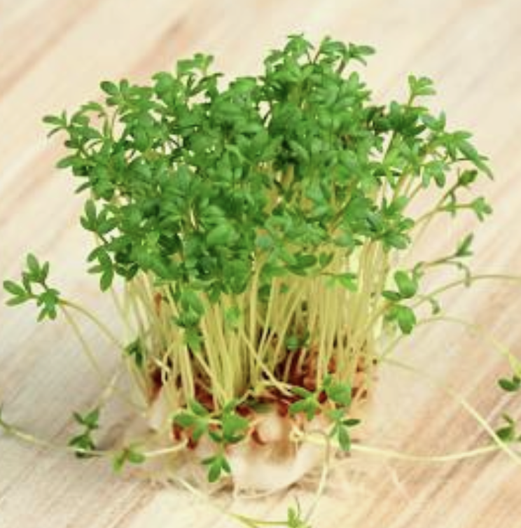
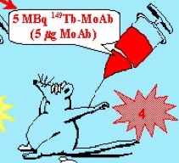
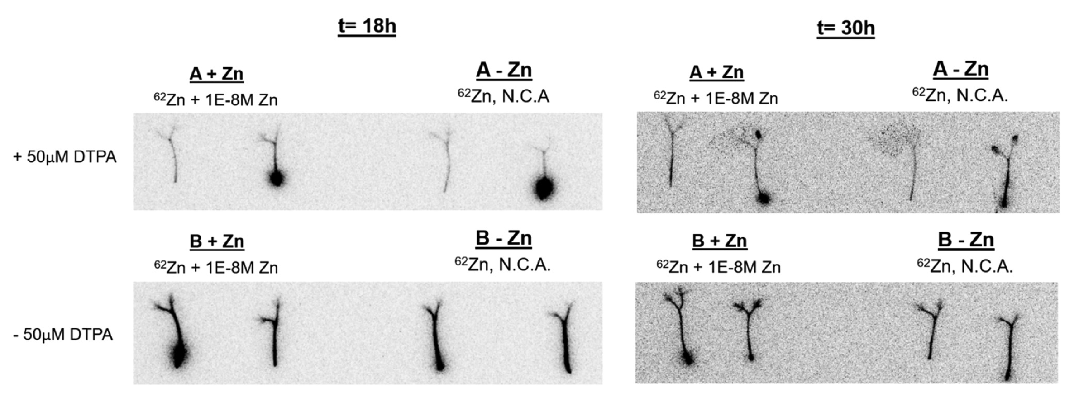
Isotope Harvesting at FRIB
PAC1 and PAC 2 accepted isotope harvesting proposals
FRIB produces a broad range of rare isotopes that can be made available for applications
  Commensal mode of operation: delivery of rare isotope beam to main user while harvesting unused rare isotopes for applications
  $13M grant awarded in 2021 by the DOE Isotope Program (PI: G. Severin, FRIB & Dept. of Chemistry)
¹⁴⁹Tb
  ¹⁴⁹Tb: simultaneous emission of α-particles (therapy) and β⁺ decay (PET)
  Garden cress – study of of Zn absorption using radioactive ⁶²Zn
  Domnanich et al, 2020

Slide 11
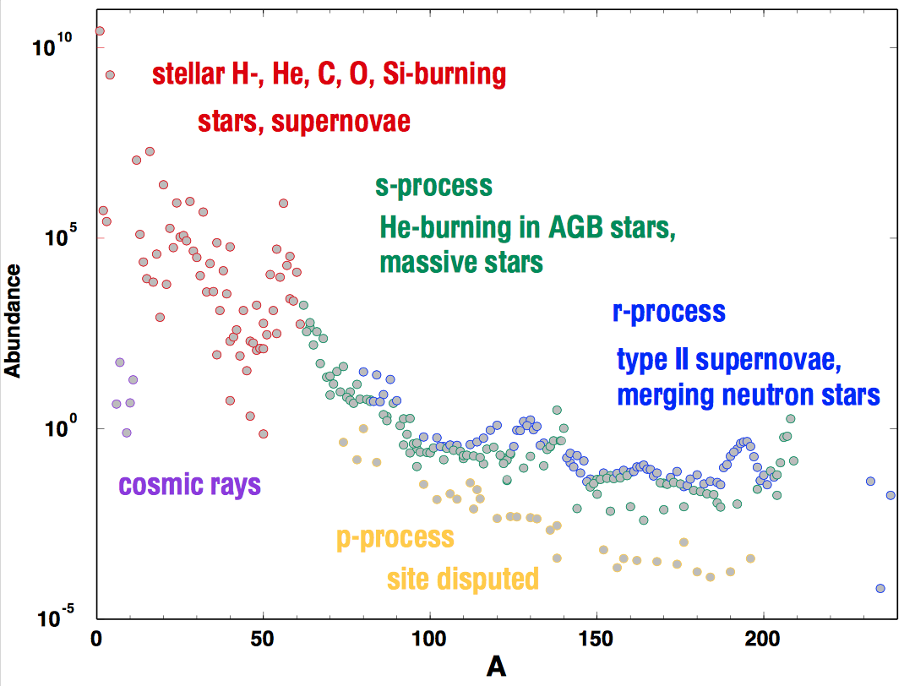
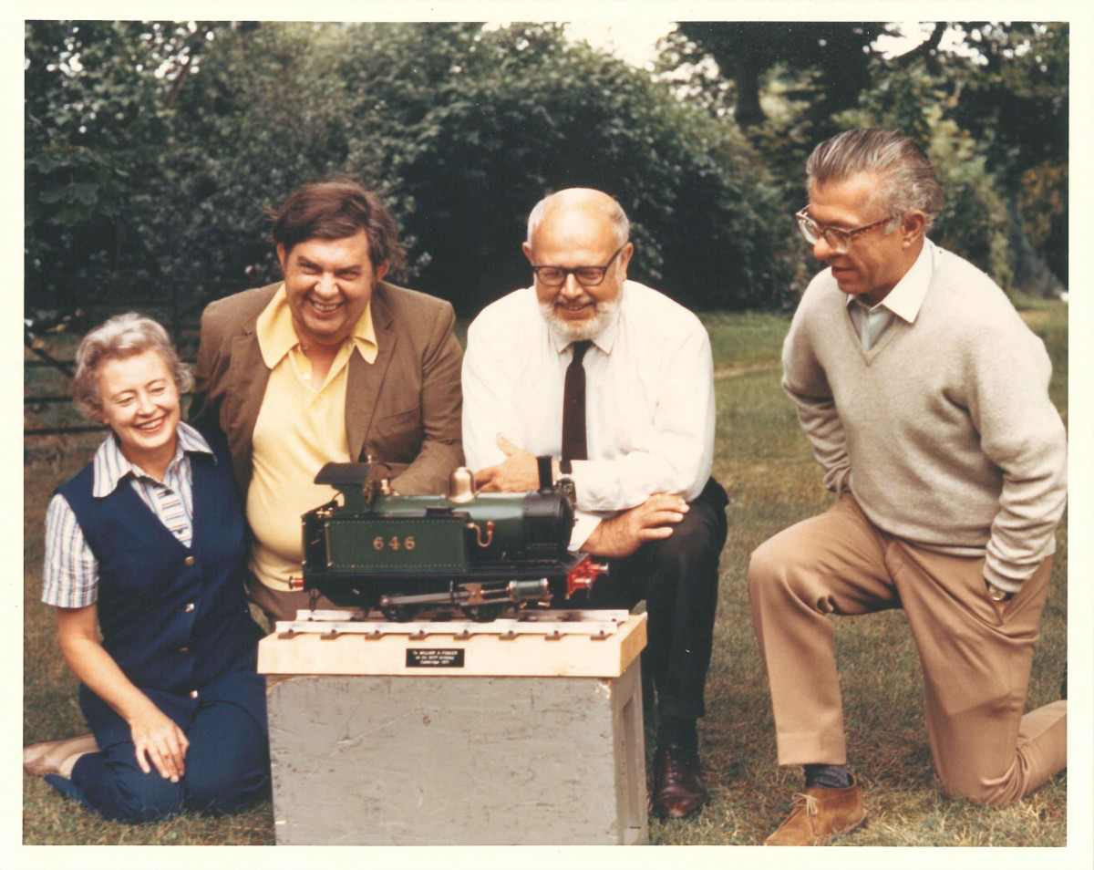
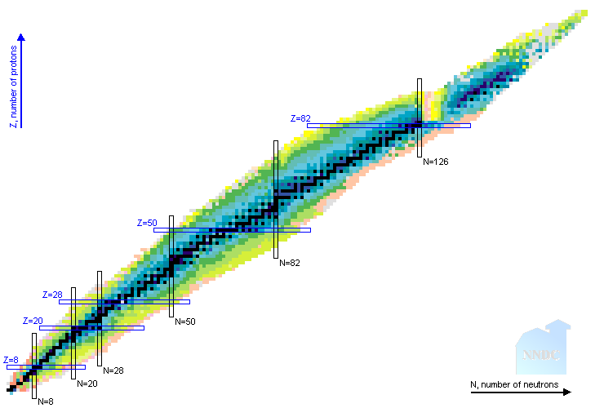
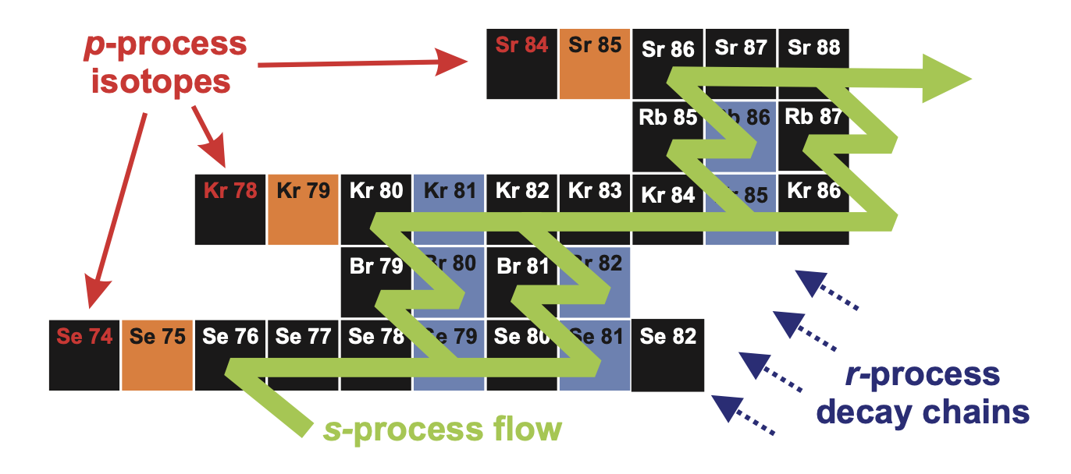
Stellar Nucleosynthesis: Classic picture
Margaret Burbidge
Geoffrey Burbidge
William A. Fowler
Fred Hoyle
B²FH, 1957
r process
Z=82
s process
N=126
p process
From M. Wiescher, JINA web
proton
Z=50
N=82
Z=28
Fe
Z=20
N=50
Z=8
stellar fusion
neutron
N=28
N=20
Dillmann, et al, 2010
N=8

Slide 12
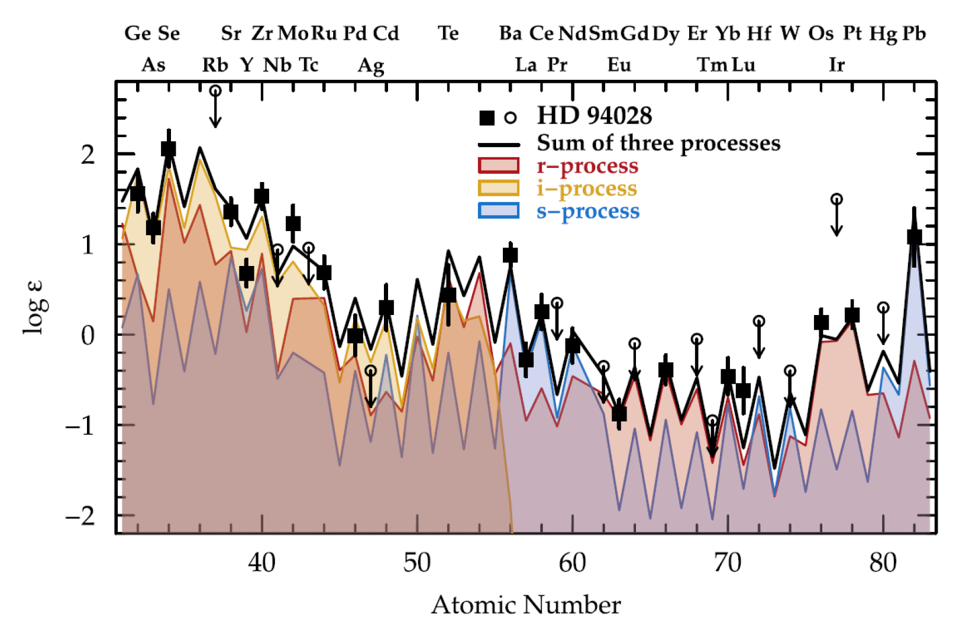
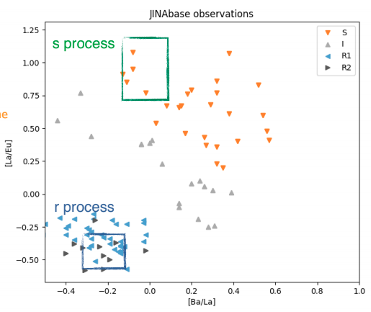
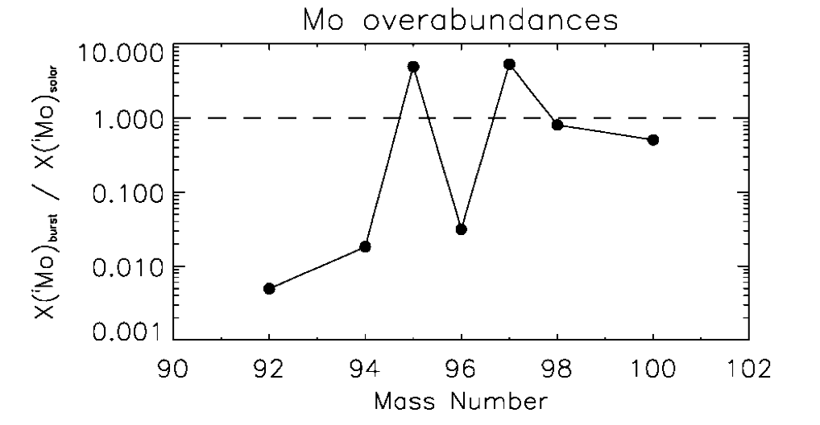
Evidence for additional nucleosynthesis processes
Stellar observations and stardust measurements provide evidence for additional processes
Models attempt to disentangle the contributions from each process
Accurate nuclear physics input is necessary with guidance from observations
~10⁸ n/cm³
Roederer et al Astroph. J. 2016
Mo overabundances
10
s,r
s,r
1
La/Eu
s,r
r
X(^{i}Mo) / X(^{i}Mo)_{solar}
0.1
p
?
?
s
p
0.01
Stardust grains
~10²⁰ n/cm³
0.001
JINAbase
92
94
96
98
100
Ba/La
Mass Number
Meyer et al, APJ 2000
Herwig, Denissenkov

Slide 13
Heavy Element Nucleosynthesis
  New processes proposed to explain modern astronomical observations
Levan et. al. Nature 2023
Z=82
r process
s process
N=126
p process
Need rare isotope science:
To “interpolate” sparse observations to determine contributions from each process
To connect multi-messenger observations with the underlying physics of the events
Identify stellar environments for each process
proton
Z=50
i, n processes
rp,νp process
N=82
Z=28
Weak r process
Pre-solar grains
Z=20
Fe
nova
N=50
Z=8
stellar fusion
N=28
neutron
N=20
N=8

Slide 14
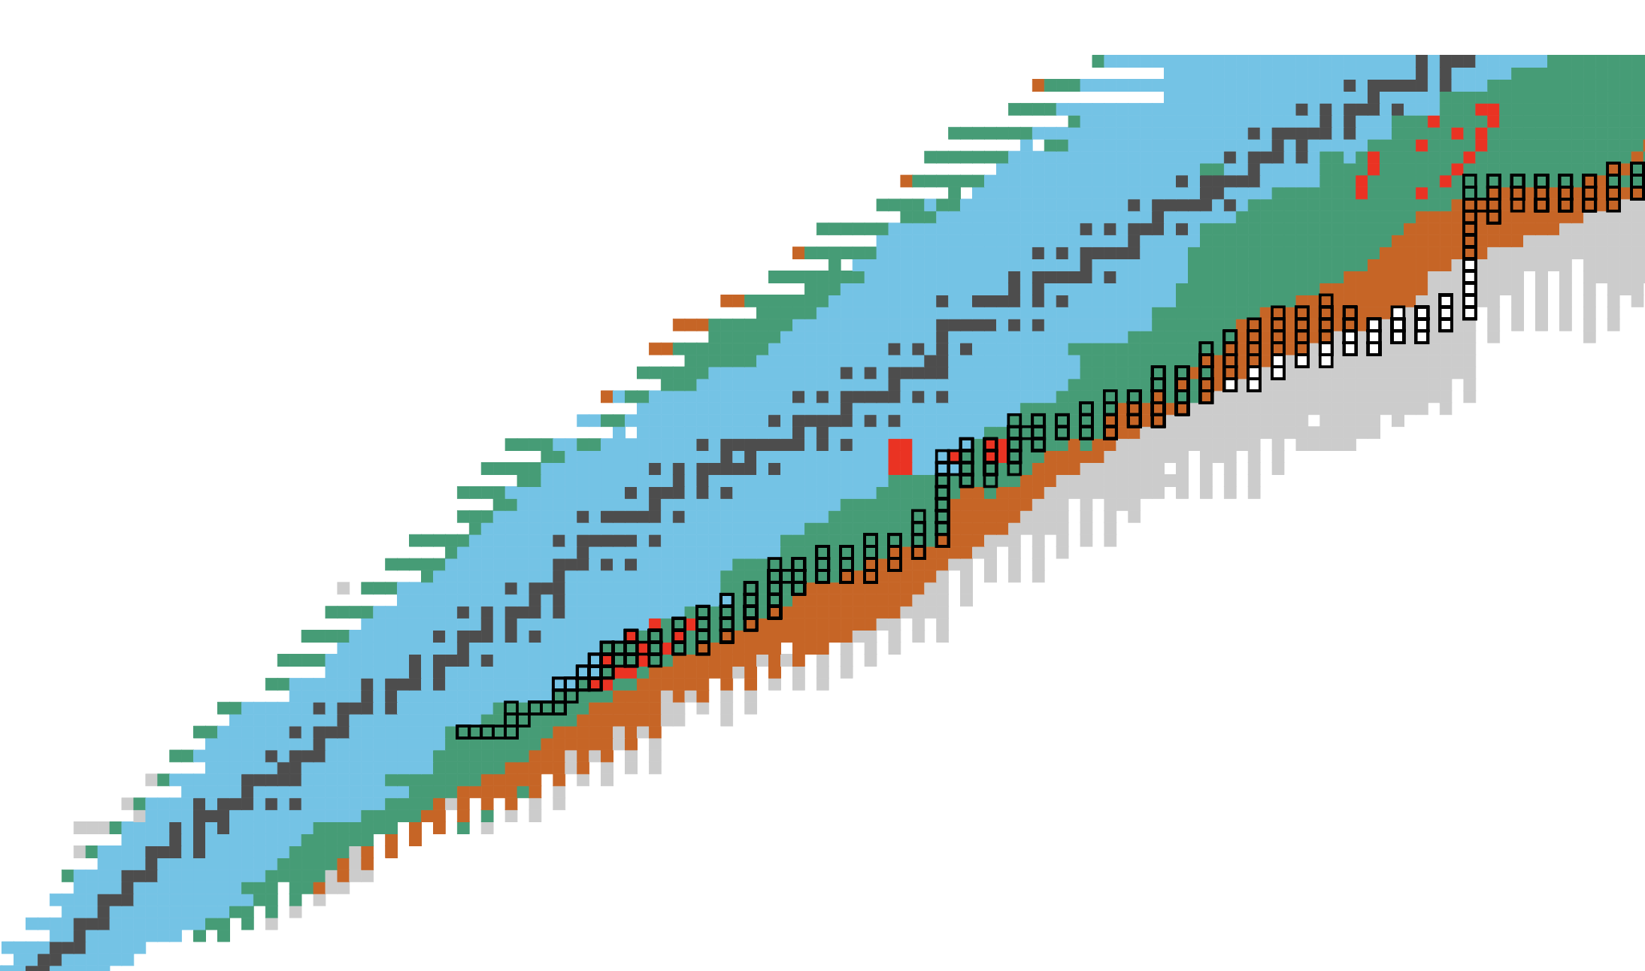
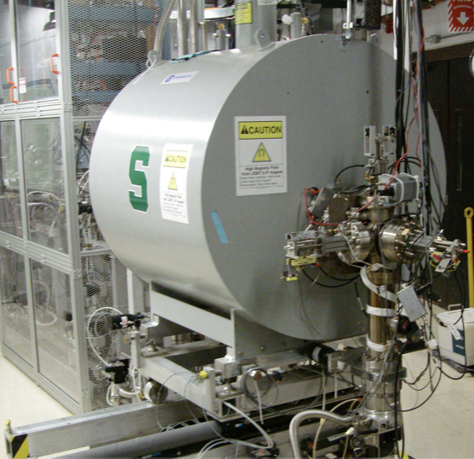
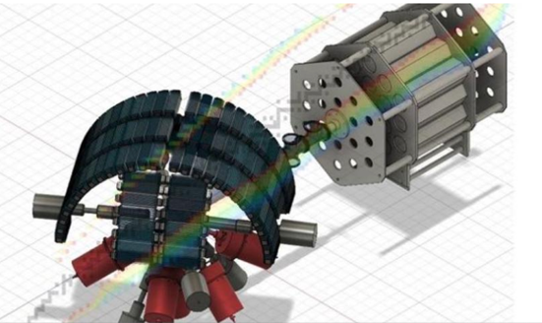
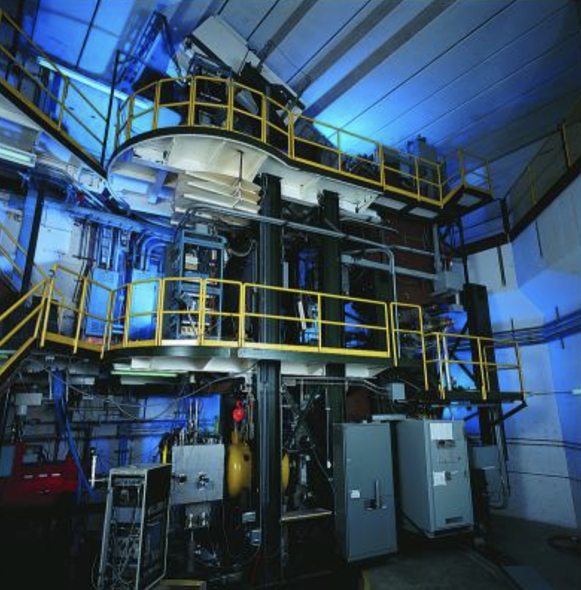
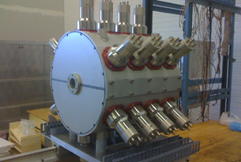
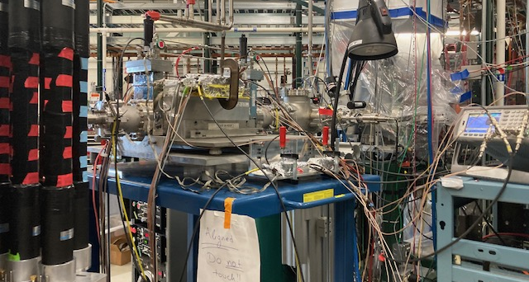
FRIB is Beginning to Address
Key Nuclear Physics of the i and r-process
Karthein MIT: r process
Mass measurements
Known S_{n} and T_{1/2}
FRIB
Wu (ANL/CMU): r process
β-decay properties
FRIB 400 Gain
Ronning (MSU) : i-process
Neutron capture
Richard (OhioU): i process
neutron-capture rates
Spyrou MSU: r process
Neutron-capture rates
Korkulu IBS(Korea)/CMU: r process
Masses measurements
Ong LLNL/ANL: weak r process
(a,n) measurements
Pain, ORNL: i-process
(d,p) for (n,γ)

Slide 15
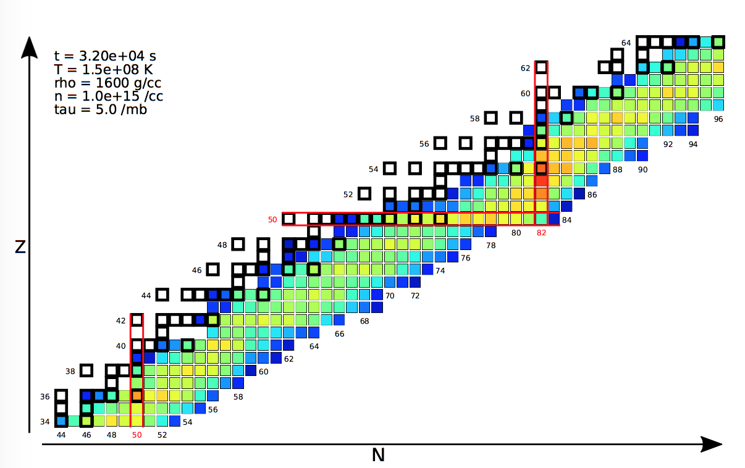
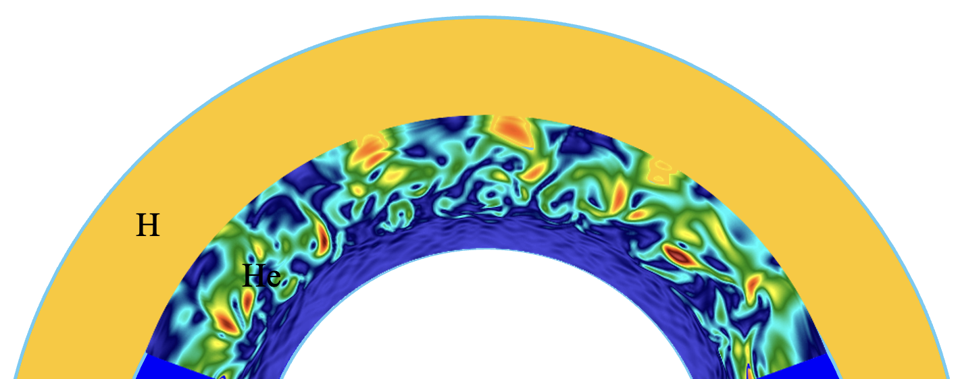

Constraining the conditions of the i process
Neutron density: 10¹³ -10¹⁵ cm⁻³
Neutron production: ¹³C(α,n)¹⁶O reaction
Replenishment of ¹³C via ¹²C(p,γ)¹³N and ¹³N(e⁺)¹³C with T_{1/2}~10 minutes.
Site candidates:
  Low-Z AGB
  Post-AGB
  RAWDs
  …
Most nuclear input already known
Largest uncertainty: neutron-capture reactions
Direct measurement of neutron-capture reactions on short-lived nuclei: extremely challenging
Use of Indirect techniques to provide constraints
Denissenkov, et al, MNRAS (2019)

Slide 16
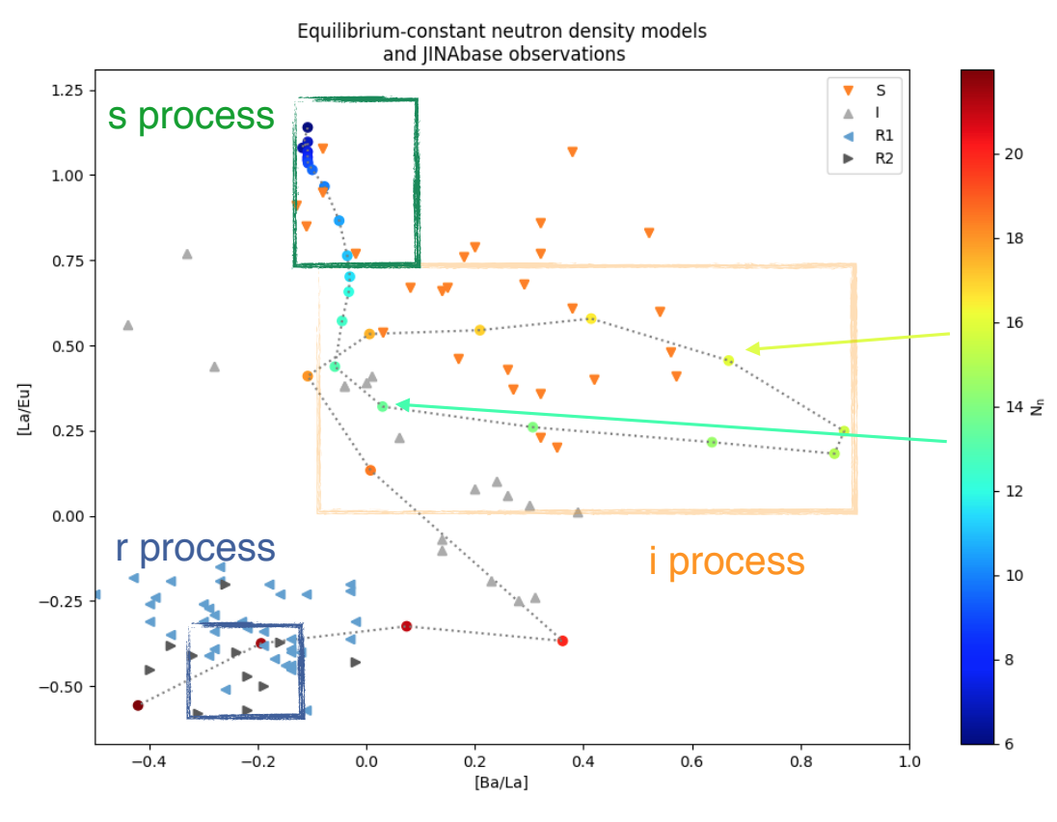
Simple i process calculations
~10⁸ n/cm³
Simple one zone model changing the neutron density
s and r process stars exhibit different abundance ratios
Group of stars not explained by s or r neutron densities
~10²⁰ n/cm³
Herwig, Denissenkov
Ba/La

Slide 17
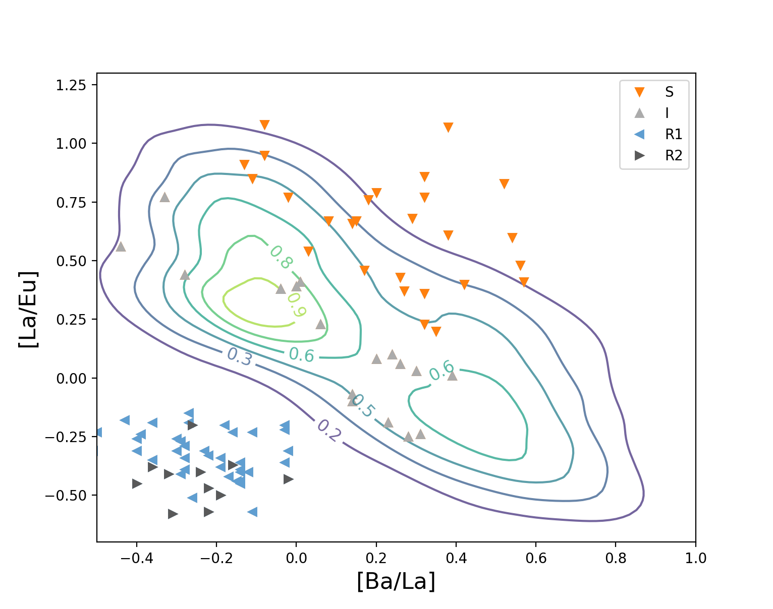
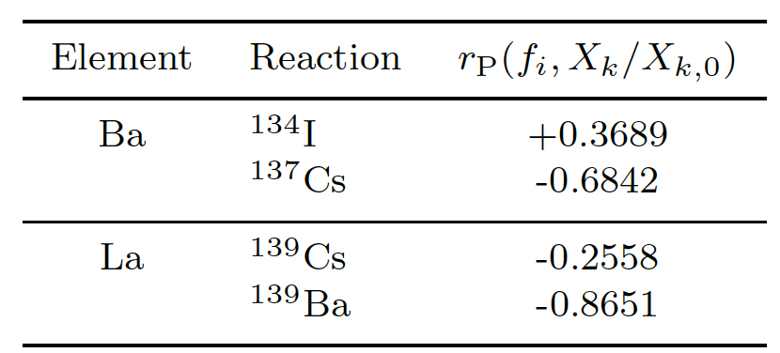

Sensitivity to neutron-capture rates
~10⁸ n/cm³
s process
La/Eu
10¹³ n/cm3
r process
Denissenkov, et al, MNRAS (2019)
~10²⁰ n/cm³
~10⁸ n/cm³
JINAbase
Herwig, Denissenkov
Herwig et al, 2018
Ba/La

Slide 18

Sensitivity to neutron-capture rates
~10⁸ n/cm³
Spyrou, Muecher et al. PRL 2024
s process
La/Eu
10¹³ n/cm3
r process
Denissenkov, et al, MNRAS (2019)
Verified that within the specific model, 10¹³n/cm³ is a viable neutron density to reproduce observations
~10²⁰ n/cm³
~10⁸ n/cm³
JINAbase
Herwig, Denissenkov
Ba/La

Slide 19


FRIB i-process reach
i-process abundances using different nuclear models
@ FRIB
Martinet et al 2023
Heavier nuclei accessible at FRIB
Nuclear uncertainties larger at higher masses
New proposals @ next PAC
CARIBU @ Argonne National Lab

Slide 20


Astrophysical r process
The r-process is responsible for the synthesis of about half of the isotopes of the heavy elements
2017
What is the site of the r process?
Figure by Shinya Wanajo, http://www.ph.sophia.ac.jp/~shinya/research/research.html

Slide 21



Astrophysical r process - observables
Kilpatrick, et al, Science 2017
Wallner et al, Science 2021
Solar system abundances
Metal-poor star observations
Kilonova signal from neutron-star merger
Signals from deep-sea archives
Roederer, ApJS 2022
days

Slide 22




More observations
Uncertain nuclear physics data limit our confidence in this conclusion

Slide 23

r-process sensitivity to neutron captures
Liddick, Spyrou, et al., PRL 2016
Neutron-capture uncertainties can impact the r-process abundances up to an order of magnitude
Most important reactions around closed shells
Mumpower et. al., PPNP 86 (2016) 86
Monte-Carlo variations of (n,γ) rates within a factor
100 – 10 – 2
light – darker – dark bands

Slide 24


Neutron Captures @ FRIB
PAC1 Approved Experiment: Spyrou & Muecher
FRIB Decay Station
Cote et al, Science 2021
¹²⁹I/²⁴⁷Cm
MTAS
Reactions that impact the production of ¹²⁹I
Mumpower/Surman et al

Slide 25

By Alex Parsons, MSU
Summary
Summary
FRIB is online and running experiments
Diverse program in Nuclear Astrophysics
Neutron-capture reactions are an important nuclear uncertainty for i and r processes
Plans for the future at FRIB: Approved proposals for neutron-captures for i and r processes
spyrou@frib.msu.edu

Slide 26
Backup slides

Slide 27

Neutron Captures
Direct measurement of (n,γ) reactions on short-lived isotopes: challenging
Indirect techniques to provide constraints
A few techniques available (Oslo, Surrogate, particle evaporation, Coulomb dissociation, Shape Method, etc)
Oslo
Inverse-Oslo
(d,p)
(³He,³He)
β-Oslo
(p,t)
(³He,⁴He)
(p,⁴He)
(n,γ)
β⁻
(A, Z-1)
(A-1, Z)
¹³⁹Ba
¹⁴⁰Ba
Muecher et al, PRCL (2023)
γ
β⁻
(n,γ)
Wiedeking et al, PRC (2021)
¹⁴⁰Cs
SuN
Larsen et al, PPNP 107 (2019) 69
Spyrou, Liddick, et. al., PRL 2014
(A, Z)

Slide 28




SuN at ANL
fiber
SuN
beam
SuNTAN
¹³⁹Ba(n,γ)¹⁴⁰Ba

