Slide 1
TJNAF S&T Strategy Update
David J. Dean
Deputy Director for Science
Presented To:
JLUO Annual Meeting
June 10, 2024

Slide 2

Outline
I will walk through our overall S&T strategy based on the Annual Laboratory Plan (an Office of Science Exercise, presented to SC leadership on June 4, 2024)

Slide 3




Jefferson Lab Agenda
Vision
Design, build and operate unprecedented instruments and facilities to enable scientists to unlock the hidden mysteries of matter and the universe
Strategic Outcomes
Deliver scientific advances, discoveries, and technological innovations that support DOE missions, and sustain and enhance JLab’s distinctive capabilities
Laboratory Operations: Deliver innovative operations
using optimized processes and state of the art tools to enable our diverse scientific and technology mission
Major initiatives
Maintain role as the world’s premier cold QCD laboratory, through experimental programs in hadron structure and spectroscopy
Provide leadership in nuclear theory investigations of hadron structure and spectroscopy
Deliver CEBAF, SRF, and Project and Systems Engineering capabilities
Lead cryo-SRF and accelerator research capability to compete for new projects across the DOE complex
Realize CEBAF reliability at 12 GeV and develop concepts for future upgrades
Demonstrate leadership in EIC science and deliver on EIC
Project responsibilities
Deliver the High Performance
Data Facility
Expand research programs in Data and Computational Science with EIC and 12 GeV Physics programs as science exemplars of HPDF
Execute Operational Excellence Strategy to enable transition from single to multipurpose lab:
Work planning and control transformation to ensure work is performed safely and in an environmentally sound manner, contributing to continuous improvement of lab safety culture
Leverage Supervisor Academy to develop lab leaders at all levels to successfully execute the mission, fostering a healthy DEIA and safety culture
Enhance IT Governance to optimize IT portfolio, increasing workforce effectiveness and efficiency.
Redesign job structure and compensation system to recruit and retain talent
Scale lab processes and implement enterprise tools to enable a multipurpose lab to meet strategic objectives
5-7 Year Goals
Mission
To deliver fundamental scientific discoveries and technical breakthroughs by fostering a diverse user community and by designing, delivering and deploying world-leading scientific capabilities, technologies, and facilities to meet the needs of the nation’s scientist users
Foundations
Values
Pursuing scientific discovery; working safely; embracing diversity; achieving with integrity; and leading in the community

Slide 4
Core Capabilities Underpin Impactful S&T
187
Patents granted
2444
Journal articles
published
Nuclear Physics
Research
Advanced
Computer Science,
Visualization, &
Data
755
PhDs granted
(236 in progress)
938
employees
Two National User
Facilities:
CEBAF & HPDF
Accelerator
Science &
Technology
$206M
FY23
expenditures
1,905
research
guests
annually
Mechanical
Engineering &
Design
$200M
modernization
investment
Systems
Engineering

Slide 5
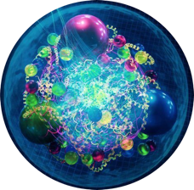
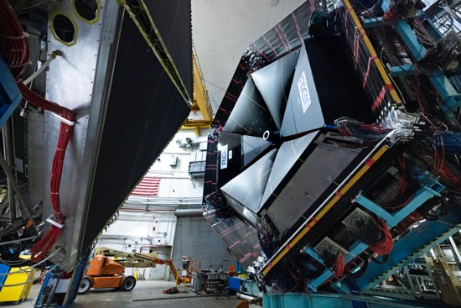
Experiments (data) Coupled with Theory Reveal Emergence
Quarks and gluons are ‘confined’ → experiments ‘see’ hadrons and infer an underlying quark and gluon structure and their dynamics
Experiments measure outgoing particles (hadrons and leptons)
Theory
Data
Computation
e
e’
Hadrons
True across the sciences: “Quantifying emergence and modeling emergent dynamics in a data-driven manner for complex dynamical systems is challenging due to the lack of direct observations at the micro-level.” Yang, et al., arXiv:2308.09952 (2023)
Hall B detector
The combination of experimental data, theory, and computing create a new approach to science

Slide 6
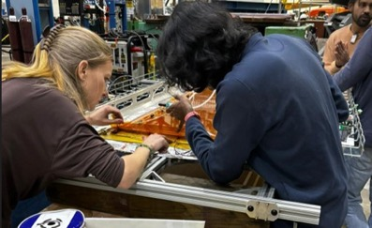
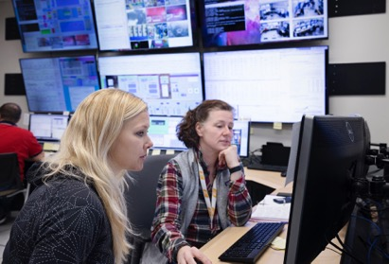
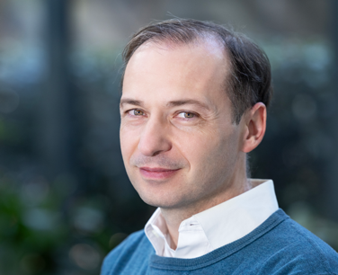
Sustain Global Leadership in Nuclear Physics R&D
Vision
Strategy
CEBAF delivers a vibrant research program, operating more than 30 weeks per year, supporting ~1,900 users annually
Priority areas
Ensure that TJNAF maintains a role as the premier cold QCD laboratory in the world through a world-class experimental program and theoretical leadership in hadron structure and spectroscopy
Realize CEBAF reliability at 12 GeV and develop concepts for future upgrades
Recent achievements
Physics:
  Explore Exotic Hybrid Mesons
  Precision nuclear femtography of quarks and gluons
  Precision tests of the Standard Model
Continue the CEBAF Performance Plan implementation to ensure high-intensity high-reliability 12 GeV operations.
Pursue a cost-effective approach to building the SoLID detector
Develop pathways to CEBAF upgrades (positrons and 22 GeV)
Over the last 5 years: 300 publications including 49 PRLs and 15 Nature articles
107 doctoral theses awarded based on experiments from JLab
23 (inter)national awards: 2 DOE Early Career; 3 APS Fellows; Altarelli Prize; DOE SC Distinguished Scientist Fellow.
MOLLER BSM experiment achieves CD-2/3
MOLLER
Hall A GEMs
Hall A/C Staff scientist, Holly Szumila-Vance, working with graduate students and postdocs from the University of Virginia on the GEMs used in the Hall A Super BigBite experiments.
American Physical Society Fellow: Alexandre Deur

Slide 7
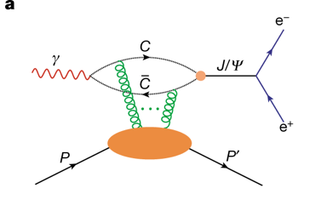
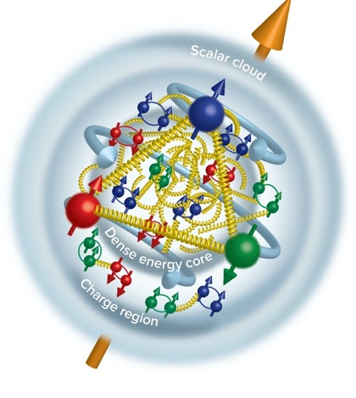
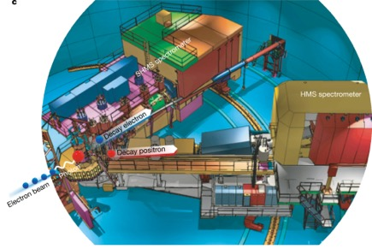
CEBAF Experiment Locates Gluon Mass in the Proton
Near threshold J/psi photoproduction experiment
Inner Gluon radius: 0.52 +/- 0.03 fm
Charge radius: ~0.84-0.88 fm
Scalar gluon rad: 1.069+/-0.056 fm
Measured in Hall C
“Determining the gluonic gravitational form factors of the proton," Duran et al, Nature 615, 813 (2023)

Slide 8
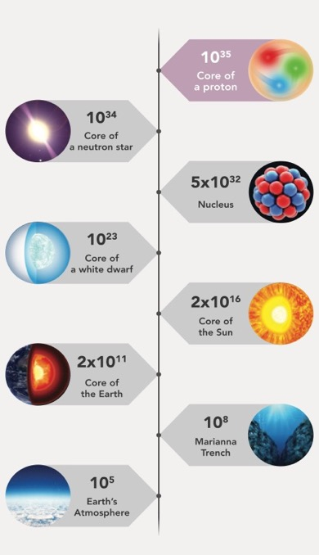
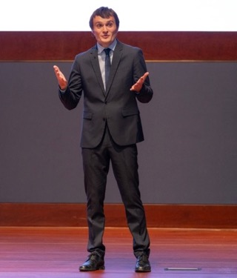

Mechanical Structure of the Proton: Pressure and Sheer Forces
Pressure Distribution
Inside the Proton
Peak pressure in objects on earth, the sun, and the universe
Tangential stress force inside the proton changes direction near r ~ 0.45 fm
Peak : 38,000 N (4 metric tons)
V.Burkert, L. Elouadrhiri, F.X. Girod, Nature 557 (2018) 7705, 396
Pierre Chatagnon
JLab – Post-doc
Burkert, V.D., et al., Colloquium: Gravitational form factors of the proton. Reviews of Modern Physics 95, 041002 (2023)
This breakthrough has paved the way for a completely groundbreaking approach to unraveling the intricate structure of the proton.

Slide 9
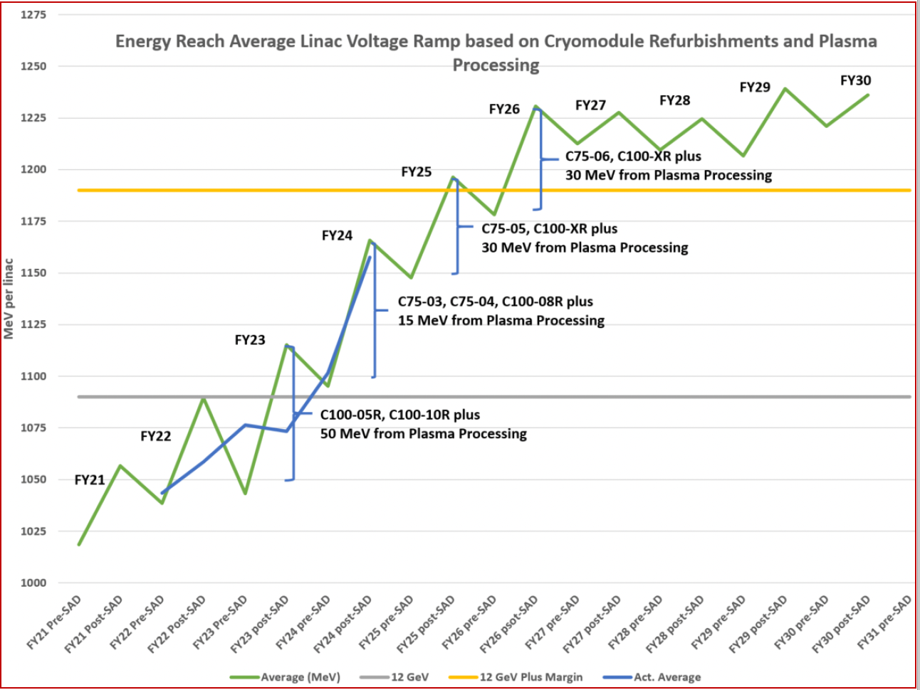
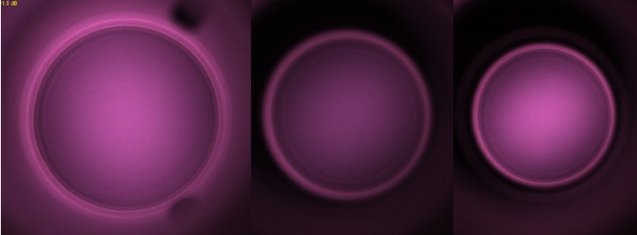
Energy Reach and Reliability in CEBAF Operations
Lower run E
Continuous improvement efforts (CPP) are enabling both better performance and energy reach required by experiments

Slide 10
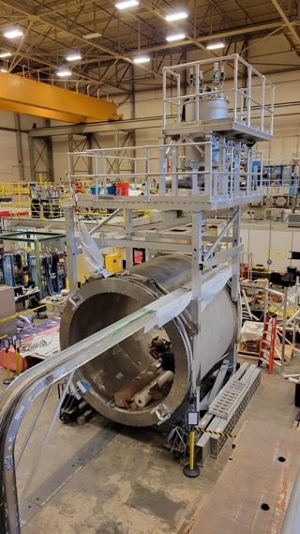
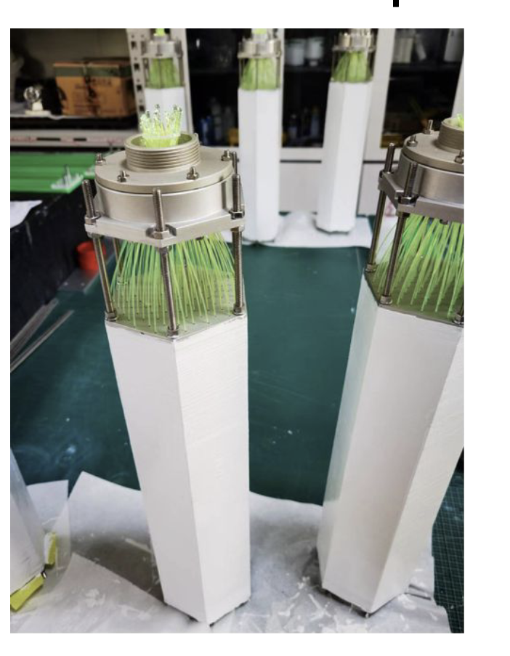
SoLID Fully Enables CEBAF 12 GeV at the Intensity Frontier
The SoLID science program was endorsed by the 2023 NSAC Long Range Plan (Recommendation #4) as one of the projects "that lay the foundation for the discovery science of tomorrow". SoLID is mentioned positively over 25 times in the Plan.
Nucleon spin, proton mass, BSM experiments require precision measurements of small cross sections and asymmetries, combined with multiple particle detection
There is a critical need for a high luminosity 10³⁷-10³⁹ cm⁻²s⁻¹ and large acceptance working in tandem – takes full advantage of Jefferson Lab capabilities
SoLID Whitepaper Published in: J.Phys.G 50 (2023)
Highlights of SoLID scientific programs and instrumentation
Risk-reducing R&D continues!
SoLID cost updated FY2023 (TPC = ~$92M)
Experimental operations and CE, with some sacrifice, could support ~$24M dependencies
Electromagnetic Calorimeter Prototype for the SoLID Project at Jefferson Lab
TIPP, SPRINGER NATURE (2018)
Magnet testing

Slide 11
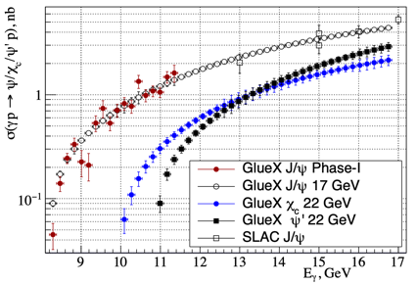

The Physics of CEBAF at 22 GeV
How does QCD generate hadrons?
Are there pure exotic states?
Can we harness threshold charmonium production to probe proton/gluon properties?
Q² evolution of the γ_{v}pN* electrocouplings could offer an insight into hadron mass generation and the emergence of the N* structure from QCD
Simulations indicate JLab22 is the only foreseeable facility to extend these measurements up to 30 GeV² and down to α_{s}/π=0.15 where non-and perturbative QCD coexist.
Direct (photon) probe of the
$Z_{c}→J/ψπ$ coupling without rescattering effects provides unique complementary data to constrain interpretation of $e^{+}e^{−}$ data.
Exclusive charmonium production near threshold probes gluon/mass properties of
A. Accardi et al., Strong Interaction Physics at the Luminosity Frontier with 22 GeV Electrons at Jefferson Lab, arXiv:2306.09360 (2023), and European J. Phys. (in press, 2024).

Slide 12
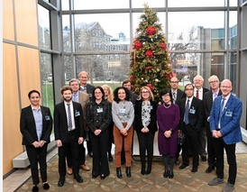
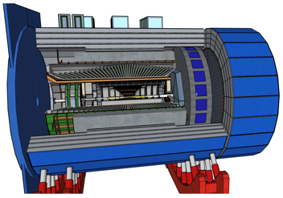
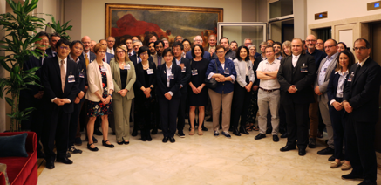
Ensure Excellence in Delivering on the EIC Partnership
Vision
Apply our extensive decades-long expertise in electron scattering science and technology in partnership with BNL to ensure the success of both the EIC Project and its scientific program, in both experiment and theory
Strategy
Demonstrate leadership in the EIC scientific program and deliver on TJNAF Project Partnership responsibilities
Develop a strong R&D effort that encompasses the physics covered by the EIC in both theory and experiment
Priority areas
Recent achievements
Execute TJNAF CD-3A scope
Develop with BNL project plans for CD-3B and CD-2
Promote scientific community support for the EIC detector
Establish key scientific roles in the EIC in computing and femtography
Strong partnership with BNL
CD-3A approval in March, 2024
International Resource Review Board Established (3rd meeting completed)
Completed many technical reviews for aspects of the detector and accelerator
EIC FPD Status Update Meeting @ BNL June 28-30, 2022
EIC Collaboration Statement of Interest signing France CNRS and DOE Nov. 13, 2023
DOE EIC CD-3A/Status Independent Project Review Nov. 14-16, 2023

Slide 13
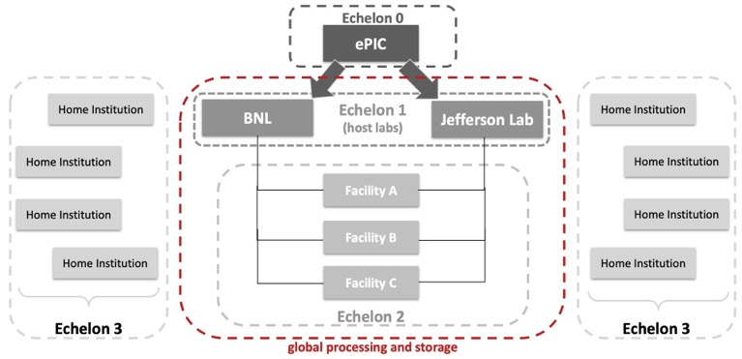
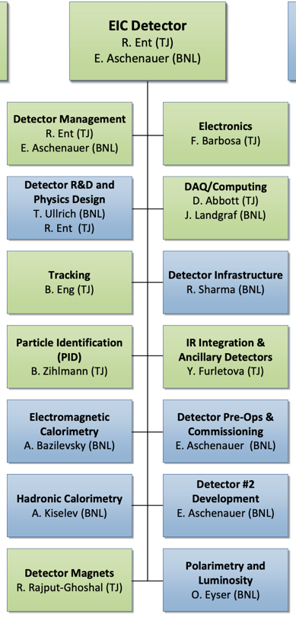
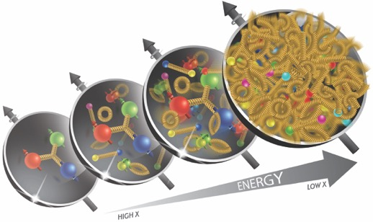
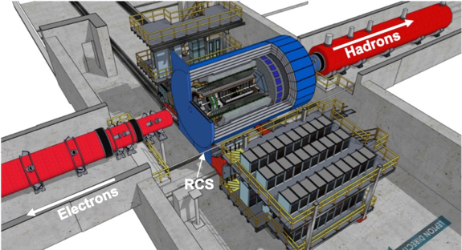
ePIC and the Interaction Region
The EIC Project is designing the detector to accomplish the physics goals of ePIC collaboration.
Computing for ePIC is also being developed

Slide 14
Notional CEBAF and EIC Efforts on One Chart
Accelerator team has worked up an early schedule and cost estimate
  Schedule assumptions based on a notional timing of when funds might be available (near EIC ramp down based on EIC V3 profile)
  For completeness, Moller and SoLID (part of 12 GeV program) are shown; positron source dev shown
EIC Project is shown
Activities | Fiscal Year
 | 24 | 25 | 26 | 27 | 28 | 29 | 30 | 31 | 32 | 33 | 34 | 35 | 36 | 37 | 38 | 39 | 40 | 41 | 42
Moller (MIE, 413.3B, CD-2/3)
SoLID (LRP, Rec 4)
Positron Source (R&D)
CEBAF Upgrade preCDR/preplan
Positron Project (potential)
Transport e+
22 GeV Development (R&D)
22 GeV Project (potential)
EIC Project (V4.2, CD-1, CD-3A)
CEBAF Up

Slide 15
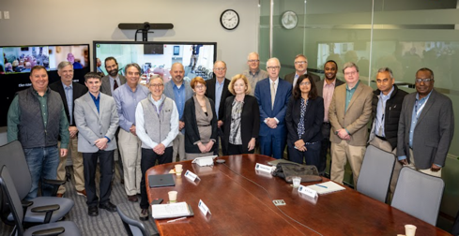

Deploy HPDF and Develop an Associated R&D Program
Vision
Strategy
Further the SC mission of scientific discovery through expanded access to computational resources and application of data science techniques to real-time needs and the deep integration of theory and experiment
Empower researchers to merge DOE’s world-class tools, infrastructure, and user facilities in novel ways to radically accelerate discovery and innovation. Provide paradigm-shifting data-focused capabilities and lead the stewardship of the scientific data lifecycle
Priority areas
Deliver the High Performance Data Facility including its supporting organization.
Establish strong research programs in Data Science and AI/ML with HPDF spoke development in mind.
Partner with LBNL to design and deliver the HPDF Hub
Design HPDF as a part of the Integrated Research Infrastructure Program.
Recent achievements
Design the Hub, a centralized data-centric infrastructure with high availability and performance
Orchestrate hardware, software, and services for data movement, storage, and retrieval
Design distributed data-centric infrastructure (spokes) to enhance HPDF access.
Integrate HPDF with DOE SC user facilities
Started the second phase of the Streaming Readout Grand Challenge in support of the 12 GeV Nuclear Physics and EIC programs
Established the iPT and parameters for the HPDF Project. (FY24: $8M; FY25 PBR: $16M)
Initiated design of the Jefferson Laboratory Data Center (funded by Virginia)
Implemented AI/ML to improve CEBAF performance
JLAB/LBNL HPDF Leadership Meeting at LBNL, March 6, 2024

Slide 16
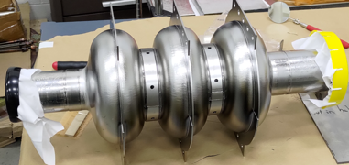
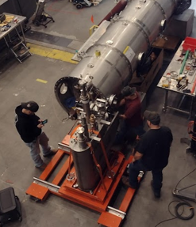
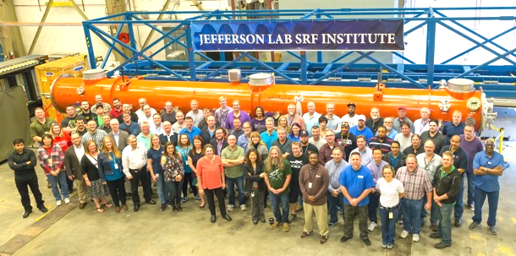
Advance S&T To Enhance Particle Accelerator Capability at CEBAF and Beyond
Vision
Strategy
Two-fold Vision:
Operate the unique accelerator CEBAF, which can be upgraded in energy and by adding positrons.
Enhance stewardship role within the SC lab complex for furthering the application of SRF technologies
Priority areas
Advance world-leading cryo-SRF and accelerator research capabilities to enable new accelerator concepts, while exploiting performance gains in CEBAF
Develop concepts for future upgrades of CEBAF. Develop applications of SRF to variety of sciences and industries
Recent achievements
Lead cryo-SRF and accelerator research capability to compete for new projects across the DOE complex
Realize CEBAF reliability at 12 GeV and develop concepts for future upgrades
Executed to completion the TJNAF portion of the SNS PPU project
Executing the TJNAF portion of the LCLS-II HE project
Implemented ISO-9001 quality assurance program for cryomodule work
First multi-cell Nb cavity with conduction cooling Nb ring. Attained Eacc 8 MV/m with Q₀ 1x10¹⁰ at 4.3 K
LCLS-II HE

Slide 17
The User Survey: Take it while you are here…
The survey was designed by JLab and the JLUO to provide insights into how we are doing in working with the community on science.
This is a ’best practice’ at other National User Facilities.
It is:
  Brief!!!!!!
  Timely…we can use results to inform what we need to work on.
  Yearly…we will track our user-JLab relationship with it.

Slide 18
Discussion
Questions?

