Slide 1
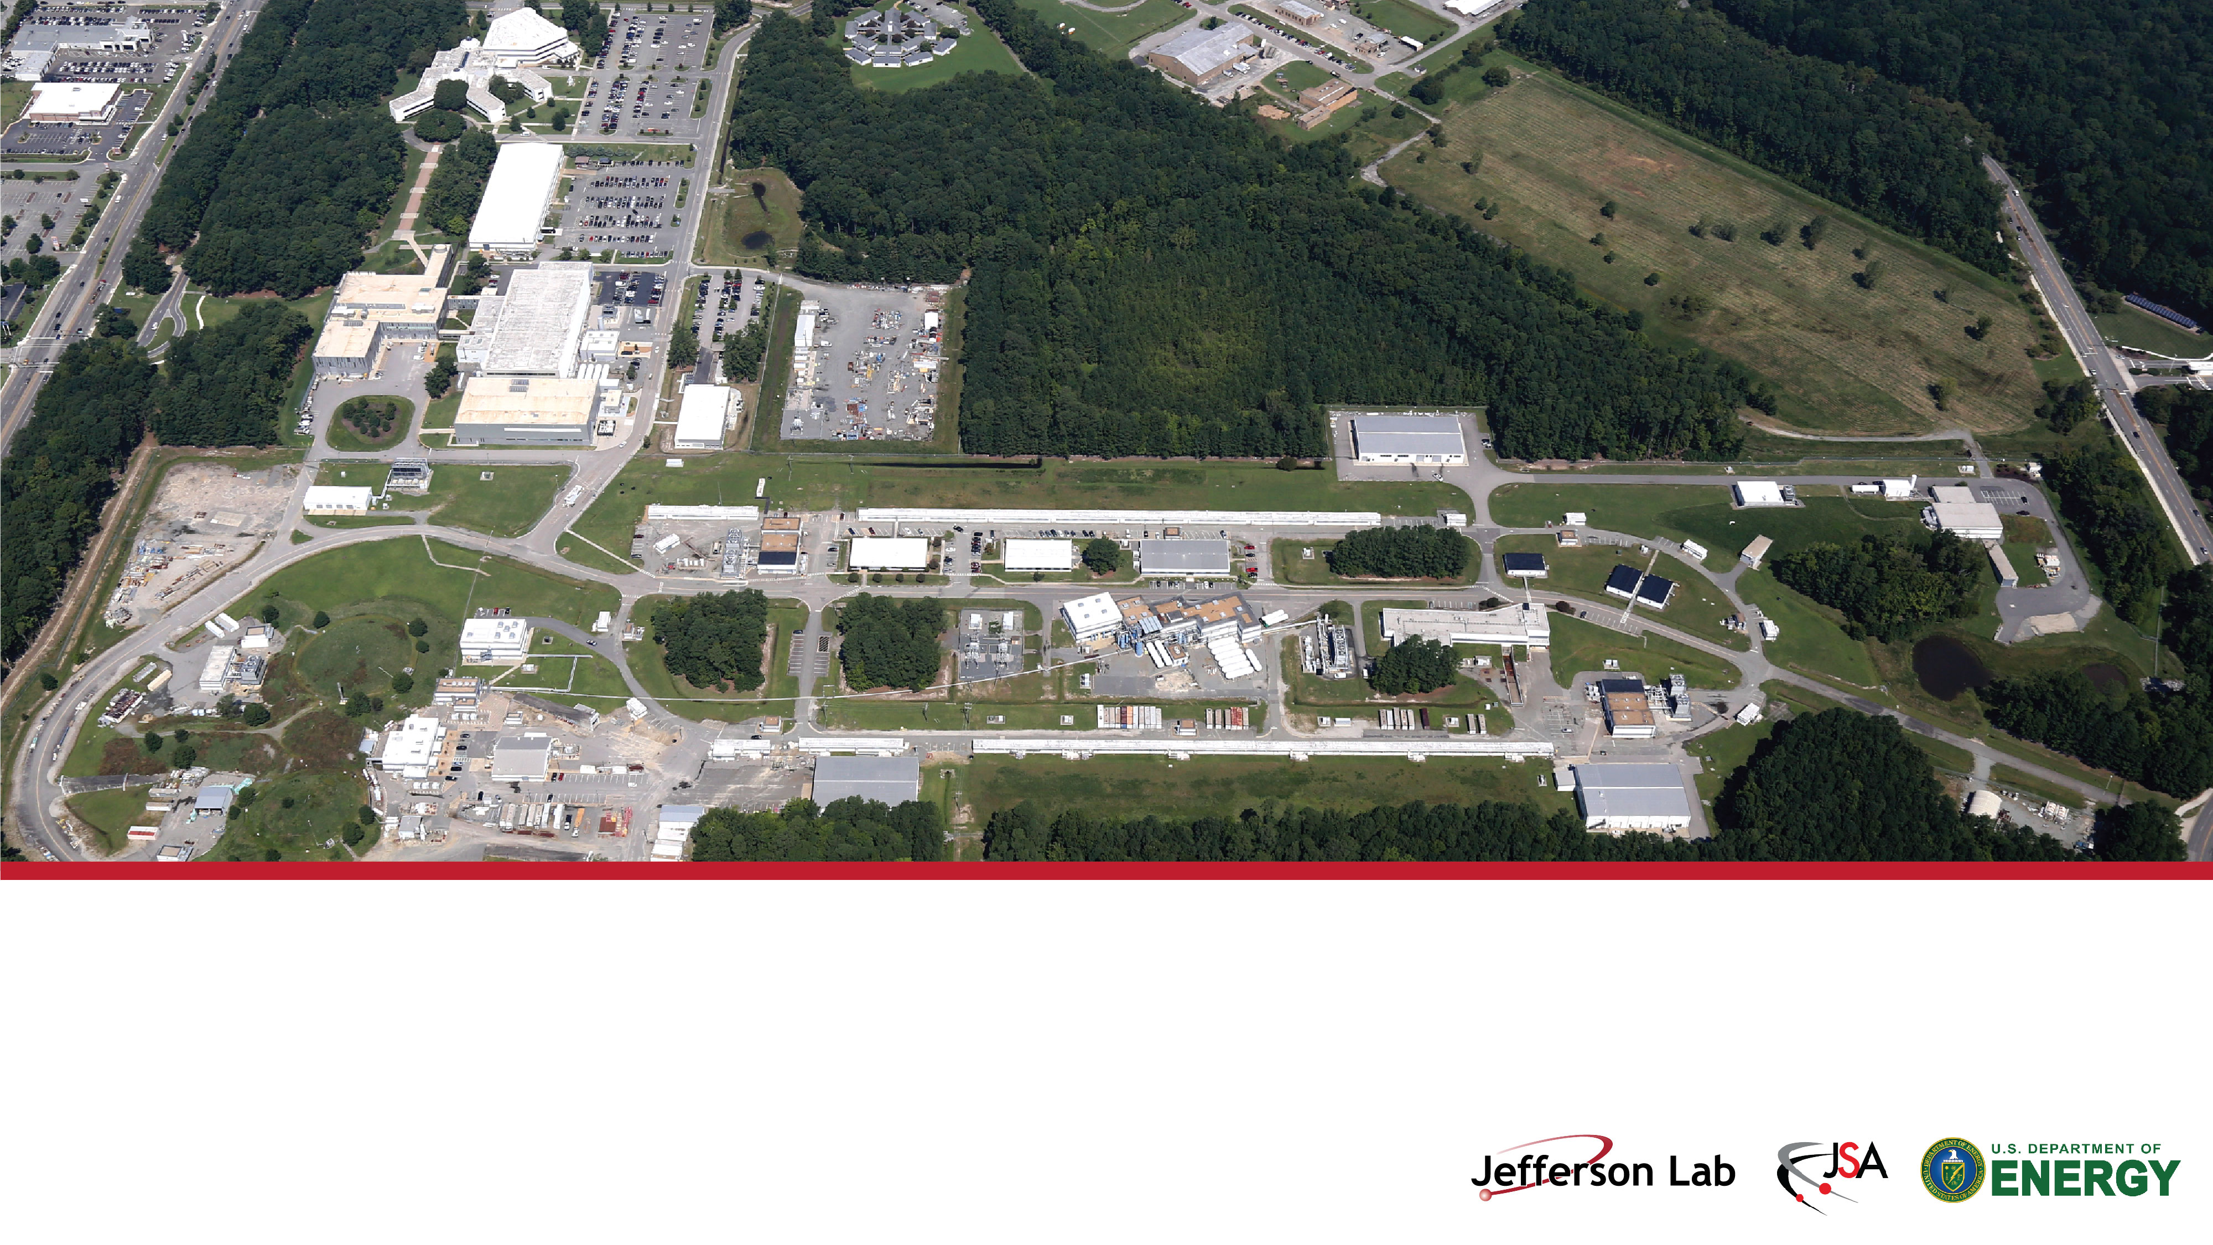
Jefferson Lab User’s Meeting
Jefferson Lab Status: News from the Lab
Stuart Henderson
Director, Thomas Jefferson National Accelerator Facility
June 10, 2024

Slide 2

Reminder: Community Standards

Slide 3
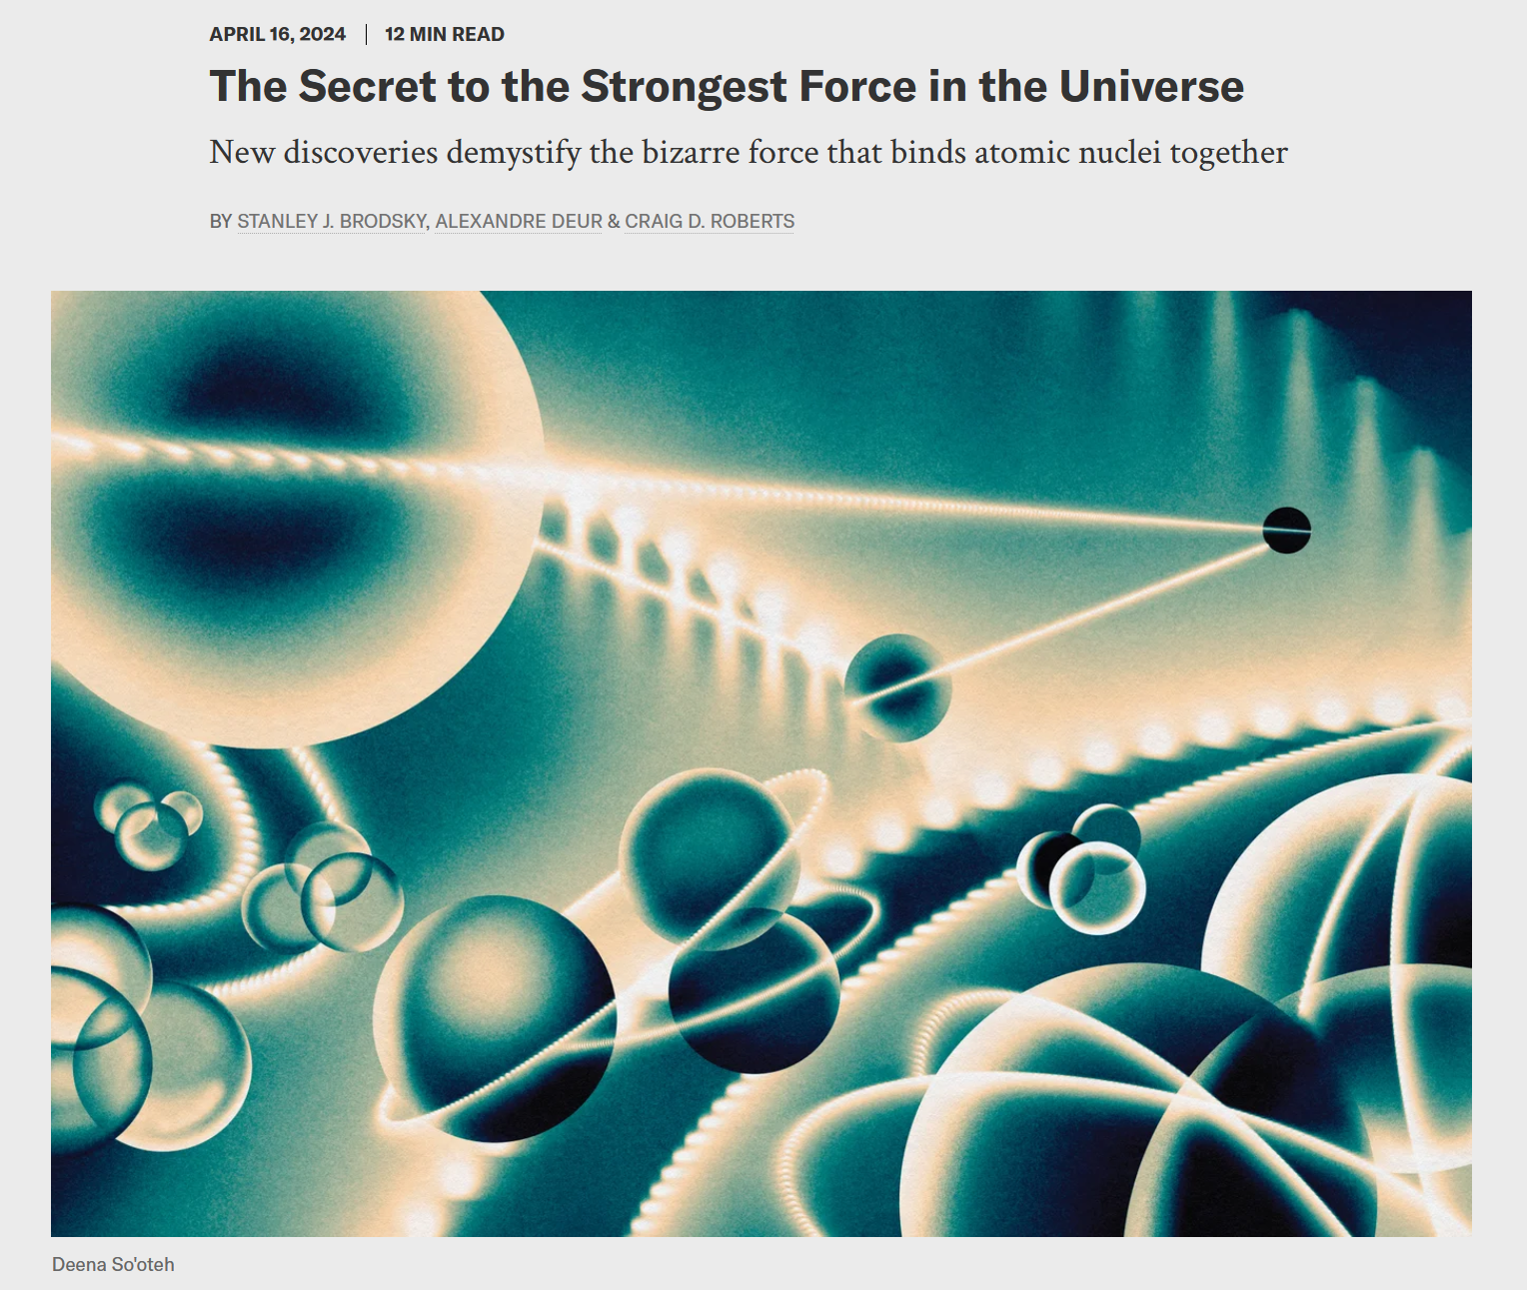
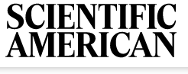
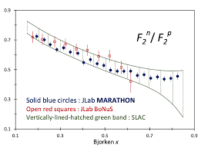
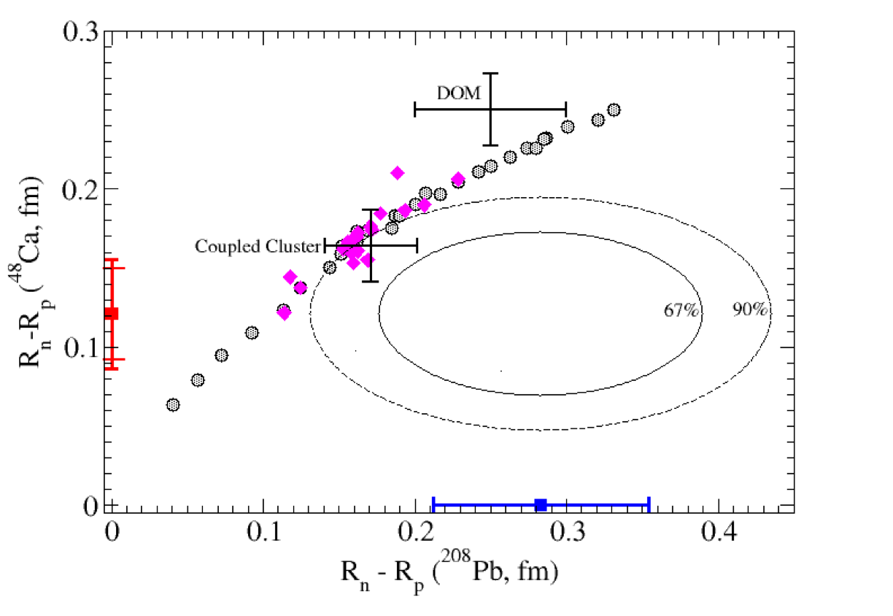
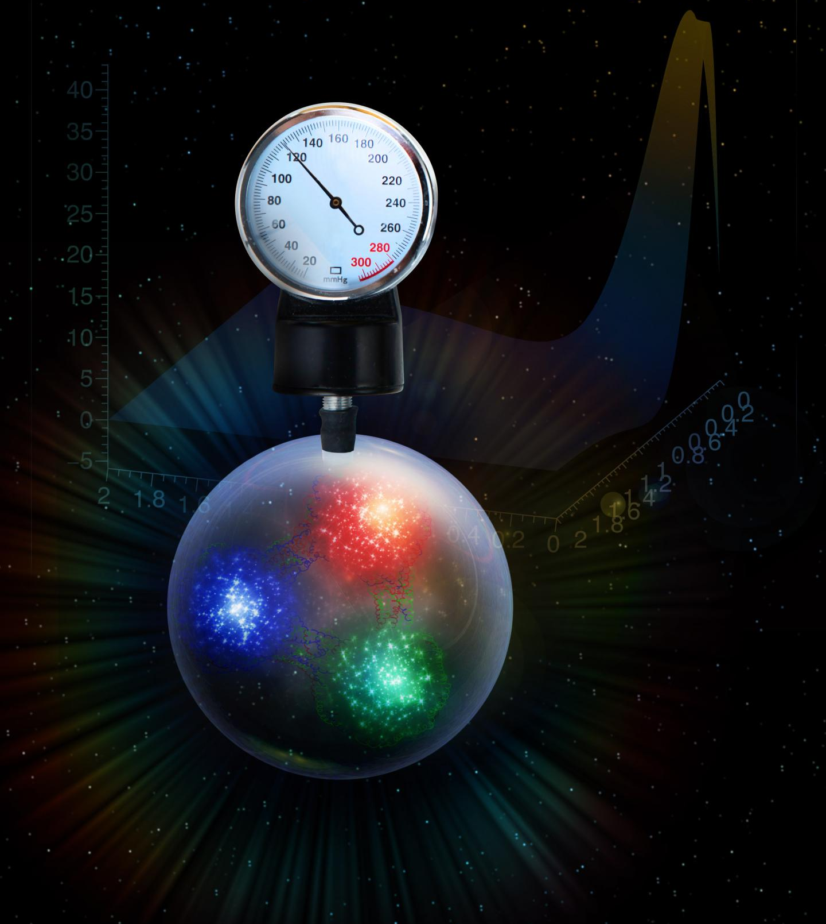
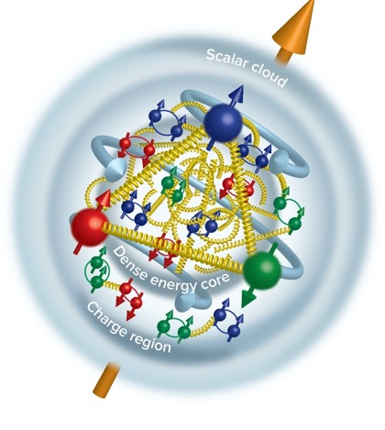
Fantastic Scientific Results!
MARATHON used mirror nuclei to assess neutron valence structure
Proton Radius: Nature 575, 147 (2019)
Phys. Rev. Lett. 128, 13, 132003 (2022)
Neutron radii measured by parity violating electron scattering – implications for neutron stars
Tangential stress force inside the proton changes direction near r ~ 0.45 fm
Peak: 38,000 N (4 metric tons)
“Determining the gluonic gravitational form factors of the proton," Duran et al, Nature 615, 813 (2023)
PREX-II PRL 126, 172502 (2021)
CREX Phys. Rev. Lett. 129, 4, 042501 (2022)
Burkert, V.D., et al., Gravitational form factors of the proton. Reviews of Modern Physics 95, 041002 (2023)

Slide 4
12 GeV CEBAF Program News
CEBAF Operations funding reduced by ~$6M in FY24 (relative to FY23), causing us to curtail operations; we will startup in early FY25 instead of August 2024.
Our ~30 week CEBAF Run completed with 75% reliablility; in the summer SAD now
We instituted a Hazardous Energy Control Lockout/Tagout pause in response to observed deficiencies in our program
Planning for ~26 weeks of CEBAF Operations in FY25
MOLLER Project CD-2/3 approval!
ESR2 Project met its KPP; commissioning nearly complete
CEBAF Performance Plan delivering refurbished cryomodules and higher gradient margin
Upcoming DOE CEBAF Operations Review is June 25-27, 2024

Slide 5
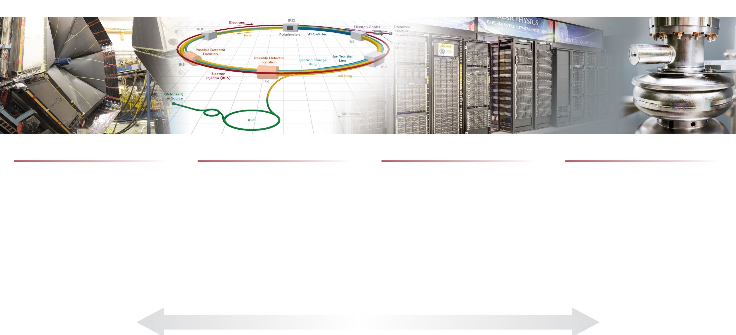
Jefferson Lab’s Science and Technology Vision
Nuclear Physics at CEBAF
Electron-Ion Collider
Computational Science &
Technology
Accelerator Science & Technology
Vibrant nuclear physics research program at CEBAF supporting ~1,900 annual users
MOLLER Project
Future opportunities complementary to EIC
Theory and computation supporting NP goals
Partnering with BNL in the management, design, and construction of the Electron-Ion Collider Project
Leadership in EIC scientific program
Leadership of the Generic EIC–related Detector R&D Program
Design, construction, operation of first-of-its-kind data-intensive computing facility: High Performance Data Facility
Building out data science, domain science capabilities in support of HPDF and to take advantage of HPDF
Accelerator component production for DOE construction projects partnering across the National Lab complex.
Develop CEBAF upgrade concepts
R&D in accelerator, detectors and applications in nuclear imaging and medicine
S&T thrusts are synergistic and mutually supportive
5

Slide 6
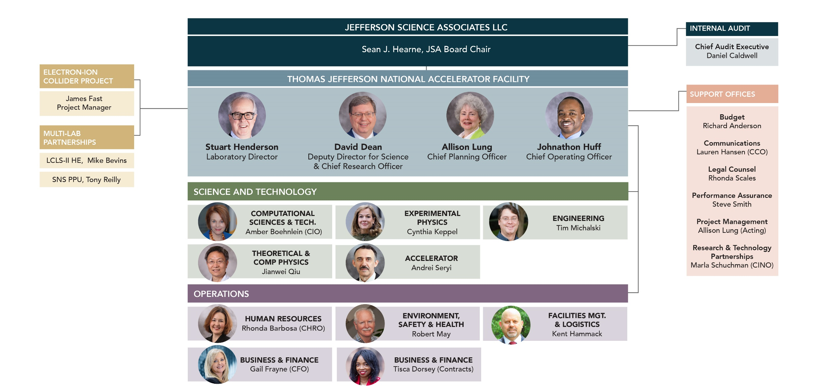
Jefferson Lab Organization and Leadership Team

Slide 7
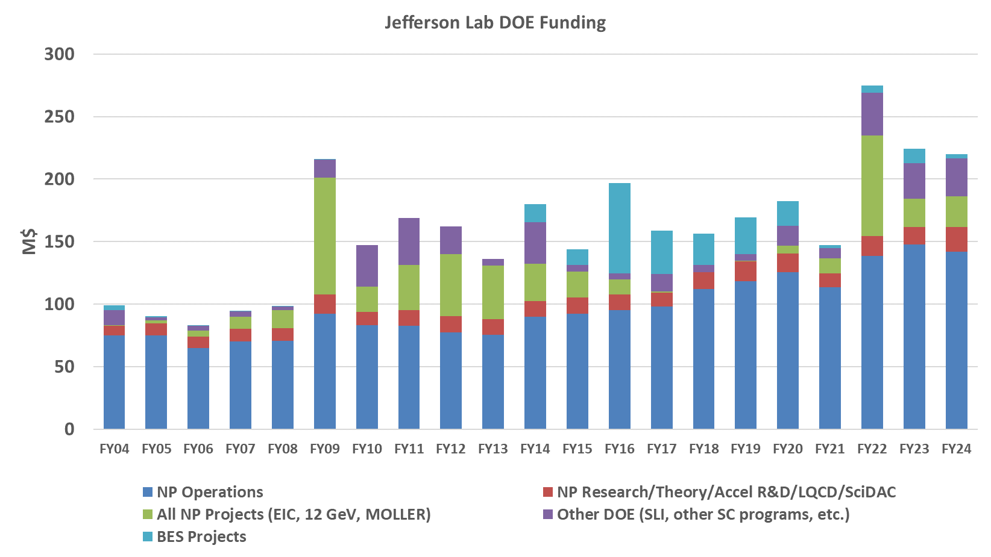
Jefferson Lab Funding and Staffing History

Slide 8
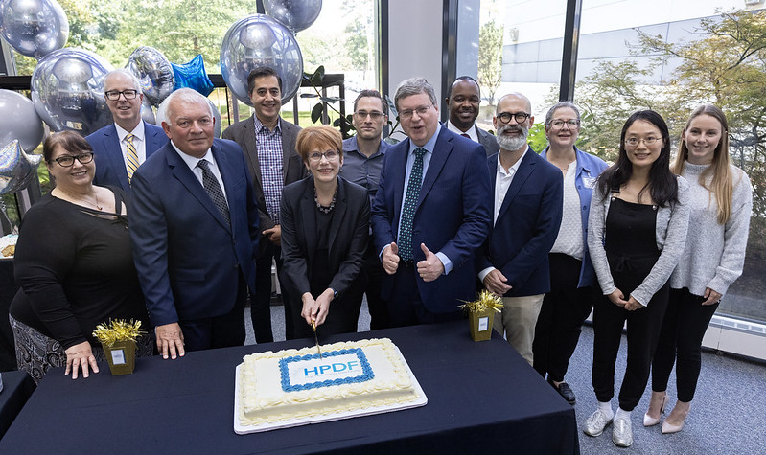

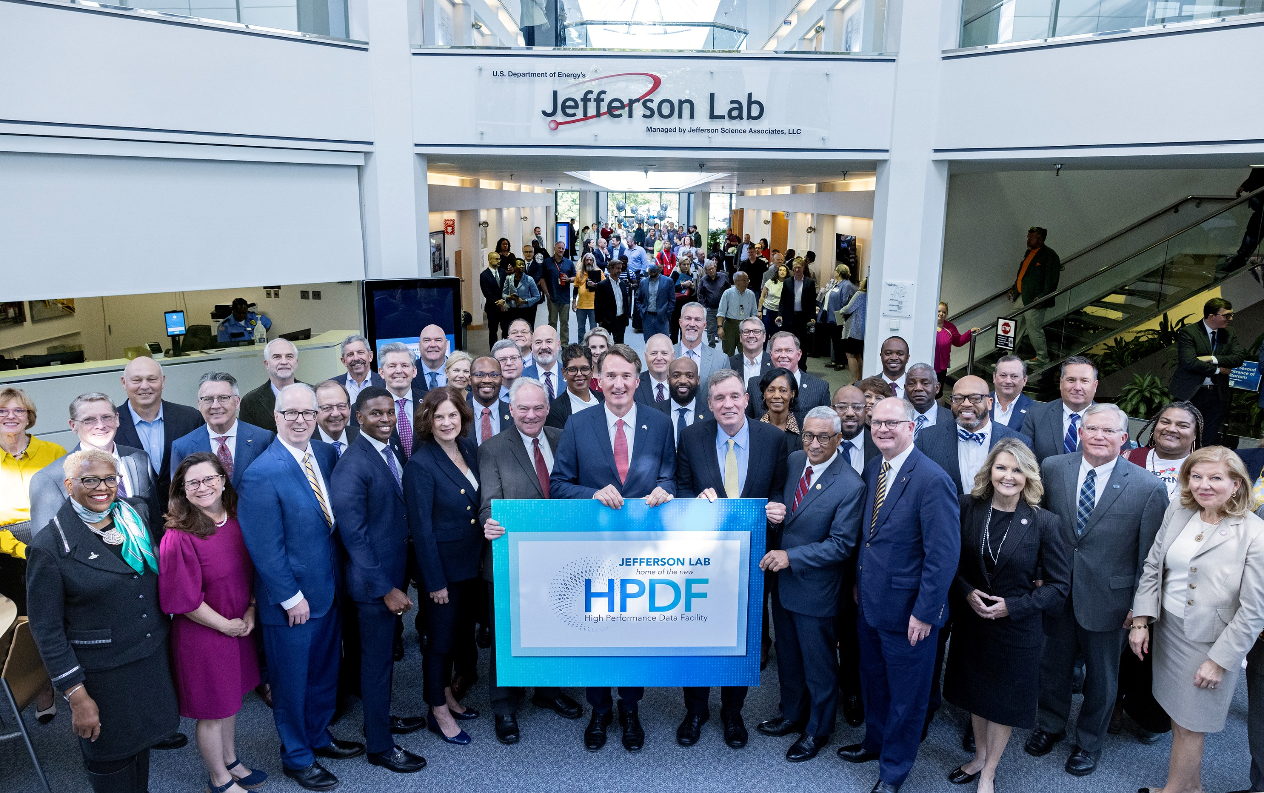
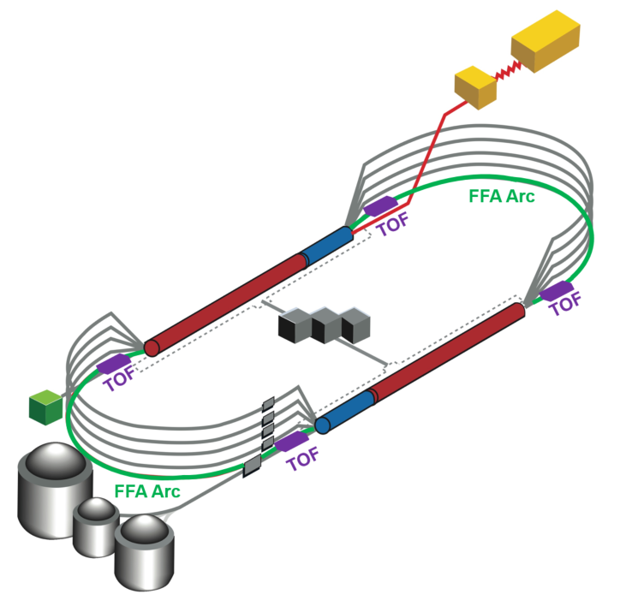
Jefferson Lab’s Future is Bright!
Jefferson Lab will design, build and host the High Performance Data Facility, in partnership with Lawrence Berkeley National Lab
Nuclear Science Long-Range Plan
12 GeV CEBAF Program, including SoLID
Electron Ion Collider
Future long-term opportunities with CEBAF: positron program and 22 GeV
8

Slide 9
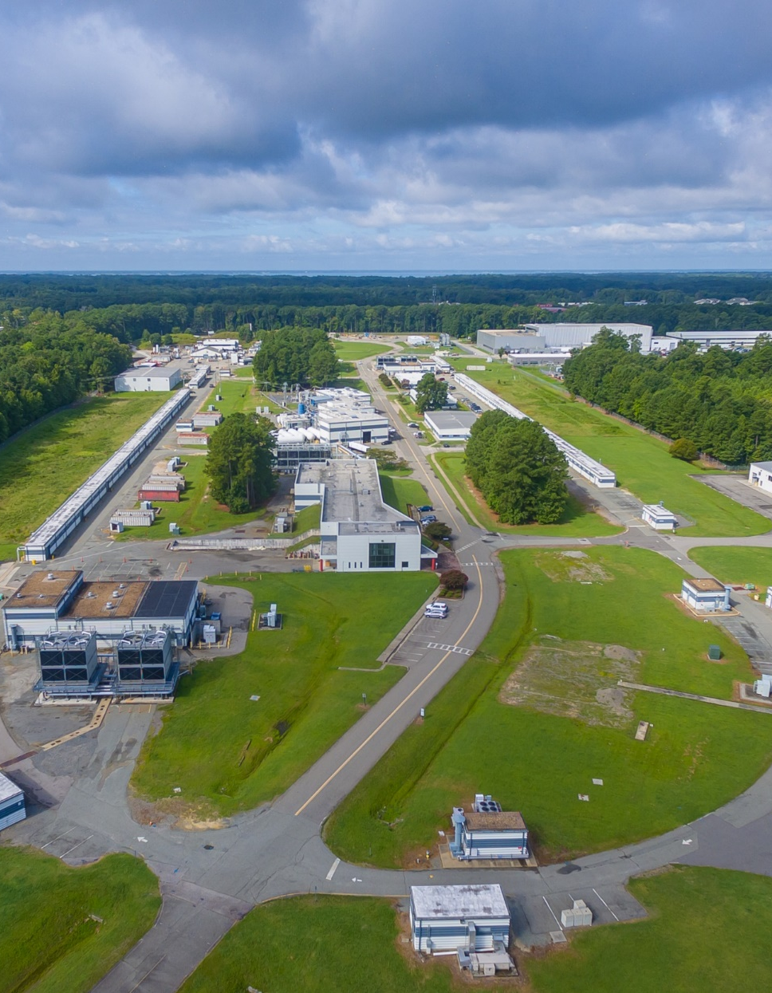
The Jefferson Lab of the Future
We are entering a new era at Jefferson Lab. We are facing a time of change and opportunity unprecedented since the Lab’s founding
We are reinventing Jefferson Lab
  to take on a more significant role with a diversified mission – with a goal of delivering even greater impact for the Nation
  with a goal of achieving a higher standard of performance in laboratory operations to better deliver on our mission
  to enable a multi-program future
This means changes across the board in how we operate and manage the Lab

Slide 10
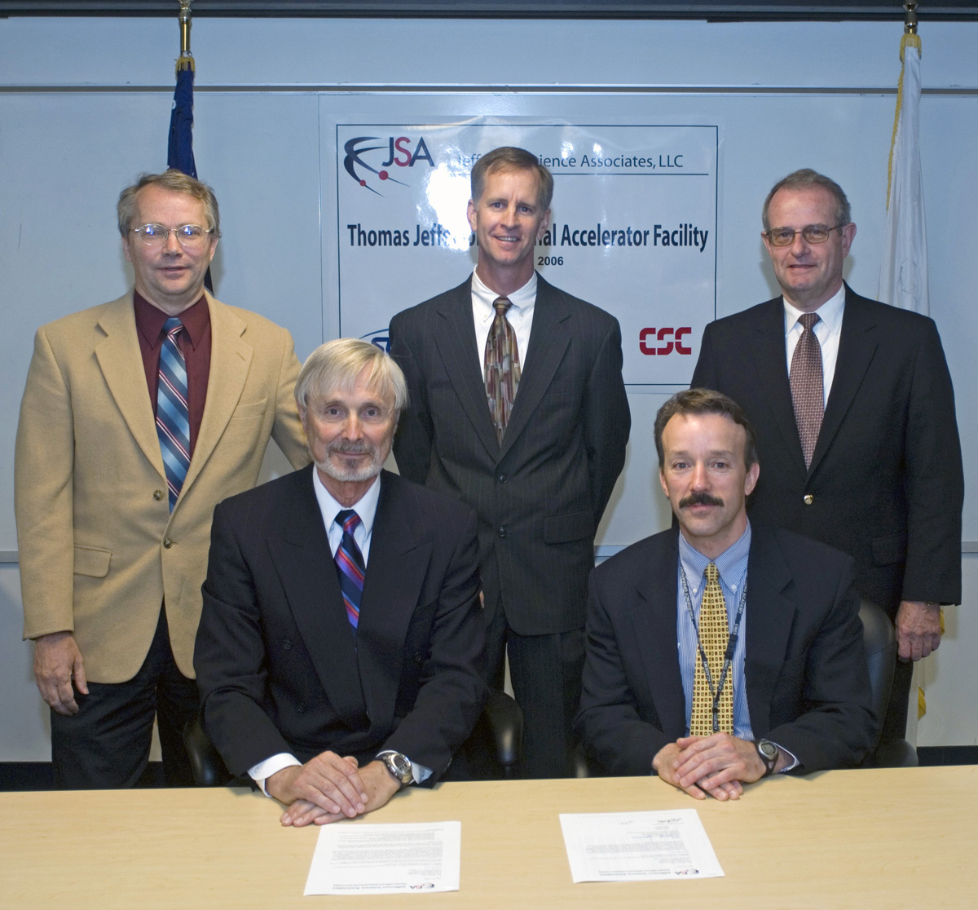
Management & Operations (M&O) Contract Competition
Jefferson Lab is a Government Owned-Contractor Operated (GOCO) Federally Funded Research and Development Center (FFRDC)
Jefferson Lab has been managed by:
  Southeastern Universities Research Association: 1984-2005
  Jefferson Science Associates: 2006-present
Most DOE National Labs’ M&O contracts are re-competed every ~20 years
Department of Energy announced intent to compete the M&O Contract for Jefferson Lab with a new contract in place on June 1, 2025
Next steps will be a Request for Proposals
SURA will respond with a Proposal
The next M&O contractor is expected to transition lab staff to the new employer so staff should not fear that their employment is in jeopardy
Contract signing ceremony on May 31, 2006

Slide 11
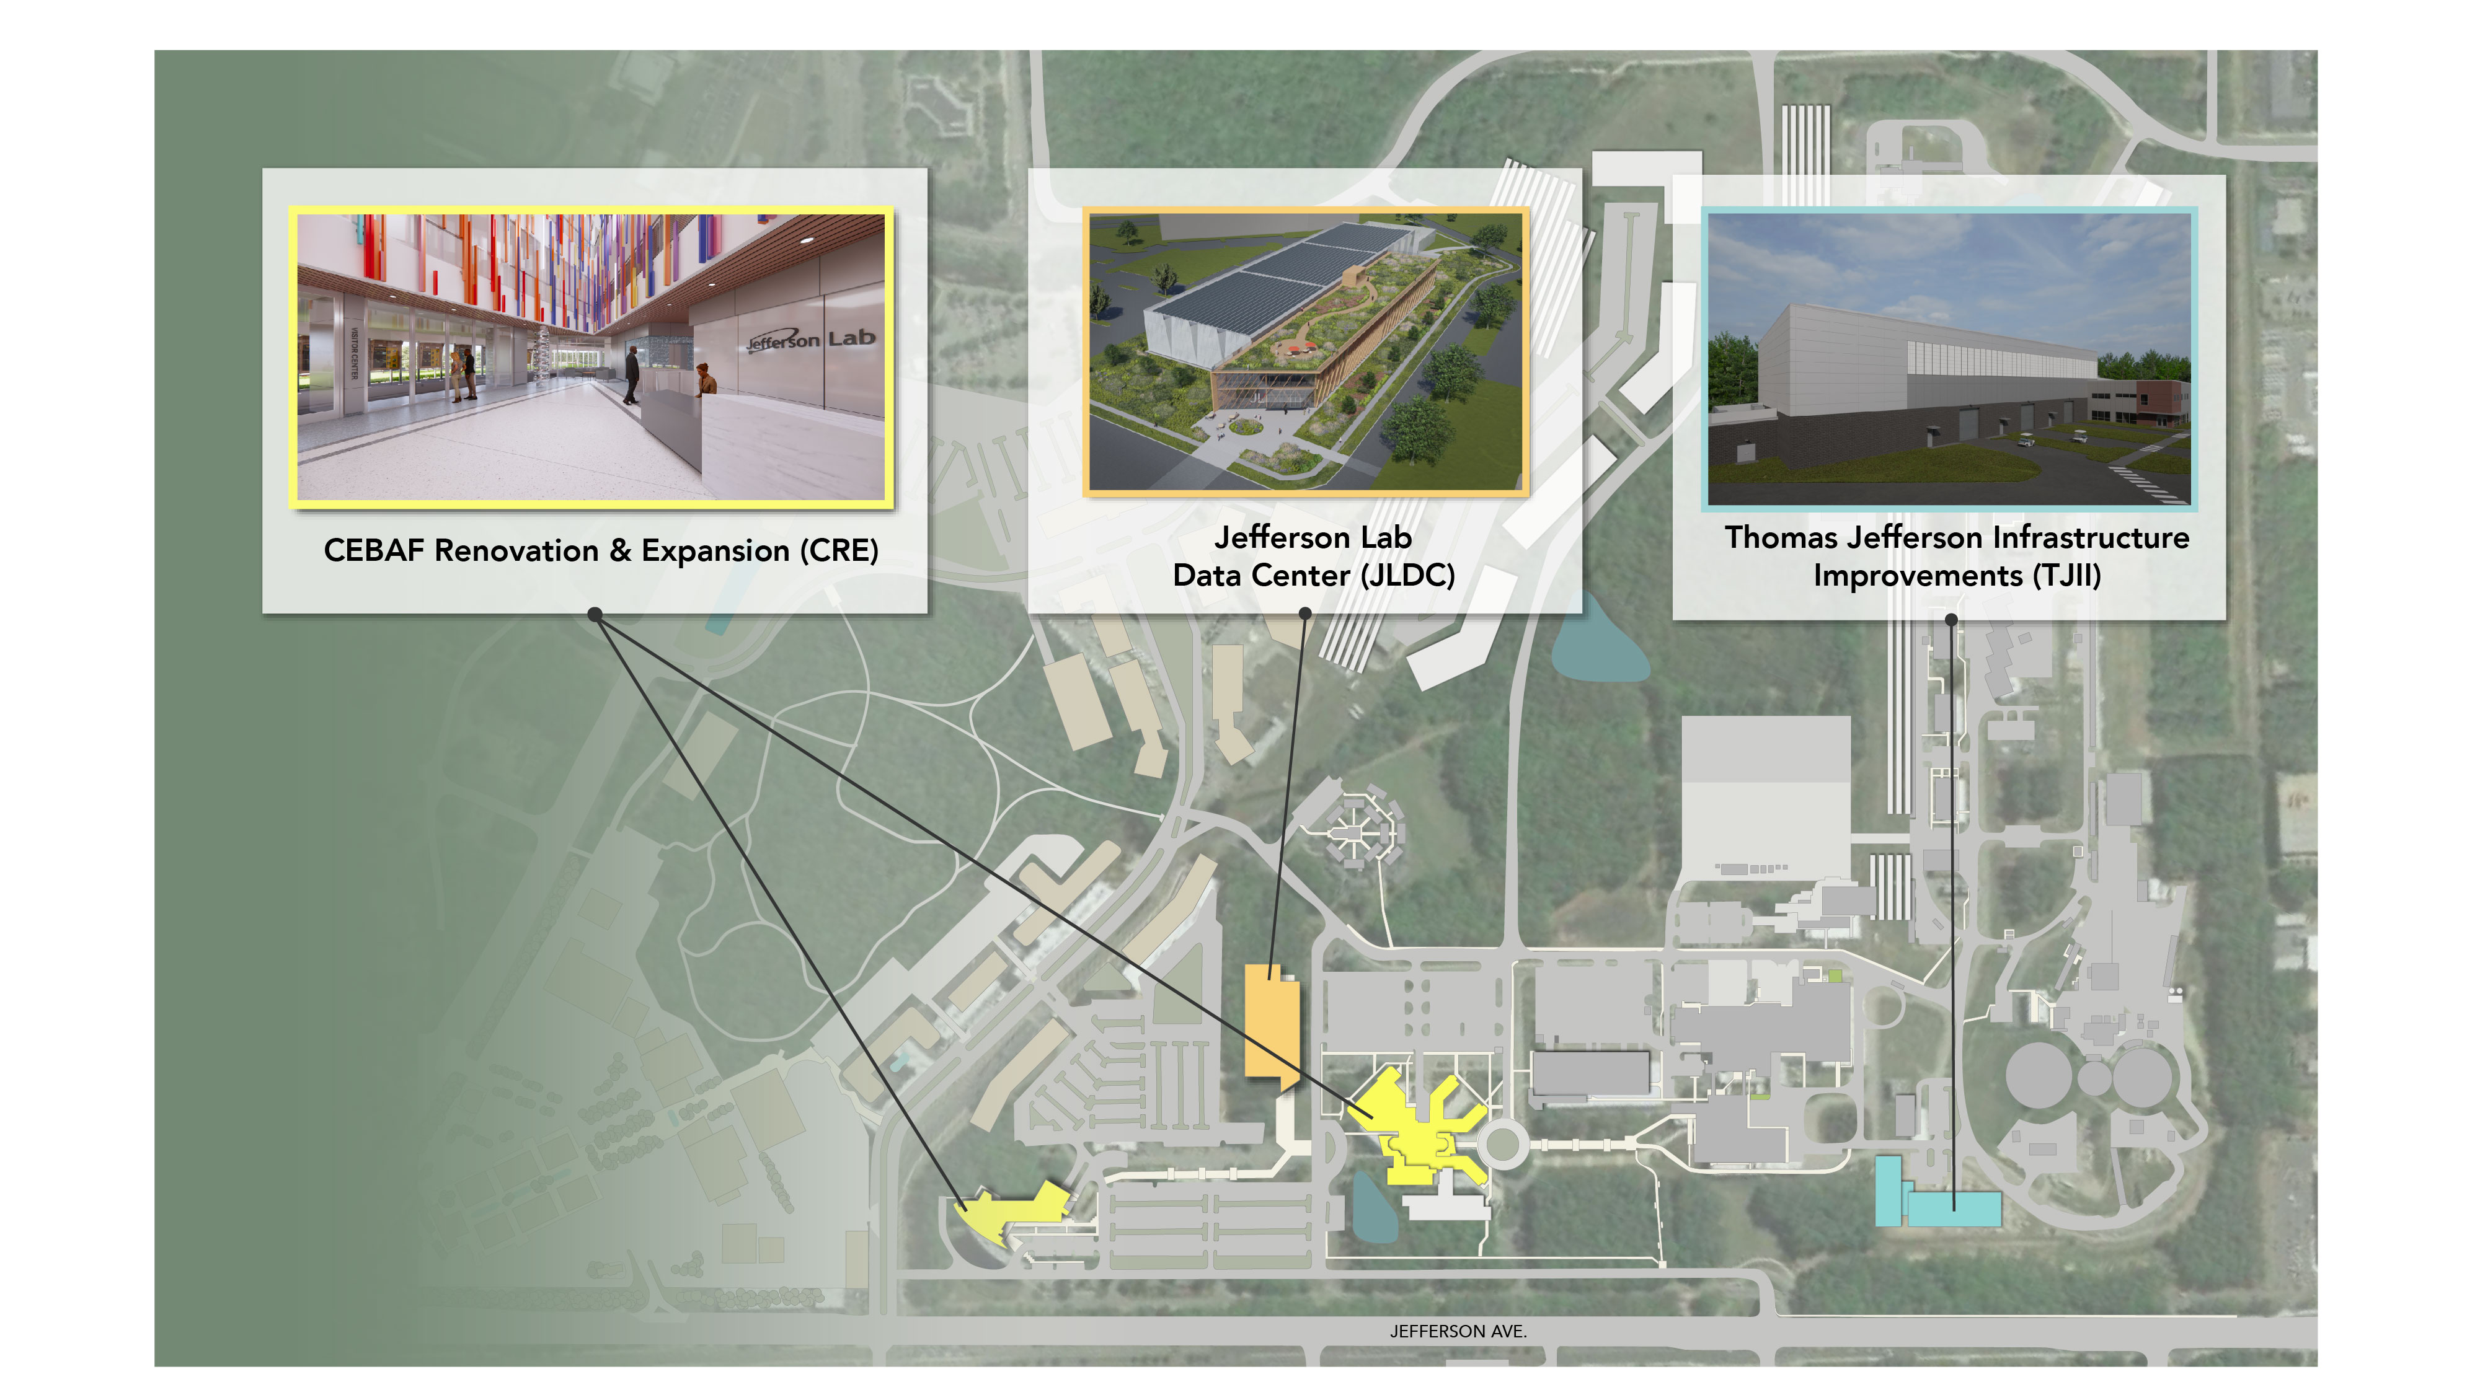
Evolution of our campus to deliver our expanded mission

Slide 12
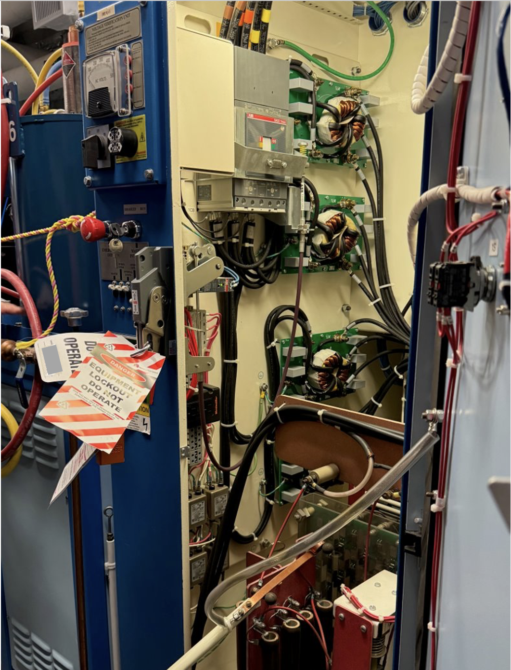
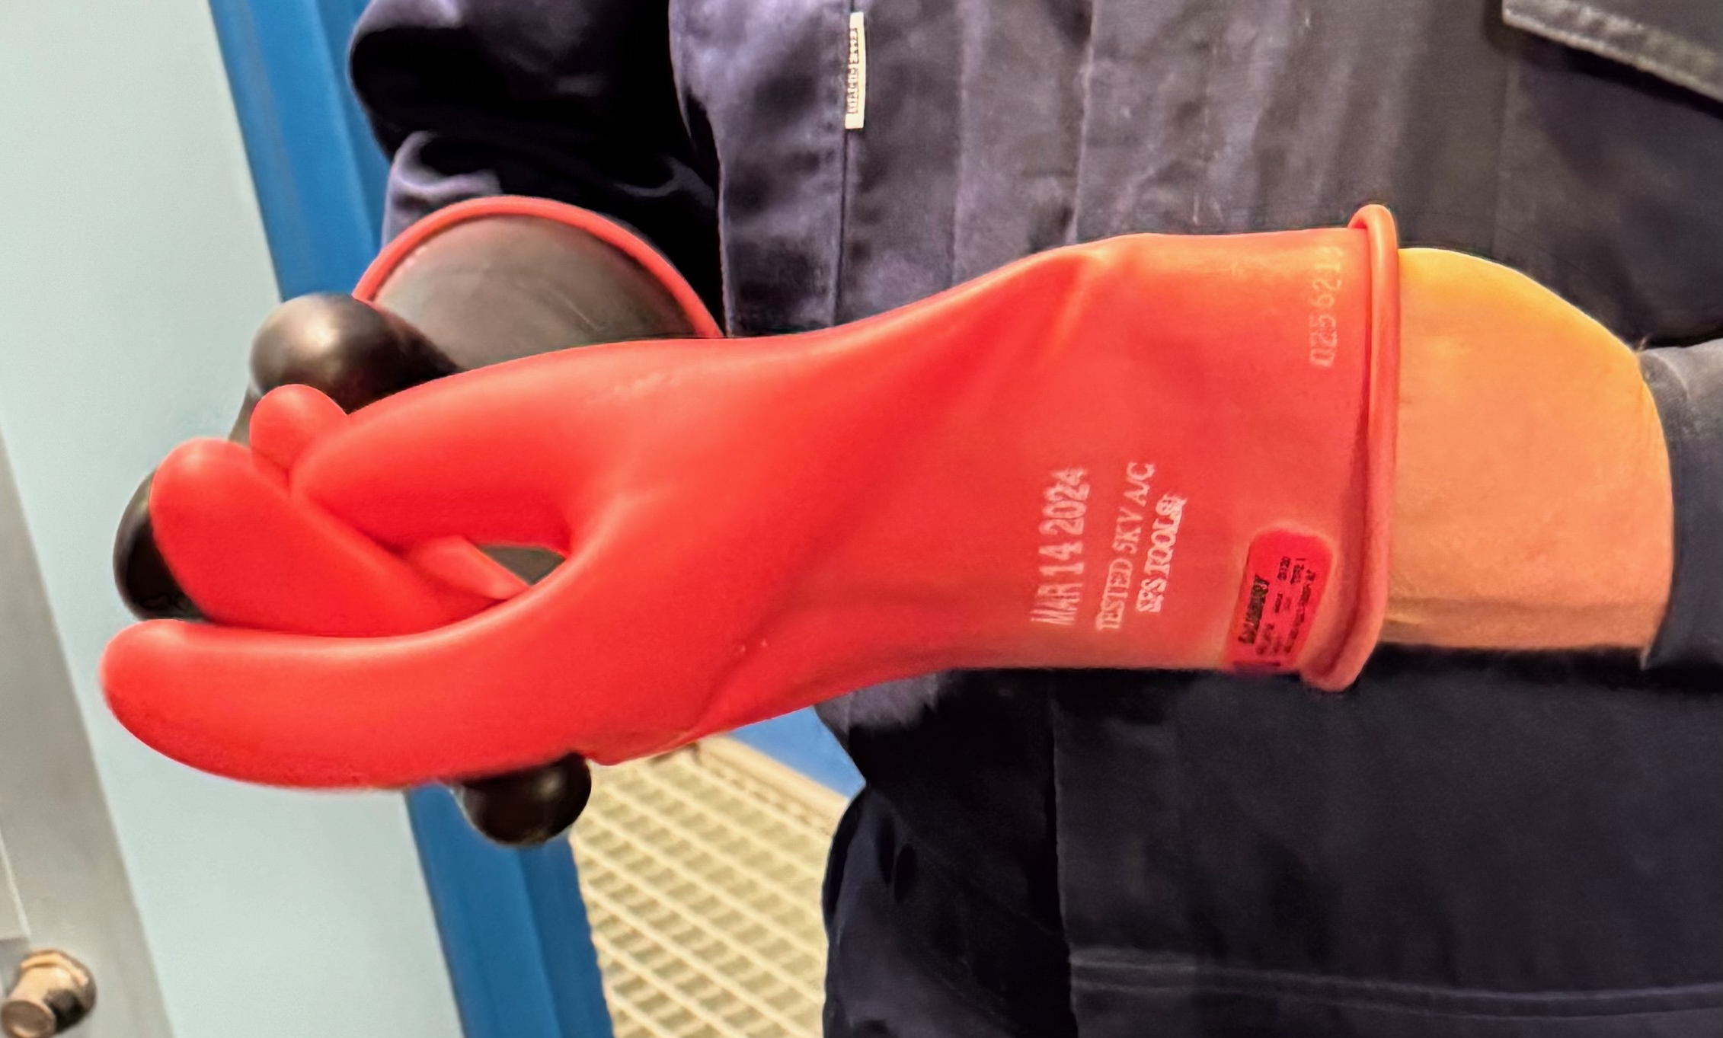
Recent Safety Events Demand our Collective Attention
We continue to struggle with significant safety lapses and challenges, particularly in Hazardous Energy Control
Observations from PROActive Peer Review highlighted gaps
  Lack of consistent pre-job briefings
  Lack of PPE or incorrect PPE for the job,
  Not using procedures
  Lack of processes to support successful execution of LOTO,
  Confusion and inconsistencies in ePAS utilization
Suggestions for improvement from independent Longenecker and Associates Review
  Ineffective task hazard analysis and work planning
  Ineffective job walkdowns and pre-job briefs,
  Improvement needed in overall safety knowledge and awareness across all levels
Because of particularly concerning observations, we have taken the step of pausing all HEC LOTO operations at Jefferson Lab pending competency evaluations
12

Slide 13
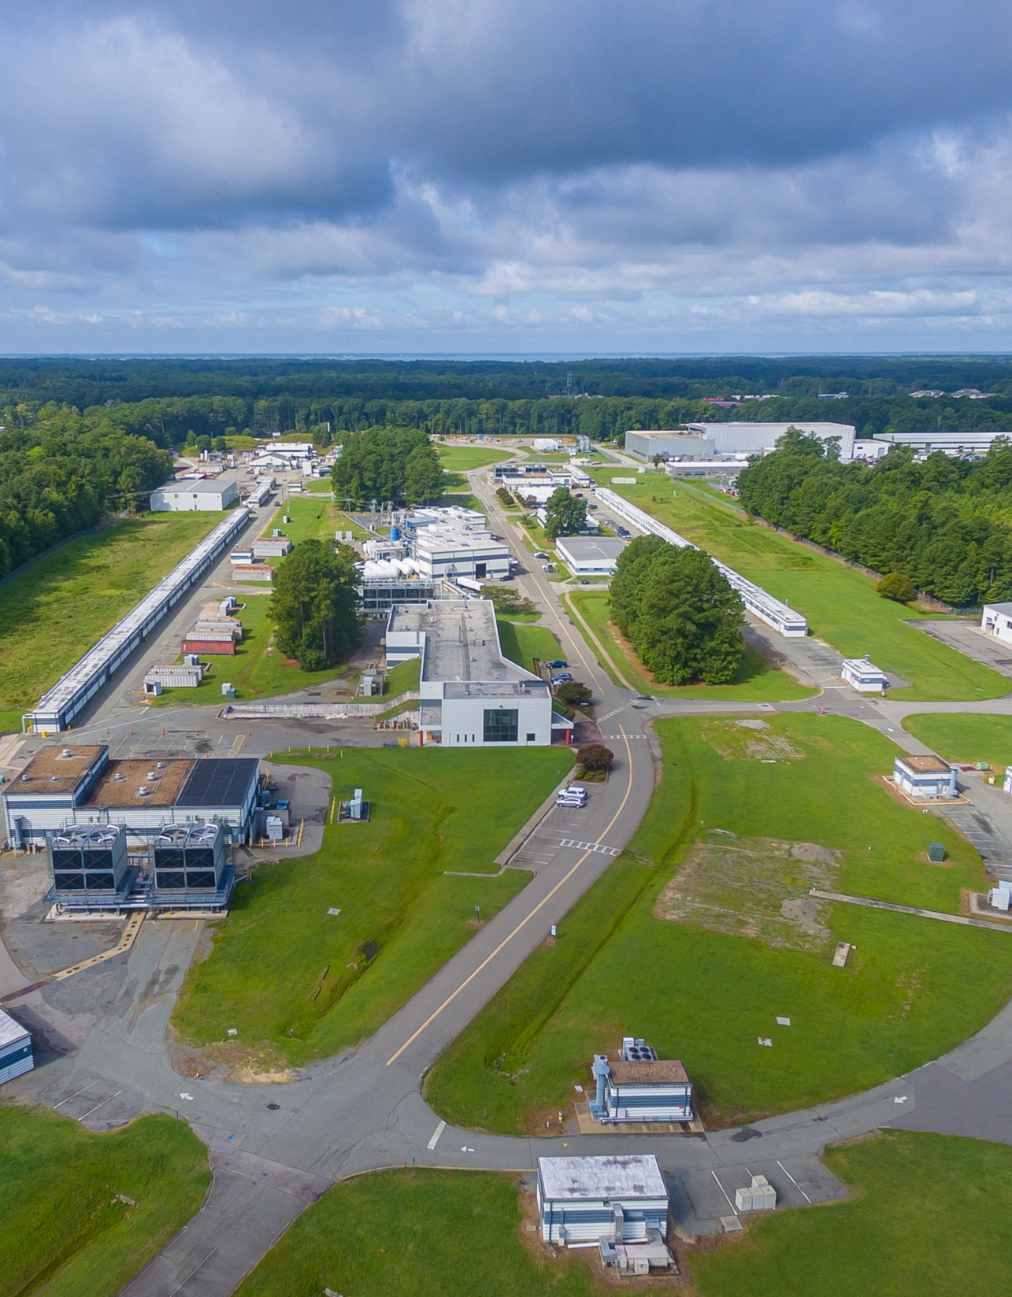
Perspective
We’re making excellent progress on our nuclear physics mission with exciting science ahead. Thank you!
Our priorities are clear:
  Ensuring that the 12 GeV program is successful in all facets
  Moving EIC forward aggressively
  Laying the groundwork for an exciting role for CEBAF in the EIC era
  Diversifying Jefferson Lab’s scientific mission with a significant role in Advanced Computing
Thank you for your continued enthusiasm and support for Jefferson Lab and your partnership in the lab’s future

