Slide 1
Simulation Study of W-ScFi Calorimeter for Pair Spectrometer Luminosity Detector at ePIC
Early Career Day – EICUG 2024 – Lehigh University
Aranya Giri
Relativistic Heavy Ion Lab
Department of Physics, University of Houston
Advisor – Prof. Rene Bellwied
Date - 22nd June, 2024

Slide 2
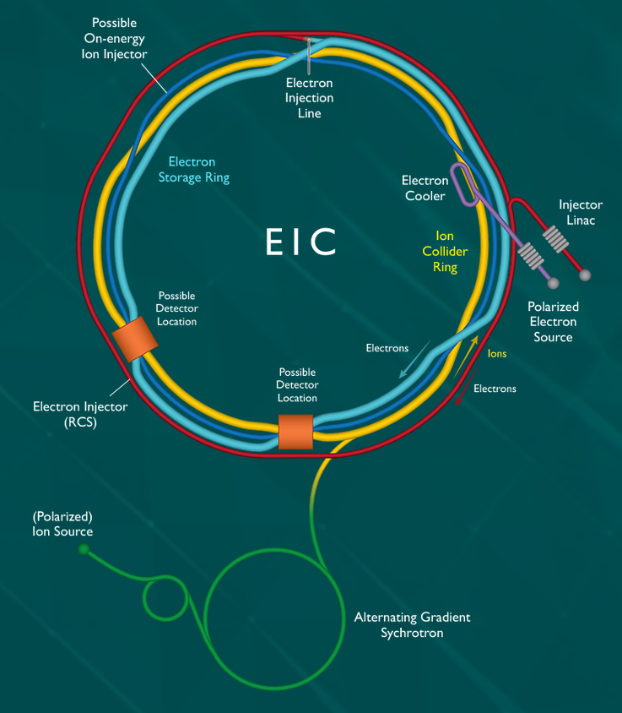
The Electron Ion Collider
Brookhaven National Laboratory ( BNL ), New York is the host site for the future Electron-Ion Collider (EIC).
First detector (experiment) is @ IP6, the electron Proton-Ion Collider (ePIC) experiment.
The collider and experiment is expected to commission at 2032.
Variable e-p COM energy range from ∼ 20 to 100 GeV, upgradable to ∼140 GeV.
High electron-nucleon luminosity.
arXiv.2103.05419
1

Slide 3
Luminosity
Luminosity is the maximum no. of collisions that can be produced in the collider
L = f N² / 4 πr²
Rate of any event during collision (R) = L · cross-section (σ) of the associated process
Precise measurement of L = Precise measurement of σ
Higher Luminosity = Higher rate to observe any physics processes
At EIC, precision ~ 1% & High Luminosity ~ 10³³⁻³⁴ cm⁻² s⁻¹
https://www.lhc-closer.es/taking_a_closer_look_at_lhc/0.luminosity
2

Slide 4
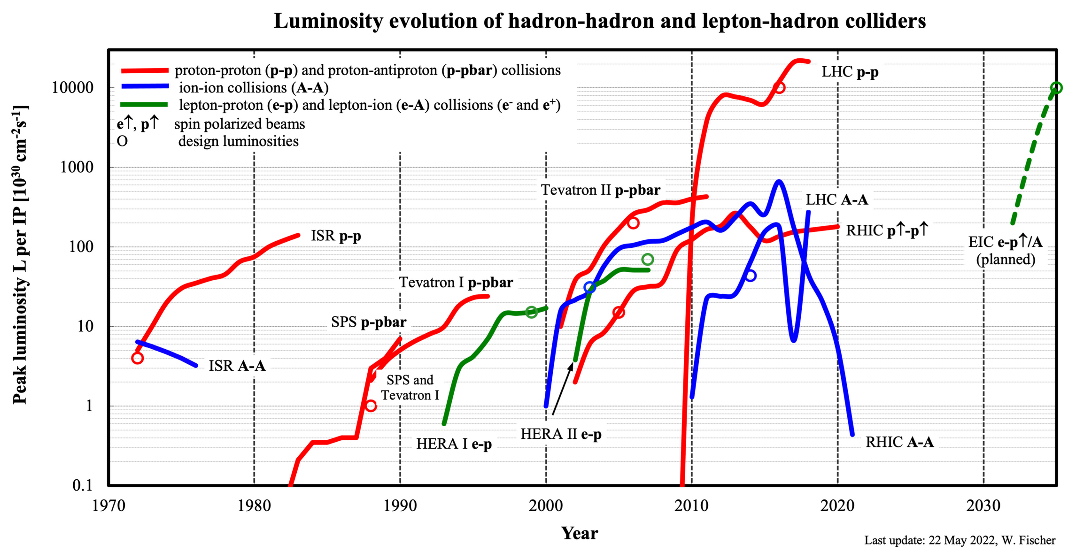
Luminosity Detector – Past to Future
The Forerunner ( precision of ~ 2% )
The Future !
[1] https://www.rhichome.bnl.gov/RHIC/Runs/
3

Slide 5
Luminosity Detector – Bremsstrahlung Process
HERA ( Forerunner of EIC ) measured luminosity via Bremsstrahlung (BH) radiation produced during collisions.
Radiation due to elastic scattering of electron near strong electric field ( p / Nu ).
Bremsstrahlung
Photons
θγ
E_{e} : Incoming e⁻ energy
E_{p} : Incoming p energy
E_{e}’ : Outgoing e⁻ energy
E_{p}’ : Outgoing p energy
1. High Rate ~ 4.7 MHz [2]
2. Precisely calculable cross-section from QED, Bethe-Heilter equation
3. Almost all produced BH γs are along e- beam direction, θγ ~ me / Ee
[1] https://arxiv.org/pdf/2106.08993.pdf
[2] http://www-library.desy.de/preparch/desy/1992/desy92-066.kek.pdf
4

Slide 6
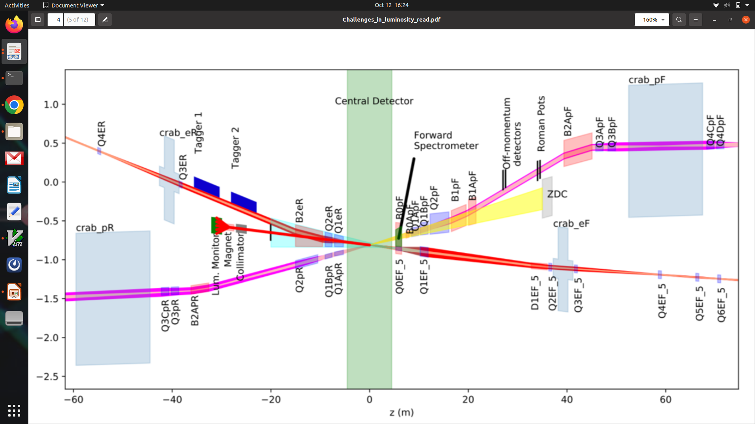
Interaction Region of ePIC at EIC
e⁻ beam
p or A beam
far-backward
far-forward
Fig: Schematic Diagram of ePIC interaction region
Measurement of bremsstrahlung photons
https://arxiv.org/abs/2103.05419
5

Slide 7
Interaction Region of ePIC at EIC
Low energy synchrotron radiation as major background
e⁻ beam
p or A beam
far-backward
far-forward
Fig: Schematic Diagram of ePIC interaction region
Measurement of bremsstrahlung photons
https://arxiv.org/abs/2103.05419
5

Slide 8
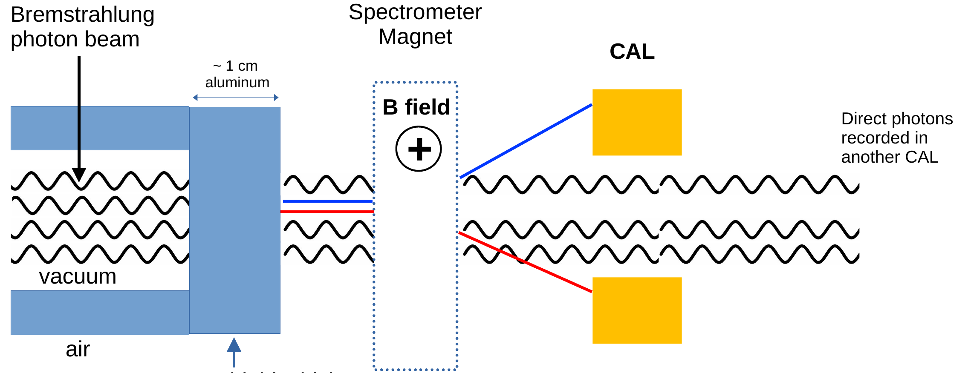
Pair Spectrometer Luminosity Detector
e⁻
y-axis
z-axis
e⁺
Fig. The base model of ePIC Pair Spectrometer Luminosity Detector
To measure LUMINOSITY !
L = R / σBH
6

Slide 9
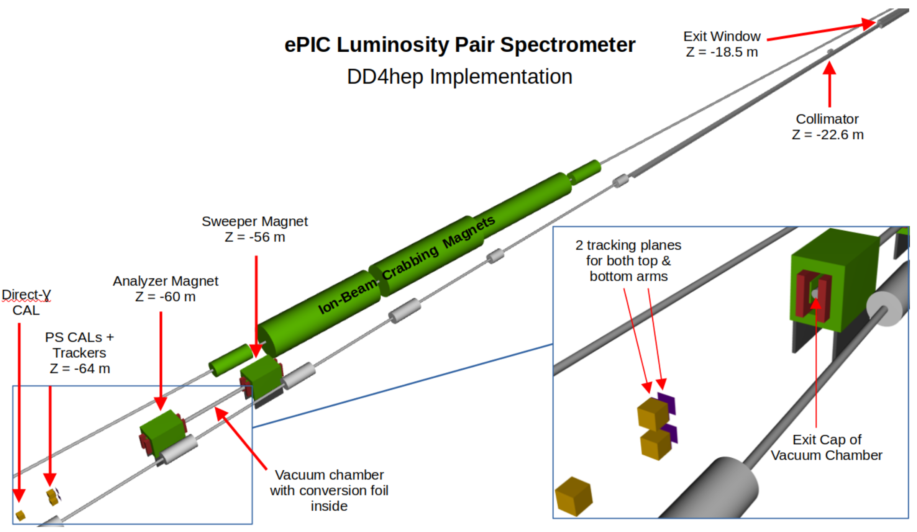
Pair Spectrometer Luminosity Detector
Interaction
Point
Fig. Current ePIC Luminosity Detector design with e⁻ and p beam pipes and magnets built by Dhevan G., Aranya G.
& Justin C. in DD4hep. The placement of different component not fixed, changes according to experimental needs.
https://arxiv.org/pdf/2106.08993.pdf
7

Slide 10
Calorimeter
Calorimeters completely absorbs the incident particle and measure its energy and position.
The incident particle initiates a particle shower. Each secondary particle deposits energy and produces further particles until the full energy is absorbed.
The composition and the dimensions of these showers depend on the type and energy of the primary particle (e±, photons or hadrons ) .
Fig. Shower generation by photon in EM CAL
8

Slide 11
W-ScFi Calorimeter
Requirements
Fairly good energy and position resolution.
Radiation Hard for compact size.
Low integration time (< 10 ns bunch spacing).
Track shower profile for improved pile-up
(multiple e⁻ hits) treatment.
A Electromagnetic Sampling Calorimeter
Passive “hard” material – Tungsten (W)
Active Absorber – Plastic Scintillating Fibers
The Volumetric Ratio of W : ScFi is 4:1
Layered Structure – Alternate layers have fiber
running parallel along X or Y direction.
Brass holders are used to keep the fibers uniform.
9

Slide 12
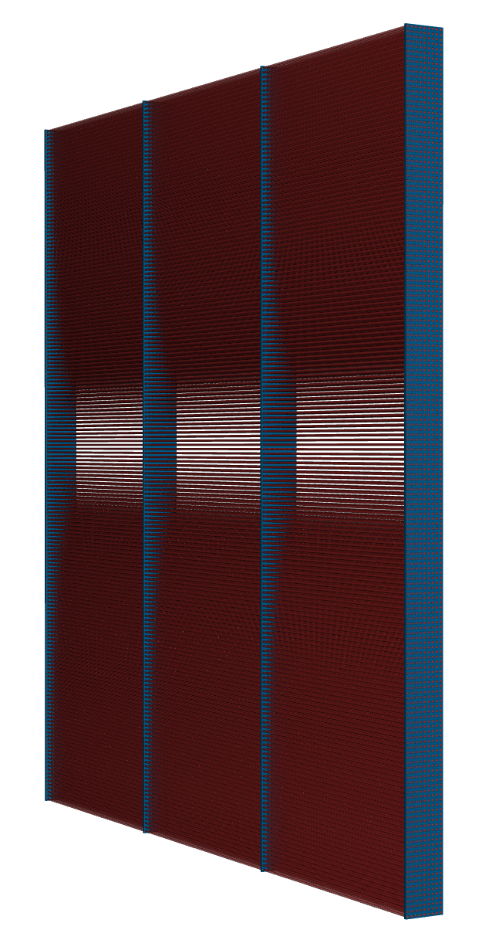
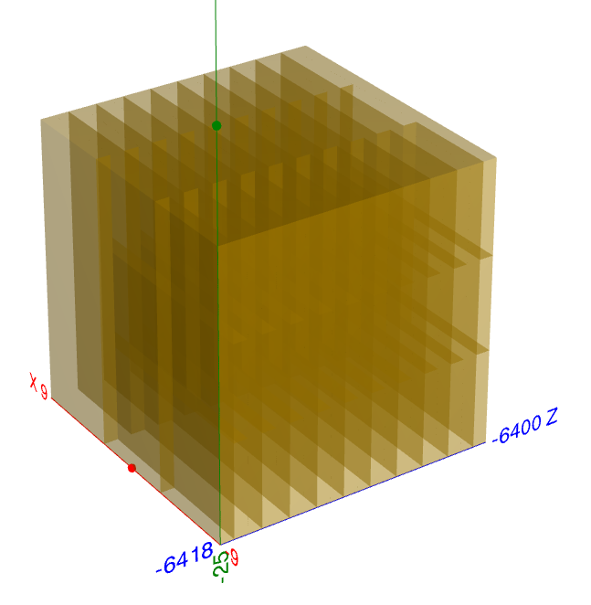
W-ScFi Calorimeter
Requirements
Fairly good energy and position resolution.
Radiation Hard for compact size.
Low integration time (< 10 ns bunch spacing).
Track shower profile for improved pile-up
(multiple e⁻ hits) treatment.
A Electromagnetic Sampling Calorimeter
Passive “hard” material – Tungsten (W)
Active Absorber – Plastic Scintillating Fibers
The Volumetric Ratio of W : ScFi is 4:1
Layered Structure – Alternate layers have fiber
running parallel along X or Y direction.
Brass holders are used to keep the fibers uniform.
x-axis
y-axis
z-axis
Fig. W-SciFi calorimeter built in DD4hep
Fig. X|| layer in CAL

Slide 13
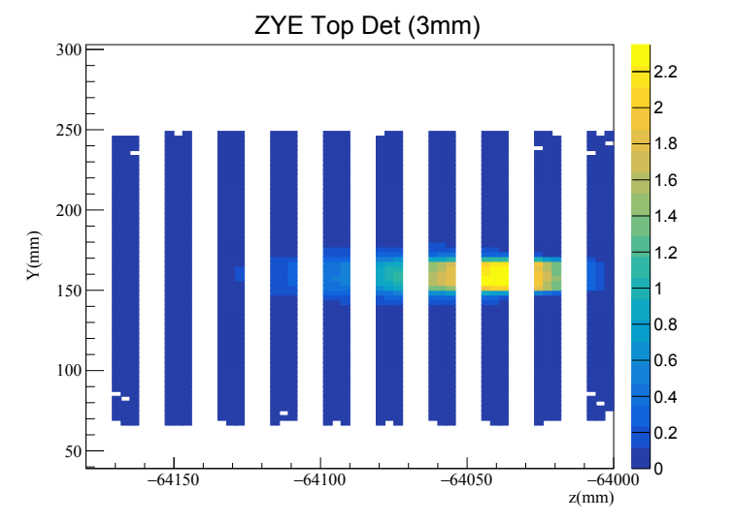
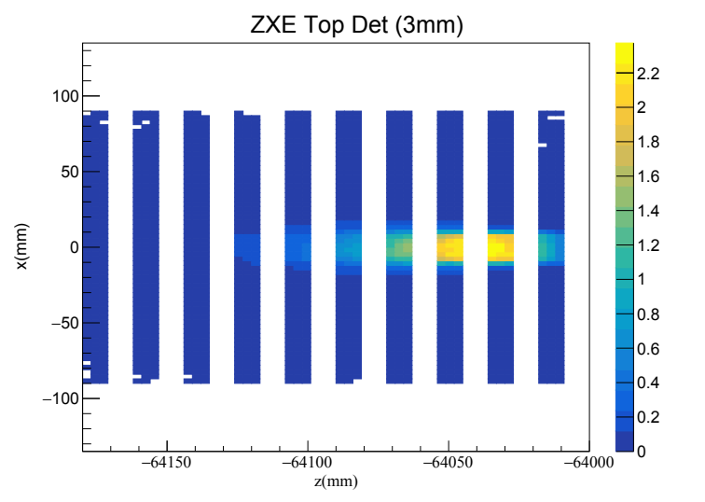
W-ScFi Calorimeter
Y-Z shower profile from X|| layer
e⁻
x-axis
y-axis
X-Z shower profile from Y|| layer
z-axis
e⁻
Fig. W-SciFi calorimeter built in DD4hep
Fig. X|| layer in CAL

Slide 14
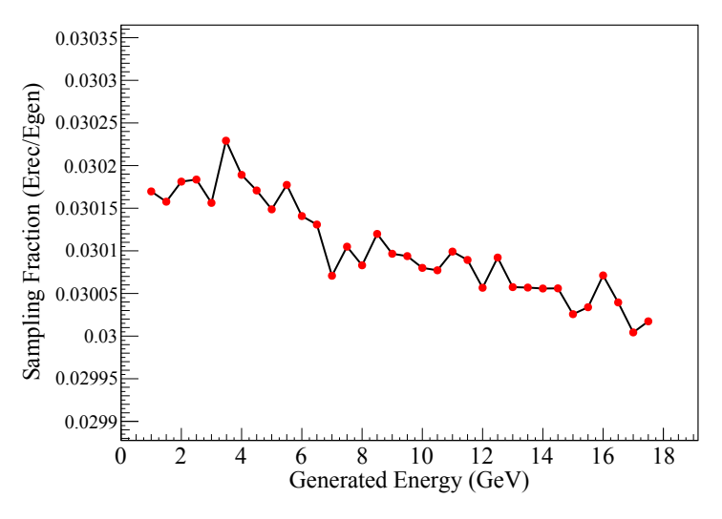
Simulation Results – Sampling Fraction
Sampling Fraction is ~ 3% and independent of incident particle energy
12
σ²/E² = a²/E² + b²/E + c²
σ²/E² = a²/E² + b²/E + c²
σ²/E² = a²/E² + b²/E + c²

Slide 15
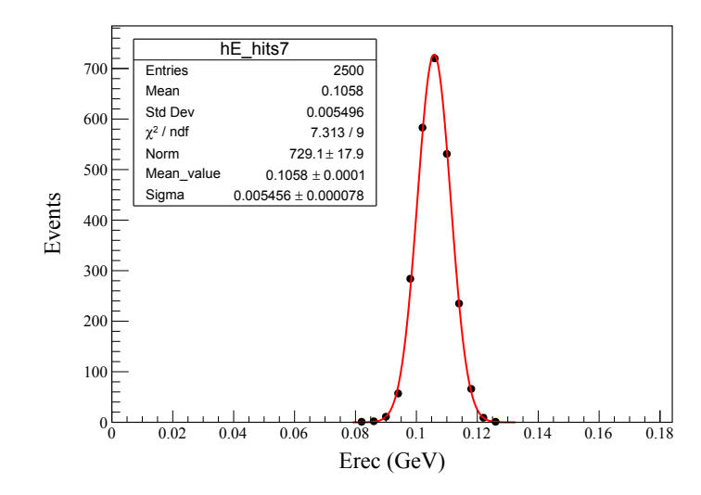
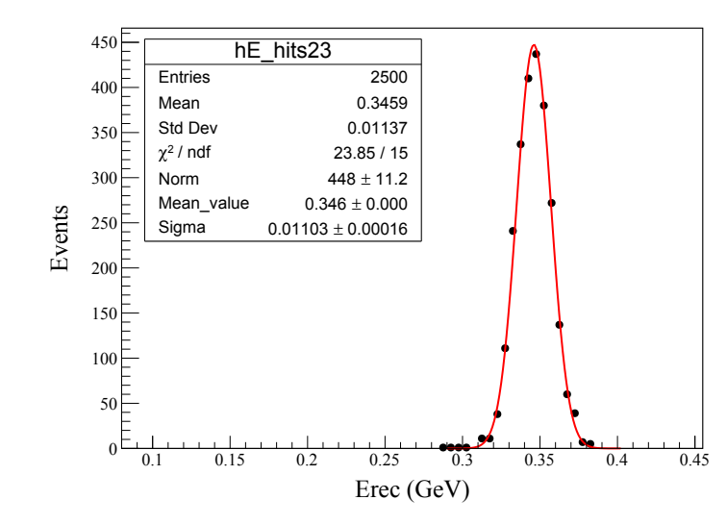
Simulation Results – Energy Resolution
e⁻
Electron Gun Parameters:
Vx = Uniform(-1.0, 1.0)
Vy = Uniform(14.9, 15.9)
Vz = -6388 cm
θ = Uniform(-.25º, 2.5º)
φ = Uniform(-.25º, 2.5º)
Egen = 3.5 GeV
Egen = 11.5 GeV
For each generated energy (0.5, 18.0) GeV, the reconstructed energy distribution is fitted with Gaussian distribution.
The fit parameters, mean (Erec) and sigma is used to calculate energy resolution.
Z = -6400 cm
13
σ²/E² = a²/E² + b²/E + c²
σ²/E² = a²/E² + b²/E + c²
σ²/E² = a²/E² + b²/E + c²

Slide 16
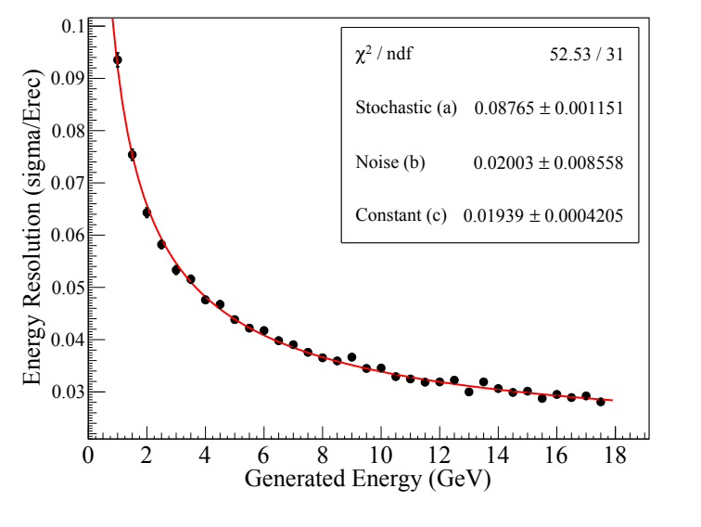
Simulation Results – Energy Resolution
σ²/E² = a²/E + b²/E² + c²

Slide 17
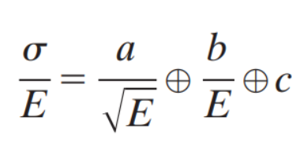
Simulation Results – Energy Resolution
Energy resolution of a calorimeter is determined by fluctuations in the processes by which energy is deposited and measured.
σ²/E² = a²/E + b²/E² + c²
Respective terms in the equation :
Stochastic (a): Includes the event-by-event fluctuations of shower development in calorimeter. ( 8.8%/√E(GeV) )
Noise (b): From the electronic noise of the readout chain and depends on the detector technique and on the features of the readout circuit. ( 20 MeV )
Constant (c): From non-uniformity, like from imperfections in the detector mechanical structure and readout system, from temperature gradients, from the detector aging, from radiation damage, etc. ( ~ 0 )

Slide 18
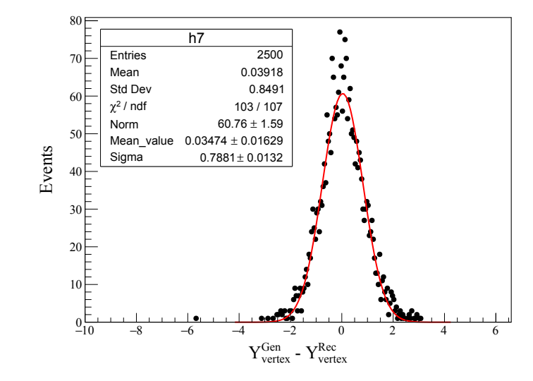
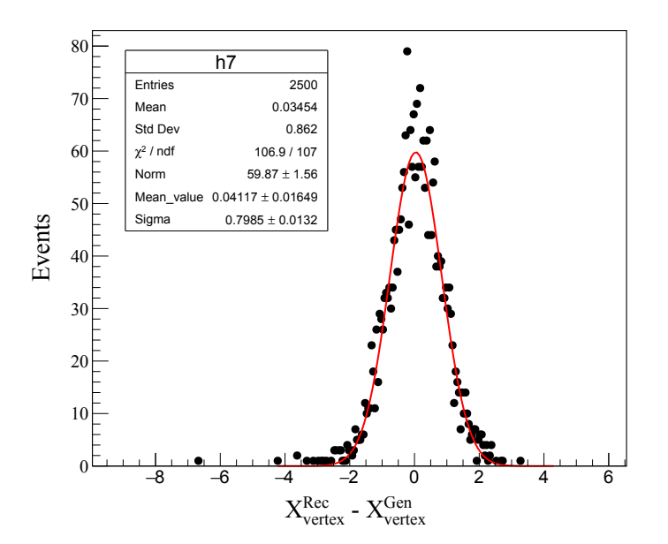
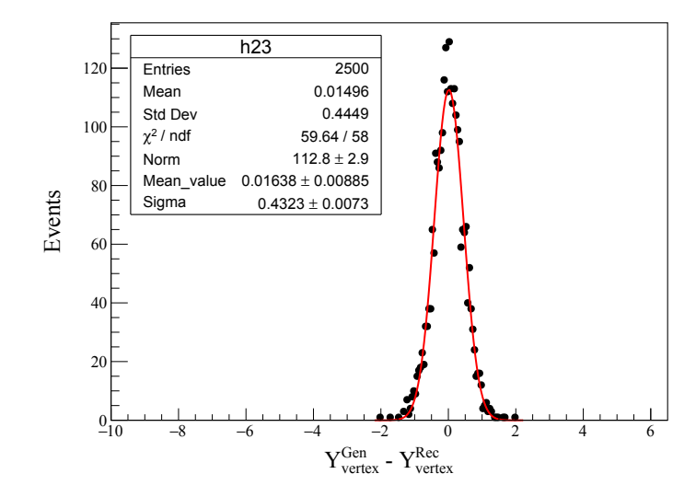
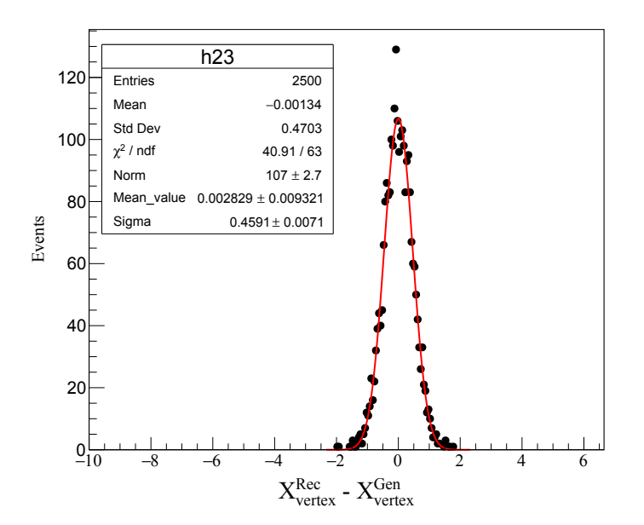
Simulation Results – Position resolution
Egen = 3.5 GeV
Egen = 3.5 GeV
For each generated energy (1.0, 18.0) GeV, the (reconstructed – generated ) vertex distribution is fitted with Gaussian distribution.
The fit parameters,
sigma is used to calculate position resolution.
Mean ideally should be equal to zero but deviations was observed.
Egen = 11.5 GeV
Egen = 11.5 GeV
*Position measurements are in centimeters
17
σ²/E² = a²/E² + b²/E + c²
σ²/E² = a²/E² + b²/E + c²
σ²/E² = a²/E² + b²/E + c²

Slide 19
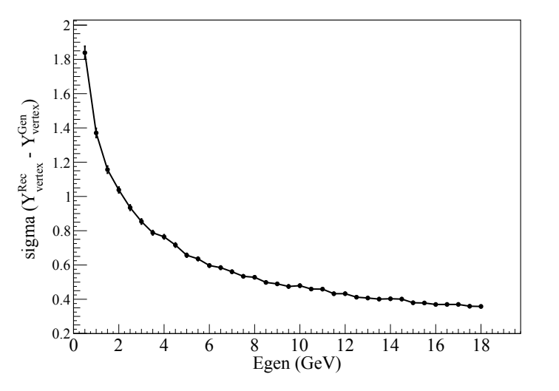
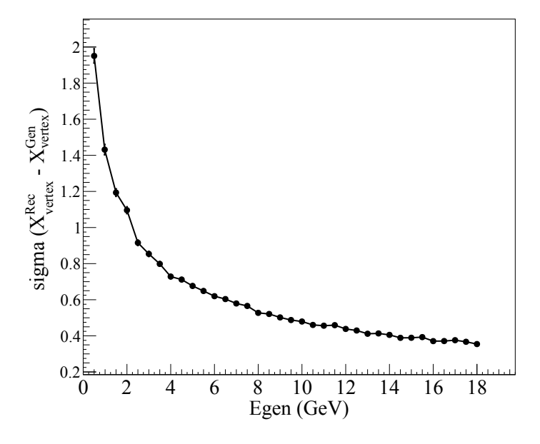
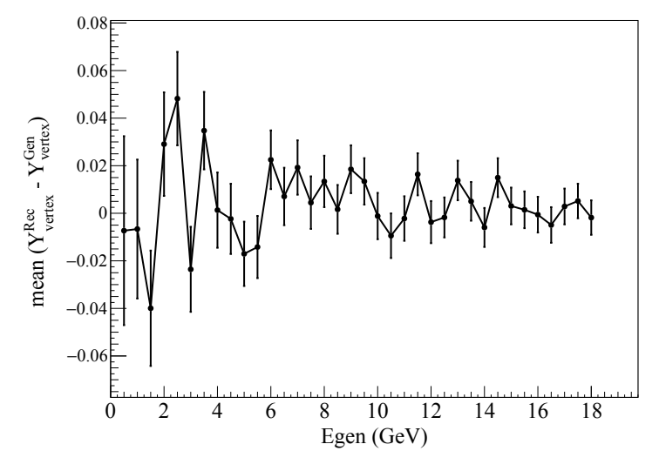
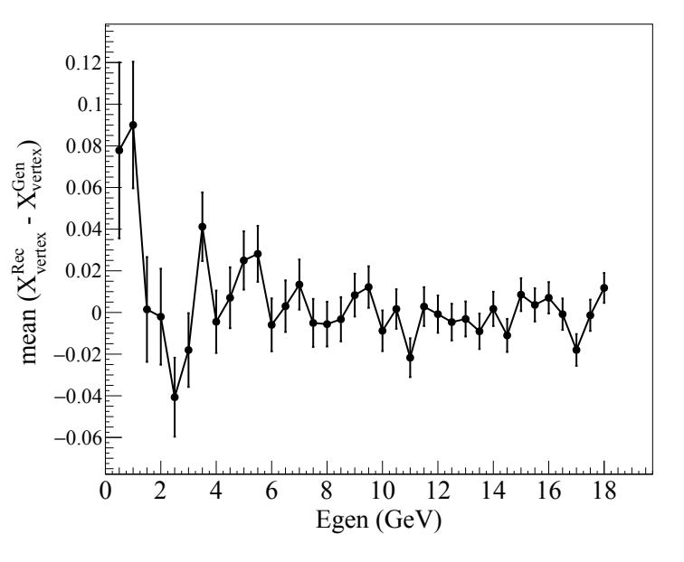
Simulation Results – Position Resolution
Both x or y resolution is inversely proportional to energy of incident particle.
Position resolution increases as the energy increases.
The mean should ideally be 0 but for both x & y shows max deviation of about 0.06 cm.
*Position measurements are in centimeters
18
σ²/E² = a²/E² + b²/E + c²
σ²/E² = a²/E² + b²/E + c²
σ²/E² = a²/E² + b²/E + c²

Slide 20
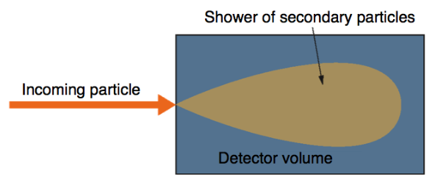
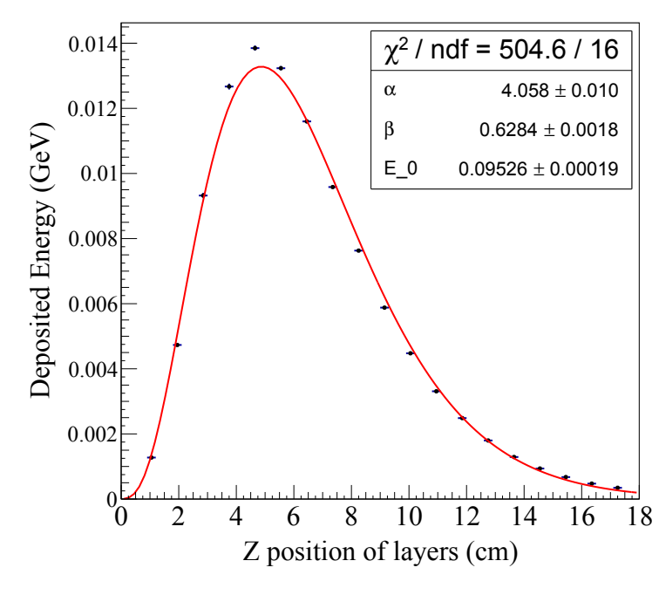
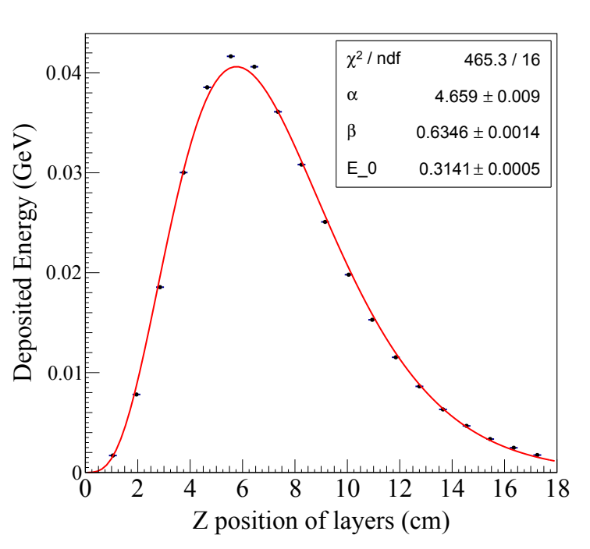
Simulation Results – Radiation Length
Radiation length (X0) of a calorimeter is the longitudinal distance where energy of shower becomes 1/e times the incident energy.
Depends on material of calorimeter.
X0
For each generated energy (1.0, 18.0) GeV, the deposited energy distribution along longitudinal direction (z) is fitted with Gamma distribution.
Egen = 3.5 GeV
Egen = 11.5 GeV
19
σ²/E² = a²/E² + b²/E + c²
σ²/E² = a²/E² + b²/E + c²
σ²/E² = a²/E² + b²/E + c²

Slide 21
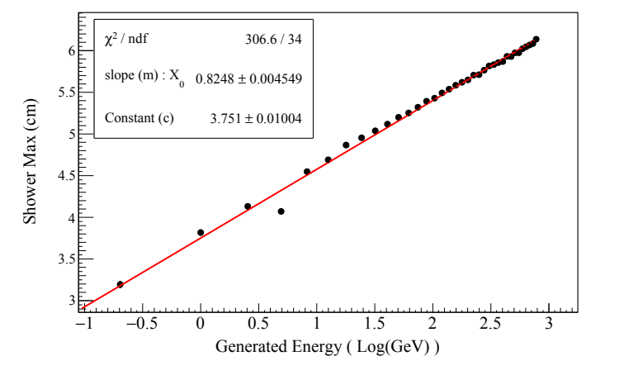
Simulation Results – Radiation Length & Shower Depth
The fit parameters, alpha and beta is used to calculate zmax = (ɑ -1)/β, the location where maximum energy is deposited.
zmax = X0 ( log(Egen) + c) , X0 = 0.8248 cm
Shower Depth – Longitudinal depth of calorimeter in terms of X0 : ( 18 cm / 0.8248 cm ) = 22X0
20
σ²/E² = a²/E² + b²/E + c²
σ²/E² = a²/E² + b²/E + c²
σ²/E² = a²/E² + b²/E + c²

Slide 22
Simulation Results – Moliere Radius
Energy 3.5 GeV
Energy 11.5 GeV
rm
rm ~ 1.4 cm
Moliere radius (rm) is the radius of a cylinder containing on average 90% of the shower's energy deposition.
Depends on the material of calorimeter.
20

Slide 23
Conclusion
Design of W-ScFi calorimeter of Pair Spectrometer Luminosity Detector at EIC for ePIC experiment.
It has been successfully implemented DD4hep for simulation.
Characteristics of calorimeter like energy resolution, position resolution, radiation length
& Moliere radius is studied.
Future Work
To study effect of radiation damage in the calorimeter.
Study optical parameters of scintillating fiber.
Beam test with first prototype build with collaborators at York University, UK
21

Slide 24
Thank You

Slide 25
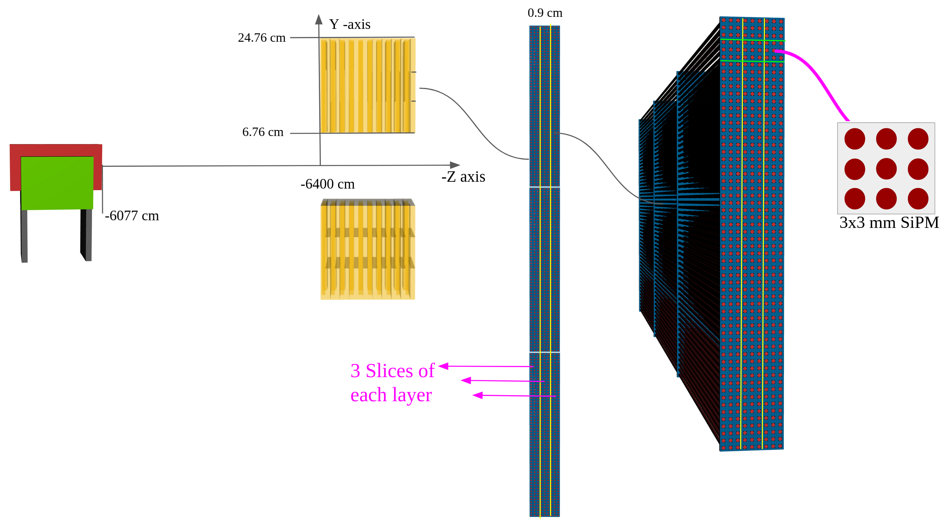
Simulation Results – Position Resolution
Electron Gun Parameters:
Vx = Uniform(-1.0, 1.0)
Vy = Uniform(14.9, 15.9)
Vz = -6388 cm
θ = Uniform(-.25º, 2.5º)
φ = Uniform(-.25º, 2.5º)
e⁻
15

Slide 26
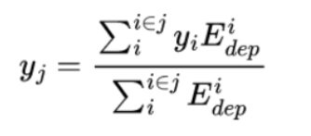
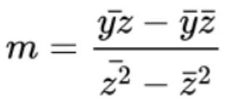
Simulation Results – Position Resolution
Energy deposition (Edep_i) in 9 fibers of each SiPM is associated with a position, pos_i where i = {SiPMs}
The center of SiPM is the associated position , Pos_i = { x_center or y_center } depending on layer.
For a slice say j, in Suppose X|| layers, the mean y_j is
y_center
Find the mean position in each slice
y-axis
SiPM from X|| layers
x-axis
o o o o o o o o o o
SiPM from Y|| layers
x_center
16

