Slide 1
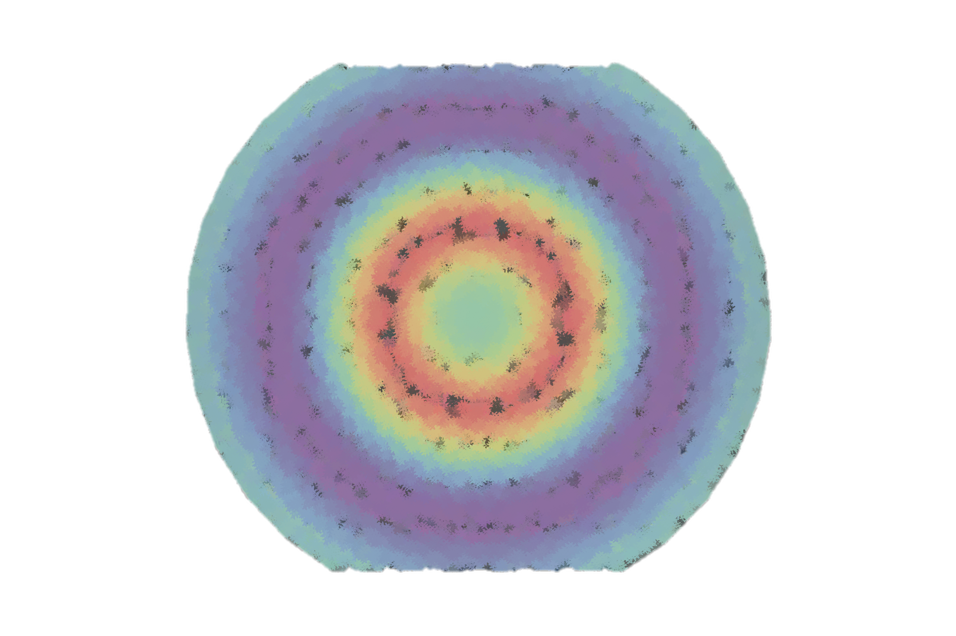
Accessing The strange mechanical structure of the proton at the EIC
erhtjhtyhy
STRANGE
Henry Klest
EICUG EC Workshop
July 2024

Slide 2
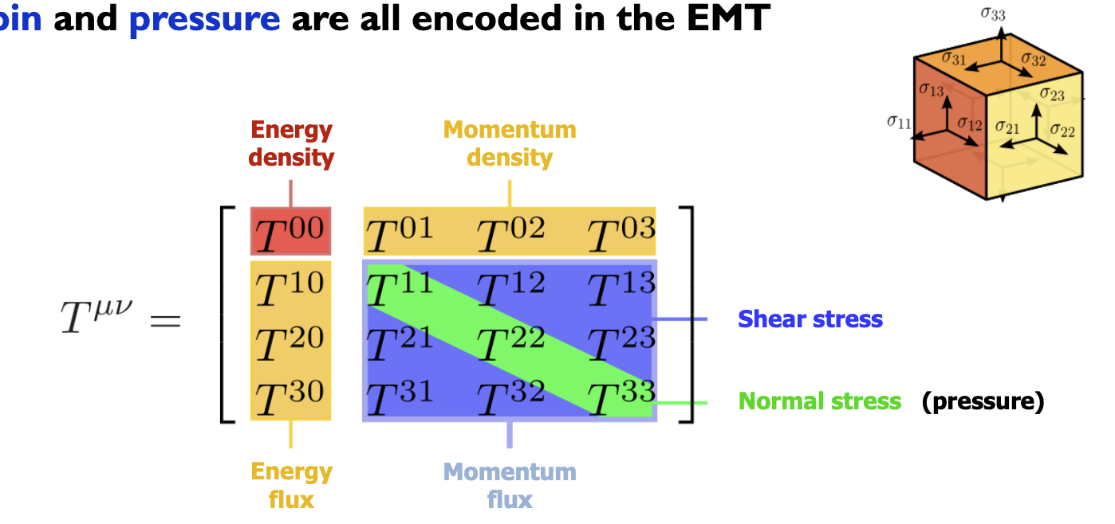
Energy momentum tensor

Slide 3
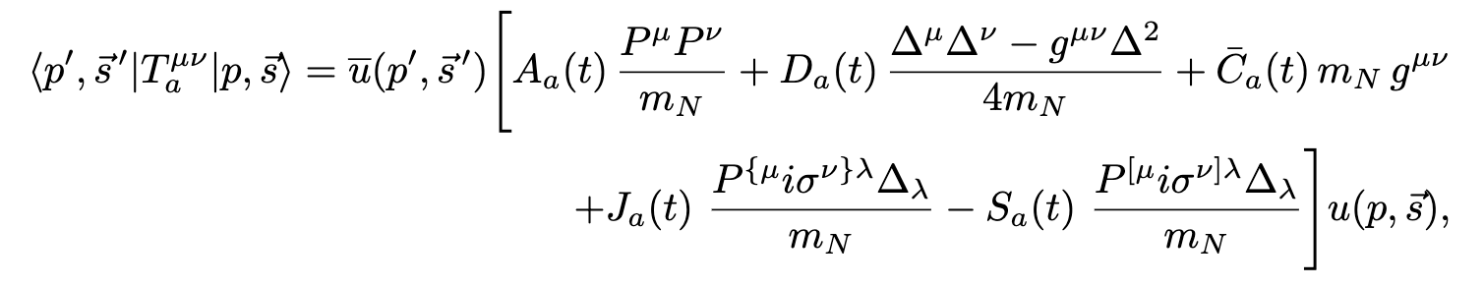
Motivation
Proton gravitational form factors (GFFs) encode information about the matrix elements of the QCD energy-momentum tensor
This messy equation is just an informed parameterization of the terms in the QCD EMT
Spiritually similar to e.g. the Wolfenstein parameterization of the CKM matrix

Slide 4
Motivation
Proton gravitational form factors (GFFs) encode information about the matrix elements of the QCD energy-momentum tensor
Form factors
Fourier transforms of t distributions

Slide 5
Motivation
Proton gravitational form factors (GFFs) encode information about the matrix elements of the QCD energy-momentum tensor
Form factors
Fourier transforms of t distributions
“Gravitational”
Describing the energy-momentum tensor
I.e. what would be seen from proton-graviton scattering

Slide 6
Motivation
Proton gravitational form factors (GFFs) encode information about the matrix elements of the QCD energy-momentum tensor
D-term at zero momentum transfer (t = 0) represents a fundamental property of the proton, on par with charge, spin, and mass!

Slide 7
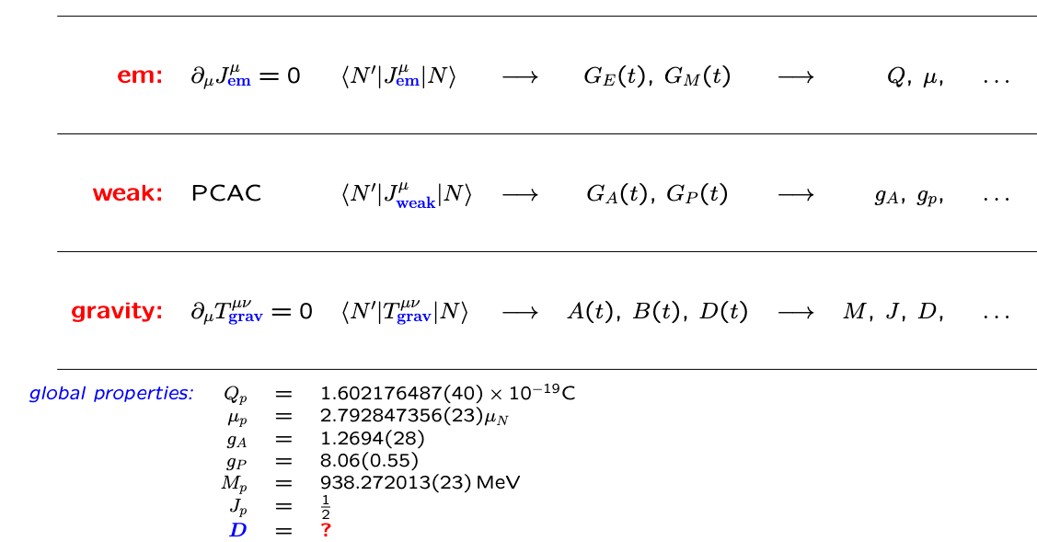
Slide of P. Schweitzer

Slide 8
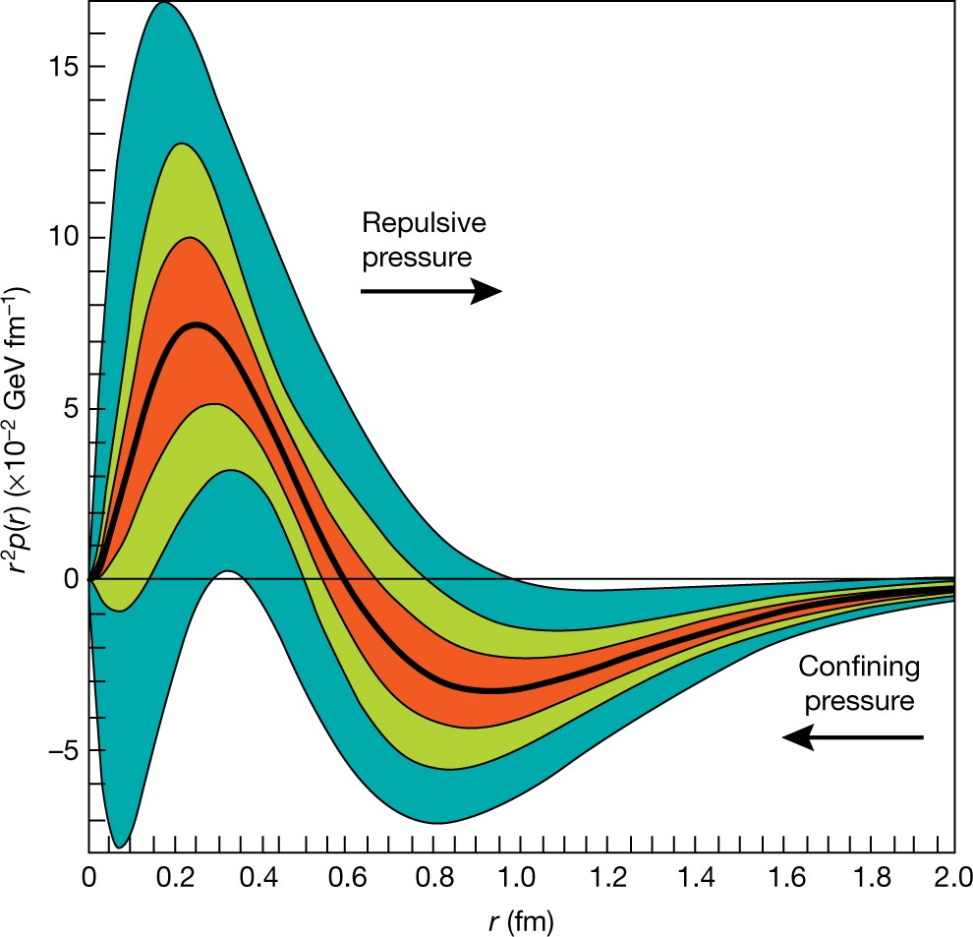
Motivation
The D-term provides a gateway for extraction of various mechanical properties of the proton, including:
  Pressure distribution*
  Mass & Mechanical radii*
  Normal & shear force distributions
*only defined for the total D-term, not individual partonic components

Slide 9
Motivation
The D-term provides a gateway for extraction of various mechanical properties of the proton, including:
  Pressure distribution*
  Mass & Mechanical radii*
  Normal & shear force distributions
*only defined for the total D-term, not individual partonic components

Slide 10
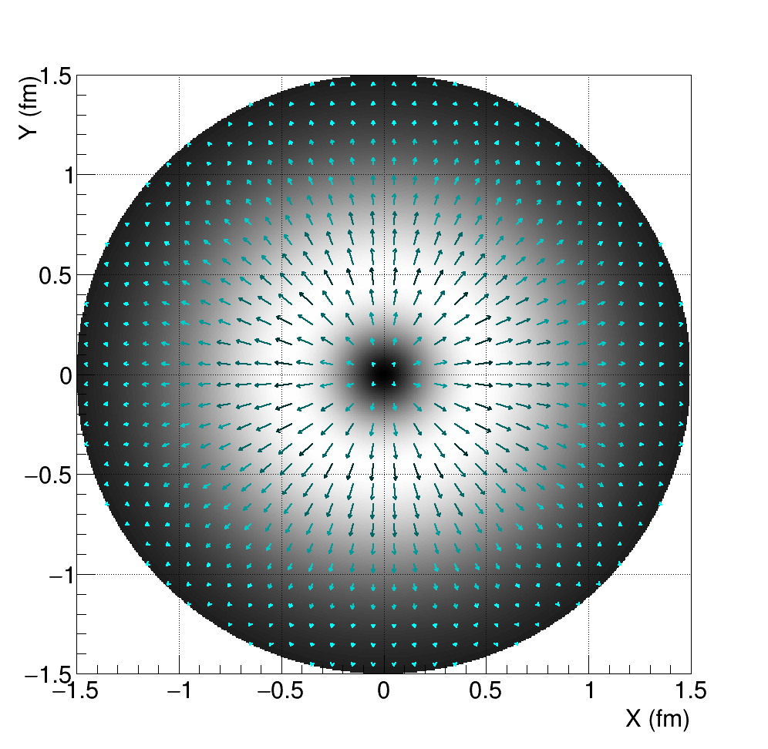
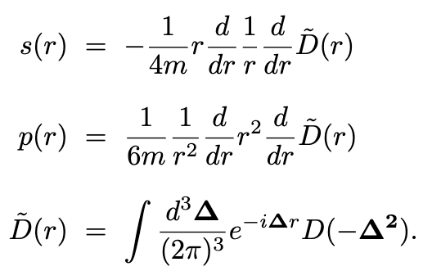
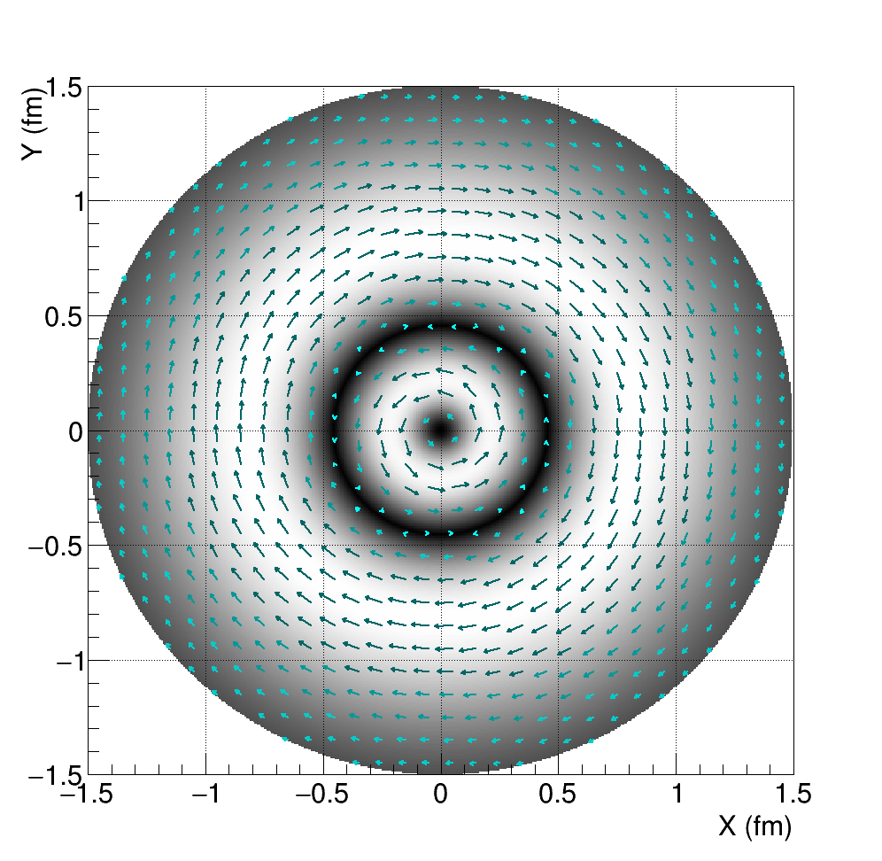
Motivation
The D-term provides a gateway for extraction of various mechanical properties of the proton, including:
  Pressure distribution*
  Mass & Mechanical radii*
  Normal & shear force distributions
*only defined for the total D-term, not individual partonic components

Slide 11
How do we measure it?
The total D-term is related to the partonic D-terms by a simple sum rule:
Different physics processes provide insights into the various partonic D-terms
Only know total D-term once all the partonic components are known!

Slide 12
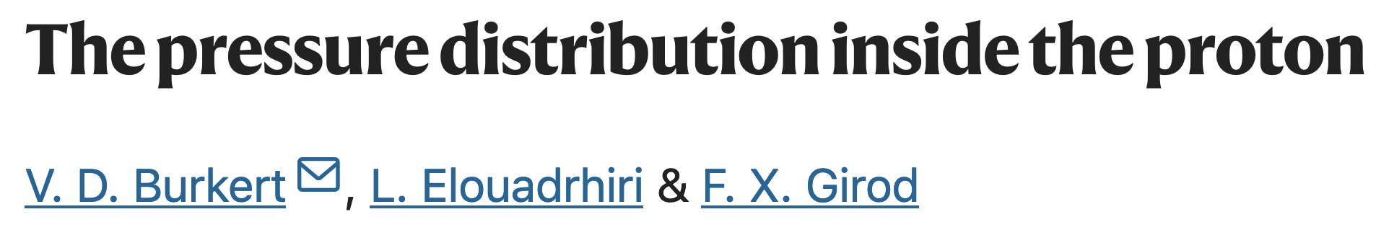
Up & down quarks: Accessible via DVCS cross section & beam-spin asymmetries

Slide 13
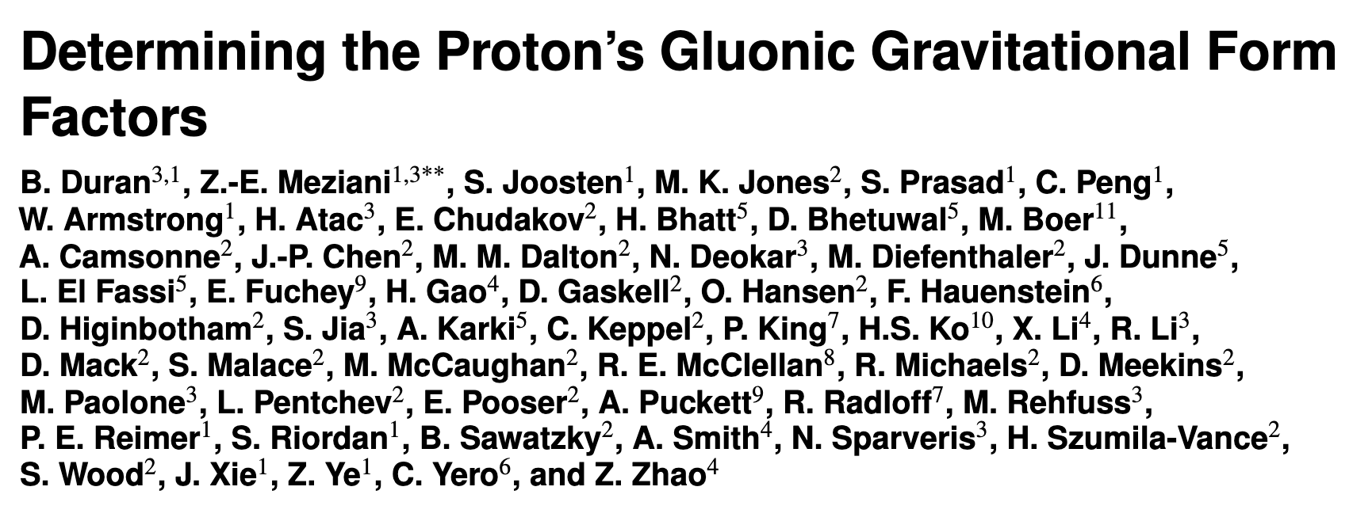
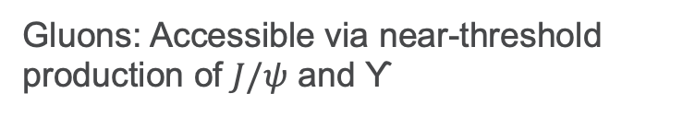
Gluons: Accessible via near-threshold production of $J/ψ$ and ϒ

Slide 14
Strange quarks: Accessible via ?

Slide 15
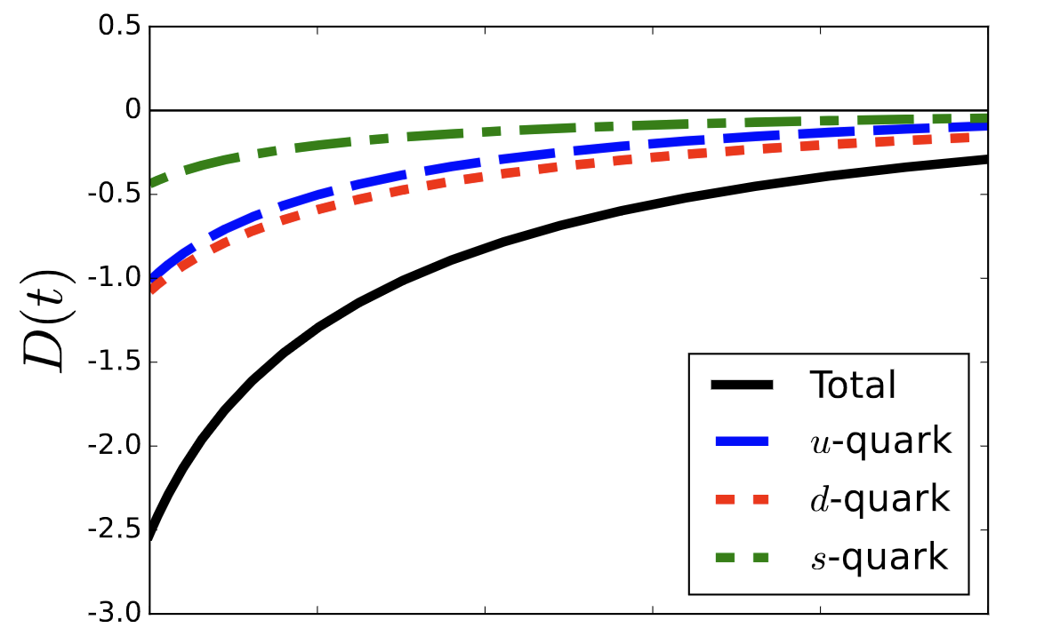
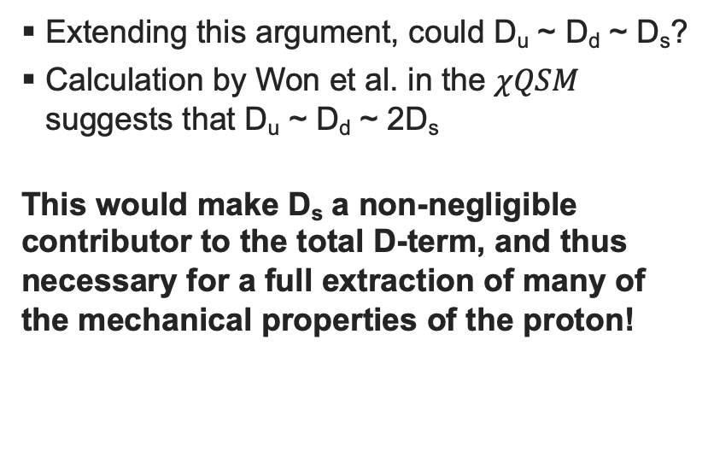
Who cares about D_{s}?
Naively, D_{s} should be small
However, large-N_{c} theory predicts that the D-term is ”flavor-blind”, i.e. D_{u} ~ D_{d} despite their different number densities
  D_{u} ~ D_{d} is supported by lattice results
Extending this argument, could D_{u} ~ D_{d} ~ D_{s}?
Calculation by Won et al. in the $χQSM$ suggests that D_{u} ~ D_{d} ~ 2D_{s}
This would make D_{s} a non-negligible contributor to the total D-term, and thus necessary for a full extraction of many of the mechanical properties of the proton!

Slide 16
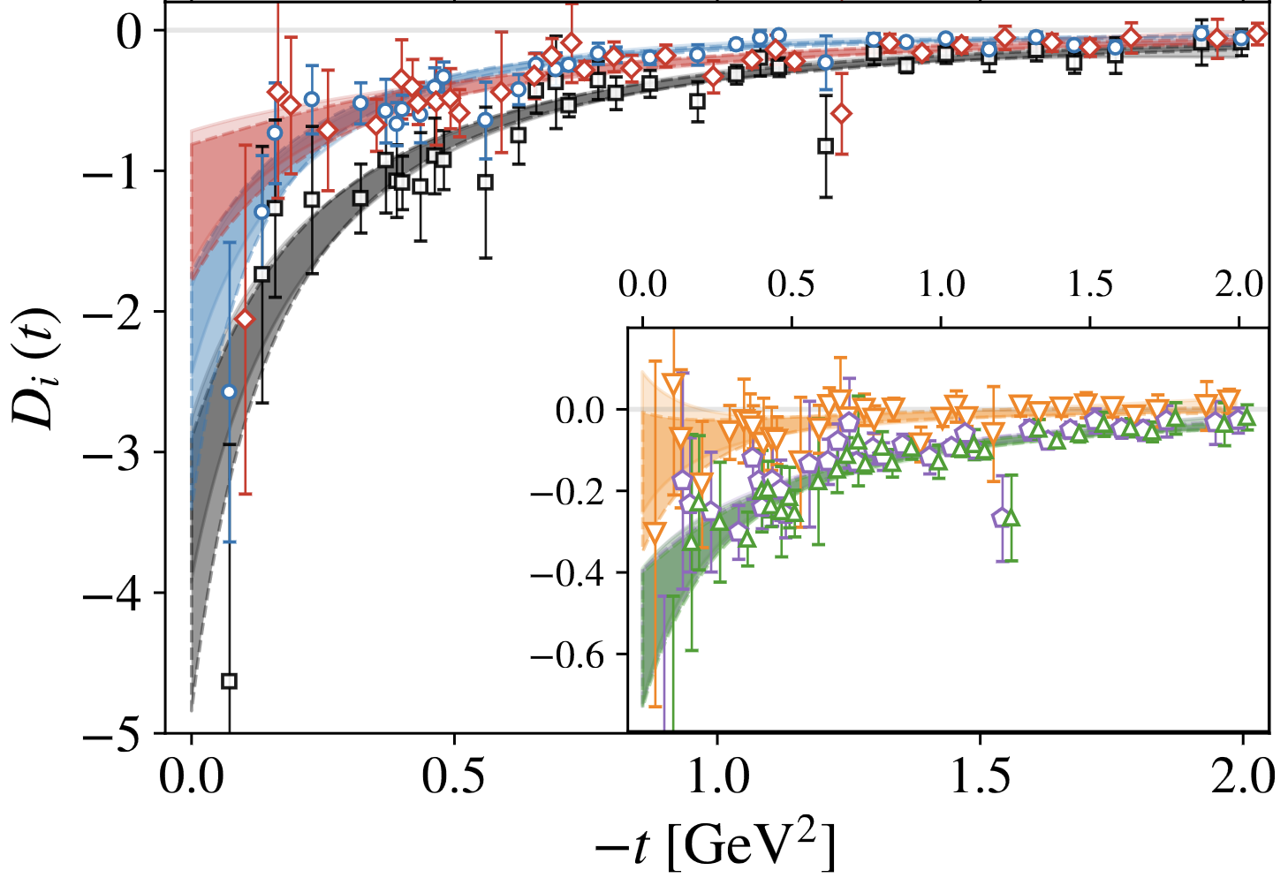
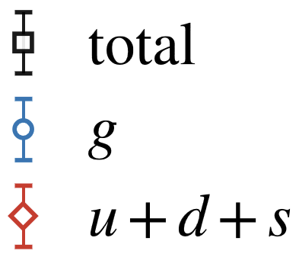
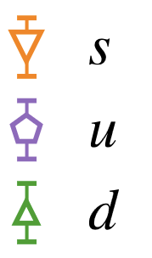
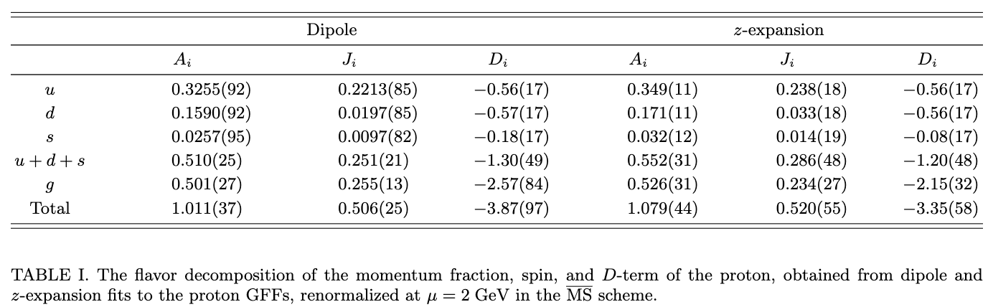
Who cares about D_{s}?
On the other hand, the lattice results by Hackett et al. show that D_{s} is consistent with zero
Uncertainties are still large, but the results do not exclude positive values of D_{s}
D_{s} > 0 suggests the intriguing possibility that strange quarks exert forces in the opposite direction as up & down quarks!

Slide 17
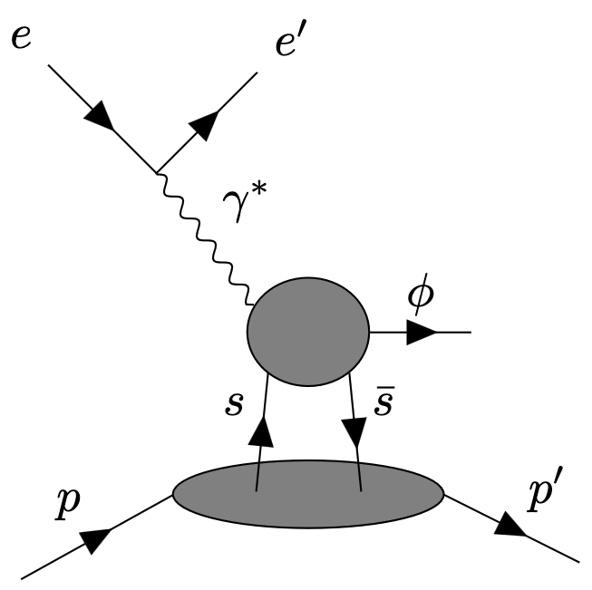
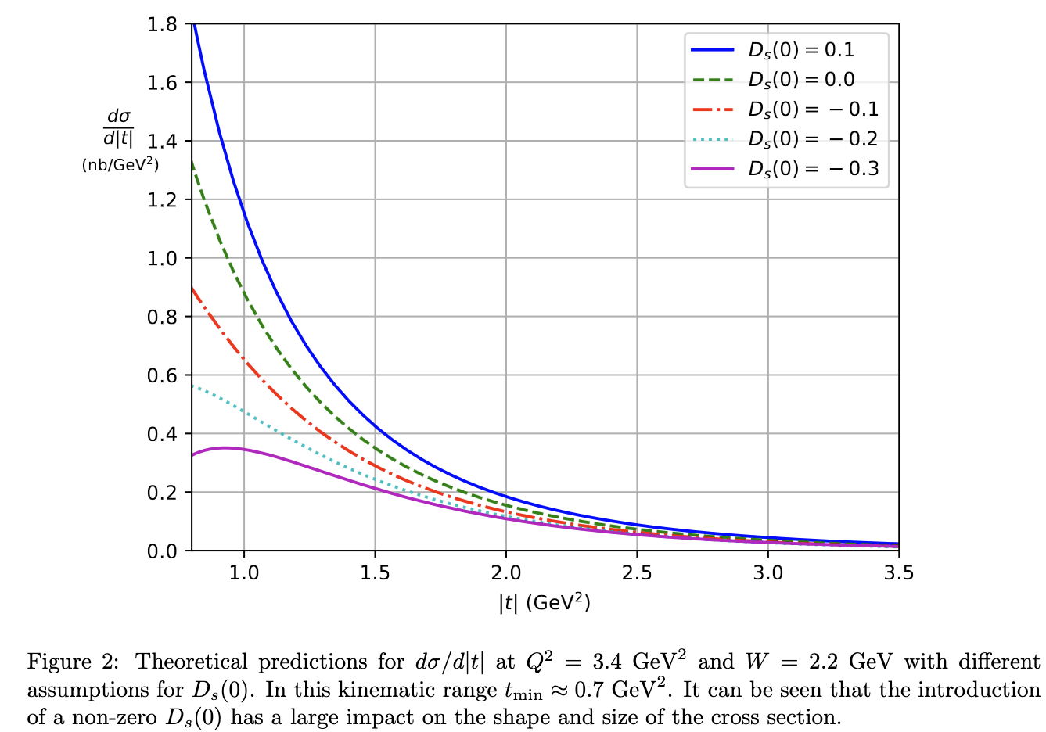
Accessing the strangeness d-term
Information on strangeness in the valence region of the proton is limited in general
  Disentangling it from up & down requires use of specialized processes, e.g. W/Z exchange or kaon SIDIS
Recently, Hatta & Strikman proposed that near-threshold electroproduction of ɸ mesons could provide sensitivity to the strangeness D-term
  Utilized a novel OPE framework that applies in the near-threshold region (unlike the collinear framework)
This is the only known process to access this potentially important piece of the sum rule!
ArXiv:2102.12631

Slide 18

Deep near-threshold ɸ kinematics
Deep = high momentum transfer = high Q²
Near-threshold = invariant mass of final-state hadrons W ~ M_{ɸ} + M_{p} ~ 1.96 GeV
Small momentum transfer to proton = Low-|t|
  Most sensitive to strangeness D-term
Q²
$\sqrt{s}≈4$ GeV
W
|t|

Slide 19
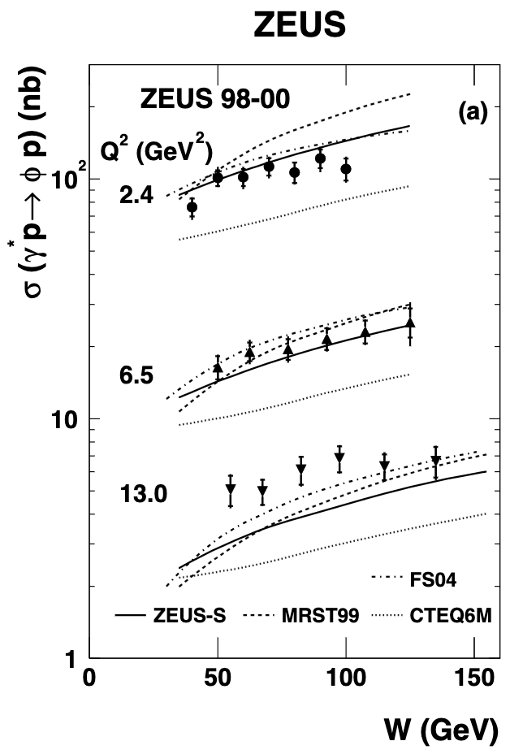
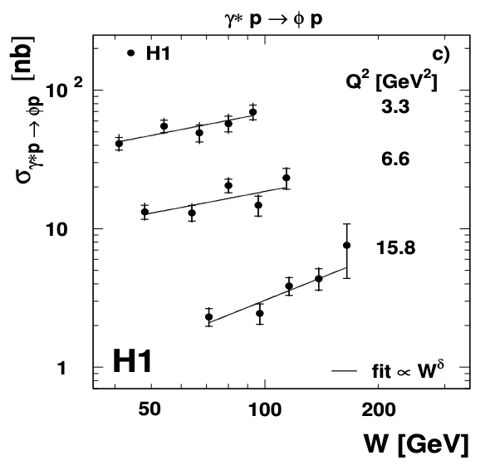
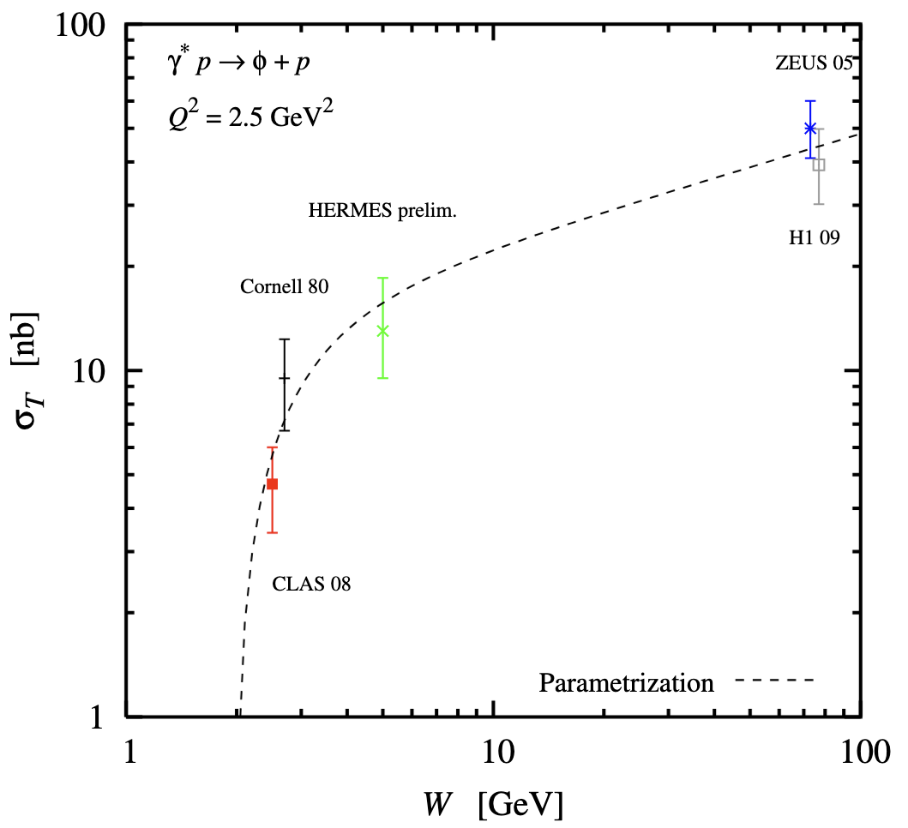
Near-threshold ɸ at EIC?
Explore EIC’s capabilities to measure exclusive ɸ near-threshold
Near-threshold reactions are hard at colliders
  This reaction wasn’t measurable for H1 or ZEUS
  Near-threshold implies that the invariant mass of the proton + produced particles is small
  Requires acceptance for particles near the beam
Several aspects make the EIC superior to HERA for these measurements
  Ability to go to lower proton beam energies, enabling measurement of ɸ decay in central region
  High luminosity to measure small cross sections
  Better far forward acceptance

Slide 21
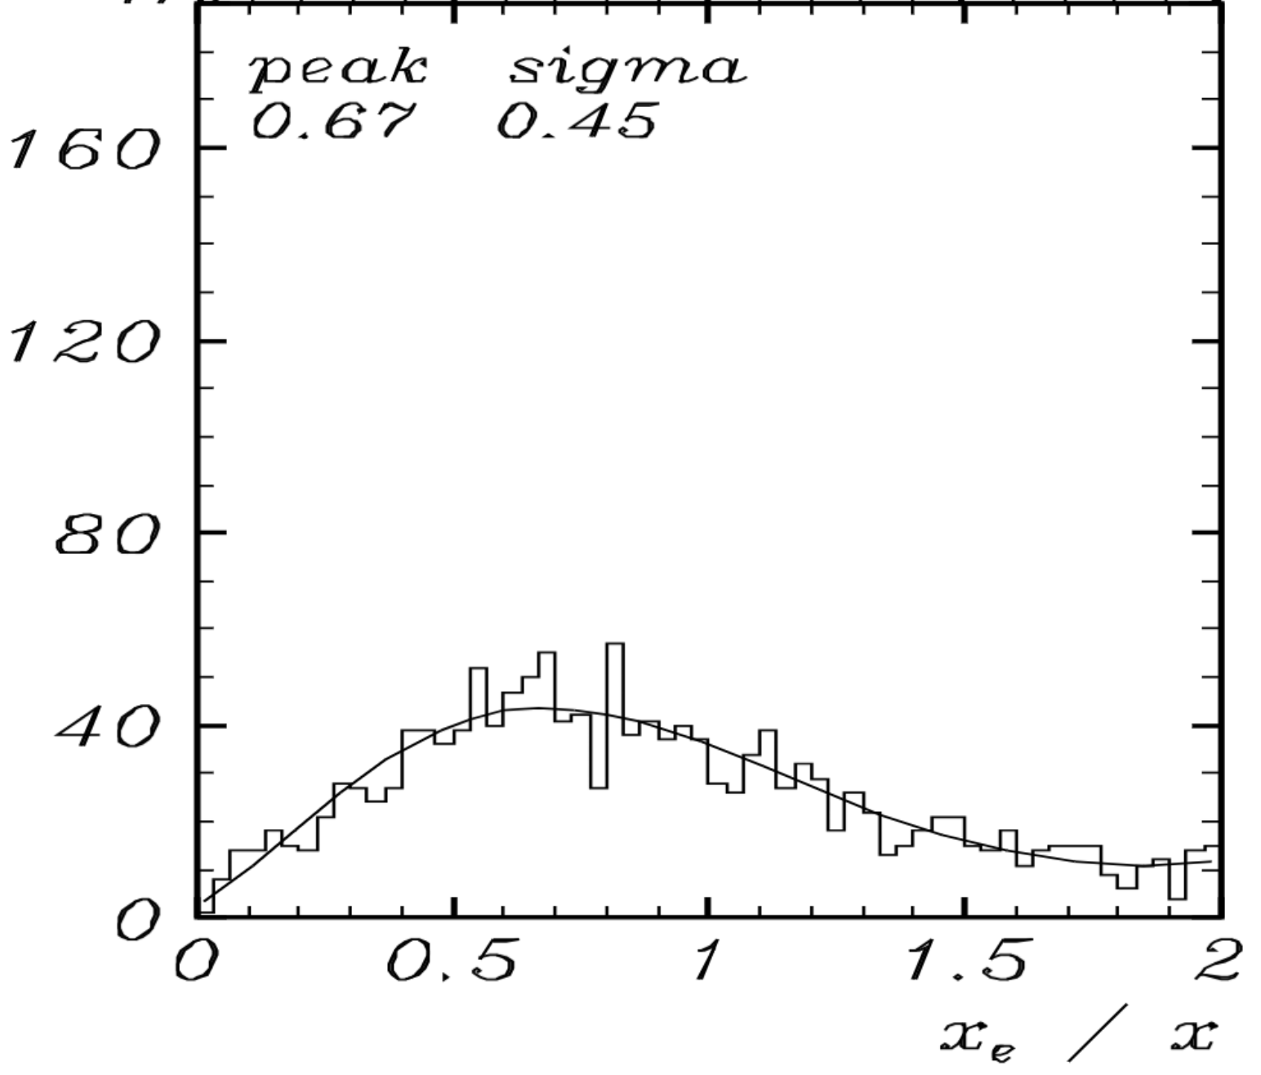

Aside: kinematics
Near-threshold kinematics for ɸ production sits at high x, low y
Scattered electron is well contained in central detector
  However, this is the dreaded low y kinematic region!
  Near the kinematic peak of E_{e’} = E_{e,beam}, tiny mis-measurements of E_{e’} have a huge impact on where the kinematics are reconstructed (x in particular)
  The only way out is to use information from the hadronic final state to reconstruct the kinematics, e.g. double-angle method, $Σ$ method

Slide 22
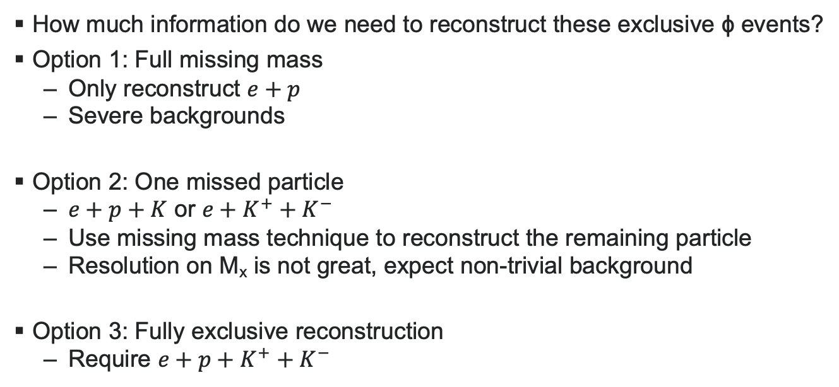
EIC Analysis strategy
How much information do we need to reconstruct these exclusive ɸ events?
Option 1: Full missing mass
  Only reconstruct $e+p$
  Severe backgrounds
Option 2: One missed particle
  $e+p+K$ or $e+K^{+}+K^{−}$
  Use missing mass technique to reconstruct the remaining particle
  Resolution on M_{x} is not great, expect non-trivial background
Option 3: Fully exclusive reconstruction
  Require $e+p+K^{+}+K^{−}$

Slide 23
EIC Analysis strategy
How much information do we need to reconstruct these exclusive ɸ events?
Option 1: Full missing mass
  Only reconstruct $e+p$
  Severe backgrounds
Option 2: One missed particle
  $e+p+K$ or $e+K^{+}+K^{−}$
  Use missing mass technique to reconstruct the remaining particle
  Resolution on M_{x} is not great, expect non-trivial background
Option 3: Fully exclusive reconstruction
  Require $e+p+K^{+}+K^{−}$
Assume only this technique in this talk

Slide 24
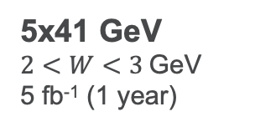
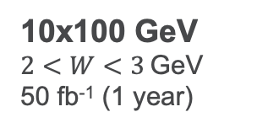
Eic simulation setup
Only the 5x41 energy setting allows the kaons from the ɸ decay to make it into the central detector acceptance
  Boost from proton beam is too large even for 100 GeV proton beam energy
5 fb⁻¹ of 5 GeV e⁻ on 41 GeV p data
  Q² > 2 GeV²
  1 year of data taking
  Use lAger event generator
  Cross section model based on a parameterization of all existing world data, developed for CLAS12
5x41 GeV
$2<W<3$GeV
5 fb⁻¹ (1 year)
Nominal Acceptances
10x100 GeV
$2<W<3$GeV
50 fb⁻¹ (1 year)
Nominal Acceptances

Slide 25
Pessimistically assume 50% B0 acceptance & 0% RP & OMD acceptance
  Fairly few detectable events send proton to RPs or OMDs for Q² > 2 GeV²
  |t| distribution is steep!
Statistics seem reasonable in this case!

Slide 26
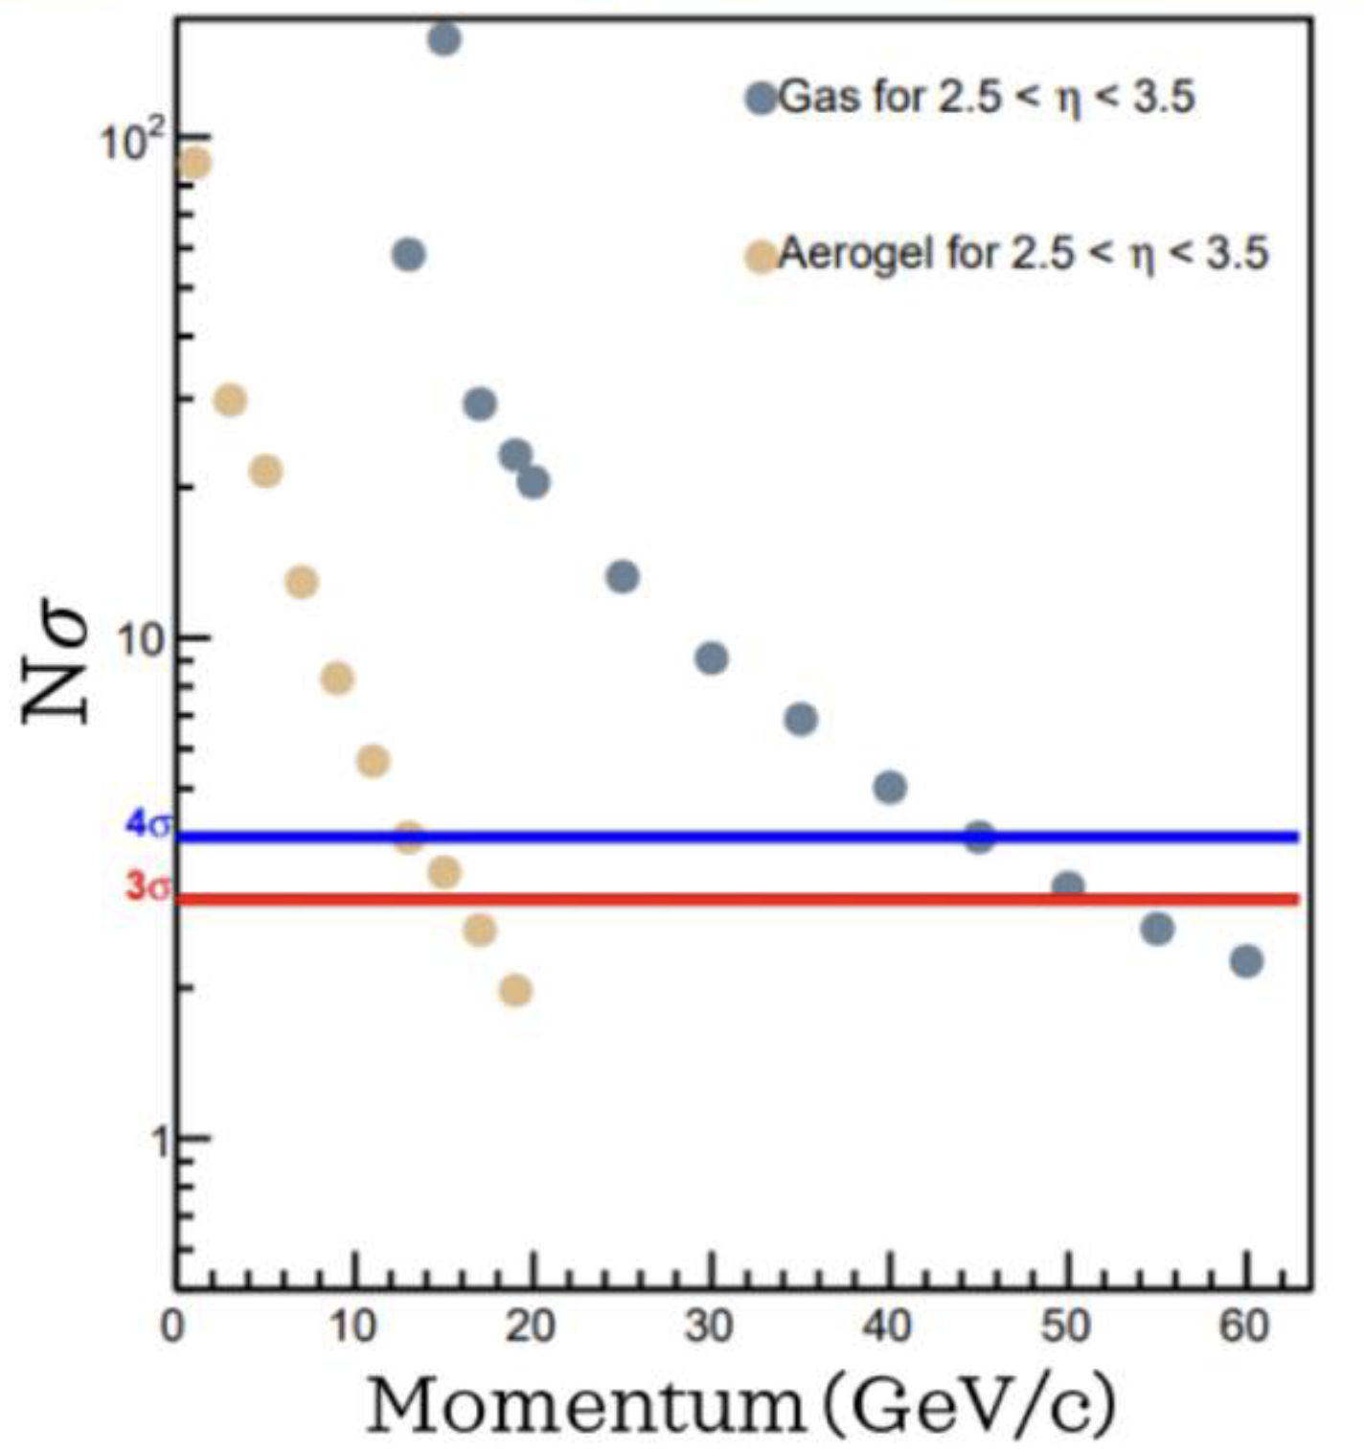
PID
Kaon momenta range from a few GeV to ~20 GeV
dRICH can separate pions from kaons consistently in this momentum & pseudorapidity range
  Kaons begin to radiate in aerogel (n = 1.026) around 2.5 GeV
  Kaons in C₂F₆ produce rings above 15 GeV
Expect greater than 4σ separation power for all kaons from this process!
K momentum range

Slide 27
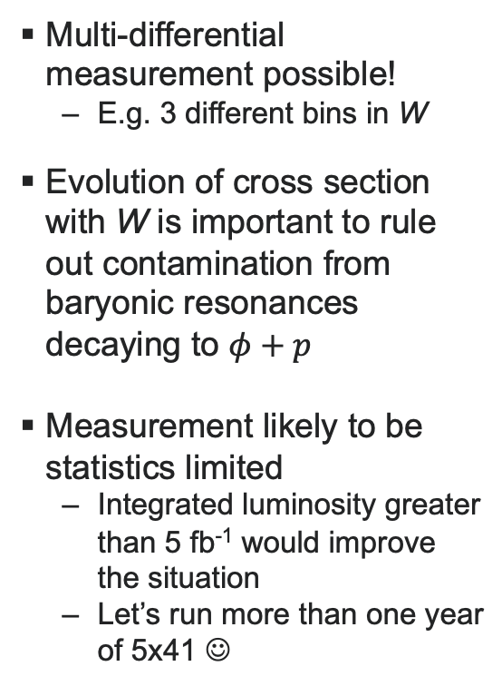
Multi-differential measurement possible!
  E.g. 3 different bins in W
Evolution of cross section with W is important to rule out contamination from baryonic resonances decaying to $φ+p$
Measurement likely to be statistics limited
  Integrated luminosity greater than 5 fb⁻¹ would improve the situation
  Let’s run more than one year of 5x41 ☺
Accepted |t|-distributions

Slide 28
Conclusion
If we ever want a complete experimental picture of the mechanical forces in the proton, will need to measure the strangeness D-term
  More theoretical & phenomenological input is needed!
Deep exclusive ɸ production offers the opportunity to learn about the forces exerted by strange quarks inside the proton!
EIC 5x41 energy configuration can provide access to near-threshold ɸ electroproduction!
  Sensitive to high η acceptance for tracking & dRICH

Slide 29
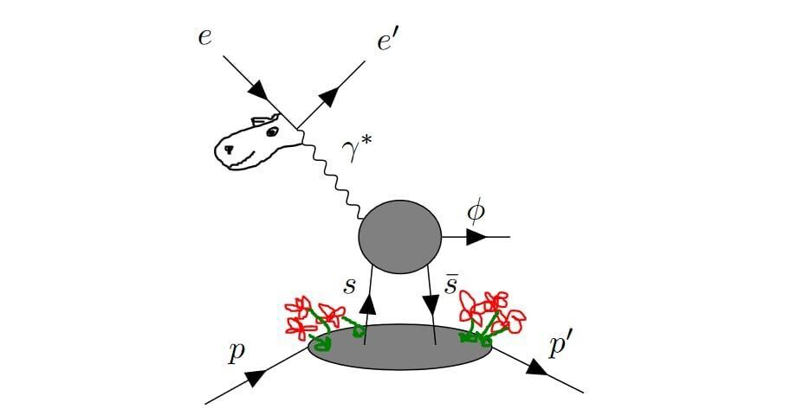
Backup

Slide 30
Accepted particle distributions

Slide 31
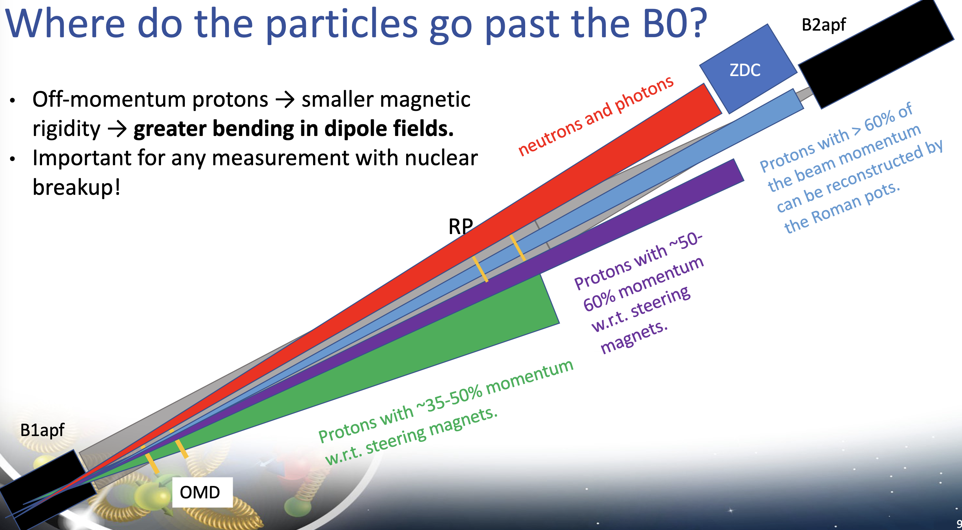

Slide 33

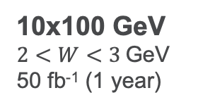

Pseudorapidity acceptance
If the $η$ range of the dRICH PID extends even to $η$= 3.7, could potentially reconstruct this final state also in the 10x100 energy configuration
  Note y-axes! 10x more integrated luminosity available in 10x100
  Possible that the tail of the 10x100 statistics could provide a better measurement than the whole 5x41 dataset
5x41 GeV
$2<W<3$GeV
5 fb⁻¹ (1 year)
10x100 GeV
$2<W<3$GeV
50 fb⁻¹ (1 year)

Slide 35
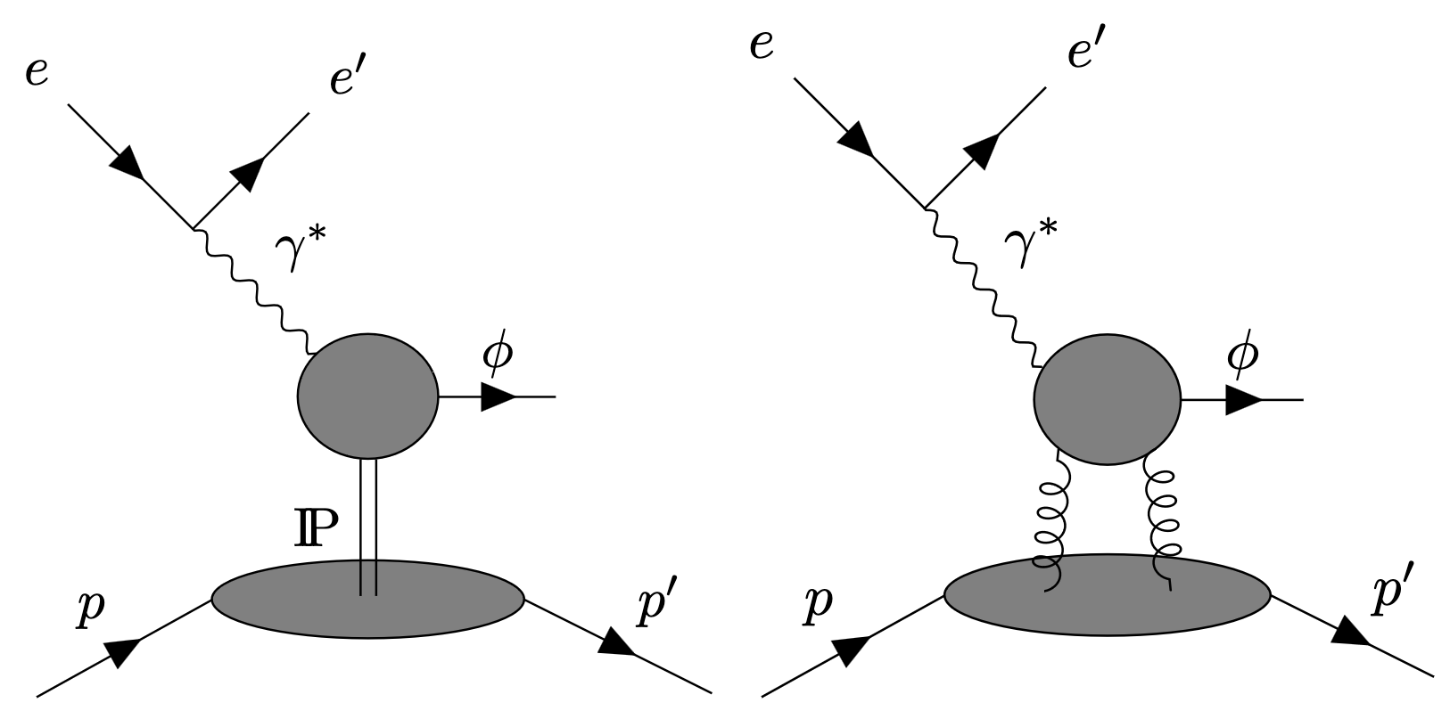

Reality check
The reality is (as always) that it’s not so simple!
Other physics processes can contribute to ɸ electroproduction
  This will dilute the sensitivity to the D-term
Needs more phenomenological input before we can really claim an extraction of D_{s}
  E.g. calculation of gluon exchange contribution within the same framework
Additional caveats:
  Calculation wants Q² $≫\left|t\right|$
    For $\left|t\right|$ ~ 1 GeV² is Q² ~ 3.5 GeV² high enough?
  Non-linear behavior observed in the photoproduction cross section for $W<2.4$ GeV, resonances?
Pomeron exchange
(insensitive to D_{s})
Strange exchange (sensitive to D_{s})
Two gluon exchange (insensitive to D_{s})

Slide 36
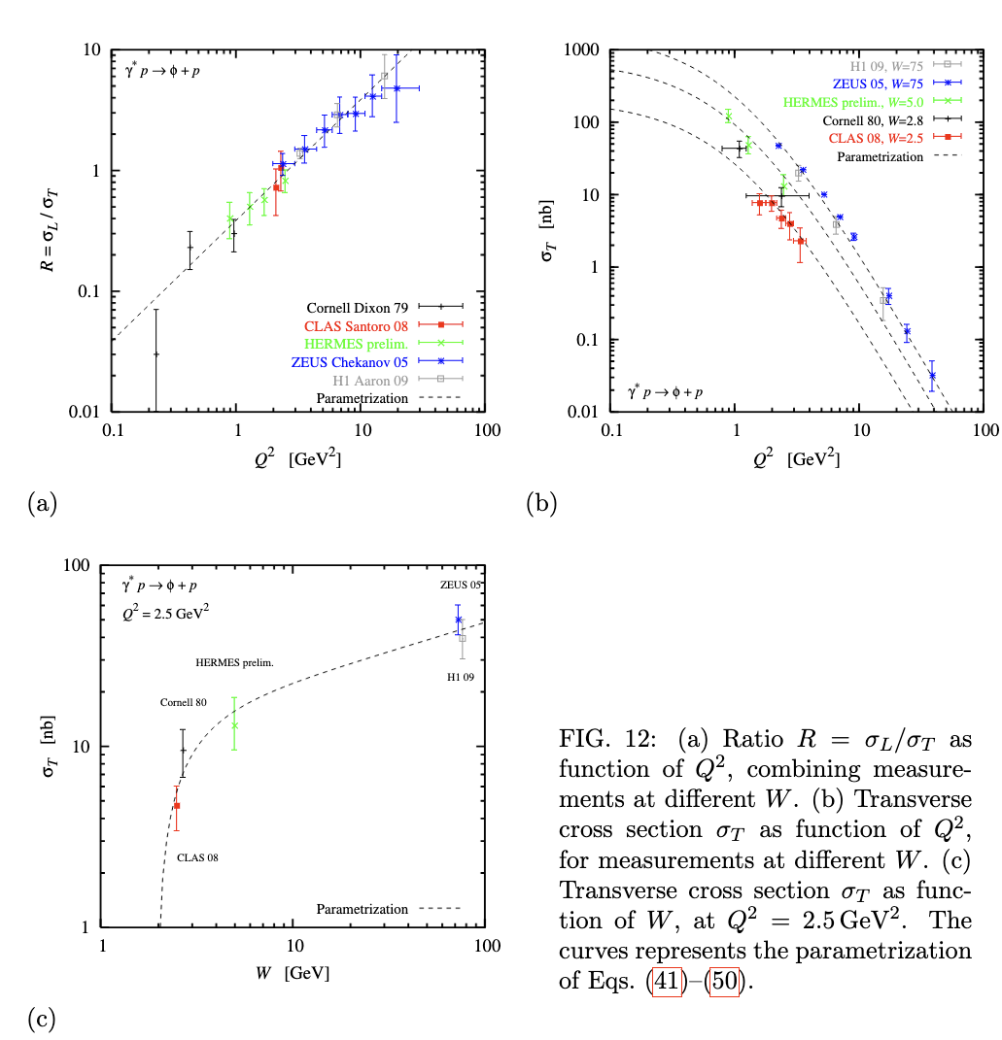
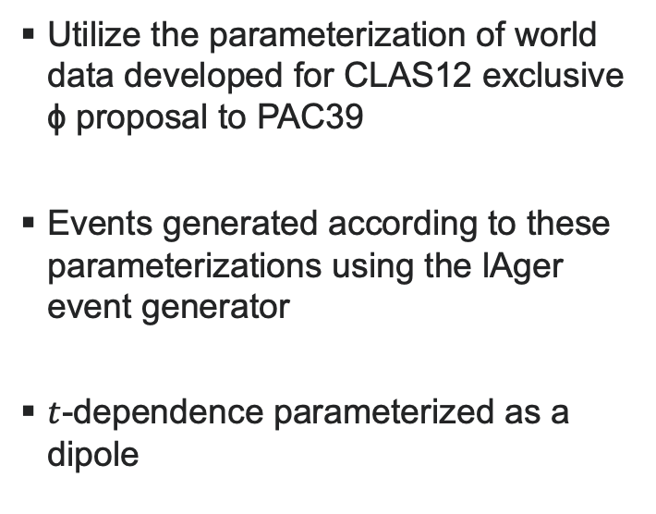
Cross section Model
Utilize the parameterization of world data developed for CLAS12 exclusive ɸ proposal to PAC39
Events generated according to these parameterizations using the lAger event generator
$t$-dependence parameterized as a dipole

Slide 37
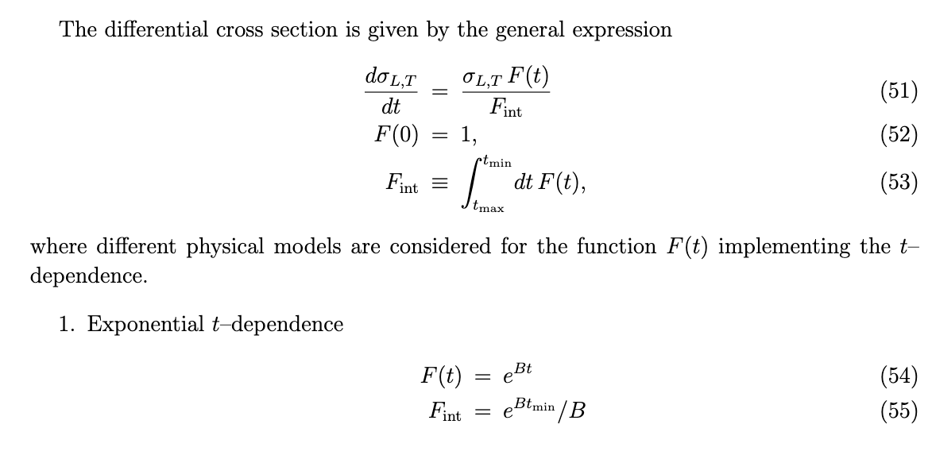
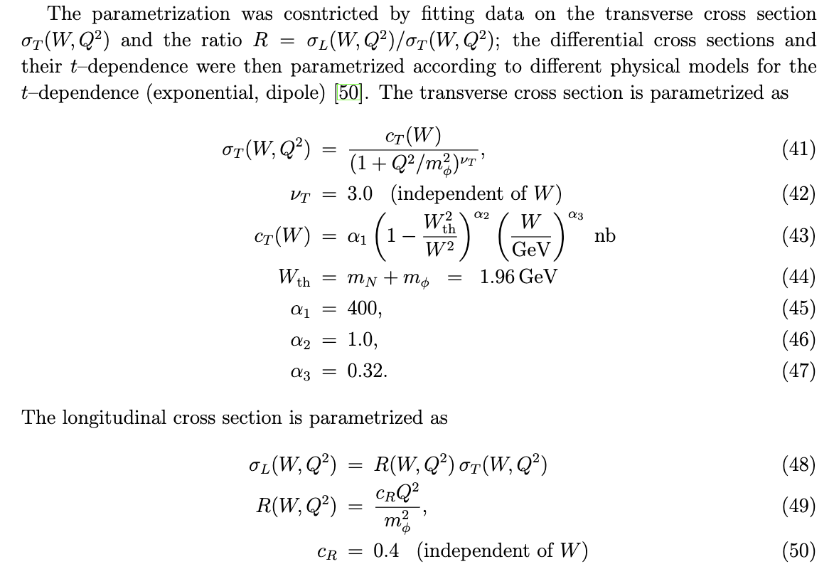
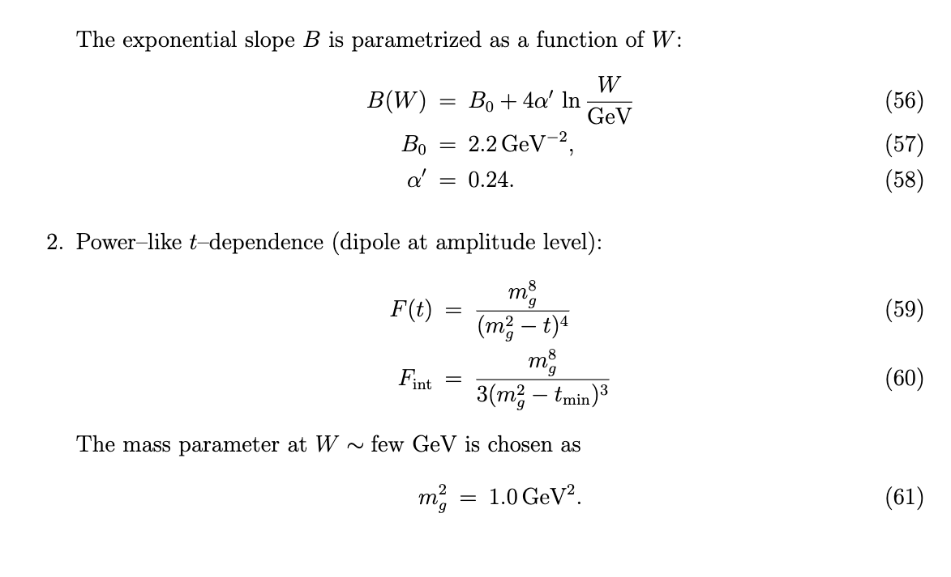
Cross section Model

