Slide 1
Construction of a Cosmic Ray Telescope for the hpDIRC Radiators at the Electron Ion Collider
Nathan Shankman
Stony Brook University Department of Physics and Astronomy
Center for Frontiers in Nuclear Science
Notes:
My name is Nathan Shankman.
I’m a PhD student at Stony Brook University and a member of the Center for Frontiers in Nuclear Science.
I’m going to be talking about the construction of a cosmic ray telescope for the hpDIRC radiators at the EIC.

Slide 2
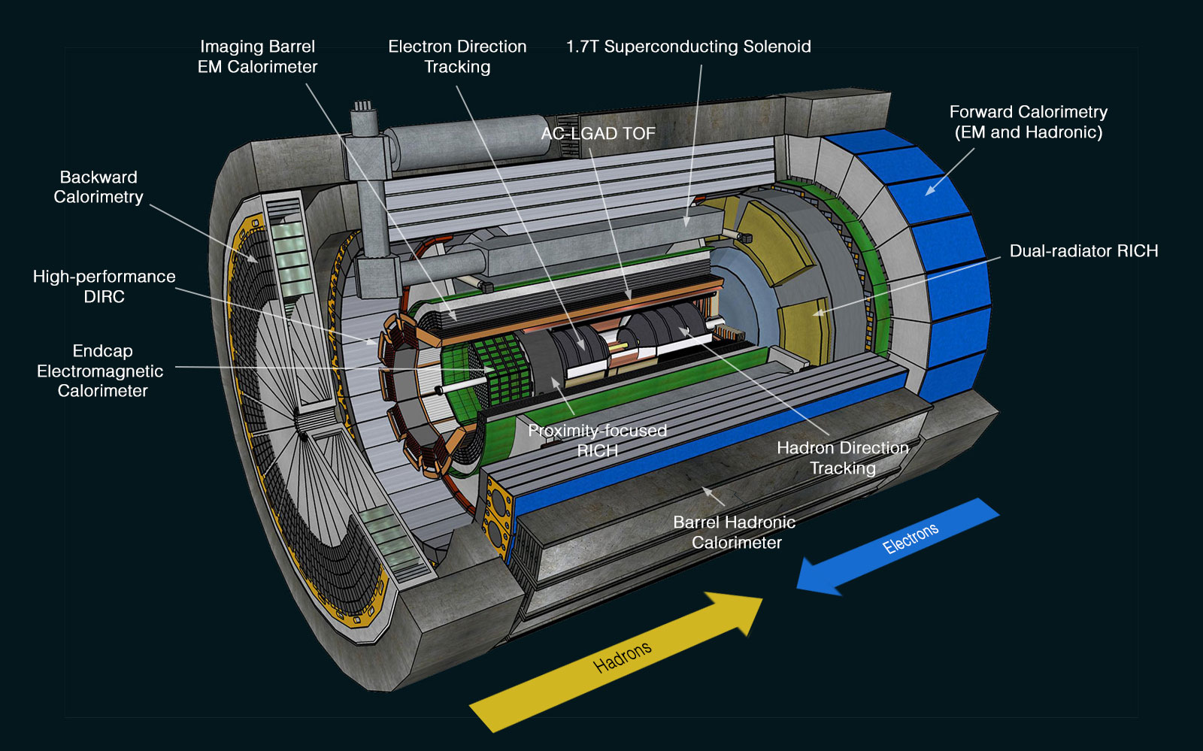
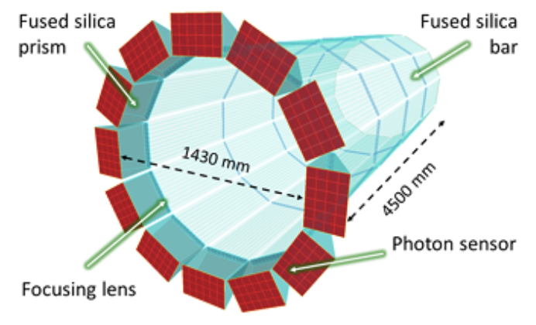
High Performance DIRC Detector
DIRC radiator bars will be used in the hpDIRC detector in the ePIC detector at the EIC for hadronic PID
(Left) https://www.bnl.gov/eic/epic.php
(Right) J. Adkins et al., arXiv preprint arXiv:2209.02580 (2022)
Notes:
DIRC radiator bars are going to be used in the barrel region of the ePIC detector in the EIC.
These bars will make up the high performance DIRC detector which will be used for hadronic PID.
The hpDIRC will be able to provide precise PID up to 6 GeV momenta.

Slide 3
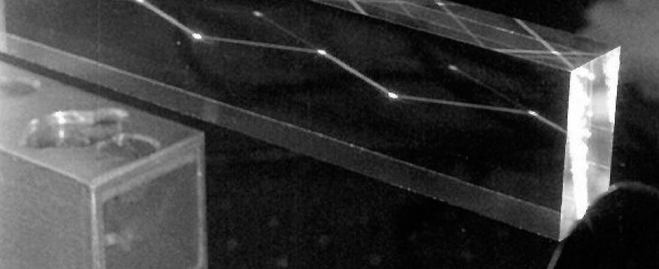
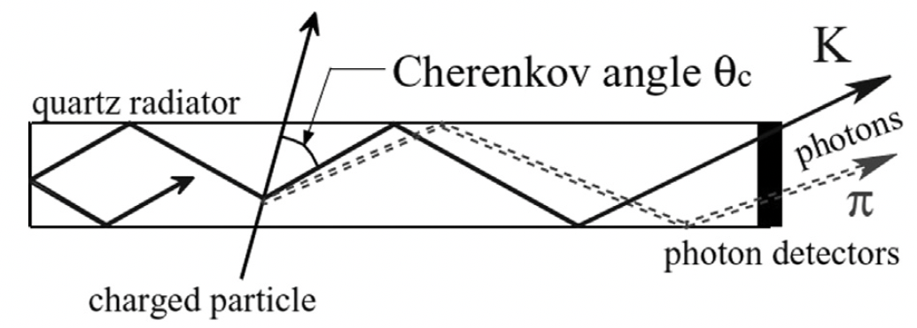
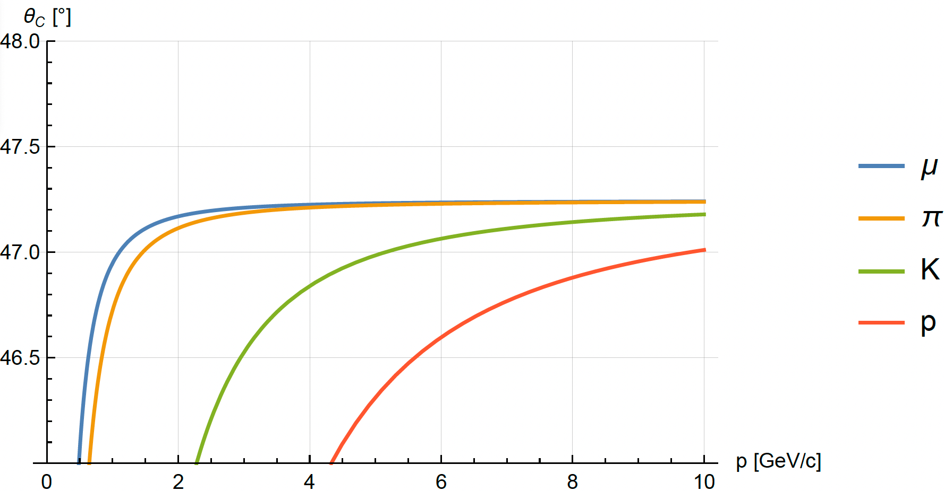
DIRC
Detection of Internally Reflected Cherenkov radiation
Charged particles moving faster than light in a medium → Cherenkov radiation
DIRC radiators: Synthetic Fused Silica (SiO₂)
n = 1.473
Internal reflection coefficient: 0.9997
Cherenkov photons produced in the radiators internally reflect to an electronic readout where their trajectories can be reconstructed and analyzed for PID via the Cherenkov angle
(Top & Middle) J. Cohen-Tanugi et al., Nuclear Instruments and Methods in Physics Research Section A: Accelerators, Spectrometers, Detectors and Associated Equipment 515, 680 (2003).
Notes:
DIRC stands for the detection of internally reflected Cherenkov radiation.
Like a RICH detector they utilize the creation of Cherenkov photons from charged particles moving faster than light in a medium, but this time we detect the photons after multiple reflections within the radiator.
These bars are made of synthetic fused silica, which is silicone dioxide arranged in a crystalline lattice structure.
The index of refraction of the material is 1.473, and the outer surfaces of the bars are polished to be very flat, resulting in an internal reflection coefficient of 0.9997.
The general idea is that the produced Cherenkov photons internally reflect within the bar until they hit an electronic readout, where their trajectories can be reconstructed to find the Cherenkov angle of the incident particles.
Because different particle species have different Cherenkov angles, we can obtain PID.

Slide 4
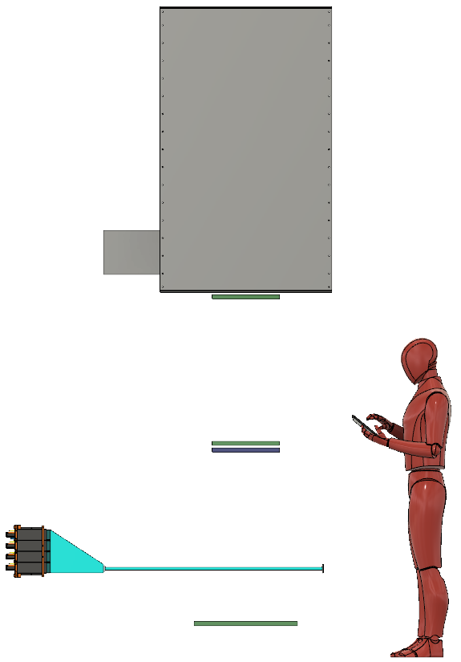
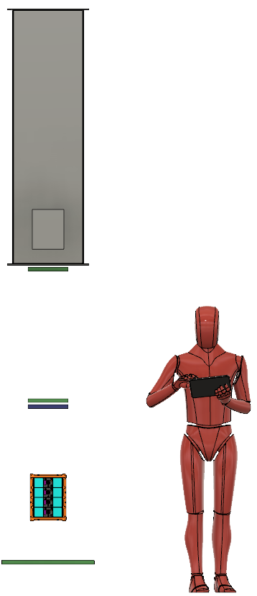
Cosmic Ray Telescope
Test and characterize DIRC radiators
CO₂ Momentum Threshold Tagger (momentum cutoff)
μ-RWELL (tracker)
μ-RWELL (tracker)
PICOSEC (timing)
DIRC bar (radiator and light guide)
GEM (tracker)
Tagger
Tracker
Tracker
Precise Timing
Readout
Radiator
Tracker
Notes:
At Stony Brook we are constructing a cosmic ray telescope utilizing high energy muons to characterize these DIRC radiators.
The general design of the CRT consists of a momentum threshold tagger at the top to veto muons with less than 3.5 GeV momenta.
Below are two layers of micro-RWELLs for tracking, followed by a PICOSEC detector for precise timing.
Then we have the DIRC radiator which eventually leads to the electronic readout.
Finally, we have a GEM detector as the lowest layer of tracking.

Slide 5
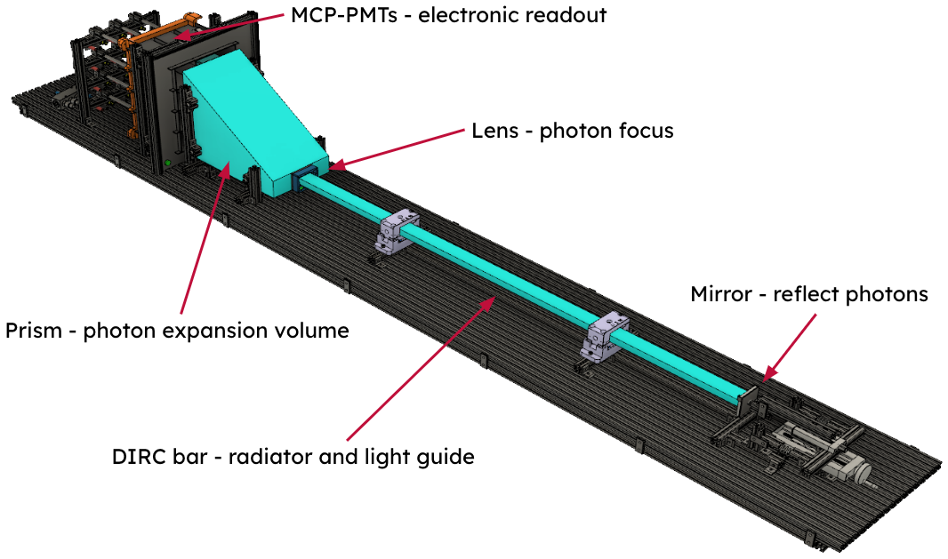
Dark Box
Block external light
User friendly bar mobility
House DIRC hardware
  Mirror
  Radiator
Lens
Prism
Electronic readout
Notes:
A major part of this construction was creating a dark box for the DIRC materials, because external light hitting the readout would interfere with the Cherenkov radiation.
Thus we need the box to be light tight, and because we will be testing multiple bars, we need it to be easy to use in terms of putting in and taking out bars.
Besides the actual DIRC bar, the box houses a mirror to reflect Cherenkov photons towards the readout end, as well as a lens and prism.
This leads to the electronic readout on one end which consists of micro channel plate PMTs.

Slide 6
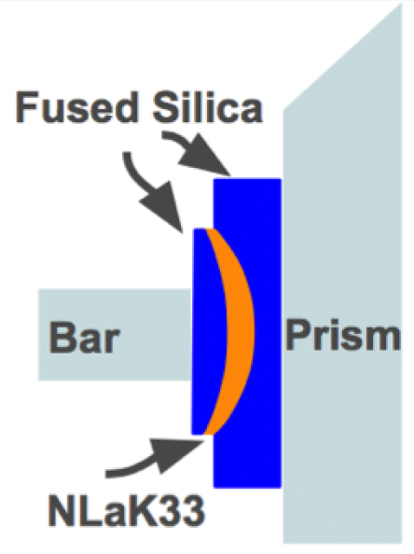
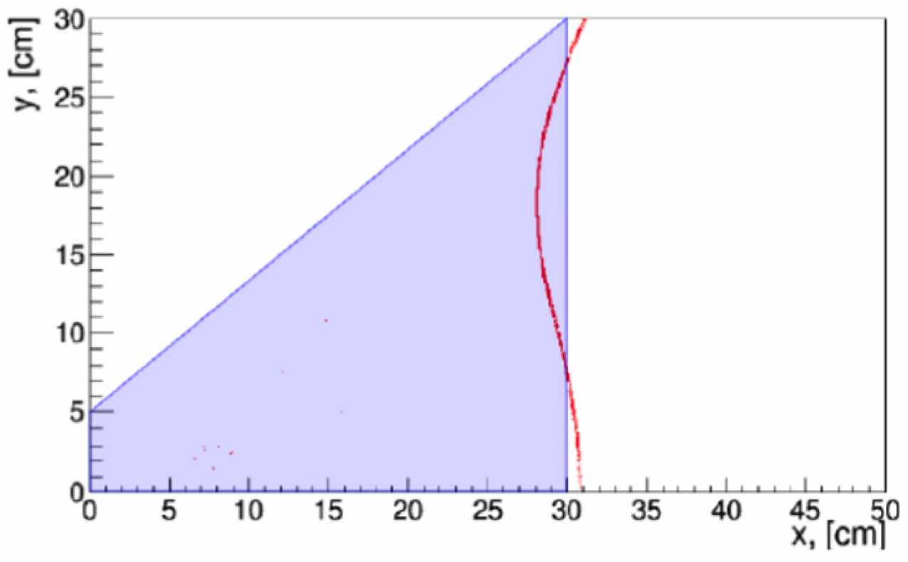
Lens and Prism
Focus and defocus photons onto a flat readout plane
3-layer-lens
Originally lanthanum crown glass, now synthetic sapphire
Synthetic fused silica
G. Kalicy et al., Journal of Instrumentation 11, C07015 (2016)
Notes:
The lens is used to focus and defocus the Cherenkov photons while the prism acts as an expansion volume.
The lens has 3 layers, the outer two being made of synthetic fused silica and the inner being made of Lanthanum crown glass (though this may change).
The prism is also made of synthetic fused silica.
The combination of the lens and prism produces a flat, focused image on the focal plane of the readout, roughly aligning with the red curve.

Slide 7
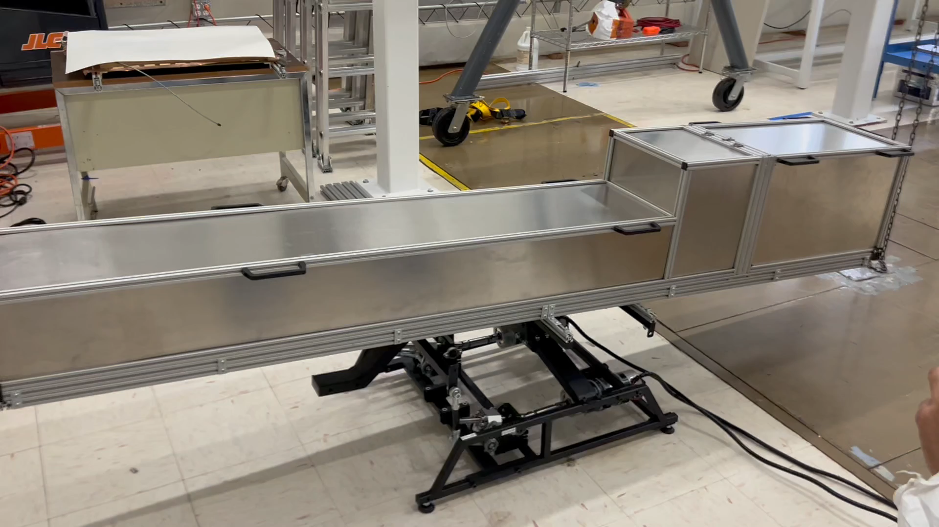
Motion Platform
Controlled Pitch and Roll for multiple muon incident angles
Completed box on motion platform
Notes:
The dark box sits on top of a motion platform which allows us to test multiple incident muon angles.
With this platform we can control the orientation of the box in the pitch and roll degrees of freedom.
Here’s a quick demonstration of that process.

Slide 8
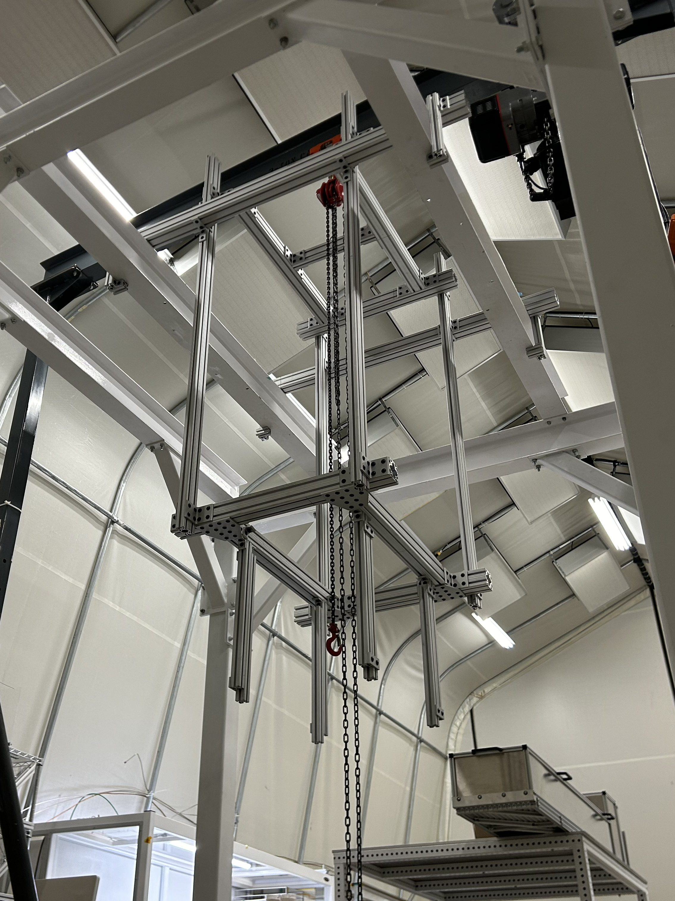
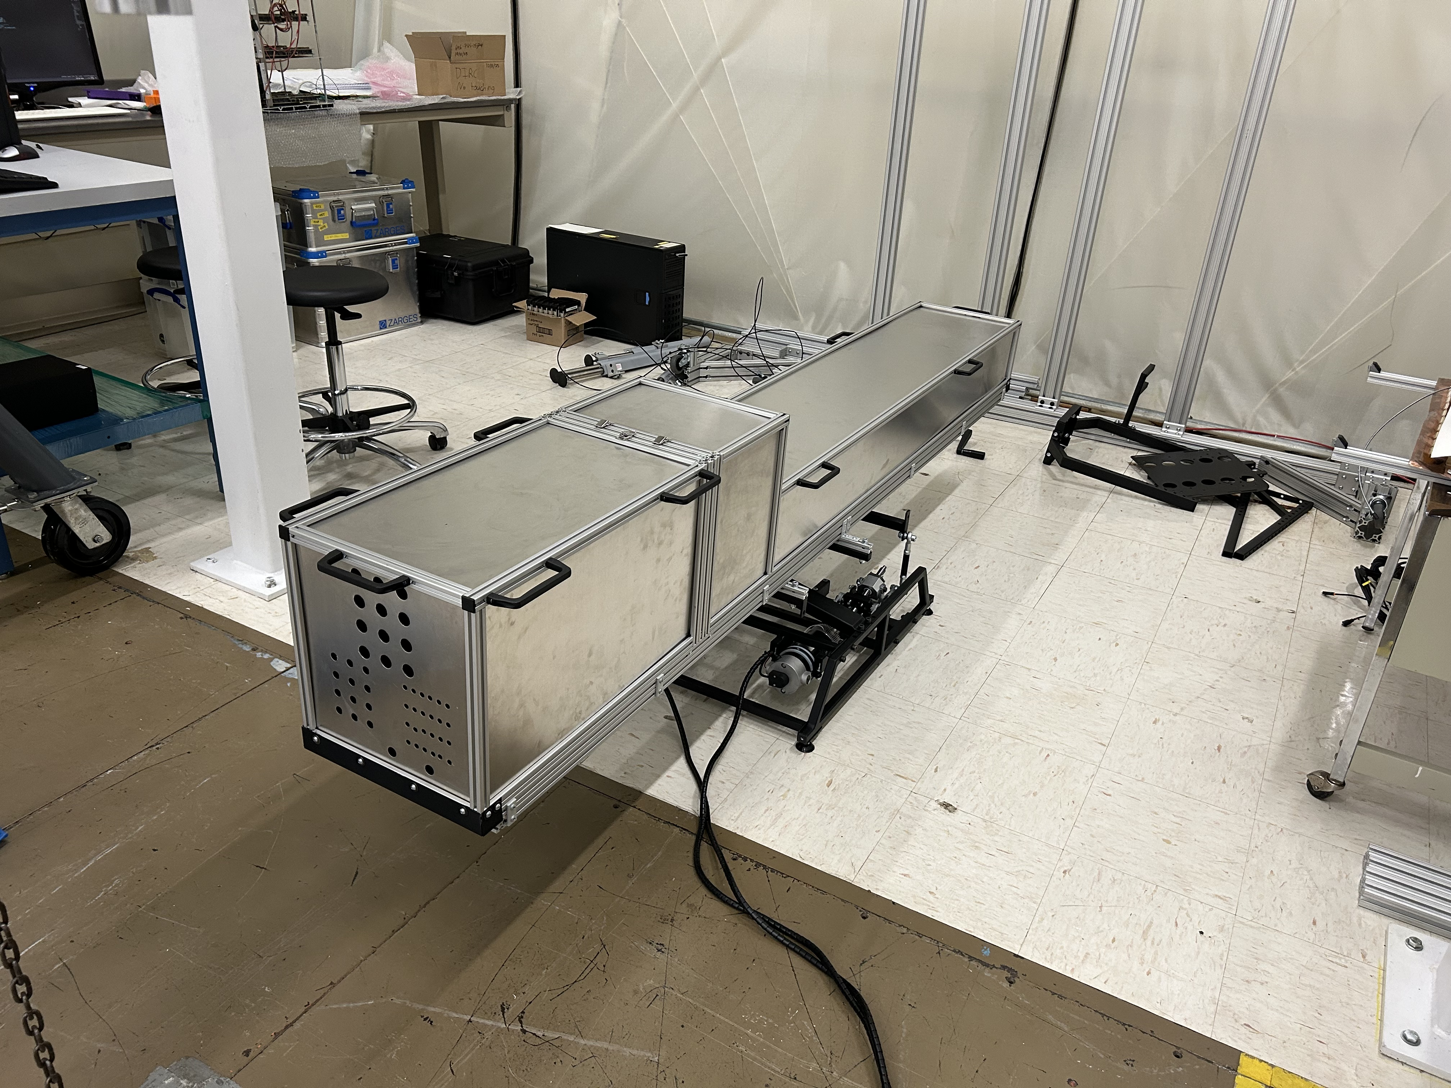
SBU Clean Tent
Notes:
All of this is being done in a clean tent at Stony Brook.
On the left is the support structure for the momentum threshold tagger as well as the top two layers of tracking and the PICOSEC detector
On the right is the dark box on the motion platform from the previous slide..

Slide 9
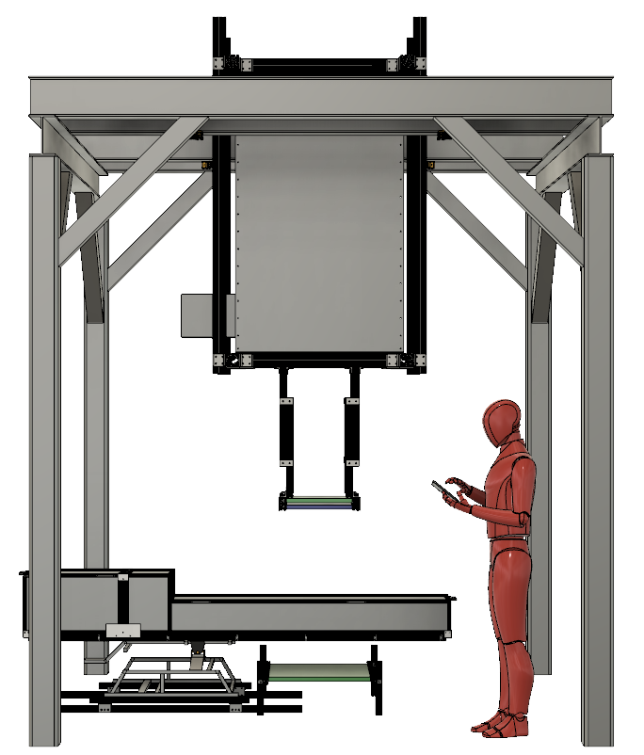
Summary
Constructing a Cosmic Ray Telescope to characterize the DIRC radiators to be used in the hpDIRC detector in the ePIC detector in the EIC
The dark box and its parts are completed
Installation of tracking, timing, and tagging
We will start taking cosmic ray data before 2025
Notes:
In conclusion, we are constructing a cosmic ray telescope to characterize the DIRC radiators to be used in the ePIC detector.
The dark box is complete.
Now we will install and configure the trackers, the PICOSEC detector, and the momentum threshold tagger.
We will start taking data this fall.

Slide 10
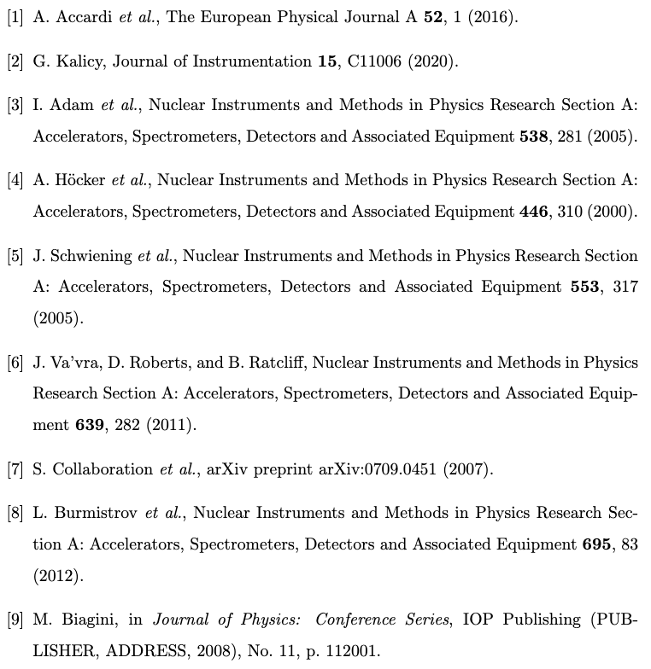
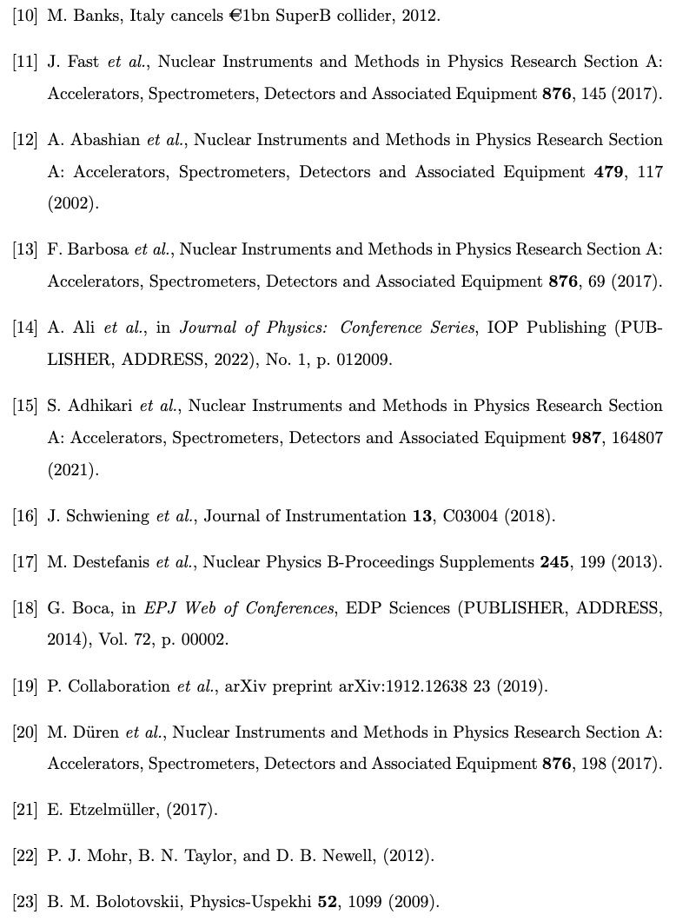
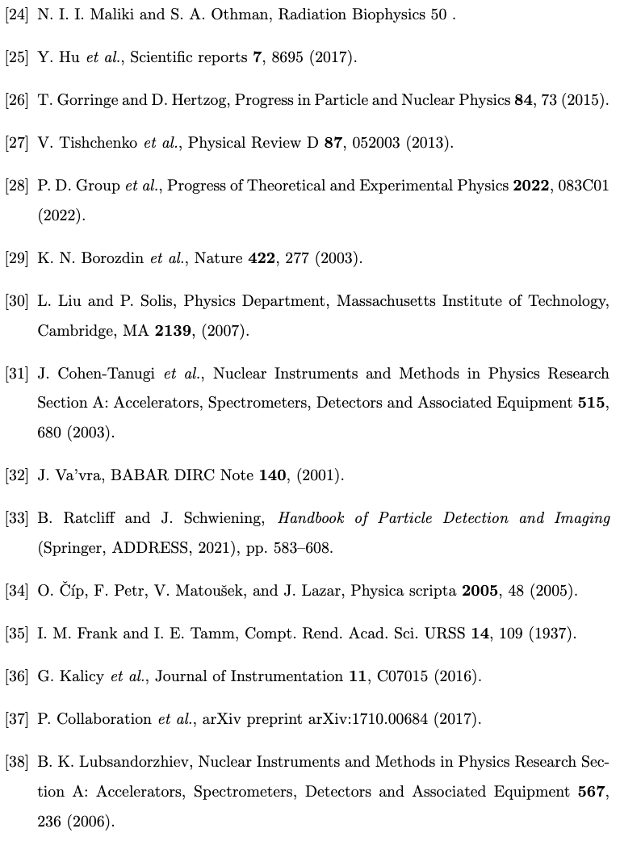
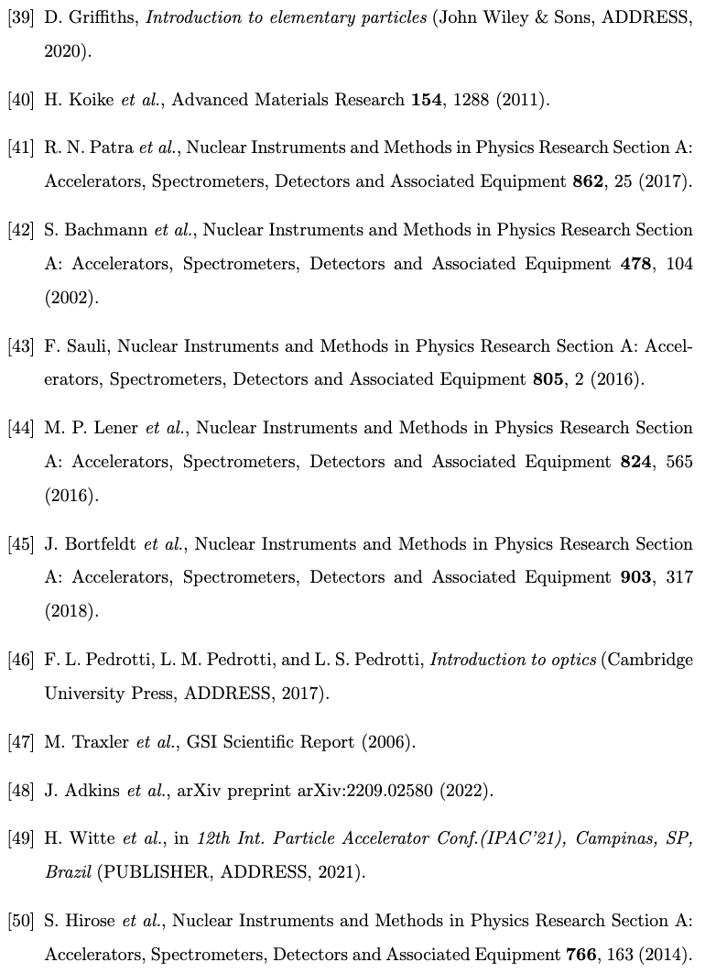
References

