Slide 1
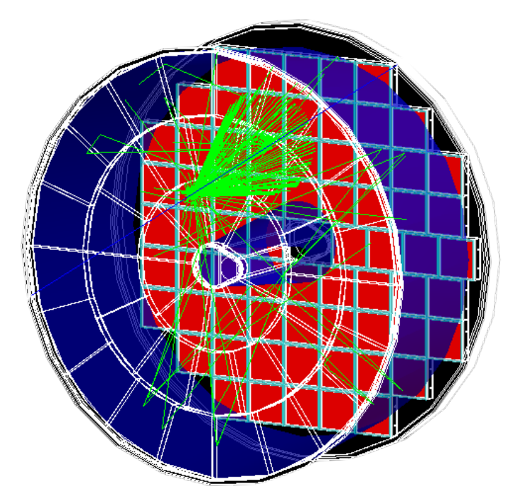
Particle identification performance studies with pfRICH simulations
Youqi Song (youqi.song@yale.edu)
EIC User Group Early Career Workshop
Bethelehem, PA
07/22/2024

Slide 2
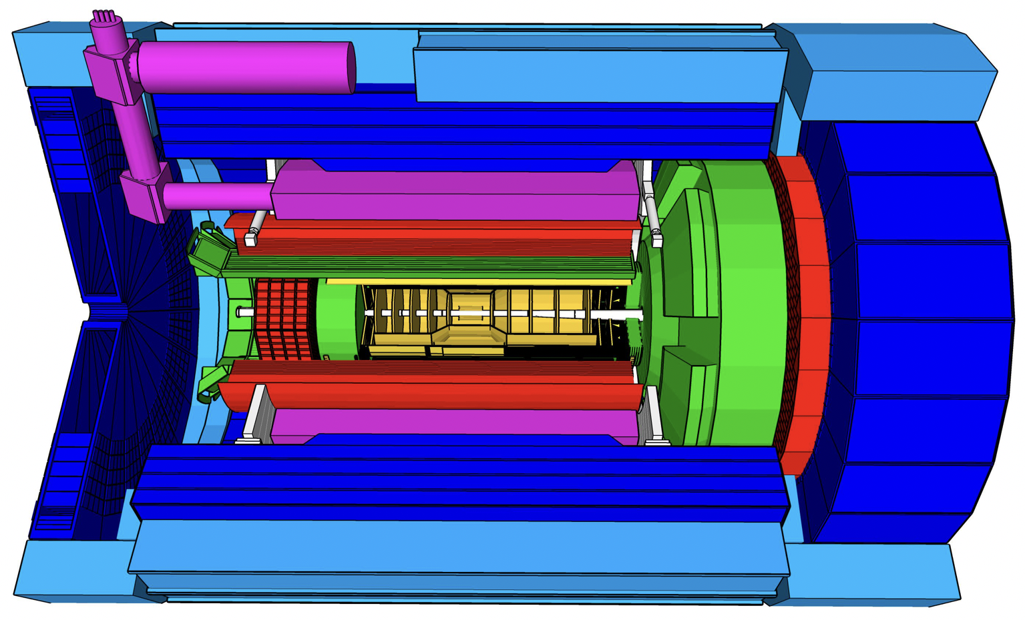
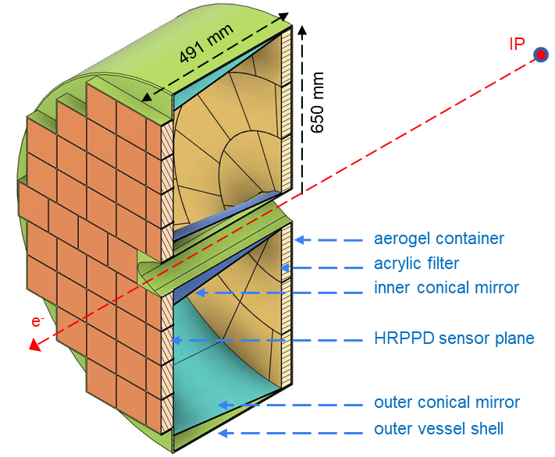
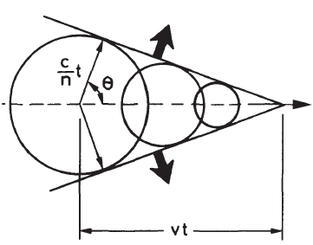
Overview of pfRICH
pfRICH (proximity-focusing Ring Imaging CHerenkov)
Crucial for PID in e-going direction in $−3.5<η<−1.5$
Excellent separation power up to 7 GeV:
Cherenkov radiation angle $θ_{c}$, is related to particle’s speed $β=v/c$ and medium’s refractive index $n$
pfRICH also has potential application for global timing
Competing species | Separation range [GeV]
$e$ vs hadrons ($π/K/p$) | ~0.2 to ~2.5
$K$ vs $π/p$ | ~2.0 to ~7.0
pfRICH
“electromagnetic shock wave”
Notes:
Mention what is omega
Cherenkov bullet point

Slide 3
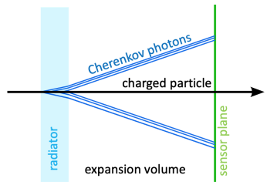
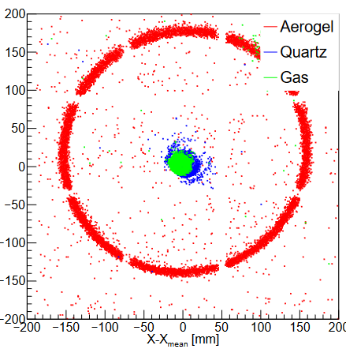
Path of a Cherenkov photon
[Fig 1.3, CDR]
Aerogel
“Radiator”: Cherenkov photons produced here
$\left\langle n\right\rangle =1.045,$ 2.5 cm thick, 42 tiles
Optimize angle resolution & number of photons
Acrylic layer
Filters out photons with wavelength < 300 nm
Minimize dependency on $n(ω)$
Vessel
Encloses a 40 cm long “expansion volume”: Photons travel through here
Large gap improves angle resolution
Sensor plane
Detects the photons and amplifies the signals
68 HRPPD (High Rate Picosecond Photo Detector) sensors
from HRPPD window
from expansion volume
Multiple sources of Cherenkov photons. Aerogel photons are used for PID (today’s focus)
[Fig 7.3 (a), CDR]
Notes:
Preet’s talk on mirrors: https://indico.jlab.org/event/855/contributions/14991/
Don’t talk too much about sub-bullets
N for aerogel, careful with what is said
Schematic
overall

Slide 4
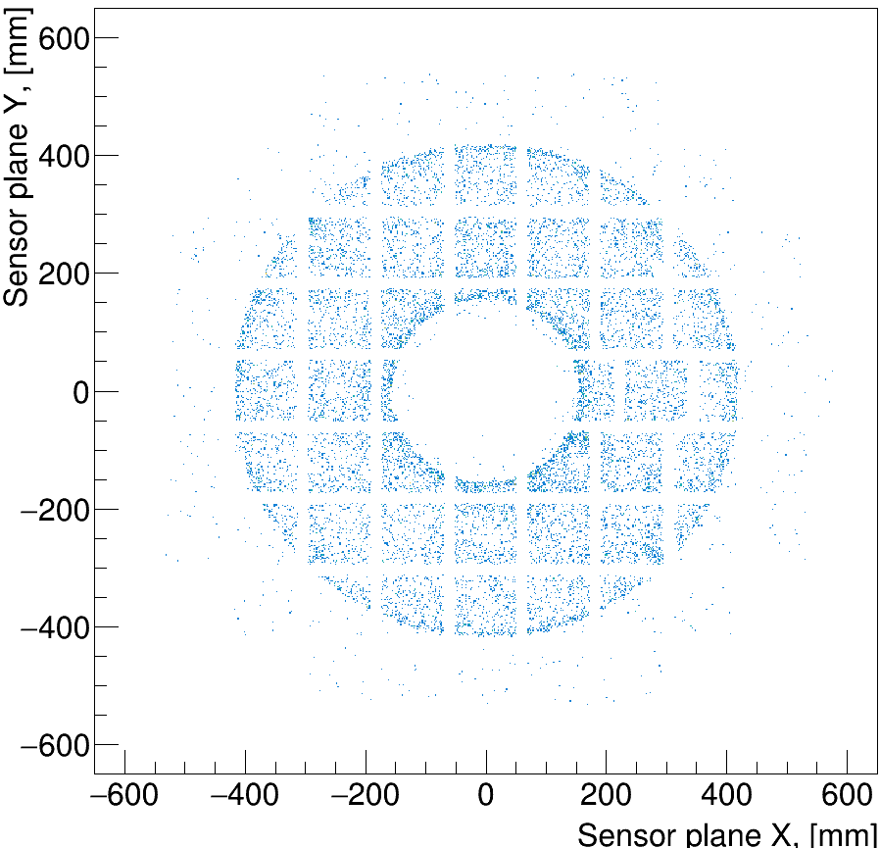
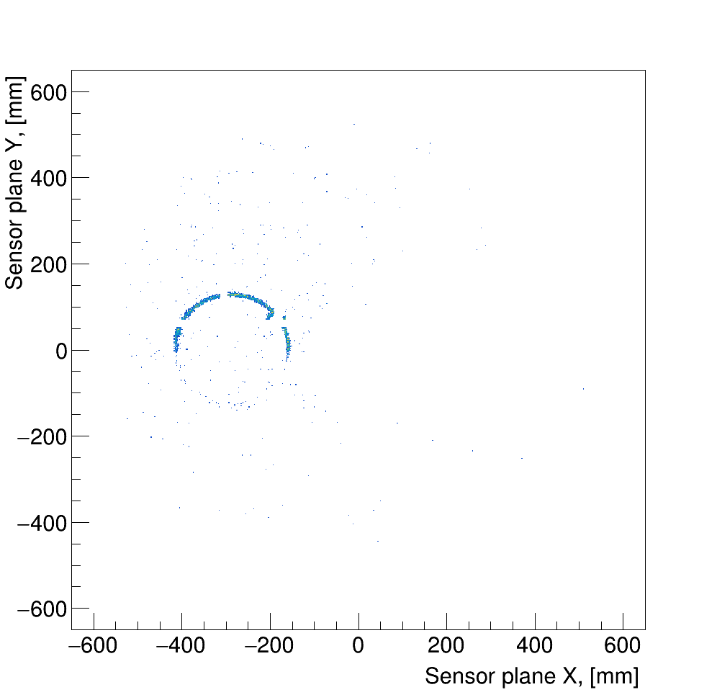
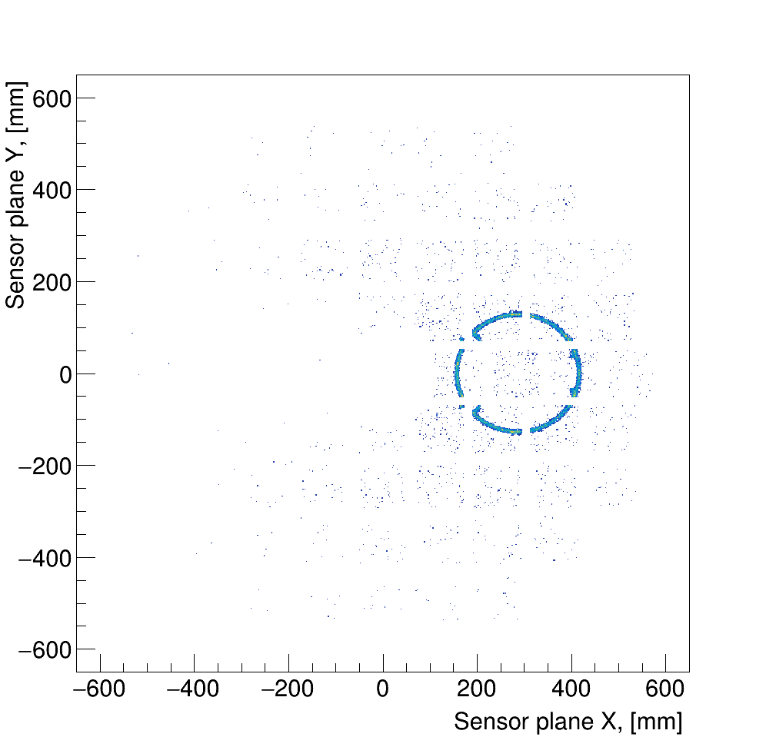
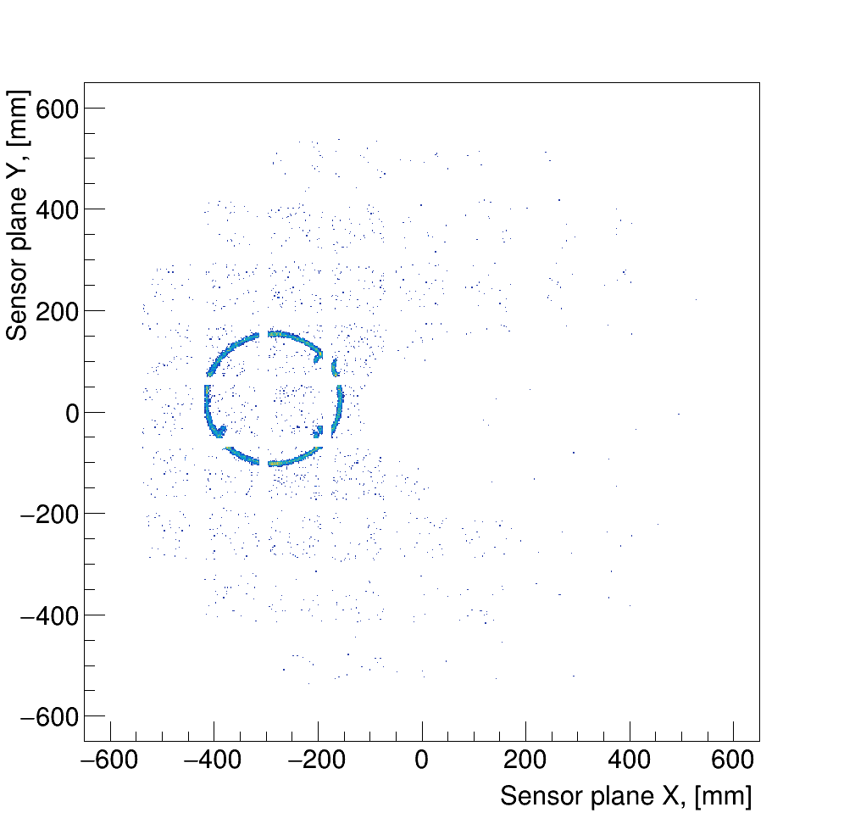
“Imaging” sensor plane
$$η=−2.5$$
Study pfRICH performance with standalone software https://github.com/eic/pfRICH
E.g., “imaging” part of the HRPPD sensor plane
$$π^{+}$$
$$y$$
$$x$$
1000 single-particle events, $π^{+},p=10$ GeV, $η=−2.5$
$$φ=0$$
$$φ=175$$
$$φ=180$$
$$φ∈(0,360)$$
Notes:
Look at extremely low p LUT. Do particles reach them or radiate

Slide 5
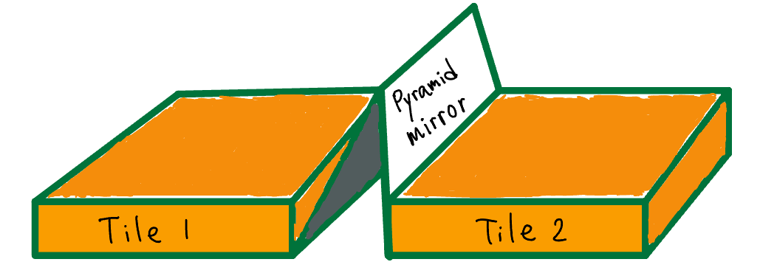
“Imaging” sensor plane
$$η=−2.5$$
Study pfRICH performance with standalone software https://github.com/eic/pfRICH
Check other features of setup
“Pyramid” mirrors help reconstruct photons lost in gaps between HRPPD tiles
$$π^{+}$$
$$π^{+}$$
$$y$$
$$x$$
Missing half ring due to gap in aerogel wall
$$φ=175$$
$$φ=180$$

Slide 6
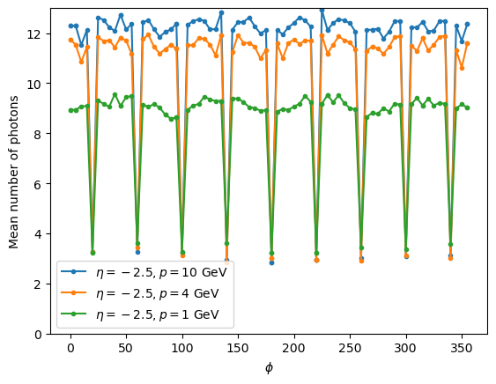
Efficiency vs azimuthal angle
Periodic efficiency drops due to aerogel support structure
Number of tracks
Mean $N_{γ}$~ 12
Mean $N_{γ}$higher for higher $p$
Expected from
$N_{γ}=\frac{N_{c}(1− \frac{1}{β^{2}n^{2}})}{1− \frac{1}{n^{2}}}$, where $N_{c}$ is a constant dependent on detector geometry
$$N_{γ}$$
1000 single-particle events for each $φ$ value,
$π^{+},$ $η=−2.5$
$$φ=175$$

Slide 7
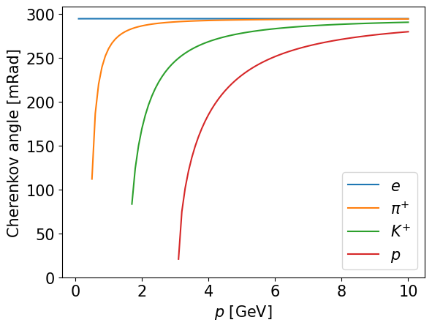
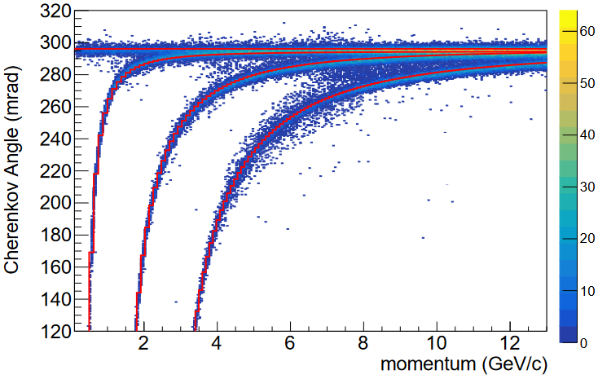
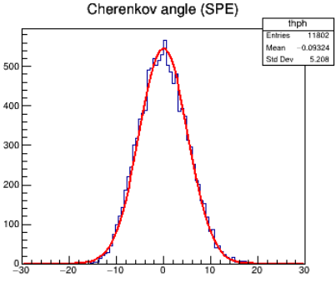
From Cherenkov angle to PID
Theoretical expectation
Reconstruction result from simulation
$$θ_{0}$$
→ Systematically determine particle type through a $χ^{2}$ analysis, with framework integrated in standalone software
$$θ_{0}=arccos\left[{\sqrt{1+\frac{m^{2}}{p^{2}}}}/n\right]⁡$$
[Fig 4.8 (a), CDR]
Roughly, for single-particle events…
Step 1. Determine if a photon hit is associated with the track, or is “background”
Step 2. For each track, calculate for each PID hypothesis, $χ^{2}=$ $\sum_{i∈\{hits\}}{{\left(θ_{measured, i}−θ_{0}\right)}^{2}/σ^{2}}$
$θ_{0}$ is the expected angle for the given PID hypothesis
$σ$ is the single photon Cherenkov angle resolution
Step 3. Find the PID hypothesis that minimizes $χ^{2}$
$$σ$$

Slide 8
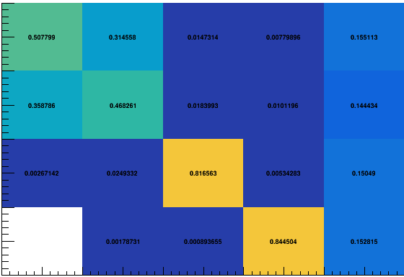
Quantifying PID performance: Look-up tables
For a given kinematic selection, what is the probability of correctly identifying PID?
E.g., $p∈(5.4, 5.8)$ GeV, $η∈\left(−2.10,−2.01\right)$, $φ∈\left(0, 3\right)$ degrees
Probability that it is reconstructed as…
Number of tracks
$$N_{γ}<3$$
e
$$π$$
K
p
unidentified
e
0.51
0.31
0.16
$$N_{γ}$$
Note:
Unidentified column for $N_{γ}<3$, mostly from detector geometry
$p>3$ GeV, worse e/$π$ separation
→ next step: have separate tables for e/h and $π$/K/p
For a truth level …
$$π$$
0.36
0.47
0.14
Probability
K
0.82
0.15
p
0.84
0.15

Slide 9
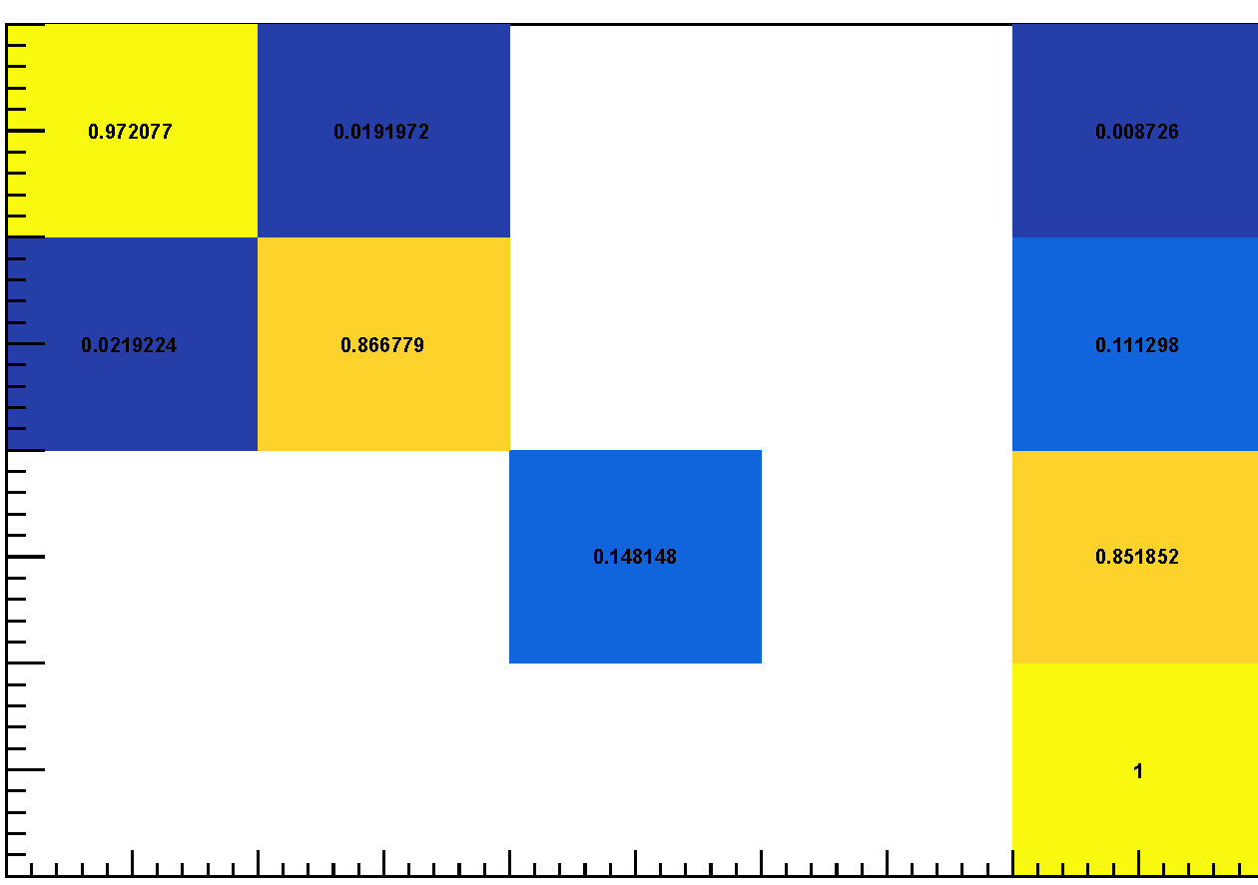
Quantifying PID performance: Look-up tables
For a given kinematic selection, what is the probability of correctly identifying PID?
We created 37x20x120 = 88800 histograms, covering
$p∈(0.1, 15)$ GeV
$θ∈\left(2.65, 3.1\right) →η∈(−3.87,−1.38)$
$φ∈(0, 360)$ degrees
400M single-particle events (100M e, $π$, K, p each)
The latest tables: https://github.com/eic/epic-data/blob/main/pfrich.lut , made with the latest magnetic field map MARCO_v.7.6.2.2.11_1.7T, 2024_05_02
E.g., $p∈(1.6, 2.0)$ GeV, $η∈\left(−2.10,−2.01\right)$, $φ∈\left(0, 3\right)$ degrees
Probability that it is reconstructed as…
Highly differential!
e
$$π$$
K
p
unidentified
e
0.97
Large statistics!
For a truth level …
$$π$$
0.87
0.11
Probability
K
0.15
0.85
p
1.00
Notes:
Mention effect of field map is not different

Slide 10
Conclusions
pfRICH is crucial for PID in the e-going direction at ePIC
through detection and measurement of Cherenkov photons emitted by charged particles
Standalone software offers flexibility for examining detector features and enables detailed studies of detector performance
Look-up table with fine binnings and large statistics is available
Looking forward to feedback on the table from analysis teams!

Slide 11
Backup

Slide 12
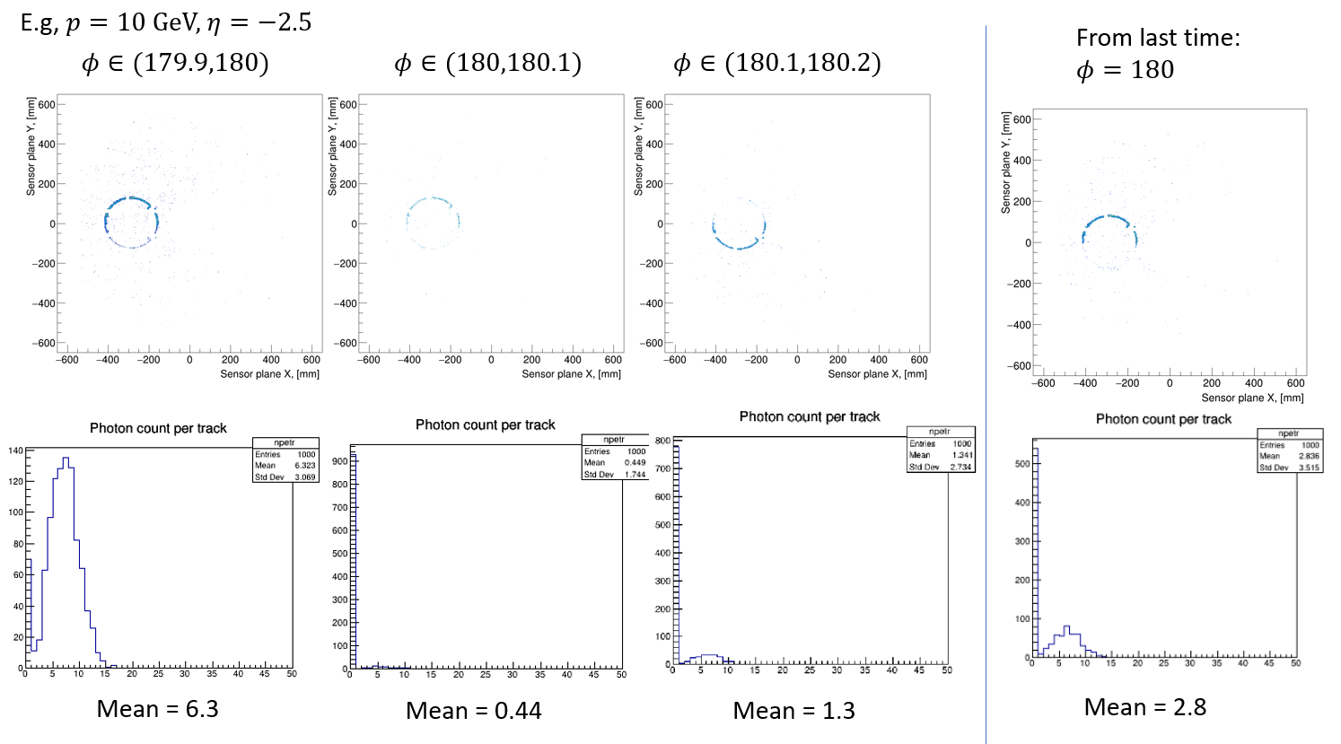
Efficiency vs azimuthal angle
1000 single-$π^{+}$ events for each $φ$ range

Slide 13
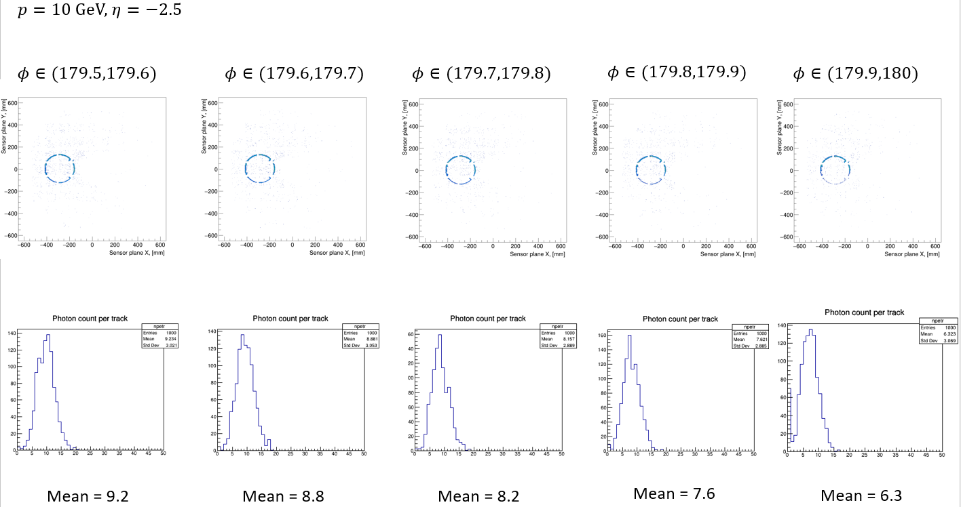
Efficiency vs azimuthal angle

Slide 14
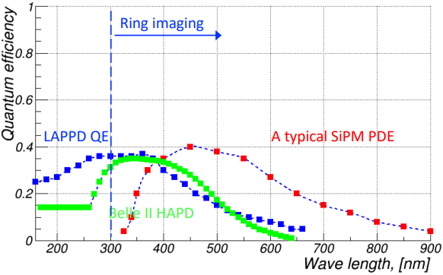
QE vs wavelength
Talk by Alexander Kiselev at HADRON 2023

